Slide 1
CSMC 412
Operating Systems
Prof. Ashok K Agrawala
Set 18
File System Implementation

Slide 2
File System
Structure
Naming
Directory structure
Operations
…

Slide 3
File system Implementation
Defines
  How files and directories are stored
  How disk space is managed
  How to make everything work efficiently and reliably

Slide 4
File-System Structure
File structure
  Logical storage unit
  Collection of related information
File system resides on secondary storage (disks)
  Provides user interface to storage, mapping logical to physical
  Provides efficient and convenient access to disk by allowing data to be stored, located, and retrieved easily
Disk provides in-place rewrite and random/direct access
  I/O transfers performed in blocks of sectors (usually 512 bytes)
File control block – storage structure consisting of information about a file
Device driver controls the physical device
File system organized into layers

Slide 5
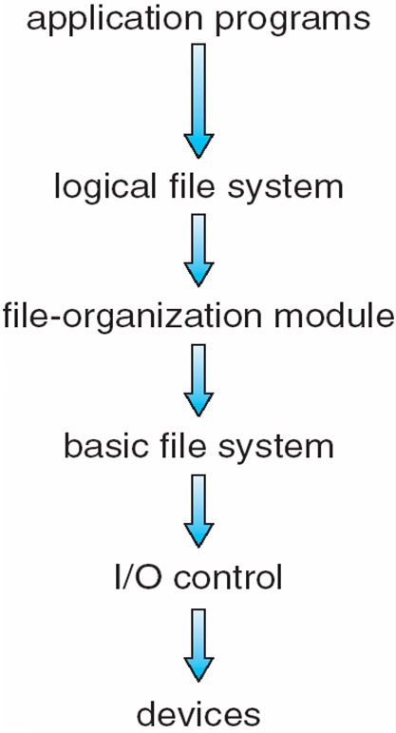
Layered File System

Slide 6
File System Layers
Device drivers manage I/O devices at the I/O control layer
  Given commands like “read drive1, cylinder 72, track 2, sector 10, into memory location 1060” outputs low-level hardware specific commands to hardware controller to carry out the operations called for
Basic file system given command like “retrieve block 123” translates to device driver commands
Also manages memory buffers and caches (allocation, freeing, replacement)
  Buffers hold data in transit
  Caches hold frequently used data
File organization module understands files, logical address, and physical blocks
  Translates logical block # to physical block #
  Manages free space, disk allocation

Slide 7
File System Layers (Cont.)
Logical file system manages metadata information
  Translates file name into file number, file handle, location by maintaining file control blocks (inodes in UNIX)
  Directory management
  Protection
Layering useful for reducing complexity and redundancy but
  adds overhead and can decrease performance.
Translates file name into file number, file handle, location by maintaining file control blocks (inodes in UNIX)
  Logical layers can be implemented by any coding method according to OS designer

Slide 8
File System Layers (Cont.)
Many file systems, sometimes many within an operating system
  Each with its own format (CD-ROM is ISO 9660; Unix has UFS, FFS; Windows has FAT, FAT32, NTFS as well as floppy, CD, DVD Blu-ray;
  Linux has more than 40 types, with extended file system ext2 and ext3 leading; plus distributed file systems, etc.)
  New ones still arriving – ZFS, GoogleFS, Oracle ASM, FUSE

Slide 9
File-System Implementation
We have system calls at the API level, but how do we implement their functions?
  On-disk and in-memory structures
Boot control block contains info needed by system to boot OS from that volume
  Needed if volume contains OS, usually first block of volume
Volume control block (superblock, master file table) contains volume details
  Total # of blocks, # of free blocks, block size, free block pointers or array
Directory structure organizes the files
  Names and inode numbers, master file table

Slide 10
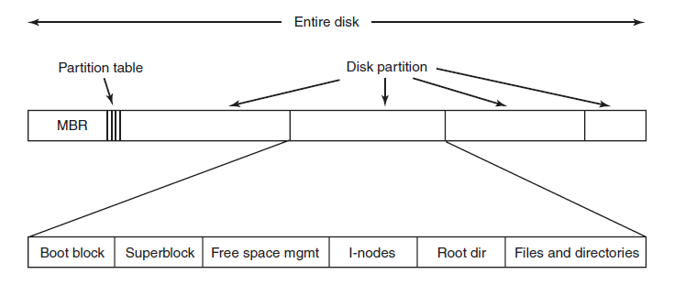
File System Layout

Slide 11
File System Layout
MBR: Master Boot Record
Partition table:
  present at the end of MBR
  Gives the starting and ending address of each partition
Boot Block: When a computer is booted,
  BIOS reads and executes MBR
  Locates active partition
  Reads the first block – Boot Block – and executes it.
    Program in the boot block loads the operating system contained in that partition
  Every partition contains a boot block even though it may not have a bootable OS

Slide 12
File System Layout (Cont.)
Volume Control Block – per volume
    Number of blocks in the volume
    Size of blocks
    Free blocks count
    Free-block pointers
    Free-FCB count
    FCB pointer
  In UFS it is called a Superblcok
  In NTFS it is stored in Master File Table
Directory Structure – per file system
  Used to organize files
  In UFS - File names and associated inode numbers

Slide 13
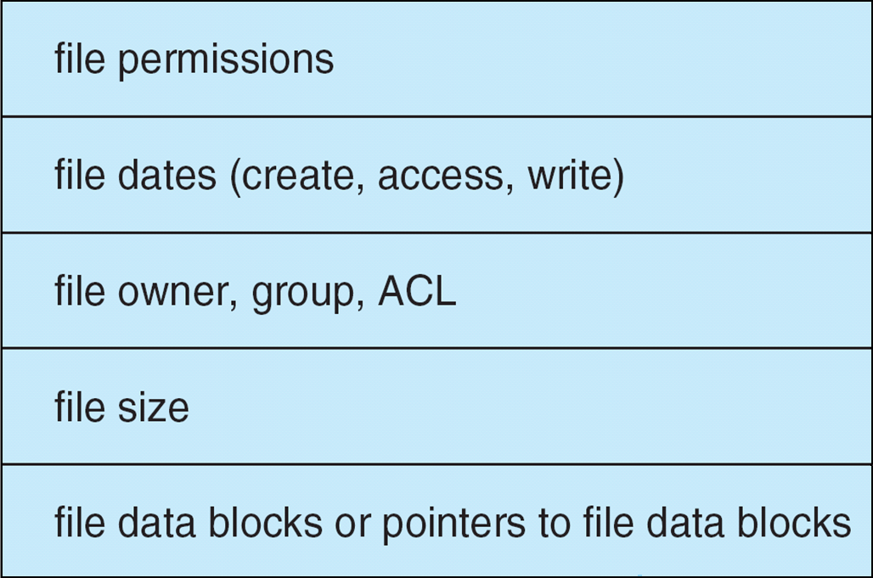
File-System Layout (Cont.)
Per-file File Control Block (FCB) contains many details about the file
  In UFS it includes inode number, permissions, size, dates
  In NTFS stores into master file table
    using relational DB structures
    One row per file

Slide 14
Operations
Open
  Call passes the file name to the logical file system
  Open system call searches the system-wide open-file table
    To check if the file is in use by another process
      Create a per-process open-file table entry, pointing to the system-wide open-file table entry
    Else
      Search the directory structure
      Copy FCB into a system-wide open-file table entry in the memory
      Make an entry in per-process open-file table with a pointer to the system-wide table entry
      Per-process open-file table also stores information such as the current location in the file
  Returns a pointer to the per-process entry
    File descriptor in UFS
    File handle in Windows

Slide 15
Operations
Close
  Remove per-process table entry
  Decrement system-wide entry’s open count
    When count goes to zero
      Any updated meta data copied to disk-based directory structure
      System-wide entry is removed

Slide 16
In-Memory File System Structures
Mount table storing file system mounts, mount points, file system types
The following figure illustrates the necessary file system structures provided by the operating systems
opening a file
reading a file
Plus, buffers hold data blocks from secondary storage
Open returns a file handle for subsequent use
Data from read eventually copied to specified user process memory address

Slide 17
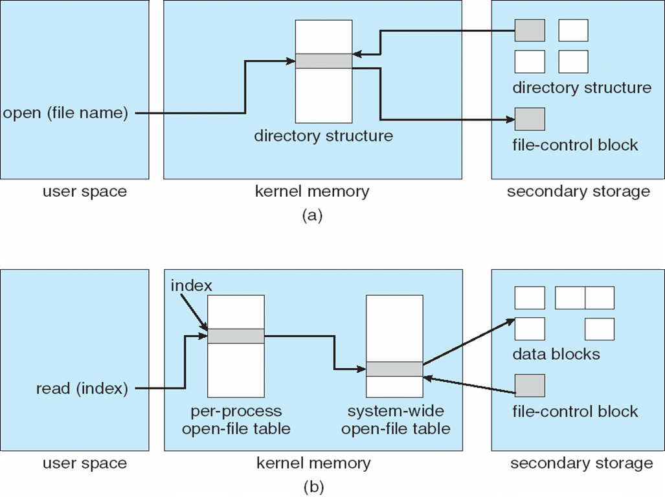
In-Memory File System Structures

Slide 18
Directory Implementation
Linear list of file names with pointer to the data blocks
  Simple to program
  Time-consuming to execute
    Linear search time
    Could keep ordered alphabetically via linked list or use B+ tree
Hash Table – linear list with hash data structure
  Decreases directory search time
  Collisions – situations where two file names hash to the same location
  Only good if entries are fixed size, or use chained-overflow method

Slide 19
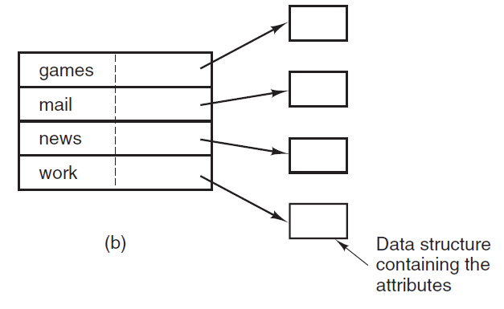
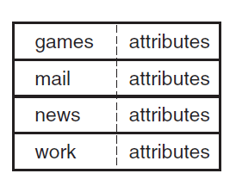
Directory Implementation

Slide 20
Allocation Methods - Contiguous
An allocation method refers to how disk blocks are allocated for files:
Contiguous allocation – each file occupies set of contiguous blocks
  Best performance in most cases
  Simple – only starting location (block #) and length (number of blocks) are required
  Problems include
    finding space for file,
    knowing file size,
    external fragmentation,
    need for compaction
      off-line (downtime) or on-line

Slide 21
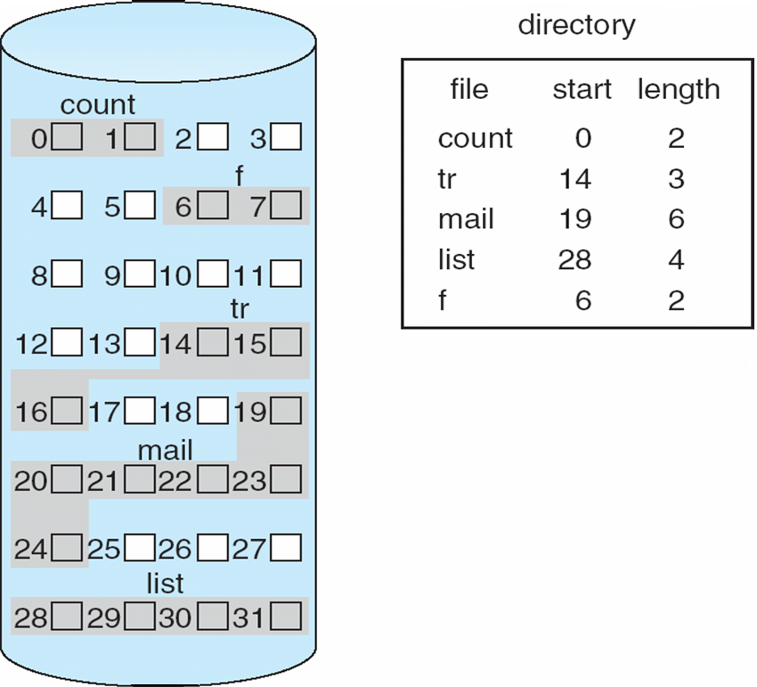
Contiguous Allocation
Mapping from logical to physical
Q
LA/512
R
  Block to be accessed = Q + starting address
  Displacement into block = R

Slide 22
Extent-Based Systems
Many newer file systems (i.e., Veritas File System) use a modified contiguous allocation scheme
Extent-based file systems allocate disk blocks in extents
  Allocate in contiguous chunk of space
An extent is a contiguous block of disks sectors
  Extents are allocated for file allocation

Slide 23
Allocation Methods - Linked
Linked allocation – each file a linked list of blocks
  File ends at nil pointer
  No external fragmentation
  Each block contains pointer to next block
  No compaction required
  Free space management system called when new block needed
  Improve efficiency by clustering blocks into groups but increases internal fragmentation
  Reliability can be a problem
  Locating a block can take many I/Os and disk seeks

Slide 24
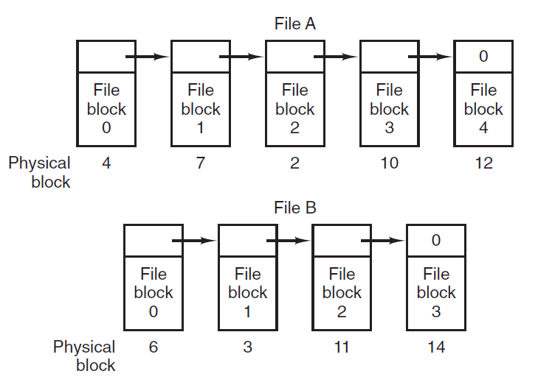
Linked Allocation

Slide 25
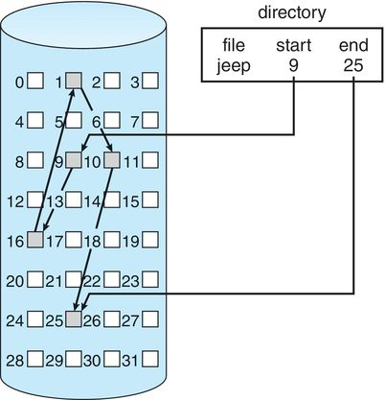
Linked Allocation

Slide 26
Allocation Methods – Linked (Cont.)
FAT (File Allocation Table) variation
  Beginning of volume has table, indexed by block number
  Much like a linked list, but faster on disk and cacheable
  New block allocation simple

Slide 27
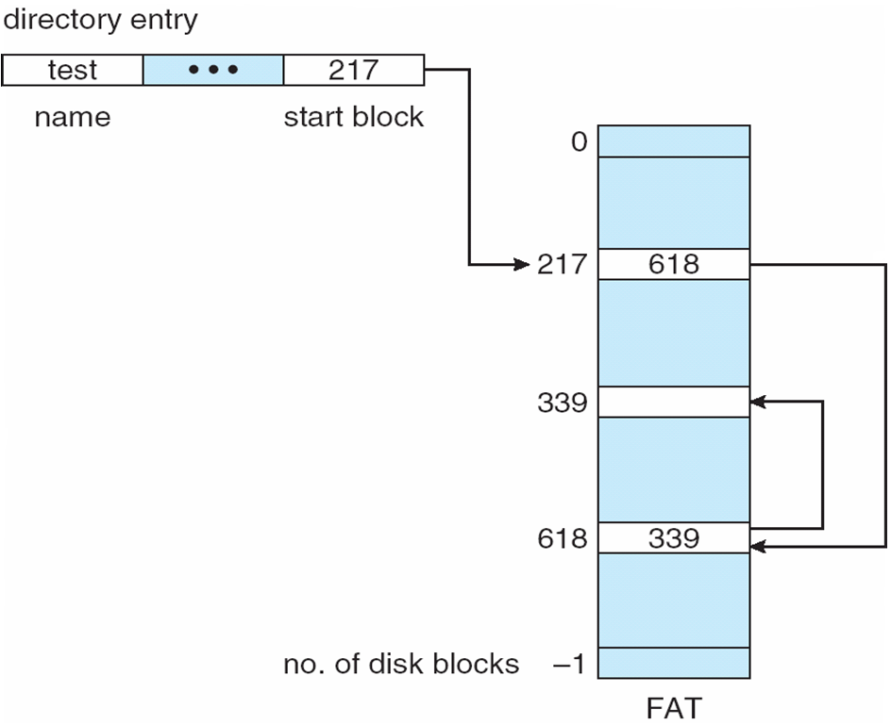
File-Allocation Table

Slide 28
Allocation Methods - Indexed
Indexed allocation
  Each file has its own index block(s) of pointers to its data blocks
Logical view

Slide 29
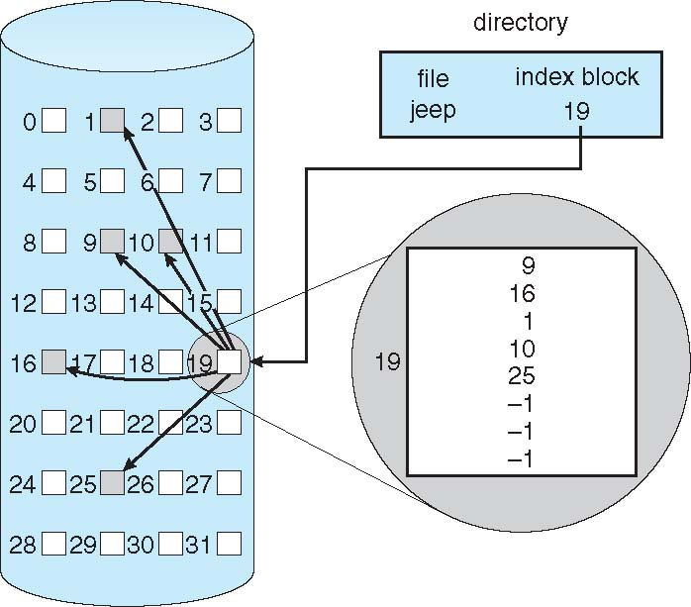
Example of Indexed Allocation

Slide 30
Indexed Allocation (Cont.)
Need index table
Random access
Dynamic access without external fragmentation, but have overhead of index block
Mapping from logical to physical in a file of maximum size of 256K bytes and block size of 512 bytes. Therefore a file can have 512 blocks and the index table 512 entries.

Slide 31
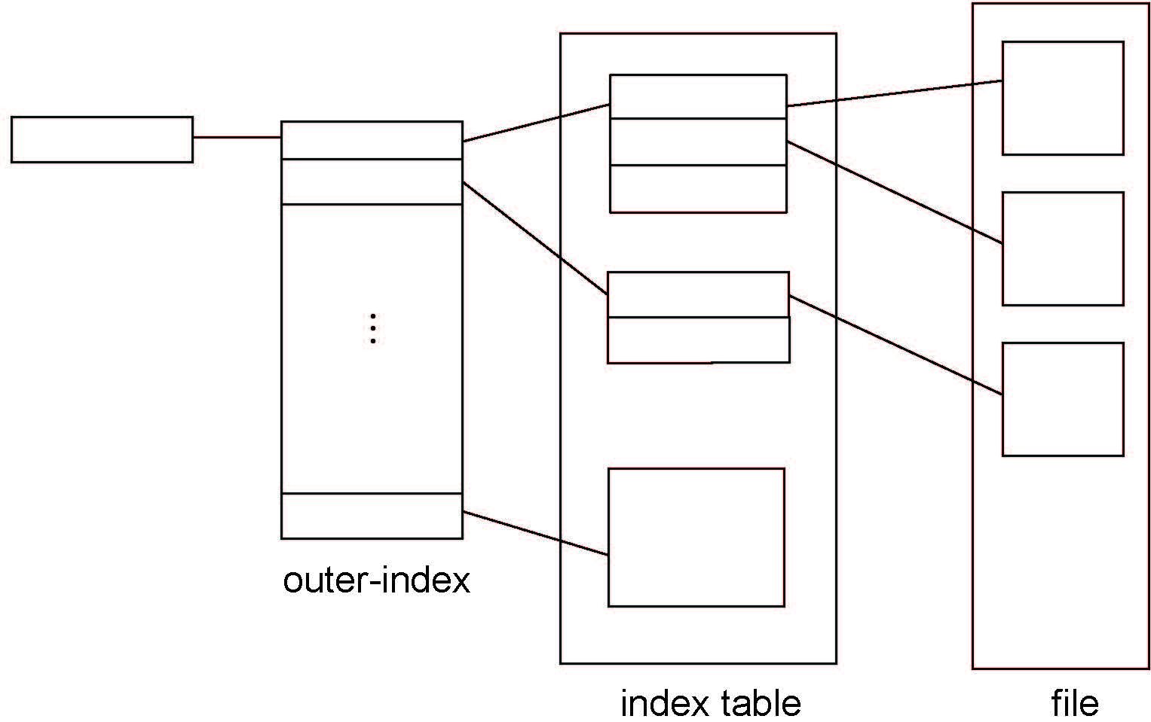
Indexed Allocation – Mapping (Cont.)

Slide 32
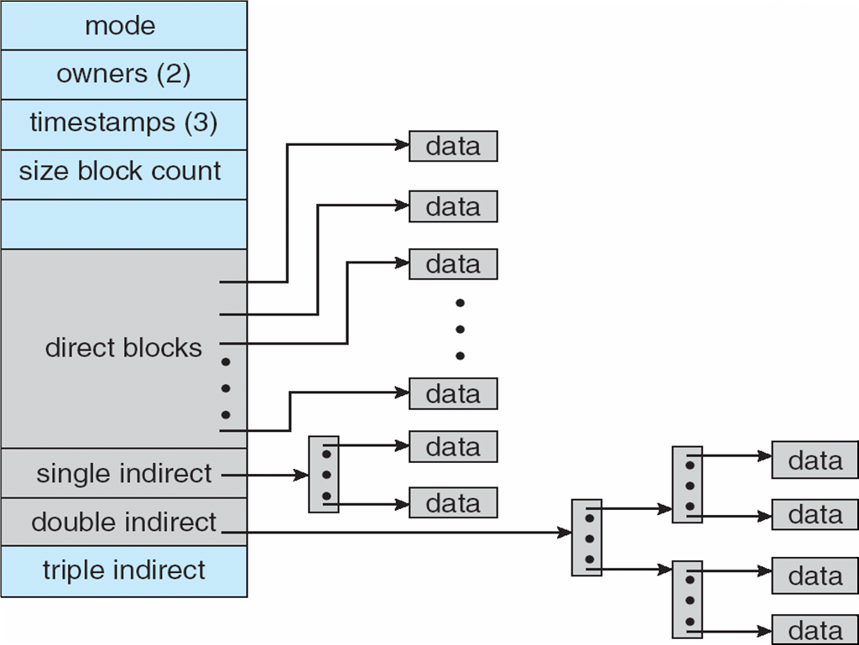
Combined Scheme: UNIX UFS
4K bytes per block, 32-bit addresses
More index blocks than can be addressed with 32-bit file pointer

Slide 33
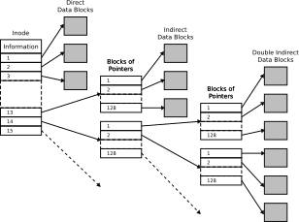
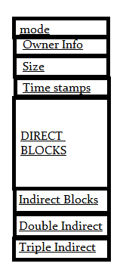
Inode Structure

Slide 34
Windows File Systems

Slide 35
Windows File System - Terminology
Sectors:
  hardware-addressable blocks on a storage medium
  Typical sector size on hard disks for x86-based systems is 512 bytes
File system formats:
  Define the way data is stored on storage media
  Impact a file system features: permissions & security, limitations on file size, support for small/large files/disks
Clusters:
  Addressable blocks that many file system formats use
  Cluster size is always a multiple of the sector size
  Cluster size tradeoff: space efficiency vs. access speed
Metadata:
  Data stored on a volume in support of file system format management
  Metadata includes the data that defines the placement of files and directories on a volume, for example
  Typically not accessible to applications
Notes:
From the start, the Windows NT File System (NTFS) was designed to include features required of an enterprise-class file system. To minimize data loss in the face of an unexpected system outage or crash, a file system must ensure that the integrity of the file system‘s metadata be guaranteed at all times, and to protect sensitive data from unauthorized access, a file system must have an integrated security model. Finally, a file system must allow for software-based data redundancy as a low-cost alternative to hardware-redundant solutions for protecting user data.

Slide 36
Formats Supported by Windows
CD-ROM File System (CDFS)
Universal Disk Format (UDF)
File Allocation Table (FAT12, FAT16, and FAT32)
New Technology File System (NTFS)

Slide 37
CDFS
CDFS, or, is a relatively simple format that was defined in 1988 as the read-only formatting standard for CD-ROM media.
Windows 2000 implements ISO 9660-compliant CDFS in \Winnt\System32\Drivers\Cdfs.sys, with long filename support defined by Level 2 of the ISO 9660 standard
Because of its simplicity, the CDFS format has a number of restrictions
  Directory and file names must be fewer than 32 characters long
  Directory trees can be no more than eight levels deep
CDFS is considered a legacy format because the industry has adopted the Universal Disk Format (UDF) as the standard for read-only media

Slide 38
UDF
OSTA (Optical Storage Technology Association) defined UDF in 1995 as a format to replace CDFS for magneto-optical storage media, mainly DVD-ROM
  The Windows 2000 UDF file system implementation is ISO 13346-compliant and supports UDF versions 1.02 and 1.5
UDF file systems have the following traits:
  Filenames can be 255 characters long
  The maximum path length is 1023 characters
Although the UDF format was designed with rewritable media in mind, the Windows 2000 UDF driver (\Winnt\System32\Drivers\Udfs.sys) provides read-only support

Slide 39
FAT
FAT (File Allocation Table) file systems are a legacy format that originated in DOS and Windows 9x
Reasons why Windows supports FAT file systems:
  to enable upgrades from other versions of Windows
  compatibility with other operating systems in multiboot systems
  as a floppy disk format
Windows FAT file system driver is implemented in \Winnt\System32\Drivers\Fastfat.sys
Each FAT format includes a number that indicates the number of bits the format uses to identify clusters on a disk
Boot sector
File allocation
table 1
File allocation
table 2 (duplicate)
Root directory
Other directories and all files
FAT format organization

Slide 40
FAT12
FAT12's 12-bit cluster identifier limits a partition to storing a maximum of 2¹² (4096) clusters
  Windows uses cluster sizes from 512 bytes to 8 KB in size, which limits a FAT12 volume size to 32 MB
  Windows uses FAT12 as the format for all 5-inch floppy disks and 3.5-inch floppy disks, which store up to 1.44 MB of data

Slide 41
FAT16
FAT16, with a 16-bit cluster identifier, can address 2¹⁶ (65,536) clusters
  On Windows, FAT16 cluster sizes range from 512 bytes (the sector size) to 64 KB, which limits FAT16 volume sizes to 4 GB
  The cluster size Windows uses depends on the size of a volume

Slide 42
FAT32
FAT32 is the upgraded version of FAT-based file system format
  it's included since Windows 95 OSR2, Windows 98, and now in Windows 10 and 11.
FAT32 uses 32-bit cluster identifiers but reserves the high 4 bits, so in effect it has 28-bit cluster identifiers
  Because FAT32 cluster sizes can be as large as 32 KB, FAT32 has a theoretical ability to address 8 TB volumes
  Although Windows works with existing FAT32 volumes of larger sizes (created in other operating systems), it limits new FAT32 volumes to a maximum of 32 GB
  FAT32's higher potential cluster numbers let it more efficiently manage disks than FAT16; it can handle up to 128-MB volumes with 512-byte clusters
Unlike FAT12 and FAT16, root directory is not fixed size or location
  Largest file size on Windows is 4GB (largest on Win9x is 2G)

Slide 43
NTFS
NTFS is the native file system format of Windows
NTFS uses 64-bit cluster indexes
  Theoretical ability to address volumes of up to 16 exabytes (16 billion GB)
  Windows 11 limits the size of an NTFS volume to that addressable with 32-bit clusters, which is 128 TB (using 32-KB clusters)
Why use NTFS instead of FAT? FAT is simpler, making it faster for some operations, but NTFS supports:
  Efficient handling of large files and high-capacity drives
  Support for advanced features like compression, encryption (EFS), and disk quotas
  Fault tolerance and metadata journaling for improved data integrity

Slide 44
CIFS – The Common Internet File System
The standard Windows network file system
The file sharing protocol at the heart of CIFS is an updated version of the Server Message Block (SMB) protocol
  dates back to the mid-1980s
  in 1996/97, Microsoft submitted draft CIFS specifications to the IETF
The SMB protocol was originally developed to run over NetBIOS (Network Basic Input Output System) LANs
  Until Windows 2000, NetBIOS support was required for SMB transport
  The machine and service names visible in the Windows Network Neighborhood are, basically, NetBIOS addresses (Windows 2000 and later use DNS names)
Notes:
There are also several SMB "dialects". These correspond roughly with major OS product releases or updates from Microsoft, and each adds extensions to the core SMB protocol.
In their IETF CIFS draft Microsoft presented an SMB dialect that was independent of NetBIOS – Windows implements that particular protocol version. As part of the split with NetBIOS, Windows also offers new name resolution, service announcement, authentication, and authorization mechanisms -- all based upon Internet standards.

Slide 45
CIFS – The Common Internet File System
Key Features of CIFS
  File Sharing:
    Enables users to access, read, write, and manage files on remote systems as if they were local files.
  Printer Sharing:
    Provides shared access to printers over the network.
  Authentication and Security:
    Supports user authentication (via passwords) and file permissions to control access.
  Resource Locking:
    Implements file and record locking to prevent conflicts when multiple users access the same resource.
  Wide Compatibility:
    Works across different operating systems, including Windows, Linux, and macOS.
  Opportunistic Locking (OpLocks):
    Optimizes network performance by allowing clients to cache file data locally, reducing the number of network operations.
CIFS Works on Client Server Model

Slide 46
File System Format Compatibility
FAT12/FAT16 supported on all Microsoft OS’s
FAT32:
  Only Windows 2000/XP/2003
  Winternals FAT32 driver for NT4
NTFS:
  Only Windows NT-based OS’s
  Winternals NTFSDOS for DOS access
  Winternals NTFS for Windows 98 for Win9x/Me

Slide 47
NTFS Design Goals
Overcome limitations inherent in FAT / HPFS
  FAT (File Allocation Table) does not support large disks very well
  FAT16 (MS-DOS file system) supports only up to 2¹⁶ clusters
  and 2 GB disks (with 64 Kb clusters!!)
  FAT / root directory represents single point of failure
  Number of entries in root directory is limited

Slide 48
Large Disks and Large Files
Efficient support for large files and disks in NTFS
FAT16:
  16-bit wide table stores allocation status of disk
  Up to 65.536 clusters per volume (#files !!); adjustable cluster size
FAT32:
  New in since Windows 2000
  4kb clusters on volumes up to 8 GB
  Can relocate root directory / use backup copy of FAT
  Root directory is ordinary cluster chain – no limits on #entries

Slide 49
Large Disks and Large Files (contd.)
NTFS enumerates cluster with 64-bit numbers
Up to 2⁶⁴ clusters of up to 64 Kbytes size
Maximum file size: 2⁶⁴ bytes
Cluster size is adjustable
  512 bytes on small disks
  Maximum of 64Kb on large disks
Multiple data streams
  File info: name, owner, time stamps, type implemented as attribute
  Each attribute consists of a stream – sequence of bytes
  Default data stream has no name
  New streams can be added: myfile.dat:stream2
  File operations manipulate all streams simultaneously
Used to implement
services for Macintosh
in Windows NT Server
Notes:
Lab:
Create a file with an additional data stream. Monitor the size of the file as reported by the ls –l command (alternatively, use the dir command). Copy the file. Try to access the second data stream.
Cat -> file ; ls –l
Cat –> file:1 ; ls –l
Cp file file1
More < file1:1

Slide 50
NTFS Recoverability
PC disk I/O in the old days: Speed was most important
NTFS changes this view – Reliability counts most:
I/O operations that alter NTFS structure are implemented as atomic transactions
  Change directory structure,
  extend files, allocate space for new files
Transactions are either completed or rolled back
NTFS uses redundant storage for vital FS information
  Contrasts with FAT / HPFS on-disk structures, which have single sectors containing critical file system data
  Read error in these sectors -> volume lost

Slide 51
NTFS Security and Recoverability
NTFS security is derived from Windows object model
Open file is implemented as file object;
security descriptor is stored on disk as part of the file
NT security system verifies access rights when a process tries to open a handle to any object
Administrator or file owner may set permissions
NTFS recoverability ensures integrity of FS structure
No guarantees for complete recovery of user files
Layered driver model + FTDISK driver
  Mirroring of data – RAID level 1
  Striping of data - RAID level 5 (one disk with parity info)

Slide 52
Other NTFS Features
Multiple data streams
Unicode-based names
Hard links
Junctions
Compression and sparse files
Change logging
Per-user volume quotas
Link tracking
Encryption
POSIX support
Defragmentation

Slide 53
Multiple Data Streams
In NTFS, each unit of information associated with a file, including its name, its owner, its time stamps, its contents, and so on, is implemented as a file attribute (NTFS object attribute)
Each attribute consists of a single stream, that is, a simple sequence of bytes
  This generic implementation makes it easy to add more attributes (and therefore more streams) to a file
  Because a file's data is "just another attribute" of the file and because new attributes can be added, NTFS files (and file directories) can contain multiple data streams

Slide 54
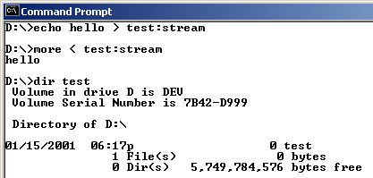
Multiple Data Streams
An NTFS file has one default data stream, which has no name
  An application can create additional, named data streams and access them by referring to their names.
  To avoid altering the Microsoft Windows I/O APIs, which take a string as a filename argument, the name of the data stream is specified by appending a colon (:) to the filename e.g. myfile:stream2

Slide 55
Unicode Names
Like Windows as a whole, NTFS is fully Unicode enabled, using Unicode characters to store names of files, directories, and volumes

Slide 56
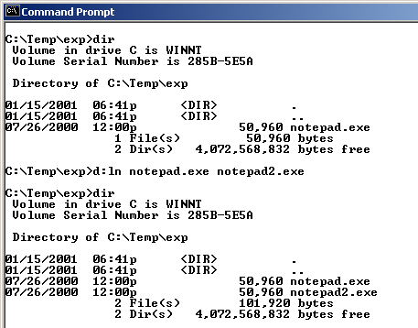
Hard Links
A hard link allows multiple paths to refer to the same file or directory
  If you create a hard link named C:\Users\Documents\Spec.doc that refers to the existing file C:\My Documents\Spec.doc, the two paths link to the same on-disk file and you can make changes to the file using either path
  can create hard links
  with the Windows API
  CreateHardLink function
  or the ln POSIX function

Slide 57
Junctions
Junctions, also called symbolic links, allow a directory to redirect file or directory pathname translation to an alternate directory
  If the path C:\Drivers is a junction that redirects to C:\Winnt\System32\Drivers, an application reading C:\Drivers\Ntfs.sys actually reads C:\Winnt\System\Drivers\Ntfs.sys
  Junctions are a useful way to lift directories that are deep in a directory tree to a more convenient depth without disturbing the original tree's structure or contents

Slide 58
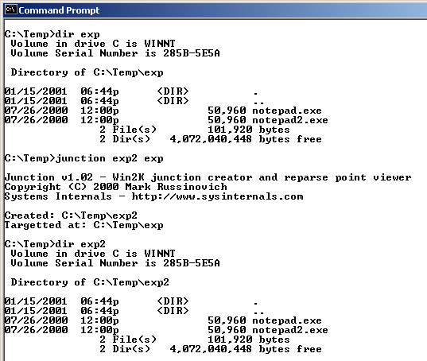
Junctions
You can create junctions with the junction tool from Sysinternals or the linkd tool from the Resource Kits

Slide 59
Change Logging
Many types of applications, such as incremental backup utilities, need to monitor a volume for changes
An obvious way to watch for changes is to perform a full scan
  Very performance inefficient
There is a way for an application to “wait” on a directory and be told of notifications
  An application can miss changes since it must specify a buffer to hold them

Slide 60
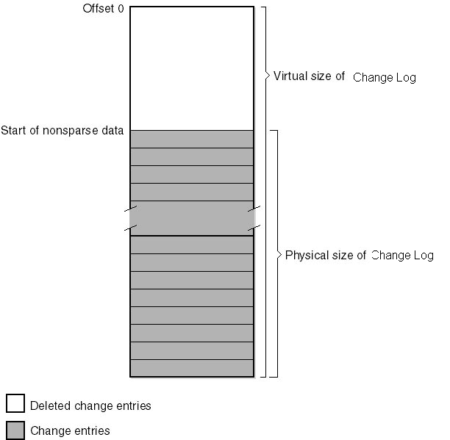
Change Logging
With Windows NTFS introduces the change log, which is a sparse metadata file that records file system events (not enabled by default)
  As the file exceeds its maximum on-disk size, NTFS frees the disk space for the oldest portions marking them empty
  An application uses Win32 APIs to read events
  The log file is shared, and generally large enough that an application won’t miss changes even during heavy file system activity

Slide 61
Per-User Volume Quotas
NTFS quota-management support allows for per-user specification of quota enforcement
  Can be configured to log an event indicating the occurrence to the system Event Log if a user surpasses his warning limit
  If a user attempts to use more volume storage then her quota limit permits, NTFS can log an event to the system Event Log and fail the application file I/O that would have caused the quota violation with a "disk full" error code
User disk space is tracked on a per-volume basis by summing the logical sizes of all the files and directories that have the user as the owner in their security descriptors

Slide 62
Link Tracking
Several types of symbolic file links are used by layered applications
  Shell shortcuts allow users to place files in their shell namespace (on their desktop, for example) that link to files located in the file system namespace
  Object linking and embedding (OLE) links allow documents from one application to be transparently embedded in the documents of other applications
In the past, these links were difficult to manage
  If someone moved a link source (what a link points to), the link broke
Windows now has a link-tracking service, TrkWks (it runs in services.exe), tags link sources with a unique object ID
  NTFS can return the name of a file given a link, so if the link moves the service can query each of a system’s volume for the object ID
  A distributed link-tracking service, TrkSvr, works to track link source movement across systems

Slide 63
Encryption
While NTFS implements security for files and directories, the security is ineffective if the physical security of the computer is compromised
  Can install a parallel copy of Windows
  NTFSDOS
Encrypting File System (EFS)
  Like compression, its operation is transparent
  Also like compression, encryption is a file and directory attribute
  Files that are encrypted can be accessed only by using the private key of an account's EFS private/public key pair, and private keys are locked using an account's password
While you might think that its implemented as a file system filter driver, it’s a driver that’s tightly connected to NTFS

Slide 64
NTFS File System Driver
Log file
service
I/O manager
Read/write
a mirrored
or striped
volume
Log the transaction
Read/write the file
NTFS driver
Flush the
log file
Write the
cache
Fault tolerant
driver
Read/write
the disk
Cache
manager
Load data
from disk
into
memory
Disk driver
Access the mapped
file or flush the cache
Virtual memory
manager

Slide 65
Components related to NTFS
Cache Manager
System wide caching
  for NTFS and other file systems drivers
  Including network file system drivers (server and redirectors)
Cached files are mapped into virtual memory
  Specialized interface from Cache Manager to NT virtual memory manager
  Memory manager calls NTFS to access disk driver and obtain file
Log File Service
  2 copies of transaction logs
  Transaction log is flushed to disk before write-data is sent to disk
  Cache manager performs actual flush operation

Slide 66
NTFS & File Objects
Process
Handle table
Stream
control
blocks
File
control
block
File object
Object
manager
data
structures
File object
Data
attribute
Master file
table
User-
defined
attribute
NTFS data
structures
(used to manage
the on-disk
structure)
App accesses files as
NT objects by handles.
Object Manager and security
subsystem verify access rights
NTFS
database
(on disk)

Slide 67
NTFS On-Disk Structure
Volumes correspond to logical partitions on disk
Fault tolerant volumes may span multiple disks
  Windows 2000 Disk Administrator utility
Volume consists of series of files + unallocated space
  FAT volume: some areas specially formatted for file system
  NTFS volume: all data are stored as ordinary files
NTFS refers internally to clusters
  Cluster factor: #sectors/cluster; varies with volume size;
  (integral number of physical sectors; always a power of 2)
Logical Cluster Numbers (LCNs):
  refer to physical location
  LCNs are contiguous enumeration of all clusters on a volume

Slide 68
NTFS Cluster Size
Default cluster size is disk-size dependent
  512 bytes for small disks (up to 512 MB)
  1 KB for disks up to 1 GB
  2 KB for disks between 1 and 2 GB
  4 KB for disks larger than 2 GB
Tradeoff: disk fragmentation versus wasted space
NTFS refers to physical locations via LCNs
  Physical cluster = LCN * cluster-factor
Virtual Cluster Numbers (VCNs):
  Enumerates clusters belonging to a file; mapped to LCNs
  LCNs are not necessarily physically contiguous

Slide 69
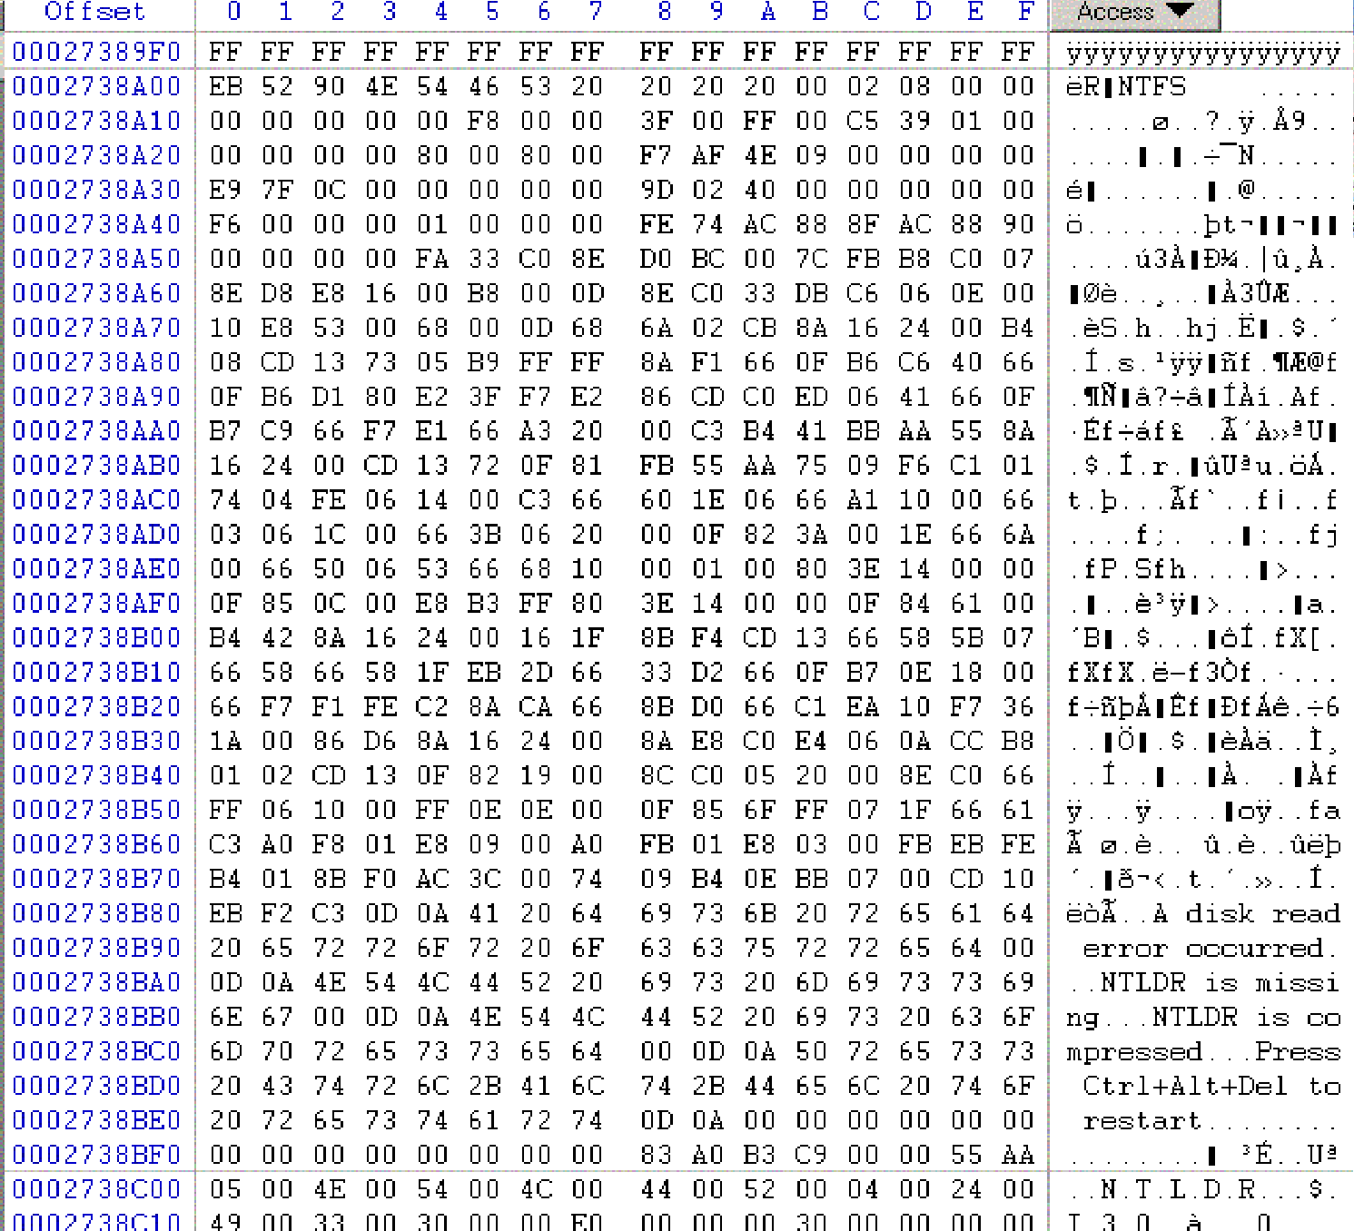
NTFS Boot Sector

Slide 70
NTFS Boot Sector
■
■
0x00 | 3B | Jump Instruction
0x03 | 8B | OEM ID
0x0B
0x24
0x54
25B BPB
48B Extended BPB 426B Bootstrap Code.
End of Sector
■
■
■
■
0x1FE 2B
Marker

Slide 71
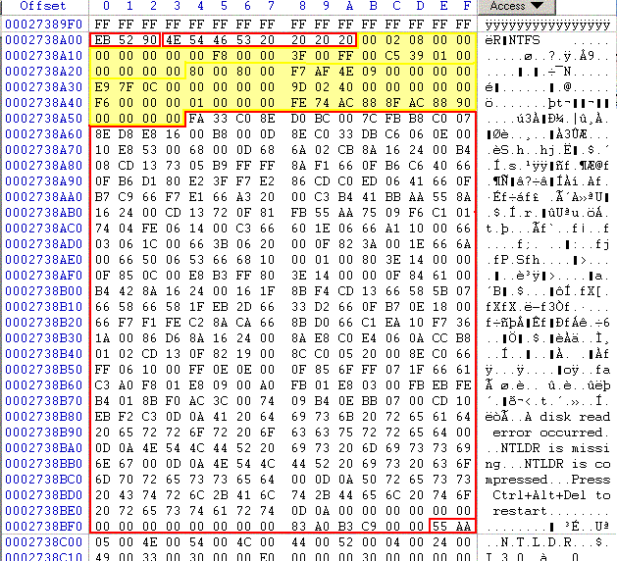
NTSF Boot Sector

Slide 72
NTSF Boot Sector
Many fields are not important, but:
0x0B, Bytes per sector.
■
0x0D 0x15
0x28
0x30
0x38
0x40
0x48
Sectors per Cluster
Media descriptor. F8: HD; F0: HD Floppy Total sectors.
Logical cluster number for the MFT Logical cluster number copy of the MFT Clusters per MFT Record.
Volume serial
■
■
■
■
■
■

Slide 73
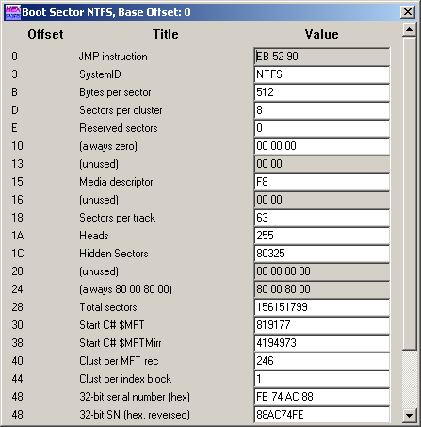
NTFS Boot Sector
■
WinHex allows access to an interpreted NTFS Boot Sector.
Use the Access Tab.

Slide 74
Master File Table
All data stored on a volume is contained in a file
MFT: Heart of NTFS volume structure
  Implemented as array of file records
  One row for each file on the volume
  (including one row for MFT itself)
  Metadata files store file system structure information
  (hidden files; $MFT; $Volume...)
  More than one MFT record for highly fragmented files
  Nfi.exe Utility from OEM Support Tools allows to dump MFT content
  (see support.microsoft.com/support/
  kb/articles/Q253/0/66.asp)
MFT
MFT copy (partial)
Log file
NTFS
metadata
file
Volume file
Attribute def. table
Root directory
Bitmap file
Boot file
Bad cluster file
...
User files and dirs.
Notes:
Lab:
View NTFS Metadate files
Nfi.exe c:\ (Dir /a:h $mft)
See http://support.microsoft.com/support/kb/articles/Q253/0/66.asp

Slide 75
NTFS Master File Table
First four entries are replicated, so that MFT can be repaired
First 16 records are reserved for metadata files, their name begins with a dollar sign ($)
■
■

Slide 76
NTFS Master File Table
Master file table $MFT.
Master file table mirror $MftMirr.
Log file $LogFile.
Volume $Volume Attribute definitions $AttrDef.
The root folder “.”
Cluster bitmap $Bitmap
Boot sector $Boot,
Bad cluster file $BadClus
Security file $Secure
Upcase table $Upcase
NTFS extension file $Extend, that is used for future use.

Slide 77
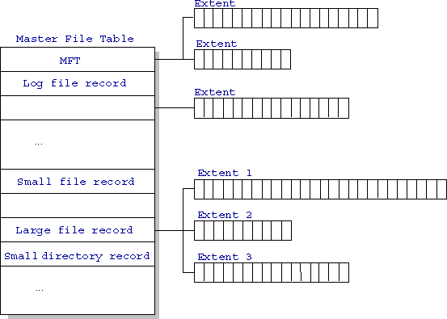
NTFS Master File Table

Slide 78
MFT Records
Entries are 1KB each Entries contain
■
■
File Attributes
Location Data

Slide 79
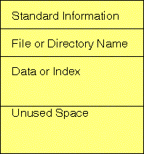
MFT Records
■
Small Files (<900B) are contained completely in the MFT entry.

Slide 80
MFT Records
Folders contain index data.
Small folders reside within the MFT record
Larger folders have an index structure to other data blocks. They use a B-tree structure.
■
■
■

Slide 81
NTFS operation
Mounting a volume
NTFS looks in boot file for physical address of MFT ($MFT)
2nd entry in MFT points to copy of MFT ($MFTMirr)
  used to locate metadata files if MFT is corrupted
MFT entry in MFT contains VCN-to-LCN mapping info
NTFS obtains from MFT addresses of metadata files
  NTFS opens these files
NTFS performs recovery operations
File system is now ready for user access

Slide 82
NTFS metadata
NTFS writes to log file ($LogFile)
  Record all commands that change volume structure
Root directory:
  When NTFS tries to open a file, it starts search in the root directory
  Once the file is found, NTFS stores the file‘s MFT file reference
  Subsequent read/write ops. may access file‘s MFT record directly
Bitmap file ($Bitmap):
  stores allocation state volume; each bit represents one cluster
Boot file ($Boot):
  Stores bootstrap code
  Has to be located at special disk address
  Represented as file by NTFS -> file ops. possible (!) (no editing)

Slide 83
NTFS metadata (contd.)
Bad-cluster file ($BadClus)
  Records bad spots on the disk
Volume file ($Volume)
  Contains: volume name, NTFS version
  Bit, which indicates whether volume is corrupted
Attribute Definition Table ($AttrDef)
  Defines attribute types supported on the volume
  Indicates whether they can be indexed, recovered, etc.

Slide 84
File Records &
File Reference Numbers
Sequence
number
File number
63
47
0
File on NTFS volume is identified by file reference
  File number == index in MFT
  Sequence number – used by NTFS for consistency checking;
  incremented each time a reference is re-used
File Records:
  File is collection of attribute/value pairs (one of which is data)
  Unnamed data attribute
  Other attributes: filename, time stamp, security descriptor,...
  Each file attribute is stored as separate stream of bytes within a file

Slide 85
File Records (contd.)
NTFS doesn‘t read/write files:
  It reads/writes attribute streams
  Operations: create, delete, read (byte range), write (byte range)
  Read/write normally operate on unnamed data attribute
Master File Table
Windows optimization: Security descriptors
are stored in a central file and referenced
by each file record (saves disk space)
Standard
information
Security
descriptor
Filename
Data
MFT record for a small file

Slide 86
Standard Attributes for NTFS Files
Attribute | Description
Standard information | File attributes: read-only, archive, etc; time stamps; creation/modification time; hard link count
Filename | Name in Unicode characters; multiple filename attributes possible (POSIX links!!); short names for access by MS-DOS and 16-bin Win applications
Security descriptor | Specifies who owns the file and who can access it
data | Contents of the file; a file has one default unnamed data attribute; directory has no default data attrib.
Index root, index | Three attributes used to implement filename allocation, bitmap index for large directories (dirs. only)
Attribute list | List of attributes that make up the file and first reference of the MFT record in which the attribute is located (for files which require multiple MFT file records)

Slide 87
Attributes (contd.)
Each attribute in a file record has a name and a value
NTFS identifies attributes:
  Uppercase name starting with $: $FILENAME, $DATA
Attribute‘s value: Byte stream
  The filename for $FILENAME
  The data bytes for $DATA
Attribute names correspond to numeric typecodes
File attributes in an MFT record are ordered by typecodes
  Some attribute types may appear more than once (e.g. Filename)

Slide 88
Filenames
POSIX:
  Case-sensitive, trailing periods & spaces
  NTFS namespace equiv. to POSIX space
Win32:
  Long filenames, unicode names
  Multiple dots, embedded spaces, beginning dots
MS-DOS:
  8.3 names, case does not matter
NTFS generates MS-DOS names for Win32 files automatically
  Fully functional aliases for NTFS names
  Stored in same directory as long names; dir /x
Namespaces
POSIX
subsystem
Win32
subsystem
MS-DOS
Win16 clients

Slide 89
MS-DOS filenames in NTFS
Standard info
NTFS filename
MS-DOS filename
Security desc.
Data
MFT file record with MS-DOS filename attribute
NTFS name and MS-DOS name are stored in same file record and refer to same file
  Renaming changes both filenames
  Open, read, write, delete work with both names equally
POSIX hardlinks are implemented in similar way
  Deleting a file with multiple names only decreases link count
Generation of MS-DOS names:
  Remove all illegal chars; remove all but one period; truncate to 6 chars
  Append ~1 to name; truncate extension to 3 chars; all uppercase
  Increment ~1 if filename duplicates an existing name in directory
Notes:
Lab:
Explore the name space for files under NTFS. Watch the 8.3 names automatically created by the system
Touch LongFileName File.Name.With.Dots File.Name.2.With.Dots “Name with spaces“ .begin
Dir /x

Slide 90
Resident & Nonresident Attributes
Small files:
  All attributes and values fit into MFT
  Attribute with value in MFT is called „resident“
  All attributes start with header (always resident)
  Header contains offset to attr. value and length of value
Standard info
NTFS filename
Security desc.
Data
header
„RESIDENT“
Offset: 8h
Length: 14h
MYFILE.DAT
value

Slide 91
Attributes (contd.)
Small directory:
  index root attribute contains index of file references for files and subdirectories
Standard info
NTFS filename
Security desc.
Index root
Empty
Index of files
file1, file2, file3,...
MFT file record for a small directory
If file attribute does not fit into MFT:
  NTFS allocates separate cluster (run, extent) to store the values
  NTFS allocates additional runs if an attribute‘s value later grows
  Those attributes are called „non-resident“
  Header of non-resident attribute contains location info

Slide 92
Large files & directories
Standard info
NTFS filename
Security desc.
Data
HPFS extended attr.
MFT record for large file with 2 data runs
Only attributes that can grow can be non-resident
Filename & standard info are always resident
Index of files for directories forms B+ tree
Standard info
NTFS filename
Security desc.
Index root
Index allocation
Bitmap
Index of files
file4, file8
VCN-to-LCN
mappings
MFT file record for a large directory
with nonresident filename index
file1, file2, file3
file5, file6

Slide 93
Large files (contd.)
NTFS keeps track of runs by means of VCN
(Virtual Cluster Numbers)
  Logical Cluster Numbers represent an entire volume
  Virtual Cluster Numbers represent clusters belonging to one file
  Attribute lists may extend over multiple runs (not only data)
Standard info
NTFS filename
Security desc.
Data
Starting VCN | Starting LCN | Number of clusters
0 | 1355 | 4
4 | 1588 | 4
VCN-to-LCN mappings for a
nonresident data attribute
VCN 0 1 2 3
VCN 4 5 6 7
Data
Data
LCN 1355 1356 1357 1358
LCN 1588 1589 1590 1591

Slide 94
Data Compression
NTFS supports compression
  Per-file, per-directory, per-volume basis
  NTFS compression is performed on user data only,
  not NTFS metadata
Inspect files/volume via Winndows API:
GetVolumeInformation(), GetCompressedFileSize()
Change settings for files/directories:
DeviceIoControl()
with flags
FSCTL_GET_COMPRESSION, FSCTL_SET_COMPRESSION

Slide 95
Compression of sparse files
NTFS zeroes all file contents on creation (C2 req.)
Many sparse files contain large amount of zero-bytes
  These bytes occupy space on disk – unless files are compressed
Standard info
NTFS filename
Security desc.
Data
Starting VCN | Starting LCN | Number of clusters
0 | 1355 | 16
32 | 1588 | 16
48 | 96 | 16
128 | 324 | 16
VCN 0 1 2 3 .... 15
Data
LCN 1355 1356 1357 1358 .... 1370
VCN 32 33 34 35 ... 47
Data
Certain ranges of VCNs have no
disk allocation (16-31, 64-127)
LCN 1588 1589 1590 1591 .... 1603

Slide 96
Compressing Nonsparse Data
NTFS divides the file‘s unprocessed data into
compression units 16 clusters long
Certain sequence might not compress much
  NTFS determines for each compression unit whether it will shrink
  by at least on cluster
  If data does not compress, NTFS allocates cluster space and simply writes data
  If data compresses at least one cluster, NTFS allocates only the clusters needed for compressed data
When writing data, NTFS ensures that each run begins on virtual 16-cluster boundary
  NTFS reads/writes at least one compression unit when accessing a file
  Read-ahead + asynch. decompression improves performance

Slide 97
Data runs of a compressed file
VCN
0
15
Compressed data
LCN
19
20
21
22
16
31
Compressed data
23
24
25
26
27
28
29
30
32
47
Noncompressed data
97 98 99 100 101 102
103 104 105 106 107 108 109 110 111 112
48
63
Starting VCN | Starting LCN | No. of clusters
0 | 19 | 4
16 | 23 | 8
32 | 97 | 16
48 | 113 | 10
Compressed data
113 114 115 116 117 118 119 120 121 122
MFT record for a compressed file

Slide 98
Windows - NTFS Extensions
Disk quotas on per-user bases
Security descriptors (ACLs) can be stored once but referenced in multiple files
Native support for properties (OLE), including indexing
Reparse points – implementation of symbolic links
  Mount points for arbitrary file system volumes
Support for sparse files
Distributed link tracking (via global object Ids)
  Renaming the target file will no longer break links (shortcuts...)
Add disk space to an NTFS volume without reboot
No decompressing when transmitting files over network

Slide 99
File System Driver Architecture
Local File System Drivers (Local FSDs):
  Ntfs.sys, Fastfat.sys, Udfs,sys, Cdfs,sys
  Responsible for registering with the I/O manager and volume recognition/integrity checks
  FSD creates device objects for each mounted file system format
  I/O manager makes connection between volume‘s device objects (Created by storage device) and the FSD‘s device object
  Local FSDs use cache manager to improve file access performance
  Dismount operation permits the system to disconnect FSD from volume object
    When media is changed or when application requires raw device access
    I/O manager reinitiated volume mount operation on next access to media

Slide 100
Layered Drivers -
I/O System Architecture
Environment
subsystem or
DLL
Call I/O service
7)Return I/O pending status
User mode
Kernel mode
2)The I/O manager creates an IRP, initializes first stack location and calls file system driver
Services
I/O manager
IRP
6)Return I/O pending status
3)File system driver fills in a 2nd IRP stack location and calls
the disk driver
File system
driver
IRP
5)Return I/O pending status
Disk
driver
4)Send IRP data to device
(or queue IRP), and return
Optimization: associated IRPs
may work in parallel on a single
I/O request

Slide 101
File System Driver Architecture (contd.)
Remote File System Drivers (Remote FSDs):
Client-side FSD translates I/O requests from applications into network file system protocol commands
Server-side FSD listens for network commands and issues I/O requests to local FSD
Windows client-side remote FSD: LANMan Redirector
  Implemented as port/miniport driver
  Includes Windows service Workstation
Server-side FSD server: LANMan Server
  Includes Windows service Server
  CIFS – common internet file system (enhancement of Server Message Block protocol)
Application
user mode
I/O manager
kernel mode
Remote FSD
(redirector)
client
server
Remote FSD
(server)
Local FSD
volume
Storage device
driver

Slide 102
Performance
Best method depends on file access type
  Contiguous great for sequential and random
Linked good for sequential, not random
Declare access type at creation -> select either contiguous or linked
Indexed more complex
  Single block access could require 2 index block reads then data block read
  Clustering can help improve throughput, reduce CPU overhead

Slide 103
Performance (Cont.)
Adding instructions to the execution path to save one disk I/O is reasonable
  Intel Core i9 – 9900K (2019) at 4.7Ghz = 412,090 MIPS
    http://en.wikipedia.org/wiki/Instructions_per_second
  Typical disk drive at 250 I/Os per second
    412,090 MIPS / 250 = 1,648 million instructions during one disk I/O
  Fast SSD drives provide 60,000 IOPS
    412,090 MIPS / 60,000 = 6.86 millions instructions during one disk I/O

Slide 104
Free-Space Management
File system maintains free-space list to track available blocks/clusters
  (Using term “block” for simplicity)
Bit vector or bit map (n blocks)
0
1
2
n-1
…
1 ⇒ block[i] free
0 ⇒ block[i] occupied
bit[i] =

Block number calculation
(number of bits per word) *
(number of 0-value words) +
offset of first 1 bit
CPUs have instructions to return offset within word of first “1” bit

Slide 105
Free-Space Management (Cont.)
Bit map requires extra space
  Example:
block size = 4KB = 2¹² bytes
disk size = 2⁴⁰ bytes (1 terabyte)
n = 2⁴⁰/2¹² = 2²⁸ bits (or 32MB)
if clusters of 4 blocks -> 8MB of memory
Easy to get contiguous files

Slide 106
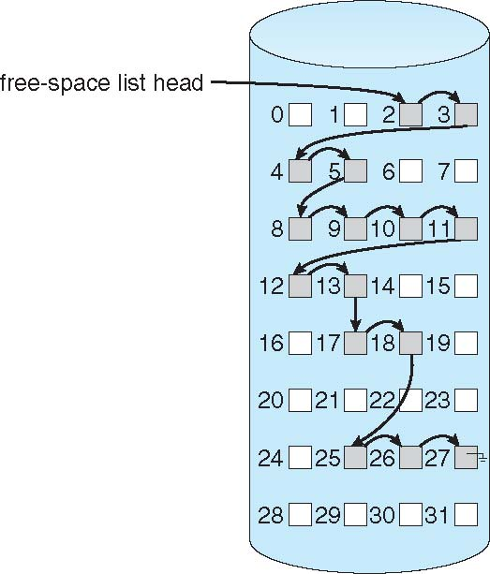
Linked Free Space List on Disk
Linked list (free list)
  Cannot get contiguous space easily
  No waste of space
  No need to traverse the entire list (if # free blocks recorded)

Slide 107
Free-Space Management (Cont.)
Grouping
  Modify linked list to store address of next n-1 free blocks in first free block, plus a pointer to next block that contains free-block-pointers (like this one)
Counting
  Because space is frequently contiguously used and freed, with contiguous-allocation, extents, or clustering
    Keep address of first free block and count of following free blocks
    Free space list then has entries containing addresses and counts

Slide 108
Efficiency and Performance
Efficiency dependent on:
  Disk allocation and directory algorithms
  Types of data kept in file’s directory entry
  Pre-allocation or as-needed allocation of metadata structures
  Fixed-size or varying-size data structures

Slide 109
Efficiency and Performance (Cont.)
Performance
  Keeping data and metadata close together
  Buffer cache – separate section of main memory for frequently used blocks
  Synchronous writes sometimes requested by apps or needed by OS
    No buffering / caching – writes must hit disk before acknowledgement
    Asynchronous writes more common, buffer-able, faster
  Free-behind and read-ahead – techniques to optimize sequential access
  Reads frequently slower than writes

Slide 110
Page Cache
A page cache caches pages rather than disk blocks using virtual memory techniques and addresses
Memory-mapped I/O uses a page cache
Routine I/O through the file system uses the buffer (disk) cache
This leads to the following figure

Slide 111
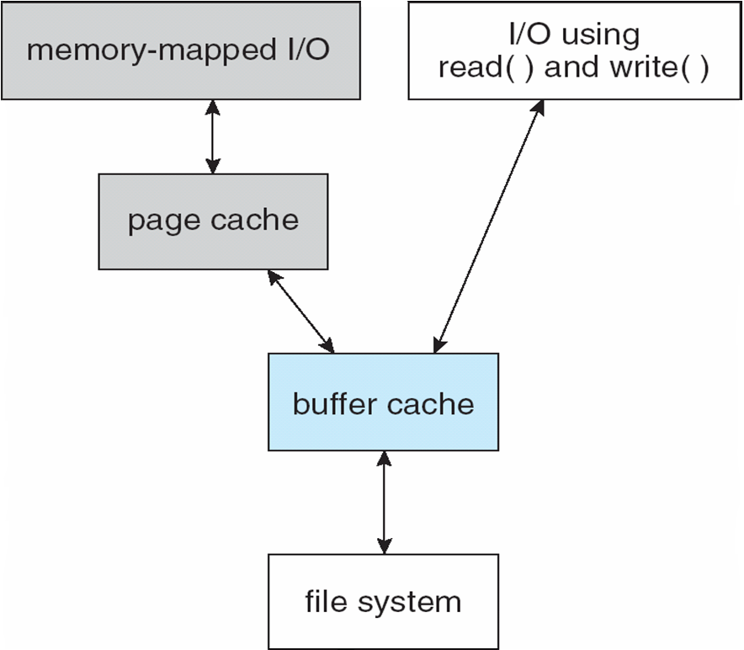
I/O Without a Unified Buffer Cache

Slide 112
Unified Buffer Cache
A unified buffer cache uses the same page cache to cache both memory-mapped pages and ordinary file system I/O to avoid double caching
  But which caches get priority, and what replacement algorithms to use?

Slide 113
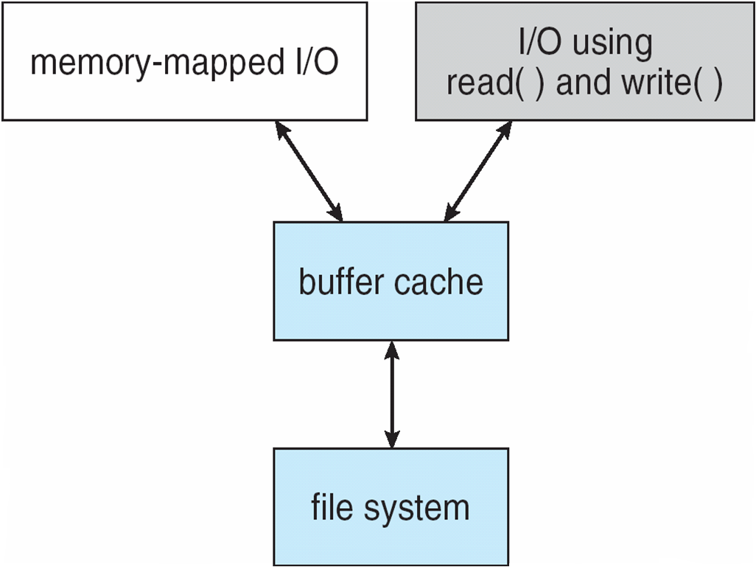
I/O Using a Unified Buffer Cache

Slide 114
Recovery
Consistency checking – compares data in directory structure with data blocks on disk, and tries to fix inconsistencies
  Can be slow and sometimes fails
Use system programs to back up data from disk to another storage device (magnetic tape, other magnetic disk, optical)
Recover lost file or disk by restoring data from backup

Slide 115
Log Structured File Systems
Log structured (or journaling) file systems record each metadata update to the file system as a transaction
All transactions are written to a log
  A transaction is considered committed once it is written to the log (sequentially)
  Sometimes to a separate device or section of disk
  However, the file system may not yet be updated
The transactions in the log are asynchronously written to the file system structures
  When the file system structures are modified, the transaction is removed from the log
If the file system crashes, all remaining transactions in the log must still be performed
Faster recovery from crash, removes chance of inconsistency of metadata

