Slide 1
CSMC 412
Operating Systems
Prof. Ashok K Agrawala
Distributed Systems

Slide 2
Overview
A distributed system is a collection of loosely coupled nodes interconnected by a communications network
Nodes variously called processors, computers, machines, hosts
  Site is location of the machine,
    Node refers to specific system
  Generally, a server has a resource a client node at a different site wants to use

Slide 3
Overview (cont.)
Nodes may exist in a client-server, peer-to-peer, or hybrid configuration.
  In client-server configuration, server has a resource that a client would like to use
  In peer-to-peer configuration, each node shares equal responsibilities and can act as both clients and servers
Communication over a network occurs through message passing
  All higher-level functions of a standalone system can be expanded to encompass a distributed system

Slide 4
Reasons for Distributed Systems
Resource sharing
  Sharing files or printing at remote sites
  Processing information in a distributed database
  Using remote specialized hardware devices such as graphics processing units (GPUs)
Computation speedup
  Distribute subcomputations among various sites to run concurrently
  Load balancing – moving jobs to more lightly-loaded sites
Reliability
  Detect and recover from site failure, function transfer, reintegrate failed site

Slide 5
Network Structure
Local-Area Network (LAN) – designed to cover small geographical area
  Consists of multiple computers (workstations, laptops, mobile devices), peripherals (printers, storage arrays), and routers providing access to other networks
  Ethernet and/or Wireless (WiFi) most common way to construct LANs
    Ethernet defined by standard IEEE 802.3 with speeds typically varying from 10Mbps to over 10Gbps
    WiFi defined by standard IEEE 802.11 with speeds typically varying from 11Mbps to over 1Gb.
    Both standards constantly evolving

Slide 6
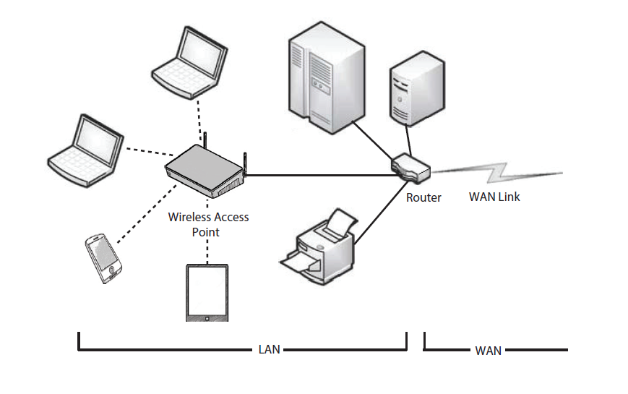
Local-Area Network (LAN)

Slide 7
Network Structure (Cont.)
Wide-Area Network (WAN) – links geographically separated sites
  Point-to-point connections via links
    Telephone lines, leased (dedicated data) lines, optical cable, microwave links, radio waves, and satellite channels
  Implemented via routers to direct traffic from one network to another
  Internet (World Wide Web) WAN enables hosts world wide to communicate
  Speeds vary
    Many backbone providers have speeds at 40-100Gbps
    Local Internet Service Providers (ISPs) may be slower
    WAN links constantly being upgraded
  WANs and LANs interconnect, similar to cell phone network:
    Cell phones use radio waves to cell towers
    Towers connect to other towers and hubs

Slide 8
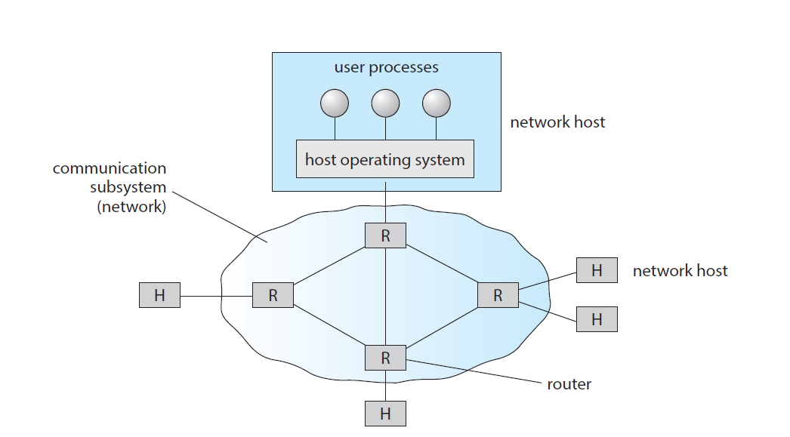
Wide-Area Network (WAN)

Slide 9
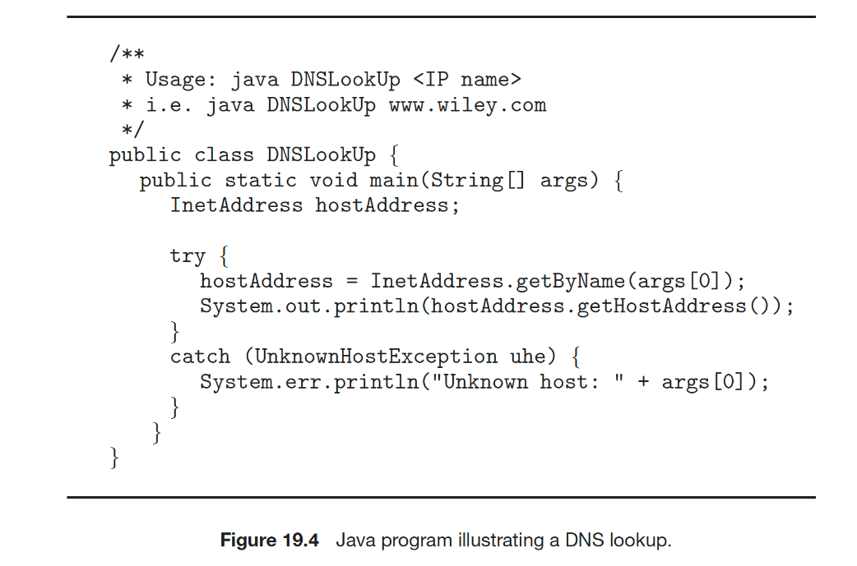
Naming and Name Resolution
Each computer system in the network has a unique name
Each process in each system has a unique name (process-id)
Identify processes on remote systems by
      <host-name, identifier> pair
Domain name system (DNS) – specifies the naming structure of the hosts, as well as name to address resolution (Internet)

Slide 10
Communication Protocol
The communication network is partitioned into the following multiple layers:
Layer 1: Physical layer – handles the mechanical and electrical details of the physical transmission of a bit stream
Layer 2: Data-link layer – handles the frames, or fixed-length parts of packets, including any error detection and recovery that occurred in the physical layer
Layer 3: Network layer – provides connections and routes packets in the communication network, including handling the address of outgoing packets, decoding the address of incoming packets, and maintaining routing information for proper response to changing load levels

Slide 11
Communication Protocol (Cont.)
Layer 4: Transport layer – responsible for low-level network access and for message transfer between clients, including partitioning messages into packets, maintaining packet order, controlling flow, and generating physical addresses
Layer 5: Session layer – implements sessions, or process-to-process communications protocols
Layer 6: Presentation layer – resolves the differences in formats among the various sites in the network, including character conversions, and half duplex/full duplex (echoing)
Layer 7: Application layer – interacts directly with the users, deals with file transfer, remote-login protocols and electronic mail, as well as schemas for distributed databases

Slide 12
OSI Network Model
Logical communication between two computers, with the three lowest-level layers implemented in hardware

Slide 13
OSI Protocol Stack

Slide 14
OSI Network Message

Slide 15
The OSI model
The OSI model formalizes some of the earlier work done in network protocols but was developed in the late 1970s and is currently not in widespread use
The most widely adopted protocol stack is the TCP/IP model, which has been adopted by virtually all Internet sites
The TCP/IP protocol stack has fewer layers than the OSI model. Theoretically, because it combines several functions in each layer, it is more difficult to implement but more efficient than OSI networking
The relationship between the OSI and TCP/IP models is shown in the next slide

Slide 16
The OSI and TCP/IP Protocol Stacks

Slide 17
TCP/IP Example
Every host has a name and an associated IP address (host-id)
  Hierarchical and segmented
Sending system checks routing tables and locates a router to send packet
Router uses segmented network part of host-id to determine where to transfer packet
  This may repeat among multiple routers
Destination system receives the packet
  Packet may be complete message, or it may need to be reassembled into larger message spanning multiple packets

Slide 18
TCP/IP Example (Cont.)
Within a network, how does a packet move from sender (host or router) to receiver?
  Every Ethernet/WiFi device has a medium access control (MAC) address
  Two devices on same LAN communicate via MAC address
  If a system needs to send data to another system, it needs to discover the IP to MAC address mapping
    Uses address resolution protocol (ARP)
  A broadcast uses a special network address to signal that all hosts should receive and process the packet
    Not forwarded by routers to different networks

Slide 19
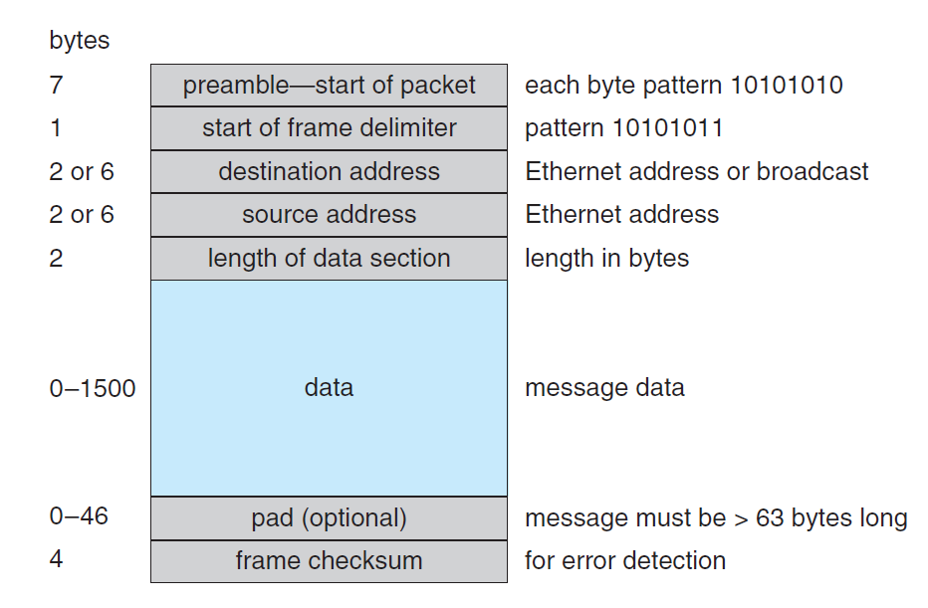
Ethernet Packet

Slide 20
Transport Protocols UDP and TCP
Once a host with a specific IP address receives a packet, it must somehow pass it to the correct waiting process
Transport protocols TCP and UDP identify receiving and sending processes using a port number
  Allows host with single IP address to have multiple server/client processes sending/receiving packets
  Well-known port numbers are used for many services
    FTP – port 21
    ssh – port 22
    SMTP – port 25
    HTTP – port 80
Transport protocol can be simple or can add reliability to network packet stream

Slide 21
User Datagram Protocol
UDP is unreliable – bare-bones extension to IP with addition of port number
  Since there are no guarantees of delivery in the lower network (IP) layer, packets may become lost
  Packets may also be received out-out-order
UDP is also connectionless – no connection setup at the beginning of the transmission to set up state
  Also, no connection tear-down at the end of transmission
UDP packets are also called datagrams

Slide 22
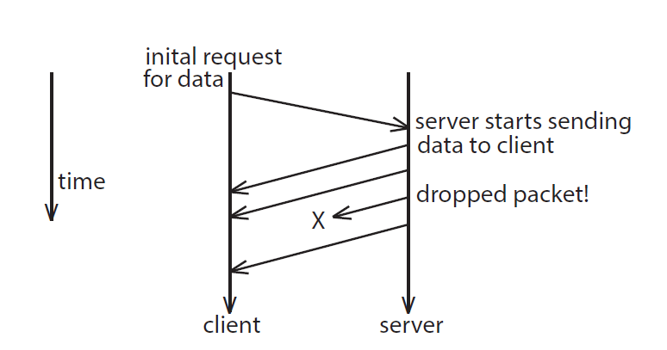
UDP Dropped Packet Example

Slide 23
Transmission Control Protocol
TCP is both reliable and connection-oriented
In addition to port number, TCP provides abstraction to allow in-order, uninterrupted byte-stream across an unreliable network
  Whenever host sends packet, the receiver must send an acknowledgement packet (ACK). If ACK not received before a timer expires, sender will resend.
  Sequence numbers in TCP header allow receiver to put packets in order and notice missing packets
  Connections are initiated with series of control packets called a three-way handshake
    Connections also closed with series of control packets

Slide 24
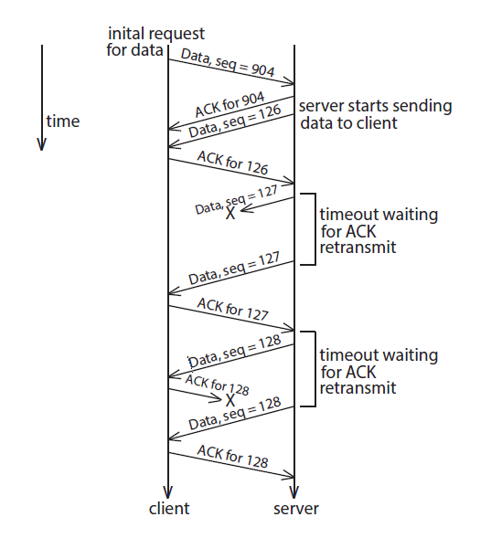
TCP Data Transfer Scenario

Slide 25
Transmission Control Protocol (Cont.)
Receiver can send a cumulative ACK to acknowledge series of packets
  Server can also send multiple packets before waiting for ACKs
  Takes advantage of network throughput
Flow of packets regulated through flow control and congestion control
  Flow control – prevents sender from overrunning capacity of receiver
  Congestion control – approximates congestion of the network to slow down or speed up packet sending rate

Slide 26
Network-oriented Operating Systems
Two main types
Network Operating Systems
  Users are aware of multiplicity of machines
Distributed Operating Systems
  Users not aware of multiplicity of machines

Slide 27
Network Operating Systems
Users are aware of multiplicity of machines
Access to resources of various machines is done explicitly by:
  Remote logging into the appropriate remote machine (ssh)
    ssh kristen.cs.yale.edu
  Transferring data from remote machines to local machines, via the File Transfer Protocol (FTP) mechanism
  Upload, download, access, or share files through cloud storage
Users must change paradigms – establish a session, give network-based commands, use a web browser
  More difficult for users

Slide 28
Distributed Operating Systems
Users not aware of multiplicity of machines
  Access to remote resources similar to access to local resources
Data Migration – transfer data by transferring entire file, or transferring only those portions of the file necessary for the immediate task
Computation Migration – transfer the computation, rather than the data, across the system
  Via remote procedure calls (RPCs)
  Via messaging system

Slide 29
Distributed-Operating Systems (Cont.)
Process Migration – execute an entire process, or parts of it, at different sites
  Load balancing – distribute processes across network to even the workload
  Computation speedup – subprocesses can run concurrently on different sites
  Hardware preference – process execution may require specialized processor
  Software preference – required software may be available at only a particular site
  Data access – run process remotely, rather than transfer all data locally
Consider the World Wide Web

Slide 30
Design Issues of Distributed Systems
We investigate three design questions:
  Robustness – Can the distributed system withstand failures?
  Transparency – Can the distributed system be transparent to the user both in terms of where files are stored and user mobility?
  Scalability – Can the distributed system be scalable to allow addition of more computation power, storage, or users?

Slide 31
Robustness
Hardware failures can include failure of a link, failure of a site, and loss of a message.
A fault-tolerant system can tolerate a certain level of failure
  Degree of fault tolerance depends on design of system and the specific fault
  The more fault tolerance, the better!
Involves failure detection, reconfiguration, and recovery

Slide 32
Failure Detection
Detecting hardware failure is difficult
To detect a link failure, a heartbeat protocol can be used
Assume Site A and Site B have established a link
  At fixed intervals, each site will exchange an I-am-up message indicating that they are up and running
If Site A does not receive a message within the fixed interval, it assumes either (a) the other site is not up or (b) the message was lost
Site A can now send an Are-you-up? message to Site B
If Site A does not receive a reply, it can repeat the message or try an alternate route to Site B

Slide 33
Failure Detection (Cont.)
If Site A does not ultimately receive a reply from Site B, it concludes some type of failure has occurred
Types of failures:
- Site B is down
- The direct link between A and B is down
- The alternate link from A to B is down
- The message has been lost
However, Site A cannot determine exactly why the failure has occurred

Slide 34
Reconfiguration and Recovery
When Site A determines a failure has occurred, it must reconfigure the system:
  If the link from A to B has failed, this must be broadcast to every site in the system
  If a site has failed, every other site must also be notified indicating that the services offered by the failed site are no longer available
When the link or the site becomes available again, this information must again be broadcast to all other sites

Slide 35
Transparency
The distributed system should appear as a conventional, centralized system to the user
  User interface should not distinguish between local and remote resources
    Example: NFS
  User mobility allows users to log into any machine in the environment and see his/her environment
    Example: LDAP plus desktop virtualization

Slide 36
Scalability
As demands increase, the system should easily accept the addition of new resources to accommodate the increased demand
  Reacts gracefully to increased load
  Adding more resources may generate additional indirect load on other resources if not careful
  Data compression or deduplication can cut down on storage and network resources used

Slide 37
Distributed File System
Distributed file system (DFS) – a file system whose clients, servers, and storage devices are dispersed among the machines of a distributed system
  Should appear to its clients as a conventional, centralized file system
Key distinguishing feature is management of dispersed storage devices

Slide 38
Distributed File System (Cont.)
Service – software entity running on one or more machines and providing a particular type of function to a priori unknown clients
Server – service software running on a single machine
Client – process that can invoke a service using a set of operations that forms its client interface
A client interface for a file service is formed by a set of primitive file operations (create, delete, read, write)
Client interface of a DFS should be transparent; i.e., not distinguish between local and remote files
Sometimes lower-level inter-machine interface needed for cross-machine interaction

Slide 39
Distributed File System (Cont.)
Two widely-used architectural models include client-server model and cluster-based model
Challenges include:
  Naming and transparency
  Remote file access
  Caching and cache consistency

Slide 40
Client-Server DFS Model
Server(s) store both files and metadata on attached storage
  Clients contact the server to request files
  Sever responsible for authentication, checking file permissions, and delivering the file
  Changes client makes to file must be propagated back to the server
Popular examples include NFS and OpenAFS
Design suffers from single point of failure if server crashes
Server presents a bottleneck for all requests of data and metadata
  Could pose problems with scalability and bandwidth

Slide 41
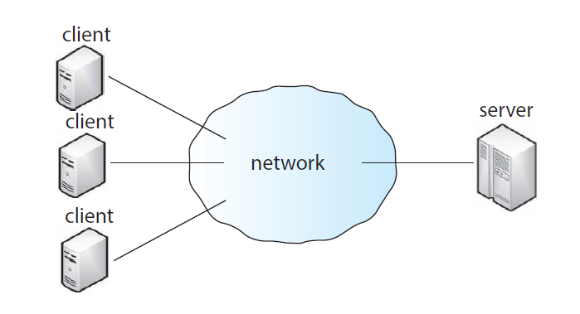
Client-Server DFS Model (Cont.)

Slide 42
Cluster-based DFS Model
Built to be more fault-tolerant and scalable than client-server DFS
Examples include the Google File System (GFS) and Hadoop Distributed File System (HDFS)
  Clients connected to master metadata server and several data servers that hold “chunks” (portions) of files
  Metadata server keeps mapping of which data servers hold chunks of which files
    As well as hierarchical mapping of directories and files
  File chunks replicated n times

Slide 43
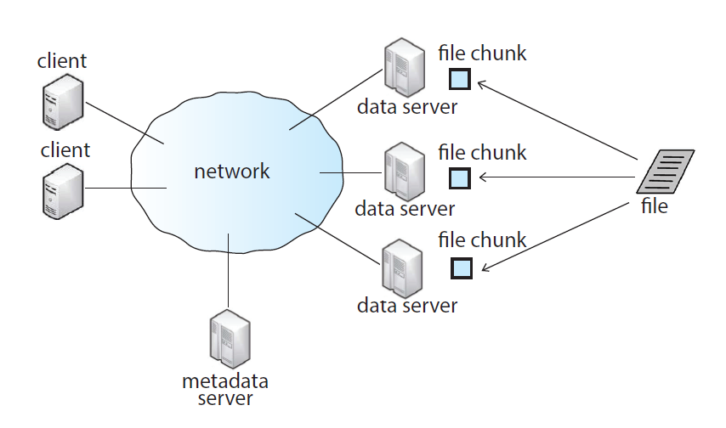
Cluster-based DFS Model (Cont.)

Slide 44
Cluster-based DFS Model (Cont.)
GFS design was influenced by following observations:
  Hardware component failures are the norm rather than the exception and should be routinely expected.
  Files stored on such a system are very large.
  Most files are changed by appending new data to the end rather than overwriting existing data.
  Redesigning the applications and file system API increases system flexibility
    Requires applications to be programmed specially with new API
Modularized software layer MapReduce can sit on top of GFS to carry out large-scale parallel computations while utilizing benefits of GFS
  Hadoop framework also stackable and modularized

Slide 45
Naming and Transparency
Naming – mapping between logical and physical objects
Multilevel mapping – abstraction of a file that hides the details of how and where on the disk the file is actually stored
A transparent DFS hides the location where in the network the file is stored
For a file being replicated in several sites, the mapping returns a set of the locations of this file’s replicas; both the existence of multiple copies and their location are hidden

Slide 46
Naming Structures
Location transparency – file name does not reveal the file’s physical storage location
Location independence – file name does not need to be changed when the file’s physical storage location changes
In practice most DFSs use static, location-transparent mapping for user-level names
  Some support file migration (e.g., OpenAFS)
  Hadoop supports file migration but without following POSIX standards; hides information from clients
  Amazon S3 provides blocks of storage on demand via APIs, placing storage dynamically and moving data as necessary

Slide 47
Naming Schemes
Three approaches:
  Files named by combination of their host name and local name; guarantees a unique system-wide name. This naming scheme is neither location transparent nor location independent.
  Attach remote directories to local directories, giving the appearance of a coherent directory tree; only previously mounted remote directories can be accessed transparently
  Single global name structures spans all files in the system. If a server is unavailable, some arbitrary set of directories on different machines also becomes unavailable

Slide 48
Remote File Access
Consider a user who requests access to a remote file. The server storing the file has been located by the naming scheme, and now the actual data transfer must take place.
Remote-service mechanism is one transfer approach.
  A request for accesses are delivered to the server, the server machine performs the accesses, and their results are forwarded back to the user.
  One of the most common ways of implementing remote service is the RPC paradigm

Slide 49
Remote File Access (Cont.)
Reduce network traffic by retaining recently accessed disk blocks in a cache, so that repeated accesses to the same information can be handled locally
  If needed data is not already cached, a copy of data is brought from the server to the user
  Accesses are performed on the cached copy
  Files identified with one master copy residing at the server machine, but copies of (parts of) the file are scattered in different caches
Cache-consistency problem – keeping the cached copies consistent with the master file
  Could be called network virtual memory

Slide 50
Cache Location – Disk vs. Main Memory
Advantages of disk caches
  More reliable
  Cached data kept on disk are still there during recovery and don’t need to be fetched again
Advantages of main-memory caches:
  Permit workstations to be diskless
  Data can be accessed more quickly
  Performance speedup in bigger memories
  Server caches (used to speed up disk I/O) are in main memory regardless of where user caches are located; using main-memory caches on the user machine permits a single caching mechanism for servers and users

Slide 51
Cache Update Policy
Write-through – write data through to disk as soon as they are placed on any cache
  Reliable, but poor performance
Delayed-write (write-back) – modifications are written to the cache and then written through to the server later
  Write accesses complete quickly; some data may be overwritten before they are written back, and so need never be written at all
  Poor reliability; unwritten data will be lost whenever a user machine crashes
  Variation – scan cache at regular intervals and flush blocks that have been modified since the last scan
  Variation – write-on-close, writes data back to the server when the file is closed
    Best for files that are open for long periods and frequently modified

Slide 52
Consistency
Is locally cached copy of the data consistent with the master copy?
Client-initiated approach
  Client initiates a validity check
  Server checks whether the local data are consistent with the master copy
Server-initiated approach
  Server records, for each client, the (parts of) files it caches
  When server detects a potential inconsistency, it must react

Slide 53
Consistency (Cont.)
In cluster-based DFS, cache-consistency issue more complicated due to the presence of metadata server and replicated file data chunks
  HDFS allows append-only write operations (no random writes) and a single file writer
  GFS allows random writes with concurrent writers
Complicates write consistency guarantees for GFS while simplifying it for HDFS

Slide 54
The Sun Network File System (NFS)
An implementation and a specification of a software system for accessing remote files across LANs (or WANs)
The implementation is part of the Solaris and SunOS operating systems running on Sun workstations using an unreliable datagram protocol (UDP/IP protocol) and Ethernet
  Later version support TCP also

Slide 55
NFS (Cont.)
Interconnected workstations viewed as a set of independent machines with independent file systems, which allows sharing among these file systems in a transparent manner
  A remote directory is mounted over a local file system directory
    The mounted directory looks like an integral subtree of the local file system, replacing the subtree descending from the local directory
  Specification of the remote directory for the mount operation is nontransparent; the host name of the remote directory has to be provided
    Files in the remote directory can then be accessed in a transparent manner
  Subject to access-rights accreditation, potentially any file system (or directory within a file system), can be mounted remotely on top of any local directory

Slide 56
NFS (Cont.)
NFS is designed to operate in a heterogeneous environment of different machines, operating systems, and network architectures; the NFS specifications are independent of these media
This independence is achieved using RPC primitives built on top of an External Data Representation (XDR) protocol used between two implementation-independent interfaces
The NFS specification distinguishes between the services provided by a mount mechanism and the actual remote-file-access services

Slide 57
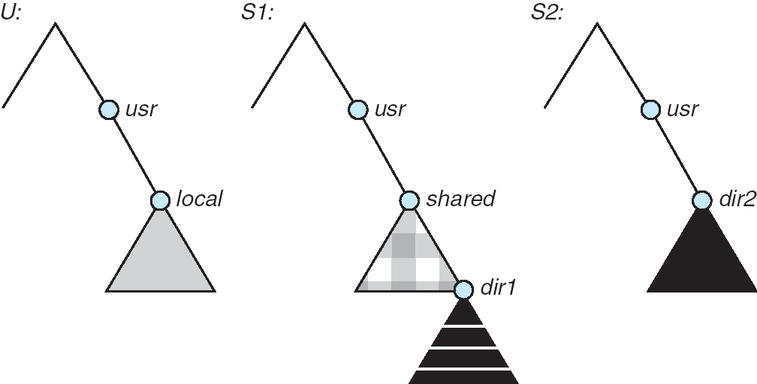
Three Independent File Systems

Slide 58
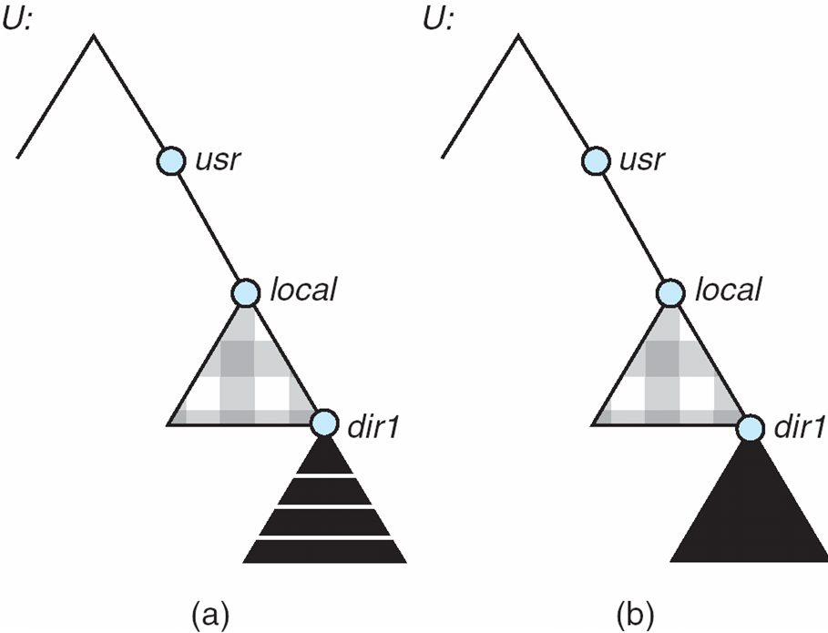
Mounting in NFS
Mounts
Cascading mounts

Slide 59
NFS Mount Protocol
Establishes initial logical connection between server and client
Mount operation includes name of remote directory to be mounted and name of server machine storing it
  Mount request is mapped to corresponding RPC and forwarded to mount server running on server machine
  Export list – specifies local file systems that server exports for mounting, along with names of machines that are permitted to mount them
Following a mount request that conforms to its export list, the server returns a file handle—a key for further accesses
File handle – a file-system identifier, and an inode number to identify the mounted directory within the exported file system
The mount operation changes only the user’s view and does not affect the server side

Slide 60
NFS Protocol
Provides a set of remote procedure calls for remote file operations. The procedures support the following operations:
  searching for a file within a directory
  reading a set of directory entries
  manipulating links and directories
  accessing file attributes
  reading and writing files
NFS servers are stateless; each request has to provide a full set of arguments (NFS V4 is just coming available – very different, stateful)
Modified data must be committed to the server’s disk before results are returned to the client (lose advantages of caching)
The NFS protocol does not provide concurrency-control mechanisms

Slide 61
Three Major Layers of NFS Architecture
UNIX file-system interface (based on the open, read, write, and close calls, and file descriptors)
Virtual File System (VFS) layer – distinguishes local files from remote ones, and local files are further distinguished according to their file-system types
  The VFS activates file-system-specific operations to handle local requests according to their file-system types
  Calls the NFS protocol procedures for remote requests
NFS service layer – bottom layer of the architecture
  Implements the NFS protocol

Slide 62
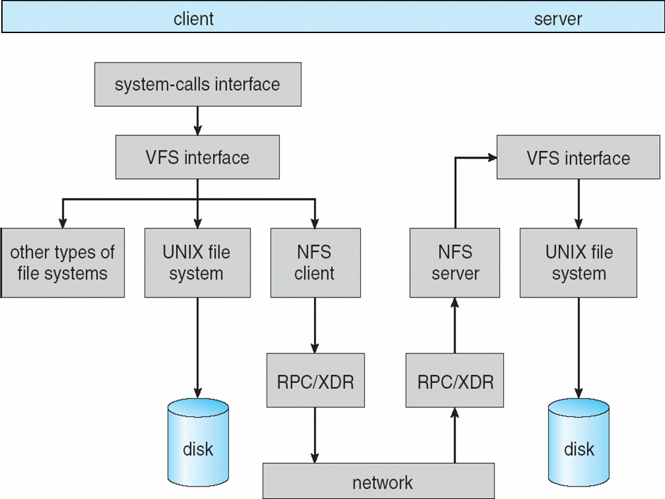
Schematic View of NFS Architecture

Slide 63
NFS Path-Name Translation
Performed by breaking the path into component names and performing a separate NFS lookup call for every pair of component name and directory vnode
To make lookup faster, a directory name lookup cache on the client’s side holds the vnodes for remote directory names

Slide 64
NFS Remote Operations
Nearly one-to-one correspondence between regular UNIX system calls and the NFS protocol RPCs (except opening and closing files)
NFS adheres to the remote-service paradigm, but employs buffering and caching techniques for the sake of performance
File-blocks cache – when a file is opened, the kernel checks with the remote server whether to fetch or revalidate the cached attributes
  Cached file blocks are used only if the corresponding cached attributes are up to date
File-attribute cache – the attribute cache is updated whenever new attributes arrive from the server
Clients do not free delayed-write blocks until the server confirms that the data have been written to disk

