Slide 1
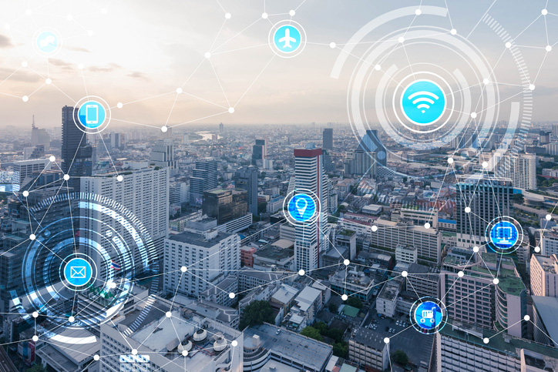
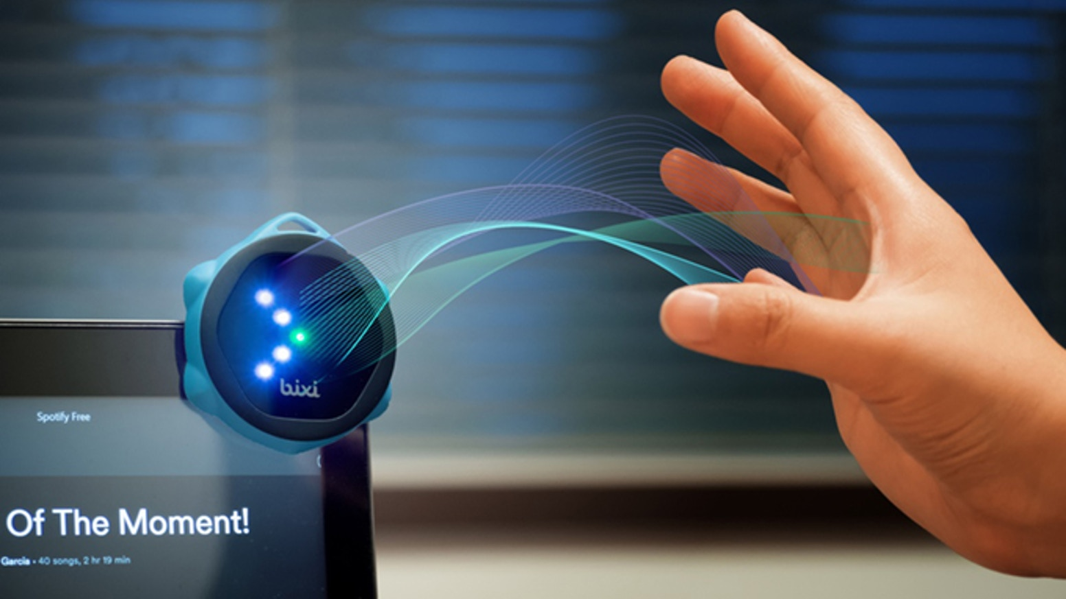
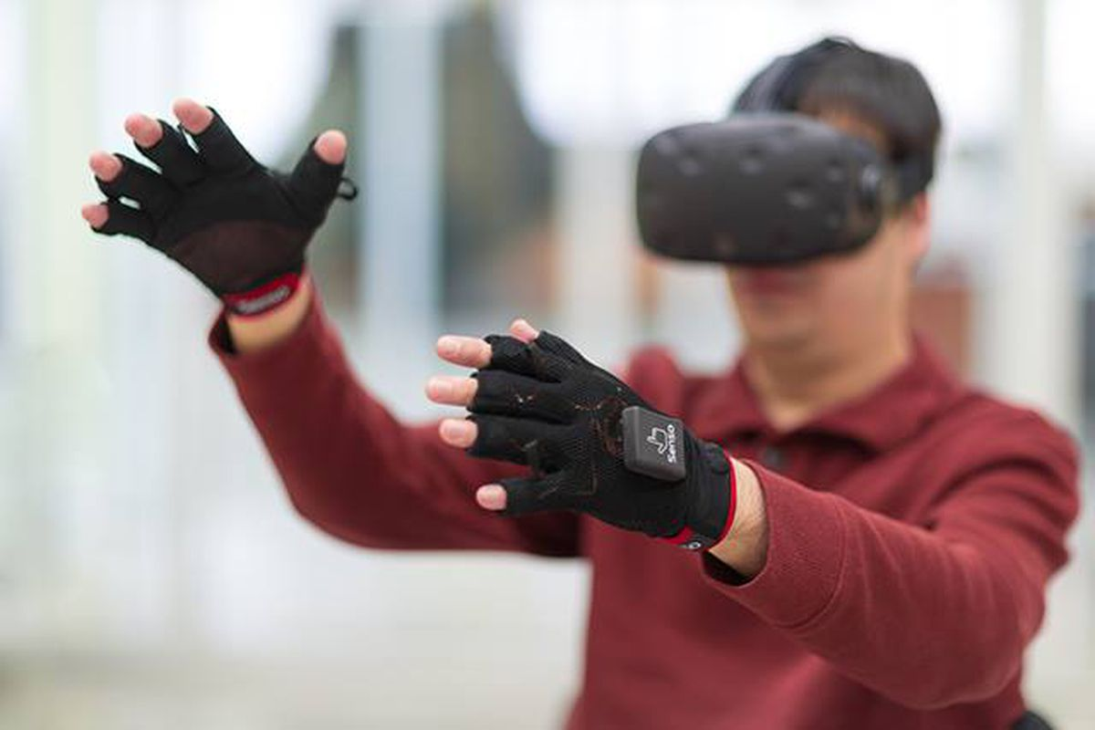
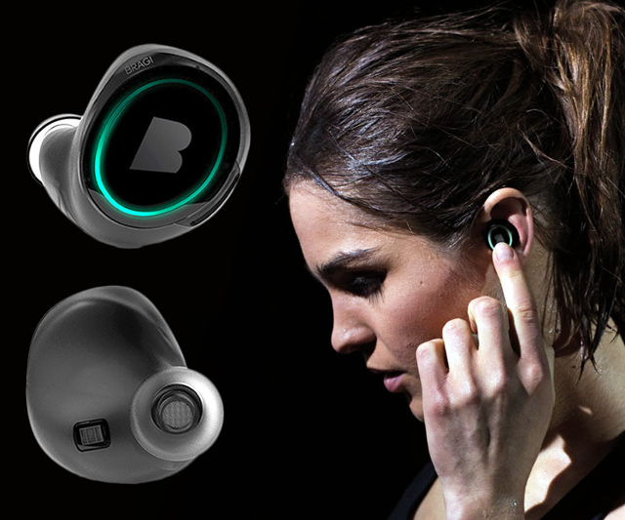
Wireless and Mobile Systems
for the IoT
CMSC 715 : Fall 2024
Lecture 1.1: Sensors and Sensing basics
Nirupam Roy
Tu-Th 2:00 – 3:15pm
IRB 2207

Slide 2
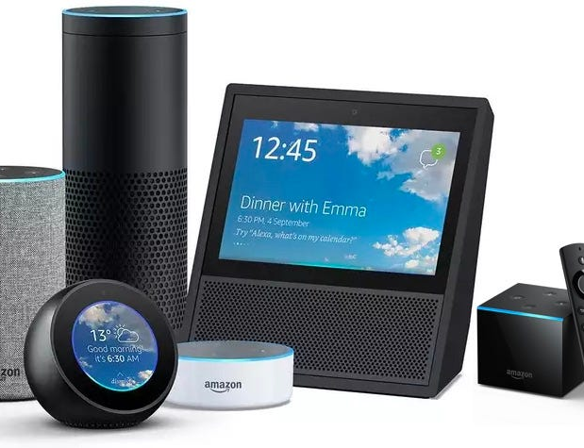
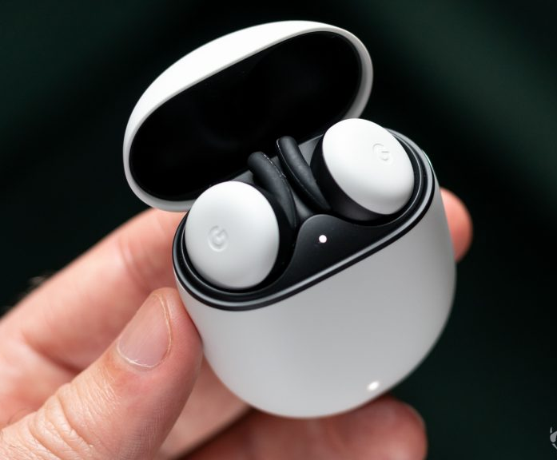
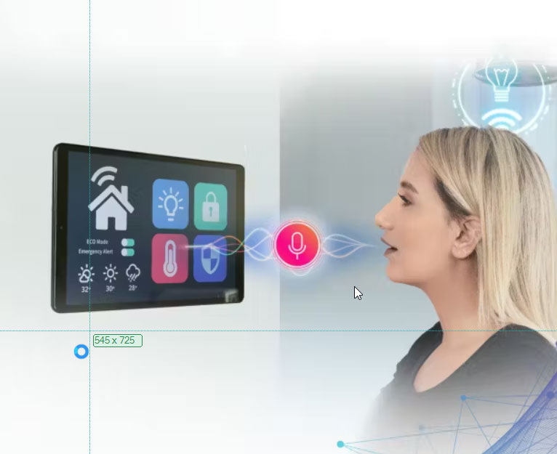
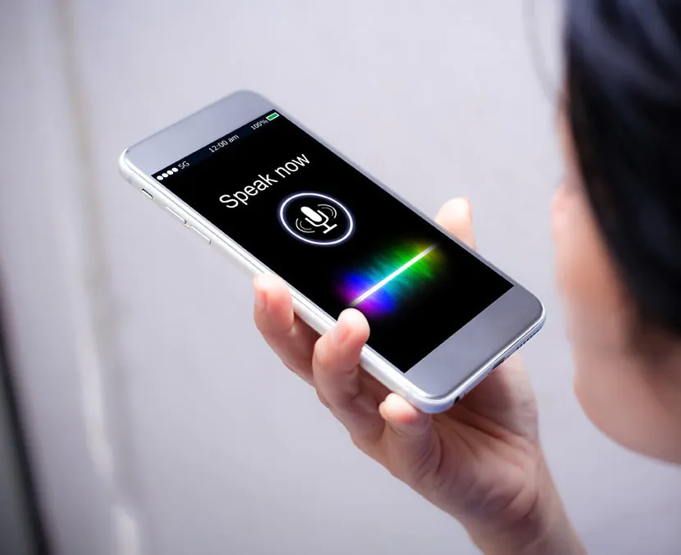
Voice-first revolution is here.

Slide 3
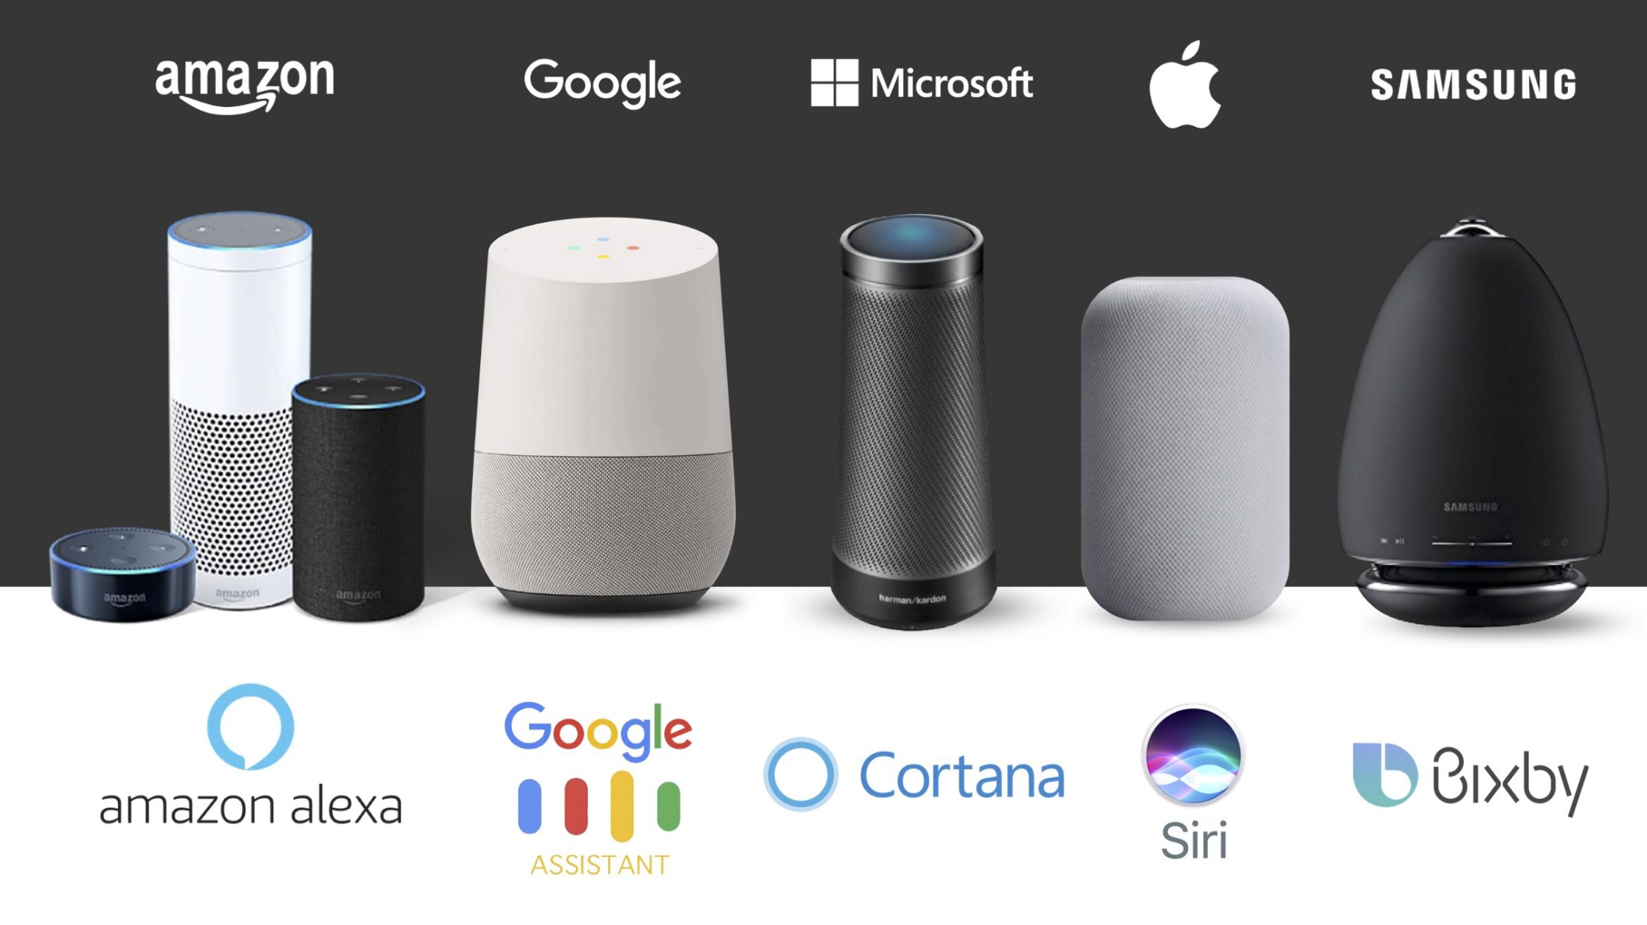
Voice assistants

Slide 4
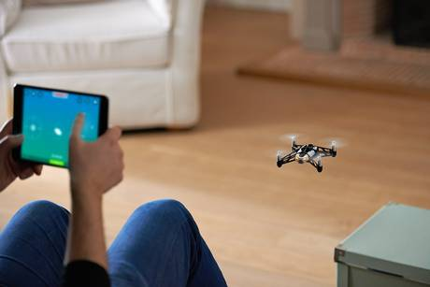
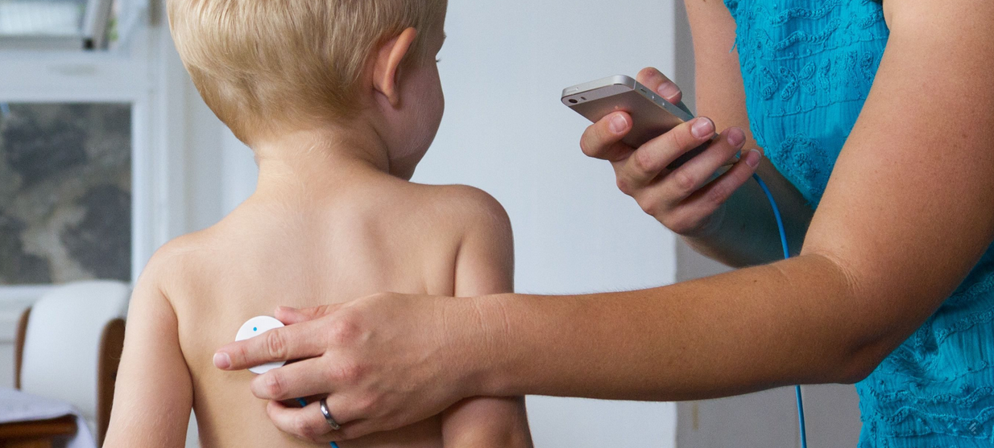
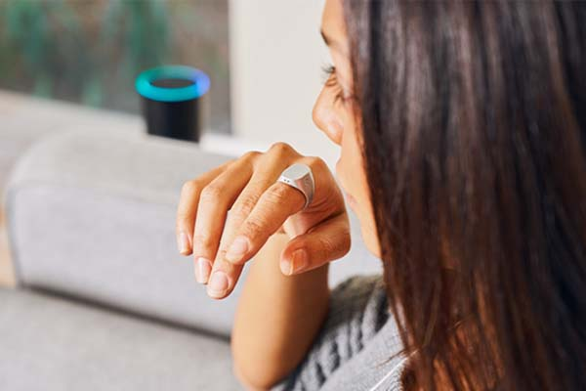
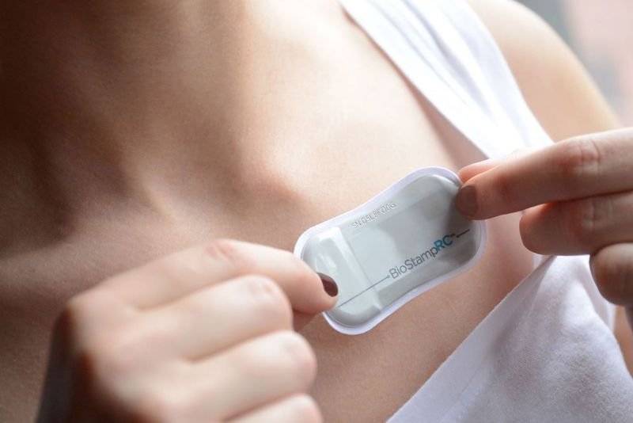
Sensing
Learning
&
Computing
Cyber-Physical
Health
Human-Machine
Wearables
Communication
&
Networking
…and privacy/security

Slide 5
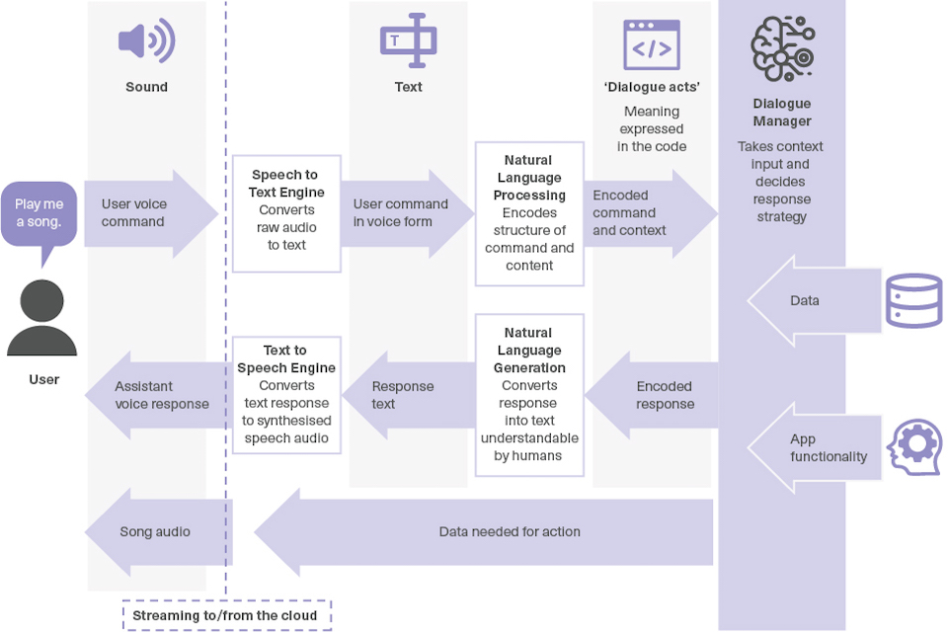

Slide 7
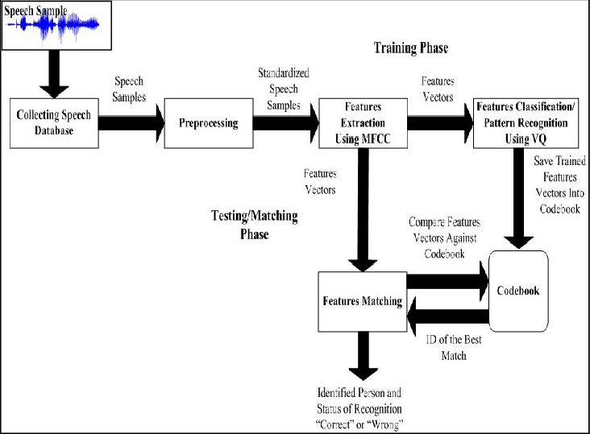

Slide 8
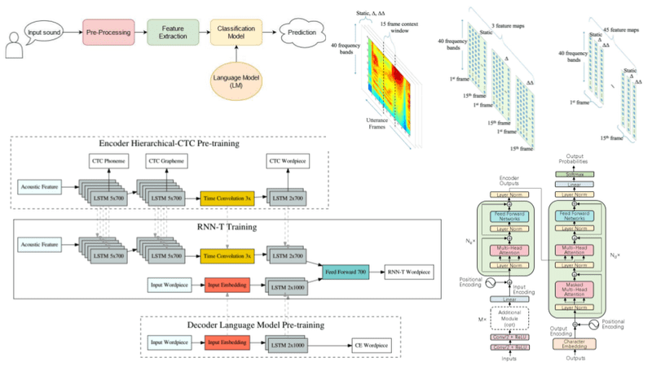

Slide 9
PC: https://theaisummer.com/speech-recognition/

Slide 10
Environments
Sensors
- Familiarity with existing sensing technologies
Physics & mathematical models of signals
- Propagation of sounds and other waves
- Time and frequency domain modeling
of signals
- Array theory, Spatial analysis
Computing & learning
- Analytical solutions, parsimonious approaches
- Physics-informed neural networks (PINN)
Communication
& networks
- Ultra-low-power communication
- Edge computing

Slide 11
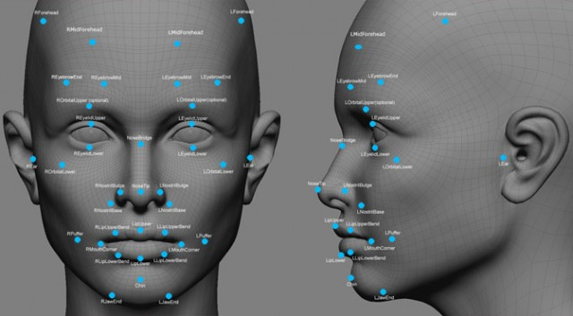
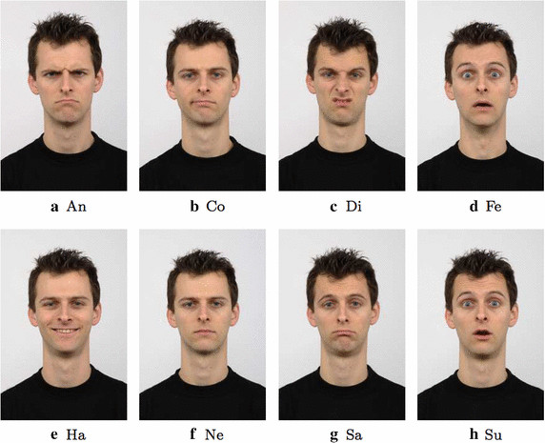
Abstraction
Computing: Models and Algorithms
Data
Sensing techniques

Slide 12
Abstraction: Traditional view
Computing: Models and Algorithms
Data
Data
Sensing techniques

Slide 13
Abstraction: Traditional view
Natural language
processing
Computer
vision
Networking
Data packets
Voice recording
Image/video

Slide 14
Abstraction: Traditional view
Natural language
processing
Computer
vision
Networking
Data packets
Voice recording
Image/video
WiFi signal
Acoustic signal
Light

Slide 15
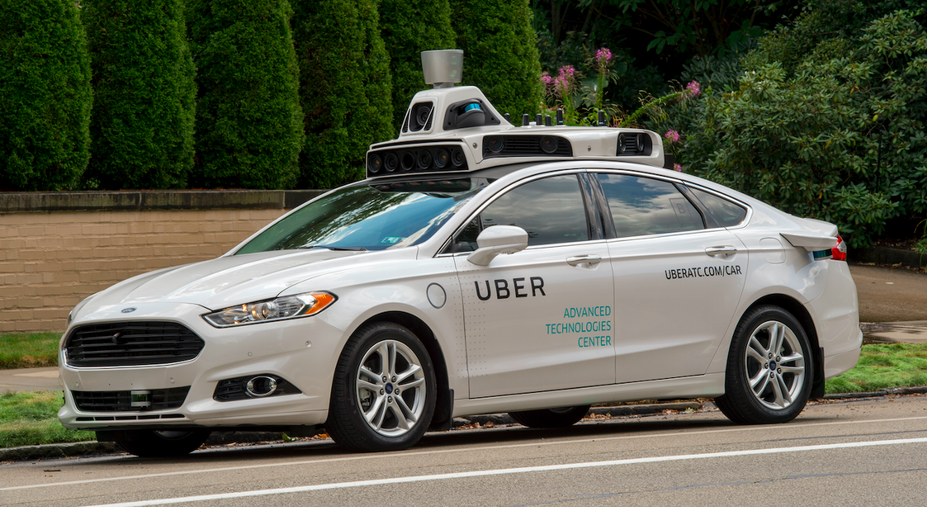
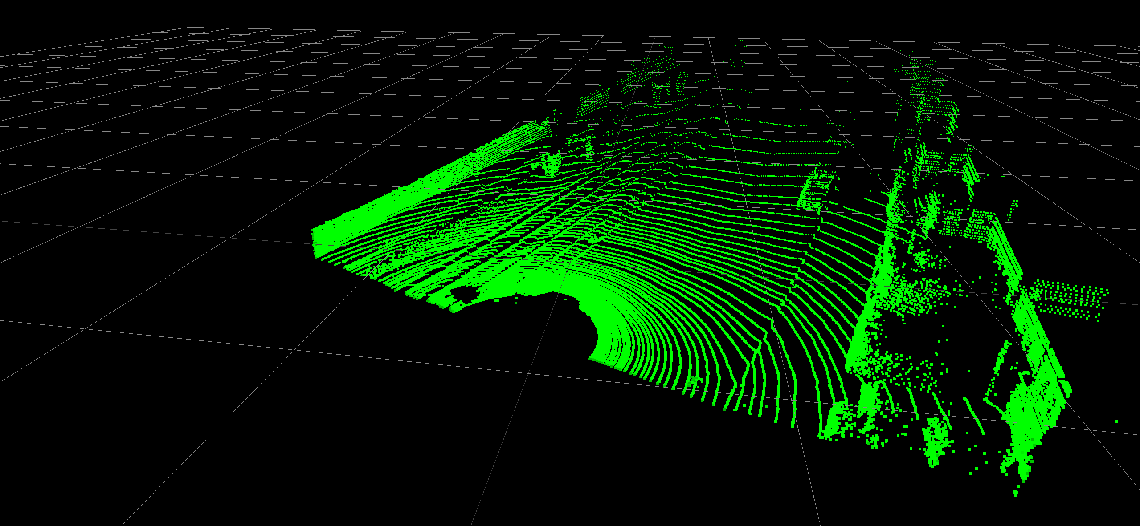
Integration of sensing and computing
Notes:
Image source: https://www.geospatialworld.net/blogs/5-ways-lidar-is-transforming-the-world-before-our-eyes/
Image source: https://github.com/alvinwan/pc2vid

Slide 16
Integration of sensing and computing
Notes:
Image source: https://searchcustomerexperience.techtarget.com/definition/voice-recognition-speaker-recognition

Slide 17
Abstraction
Computing: Models and Algorithms
Data
Sensing techniques

Slide 18
Sensing
PC: https://theaisummer.com/speech-recognition/

Slide 19
Concept of Sensing

Slide 20
Gesture/Motion/
Orientation
Vital signs detection
Autonomous vehicle control
Physical environment
(light, sound, speed, geomagnetism, radio waves, …)

Slide 21
Gesture/Motion/
Orientation
Vital signs detection
Autonomous vehicle control
Physical environment
(light, sound, speed, geomagnetism, radio waves, …)

Slide 22
Gesture/Motion/
Orientation
Vital signs detection
Autonomous vehicle control
Signal
Physical environment
(light, sound, speed, geomagnetism, radio waves, …)

Slide 23
Sensors
- Definitions
- Generic working principle
2. Signals
- Digital abstraction
- Mathematical model

Slide 24
What is a sensor?

Slide 25
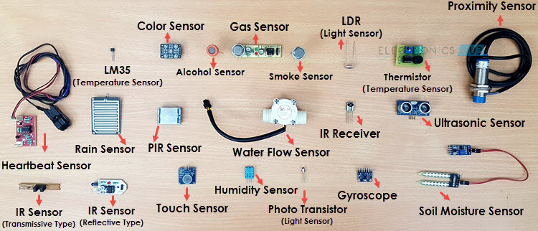
What is a sensor?
Is there a common principle?
Notes:
Image source: https://www.electronicshub.org/different-types-sensors/

Slide 26
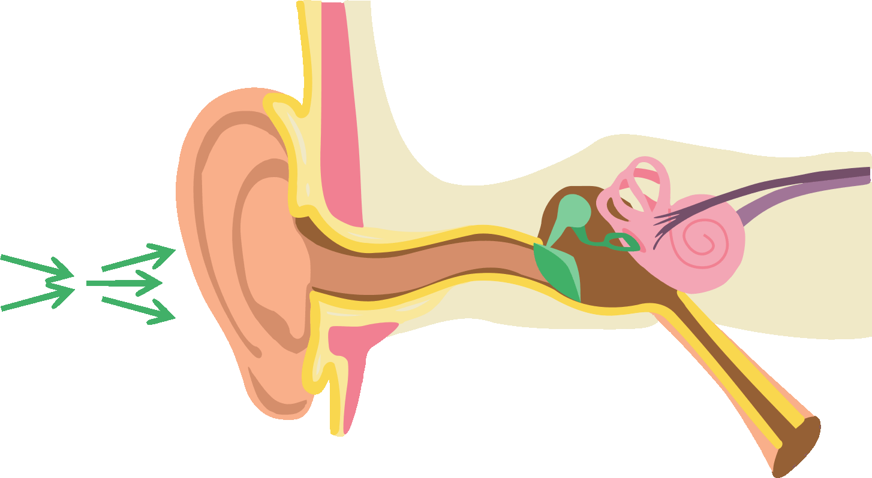
How does a sound sensor work?

Slide 27
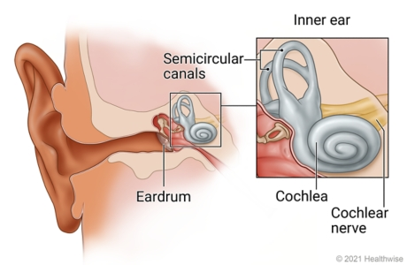
How does a sound sensor work?

Slide 28
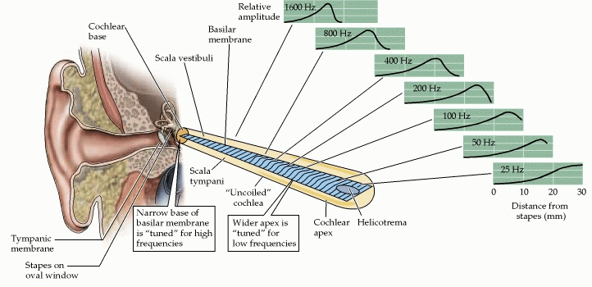
How does a sound sensor work?
PC: https://www.researchgate.net/publication/346332141_THE_SAHLGRENSKA_ACADEMY_INSTITUTE_OF_MEDICINE_THE_IMPORTANCE_OF_LOW_FREQUENCY_MASKING_ON_AUDITORY_PERCEPTION_Literature_Review_REPORT_NO_42017_FROM_THE_UNIT_FOR_OCCUPATIONAL_ENVIRONMENTAL_MEDICINE_IN_/figures?lo=1&utm_source=google&utm_medium=organic

Slide 29
How does a sound sensor (microphone) work?

Slide 30
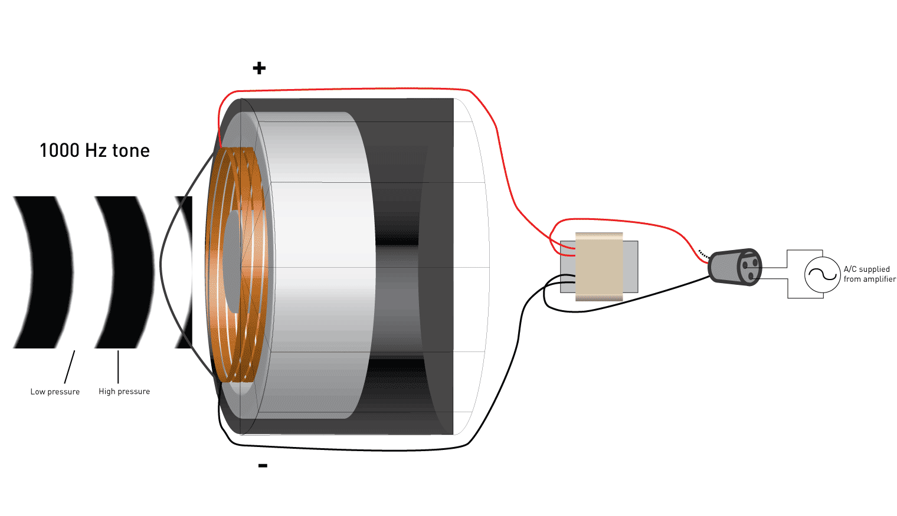
How does a sound sensor (microphone) work?

Slide 31
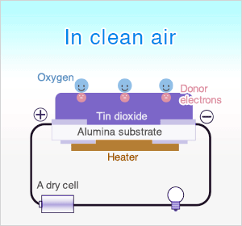
2. How does a gas sensor work?

Slide 32
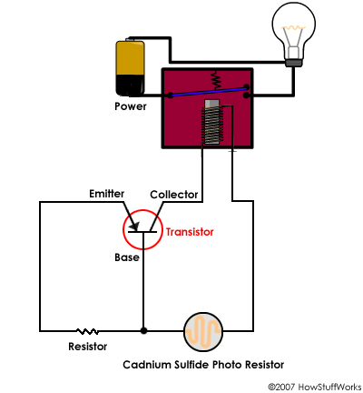
3. How does a light sensor work?

Slide 33
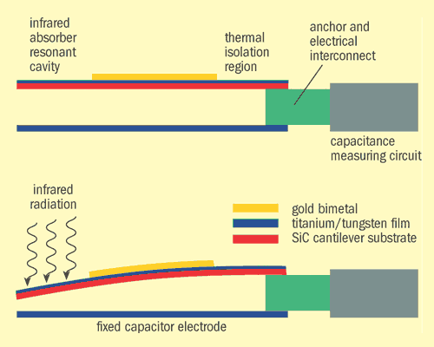
How does a temperature sensor work?
Circuit sensitive to capacitance change
Voltage signal

Slide 34
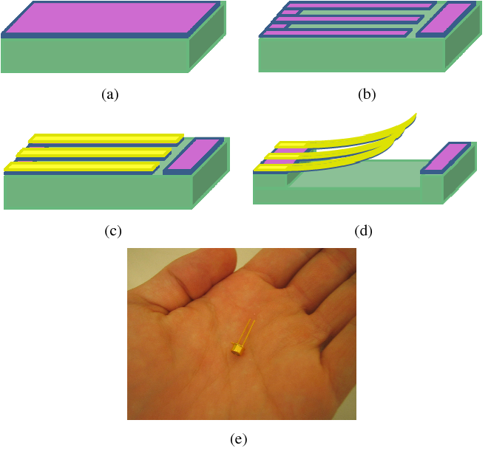
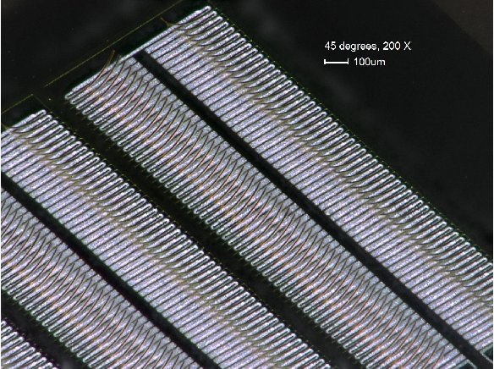
How does a temperature sensor work?
MEMS (Micro-Electro Mechanical Systems)

Slide 35
Fundamental principle of sensors
Electrical fluctuations
proportional to the
speed/volume of air-flow
Air flow
Mapping
10 Miles per hour
Mapping

Slide 36
SENSOR
A circuit that converts the reaction to measurable electrical signal (voltage, current, or energy)
A structure or material
that reacts to the physical phenomenon
A physical phenomenon
We want to measure
Interpretation of the signal, storing the data

Slide 37
Fundamental principle of sensors
Temperature
Voltage
Thermo-couple
Time
At time t
Mapping
Temp.
40° F
(a scalar value)
Time

Slide 38
Scalar vs. Vector Output

Slide 39
Scalar and vector output

Slide 40
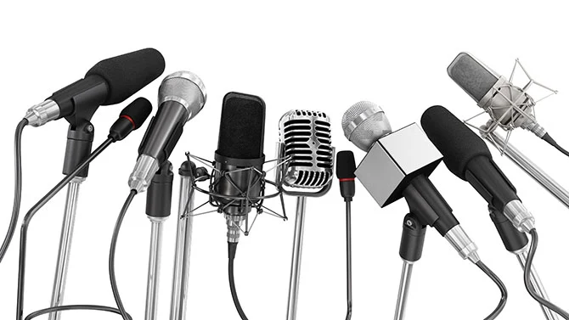
Scalar and vector output
Acoustic Pressure Sensor (Scalar)

Slide 41
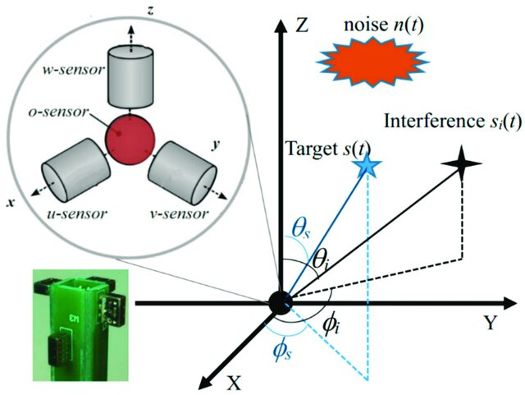
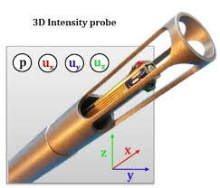
Scalar and vector output
Acoustic Vector Sensor
(particle velocity sensor)

Slide 42
Scalar and vector output
Y
X
Global coordinate system

Slide 43
Coordinate system
Y
X

Slide 44
Coordinate system
Local coordinate system
Y
X

Slide 45
Coordinate system
Local coordinate system
Y
V_{y}
V_{X}
X

Slide 46
Coordinate system
Local coordinate system
Y
V_{y}
V_{X}
X
Output = <V_{x}, V_{y}>

Slide 47
Coordinate system
Local coordinate system
Y
V_{y}
V_{x}
X
Output at time t
<V_{x} (t), V_{y}(t)>
for a 2-axis sensor

Slide 48
Coordinate system
Local coordinate system
Y
V_{y}
V_{x}
X
Z
Output at time t
<V_{x} (t), V_{y}(t), V_{z}(t)>
for a 3-axis sensor

Slide 49
Coordinate system

Slide 50
Coordinate system
North
Y
Local coordinate system
X
Z
Global coordinate system
East

Slide 51
Sensor data
Sensor data
Sensor
Scalar
Time
Vector
Sensor data
Time
Mapping

Slide 52
Sensor data
Sensor data
Sensor
Scalar
Time
Vector
Sensor data
Output at time t
<V_{x} (t), V_{y}(t), V_{z}(t)>
Time
Mapping

Slide 53
Sensor data
Is an image a scalar data or a vector data?

Slide 54
Sensor data
Is a gray-scale image a scalar data or a vector data?

Slide 55
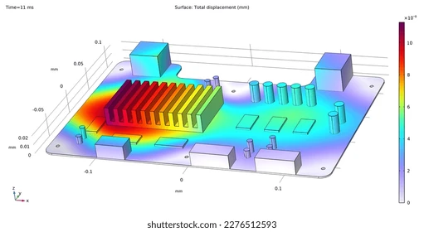
Scalar and Vector fields
Temperature distribution (scalar field)

Slide 56
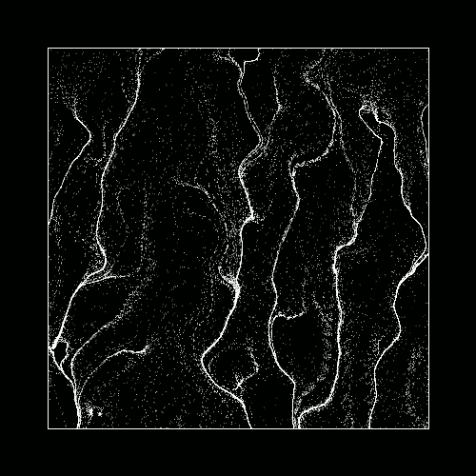
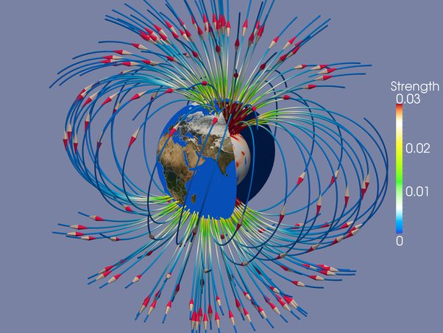
Scalar and Vector fields
Particle flow
(vector field)
Magnetic field (vector field)

Slide 57
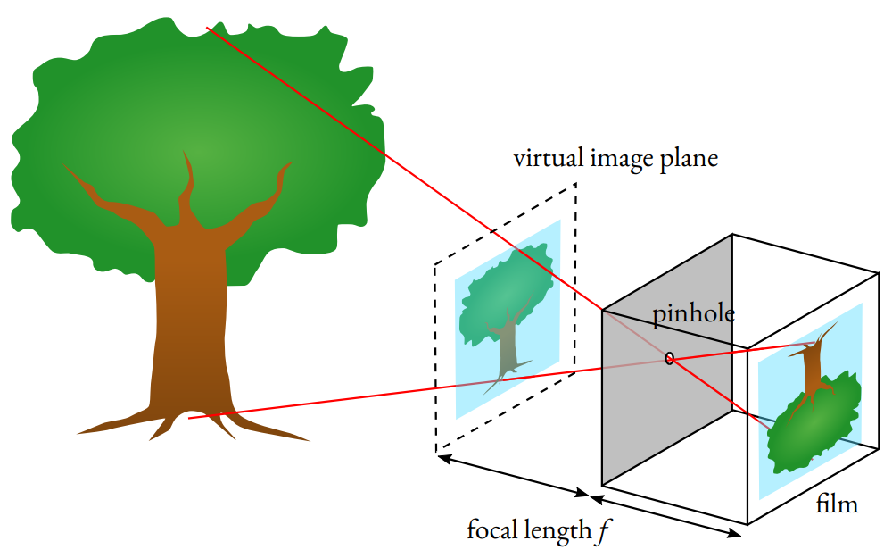
Scalar and Vector fields
Is a gray-scale image a scalar data or a vector data?

Slide 58
Scalar and Vector fields
Is a gray-scale image a scalar data or a vector data?
How is the camera data different from the microphone data?

Slide 59
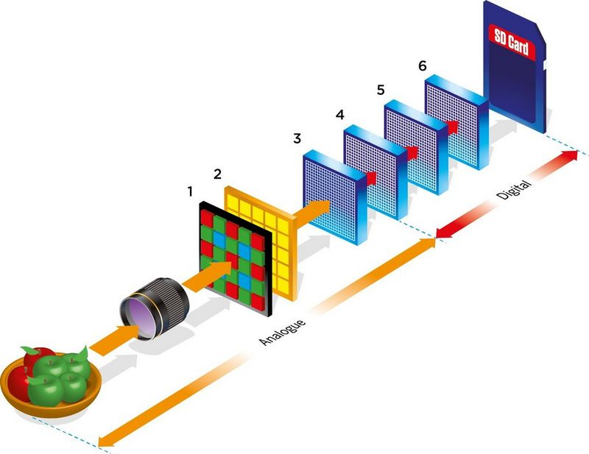
How does a camera sensor work?
Ref: https://www.canon-europe.com/pro/infobank/image-sensors-explained/#:~:text=Just%20as%20the%20retina%20in,to%20form%20a%20digital%20image.

Slide 60
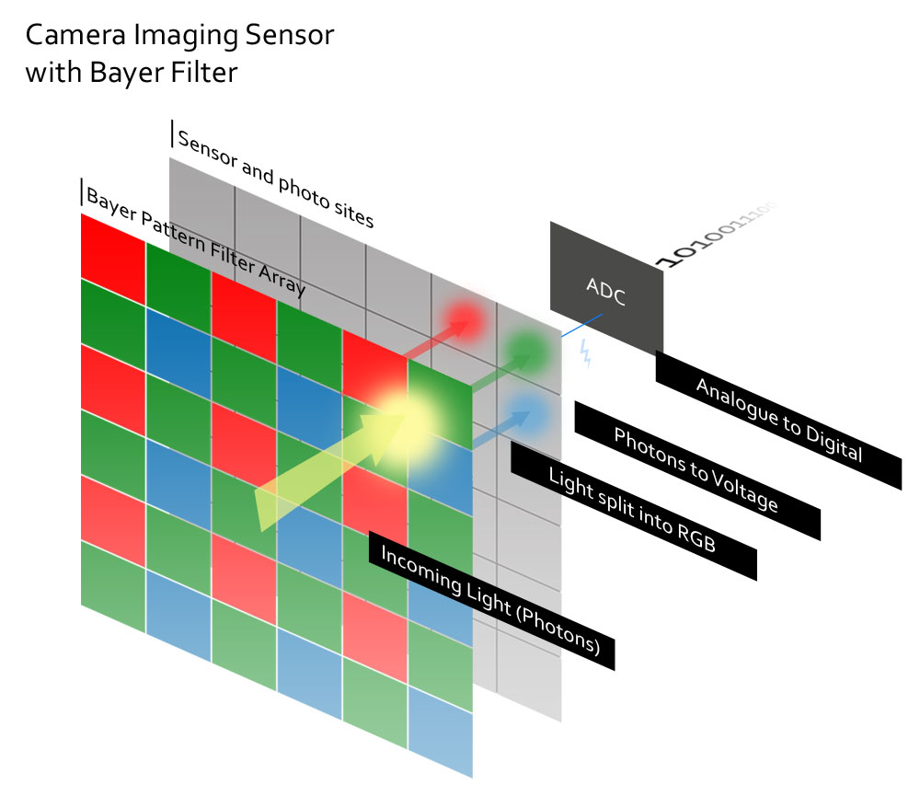
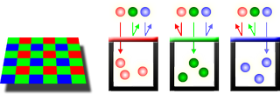
How does a camera sensor work?

Slide 61
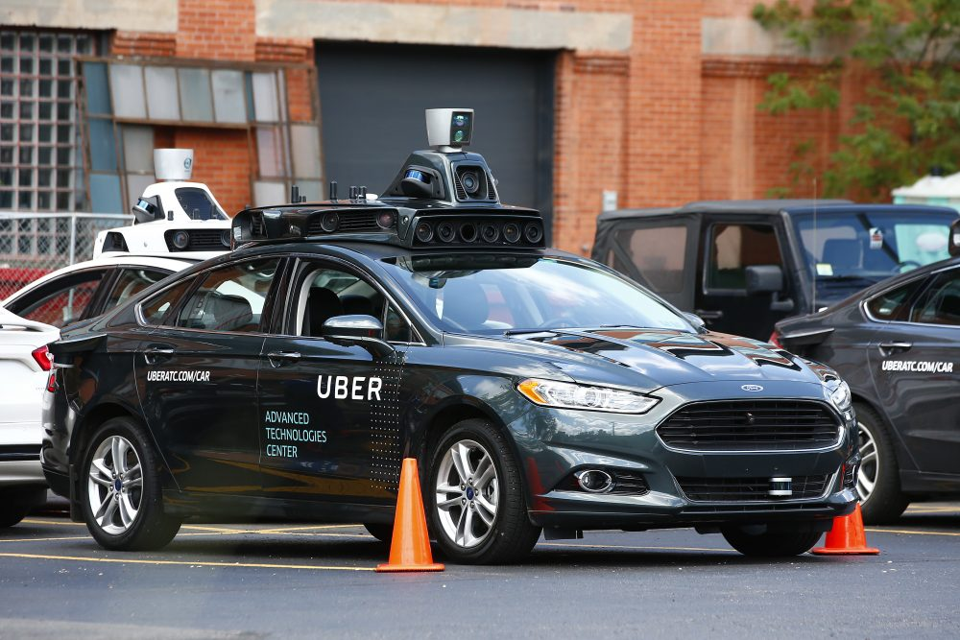
What is this on the top of the car?

Slide 62
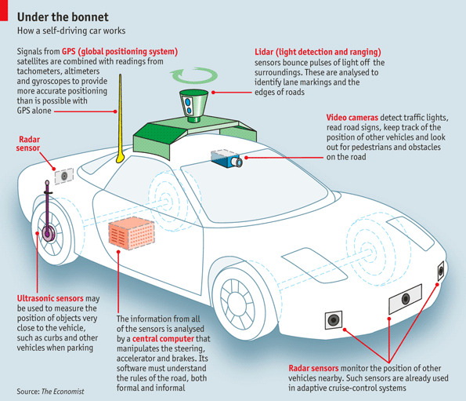
How does a lidar (depth) sensor work?

Slide 63
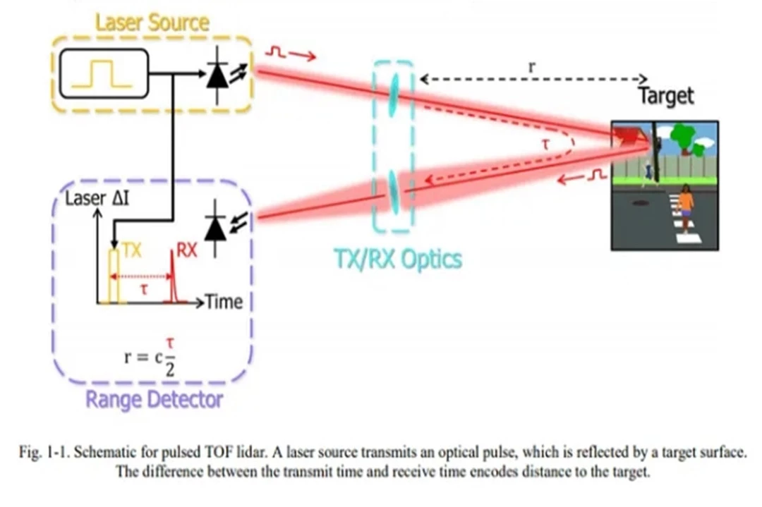
How does a lidar (depth) sensor work?
Ref: https://www.jouav.com/blog/what-is-lidar.html

Slide 64
How does a sound sensor (microphone) work?
Amplitude
Time (sec)
0.00
0.25
0.50
0.75
1.00
1.25

Slide 65
Thank you

Slide 67
Properties of a signal
Frequency, Amplitude, and Phase

Slide 68
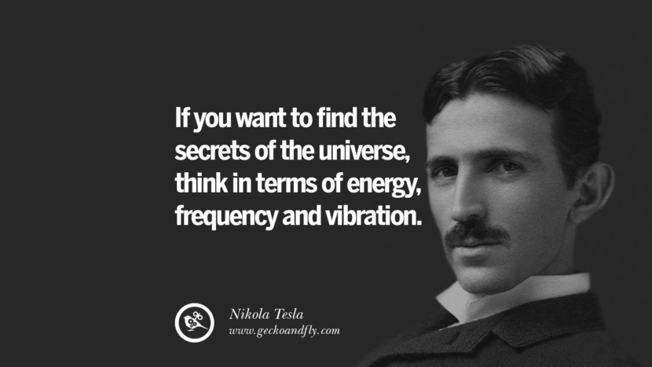
What is frequency?

Slide 69
Definition of Frequency
Frequency is the number of occurrences of a repeating event per unit of time.

Slide 70
Frequency, Amplitude, and Phase

Slide 71
Frequency, Amplitude, and Phase
Time

Slide 72
Frequency, Amplitude, and Phase
$$f cycles per second$$
$$2π angles per cycle$$
Time

Slide 73
Frequency, Amplitude, and Phase
One cycle
+A
A
0
Amplitude
-A
Time

Slide 74
Frequency, Amplitude, and Phase
$$2π angles per cycle$$
$$f cycles per second$$
A
𝚹
time = t second
$$=$$
$$A . sin⁡(θ)$$
$$=$$
$$A . sin⁡(2πft)$$

Slide 75
Frequency, Amplitude, and Phase
$$2π angles per cycle$$
$$f cycles per second$$
A
𝚹
Phase
time = t second
$$=$$
$$A . sin⁡(θ)$$
$$=$$
$$A . sin⁡(2πft)$$

Slide 76
Frequency, Amplitude, and Phase
$$2π angles per cycle$$
$$f cycles per second$$
A
𝚹
Phase
time = t second
$$=$$
$$A . sin⁡(θ)$$
$$=$$
$$A . sin⁡(2πft)$$
$$A . sin⁡(2πft+φ)$$
-- with initial/additional phase ϕ

Slide 77
Frequency, Amplitude, and Phase

Slide 78
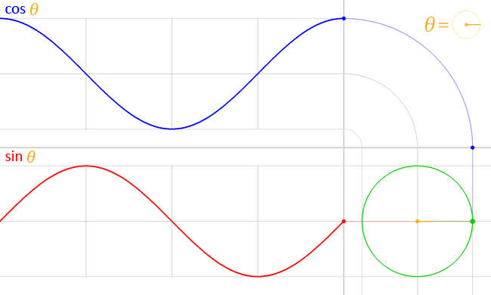
Frequency, Amplitude, and Phase
$$A . sin⁡(θ)$$
$$A . cos⁡(θ)$$

Slide 79
Frequency, Amplitude, and Phase
$$2π angles per cycle$$
$$f cycles per second$$
A
𝚹
time = t second
$$=$$
$$A . cos⁡(θ)$$
$$=$$
$$A . cos⁡(2πft)$$
$$=$$
$$A . sin⁡(2πft+(π/2))$$

Slide 80
Frequency, Amplitude, and Phase
Frequency: 2Hz
Amplitude
Time (sec)
0.00
0.25
0.50
0.75
1.00
1.25
Notes:
1) Two common terms related to signals are amplitude and frequency. Frequency is the number of repetition of the signal per second.

Slide 81
Frequency, Amplitude, and Phase
Frequency: 2Hz
Amplitude
Time (sec)
0.00
0.25
0.50
0.75
1.00
1.25
Frequency: 4Hz
Amplitude
Time (sec)
0.00
0.25
0.50
0.75
1.00
1.25

Slide 82
Frequencies of an arbitrary signal
Frequency: 2Hz
Amplitude
Time (sec)
0.00
0.25
0.50
0.75
1.00
1.25
Amplitude
Time (sec)
0.00
0.25
0.50
0.75
1.00
1.25

Slide 83
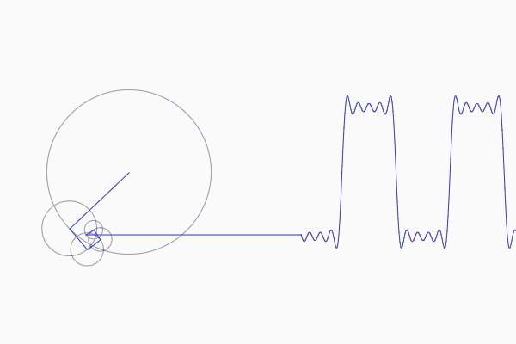
Frequencies of an arbitrary signal

Slide 84
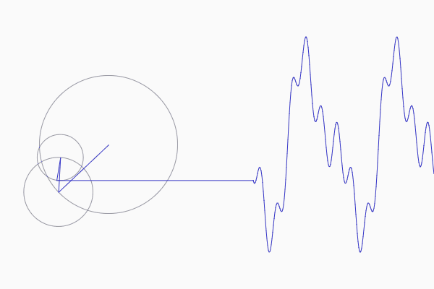
Frequencies of an arbitrary signal

Slide 85
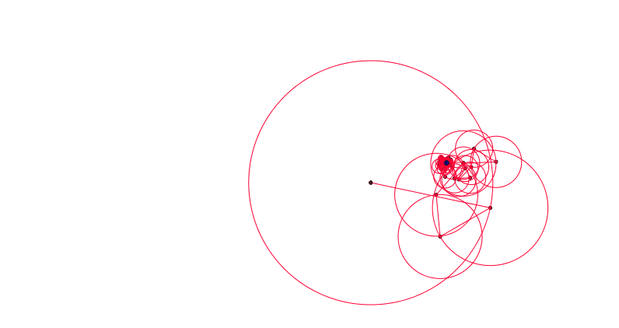
Frequencies of an arbitrary signal

Slide 86
The concept of the Fourier series
Amplitude
Time (sec)
0.00
0.25
0.50
0.75
1.00
1.25
Amplitude
Time (sec)
0.00
0.25
0.50
0.75
1.00
1.25

Slide 87
Time Domain and Frequency Domain
Approx. square wave
$$1 .\sin\left(2πft\right)$$
$$\frac{1}{3} .\sin\left(2π.3ft\right)$$
$$\frac{1}{5} .\sin\left(2π.5ft\right)$$
$$\frac{1}{7} .\sin\left(2π.7ft\right)$$

Slide 88
Time Domain and Frequency Domain
Time domain view
Frequency domain view

Slide 89
Analogy: Food coloring chart
Basis for food colors
Notes:
Emphasize basis and coefficient using Color analogy

Slide 90
Analogy: Food coloring chart
Basis for food colors
Notes:
Emphasize basis and coefficient using Color analogy

Slide 91
Analogy: Food coloring chart
Basis for food colors
Notes:
Emphasize basis and coefficient using Color analogy

Slide 92
Analogy: Food coloring chart
Basis for food colors
Notes:
Emphasize basis and coefficient using Color analogy

Slide 93
Time Domain and Frequency Domain
Amplitude
Time (sec)
0.00
0.25
0.50
0.75
1.00
1.25
$$= A1 .\sin\left(2πf1t\right)+B1 . cos⁡(2πf1t)$$
$$+ A2 .\sin\left(2πf2t\right)+B2 . cos⁡(2πf2t)$$
$$+ A3 .\sin\left(2πf3t\right)+B3 . cos⁡(2πf3t)$$
$$+ …$$

Slide 94
Time Domain and Frequency Domain
Fourier Transform
FFT
Amplitude
Amplitude
IFFT
0.00
0.25
0.50
0
2
4
6
8
Time
Frequency (Hz)
Time domain
Frequency domain
FFT = Fast Fourier Transform
IFFT = Inverse Fast Fourier Transform

