Slide 1
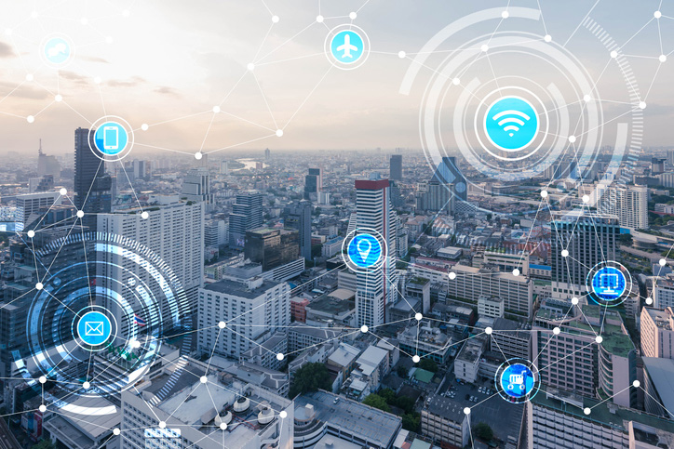
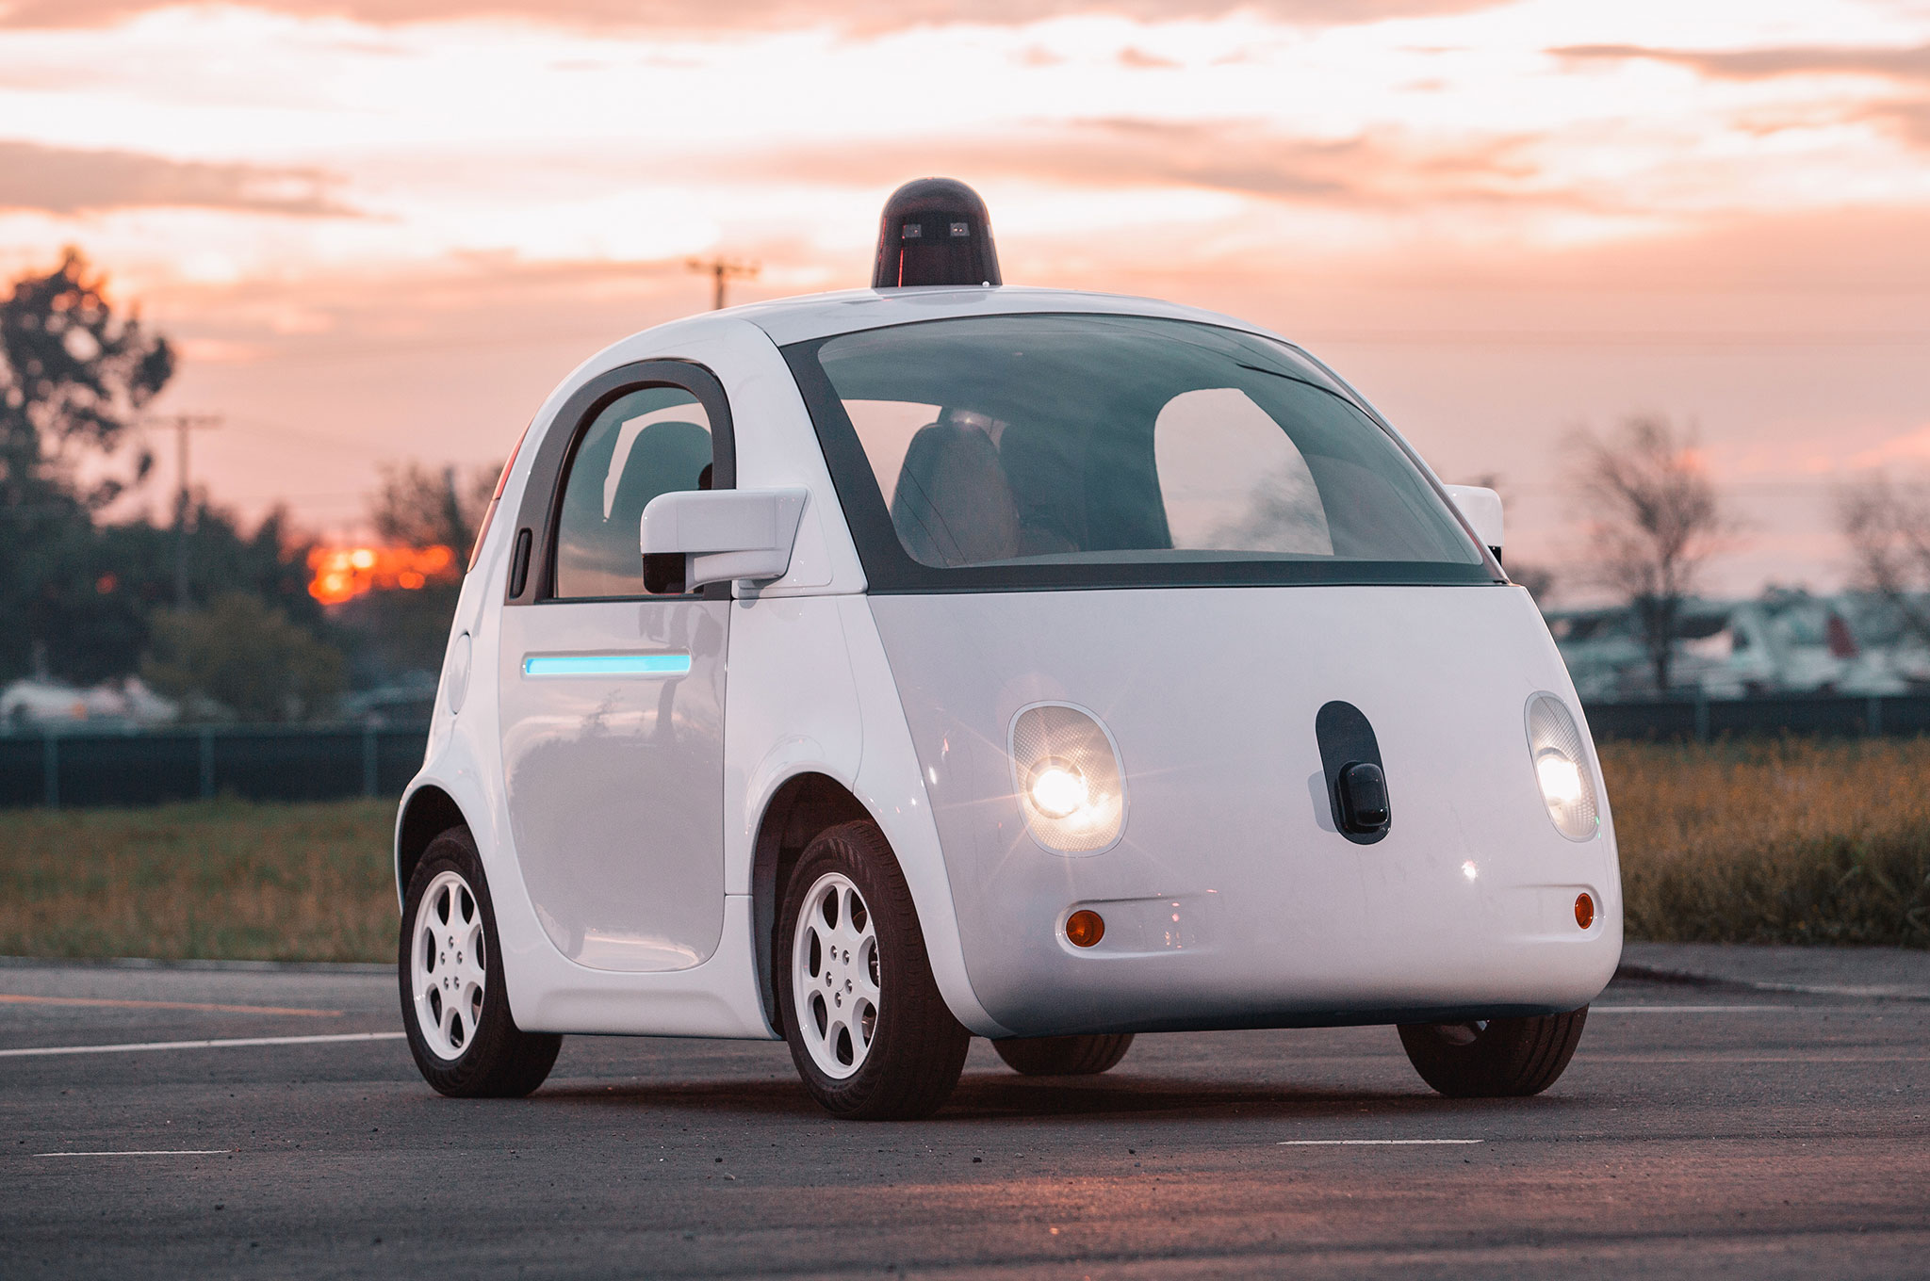
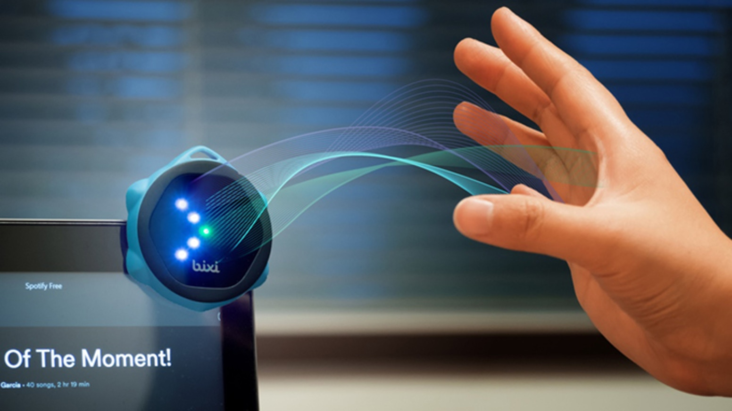
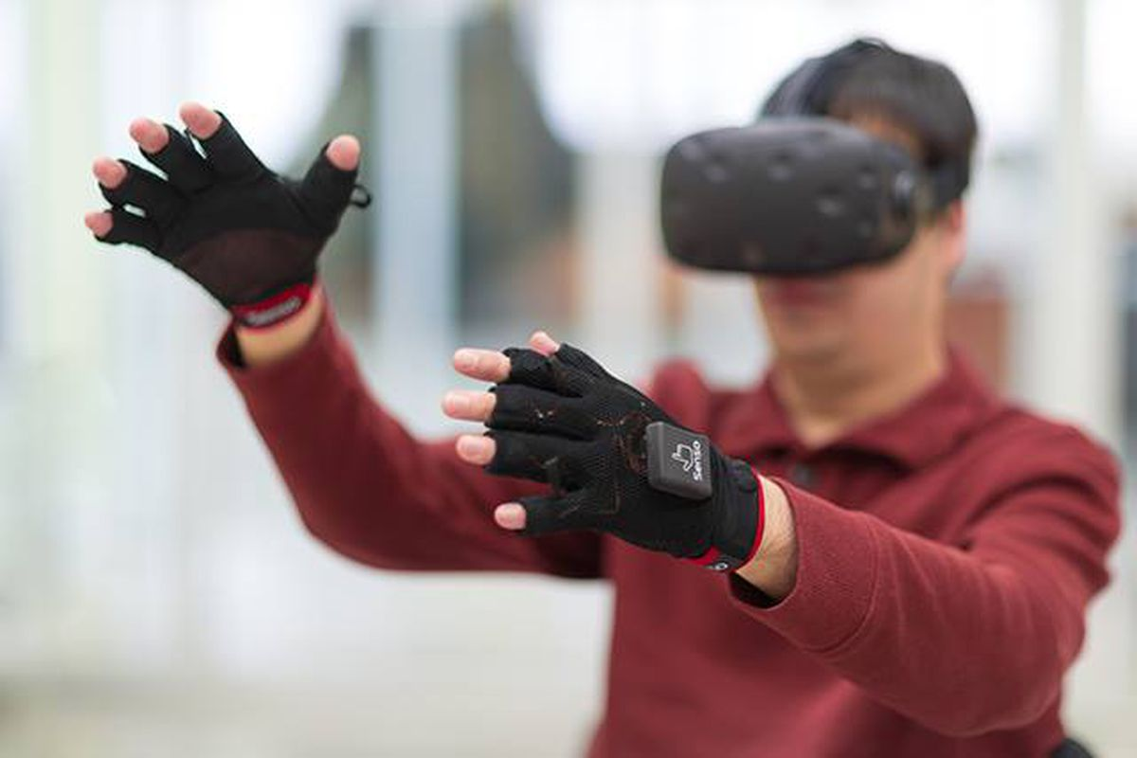

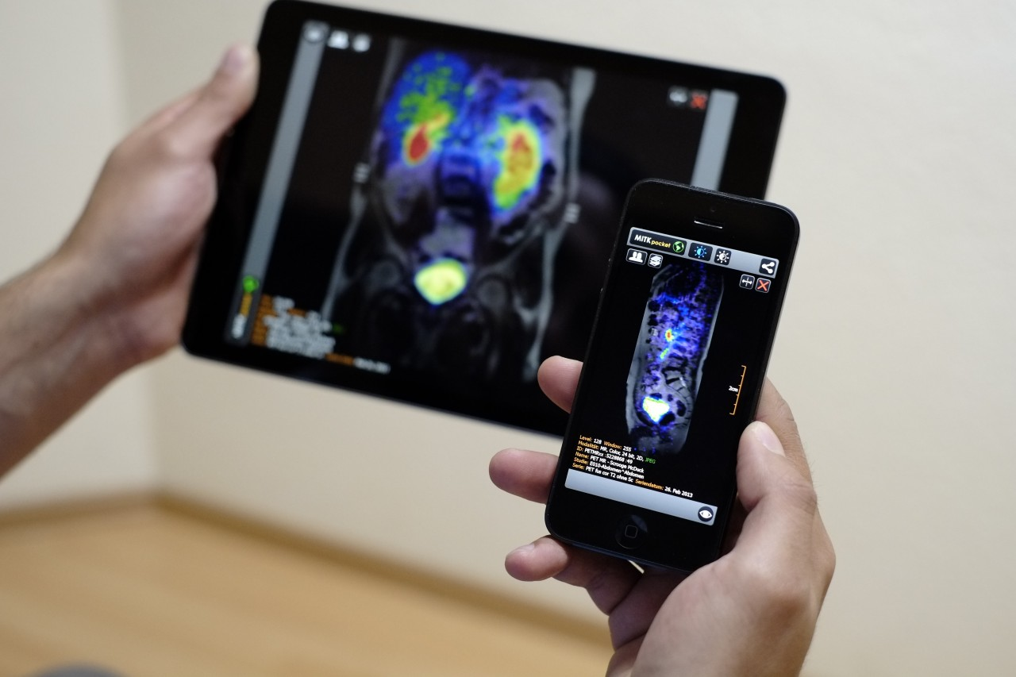
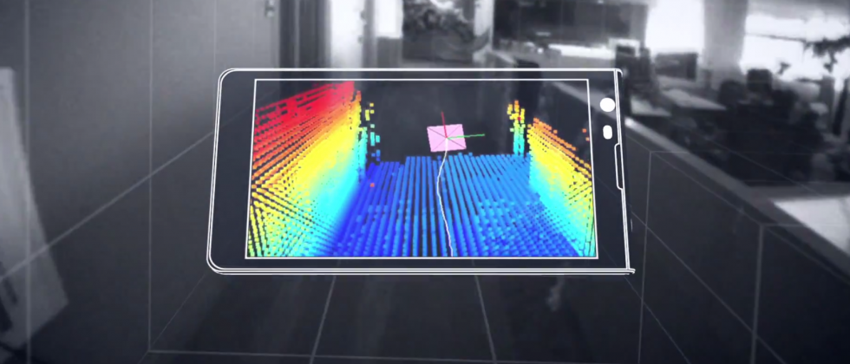
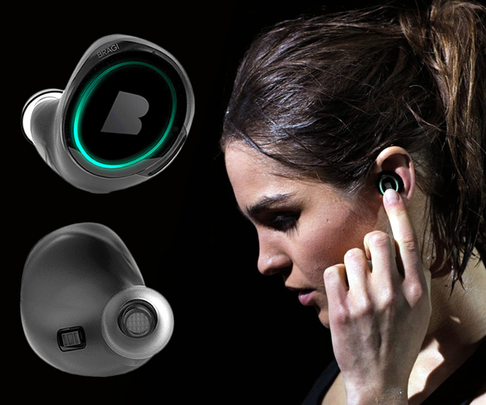
Wireless and Mobile Systems
for the IoT
CMSC 715 : Fall 2024
Lecture 1.2: Time & Frequency domains
Nirupam Roy
Tu-Th 2:00 – 3:15pm
IRB 2207

Slide 2
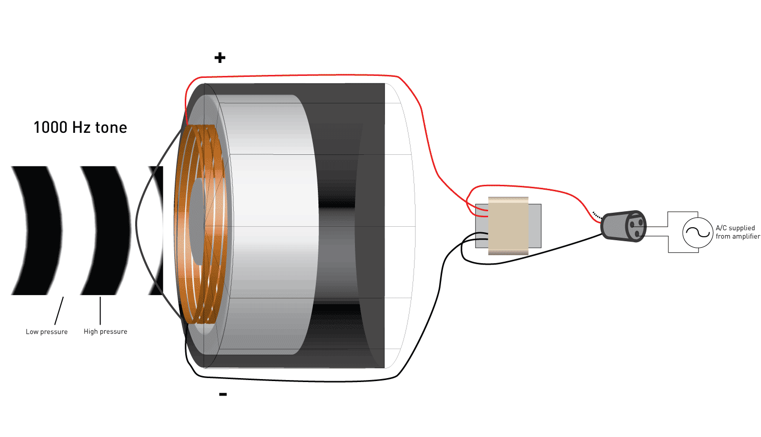
How does a sound sensor (microphone) work?
Amplitude
Time (sec)
0.00
0.25
0.50
0.75
1.00
1.25

Slide 3
Properties of a signal
Frequency, Amplitude, and Phase

Slide 4
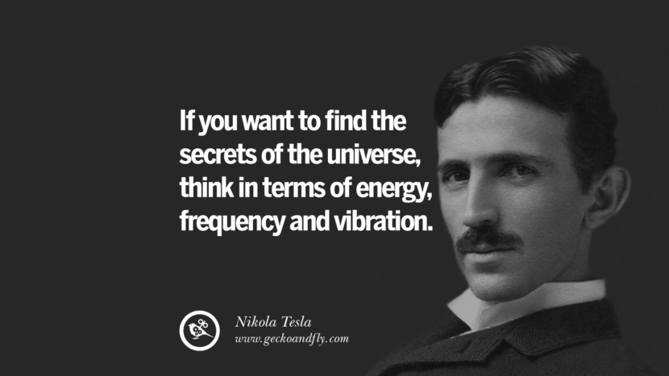
What is frequency?

Slide 5
Definition of Frequency
Frequency is the number of occurrences of a repeating event per unit of time.

Slide 6


Bus depot

Slide 7
Bus depot
Observations
Time

Slide 8
What can be a simple (the simplest ?) repeating
function?

Slide 9
Frequency, Amplitude, and Phase

Slide 10
Frequency, Amplitude, and Phase
Time

Slide 11
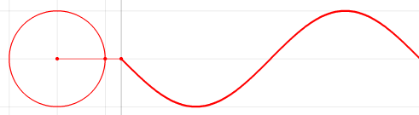


Frequency, Amplitude, and Phase
$$f cycles per second$$
$$2π angles per cycle$$
Time

Slide 12
Frequency, Amplitude, and Phase
One cycle
+A
A
0
Amplitude
-A
Time

Slide 13
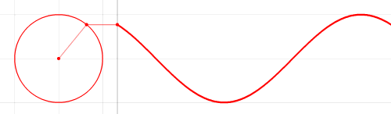




Frequency, Amplitude, and Phase
$$2π angles per cycle$$
$$f cycles per second$$
A
𝚹
time = t second
$$=$$
$$A . sin⁡(θ)$$
$$=$$
$$A . sin⁡(2πft)$$

Slide 14
Frequency, Amplitude, and Phase
$$2π angles per cycle$$
$$f cycles per second$$
A
𝚹
Phase
time = t second
$$=$$
$$A . sin⁡(θ)$$
$$=$$
$$A . sin⁡(2πft)$$

Slide 15

Frequency, Amplitude, and Phase
$$2π angles per cycle$$
$$f cycles per second$$
A
𝚹
Phase
time = t second
$$=$$
$$A . sin⁡(θ)$$
$$=$$
$$A . sin⁡(2πft)$$
$$A . sin⁡(2πft+φ)$$
-- with initial/additional phase ϕ

Slide 16
Frequency, Amplitude, and Phase

Slide 17
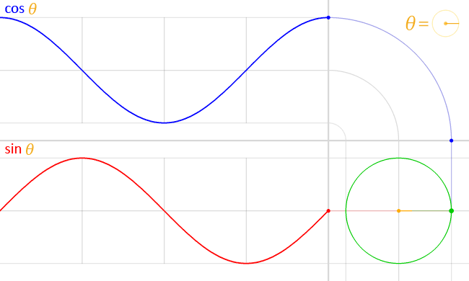


Frequency, Amplitude, and Phase
$$A . sin⁡(θ)$$
$$A . cos⁡(θ)$$

Slide 18




Frequency, Amplitude, and Phase
$$2π angles per cycle$$
$$f cycles per second$$
A
𝚹
time = t second
$$=$$
$$A . cos⁡(θ)$$
$$=$$
$$A . cos⁡(2πft)$$
$$=$$
$$A . sin⁡(2πft+(π/2))$$

Slide 19
Frequency, Amplitude, and Phase
Frequency: 2Hz
Amplitude
Time (sec)
0.00
0.25
0.50
0.75
1.00
1.25
Notes:
1) Two common terms related to signals are amplitude and frequency. Frequency is the number of repetition of the signal per second.

Slide 20
Frequency, Amplitude, and Phase
Frequency: 2Hz
Amplitude
Time (sec)
0.00
0.25
0.50
0.75
1.00
1.25
Frequency: 4Hz
Amplitude
Time (sec)
0.00
0.25
0.50
0.75
1.00
1.25

Slide 21
Frequencies of an arbitrary signal
Frequency: 2Hz
Amplitude
Time (sec)
0.00
0.25
0.50
0.75
1.00
1.25
Amplitude
Time (sec)
0.00
0.25
0.50
0.75
1.00
1.25

Slide 22
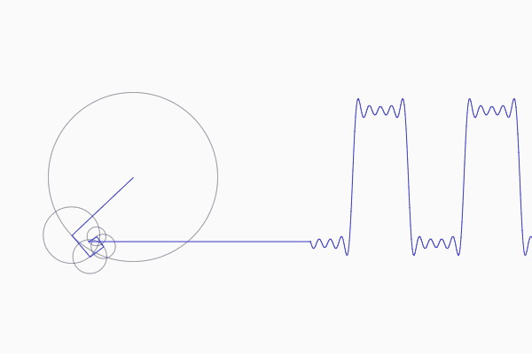
Frequencies of an arbitrary signal

Slide 23
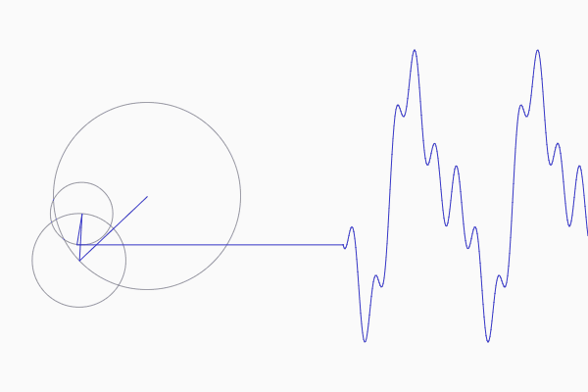
Frequencies of an arbitrary signal

Slide 24
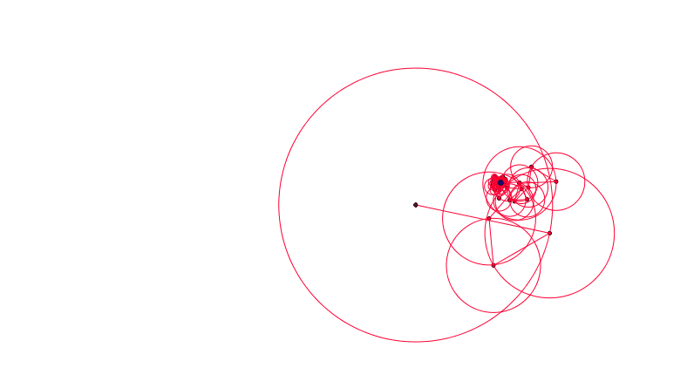
Frequencies of an arbitrary signal

Slide 25
The concept of the Fourier series
Amplitude
Time (sec)
0.00
0.25
0.50
0.75
1.00
1.25
The key idea: Any function can be written as the sum of sinusoidal functions.
Amplitude
Time (sec)
0.00
0.25
0.50
0.75
1.00
1.25

Slide 26

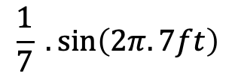
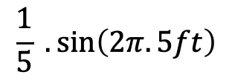
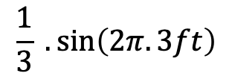
Time Domain and Frequency Domain
Approx. square wave
$$1 .\sin\left(2πft\right)$$
$$\frac{1}{3} .\sin\left(2π.3ft\right)$$
$$\frac{1}{5} .\sin\left(2π.5ft\right)$$
$$\frac{1}{7} .\sin\left(2π.7ft\right)$$

Slide 27
Time Domain and Frequency Domain
Time domain view
Frequency domain view

Slide 28
Analogy: Food coloring chart
Basis for food colors
Notes:
Emphasize basis and coefficient using Color analogy

Slide 29
Analogy: Food coloring chart
Basis for food colors
Notes:
Emphasize basis and coefficient using Color analogy

Slide 30
Analogy: Food coloring chart
Basis for food colors
Notes:
Emphasize basis and coefficient using Color analogy

Slide 31
Analogy: Food coloring chart
Basis for food colors
Notes:
Emphasize basis and coefficient using Color analogy

Slide 32




Time Domain and Frequency Domain
Amplitude
Time (sec)
0.00
0.25
0.50
0.75
1.00
1.25
$$= A1 .\sin\left(2πf1t\right)+B1 . cos⁡(2πf1t)$$
$$+ A2 .\sin\left(2πf2t\right)+B2 . cos⁡(2πf2t)$$
$$+ A3 .\sin\left(2πf3t\right)+B3 . cos⁡(2πf3t)$$
$$+ …$$
How can we find these coefficients?

Slide 33
Time Domain and Frequency Domain
Fourier Transform
FFT
Amplitude
Amplitude
IFFT
0.00
0.25
0.50
0
2
4
6
8
Time
Frequency (Hz)
Time domain
Frequency domain
FFT = Fast Fourier Transform
IFFT = Inverse Fast Fourier Transform

Slide 34
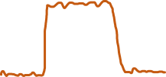

Frequency band
Amplitude
0
2
4
6
8
Frequency (kHz)
A 4 kHz frequency band starting at 2 kHz
What is bandwidth?
What is baseband?

Slide 35
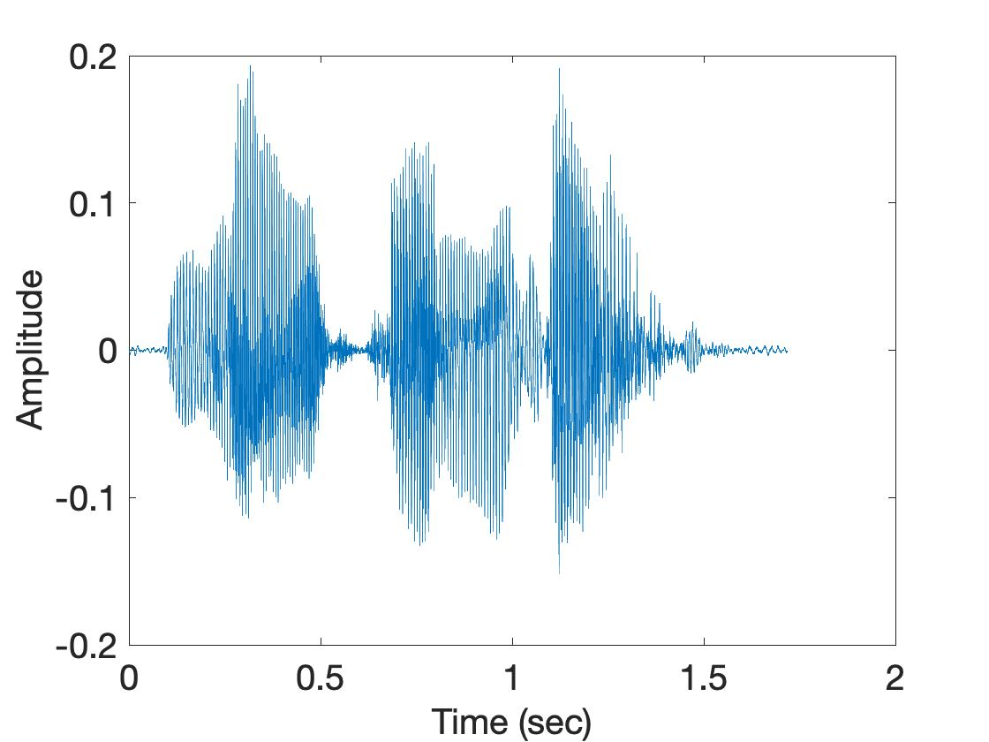
Visualizing transient frequencies
U
M
D

Slide 36
Spectrogram
U
M
D
[
[
[
FFT of overlapping windows
of samples
(Spectrogram)
[
FFT
FFT
FFT
FFT

Slide 37
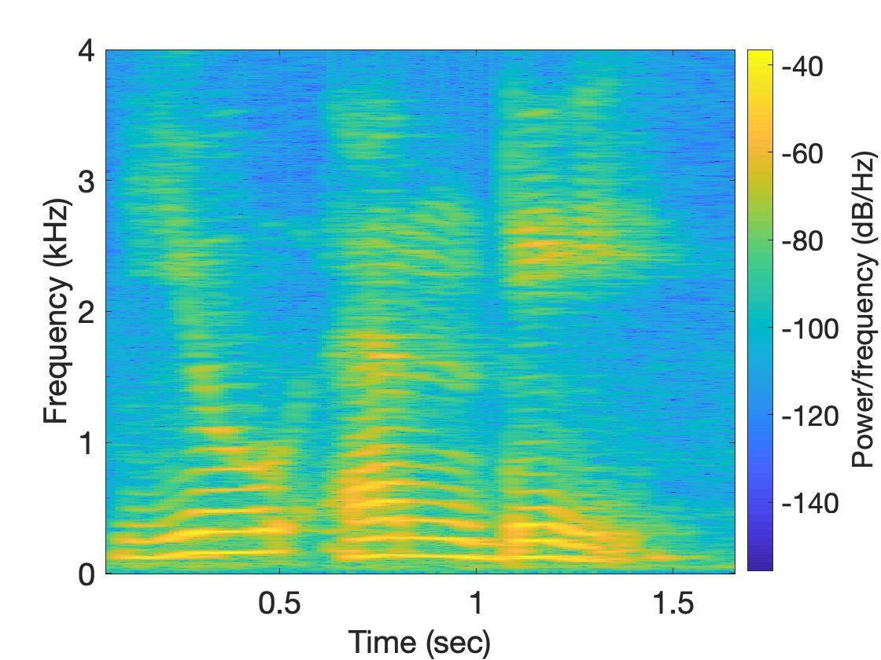
Spectrogram
U
M
D

Slide 38
Time and Frequency domain view

Slide 39
The concept of the Fourier series
Amplitude
Time (sec)
0.00
0.25
0.50
0.75
1.00
1.25
Amplitude
Time (sec)
0.00
0.25
0.50
0.75
1.00
1.25

Slide 40
Frequency components change over time
Amplitude
Time (sec)
0.00
0.25
0.50
0.75
1.00
1.25
FFT
A set of
frequencies

Slide 41
Frequency components change over time
Amplitude
Time (sec)
0.00
0.25
0.50
0.75
1.00
1.25
FFT

Slide 42
Frequency components change over time
Amplitude
Time (sec)
0.00
0.25
0.50
0.75
1.00
1.25
FFT
FFT

Slide 43
Frequency components change over time
U
M
D

Slide 44
Spectrogram
U
M
D
[
[
[
FFT of overlapping windows
of samples
(Spectrogram)
[
FFT
FFT
FFT
FFT

Slide 45
Spectrogram
U
M
D

