Slide 1

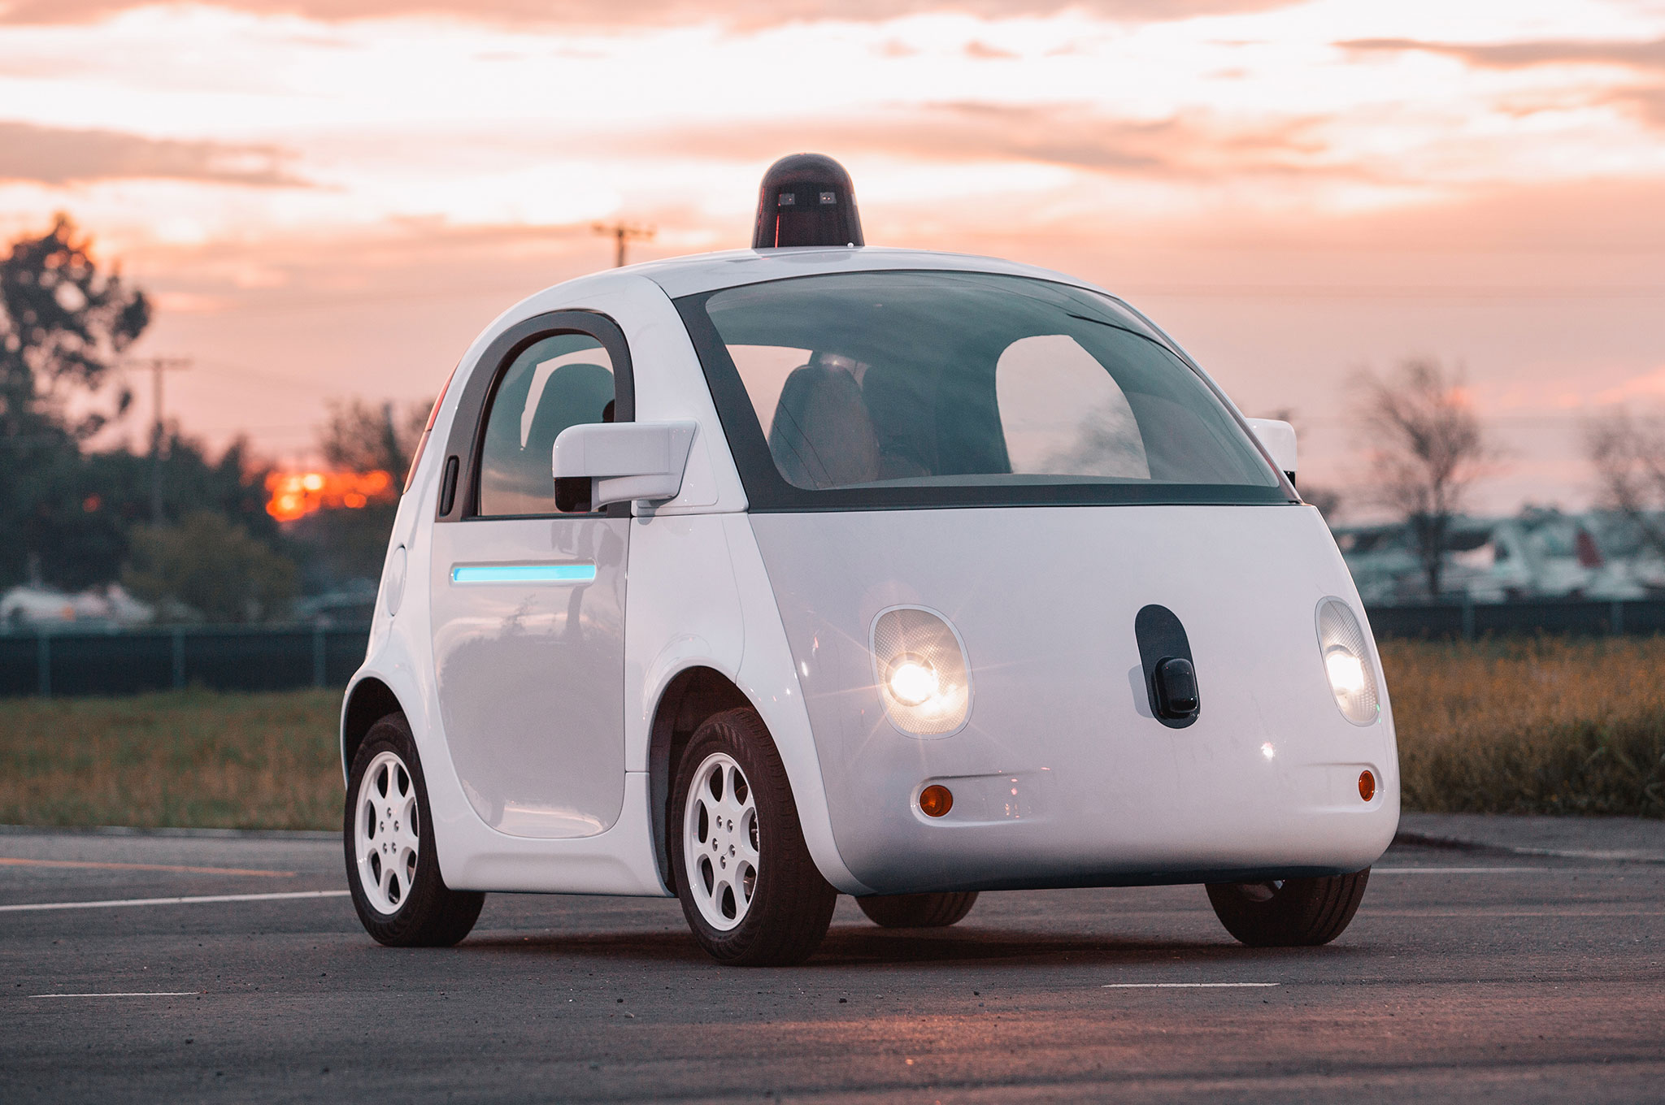



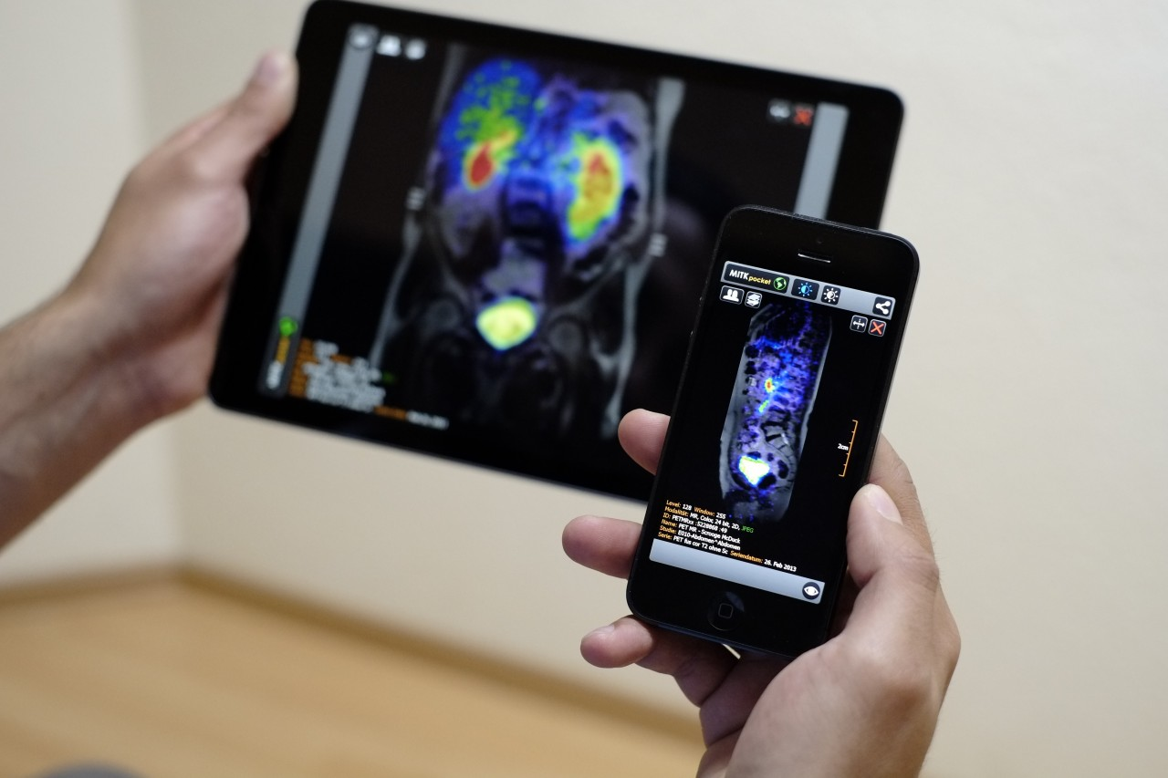
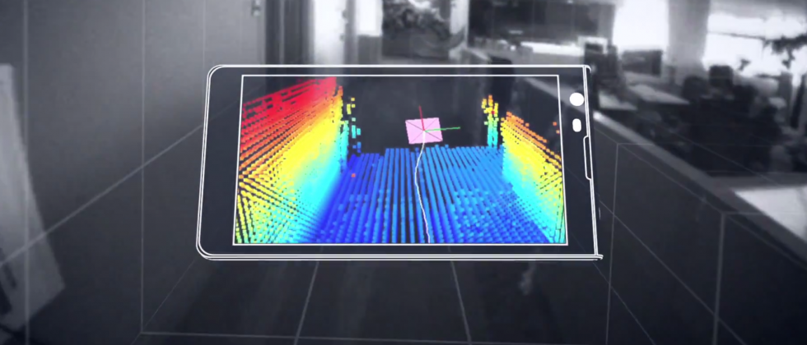
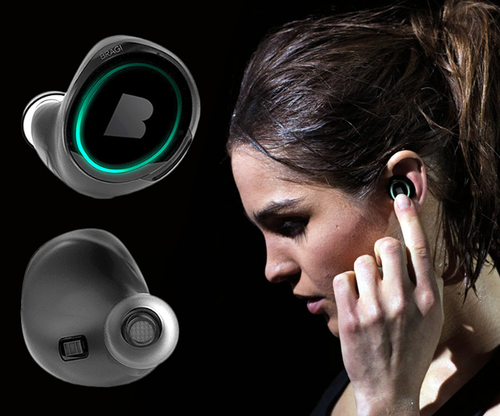
Wireless and Mobile Systems
for the IoT
CMSC 715 : Fall 2024
Lecture 1.3: Discrete signals, Sampling,
Complex representation of signal.
Nirupam Roy
Tu-Th 2:00 – 3:15pm
IRB 2207

Slide 2
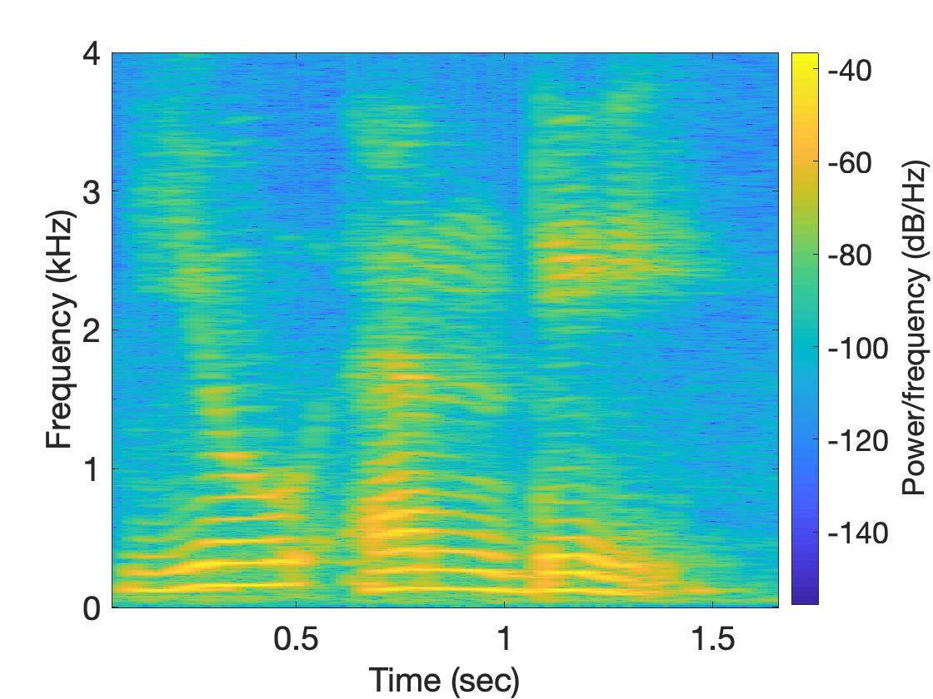
Spectrogram
U
M
D

Slide 3
Why do we need
the frequency domain view?

Slide 4

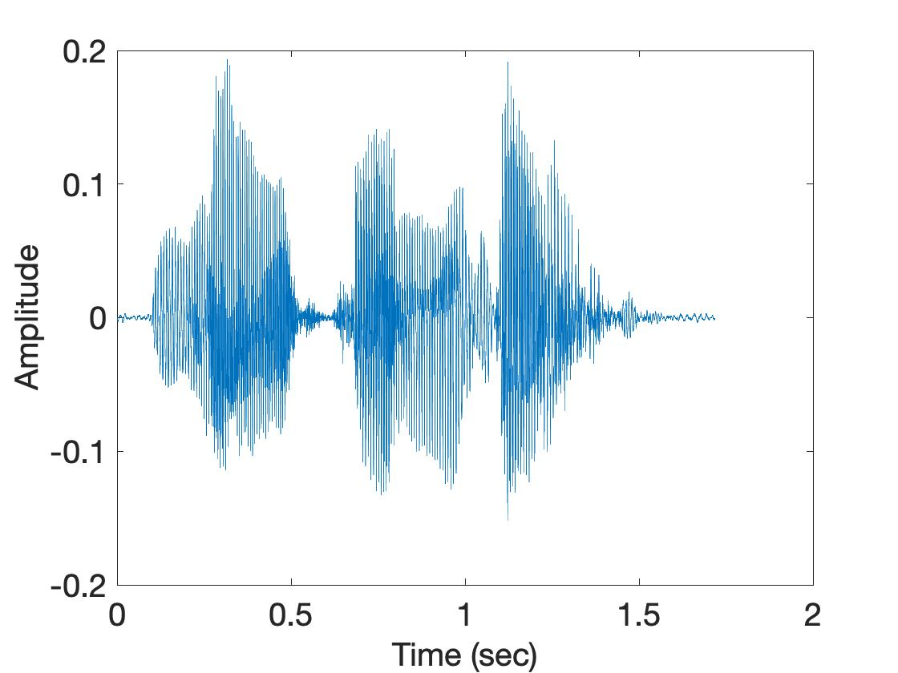
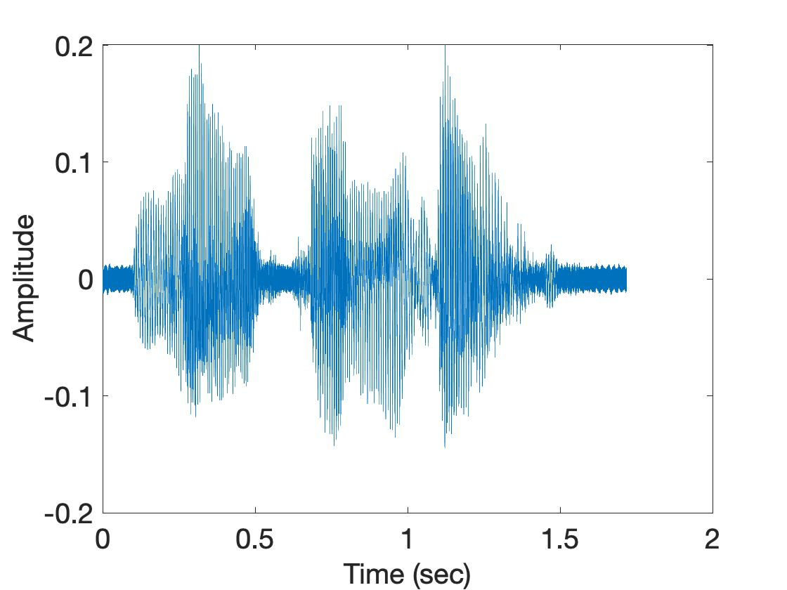
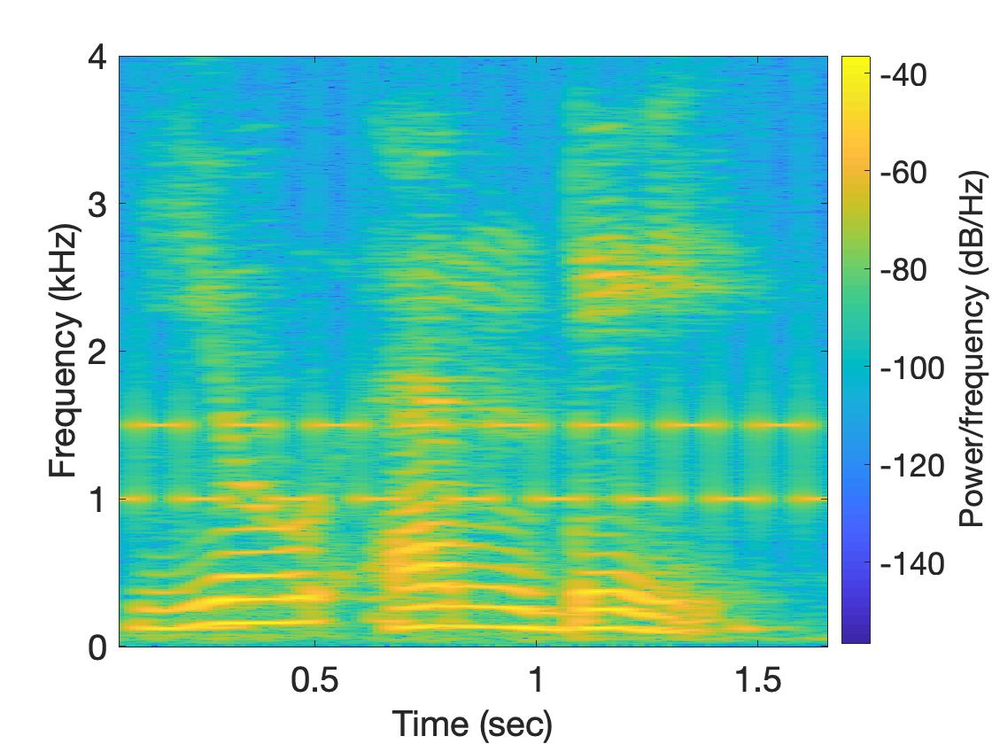
Why do we need the frequency domain view?
Sound
Sound + Noise
Time
domain
Freq.
domain

Slide 5
Analog
Physical signal
(voice)
What are different ways can we think of capturing an
analog signal (say sound) ?
Time varying voltage
signal

Slide 6
Analog
Digital
Physical signal
(voice)
Spectrogram plot
on computer
FFT
Time varying voltage
signal
A collection of numbers

Slide 7
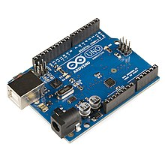
SENSOR
Analog
Analog
A structure or material
That reacts to the physical phenomenon
A circuit that converts the reaction to measurable electrical signal (e.g. voltage)
A physical phenomenon
We want to measure
Interpretation of the signal, storing the data
Digital

Slide 8
Analog
Digital
Physical signal
(voice)
Spectrogram plot
on computer
FFT
Time varying voltage
signal
A collection of numbers
?

Slide 9
Analog
Digital
Physical signal
(voice)
Spectrogram plot
on computer
FFT
Time varying voltage
signal
A collection of numbers
ADC
Analog-to-Digital Converter

Slide 10
Sampling theorem
Amplitude
Time (sec)
0.00
0.25
0.50
0.75
1.00
1.25

Slide 11
Sampling theorem
Amplitude
Time (sec)
0.00
0.25
0.50
0.75
1.00
1.25
Amplitude
Time (sec)
0.00
0.25
0.50
0.75
1.00
1.25
[ 0.34 0.22 0.09 0.21 0.30 0.08 0.09 ]

Slide 12
Sampling theorem
Amplitude
Time (sec)
0.00
0.25
0.50
0.75
1.00
1.25
T = Sampling interval
f_{s}= 1/T = Sample rate (or sampling frequency)
Clock

Slide 13
1-dimensional sampling

Slide 14
1-dimensional sampling
Y
V_{y}
V_{x}
X

Slide 15
1-dimensional sampling
2-dimensional sampling

Slide 16
1-dimensional sampling
2-dimensional sampling
3-dimensional sampling

Slide 17
Sampling theorem
Amplitude
Time (sec)
0.00
0.25
0.50
0.75
1.00
1.25
Amplitude
Time (sec)
0.00
0.25
0.50
0.75
1.00
1.25

Slide 18
Sampling theorem
Amplitude
Time (sec)
0.00
0.25
0.50
0.75
1.00
1.25
Aliasing: Two signals become indistinguishable
after sampling
Amplitude
Time (sec)
0.00
0.25
0.50
0.75
1.00
1.25

Slide 19
Aliasing
Amplitude
Time (sec)
0.00
0.25
0.50
0.75
1.00
1.25
Amplitude
Time (sec)
0.00
0.25
0.50
0.75
1.00
1.25

Slide 20

Aliasing

Slide 21
How to find a good sample rate?
Suppose you sample a signal in some way. If you can exactly reconstruct the signal from the samples, then you have done a proper sampling and captured the key signal information
Notes:
[Reference slides] http://terrano.ucsd.edu/jorge/teaching/mae143a/lectures/8sampling.pdf

Slide 22
How to find a good sample rate?
Suppose you sample a signal in some way. If you can exactly reconstruct the signal from the samples, then you have done a proper sampling and captured the key signal information
The sampling frequency f_{s} , is the number of samples per second. This is to be compared with the signal cyclic frequencies
Notes:
[Reference slides] http://terrano.ucsd.edu/jorge/teaching/mae143a/lectures/8sampling.pdf

Slide 23
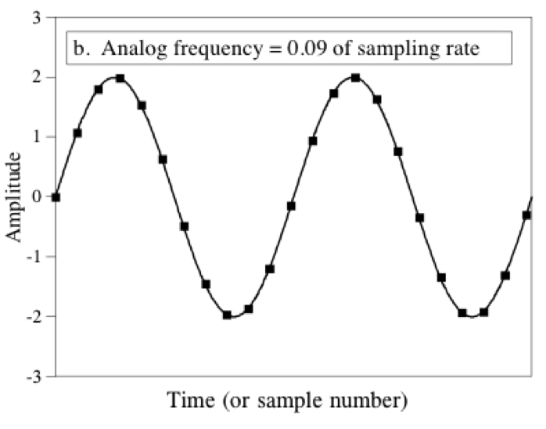
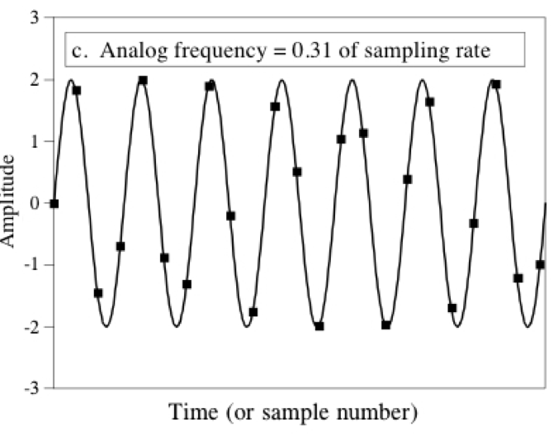
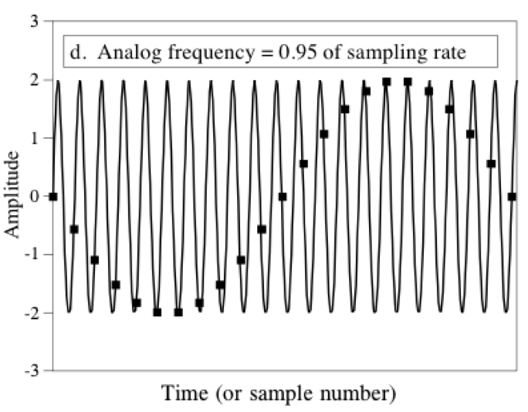
How to find a good sample rate?
11.1 samples/cycle
3.2 samples/cycle
1.05
samples/cycle

Slide 24
How to find a good sample rate?
Nyquist-Shannon sampling theorem:
In order to uniquely represent a signal F(t) by a set of samples, the sampling rate must be more than twice the highest frequency component present in F(t).
If sample rate is f_{s} and maximum frequency we want to
record is f_{max} , then
f_{s} > 2f_{max}

Slide 25
Amplitude
Time (sec)
0.00
0.25
0.50
0.75
1.00
1.25
Nyquist frequency = Maximum alias-free frequency
for a given sample rate.
Nyquist rate = Lower bound of sample rate for a
signal.
(f_{s} / 2)
(2f_{max})

Slide 26
Aliasing
f_{max} = 12 Hz
Amplitude
0
4
8
12
16
Frequency (Hz)

Slide 27
Commonly, the maximum frequency in human voice is 4 kHz, what sample rate will you use in your audio recorder?
Is there any limit on the maximum sample rate you can use?

Slide 28
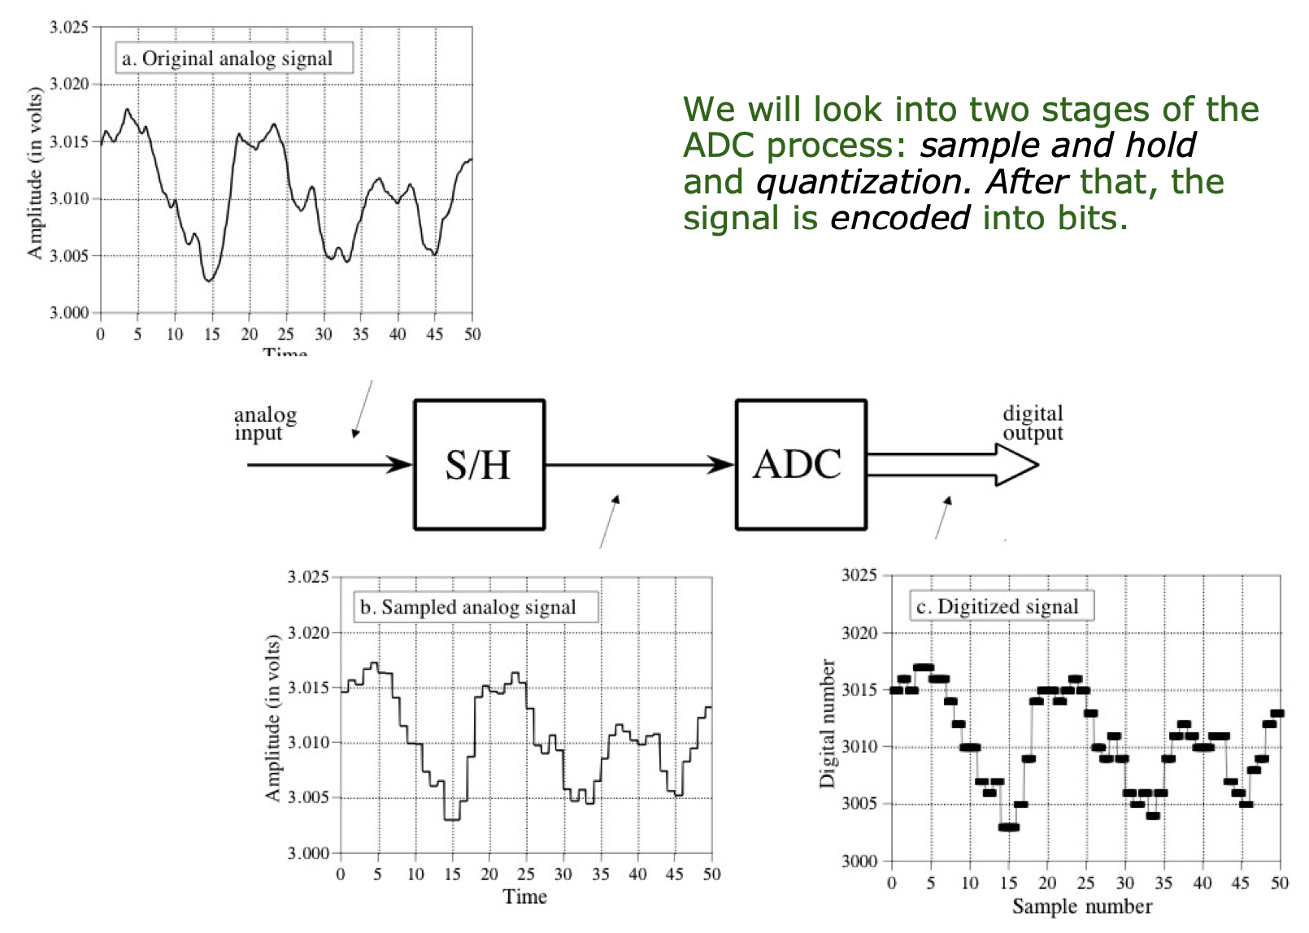
Digitization process
Notes:
[PC] https://www.monolithicpower.com/en/learning/mpscholar/analog-to-digital-converters/introduction-to-adcs/fundamental-concepts

Slide 29
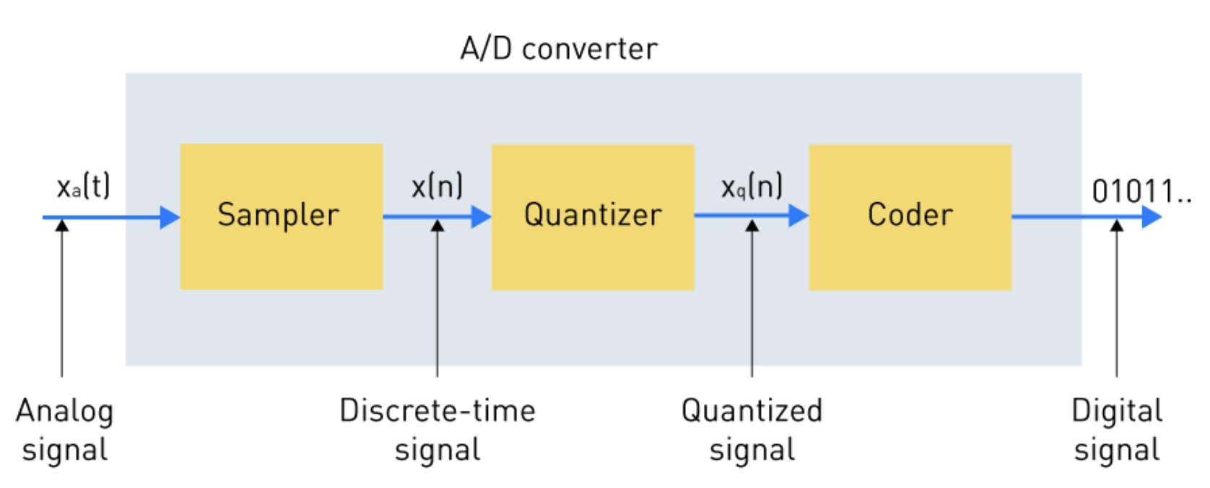
Digitization process (What is inside an ADC)

Slide 30
Digitization process (What is inside an ADC)

Slide 31
Digitization process (What is inside an ADC)
Sample and hold

Slide 32
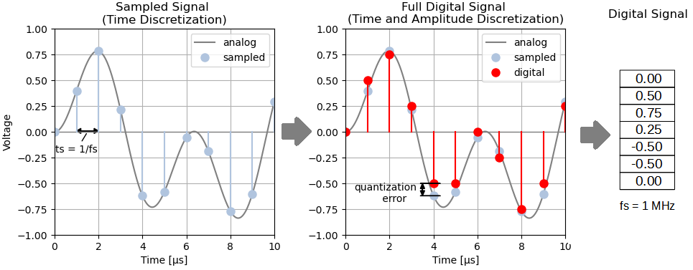
Digitization process (What is inside an ADC)
Notes:
[PC] https://panoradio-sdr.de/analog-digital-conversion/

Slide 33
Discrete in time and in amplitude
Amplitude
Time (sec)
0.00
0.25
0.50
0.75
1.00
1.25
Amplitude
Time (sec)
0.00
0.25
0.50
0.75
1.00
1.25
[ 0.34 0.22 0.09 0.21 0.30 0.08 0.09 ]

Slide 34
Digitization process (What is inside an ADC)
Notes:
[PC] https://panoradio-sdr.de/analog-digital-conversion/

Slide 35
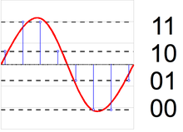
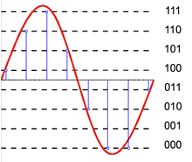
Quantization level and Bit resolution of an ADC
Notes:
[PC] https://en.wikipedia.org/wiki/Quantization_%28signal_processing%29

Slide 36
Digitization process (What is inside an ADC)
Sample and hold
Quantized

Slide 37
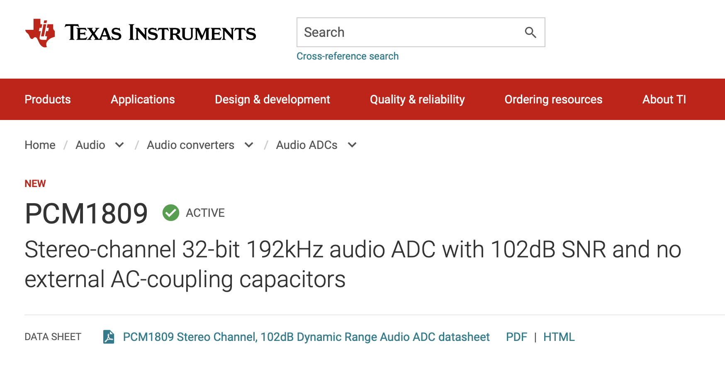
Digitization process (What is inside an ADC)

Slide 38
Mathematical model for a signal

Slide 39
Mathematical abstractions

Slide 40
Mathematical abstractions
… we use them everyday to
understand our world

Slide 41
A few examples
What is a number?
What is a negative number?
What do they model?
Any other example?

Slide 42
Model for a signal (frequency, amplitude, and phase)

Slide 43


Model for a signal (frequency, amplitude, and phase)
$$A . sin⁡(θ)$$
$$A . cos⁡(θ)$$

Slide 44


Model for a signal (frequency, amplitude, and phase)
$$A . sin⁡(θ)$$
$$A . cos⁡(θ)$$
Why not use the sinusoid as the model ?

Slide 45
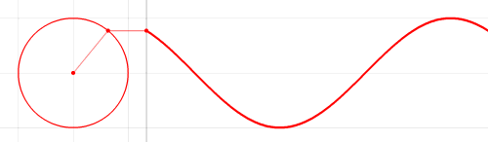

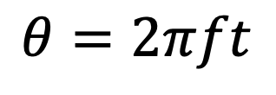



Model for a signal (frequency, amplitude, and phase)
1
$$sin⁡(θ)$$
𝚹
$$cos⁡(θ)$$
$$f cycles per second$$
$$θ=2πft$$
$$2π angles per cycle$$

Slide 46
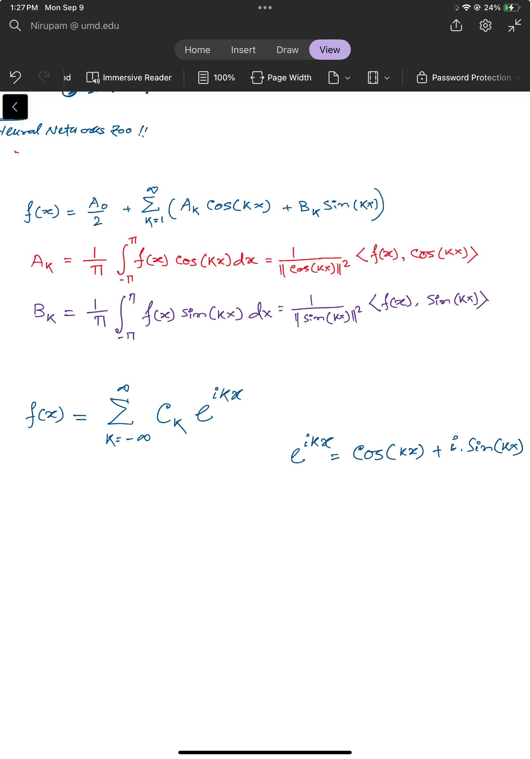
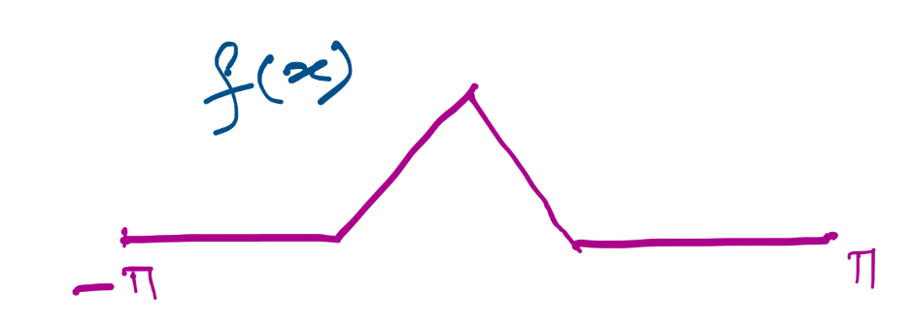

Slide 48
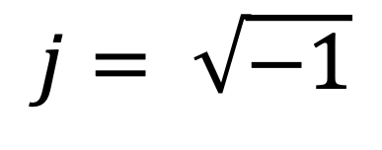
Complex numbers
Imaginary
$$j= \sqrt{−1}$$

Slide 49
Complex numbers and Natural exponential
j
j

Slide 50
Complex numbers and Natural exponential
…

Slide 51
Complex numbers and Natural exponential
…
…

Slide 52
Complex numbers and Natural exponential
…
…
…

Slide 53
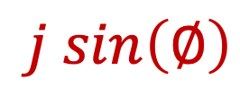

Complex numbers and Natural exponential
…
…
…
$$\cos\left(∅\right)$$
$$j sin\left(∅\right)$$
Euler’s formula

Slide 54

Complex numbers and Natural exponential
$$e^{j∅}=\cos{∅+j sin∅}$$

Slide 55
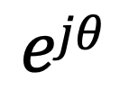
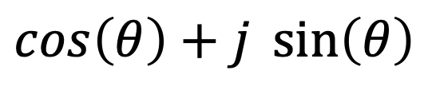

Model for a signal (frequency, amplitude, and phase)
$$\cos\left(θ\right)+j \sin\left(θ\right)$$
$$=$$
$$ejθ$$

Slide 56
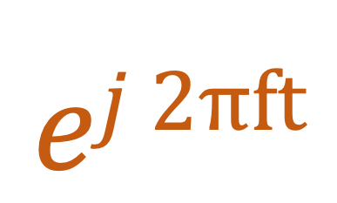

Model for a signal (frequency, amplitude, and phase)
$$ej 2πft$$
$$\cos\left(θ\right)+j \sin\left(θ\right)$$
$$=$$
$$ejθ$$
$$=$$

Slide 57
Model for a signal (frequency, amplitude, and phase)
$$ej 2πft$$
$$\cos\left(θ\right)+j \sin\left(θ\right)$$
$$=$$
$$ejθ$$
$$=$$

Slide 58
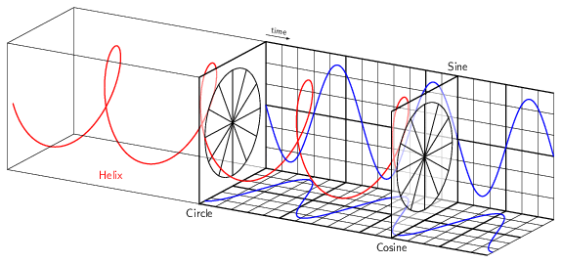
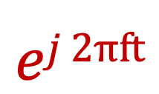
Model for a signal (frequency, amplitude, and phase)
$$ej 2πft$$

Slide 59
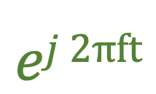
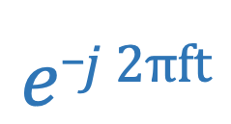
Model for a signal (frequency, amplitude, and phase)
$$ej 2πft$$
$$e_j 2πft$$

Slide 60
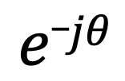

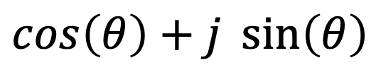
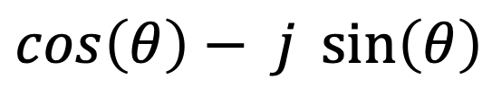
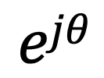
Model for a signal (frequency, amplitude, and phase)
$$ejθ$$
$$=$$
$$\cos\left(θ\right)+j \sin\left(θ\right)$$
$$e_jθ$$
$$=$$
$$\cos\left(θ\right)− j \sin\left(θ\right)$$

Slide 61




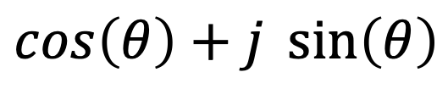

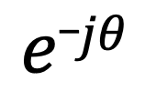
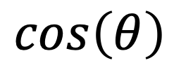

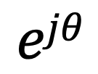
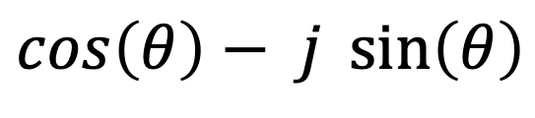
Presenting real signal with the complex model
$$ejθ$$
$$=$$
$$\cos\left(θ\right)+j \sin\left(θ\right)$$
$$e_jθ$$
$$=$$
$$\cos\left(θ\right)− j \sin\left(θ\right)$$
How about real sinusoids?
$$\cos\left(θ\right)$$
$$=$$
$$?$$
$$\sin\left(θ\right)$$
$$=$$
$$?$$

Slide 62

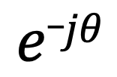
Presenting real signal with the complex model
$$ejθ$$
$$=$$
$$\cos\left(θ\right)+j \sin\left(θ\right)$$
$$e_jθ$$
$$=$$
$$\cos\left(θ\right)− j \sin\left(θ\right)$$
How about real sinusoids?
$$ejθ$$
$$+$$
$$e_jθ$$
$$\cos\left(θ\right)$$
$$=$$
2
$$\sin\left(θ\right)$$
$$=$$
$$?$$

Slide 63
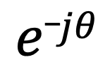
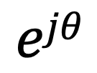

Presenting real signal with the complex model
$$ejθ$$
$$=$$
$$\cos\left(θ\right)+j \sin\left(θ\right)$$
$$e_jθ$$
$$=$$
$$\cos\left(θ\right)− j \sin\left(θ\right)$$
How about real sinusoids?
$$ejθ$$
$$+$$
$$e_jθ$$
$$\cos\left(θ\right)$$
$$=$$
2
$$ejθ$$
$$−$$
$$e_jθ$$
$$\sin\left(θ\right)$$
$$=$$
2j

Slide 64
Presenting real signal with the complex model

Slide 65


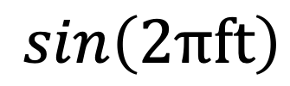
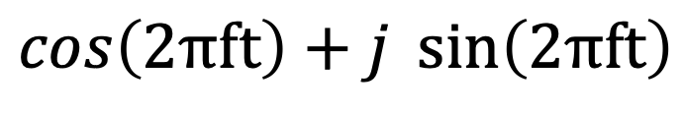




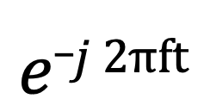
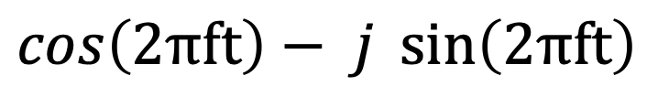
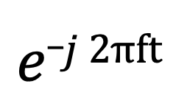
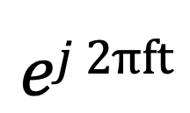
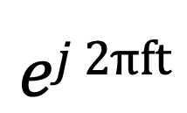

Presenting real signal with the complex model
$$ej 2πft$$
$$=$$
$$\cos\left(2πft\right)+j \sin\left(2πft\right)$$
$$e_j 2πft$$
$$=$$
$$\cos\left(2πft\right)− j \sin\left(2πft\right)$$
$$ej 2πft$$
$$+$$
$$e_j 2πft$$
$$\cos\left(2πft\right)$$
$$=$$
2
$$ej 2πft$$
$$−$$
$$e_j 2πft$$
$$\sin\left(2πft\right)$$
$$=$$
2j

Slide 68
Time Domain and Frequency Domain
Fourier Transform
FFT
Amplitude
Amplitude
IFFT
0.00
0.25
0.50
0
2
4
6
8
Time
Frequency (Hz)
Time domain
Frequency domain
FFT = Fast Fourier Transform
IFFT = Inverse Fast Fourier Transform

Slide 69

Time Domain and Frequency Domain
Fourier Transform
$$ej 2π4t$$
FFT
Amplitude
0
2
4
6
8
Frequency (Hz)
Time domain
Frequency domain
FFT = Fast Fourier Transform
IFFT = Inverse Fast Fourier Transform

Slide 70

Time Domain and Frequency Domain
Fourier Transform
FFT
?
$$\cos\left(2π4t\right)$$
Amplitude
0
2
4
6
8
Frequency (Hz)
Time domain
Frequency domain
FFT = Fast Fourier Transform
IFFT = Inverse Fast Fourier Transform

Slide 71




Time Domain and Frequency Domain
Fourier Transform
FFT
?
$$\cos\left(2π4t\right)$$
Amplitude
$$ej 2π4t$$
$$+$$
$$e_j 2π4t$$
$$=$$
2
0
2
4
6
8
Frequency (Hz)
Time domain
Frequency domain
FFT = Fast Fourier Transform
IFFT = Inverse Fast Fourier Transform

Slide 72
Time Domain and Frequency Domain
Fourier Transform
FFT
$$\cos\left(2π4t\right)$$
Amplitude
$$ej 2π4t$$
$$+$$
$$e_j 2π4t$$
$$=$$
2
-6
-4
-2
0
2
4
6
8
Frequency (Hz)
Time domain
Frequency domain
FFT = Fast Fourier Transform
IFFT = Inverse Fast Fourier Transform

Slide 73

Time Domain and Frequency Domain
Fourier Transform
FFT
$$\cos\left(2π4t\right)$$
Amplitude
$$ej 2π4t$$
$$+$$
$$e_j 2π4t$$
$$=$$
2
-6
-4
-2
0
2
4
6
8
Frequency (Hz)
Time domain
Frequency domain
FFT = Fast Fourier Transform
IFFT = Inverse Fast Fourier Transform

Slide 74
Matlab demo
function fft_test()
freq = 200;
sampleRate = 1000;
time_ticks = 0:1/sampleRate:1;
realSignal = sin(2*pi*freq*time_ticks);
plot_fft(realSignal, sampleRate);
complexSignal = exp(j*2*pi*freq*time_ticks);
plot_fft(complexSignal, sampleRate);
end

Slide 75
Calculating
Discrete Fourier Transform (DFT)

Slide 76
Discrete Fourier Transform
…
0
1
2
3
4
5
6
N-1
Sample number
X = [ ]
x[0], x[1], x[2], x[3], x[4], … x[N-1]

Slide 77
Discrete Fourier Transform
…
0
1
2
3
4
5
6
N-1
Sample number
X = [ ]
x[0], x[1], x[2], x[3], x[4], … x[N-1]

Slide 78





Discrete Fourier Transform
…
0
1
2
3
4
5
6
N-1
Sample number
$$e^{j2.\frac{2π}{N}}$$
$$e^{j1.\frac{2π}{N}}$$
$$\frac{2π}{N}$$
$$e^{j0.\frac{2π}{N}}$$
$$e^{j(N−1).\frac{2π}{N}}$$

Slide 79




Discrete Fourier Transform
…
0
1
2
3
4
5
6
N-1
Sample number
= [ ]
Freq f₁
$$e^{j0.\frac{2π}{N}},$$
$e^{j1.\frac{2π}{N}}$,
$$e^{j2.\frac{2π}{N}},$$
…
$${,e}^{j(N−1).\frac{2π}{N}}$$
$$e^{j2.\frac{2π}{N}}$$
$$e^{j1.\frac{2π}{N}}$$
$$\frac{2π}{N}$$
$$e^{j0.\frac{2π}{N}}$$
$$e^{j(N−1).\frac{2π}{N}}$$

Slide 80




Discrete Fourier Transform
…
0
1
2
3
4
5
6
N-1
Sample number
$$e^{j1.\frac{2.2π}{N}}$$
$$\frac{2.2π}{N}$$
$$e^{j0.\frac{2.2π}{N}}$$
$$e^{j(N−1).\frac{2.2π}{N}}$$

Slide 81




Discrete Fourier Transform
…
0
1
2
3
4
5
6
N-1
Sample number
= [ ]
Freq f₂
$$e^{j0.\frac{2.2π}{N}},$$
$e^{j1.\frac{2.2π}{N}}$,
$$e^{j2.\frac{2.2π}{N}},$$
…
$${,e}^{j(N−1).\frac{2.2π}{N}}$$
$$e^{j1.\frac{2.2π}{N}}$$
$$\frac{2.2π}{N}$$
$$e^{j0.\frac{2.2π}{N}}$$
$$e^{j(N−1).\frac{2.2π}{N}}$$

Slide 82
Discrete Fourier Transform
…
0
1
2
3
4
5
6
N-1
Sample number
What is the MINIMUM number of cycles
observable in this model?

Slide 83

Discrete Fourier Transform
…
0
1
2
3
4
5
6
N-1
Sample number
$$0$$

Slide 84




Discrete Fourier Transform
…
0
1
2
3
4
5
6
N-1
Sample number
= [ ]
Freq f₀
$$e^{j0},$$
$e^{j0}$,
$$e^{j0},$$
…
$${,e}^{j0}$$
$$0$$

Slide 85





Discrete Fourier Transform
…
0
1
2
3
4
5
6
N-1
Sample number
= [ ]
Freq f₀
$$e^{j0.\frac{2π}{N}},$$
$e^{j1.\frac{2π}{N}}$,
$$e^{j2.\frac{2π}{N}},$$
…
$${,e}^{j(N−1).\frac{2π}{N}}$$
$$e^{j2.\frac{2π}{N}}$$
$$e^{j1.\frac{2π}{N}}$$
$$\frac{2π}{N}$$
$$e^{j0.\frac{2π}{N}}$$
$$e^{j(N−1).\frac{2π}{N}}$$

Slide 86
Discrete Fourier Transform
…
0
1
2
3
4
5
6
N-1
Sample number
What is the MAXIMUM number of cycles
observable in this model?

Slide 87
Discrete Fourier Transform
…
0
1
2
3
4
5
6
N-1
Sample number
What happens when the ball rotates exactly N times?
$$0$$
We can uniquely observe up to (N-1) number of cycles.

Slide 88


Discrete Fourier Transform
Freq f₀
n=0
$$e^{j0}$$
n=1
$$e^{j0}$$
n=2
$$e^{j0}$$
…
…
n=N-1
$$e^{j0}$$

Slide 89
Discrete Fourier Transform
Number of cycles
…
…
Freq f₀
Freq f₁
Freq f_{m}
Freq f_{N-1}
n=0
$$e^{j0}$$
n=1
$$e^{j0}$$
Sample number
n=2
$$e^{j0}$$
…
…
n=N-1
$$e^{j0}$$

Slide 90












Discrete Fourier Transform
Number of cycles
…
…
Freq f₀
Freq f₁
Freq f_{m}
Freq f_{N-1}
n=0
$$e^{j0}$$
$$e^{j0.\frac{2π}{N}}$$
$$e^{j0.\frac{m.2π}{N}}$$
$$e^{j0.\frac{(N−1).2π}{N}}$$
n=1
$$e^{j0}$$
$$e^{j1.\frac{2π}{N}}$$
$$e^{j1.\frac{m.2π}{N}}$$
$$e^{j1.\frac{(N−1).2π}{N}}$$
Sample number
…
…
$$e^{j2.\frac{(N−1).2π}{N}}$$
$$e^{j2.\frac{2π}{N}}$$
$$e^{j2.\frac{m.2π}{N}}$$
n=2
$$e^{j0}$$
…
…
…
…
…
$$e^{j(N−1).\frac{2π}{N}}$$
$$e^{j(N−1).\frac{m.2π}{N}}$$
$$e^{j(N−1).\frac{(N−1).2π}{N}}$$
n=N-1
$$e^{j0}$$

Slide 91














Discrete Fourier Transform
$$e^{j0}$$
$$e^{j0.\frac{2π}{N}}$$
$$e^{j0.\frac{m.2π}{N}}$$
$$e^{j0.\frac{(N−1).2π}{N}}$$
$$e^{j0}$$
$$e^{j1.\frac{2π}{N}}$$
$$e^{j1.\frac{m.2π}{N}}$$
$$e^{j1.\frac{(N−1).2π}{N}}$$
+
$$e^{j2.\frac{2π}{N}}$$
+
$$e^{j2.\frac{m.2π}{N}}$$
+
$$e^{j2.\frac{(N−1).2π}{N}}$$
Z₀
$$e^{j0}$$
Z₁
…
Z_{m}
…
Z_{N-1}
…
…
…
…
$$e^{j(N−1).\frac{2π}{N}}$$
$$e^{j(N−1).\frac{m.2π}{N}}$$
$$e^{j(N−1).\frac{(N−1).2π}{N}}$$
$$e^{j0}$$

Slide 92














Discrete Fourier Transform
$$e^{j0}$$
$$e^{j0.\frac{2π}{N}}$$
$$e^{j0.\frac{m.2π}{N}}$$
$$e^{j0.\frac{(N−1).2π}{N}}$$
$$e^{j0}$$
$$e^{j1.\frac{2π}{N}}$$
$$e^{j1.\frac{m.2π}{N}}$$
$$e^{j1.\frac{(N−1).2π}{N}}$$
+
$$e^{j2.\frac{2π}{N}}$$
+
$$e^{j2.\frac{m.2π}{N}}$$
+
$$e^{j2.\frac{(N−1).2π}{N}}$$
Z₀
$$e^{j0}$$
Z₁
…
Z_{m}
…
Z_{N-1}
…
…
…
…
$$e^{j(N−1).\frac{2π}{N}}$$
$$e^{j(N−1).\frac{m.2π}{N}}$$
$$e^{j(N−1).\frac{(N−1).2π}{N}}$$
$$e^{j0}$$

Slide 93
Discrete Fourier Transform
$$e^{j0}$$
$$e^{j0.\frac{2π}{N}}$$
$$e^{j0.\frac{m.2π}{N}}$$
$$e^{j0.\frac{(N−1).2π}{N}}$$
$$e^{j0}$$
$$e^{j1.\frac{2π}{N}}$$
$$e^{j1.\frac{m.2π}{N}}$$
$$e^{j1.\frac{(N−1).2π}{N}}$$
+
$$e^{j2.\frac{2π}{N}}$$
+
$$e^{j2.\frac{m.2π}{N}}$$
+
$$e^{j2.\frac{(N−1).2π}{N}}$$
Z₀
$$e^{j0}$$
Z₁
…
Z_{m}
…
Z_{N-1}
…
…
…
…
$$e^{j(N−1).\frac{2π}{N}}$$
$$e^{j(N−1).\frac{m.2π}{N}}$$
$$e^{j(N−1).\frac{(N−1).2π}{N}}$$
$$e^{j0}$$
=
…
0
1
2
3
4
5
6
N-1
Sample number

Slide 94
Discrete Fourier Transform
Frequency domain coefficients
$$e^{j0}$$
$$e^{j0.\frac{2π}{N}}$$
$$e^{j0.\frac{m.2π}{N}}$$
$$e^{j0.\frac{(N−1).2π}{N}}$$
$$e^{j0}$$
$$e^{j1.\frac{2π}{N}}$$
$$e^{j1.\frac{m.2π}{N}}$$
$$e^{j1.\frac{(N−1).2π}{N}}$$
+
$$e^{j2.\frac{2π}{N}}$$
+
$$e^{j2.\frac{m.2π}{N}}$$
+
$$e^{j2.\frac{(N−1).2π}{N}}$$
Z₀
$$e^{j0}$$
Z₁
…
Z_{m}
…
Z_{N-1}
…
…
…
…
$$e^{j(N−1).\frac{2π}{N}}$$
$$e^{j(N−1).\frac{m.2π}{N}}$$
$$e^{j(N−1).\frac{(N−1).2π}{N}}$$
$$e^{j0}$$
x[0]
x[1]
=
X =
x[2]
Time domain samples
…
x[N-1]

Slide 95
Discrete Fourier Transform
_{F}
…
DFT matrix,
=
f₀
f₁
…
f_{m}
f_{N-1}

Slide 96
Discrete Fourier Transform
_{F}
…
DFT matrix,
=
f₀
f₁
…
f_{m}
f_{N-1}
_{Z}
Z₀
Fourier coefficients,
=
Z₁
…
Z_{m}
…
Z_{N-1}

Slide 97
Discrete Fourier Transform
_{F}
…
DFT matrix,
=
f₀
f₁
…
f_{m}
f_{N-1}
_{Z}
Z₀
x[0]
X =
Fourier coefficients,
=
Z₁
Time series,
…
x[1]
Z_{m}
x[2]
…
…
Z_{N-1}
x[N-1]

Slide 98
Discrete Fourier Transform
_{X}
_{F}
_{Z}
=
_{X}
_{Z}
_{F}⁻¹
=
_{H}
_{X}
_{Z}
_{F}
=

Slide 99
Discrete Fourier Transform
_{X}
_{F}
_{Z}
=
_{X}
_{Z}
_{F}⁻¹
=
_{H}
_{X}
_{Z}
_{F}
=
*
f₀
*
f₁
…
*
f_{m}
…
*
f_{N-1}

Slide 100
Discrete Fourier Transform
_{X}
_{F}
_{Z}
=
IDFT
_{X}
_{Z}
_{F}⁻¹
=
DFT
_{H}
_{X}
_{Z}
_{F}
=
*
f₀
x[0]
Z₀
*
Z₁
f₁
x[1]
…
=
…
*
x[2]
Z_{m}
f_{m}
…
…
…
Z_{N-1}
*
x[N-1]
f_{N-1}

Slide 101


Discrete Fourier Transform
$$\sum_{n=0}^{N−1}{x(n)e^{−j\frac{2π}{N}.m.n}}$$
DFT:
z(m) =
$$\sum_{m=0}^{N−1}{z(m)e^{j\frac{2π}{N}.m.n}}$$
IDFT:
x(n) =

Slide 102
Preserving energy in time and frequency domain

Slide 103
Preserving energy in time and frequency domain
Is IDFT( DFT(x) ) = x ?

Slide 104

Preserving energy in time and frequency domain
Is IDFT( DFT(x) ) = x ?
*
_{X ?}
_{X}
_{F F}
=
*
_{N.X}
_{X}
_{F F}
=
_{F}
$$\frac{1}{\sqrt{N}}$$
…
DFT matrix,
=
f₀
f₁
…
f_{m}
f_{N-1}

Slide 105




Discrete Fourier Transform
$$\sum_{n=0}^{N−1}{x(n)e^{−j\frac{2π}{N}.m.n}}$$
z(m) =
$$\frac{1}{\sqrt{N}}$$
DFT:
$$\sum_{m=0}^{N−1}{z(m)e^{j\frac{2π}{N}.m.n}}$$
x(n) =
$$\frac{1}{\sqrt{N}}$$
IDFT:

Slide 106
Plotting
DFT spectrum

Slide 107
Plotting the DFT spectrum
Magnitude
|z_{m}|
m = 0
1
2
3
4
…
Frequency
N-2
N-1

Slide 108
Plotting the DFT spectrum
Magnitude
|z_{m}|
m = 0
1
2
3
4
…
Frequency
N-2
N-1
Phase
⦨ z_{m}
m = 0
1
2
3
4
…
Frequency
N-2
N-1

Slide 109






The Curious Case of “Negative frequency”
$$\frac{(N−1)2π}{N}=2π−\frac{2π}{N}$$
$$\frac{2π}{N}$$
$$\frac{2π}{N}$$
$$\frac{(N−1)2π}{N}=2π−\frac{2π}{N}$$
Positive rotation with $\frac{2π}{N}$ radian angle per step
Negative rotation with $\frac{2π}{N}$ radian angle per step

Slide 110
The Curious Case of “Negative frequency”
m = 0
1
2
3
4
…
Frequency
N-2
N-1
+
+
+
-
-
-

Slide 111
The Curious Case of “Negative frequency”
-4
-3
-2
-1
m = 0
1
2
3
4
Frequency

Slide 112
The Curious Case of “Negative frequency”
Magnitude
|z_{m}|
-4
-3
-2
-1
m = 0
1
2
3
4
Frequency
Real signal’s magnitude spectrum is symmetric.
Why?

Slide 113
The Curious Case of “Negative frequency”
Magnitude
|z_{m}|
-4
-3
-2
-1
m = 0
1
2
3
4
Frequency
Complex signal’s magnitude spectrum may or may not be symmetric.
Why?

Slide 114

Estimating the real-world frequencies
Sampling frequency = f_{s} (i.e., f_{s} samples per second)
Slowest frequency ($\frac{2π}{N}$ radians per step) = N samples per rotation
= (N/ f_{s}) seconds per rotation
Therefore, the slowest frequency = (f_{s} /N) Hz
Higher frequencies are integer multiple of (f_{s} /N) Hz
0, $\frac{\text{f}\text{s}}{N}\text{, }\frac{\text{2}\text{f}\text{s}}{N}$ , $\frac{\text{3}\text{f}\text{s}}{N}$ , $\frac{\text{4}\text{f}\text{s}}{N}$, … , , $\frac{\text{(}\text{N}\text{−1)}\text{f}\text{s}}{N}$

Slide 115

The resolution and the highest frequency
Magnitude/Phase of z_{m}
-4
-3
-2
-1
m = 0
1
2
3
4
Frequency
Resolution
= minimum observable frequency difference =
$\frac{\text{f}\text{s}}{N}$
What if the actual frequency falls in between two frequency bins?

Slide 116



Estimating the real-world frequencies
Sampling frequency = f_{s} (i.e., f_{s} samples per second)
Slowest frequency ($\frac{2π}{N}$ radians per step) = N samples per rotation
= (N/ f_{s}) seconds per rotation
Therefore, the slowest frequency = (f_{s} /N) Hz
Higher frequencies are integer multiple of (f_{s} /N) Hz
0, $\frac{\text{f}\text{s}}{N}\text{, }\frac{\text{2}\text{f}\text{s}}{N}$ , $\frac{\text{3}\text{f}\text{s}}{N}$ , $\frac{\text{4}\text{f}\text{s}}{N}$, … , , $\frac{\text{(}\text{N}\text{/2)}\text{f}\text{s}}{N}$
$$\frac{\text{f}\text{s}}{2}$$
- $\frac{\text{f}\text{s}}{N}\text{, }\text{−}\frac{\text{2}\text{f}\text{s}}{N}$ , - $\frac{\text{3}\text{f}\text{s}}{N}$ , - $\frac{\text{4}\text{f}\text{s}}{N}$, … , , - $\frac{\text{(}\text{N}\text{/2)}\text{f}\text{s}}{N}$

Slide 117
The resolution and the highest frequency
Magnitude/Phase of z_{m}
-4
-3
-2
-1
m = 0
1
2
3
4
Frequency
Resolution
= minimum observable frequency difference =
$\frac{\text{f}\text{s}}{N}$
What if the actual frequency falls in between two frequency bins?

Slide 118


The resolution and the highest frequency
Magnitude/Phase of z_{m}
-4
-3
-2
-1
m = 0
1
2
3
4
Frequency
$−\frac{\text{f}\text{s}}{2}$
$\frac{\text{f}\text{s}}{2}$
Highest frequency =

Slide 119




The resolution and the highest frequency
How can we increase the resolution?
$$\frac{\text{f}\text{s}}{N}$$
= $\frac{\text{sample} \text{rate}}{\# of FFT points}$
How can we increase the range of the spectrum?
$[−\frac{\text{f}\text{s}}{2}$
, $\frac{\text{f}\text{s}}{2} ]$

Slide 120
Time resolution v/s Frequency resolution

Slide 121


Time resolution v/s Frequency resolution
U
M
D
[
[
DFT
DFT
$$\frac{\text{f}\text{s}}{N}$$
= $\frac{\text{sample} \text{rate}}{\# of FFT points}$
How can we increase the frequency resolution?
How can we increase the time resolution?

Slide 122
Aliasing

Slide 123
Sampling theorem
Amplitude
Time (sec)
0.00
0.25
0.50
0.75
1.00
1.25
Amplitude
Time (sec)
0.00
0.25
0.50
0.75
1.00
1.25
Aliasing: Two signals become indistinguishable after sampling

Slide 124
Time domain samples
Amplitude
Time (sec)
0.00
0.25
0.50
0.75
1.00
1.25
FFT
Amplitude
-6
-4
-2
0
2
4
6
8
Frequency (Hz)
Frequency domain

Slide 125

Aliasing: Different frequencies, same name!!
Magnitude/Phase of z_{m}
-4
-3
-2
-1
m = 0
1
2
3
4
Frequency
Assume, Sample rate $\text{f}\text{s}$ = 8 Hz
For a COMPLEX signal, what value will we see if the actual frequency is:
a) 3 Hz
b) -2 Hz
c) 6 Hz
d) -5 Hz
e) 4 Hz and -4Hz

Slide 126
Magnitude/Phase of z_{m}
-4
-3
-2
-1
m = 0
1
2
3
4
Frequency
5
6
7
8

Slide 127
Magnitude/Phase of z_{m}
-4
-3
-2
-1
m = 0
1
2
3
4
Frequency
5
6
7
8

Slide 128
Magnitude/Phase of z_{m}
-4
-3
-2
-1
m = 0
1
2
3
4
Frequency
0
- F_{s}/4
F_{s}/4
F_{s}/2

Slide 129
Magnitude/Phase of z_{m}
-4
-3
-2
-1
m = 0
1
2
3
4
Frequency
0
-1
1
- 2
2
-3
3
4
-4

Slide 130
Aliasing: Different frequencies, same name!!
Magnitude/Phase of z_{m}
-4
-3
-2
-1
m = 0
1
2
3
4
Frequency
Assume, Sample rate $\text{f}\text{s}$ = 8 Hz
For a COMPLEX signal, what value will we see if the actual frequency is:
a) 3 Hz
b) -2 Hz
c) 6 Hz
d) -5 Hz
e) 4 Hz and -4Hz

Slide 131
Aliasing: Different frequencies, same name!!
Magnitude/Phase of z_{m}
-4
-3
-2
-1
m = 0
1
2
3
4
Frequency
Assume, Sample rate $\text{f}\text{s}$ = 8 Hz
For a REAL signal, what value will we see if the actual frequency is:
a) 3 Hz
b) -2 Hz
c) 6 Hz
d) -5 Hz
e) 4 Hz and -4Hz

Slide 132

Aliasing: Spectrogram of increasing frequency

Slide 133


Calculating the aliased frequency value for real signals
Sampling frequency = 10Hz
Nyquist frequency = 5Hz
Amplitude
0
2
4
6
8
Frequency (Hz)

Slide 134

Calculating the aliased frequency value for real signals
Sampling frequency = 10Hz
Nyquist frequency = 5Hz
Amplitude
Received
signal
Amplitude
0
2
4
6
8
0
2
4
6
8
Frequency (Hz)
Frequency (Hz)

Slide 135
Calculating the aliased frequency value for real signals
Sampling frequency = 10Hz
Nyquist frequency = 5Hz
Amplitude
Received
signal
Amplitude
0
2
4
6
8
0
2
4
6
8
Frequency (Hz)
Frequency (Hz)
f_{s} = Sampling frequency
f = Target frequency
f_{a} = Aliased(perceived) frequency
K = Non-negative integer
f_{a} = min(abs(K*f_{s} - f))

Slide 136
Aliasing: A real life scenario
Nyquist frequency
Amplitude
10k
20k
30k
40k
50k
60k
70k
80k
90k
100k
Frequency spectrum
Notes:
to amplify the signal power …
Now, this signal typically contains many more frequencies than the sampling system can handle …

Slide 137
Aliasing: A real life scenario
Nyquist frequency
Amplitude
10k
20k
30k
40k
50k
60k
70k
80k
90k
100k
Frequency spectrum
Notes:
to amplify the signal power …
Now, this signal typically contains many more frequencies than the sampling system can handle …

Slide 138
Aliasing: A real life scenario
Nyquist frequency
Amplitude
10k
20k
30k
40k
50k
60k
70k
80k
90k
100k
Frequency spectrum
We need a “Low-pass filter”
to remove unwanted high frequency signals
Notes:
to amplify the signal power …
Now, this signal typically contains many more frequencies than the sampling system can handle …

Slide 139
Anti-aliasing filter
Nyquist frequency
Amplitude
10k
20k
30k
40k
50k
60k
70k
80k
90k
100k
Frequency spectrum
Sensor
ADC
Anti-aliasing
Filter
Notes:
to amplify the signal power …
Now, this signal typically contains many more frequencies than the sampling system can handle …

Slide 140
Anti-aliasing filter
Nyquist frequency
Amplitude
10k
20k
30k
40k
50k
60k
70k
80k
90k
100k
Frequency spectrum
Sensor
ADC
Anti-aliasing
Filter
Notes:
Hence, a low pass filter…

Slide 141
Anti-aliasing filter
Anti-aliasing
filter
Amplitude
10k
20k
30k
40k
50k
60k
70k
80k
90k
100k
Frequency spectrum
Sensor
ADC
Anti-aliasing
Filter
Notes:
removes the unwanted frequencies above 24 kHz …
And ultimately, this filtered signal is sampled by an ADC to generate digital sound samples

