Slide 1

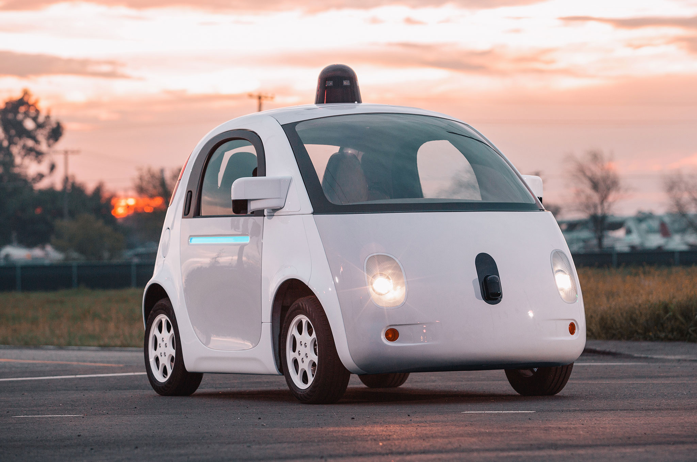



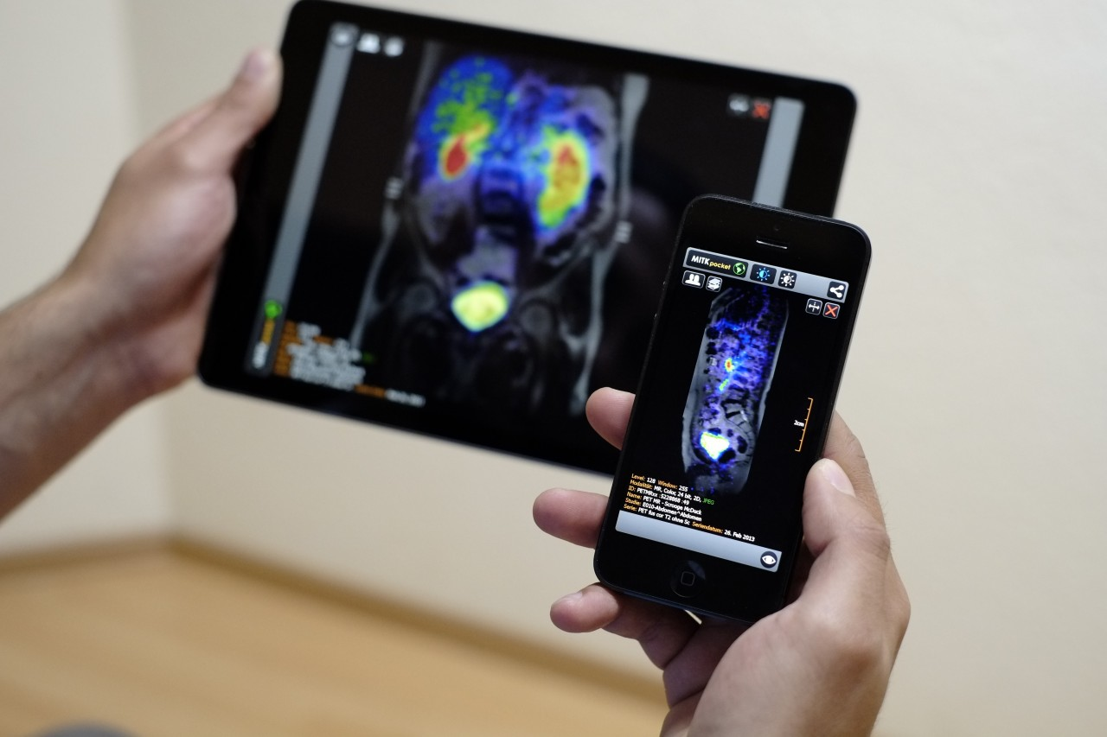
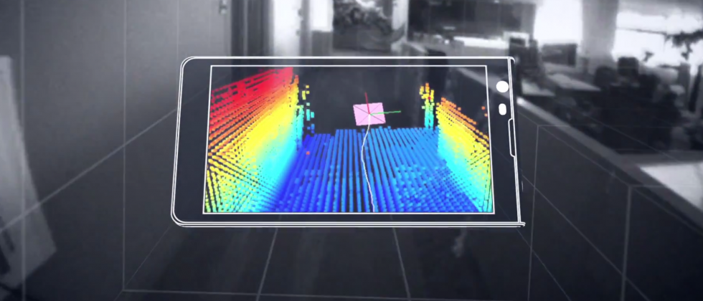
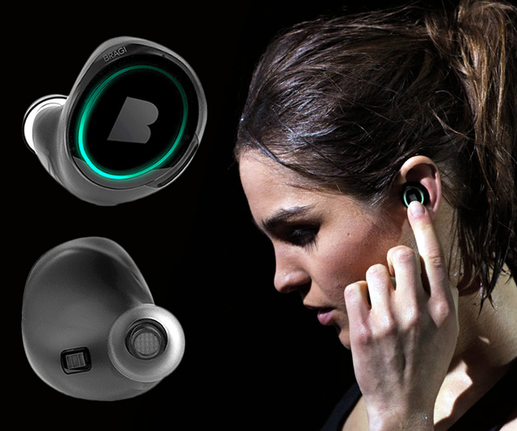
Wireless and Mobile Systems
for the IoT
CMSC 715 : Fall 2024
Lecture 1.4: Frequency domain visualizations
Nirupam Roy
Tu-Th 2:00 – 3:15pm
IRB 2207

Slide 2
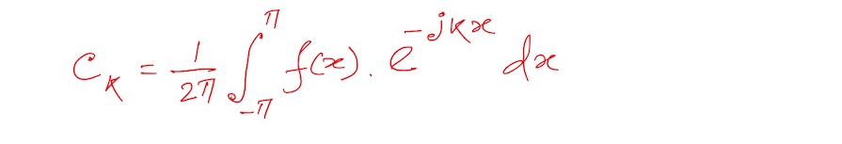
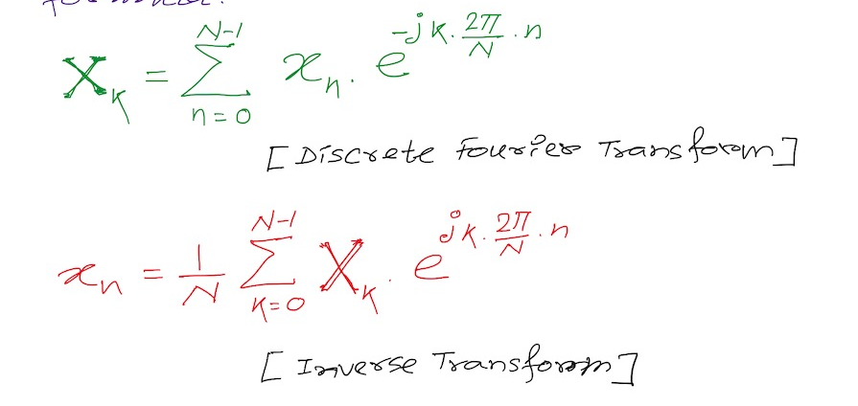
Discrete Fourier Transform formula
Discrete version:

Slide 3
Calculating
Discrete Fourier Transform (DFT)

Slide 4
Discrete Fourier Transform
…
0
1
2
3
4
5
6
N-1
Sample number
X = [ ]
x[0], x[1], x[2], x[3], x[4], … x[N-1]

Slide 5
Discrete Fourier Transform
…
0
1
2
3
4
5
6
N-1
Sample number
X = [ ]
x[0], x[1], x[2], x[3], x[4], … x[N-1]

Slide 6
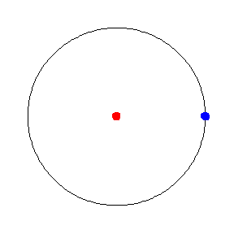

Circular motion
(depicting pure sinusoid)
Sampling system
(taking snapshot at a constant rate)

Slide 7
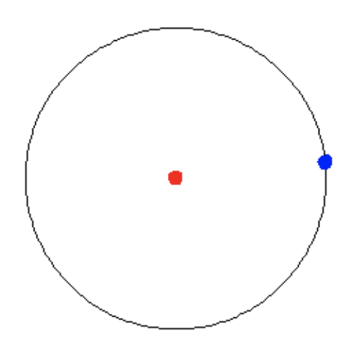
Sample-2
Circular motion
(depicting pure sinusoid)
Sample-1
Sampling system
(taking snapshot at a constant rate)

Slide 8
Sample-3
Sample-2
Circular motion
(depicting pure sinusoid)
Sample-1
Sampling system
(taking snapshot at a constant rate)

Slide 9
Sample-3
Sample-2
Circular motion
(depicting pure sinusoid)
Sample-1
Sampling system
(taking snapshot at a constant rate)

Slide 10
Sample-3
Sample-2
Circular motion
(depicting pure sinusoid)
Sample-1

Slide 11


Sample-3
$$e^{j1.\frac{2π}{N}}$$
$$\frac{2π}{N}$$
Sample-2
Circular motion
(depicting pure sinusoid)
Sample-1

Slide 12


$$e^{j2.\frac{2π}{N}}$$
2 X
$$\frac{2π}{N}$$
Sample-3
$$e^{j1.\frac{2π}{N}}$$
$$\frac{2π}{N}$$
Sample-2
Circular motion
(depicting pure sinusoid)
Sample-1

Slide 13





Discrete Fourier Transform
…
0
1
2
3
4
5
6
N-1
Sample number
$$e^{j2.\frac{2π}{N}}$$
$$e^{j1.\frac{2π}{N}}$$
$$\frac{2π}{N}$$
$$e^{j0.\frac{2π}{N}}$$
$$e^{j(N−1).\frac{2π}{N}}$$

Slide 14



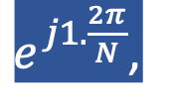
Discrete Fourier Transform
…
0
1
2
3
4
5
6
N-1
Sample number
= [ ]
Freq f₁
$$e^{j0.\frac{2π}{N}},$$
$e^{j1.\frac{2π}{N}}$,
$$e^{j2.\frac{2π}{N}},$$
…
$${,e}^{j(N−1).\frac{2π}{N}}$$
$$e^{j2.\frac{2π}{N}}$$
$$e^{j1.\frac{2π}{N}}$$
$$\frac{2π}{N}$$
$$e^{j0.\frac{2π}{N}}$$
$$e^{j(N−1).\frac{2π}{N}}$$

Slide 15
Discrete Fourier Transform
…
0
1
2
3
4
5
6
N-1
Sample number
Why do these “basis” sinusoids must complete full cycles within N samples?

Slide 16
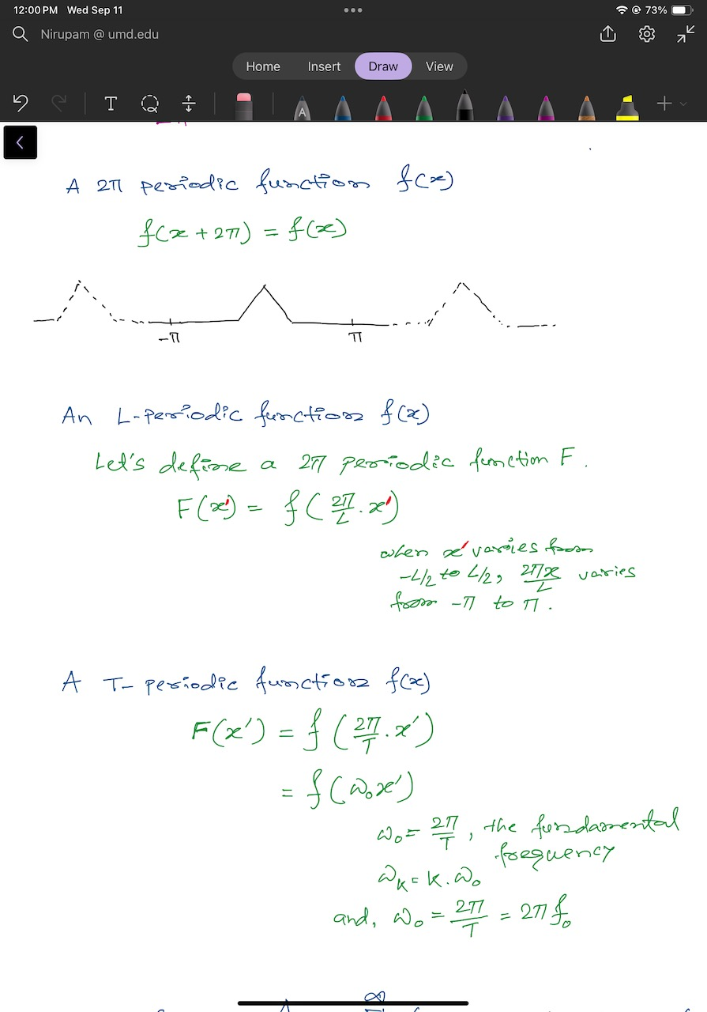

Slide 17

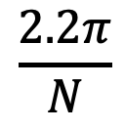


Discrete Fourier Transform
…
0
1
2
3
4
5
6
N-1
Sample number
$$e^{j1.\frac{2.2π}{N}}$$
$$\frac{2.2π}{N}$$
$$e^{j0.\frac{2.2π}{N}}$$
$$e^{j(N−1).\frac{2.2π}{N}}$$

Slide 18


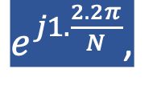
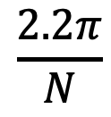




Discrete Fourier Transform
…
0
1
2
3
4
5
6
N-1
Sample number
= [ ]
Freq f₂
$$e^{j0.\frac{2.2π}{N}},$$
$e^{j1.\frac{2.2π}{N}}$,
$$e^{j2.\frac{2.2π}{N}},$$
…
$${,e}^{j(N−1).\frac{2.2π}{N}}$$
$$e^{j1.\frac{2.2π}{N}}$$
$$\frac{2.2π}{N}$$
$$e^{j0.\frac{2.2π}{N}}$$
$$e^{j(N−1).\frac{2.2π}{N}}$$

Slide 19
Discrete Fourier Transform
…
0
1
2
3
4
5
6
N-1
Sample number
What is the MINIMUM number of cycles
observable in this model?

Slide 20

Discrete Fourier Transform
…
0
1
2
3
4
5
6
N-1
Sample number
$$0$$

Slide 21



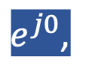
Discrete Fourier Transform
…
0
1
2
3
4
5
6
N-1
Sample number
= [ ]
Freq f₀
$$e^{j0},$$
$e^{j0}$,
$$e^{j0},$$
…
$${,e}^{j0}$$
$$0$$

Slide 22





Discrete Fourier Transform
…
0
1
2
3
4
5
6
N-1
Sample number
= [ ]
Freq f₀
$$e^{j0.\frac{2π}{N}},$$
$e^{j1.\frac{2π}{N}}$,
$$e^{j2.\frac{2π}{N}},$$
…
$${,e}^{j(N−1).\frac{2π}{N}}$$
$$e^{j2.\frac{2π}{N}}$$
$$e^{j1.\frac{2π}{N}}$$
$$\frac{2π}{N}$$
$$e^{j0.\frac{2π}{N}}$$
$$e^{j(N−1).\frac{2π}{N}}$$

Slide 23
Discrete Fourier Transform
…
0
1
2
3
4
5
6
N-1
Sample number
What is the MAXIMUM number of cycles
observable in this model?

Slide 24
Discrete Fourier Transform
…
0
1
2
3
4
5
6
N-1
Sample number
What happens when the ball rotates exactly N times?
$$0$$
We can uniquely observe up to (N-1) number of cycles.

Slide 25


Discrete Fourier Transform
Freq f₀
n=0
$$e^{j0}$$
n=1
$$e^{j0}$$
n=2
$$e^{j0}$$
…
…
n=N-1
$$e^{j0}$$

Slide 26
Discrete Fourier Transform
Number of cycles
…
…
Freq f₀
Freq f₁
Freq f_{m}
Freq f_{N-1}
n=0
$$e^{j0}$$
n=1
$$e^{j0}$$
Sample number
n=2
$$e^{j0}$$
…
…
n=N-1
$$e^{j0}$$

Slide 27












Discrete Fourier Transform
Number of cycles
…
…
Freq f₀
Freq f₁
Freq f_{m}
Freq f_{N-1}
n=0
$$e^{j0}$$
$$e^{j0.\frac{2π}{N}}$$
$$e^{j0.\frac{m.2π}{N}}$$
$$e^{j0.\frac{(N−1).2π}{N}}$$
n=1
$$e^{j0}$$
$$e^{j1.\frac{2π}{N}}$$
$$e^{j1.\frac{m.2π}{N}}$$
$$e^{j1.\frac{(N−1).2π}{N}}$$
Sample number
…
…
$$e^{j2.\frac{(N−1).2π}{N}}$$
$$e^{j2.\frac{2π}{N}}$$
$$e^{j2.\frac{m.2π}{N}}$$
n=2
$$e^{j0}$$
…
…
…
…
…
$$e^{j(N−1).\frac{2π}{N}}$$
$$e^{j(N−1).\frac{m.2π}{N}}$$
$$e^{j(N−1).\frac{(N−1).2π}{N}}$$
n=N-1
$$e^{j0}$$

Slide 28














Discrete Fourier Transform
$$e^{j0}$$
$$e^{j0.\frac{2π}{N}}$$
$$e^{j0.\frac{m.2π}{N}}$$
$$e^{j0.\frac{(N−1).2π}{N}}$$
$$e^{j0}$$
$$e^{j1.\frac{2π}{N}}$$
$$e^{j1.\frac{m.2π}{N}}$$
$$e^{j1.\frac{(N−1).2π}{N}}$$
+
$$e^{j2.\frac{2π}{N}}$$
+
$$e^{j2.\frac{m.2π}{N}}$$
+
$$e^{j2.\frac{(N−1).2π}{N}}$$
Z₀
$$e^{j0}$$
Z₁
…
Z_{m}
…
Z_{N-1}
…
…
…
…
$$e^{j(N−1).\frac{2π}{N}}$$
$$e^{j(N−1).\frac{m.2π}{N}}$$
$$e^{j(N−1).\frac{(N−1).2π}{N}}$$
$$e^{j0}$$

Slide 29














Discrete Fourier Transform
$$e^{j0}$$
$$e^{j0.\frac{2π}{N}}$$
$$e^{j0.\frac{m.2π}{N}}$$
$$e^{j0.\frac{(N−1).2π}{N}}$$
$$e^{j0}$$
$$e^{j1.\frac{2π}{N}}$$
$$e^{j1.\frac{m.2π}{N}}$$
$$e^{j1.\frac{(N−1).2π}{N}}$$
+
$$e^{j2.\frac{2π}{N}}$$
+
$$e^{j2.\frac{m.2π}{N}}$$
+
$$e^{j2.\frac{(N−1).2π}{N}}$$
Z₀
$$e^{j0}$$
Z₁
…
Z_{m}
…
Z_{N-1}
…
…
…
…
$$e^{j(N−1).\frac{2π}{N}}$$
$$e^{j(N−1).\frac{m.2π}{N}}$$
$$e^{j(N−1).\frac{(N−1).2π}{N}}$$
$$e^{j0}$$

Slide 30
Discrete Fourier Transform
$$e^{j0}$$
$$e^{j0.\frac{2π}{N}}$$
$$e^{j0.\frac{m.2π}{N}}$$
$$e^{j0.\frac{(N−1).2π}{N}}$$
$$e^{j0}$$
$$e^{j1.\frac{2π}{N}}$$
$$e^{j1.\frac{m.2π}{N}}$$
$$e^{j1.\frac{(N−1).2π}{N}}$$
+
$$e^{j2.\frac{2π}{N}}$$
+
$$e^{j2.\frac{m.2π}{N}}$$
+
$$e^{j2.\frac{(N−1).2π}{N}}$$
Z₀
$$e^{j0}$$
Z₁
…
Z_{m}
…
Z_{N-1}
…
…
…
…
$$e^{j(N−1).\frac{2π}{N}}$$
$$e^{j(N−1).\frac{m.2π}{N}}$$
$$e^{j(N−1).\frac{(N−1).2π}{N}}$$
$$e^{j0}$$
=
…
0
1
2
3
4
5
6
N-1
Sample number

Slide 31
Discrete Fourier Transform
Frequency domain coefficients
$$e^{j0}$$
$$e^{j0.\frac{2π}{N}}$$
$$e^{j0.\frac{m.2π}{N}}$$
$$e^{j0.\frac{(N−1).2π}{N}}$$
$$e^{j0}$$
$$e^{j1.\frac{2π}{N}}$$
$$e^{j1.\frac{m.2π}{N}}$$
$$e^{j1.\frac{(N−1).2π}{N}}$$
+
$$e^{j2.\frac{2π}{N}}$$
+
$$e^{j2.\frac{m.2π}{N}}$$
+
$$e^{j2.\frac{(N−1).2π}{N}}$$
Z₀
$$e^{j0}$$
Z₁
…
Z_{m}
…
Z_{N-1}
…
…
…
…
$$e^{j(N−1).\frac{2π}{N}}$$
$$e^{j(N−1).\frac{m.2π}{N}}$$
$$e^{j(N−1).\frac{(N−1).2π}{N}}$$
$$e^{j0}$$
x[0]
x[1]
=
X =
x[2]
Time domain samples
…
x[N-1]

Slide 32
Discrete Fourier Transform
_{F}
…
DFT matrix,
=
f₀
f₁
…
f_{m}
f_{N-1}

Slide 33
Discrete Fourier Transform
_{F}
…
DFT matrix,
=
f₀
f₁
…
f_{m}
f_{N-1}
_{Z}
Z₀
Fourier coefficients,
=
Z₁
…
Z_{m}
…
Z_{N-1}

Slide 34
Discrete Fourier Transform
_{F}
…
DFT matrix,
=
f₀
f₁
…
f_{m}
f_{N-1}
_{Z}
Z₀
x[0]
X =
Fourier coefficients,
=
Z₁
Time series,
…
x[1]
Z_{m}
x[2]
…
…
Z_{N-1}
x[N-1]

Slide 35
Discrete Fourier Transform
_{X}
_{F}
_{Z}
=
_{X}
_{Z}
_{F}⁻¹
=
_{H}
_{X}
_{Z}
_{F}
=

Slide 36
Discrete Fourier Transform
_{X}
_{F}
_{Z}
=
_{X}
_{Z}
_{F}⁻¹
=
_{H}
_{X}
_{Z}
_{F}
=
*
f₀
*
f₁
…
*
f_{m}
…
*
f_{N-1}

Slide 37
Discrete Fourier Transform
_{X}
_{F}
_{Z}
=
IDFT
_{X}
_{Z}
_{F}⁻¹
=
DFT
_{H}
_{X}
_{Z}
_{F}
=
*
f₀
x[0]
Z₀
*
Z₁
f₁
x[1]
…
=
…
*
x[2]
Z_{m}
f_{m}
…
…
…
Z_{N-1}
*
x[N-1]
f_{N-1}

Slide 38
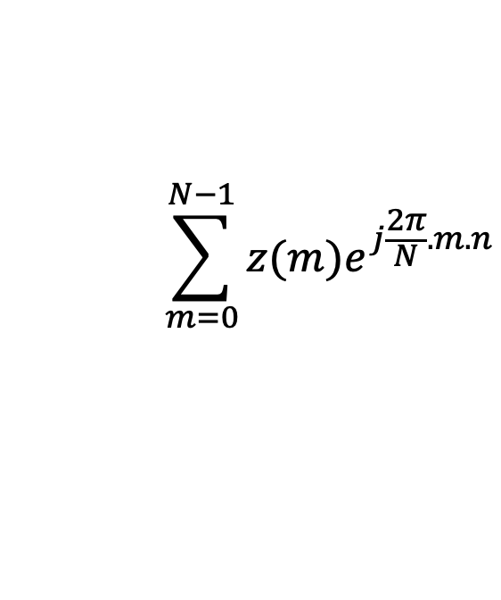
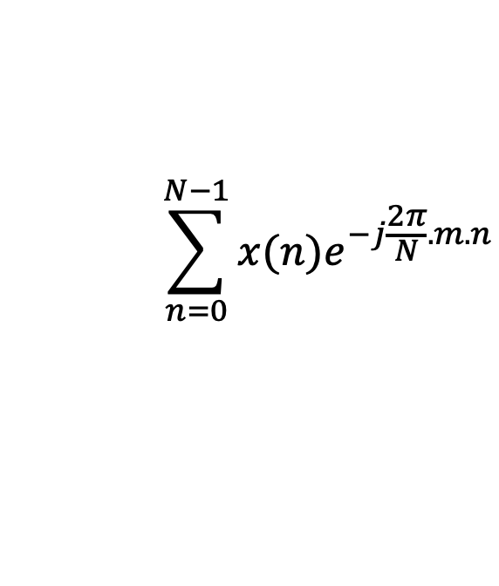
Discrete Fourier Transform
$$\sum_{n=0}^{N−1}{x(n)e^{−j\frac{2π}{N}.m.n}}$$
DFT:
z(m) =
$$\sum_{m=0}^{N−1}{z(m)e^{j\frac{2π}{N}.m.n}}$$
IDFT:
x(n) =

Slide 39
Preserving energy in time and frequency domain

Slide 40
Preserving energy in time and frequency domain
Is IDFT( DFT(x) ) = x ?

Slide 41

Preserving energy in time and frequency domain
Is IDFT( DFT(x) ) = x ?
*
_{X ?}
_{X}
_{F F}
=
*
_{N.X}
_{X}
_{F F}
=
_{F}
$$\frac{1}{\sqrt{N}}$$
…
DFT matrix,
=
f₀
f₁
…
f_{m}
f_{N-1}

Slide 42
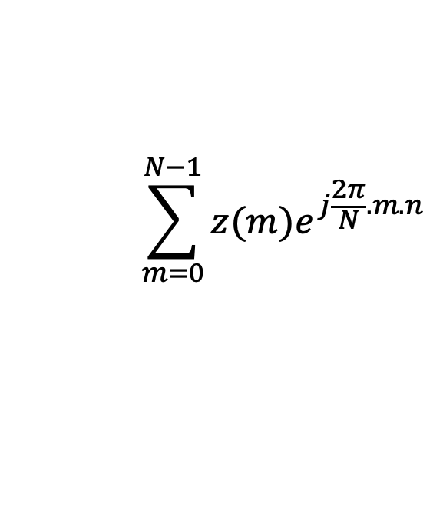
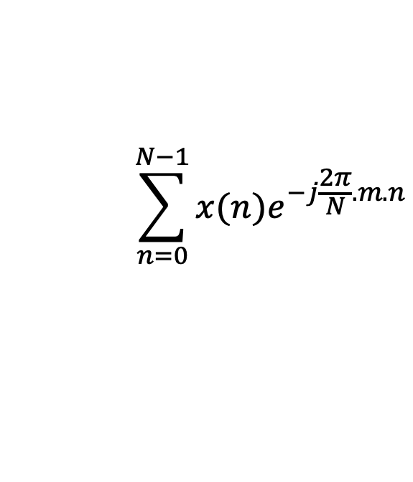


Discrete Fourier Transform
$$\sum_{n=0}^{N−1}{x(n)e^{−j\frac{2π}{N}.m.n}}$$
z(m) =
$$\frac{1}{\sqrt{N}}$$
DFT:
$$\sum_{m=0}^{N−1}{z(m)e^{j\frac{2π}{N}.m.n}}$$
x(n) =
$$\frac{1}{\sqrt{N}}$$
IDFT:

Slide 43
Plotting
DFT spectrum

Slide 44
Plotting the DFT spectrum
Magnitude
|z_{m}|
m = 0
1
2
3
4
…
Frequency
N-2
N-1

Slide 45
Plotting the DFT spectrum
Magnitude
|z_{m}|
m = 0
1
2
3
4
…
Frequency
N-2
N-1
Phase
⦨ z_{m}
m = 0
1
2
3
4
…
Frequency
N-2
N-1

Slide 46

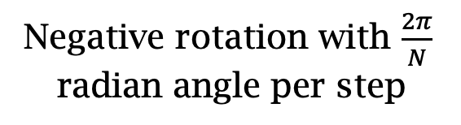

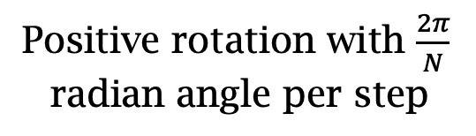
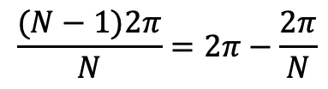
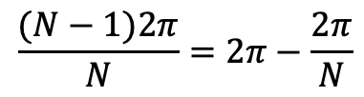
The Curious Case of “Negative frequency”
$$\frac{(N−1)2π}{N}=2π−\frac{2π}{N}$$
$$\frac{2π}{N}$$
$$\frac{2π}{N}$$
$$\frac{(N−1)2π}{N}=2π−\frac{2π}{N}$$
Positive rotation with $\frac{2π}{N}$ radian angle per step
Negative rotation with $\frac{2π}{N}$ radian angle per step

Slide 47
The Curious Case of “Negative frequency”
m = 0
1
2
3
4
…
Frequency
N-2
N-1
+
+
+
-
-
-

Slide 48
The Curious Case of “Negative frequency”
-4
-3
-2
-1
m = 0
1
2
3
4
Frequency

Slide 49
The Curious Case of “Negative frequency”
Magnitude
|z_{m}|
-4
-3
-2
-1
m = 0
1
2
3
4
Frequency
Real signal’s magnitude spectrum is symmetric.
Why?

Slide 50
The Curious Case of “Negative frequency”
Magnitude
|z_{m}|
-4
-3
-2
-1
m = 0
1
2
3
4
Frequency
Complex signal’s magnitude spectrum may or may not be symmetric.
Why?

Slide 51
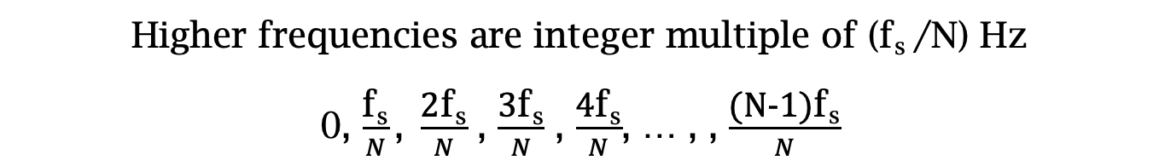
Estimating the real-world frequencies
Sampling frequency = f_{s} (i.e., f_{s} samples per second)
Slowest frequency ($\frac{2π}{N}$ radians per step) = N samples per rotation
= (N/ f_{s}) seconds per rotation
Therefore, the slowest frequency = (f_{s} /N) Hz
Higher frequencies are integer multiple of (f_{s} /N) Hz
0, $\frac{\text{f}\text{s}}{N}\text{, }\frac{\text{2}\text{f}\text{s}}{N}$ , $\frac{\text{3}\text{f}\text{s}}{N}$ , $\frac{\text{4}\text{f}\text{s}}{N}$, … , , $\frac{\text{(}\text{N}\text{−1)}\text{f}\text{s}}{N}$

Slide 52

The resolution and the highest frequency
Magnitude/Phase of z_{m}
-4
-3
-2
-1
m = 0
1
2
3
4
Frequency
Resolution
= minimum observable frequency difference =
$\frac{\text{f}\text{s}}{N}$
What if the actual frequency falls in between two frequency bins?

Slide 53
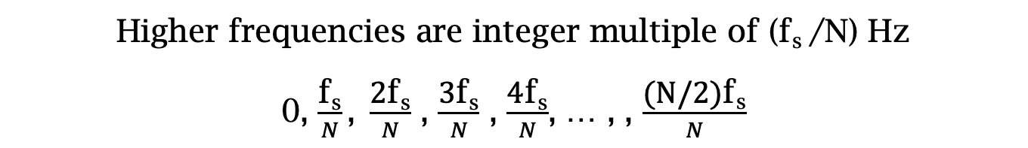
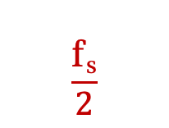

Estimating the real-world frequencies
Sampling frequency = f_{s} (i.e., f_{s} samples per second)
Slowest frequency ($\frac{2π}{N}$ radians per step) = N samples per rotation
= (N/ f_{s}) seconds per rotation
Therefore, the slowest frequency = (f_{s} /N) Hz
Higher frequencies are integer multiple of (f_{s} /N) Hz
0, $\frac{\text{f}\text{s}}{N}\text{, }\frac{\text{2}\text{f}\text{s}}{N}$ , $\frac{\text{3}\text{f}\text{s}}{N}$ , $\frac{\text{4}\text{f}\text{s}}{N}$, … , , $\frac{\text{(}\text{N}\text{/2)}\text{f}\text{s}}{N}$
$$\frac{\text{f}\text{s}}{2}$$
- $\frac{\text{f}\text{s}}{N}\text{, }\text{−}\frac{\text{2}\text{f}\text{s}}{N}$ , - $\frac{\text{3}\text{f}\text{s}}{N}$ , - $\frac{\text{4}\text{f}\text{s}}{N}$, … , , - $\frac{\text{(}\text{N}\text{/2)}\text{f}\text{s}}{N}$

Slide 54
The resolution and the highest frequency
Magnitude/Phase of z_{m}
-4
-3
-2
-1
m = 0
1
2
3
4
Frequency
Resolution
= minimum observable frequency difference =
$\frac{\text{f}\text{s}}{N}$
What if the actual frequency falls in between two frequency bins?

Slide 55
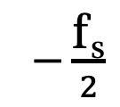
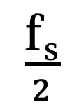
The resolution and the highest frequency
Magnitude/Phase of z_{m}
-4
-3
-2
-1
m = 0
1
2
3
4
Frequency
$−\frac{\text{f}\text{s}}{2}$
$\frac{\text{f}\text{s}}{2}$
Highest frequency =

Slide 56
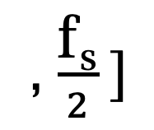
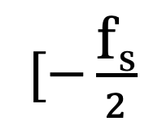
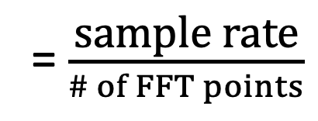
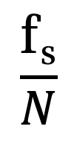
The resolution and the highest frequency
How can we increase the resolution?
$$\frac{\text{f}\text{s}}{N}$$
= $\frac{\text{sample} \text{rate}}{\# of FFT points}$
How can we increase the range of the spectrum?
$[−\frac{\text{f}\text{s}}{2}$
, $\frac{\text{f}\text{s}}{2} ]$

Slide 57
Time resolution v/s Frequency resolution

Slide 58
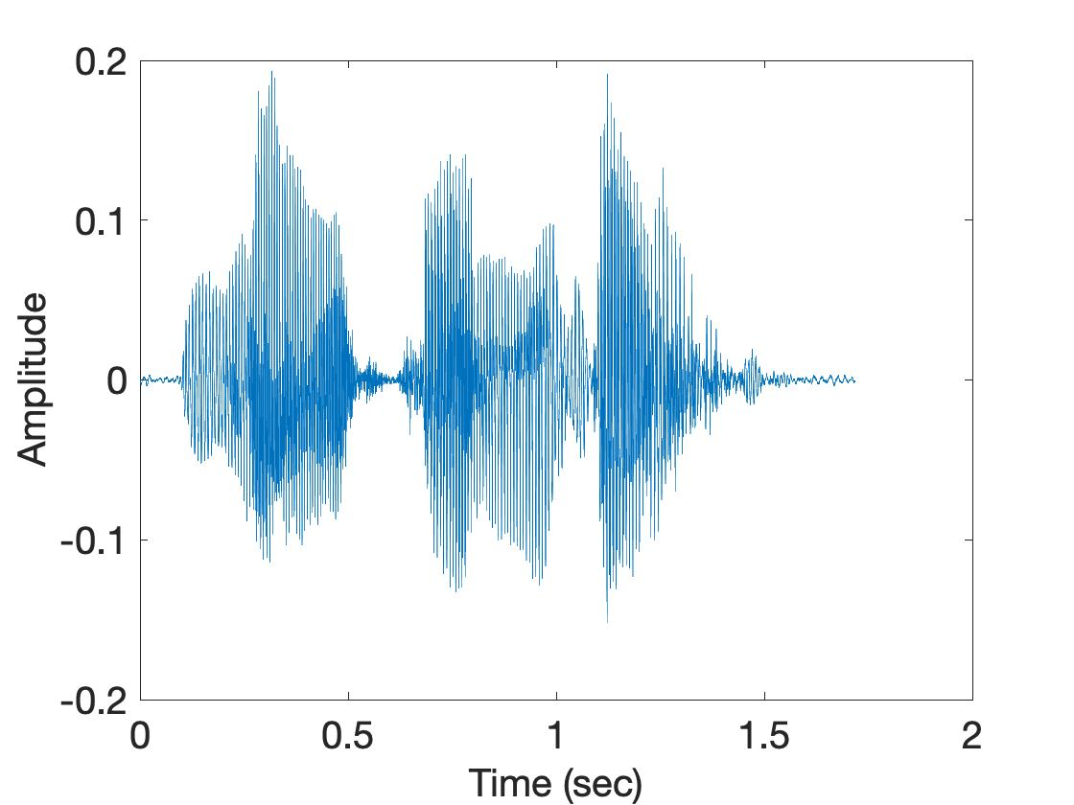
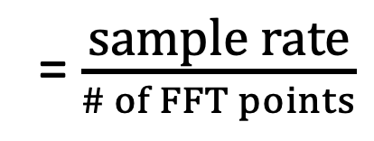
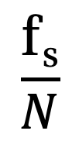
Time resolution v/s Frequency resolution
U
M
D
[
[
DFT
DFT
$$\frac{\text{f}\text{s}}{N}$$
= $\frac{\text{sample} \text{rate}}{\# of FFT points}$
How can we increase the frequency resolution?
How can we increase the time resolution?

Slide 59
Aliasing

Slide 60
Sampling theorem
Amplitude
Time (sec)
0.00
0.25
0.50
0.75
1.00
1.25
Amplitude
Time (sec)
0.00
0.25
0.50
0.75
1.00
1.25
Aliasing: Two signals become indistinguishable after sampling

Slide 61
Time domain samples
Amplitude
Time (sec)
0.00
0.25
0.50
0.75
1.00
1.25
FFT
Amplitude
-6
-4
-2
0
2
4
6
8
Frequency (Hz)
Frequency domain

Slide 62
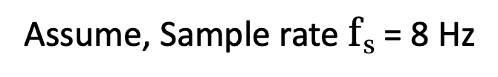
Aliasing: Different frequencies, same name!!
Magnitude/Phase of z_{m}
-4
-3
-2
-1
m = 0
1
2
3
4
Frequency
Assume, Sample rate $\text{f}\text{s}$ = 8 Hz
For a COMPLEX signal, what value will we see if the actual frequency is:
a) 3 Hz
b) -2 Hz
c) 6 Hz
d) -5 Hz
e) 4 Hz and -4Hz

Slide 63
Magnitude/Phase of z_{m}
-4
-3
-2
-1
m = 0
1
2
3
4
Frequency
5
6
7
8

Slide 64
Magnitude/Phase of z_{m}
-4
-3
-2
-1
m = 0
1
2
3
4
Frequency
5
6
7
8

Slide 65
Magnitude/Phase of z_{m}
-4
-3
-2
-1
m = 0
1
2
3
4
Frequency
0
- F_{s}/4
F_{s}/4
F_{s}/2

Slide 66
Magnitude/Phase of z_{m}
-4
-3
-2
-1
m = 0
1
2
3
4
Frequency
0
-1
1
- 2
2
-3
3
4
-4

Slide 67
Aliasing: Different frequencies, same name!!
Magnitude/Phase of z_{m}
-4
-3
-2
-1
m = 0
1
2
3
4
Frequency
Assume, Sample rate $\text{f}\text{s}$ = 8 Hz
For a COMPLEX signal, what value will we see if the actual frequency is:
a) 3 Hz
b) -2 Hz
c) 6 Hz
d) -5 Hz
e) 4 Hz and -4Hz

Slide 68
Aliasing: Different frequencies, same name!!
Magnitude/Phase of z_{m}
-4
-3
-2
-1
m = 0
1
2
3
4
Frequency
Assume, Sample rate $\text{f}\text{s}$ = 8 Hz
For a REAL signal, what value will we see if the actual frequency is:
a) 3 Hz
b) -2 Hz
c) 6 Hz
d) -5 Hz
e) 4 Hz and -4Hz

Slide 69
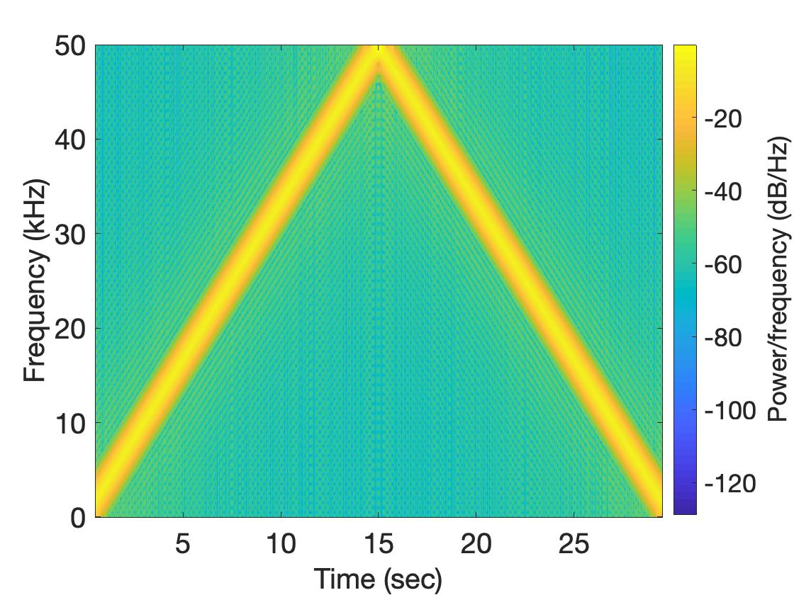
Aliasing: Spectrogram of increasing frequency

Slide 70
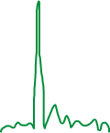

Calculating the aliased frequency value for real signals
Sampling frequency = 10Hz
Nyquist frequency = 5Hz
Amplitude
0
2
4
6
8
Frequency (Hz)

Slide 71

Calculating the aliased frequency value for real signals
Sampling frequency = 10Hz
Nyquist frequency = 5Hz
Amplitude
Received
signal
Amplitude
0
2
4
6
8
0
2
4
6
8
Frequency (Hz)
Frequency (Hz)

Slide 72
Calculating the aliased frequency value for real signals
Sampling frequency = 10Hz
Nyquist frequency = 5Hz
Amplitude
Received
signal
Amplitude
0
2
4
6
8
0
2
4
6
8
Frequency (Hz)
Frequency (Hz)
f_{s} = Sampling frequency
f = Target frequency
f_{a} = Aliased(perceived) frequency
K = Non-negative integer
f_{a} = min(abs(K*f_{s} - f))

Slide 73
Aliasing: A real life scenario
Nyquist frequency
Amplitude
10k
20k
30k
40k
50k
60k
70k
80k
90k
100k
Frequency spectrum
Notes:
to amplify the signal power …
Now, this signal typically contains many more frequencies than the sampling system can handle …

Slide 74
Aliasing: A real life scenario
Nyquist frequency
Amplitude
10k
20k
30k
40k
50k
60k
70k
80k
90k
100k
Frequency spectrum
Notes:
to amplify the signal power …
Now, this signal typically contains many more frequencies than the sampling system can handle …

Slide 75
Aliasing: A real life scenario
Nyquist frequency
Amplitude
10k
20k
30k
40k
50k
60k
70k
80k
90k
100k
Frequency spectrum
We need a “Low-pass filter”
to remove unwanted high frequency signals
Notes:
to amplify the signal power …
Now, this signal typically contains many more frequencies than the sampling system can handle …

Slide 76
Anti-aliasing filter
Nyquist frequency
Amplitude
10k
20k
30k
40k
50k
60k
70k
80k
90k
100k
Frequency spectrum
Sensor
ADC
Anti-aliasing
Filter
Notes:
to amplify the signal power …
Now, this signal typically contains many more frequencies than the sampling system can handle …

Slide 77
Anti-aliasing filter
Nyquist frequency
Amplitude
10k
20k
30k
40k
50k
60k
70k
80k
90k
100k
Frequency spectrum
Sensor
ADC
Anti-aliasing
Filter
Notes:
Hence, a low pass filter…

Slide 78
Anti-aliasing filter
Anti-aliasing
filter
Amplitude
10k
20k
30k
40k
50k
60k
70k
80k
90k
100k
Frequency spectrum
Sensor
ADC
Anti-aliasing
Filter
Notes:
removes the unwanted frequencies above 24 kHz …
And ultimately, this filtered signal is sampled by an ADC to generate digital sound samples

