Slide 1
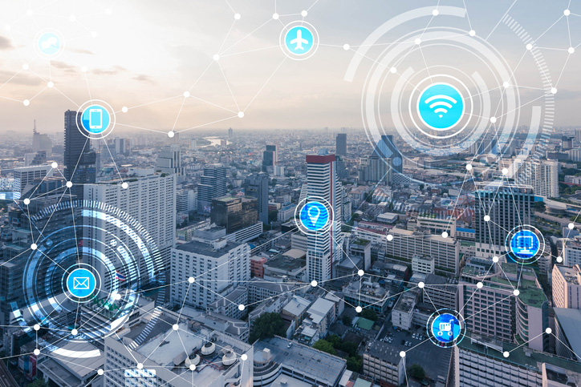
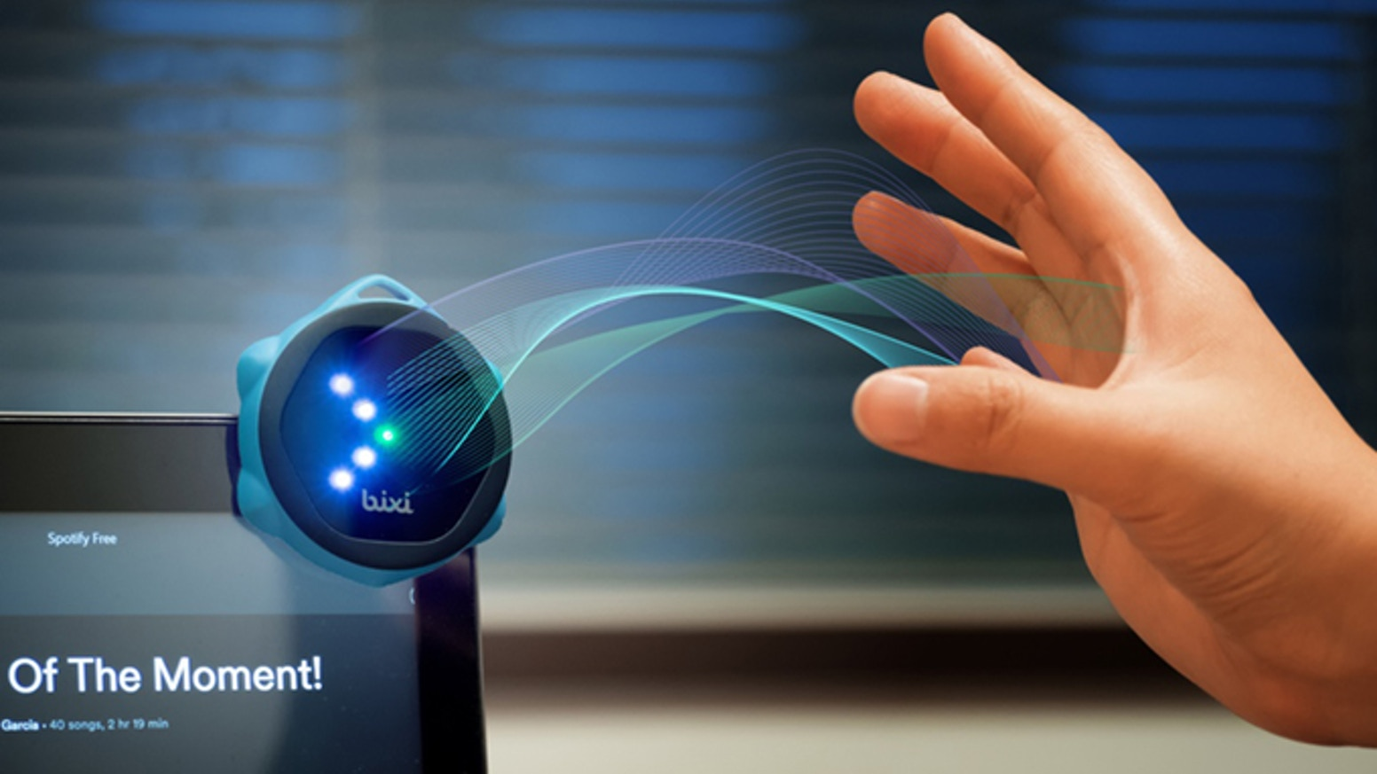
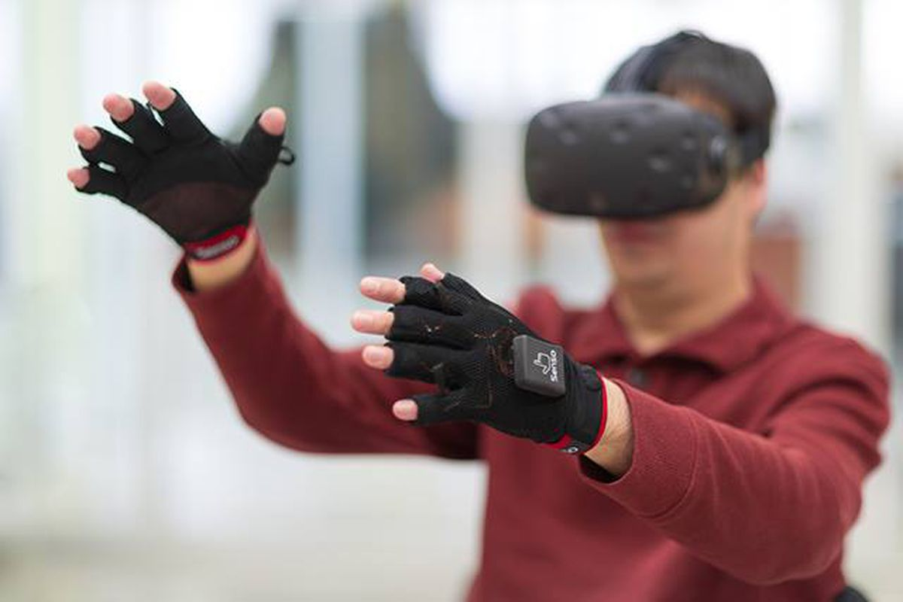
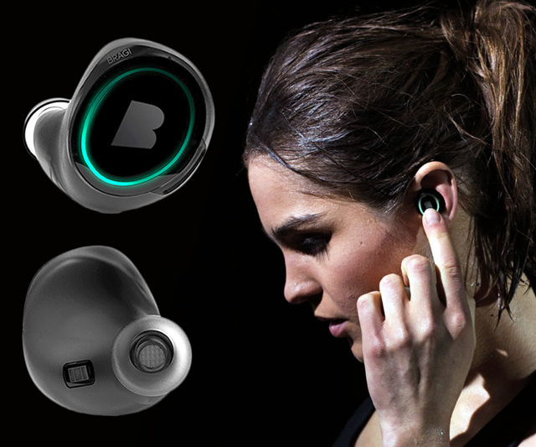
Wireless and Mobile Systems
for the IoT
CMSC 715 : Fall 2024
Lecture 1.6: Aliasing and Frequency Shifting
Nirupam Roy
Tu-Th 2:00 – 3:15pm
IRB 2207

Slide 2
The resolution and the highest frequency
How can we increase the resolution?
$$\frac{\text{f}\text{s}}{N}$$
= $\frac{\text{sample} \text{rate}}{\# of FFT points}$
How can we increase the range of the spectrum?
$[−\frac{\text{f}\text{s}}{2}$
, $\frac{\text{f}\text{s}}{2} ]$

Slide 3
Time resolution v/s Frequency resolution

Slide 4
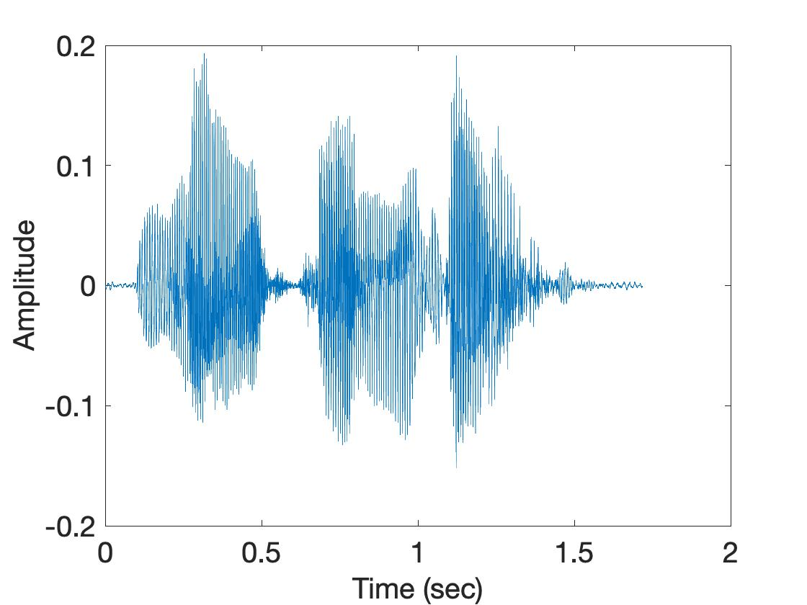
Time resolution v/s Frequency resolution
U
M
D
[
[
DFT
DFT
$$\frac{\text{f}\text{s}}{N}$$
= $\frac{\text{sample} \text{rate}}{\# of FFT points}$
How can we increase the frequency resolution?
How can we increase the time resolution?

Slide 5
Aliasing

Slide 6
Sampling theorem
Amplitude
Time (sec)
0.00
0.25
0.50
0.75
1.00
1.25
Amplitude
Time (sec)
0.00
0.25
0.50
0.75
1.00
1.25
Aliasing: Two signals become indistinguishable after sampling

Slide 7
Time domain samples
Amplitude
Time (sec)
0.00
0.25
0.50
0.75
1.00
1.25
FFT
Amplitude
-6
-4
-2
0
2
4
6
8
Frequency (Hz)
Frequency domain

Slide 8
Aliasing: Different frequencies, same name!!
Magnitude/Phase of z_{m}
-4
-3
-2
-1
m = 0
1
2
3
4
Frequency
Assume, Sample rate $\text{f}\text{s}$ = 8 Hz
For a COMPLEX signal, what value will we see if the actual frequency is:
a) 3 Hz
b) -2 Hz
c) 6 Hz
d) -5 Hz
e) 4 Hz and -4Hz

Slide 9
Magnitude/Phase of z_{m}
-4
-3
-2
-1
m = 0
1
2
3
4
Frequency
5
6
7
8

Slide 10
Magnitude/Phase of z_{m}
-4
-3
-2
-1
m = 0
1
2
3
4
Frequency
5
6
7
8

Slide 11
Magnitude/Phase of z_{m}
-4
-3
-2
-1
m = 0
1
2
3
4
Frequency
0
- F_{s}/4
F_{s}/4
F_{s}/2

Slide 12
Magnitude/Phase of z_{m}
-4
-3
-2
-1
m = 0
1
2
3
4
Frequency
0
-1
1
- 2
2
-3
3
4
-4

Slide 13
Aliasing: Different frequencies, same name!!
Magnitude/Phase of z_{m}
-4
-3
-2
-1
m = 0
1
2
3
4
Frequency
Assume, Sample rate $\text{f}\text{s}$ = 8 Hz
For a COMPLEX signal, what value will we see if the actual frequency is:
a) 3 Hz
b) -2 Hz
c) 6 Hz
d) -5 Hz
e) 4 Hz and -4Hz

Slide 14
Aliasing: Different frequencies, same name!!
Magnitude/Phase of z_{m}
-4
-3
-2
-1
m = 0
1
2
3
4
Frequency
Assume, Sample rate $\text{f}\text{s}$ = 8 Hz
For a REAL signal, what value will we see if the actual frequency is:
a) 3 Hz
b) -2 Hz
c) 6 Hz
d) -5 Hz
e) 4 Hz and -4Hz

Slide 15
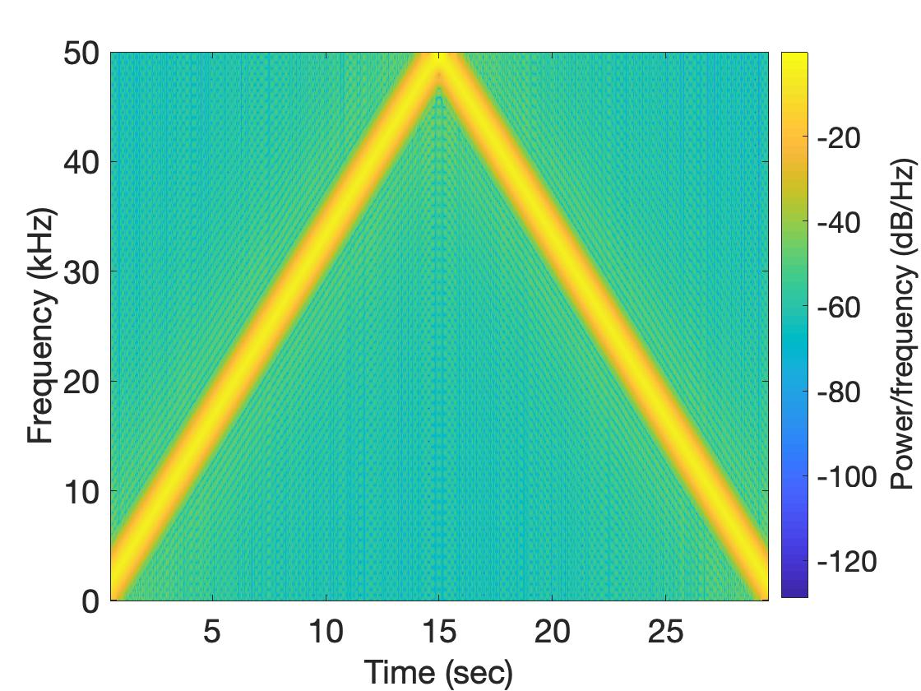
Aliasing: Spectrogram of increasing frequency

Slide 16
Calculating the aliased frequency value for real signals
Sampling frequency = 10Hz
Nyquist frequency = 5Hz
Amplitude
0
2
4
6
8
Frequency (Hz)

Slide 17
Calculating the aliased frequency value for real signals
Sampling frequency = 10Hz
Nyquist frequency = 5Hz
Amplitude
Received
signal
Amplitude
0
2
4
6
8
0
2
4
6
8
Frequency (Hz)
Frequency (Hz)

Slide 18
Calculating the aliased frequency value for real signals
Sampling frequency = 10Hz
Nyquist frequency = 5Hz
Amplitude
Received
signal
Amplitude
0
2
4
6
8
0
2
4
6
8
Frequency (Hz)
Frequency (Hz)
f_{s} = Sampling frequency
f = Target frequency
f_{a} = Aliased(perceived) frequency
K = Non-negative integer
f_{a} = min(abs(K*f_{s} - f))

Slide 19
Aliasing: A real life scenario
Nyquist frequency
Amplitude
10k
20k
30k
40k
50k
60k
70k
80k
90k
100k
Frequency spectrum
Notes:
to amplify the signal power …
Now, this signal typically contains many more frequencies than the sampling system can handle …

Slide 20
Aliasing: A real life scenario
Nyquist frequency
Amplitude
10k
20k
30k
40k
50k
60k
70k
80k
90k
100k
Frequency spectrum
Notes:
to amplify the signal power …
Now, this signal typically contains many more frequencies than the sampling system can handle …

Slide 21
Aliasing: A real life scenario
Nyquist frequency
Amplitude
10k
20k
30k
40k
50k
60k
70k
80k
90k
100k
Frequency spectrum
We need a “Low-pass filter”
to remove unwanted high frequency signals
Notes:
to amplify the signal power …
Now, this signal typically contains many more frequencies than the sampling system can handle …

Slide 22
Anti-aliasing filter
Nyquist frequency
Amplitude
10k
20k
30k
40k
50k
60k
70k
80k
90k
100k
Frequency spectrum
Sensor
ADC
Anti-aliasing
Filter
Notes:
to amplify the signal power …
Now, this signal typically contains many more frequencies than the sampling system can handle …

Slide 23
Anti-aliasing filter
Nyquist frequency
Amplitude
10k
20k
30k
40k
50k
60k
70k
80k
90k
100k
Frequency spectrum
Sensor
ADC
Anti-aliasing
Filter
Notes:
Hence, a low pass filter…

Slide 24
Anti-aliasing filter
Anti-aliasing
filter
Amplitude
10k
20k
30k
40k
50k
60k
70k
80k
90k
100k
Frequency spectrum
Sensor
ADC
Anti-aliasing
Filter
Notes:
removes the unwanted frequencies above 24 kHz …
And ultimately, this filtered signal is sampled by an ADC to generate digital sound samples

Slide 25
Addition and Multiplication of Frequencies
Magnitude
0
f₁
Frequency
$$e^{j2π(f1)t}$$

Slide 26
Addition and Multiplication of Frequencies
Magnitude
Addition (complex)
0
f_{c}
f₁
Frequency
$$e^{j2π(f1)t}$$
+
$$e^{j2π(fc)t}$$
=
?

Slide 27
Addition and Multiplication of Frequencies
Magnitude
Multiplication (complex)
0
f_{c}
f₁
Frequency
$$e^{j2π(f1)t}$$
X
$$e^{j2π(fc)t}$$
=
?

Slide 28
Addition and Multiplication of Frequencies
Magnitude
Multiplication (complex)
0
f₁+ f_{c}
Freq
$$e^{j2π(f1)t}$$
X
$$e^{j2π(fc)t}$$
=
$$e^{j2π(f1+fc)t}$$

Slide 29
Addition and Multiplication of Frequencies
Magnitude
Multiplication (complex)
-f_{c}
0
f₁
Freq
$$e^{j2π(f1)t}$$
X
$$e^{j2π(−fc)t}$$
=
?

Slide 30
Addition and Multiplication of Frequencies
Magnitude
Multiplication (complex)
0
f₁- f_{c}
Freq
$$e^{j2π(f1)t}$$
X
$$e^{j2π(−fc)t}$$
=
$$e^{j2π(f1−fc)t}$$

Slide 31
Addition and Multiplication of Frequencies
Magnitude
Multiplication (band, complex)
-f_{c}
0
f₁
Freq
$$e^{j2π(f1)t}$$
X
$$e^{j2π(−fc)t}$$
=
?

Slide 32
Addition and Multiplication of Frequencies
Magnitude
Multiplication (band, complex)
-f_{c}
0
f_{x}
Freq
$$e^{j2π(fx)t}$$
X
$$e^{j2π(−fc)t}$$
=
?
f₁<= X <= f₂

Slide 33
Addition and Multiplication of Frequencies
Magnitude
Multiplication (band, complex)
-f_{c}
0
f_{y}
Freq
$$e^{j2π(fx)t}$$
X
$$e^{j2π(−fc)t}$$
=
$$e^{j2π(fy)t}$$
f₁<= X <= f₂
f₁- f_{c}<= X <= f₂- f_{c}

Slide 34
Addition and Multiplication of Frequencies
Magnitude
Multiplication (band, real/complex)
-f_{x}
-f_{c}
0
f_{x}
Freq
$$R[e^{j2π\left(fx\right)t}]$$
X
$$e^{j2π(−fc)t}$$
=
?
f₁<= X <= f₂

Slide 35
Addition and Multiplication of Frequencies
Magnitude
Multiplication (band, real/complex)
-f_{x}
-f_{c}
0
f_{x}
Freq
$$R[e^{j2π\left(fx\right)t}]$$
X
$$e^{j2π(−fc)t}$$
=
?
f₁<= X <= f₂

Slide 36
Addition and Multiplication of Frequencies
Magnitude
Multiplication (band, real/real)
-f_{x}
-f_{c}
0
f_{c}
f_{x}
Freq
$$R[e^{j2π\left(fx\right)t}]$$
X
$$R[e^{j2π\left(−fc\right)t}]$$
=
?
f₁<= X <= f₂

Slide 37
Addition and Multiplication of Frequencies
Magnitude
Multiplication (band, real/real)
-f_{x}
-f_{c}
0
f_{c}
Freq
$$R[e^{j2π\left(fx\right)t}]$$
X
$$R[e^{j2π\left(−fc\right)t}]$$
=
Four bands
f₁<= X <= f₂

Slide 38
Addition and Multiplication of Frequencies
Magnitude
Multiplication (band, real/real)
Filter
-f_{x}
-f_{c}
0
f_{c}
Freq
$$R[e^{j2π\left(fx\right)t}]$$
X
$$R[e^{j2π\left(−fc\right)t}]$$
=
Four bands
f₁<= X <= f₂

Slide 39
Addition and Multiplication of Frequencies
Typical usage of frequency band conversion
in communication devices.

Slide 40
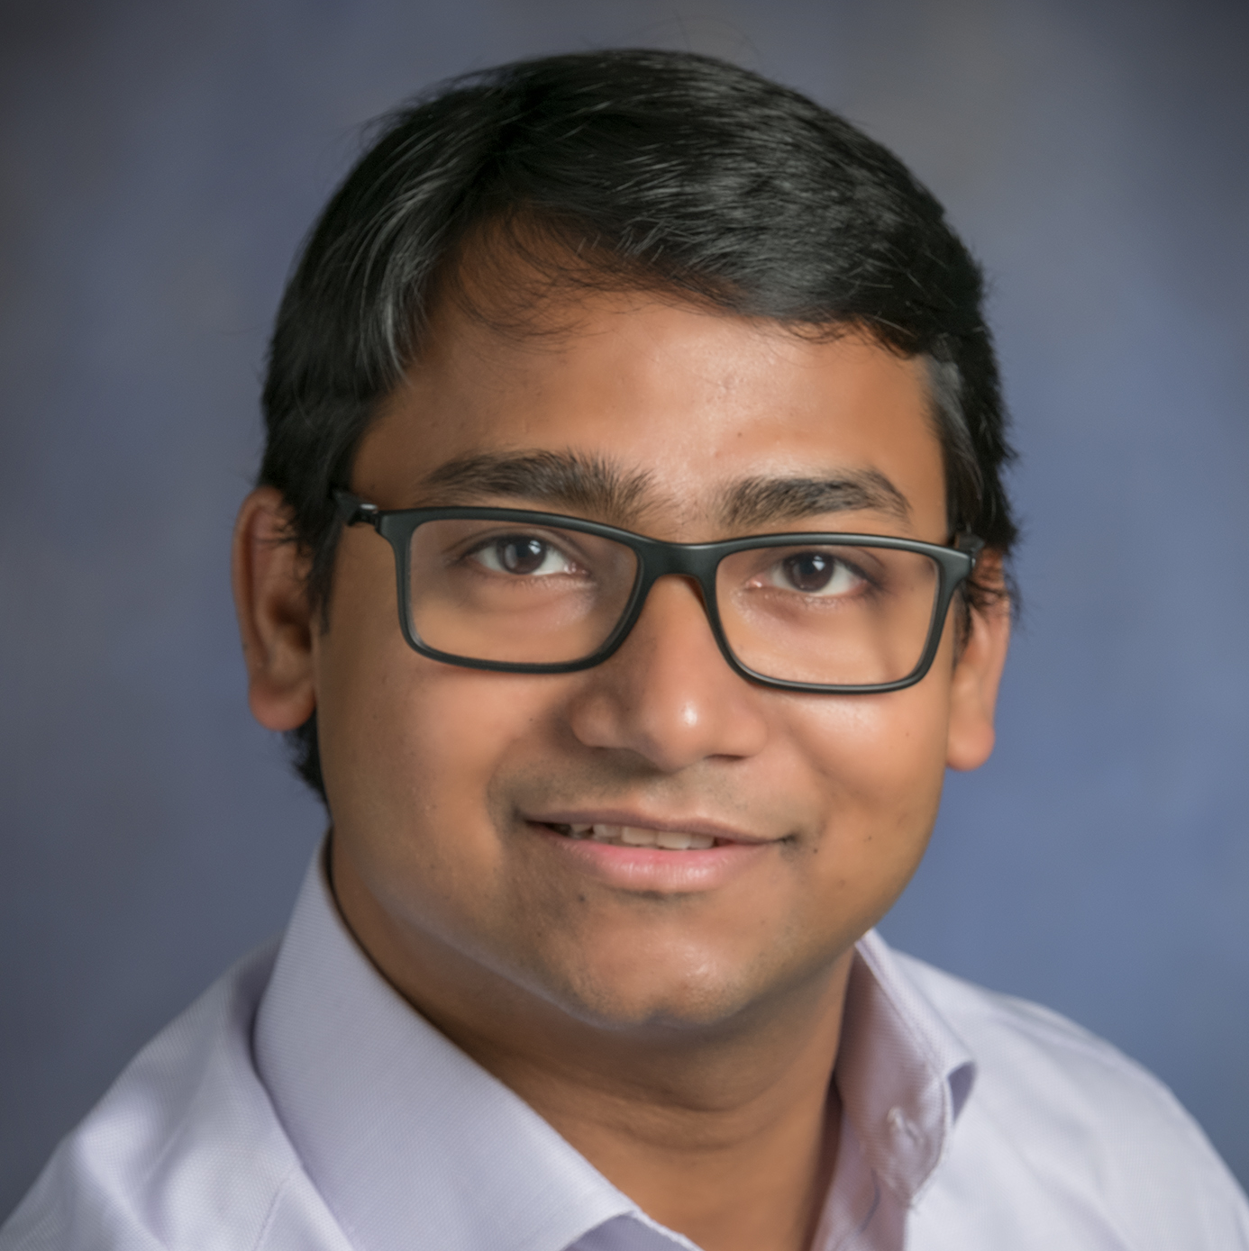
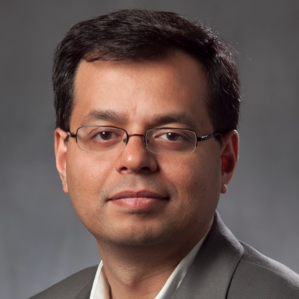
BackDoor: Making Microphones Hear Inaudible Sounds
(MobiSys 2017)
Nirupam Roy
Haitham Hassanieh
Romit Roy Choudhury
University of Illinois at Urbana-Champaign
Notes:
1. Good morning, I am Nirupam Roy and today I want to talk to you about our work … on how sounds can be designed such that … microphones hear what they are NOT supposed to hear.
This is a joint work with Haitham and Romit, and we are all from the University of Illinois at Urbana Champaign.

Slide 41
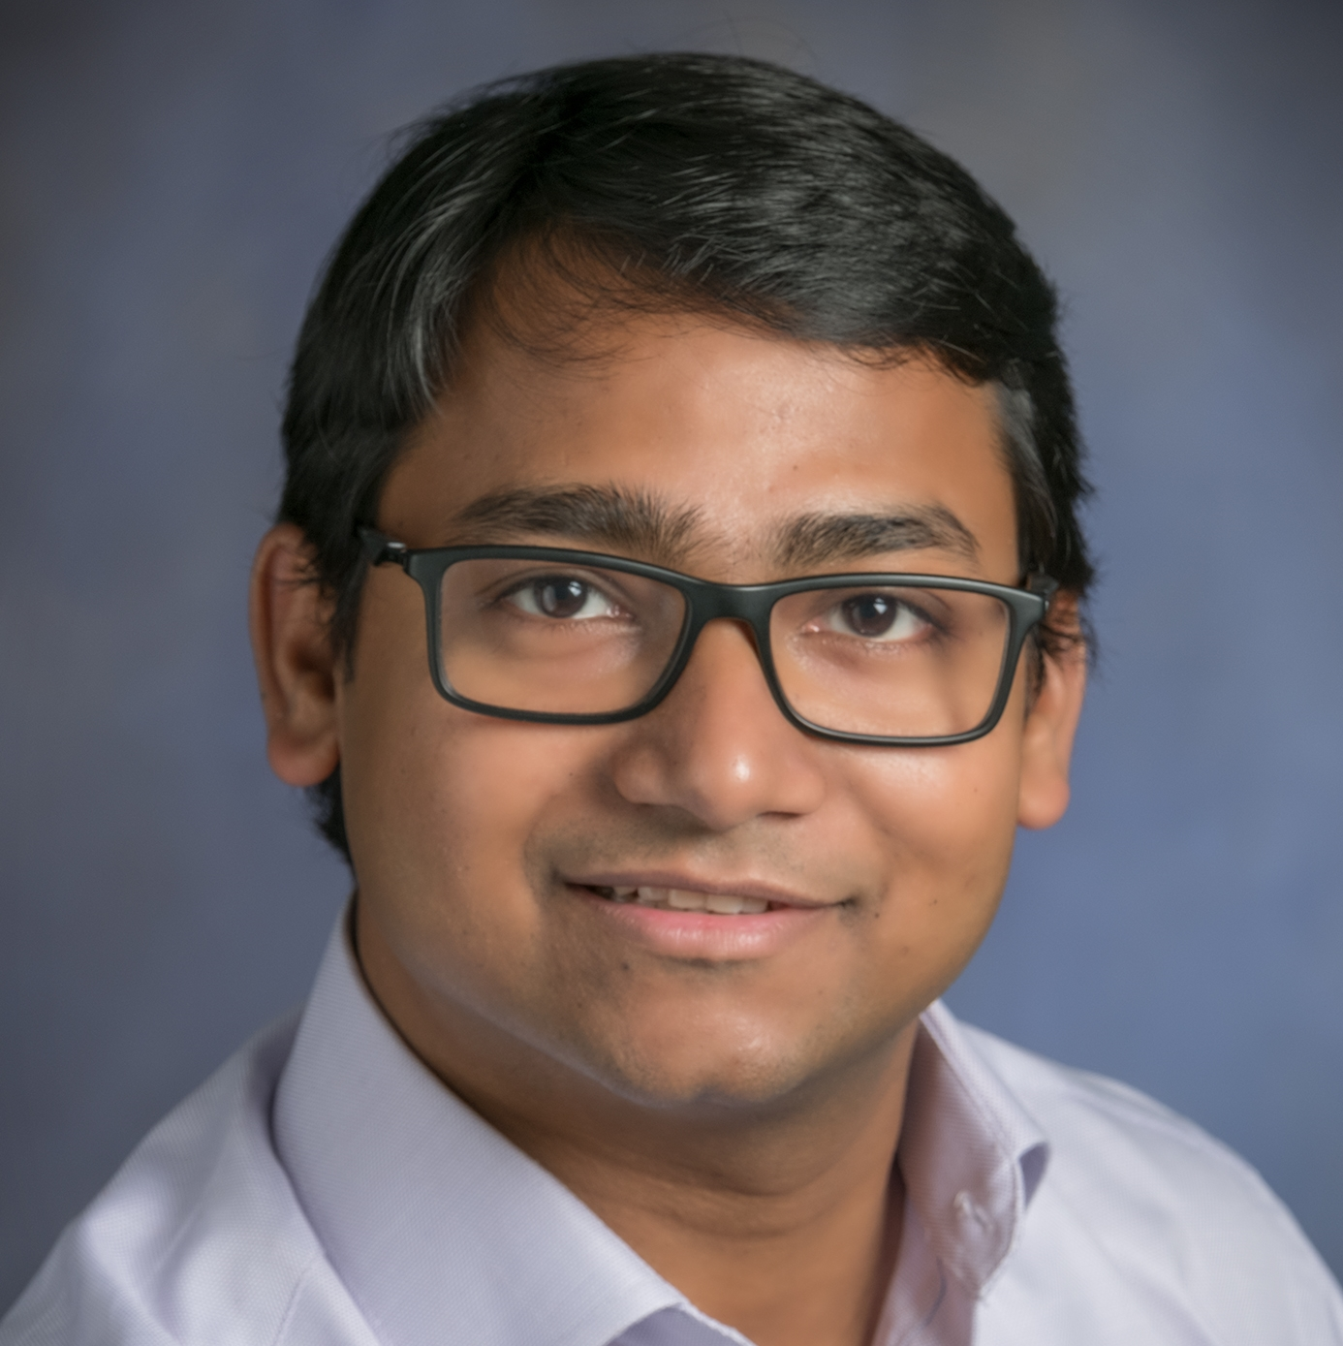
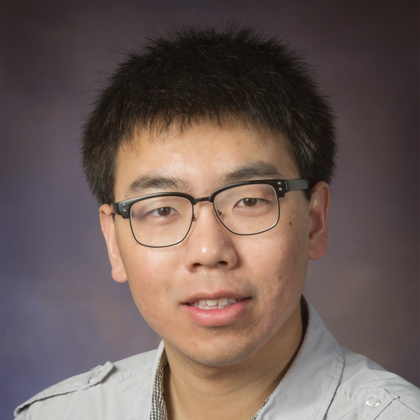
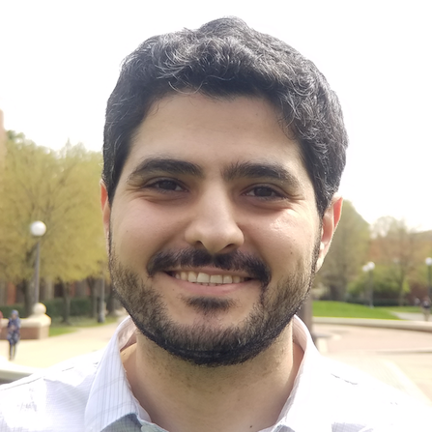
Inaudible Voice Commands: The Long-Range Attack and Defense
(NSDI 2018)
Nirupam Roy
Sheng Shen
Haitham Hassanieh
Romit Roy Choudhury
University of Illinois at Urbana-Champaign

Slide 42
50 million voice assistants are sold in US

Slide 43
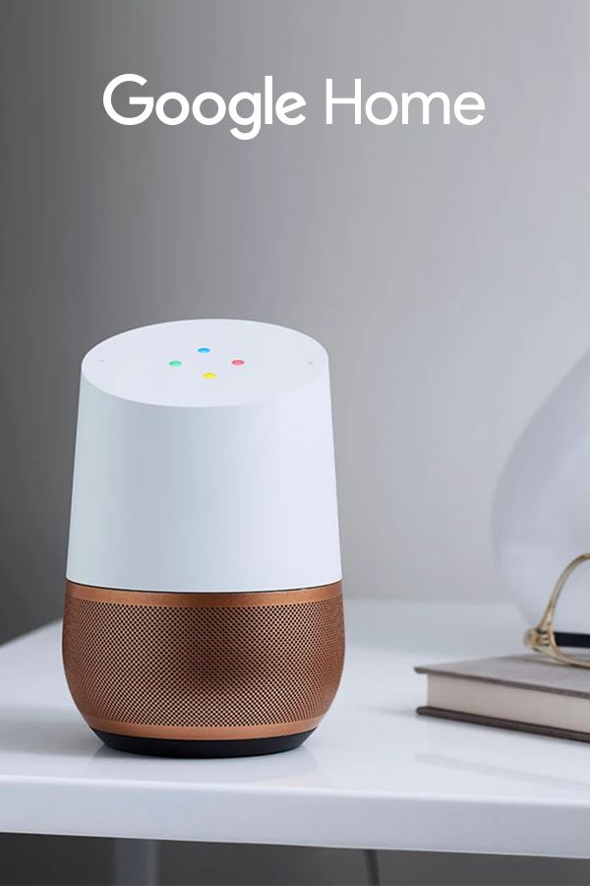
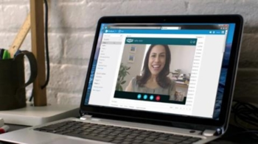
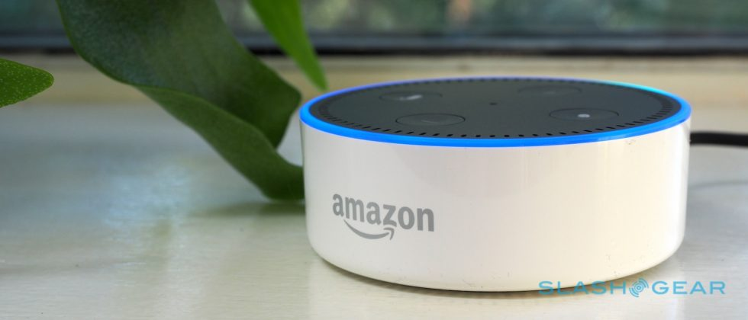
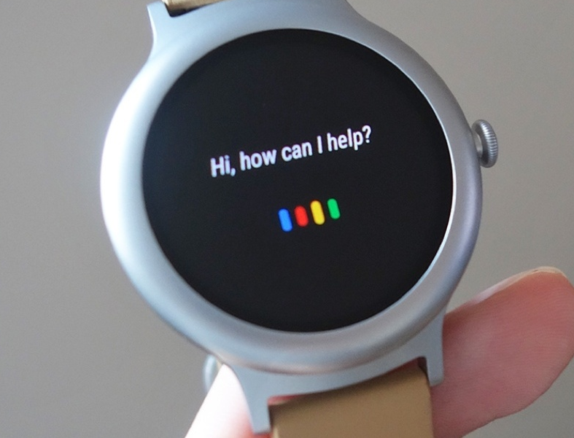
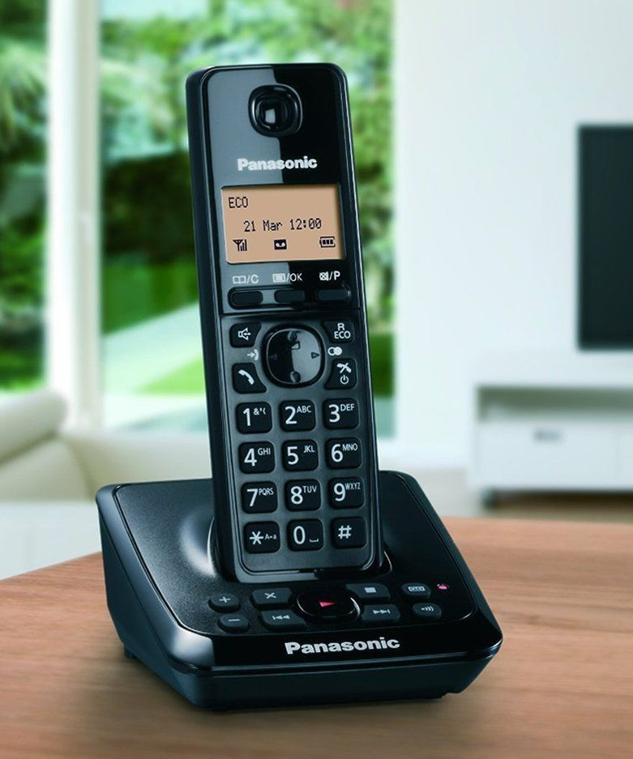
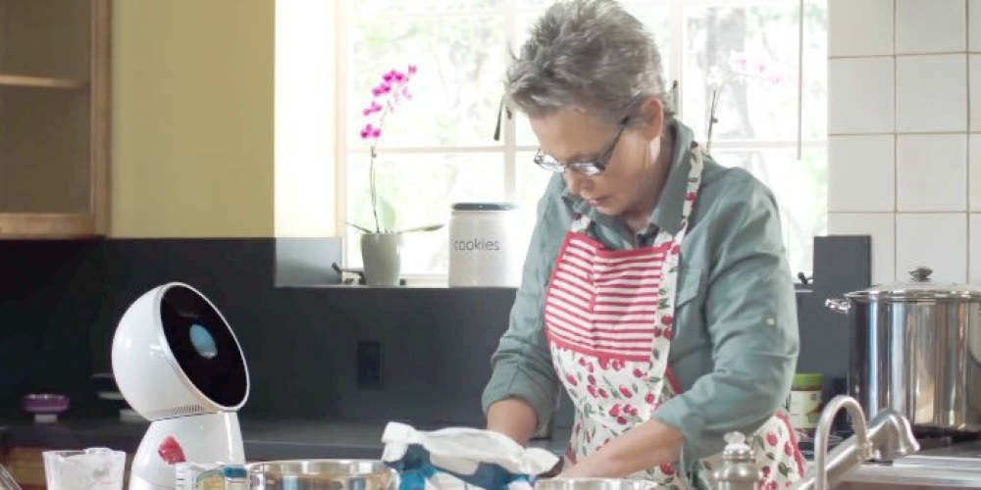
Microphones are everywhere
Notes:
2. We all know that hundreds of devices and applications are designed to record and process audible sounds …

Slide 44
Microphones are everywhere
Notes:
3. and all these systems obviously rely on the microphone embedded in them.

Slide 45
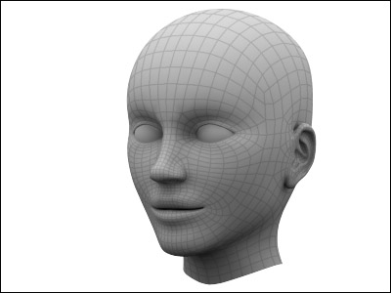
Microphones record audible sounds
I hear that
Audible sound
Speaker
I record that
Notes:
And as we know, microphones are just like human ears … if we play an audible sound … both microphones and humans can hear them ...

Slide 46
Inaudible, but recordable !
Speaker
Notes:
5. In this project … … we design sound…

Slide 47
Inaudible, but recordable !
I can’t hear that
Speaker
I record that
Notes:
that is inaudible to human ears … … but still recordable by microphones …
And to do that we don’t need to change anything in the microphone hardware ...

Slide 48
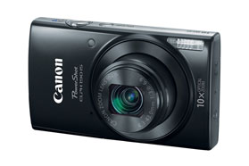
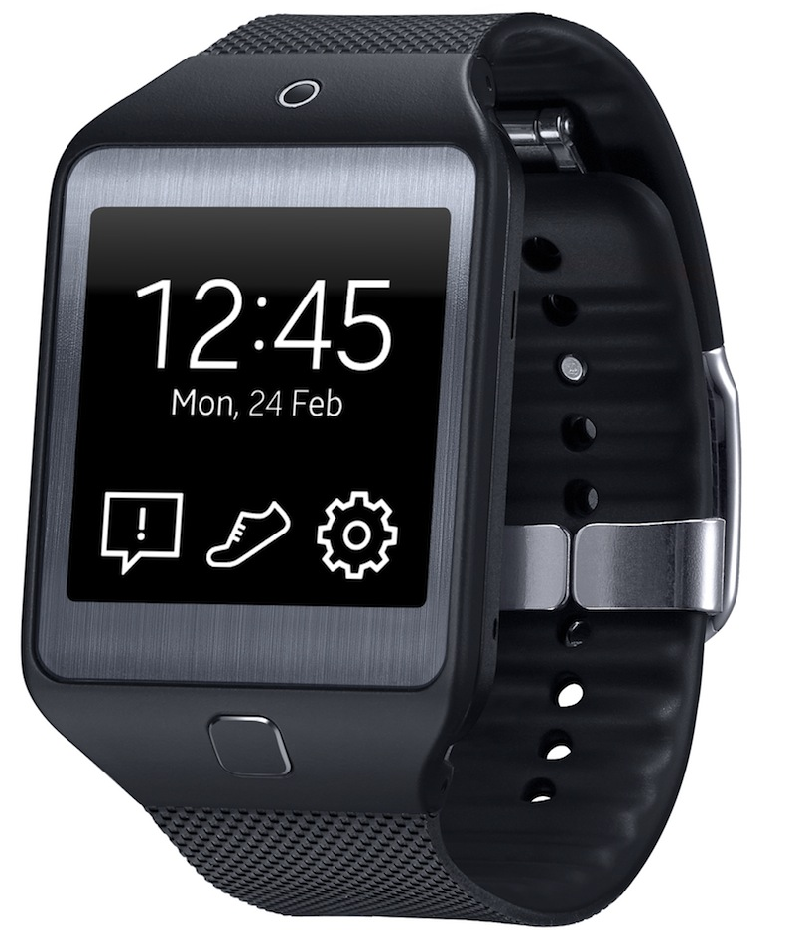
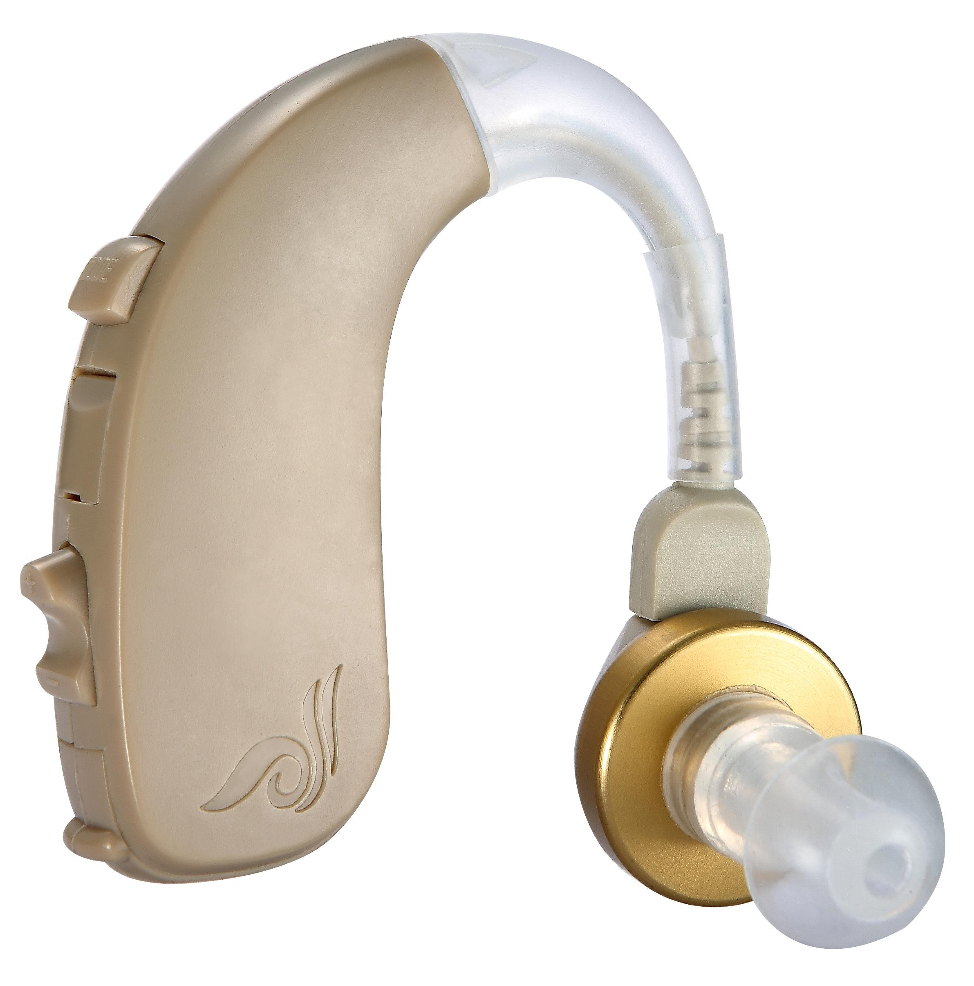
Works with unmodified devices
Camera
Smartwatch
Speaker
Laptop
Hearing Aid
Notes:
… which means our ideas are immediately applicable to all off-the-shelf devices that have microphones in them … … including smartphones, smartwatches, cameras, Amazon Echo, hearing aids, etc.

Slide 49
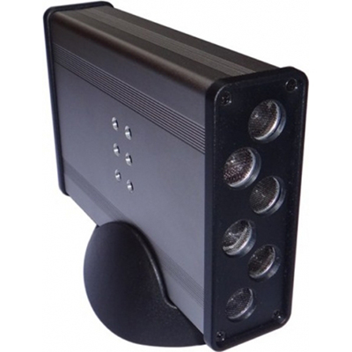
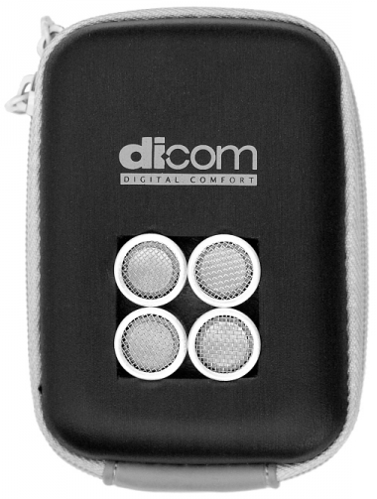
It’s not “near-ultrasound”
Near-ultrasound
Amplitude
10k
20k
30k
40k
50k
Frequency
Pseudo-ranging
SenSys’12
ApneaApp
MobiSys’15
chirp.io
DopLink
UbiComp’13
SoundWave
CHI’12
AAMouse
MobiSys’15
AirLink
UbiComp’14
lisnr.com
Spartacus
MobiSys’13
Crowd-counting
SenSys’12
Notes:
Now when I say this to people, they often think we are using NEAR ultrasound frequencies … which a small frequency band … just ABOVE human hearing range … but WITHIN the microphone’s processing range ...
Actually lot of past work have leveraged this difference to enable creative products and applications …
Our system has NOTHING to do with near ultrasound … …
nor is it about sending very soft sounds that humans cannot hear ...
Instead ... our idea is the following … …

Slide 50
Exploiting fundamental nonlinearity
Amplitude
10k
20k
30k
40k
50k
Frequency
Microphone
hardware
Notes:
We will use loud sounds at HIGH ultrasound frequencies … … WAY ABOVE the human AND microphone hearing range … but design them in a way such that … … when it passes through the microphone hardware, it automatically gets SHIFTED to the recordable range … … … …
In some sense … … the higher frequencies have found a BACKDOOR into the lower frequencies … and hence they become recordable … even if they should not have been …
I will explain the technical details in a few slides … … but before that let’s ask …

Slide 51
What can we do with it?
Notes:
What can we do with this BACKDOOR capability?

