Slide 1
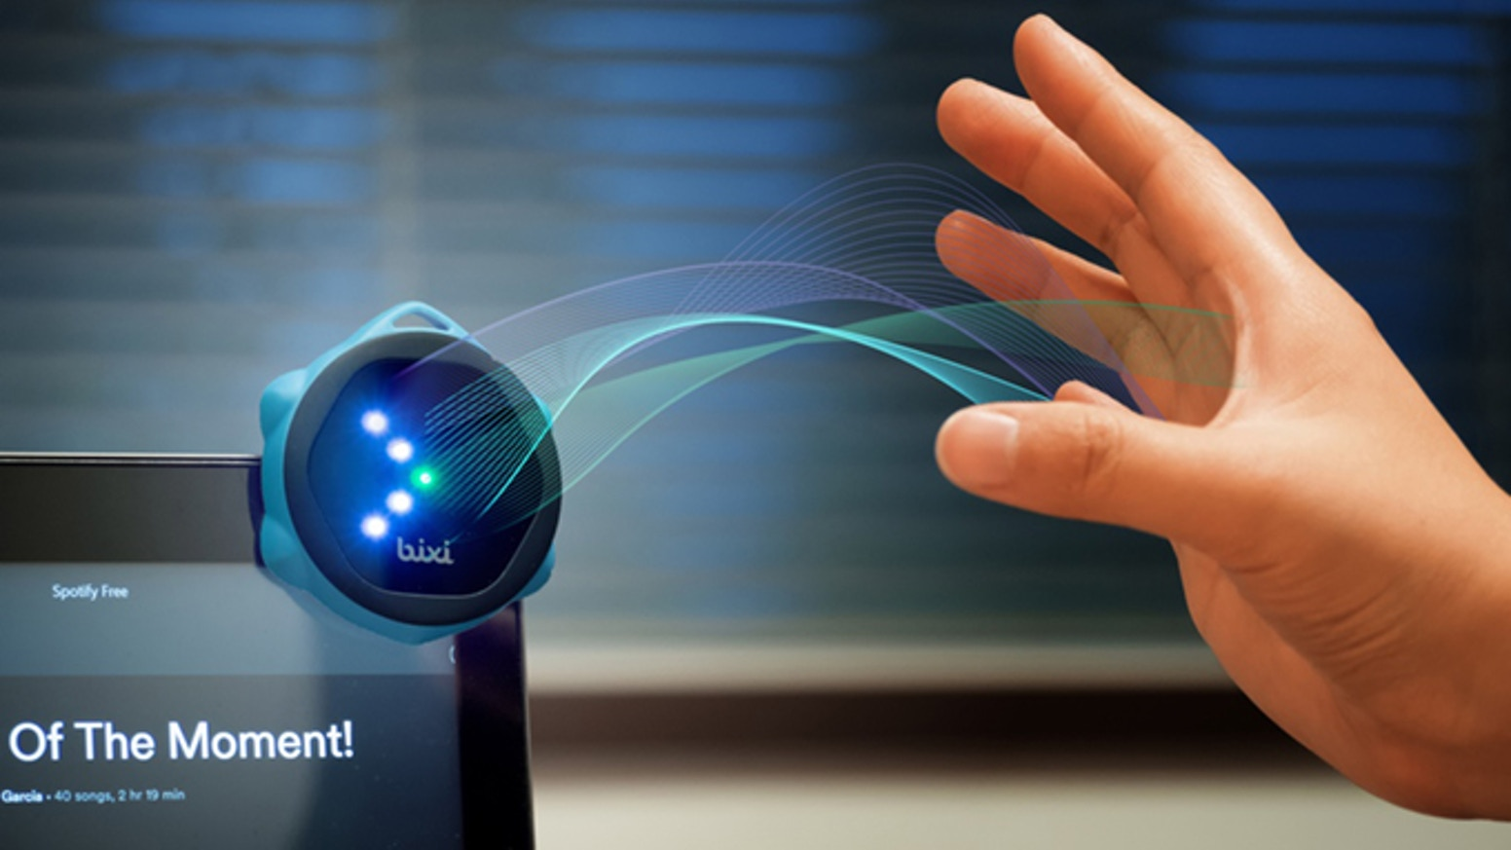
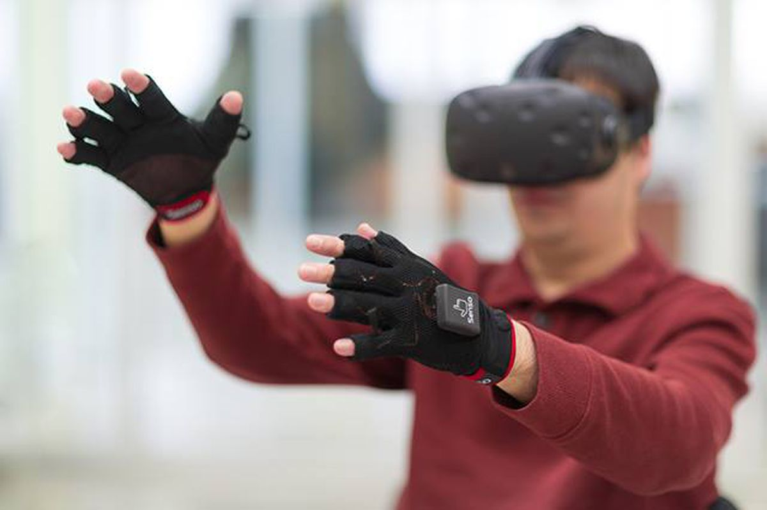
Wireless and Mobile Systems
for the IoT
CMSC 715 : Fall 2024
Lecture 2.1: Waves
Nirupam Roy
Tu-Th 2:00 – 3:15pm
IRB 2207

Slide 2
Waves

Slide 3
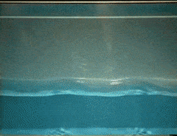
Waves: Transfer of energy, not mass

Slide 4
Sound
Visible light
Physical vibrations
WiFi signal
Ripples in water
Infrared
…
…

Slide 5
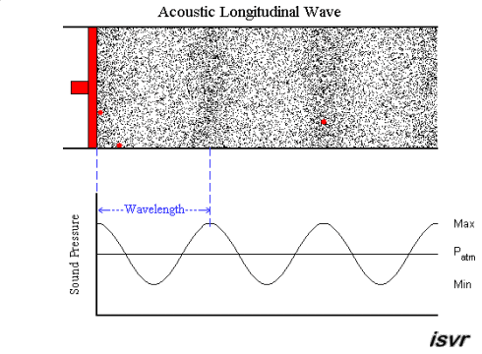
Mechanical Wave
Electromagnetic Wave
Sound
Visible light
Physical vibrations
WiFi signal
Ripples in water
Infrared
…
…

Slide 8
Waves made this possible

Slide 9
Waves made this possible

Slide 10
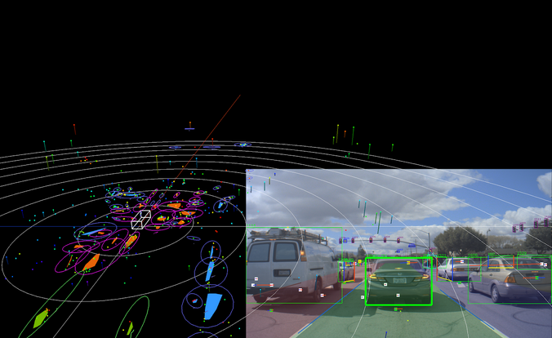
Waves made this possible

Slide 11
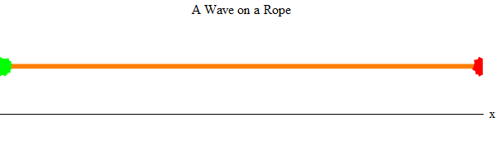
Waves properties:
frequency, amplitude, phase + speed

Slide 12
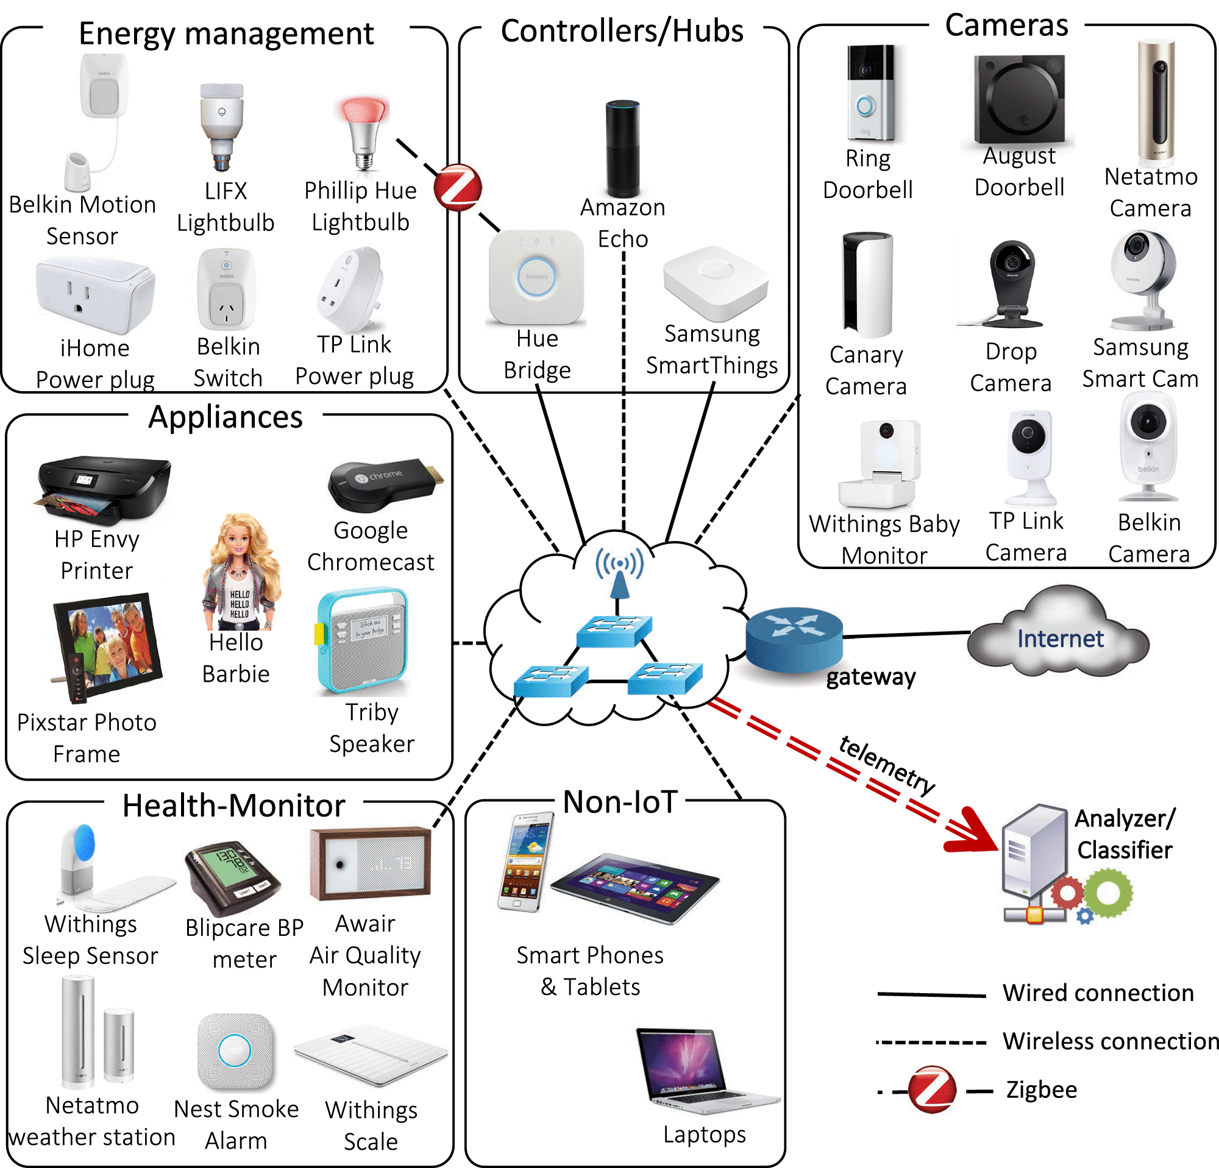
Waves made this possible

Slide 13
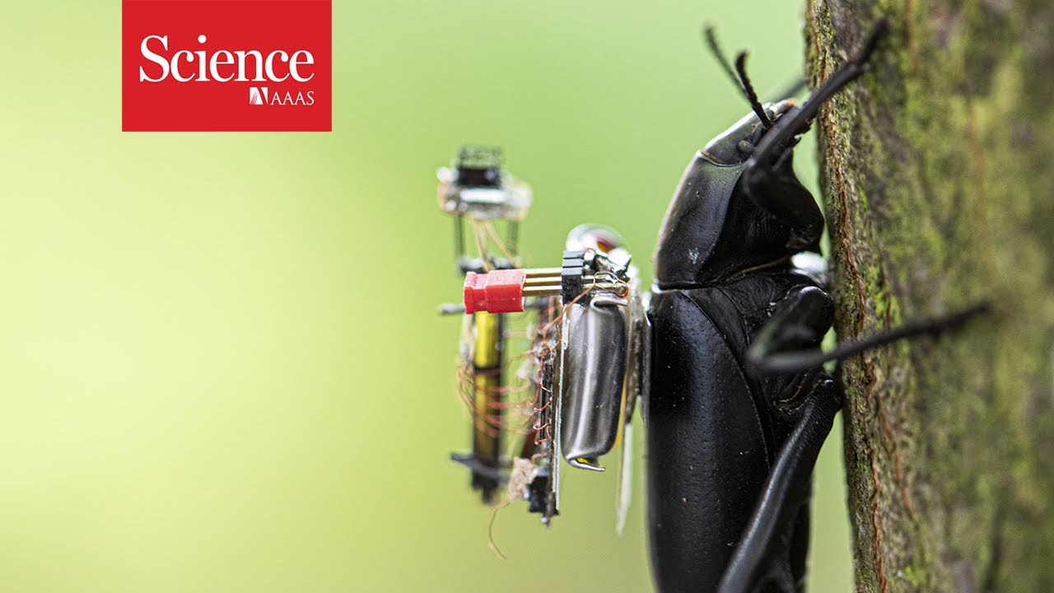
Waves made this possible

Slide 14
Waves in time and space

Slide 15
Waves in time and space
Temporal variation of the wave’s amplitude

Slide 16
Waves in time and space

Slide 17
Waves in time and space

Slide 18
Waves in time and space

Slide 19
Waves in time and space

Slide 20
Waves in time and space

Slide 21
Waves in time and space

Slide 22
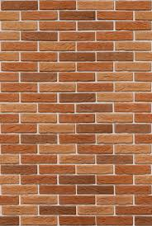
Reflection
Absorption
+
Reflection
echo

Slide 23
Reflection
Time = t1

Slide 24
Reflection
Time = t1
Absorption
+
Reflection

Slide 25
Reflection
Time = t1
Absorption
+
Reflection
echo
t2

Slide 26
Reflection
Time = t1
Absorption
+
Reflection
d
echo
t2
Sound travelled (2d) distance

Slide 27
The speed of the wave is known

Slide 28
Reflection
Time = t1
Absorption
+
Reflection
d
echo
t2
Sound travelled (2d) distance
C.(t2-t1) = 2d

Slide 29
Reflection
Time = t1
Absorption
+
Reflection
d
Echolocation
echo
t2
Sound travelled (2d) distance
C.(t2-t1) = 2d

Slide 30
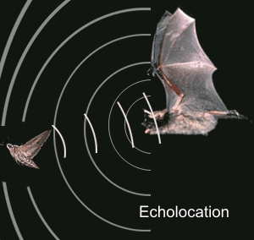
Echolocation in nature
Bat

Slide 31
Distance from the speed information
Round-trip Time of Flight (RToF)
Signal source
+ observer
Reflector

Slide 32
Distance from the speed information
Dist. = (speed) X (time of travel)
Time of Arrival (ToA)
Signal source
observer
Round-trip Time of Flight (RToF)
Signal source
+ observer
Reflector

Slide 33
Distance from the speed information
Dist. = (speed) X (time of travel)
Time of Arrival (ToA)
Signal source
observer
Signal source
Time Difference of Arrival (TDoA)
observer 1
observer2
Round-trip Time of Flight (RToF)
Signal source
+ observer
Reflector

Slide 34
Distance from the speed information
Dist. = (speed) X (time of travel)
Time of Arrival (ToA)
Signal source
observer
How to detect the signal at the receiver/observer?
Signal source
Time Difference of Arrival (TDoA)
observer 1
observer2
Round-trip Time of Flight (RToF)
Signal source
+ observer
Reflector

Slide 35
Signal detection
Amplitude
Time/Sample
Transmitter signal

Slide 36
Signal detection
Amplitude
Amplitude
Time/Sample
Time/Sample
Transmitter signal
Receiver signal

Slide 37
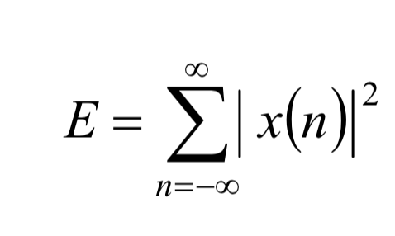
Signal detection
Amplitude
Amplitude
Time/Sample
Time/Sample
Transmitter signal
Receiver signal
Energy based signal detector
Energy of a discrete signal x(n),

Slide 38
Signal to Noise ratio (SNR)
Noise
Amplitude
Amplitude
Time/Sample
Time/Sample
Transmitter signal
Receiver signal

Slide 39
Signal to Noise ratio (SNR)
Noise
Amplitude
Amplitude
Time/Sample
Time/Sample
Transmitter signal
Receiver signal
Detection accuracy will depend on the
Signal’s strength compared to Noise’s strength.

Slide 40
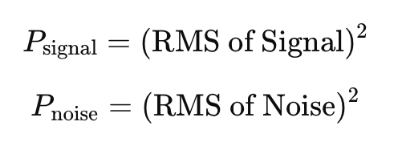
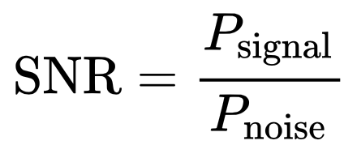
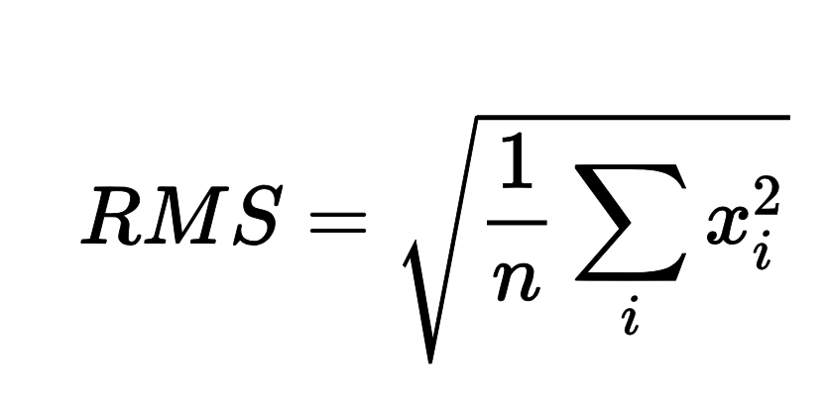
Signal to Noise ratio (SNR)
Amplitude
Amplitude
Time/Sample
Time/Sample
Transmitter signal
Receiver signal
Signal-to-Noise Ratio (SNR)

Slide 41
Signal to Noise ratio (SNR)
Amplitude
Amplitude
Time/Sample
Time/Sample
Transmitter signal
Receiver signal
Signal-to-Noise Ratio (SNR)

Slide 42
Signal detection
Amplitude
Amplitude
Time/Sample
Time/Sample
Transmitter signal
Receiver signal

Slide 43
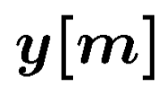
Signal detection
Received signal
Signal matching
Transmit signal template

Slide 44
Signal detection
Received signal
Signal matching
Transmit signal template
Correlation

Slide 45
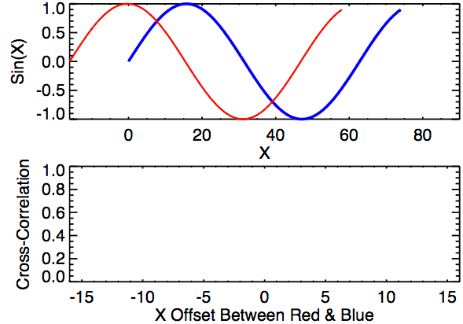
Signal detection
Correlation

Slide 47
Correlation for signal detection.
Matched filtering
Connection with this with traditional radar.
Popular methods for radars for automotive applications

Slide 48
Signal Detection and Ranging: RADAR & SONAR
Automotive Radar

Slide 50
Sensing Signal in Time & Space

Slide 51
Equation of waves in time and space

Slide 52
Equation of waves in time and space

Slide 53
Equation of waves in time and space

Slide 54
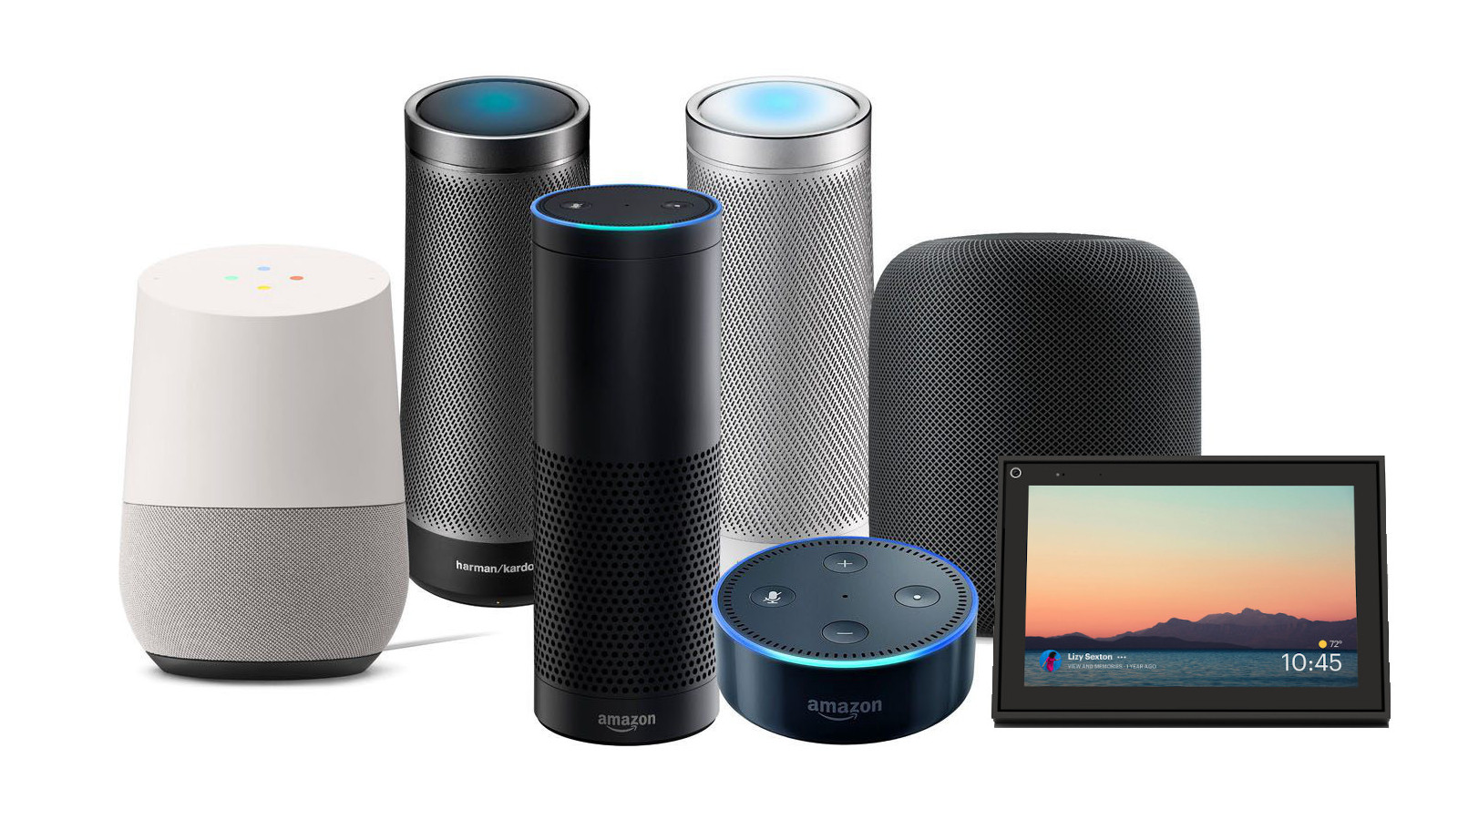

Slide 55
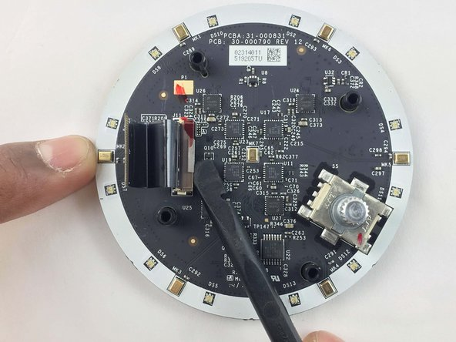
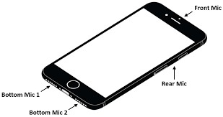
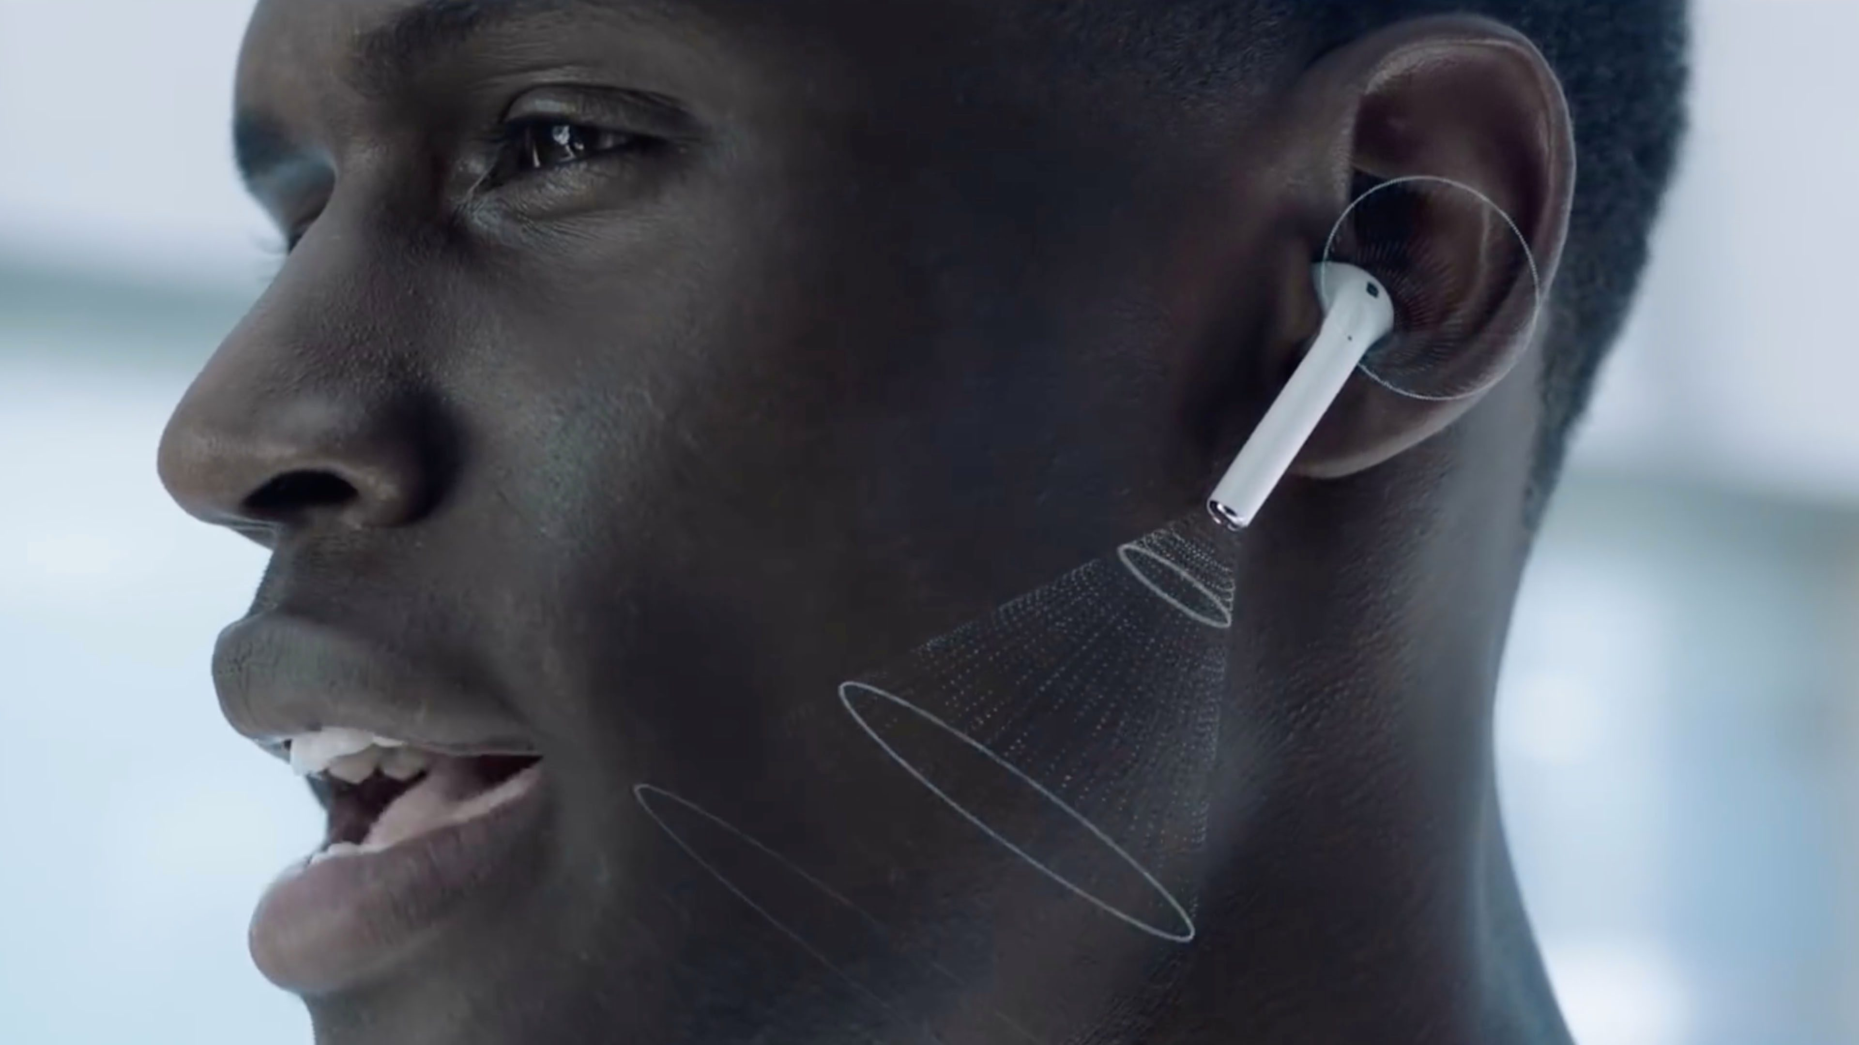

Slide 56
Alexa!

Slide 57
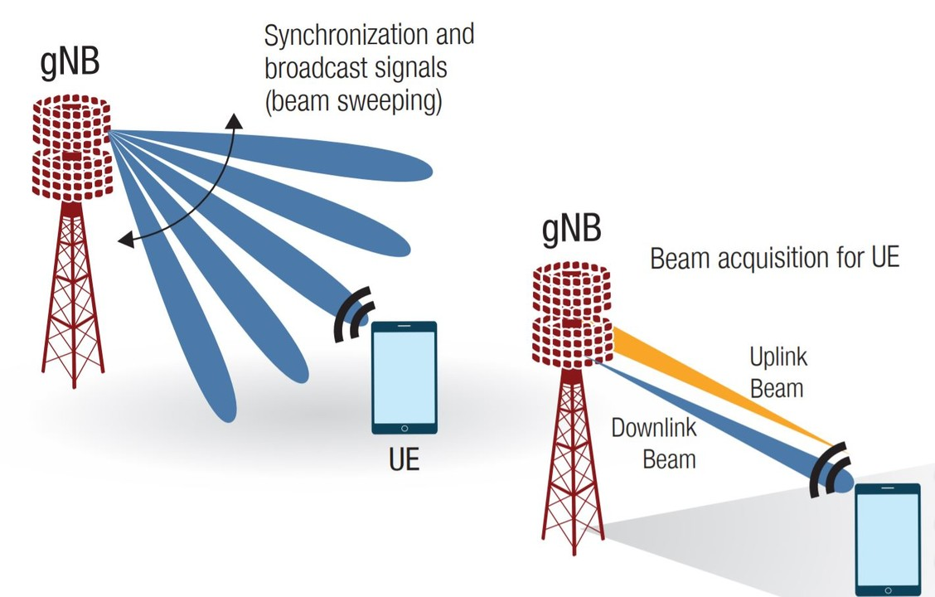
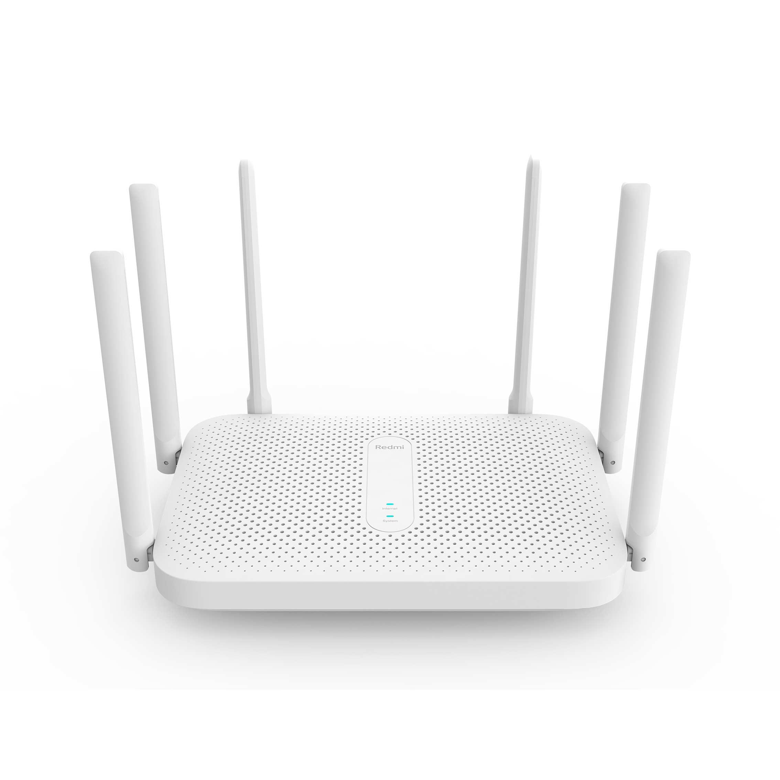

Slide 58
Equation of waves in time and space

Slide 59
Equation of waves in time and space
$$distance from the source (x)$$
$$space$$

Slide 60
Equation of waves in time and space
Amplitude here
$$distance from the source (x)$$
$$space$$
is a delayed version of
the amplitude here.

Slide 61
Equation of waves in time and space
Amplitude here
$$distance from the source (x)$$
$$space$$
is a delayed version of
the amplitude here.

Slide 62
Equation of waves in time and space
Amplitude here
The delay depends
on the distance.
$$distance from the source (x)$$
$$space$$
is a delayed version of
the amplitude here.

Slide 63
Equation of waves in time and space
Amplitude here
The delay depends
on the distance.
$$distance from the source (x)$$
$$space$$
is a delayed version of
the amplitude here.
$$A . sin⁡(\frac{2π}{T}t)$$
$Ψ$(t)
$$=$$
$$A . sin⁡(2πft)$$
$$=$$

Slide 64
Equation of waves in time and space
Amplitude here
The delay depends
on the distance.
$$distance from the source (x)$$
$$space$$
is a delayed version of
the amplitude here.
$Ψ$(t, x)
$$=$$
$$A . sin⁡(2πft−θ(x))$$
Why is this negative?

Slide 65
Equation of waves in time and space
$wavelength$ = λ
$$distance from the source (x)$$
$$space$$
$Ψ$(t, x)
$$=$$
$$A . sin⁡(2πft−θ(x))$$

Slide 66
Equation of waves in time and space
$wavelength$ = λ
$$f number of cycles per second$$
$$C meters of distance per second$$
$$(speed of the wave)$$
$distance per cycle=\text{λ}$ = $C$/ $f$

Slide 67
Equation of waves in time and space
$wavelength$ = λ
$$distance from the source (x)$$
$$space$$
$Ψ$(t, x)
$$=$$
$$A . sin⁡(2πft−θ(x))$$

Slide 68
Equation of waves in time and space
$wavelength$ = λ
$$f number of cycles per second$$
$$C meters of distance per second$$
$$(speed of the wave)$$
$distance per cycle=\text{λ}$ = $C$/ $f$

Slide 69
Equation of waves in time and space
$wavelength$ = λ
$$f number of cycles per second$$
$$C meters of distance per second$$
$$(speed of the wave)$$
$distance per cycle=\text{λ}$ = $C$/ $f$
$$2π radians of angle is covered per cycle$$

Slide 70
$wavelength$ = λ
Equation of waves in time and space
$$f number of cycles per second$$
$$C meters of distance per second$$
$$(speed of the wave)$$
$distance per cycle=\text{λ}$ = $C$/ $f$
$$2π radians of angle is covered per cycle$$
$$\frac{2π}{\text{λ}}radians of angle is covered per unit distance$$

Slide 71
Equation of waves in time and space
$wavelength$ = λ
$$distance from the source (x)$$
$$space$$
$Ψ$(t, x)
$$=$$
$$A . sin⁡(2πft−θ(x))$$

Slide 72
Equation of waves in time and space
$wavelength$ = λ
$$distance from the source (x)$$
$$space$$
$Ψ$(t, x)
$$=$$
$$A . sin⁡(2πft−θ(x))$$
$$A . sin⁡(2πft−\frac{2π}{\text{λ}}x)$$
$$=$$

Slide 73
Equation of waves in time and space
$wavelength$ = λ
$$distance from the source (x)$$
$$space$$
$Ψ$(t, x)
$$=$$
$$A . sin⁡(2πft−θ(x))$$
$$A . sin⁡(2πft−\frac{2π}{\text{λ}}x)$$
$$=$$
$$⁡j(2πft−\frac{2π}{\text{λ}}x)$$
$$A . e$$
$$=$$

Slide 74
Time and space
Cycles per sec = frequency = f Hz
Distance per cycle = wavelength = λ meters
Distance per second = speed = C meters/sec
C = f . λ
Speed of sound in air: 343 m/s
Speed of sound in water: 1493 m/s
Speed of sound in iron: 5130 m/s
Speed of electromagnetic waves: 3*10⁸ m/s
(~ a million times faster than sound)

Slide 75
Time and space
$$A . sin⁡(2πft)$$

Slide 76
Time and space
$$⁡j(2πft)$$
$$A . e$$

Slide 77
Time and space
Distance = d meter
$$⁡j(2πft)$$
$$A . e$$

Slide 78
Time and space
$$⁡j(2πft−\frac{2π}{\text{λ}}d)$$
$$A . e$$
Distance = d meter
$$⁡j(2πft)$$
$$A . e$$

Slide 79
Time and space
$$⁡j(2πft−\frac{2π}{\text{λ}}d)$$
$$A . e$$
d meter
$$⁡j(2πft−\frac{2π}{\text{λ}}d)$$
$$A . e$$
Distance = d meter
$$⁡j(2πft)$$
$$A . e$$

Slide 80
Time and space
$$⁡j(2πft−\frac{2π}{\text{λ}}d)$$
$$A . e$$
d meter
$$⁡j(2πft−\frac{2π}{\text{λ}}d)$$
$$A . e$$
Distance = d meter
$$⁡j(2πft)$$
$$A . e$$

Slide 81
Time and space
$$⁡j(2πft)$$
$$A . e$$

Slide 82
Time and space
X meters
$$⁡j(2πft)$$
$$A . e$$

Slide 83
Time and space
X meters
$$⁡j(2πft)$$
$$Θ$$
$$A . e$$

Slide 84
Time and space
X.sin($Θ$)
X meters
$$⁡j(2πft)$$
$$Θ$$
$$A . e$$

Slide 85
Time and space
d = X.sin($Θ$)
X meters
$$⁡j(2πft)$$
$$Θ$$
$$A . e$$

Slide 86
Time and space
d = X.sin($Θ$)
X meters
$$⁡j(2πft)$$
$$Θ$$
$$A . e$$
Did you notice a small error?

Slide 87
Time and space
d = X.sin($Θ$)
X
X meters
$$⁡j(2πft)$$
$$Θ$$
$$A . e$$

Slide 88
Time and space
d = X.sin($Θ$)
X meters
$$⁡j(2πft)$$
$$Θ$$
$$A . e$$
Far-field approximation, Planar wave

