Slide 1


RF-IDraw: Virtual Touch Screen in the Air
Deepak Vasisht
Jue Wang, Dina Katabi

Slide 2

How Do We Get Virtual Touch Screens?

Slide 3
How Do We Get Virtual Touch Screens?
Use RF-localization to track the RFIDs
But … accuracy is not enough …

Slide 4
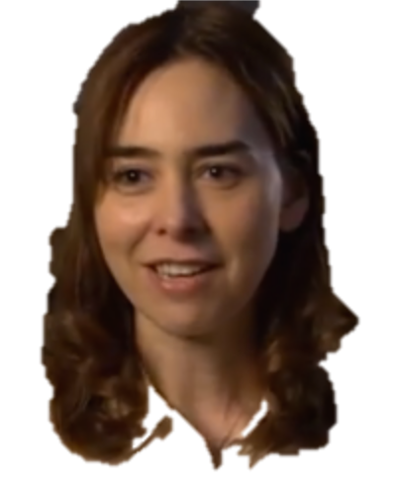
How Do We Get Virtual Touch Screens?

Slide 5
Localization with Antenna Arrays
_{Wireless}
_{Source}
Antenna Array Receiver

Slide 6

Localization with Antenna Arrays
Array’s beam points to source
Antenna Array Receiver

Slide 7

Localization with Antenna Arrays
çç

Slide 8

Localization with Antenna Arrays
Location Uncertainty

Slide 9
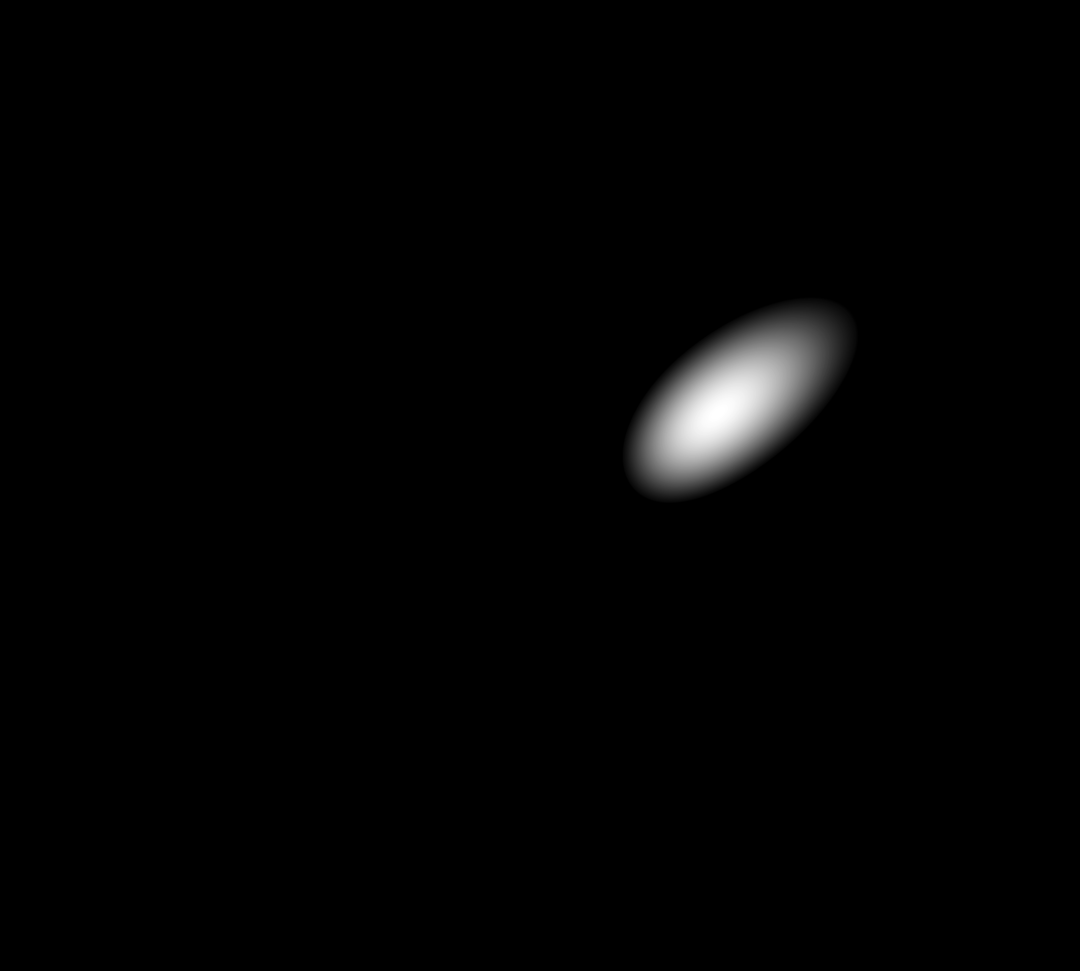
Localization with Antenna Arrays
More Antennas
→ Less uncertainty

Slide 10
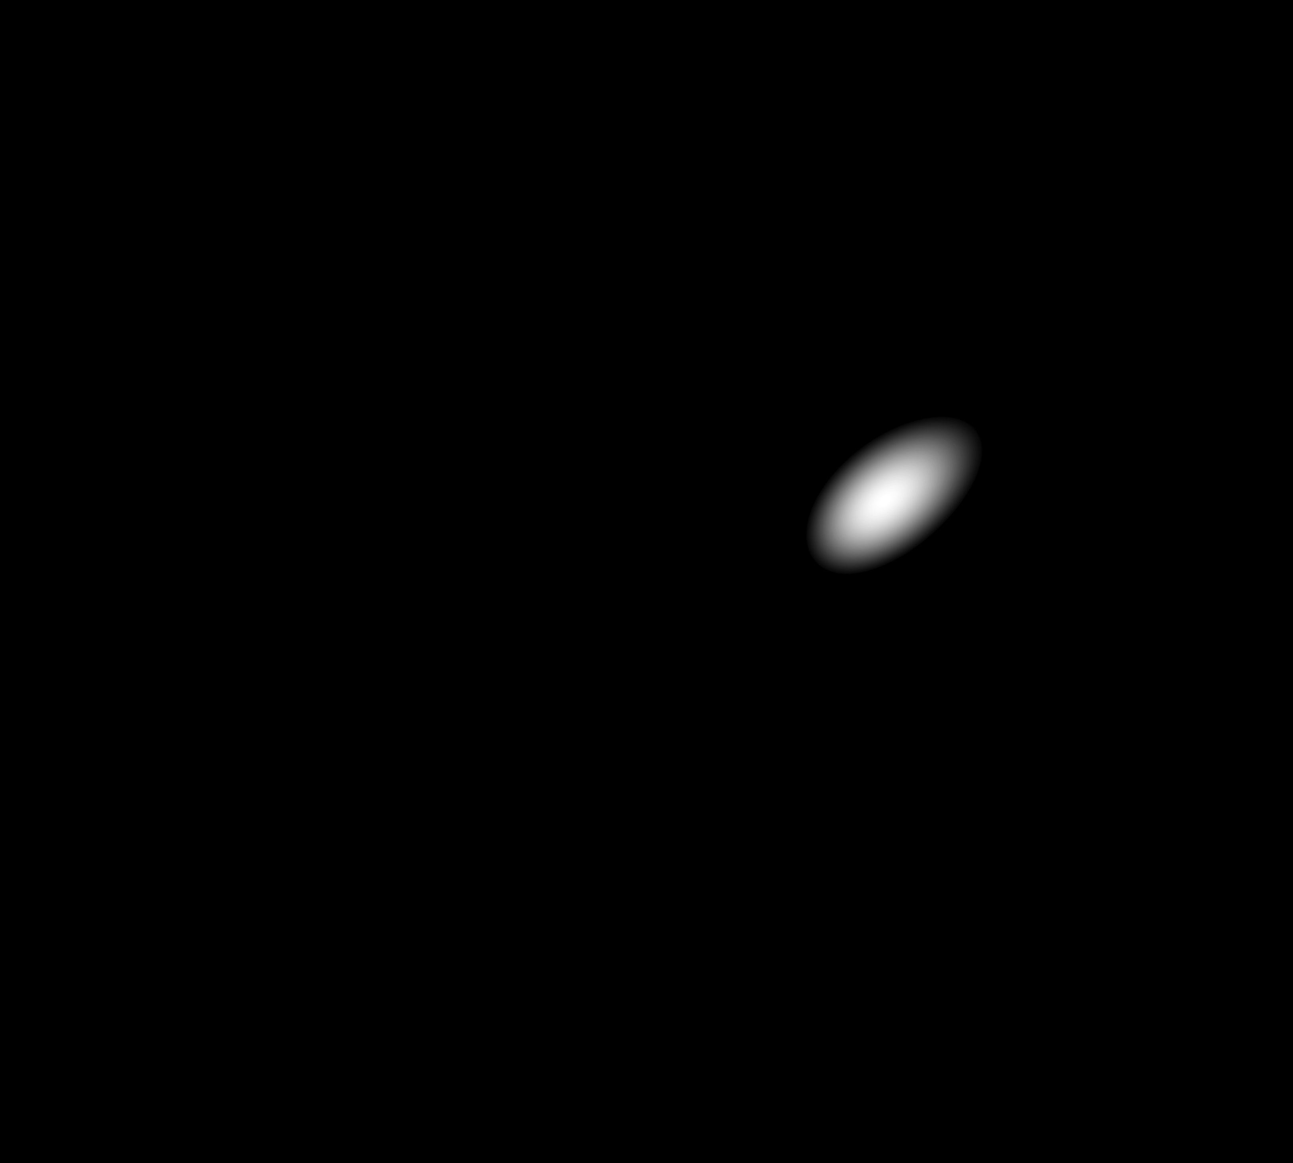
Localization with Antenna Arrays

Slide 11

Localization with Antenna Arrays
Not practical!

Slide 12
RF-IDraw
Enables virtual touch screens in the air
Motion tracking to within 3.7cm
Rich interface that recognizes words written in the air
Works with standard RFIDs and RFID readers

Slide 13
How Does it Work?

Slide 14
Ambiguity-Resolution Tradeoff

Slide 15

Ambiguity-Resolution Tradeoff
Antenna spacing is λ/2,
λ is the wavelength

Slide 16

Ambiguity-Resolution Tradeoff
Ambiguity
Higher resolution
Spacing is λ

Slide 17

Ambiguity-Resolution Tradeoff
8 λ

Slide 18
Ambiguity-Resolution Tradeoff
High resolution
Low resolution
Ambiguity in position
No ambiguity

Slide 19

RF-IDraw: Multi-Resolution Array
Narrowly spaced and widely spaced antennas create an overlay of multi-resolution beams.
Use fewer antennas, but place them smartly
8 λ
λ/2

Slide 20

Localization

Slide 21

Localization
Are we done?

Slide 22
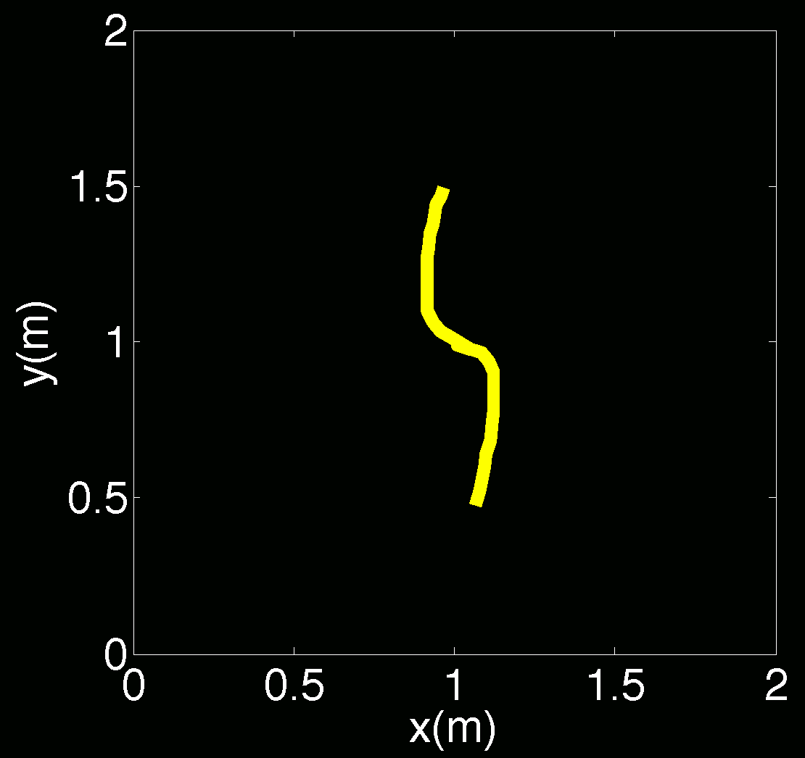
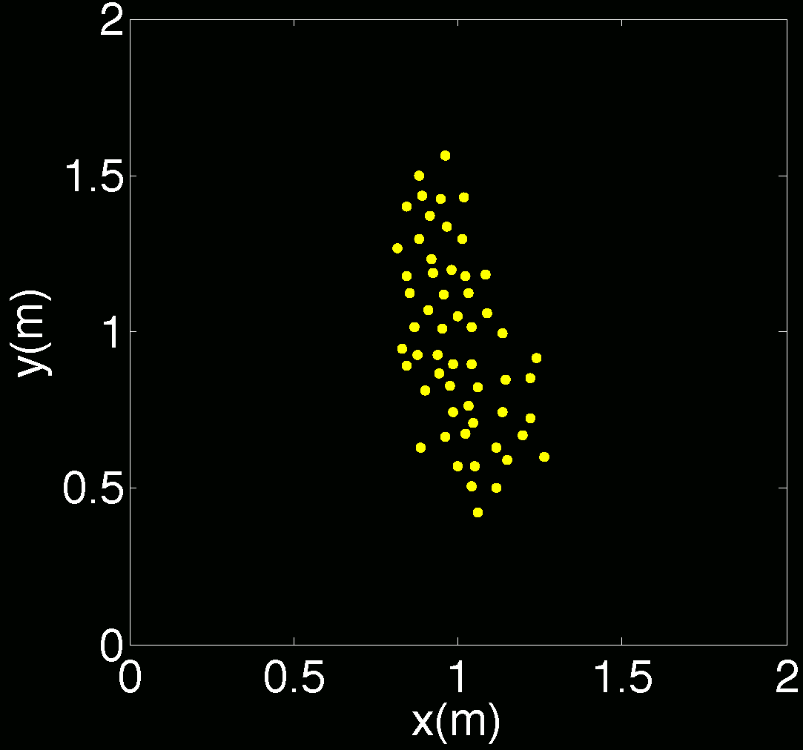
Let’s Try
Accuracy ~ 15cm
Errors are random and don’t preserve the shape of the trajectory.

Slide 23

Noiseless Scenario

Slide 24
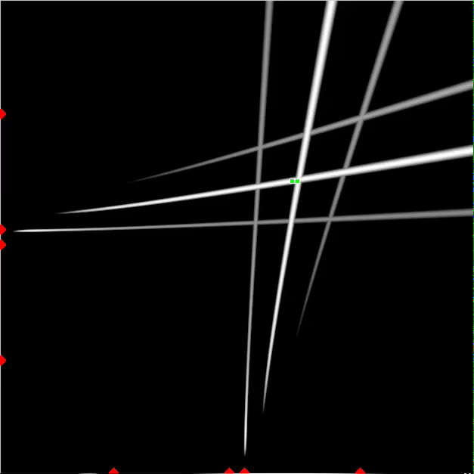
Noiseless Scenario

Slide 25
Noiseless Scenario

Slide 26

Impact of Noise
Mistaken location
Incorrect beams

Slide 27
Impact of Noise
Want errors to be systematic –i.e., they may move the trajectory but preserve its shape

Slide 28
Idea: Stick with your choices

Slide 29
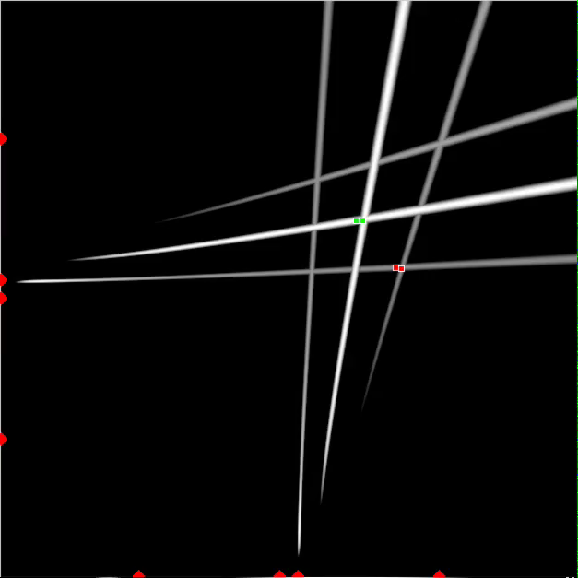
Idea: Stick with your choices
Mistaken location
Incorrect beams
Sticking with a beam, even if it is not in the exact location, causes systematic errors

Slide 30
Performance Results

Slide 31
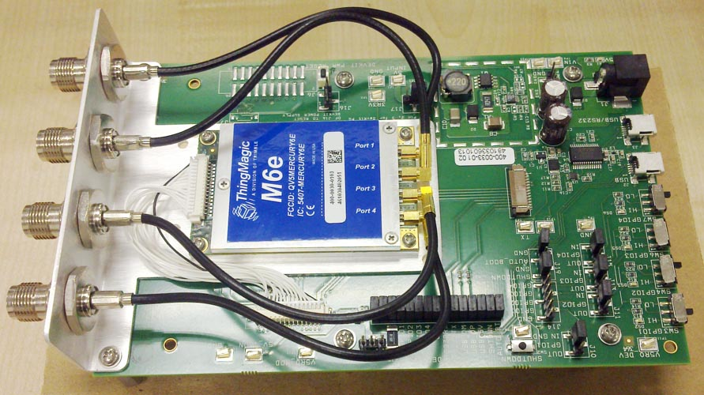
Implementation
ThingMagic RFID Readers
  Reader has 4 antennas
  Used two readers
Alien Squiggle RFID Tags
Baseline: 2 Antenna arrays with 4 antennas each

Slide 32
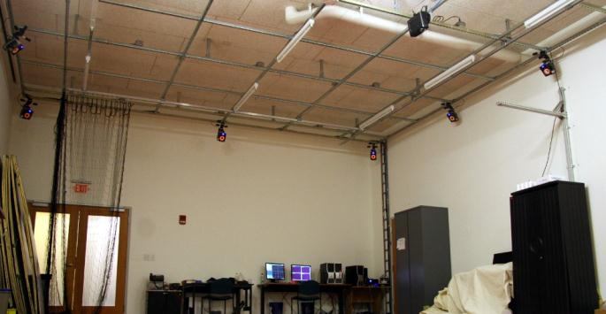
Setup
Ground Truth: VICON motion capture system
Notes:
Of course, we need a ground truth for the location of the source. For that we use the Vicon motion capture system. It is half a million dollar system of infra-red camera mounted on a celing. The good thing, however, about this system is that it can track motion to few milimeters.
Animate for distance

Slide 33
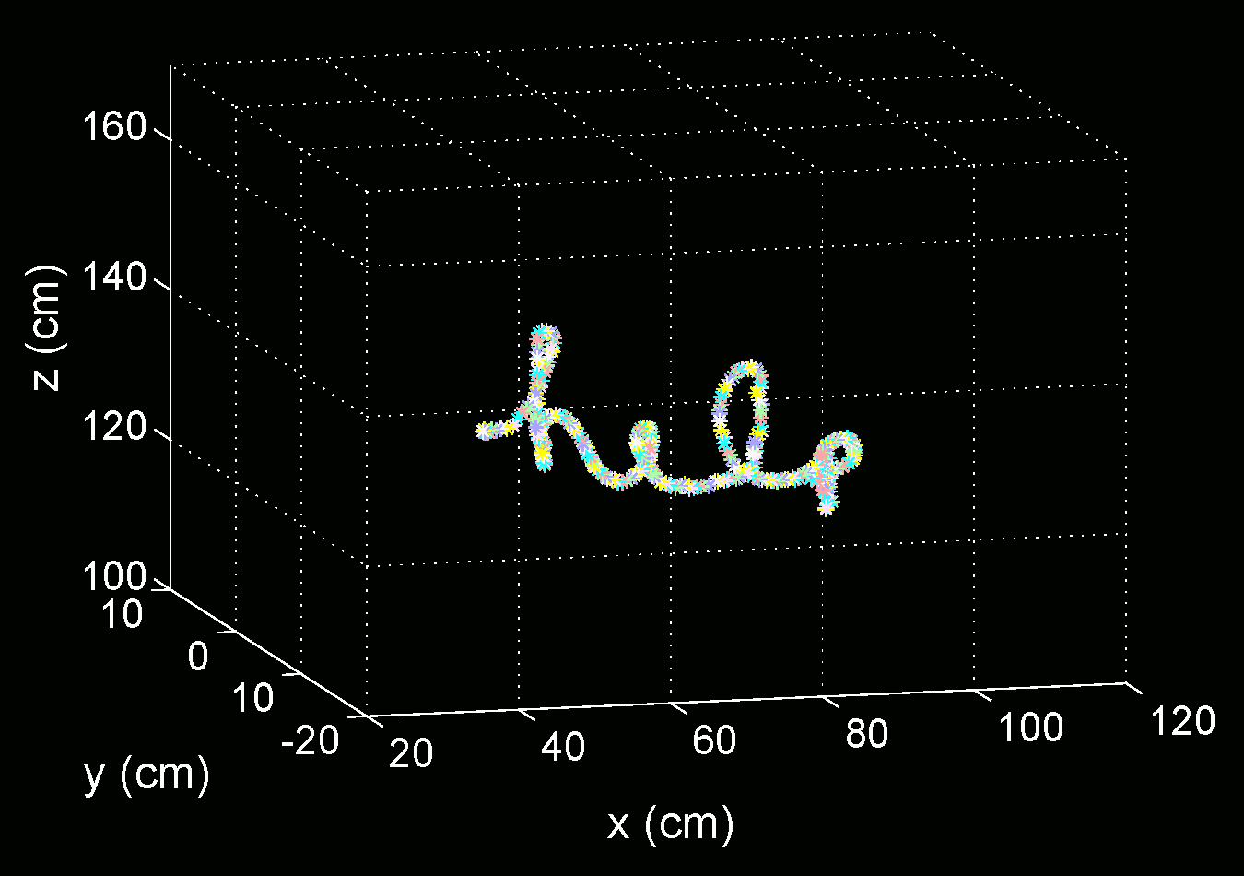
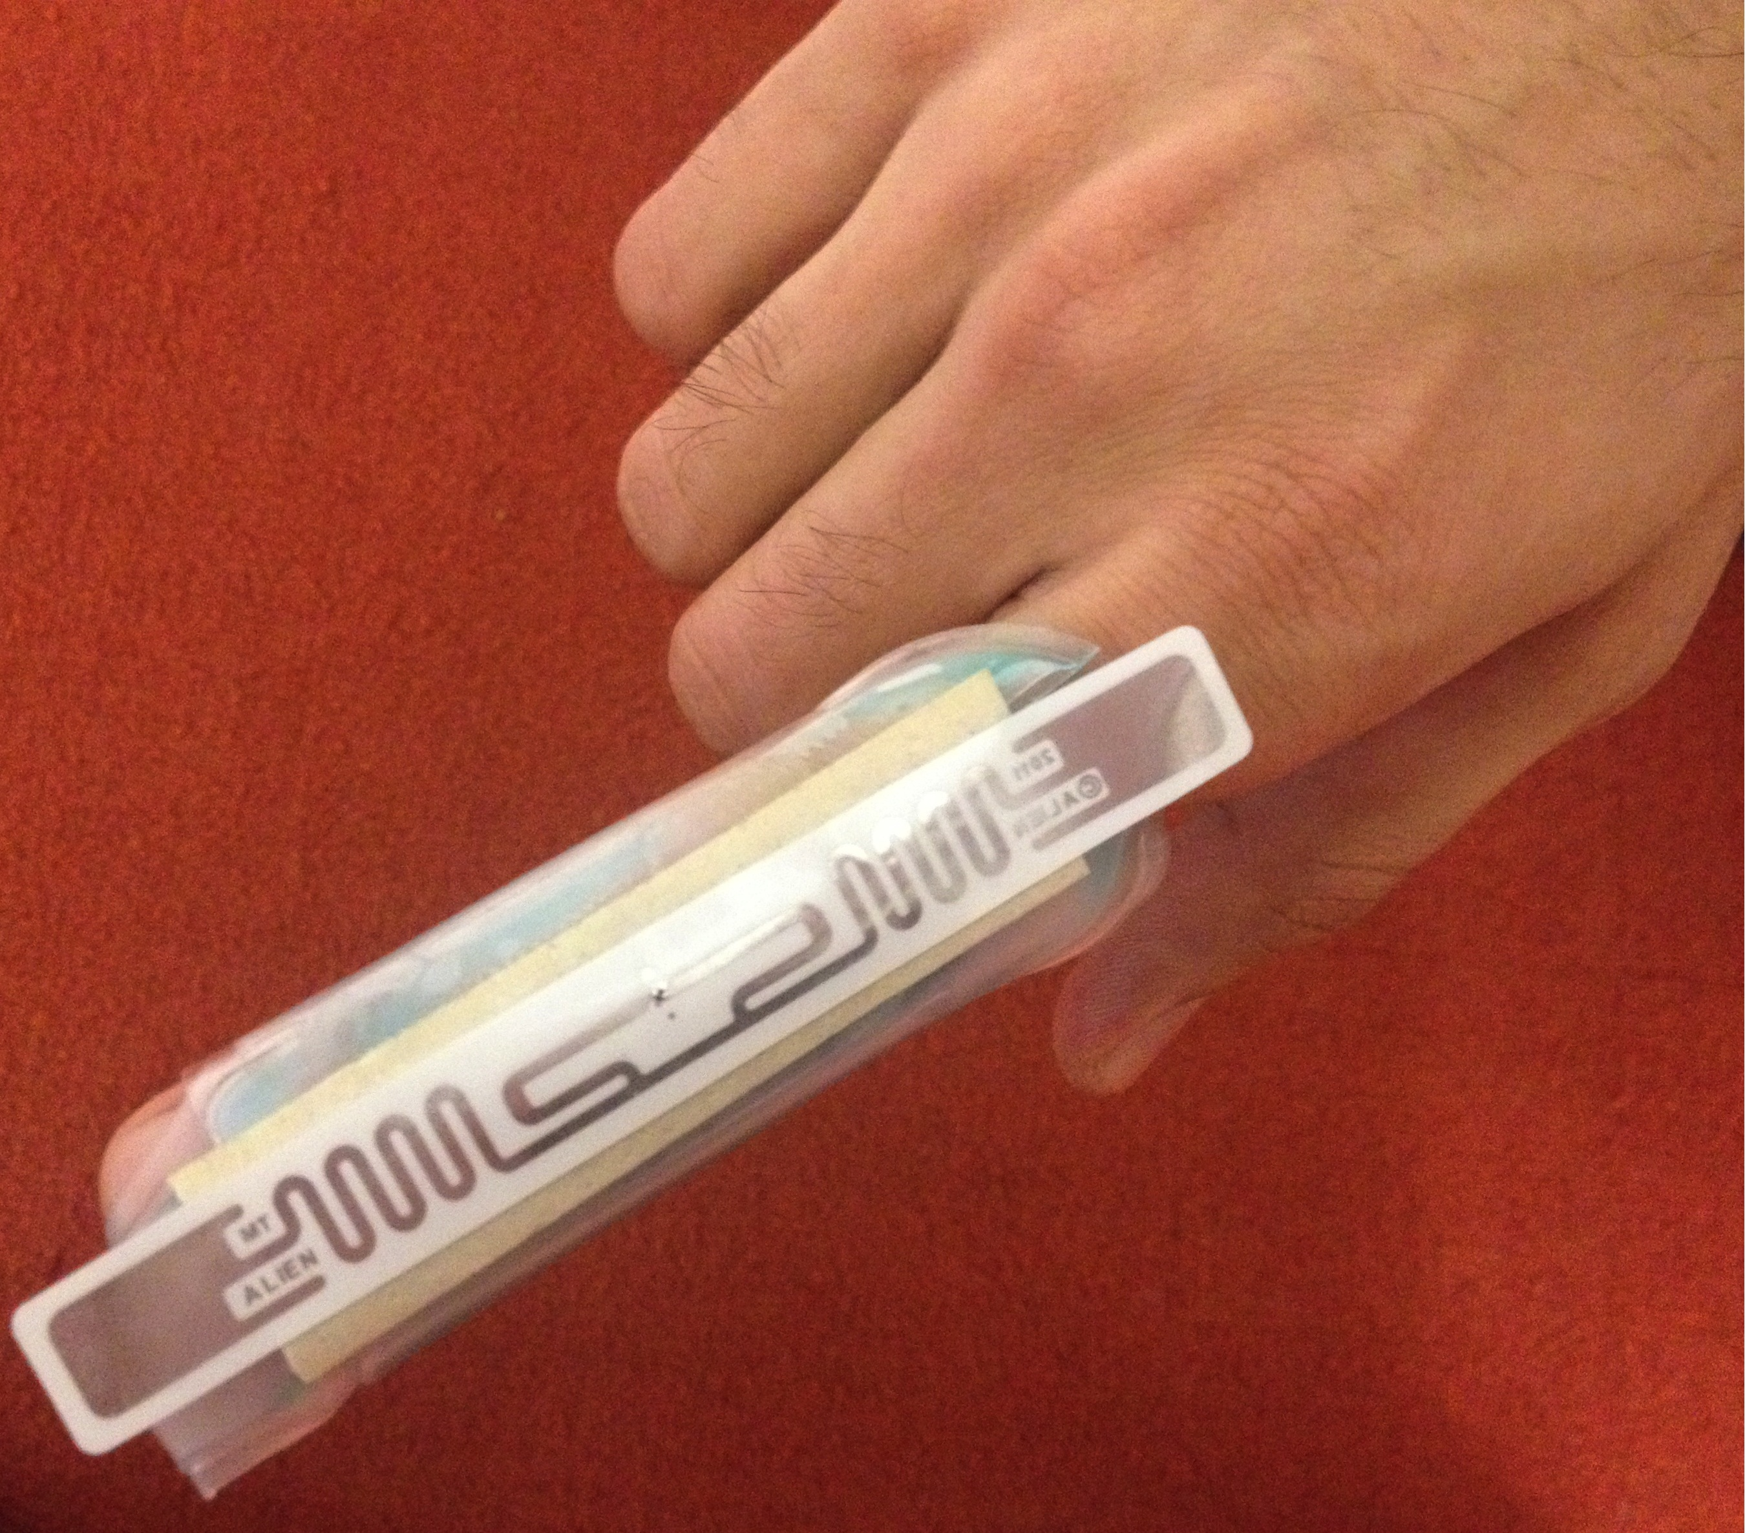
Example

Slide 34
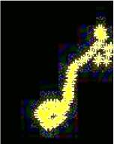
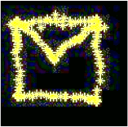
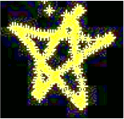





Examples
4 cm wide
“Clear”
“Jue”

Slide 35
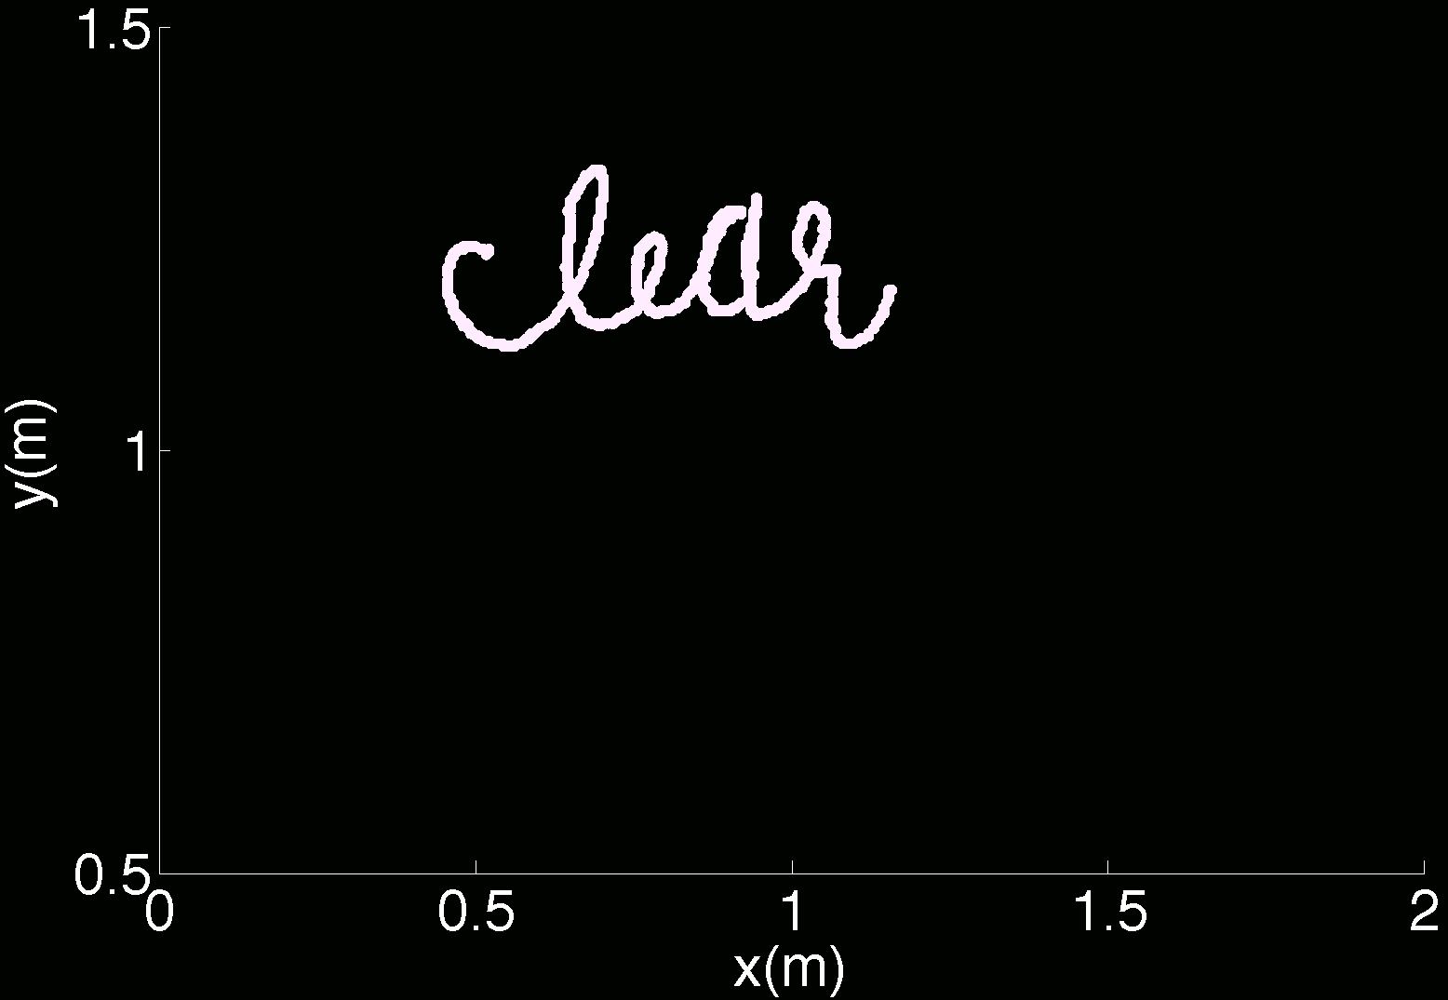

Metric: Absolute Positioning Error
Ground truth

Slide 36
Absolute Positioning Error
RF-IDraw
Antenna Arrays
19cm
CDF
42cm
Positioning error (in m)

Slide 37
Metric: Trajectory Error
Ground truth

Slide 38
Trajectory Error
RF-IDraw
Antenna Arrays
3.7cm
CDF
40.8cm
Trajectory Error (in m)

Slide 39
Virtual Touch Screen Application
5 users wrote 150 words
Words used as touch gestures on Android using MonkeyRunner API
Word recognition using MyScript Stylus app

Slide 40
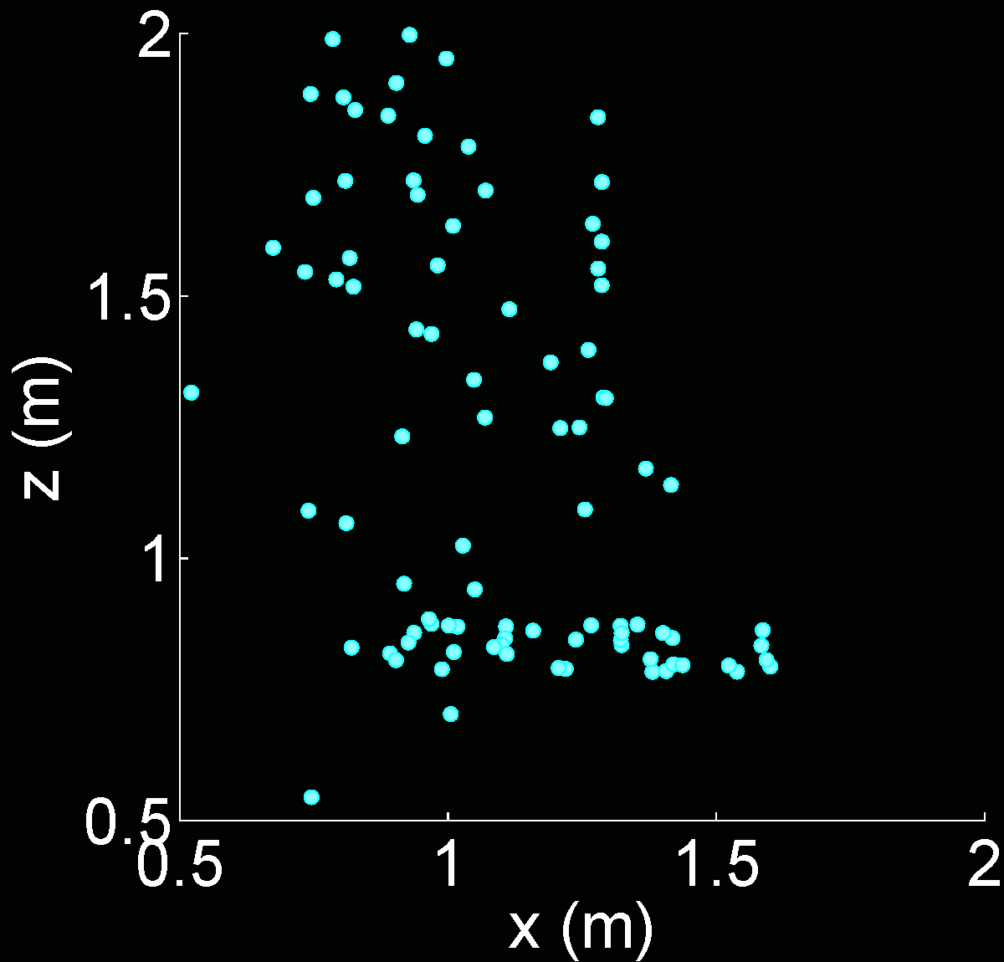
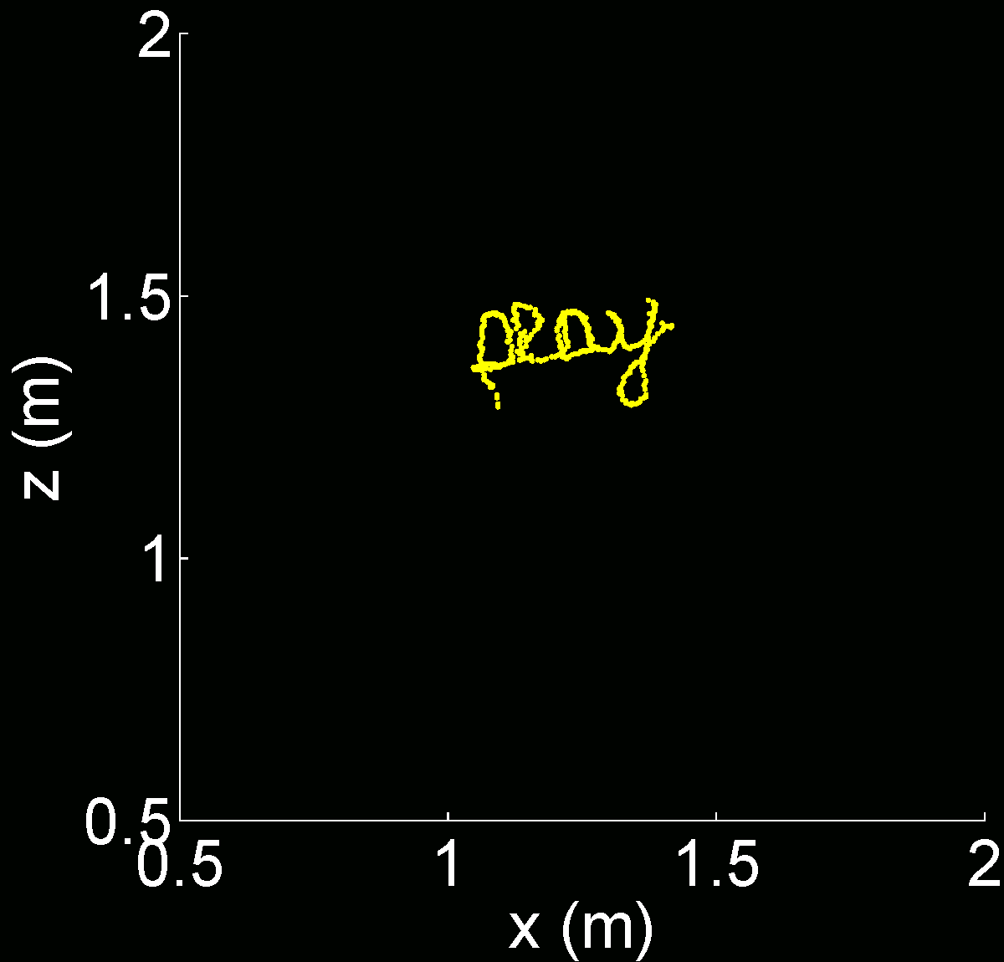
Example
Antenna Arrays
RF-IDraw

Slide 41
Character Recognition Rate
RF-IDraw delivers accurate virtual touch screens
Character Recognition Rate(%)
Distance from Source (in m)

Slide 42
Related Work
RF-based localization
  Witrack [NSDI,14], WiSee [Mobicom’14], ArrayTrack [NSDI’13], PinPoint [NSDI’13], PinIt [SIGCOMM’13], Zee [MobiCom’12], PinLoc [MobySys’12], FM-based [MobySys’12], EZ [MobiCom’10], ….
Kinect and vision-based gesture recognition
  Zhang et al [IEEE Multimedia’13], Murata et al [IJDSN’14] , Yin et al [IEEE VL/HCC’14]

Slide 43

Conclusion
RF-IDraw the first wireless system that enables virtual touch screens on the air
It focuses on trajectory tracking as opposed to point-by-point localization
It introduces the concept of multi-resolution arrays
Its design applies beyond RFIDs to other wireless technologies – e.g., WiFi

Slide 45


FingerIO: Using Active Sonar for Fine Grained Finger Tracking
Rajalakshmi Nandakumar, Vikram Iyer
Shyam Gollakota, Desney Tan

Slide 46
Can we achieve finger tracking for near device interaction with no finger instrumentation and no line of sight?

Slide 47
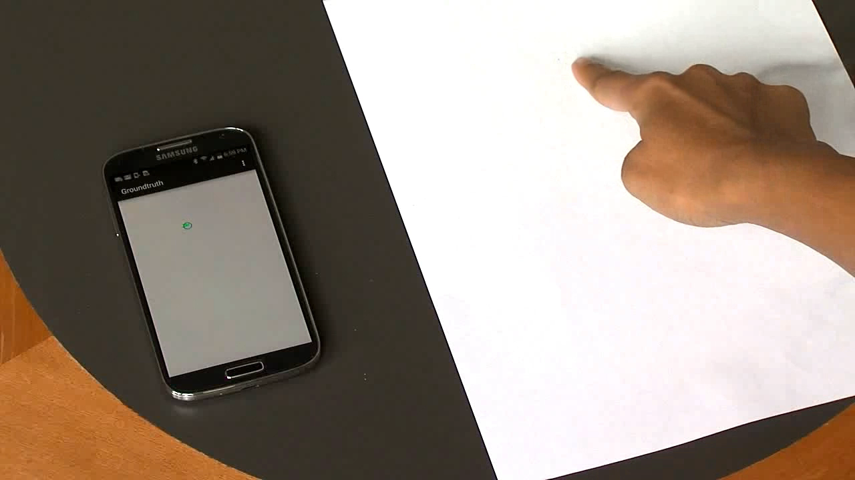
Application 1: Make anything an input surface

Slide 48
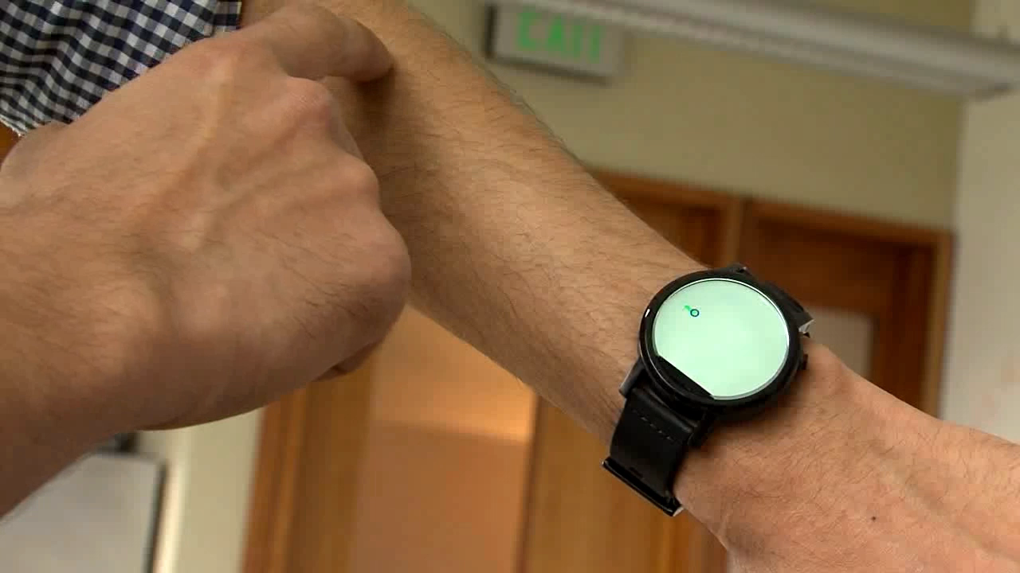
Application 2: Move beyond tiny screens

Slide 49
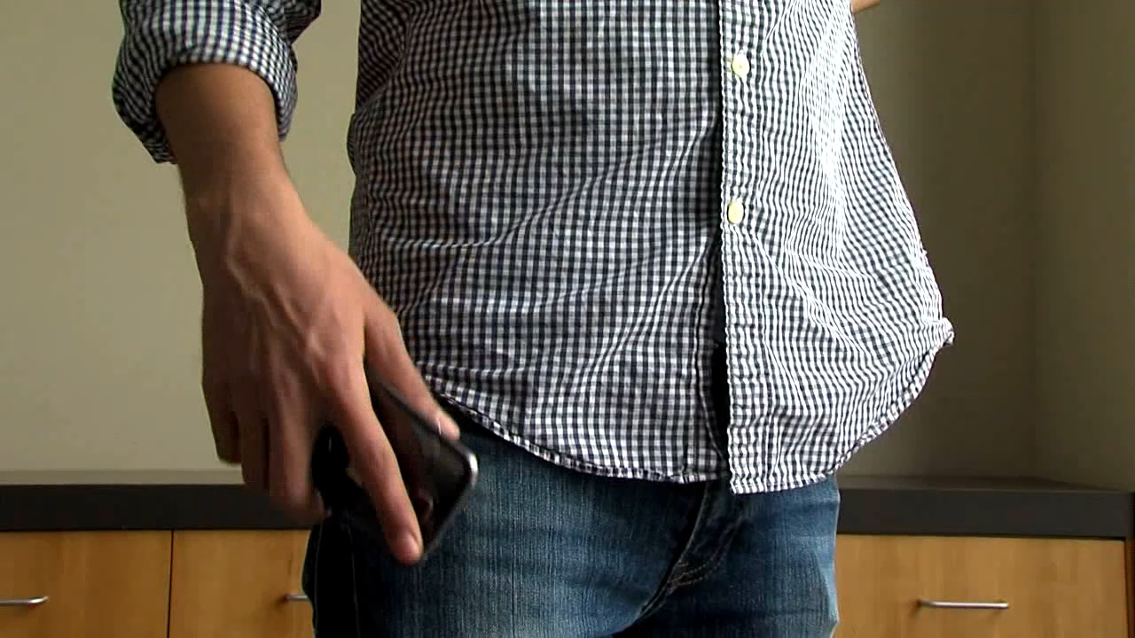
Application 3: Interaction with occlusions

Slide 50

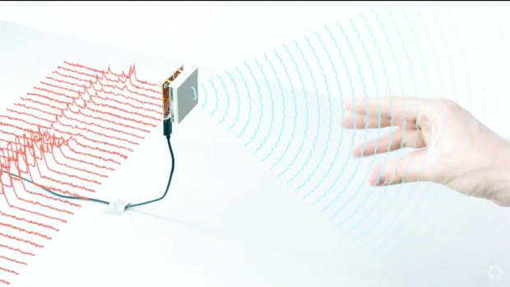
Existing Approaches: Doppler Radar
Complex processing
RF travels at the speed of light→ need GHz of bandwidth
Mobile devices have limited processing capabilities
Custom hardware
Requires yet another radio on mobile devices
Consumes additional power and area on devices

Slide 51
FingerIO
Track a finger with no instrumentation and no line of sight
Introduce algorithms and techniques for active sonar without custom hardware
Achieve 0.8 —1.2 cm accuracy on a Galaxy S4 and smartwatch prototype

Slide 52
Challenges
Transform mobile devices into active sonar systems
Achieve sub-centimeter level tracking accuracy

Slide 53
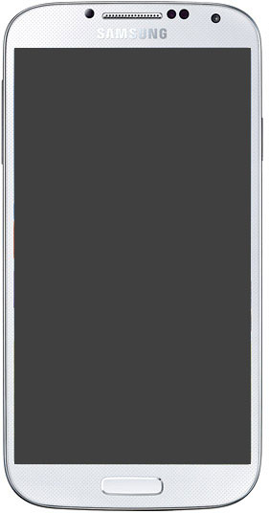
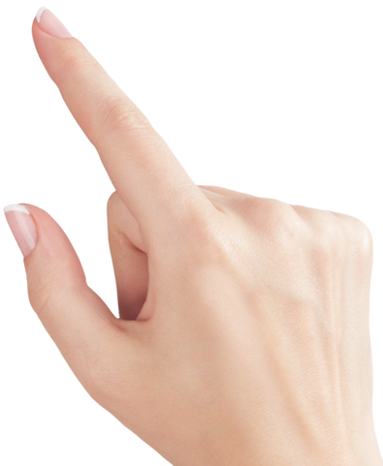

Key Idea: Transform the Device into Active Sonar
Sound waves transmitted by the phone speaker reflect off of the finger

Slide 54
Key Idea: Transform the Device into Active Sonar
Mic 1
Mic 2
Echo from finger is recorded by 2 microphones

Slide 55
Key Idea: Transform the Device into Active Sonar
Time for the echo to arrive back at the phone changes as the finger moves

Slide 56
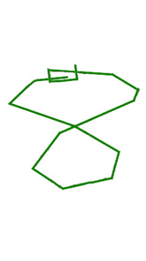
Accuracy Depends on Time Measurement
Mic 1
t₁
t₂
Mic 2
Sampling at 48kHz, 1 sample → 0.7cm

Slide 57
Challenges
Transform mobile devices into active sonar systems
Achieve sub-centimeter tracking accuracy

Slide 58
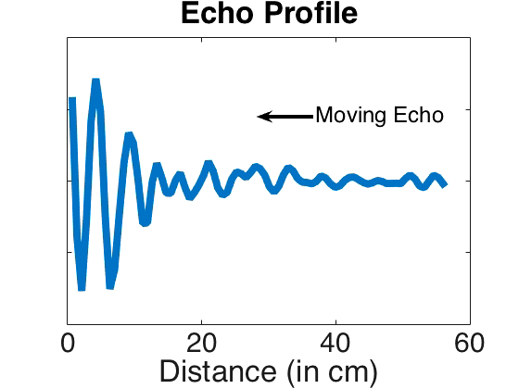
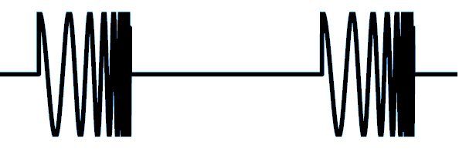
How can we measure arrival time?
Correlation Profile
Chirp
Transmit chirp signals and use autocorrelation to determine arrival times

Slide 59
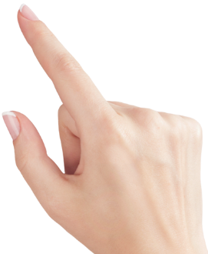
First Order Solution: Correlation
t₁
Correlation Profile
Moving Finger Echo
t₂
We use the closest moving echo to achieve finger tracking

Slide 60
Correlation in Practice
Estimate echo arrival with 2-3 sample error
→ tracking accuracy of 3 cm
How to get the exact arrival time of the echoes?

Slide 61
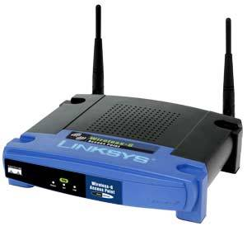
Inspiration from WiFi Networks
Transmitters and receivers do not share a common, synchronized clock
Receivers need to determine the start of a message to successfully decode

Slide 62
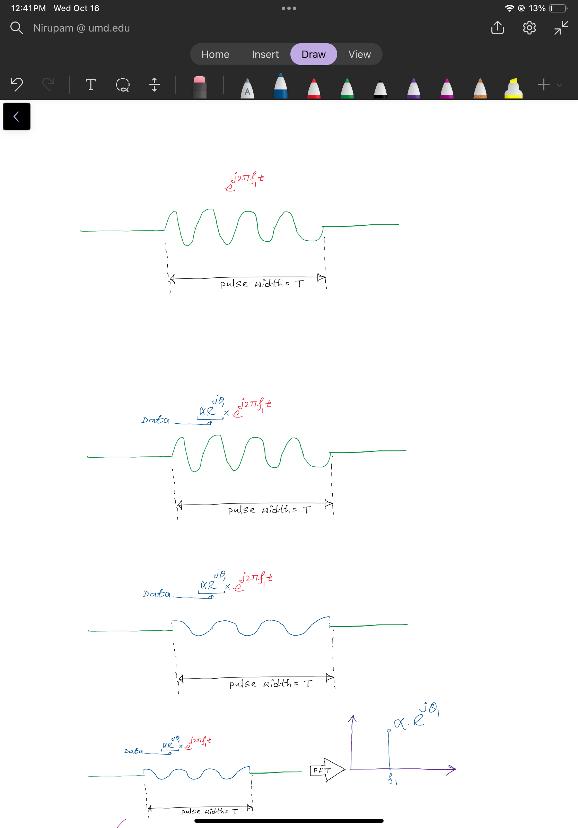
Understanding OFDM

Slide 63
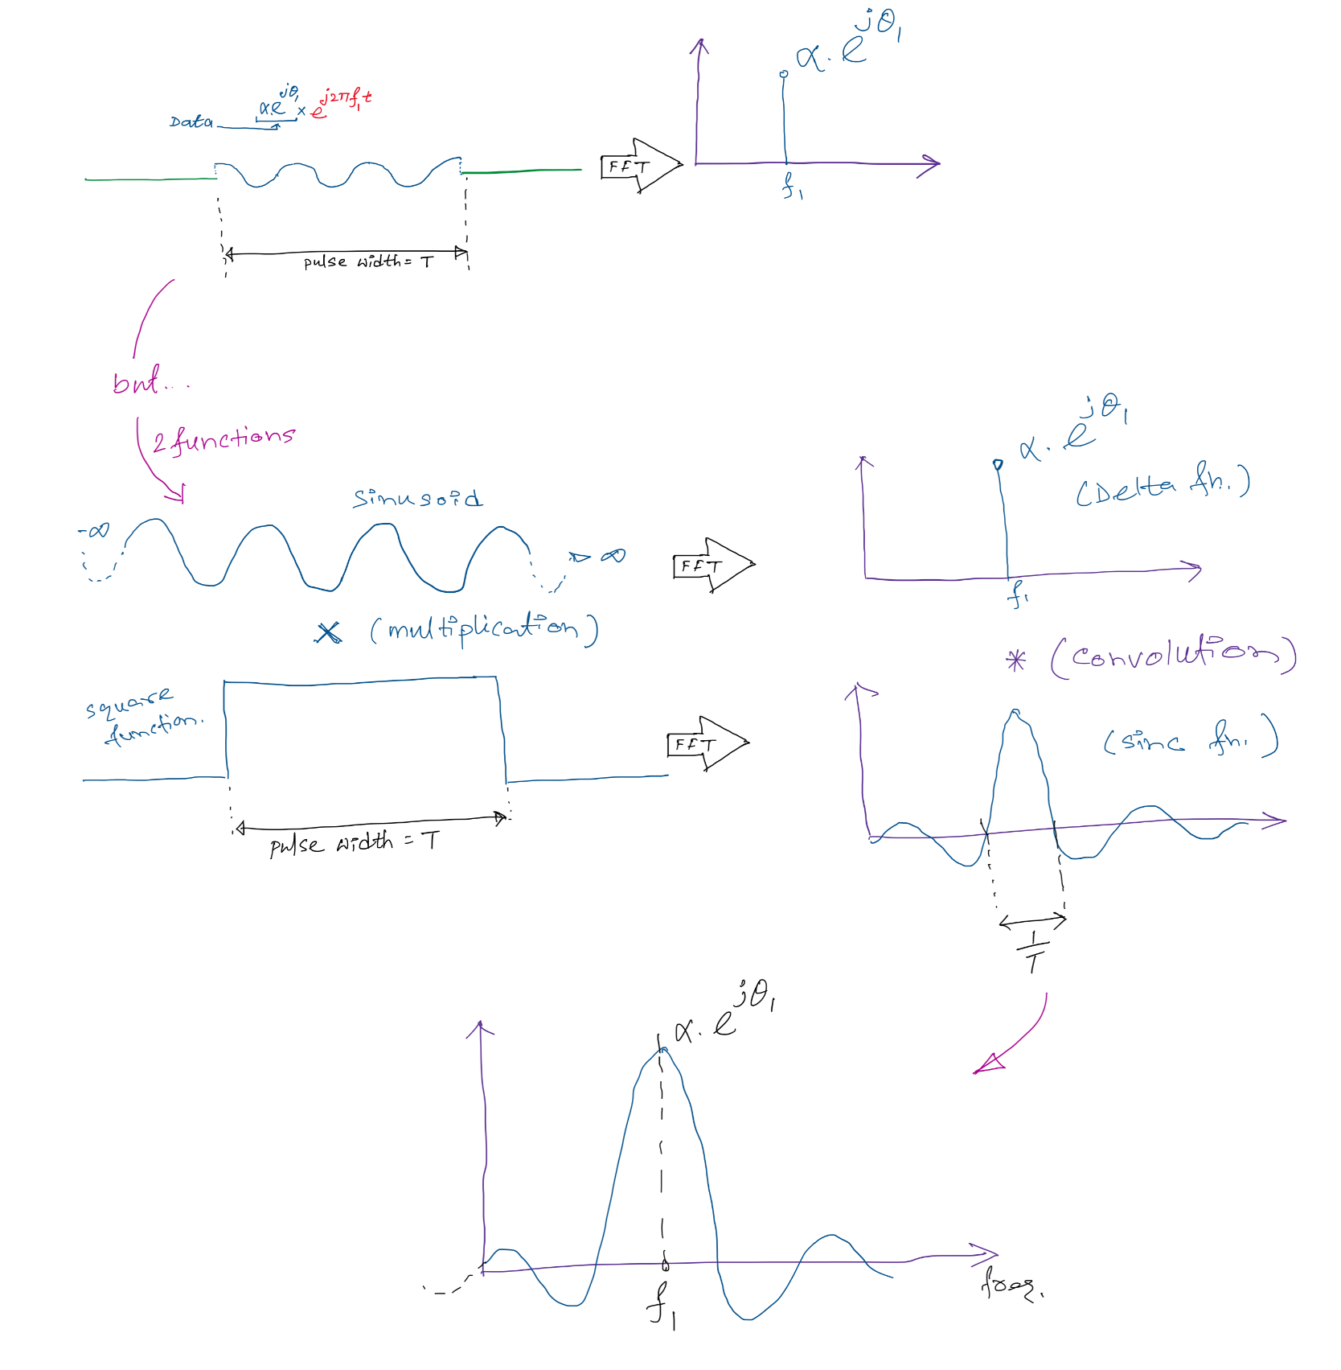
Understanding OFDM: Sinc function
2/T

Slide 64
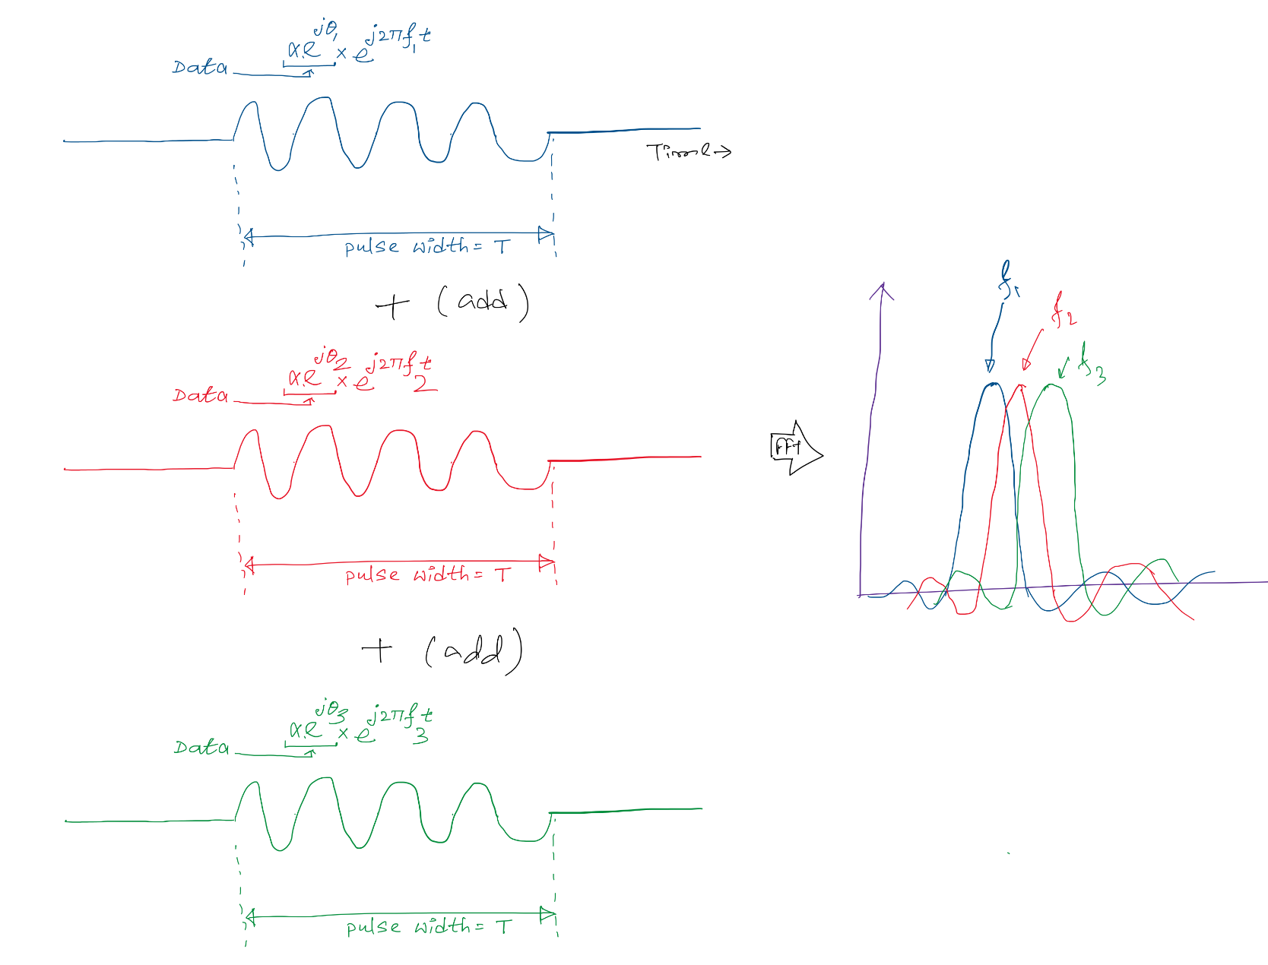
Understanding OFDM: Subcarriers

Slide 65
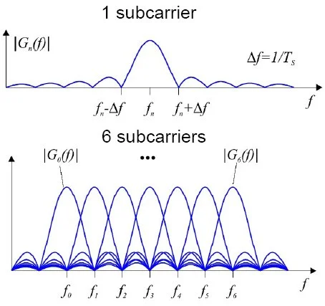
Understanding OFDM: Subcarriers
Frequency domain

Slide 66
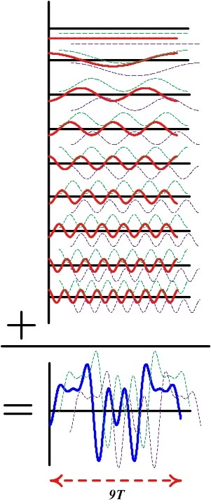
Understanding OFDM: Subcarriers
Frequency domain
Time domain

Slide 67
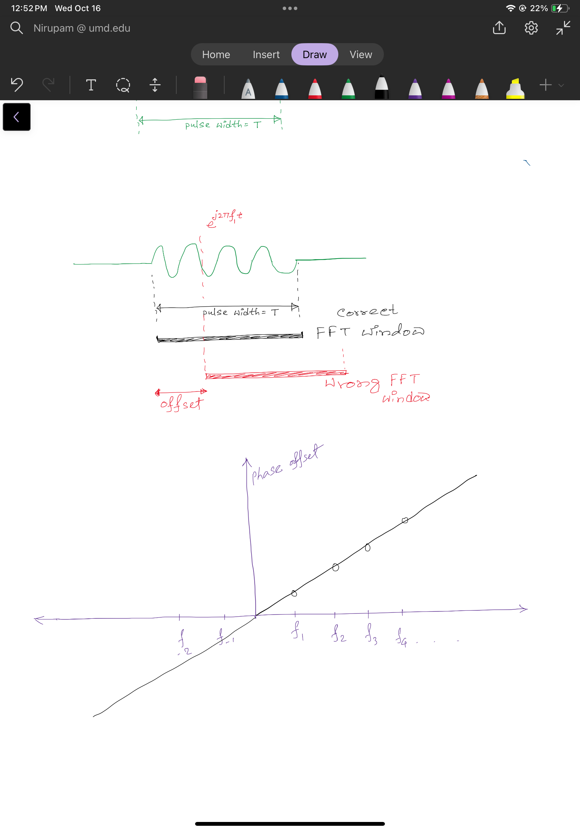
Understanding OFDM: Phase offset

Slide 68
Understanding OFDM: Phase offset

Slide 69
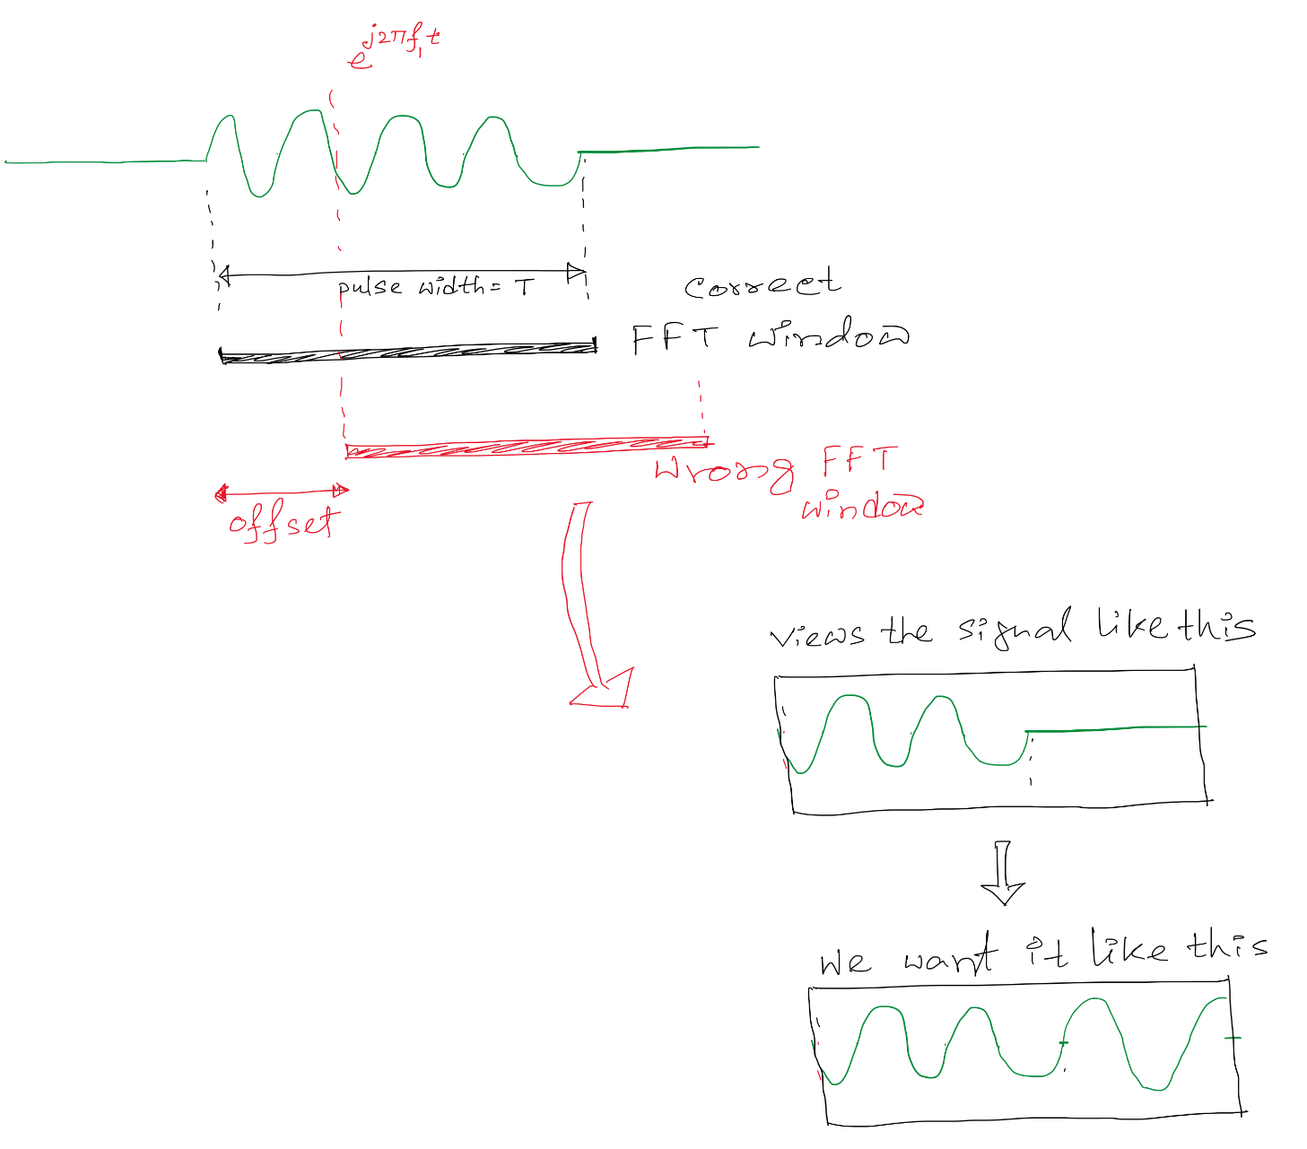
Understanding OFDM: Cyclic prefix

Slide 70
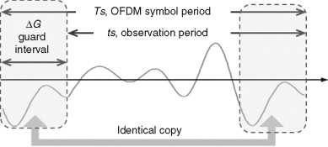
Understanding OFDM: Cyclic prefix

Slide 71
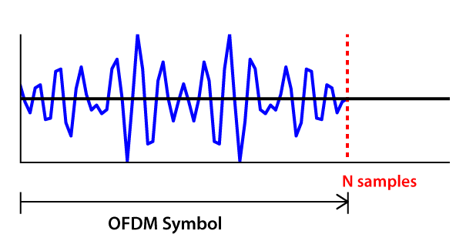
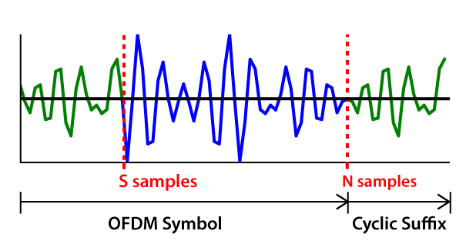
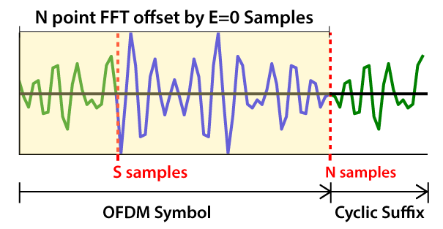
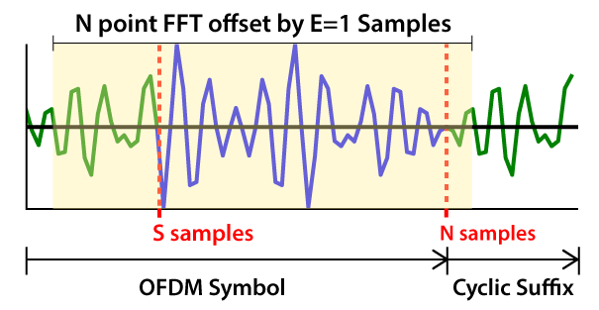
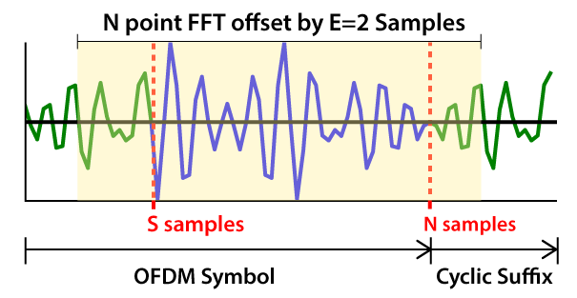
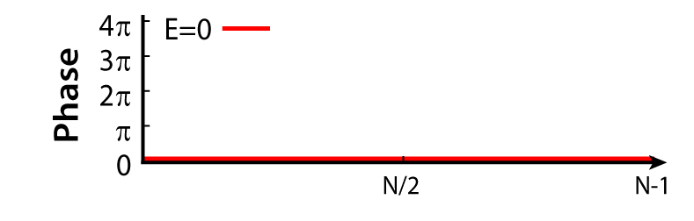
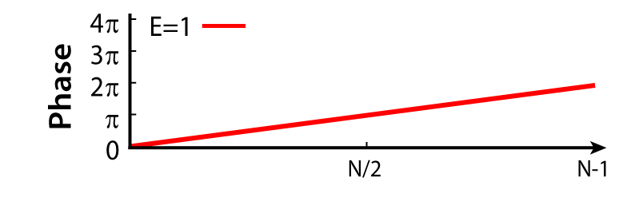
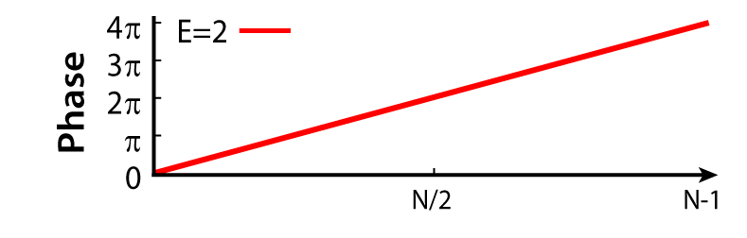
WiFi’s Solution: OFDM
Timing Errors Create FFT Phase Offsets
FFT Phase
Append the first S samples to create a cyclic suffix
→ Creates a periodic signal
Compute inverse FFT to generate N sample OFDM symbol
We leverage this phase to get exact echo arrival time

Slide 72
Putting it All Together
5.92 ms
t
Transmit 18-20 kHz OFDM symbols every 5.92 ms
Use correlation to get a coarse timing estimate within 2-3 samples
Correct error using phase properties of OFDM to achieve < 1 cm accuracy

Slide 73
Evaluation

Slide 74
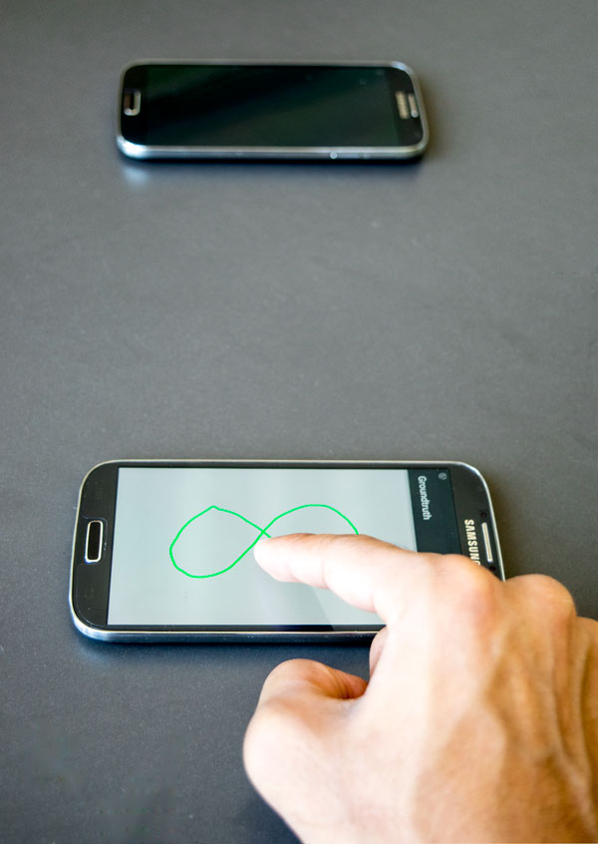
How accurate is FingerIO?
Random user drawings
10 Users
3 Repetitions
30 Total measurements
FingerIO Phone
Reference Phone
0.8 cm accuracy
50 x 100 cm² around phone

Slide 75
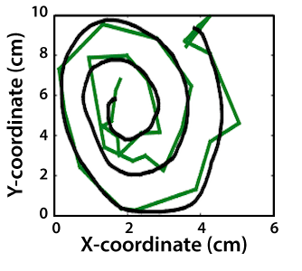
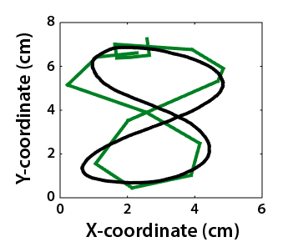
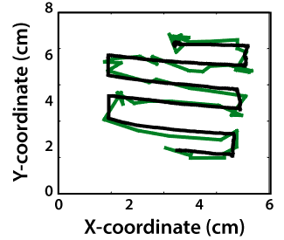
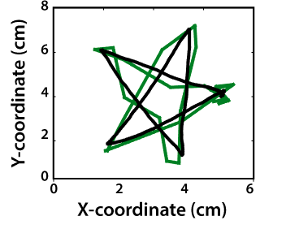
How accurate is FingerIO?
10
8
6
4
2
0

Slide 76
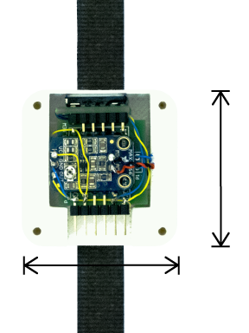
Smartwatch Tracking Accuracy
10 Participants
3 Drawings
30 Total measurements
Speaker
40mm
Mic 1
Mic 2
1.2 cm accuracy
25 x 50 cm² on one side
40mm

Slide 77

Addressing unintended motion
Start-Stop Gesture
10 users
1 min random motion
10 min of motion
5 cm
0 false detection (watch)
2 false detection (phone)

Slide 78
Conclusion
Track a finger with no instrumentation and no line of sight
Introduce algorithms and techniques for active sonar without custom hardware
Enable exciting new directions for finger tracking research

Slide 79
FingerIO: Using Active Sonar for Fine Grained Finger Tracking
Rajalakshmi Nandakumar, Vikram Iyer
Shyam Gollakota, Desney Tan

