Slide 1

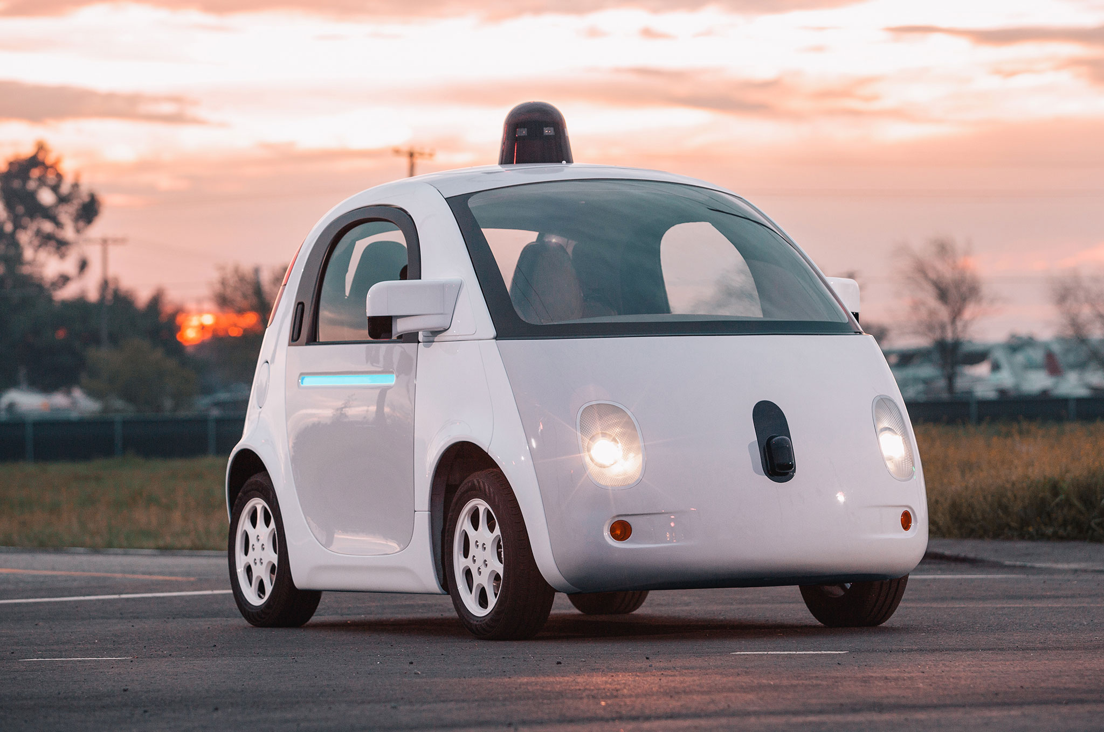

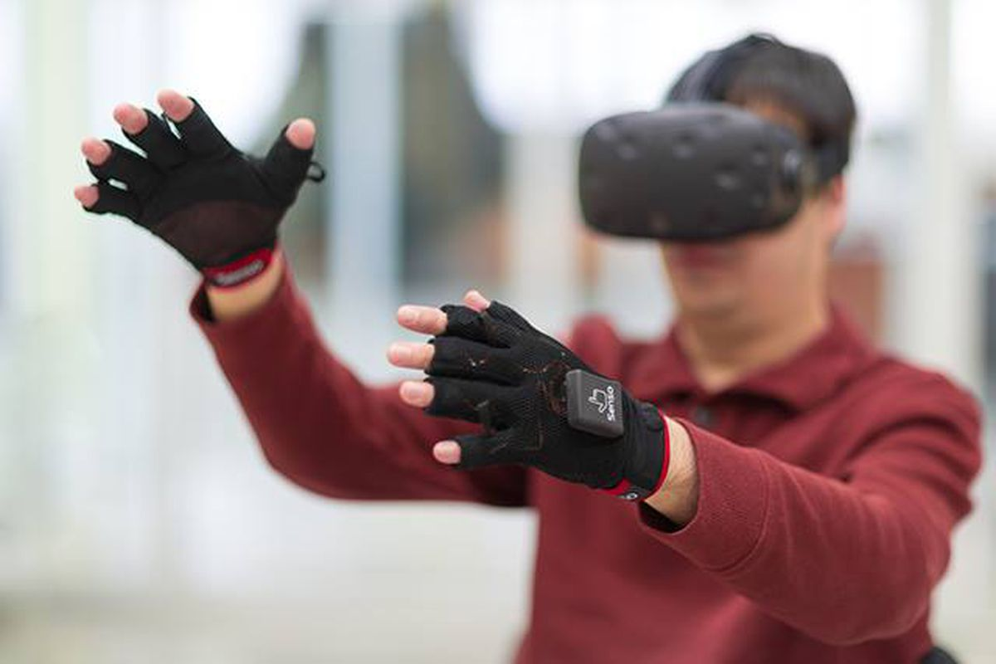


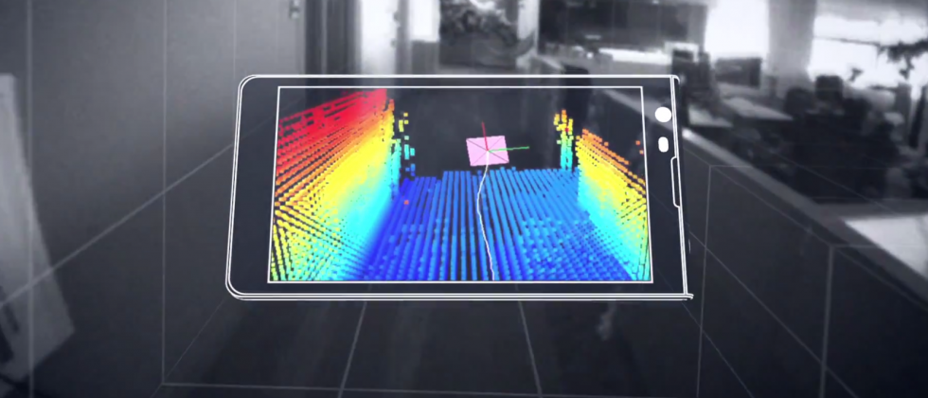

Wireless and Mobile Systems
for the IoT
CMSC 715 : Fall 2024
Lecture 3.1: Inference in Physical Space
Nirupam Roy
Tu-Th 12:30-1:45pm
IRB 2207

Slide 2
Happy or sad?

Slide 3
Happy or sad?

Slide 4
Happy or sad?

Slide 5
Happy or sad?
Past experience
P (The dolphin is happy | Experience)

Slide 6
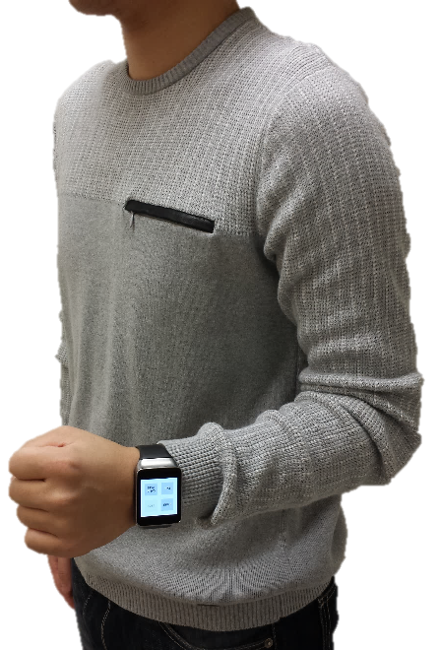
Inference from sensor data
Tracking arm motion

Slide 7
Inference from sensor data
Tracking arm motion
Partial information from sensors

Slide 8
Inference from sensor data
Tracking arm motion
Knowledge about the arm’s motion
(probabilistic models)
+
Partial information from sensors

Slide 9
Inference from sensor data
Tracking arm motion
Knowledge about the arm’s motion
(probabilistic models)
Arm’s gesture
and movement
tracking
+
Partial information from sensors

Slide 10

Which one of these orange circles is bigger?

Slide 11
Sensors are not perfect

Slide 12

The physical world
Statistical models, learning, perception
Meaningful information

Slide 13
The physical world
Neither perfect nor adequate
Statistical models, learning, perception
Inherently probabilistic
in nature
Meaningful information

Slide 14
Probability refresher

Slide 15
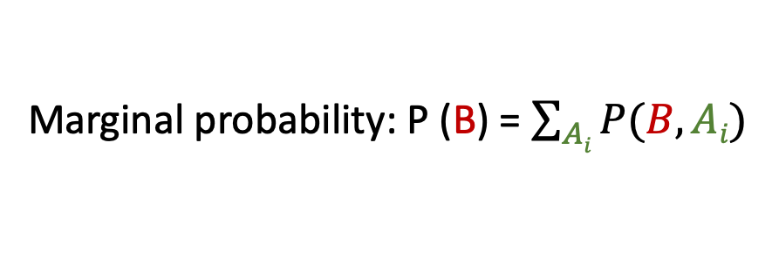
A few basic probability rules
Joint probability: P (A, B) = P (B, A)
Likelihood of multiple events occurring simultaneously
Conditional probability: P (A|B) = P(A,B)/P(B)
Probability of an event, given another event has occurred
Marginal probability: P (B) = $\sum_{Ai}{P(B,Ai)}$

Slide 16
A few basic probability rules
Joint probability: P (A, B) = P (B, A)
Likelihood of multiple events occurring simultaneously
Conditional probability: P (A|B) = P(A,B)/P(B)
Probability of an event, given another event has occurred
Marginal probability: P (B) = $\sum_{Ai}{P(B,Ai)}$
A1
A2
A3
B

Slide 17
A few basic probability rules
Joint probability: P (A, B) = P (B, A)
Likelihood of multiple events occurring simultaneously
Conditional probability: P (A|B) = P(A,B)/P(B)
Probability of an event, given another event has occurred
Marginal probability: P (B) = $\sum_{Ai}{P(B,Ai)}$
Chain rule: P (A, B, C) = P(A|B,C) P(B,C) = P(A|B,C) P(B|C) P(C)

Slide 18
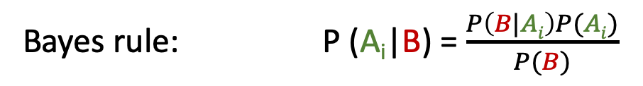
Bayes rule
Bayes rule: P (A_{i}|B) = $\frac{P\left(B|Ai\right)P(Ai)}{P(B)}$

Slide 19
Bayes rule
Likelihood
Posterior
Prior
Bayes rule: P (A_{i}|B) = $\frac{P\left(B|Ai\right)P(Ai)}{P(B)}$

Slide 20
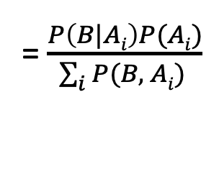
Bayes rule
Likelihood
Posterior
Prior
Bayes rule: P (A_{i}|B) = $\frac{P\left(B|Ai\right)P(Ai)}{P(B)}$
= $\frac{P\left(B|Ai\right)P(Ai)}{\sum_{i}{P(B, Ai) }}$

Slide 21
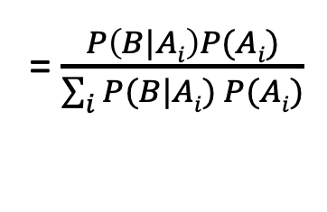
Bayes rule
Likelihood
Posterior
Prior
Bayes rule: P (A_{i}|B) = $\frac{P\left(B|Ai\right)P(Ai)}{P(B)}$
= $\frac{P\left(B|Ai\right)P(Ai)}{\sum_{i}{P(B, Ai) }}$
= $\frac{P\left(B|Ai\right)P(Ai)}{\sum_{i}{P(B|Ai) P(Ai)}}$

Slide 22
Bayes rule
Likelihood
Posterior
Prior
Bayes rule: P (A_{i}|B) = $\frac{P\left(B|Ai\right)P(Ai)}{P(B)}$
= $\frac{P\left(B|Ai\right)P(Ai)}{\sum_{i}{P(B, Ai) }}$
= $\frac{P\left(B|Ai\right)P(Ai)}{\sum_{i}{P(B|Ai) P(Ai)}}$
Relates inverse representations of the probabilities concerning two events

Slide 23
Bayes rule: View 1
Healthy: A1
Diabetes: A2
Cancer: A3
Smoker: B

Slide 24
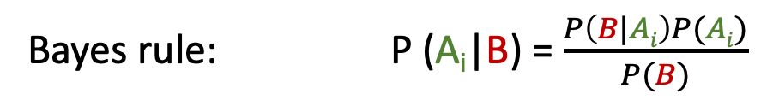
Bayes rule: View 1
Healthy: A1
Diabetes: A2
Cancer: A3
Smoker: B
Likelihood
Posterior
Prior
Bayes rule: P (A_{i}|B) = $\frac{P\left(B|Ai\right)P(Ai)}{P(B)}$

Slide 25
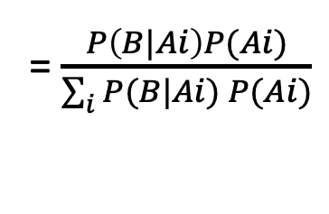
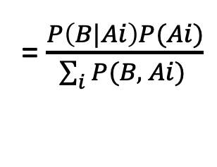
Bayes rule: View 1
Healthy: A1
Diabetes: A2
Cancer: A3
Smoker: B
Likelihood
Posterior
Prior
Bayes rule: P (A_{i}|B) = $\frac{P\left(B|Ai\right)P(Ai)}{P(B)}$
= $\frac{P\left(B|Ai\right)P(Ai)}{\sum_{i}{P(B, Ai) }}$
= $\frac{P\left(B|Ai\right)P(Ai)}{\sum_{i}{P(B|Ai) P(Ai)}}$
Relates inverse representations of the probabilities concerning two events

Slide 26
Bayes rule: View 2
Not cancer: ~A
Cancer: A
Smoker: B

Slide 27
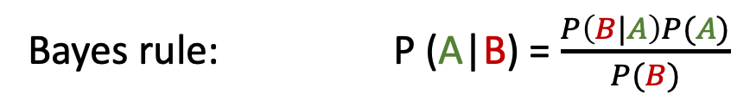
Bayes rule: View 2
Not cancer: ~A
Cancer: A
Smoker: B
Likelihood
Posterior
Prior
Bayes rule: P (A|B) = $\frac{P\left(B|A\right)P(A)}{P(B)}$

Slide 28
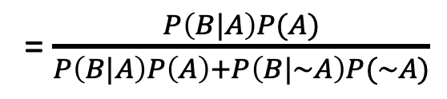
Bayes rule: View 2
Not cancer: ~A
Cancer: A
Smoker: B
Likelihood
Posterior
Prior
Bayes rule: P (A|B) = $\frac{P\left(B|A\right)P(A)}{P(B)}$
= $\frac{P\left(B|A\right)P(A)}{P\left(B|A\right)P\left(A\right)+P\left(B|\sim A\right)P(\sim A)}$
Updates the believes, based on evidences

Slide 29
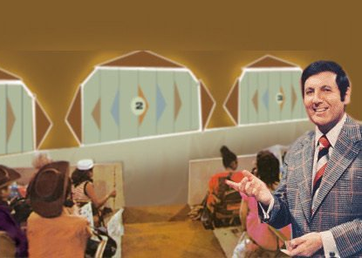


Slide 30
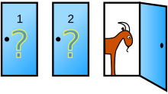
Monty Hall Problem

Slide 31
Monty Hall Problem
A
B
C

Slide 32

Monty Hall Problem
A
C
B

Slide 33

Monty Hall Problem
2
C
A
B

Slide 34
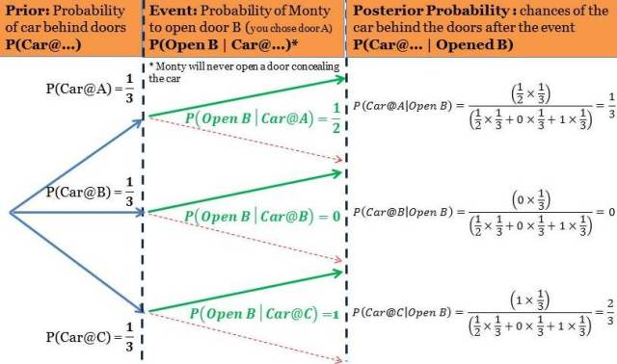
Bayes rule:
PC: https://ucanalytics.com/blogs/bayes-theorem-monty-hall-problem/

Slide 35
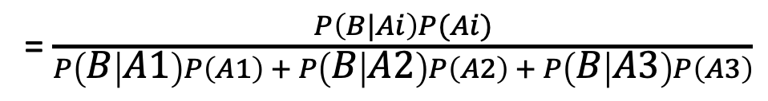
Bayes rule:
Healthy: A1
Diabetes: A2
Cancer: A3
Smoker: B
Likelihood
Posterior
Prior
Bayes rule: P (A_{i}|B) = $\frac{P\left(B|Ai\right)P(Ai)}{P(B)}$
= $\frac{P\left(B|Ai\right)P(Ai)}{\sum_{i}{P(B, Ai) }}$
= $\frac{P\left(B|Ai\right)P(Ai)}{\sum_{i}{P(B|Ai) P(Ai)}}$
= $\frac{P\left(B|Ai\right)P(Ai)}{P\left(B | A1\right)P\left(A1\right) + P\left(B | A2\right)P\left(A2\right) + P\left(B | A3\right)P\left(A3\right)}$

Slide 36
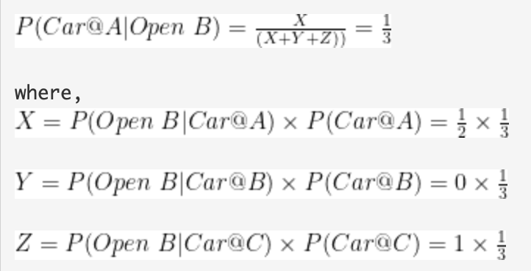
Bayes rule:

Slide 37
Bayes rule:
PC: https://ucanalytics.com/blogs/bayes-theorem-monty-hall-problem/

Slide 38

Happy or sad?

Slide 39
Happy or sad?
Given the “sequence” of tricky questions asked today, what should be the answer?

Slide 40
Markov Model

Slide 41
Markov Model
Sunny
Sunny
Rainy
Sunny
Rainy
Rainy
t1 t2 t3 t4 t5 t6 (time)

Slide 42
Markov Model
Sunny
Sunny
Rainy
Sunny
Rainy
Rainy
t1 t2 t3 t4 t5 t6 (time)
Sunny
day
Rainy
day

Slide 43
Markov Model
Sunny
Sunny
Rainy
Sunny
Rainy
Rainy
t1 t2 t3 t4 t5 t6 (time)
P (sunny after rainy)
P (sunny after sunny)
P (rainy after rainy)
Sunny
day
Rainy
day
P (rainy after sunny)
Mth order Markov assumption: Current state depends on past M states

Slide 44
Markov Model
Sunny
Sunny
Rainy
Sunny
Rainy
Rainy
t1 t2 t3 t4 t5 t6 (time)
P (sunny after rainy)
P (sunny after sunny)
P (rainy after rainy)
1st Order Markov assumption: The future depends on the present only, not on the past
Sunny
day
Rainy
day
P (rainy after sunny)

Slide 45
Markov Model
Sunny
Sunny
Rainy
Sunny
Rainy
Rainy
t1 t2 t3 t4 t5 t6 (time)
P (sunny after rainy)
P (sunny after sunny)
P (rainy after rainy)
Sunny
day
Rainy
day
P (rainy after sunny)

Slide 46
Markov Model
Sunny
Sunny
Rainy
Sunny
Rainy
Rainy
t1 t2 t3 t4 t5 t6 (time)
P (sunny after rainy)
P (sunny after sunny)
P (rainy after rainy)
Sunny
day
Rainy
day
Temp.
P (rainy after sunny)
Temp.
Humidity
Humidity
Wind
Wind

Slide 47
Hidden Markov Model

Slide 48
Hidden Markov Model: Toy robot localization example
Find location of the robot
(Hidden information)
Observations =
sensor measurement
S₁
S₂
S₃
…

Slide 49
Hidden Markov Model: Toy robot localization example
Starting from an arbitrary location
(All locations are equally likely)
Prob
0
1
t=0

Slide 50
Hidden Markov Model: Toy robot localization example
Sensing changes the probabilities
Prob
0
1
t=1

Slide 51
Hidden Markov Model: Toy robot localization example
Prob
0
1
t=1

Slide 52
Hidden Markov Model: Toy robot localization example
Prob
0
1
t=2

Slide 53
Hidden Markov Model: Toy robot localization example
Prob
0
1
t=3

Slide 54
Hidden Markov Model: Toy robot localization example
Prob
0
1
t=4

Slide 55
Hidden Markov Model: Toy robot localization example
Prob
0
1
t=5

Slide 56
Hidden Markov Model: Toy robot localization example
State = location on the grid = S_{i}
S₁
S₂
S₃
…

Slide 57
Hidden Markov Model: Toy robot localization example
Observations =
sensor measurement = M_{i}
State = location on the grid = S_{i}
S₁
S₂
S₃
…

Slide 58
Hidden Markov Model: Toy robot localization example
Observations =
sensor measurement = M_{i}
State = location on the grid = S_{i}
S₁
S₂
S₃
…
Depends on the current state
only
(Emission)
S_{i}

Slide 59
Hidden Markov Model: Toy robot localization example
Observations =
sensor measurement = M_{i}
State = location on the grid = S_{i}
S₁
S₂
S₃
…
Depends on the current state
only
(Emission)
S_{i}
S_{i+1}
S_{i+2}
…
S_{i}
States change over time (Transition)

Slide 60
Hidden Markov Model: Definition
S₁
S₂
S₃
S₄
M₁
M₂
M₃
M₄

Slide 61
Hidden Markov Model: Definition
Hidden states
S₁
S₂
S₃
S₄
M₁
M₂
M₃
M₄

Slide 62
Hidden Markov Model: Definition
Hidden states
S₁
S₂
S₃
S₄
M₁
M₂
M₃
M₄
Observations

Slide 63
Hidden Markov Model: Definition
S₁
S₁
S₂
M₁
Transition
Emission

Slide 64
Hidden Markov Model: Definition
S₁
S₁
S₂
M₁
Transition
Emission
1st order Markov assumption:
Transition probability depends on the current state only.
Output independence assumption:
Output/Emission probability depends on the current state only.

Slide 65
Hidden Markov Model: Definition
Hidden states
S₁
S₁
S₂
S₃
S₄
S₁
S₂
M₁
M₁
M₂
M₃
M₄
Transition
Emission
Observations
1st order Markov assumption:
Transition probability depends on the current state only.
Output independence assumption:
Output/Emission probability depends on the current state only.

Slide 66
Hidden Markov Model: Definition
Probability of a sequence of hidden states, given a sequence of observations

Slide 67
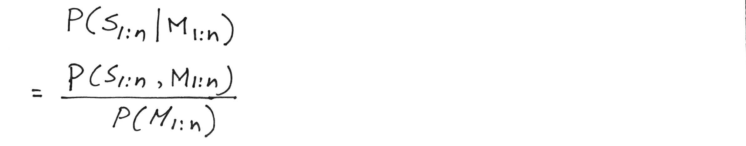
Hidden Markov Model: Definition
Probability of a sequence of hidden states, given a sequence of observations

Slide 68
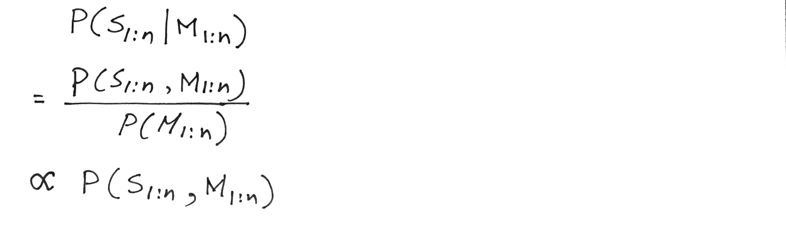
Hidden Markov Model: Definition
Probability of a sequence of hidden states, given a sequence of observations

Slide 69
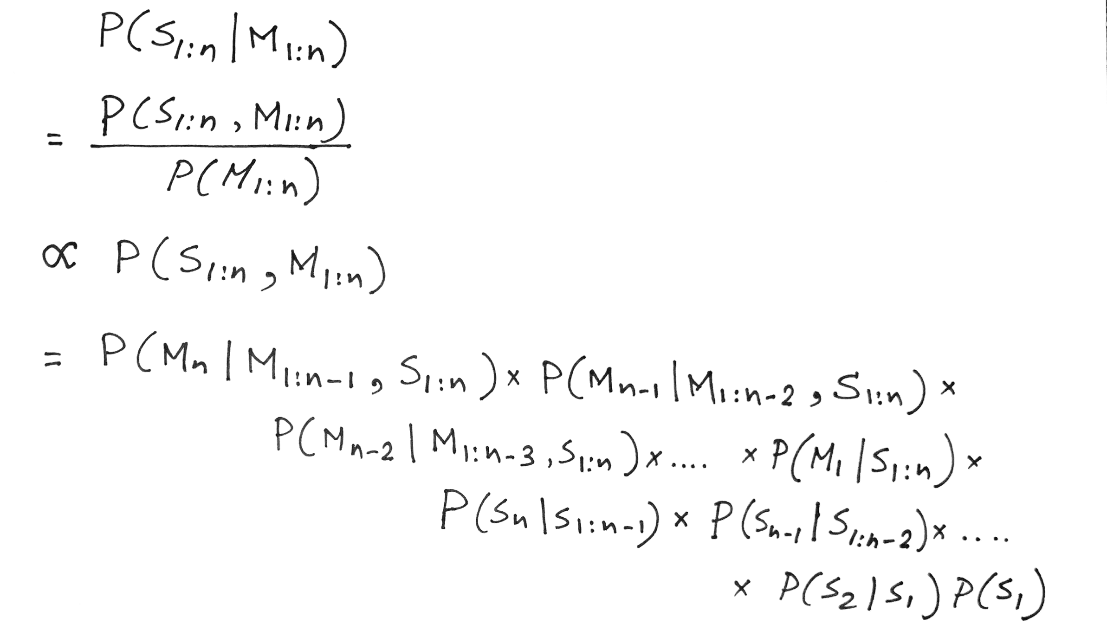
Hidden Markov Model: Definition
Chain rule

Slide 70
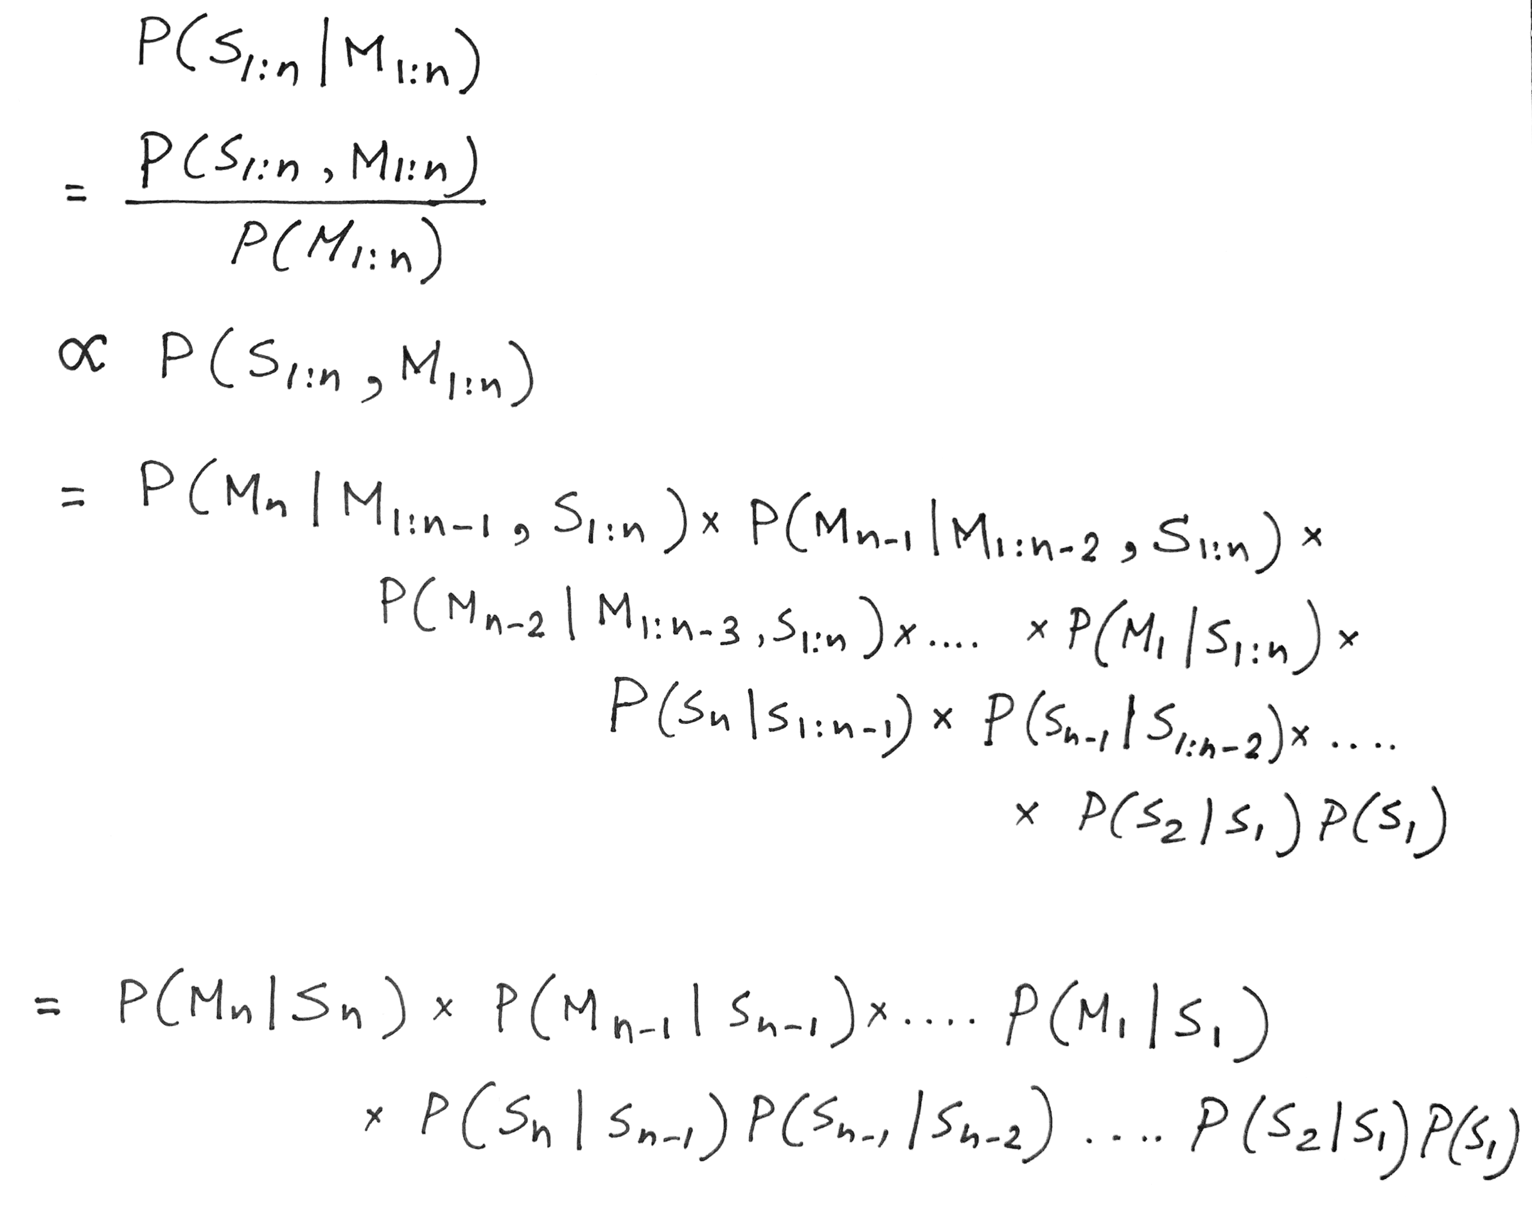
Hidden Markov Model: Definition
Observation depends on the current state only

Slide 71
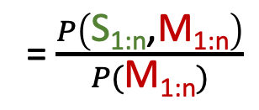
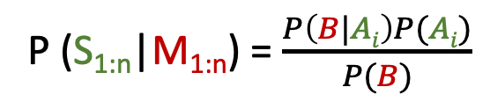
Hidden Markov Model: Definition
P (S_{1:n}|M_{1:n}) = $\frac{P\left(B|Ai\right)P(Ai)}{P(B)}$
= $\frac{P\left(\text{S}\text{1:}\text{n}\text{,}\text{M}\text{1:}\text{n}\right)}{P(\text{M}\text{1:}\text{n})}$
Observation depends on the current state only
Future state depends on the current state only

Slide 72
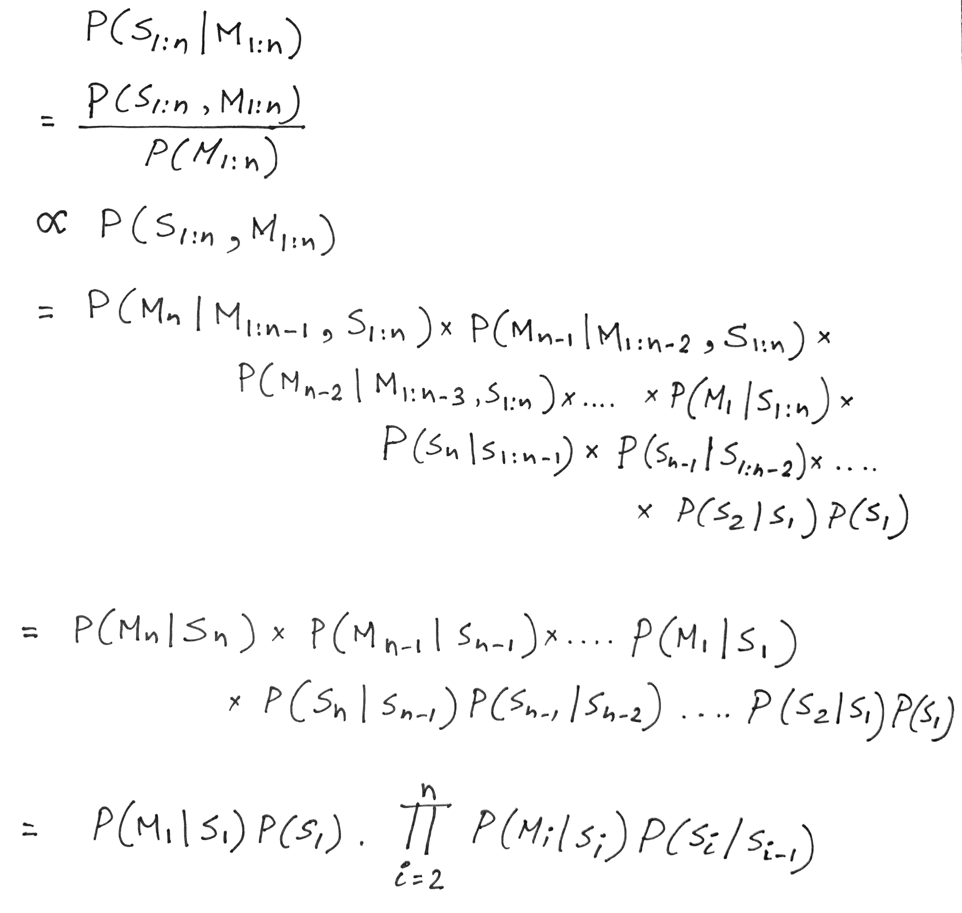
Hidden Markov Model: Definition
For N hidden states and a sequence of T observations, N^{T} different combinations

Slide 73
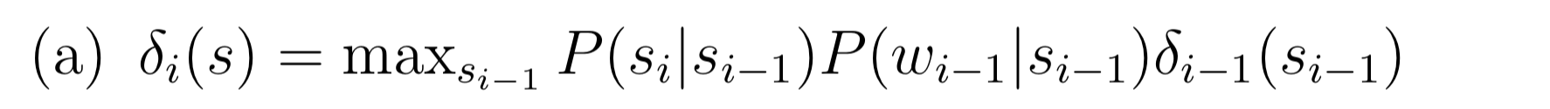
Opportunity for a dynamic algorithm
Recursion
M_{i-1}
[Ref] http://www.davidsbatista.net/assets/documents/posts/2017-11-11-hmm_viterbi_mini_example.pdf

Slide 74
Problems solved by HMM
1) Likelihood:
  Determine the likelihood of an observation sequence.
2) Decoding:
  Given an observation sequence, determine the best sequence of hidden states.
[Viterbi algorithm]
[Forward-backward algorithm]
[Baum-Welch algorithm]
3) Learning:
  Given an observation sequence and a sequence of states, learn the HMM parameters:
  i) Transition probabilities
  ii) Emission probabilities

