Slide 1

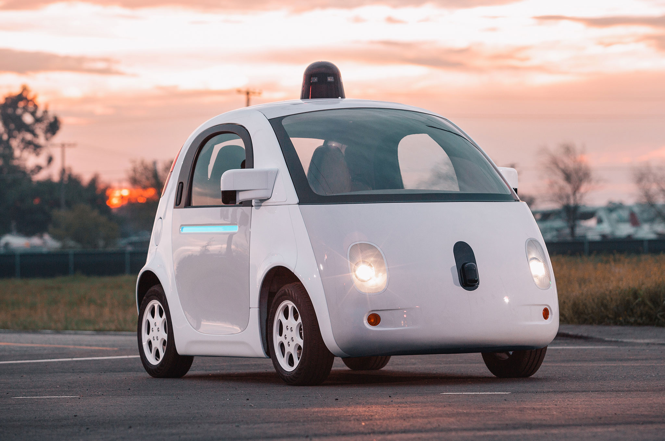
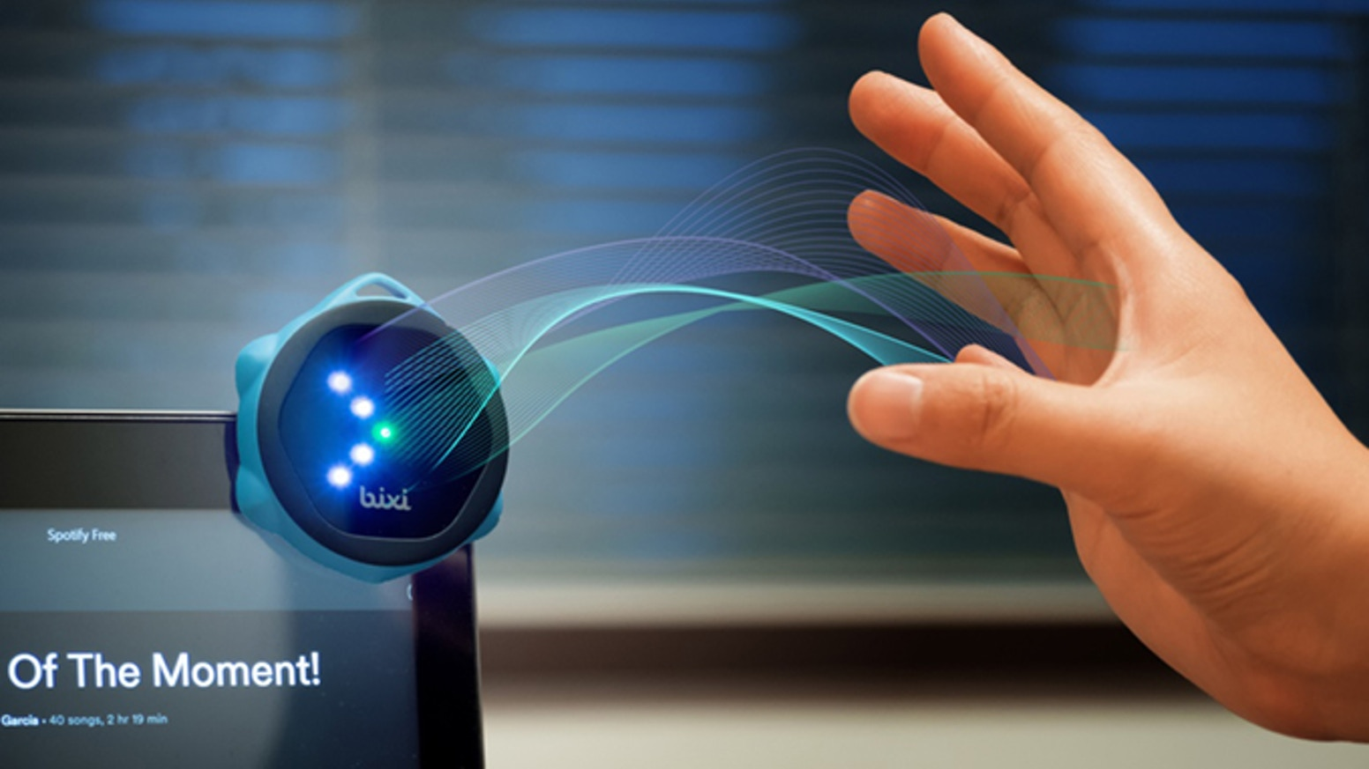
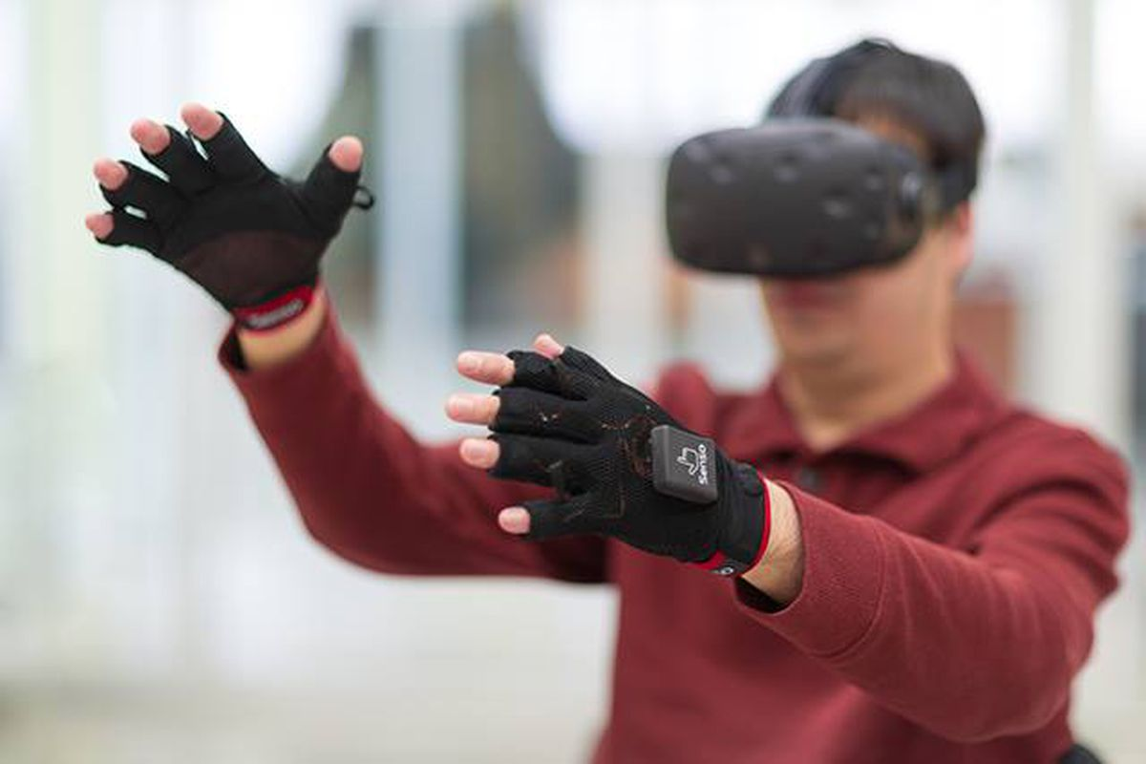

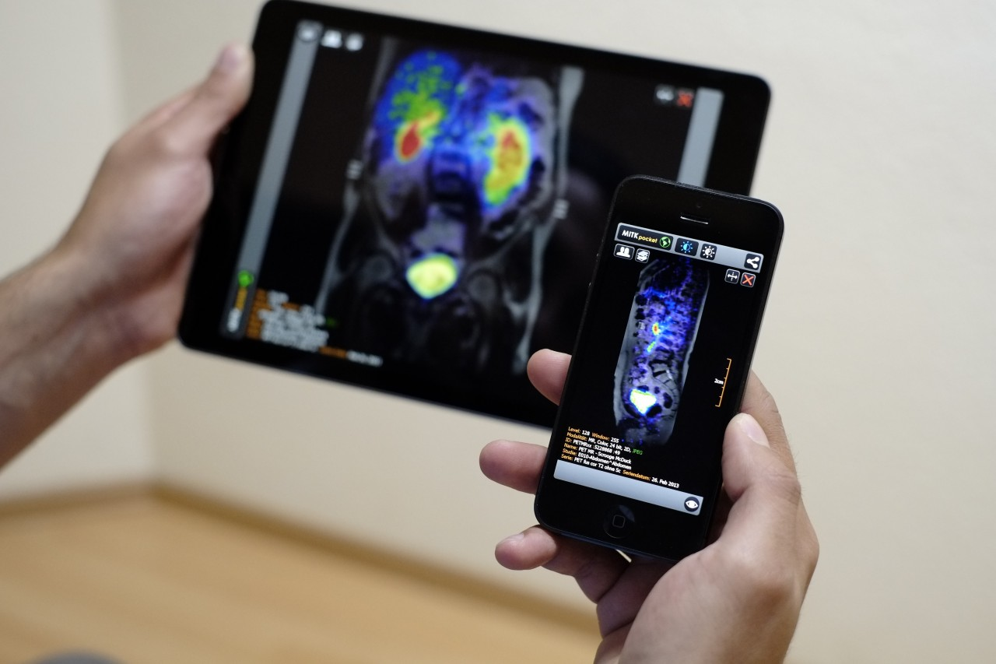
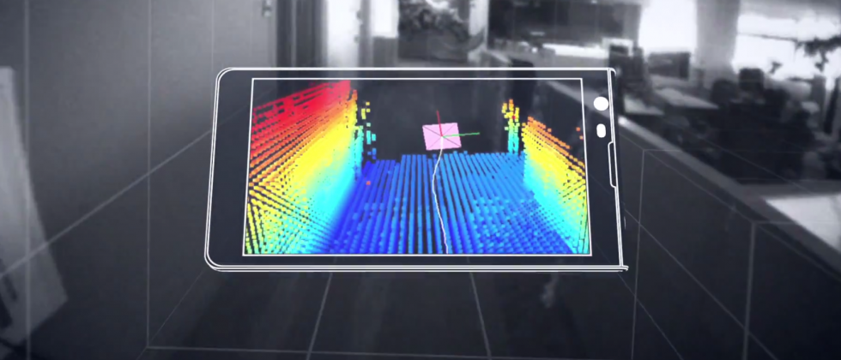
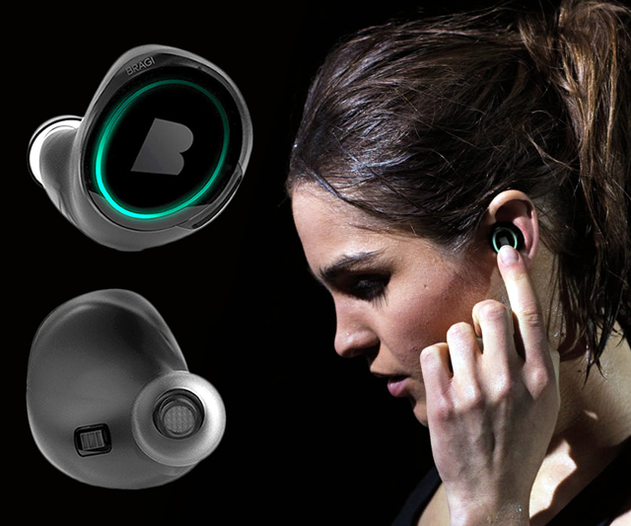
Wireless and Mobile Systems
for the IoT
CMSC 715 : Fall 2024
Lecture 3.2: Statistical Inference for IoT
Nirupam Roy
Tu-Th 12:30-1:45pm
IRB 2207

Slide 2

MoLe
Motion Leaks through Smartwatch Sensors
He Wang
Ted Tsung-Te Lai
Romit Roy Choudhury
UIUC
MobiCom’15 Presentation

Slide 3
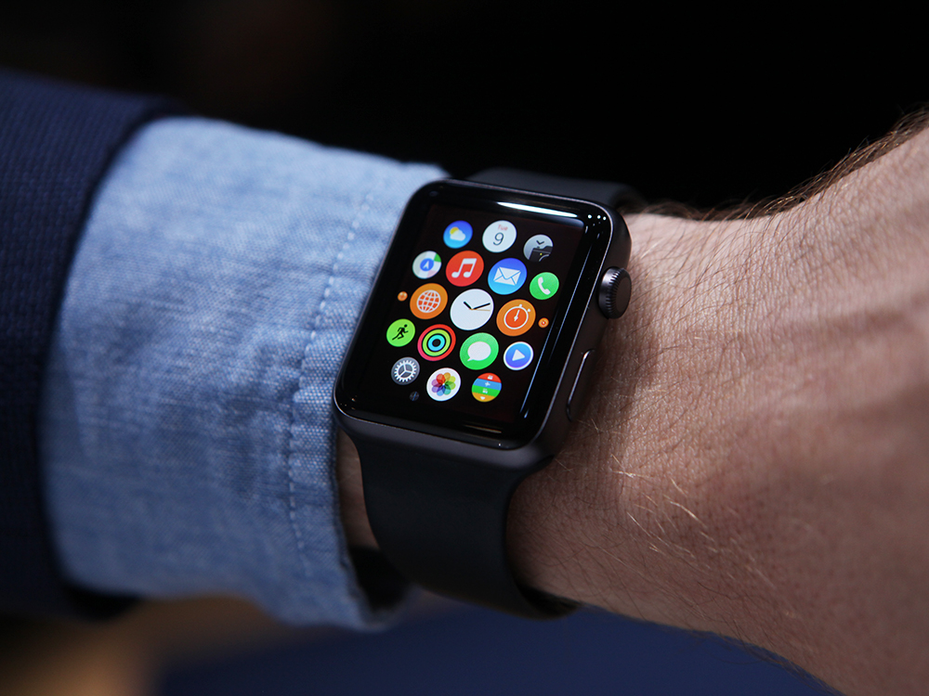
Your Watch Knows About You
More Than You Think?

Slide 4
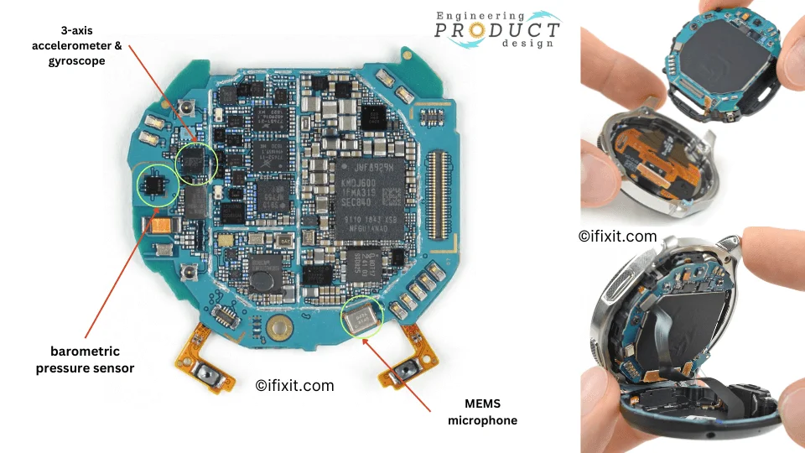

Slide 5
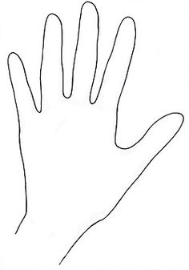
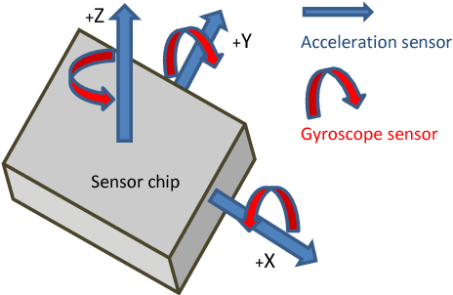
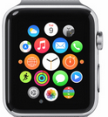
Y Displacement
0
-10
X Displacement

Slide 6
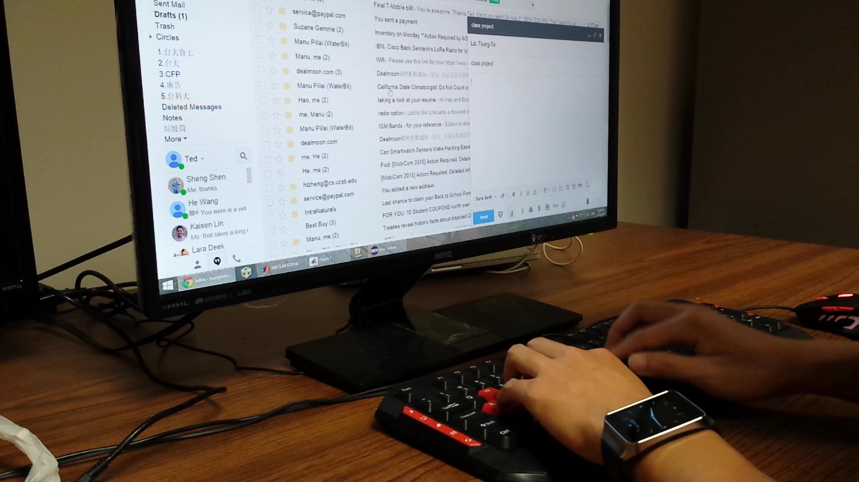
Watch = Spy? Monitor Typing in Background?

Slide 7
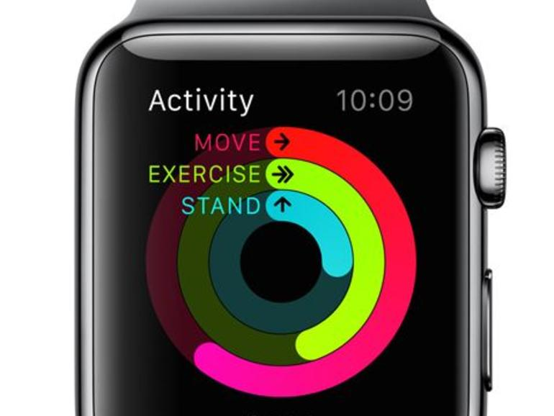
Watch motion sensor to infer input words?

Slide 8
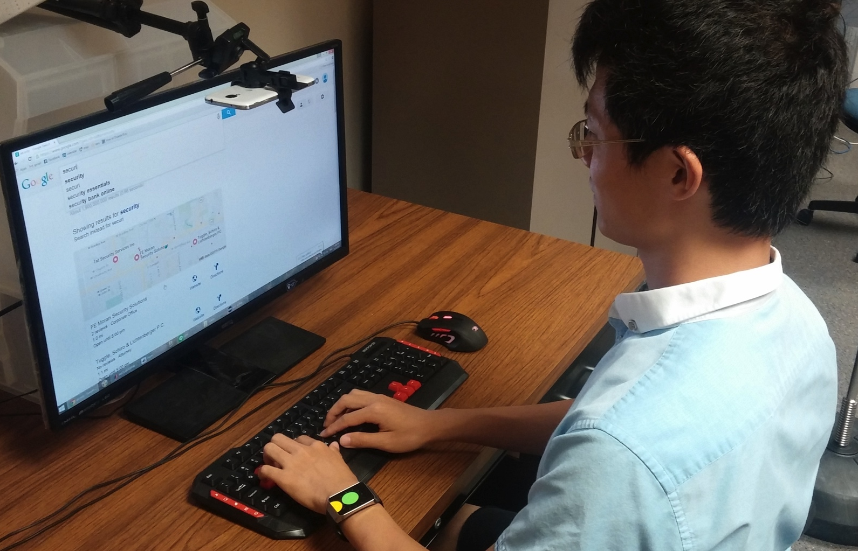
Understand Human Typing

Slide 9
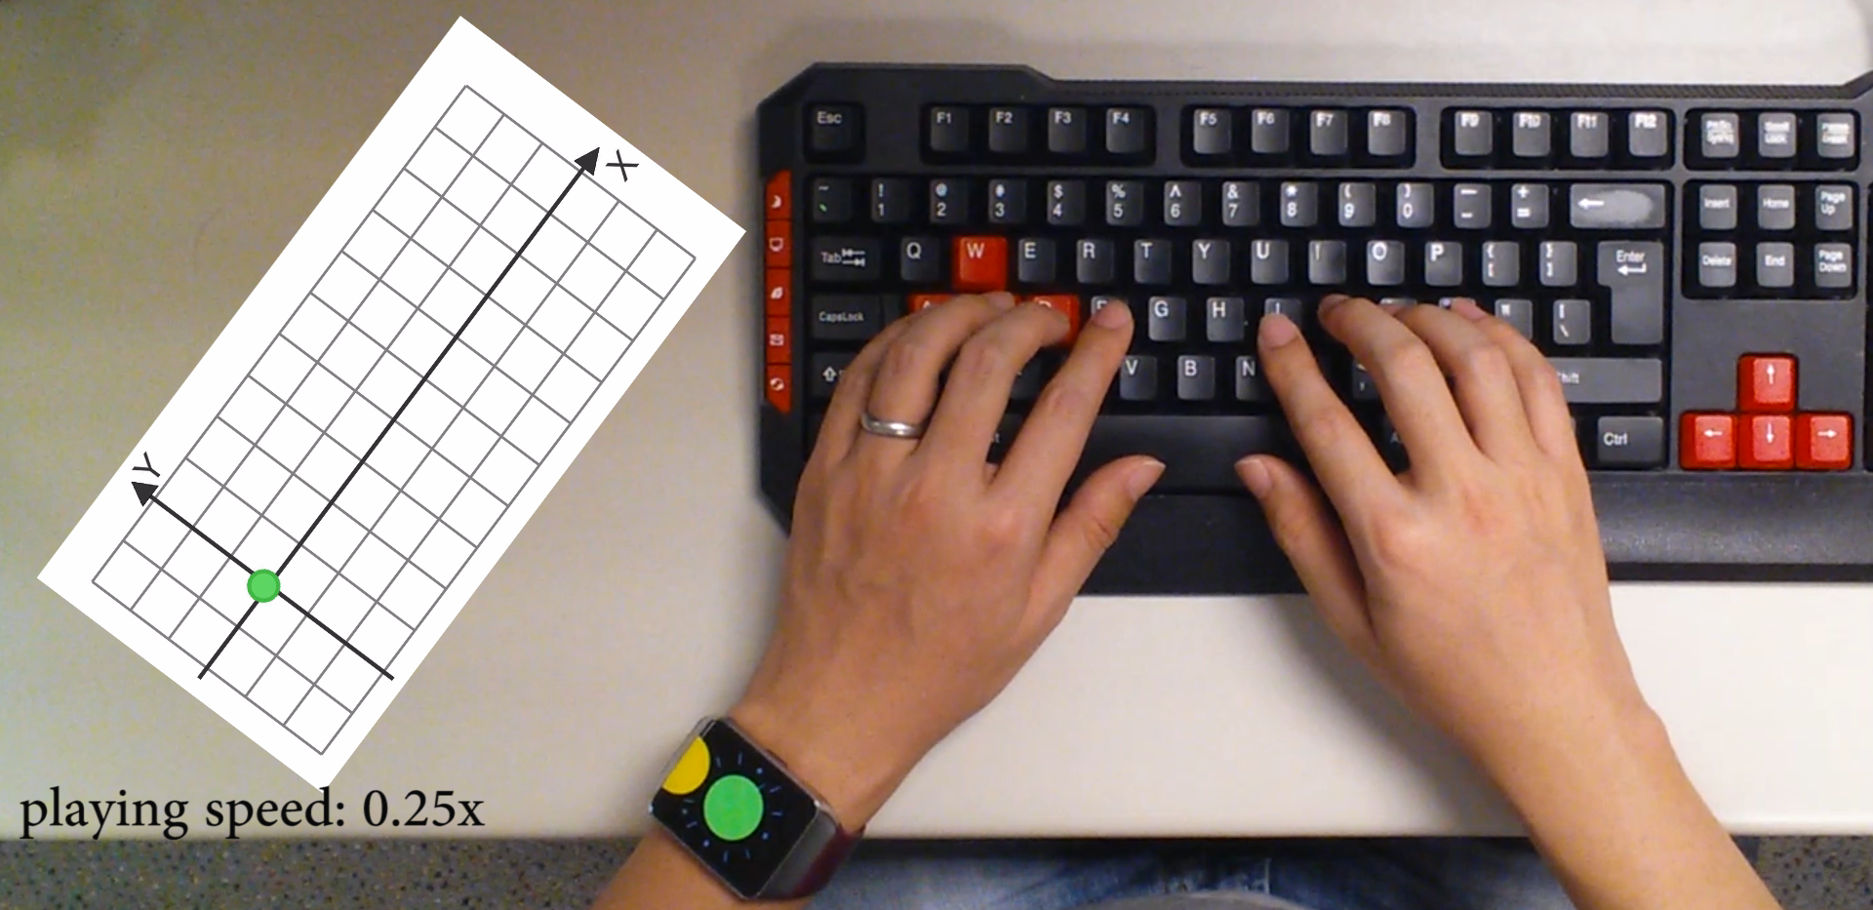
Correlation Between Watch Movement and keystrokes
watch
movement
groundtruth

Slide 10
Design Challenges
Noisy sensor data
Watch location ≠ keystroke
Information from the other hand is missing

Slide 11

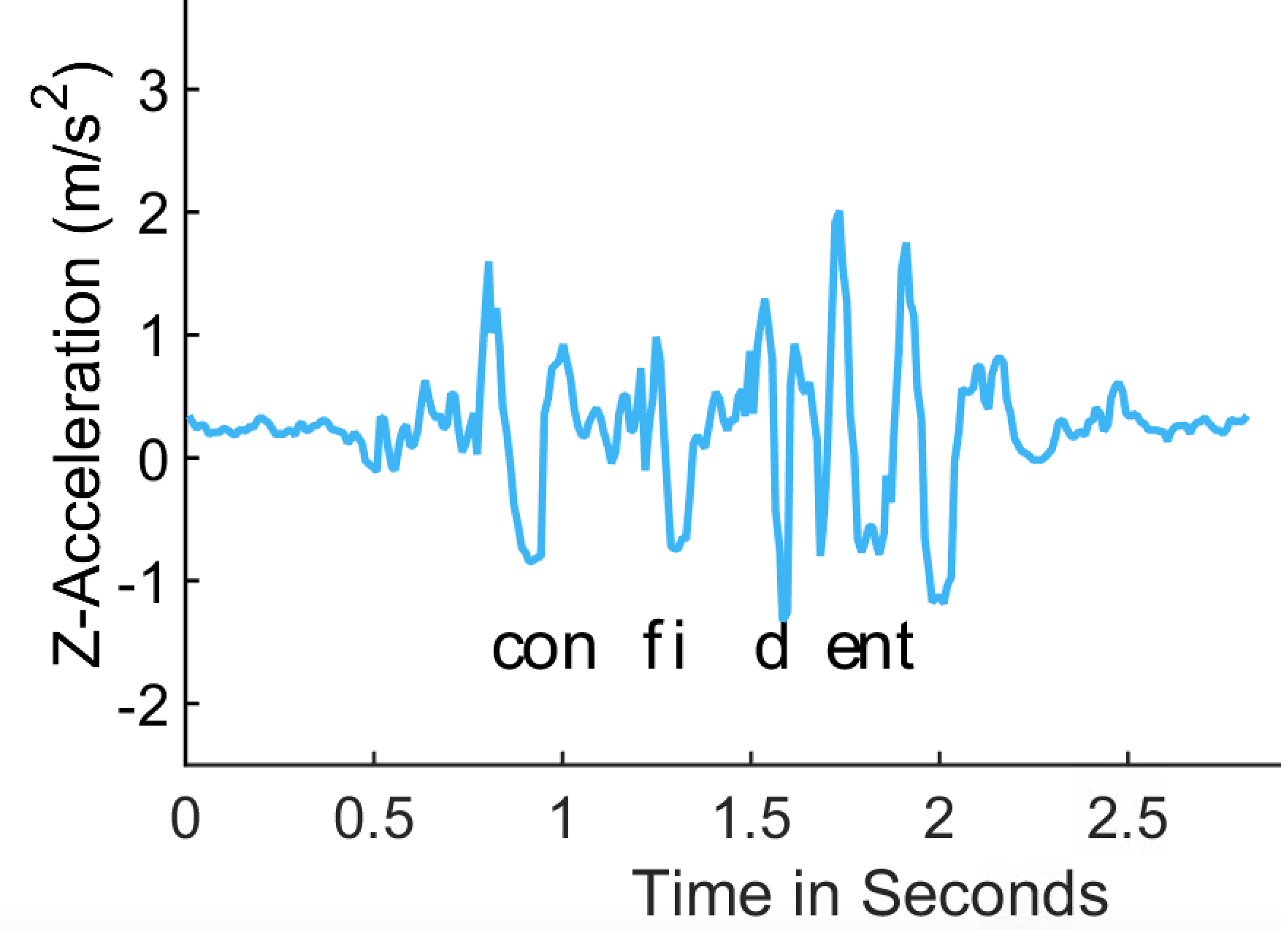
Keystroke Time
Use z-acceleration to infer keystroke time
true positive
false positive
Z-acceleration

Slide 12
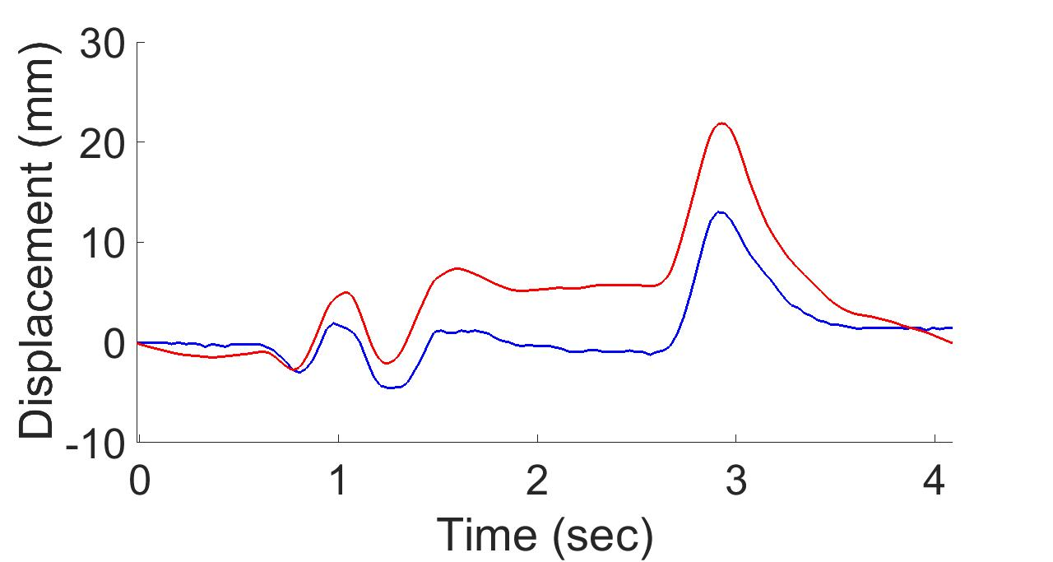
Watch Displacement
Use Android linear acceleration to estimate watch displacement
Android API
ground truth

Slide 13
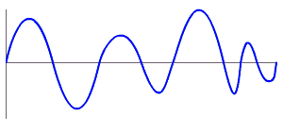
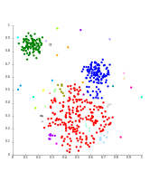
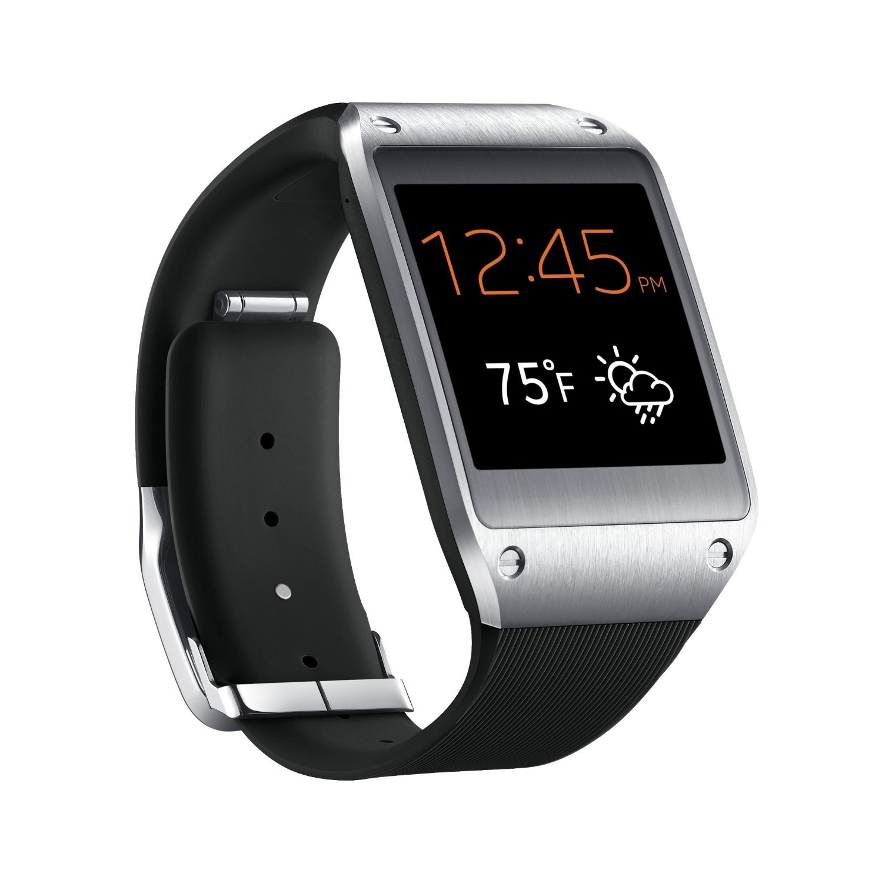
MoLe Architecture
Keystroke
Detector
Time
Location
User Data

Slide 14
Design Challenges
Noisy sensor data
Watch location ≠ keystroke
Information from the other hand is missing

Slide 15
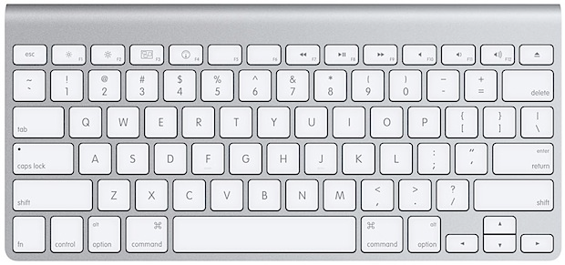
Watch Location ≠ Keystroke
Y Displacement
0
-10
20
X Displacement
Y Displacement (mm)
10
0
-10
-10 0 10 20
X Displacement (mm)

Slide 16
Watch Location ≠ Keystroke
Groundtruth location
20
Y Displacement (mm)
10
0
c
-10
-10 0 10 20
X Displacement (mm)

Slide 17
Watch Location ≠ Keystroke
Groundtruth location
20
Y Displacement (mm)
10
c
0
c
-10
-10 0 10 20
X Displacement (mm)

Slide 18
Watch Location ≠ Keystroke
Groundtruth location
20
Y Displacement (mm)
10
0
x
c
-10
-10 0 10 20
X Displacement (mm)

Slide 19
Watch Location ≠ Keystroke
Groundtruth location
20
Y Displacement (mm)
10
c
x
0
x
c
-10
-10 0 10 20
X Displacement (mm)

Slide 20
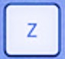
Watch Location ≠ Keystroke
Groundtruth location
20
Y Displacement (mm)
10
0
x
z
c
-10
-10 0 10 20
X Displacement (mm)

Slide 21
Watch Location ≠ Keystroke
Groundtruth location
20
Y Displacement (mm)
10
z
c
cluster
x
0
x
z
c
-10
-10 0 10 20
X Displacement (mm)

Slide 22
Watch Location ≠ Keystroke
Groundtruth location
20
q
Y Displacement (mm)
r
10
w
e
a
d
s
f
0
b
t
x
g
z
c
v
-10
-10 0 10 20
X Displacement (mm)

Slide 23
Watch Location ≠ Keystroke
Unlabeled keystrokes
20
Y Displacement (mm)
10
0
-10
-10 0 10 20
X Displacement (mm)

Slide 24
MoLe Architecture
Keystroke
Detector
Time
Location
User Data

Slide 25
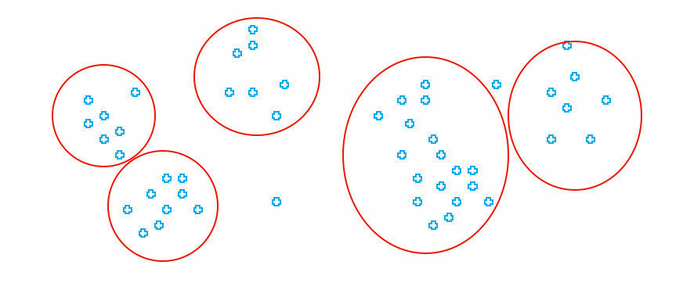
MoLe Architecture
Attacker Training Data
Attacker Point Cloud
a b c d
Keystroke
Detector
Point
Cloud
Fitting
Time
Location
Unlabeled Point Cloud
User Data

Slide 26
Design Challenges
Noisy sensor data
Watch location ≠ keystroke
Information from the other hand is missing

Slide 27
Right Hand Keystrokes Are Missing

Slide 28
MoLe Architecture
Attacker Training Data
Attacker Point Cloud
a b c d
Keystroke
Detector
Point
Cloud
Fitting
Time
Location
Unlabeled Point Cloud
User Data

Slide 29

MoLe Architecture
Attacker Training Data
Rank of Word_{i}
Attacker Point Cloud
a b c d
Keystroke
Detector
Point
Cloud
Fitting
Bayesian
Inference
P(O|W_{i})
Time
Location
Word W_{i}
Unlabeled Point Cloud
Observation ( O )
User Data
Dictionary

Slide 30
Outline
Motivation & Challenge
MoLe
  Keystroke detectors
  Point cloud fitting
  Bayesian inference
Evaluation
Limitations
Conclusion

Slide 31
MoLe Architecture
Attacker Training Data
Rank of Word_{i}
Attacker Point Cloud
a b c d
Keystroke
Detector
Point
Cloud
Fitting
Bayesian
Inference
P(O|W_{i})
Time
Location
Word W_{i}
Unlabeled Point Cloud
Observation ( O )
User Data
Dictionary

Slide 32
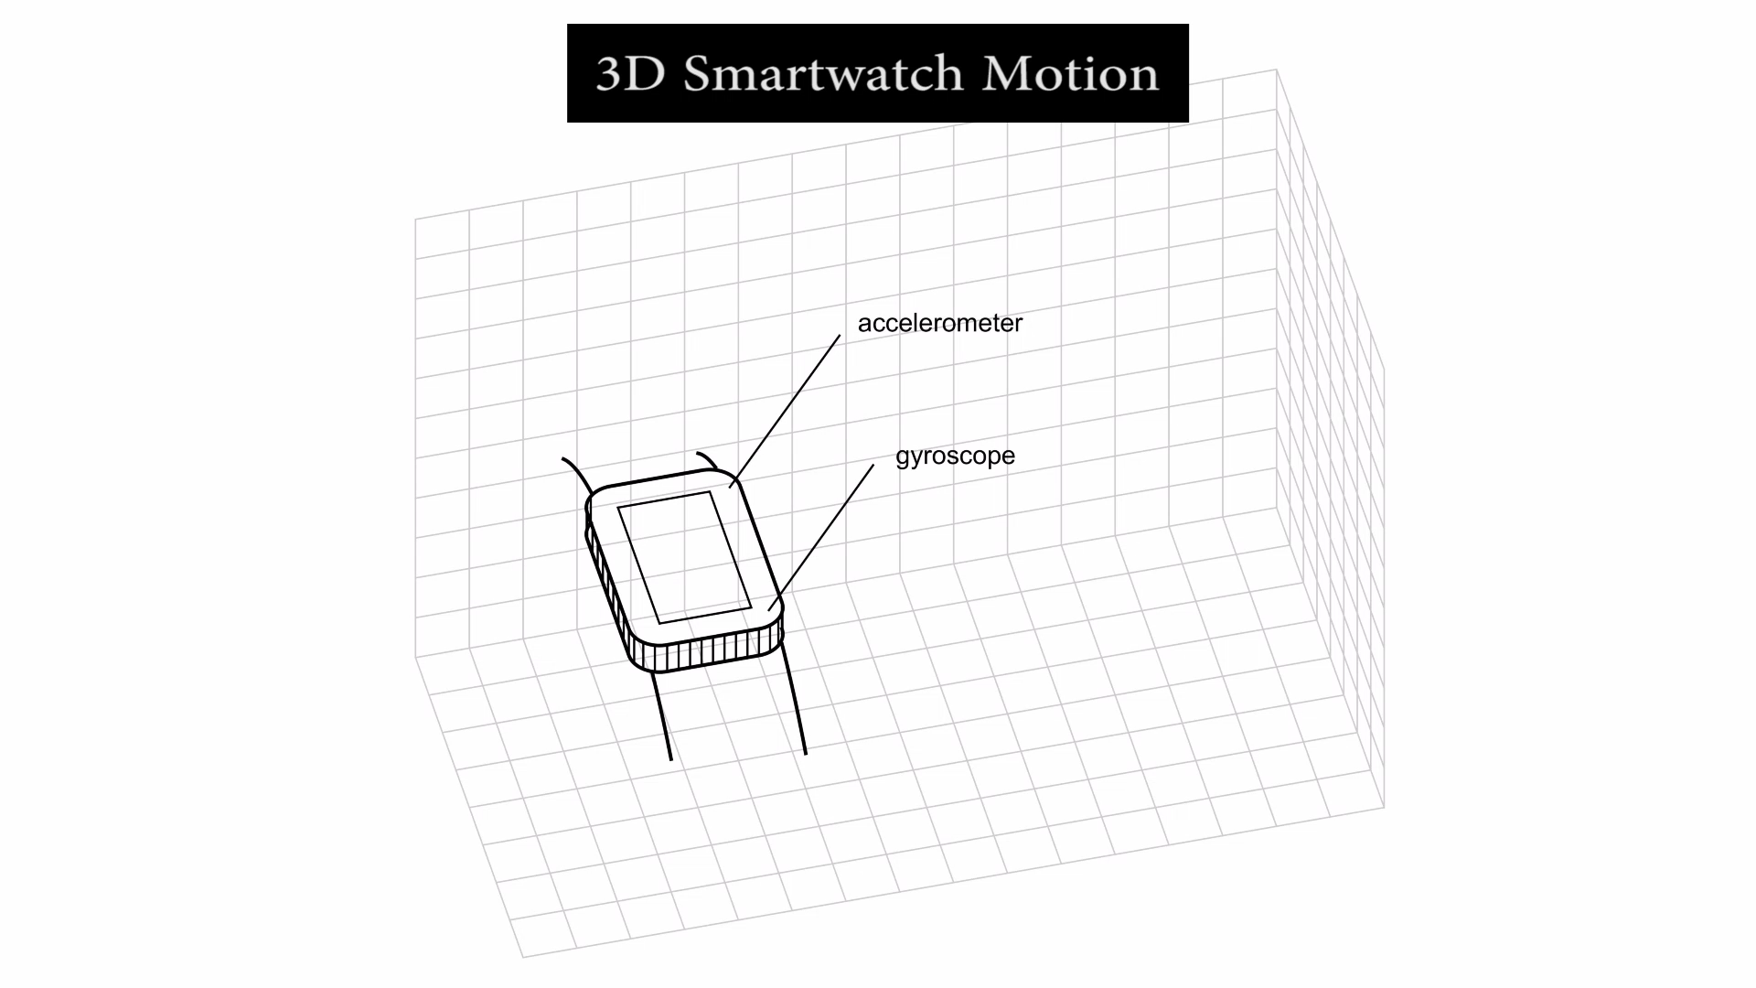
Keystroke Detector

Slide 33
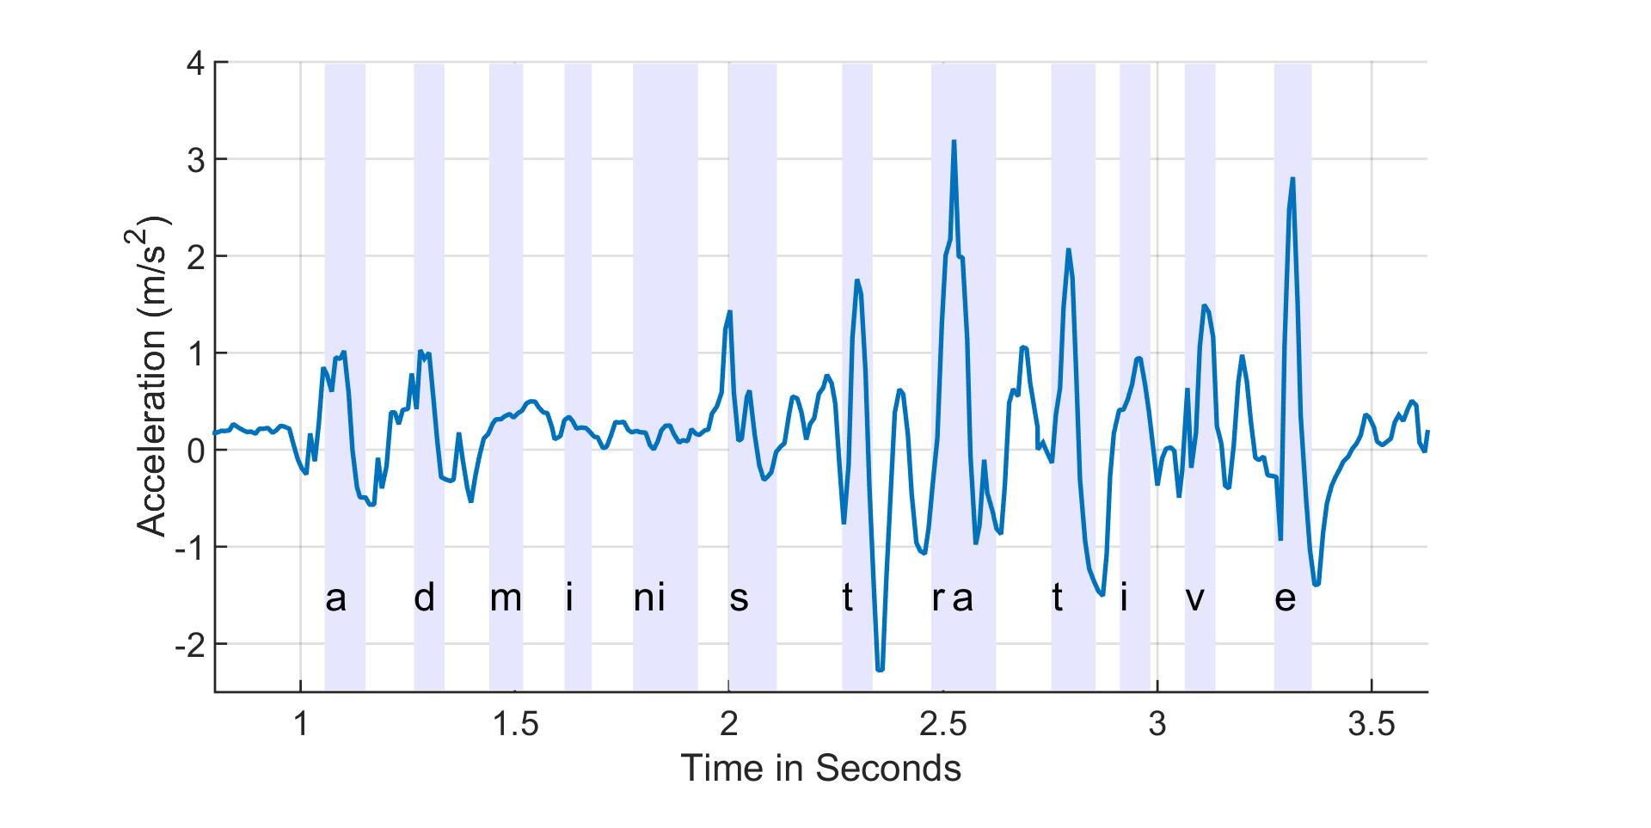
Keystroke Detector - Time
Z-acceleration
z-axis linear acceleration

Slide 34
Keystroke Detector - Time
Peak detection generates errors
z-axis linear acceleration
true detection
false detection

Slide 35
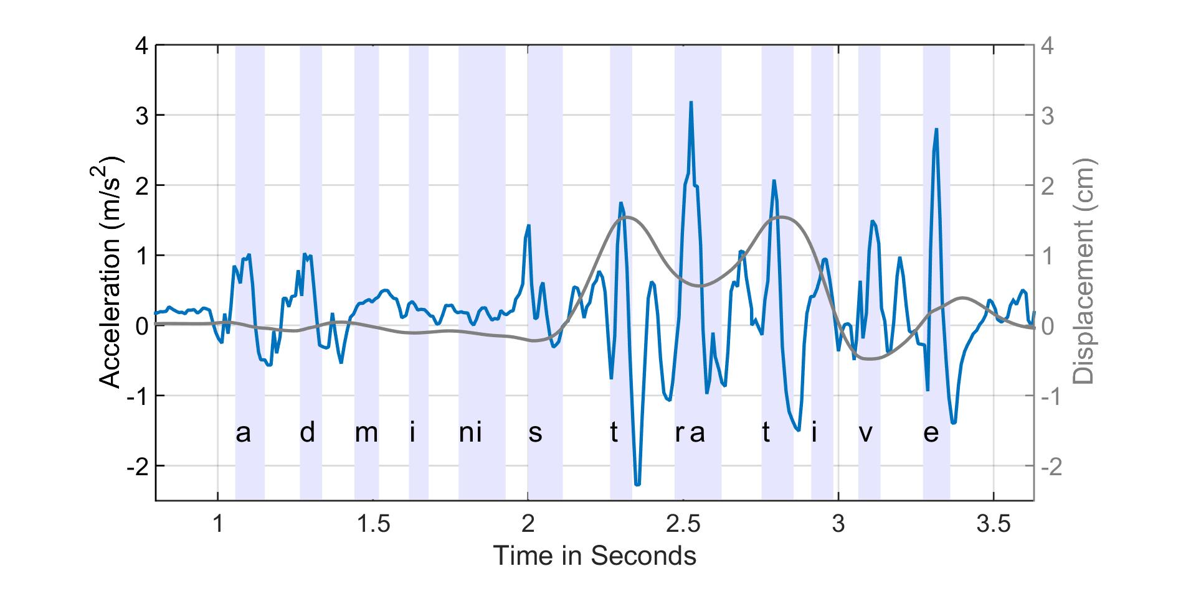
Keystroke Detector - Time
Peak detection generates errors
z-axis linear acceleration
x-axis displacement
true detection
false detection

Slide 36
Keystroke Detector - Time
Use a low threshold peak detection to generate candidates
z-axis linear acceleration
candidates

Slide 37
Keystroke Detector - Time
Apply bagged decision tree to classify keystrokes
z-axis linear acceleration
keystroke
non-keystroke

Slide 38
Keystroke Detector - Time
True positive False positive

Slide 39
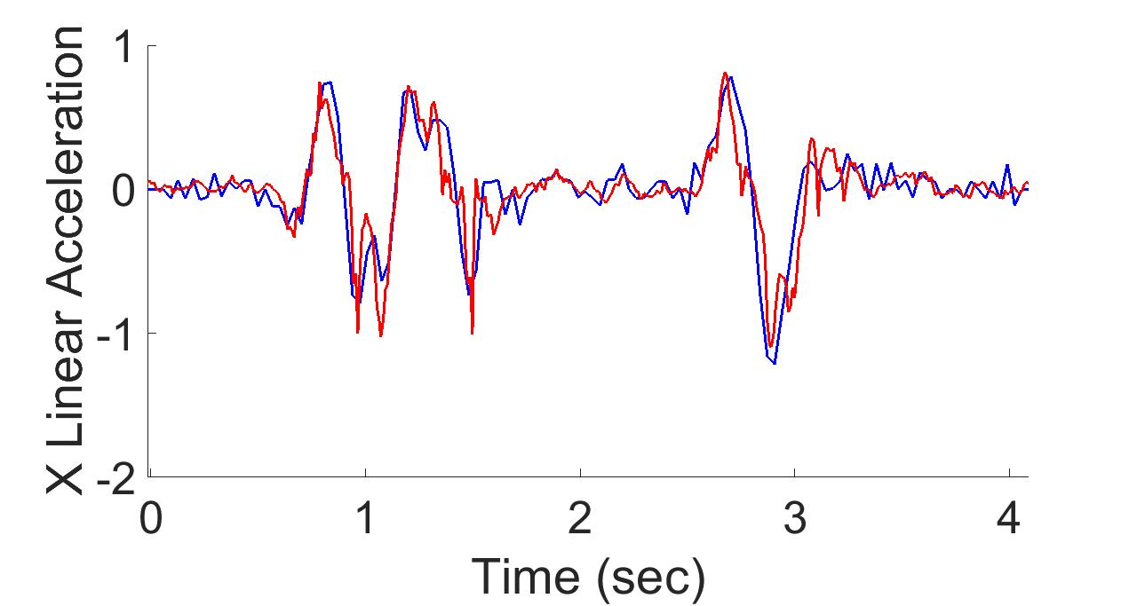
Keystroke Detector - Displacement
ground truth
Android API
double integral with mean removal

Slide 40
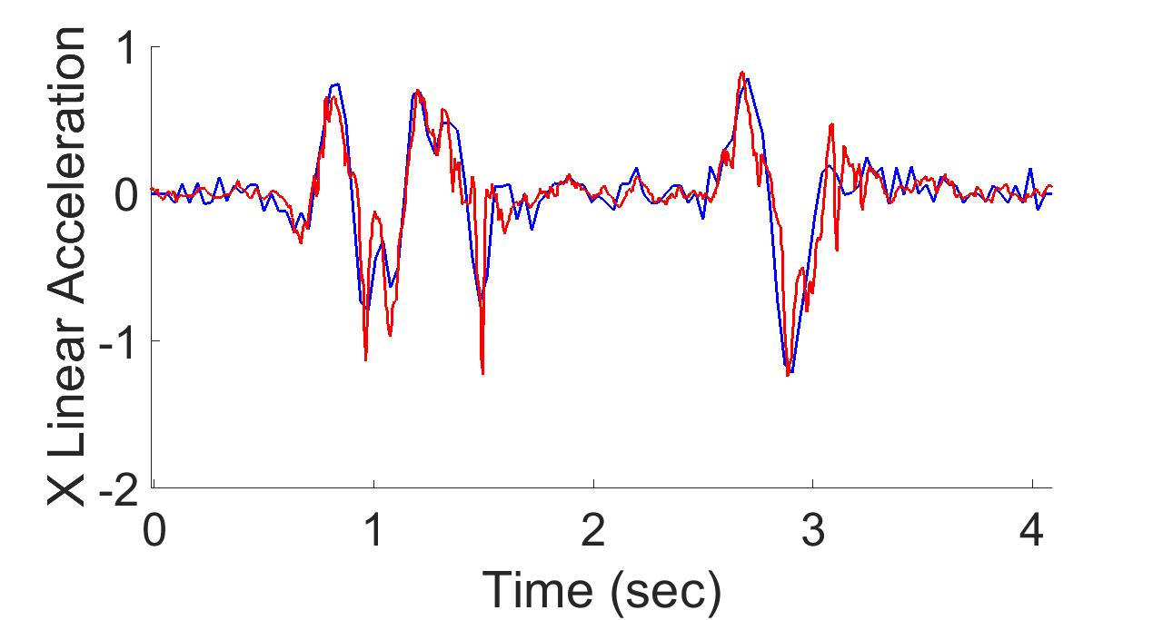
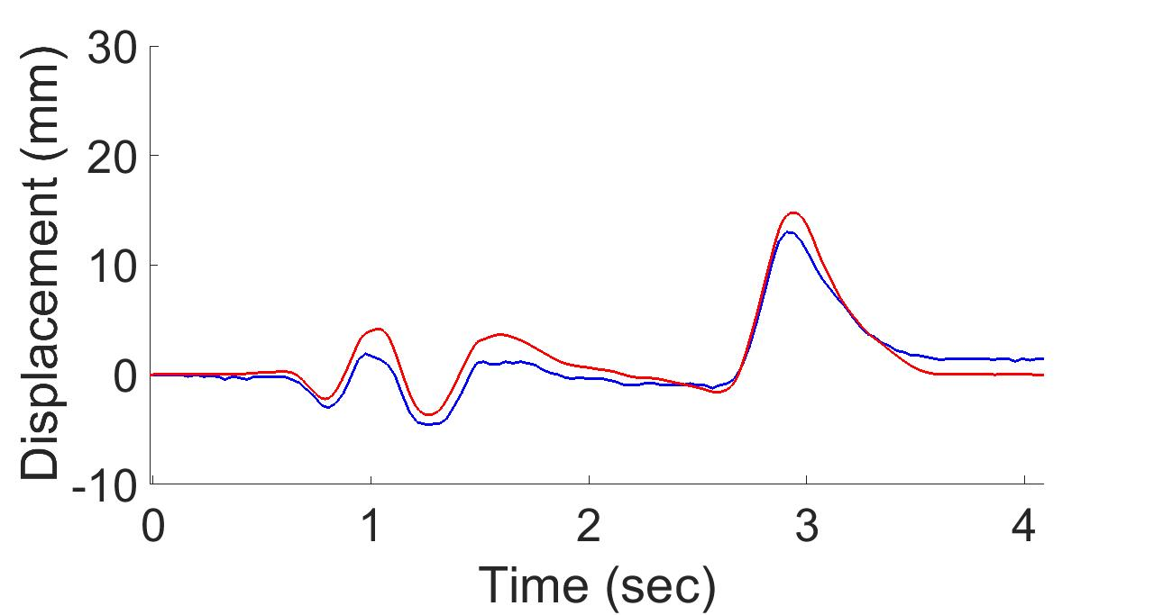
Keystroke Detector - Displacement
ground truth
MoLe
- use gyro to estimate and remove gravity
(with Kalman filter)
double integral with mean removal

Slide 41
Keystroke Detector - Displacement
Mole median error < 1.5mm
Android median error < 2.5mm

Slide 42
MoLe Architecture
Attacker Training Data
Rank of Word_{i}
Attacker Point Cloud
a b c d
Keystroke
Detector
Point
Cloud
Fitting
Bayesian
Inference
P(O|W_{i})
Time
Location
Word W_{i}
Unlabeled Point Cloud
Observation ( O )
User Data
Dictionary

Slide 43
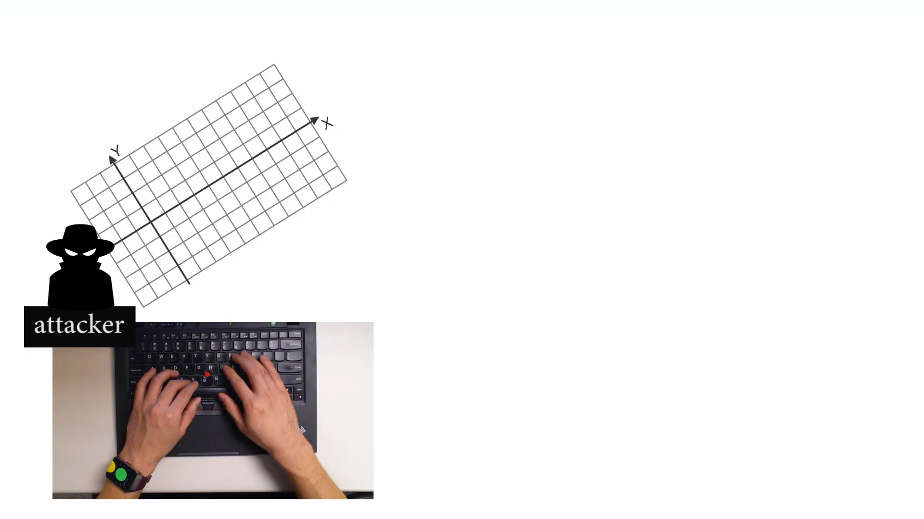
Point Cloud Fitting

Slide 44
Point Cloud Fitting
attacker training data
20
Y Displacement (mm)
Q
10
W
0
A
T
X
-10
-10 0 10 20
X Displacement (mm)

Slide 45
Point Cloud Fitting
user data (unlabeled)
attacker training data
20
Y Displacement (mm)
Q
10
W
0
A
T
X
-10
-10 0 10 20
X Displacement (mm)

Slide 46
Point Cloud Fitting
user data (unlabeled)
attacker training data
20
Y Displacement (mm)
Find convex hulls and centroids
10
0
-10
-10 0 10 20
X Displacement (mm)

Slide 47
Point Cloud Fitting
user data (unlabeled)
attacker training data
20
Y Displacement (mm)
Q
Find convex hulls and centroids
Rotate and scale
10
W
0
A
T
X
-10
-10 0 10 20
X Displacement (mm)

Slide 48
MoLe Architecture
Attacker Training Data
Rank of Word_{i}
Attacker Point Cloud
a b c d
Keystroke
Detector
Point
Cloud
Fitting
Bayesian
Inference
P(O|W_{i})
Time
Location
Word W_{i}
Unlabeled Point Cloud
Observation ( O )
User Data
Dictionary

Slide 49


Bayesian Inference
Input “confident”
Observed
watch motion
MoLe output list
Rank | word guess
1 | confident
2 | consider
3 | commander
… | …
4999 | are
5000 | is
Compute
likelihood
word₁
word₂
word₃
…
word₄₉₉₉
word₅₀₀₀

