Slide 1
CSMC 412
Operating Systems
Prof. Ashok K Agrawala
Ashok Agrawala
Set 7 Threads

Slide 2
Threads
Overview
Multicore Programming
Multithreading Models
Thread Libraries
Implicit Threading
Threading Issues
Operating System Examples

Slide 3
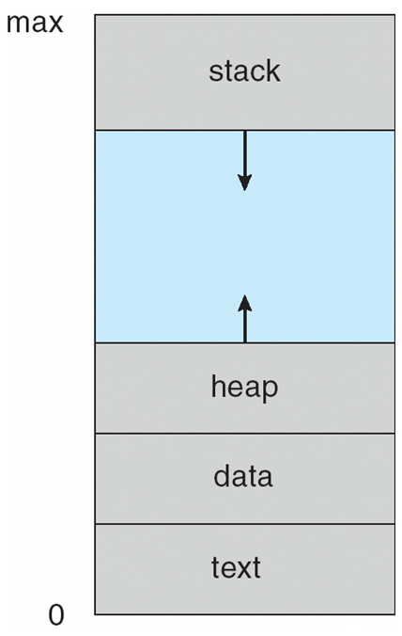
Process
PC
…
Address Space

Slide 4
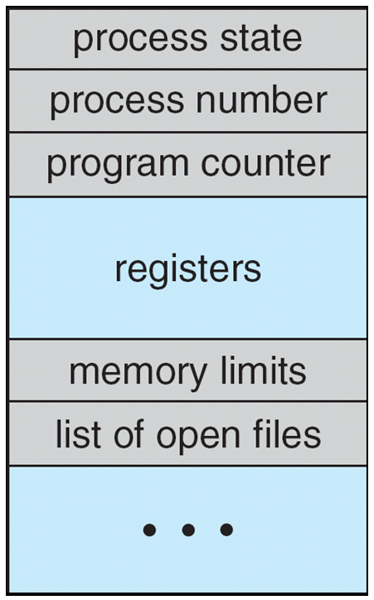
Process Control Block (PCB)
Information associated with each process
(also called task control block)
Process state – running, waiting, etc
Program counter – location of instruction to next execute
CPU registers – contents of all process-centric registers
CPU scheduling information- priorities, scheduling queue pointers
Memory-management information – memory allocated to the process
Accounting information – CPU used, clock time elapsed since start, time limits
I/O status information – I/O devices allocated to process, list of open files

Slide 5
Multiple Processors
CPU A
CPU B
GPRs
GPRs
CACHE
CACHE
Memory

Slide 6
Process
Address Space
CPU A
PC
GPRs
CACHE
Process A
CPU B
PC
GPRs
CACHE
Process B

Slide 7
Threads
Address Space
CPU A
PC
GPRs
CACHE
CPU B
Process B
PC
GPRs
CACHE

Slide 8
Motivation
Most modern applications are multithreaded
Threads run within application
Multiple tasks with the application can be implemented by separate threads
  Update display
  Fetch data
  Spell checking
  Answer a network request
Process creation is heavy-weight while thread creation is light-weight
Can simplify code, increase efficiency
Kernels are generally multithreaded

Slide 9
Multithreaded Server Architecture

Slide 10
Benefits
Responsiveness – may allow continued execution if part of process is blocked, especially important for user interfaces
Resource Sharing – threads share resources of process, easier than shared memory or message passing
Economy – cheaper than process creation, thread switching lower overhead than context switching
Scalability – process can take advantage of multiprocessor architectures

Slide 11
Multicore Programming
Multicore or multiprocessor systems putting pressure on programmers, challenges include:
  Dividing activities
  Balance
  Data splitting
  Data dependency
  Testing and debugging
Parallelism implies a system can perform more than one task simultaneously
Concurrency supports more than one task making progress
  Single processor / core, scheduler providing concurrency

Slide 12
Concurrency vs. Parallelism
Concurrent execution on single-core system:
Parallelism on a multi-core system:

Slide 14
Multicore Programming (Cont.)
Types of parallelism
  Data parallelism – distributes subsets of the same data across multiple cores, same operation on each
  Task parallelism – distributing threads across cores, each thread performing unique operation
As # of threads grows, so does architectural support for threading
  CPUs have cores as well as hardware threads
  Consider Oracle SPARC T4 with 8 cores, and 8 hardware threads per core

Slide 15
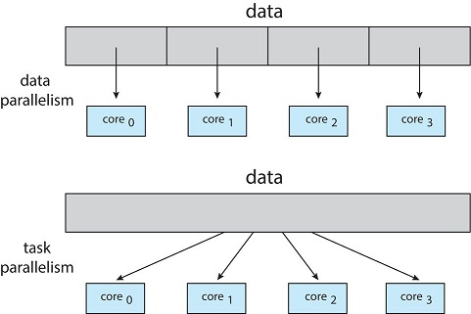
Data and Task Parallelism

Slide 16
Single and Multithreaded Processes

Slide 17
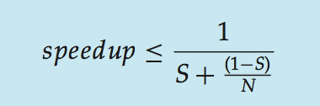
Amdahl’s Law
Identifies performance gains from adding additional cores to an application that has both serial and parallel components
S is serial portion
N processing cores
That is, if application is 75% parallel / 25% serial, moving from 1 to 2 cores results in speedup of 1.6 times
As N approaches infinity, speedup approaches 1 / S
Serial portion of an application has disproportionate effect on performance gained by adding additional cores
But does the law take into account contemporary multicore systems?

Slide 18
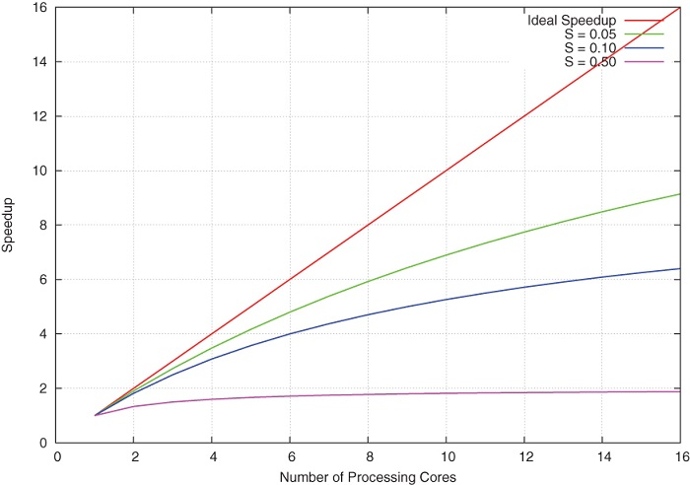
Amdahl’s Law

Slide 19
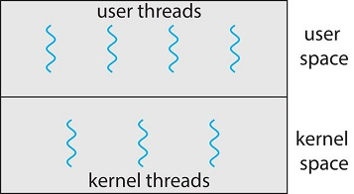
User Threads and Kernel Threads
User threads - management done by user-level threads library
Three primary thread libraries:
  POSIX Pthreads
  Windows threads
  Java threads
Kernel threads - Supported by the Kernel
Examples – virtually all general-purpose operating systems, including:
  Windows
  Solaris
  Linux
  Tru64 UNIX
  Mac OS X

Slide 20
Multithreading Models
Many-to-One
One-to-One
Many-to-Many

Slide 21
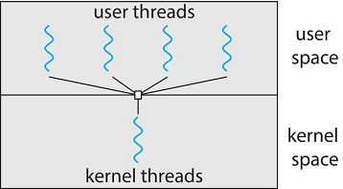
Many-to-One
Many user-level threads mapped to single kernel thread
One thread blocking causes all to block
Multiple threads may not run in parallel on muticore system because only one may be in kernel at a time
Few systems currently use this model
Examples:
  Solaris Green Threads
  GNU Portable Threads

Slide 22
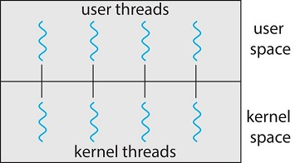
One-to-One
Each user-level thread maps to kernel thread
Creating a user-level thread creates a kernel thread
More concurrency than many-to-one
Number of threads per process sometimes restricted due to overhead
Examples
  Windows
  Linux
  Solaris 9 and later

Slide 23
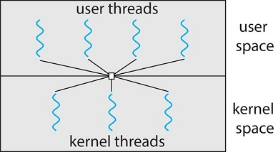
Many-to-Many Model
Allows many user level threads to be mapped to many kernel threads
Allows the operating system to create enough kernel threads
Solaris prior to version 9
Windows with the ThreadFiber package

Slide 24
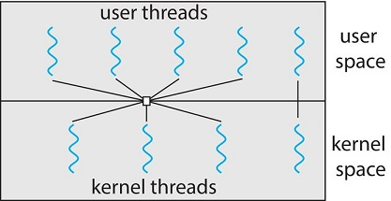
Two-level Model
Similar to M:M, except that it allows a user thread to be bound to kernel thread
Examples
  IRIX
  HP-UX
  Tru64 UNIX
  Solaris 8 and earlier

Slide 25
Thread Libraries
Thread library provides programmer with API for creating and managing threads
Two primary ways of implementing
  Library entirely in user space
  Kernel-level library supported by the OS

Slide 26
Pthreads
May be provided either as user-level or kernel-level
A POSIX standard (IEEE 1003.1c) API for thread creation and synchronization
Specification, not implementation
API specifies behavior of the thread library, implementation is up to development of the library
Common in UNIX operating systems (Solaris, Linux, Mac OS X)

Slide 27
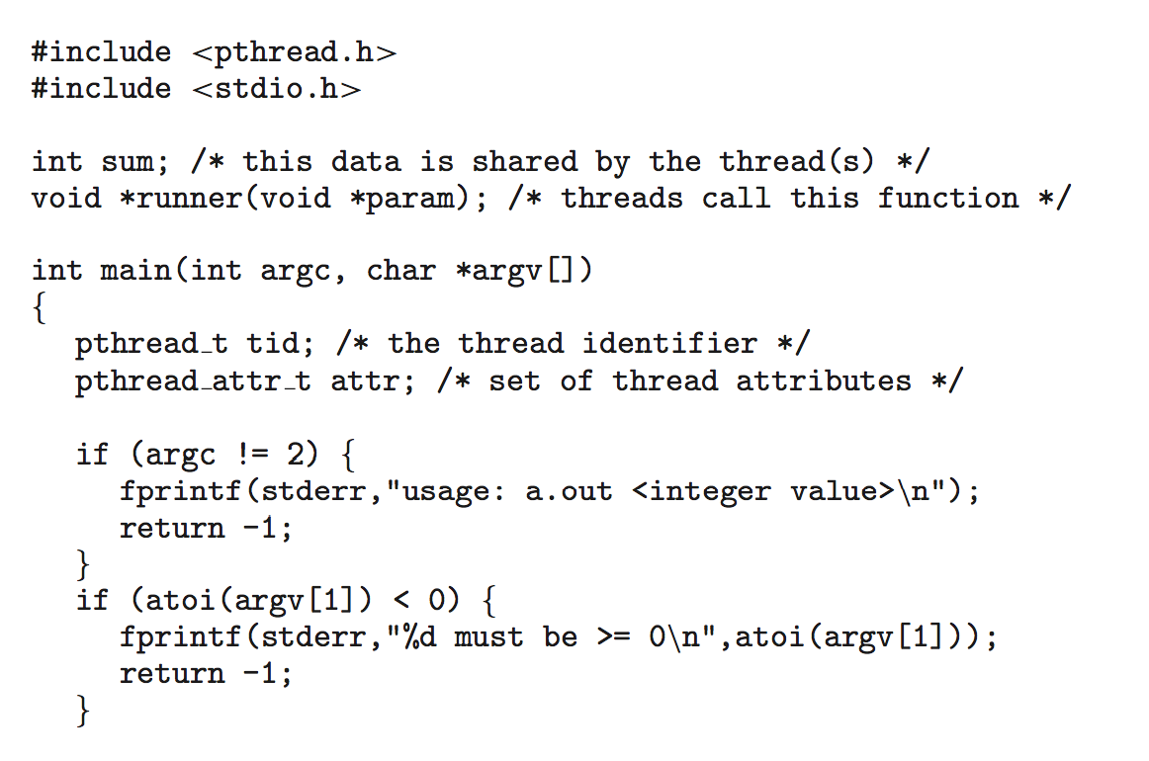
Pthreads Example
Notes:
All Pthreads programs must include the pthread.h header file. The statement pthread_t tid declares the identifier for the thread we will create. Each thread has a set of attributes, including stack size and scheduling information. The pthread_attr_t attr declaration represents the attributes for the thread. We set the attributes in the function call pthread_attr_init(&attr). Because we did not explicitly set any attributes, we use the default attributes provided. (In the chapter CPU Scheduling, we discuss some of the scheduling attributes provided by the Pthreads API.) A separate thread is created with the pthread_create() function call. In addition to passing the thread identifier and the attributes for the thread, we also pass the name of the function where the new thread will begin execution—in this case, the runner() function. Last, we pass the integer parameter that was provided on the command line, argv[1].
At this point, the program has two threads: the initial (or parent) thread in main() and the summation (or child) thread performing the summation operation in the runner() function. This program follows the thread create/join strategy, whereby after creating the summation thread, the parent thread will wait for it to terminate by calling the pthread_join() function. The summation thread will terminate when it calls the function pthread_exit(). Once the summation thread has returned, the parent thread will output the value of the shared data sum.

Slide 28
Pthreads Example (Cont.)

Slide 29
Pthreads Code for Joining 10 Threads

Slide 30
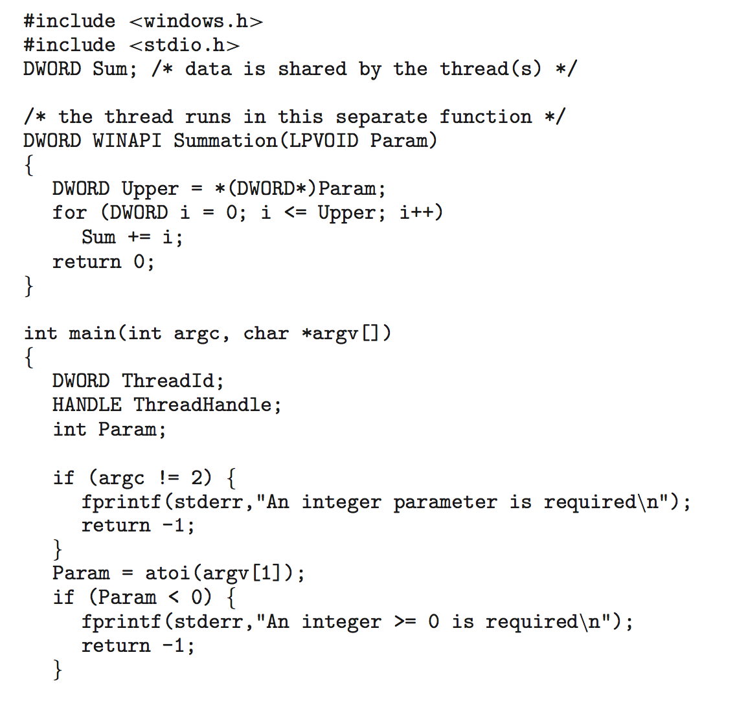
Windows Multithreaded C Program

Slide 31
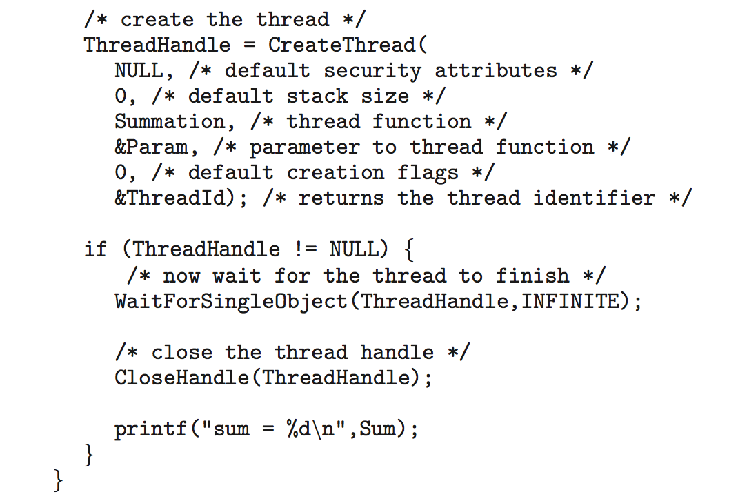
Windows Multithreaded C Program (Cont.)

Slide 32
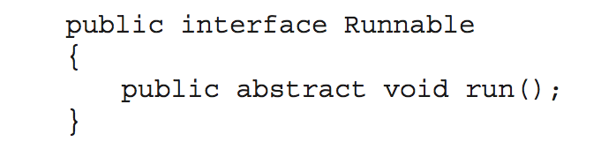
Java Threads
Java threads are managed by the JVM
Typically implemented using the threads model provided by underlying OS
Java threads may be created by:
  Extending Thread class
  Implementing the Runnable interface

Slide 33
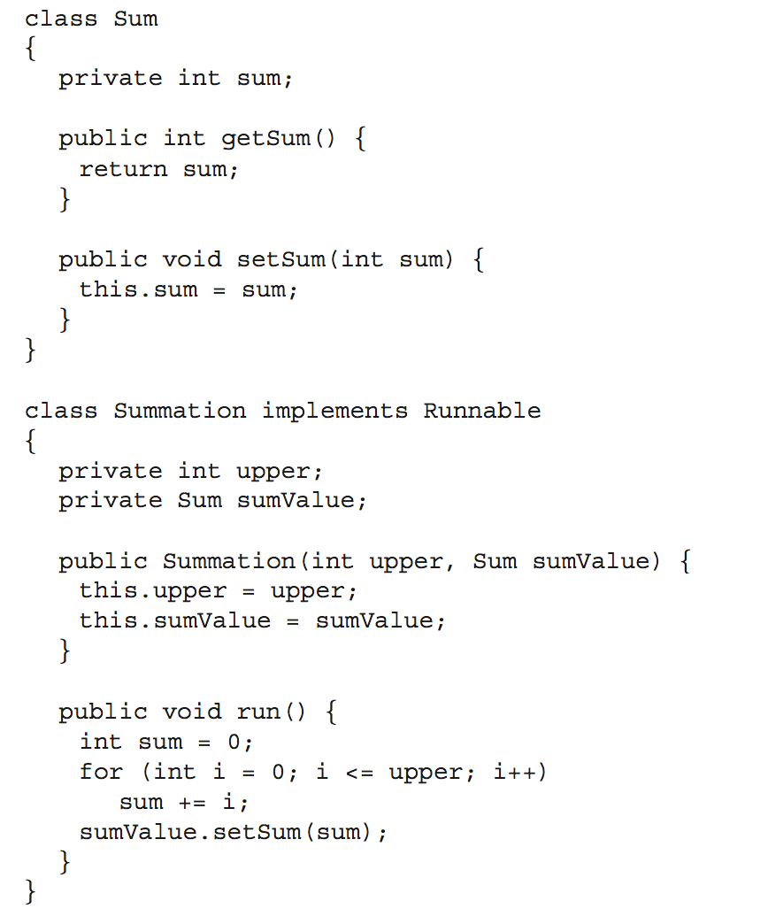
Java Multithreaded Program

Slide 34
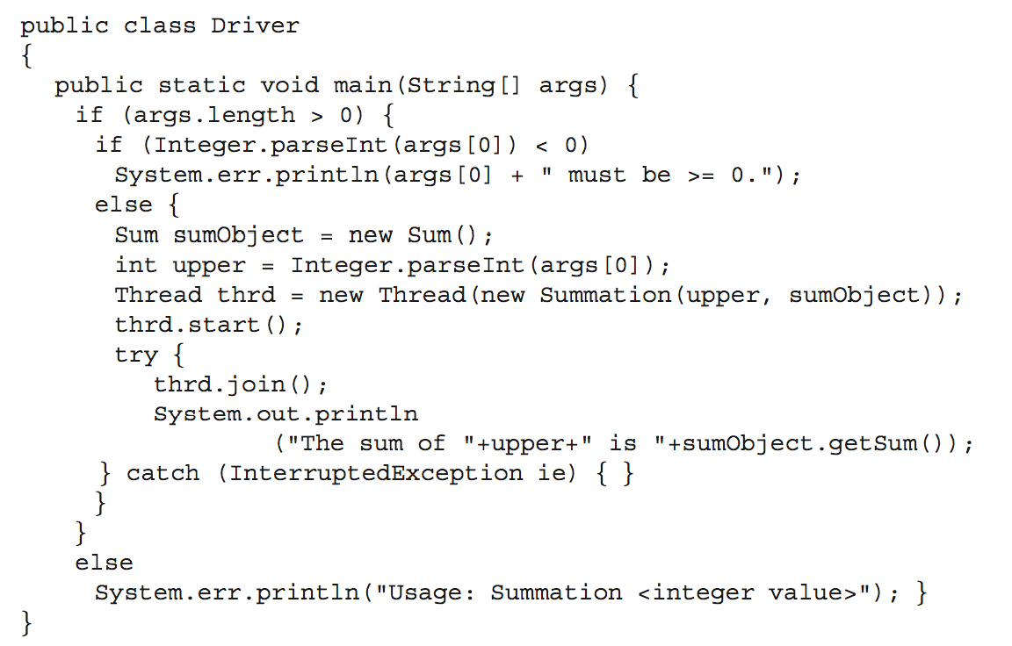
Java Multithreaded Program (Cont.)

Slide 35
Implicit Threading
Growing in popularity as numbers of threads increase, program correctness more difficult with explicit threads
Creation and management of threads done by compilers and run-time libraries rather than programmers
Three methods explored
  Thread Pools
  OpenMP
  Grand Central Dispatch
Other methods include Microsoft Threading Building Blocks (TBB), java.util.concurrent package

Slide 36
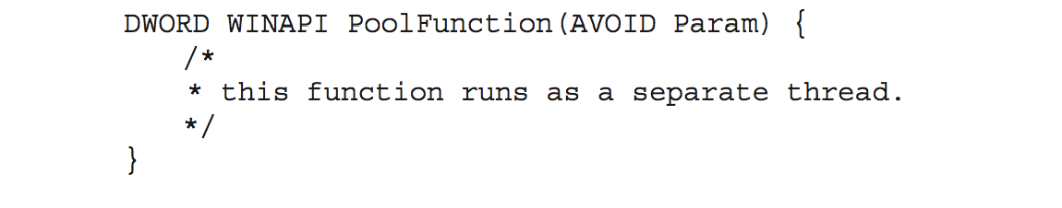
Thread Pools
Create a number of threads in a pool where they await work
Advantages:
  Usually slightly faster to service a request with an existing thread than create a new thread
  Allows the number of threads in the application(s) to be bound to the size of the pool
  Separating task to be performed from mechanics of creating task allows different strategies for running task
    i.e.Tasks could be scheduled to run periodically
Windows API supports thread pools:

Slide 37
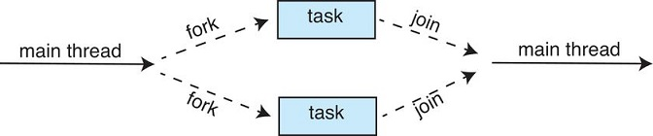
Fork Join

Slide 38
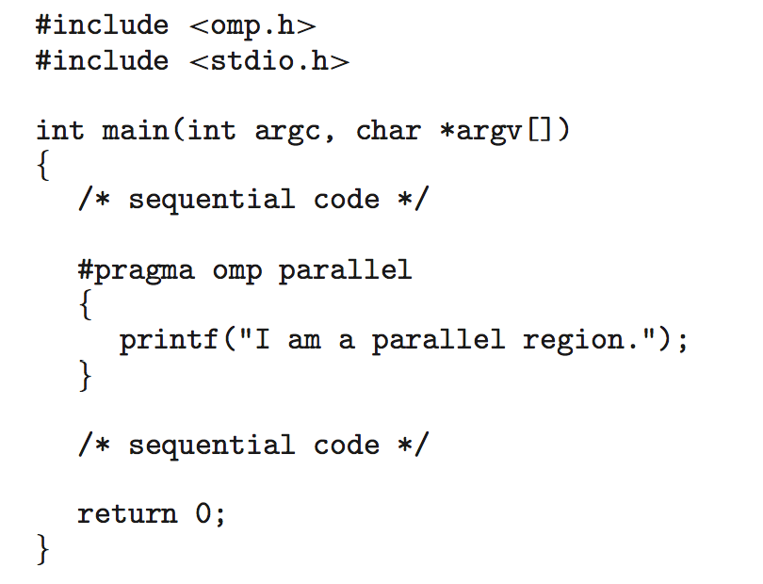
OpenMP
Set of compiler directives and an API for C, C++, FORTRAN
Provides support for parallel programming in shared-memory environments
Identifies parallel regions – blocks of code that can run in parallel
#pragma omp parallel
Create as many threads as there are cores
#pragma omp parallel for for(i=0;i<N;i++) {
c[i] = a[i] + b[i];
}
Run for loop in parallel

Slide 39
Grand Central Dispatch
Apple technology for Mac OS X and iOS operating systems
Extensions to C, C++ languages, API, and run-time library
Allows identification of parallel sections
Manages most of the details of threading
Block is in “^{ }” - ˆ{ printf("I am a block"); }
Blocks placed in dispatch queue
  Assigned to available thread in thread pool when removed from queue

Slide 40
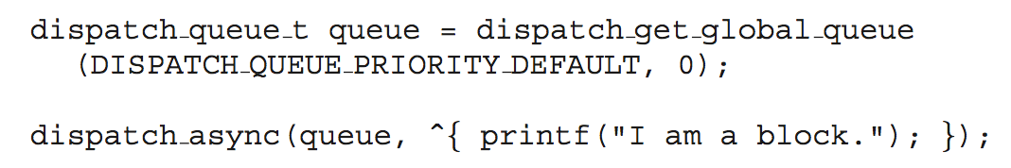
Grand Central Dispatch
Two types of dispatch queues:
  serial – blocks removed in FIFO order, queue is per process, called main queue
    Programmers can create additional serial queues within program
  concurrent – removed in FIFO order but several may be removed at a time
    Three system wide queues with priorities low, default, high

Slide 41
Intel Thread Building Blocks
Template Library for designing parallel applications
  Developer specifies what tasks can run in parallel
Schedular provides load balancing, etc.
Support for
  Parallel loop structures
  Atomic operations
  Mutual exclusion locking
  Concurrent Data Structures
    Queues
    Vectors

Slide 42
Threading Issues
Semantics of fork() and exec() system calls
Signal handling
  Synchronous and asynchronous
Thread cancellation of target thread
  Asynchronous or deferred
Thread-local storage
Scheduler Activations

Slide 43
Semantics of fork() and exec()
Does fork()duplicate only the calling thread or all threads?
  Some UNIXes have two versions of fork
exec() usually works as normal – replace the running process including all threads

Slide 44
Signal Handling
Signals are used in UNIX systems to notify a process that a particular event has occurred.
A signal handler is used to process signals
  Signal is generated by a particular event
  Signal is delivered to a process
  Signal is handled by one of two signal handlers:
    default
    user-defined
Every signal has default handler that kernel runs when handling signal
  User-defined signal handler can override default
  For single-threaded, signal delivered to process

Slide 45
Signal Handling (Cont.)
Where should a signal be delivered for multi-threaded?
  Deliver the signal to the thread to which the signal applies
  Deliver the signal to every thread in the process
  Deliver the signal to certain threads in the process
  Assign a specific thread to receive all signals for the process

Slide 46
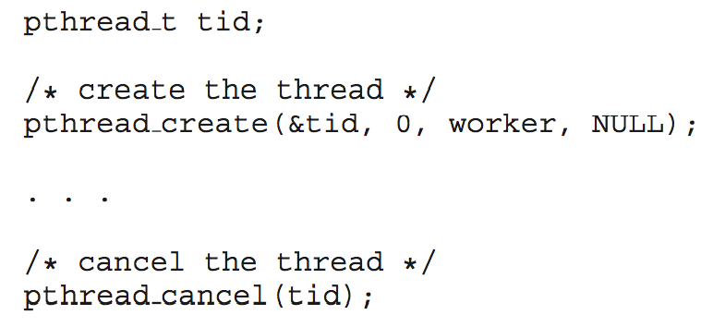
Thread Cancellation
Terminating a thread before it has finished
Thread to be canceled is target thread
Two general approaches:
  Asynchronous cancellation terminates the target thread immediately
  Deferred cancellation allows the target thread to periodically check if it should be cancelled
Pthread code to create and cancel a thread:

Slide 47
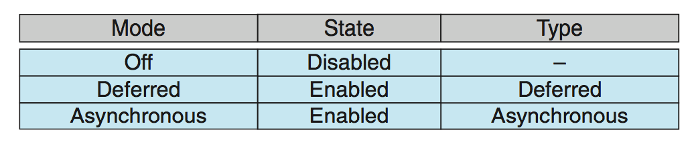
Thread Cancellation (Cont.)
Invoking thread cancellation requests cancellation, but actual cancellation depends on thread state
If thread has cancellation disabled, cancellation remains pending until thread enables it
Default type is deferred
  Cancellation only occurs when thread reaches cancellation point
    I.e. pthread_testcancel()
    Then cleanup handler is invoked
On Linux systems, thread cancellation is handled through signals

Slide 48
Thread-Local Storage
Thread-local storage (TLS) allows each thread to have its own copy of data
Useful when you do not have control over the thread creation process (i.e., when using a thread pool)
Different from local variables
  Local variables visible only during single function invocation
  TLS visible across function invocations
Similar to static data
  TLS is unique to each thread

Slide 49
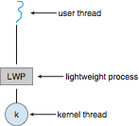
Scheduler Activations
Both M:M and Two-level models require communication to maintain the appropriate number of kernel threads allocated to the application
Typically use an intermediate data structure between user and kernel threads – lightweight process (LWP)
  Appears to be a virtual processor on which process can schedule user thread to run
  Each LWP attached to kernel thread
  How many LWPs to create?
Scheduler activations provide upcalls - a communication mechanism from the kernel to the upcall handler in the thread library
This communication allows an application to maintain the correct number kernel threads

Slide 50
Operating System Examples
Windows Threads
Linux Threads
Notes:
50

Slide 51
Windows Threads
Windows implements the Windows API
  primary API for Win 98, Win NT, Win 2000, Win XP, and Win 7,10,11
Implements the one-to-one mapping, kernel-level
Each thread contains
  A thread id
  Register set representing state of processor
  Separate user and kernel stacks for when thread runs in user mode or kernel mode
  Private data storage area used by run-time libraries and dynamic link libraries (DLLs)
The register set, stacks, and private storage area are known as the context of the thread

Slide 52
Windows Threads (Cont.)
The primary data structures of a thread include:
  ETHREAD (executive thread block) – includes pointer to process to which thread belongs and to KTHREAD, in kernel space
  KTHREAD (kernel thread block) – scheduling and synchronization info, kernel-mode stack, pointer to TEB, in kernel space
  TEB (thread environment block) – thread id, user-mode stack, thread-local storage, in user space

Slide 53
Windows Threads Data Structures

Slide 54
Linux Threads
Linux refers to them as tasks rather than threads
Thread creation is done through clone() system call
clone() allows a child task to share the address space of the parent task (process)
  Flags control behavior
struct task_struct points to process data structures (shared or unique)

