Slide 1

Operating Systems
CMSC 412

Slide 2
CSMC 412
Operating Systems
Prof. Ashok K Agrawala
© 2025 Ashok Agrawala
Set 1
Course Overview

Slide 3
Today
Introduction to the class
Review Syllabus
read the warning about the size of the projects
Class Grades Server
Grades.cs.umd.edu
Web Page
https://www.cs.umd.edu/class/fall2025/cmsc412/
Piazza
https://piazza.com/class/mer9kqker4355p/

Slide 4
Catalog Description
A hands-on introduction to operating systems, including topics in –
multiprogramming,
communication and synchronization,
memory management,
IO subsystems, and
resource scheduling polices.
The laboratory component consists of constructing a small kernel, including functions for device IO, multi-tasking, and memory management.

Slide 5
Prerequisites
Minimum grade of C or better - in
CMSC330, and
CMSC351
1 course with a minimum grade of C - from
CMSC414,
CMSC417,
CMSC420,
CMSC430,
CMSC433,
CMSC435,
ENEE440,
ENEE457

Slide 6
Teaching Assistants
Liu | Geng
Kabir | Tasmin

Slide 7
Text
Required
CMSC412:Operating Systems Fall2024
ZYBooks
1. Sign in or create an account at learn.zybooks.com
2. Enter zyBook code: UMDCMSC412AgrawalaFall2025
3. Subscribe
URL
https://learn.zybooks.com/zybook/UMDCMSC412AgrawalaFall2025

Slide 8
Grades Server And Piazza
Server -
http://grades.cs.umd.edu
Complete grade information
Interface for requesting regrades on exams and projects
Piazza
https://piazza.com/class/mer9kqker4355p/

Slide 9
Programming Projects:
Understanding operating system concepts is a hands-on activity. This class will include several substantial programming projects that will require students to read and understand provided code, write new modules, and debug the resulting system. The programming assignments will be time consuming and students taking this class should plan their class schedules accordingly.
The instructor reserves the right to fail, regardless of overall numeric score, students who do not submit a good faith attempt to complete all programming assignments.

Slide 10
Class Scheduled Times
Lecture
Tu Th 12:30 PM to 1:45 PM – IRB 1116
Recitation
Section 0101
MW 10:00 PM to 10:50 PM – IRB 2117
Section 0102
MW 11:00 AM to 11:50 AM – CSIC 2117

Slide 11
Class Schedule

Slide 12
Grading
Dates for exams will be announced
Programming Assignments
Class Participation
Reading the assigned readings
Doing the exercises from the book
Interacting in the class
…

Slide 13
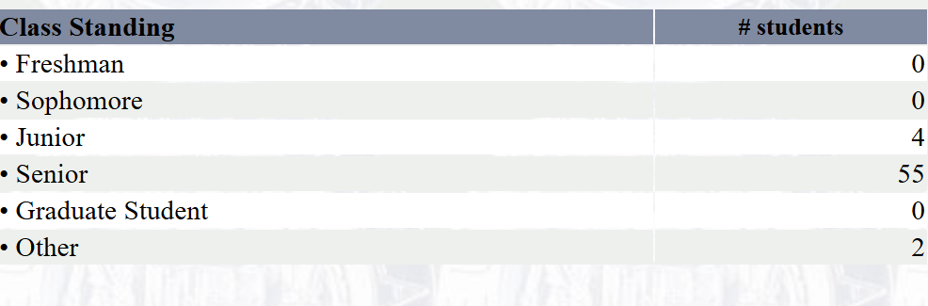
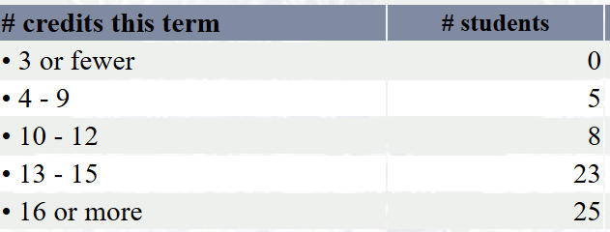
Class Profile
Total Enrollment 61

Slide 14
Some Useful Videos By Dr. Neil Spring
Review of 216
Sizes - Necessary distinction between sizeof and strlen.
Malloc - Model for how malloc tracks memory, how to interpret memory errors.
Timing - Reminder of user / kernel separation.
Synchronization Topics
Synchronization Overview - The basics
Semaphore Interface - How Semaphores can be used.
Semaphore Implementation - How Semaphores are built (so you know what they are and don't reinvent them).

