Slide 1

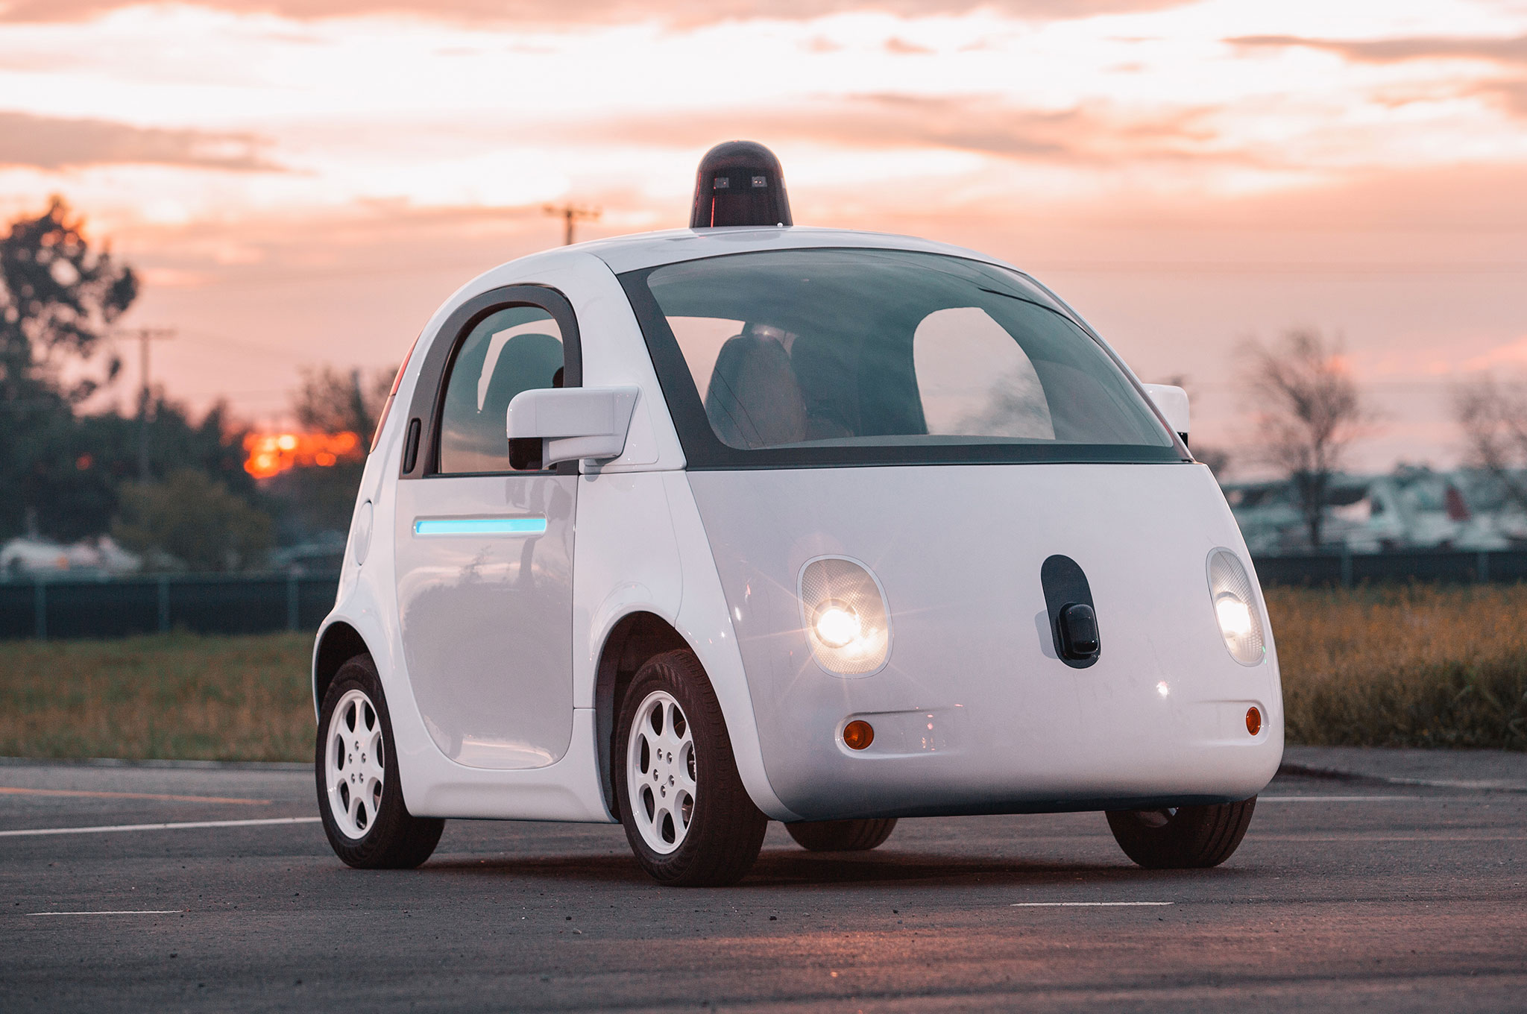

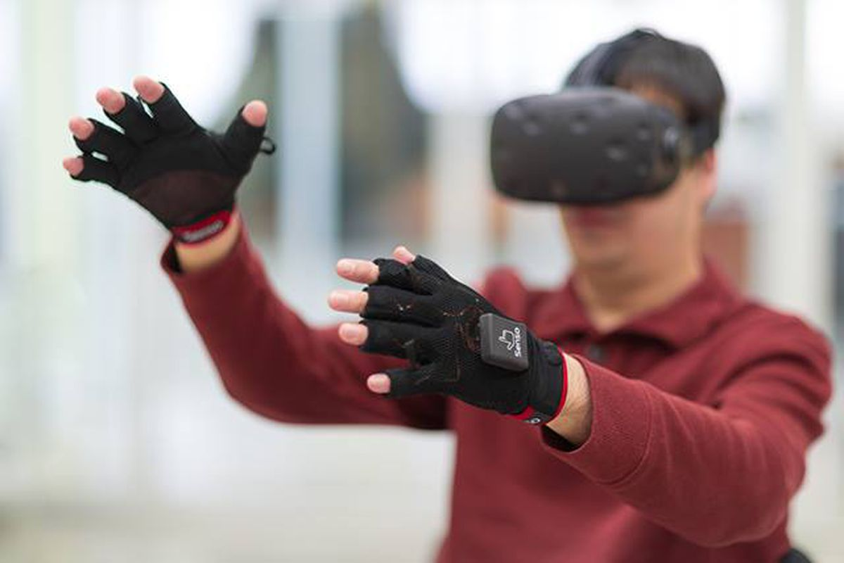

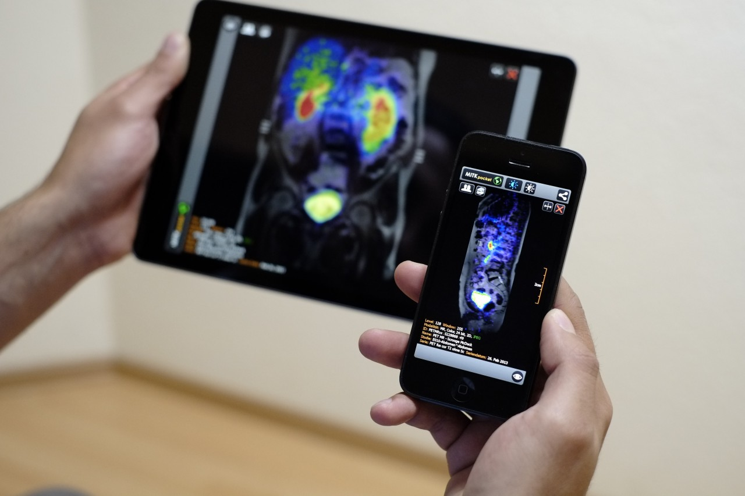
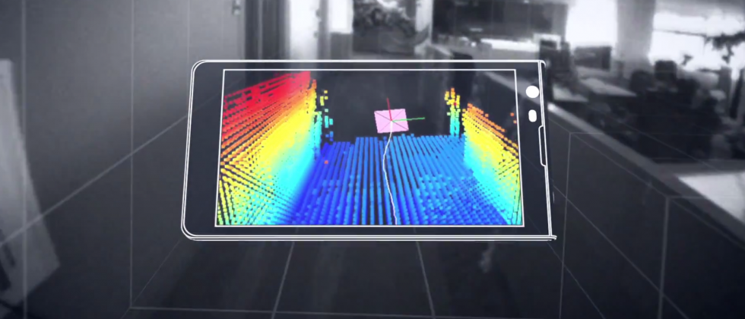
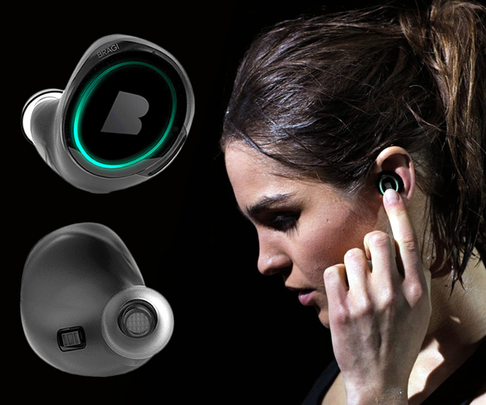
Machine Learning for Physical Sensing & Perception
CMSC 818V : Fall 2025
Lecture 1_1: Signals and Spectral Analysis Basic
Nirupam Roy
Tu-Th 3:30 – 4:45pm
IRB 1207

Slide 2
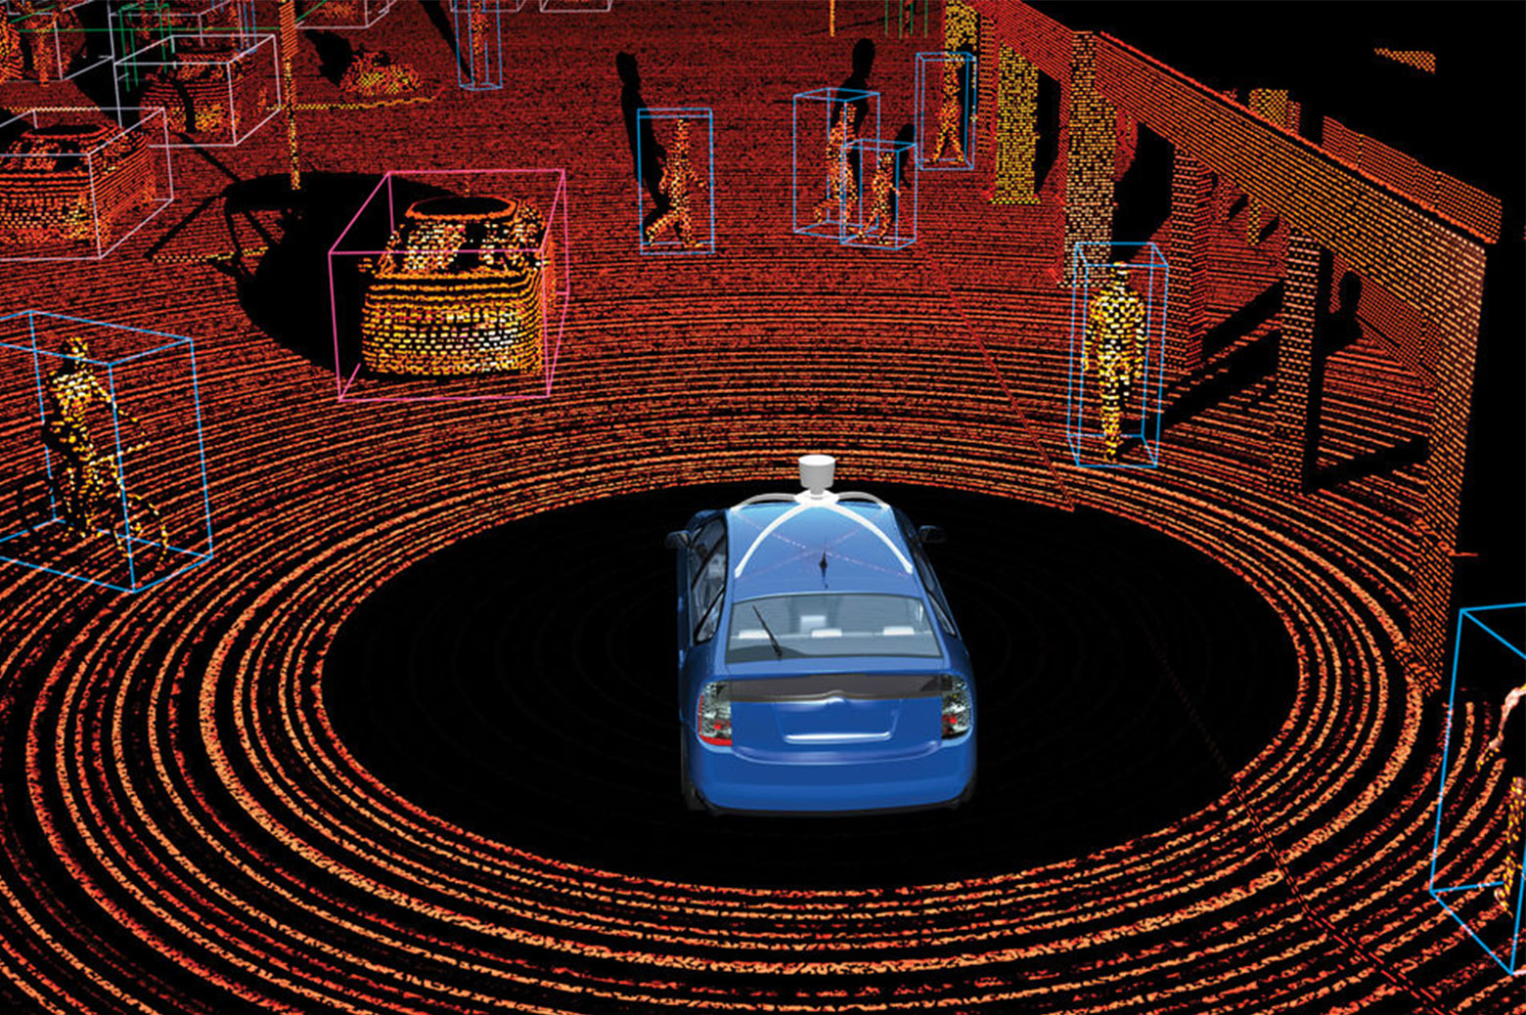
Physical Intelligence
Inverse Problem Solving
Estimation
Signal Representation
and Modeling
Signal Acquisition

Slide 3
Sensors and Signal Acquisition

Slide 4
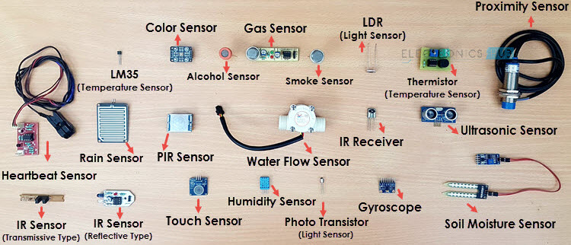
What is a sensor?
Is there a common principle?
Notes:
Image source: https://www.electronicshub.org/different-types-sensors/

Slide 5
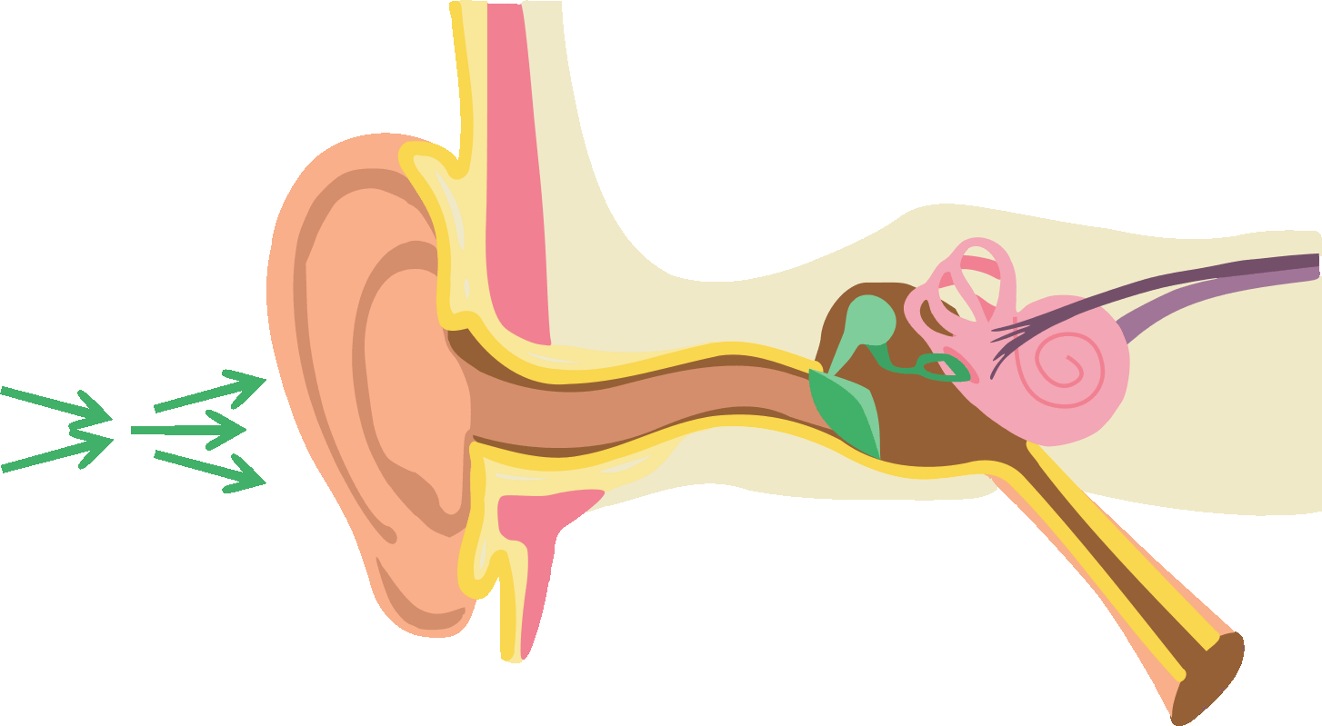
How does a sound sensor work?

Slide 6
How does a sound sensor (microphone) work?

Slide 7
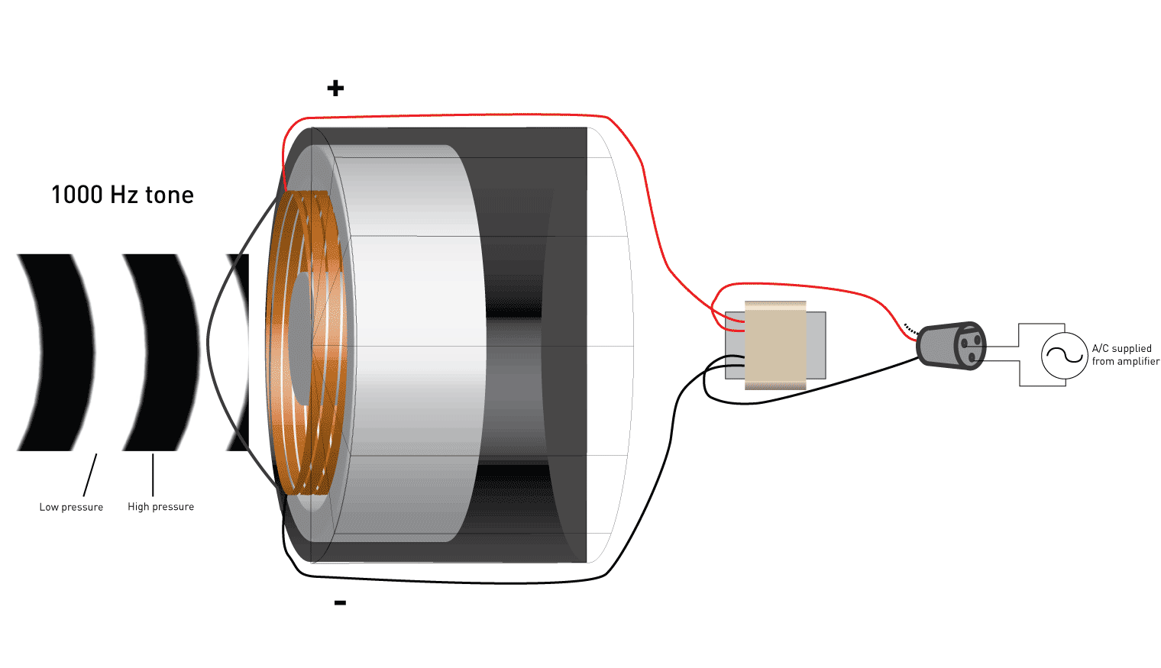
How does a sound sensor (microphone) work?

Slide 8
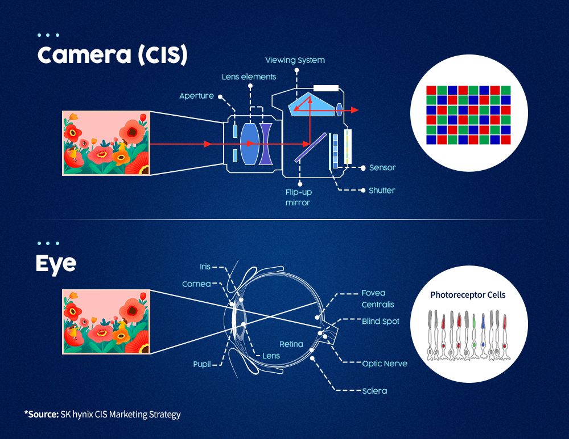
How does a camera sensor work?

Slide 9
Fundamental principle of sensors
Electrical fluctuations
proportional to the
speed/volume of air-flow
Air flow
Mapping
10 Miles per hour
Mapping

Slide 10
SENSOR
A circuit that converts the reaction to measurable electrical signal (voltage, current, or energy)
A structure or material
that reacts to the physical phenomenon
A physical phenomenon
We want to measure
Interpretation of the signal, storing the data

Slide 11
Fundamental principle of sensors
Temperature
Voltage
Thermo-couple
Time
At time t
Mapping
Temp.
40° F
(a scalar value)
Time
Temperature signal

Slide 12
Define “Signal”
A signal is any physical quantity that varies with one or more independent variables (such as time, space, or both) and conveys information about a system or phenomenon.
A signal is a mathematical function of one or more independent variables (like time or space).

Slide 13
Define “Dimension” of a signal
The number of independent variable of the function.
1D signals:
Audio waveform x(t) -- (time).
Stock price x[n] -- (discrete index).
2D signals:
Grayscale image x(m,n) -- (row, column)
3D signals:
Video x(m,n,t) (space + time)

Slide 14
Define “Dimension” of a signal
The number of independent variable of the function.
1D signals:
Audio waveform x(t) -- (time).
Stock price x[n] -- (discrete index).
2D signals:
Grayscale image x(m,n) -- (row, column)
3D signals:
Video x(m,n,t) (space + time)
What about a color image?

Slide 15
Scalar-valued vs. Vector-valued
Output of a Sensor

Slide 16

Sensor data
Sensor data
Sensor
Scalar
Time
Vector
Sensor data
Time
Mapping

Slide 17

Sensor data
Sensor data
Sensor
Scalar
Time
Vector
Sensor data
Output at time t
<V_{x} (t), V_{y}(t), V_{z}(t)>
Time
Mapping

Slide 18
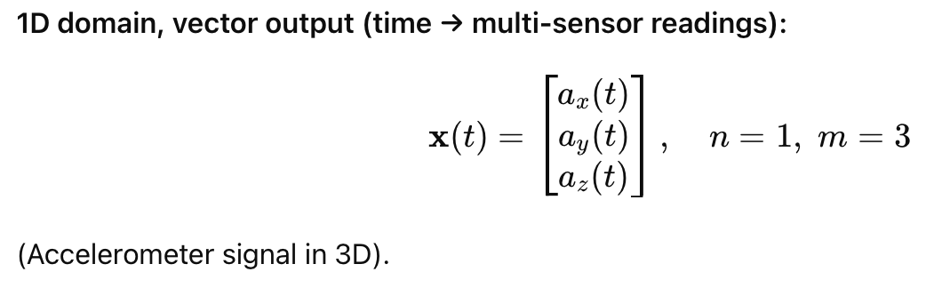
Y
V_{y}
V_{x}
X
Z
Output at time t
<a_{x} (t), a_{y}(t), a_{z}(t)>
3-axis accelerometer sensor

Slide 19
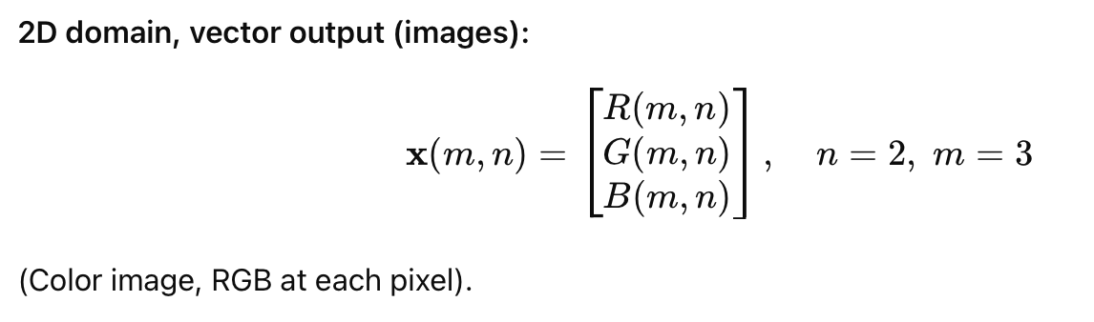
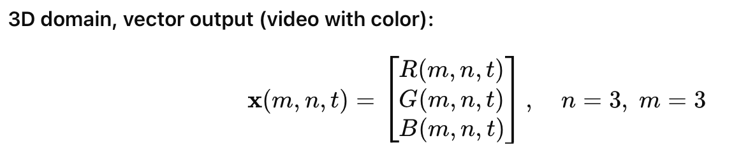
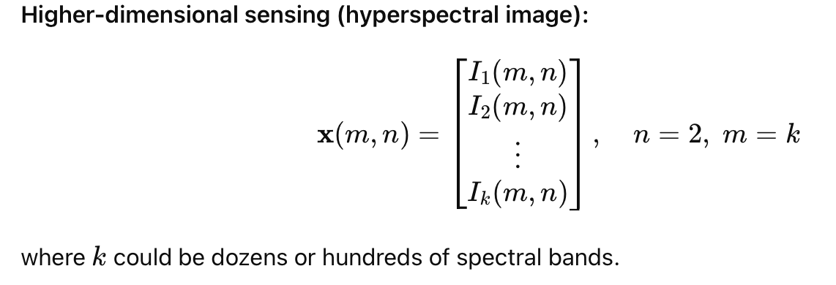

Slide 20
Sensor data
Is an image a multi-dimensional signal?

Slide 21
Sensor data
Is a gray-scale image a scalar-valued or a vector-valued signal?

Slide 22
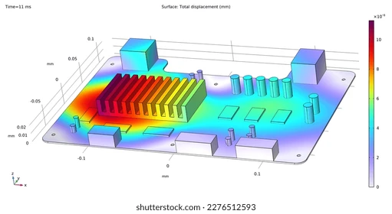
Scalar and Vector fields
Temperature distribution (scalar field)

Slide 23
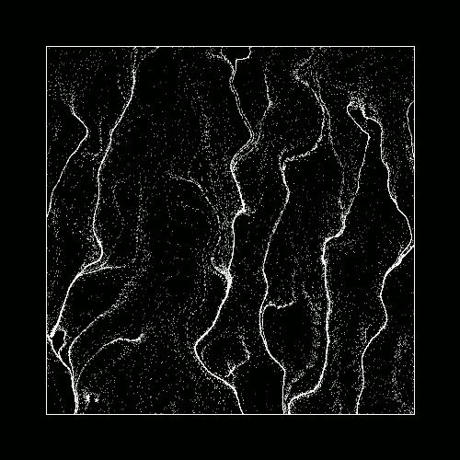
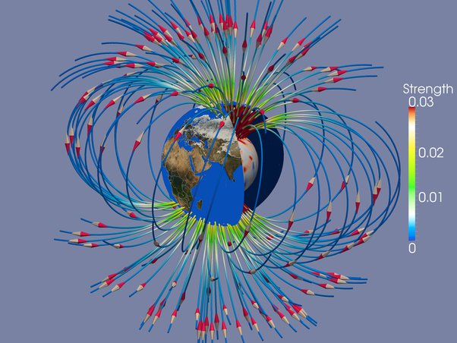
Scalar and Vector fields
Particle flow
(vector field)
Magnetic field (vector field)

Slide 24
Modeling a Signal
Amplitude
Time (sec)
0.00
0.25
0.50
0.75
1.00
1.25

Slide 25
Properties of a signal
Frequency, Amplitude, and Phase

Slide 26
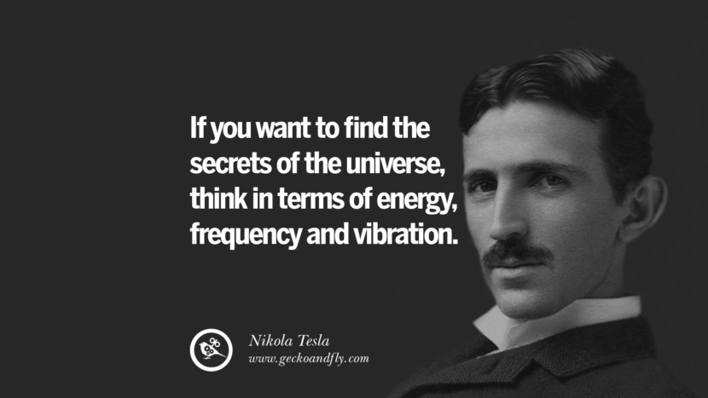
What is frequency?

Slide 27
Definition of Frequency
Frequency is the number of occurrences of a repeating event per unit time (independent variable).

Slide 28
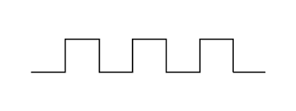
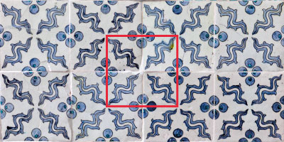
1D function
2D function

Slide 29
What can be a simple (the simplest ?) repeating
function?

Slide 30
Frequency, Amplitude, and Phase

Slide 31
Model for a signal (frequency, amplitude, and phase)

Slide 32
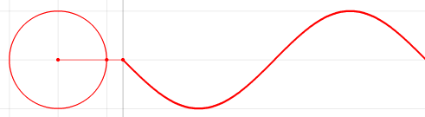
Frequencies of an arbitrary signal
Time

Slide 33


Model for a signal (frequency, amplitude, and phase)
$$A . sin⁡(θ)$$
$$A . cos⁡(θ)$$

Slide 34
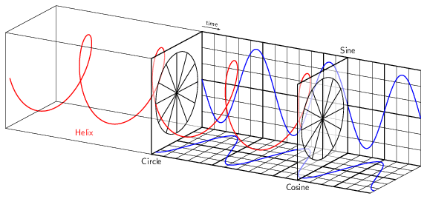

Model for a signal (frequency, amplitude, and phase)
$$Simple signal model$$

Slide 35
Frequency, Amplitude, and Phase
Frequency: 2Hz
Amplitude
Time (sec)
0.00
0.25
0.50
0.75
1.00
1.25
Notes:
1) Two common terms related to signals are amplitude and frequency. Frequency is the number of repetition of the signal per second.

Slide 36
Frequency, Amplitude, and Phase
Frequency: 2Hz
Amplitude
Time (sec)
0.00
0.25
0.50
0.75
1.00
1.25
Frequency: 4Hz
Amplitude
Time (sec)
0.00
0.25
0.50
0.75
1.00
1.25

Slide 37
Frequencies of an arbitrary signal
Frequency: 2Hz
Amplitude
Time (sec)
0.00
0.25
0.50
0.75
1.00
1.25
Amplitude
Time (sec)
0.00
0.25
0.50
0.75
1.00
1.25

Slide 38
Frequencies of an arbitrary signal
Time

Slide 39


Frequencies of an arbitrary signal
$$f cycles per second$$
$$2π angles per cycle$$
Time

Slide 40
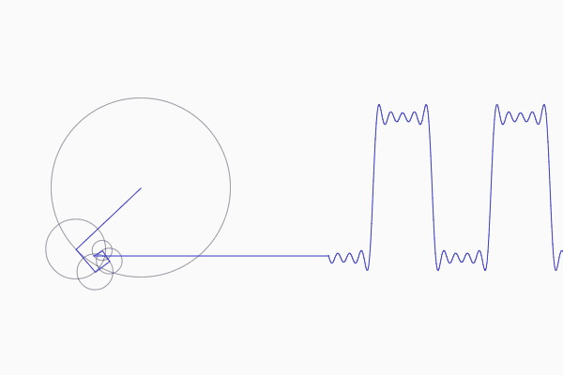
Frequencies of an arbitrary signal

Slide 41
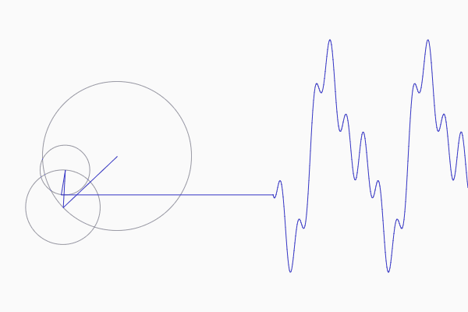
Frequencies of an arbitrary signal

Slide 42
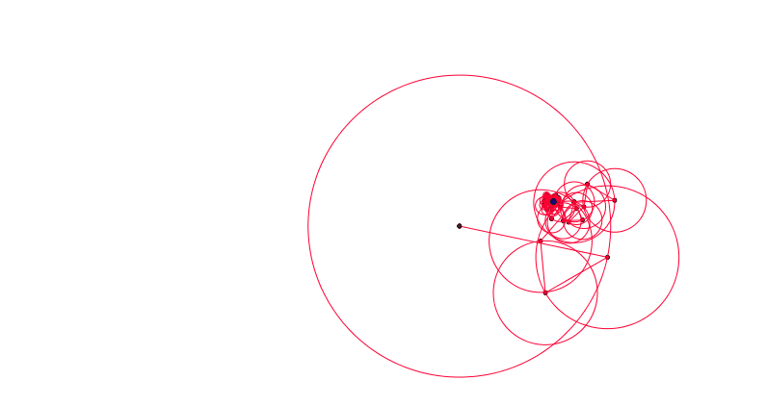
Frequencies of an arbitrary signal

Slide 43
The concept of the Fourier series
Amplitude
Time (sec)
0.00
0.25
0.50
0.75
1.00
1.25
The key idea: Any function can be written as the sum of sinusoidal functions.
Amplitude
Time (sec)
0.00
0.25
0.50
0.75
1.00
1.25

Slide 44

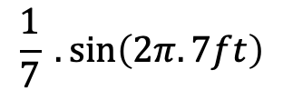
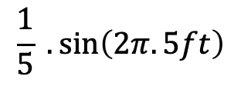
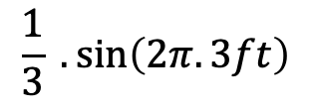
Time Domain and Frequency Domain
Approx. square wave
$$1 .\sin\left(2πft\right)$$
$$\frac{1}{3} .\sin\left(2π.3ft\right)$$
$$\frac{1}{5} .\sin\left(2π.5ft\right)$$
$$\frac{1}{7} .\sin\left(2π.7ft\right)$$

Slide 45
Analogy: Food coloring chart
Basis for food colors
Notes:
Emphasize basis and coefficient using Color analogy

Slide 46
Analogy: Food coloring chart
Basis for food colors
Notes:
Emphasize basis and coefficient using Color analogy

Slide 47
Analogy: Food coloring chart
Basis for food colors
Notes:
Emphasize basis and coefficient using Color analogy

Slide 48
Analogy: Food coloring chart
Basis for food colors
Notes:
Emphasize basis and coefficient using Color analogy

Slide 49
Time Domain and Frequency Domain
Time domain view
Frequency domain view

Slide 50
Why do we need
the frequency domain view?

Slide 51

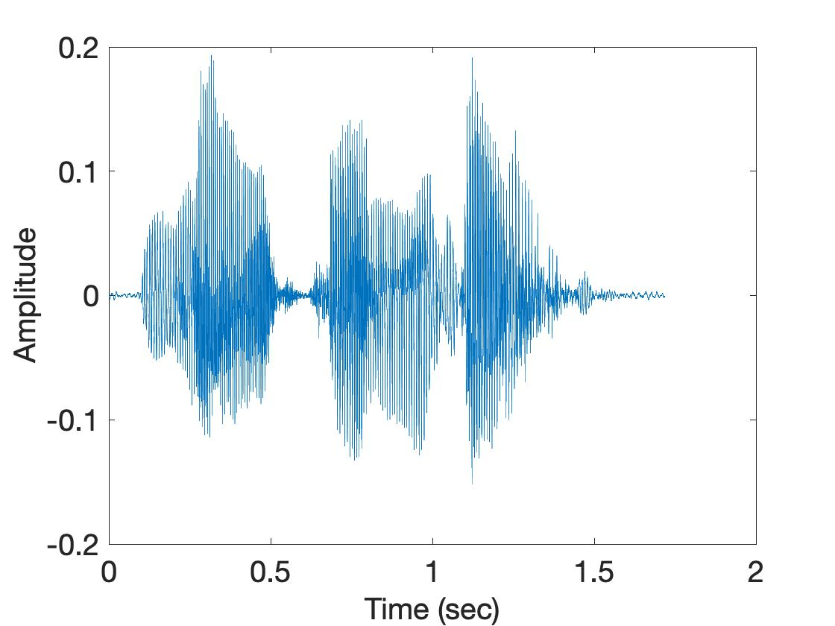
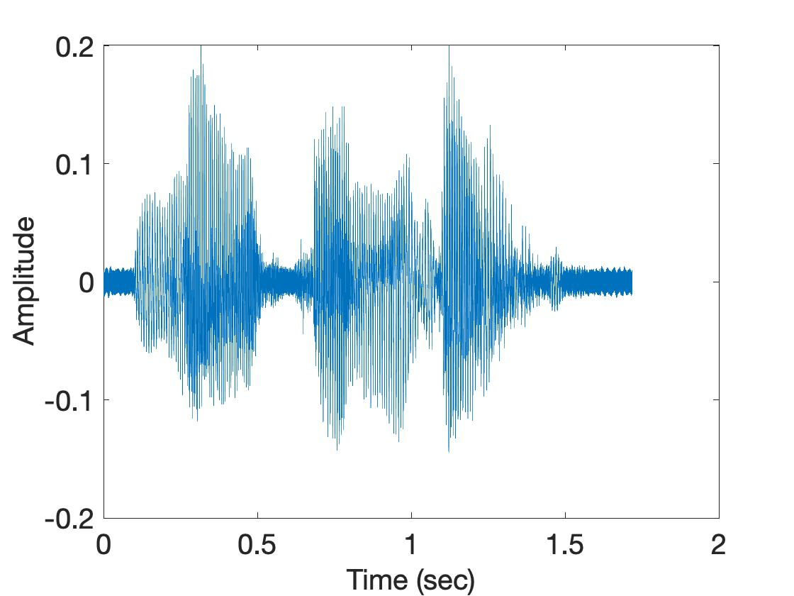
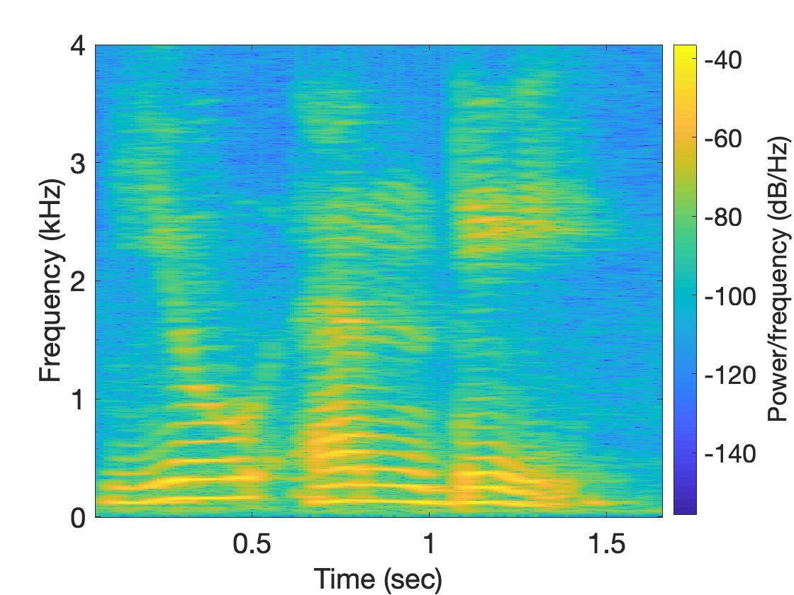
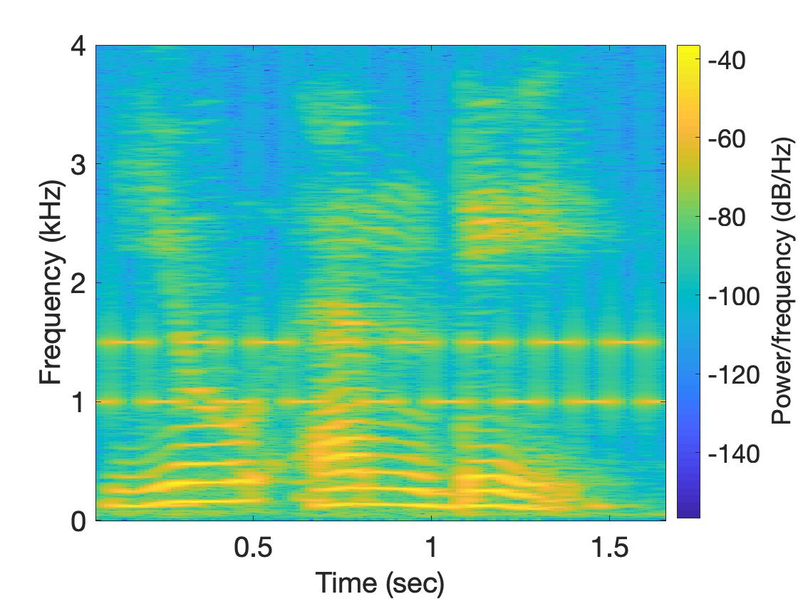
Why do we need the frequency domain view?
Sound
Sound + Noise
Time
domain
Freq.
domain

Slide 52
Model for a signal (frequency, amplitude, and phase)
Time

Slide 53


Model for a signal (frequency, amplitude, and phase)
$$f cycles per second$$
$$2π angles per cycle$$
Time

Slide 54
Model for a signal (frequency, amplitude, and phase)
One cycle
+A
A
0
Amplitude
-A
Time

Slide 55
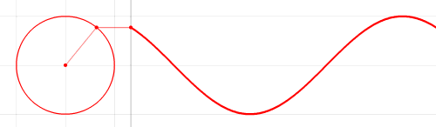




Model for a signal (frequency, amplitude, and phase)
$$2π angles per cycle$$
$$f cycles per second$$
A
𝚹
time = t second
$$=$$
$$A . sin⁡(θ)$$
$$=$$
$$A . sin⁡(2πft)$$

Slide 56
Model for a signal (frequency, amplitude, and phase)
$$2π angles per cycle$$
$$f cycles per second$$
A
𝚹
Phase
time = t second
$$=$$
$$A . sin⁡(θ)$$
$$=$$
$$A . sin⁡(2πft)$$

Slide 57

Model for a signal (frequency, amplitude, and phase)
$$2π angles per cycle$$
$$f cycles per second$$
A
𝚹
Phase
time = t second
$$=$$
$$A . sin⁡(θ)$$
$$=$$
$$A . sin⁡(2πft)$$
$$A . sin⁡(2πft+φ)$$
-- with initial/additional phase ϕ

Slide 58

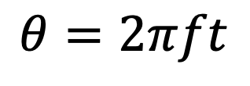



Model for a signal (frequency, amplitude, and phase)
1
$$sin⁡(θ)$$
𝚹
$$cos⁡(θ)$$
$$f cycles per second$$
$$θ=2πft$$
$$2π angles per cycle$$

Slide 59
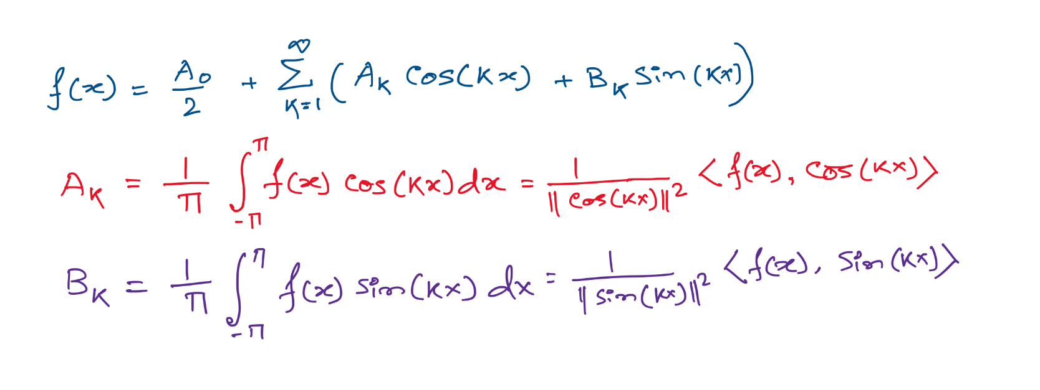
Projections on sinusoids

Slide 60
Projections on sinusoids
Notes:
Talk about cos() is an even function and sin() is odd. The even component of the function f() is captured by the cos() and odd is by sin().
Odd fn X Odd fn = Even fn.
Even X Odd = Odd
Eve X Eve = Even
Integration of an odd function between –a to a, is zero.

Slide 61
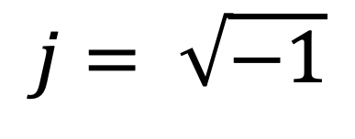
Complex numbers
Imaginary
$$j= \sqrt{−1}$$

Slide 62
Complex numbers and Natural exponential
j
j

Slide 63
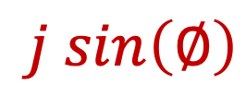

Complex numbers and Natural exponential
…
…
…
$$\cos\left(∅\right)$$
$$j sin\left(∅\right)$$
Euler’s formula

Slide 64

Complex numbers and Natural exponential
$$e^{j∅}=\cos{∅+j sin∅}$$

Slide 65
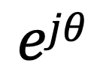
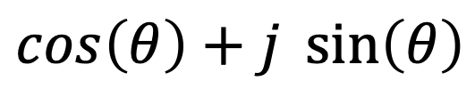

Model for a signal (frequency, amplitude, and phase)
$$\cos\left(θ\right)+j \sin\left(θ\right)$$
$$=$$
$$ejθ$$

Slide 66
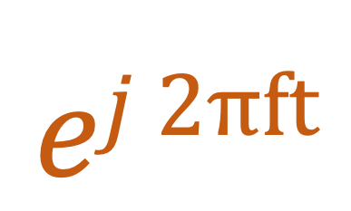

Model for a signal (frequency, amplitude, and phase)
$$ej 2πft$$
$$\cos\left(θ\right)+j \sin\left(θ\right)$$
$$=$$
$$ejθ$$
$$=$$

Slide 67
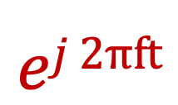
Model for a signal (frequency, amplitude, and phase)
$$ej 2πft$$

Slide 68
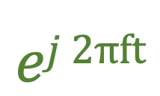
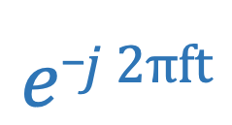
Model for a signal (frequency, amplitude, and phase)
$$ej 2πft$$
$$e_j 2πft$$

Slide 69
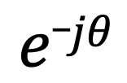

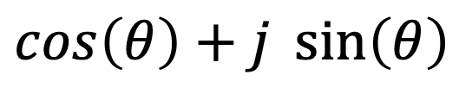
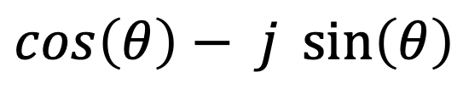
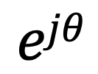
Model for a signal (frequency, amplitude, and phase)
$$ejθ$$
$$=$$
$$\cos\left(θ\right)+j \sin\left(θ\right)$$
$$e_jθ$$
$$=$$
$$\cos\left(θ\right)− j \sin\left(θ\right)$$

Slide 70




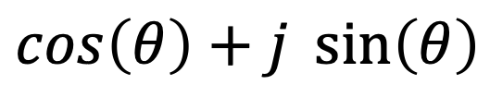

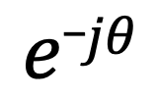
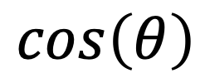



Presenting real signal with the complex model
$$ejθ$$
$$=$$
$$\cos\left(θ\right)+j \sin\left(θ\right)$$
$$e_jθ$$
$$=$$
$$\cos\left(θ\right)− j \sin\left(θ\right)$$
How about real sinusoids?
$$\cos\left(θ\right)$$
$$=$$
$$?$$
$$\sin\left(θ\right)$$
$$=$$
$$?$$

Slide 71


Presenting real signal with the complex model
$$ejθ$$
$$=$$
$$\cos\left(θ\right)+j \sin\left(θ\right)$$
$$e_jθ$$
$$=$$
$$\cos\left(θ\right)− j \sin\left(θ\right)$$
How about real sinusoids?
$$ejθ$$
$$+$$
$$e_jθ$$
$$\cos\left(θ\right)$$
$$=$$
2
$$\sin\left(θ\right)$$
$$=$$
$$?$$

Slide 72



Presenting real signal with the complex model
$$ejθ$$
$$=$$
$$\cos\left(θ\right)+j \sin\left(θ\right)$$
$$e_jθ$$
$$=$$
$$\cos\left(θ\right)− j \sin\left(θ\right)$$
How about real sinusoids?
$$ejθ$$
$$+$$
$$e_jθ$$
$$\cos\left(θ\right)$$
$$=$$
2
$$ejθ$$
$$−$$
$$e_jθ$$
$$\sin\left(θ\right)$$
$$=$$
2j

Slide 73
Presenting real signal with the complex model

Slide 74














Presenting real signal with the complex model
$$ej 2πft$$
$$=$$
$$\cos\left(2πft\right)+j \sin\left(2πft\right)$$
$$e_j 2πft$$
$$=$$
$$\cos\left(2πft\right)− j \sin\left(2πft\right)$$
$$ej 2πft$$
$$+$$
$$e_j 2πft$$
$$\cos\left(2πft\right)$$
$$=$$
2
$$ej 2πft$$
$$−$$
$$e_j 2πft$$
$$\sin\left(2πft\right)$$
$$=$$
2j

