Slide 1
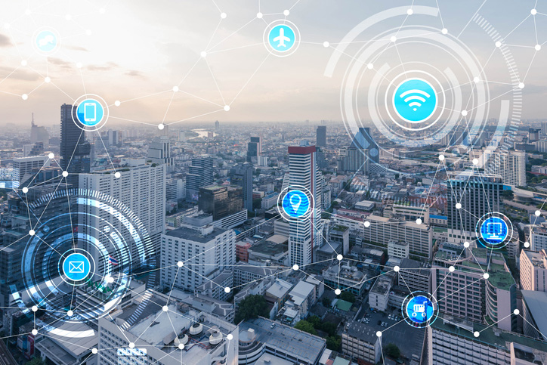
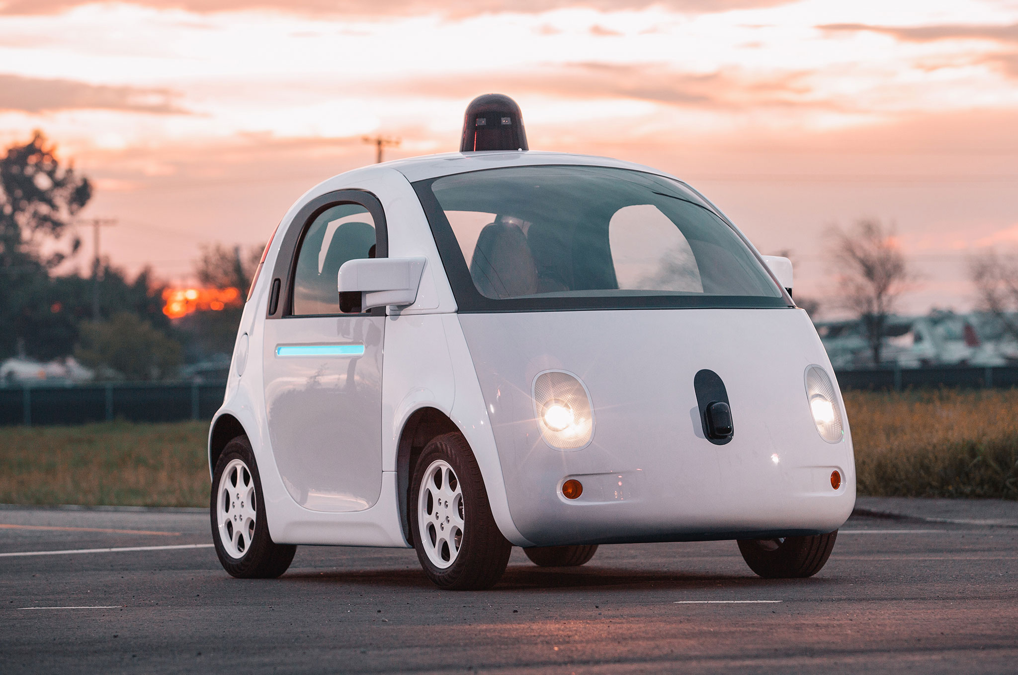
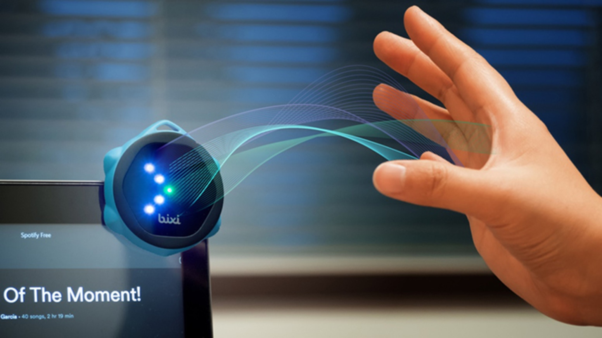
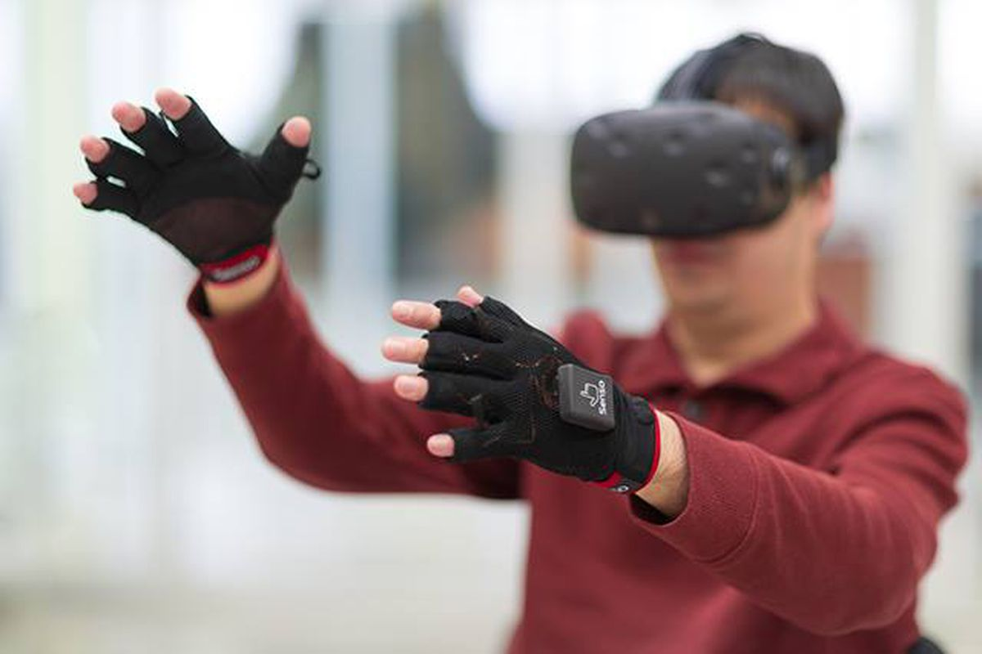

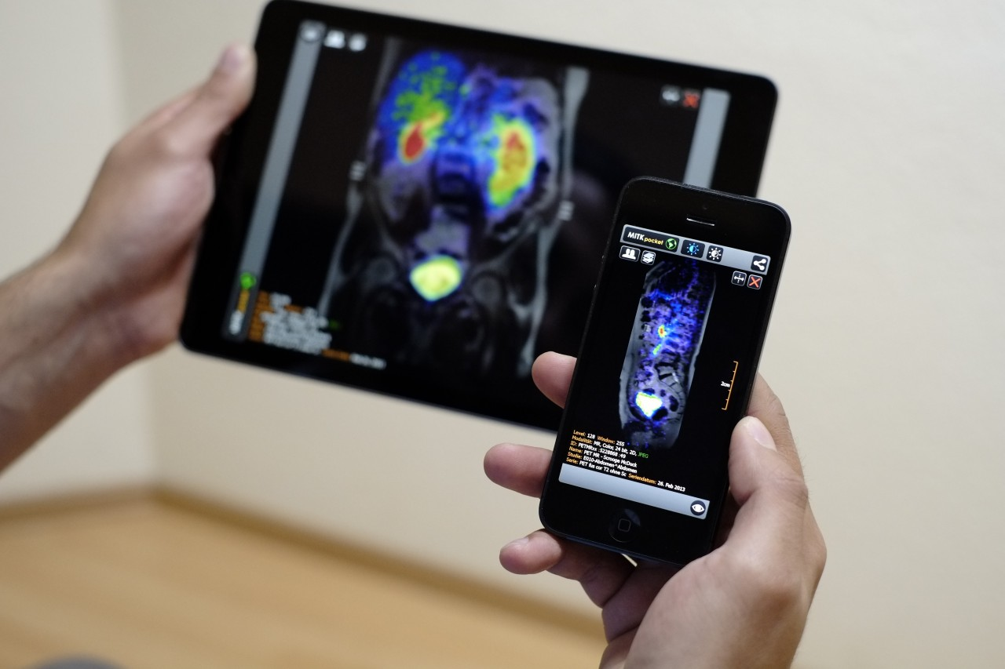
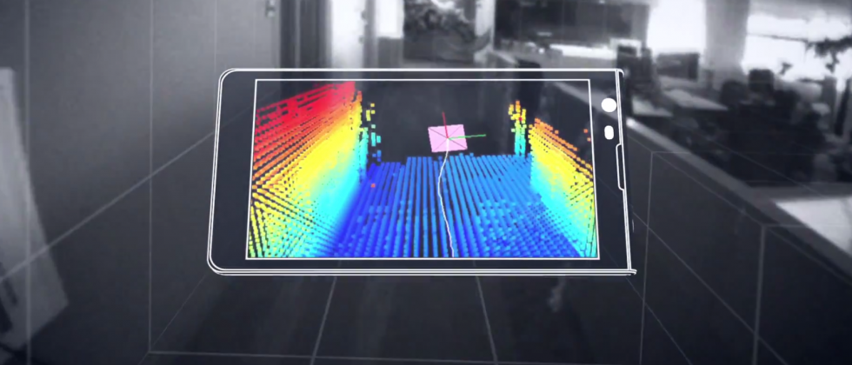
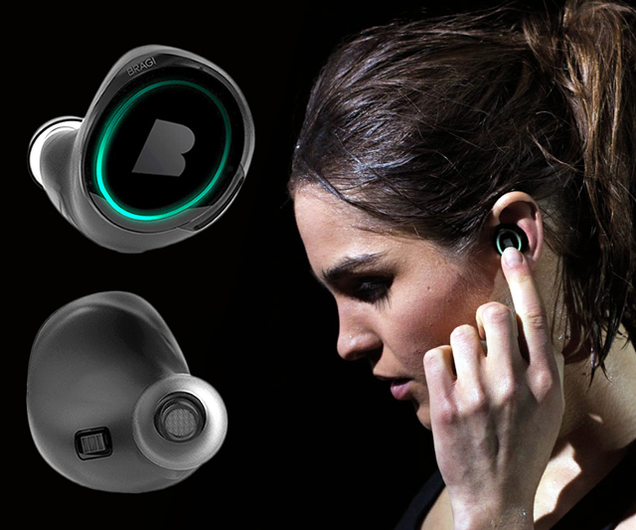
Machine Learning for Physical Sensing & Perception
CMSC 818V : Fall 2025
Lecture 1_2: Frequency Domain View
Nirupam Roy
Tu-Th 3:30 – 4:45pm
IRB 1207

Slide 2
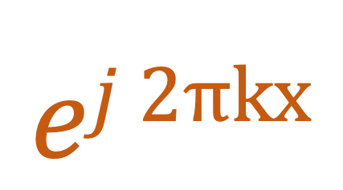
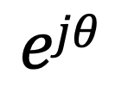
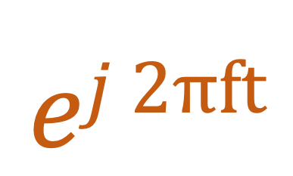



Model for a signal (frequency, amplitude, and phase)
$$ej 2πft$$
$$=$$
$$ejθ$$
$$=$$
$$Holds true for other independent variables (e.g., space)$$
$$ej 2πkx$$
$$=$$

Slide 3
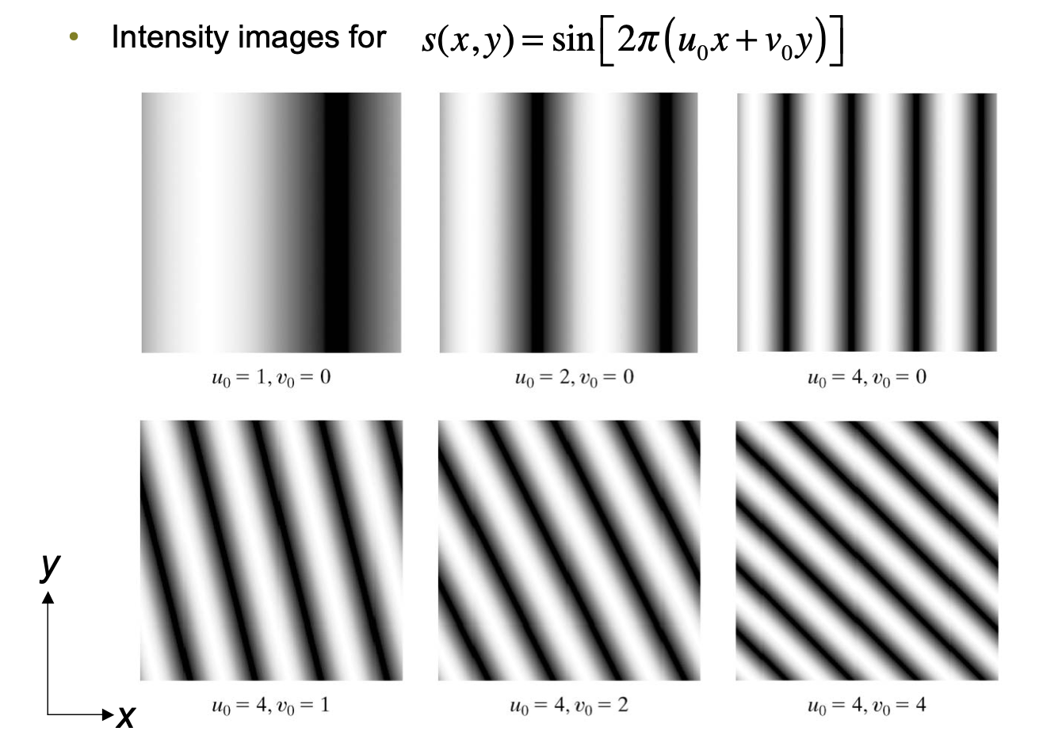
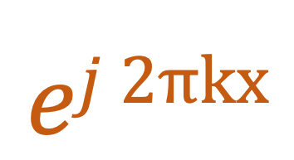
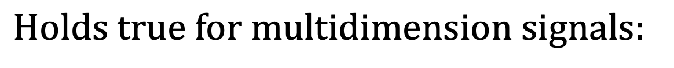
$$ej 2πkx$$
$$Holds true for multidimension signals:$$

Slide 4
Visualizing Transient Frequencies

Slide 5
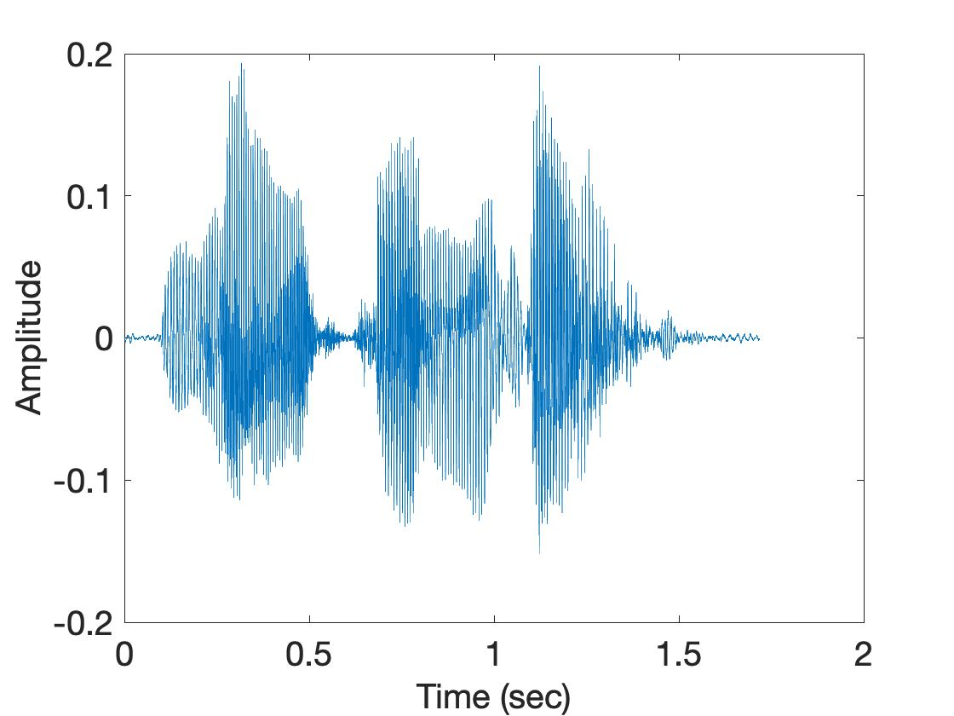
Visualizing transient frequencies
U
M
D

Slide 6
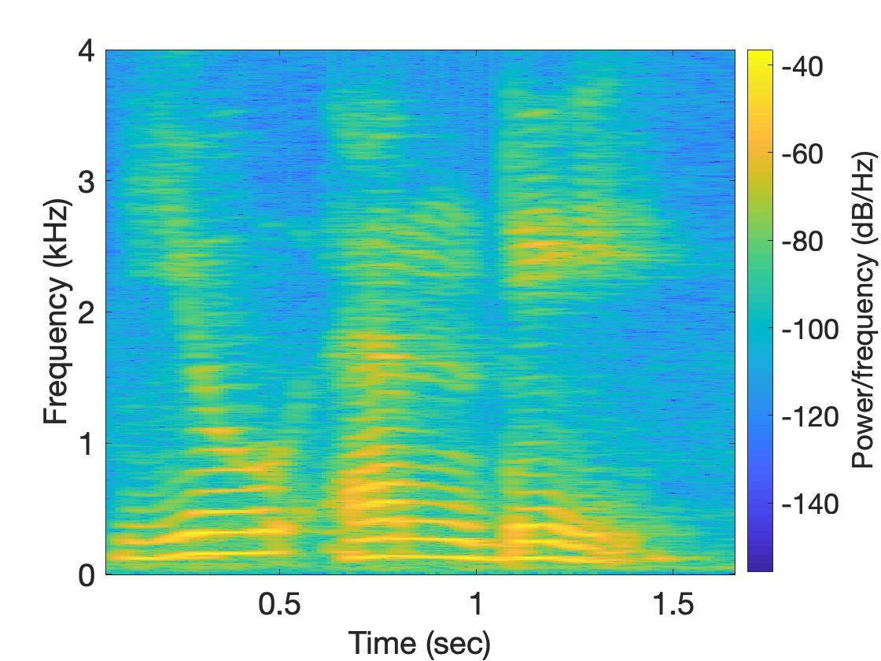
Spectrogram
U
M
D

Slide 7
Frequency components change over time
Amplitude
Time (sec)
0.00
0.25
0.50
0.75
1.00
1.25
FFT
A set of
frequencies

Slide 8
Frequency components change over time
Amplitude
Time (sec)
0.00
0.25
0.50
0.75
1.00
1.25
FFT

Slide 9
Frequency components change over time
Amplitude
Time (sec)
0.00
0.25
0.50
0.75
1.00
1.25
FFT
FFT

Slide 10
Frequency components change over time
U
M
D

Slide 11
Spectrogram
U
M
D
[
[
[
FFT of overlapping windows
of samples
(Spectrogram)
[
FFT
FFT
FFT
FFT

Slide 12
Spectrogram
U
M
D

Slide 13
Analog
Digital
Physical signal
(voice)
Spectrogram plot
on computer
FFT
Time varying voltage
signal
A collection of numbers

Slide 14
Sampling

Slide 15
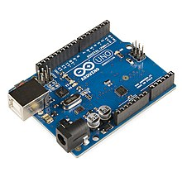
SENSOR
Analog
Analog
A structure or material
That reacts to the physical phenomenon
A circuit that converts the reaction to measurable electrical signal (e.g. voltage)
A physical phenomenon
We want to measure
Interpretation of the signal, storing the data
Digital

Slide 16
Analog
Digital
Physical signal
(voice)
Spectrogram plot
on computer
FFT
Time varying voltage
signal
A collection of numbers
?

Slide 17
Analog
Digital
Physical signal
(voice)
Spectrogram plot
on computer
FFT
Time varying voltage
signal
A collection of numbers
ADC
Analog-to-Digital Converter

Slide 18
Sampling
Amplitude
Time (sec)
0.00
0.25
0.50
0.75
1.00
1.25

Slide 19
Sampling
Amplitude
Time (sec)
0.00
0.25
0.50
0.75
1.00
1.25
Amplitude
Time (sec)
0.00
0.25
0.50
0.75
1.00
1.25
[ 0.34 0.22 0.09 0.21 0.30 0.08 0.09 ]

Slide 20
Sampling
Amplitude
Time (sec)
0.00
0.25
0.50
0.75
1.00
1.25
T = Sampling interval
f_{s}= 1/T = Sample rate (or sampling frequency)
Clock

Slide 21
1-dimensional sampling

Slide 22
1-dimensional sampling
Y
V_{y}
V_{x}
X

Slide 23
1-dimensional sampling
2-dimensional sampling

Slide 24
1-dimensional sampling
2-dimensional sampling
3-dimensional sampling

Slide 25
Analog
Digital
Physical signal
(voice)
Spectrogram plot
on computer
FFT
Time varying voltage
signal
A collection of numbers
ADC
Analog-to-Digital Converter

Slide 26
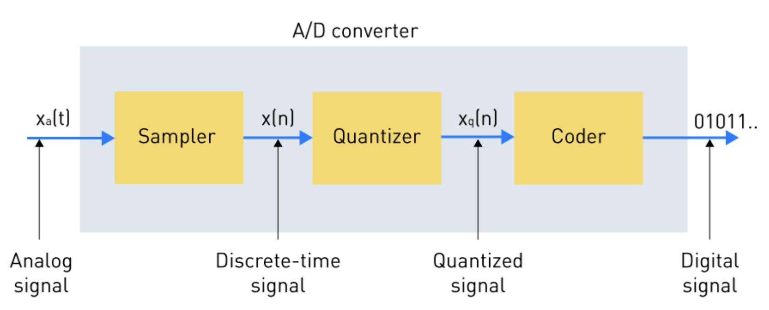
Digitization process (What is inside an ADC)

Slide 27
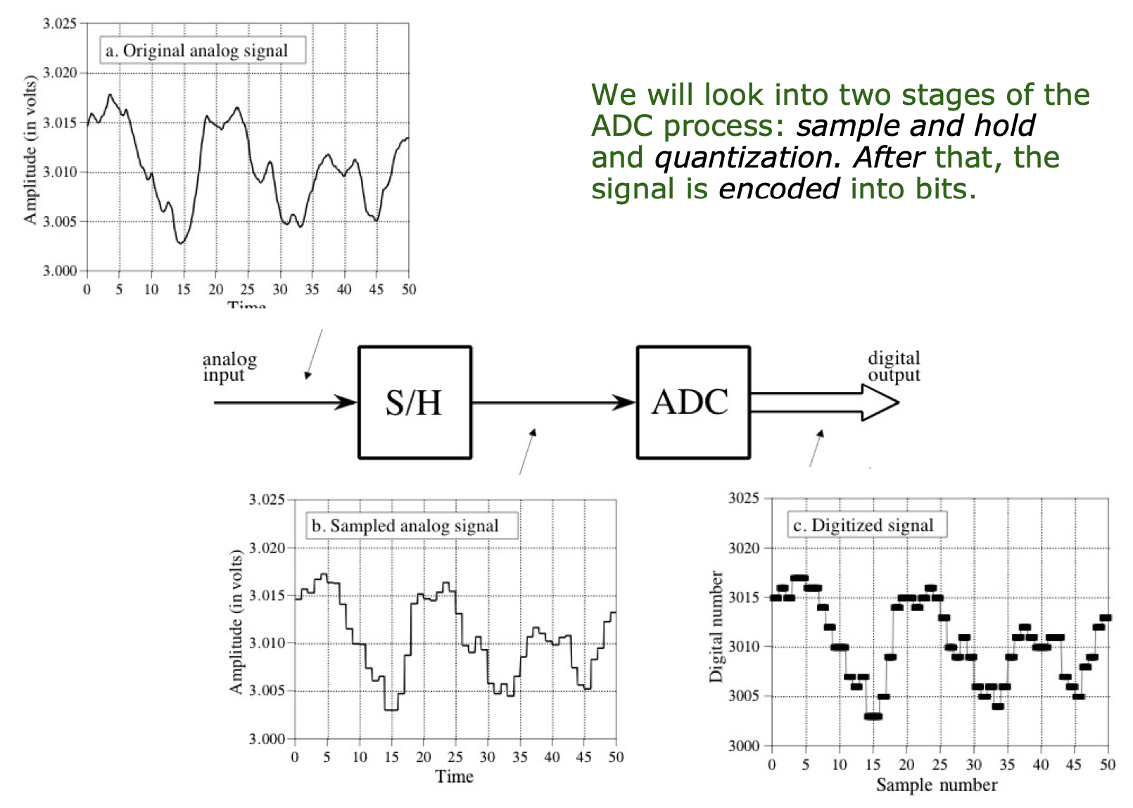
Digitization process (What is inside an ADC)

Slide 28
Digitization process (What is inside an ADC)
Sample and hold

Slide 29
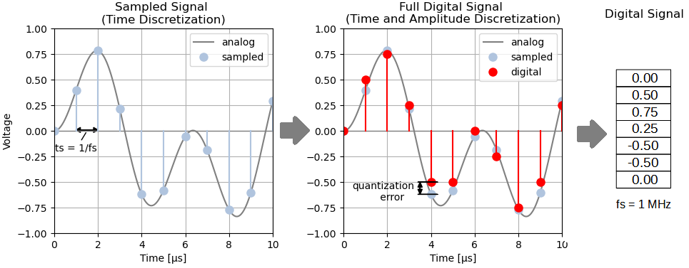
Digitization process (What is inside an ADC)
Notes:
[PC] https://panoradio-sdr.de/analog-digital-conversion/

Slide 30
Discrete in time and in amplitude
Amplitude
Time (sec)
0.00
0.25
0.50
0.75
1.00
1.25
Amplitude
Time (sec)
0.00
0.25
0.50
0.75
1.00
1.25
[ 0.34 0.22 0.09 0.21 0.30 0.08 0.09 ]

Slide 31
Digitization process (What is inside an ADC)
Notes:
[PC] https://panoradio-sdr.de/analog-digital-conversion/

Slide 32
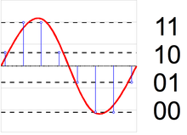
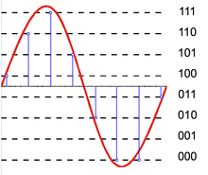
Quantization level and Bit resolution of an ADC
Notes:
[PC] https://en.wikipedia.org/wiki/Quantization_%28signal_processing%29

Slide 33
Digitization process (What is inside an ADC)
Sample and hold
Quantized

Slide 34
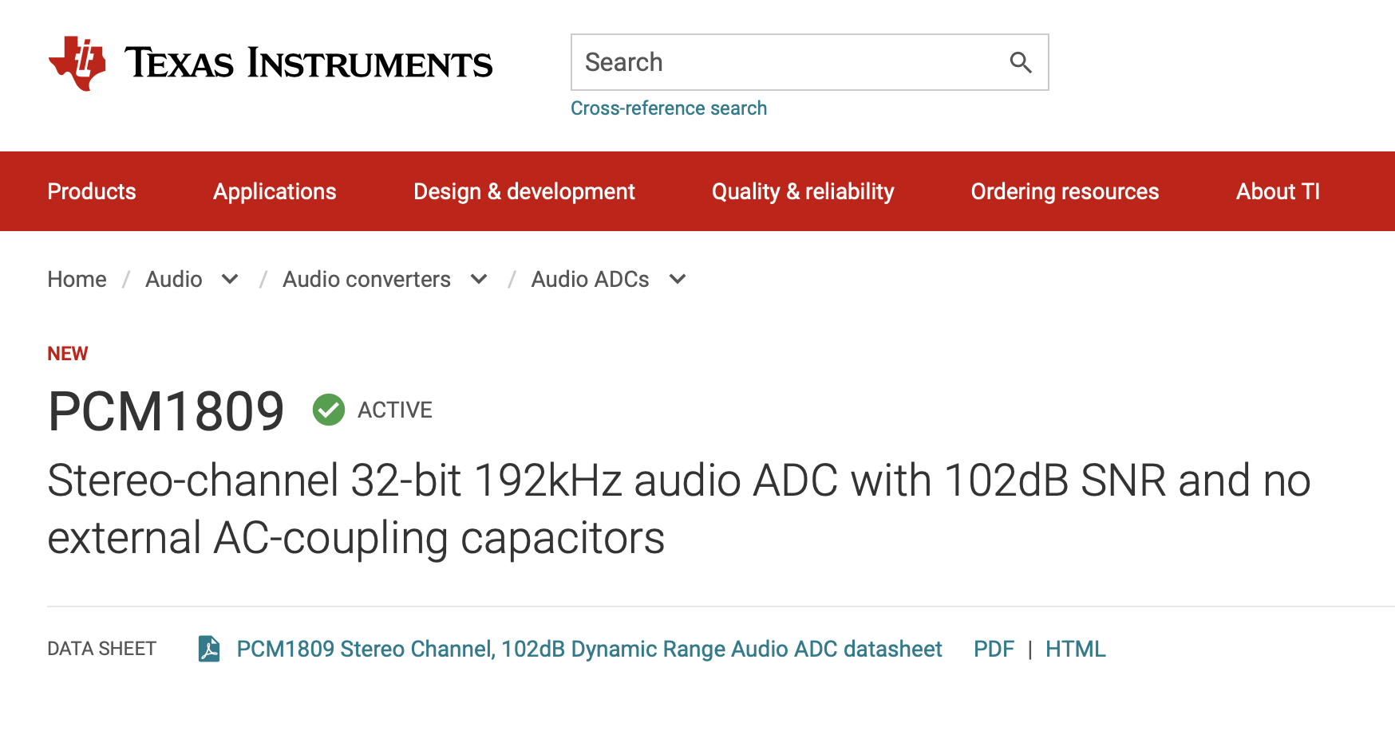
Digitization process (What is inside an ADC)

Slide 35
Samples of the physical phenomena
Amplitude
Time (sec)
0.00
0.25
0.50
0.75
1.00
1.25
Amplitude
Time (sec)
0.00
0.25
0.50
0.75
1.00
1.25
[ 0.34 0.22 0.09 0.21 0.30 0.08 0.09 ]

Slide 36
Samples of the physical phenomena
Amplitude
Time (sec)
0.00
0.25
0.50
0.75
1.00
1.25
[ 0.34 0.22 0.09 0.21 0.30 0.08 0.09 ]
A point in the N-dimensional space

Slide 37
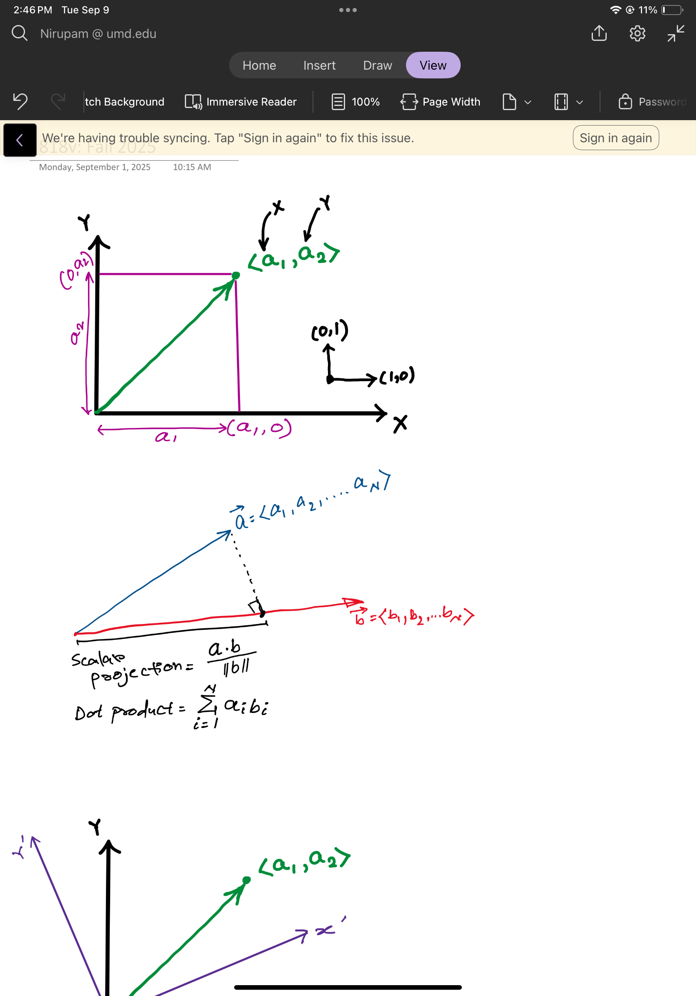
Signal as a point in a N-dimensional space

Slide 38
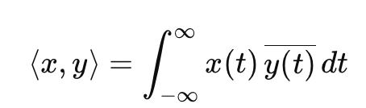
Projection and Dot product of vectors

Slide 39
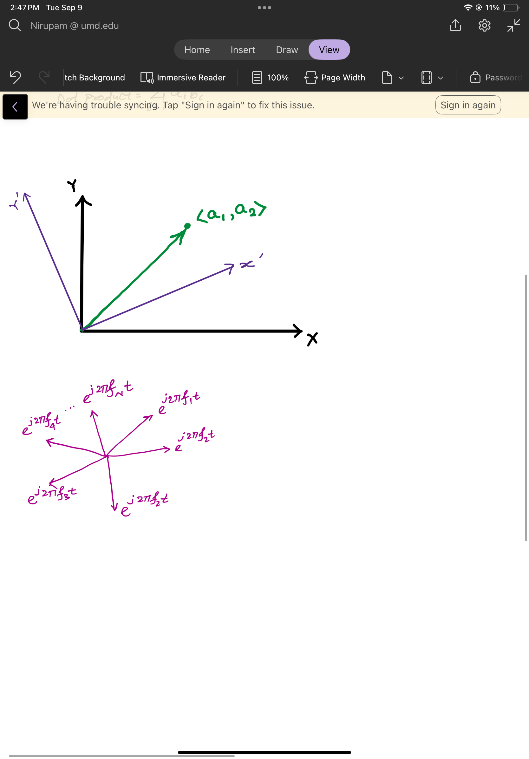
Change of basis

Slide 40
“Change of basis” to Frequency domain

Slide 41
Recall from past…
Amplitude
Time (sec)
0.00
0.25
0.50
0.75
1.00
1.25
The key idea: Any function can be written as the sum of sinusoidal functions.
Amplitude
Time (sec)
0.00
0.25
0.50
0.75
1.00
1.25

Slide 42
Time Domain and Frequency Domain
Time domain view
Frequency domain view

Slide 43
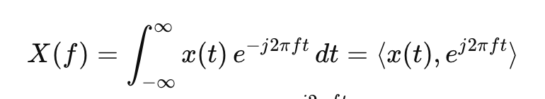
“Change of basis” to Frequency domain

