Slide 1

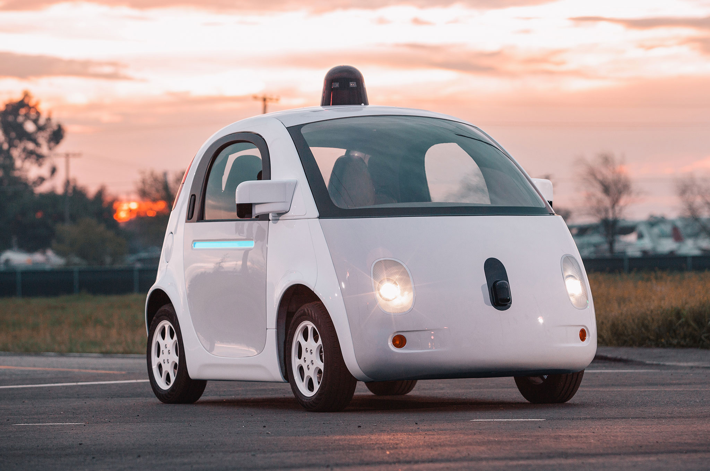



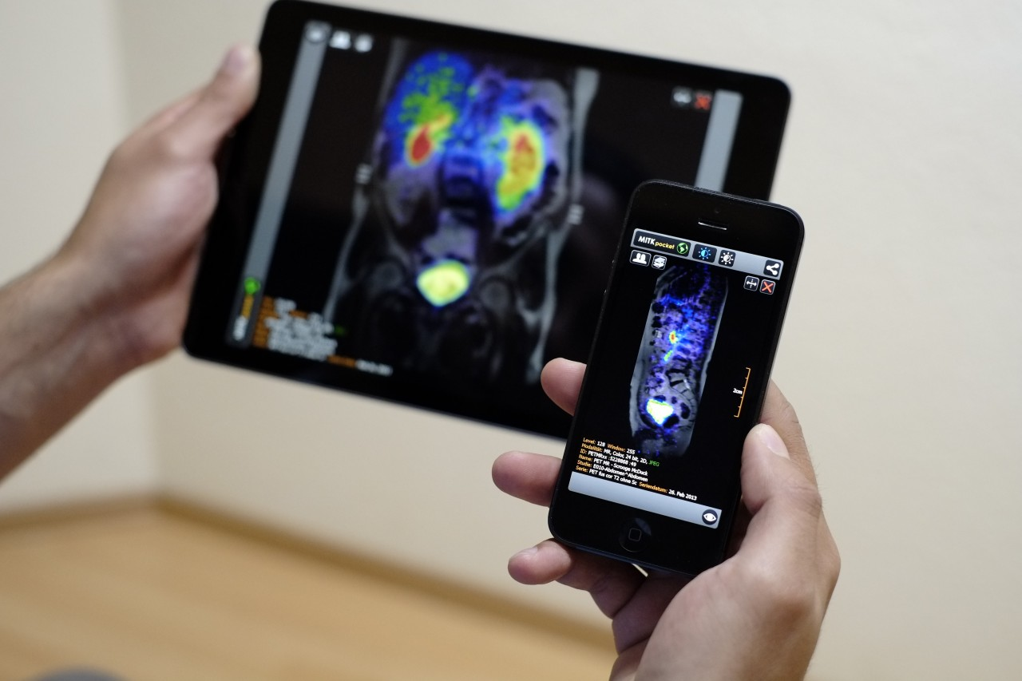
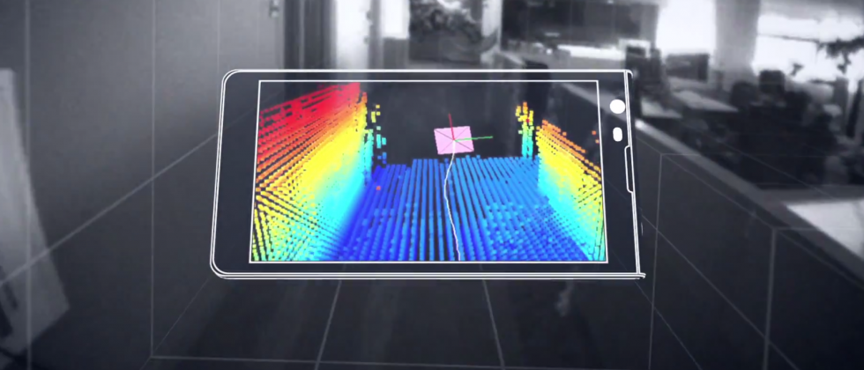
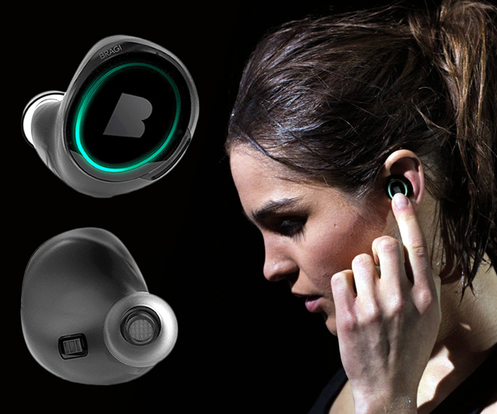
Machine Learning for Physical Sensing & Perception
CMSC 818V : Fall 2025
Lecture 1_3: Frequency Domain View
Nirupam Roy
Tu-Th 3:30 – 4:45pm
IRB 1207

Slide 2
Time Domain and Frequency Domain
Time domain view
Frequency domain view

Slide 3
Samples of the physical phenomena
Amplitude
Time (sec)
0.00
0.25
0.50
0.75
1.00
1.25
Amplitude
Time (sec)
0.00
0.25
0.50
0.75
1.00
1.25
[ 0.34 0.22 0.09 0.21 0.30 0.08 0.09 ]

Slide 4
An arbitrary signal can be shown as a sum of sinusoids
…
0
1
2
3
4
5
6
N-1
Sample number
X = [ ]
x[0], x[1], x[2], x[3], x[4], … x[N-1]

Slide 5
An arbitrary signal can be shown as a sum of sinusoids
…
0
1
2
3
4
5
6
N-1
Sample number
X = [ ]
x[0], x[1], x[2], x[3], x[4], … x[N-1]
…
0
1
2
3
4
5
6
N-1
Sample number
V1 = [ ]
v1[0], v1[1], v1[2], v1[3], v1[4], … v1[N-1]

Slide 6
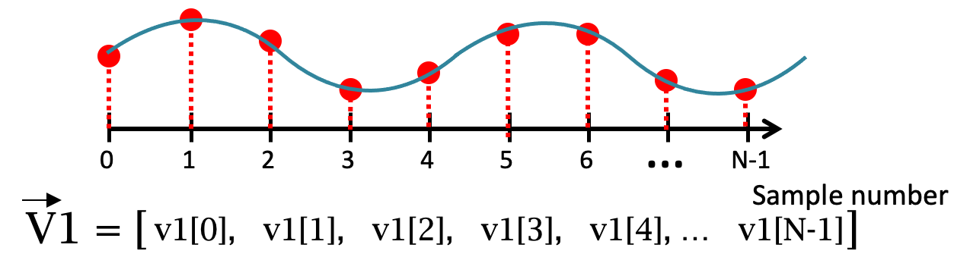
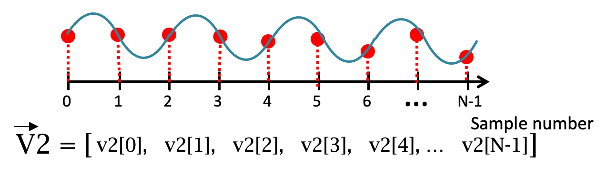
An arbitrary signal can be shown as a sum of sinusoids
…
0
1
2
3
4
5
6
N-1
Sample number
X = [ ]
x[0], x[1], x[2], x[3], x[4], … x[N-1]
W1 *
W2 *
+
+
….

Slide 7
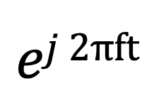

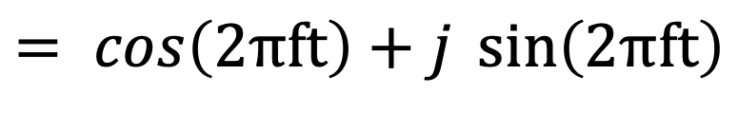
An arbitrary signal can be shown as a sum of sinusoids
…
0
1
2
3
4
5
6
N-1
Sample number
V1 = [ ]
v1[0], v1[1], v1[2], v1[3], v1[4], … v1[N-1]
$$\cos\left(2πft\right)$$
$$ej 2πft$$
$$= \cos\left(2πft\right)+j \sin\left(2πft\right)$$

Slide 8
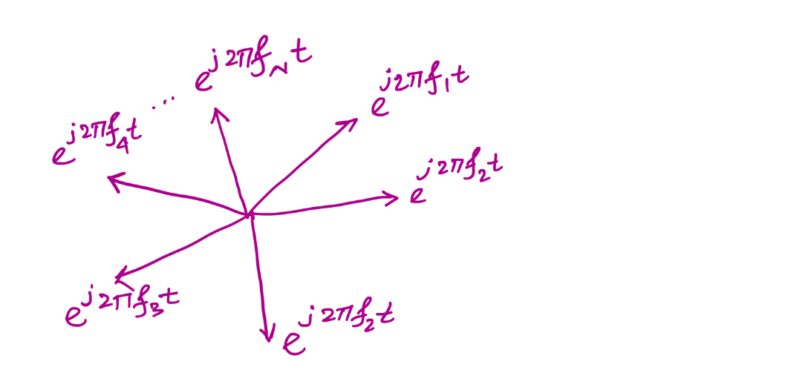
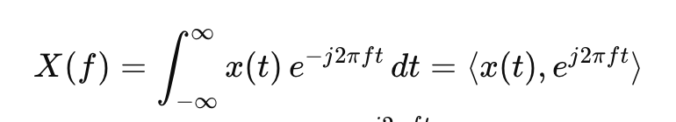
“Change of basis” to Frequency domain
Fourier Basis

Slide 9
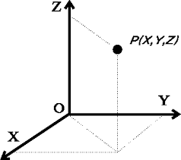
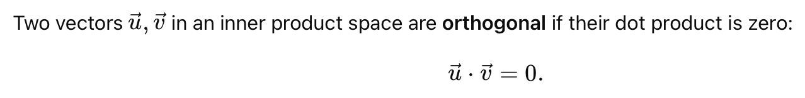
Finding good basis: Orthogonality

Slide 10
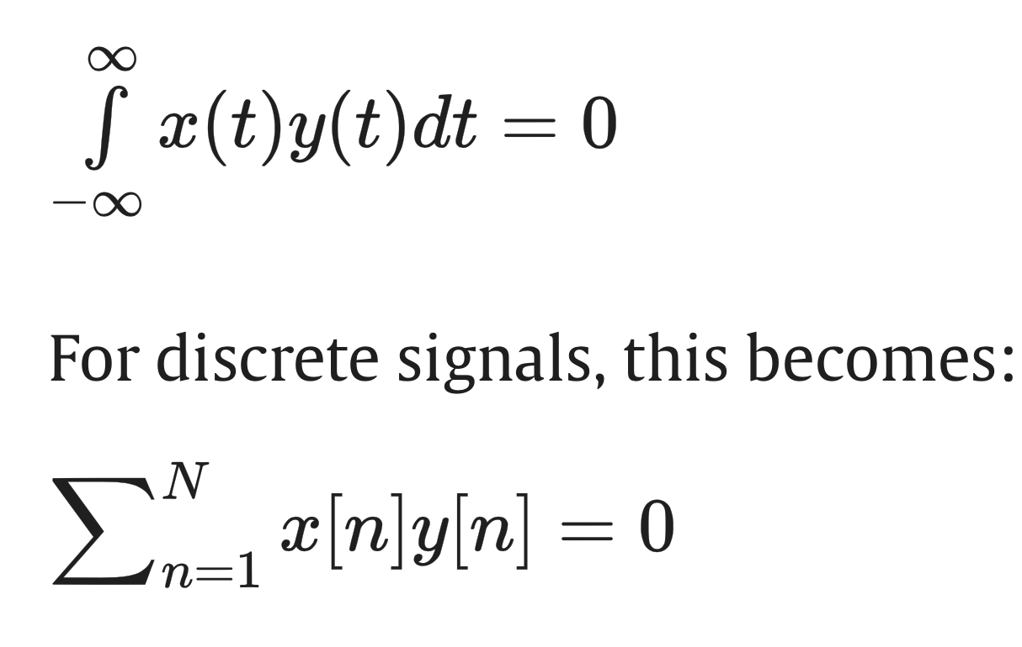
Finding good basis: Orthogonality
What makes two signals orthogonal?
The formal definition for orthogonal signals is that their inner product
(also called the dot product) is zero:

Slide 11
Finding good basis: Orthogonality
For sinusoids with different frequencies,
this means they need to complete full cycles !!
…
0
1
2
3
4
5
6
N-1
Sample number

Slide 12
Calculating
Discrete Fourier Transform (DFT)

Slide 13
Discrete Fourier Transform
…
0
1
2
3
4
5
6
N-1
Sample number
X = [ ]
x[0], x[1], x[2], x[3], x[4], … x[N-1]

Slide 14
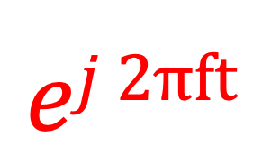
Discrete Fourier Transform
$$ej 2πft$$
…
0
1
2
3
4
5
6
N-1
Sample number
X = [ ]
x[0], x[1], x[2], x[3], x[4], … x[N-1]

Slide 15
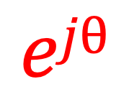
Discrete Fourier Transform
$$ejθ$$
…
0
1
2
3
4
5
6
N-1
Sample number
X = [ ]
x[0], x[1], x[2], x[3], x[4], … x[N-1]

Slide 16

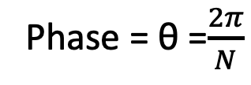



Discrete Fourier Transform
…
0
1
2
3
4
5
6
N-1
Sample number
$$e^{j2.\frac{2π}{N}}$$
$$e^{jθ}=e^{j1.\frac{2π}{N}}$$
Phase = θ =$\frac{2π}{N}$
$$e^{j0.\frac{2π}{N}}$$
$$e^{j(N−1).\frac{2π}{N}}$$

Slide 17




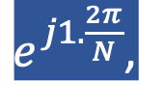

Discrete Fourier Transform
…
0
1
2
3
4
5
6
N-1
Sample number
= [ ]
Freq f₁
$$e^{j0.\frac{2π}{N}},$$
$e^{j1.\frac{2π}{N}}$,
$$e^{j2.\frac{2π}{N}},$$
…
$${,e}^{j(N−1).\frac{2π}{N}}$$
$$e^{j2.\frac{2π}{N}}$$
$$e^{j1.\frac{2π}{N}}$$
$$\frac{2π}{N}$$
$$e^{j0.\frac{2π}{N}}$$
$$e^{j(N−1).\frac{2π}{N}}$$

Slide 18

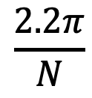


Discrete Fourier Transform
…
0
1
2
3
4
5
6
N-1
Sample number
$$e^{j1.\frac{2.2π}{N}}$$
$$\frac{2.2π}{N}$$
$$e^{j0.\frac{2.2π}{N}}$$
$$e^{j(N−1).\frac{2.2π}{N}}$$

Slide 19

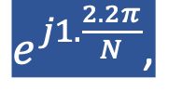


Discrete Fourier Transform
…
0
1
2
3
4
5
6
N-1
Sample number
= [ ]
Freq f₂
$$e^{j0.\frac{2.2π}{N}},$$
$e^{j1.\frac{2.2π}{N}}$,
$$e^{j2.\frac{2.2π}{N}},$$
…
$${,e}^{j(N−1).\frac{2.2π}{N}}$$
$$e^{j1.\frac{2.2π}{N}}$$
$$\frac{2.2π}{N}$$
$$e^{j0.\frac{2.2π}{N}}$$
$$e^{j(N−1).\frac{2.2π}{N}}$$

Slide 20
Discrete Fourier Transform
…
0
1
2
3
4
5
6
N-1
Sample number
What is the MINIMUM number of cycles
observable in this model?

Slide 21

Discrete Fourier Transform
…
0
1
2
3
4
5
6
N-1
Sample number
$$0$$

Slide 22



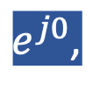
Discrete Fourier Transform
…
0
1
2
3
4
5
6
N-1
Sample number
= [ ]
Freq f₀
$$e^{j0},$$
$e^{j0}$,
$$e^{j0},$$
…
$${,e}^{j0}$$
$$0$$

Slide 23





Discrete Fourier Transform
…
0
1
2
3
4
5
6
N-1
Sample number
= [ ]
Freq f₀
$$e^{j0.\frac{2π}{N}},$$
$e^{j1.\frac{2π}{N}}$,
$$e^{j2.\frac{2π}{N}},$$
…
$${,e}^{j(N−1).\frac{2π}{N}}$$
$$e^{j2.\frac{2π}{N}}$$
$$e^{j1.\frac{2π}{N}}$$
$$\frac{2π}{N}$$
$$e^{j0.\frac{2π}{N}}$$
$$e^{j(N−1).\frac{2π}{N}}$$

Slide 24
Discrete Fourier Transform
…
0
1
2
3
4
5
6
N-1
Sample number
What is the MAXIMUM number of cycles
observable in this model?

Slide 25
Discrete Fourier Transform
…
0
1
2
3
4
5
6
N-1
Sample number
What happens when the ball rotates exactly N times?
$$0$$
We can uniquely observe up to (N-1) number of cycles.

Slide 26


Discrete Fourier Transform
Freq f₀
n=0
$$e^{j0}$$
n=1
$$e^{j0}$$
n=2
$$e^{j0}$$
…
…
n=N-1
$$e^{j0}$$

Slide 27
Discrete Fourier Transform
Number of cycles
…
…
Freq f₀
Freq f₁
Freq f_{m}
Freq f_{N-1}
n=0
$$e^{j0}$$
n=1
$$e^{j0}$$
Sample number
n=2
$$e^{j0}$$
…
…
n=N-1
$$e^{j0}$$

Slide 28












Discrete Fourier Transform
Number of cycles
…
…
Freq f₀
Freq f₁
Freq f_{m}
Freq f_{N-1}
n=0
$$e^{j0}$$
$$e^{j0.\frac{2π}{N}}$$
$$e^{j0.\frac{m.2π}{N}}$$
$$e^{j0.\frac{(N−1).2π}{N}}$$
n=1
$$e^{j0}$$
$$e^{j1.\frac{2π}{N}}$$
$$e^{j1.\frac{m.2π}{N}}$$
$$e^{j1.\frac{(N−1).2π}{N}}$$
Sample number
…
…
$$e^{j2.\frac{(N−1).2π}{N}}$$
$$e^{j2.\frac{2π}{N}}$$
$$e^{j2.\frac{m.2π}{N}}$$
n=2
$$e^{j0}$$
…
…
…
…
…
$$e^{j(N−1).\frac{2π}{N}}$$
$$e^{j(N−1).\frac{m.2π}{N}}$$
$$e^{j(N−1).\frac{(N−1).2π}{N}}$$
n=N-1
$$e^{j0}$$

Slide 29














Discrete Fourier Transform
$$e^{j0}$$
$$e^{j0.\frac{2π}{N}}$$
$$e^{j0.\frac{m.2π}{N}}$$
$$e^{j0.\frac{(N−1).2π}{N}}$$
$$e^{j0}$$
$$e^{j1.\frac{2π}{N}}$$
$$e^{j1.\frac{m.2π}{N}}$$
$$e^{j1.\frac{(N−1).2π}{N}}$$
+
$$e^{j2.\frac{2π}{N}}$$
+
$$e^{j2.\frac{m.2π}{N}}$$
+
$$e^{j2.\frac{(N−1).2π}{N}}$$
Z₀
$$e^{j0}$$
Z₁
…
Z_{m}
…
Z_{N-1}
…
…
…
…
$$e^{j(N−1).\frac{2π}{N}}$$
$$e^{j(N−1).\frac{m.2π}{N}}$$
$$e^{j(N−1).\frac{(N−1).2π}{N}}$$
$$e^{j0}$$

Slide 30














Discrete Fourier Transform
$$e^{j0}$$
$$e^{j0.\frac{2π}{N}}$$
$$e^{j0.\frac{m.2π}{N}}$$
$$e^{j0.\frac{(N−1).2π}{N}}$$
$$e^{j0}$$
$$e^{j1.\frac{2π}{N}}$$
$$e^{j1.\frac{m.2π}{N}}$$
$$e^{j1.\frac{(N−1).2π}{N}}$$
+
$$e^{j2.\frac{2π}{N}}$$
+
$$e^{j2.\frac{m.2π}{N}}$$
+
$$e^{j2.\frac{(N−1).2π}{N}}$$
Z₀
$$e^{j0}$$
Z₁
…
Z_{m}
…
Z_{N-1}
…
…
…
…
$$e^{j(N−1).\frac{2π}{N}}$$
$$e^{j(N−1).\frac{m.2π}{N}}$$
$$e^{j(N−1).\frac{(N−1).2π}{N}}$$
$$e^{j0}$$

Slide 31
Discrete Fourier Transform
$$e^{j0}$$
$$e^{j0.\frac{2π}{N}}$$
$$e^{j0.\frac{m.2π}{N}}$$
$$e^{j0.\frac{(N−1).2π}{N}}$$
$$e^{j0}$$
$$e^{j1.\frac{2π}{N}}$$
$$e^{j1.\frac{m.2π}{N}}$$
$$e^{j1.\frac{(N−1).2π}{N}}$$
+
$$e^{j2.\frac{2π}{N}}$$
+
$$e^{j2.\frac{m.2π}{N}}$$
+
$$e^{j2.\frac{(N−1).2π}{N}}$$
Z₀
$$e^{j0}$$
Z₁
…
Z_{m}
…
Z_{N-1}
…
…
…
…
$$e^{j(N−1).\frac{2π}{N}}$$
$$e^{j(N−1).\frac{m.2π}{N}}$$
$$e^{j(N−1).\frac{(N−1).2π}{N}}$$
$$e^{j0}$$
=
…
0
1
2
3
4
5
6
N-1
Sample number

Slide 32
Discrete Fourier Transform
Frequency domain coefficients
$$e^{j0}$$
$$e^{j0.\frac{2π}{N}}$$
$$e^{j0.\frac{m.2π}{N}}$$
$$e^{j0.\frac{(N−1).2π}{N}}$$
$$e^{j0}$$
$$e^{j1.\frac{2π}{N}}$$
$$e^{j1.\frac{m.2π}{N}}$$
$$e^{j1.\frac{(N−1).2π}{N}}$$
+
$$e^{j2.\frac{2π}{N}}$$
+
$$e^{j2.\frac{m.2π}{N}}$$
+
$$e^{j2.\frac{(N−1).2π}{N}}$$
Z₀
$$e^{j0}$$
Z₁
…
Z_{m}
…
Z_{N-1}
…
…
…
…
$$e^{j(N−1).\frac{2π}{N}}$$
$$e^{j(N−1).\frac{m.2π}{N}}$$
$$e^{j(N−1).\frac{(N−1).2π}{N}}$$
$$e^{j0}$$
x[0]
x[1]
=
X =
x[2]
Time domain samples
…
x[N-1]

Slide 33
Discrete Fourier Transform
_{F}
…
DFT matrix,
=
f₀
f₁
…
f_{m}
f_{N-1}

Slide 34
Discrete Fourier Transform
_{F}
…
DFT matrix,
=
f₀
f₁
…
f_{m}
f_{N-1}
_{Z}
Z₀
Fourier coefficients,
=
Z₁
…
Z_{m}
…
Z_{N-1}

Slide 35
Discrete Fourier Transform
_{F}
…
DFT matrix,
=
f₀
f₁
…
f_{m}
f_{N-1}
_{Z}
Z₀
x[0]
X =
Fourier coefficients,
=
Z₁
Time series,
…
x[1]
Z_{m}
x[2]
…
…
Z_{N-1}
x[N-1]

Slide 36
Discrete Fourier Transform
_{X}
_{F}
_{Z}
=
_{X}
_{Z}
_{F}⁻¹
=
_{H}
_{X}
_{Z}
_{F}
=

Slide 37
Discrete Fourier Transform
_{X}
_{F}
_{Z}
=
_{X}
_{Z}
_{F}⁻¹
=
_{H}
_{X}
_{Z}
_{F}
=
*
f₀
*
f₁
…
*
f_{m}
…
*
f_{N-1}

Slide 38
Discrete Fourier Transform
_{X}
_{F}
_{Z}
=
IDFT
_{X}
_{Z}
_{F}⁻¹
=
DFT
_{H}
_{X}
_{Z}
_{F}
=
*
f₀
x[0]
Z₀
*
Z₁
f₁
x[1]
…
=
…
*
x[2]
Z_{m}
f_{m}
…
…
…
Z_{N-1}
*
x[N-1]
f_{N-1}

Slide 39
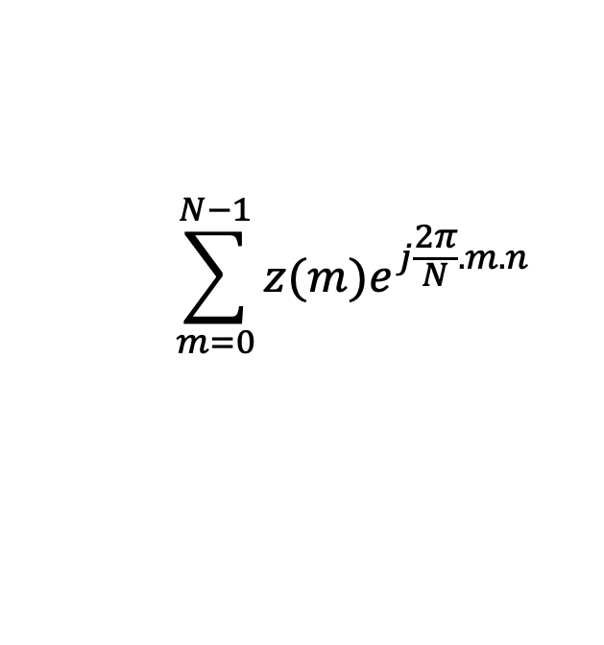
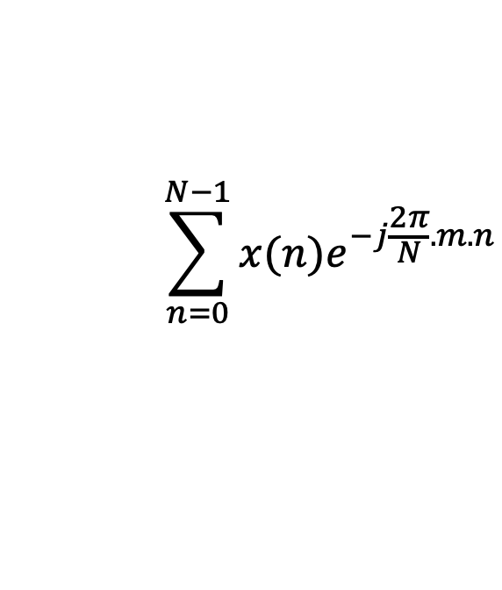
Discrete Fourier Transform
$$\sum_{n=0}^{N−1}{x(n)e^{−j\frac{2π}{N}.m.n}}$$
DFT:
z(m) =
$$\sum_{m=0}^{N−1}{z(m)e^{j\frac{2π}{N}.m.n}}$$
IDFT:
x(n) = (1/N)

Slide 40
Plotting
DFT spectrum

Slide 41
Plotting the DFT spectrum
Magnitude
|z_{m}|
m = 0
1
2
3
4
…
Frequency
N-2
N-1

Slide 42
Plotting the DFT spectrum
Magnitude
|z_{m}|
m = 0
1
2
3
4
…
Frequency
N-2
N-1
Phase
⦨ z_{m}
m = 0
1
2
3
4
…
Frequency
N-2
N-1

Slide 43



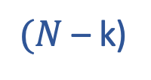




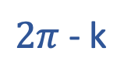

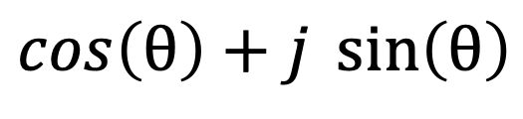



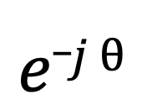

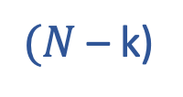

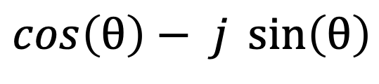




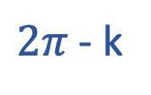
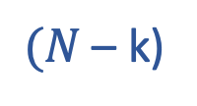
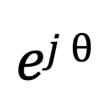
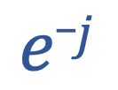




The Curious Case of “Negative frequency”
$$ej θ$$
$$=$$
$$\cos\left(θ\right)+j \sin\left(θ\right)$$
$$e_j θ$$
$$=$$
$$\cos\left(θ\right)− j \sin\left(θ\right)$$
$$e_j$$
k
$$\frac{2π}{N}$$
$$\cos\left( \right)− j \sin\left( \right)$$
$$=$$
k
$$\frac{2π}{N}$$
k
$$\frac{2π}{N}$$
$$e_j$$
k
$$\frac{2π}{N}$$
$$\cos\left( \right)+ j \sin\left( \right)$$
$$=$$
$2π$- k
$$\frac{2π}{N}$$
$2π$- k
$$\frac{2π}{N}$$
$$e_j$$
k
$$\frac{2π}{N}$$
$$\frac{2π}{N}$$
$$\cos\left( \right)+ j \sin\left( \right)$$
$$=$$
$(N$– k)
$$\frac{2π}{N}$$
$(N$– k)
$$e_j$$
k
$$\frac{2π}{N}$$
$$=$$
$$ej$$
$(N$– k)
$$\frac{2π}{N}$$

Slide 44

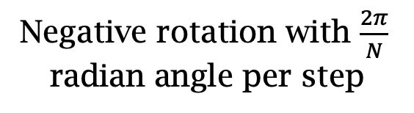

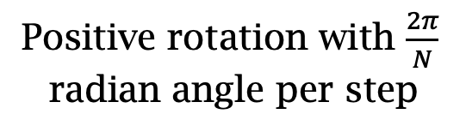
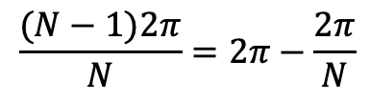
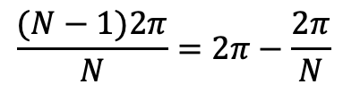
The Curious Case of “Negative frequency”
$$\frac{(N−1)2π}{N}=2π−\frac{2π}{N}$$
$$\frac{2π}{N}$$
$$\frac{2π}{N}$$
$$\frac{(N−1)2π}{N}=2π−\frac{2π}{N}$$
Positive rotation with $\frac{2π}{N}$ radian angle per step
Negative rotation with $\frac{2π}{N}$ radian angle per step

Slide 45
The Curious Case of “Negative frequency”
m = 0
1
2
3
4
…
Frequency
N-2
N-1
+
+
+
-
-
-

Slide 46
The Curious Case of “Negative frequency”
-4
-3
-2
-1
m = 0
1
2
3
4
Frequency

Slide 47
The Curious Case of “Negative frequency”
Magnitude
|z_{m}|
-4
-3
-2
-1
m = 0
1
2
3
4
Frequency
Real signal’s magnitude spectrum is symmetric.
Why?

Slide 48


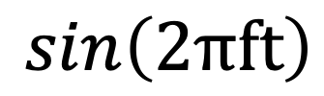



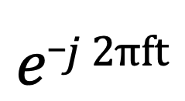
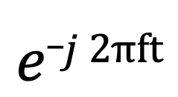
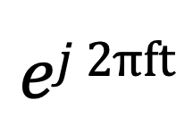
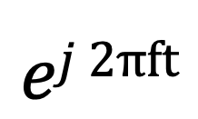
The Curious Case of “Negative frequency”
Real signal’s magnitude spectrum is symmetric.
Why?
Magnitude
|z_{m}|
Frequency
-4
-3
-2
-1
m = 0
1
2
3
4
$$ej 2πft$$
$$+$$
$$e_j 2πft$$
$$\cos\left(2πft\right)$$
$$=$$
2
$$ej 2πft$$
$$−$$
$$e_j 2πft$$
$$\sin\left(2πft\right)$$
$$=$$
2j

Slide 49
The Curious Case of “Negative frequency”
Magnitude
|z_{m}|
-4
-3
-2
-1
m = 0
1
2
3
4
Frequency
Complex signal’s magnitude spectrum may or may not be symmetric.
Why?

Slide 50
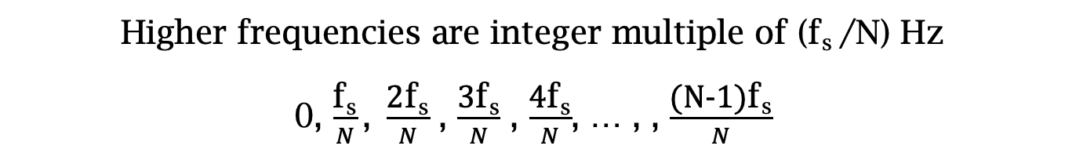
From “# of Cycles” to “the real-world frequencies”
Sampling frequency = f_{s} (i.e., f_{s} samples per second)
Slowest frequency ($\frac{2π}{N}$ radians per step) = N samples per rotation
= (N/ f_{s}) seconds per rotation
Therefore, the slowest frequency = (f_{s} /N) Hz
Higher frequencies are integer multiple of (f_{s} /N) Hz
0, $\frac{\text{f}\text{s}}{N}\text{, }\frac{\text{2}\text{f}\text{s}}{N}$ , $\frac{\text{3}\text{f}\text{s}}{N}$ , $\frac{\text{4}\text{f}\text{s}}{N}$, … , , $\frac{\text{(}\text{N}\text{−1)}\text{f}\text{s}}{N}$

Slide 51

The resolution and the highest frequency
Magnitude/Phase of z_{m}
-4
-3
-2
-1
m = 0
1
2
3
4
Frequency
Resolution
= minimum observable frequency difference =
$\frac{\text{f}\text{s}}{N}$
What if the actual frequency falls in between two frequency bins?

Slide 52
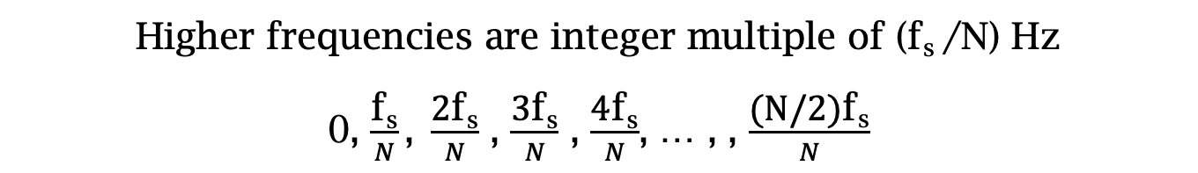
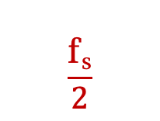

Estimating the real-world frequencies
Sampling frequency = f_{s} (i.e., f_{s} samples per second)
Slowest frequency ($\frac{2π}{N}$ radians per step) = N samples per rotation
= (N/ f_{s}) seconds per rotation
Therefore, the slowest frequency = (f_{s} /N) Hz
Higher frequencies are integer multiple of (f_{s} /N) Hz
0, $\frac{\text{f}\text{s}}{N}\text{, }\frac{\text{2}\text{f}\text{s}}{N}$ , $\frac{\text{3}\text{f}\text{s}}{N}$ , $\frac{\text{4}\text{f}\text{s}}{N}$, … , , $\frac{\text{(}\text{N}\text{/2)}\text{f}\text{s}}{N}$
$$\frac{\text{f}\text{s}}{2}$$
- $\frac{\text{f}\text{s}}{N}\text{, }\text{−}\frac{\text{2}\text{f}\text{s}}{N}$ , - $\frac{\text{3}\text{f}\text{s}}{N}$ , - $\frac{\text{4}\text{f}\text{s}}{N}$, … , , - $\frac{\text{(}\text{N}\text{/2)}\text{f}\text{s}}{N}$

Slide 53
The resolution and the highest frequency
Magnitude/Phase of z_{m}
-4
-3
-2
-1
m = 0
1
2
3
4
Frequency
Resolution
= minimum observable frequency difference =
$\frac{\text{f}\text{s}}{N}$
What if the actual frequency falls in between two frequency bins?

Slide 54
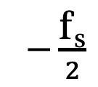
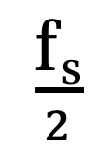
The resolution and the highest frequency
Magnitude/Phase of z_{m}
-4
-3
-2
-1
m = 0
1
2
3
4
Frequency
$−\frac{\text{f}\text{s}}{2}$
$\frac{\text{f}\text{s}}{2}$
Highest frequency =

Slide 55
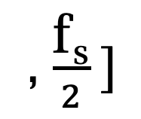
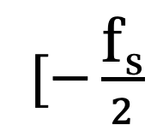
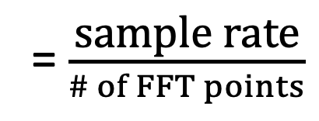
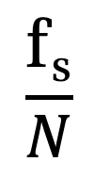
The resolution and the highest frequency
How can we increase the resolution?
$$\frac{\text{f}\text{s}}{N}$$
= $\frac{\text{sample} \text{rate}}{\# of FFT points}$
How can we increase the range of the spectrum?
$[−\frac{\text{f}\text{s}}{2}$
, $\frac{\text{f}\text{s}}{2} ]$

Slide 56
Time resolution v/s Frequency resolution

Slide 57



Time resolution v/s Frequency resolution
U
M
D
[
[
DFT
DFT
$$\frac{\text{f}\text{s}}{N}$$
= $\frac{\text{sample} \text{rate}}{\# of FFT points}$
How can we increase the frequency resolution?
How can we increase the time resolution?

Slide 58
Sampling Theorem

Slide 59
Sampling theorem
Amplitude
Time (sec)
0.00
0.25
0.50
0.75
1.00
1.25
Amplitude
Time (sec)
0.00
0.25
0.50
0.75
1.00
1.25

Slide 60
Sampling theorem
Amplitude
Time (sec)
0.00
0.25
0.50
0.75
1.00
1.25
Aliasing: Two signals become indistinguishable
after sampling
Amplitude
Time (sec)
0.00
0.25
0.50
0.75
1.00
1.25

Slide 61
Aliasing
Amplitude
Time (sec)
0.00
0.25
0.50
0.75
1.00
1.25
Amplitude
Time (sec)
0.00
0.25
0.50
0.75
1.00
1.25

Slide 62

Aliasing

Slide 63
How to find a good sample rate?
Suppose you sample a signal in some way. If you can exactly reconstruct the signal from the samples, then you have done a proper sampling and captured the key signal information
Notes:
[Reference slides] http://terrano.ucsd.edu/jorge/teaching/mae143a/lectures/8sampling.pdf

Slide 64
How to find a good sample rate?
Suppose you sample a signal in some way. If you can exactly reconstruct the signal from the samples, then you have done a proper sampling and captured the key signal information
The sampling frequency f_{s} , is the number of samples per second. This is to be compared with the signal cyclic frequencies
Notes:
[Reference slides] http://terrano.ucsd.edu/jorge/teaching/mae143a/lectures/8sampling.pdf

Slide 65



How to find a good sample rate?
11.1 samples/cycle
3.2 samples/cycle
1.05
samples/cycle

Slide 66
How to find a good sample rate?
Nyquist-Shannon sampling theorem:
In order to uniquely represent a signal F(t) by a set of samples, the sampling rate must be more than twice the highest frequency component present in F(t).
If sample rate is f_{s} and maximum frequency we want to
record is f_{max} , then
f_{s} > 2f_{max}

Slide 67
Amplitude
Time (sec)
0.00
0.25
0.50
0.75
1.00
1.25
Nyquist frequency = Maximum alias-free frequency
for a given sample rate.
Nyquist rate = Lower bound of sample rate for a
signal.
(f_{s} / 2)
(2f_{max})

Slide 68
Aliasing
f_{max} = 12 Hz
Amplitude
0
4
8
12
16
Frequency (Hz)

Slide 69
Commonly, the maximum frequency in human voice is 4 kHz, what sample rate will you use in your audio recorder?
Is there any limit on the maximum sample rate you can use?

Slide 70
Aliasing

Slide 71
Sampling theorem
Amplitude
Time (sec)
0.00
0.25
0.50
0.75
1.00
1.25
Amplitude
Time (sec)
0.00
0.25
0.50
0.75
1.00
1.25
Aliasing: Two signals become indistinguishable after sampling

Slide 72
Time domain samples
Amplitude
Time (sec)
0.00
0.25
0.50
0.75
1.00
1.25
FFT
Amplitude
-6
-4
-2
0
2
4
6
8
Frequency (Hz)
Frequency domain

Slide 73

Aliasing: Different frequencies, same name!!
Magnitude/Phase of z_{m}
-4
-3
-2
-1
m = 0
1
2
3
4
Frequency
Assume, Sample rate $\text{f}\text{s}$ = 8 Hz
For a COMPLEX signal, what value will we see if the actual frequency is:
a) 3 Hz
b) -2 Hz
c) 6 Hz
d) -5 Hz
e) 4 Hz and -4Hz

Slide 74
Magnitude/Phase of z_{m}
-4
-3
-2
-1
m = 0
1
2
3
4
Frequency
5
6
7
8

Slide 75
Magnitude/Phase of z_{m}
-4
-3
-2
-1
m = 0
1
2
3
4
Frequency
5
6
7
8

Slide 76
Magnitude/Phase of z_{m}
-4
-3
-2
-1
m = 0
1
2
3
4
Frequency
0
- F_{s}/4
F_{s}/4
F_{s}/2

Slide 77
Magnitude/Phase of z_{m}
-4
-3
-2
-1
m = 0
1
2
3
4
Frequency
0
-1
1
- 2
2
-3
3
4
-4

Slide 78
Aliasing: Different frequencies, same name!!
Magnitude/Phase of z_{m}
-4
-3
-2
-1
m = 0
1
2
3
4
Frequency
Assume, Sample rate $\text{f}\text{s}$ = 8 Hz
For a COMPLEX signal, what value will we see if the actual frequency is:
a) 3 Hz
b) -2 Hz
c) 6 Hz
d) -5 Hz
e) 4 Hz and -4Hz

Slide 79
Aliasing: Different frequencies, same name!!
Magnitude/Phase of z_{m}
-4
-3
-2
-1
m = 0
1
2
3
4
Frequency
Assume, Sample rate $\text{f}\text{s}$ = 8 Hz
For a REAL signal, what value will we see if the actual frequency is:
a) 3 Hz
b) -2 Hz
c) 6 Hz
d) -5 Hz
e) 4 Hz and -4Hz

Slide 80

Aliasing: Spectrogram of increasing frequency

Slide 81


Calculating the aliased frequency value for real signals
Sampling frequency = 10Hz
Nyquist frequency = 5Hz
Amplitude
0
2
4
6
8
Frequency (Hz)

Slide 82

Calculating the aliased frequency value for real signals
Sampling frequency = 10Hz
Nyquist frequency = 5Hz
Amplitude
Received
signal
Amplitude
0
2
4
6
8
0
2
4
6
8
Frequency (Hz)
Frequency (Hz)

Slide 83
Calculating the aliased frequency value for real signals
Sampling frequency = 10Hz
Nyquist frequency = 5Hz
Amplitude
Received
signal
Amplitude
0
2
4
6
8
0
2
4
6
8
Frequency (Hz)
Frequency (Hz)
f_{s} = Sampling frequency
f = Target frequency
f_{a} = Aliased(perceived) frequency
K = Non-negative integer
f_{a} = min(abs(K*f_{s} - f))

Slide 84
Aliasing: A real life scenario
Nyquist frequency
Amplitude
10k
20k
30k
40k
50k
60k
70k
80k
90k
100k
Frequency spectrum
Notes:
to amplify the signal power …
Now, this signal typically contains many more frequencies than the sampling system can handle …

Slide 85
Aliasing: A real life scenario
Nyquist frequency
Amplitude
10k
20k
30k
40k
50k
60k
70k
80k
90k
100k
Frequency spectrum
Notes:
to amplify the signal power …
Now, this signal typically contains many more frequencies than the sampling system can handle …

Slide 86
Aliasing: A real life scenario
Nyquist frequency
Amplitude
10k
20k
30k
40k
50k
60k
70k
80k
90k
100k
Frequency spectrum
We need a “Low-pass filter”
to remove unwanted high frequency signals
Notes:
to amplify the signal power …
Now, this signal typically contains many more frequencies than the sampling system can handle …

Slide 87
Anti-aliasing filter
Nyquist frequency
Amplitude
10k
20k
30k
40k
50k
60k
70k
80k
90k
100k
Frequency spectrum
Sensor
ADC
Anti-aliasing
Filter
Notes:
to amplify the signal power …
Now, this signal typically contains many more frequencies than the sampling system can handle …

Slide 88
Anti-aliasing filter
Nyquist frequency
Amplitude
10k
20k
30k
40k
50k
60k
70k
80k
90k
100k
Frequency spectrum
Sensor
ADC
Anti-aliasing
Filter
Notes:
Hence, a low pass filter…

Slide 89
Anti-aliasing filter
Anti-aliasing
filter
Amplitude
10k
20k
30k
40k
50k
60k
70k
80k
90k
100k
Frequency spectrum
Sensor
ADC
Anti-aliasing
Filter
Notes:
removes the unwanted frequencies above 24 kHz …
And ultimately, this filtered signal is sampled by an ADC to generate digital sound samples

Slide 90
Extra Slides

Slide 91


Slide 93

Fourier series
2

Slide 94

Fourier series

Slide 95


Slide 98


Slide 100

Discrete Fourier Transform formula
Discrete version:

Slide 101
Discrete Fourier Transform formula
Discrete version:

