Slide 1





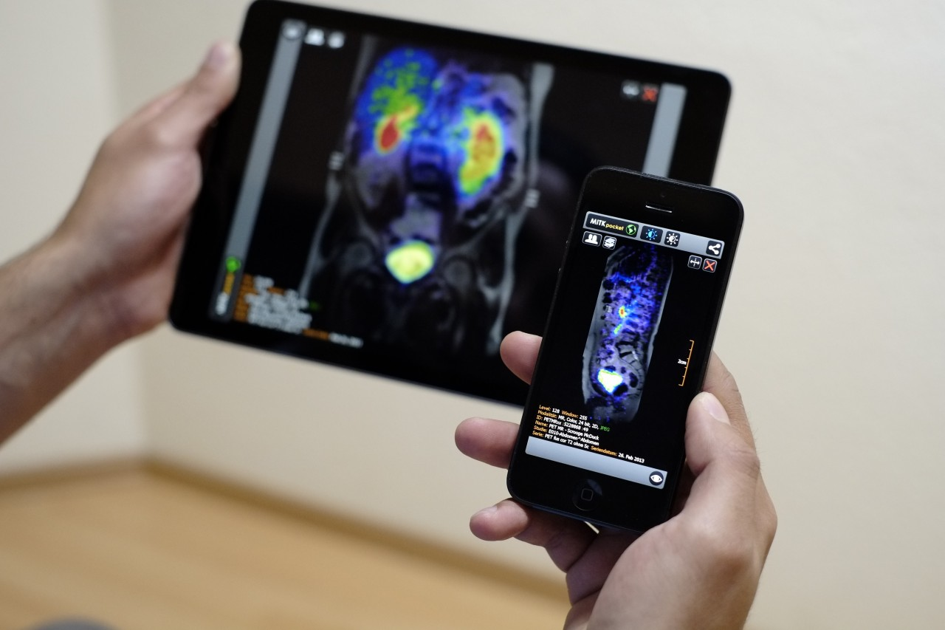
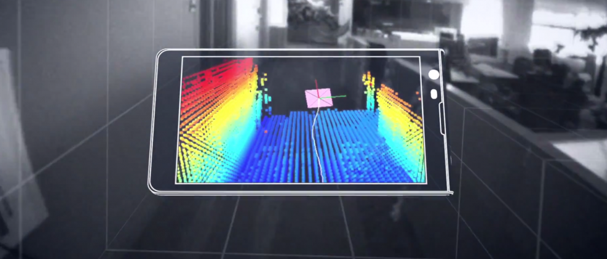

Machine Learning for Physical Sensing & Perception
CMSC 818V : Fall 2025
Lecture 1_4: Frequency in Learning
Nirupam Roy
Tu-Th 3:30 – 4:45pm
IRB 1207

Slide 2

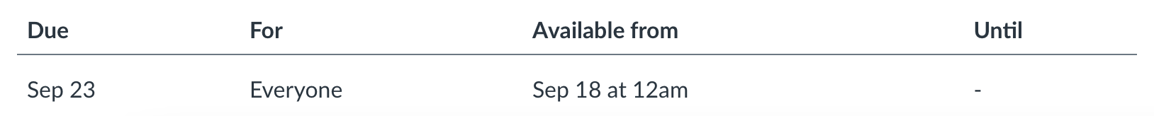
Announcement - 1
Due tonight!

Slide 3
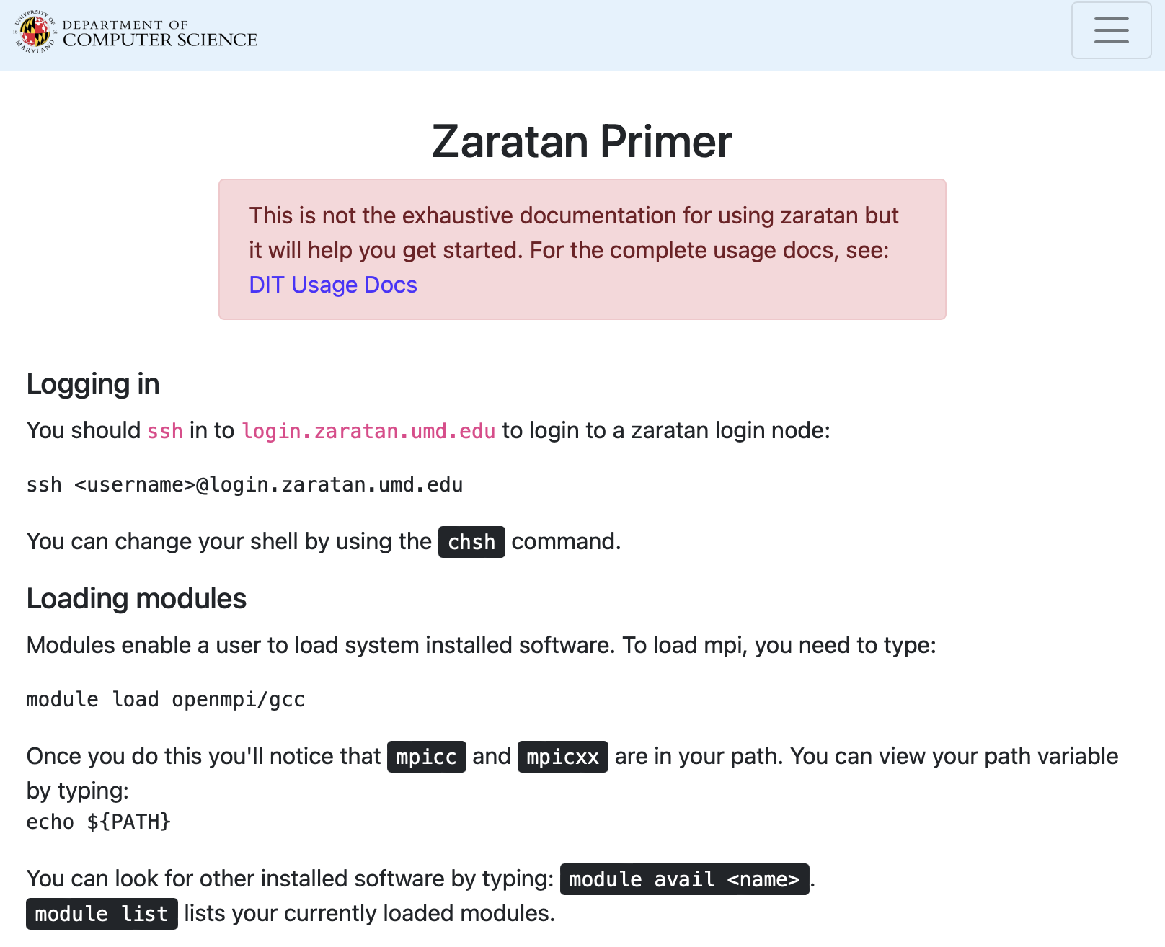
Announcement - 2
You have been added to Zaratan cluster for
818v assignments.
Get familiar with “Zaratan Primer”
https://www.cs.umd.edu/class/fall2022/cmsc416/zaratan.shtml
Stay tuned for more information.

Slide 4
The Curious Case of “Negative frequency”
m = 0
1
2
3
4
…
Frequency
N-2
N-1
+
+
+
-
-
-

Slide 5
The Curious Case of “Negative frequency”
-4
-3
-2
-1
m = 0
1
2
3
4
Frequency

Slide 6


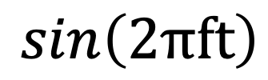



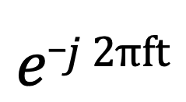
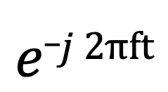
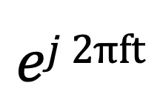
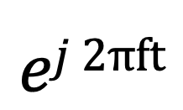
The Curious Case of “Negative frequency”
Real signal’s magnitude spectrum is symmetric.
Why?
Magnitude
|z_{m}|
Frequency
-4
-3
-2
-1
m = 0
1
2
3
4
$$ej 2πft$$
$$+$$
$$e_j 2πft$$
$$\cos\left(2πft\right)$$
$$=$$
2
$$ej 2πft$$
$$−$$
$$e_j 2πft$$
$$\sin\left(2πft\right)$$
$$=$$
2j

Slide 7
The Curious Case of “Negative frequency”
Magnitude
|z_{m}|
-4
-3
-2
-1
m = 0
1
2
3
4
Frequency
Complex signal’s magnitude spectrum may or may not be symmetric.
Why?

Slide 8
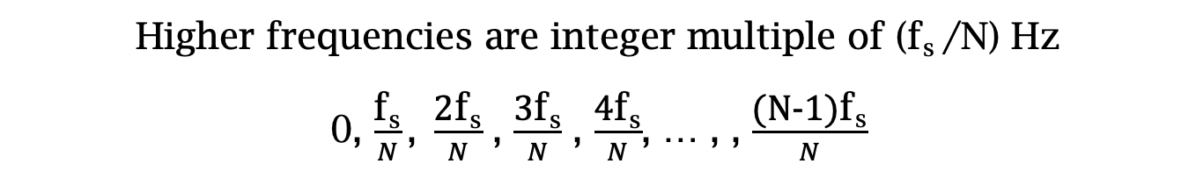
From “# of Cycles” to “the real-world frequencies”
Sampling frequency = f_{s} (i.e., f_{s} samples per second)
Slowest frequency ($\frac{2π}{N}$ radians per step) = N samples per rotation
= (N/ f_{s}) seconds per rotation
Therefore, the slowest frequency = (f_{s} /N) Hz
Higher frequencies are integer multiple of (f_{s} /N) Hz
0, $\frac{\text{f}\text{s}}{N}\text{, }\frac{\text{2}\text{f}\text{s}}{N}$ , $\frac{\text{3}\text{f}\text{s}}{N}$ , $\frac{\text{4}\text{f}\text{s}}{N}$, … , , $\frac{\text{(}\text{N}\text{−1)}\text{f}\text{s}}{N}$

Slide 9
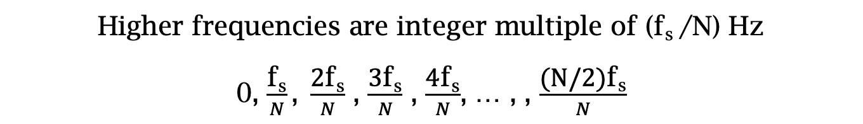
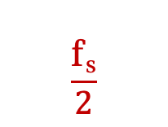

Estimating the real-world frequencies
Sampling frequency = f_{s} (i.e., f_{s} samples per second)
Slowest frequency ($\frac{2π}{N}$ radians per step) = N samples per rotation
= (N/ f_{s}) seconds per rotation
Therefore, the slowest frequency = (f_{s} /N) Hz
Higher frequencies are integer multiple of (f_{s} /N) Hz
0, $\frac{\text{f}\text{s}}{N}\text{, }\frac{\text{2}\text{f}\text{s}}{N}$ , $\frac{\text{3}\text{f}\text{s}}{N}$ , $\frac{\text{4}\text{f}\text{s}}{N}$, … , , $\frac{\text{(}\text{N}\text{/2)}\text{f}\text{s}}{N}$
$$\frac{\text{f}\text{s}}{2}$$
- $\frac{\text{f}\text{s}}{N}\text{, }\text{−}\frac{\text{2}\text{f}\text{s}}{N}$ , - $\frac{\text{3}\text{f}\text{s}}{N}$ , - $\frac{\text{4}\text{f}\text{s}}{N}$, … , , - $\frac{\text{(}\text{N}\text{/2)}\text{f}\text{s}}{N}$

Slide 10

The resolution and the highest frequency
Magnitude/Phase of z_{m}
-4
-3
-2
-1
m = 0
1
2
3
4
Frequency
Resolution
= minimum observable frequency difference =
$\frac{\text{f}\text{s}}{N}$
What if the actual frequency falls in between two frequency bins?

Slide 11
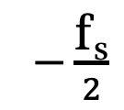
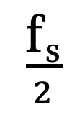
The resolution and the highest frequency
Magnitude/Phase of z_{m}
-4
-3
-2
-1
m = 0
1
2
3
4
Frequency
$−\frac{\text{f}\text{s}}{2}$
$\frac{\text{f}\text{s}}{2}$
Highest frequency =

Slide 12
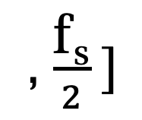
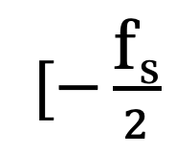
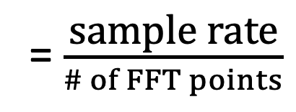
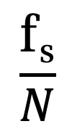
The resolution and the highest frequency
How can we increase the resolution?
$$\frac{\text{f}\text{s}}{N}$$
= $\frac{\text{sample} \text{rate}}{\# of FFT points}$
How can we increase the range of the spectrum?
$[−\frac{\text{f}\text{s}}{2}$
, $\frac{\text{f}\text{s}}{2} ]$

Slide 13
Time resolution v/s Frequency resolution

Slide 14
Time resolution v/s Frequency resolution
Uncertainty principle:
“You cannot simultaneously know a signal’s exact time location and its exact frequency content.”

Slide 15
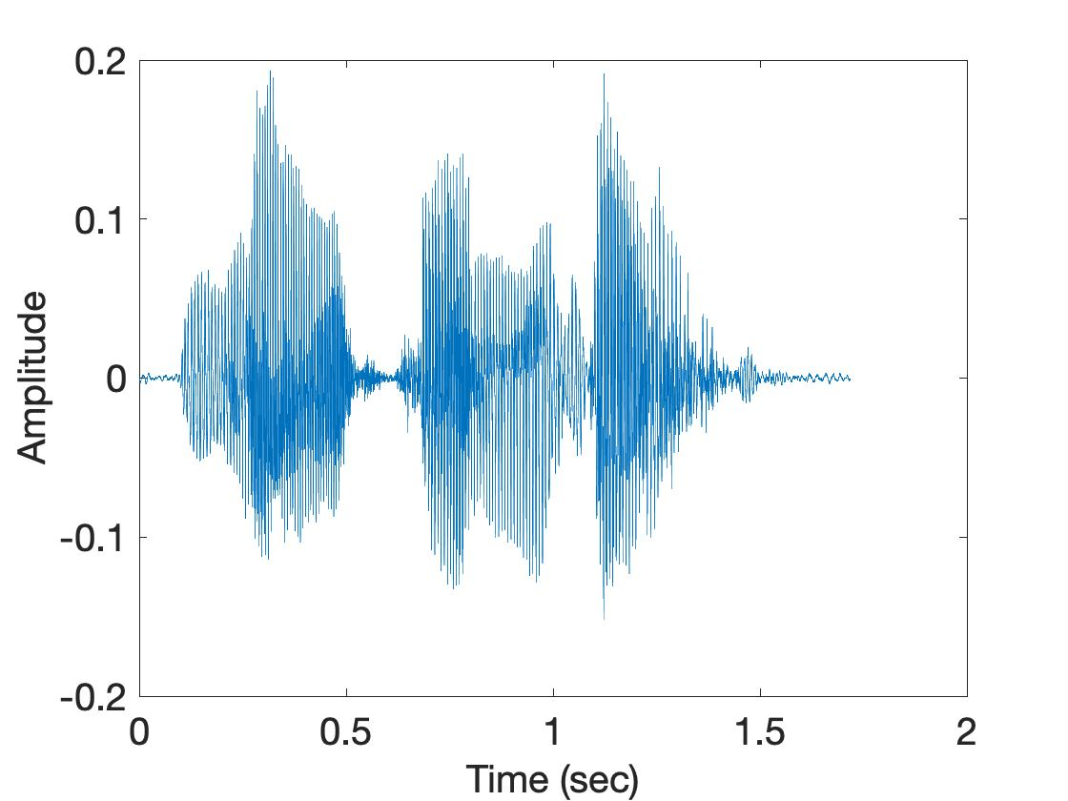
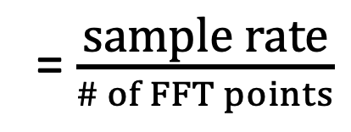
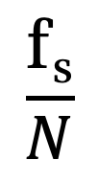
Time resolution v/s Frequency resolution
U
M
D
[
[
DFT
DFT
$$\frac{\text{f}\text{s}}{N}$$
= $\frac{\text{sample} \text{rate}}{\# of FFT points}$
How can we increase the frequency resolution?
How can we increase the time resolution?

Slide 16
Sampling Theorem

Slide 17
Sampling theorem
Amplitude
Time (sec)
0.00
0.25
0.50
0.75
1.00
1.25
Amplitude
Time (sec)
0.00
0.25
0.50
0.75
1.00
1.25

Slide 18
Sampling theorem
Amplitude
Time (sec)
0.00
0.25
0.50
0.75
1.00
1.25
Aliasing: Two signals become indistinguishable
after sampling
Amplitude
Time (sec)
0.00
0.25
0.50
0.75
1.00
1.25

Slide 19
Aliasing
Amplitude
Time (sec)
0.00
0.25
0.50
0.75
1.00
1.25
Amplitude
Time (sec)
0.00
0.25
0.50
0.75
1.00
1.25

Slide 20

Aliasing

Slide 21
How to find a good sample rate?
Suppose you sample a signal in some way. If you can exactly reconstruct the signal from the samples, then you have done a proper sampling and captured the key signal information
Notes:
[Reference slides] http://terrano.ucsd.edu/jorge/teaching/mae143a/lectures/8sampling.pdf

Slide 22
How to find a good sample rate?
Suppose you sample a signal in some way. If you can exactly reconstruct the signal from the samples, then you have done a proper sampling and captured the key signal information
The sampling frequency f_{s} , is the number of samples per second. This is to be compared with the signal cyclic frequencies
Notes:
[Reference slides] http://terrano.ucsd.edu/jorge/teaching/mae143a/lectures/8sampling.pdf

Slide 23
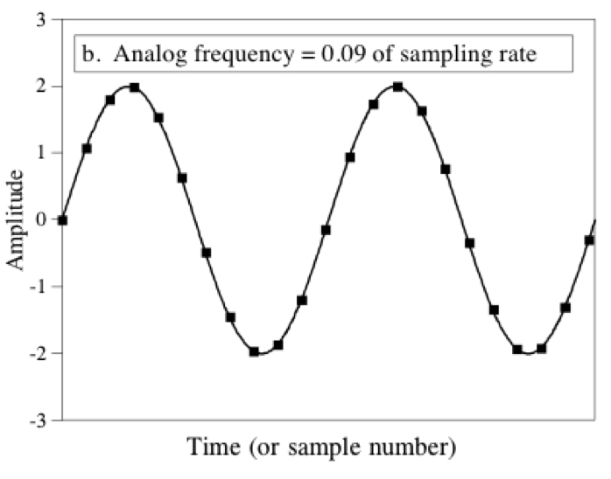
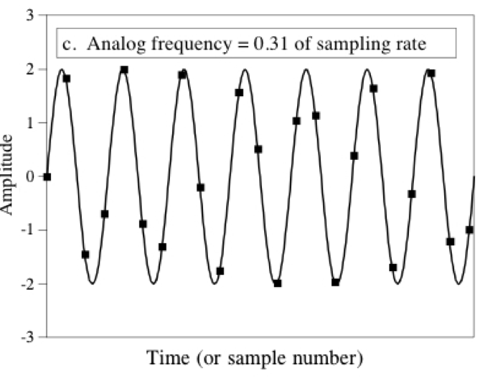
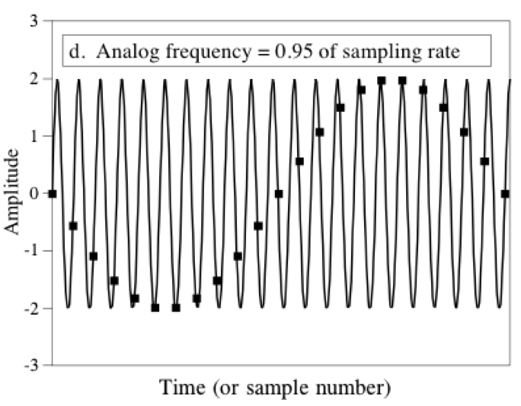
How to find a good sample rate?
11.1 samples/cycle
3.2 samples/cycle
1.05
samples/cycle

Slide 24
How to find a good sample rate?
Nyquist-Shannon sampling theorem:
In order to uniquely represent a signal F(t) by a set of samples, the sampling rate must be more than twice the highest frequency component present in F(t).
If sample rate is f_{s} and maximum frequency we want to
record is f_{max} , then
f_{s} > 2f_{max}

Slide 25
Amplitude
Time (sec)
0.00
0.25
0.50
0.75
1.00
1.25
Nyquist frequency = Maximum alias-free frequency
for a given sample rate.
Nyquist rate = Lower bound of sample rate for a
signal.
(f_{s} / 2)
(2f_{max})

Slide 26
Aliasing
f_{max} = 12 Hz
Amplitude
0
4
8
12
16
Frequency (Hz)

Slide 27
Commonly, the maximum frequency in human voice is 4 kHz, what sample rate will you use in your audio recorder?
Is there any limit on the maximum sample rate you can use?

Slide 28
Aliasing

Slide 29
Sampling theorem
Amplitude
Time (sec)
0.00
0.25
0.50
0.75
1.00
1.25
Amplitude
Time (sec)
0.00
0.25
0.50
0.75
1.00
1.25
Aliasing: Two signals become indistinguishable after sampling

Slide 30
Time domain samples
Amplitude
Time (sec)
0.00
0.25
0.50
0.75
1.00
1.25
FFT
Amplitude
-6
-4
-2
0
2
4
6
8
Frequency (Hz)
Frequency domain

Slide 31
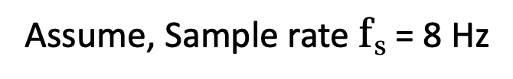
Aliasing: Different frequencies, same name!!
Magnitude/Phase of z_{m}
-4
-3
-2
-1
m = 0
1
2
3
4
Frequency
Assume, Sample rate $\text{f}\text{s}$ = 8 Hz
For a COMPLEX signal, what value will we see if the actual frequency is:
a) 3 Hz
b) -2 Hz
c) 6 Hz
d) -5 Hz
e) 4 Hz and -4Hz

Slide 32
Magnitude/Phase of z_{m}
-4
-3
-2
-1
m = 0
1
2
3
4
Frequency
5
6
7
8

Slide 33
Magnitude/Phase of z_{m}
-4
-3
-2
-1
m = 0
1
2
3
4
Frequency
5
6
7
8

Slide 34
Magnitude/Phase of z_{m}
-4
-3
-2
-1
m = 0
1
2
3
4
Frequency
0
- F_{s}/4
F_{s}/4
F_{s}/2

Slide 35
Magnitude/Phase of z_{m}
-4
-3
-2
-1
m = 0
1
2
3
4
Frequency
0
-1
1
- 2
2
-3
3
4
-4

Slide 36
Aliasing: Different frequencies, same name!!
Magnitude/Phase of z_{m}
-4
-3
-2
-1
m = 0
1
2
3
4
Frequency
Assume, Sample rate $\text{f}\text{s}$ = 8 Hz
For a COMPLEX signal, what value will we see if the actual frequency is:
a) 3 Hz
b) -2 Hz
c) 6 Hz
d) -5 Hz
e) 4 Hz and -4Hz

Slide 37
Aliasing: Different frequencies, same name!!
Magnitude/Phase of z_{m}
-4
-3
-2
-1
m = 0
1
2
3
4
Frequency
Assume, Sample rate $\text{f}\text{s}$ = 8 Hz
For a REAL signal, what value will we see if the actual frequency is:
a) 3 Hz
b) -2 Hz
c) 6 Hz
d) -5 Hz
e) 4 Hz and -4Hz

Slide 38
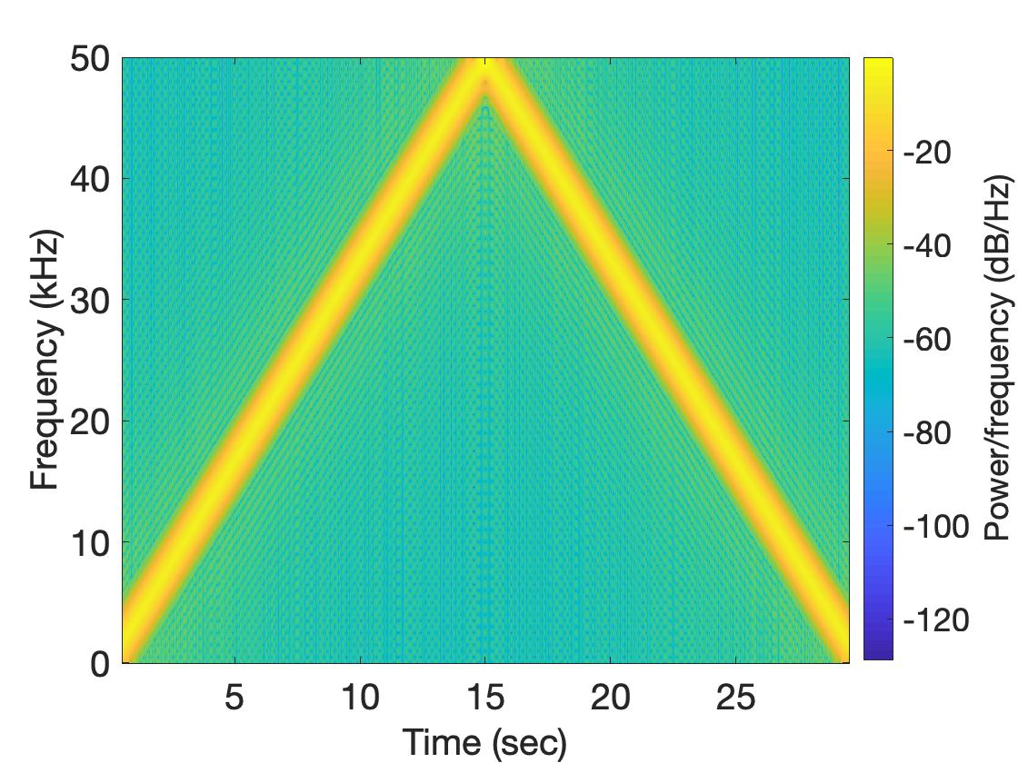
Aliasing: Spectrogram of increasing frequency

Slide 39
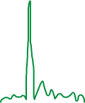

Calculating the aliased frequency value for real signals
Sampling frequency = 10Hz
Nyquist frequency = 5Hz
Amplitude
0
2
4
6
8
Frequency (Hz)

Slide 40

Calculating the aliased frequency value for real signals
Sampling frequency = 10Hz
Nyquist frequency = 5Hz
Amplitude
Received
signal
Amplitude
0
2
4
6
8
0
2
4
6
8
Frequency (Hz)
Frequency (Hz)

Slide 41
Calculating the aliased frequency value for real signals
Sampling frequency = 10Hz
Nyquist frequency = 5Hz
Amplitude
Received
signal
Amplitude
0
2
4
6
8
0
2
4
6
8
Frequency (Hz)
Frequency (Hz)
f_{s} = Sampling frequency
f = Target frequency
f_{a} = Aliased(perceived) frequency
K = Non-negative integer
f_{a} = min(abs(K*f_{s} - f))

Slide 42
Aliasing: A real life scenario
Nyquist frequency
Amplitude
10k
20k
30k
40k
50k
60k
70k
80k
90k
100k
Frequency spectrum
Notes:
to amplify the signal power …
Now, this signal typically contains many more frequencies than the sampling system can handle …

Slide 43
Aliasing: A real life scenario
Nyquist frequency
Amplitude
10k
20k
30k
40k
50k
60k
70k
80k
90k
100k
Frequency spectrum
Notes:
to amplify the signal power …
Now, this signal typically contains many more frequencies than the sampling system can handle …

Slide 44
Aliasing: A real life scenario
Nyquist frequency
Amplitude
10k
20k
30k
40k
50k
60k
70k
80k
90k
100k
Frequency spectrum
We need a “Low-pass filter”
to remove unwanted high frequency signals
Notes:
to amplify the signal power …
Now, this signal typically contains many more frequencies than the sampling system can handle …

Slide 45
Anti-aliasing filter
Nyquist frequency
Amplitude
10k
20k
30k
40k
50k
60k
70k
80k
90k
100k
Frequency spectrum
Sensor
ADC
Anti-aliasing
Filter
Notes:
to amplify the signal power …
Now, this signal typically contains many more frequencies than the sampling system can handle …

Slide 46
Anti-aliasing filter
Nyquist frequency
Amplitude
10k
20k
30k
40k
50k
60k
70k
80k
90k
100k
Frequency spectrum
Sensor
ADC
Anti-aliasing
Filter
Notes:
Hence, a low pass filter…

Slide 47
Anti-aliasing filter
Anti-aliasing
filter
Amplitude
10k
20k
30k
40k
50k
60k
70k
80k
90k
100k
Frequency spectrum
Sensor
ADC
Anti-aliasing
Filter
Notes:
removes the unwanted frequencies above 24 kHz …
And ultimately, this filtered signal is sampled by an ADC to generate digital sound samples

Slide 48
What limitations of FFT or STFT bother you?
Fixed frequency locations for a given sample rate and time window.

Slide 49
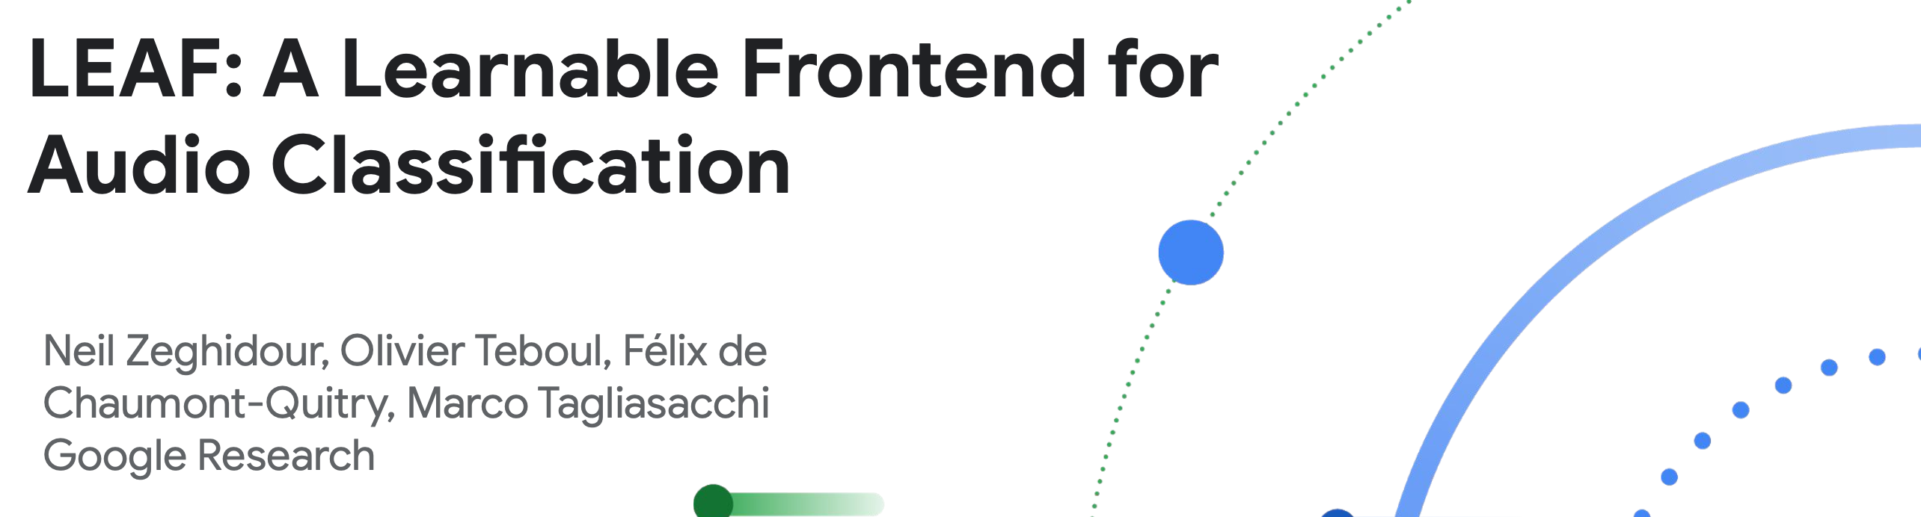
Questioning the standards
ICLR 2021
Paper: https://arxiv.org/pdf/2101.08596

Slide 50


Application: Classification
Classifier
“Dog”
Classifier
“Dog”

Slide 51
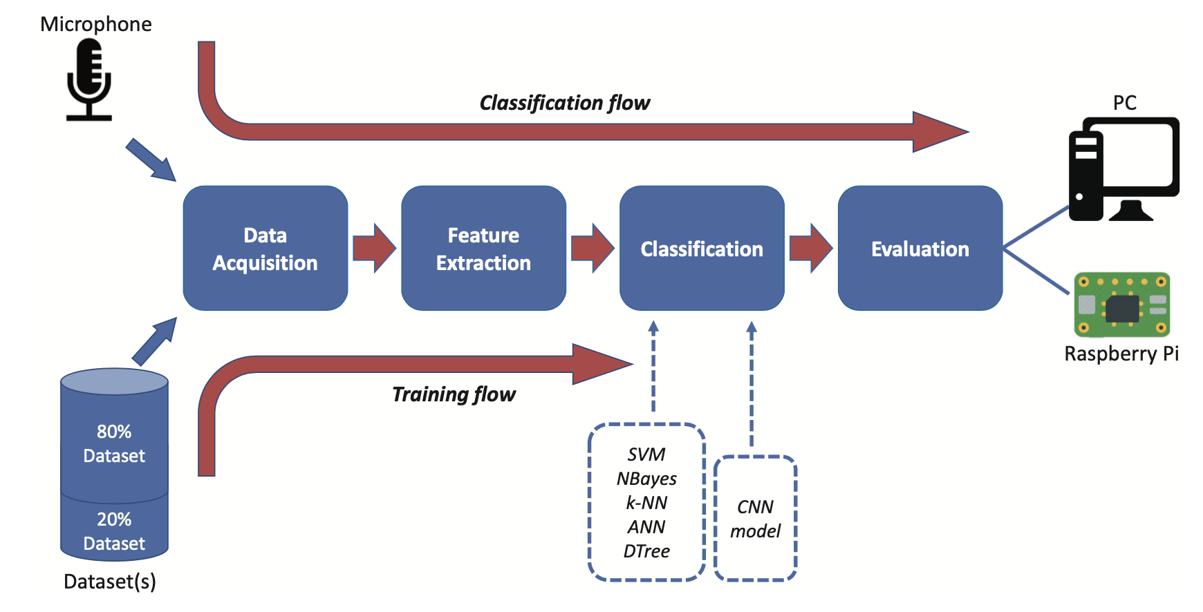
Audio Classification Steps

Slide 52
Zero-Crossing Rate (ZCR) – counts how often the signal crosses zero.
Short-Time Energy – total signal energy in a frame (loudness).
RMS Amplitude – average signal power measure.
Autocorrelation – detects periodicity and pitch.
Temporal Moments – mean/variance/skewness of waveform shape.
AMDF – pitch estimation via average magnitude differences.
Rise/Attack/Decay Times – capture onset and offset dynamics.
Temporal Centroid – center of gravity of signal energy in time.
Envelope Features – smoothed amplitude curve of signal.
Cepstrum (time-domain view) – captures pitch and vocal tract characteristics.
Time domain features
Spectral Centroid – weighted average frequency (brightness)
Spectral Bandwidth – spread of spectrum around the centroid
Spectral Rolloff – frequency below which most energy lies
Spectral Flux – frame-to-frame change in the spectrum
Spectral Flatness – how noise-like vs. tone-like the spectrum is
Spectral Contrast – difference between peaks and valleys across bands
Fundamental Frequency (F0) – lowest frequency, perceived as pitch
Harmonic-to-Noise Ratio – balance between harmonic and noise energy
Formant Frequencies – resonant peaks in speech/instrument sounds
MFCCs – compressed spectral features modeled after human hearing
Freq. domain features

Slide 53
Zero-Crossing Rate (ZCR) – counts how often the signal crosses zero.
Short-Time Energy – total signal energy in a frame (loudness).
RMS Amplitude – average signal power measure.
Autocorrelation – detects periodicity and pitch.
Temporal Moments – mean/variance/skewness of waveform shape.
AMDF – pitch estimation via average magnitude differences.
Rise/Attack/Decay Times – capture onset and offset dynamics.
Temporal Centroid – center of gravity of signal energy in time.
Envelope Features – smoothed amplitude curve of signal.
Cepstrum (time-domain view) – captures pitch and vocal tract characteristics.
Time domain features
Spectral Centroid – weighted average frequency (brightness)
Spectral Bandwidth – spread of spectrum around the centroid
Spectral Rolloff – frequency below which most energy lies
Spectral Flux – frame-to-frame change in the spectrum
Spectral Flatness – how noise-like vs. tone-like the spectrum is
Spectral Contrast – difference between peaks and valleys across bands
Fundamental Frequency (F0) – lowest frequency, perceived as pitch
Harmonic-to-Noise Ratio – balance between harmonic and noise energy
Formant Frequencies – resonant peaks in speech/instrument sounds
MFCCs – compressed spectral features modeled after human hearing
Freq. domain features

Slide 54
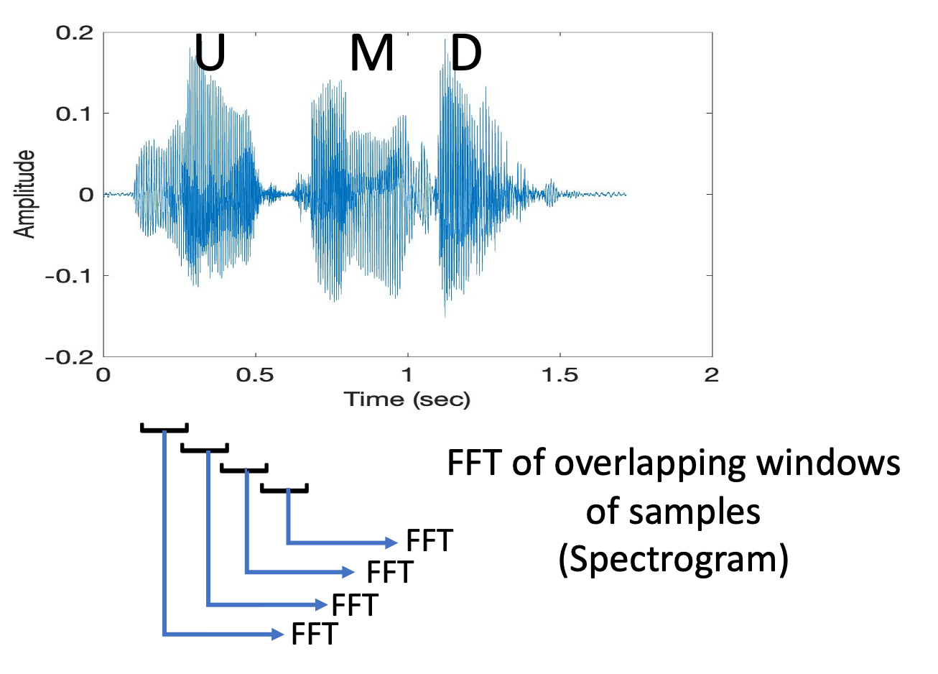
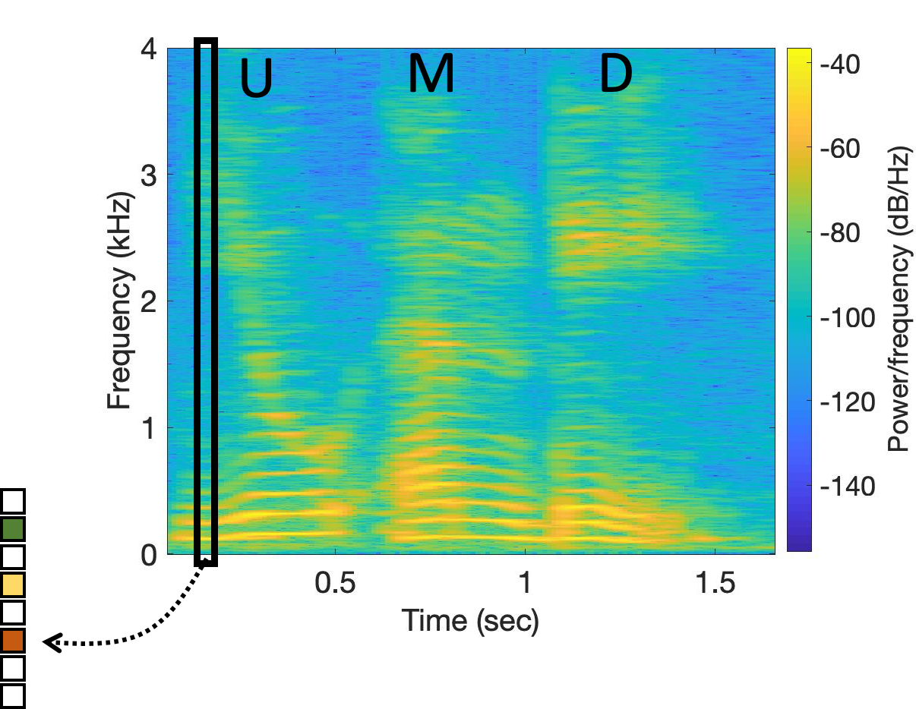
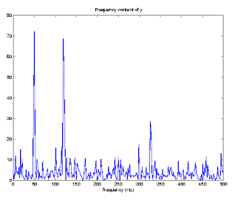
Short-Time Fourier Transform (STFT)
Spectrogram
Notes:
MFCC: https://medium.com/@MuhyEddin/feature-extraction-is-one-of-the-most-important-steps-in-developing-any-machine-learning-or-deep-94cf33a5dd46

Slide 55
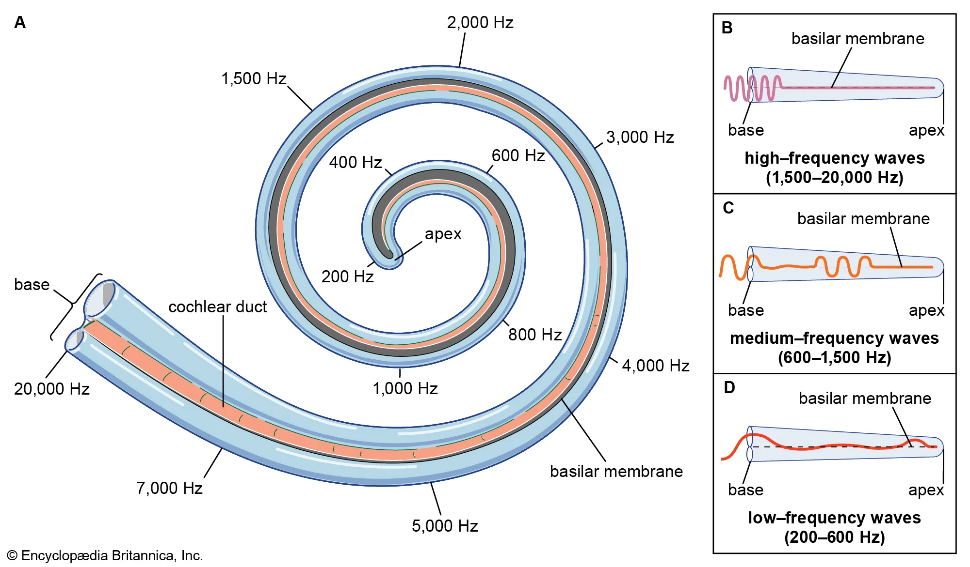
Mel-Frequency Cepstral Coefficients (MFCC)
Mel == Melody
(1) The human ear doesn’t perceive frequency linearly.
(2) We are more sensitive to low-frequency changes (e.g., distinguishing
500 Hz vs. 600 Hz) than to high-frequency changes (e.g., 5000 Hz vs.
5100 Hz).
(3) This comes from the basilar membrane in the cochlea, where spacing
of hair cells produces a nonlinear frequency resolution.
Notes:
MFCC: https://medium.com/@MuhyEddin/feature-extraction-is-one-of-the-most-important-steps-in-developing-any-machine-learning-or-deep-94cf33a5dd46

Slide 56
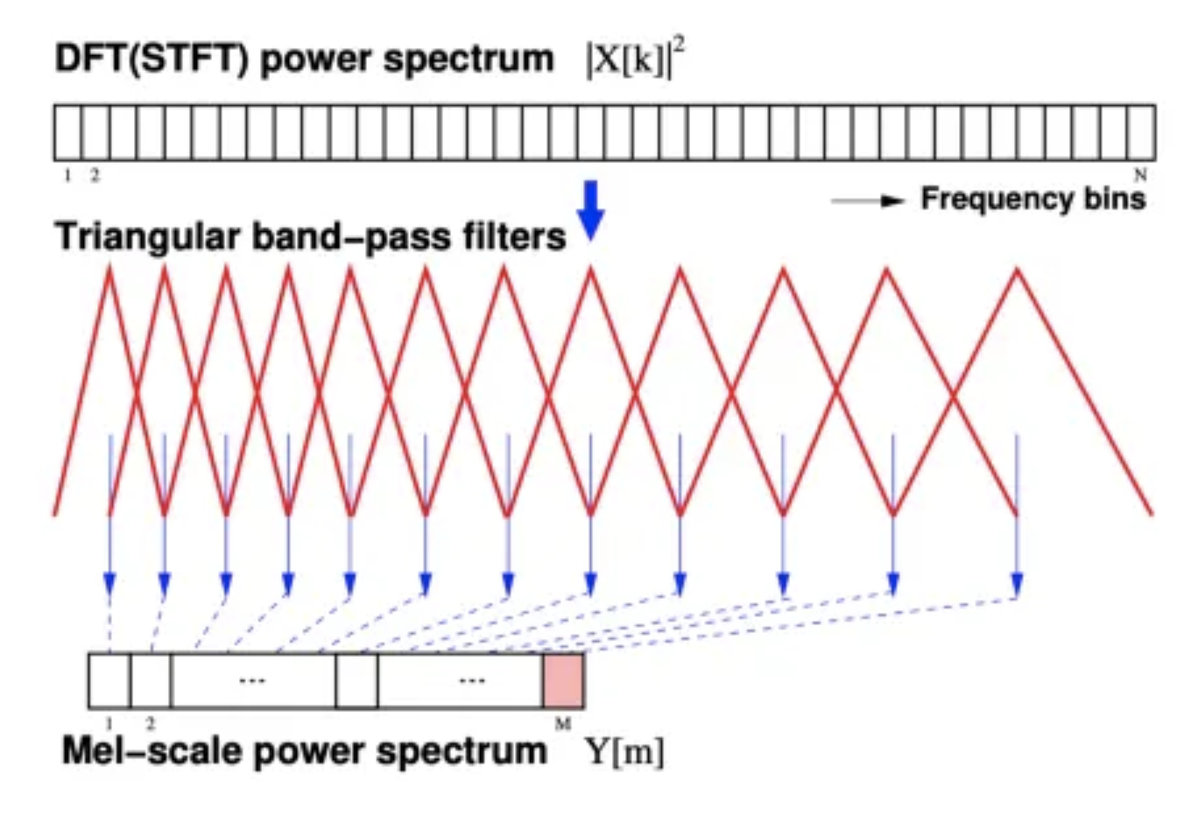
Mel-Frequency Cepstral Coefficients (MFCC)

Slide 57
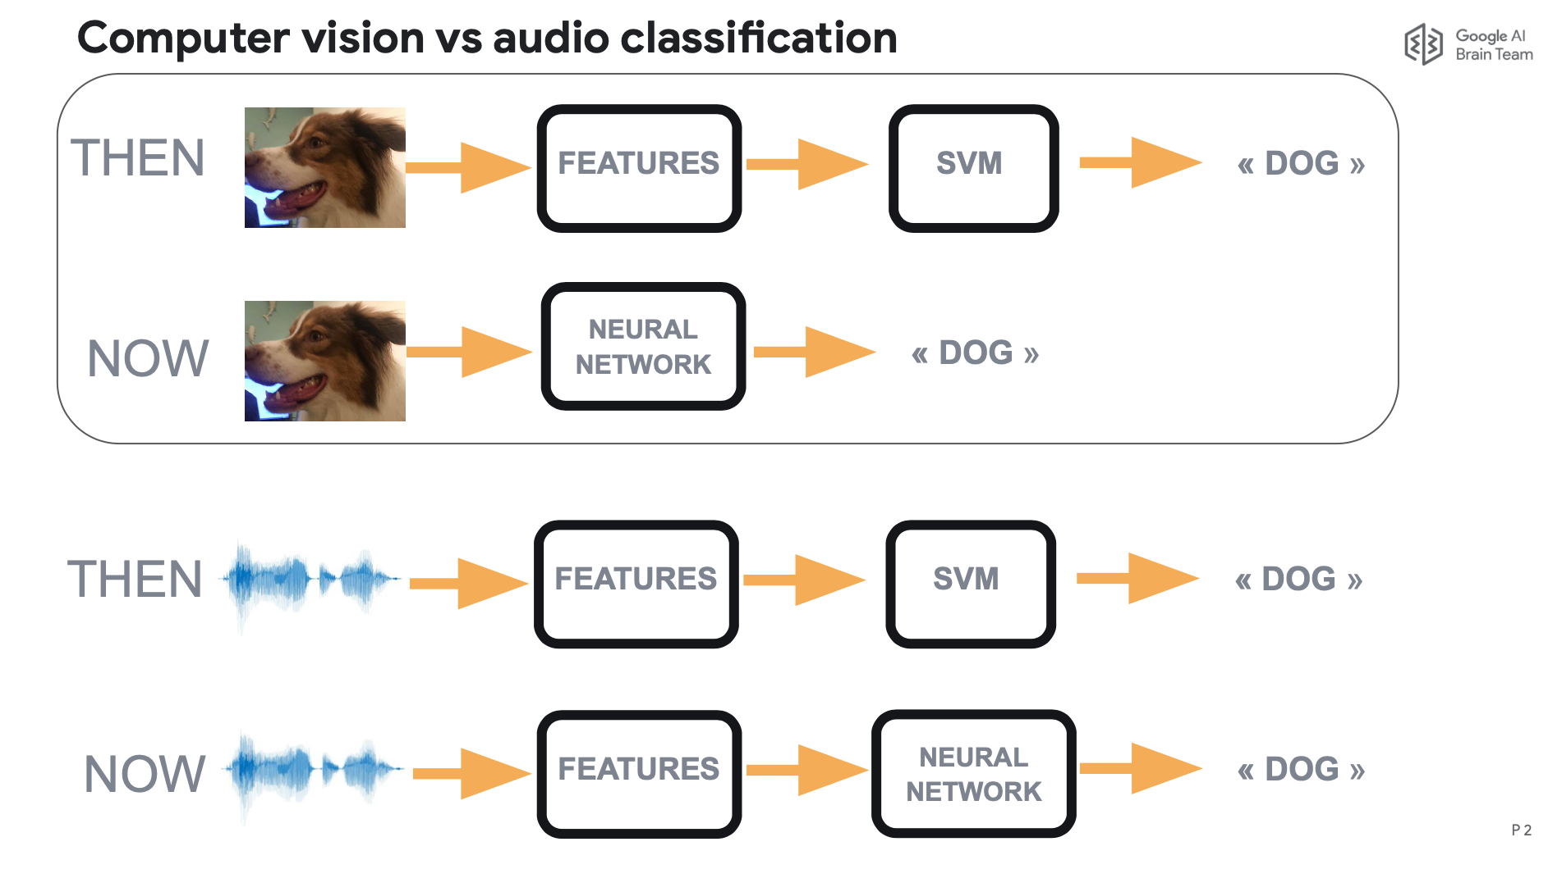
Evolution of Classification Architecture

Slide 58
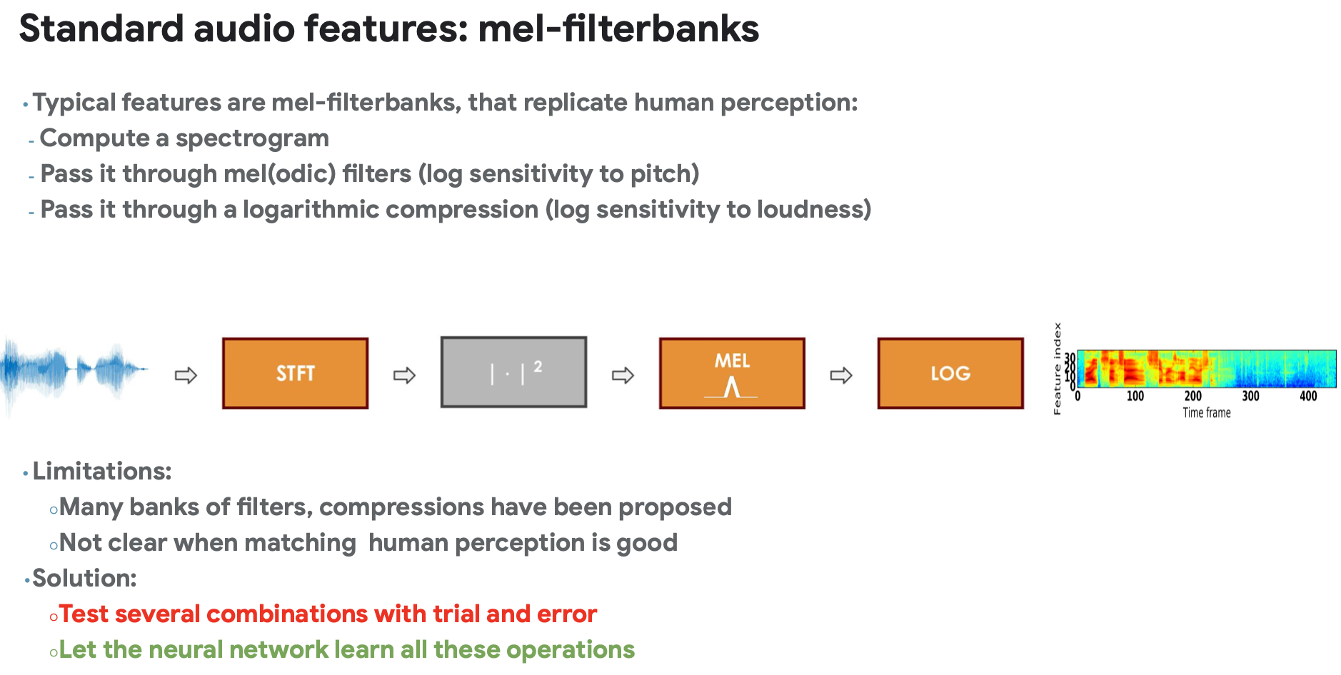

Slide 59



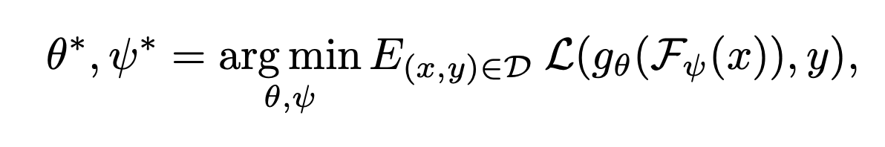
LEAF: A LEarnable Audio Frontend
= one-dimensional waveform of T samples
sampling frequency F_{s}
= Replaces MFCC
= The main model (e.g., classifier)

Slide 60
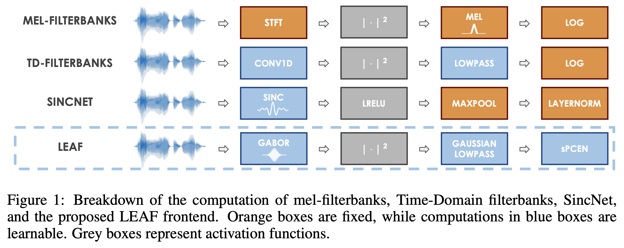
Learnable modules

Slide 61
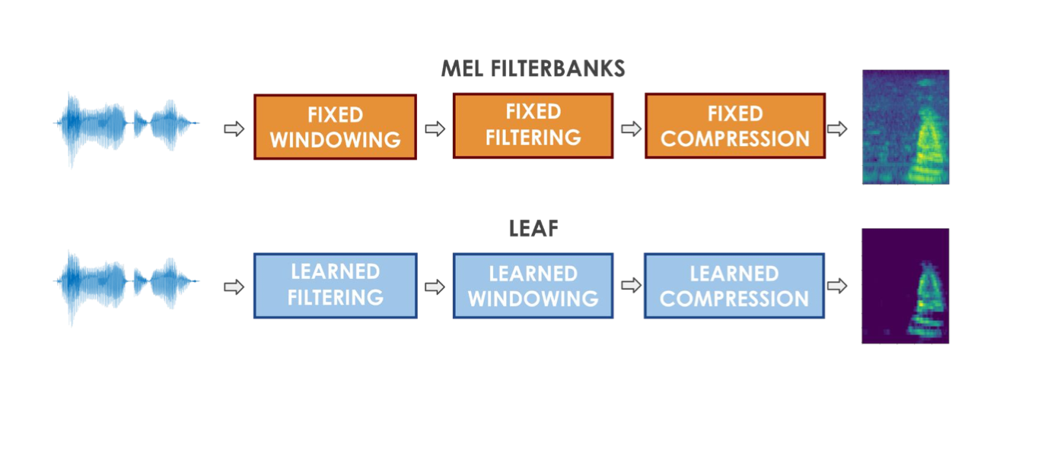
LEAF: A LEarnable Audio Frontend

Slide 62
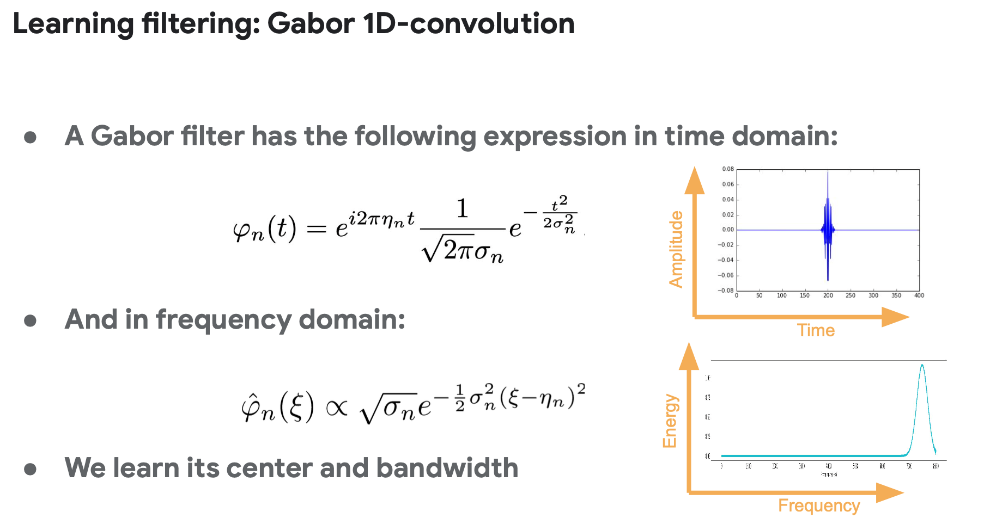

Slide 63
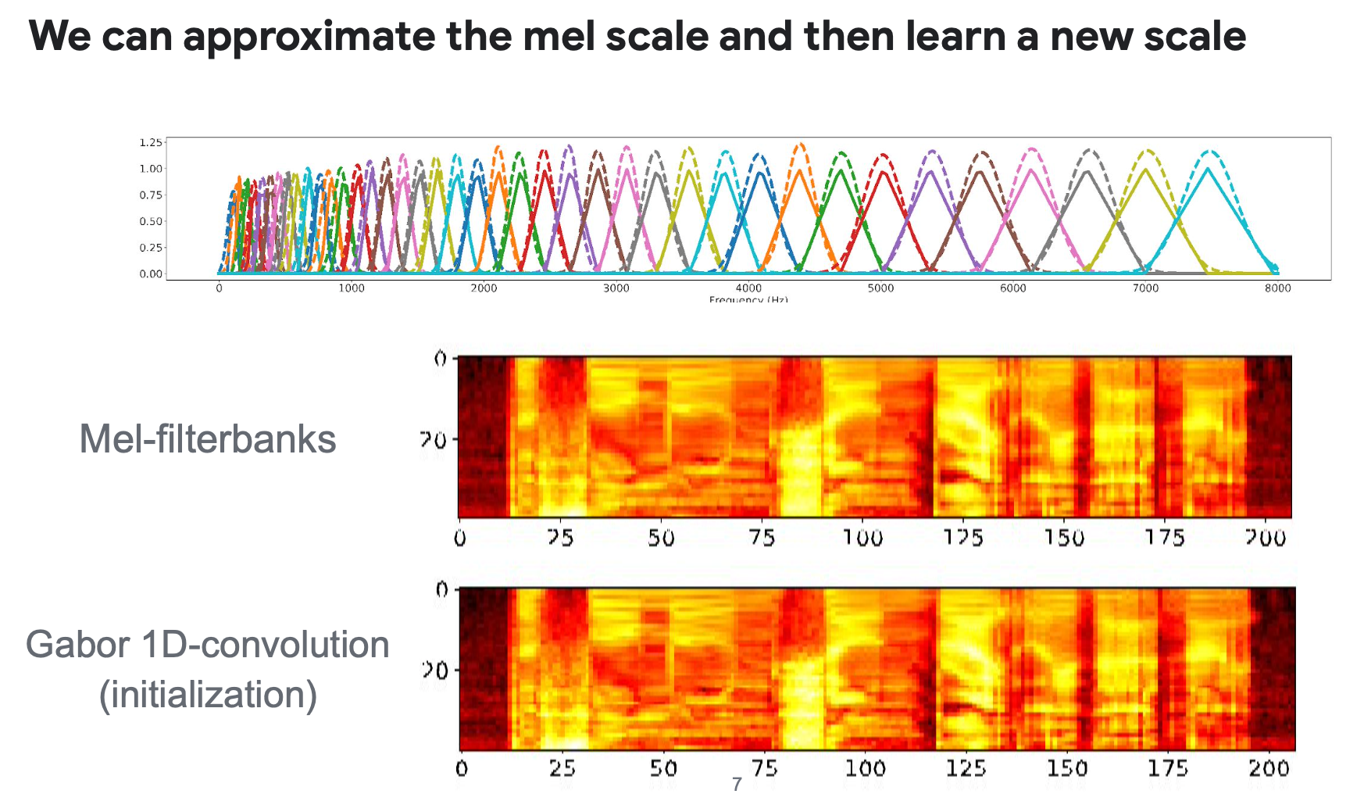

Slide 64
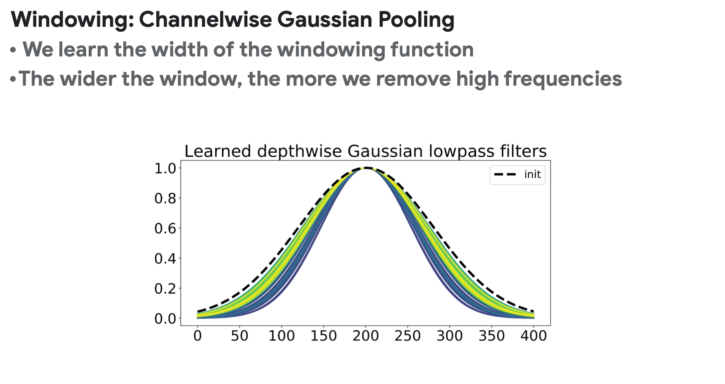

Slide 65
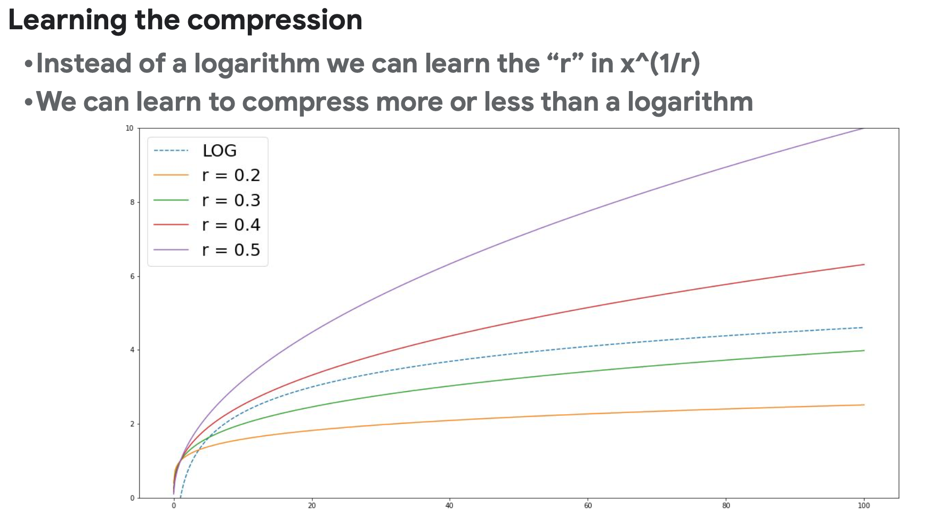

Slide 66
Extra Slides

Slide 67
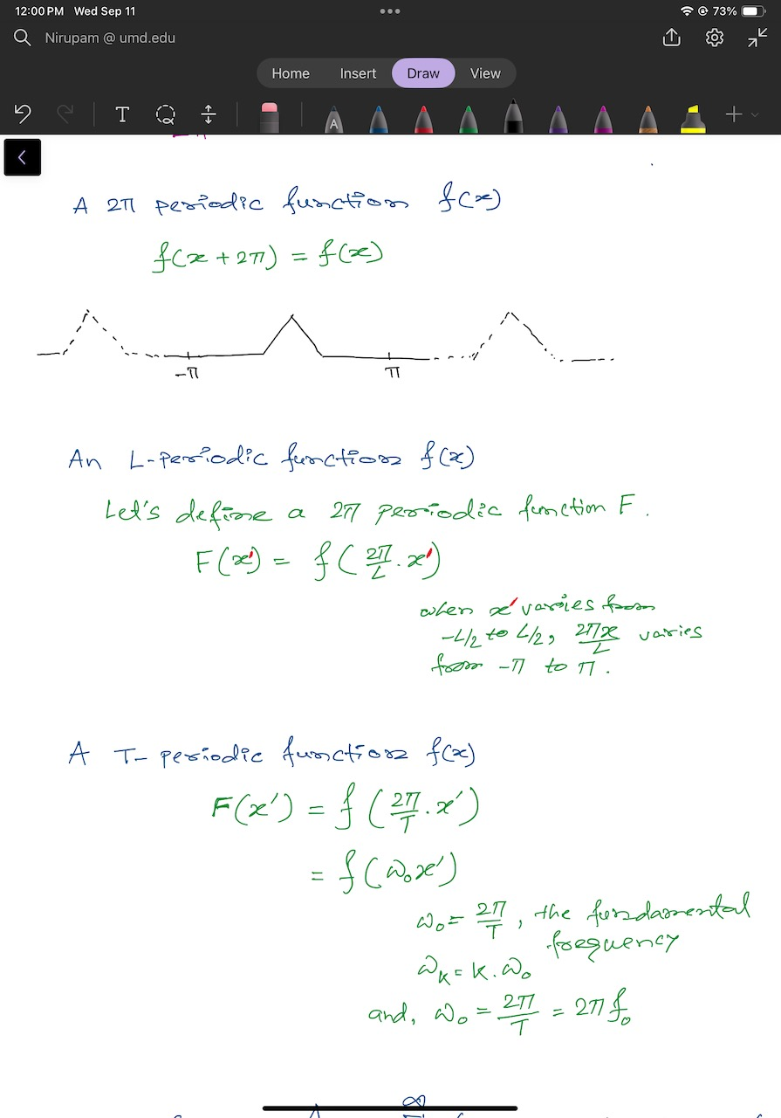

Slide 69
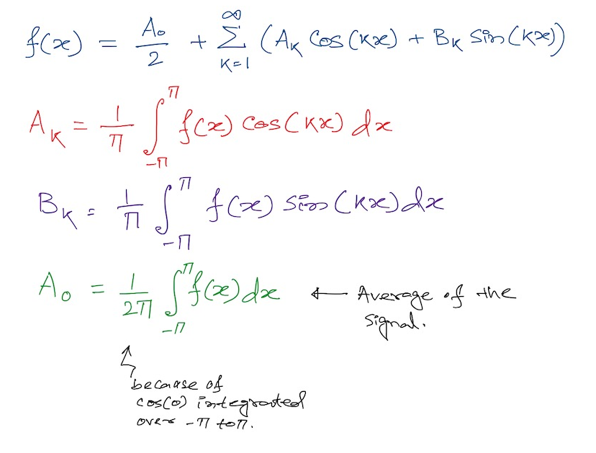
Fourier series
2

Slide 70
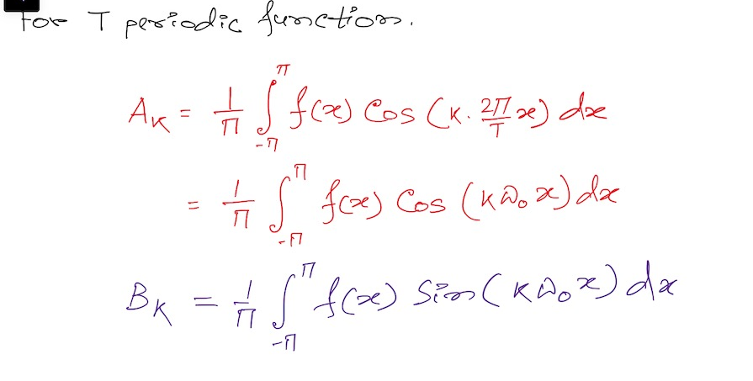
Fourier series

Slide 71
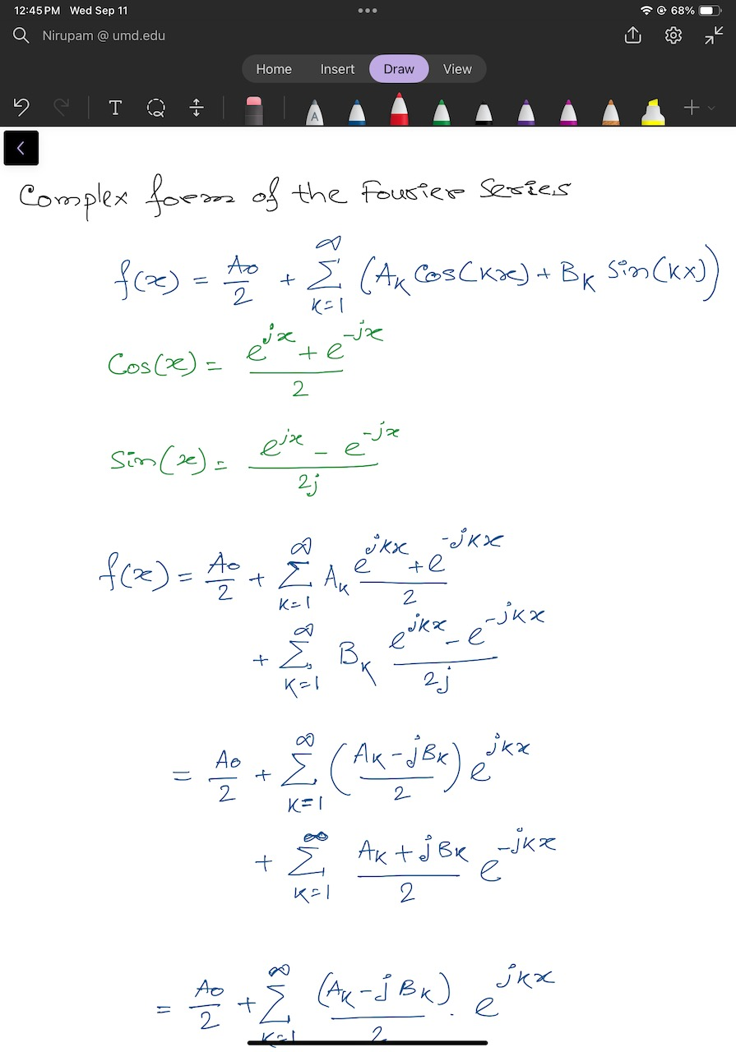

Slide 74
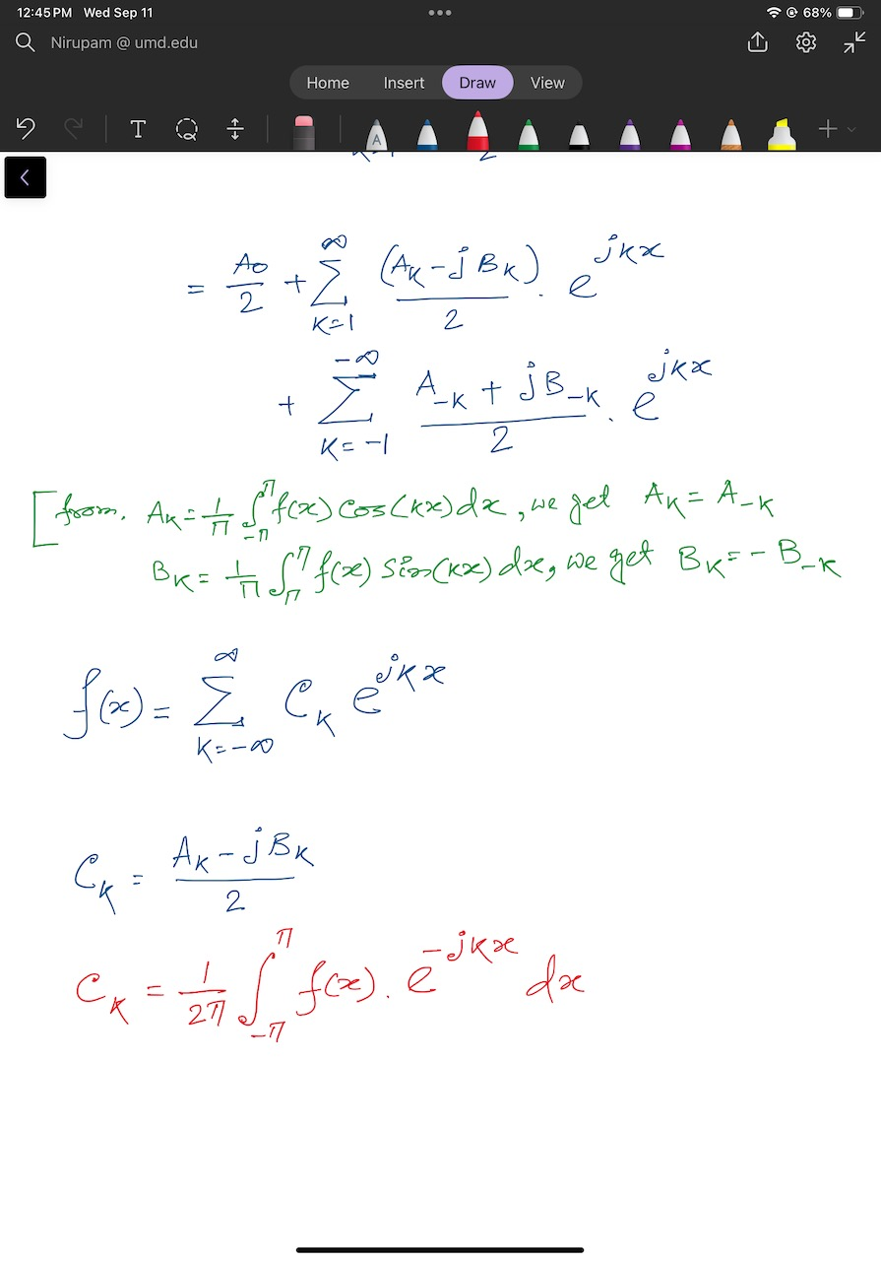

Slide 76
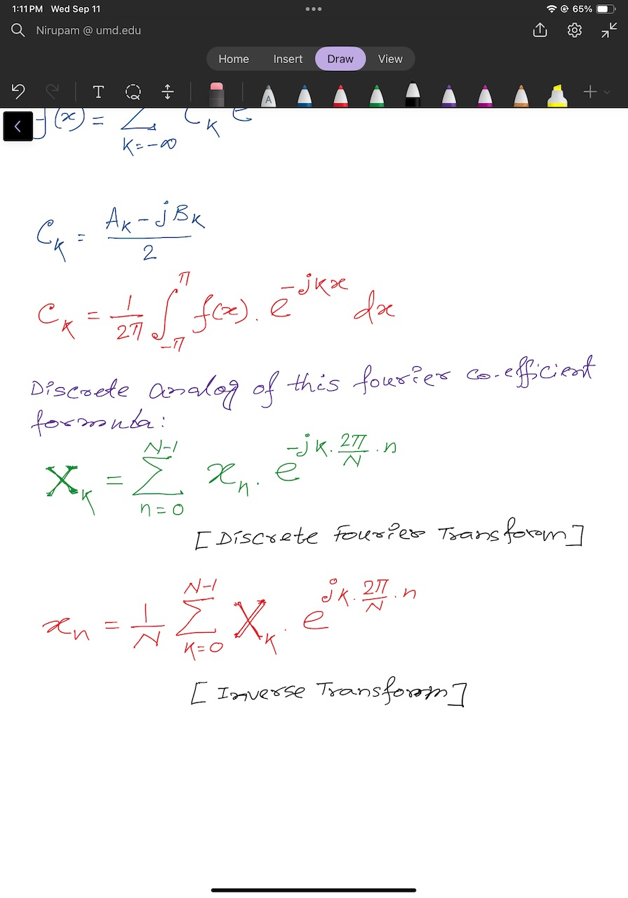
Discrete Fourier Transform formula
Discrete version:

Slide 77
Discrete Fourier Transform formula
Discrete version:

