Slide 1

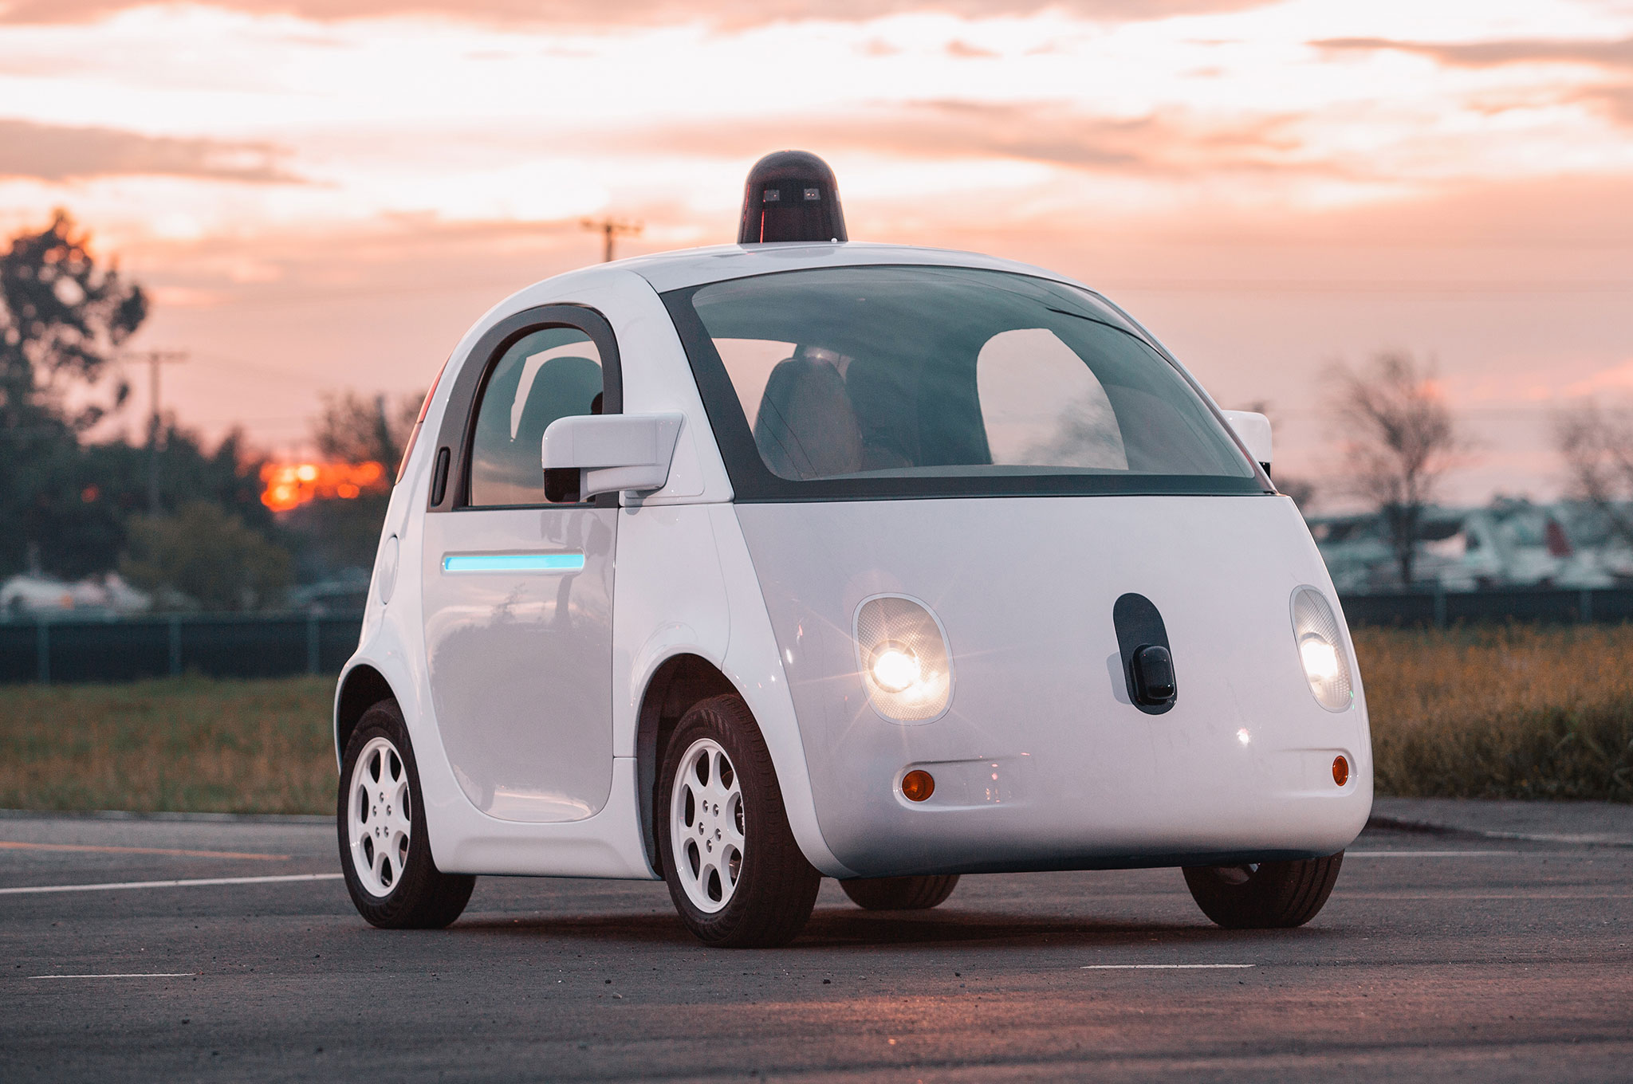

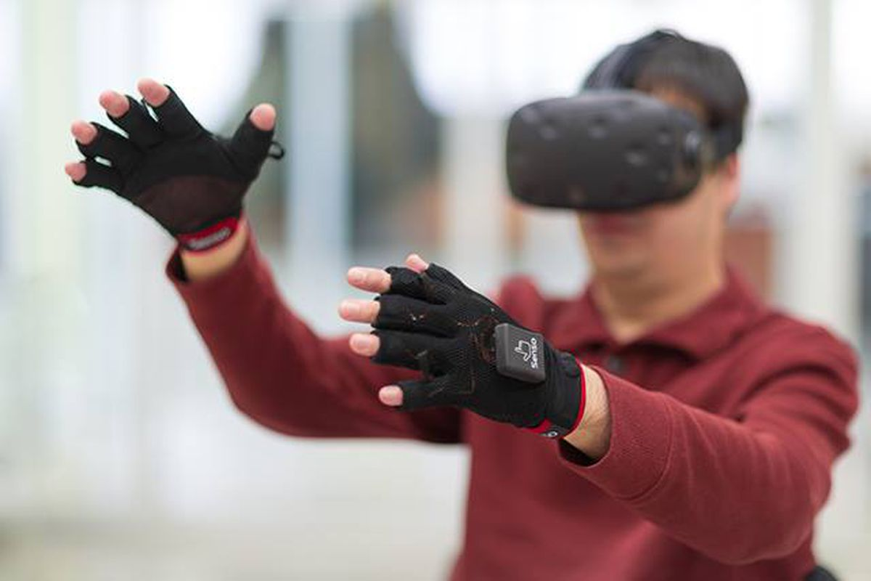

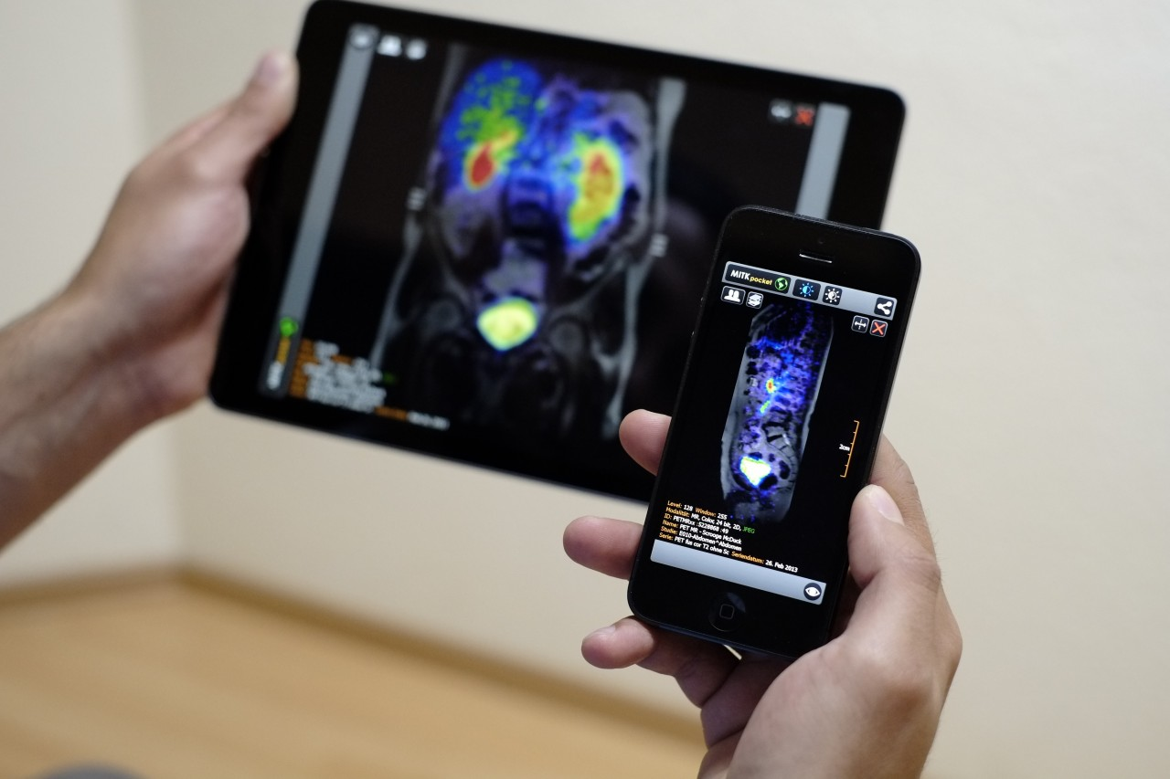
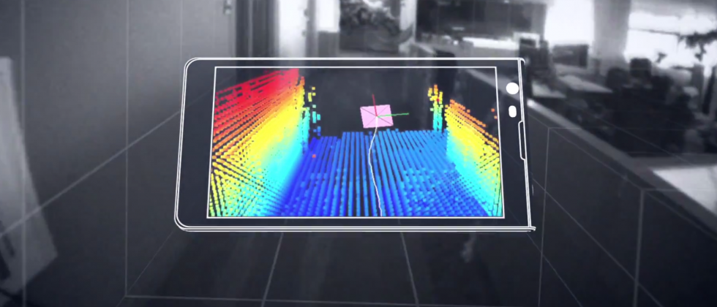
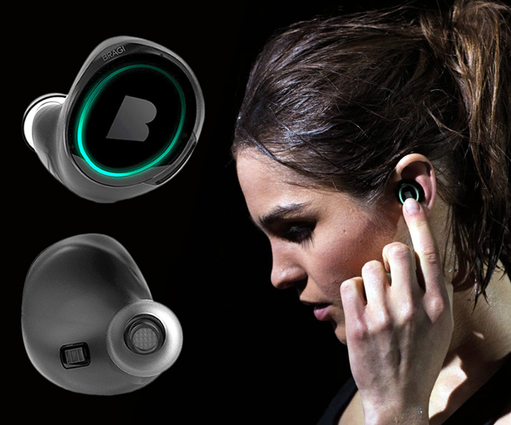
Machine Learning for Physical Sensing & Perception
CMSC 818V : Fall 2025
Lecture 1_5: Frequency in Learning
Nirupam Roy
Tu-Th 3:30 – 4:45pm
IRB 1207

Slide 2

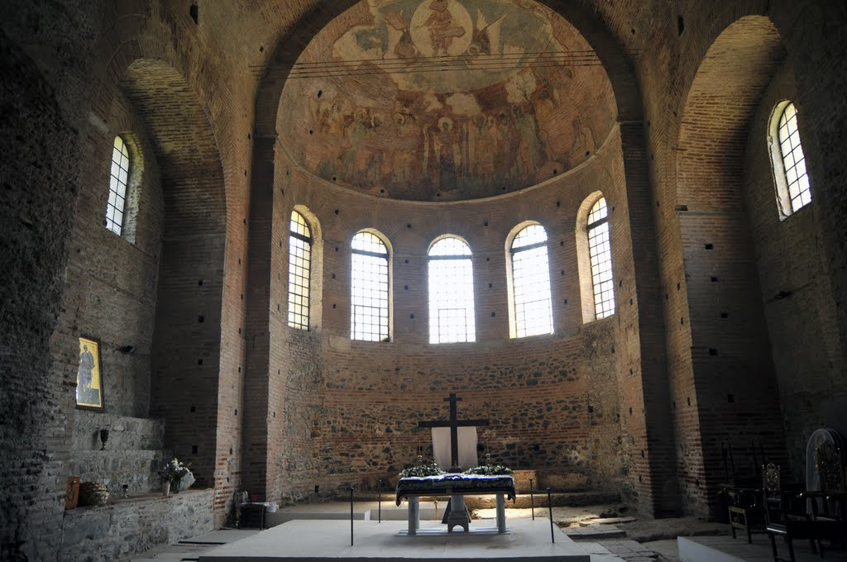
Why our voice sounds different at different places?

Slide 3
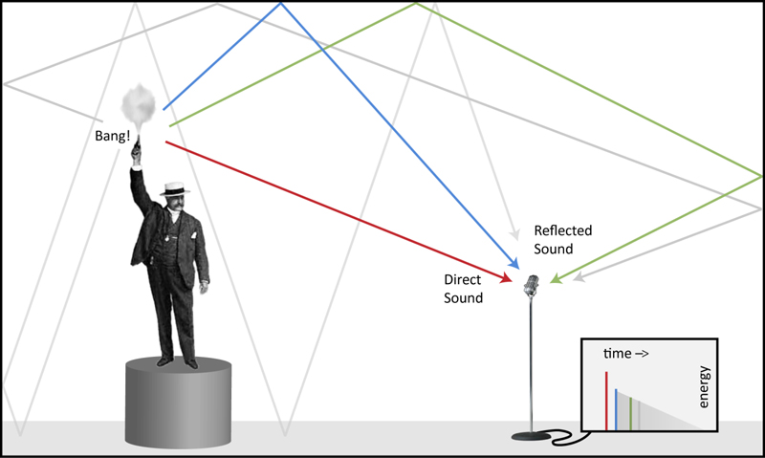

Slide 4
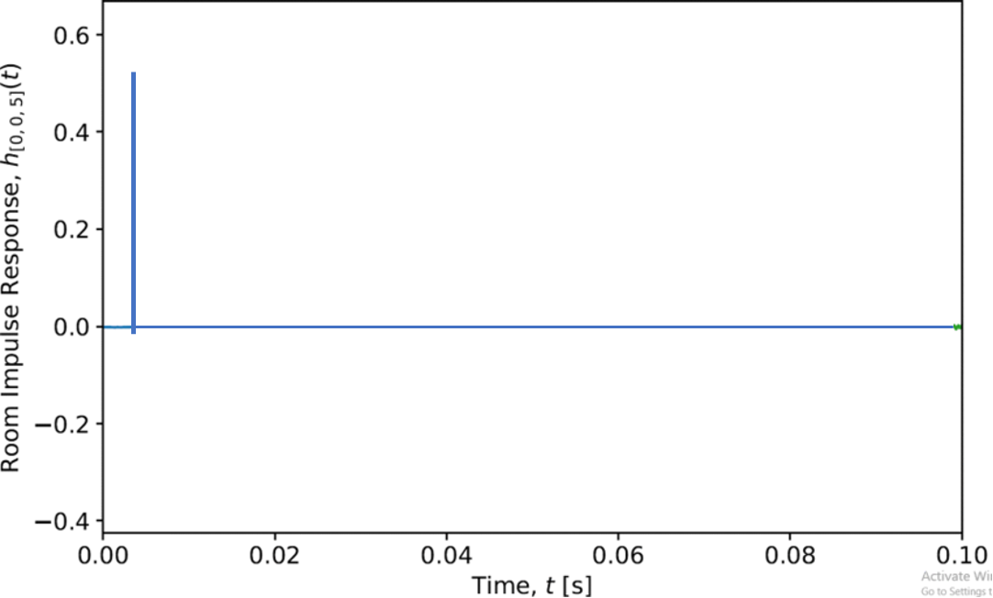
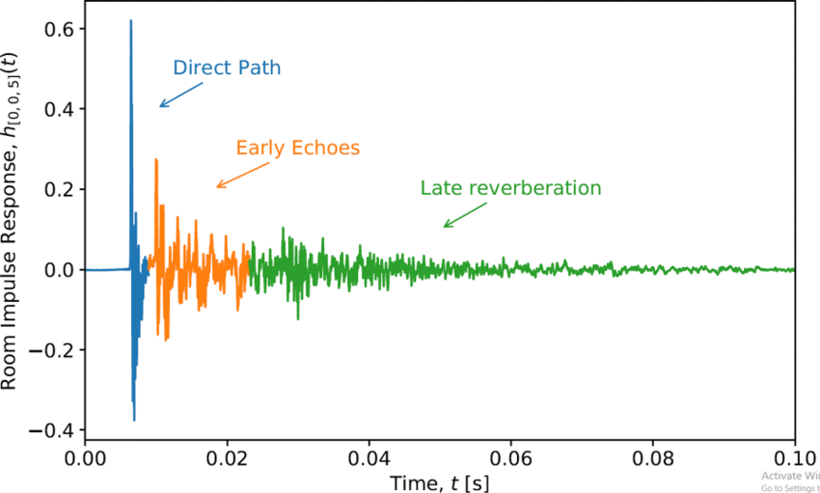
Impulse
Impulse
Response

Slide 5


Blurred glass

Slide 6

Blurred glass

Slide 7
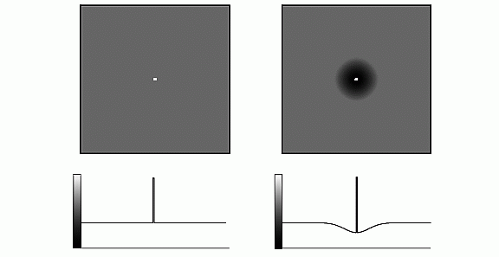
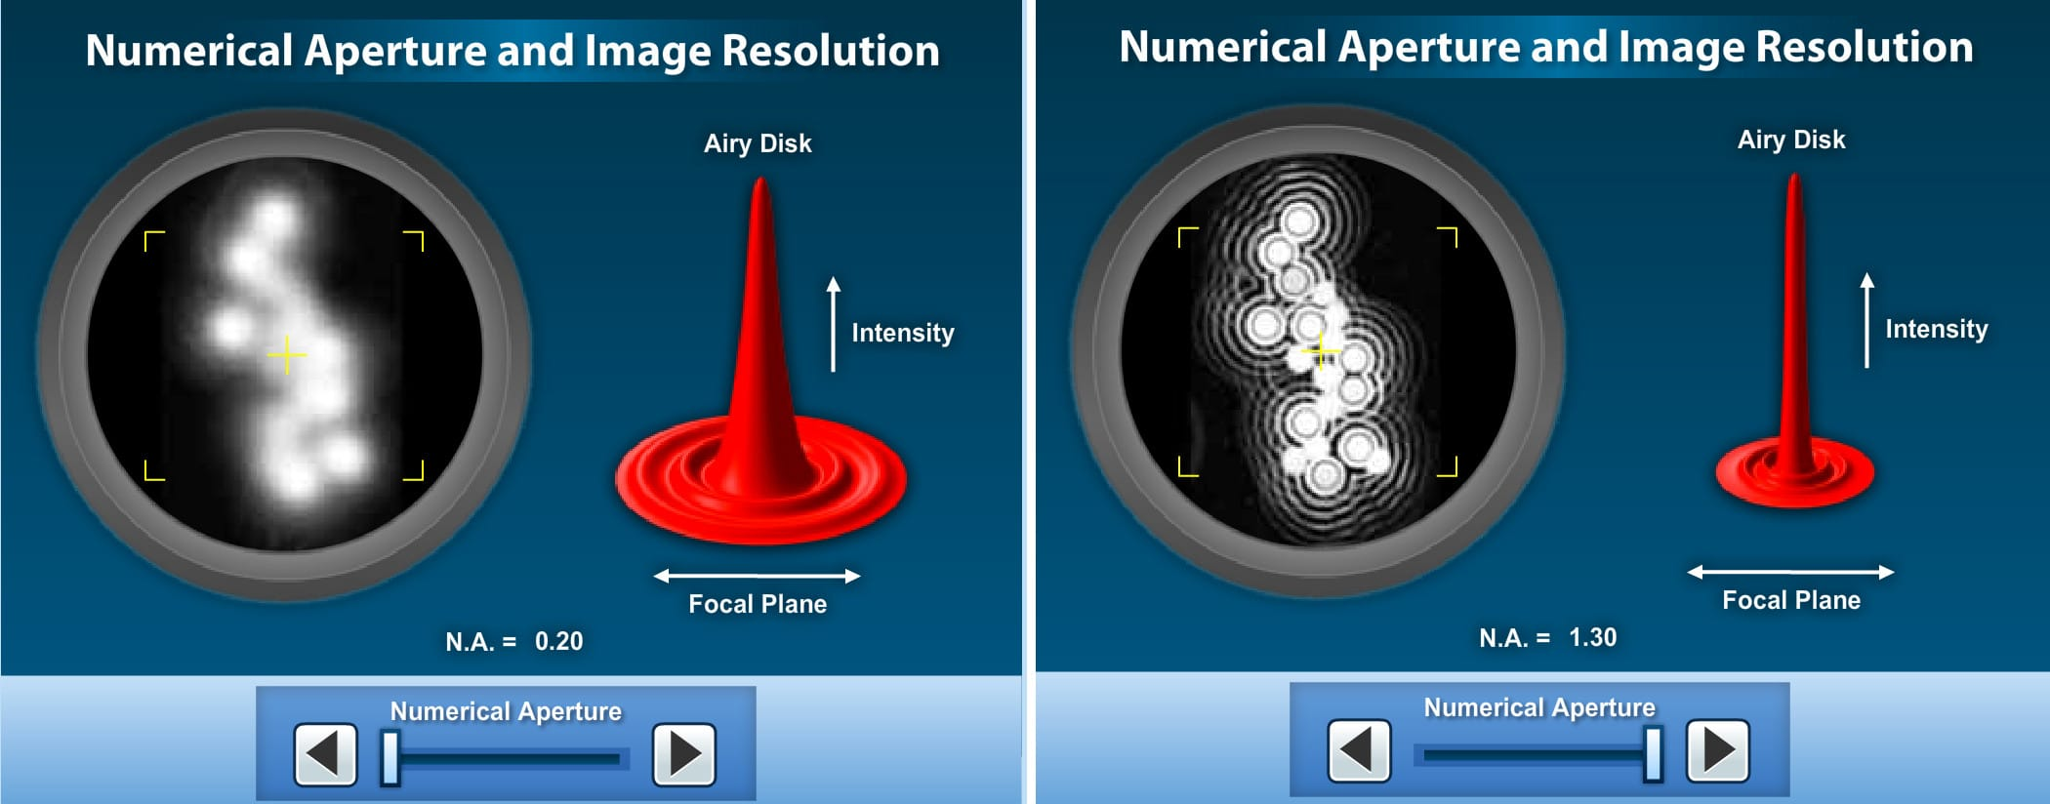
Point
Point Spread Function

Slide 8
What physical property/behavior changes the impulse or the point?

Slide 9
What physical property/behavior changes the impulse or the point?
Magnitude change, Delay, and Superposition

Slide 10
What physical property/behavior changes the impulse or the point?
Is this a property of the signal or the environment ?
Magnitude change, Delay, and Superposition

Slide 11
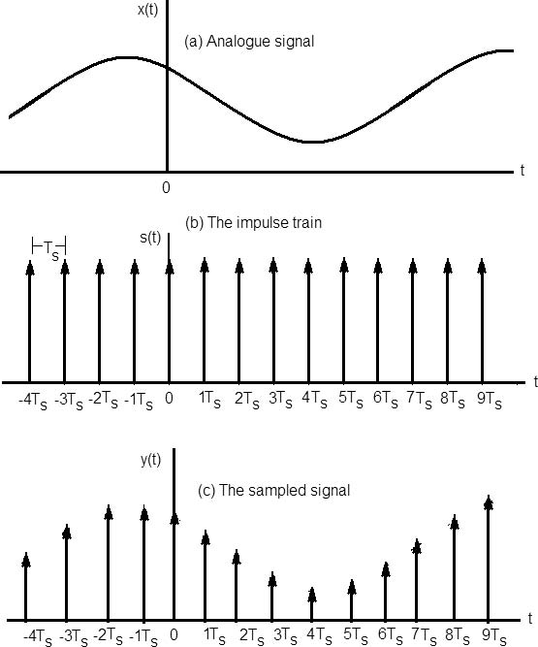

Discrete signals are made of impulses/points

Slide 12
Discrete signals are made of impulses/points
Impact on a “point signal” captures the behavior of the environment.

Slide 13
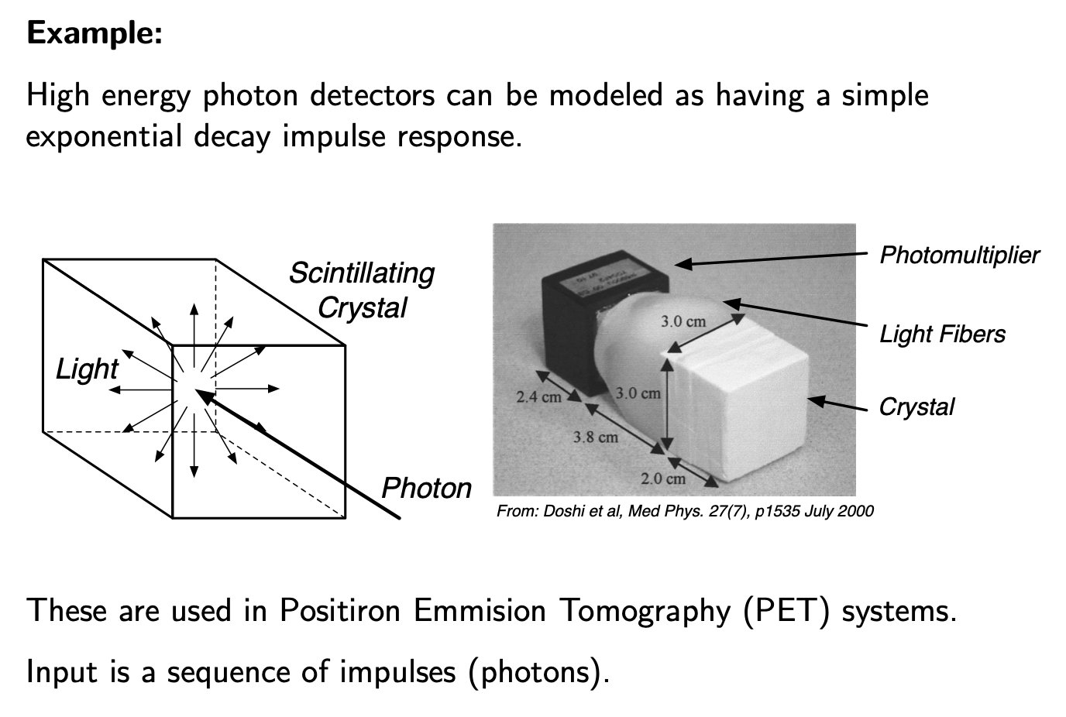

Slide 14
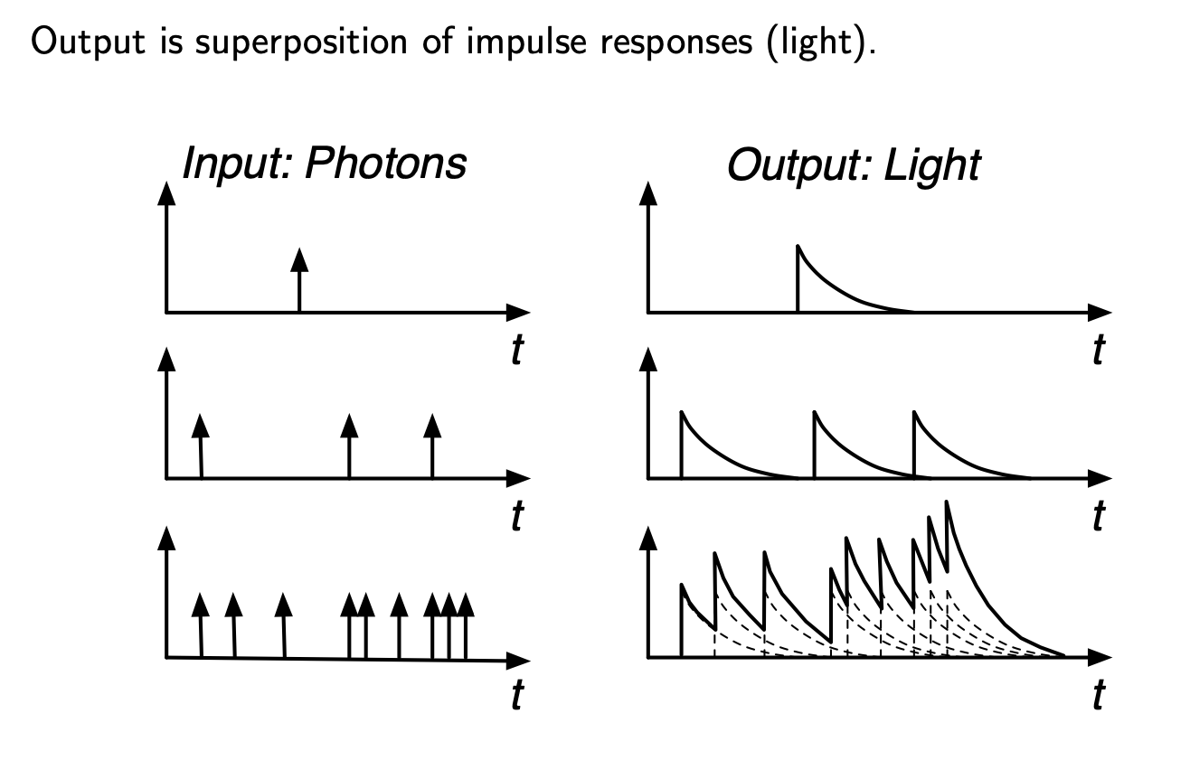

Slide 15
If I know the response of a “point signal”, how can I know response of the “entire signal”?

Slide 16
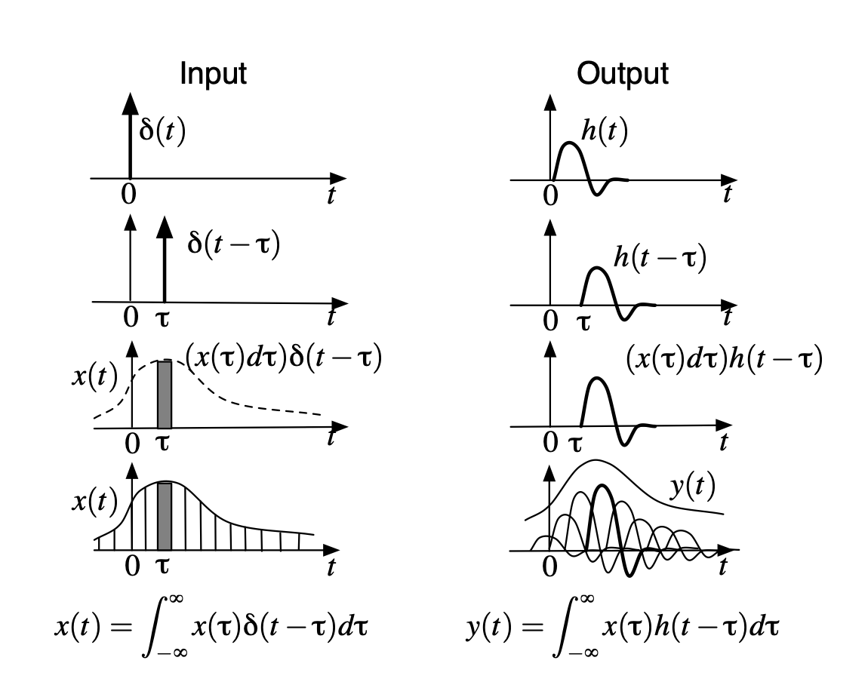
Convolution

Slide 17
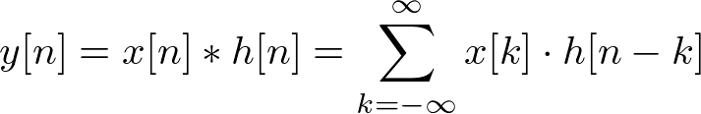
Convolution - 1D
Kernel/Impulse-response/Transfer-function

Slide 18
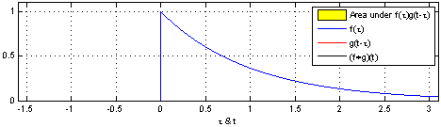
Convolution - 1D
Kernel/Impulse-response/Transfer-function

Slide 19
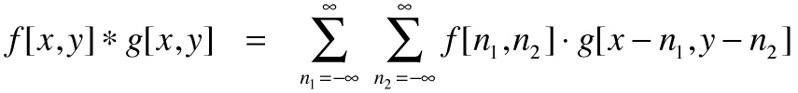
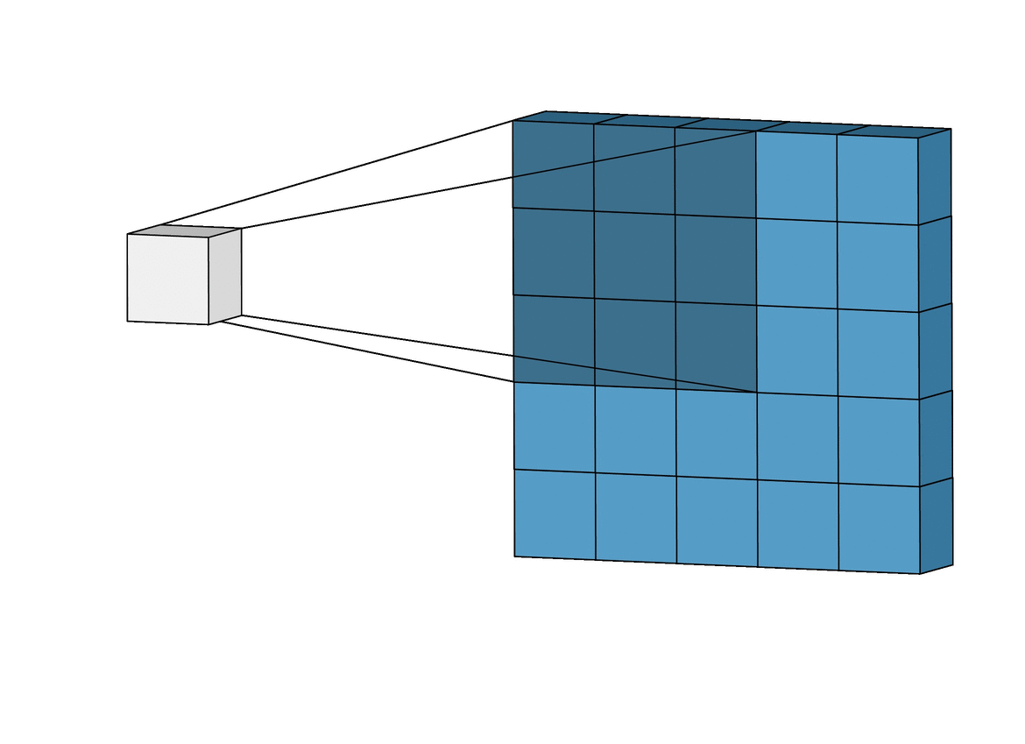
Convolution - 2D
Kernel/Point-spread function

Slide 20
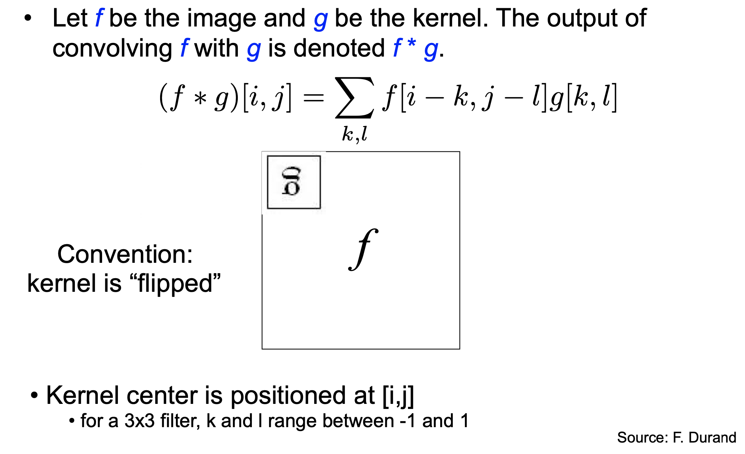
Convolution and Filtering

Slide 21
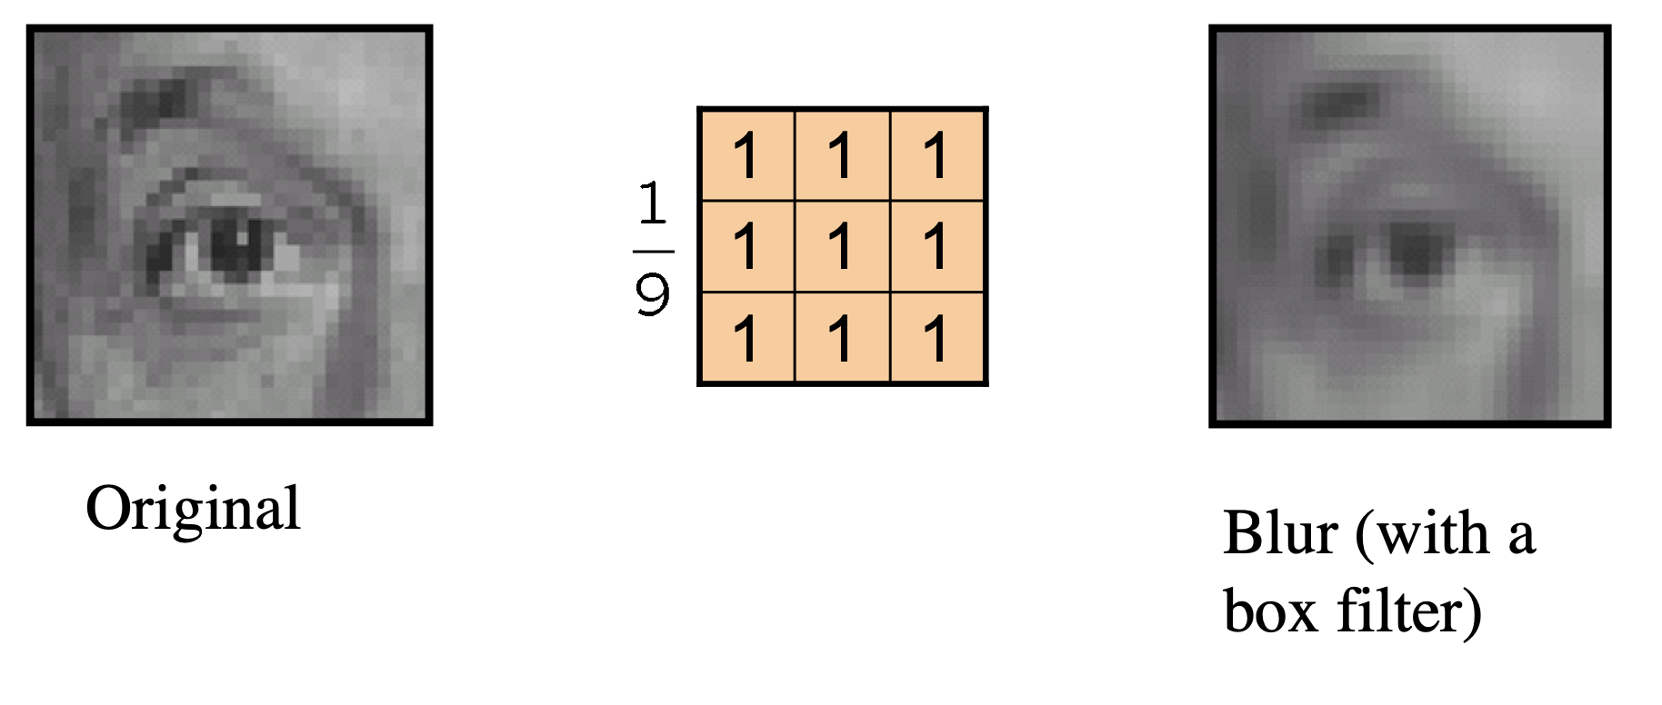
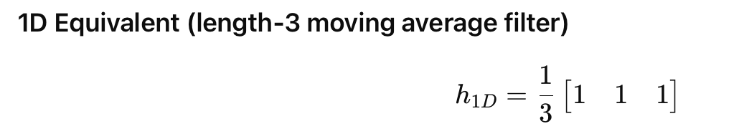

Slide 22
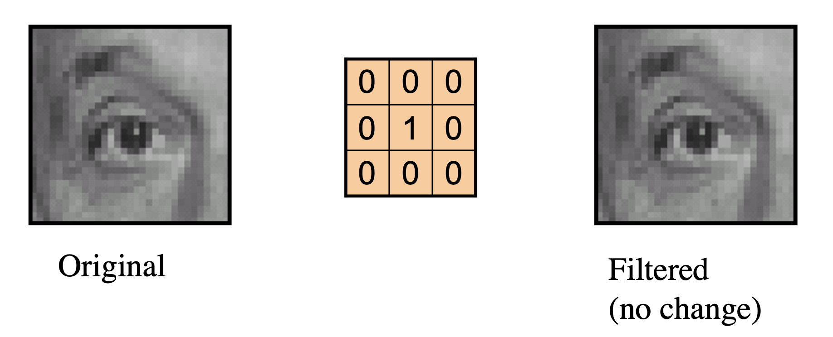
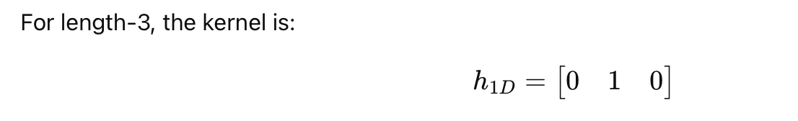

Slide 23
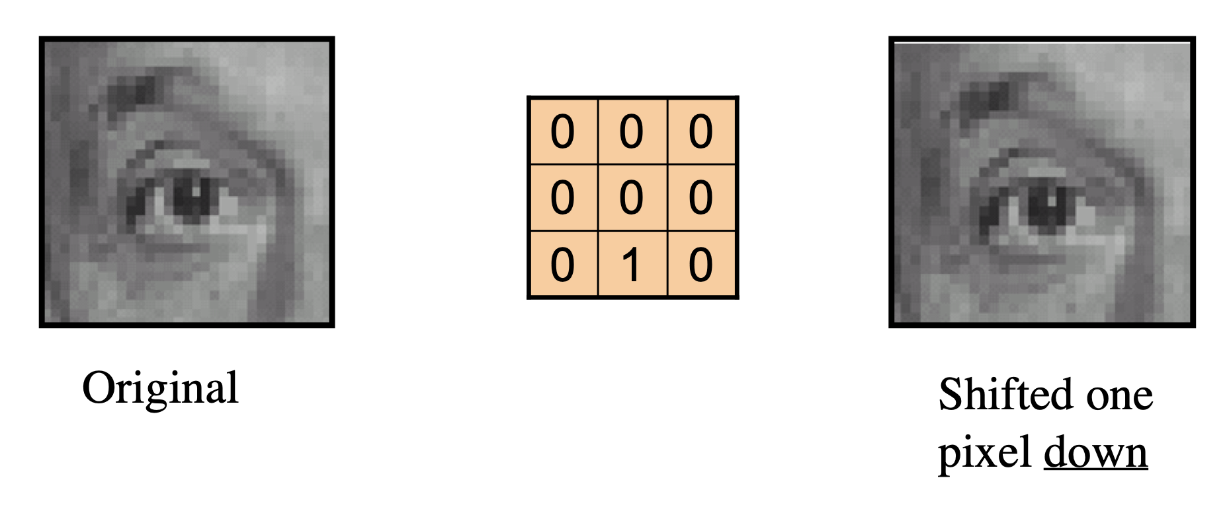
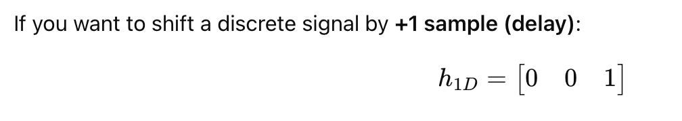

Slide 24
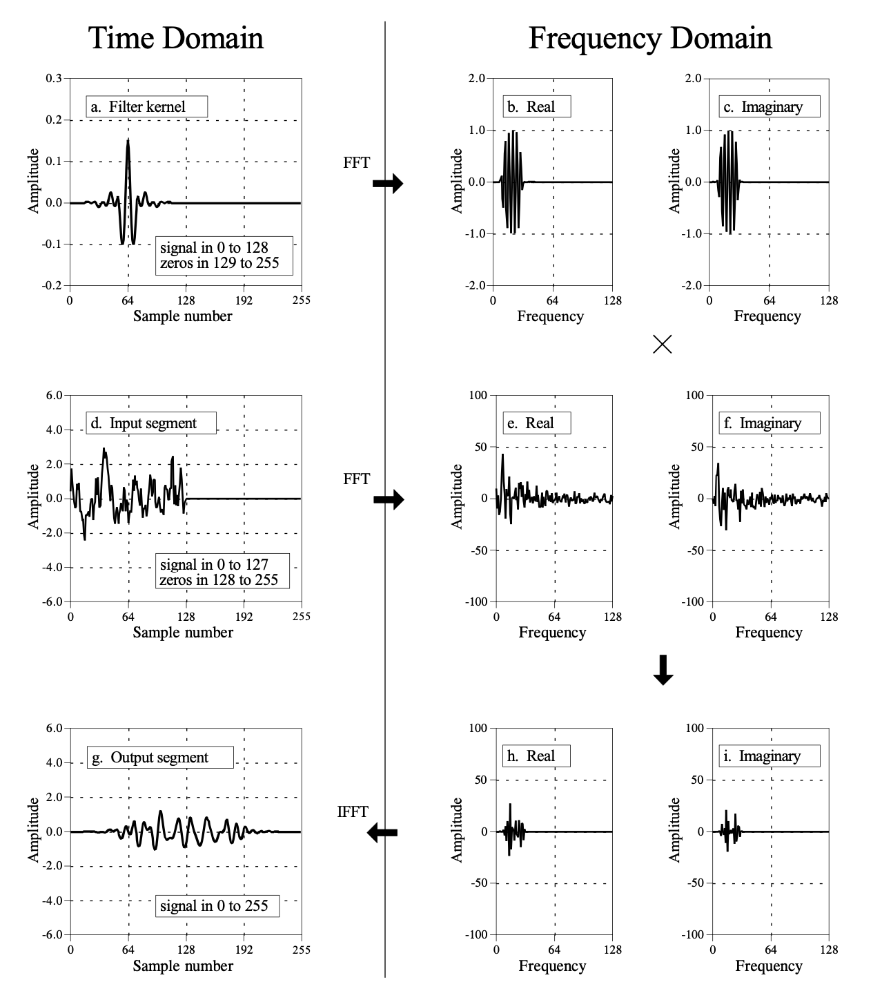
Convolution becomes “multiplication” in freq. domain
Notes:
https://www.analog.com/media/en/technical-documentation/dsp-book/dsp_book_Ch11.pdf

Slide 25
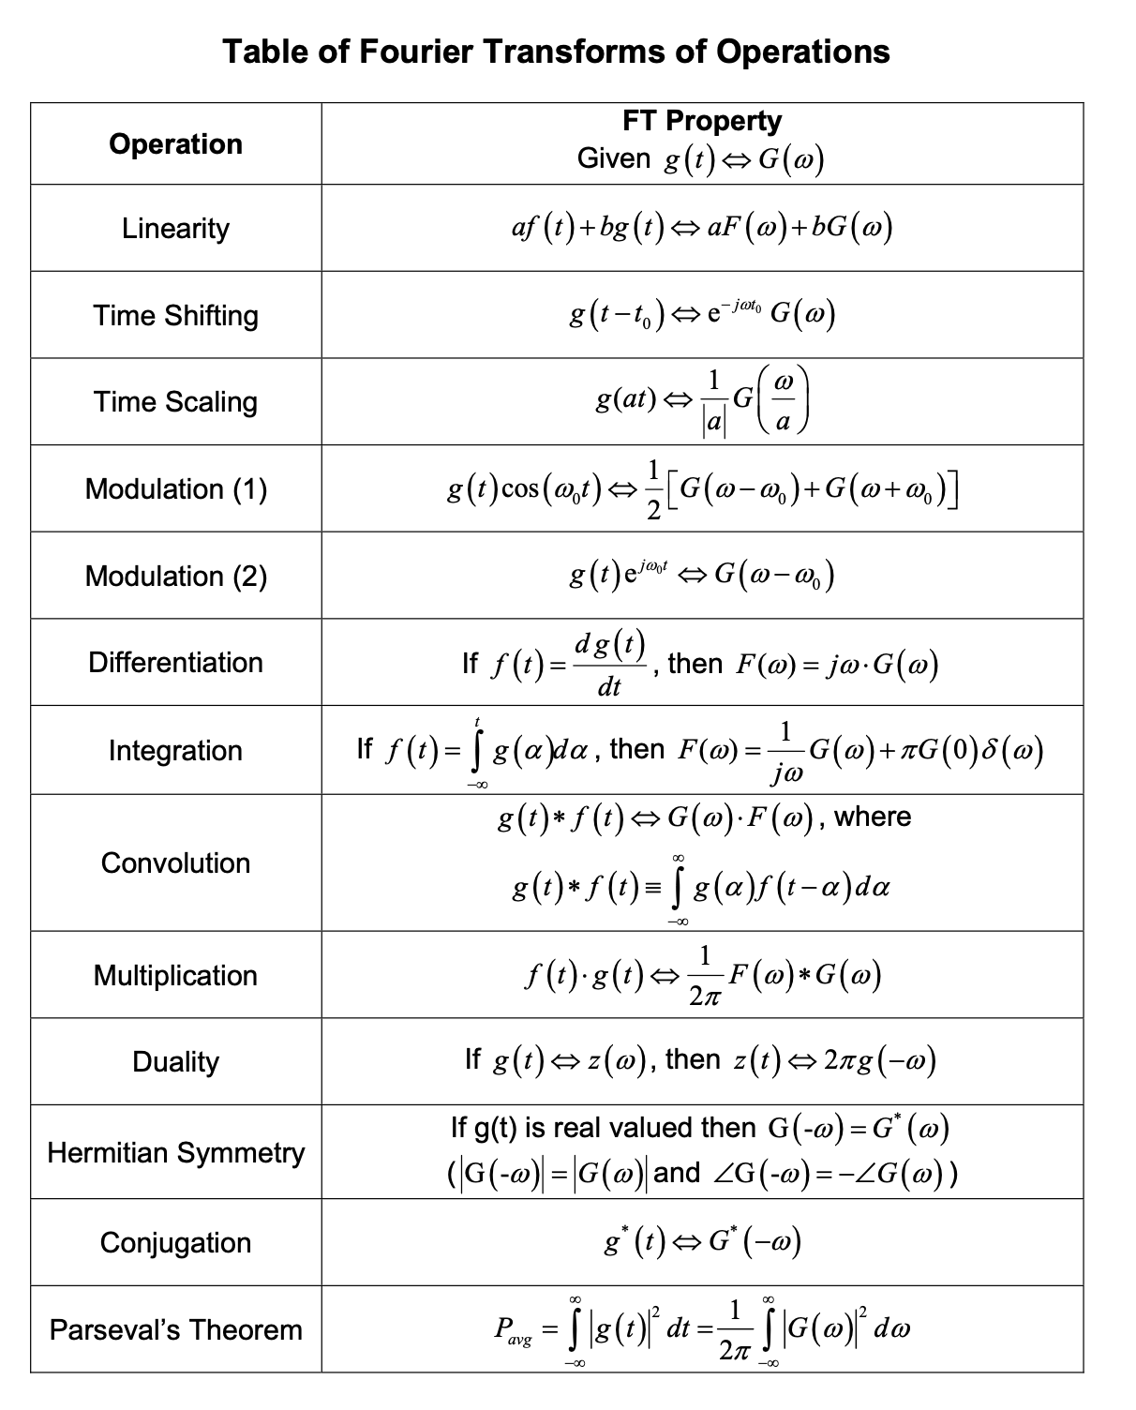

Slide 26
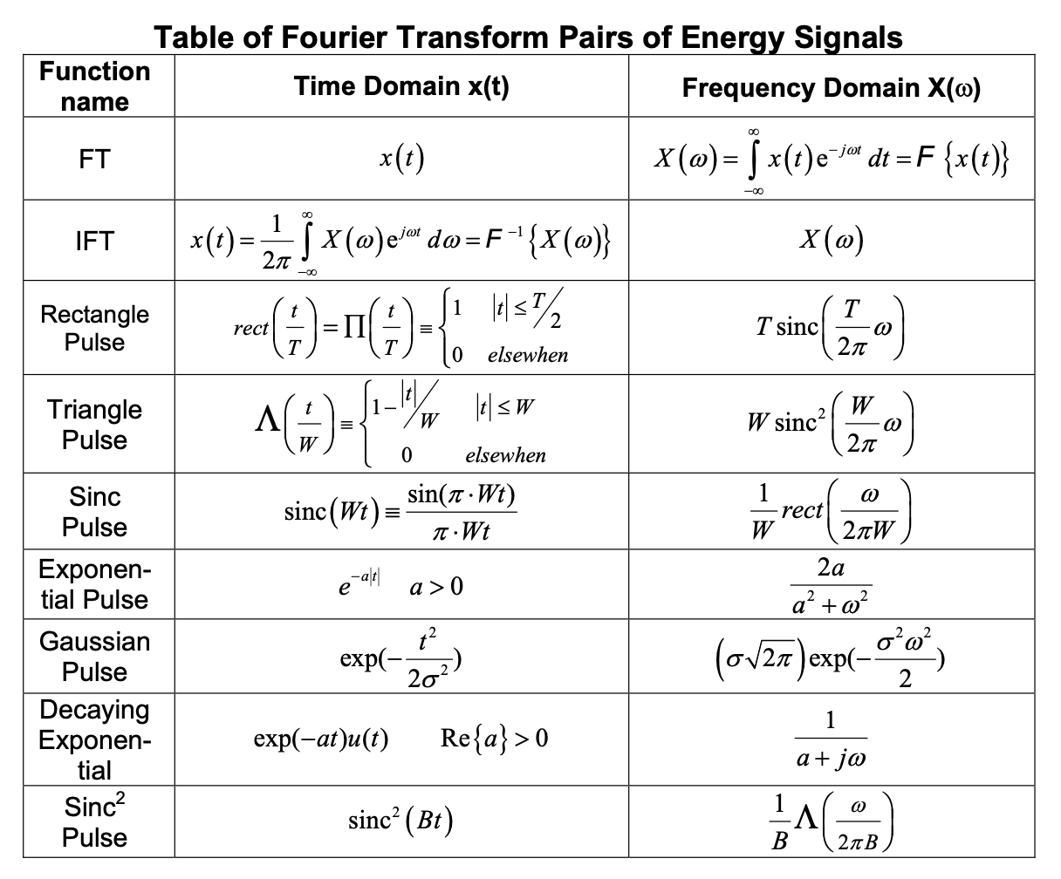

Slide 27
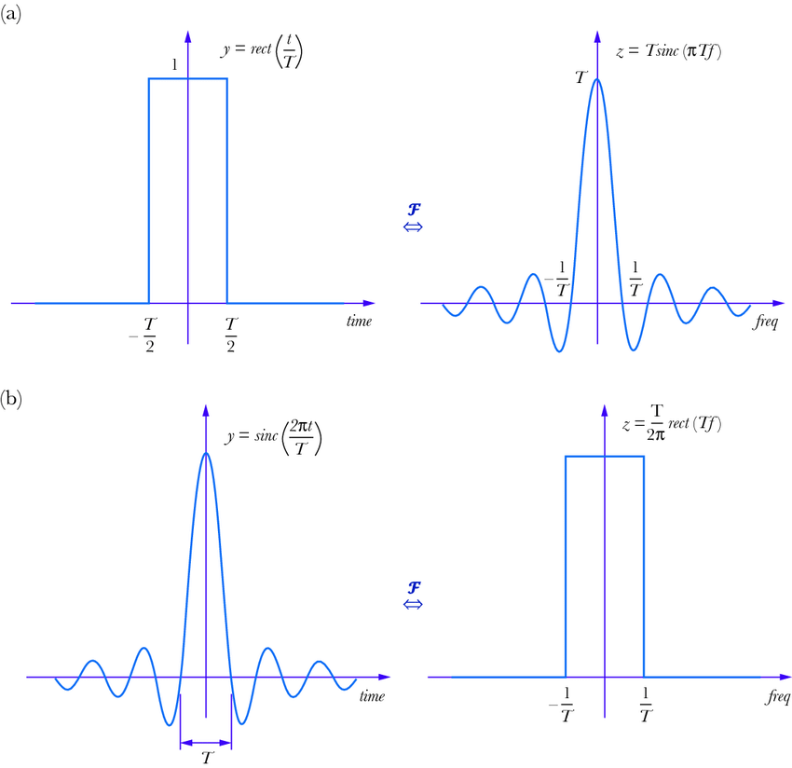
Fourier Pair: Sinc function – Rect function

Slide 28
What limitations of FFT or STFT bother you?
Fixed frequency locations for a given sample rate and time window.

Slide 29

2019
Paper: https://arxiv.org/pdf/1808.00158

Slide 30
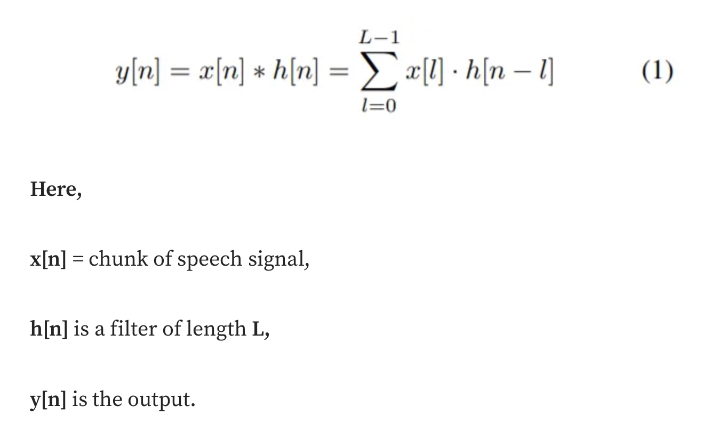
Traditional CNN

Slide 31
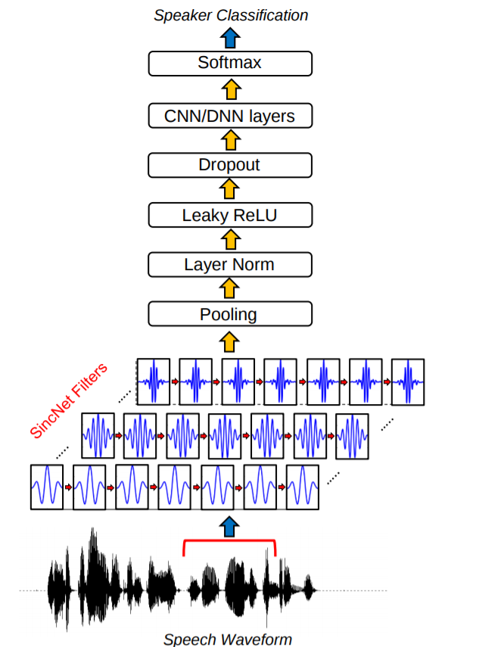
SincNet

Slide 32
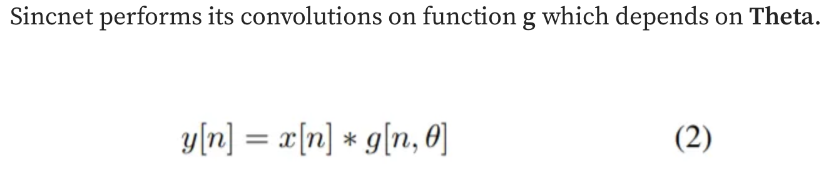
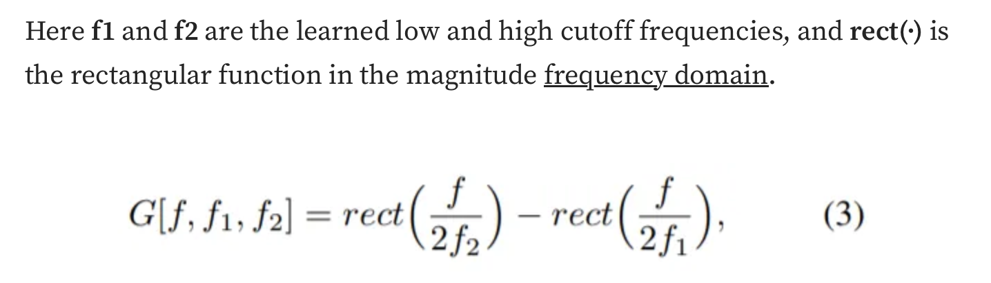
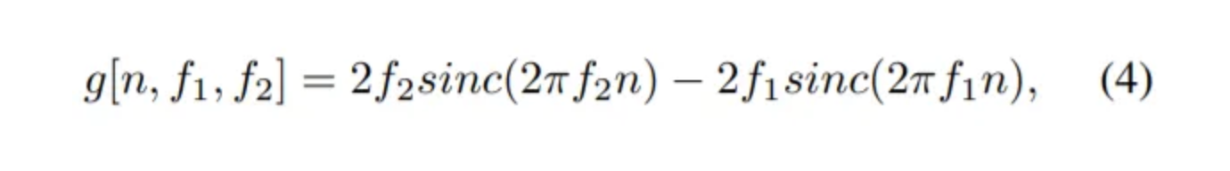
SincNet
Frequency domain
Time domain

Slide 34
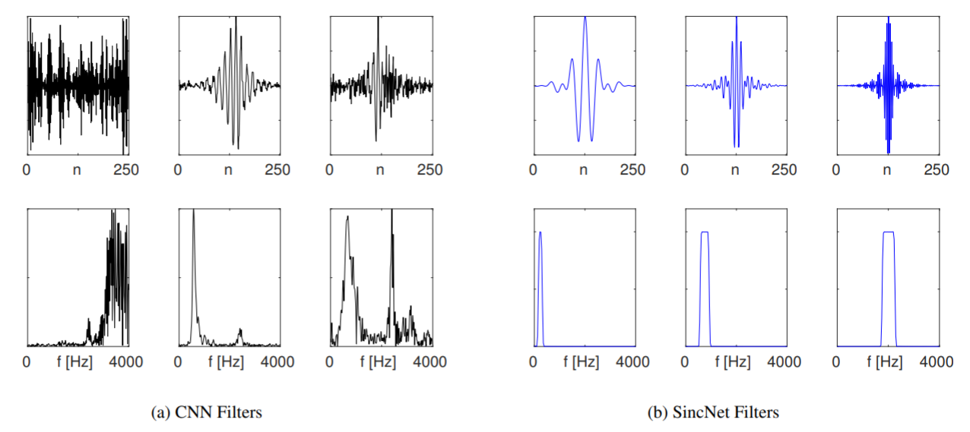

Slide 35
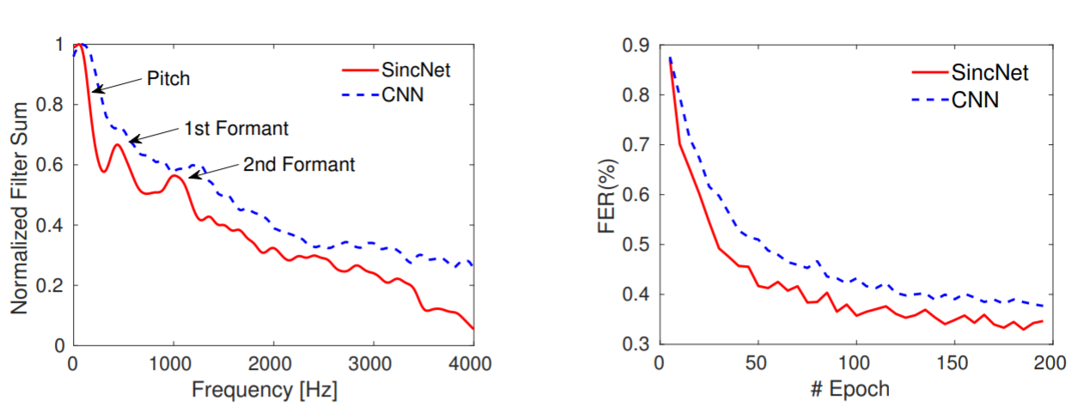

Slide 36
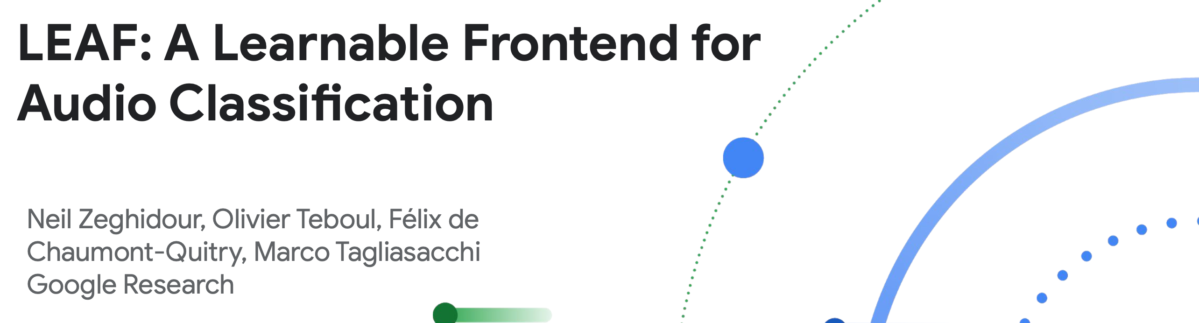
Questioning the standards
ICLR 2021
Paper: https://arxiv.org/pdf/2101.08596

Slide 37


Application: Classification
Classifier
“Dog”
Classifier
“Dog”

Slide 38
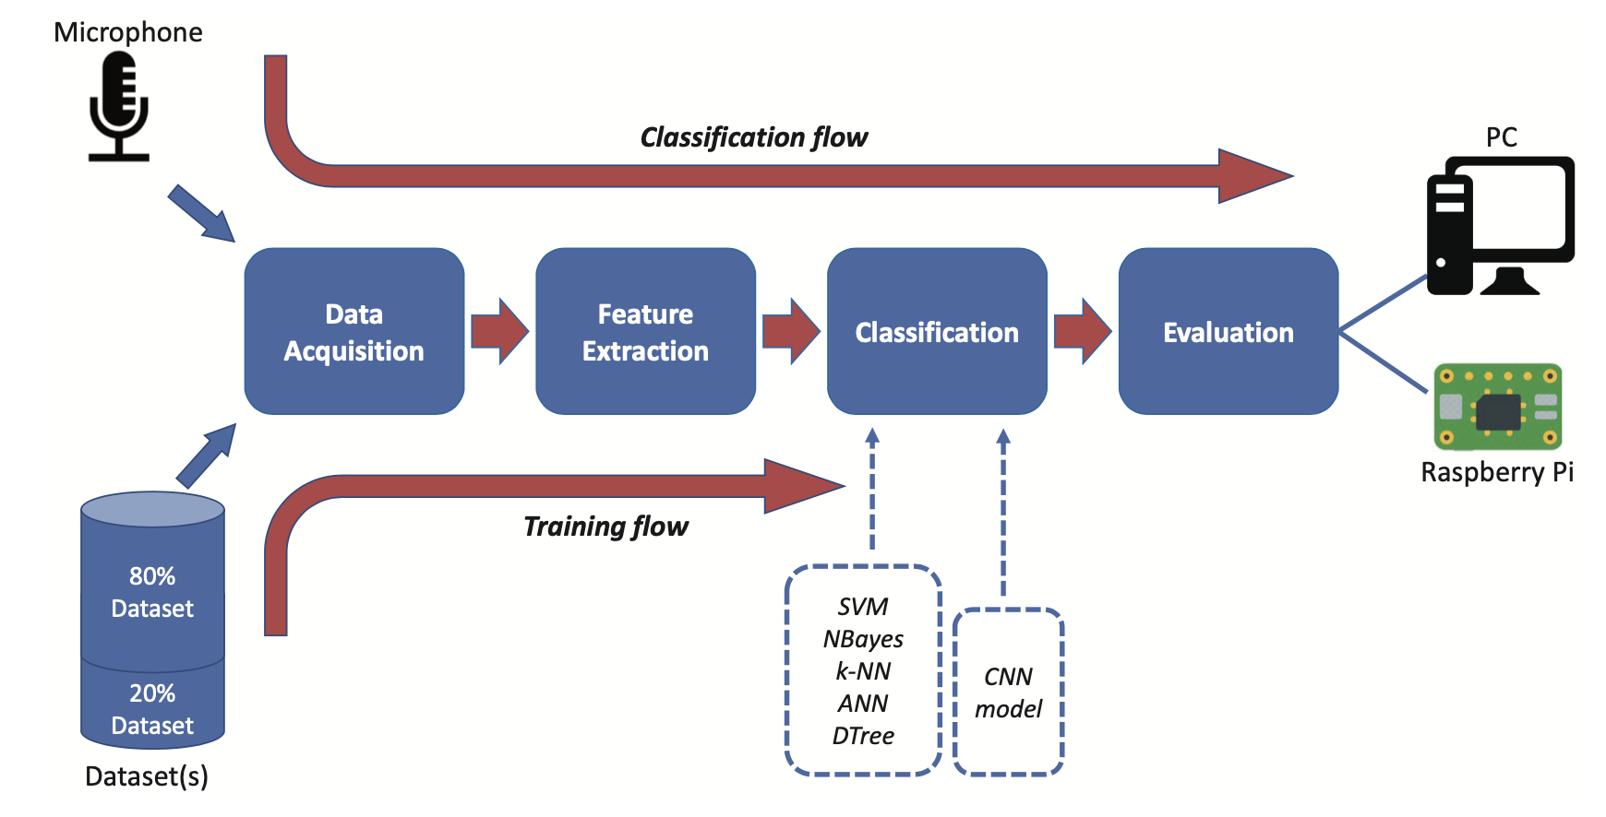
Audio Classification Steps

Slide 39
Zero-Crossing Rate (ZCR) – counts how often the signal crosses zero.
Short-Time Energy – total signal energy in a frame (loudness).
RMS Amplitude – average signal power measure.
Autocorrelation – detects periodicity and pitch.
Temporal Moments – mean/variance/skewness of waveform shape.
AMDF – pitch estimation via average magnitude differences.
Rise/Attack/Decay Times – capture onset and offset dynamics.
Temporal Centroid – center of gravity of signal energy in time.
Envelope Features – smoothed amplitude curve of signal.
Cepstrum (time-domain view) – captures pitch and vocal tract characteristics.
Time domain features
Spectral Centroid – weighted average frequency (brightness)
Spectral Bandwidth – spread of spectrum around the centroid
Spectral Rolloff – frequency below which most energy lies
Spectral Flux – frame-to-frame change in the spectrum
Spectral Flatness – how noise-like vs. tone-like the spectrum is
Spectral Contrast – difference between peaks and valleys across bands
Fundamental Frequency (F0) – lowest frequency, perceived as pitch
Harmonic-to-Noise Ratio – balance between harmonic and noise energy
Formant Frequencies – resonant peaks in speech/instrument sounds
MFCCs – compressed spectral features modeled after human hearing
Freq. domain features

Slide 40
Zero-Crossing Rate (ZCR) – counts how often the signal crosses zero.
Short-Time Energy – total signal energy in a frame (loudness).
RMS Amplitude – average signal power measure.
Autocorrelation – detects periodicity and pitch.
Temporal Moments – mean/variance/skewness of waveform shape.
AMDF – pitch estimation via average magnitude differences.
Rise/Attack/Decay Times – capture onset and offset dynamics.
Temporal Centroid – center of gravity of signal energy in time.
Envelope Features – smoothed amplitude curve of signal.
Cepstrum (time-domain view) – captures pitch and vocal tract characteristics.
Time domain features
Spectral Centroid – weighted average frequency (brightness)
Spectral Bandwidth – spread of spectrum around the centroid
Spectral Rolloff – frequency below which most energy lies
Spectral Flux – frame-to-frame change in the spectrum
Spectral Flatness – how noise-like vs. tone-like the spectrum is
Spectral Contrast – difference between peaks and valleys across bands
Fundamental Frequency (F0) – lowest frequency, perceived as pitch
Harmonic-to-Noise Ratio – balance between harmonic and noise energy
Formant Frequencies – resonant peaks in speech/instrument sounds
MFCCs – compressed spectral features modeled after human hearing
Freq. domain features

Slide 41
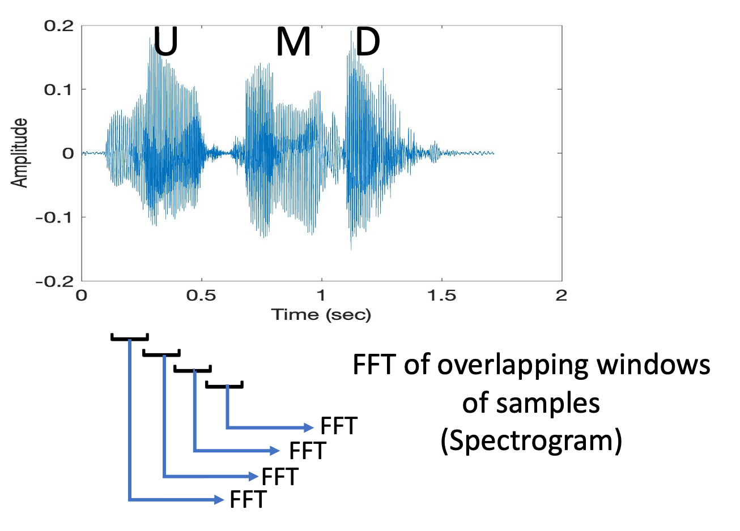
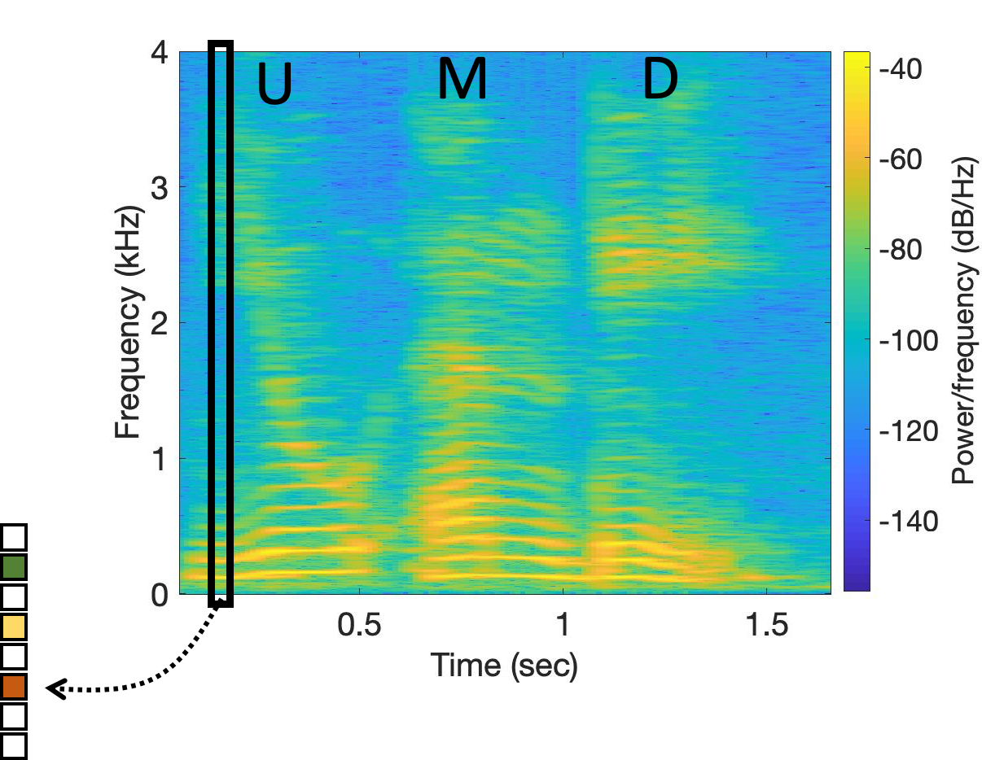
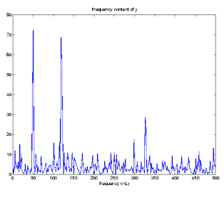
Short-Time Fourier Transform (STFT)
Spectrogram
Notes:
MFCC: https://medium.com/@MuhyEddin/feature-extraction-is-one-of-the-most-important-steps-in-developing-any-machine-learning-or-deep-94cf33a5dd46

Slide 42
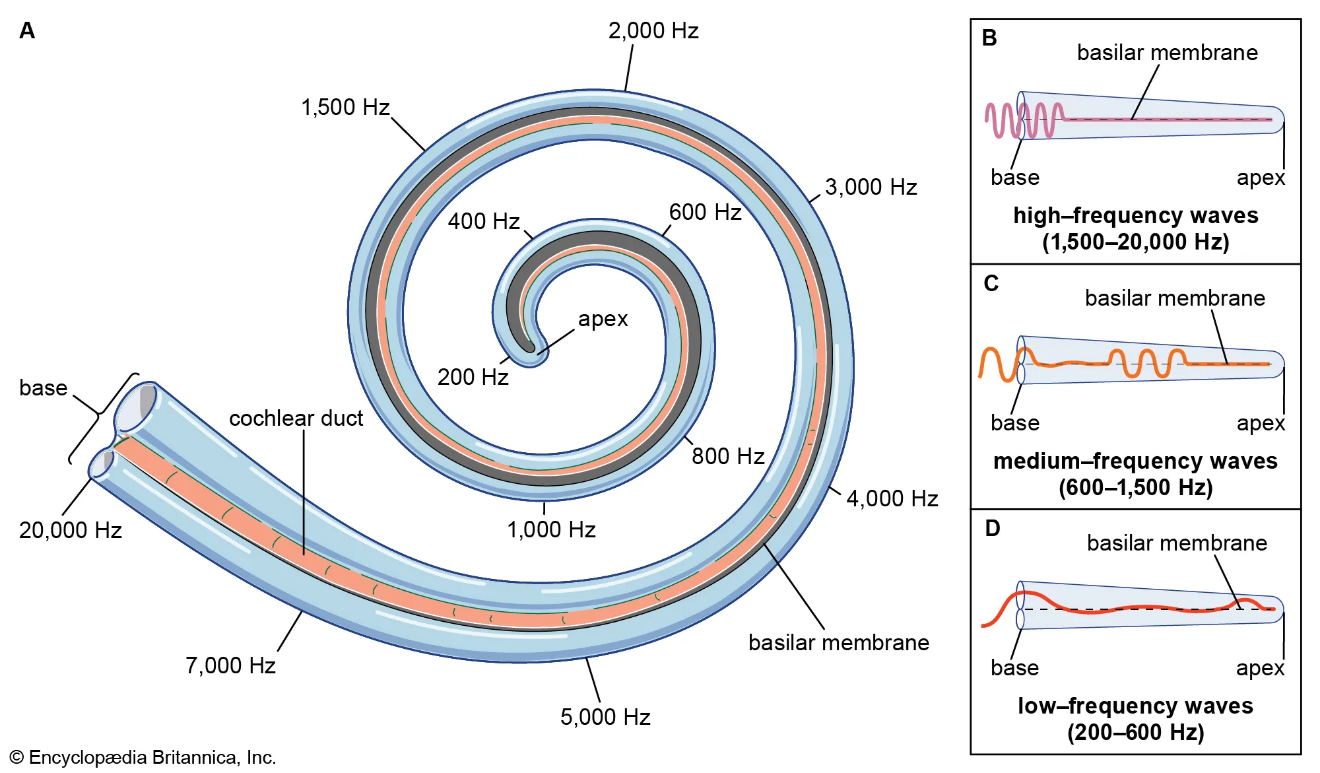
Mel-Frequency Cepstral Coefficients (MFCC)
Mel == Melody
(1) The human ear doesn’t perceive frequency linearly.
(2) We are more sensitive to low-frequency changes (e.g., distinguishing
500 Hz vs. 600 Hz) than to high-frequency changes (e.g., 5000 Hz vs.
5100 Hz).
(3) This comes from the basilar membrane in the cochlea, where spacing
of hair cells produces a nonlinear frequency resolution.
Notes:
MFCC: https://medium.com/@MuhyEddin/feature-extraction-is-one-of-the-most-important-steps-in-developing-any-machine-learning-or-deep-94cf33a5dd46

Slide 43
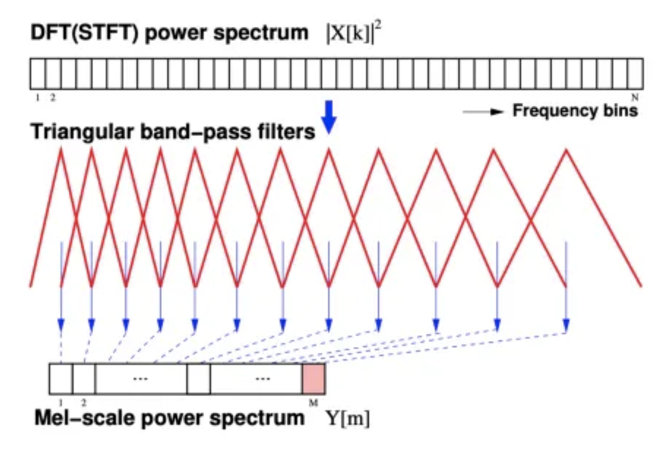
Mel-Frequency Cepstral Coefficients (MFCC)

Slide 44
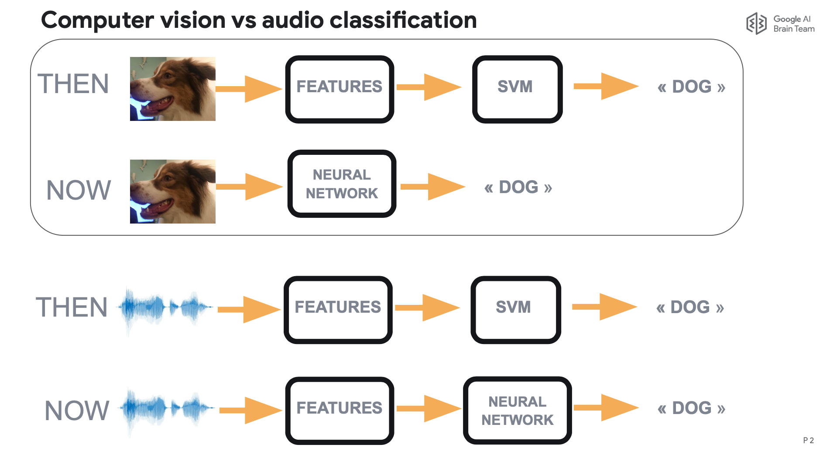
Evolution of Classification Architecture

Slide 45
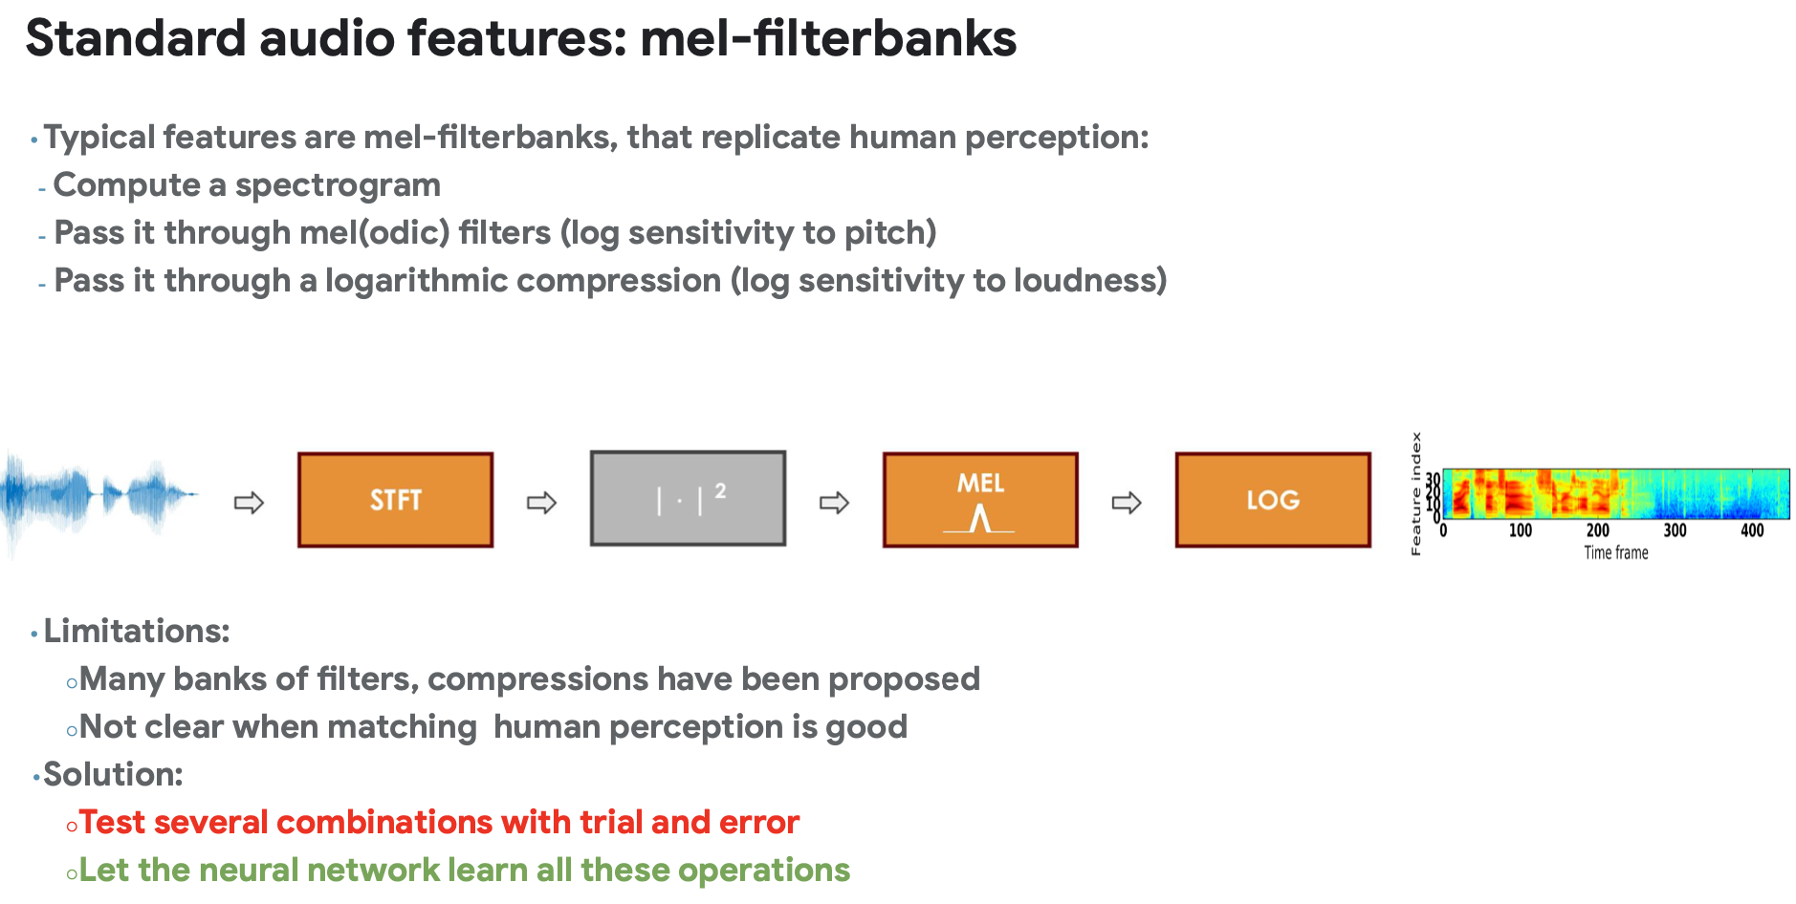

Slide 46



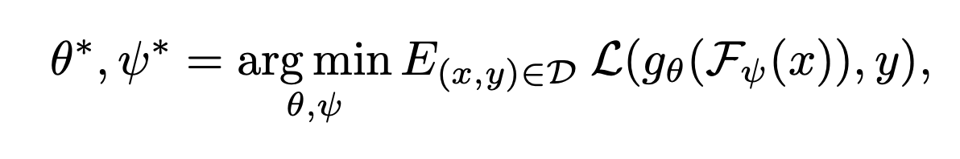
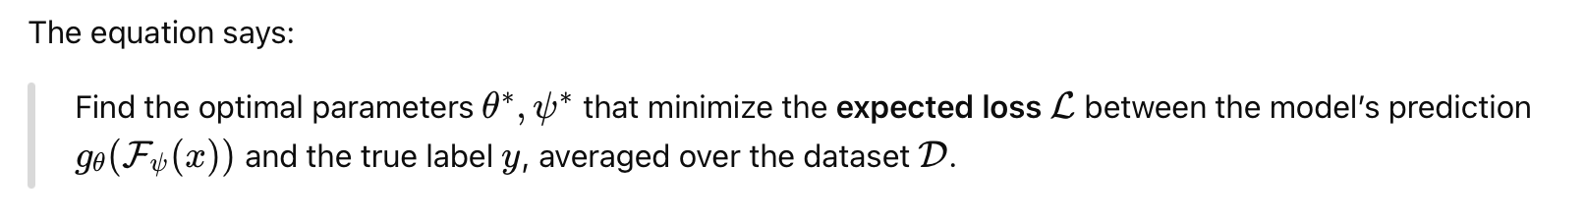
LEAF: A LEarnable Audio Frontend
= one-dimensional waveform of T samples
sampling frequency F_{s}
= Replaces MFCC
= The main model (e.g., classifier)

Slide 47
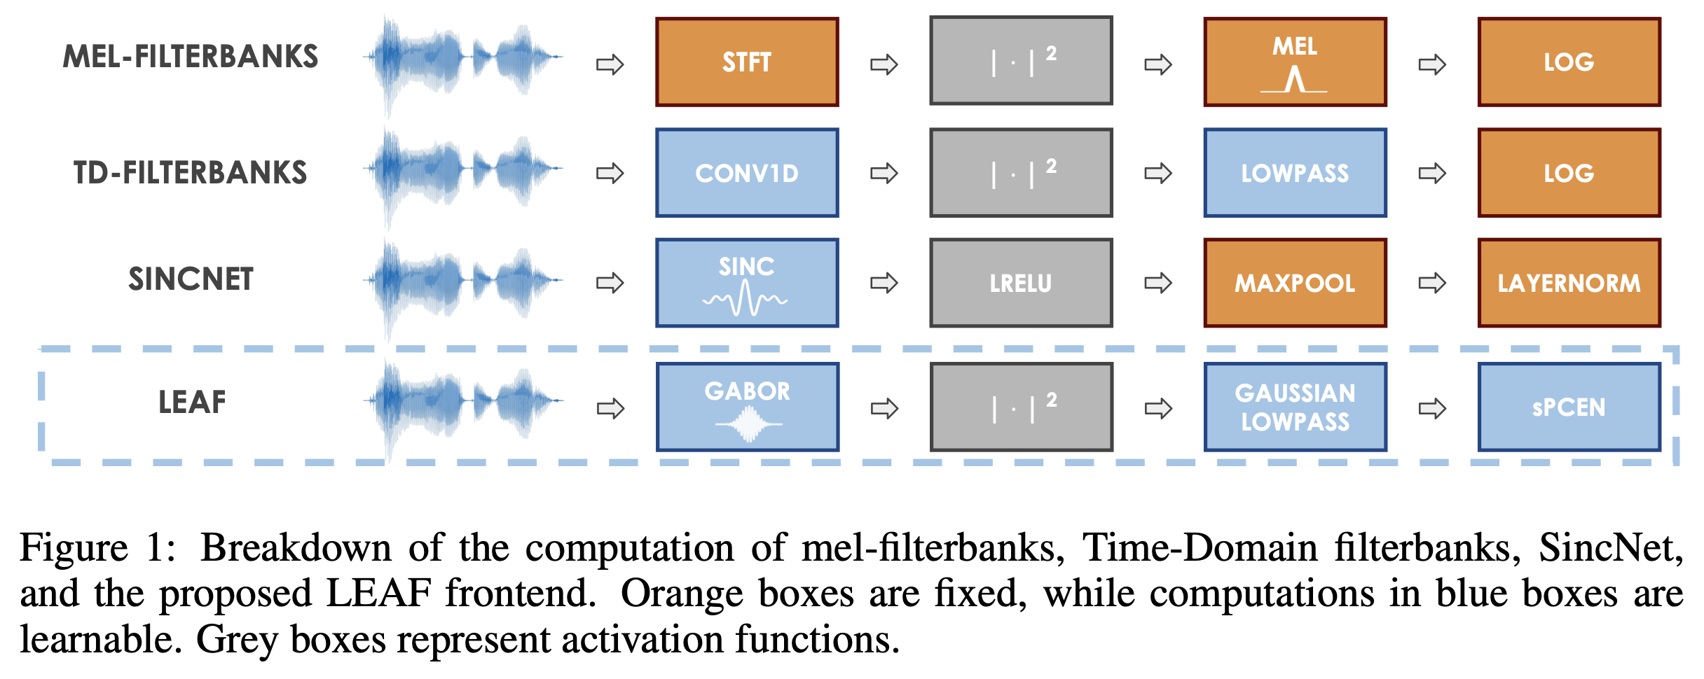
Learnable modules

Slide 48
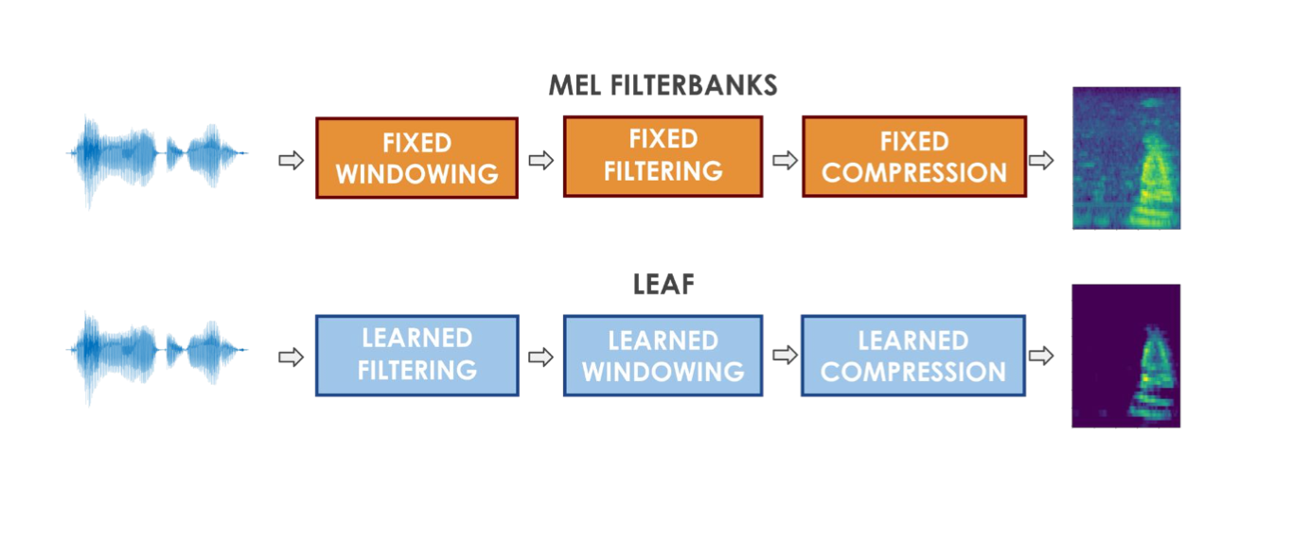
LEAF: A LEarnable Audio Frontend

Slide 49


Slide 50


Slide 51


Slide 52


Slide 53
Extra Slides

Slide 54


Slide 56

Fourier series
2

Slide 57

Fourier series

Slide 58


Slide 61


Slide 63

Discrete Fourier Transform formula
Discrete version:

Slide 64
Discrete Fourier Transform formula
Discrete version:

Slide 65
Addition and Multiplication of Frequencies
Magnitude
0
f₁
Frequency
$$e^{j2π(f1)t}$$

Slide 66
Addition and Multiplication of Frequencies
Magnitude
Addition (complex)
0
f_{c}
f₁
Frequency
$$e^{j2π(f1)t}$$
+
$$e^{j2π(fc)t}$$
=
?

Slide 67
Addition and Multiplication of Frequencies
Magnitude
Multiplication (complex)
0
f_{c}
f₁
Frequency
$$e^{j2π(f1)t}$$
X
$$e^{j2π(fc)t}$$
=
?

Slide 68
Addition and Multiplication of Frequencies
Magnitude
Multiplication (complex)
0
f₁+ f_{c}
Freq
$$e^{j2π(f1)t}$$
X
$$e^{j2π(fc)t}$$
=
$$e^{j2π(f1+fc)t}$$

Slide 69
Addition and Multiplication of Frequencies
Magnitude
Multiplication (complex)
-f_{c}
0
f₁
Freq
$$e^{j2π(f1)t}$$
X
$$e^{j2π(−fc)t}$$
=
?

Slide 70
Addition and Multiplication of Frequencies
Magnitude
Multiplication (complex)
0
f₁- f_{c}
Freq
$$e^{j2π(f1)t}$$
X
$$e^{j2π(−fc)t}$$
=
$$e^{j2π(f1−fc)t}$$

Slide 71
Addition and Multiplication of Frequencies
Magnitude
Multiplication (band, complex)
-f_{c}
0
f₁
Freq
$$e^{j2π(f1)t}$$
X
$$e^{j2π(−fc)t}$$
=
?

Slide 72
Addition and Multiplication of Frequencies
Magnitude
Multiplication (band, complex)
-f_{c}
0
f_{x}
Freq
$$e^{j2π(fx)t}$$
X
$$e^{j2π(−fc)t}$$
=
?
f₁<= X <= f₂

Slide 73
Addition and Multiplication of Frequencies
Magnitude
Multiplication (band, complex)
-f_{c}
0
f_{y}
Freq
$$e^{j2π(fx)t}$$
X
$$e^{j2π(−fc)t}$$
=
$$e^{j2π(fy)t}$$
f₁<= X <= f₂
f₁- f_{c}<= X <= f₂- f_{c}

Slide 74
Addition and Multiplication of Frequencies
Magnitude
Multiplication (band, real/complex)
-f_{x}
-f_{c}
0
f_{x}
Freq
$$R[e^{j2π\left(fx\right)t}]$$
X
$$e^{j2π(−fc)t}$$
=
?
f₁<= X <= f₂

Slide 75
Addition and Multiplication of Frequencies
Magnitude
Multiplication (band, real/complex)
-f_{x}
-f_{c}
0
f_{x}
Freq
$$R[e^{j2π\left(fx\right)t}]$$
X
$$e^{j2π(−fc)t}$$
=
?
f₁<= X <= f₂

Slide 76
Addition and Multiplication of Frequencies
Magnitude
Multiplication (band, real/real)
-f_{x}
-f_{c}
0
f_{c}
f_{x}
Freq
$$R[e^{j2π\left(fx\right)t}]$$
X
$$R[e^{j2π\left(−fc\right)t}]$$
=
?
f₁<= X <= f₂

Slide 77
Addition and Multiplication of Frequencies
Magnitude
Multiplication (band, real/real)
-f_{x}
-f_{c}
0
f_{c}
Freq
$$R[e^{j2π\left(fx\right)t}]$$
X
$$R[e^{j2π\left(−fc\right)t}]$$
=
Four bands
f₁<= X <= f₂

Slide 78
Addition and Multiplication of Frequencies
Magnitude
Multiplication (band, real/real)
Filter
-f_{x}
-f_{c}
0
f_{c}
Freq
$$R[e^{j2π\left(fx\right)t}]$$
X
$$R[e^{j2π\left(−fc\right)t}]$$
=
Four bands
f₁<= X <= f₂

Slide 79

Addition and Multiplication of Frequencies
Typical usage of frequency band conversion
in communication devices.

