Slide 1





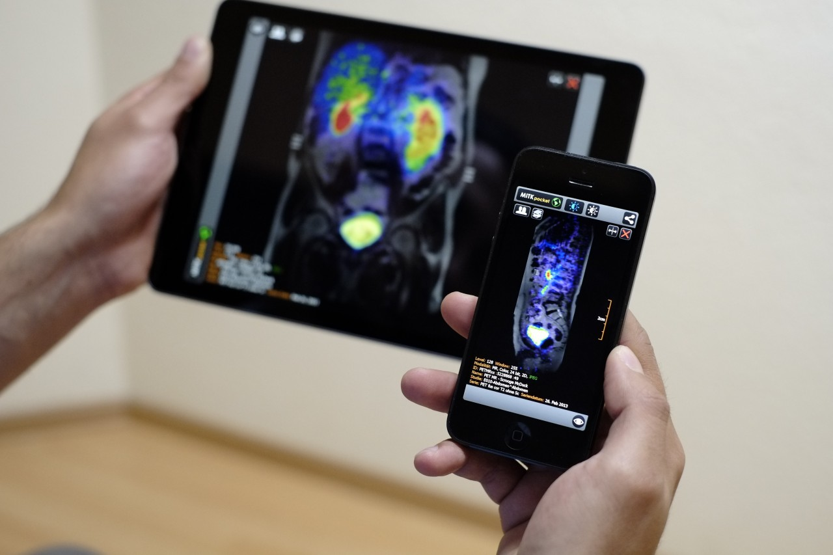
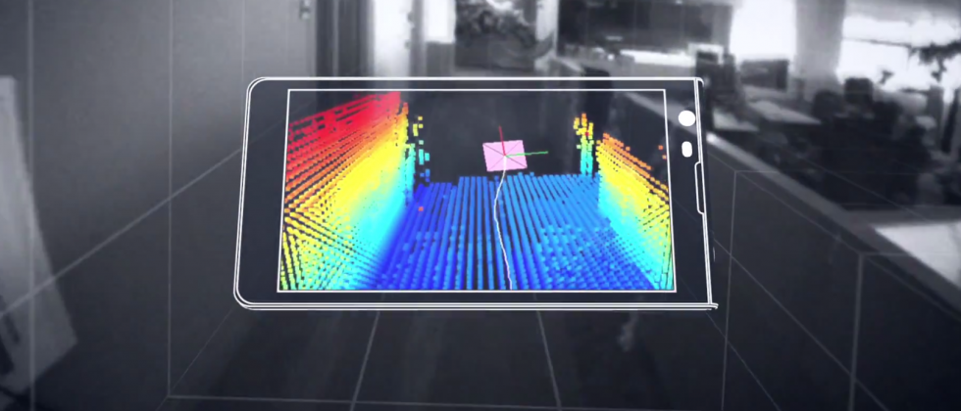

Machine Learning for Physical Sensing & Perception
CMSC 818V : Fall 2025
Lecture 1_6: Frequency in Learning
Nirupam Roy
Tu-Th 3:30 – 4:45pm
IRB 1207

Slide 2
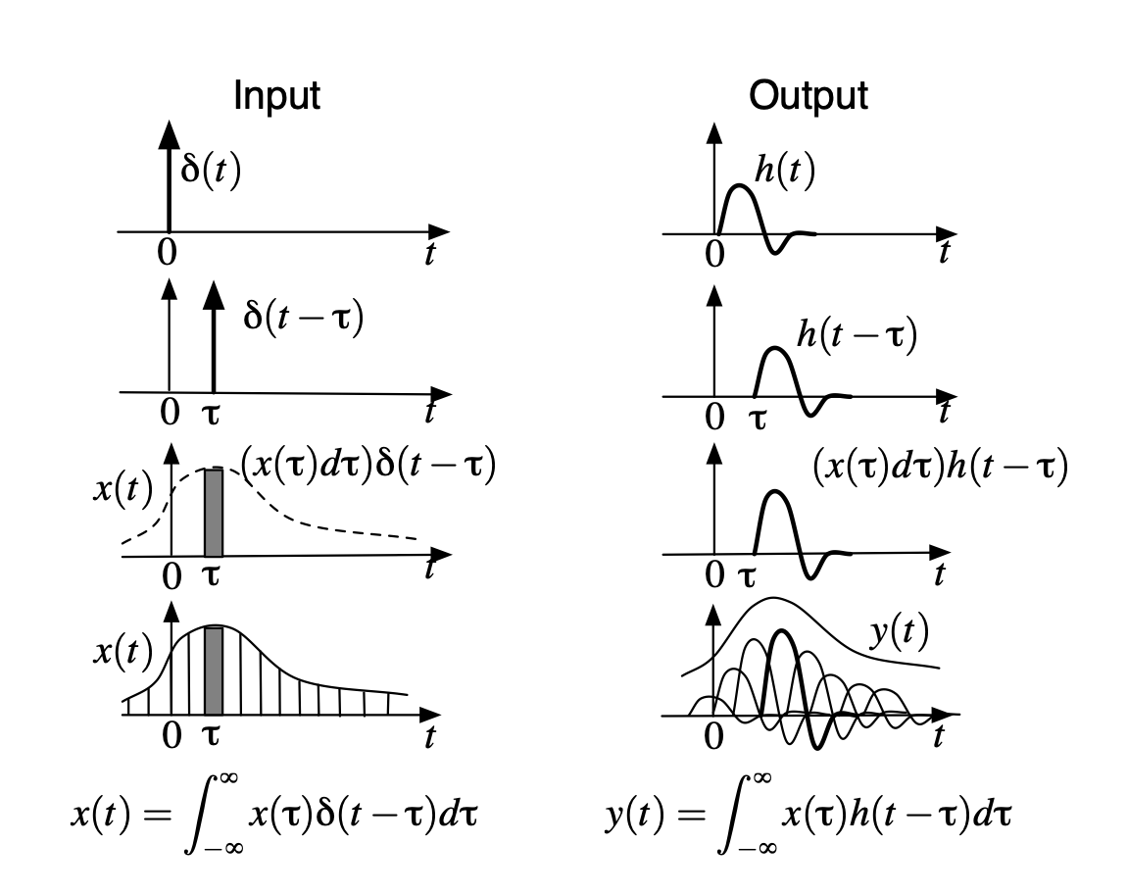
Convolution

Slide 3
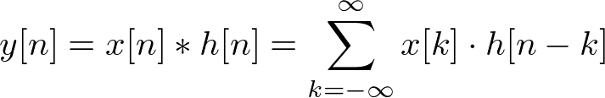
Convolution - 1D
Kernel/Impulse-response/Transfer-function

Slide 4

2019
Paper: https://arxiv.org/pdf/1808.00158

Slide 5
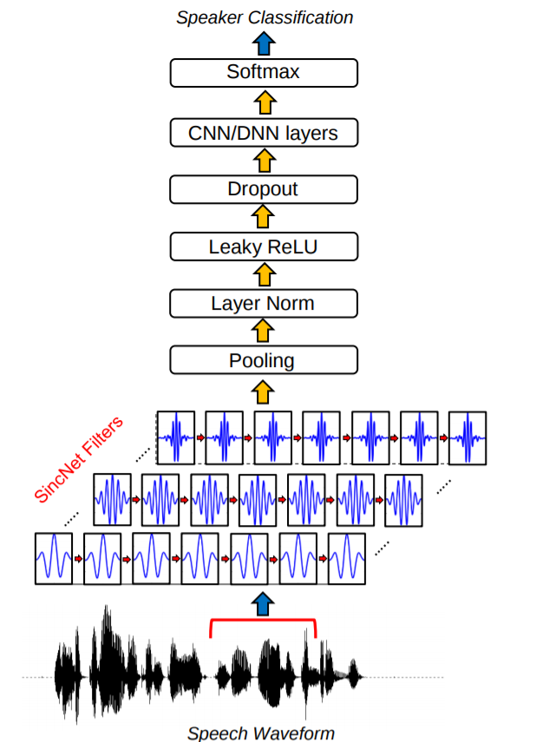
SincNet

Slide 6
Deep Learning Recap

Slide 7
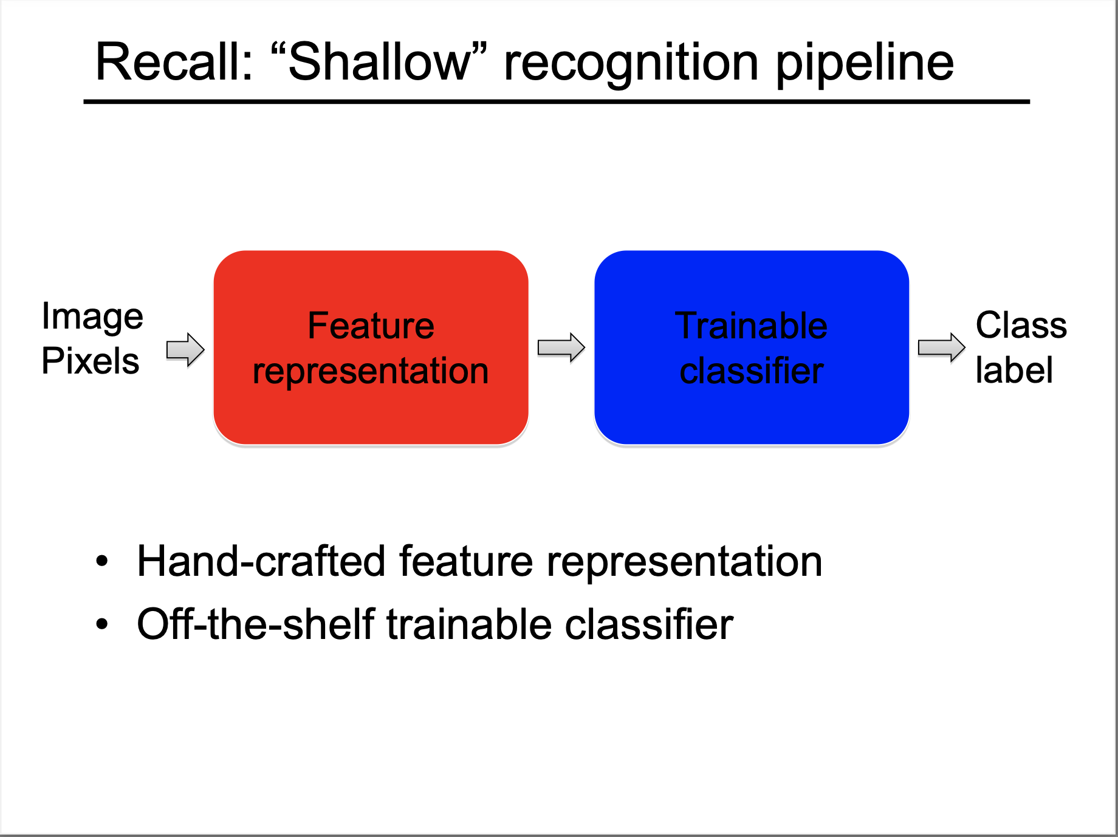
Slides: S. Gupta, UIUC https://saurabhg.web.illinois.edu/teaching/ece549/sp2023/slides/lec20_neural_nets.pdf

Slide 8
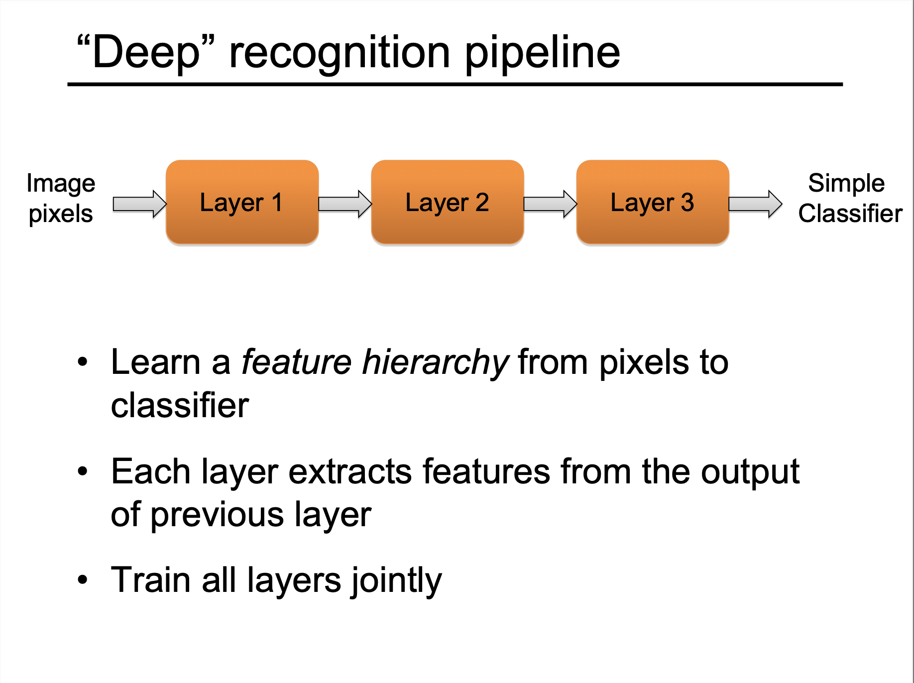

Slide 9
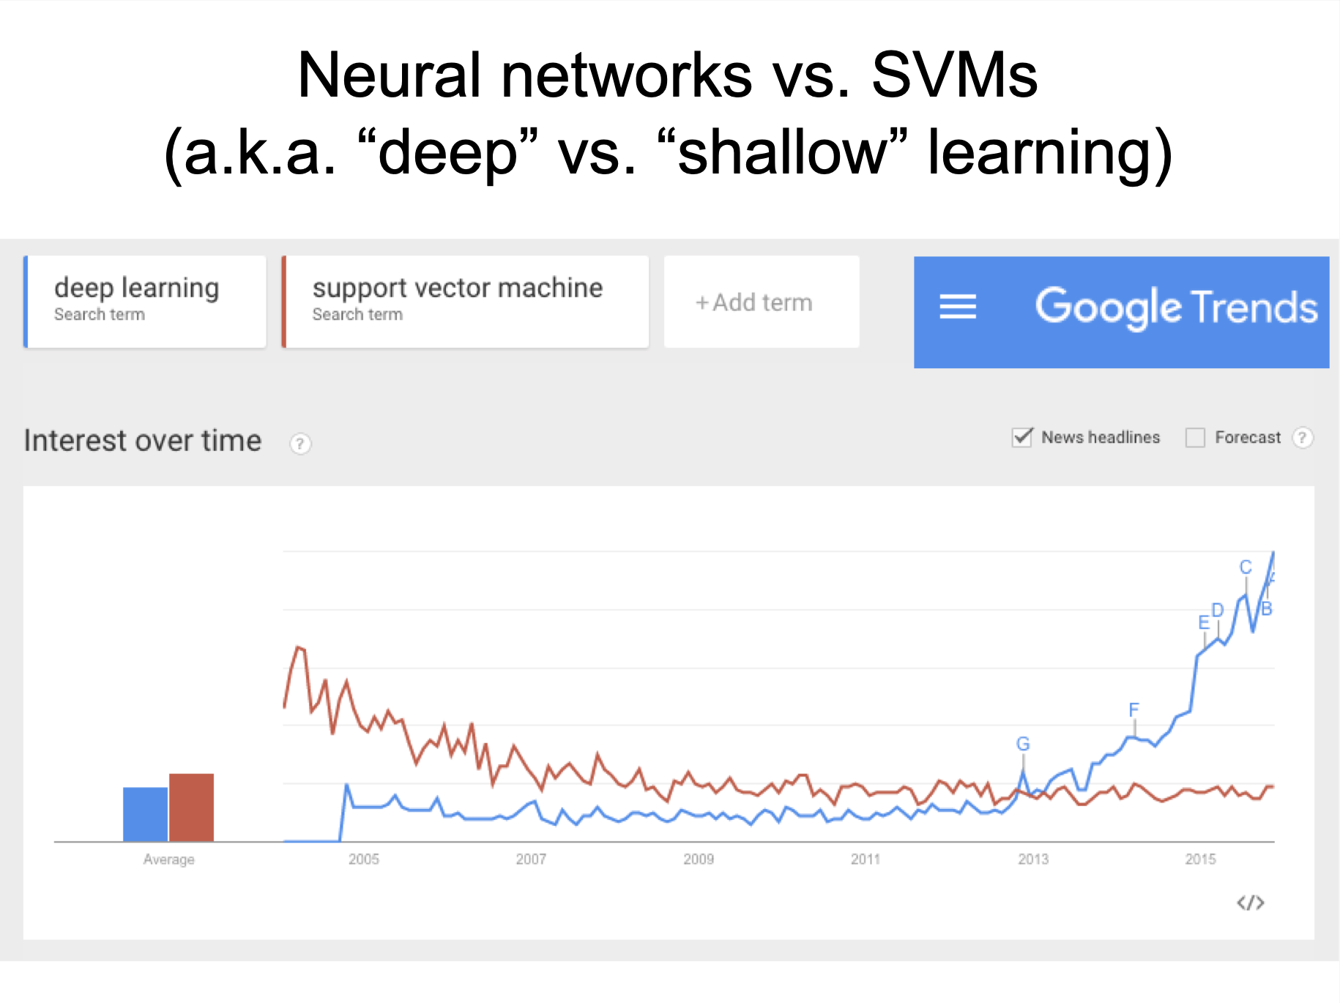

Slide 10
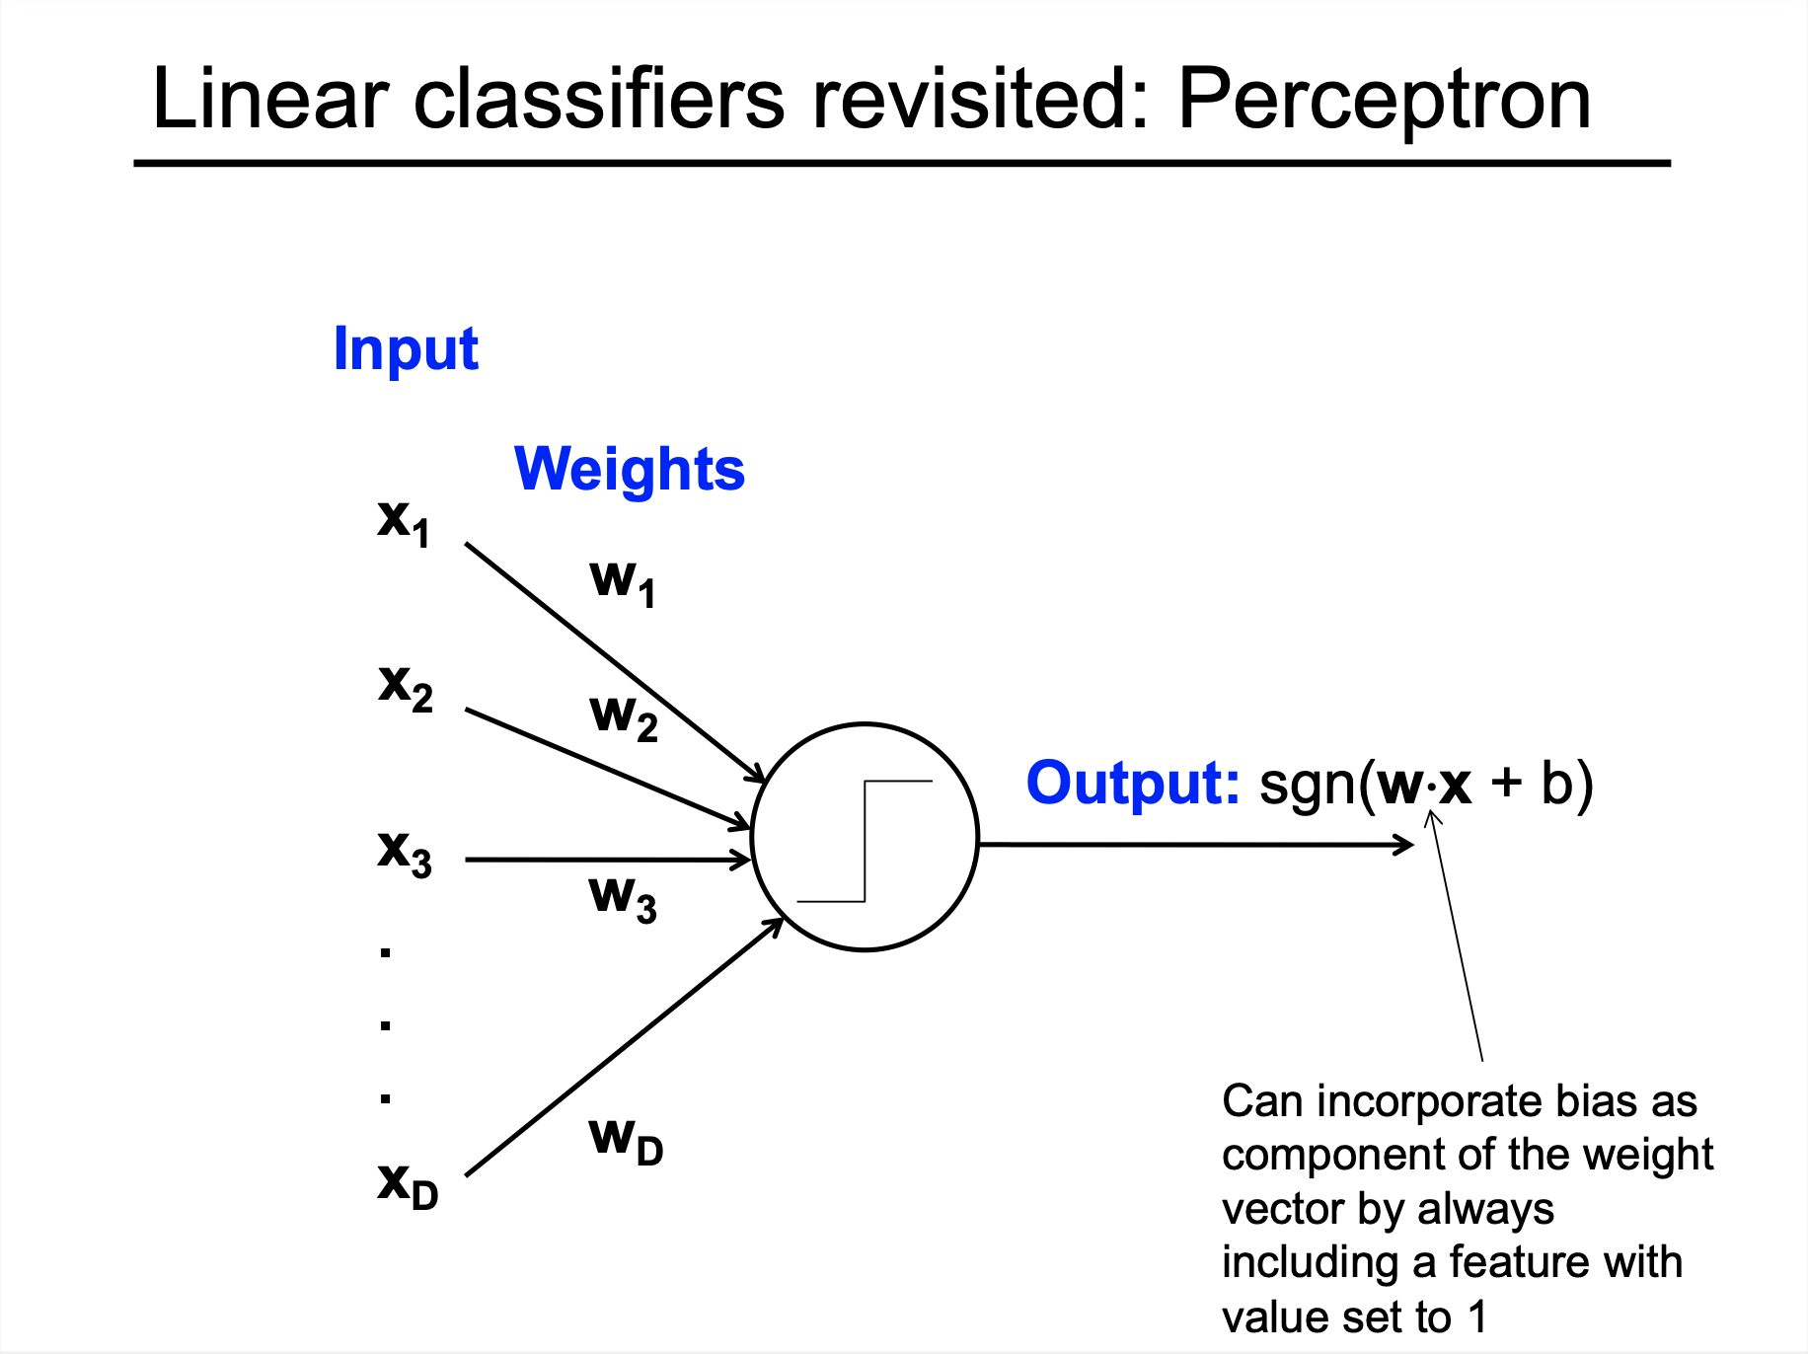
Notes:
SGN = sign function, +1 of X>0, 0 of X==0, and -1 if X<0
A linear classifier is a model that makes decisions by separating data with a straight line (in 2D), a plane (in 3D), or a hyperplane (in higher dimensions).

Slide 11
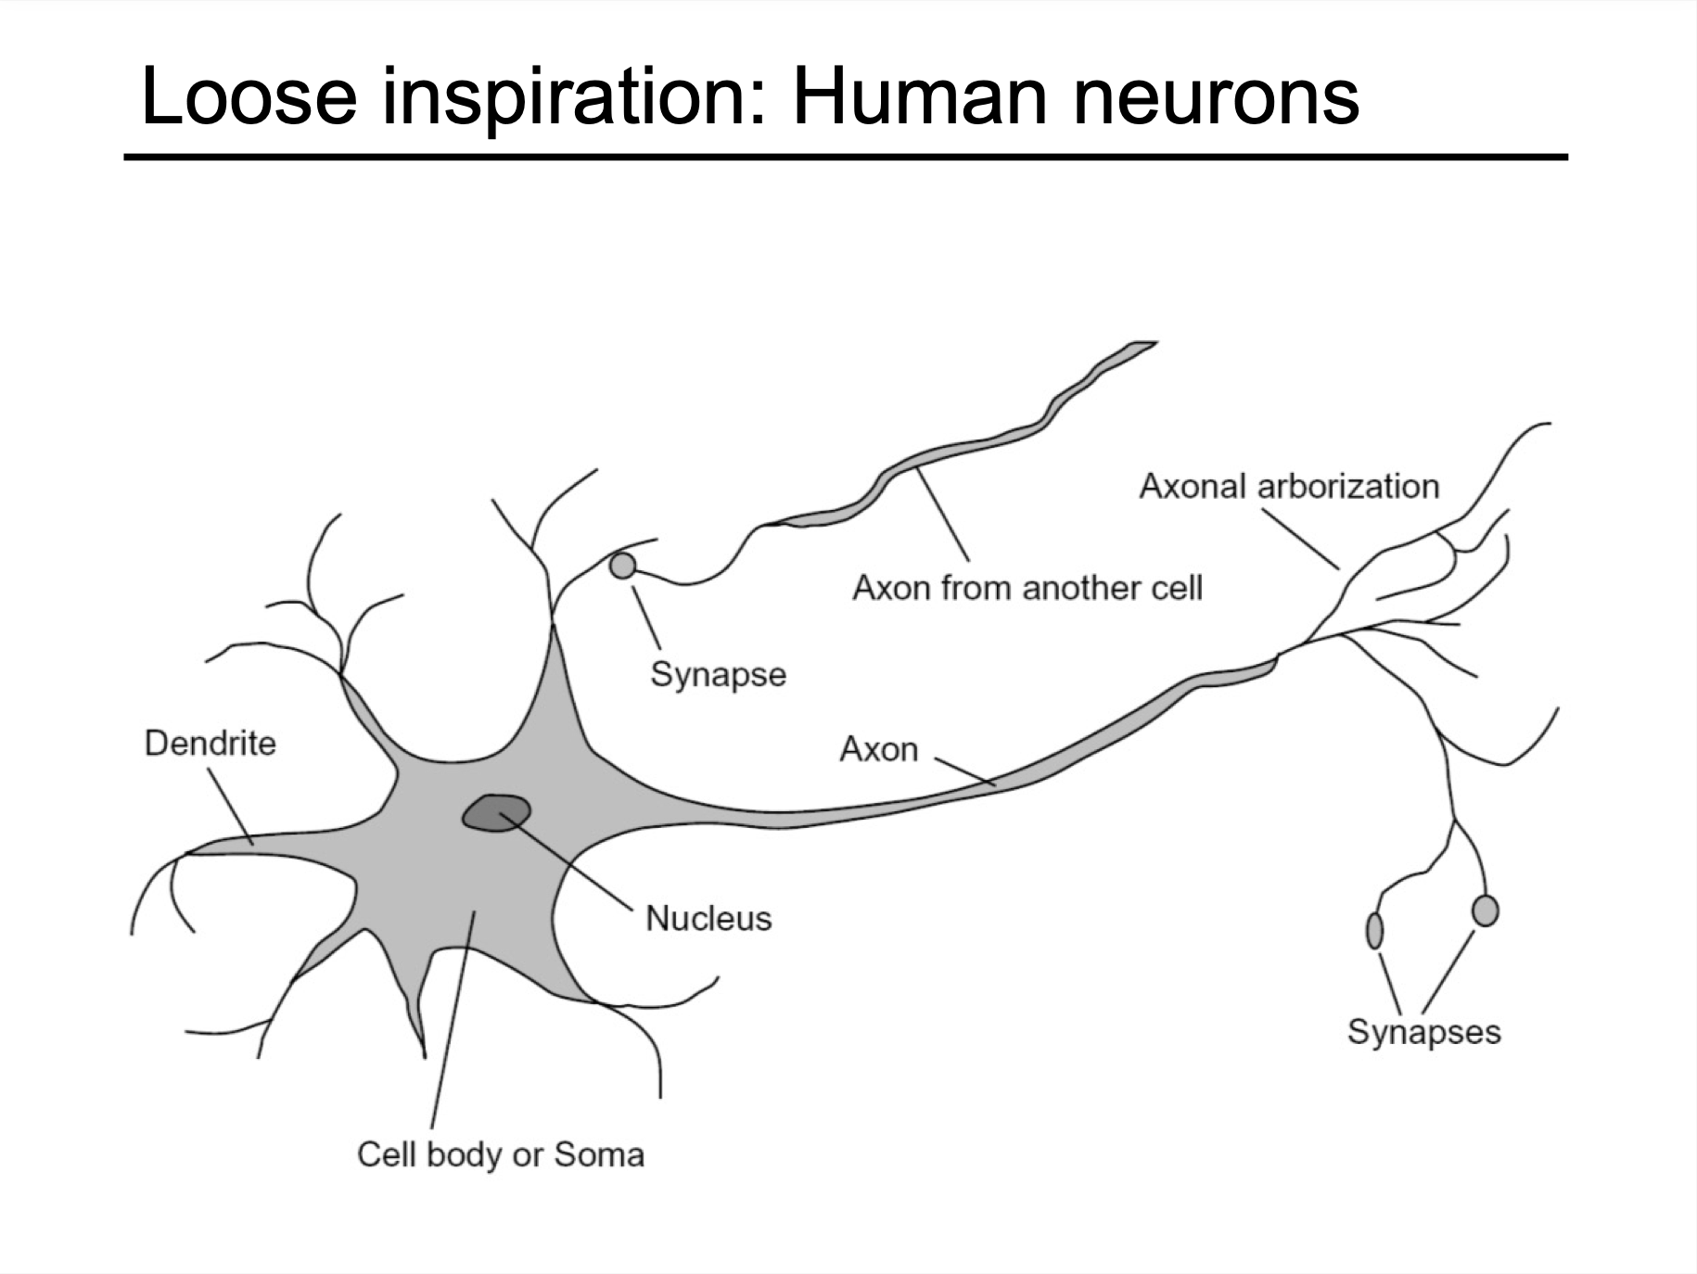

Slide 12
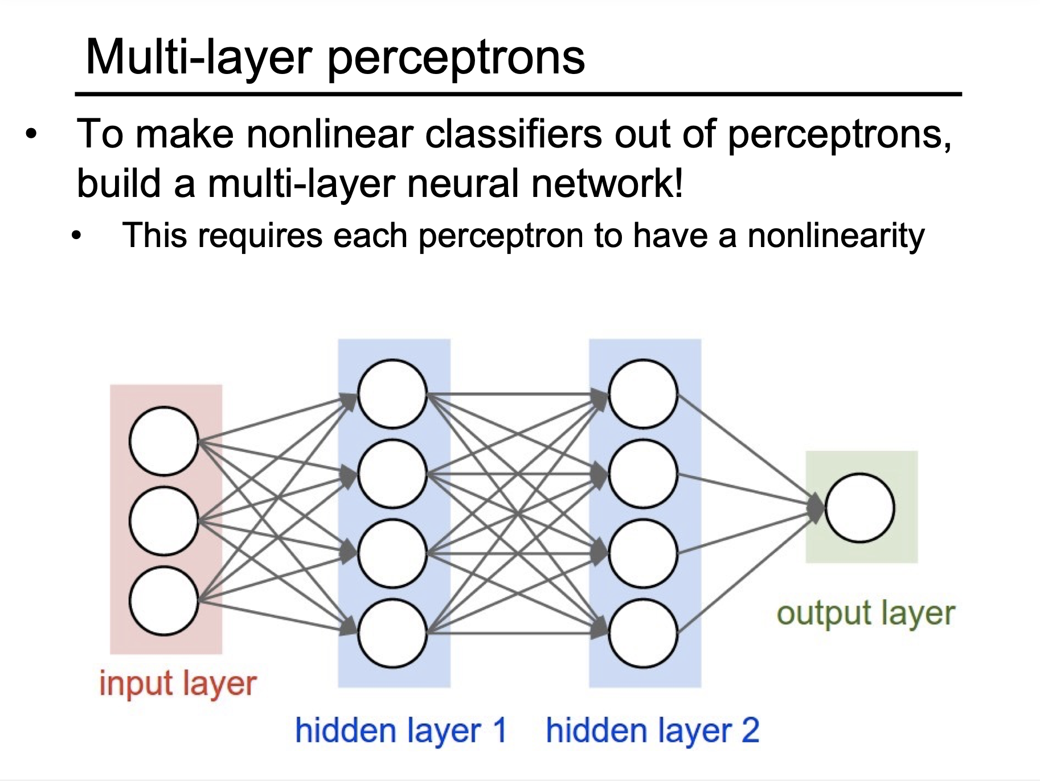

Slide 13
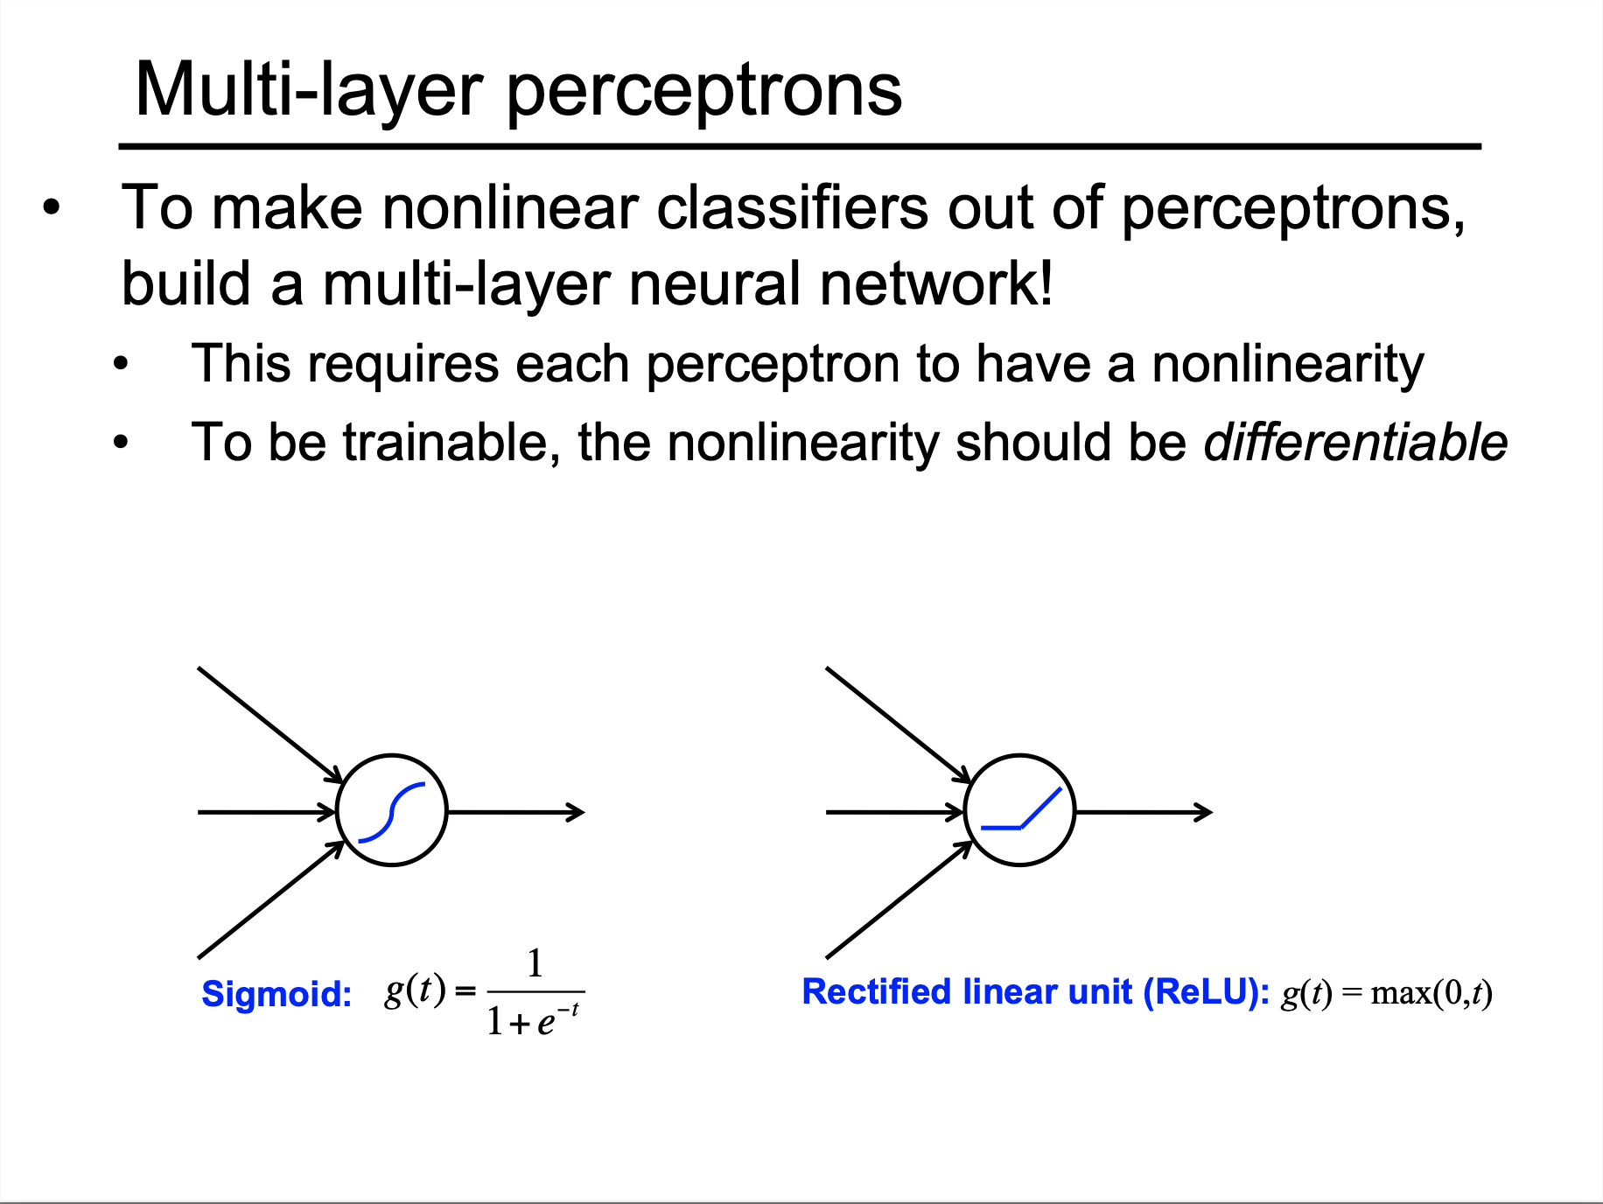

Slide 14
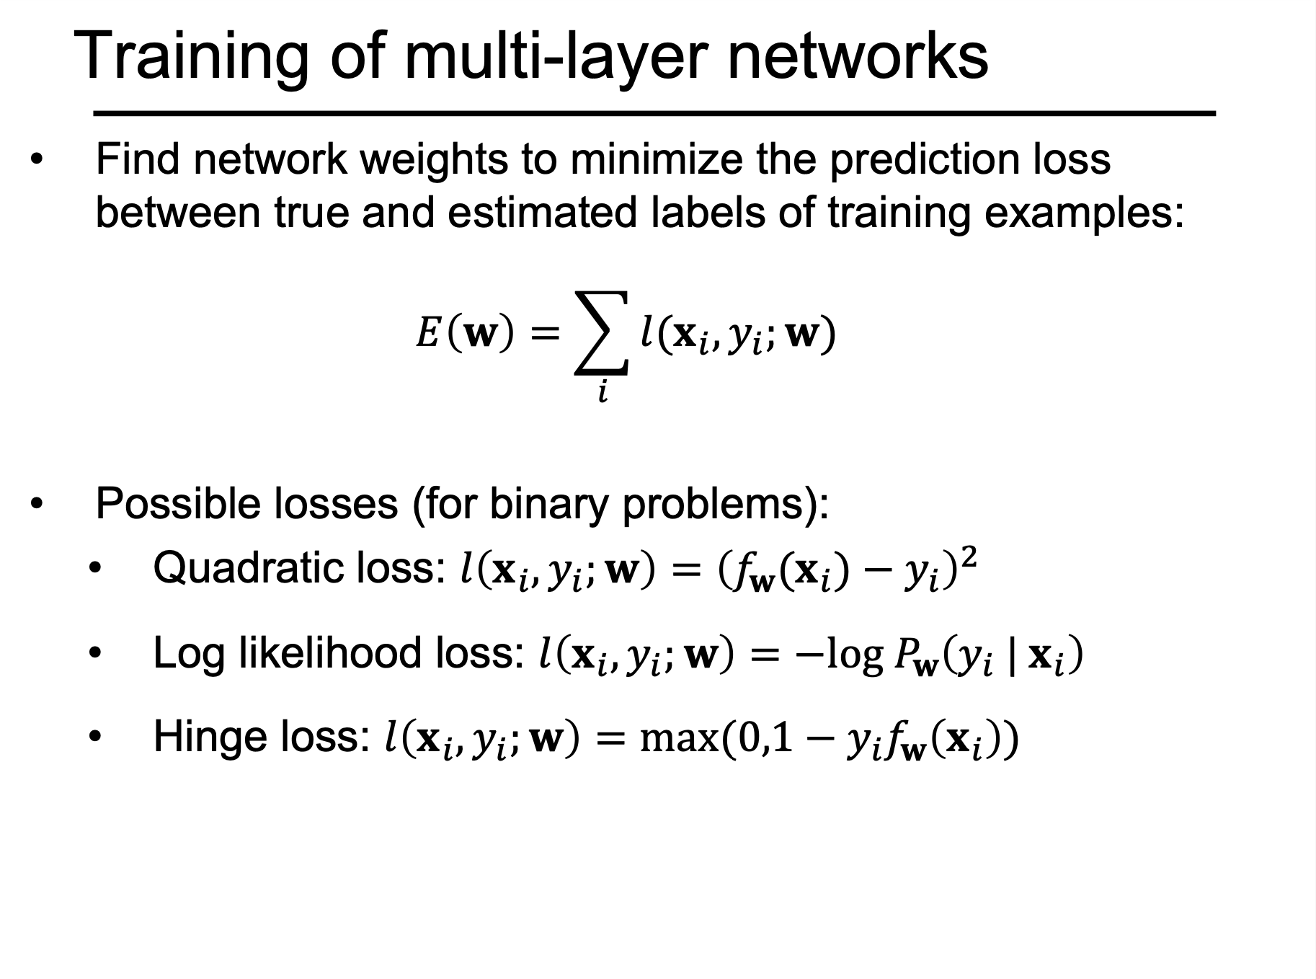

Slide 15
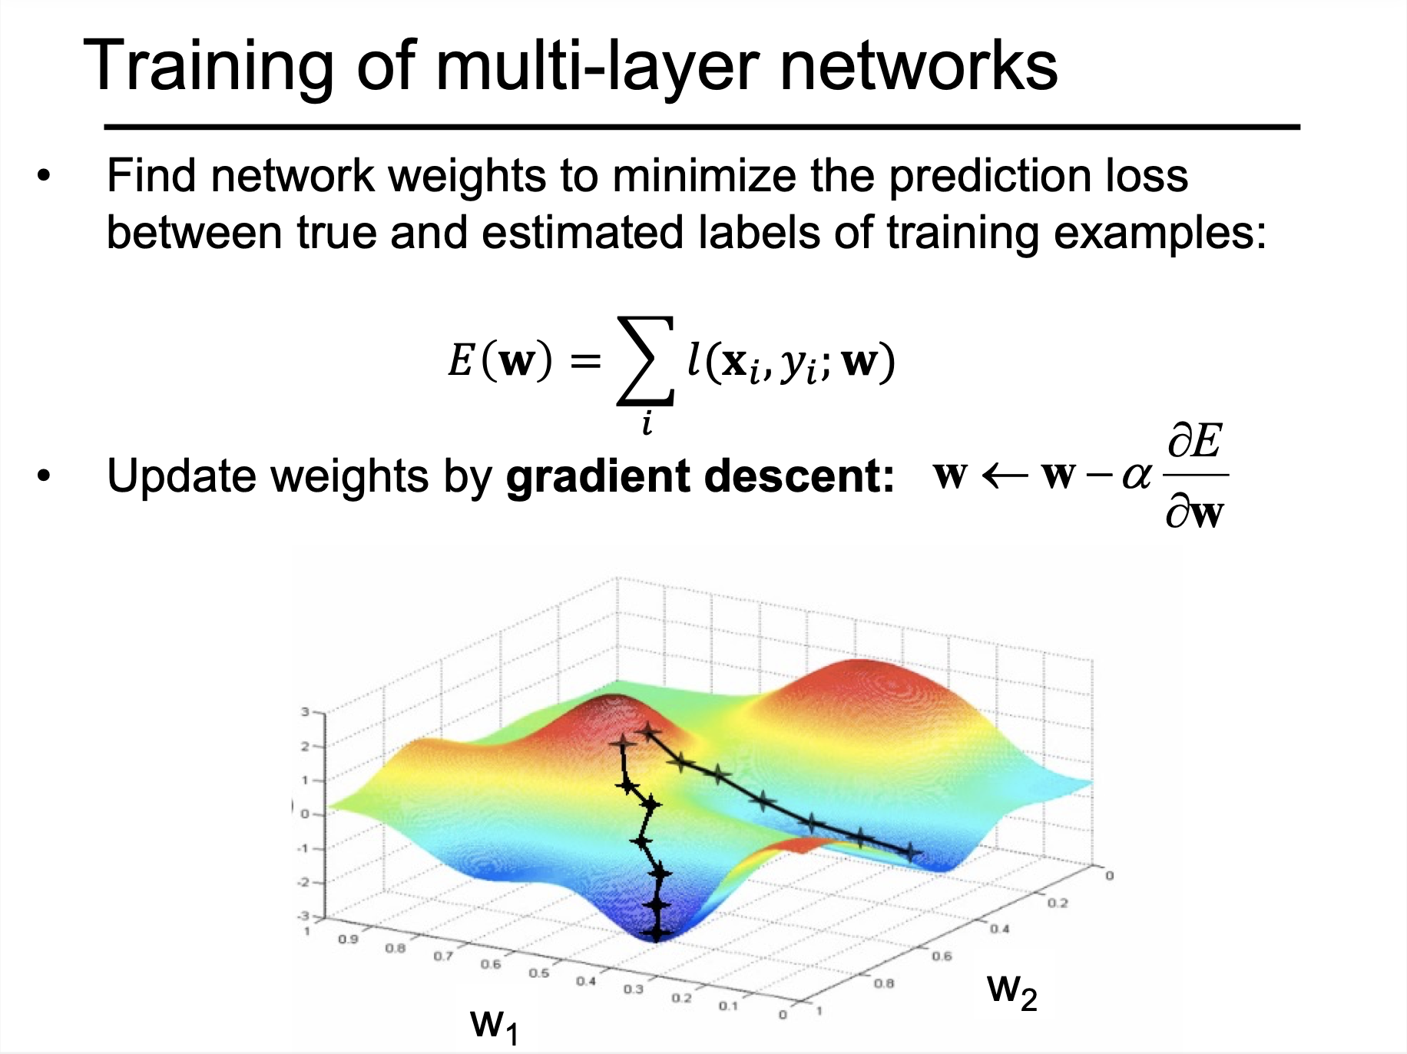

Slide 16
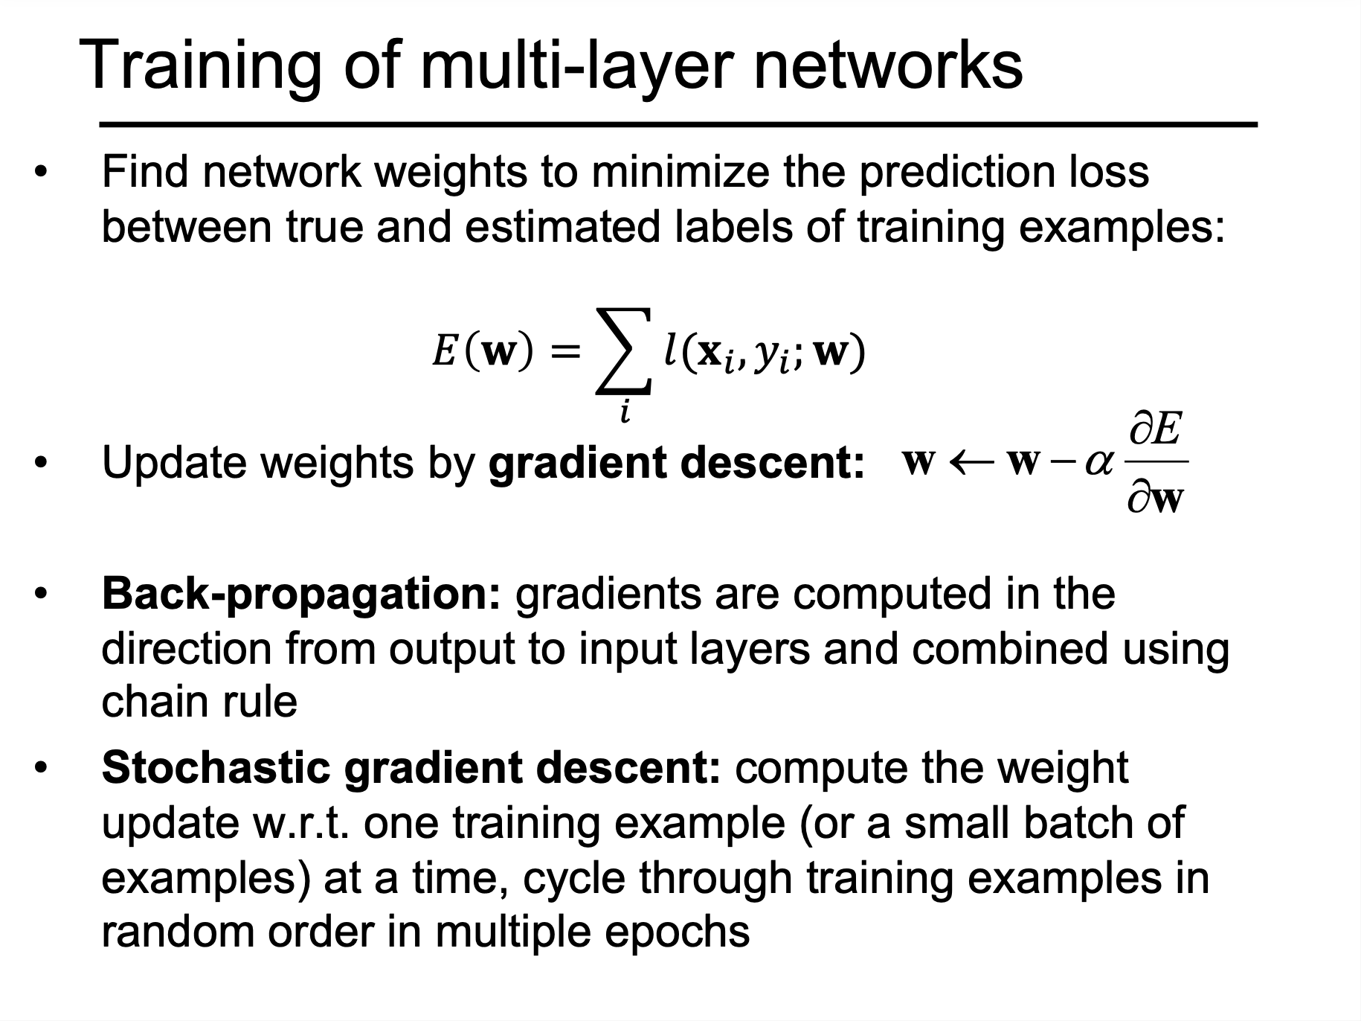

Slide 17
Slides: https://cs231n.stanford.edu/slides/2016/winter1516_lecture7.pdf

Slide 35
SincNet

Slide 36
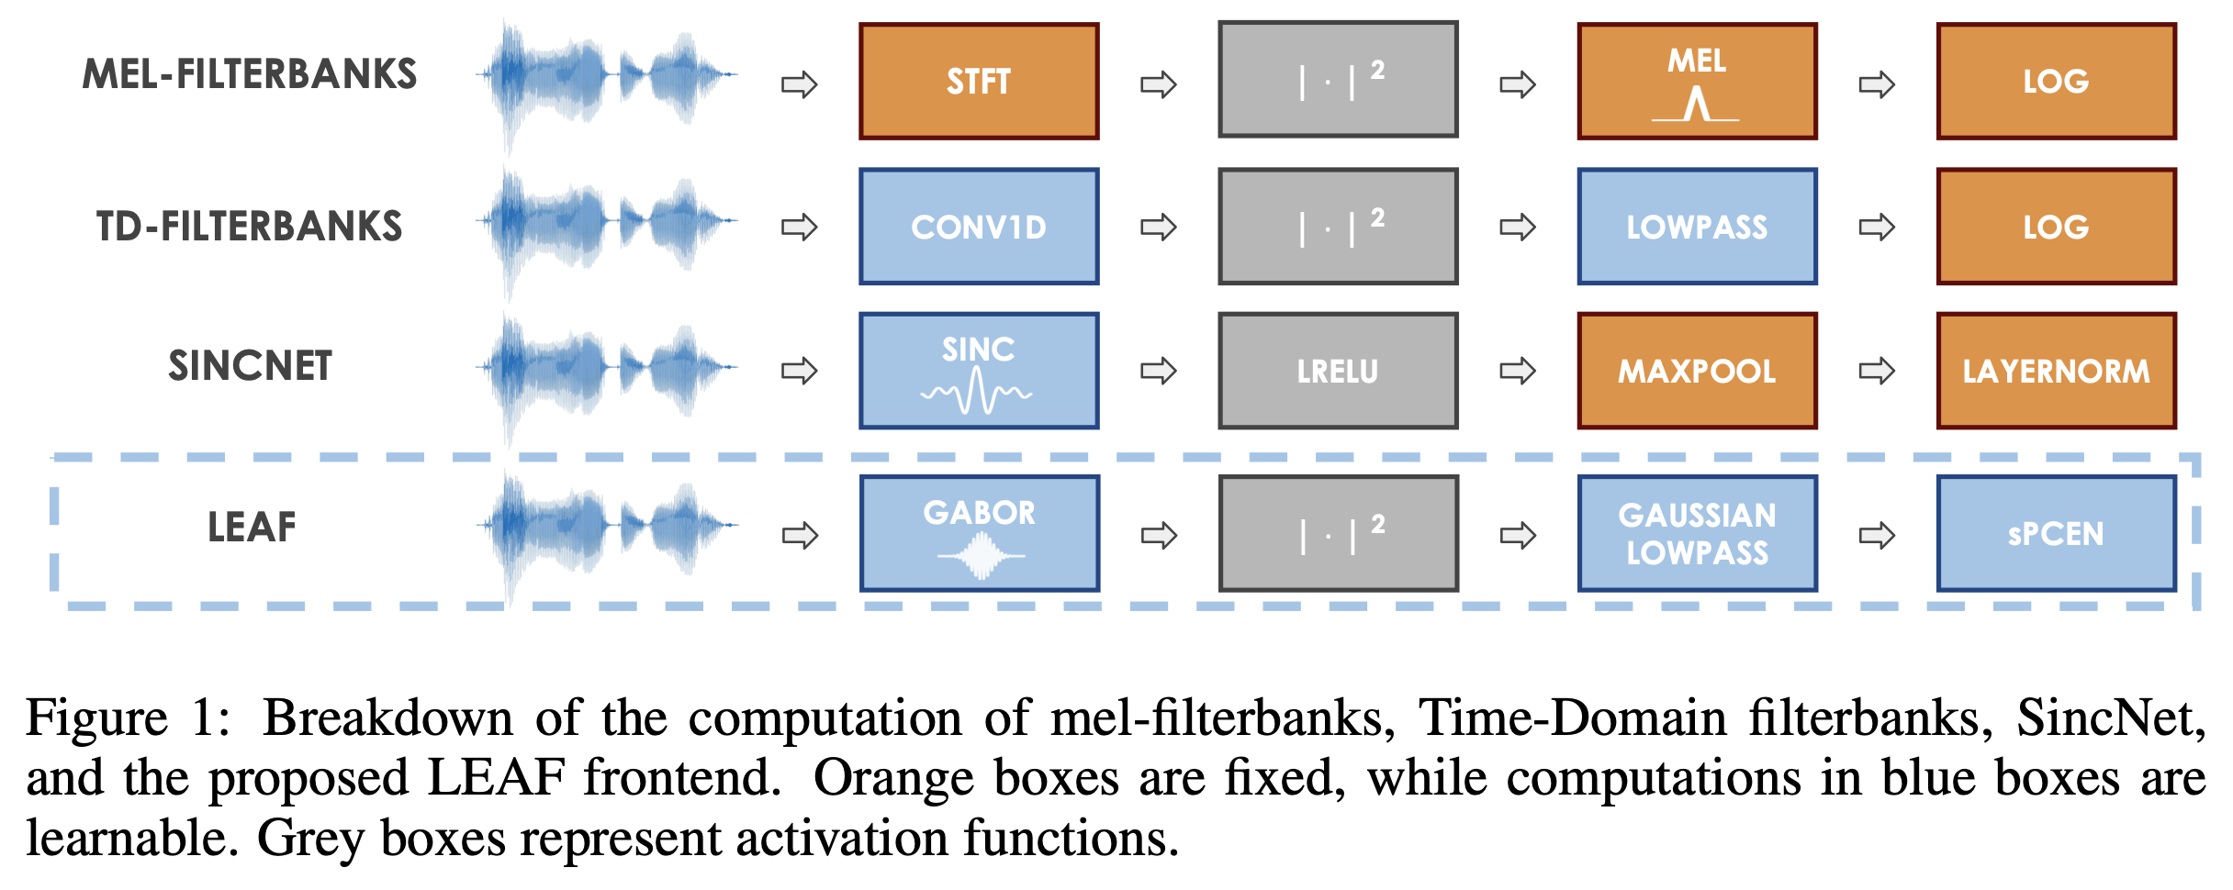
Learnable modules

Slide 37
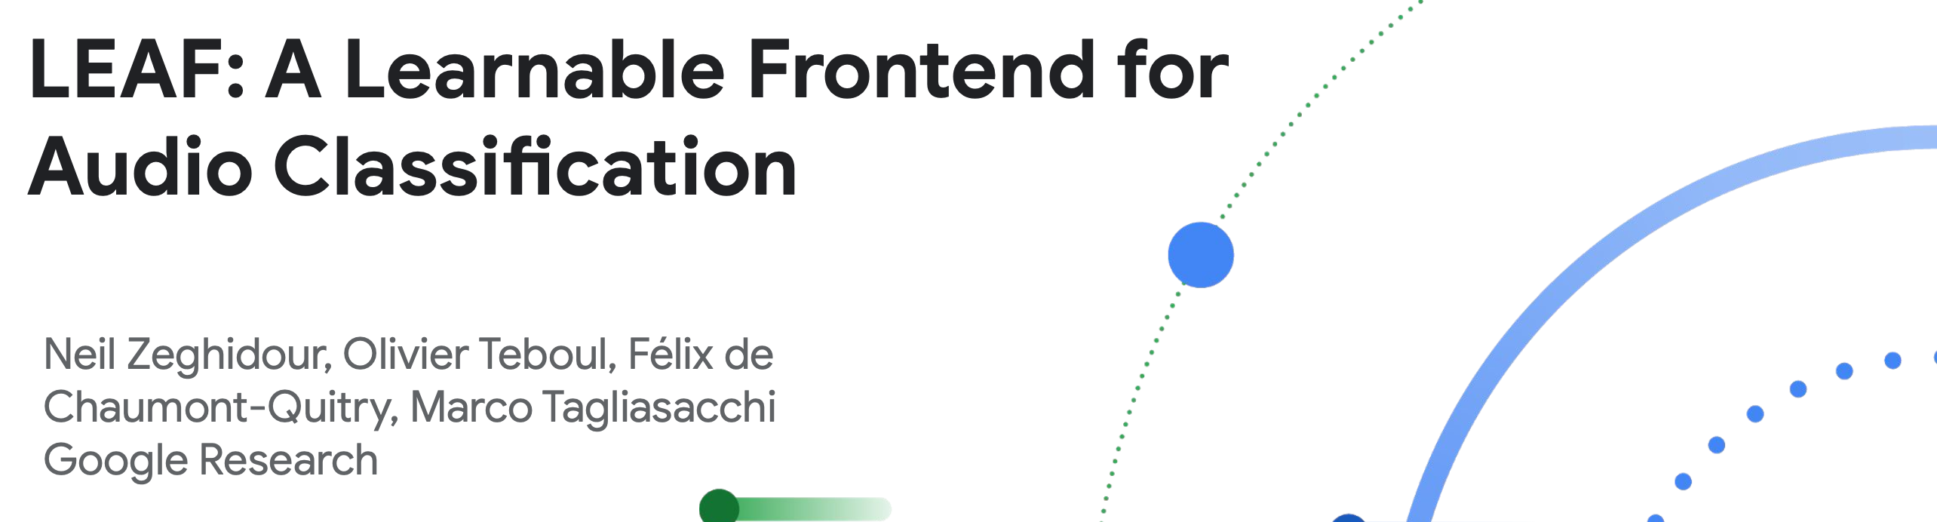
Questioning the standards
ICLR 2021
Paper: https://arxiv.org/pdf/2101.08596

Slide 38


Application: Classification
Classifier
“Dog”
Classifier
“Dog”

Slide 39
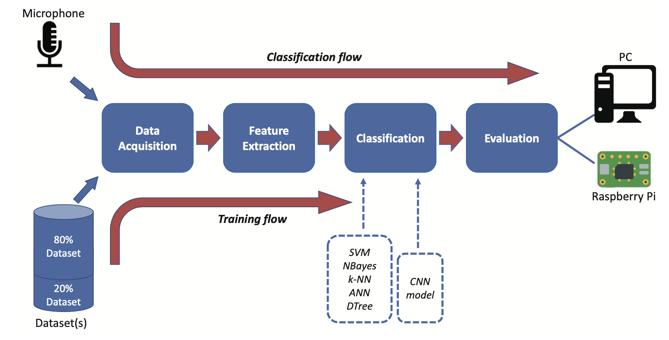
Audio Classification Steps

Slide 40
Zero-Crossing Rate (ZCR) – counts how often the signal crosses zero.
Short-Time Energy – total signal energy in a frame (loudness).
RMS Amplitude – average signal power measure.
Autocorrelation – detects periodicity and pitch.
Temporal Moments – mean/variance/skewness of waveform shape.
AMDF – pitch estimation via average magnitude differences.
Rise/Attack/Decay Times – capture onset and offset dynamics.
Temporal Centroid – center of gravity of signal energy in time.
Envelope Features – smoothed amplitude curve of signal.
Cepstrum (time-domain view) – captures pitch and vocal tract characteristics.
Time domain features
Spectral Centroid – weighted average frequency (brightness)
Spectral Bandwidth – spread of spectrum around the centroid
Spectral Rolloff – frequency below which most energy lies
Spectral Flux – frame-to-frame change in the spectrum
Spectral Flatness – how noise-like vs. tone-like the spectrum is
Spectral Contrast – difference between peaks and valleys across bands
Fundamental Frequency (F0) – lowest frequency, perceived as pitch
Harmonic-to-Noise Ratio – balance between harmonic and noise energy
Formant Frequencies – resonant peaks in speech/instrument sounds
MFCCs – compressed spectral features modeled after human hearing
Freq. domain features

Slide 41
Zero-Crossing Rate (ZCR) – counts how often the signal crosses zero.
Short-Time Energy – total signal energy in a frame (loudness).
RMS Amplitude – average signal power measure.
Autocorrelation – detects periodicity and pitch.
Temporal Moments – mean/variance/skewness of waveform shape.
AMDF – pitch estimation via average magnitude differences.
Rise/Attack/Decay Times – capture onset and offset dynamics.
Temporal Centroid – center of gravity of signal energy in time.
Envelope Features – smoothed amplitude curve of signal.
Cepstrum (time-domain view) – captures pitch and vocal tract characteristics.
Time domain features
Spectral Centroid – weighted average frequency (brightness)
Spectral Bandwidth – spread of spectrum around the centroid
Spectral Rolloff – frequency below which most energy lies
Spectral Flux – frame-to-frame change in the spectrum
Spectral Flatness – how noise-like vs. tone-like the spectrum is
Spectral Contrast – difference between peaks and valleys across bands
Fundamental Frequency (F0) – lowest frequency, perceived as pitch
Harmonic-to-Noise Ratio – balance between harmonic and noise energy
Formant Frequencies – resonant peaks in speech/instrument sounds
MFCCs – compressed spectral features modeled after human hearing
Freq. domain features

Slide 42
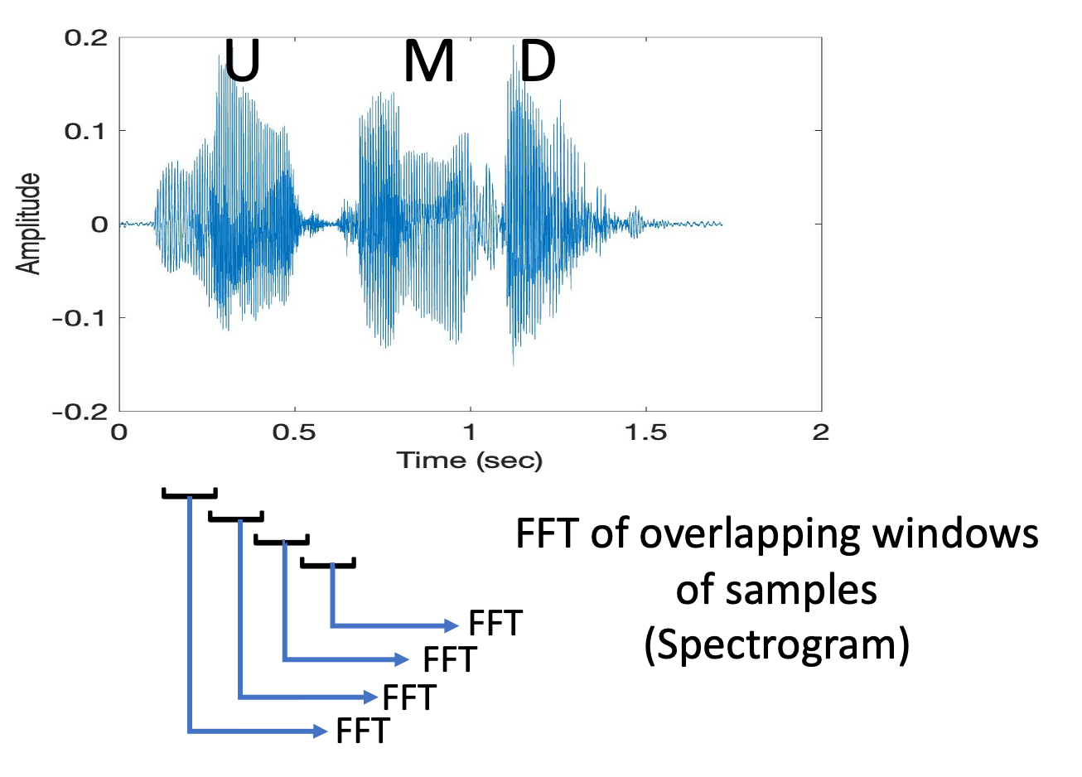
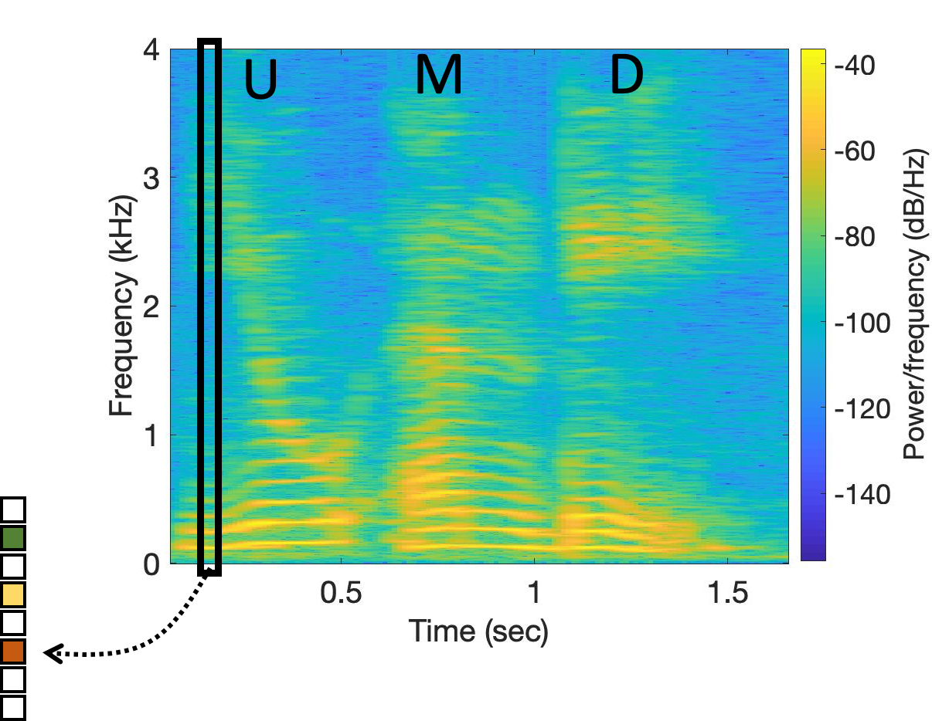
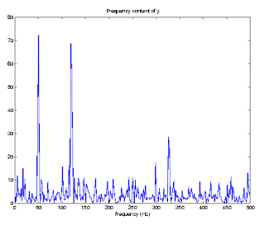
Short-Time Fourier Transform (STFT)
Spectrogram
Notes:
MFCC: https://medium.com/@MuhyEddin/feature-extraction-is-one-of-the-most-important-steps-in-developing-any-machine-learning-or-deep-94cf33a5dd46

Slide 43
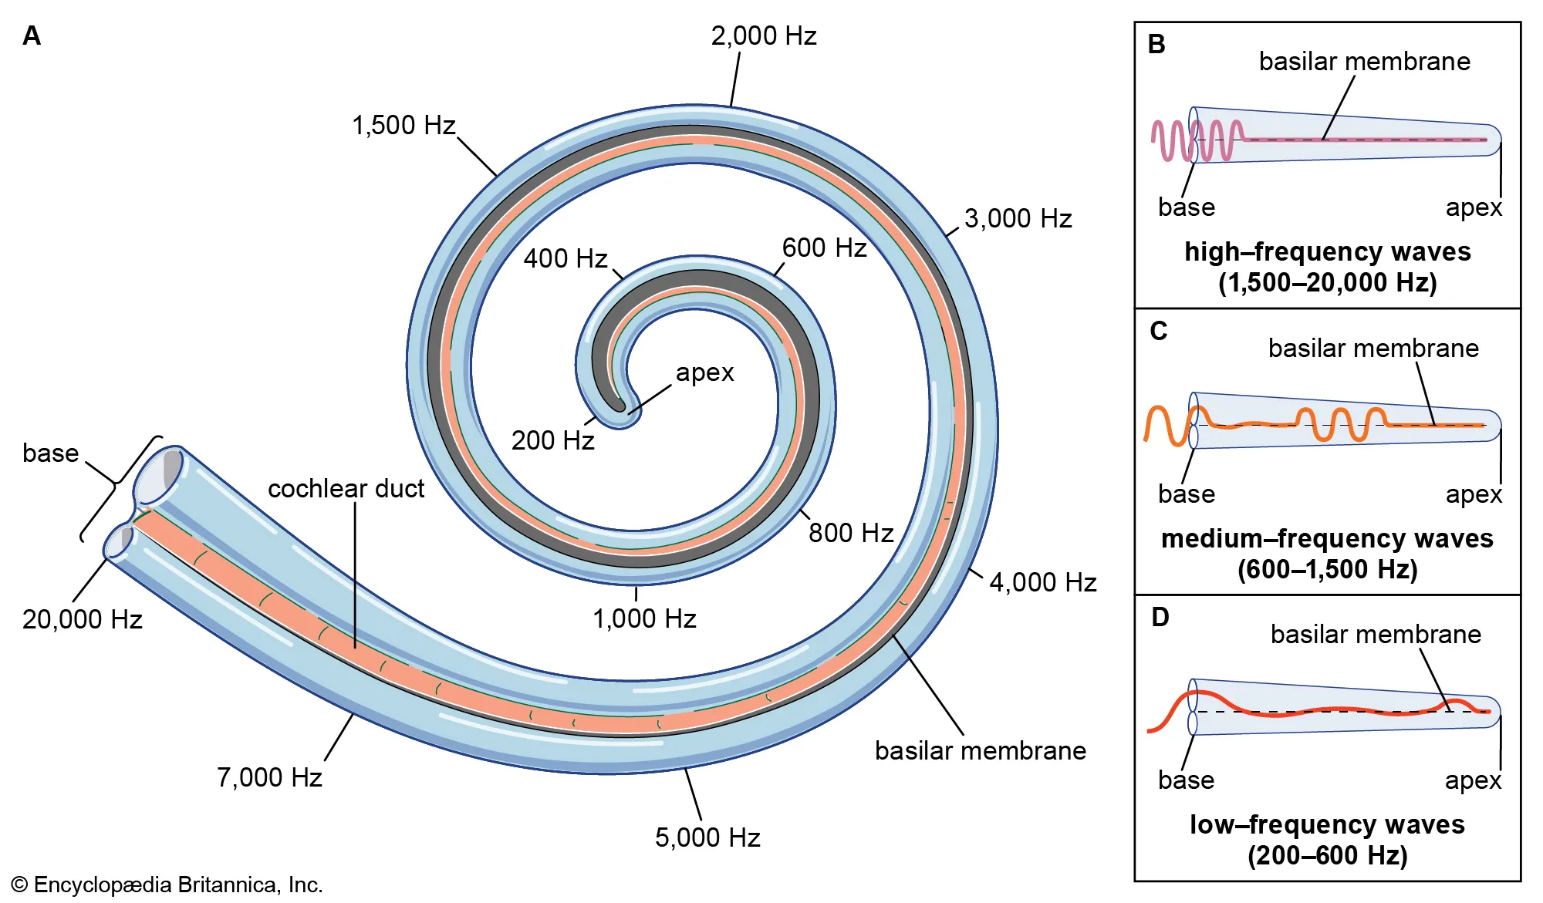
Mel-Frequency Cepstral Coefficients (MFCC)
Mel == Melody
(1) The human ear doesn’t perceive frequency linearly.
(2) We are more sensitive to low-frequency changes (e.g., distinguishing
500 Hz vs. 600 Hz) than to high-frequency changes (e.g., 5000 Hz vs.
5100 Hz).
(3) This comes from the basilar membrane in the cochlea, where spacing
of hair cells produces a nonlinear frequency resolution.
Notes:
MFCC: https://medium.com/@MuhyEddin/feature-extraction-is-one-of-the-most-important-steps-in-developing-any-machine-learning-or-deep-94cf33a5dd46

Slide 44
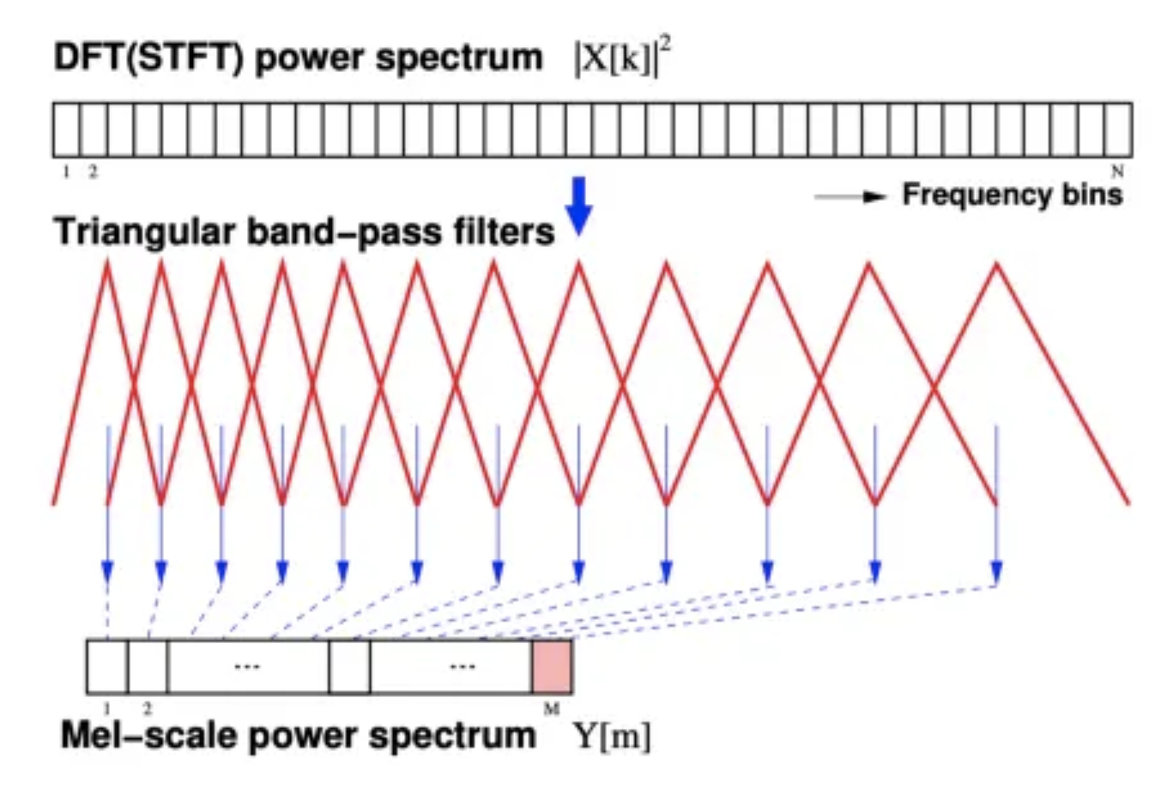
Mel-Frequency Cepstral Coefficients (MFCC)

Slide 45
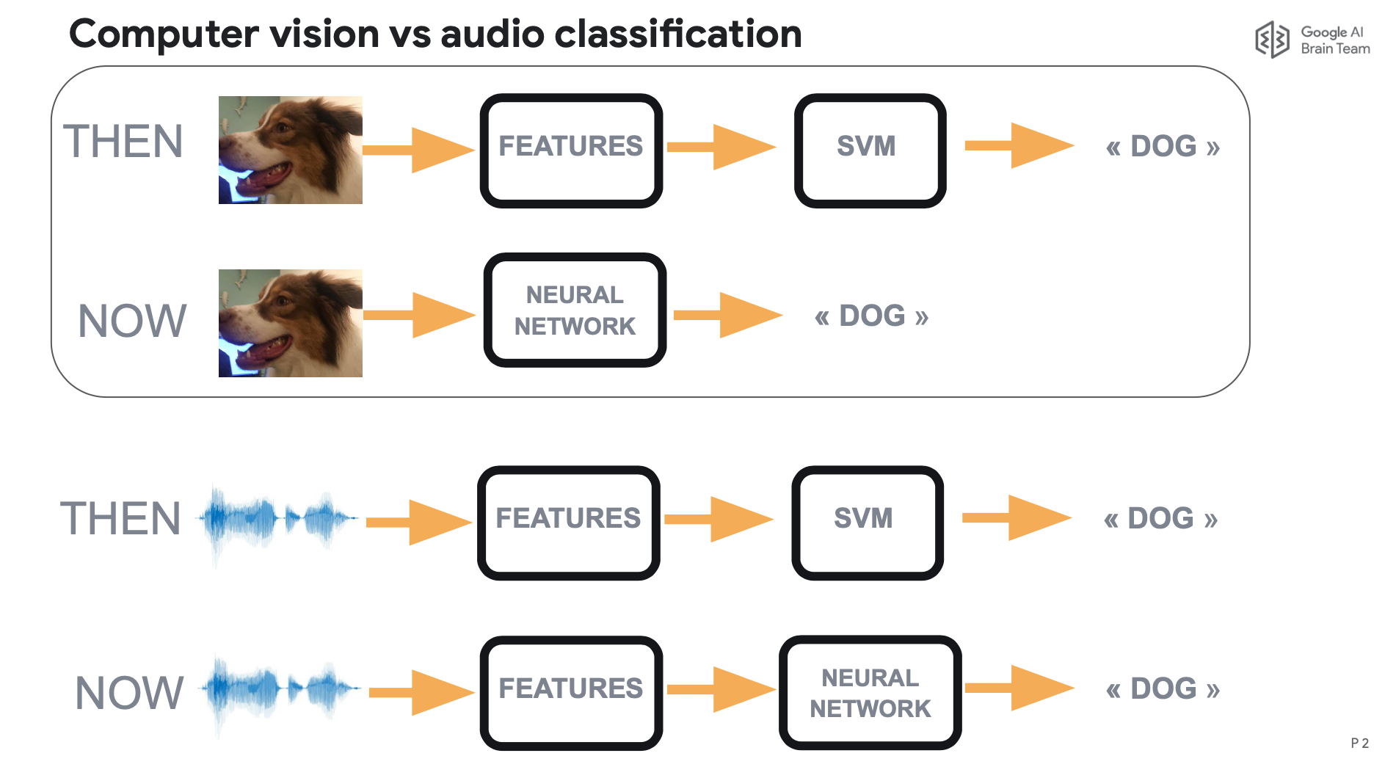
Evolution of Classification Architecture

Slide 46
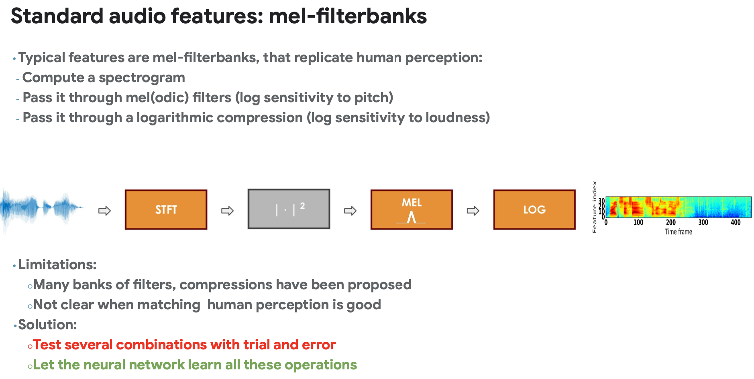

Slide 47



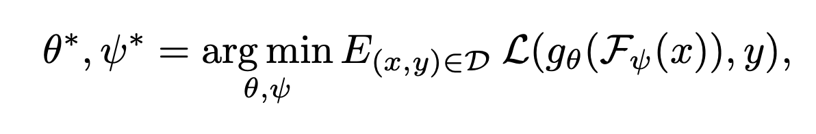
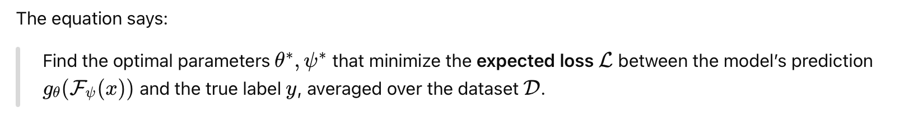
LEAF: A LEarnable Audio Frontend
= one-dimensional waveform of T samples
sampling frequency F_{s}
= Replaces MFCC
= The main model (e.g., classifier)

Slide 48
Learnable modules

Slide 49
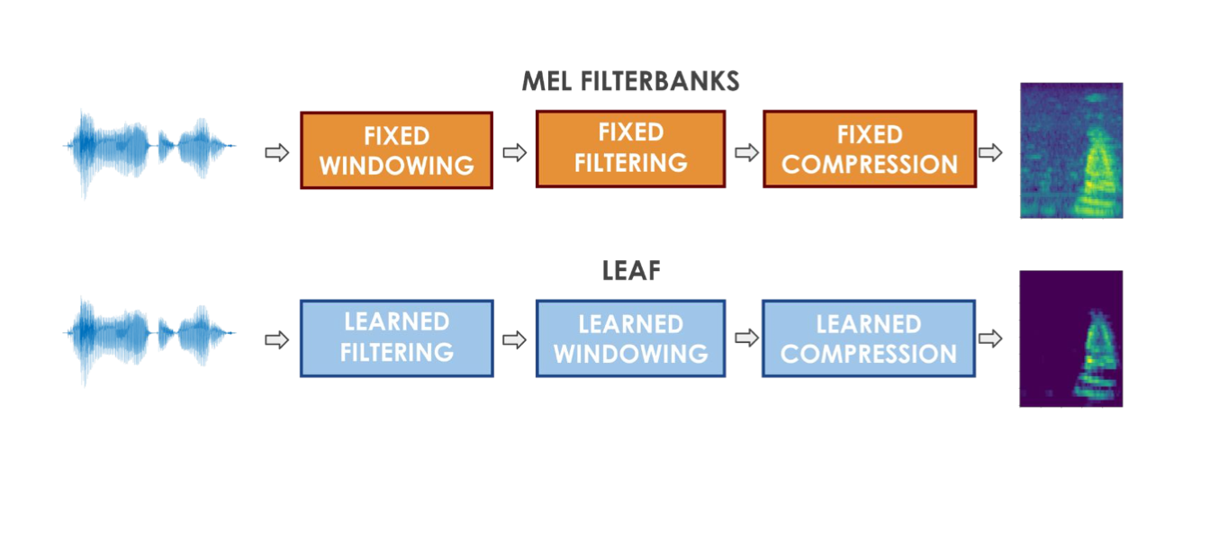
LEAF: A LEarnable Audio Frontend

Slide 50
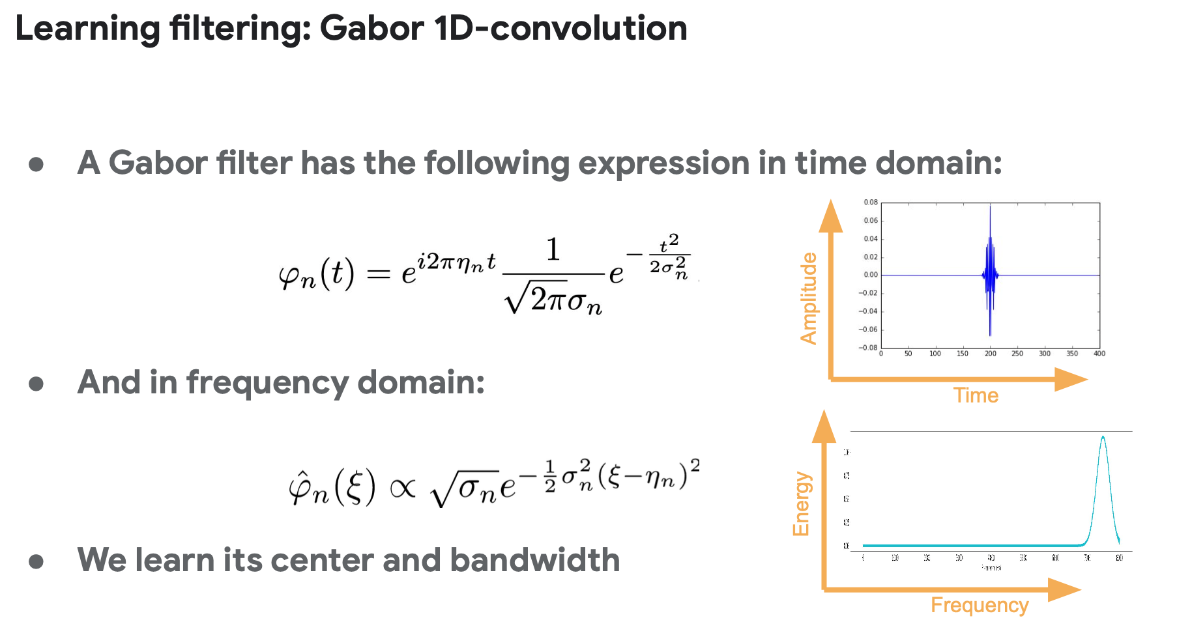

Slide 51
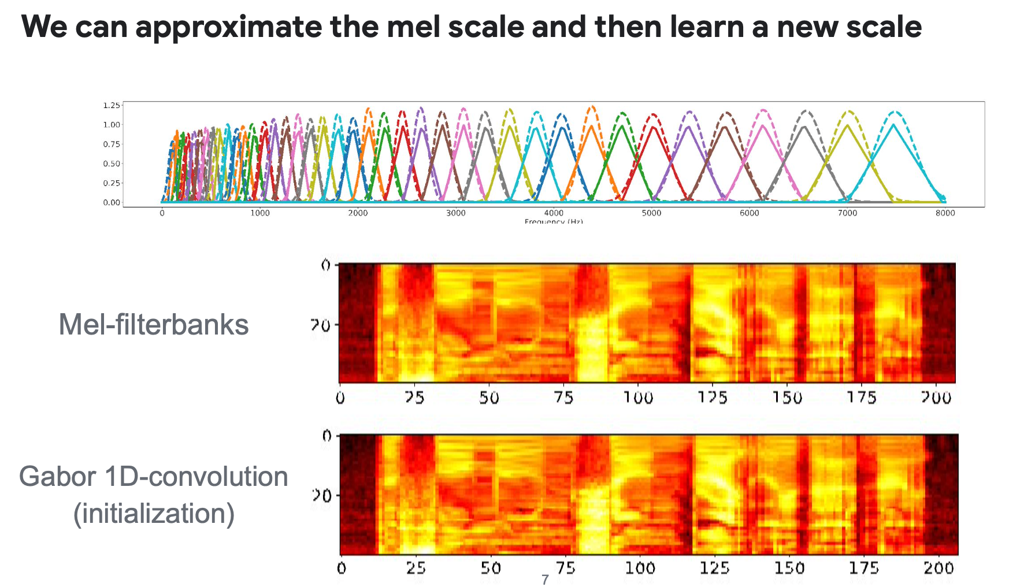

Slide 52
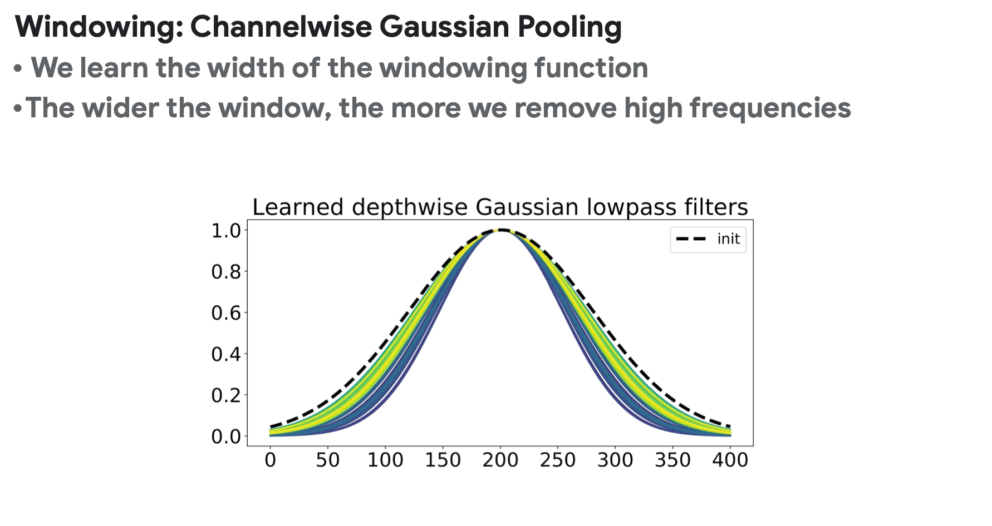

Slide 53
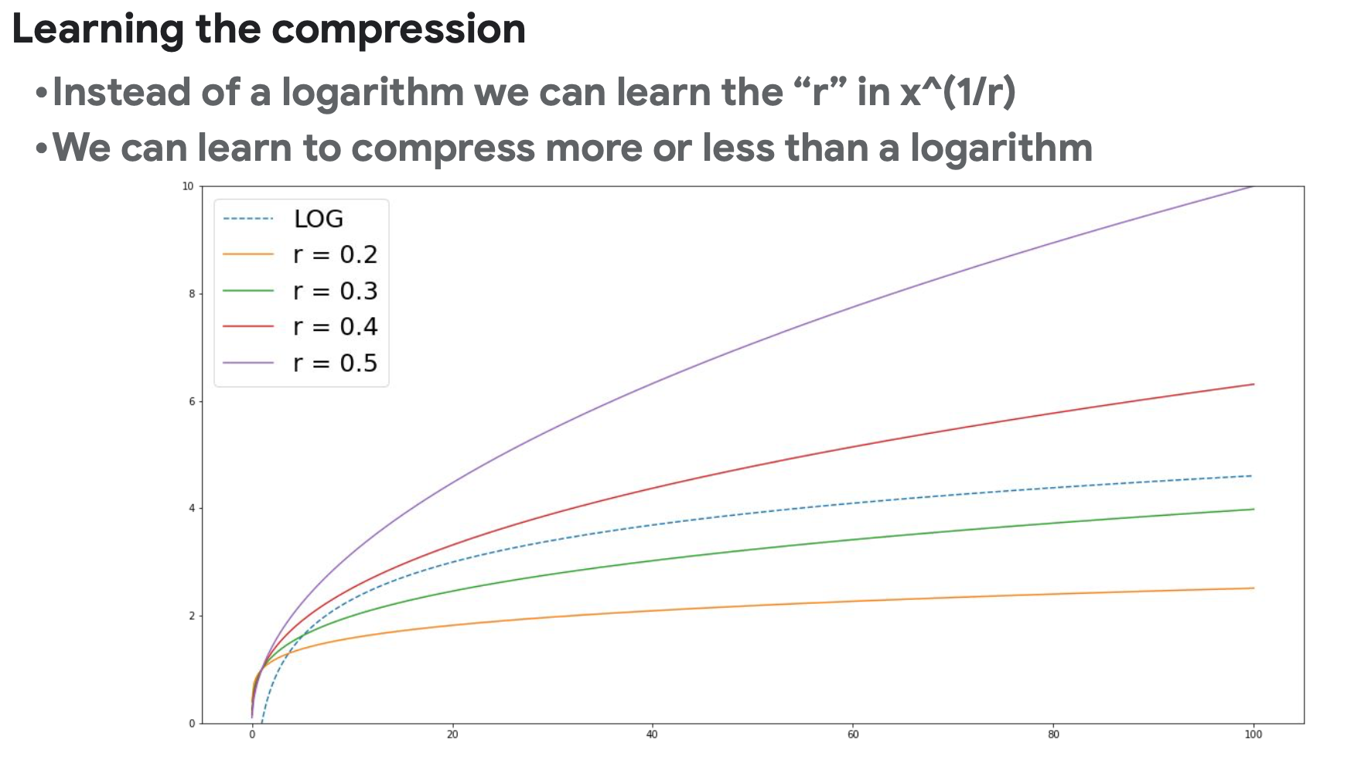

Slide 54
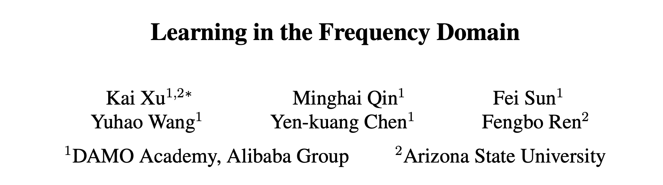
https://arxiv.org/pdf/2002.12416
CVPR 2020

Slide 55
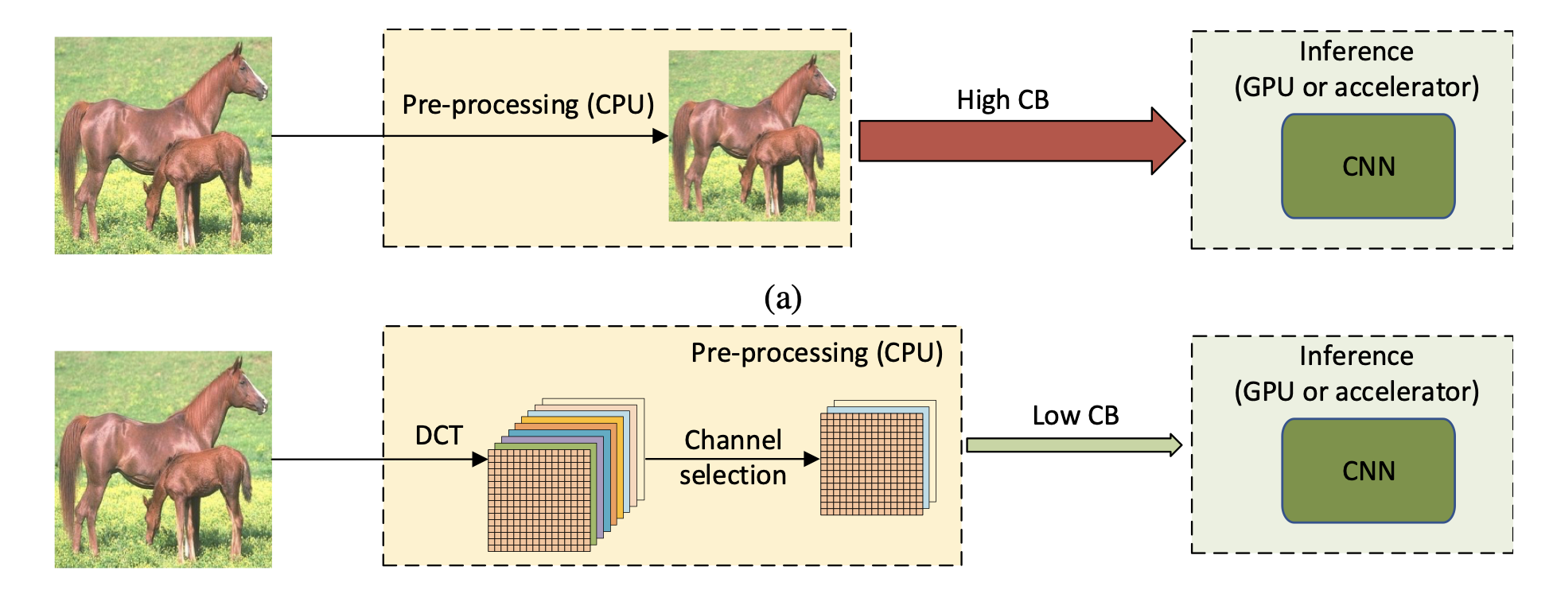

Slide 56
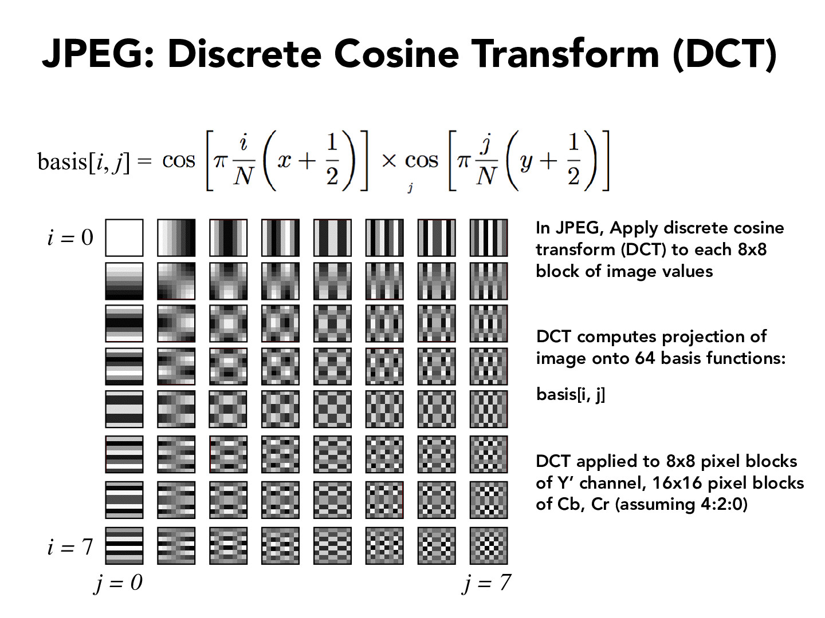

Slide 57
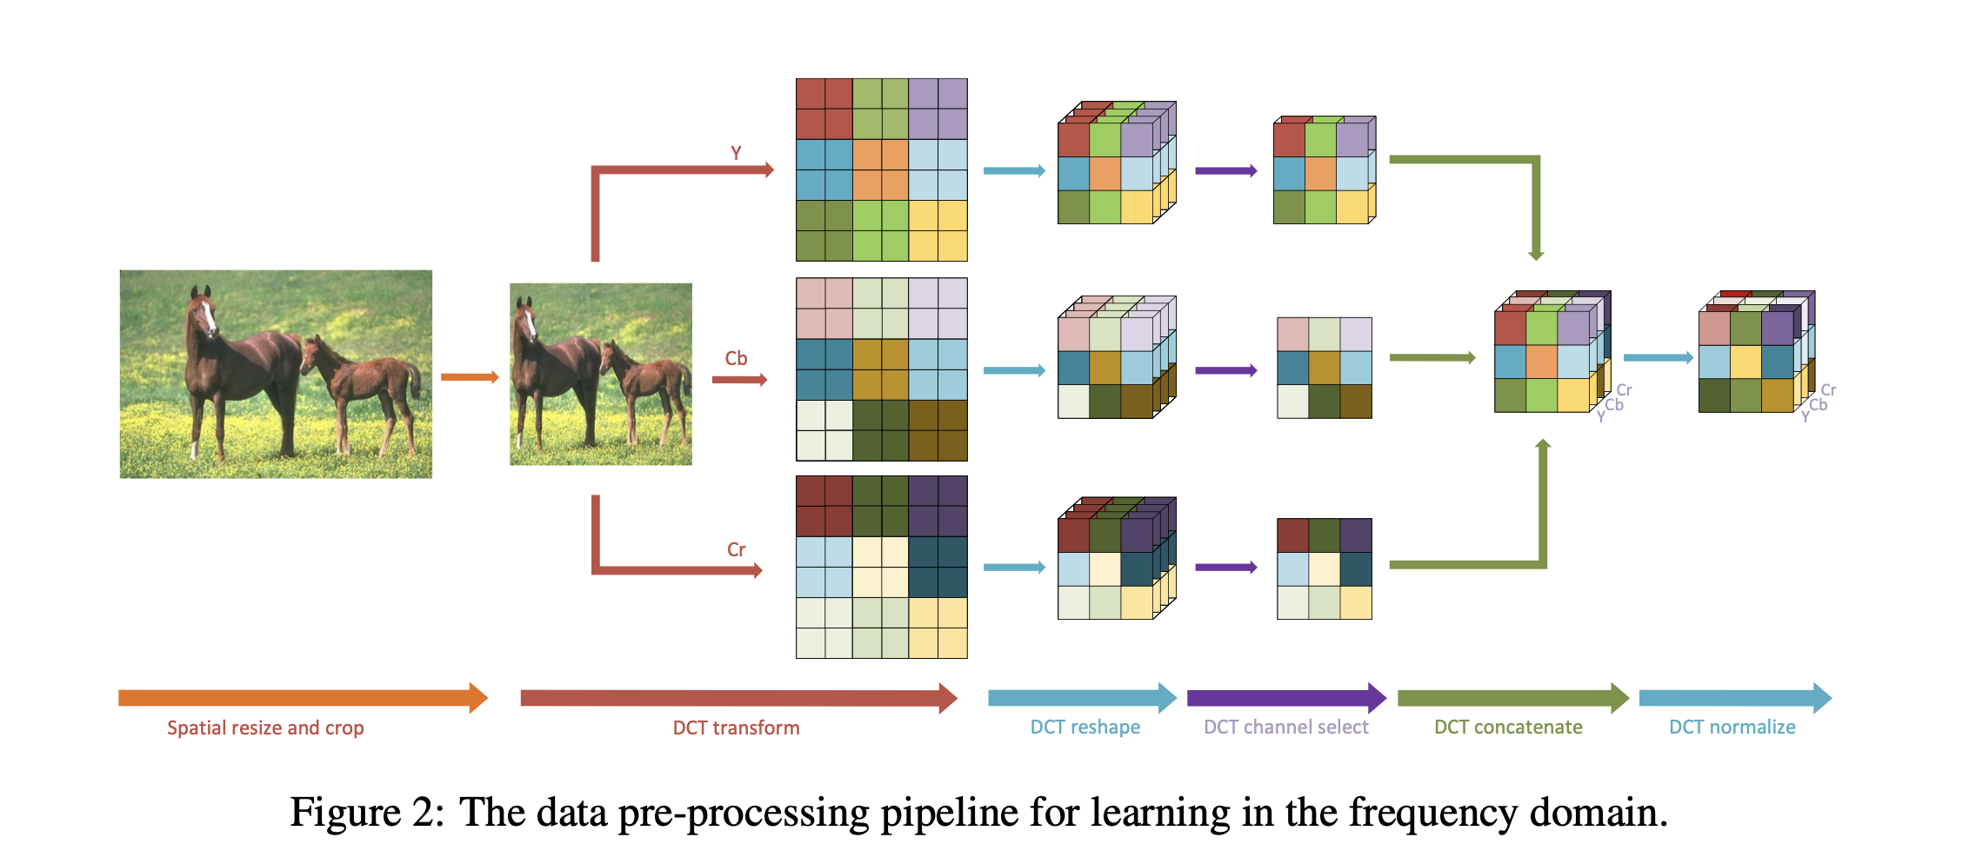

Slide 58
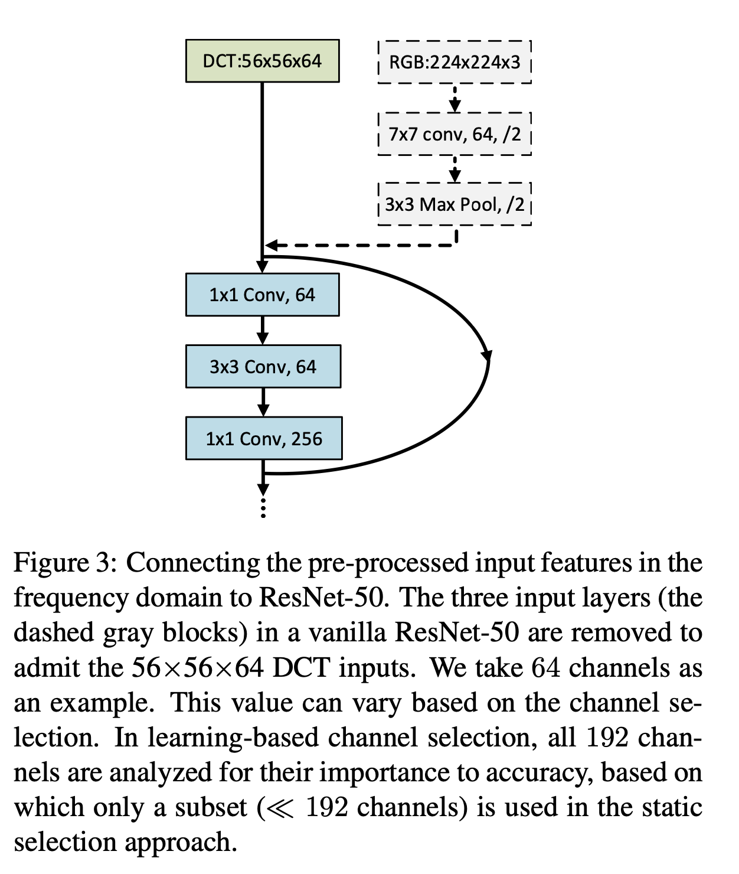

Slide 59
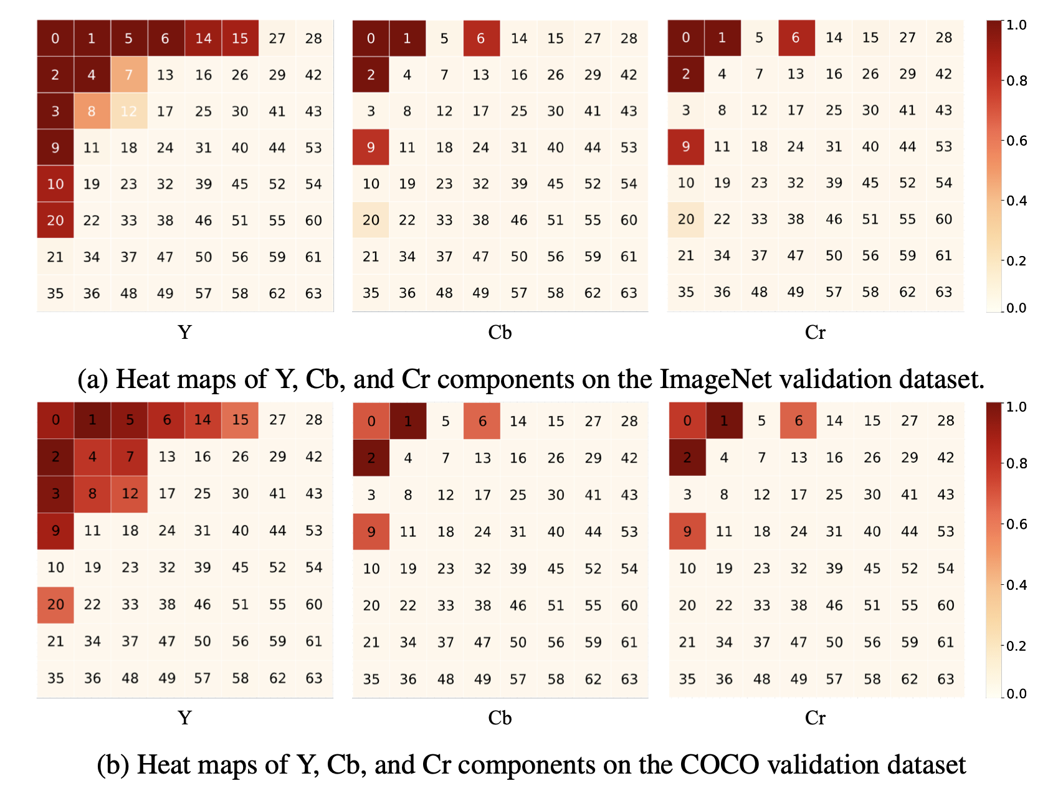

Slide 60
Extra Slides

