Slide 1

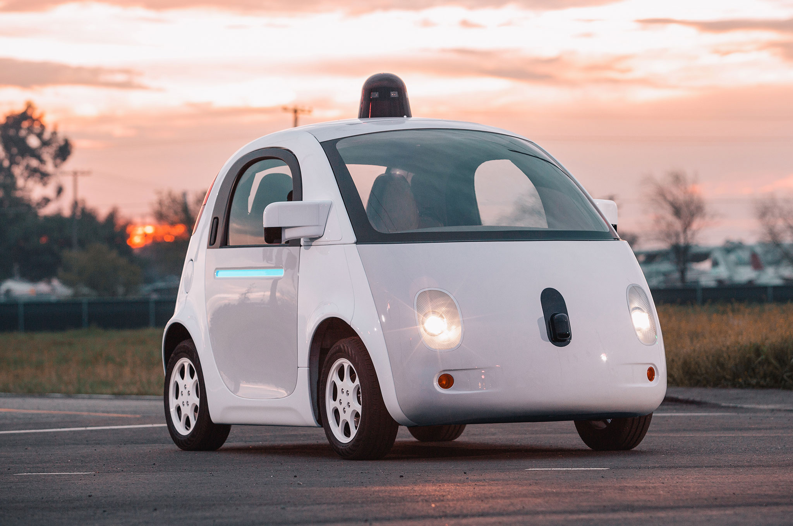

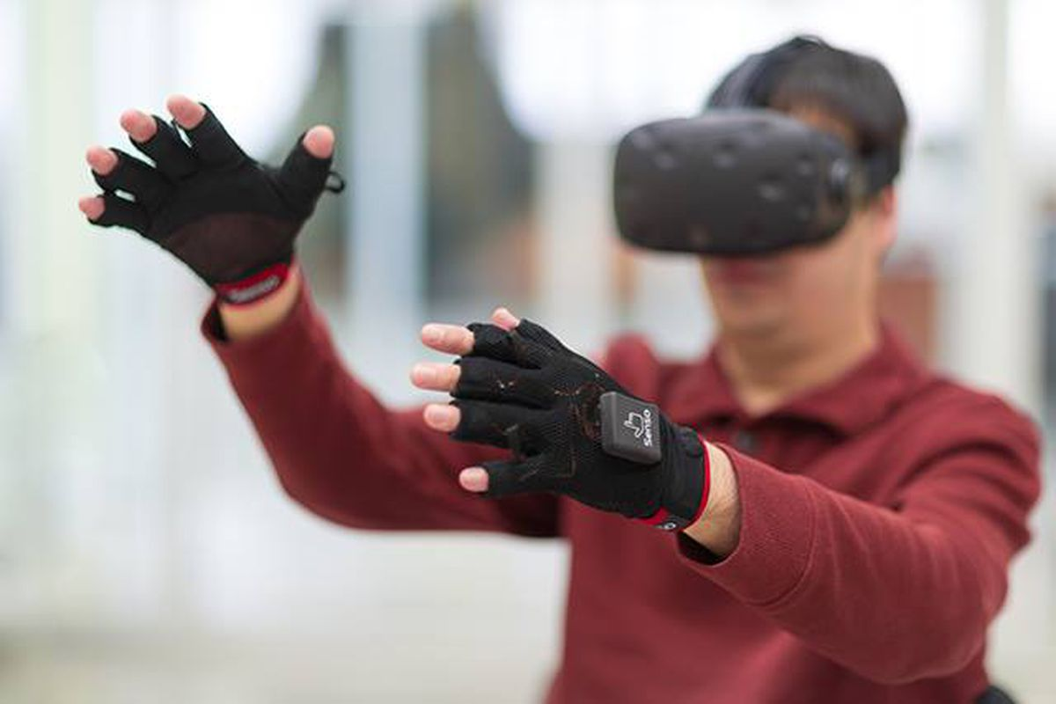

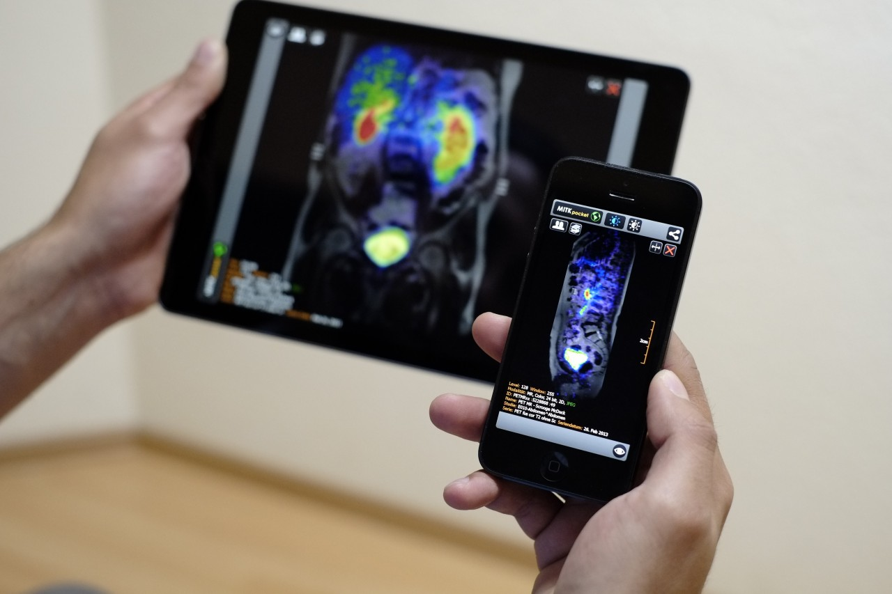
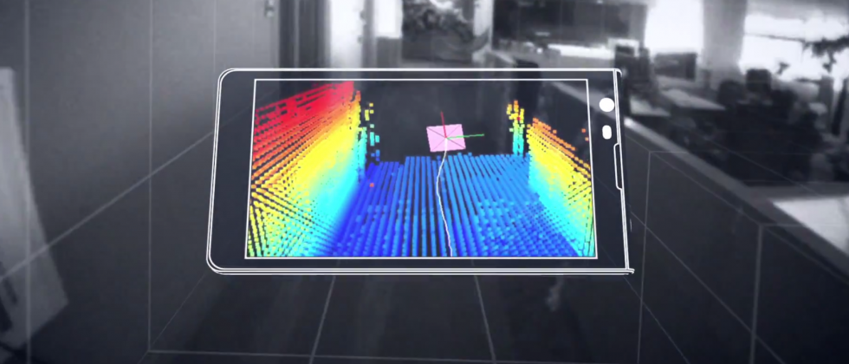

Machine Learning for Physical Sensing & Perception
CMSC 818V : Fall 2025
Lecture 2_2: Inverse problems: Spatial Perception
Nirupam Roy
Tu-Th 3:30 – 4:45pm
IRB 1207

Slide 2
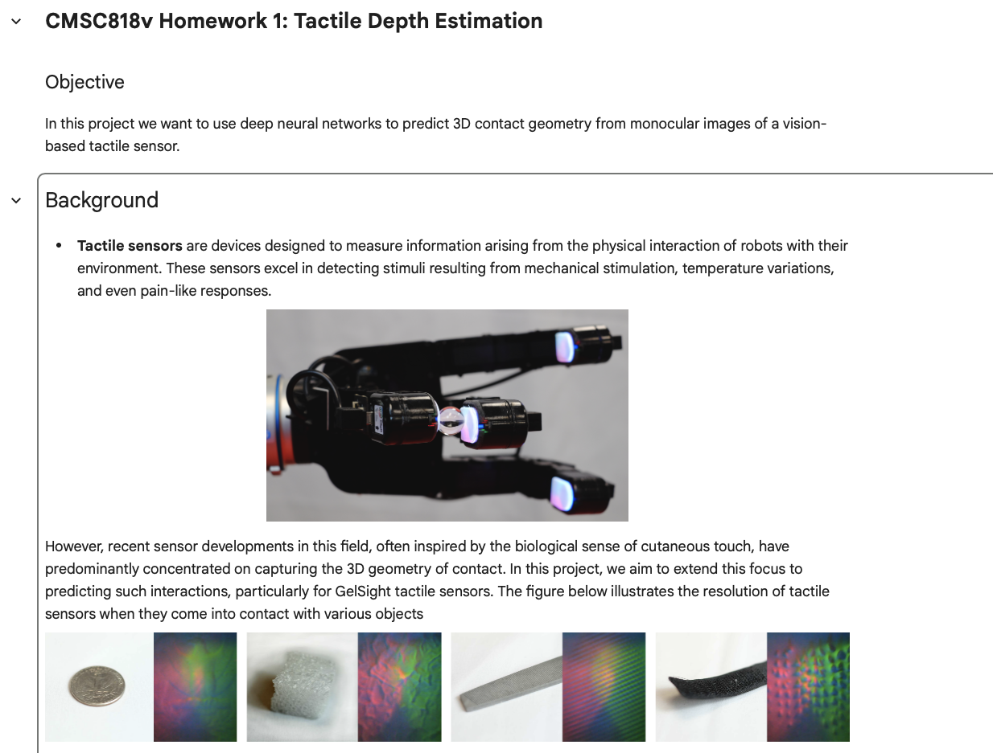
Announcement - 1
Programming Homework: Due 20th

Slide 3
Announcement - 2
Project proposal: Due 16th
Not graded, but I will read and give feedback.
One or a few paragraphs of project description.
Keeps the project on track.

Slide 4
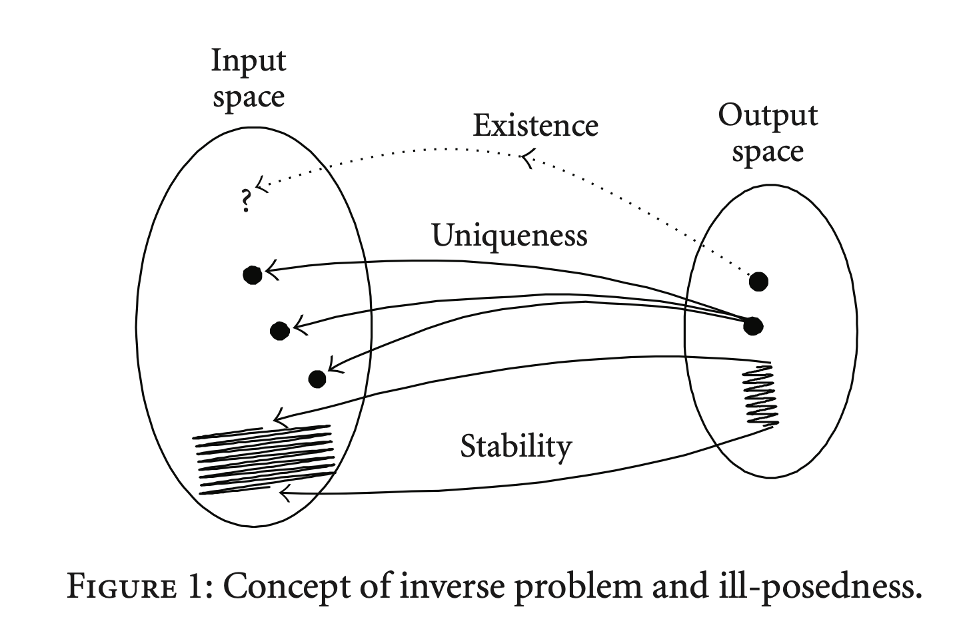
Inverse problem
Notes:
https://www.researchgate.net/publication/46401997_Solution_for_Ill-Posed_Inverse_Kinematics_of_Robot_Arm_by_Network_Inversion

Slide 5
Inverse problem: Sensing with Multiple Sensors
s(t)
Channel
x(t)

Slide 6
Inverse problem: Sensing with Multiple Sensors
Channel
x(t) = a. s(t)
s(t)
(a)

Slide 7
Inverse problem: Sensing with Multiple Sensors
Channel
x(t) = a. s(t)
+ n(t)
s(t)
(a)

Slide 8
Inverse problem: Sensing with Multiple Sensors
Channel
a₁. s₁(t)
+ n₁(t)
s₁(t)
(a₁)
Channel
a₂. s₂(t)
+ n₂(t)
s₂(t)
(a₂)
…
Channel
a_{M}. s_{M}(t)
+ n_{M}(t)
s_{M}(t)
(a_{M})

Slide 9
Inverse problem: Sensing with Multiple Sensors
Channel
a₁. s₁(t)
+ n₁(t)
s₁(t)
(a₁)
Channel
a₂. s₂(t)
+ n₂(t)
s₂(t)
(a₂)
…
Channel
a_{M}. s_{M}(t)
+ n_{M}(t)
s_{M}(t)
(a_{M})
X(t) = A S(t) + N(t)

Slide 10
Inverse problem: Sensing with Multiple Sensors
Forward Model
Channel
a₁.s₁(t)
+ n₁(t)
s₁(t)
(a₁)
Channel
a₂. s₂(t)
+ n₂(t)
s₂(t)
(a₂)
…
Channel
a_{M}. s_{M}(t)
+ n_{M}(t)
s_{M}(t)
(a_{M})
X(t) = A S(t) + N(t)

Slide 11
Inverse problem: Sensing with Multiple Sensors
Consider a simple forward model: a_{m} = 1
Channel
a₁. s₁(t)
+ n₁(t)
s₁(t)
(a₁ = 1)
Channel
a₂. s₂(t)
+ n₂(t)
s₂(t)
(a₂ = 1)
…
Channel
a_{M}. s_{M}(t)
+ n_{M}(t)
s_{M}(t)
(a_{M} = 1)
X(t) = A S(t) + N(t)

Slide 12

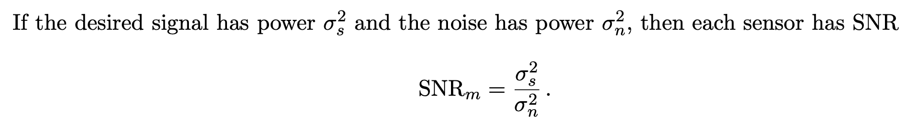
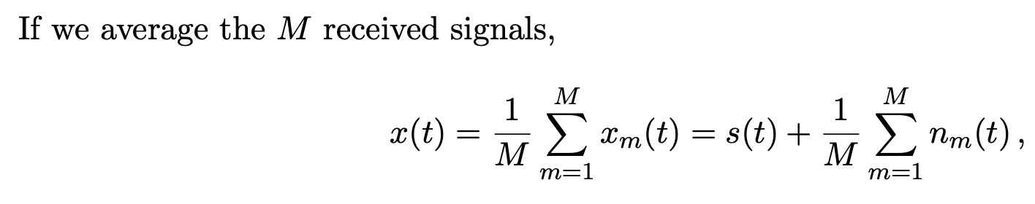
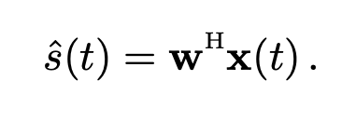
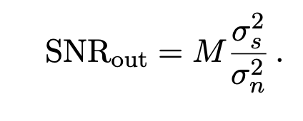
Inverse problem: Sensing with Multiple Sensors
Inverse solution (weighted average) =
Resulting in gain in signal power:
Notes:
W is known as beamformer.

Slide 13
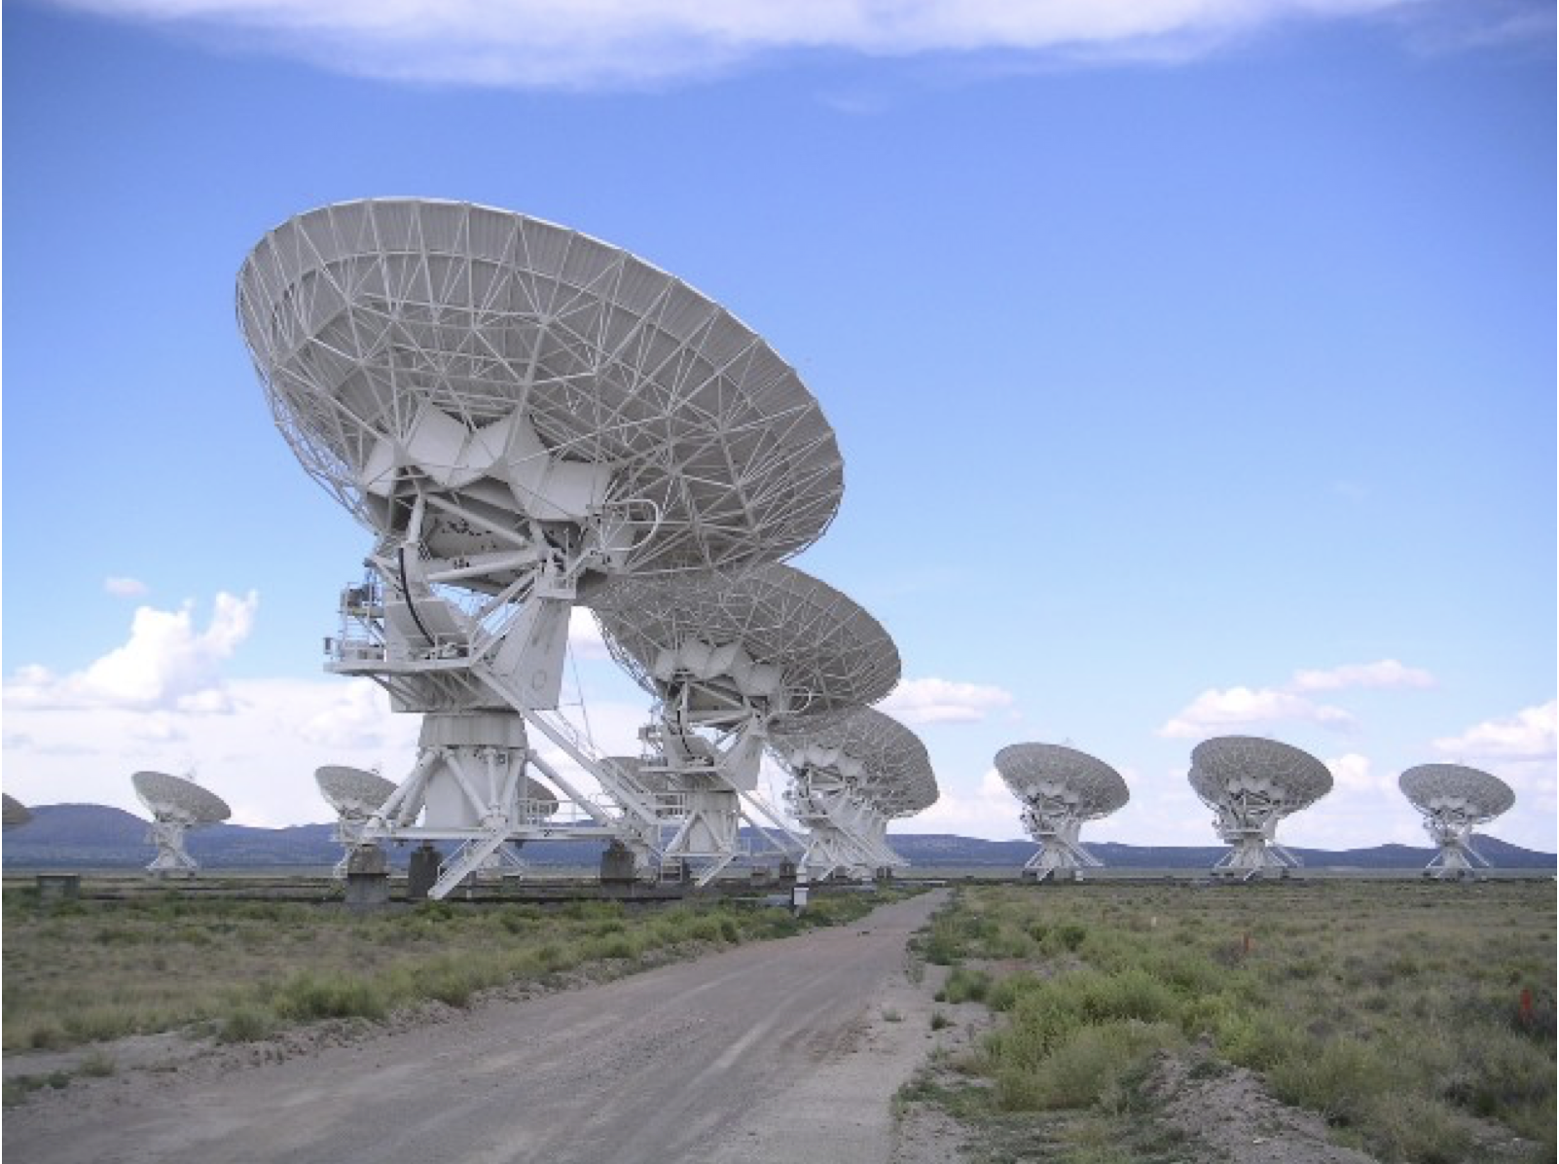
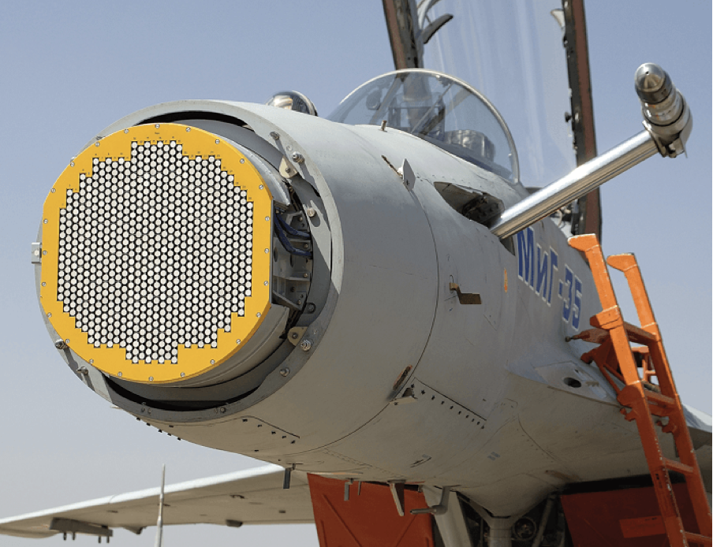
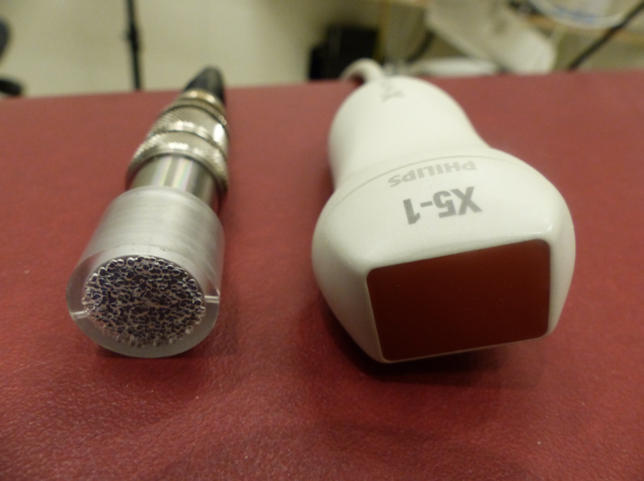
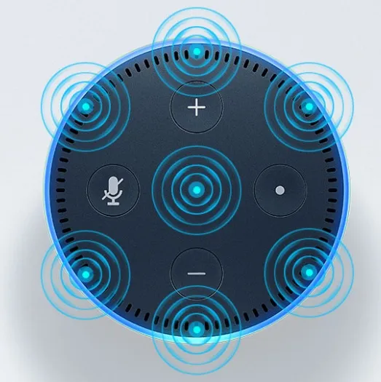
Sensor arrays are complex and everywhere

Slide 14
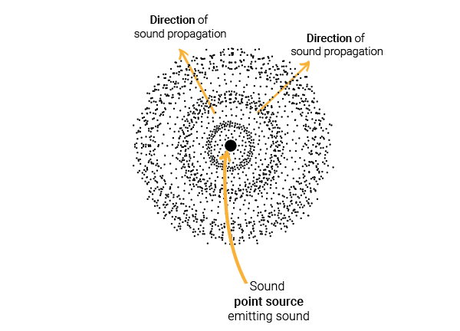
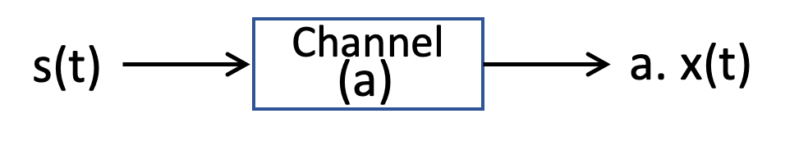
Wavefields and Sensor Array

Slide 15
Waves

Slide 16
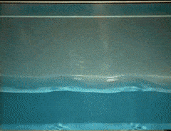
Waves: Transfer of energy, not mass

Slide 17
Sound
Visible light
Physical vibrations
WiFi signal
Ripples in water
Infrared
…
…

Slide 18
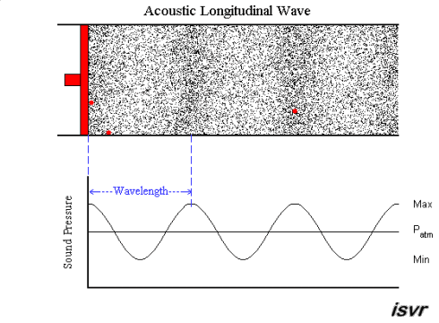
Mechanical Wave
Electromagnetic Wave
Sound
Visible light
Physical vibrations
WiFi signal
Ripples in water
Infrared
…
…

Slide 19

Waves in time and space

Slide 20
Waves in time and space
Temporal variation of the wave’s amplitude

Slide 21
Waves in time and space

Slide 22
Waves in time and space

Slide 23
Waves in time and space

Slide 24
Waves in time and space

Slide 25
Waves in time and space

Slide 26
Waves in time and space

Slide 27
Sensing Signal in Time & Space

Slide 28
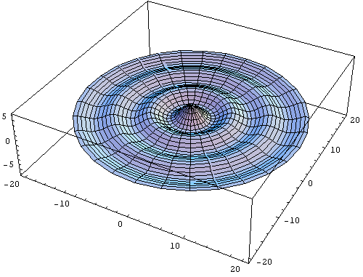

Slide 29
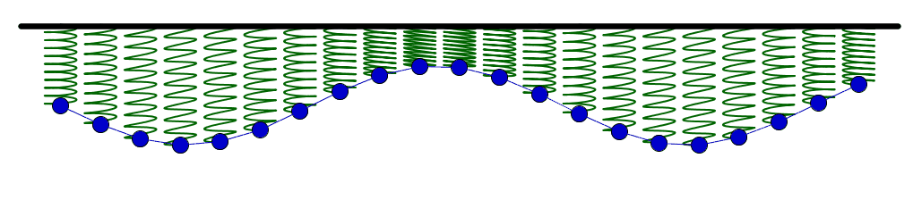

Slide 31
Cycles per sec = frequency = f Hz
Distance per cycle = wavelength = λ meters
Distance per second = speed = C meters/sec

Slide 32
Equation of waves in time and space

Slide 33
Equation of waves in time and space

Slide 34

Equation of waves in time and space

Slide 35
Equation of waves in time and space

Slide 36


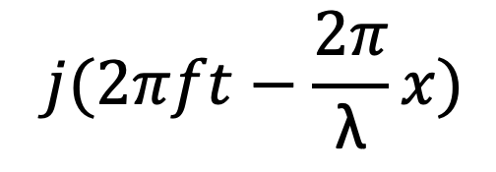
Equation of waves in time and space
$$time (t)$$
$$⁡j(2πft−\frac{2π}{\text{λ}}x)$$
$$e$$

Slide 37

Equation of waves in time and space
$$time (t)$$
$$space (x)$$

Slide 38

Equation of waves in time and space
$$time (t)$$
$$space (x)$$

Slide 39
Equation of waves in time and space
$$distance from the source (x)$$
$$space$$

Slide 40
Equation of waves in time and space
Amplitude here
$$distance from the source (x)$$
$$space$$
is a delayed version of
the amplitude here.

Slide 41
Equation of waves in time and space
Amplitude here
$$distance from the source (x)$$
$$space$$
is a delayed version of
the amplitude here.

Slide 42
Equation of waves in time and space
Amplitude here
The delay depends
on the distance.
$$distance from the source (x)$$
$$space$$
is a delayed version of
the amplitude here.

Slide 43
Equation of waves in time and space
Amplitude here
The delay depends
on the distance.
$$distance from the source (x)$$
$$space$$
is a delayed version of
the amplitude here.
$$A . sin⁡(\frac{2π}{T}t)$$
$Ψ$(t)
$$=$$
$$A . sin⁡(2πft)$$
$$=$$

Slide 44
Equation of waves in time and space
Amplitude here
The delay depends
on the distance.
$$distance from the source (x)$$
$$space$$
is a delayed version of
the amplitude here.
$Ψ$(t, x)
$$=$$
$$A . sin⁡(2πft−θ(x))$$
Why is this negative?

Slide 45
Equation of waves in time and space
$wavelength$ = λ
$$distance from the source (x)$$
$$space$$
$Ψ$(t, x)
$$=$$
$$A . sin⁡(2πft−θ(x))$$

Slide 46
Equation of waves in time and space
$wavelength$ = λ
$$f number of cycles per second$$
$$C meters of distance per second$$
$$(speed of the wave)$$
$distance per cycle=\text{λ}$ = $C$/ $f$

Slide 47
Equation of waves in time and space
$wavelength$ = λ
$$f number of cycles per second$$
$$C meters of distance per second$$
$$(speed of the wave)$$
$distance per cycle=\text{λ}$ = $C$/ $f$
$$2π radians of angle is covered per cycle$$

Slide 48
$wavelength$ = λ
Equation of waves in time and space
$$f number of cycles per second$$
$$C meters of distance per second$$
$$(speed of the wave)$$
$distance per cycle=\text{λ}$ = $C$/ $f$
$$2π radians of angle is covered per cycle$$
$$\frac{2π}{\text{λ}}radians of angle is covered per unit distance$$

Slide 49
Equation of waves in time and space
$wavelength$ = λ
$$distance from the source (x)$$
$$space$$
$Ψ$(t, x)
$$=$$
$$A . sin⁡(2πft−θ(x))$$

Slide 50
Equation of waves in time and space
$wavelength$ = λ
$$distance from the source (x)$$
$$space$$
$Ψ$(t, x)
$$=$$
$$A . sin⁡(2πft−θ(x))$$
$$A . sin⁡(2πft−\frac{2π}{\text{λ}}x)$$
$$=$$

Slide 51
Equation of waves in time and space
$wavelength$ = λ
$$distance from the source (x)$$
$$space$$
$Ψ$(t, x)
$$=$$
$$A . sin⁡(2πft−θ(x))$$
$$A . sin⁡(2πft−\frac{2π}{\text{λ}}x)$$
$$=$$
$$⁡j(2πft−\frac{2π}{\text{λ}}x)$$
$$A . e$$
$$=$$

Slide 52
Time and space
Cycles per sec = frequency = f Hz
Distance per cycle = wavelength = λ meters
Distance per second = speed = C meters/sec
C = f . λ
Speed of sound in air: 343 m/s
Speed of sound in water: 1493 m/s
Speed of sound in iron: 5130 m/s
Speed of electromagnetic waves: 3*10⁸ m/s
(~ a million times faster than sound)

Slide 53

Time and space
$$A . sin⁡(2πft)$$

Slide 54
Time and space
$$⁡j(2πft)$$
$$A . e$$

Slide 55
Time and space
Distance = d meter
$$⁡j(2πft)$$
$$A . e$$

Slide 56
Time and space
$$⁡j(2πft−\frac{2π}{\text{λ}}d)$$
$$A . e$$
Distance = d meter
$$⁡j(2πft)$$
$$A . e$$

Slide 57
Time and space
$$⁡j(2πft−\frac{2π}{\text{λ}}d)$$
$$A . e$$
d meter
$$⁡j(2πft−\frac{2π}{\text{λ}}d)$$
$$A . e$$
Distance = d meter
$$⁡j(2πft)$$
$$A . e$$

Slide 58
Time and space
$$⁡j(2πft−\frac{2π}{\text{λ}}d)$$
$$A . e$$
d meter
$$⁡j(2πft−\frac{2π}{\text{λ}}d)$$
$$A . e$$
Distance = d meter
$$⁡j(2πft)$$
$$A . e$$

Slide 59
Time and space
$$⁡j(2πft)$$
$$A . e$$

Slide 60
Time and space
X meters
$$⁡j(2πft)$$
$$A . e$$

Slide 61
Time and space
X meters
$$⁡j(2πft)$$
$$Θ$$
$$A . e$$

Slide 62
Time and space
X.sin($Θ$)
X meters
$$⁡j(2πft)$$
$$Θ$$
$$A . e$$

Slide 63
Time and space
d = X.sin($Θ$)
X meters
$$⁡j(2πft)$$
$$Θ$$
$$A . e$$

Slide 64
Time and space
d = X.sin($Θ$)
X meters
$$⁡j(2πft)$$
$$Θ$$
$$A . e$$
Did you notice a small error?

Slide 65
Time and space
d = X.sin($Θ$)
X
X meters
$$⁡j(2πft)$$
$$Θ$$
$$A . e$$

Slide 66
Time and space
d = X.sin($Θ$)
X meters
$$⁡j(2πft)$$
$$Θ$$
$$A . e$$
Far-field approximation, Planar wave

Slide 67
Spatial filtering (controlling signal gain in space)
Beamforming
Sensor Array Theory

Slide 68
Spatial filtering
Alexa!

Slide 69

Spatial filtering
Omni-directional

Slide 70
Spatial filtering

Slide 71
Spatial filtering

Slide 72
Spatial filtering

Slide 73
Applications of spatial filtering

Slide 74
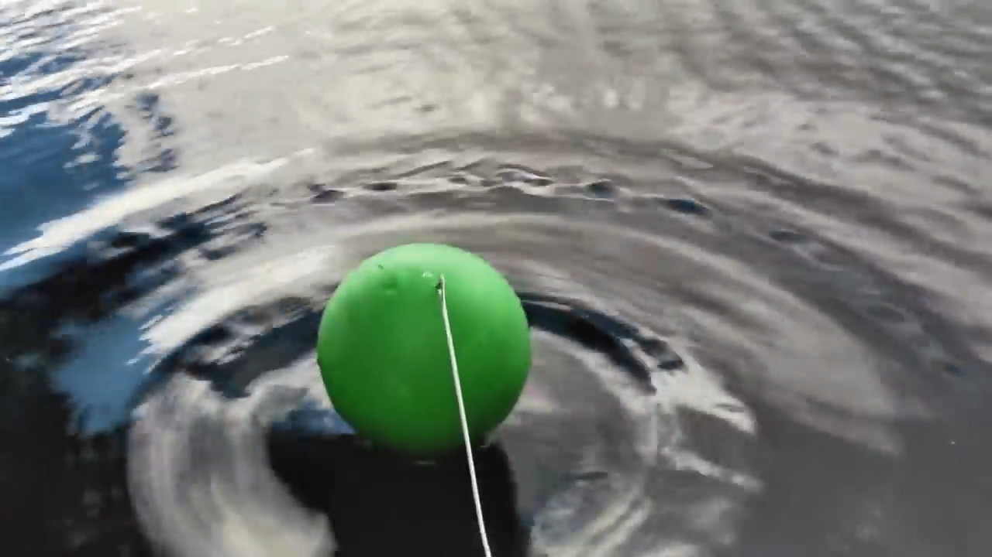
Interference of Waves
[Reference] https://www.youtube.com/watch?v=Iuv6hY6zsd0

Slide 75
Spatial filtering (controlling signal gain in space)
Superimposition of signals

Slide 76
Spatial filtering (controlling signal gain in space)
Superimposition of signals
(in time)

Slide 77
Superimposition of sinusoids
$$A1 . sin⁡(2πf1t+Θ1)$$
Amplitude
Amplitude
$$A2 . sin⁡(2πf2t+Θ2)$$

Slide 78
Superimposition of sinusoids
$$A1 . sin⁡(2πf1t+Θ1)$$
Amplitude
Amplitude
$$A2 . sin⁡(2πf2t+Θ2)$$
$Received signal= A1 .\sin\left(2πf1t+Θ1\right)$ $+A2 . sin⁡(2πf2t+Θ2)$

Slide 79
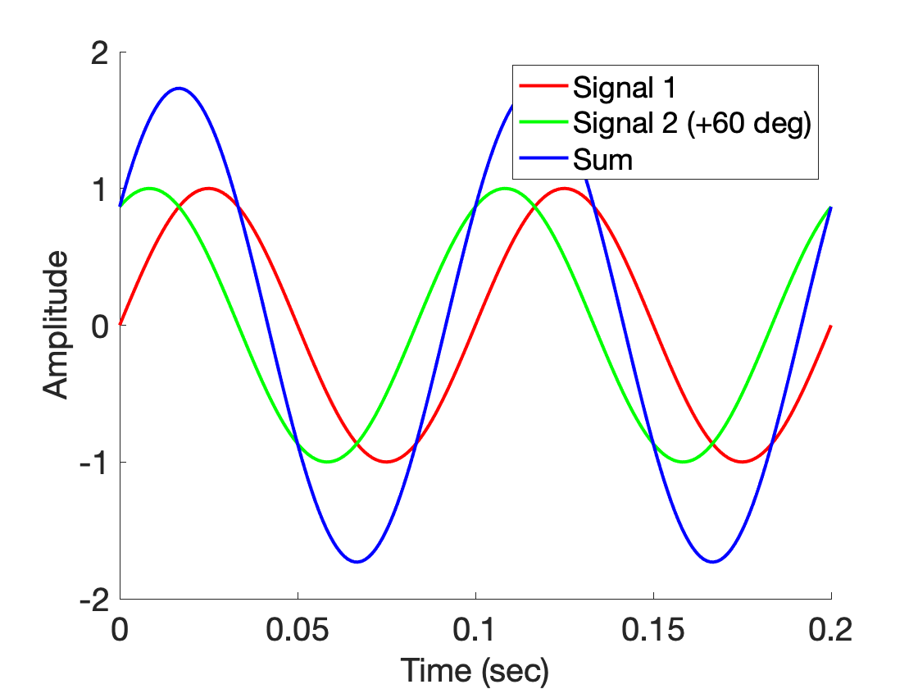
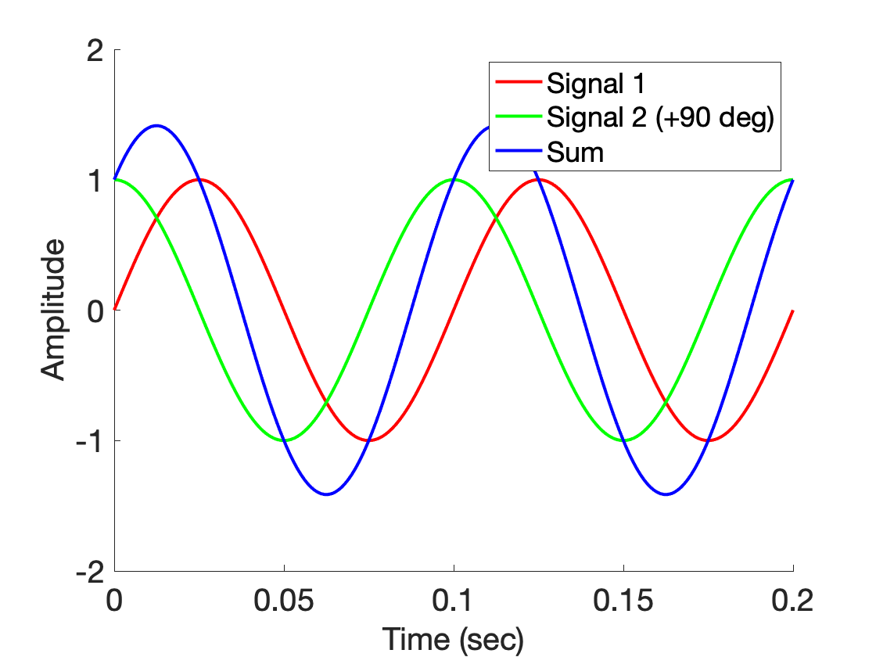
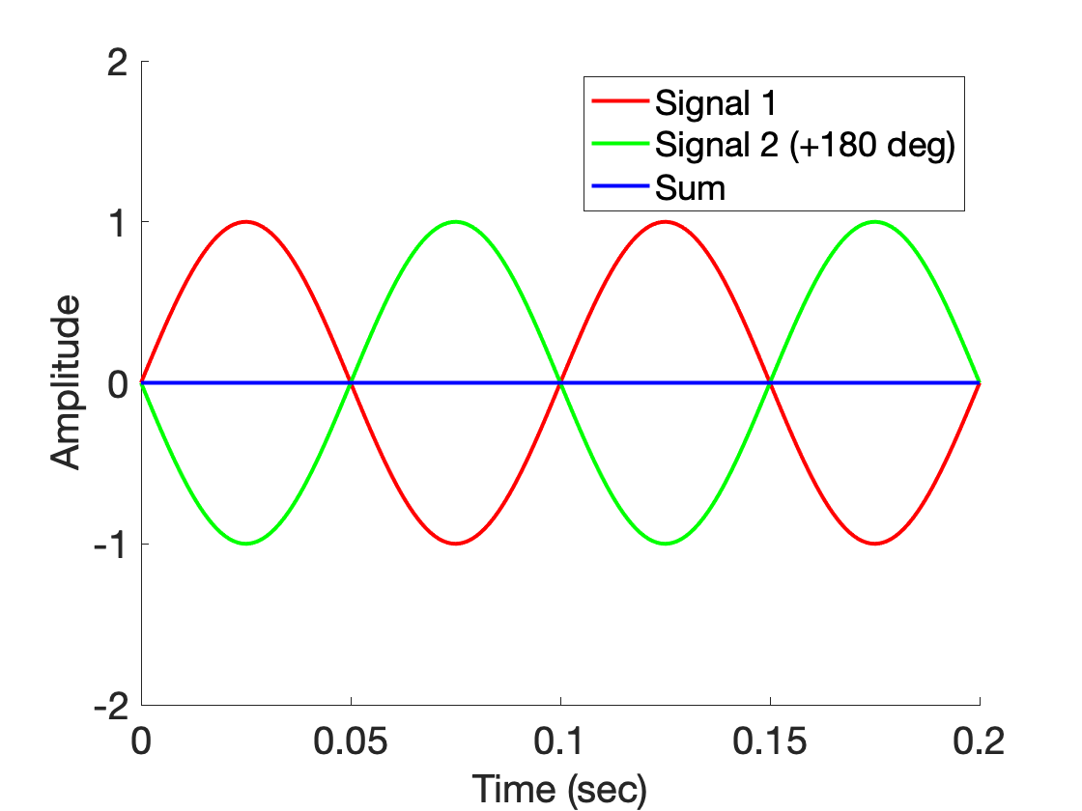
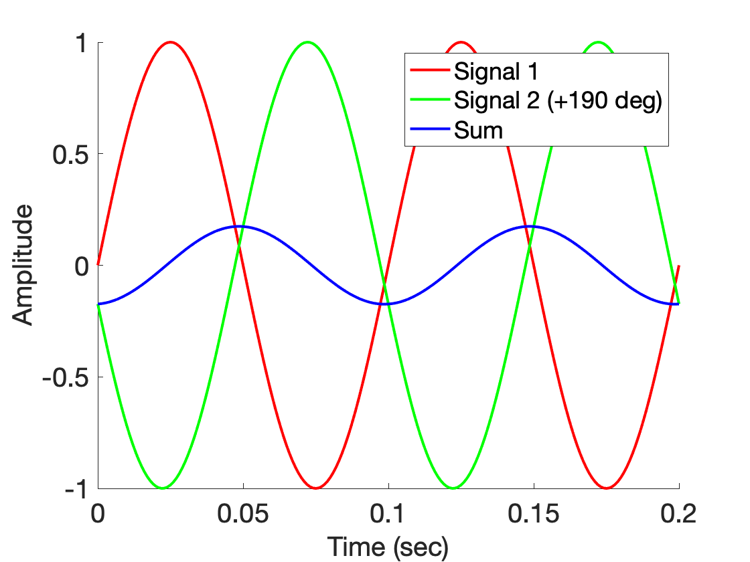
Superimposition of sinusoids

Slide 80
Spatial filtering (controlling signal gain in space)
Superimposition of signals
(in space)

Slide 81
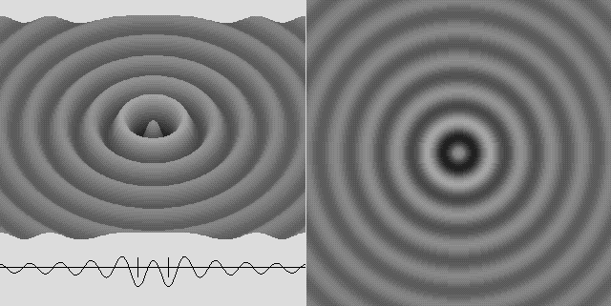
Superimposition of sinusoids

Slide 82
Superimposition of sinusoids
$$sin⁡(2πft)$$

Slide 83
Superimposition of sinusoids
>
$$sin⁡(2πft)$$

Slide 84
Superimposition of sinusoids
$$sin⁡(2πft)$$

Slide 85
Superimposition of sinusoids
$$sin⁡(2πft)$$
$$d$$
$$sin⁡(2πft+2πd/λ)$$

Slide 86
Superimposition of sinusoids
Signal amplified
(perfect constructive interference)
$$sin⁡(2πft)$$
$$d=λ/2$$
$$\sin\left(2πft+\frac{2πd}{λ}\right)$$
= $\sin\left(2πft+π\right)$
= $− sin\left(2πft\right)$
Signal nullified
Signal nullified

Slide 87
Superimposition of sinusoids: Gain
Power gain due to the array structure
Distance from the center of the array
$$−λ/4$$
$$0$$
$$λ/4$$
$$d=λ/2$$
Constant phase difference of $\frac{2πd}{λ}$

Slide 88
Superimposition of sinusoids: Gain
Beamforming in 1D space
Power gain due to the array structure
Distance from the center of the array
Controlling spatial signal gain using multiple signal sources or receivers.
$$−λ/4$$
$$0$$
$$λ/4$$
The gain depends on distance between the elements and signal wavelength.
$$d=λ/2$$
Constant phase difference of $\frac{2πd}{λ}$

Slide 89
Beamforming in 2D space

Slide 90
Beamforming in 2D space
Approximation for ‘far field’
$$φ$$
$$?$$
$$d$$

Slide 91
Beamforming in 2D space
Approximation for ‘far field’
$$φ$$
$d sin$($φ$)
$$?$$
$$φ$$
$$d$$

Slide 92
Beamforming in 2D space
Approximation for ‘far field’
$$φ$$
Along this line
$d sin$($φ$)
$$φ$$
$$d$$
Combined signal = $\sin\left(2πft\right) + \sin\left(2πft+ \frac{2π d sin (φ)}{λ}\right)$
= $e^{j\left(2πft\right)}{ }+e^{j\left(2πft+ \frac{2π d sin(φ)}{λ}\right)}{ }$

Slide 93
Beamforming in 2D space
Approximation for ‘far field’
Parameters: d, $φ$, $λ$ (or f)
Does the gain depend on the distance from the array?
$$φ$$
Along this line
$d sin$($φ$)
$$φ$$
$$d$$
Combined signal = $\sin\left(2πft\right) + \sin\left(2πft+ \frac{2π d sin (φ)}{λ}\right)$
= $e^{j\left(2πft\right)}{ }+e^{j\left(2πft+ \frac{2π d sin(φ)}{λ}\right)}{ }$

Slide 94
Beamforming in 2D space
Directional gain of an array

Slide 95
Beamforming in 2D space

Slide 96
Beamforming in 2D space
$$φ$$
$$d$$

Slide 97
Beamforming in 2D space
$$φ$$
$$d$$
+
Combined signal
= $e^{j\left(2πft\right)}{ }+e^{j\left(2πft + \frac{2π d sin(φ)}{λ}\right)}{ }$

Slide 98
Sensing with an Array

Slide 99
Sensing with an Array

Slide 100
Sensing with an Array

Slide 101
Sensing with an Array
Extra path delay
== additional phase

Slide 102
Sensing with an Array
Extra path delay
== additional phase
+
Received combined signal

Slide 103
Sensing with an Array
Extra path delay
== additional phase
+
Received combined signal

Slide 104
Sensing with an Array
Extra path delay
== additional phase
+
Received combined signal

Slide 105
Sensing with an Array
$$φ$$
Extra path delay
== additional phase
+
Received combined signal

Slide 106
Sensing with an Array
Approximation for ‘far field’

Slide 107
Sensing with an Array
Approximation for ‘far field’
Extra path delay
== additional phase

Slide 108
Sensing with an Array
Approximation for ‘far field’
$$φ$$
$d sin$($φ$)
$$d$$
+
Received combined signal

Slide 109
Sensing with an Array
Approximation for ‘far field’
$$φ$$
Along this line
$d sin$($φ$)
$$d$$
= $e^{j\left(2πft\right)}{ }+e^{j\left(2πft+ \frac{2π d sin(φ)}{λ}\right)}{ }$
Combined signal

Slide 110
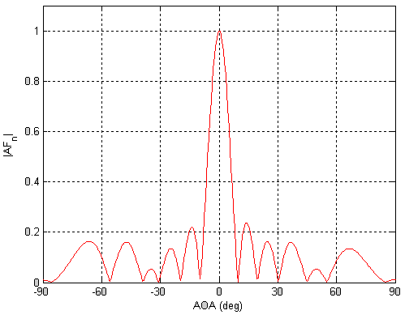
Sensing with an Array: Spatial gain
$$φ$$

Slide 111
Sensing with an Array
$$φ$$
$$d$$
+
Combined signal
= $e^{j\left(2πft\right)}{ }+e^{j\left(2πft + \frac{2π d sin(φ)}{λ}\right)}{ }$

Slide 112
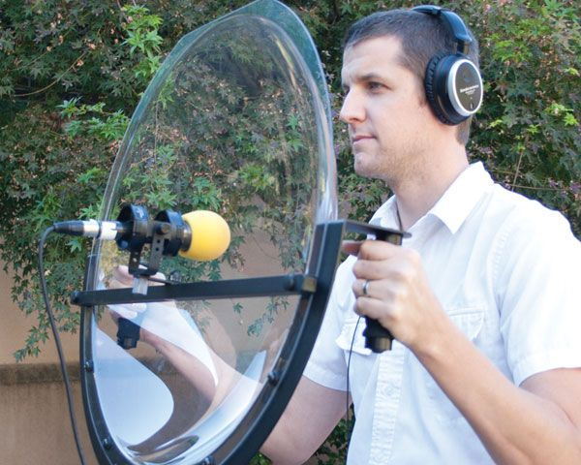
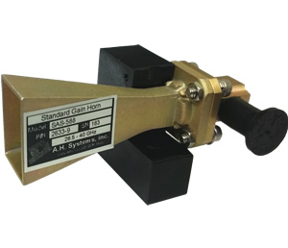
Directionality of signals: Physical guiding

Slide 113
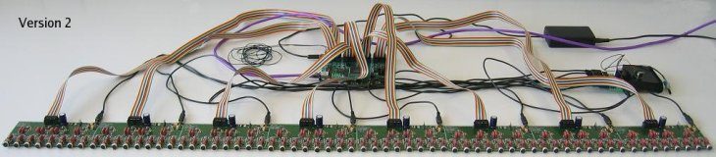
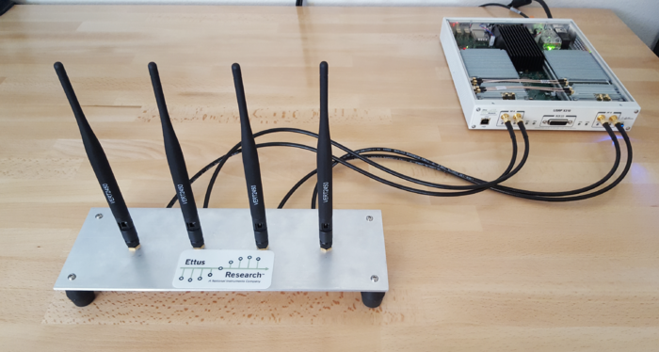
Directionality of signals: Array of sensors

Slide 114
Uniform Linear Array (ULA)

Slide 115
Beamforming in 2D space
$d sin$($φ$)
$$E1$$
$$E2$$
$$E3$$
$$E4$$
…
N elements
$$d$$
$$d$$
$$d$$
Interelement distance = d

Slide 116
Beamforming in 2D space
$3d sin$($φ$)
$2d sin$($φ$)
$d sin$($φ$)
$$E1$$
$$E2$$
$$E3$$
$$E4$$
…
N elements
$$d$$
$$d$$
$$d$$
Interelement distance = d

Slide 117
Beamforming in 2D space
$3d sin$($φ$)
$2d sin$($φ$)
$d sin$($φ$)
$$E1$$
$$E2$$
$$E3$$
$$E4$$
…
N elements
$$d$$
$$d$$
$$d$$
Path difference with n^{th} element:
$\left(n−1\right)d sin$($φ$)
Phase difference with n^{th} element:
$\left(n−1\right)d sin$($φ$) 2Π/λ

Slide 118
Beamforming in 2D space
$3d sin$($φ$)
$2d sin$($φ$)
$d sin$($φ$)
$$E1$$
$$E2$$
$$E3$$
$$E4$$
…
N elements
$$d$$
$$d$$
$$d$$
Interelement distance = d
Path difference with n^{th} element:
$\left(n−1\right)d sin$($φ$)
Phase difference with n^{th} element:
$\left(n−1\right)d sin$($φ$) 2Π/λ

Slide 119
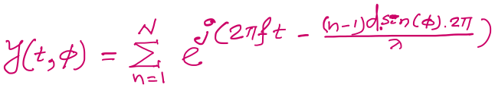

$3d cos$($φ$)
$2d sin$($φ$)
Beamforming in 2D space
$d sin$($φ$)
$$E1$$
$$E2$$
$$E3$$
$$E4$$
…
N elements
$$d$$
$$d$$
$$d$$
Path difference with n^{th} element:
$\left(n−1\right)d sin$($φ$)
Phase difference with n^{th} element:
$\left(n−1\right)d sin$($φ$) 2Π/λ
Signal at 1st sensor:
$e^{j\left(2πft\right)}{ }$
Combined signal:

Slide 120
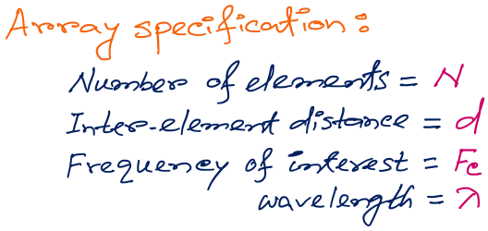
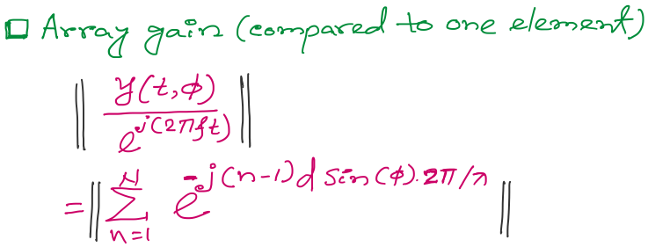
Beamforming in 2D space
f
Notes:
http://www.waves.utoronto.ca/prof/svhum/ece422/notes/15-arrays2.pdf

Slide 121

Beamforming in 2D space
Notes:
http://www.waves.utoronto.ca/prof/svhum/ece422/notes/15-arrays2.pdf

Slide 122
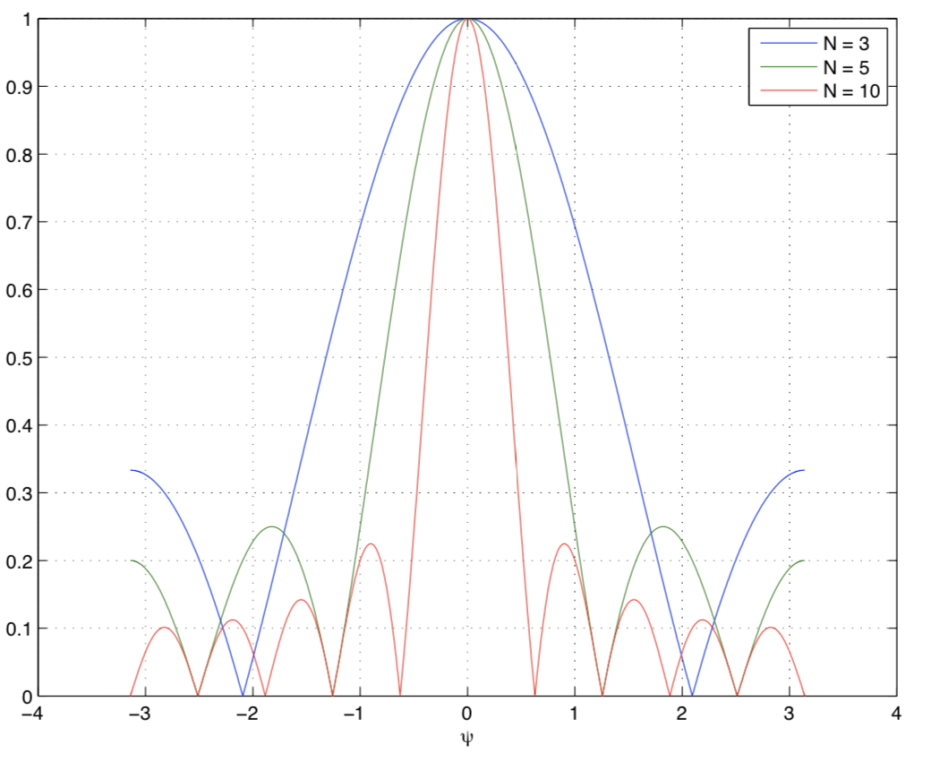
Beamforming in 2D space
Gain
-90 -60 -30 0 30 60 90
Angle
Notes:
http://www.waves.utoronto.ca/prof/svhum/ece422/notes/15-arrays2.pdf

Slide 123
Beamforming in 2D space
Notes:
http://www.waves.utoronto.ca/prof/svhum/ece422/notes/15-arrays2.pdf

Slide 124
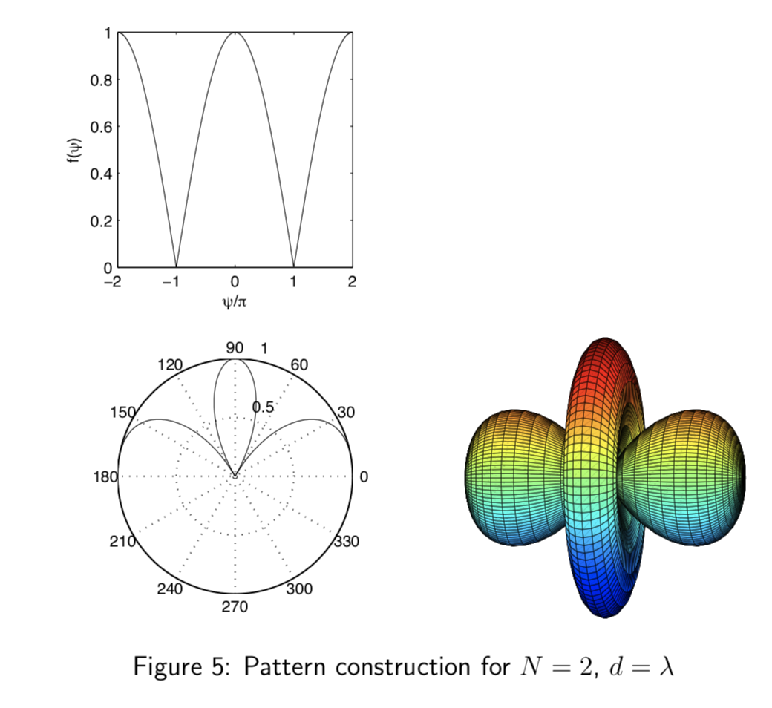
Beamforming in 2D space
Notes:
http://www.waves.utoronto.ca/prof/svhum/ece422/notes/15-arrays2.pdf

Slide 125
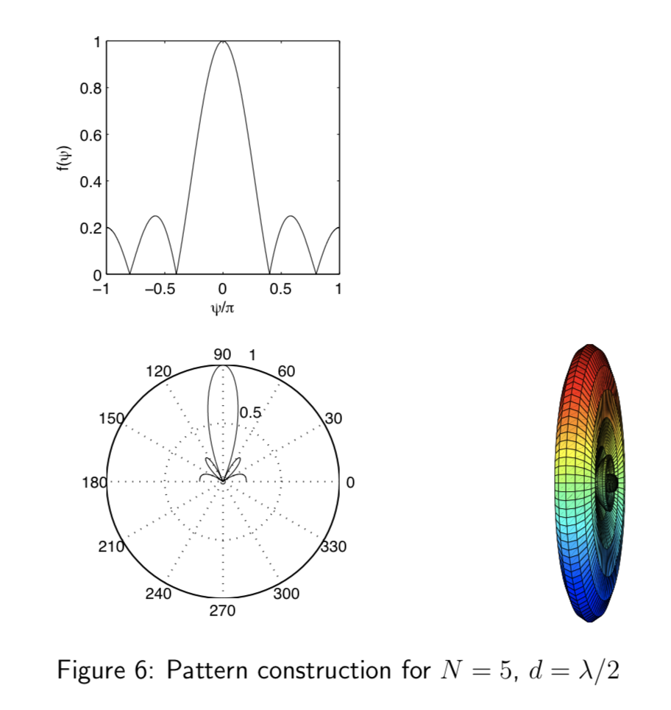
Beamforming in 2D space
Notes:
http://www.waves.utoronto.ca/prof/svhum/ece422/notes/15-arrays2.pdf

Slide 126
Beamforming in 2D space

Slide 127
Sensing with an Array
$$φ$$
$$d$$
Extra phase-1
Extra phase-2
+
Combined signal

Slide 128
Sensing with an Array
$$φ$$
$$d$$
Extra phase-1
Extra phase-2
= $e^{jΘ2}{ }$
= $e^{jΘ1}{ }$
+
= $e^{j\left(2πft\right)}{ }+e^{j\left(2πft + \frac{2π d sin(φ)}{λ}\right)}{ }$

Slide 129
Sensing with an Array
$$φ$$
$$d$$
Extra phase-1
Extra phase-2
= $e^{jΘ2}{ }$
= $e^{jΘ1}{ }$
+
= $e^{j\left(2πft+Θ1\right)}{ }+e^{j\left(2πft + \frac{2π d sin(φ)}{λ}+Θ2\right)}{ }$

Slide 130
Beam-steering
Delay-sum beamformer or Phased array
Notes:
http://www.waves.utoronto.ca/prof/svhum/ece422/notes/15-arrays2.pdf

Slide 131
Beam-steering
Phased array
Add additional phase:
$−\left(n−1\right)d sin$(𝚹_{s}) 2Π/λ
Notes:
http://www.waves.utoronto.ca/prof/svhum/ece422/notes/15-arrays2.pdf

Slide 132
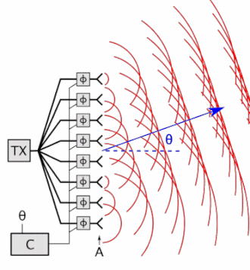

Beam-steering
Delay-sum beamformer or Phased array
Notes:
http://www.waves.utoronto.ca/prof/svhum/ece422/notes/15-arrays2.pdf

Slide 133
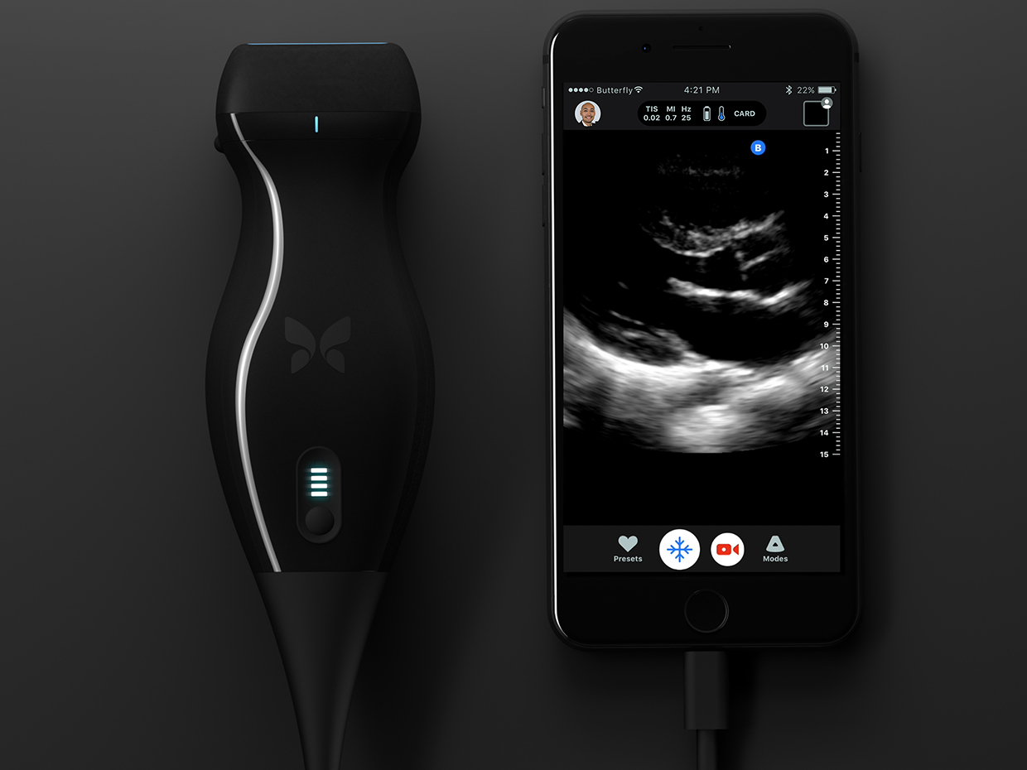
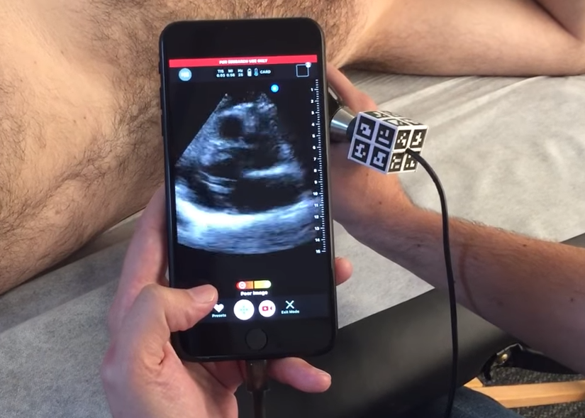

Slide 134
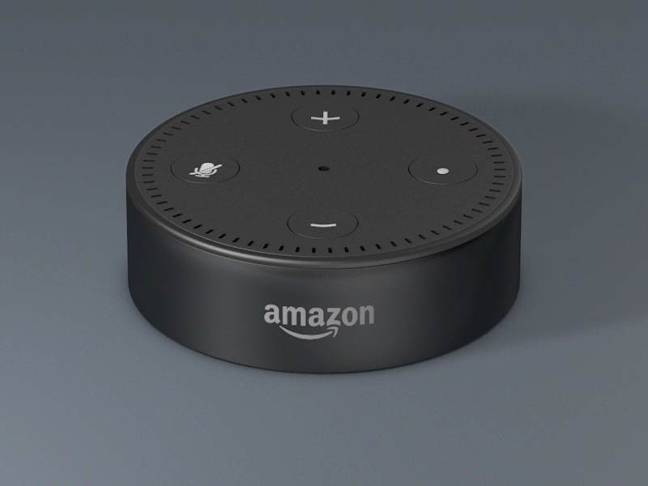

Slide 135
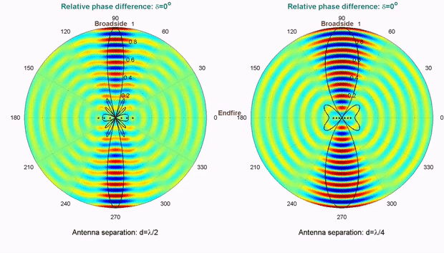
Computationally controlling beam direction

