Slide 1

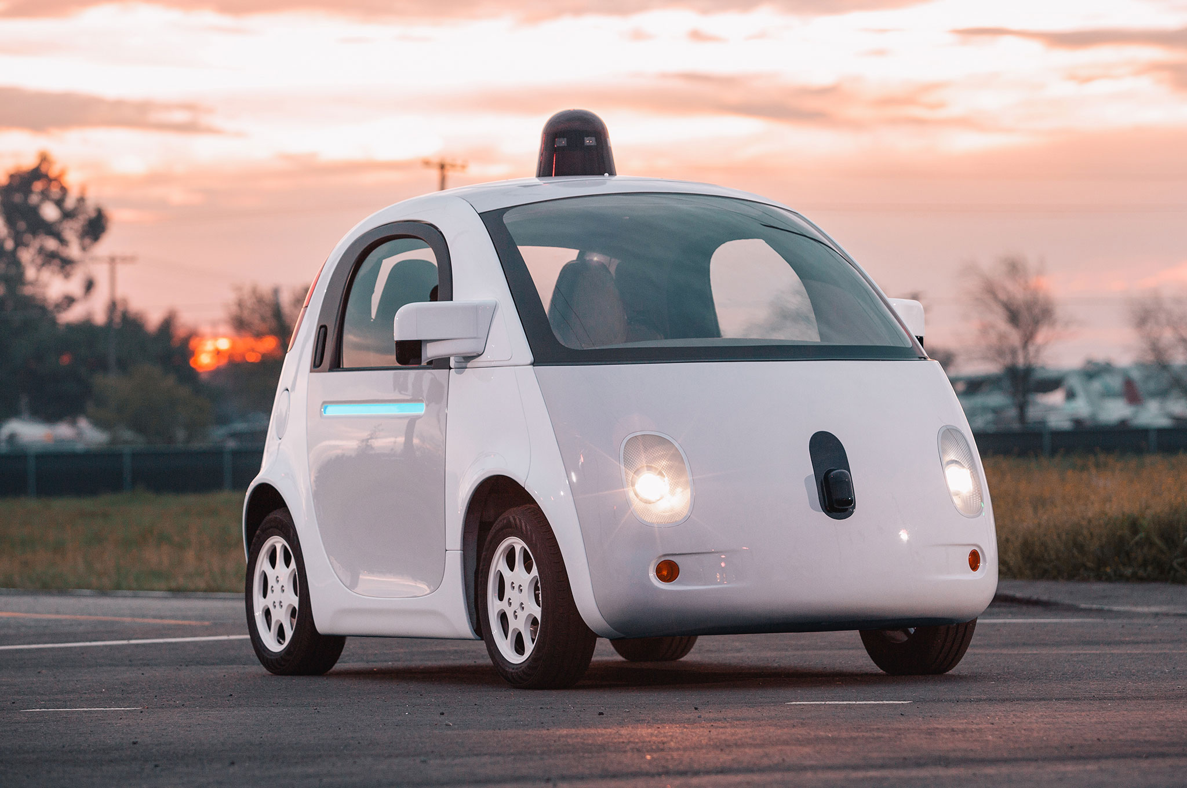

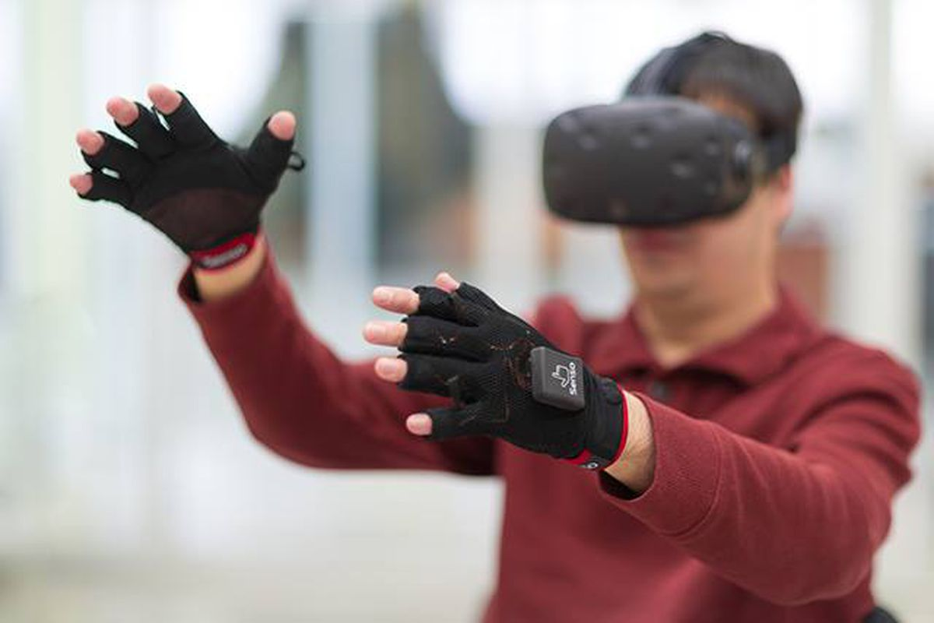

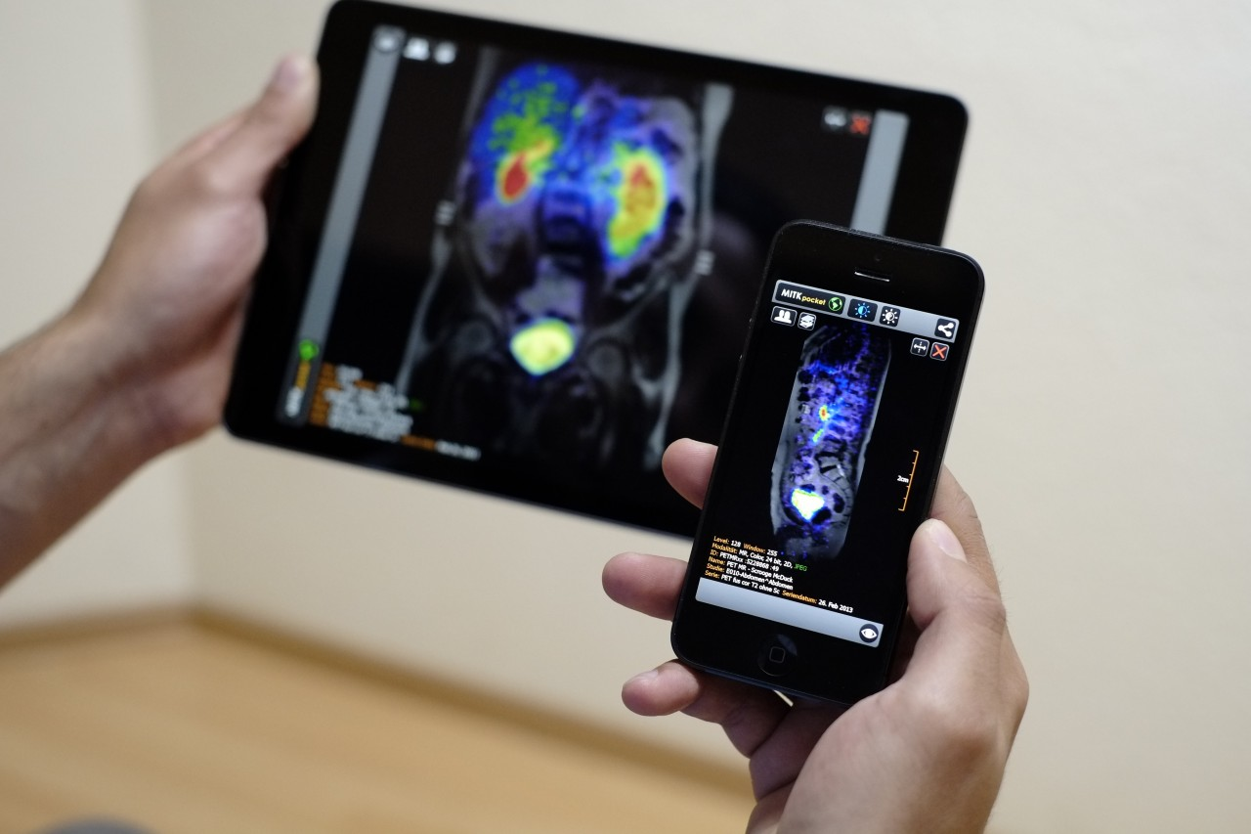
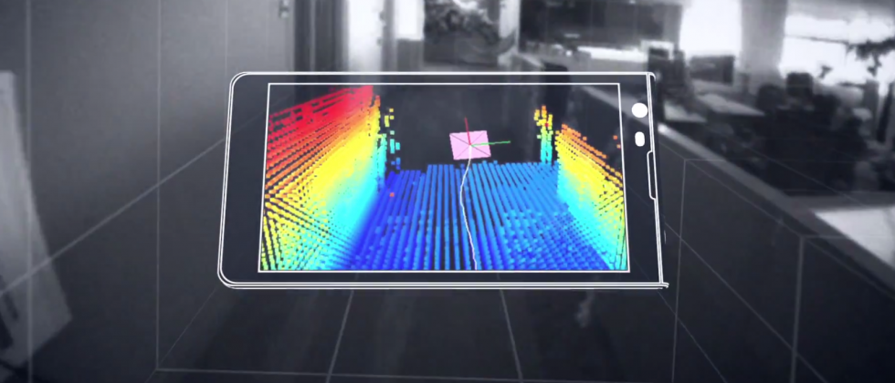
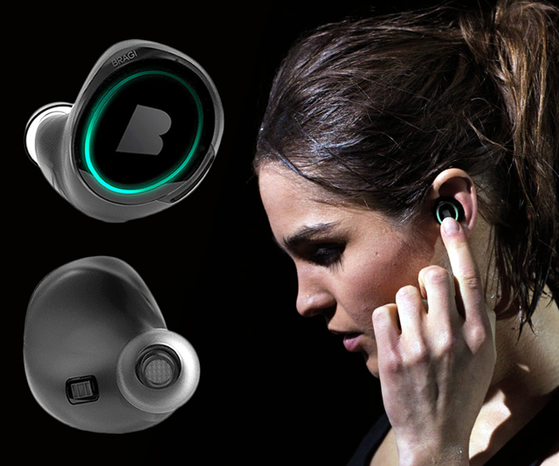
Machine Learning for Physical Sensing & Perception
CMSC 818V : Fall 2025
Lecture 2_3: Inverse problems: Spatial Perception
Nirupam Roy
Tu-Th 3:30 – 4:45pm
IRB 1207

Slide 2
Sensing with an Array

Slide 3
Sensing with an Array

Slide 4
Sensing with an Array

Slide 5
Sensing with an Array
Extra path delay
== additional phase

Slide 6
Sensing with an Array
Extra path delay
== additional phase

Slide 7
Sensing with an Array
Approximation for ‘far field’
Extra path delay
== additional phase

Slide 8
Sensing with an Array
Approximation for ‘far field’
$$φ$$
$d sin$($φ$)
$$d$$
+
Received combined signal

Slide 9
Sensing with an Array
Approximation for ‘far field’
$$φ$$
Along this line
$d sin$($φ$)
$$d$$
= $e^{j\left(2πft\right)}{ }+e^{j\left(2πft+ \frac{2π d sin(φ)}{λ}\right)}{ }$
Combined signal

Slide 10
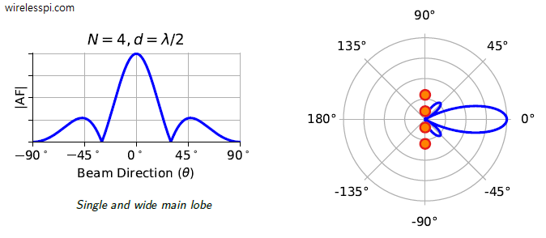
Beamforming in 2D space
Directional gain of an array

Slide 11
Beamforming in 2D space
Directional gain of an array

Slide 12

Sensing with an Array
Approximation for ‘far field’
$$φ$$
$d sin$($φ$)
$$d$$
$$. ej∅$$
+
Received combined signal

Slide 13
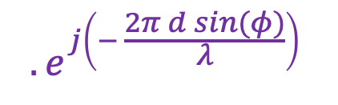
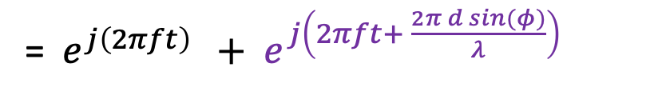
Sensing with an Array
Approximation for ‘far field’
$$φ$$
Along this line
$d sin$($φ$)
$$d$$
= $e^{j\left(2πft\right)}{ }+e^{j\left(2πft+ \frac{2π d sin(φ)}{λ}\right)}{ }$
Combined signal
$${. e}^{j\left(− \frac{2π d sin(φ)}{λ}\right)}{ }$$
Adjusted the phase of the second sensor

Slide 14
Uniform Linear Array (ULA)

Slide 15
Beamforming in 2D space
$d sin$($φ$)
$$E1$$
$$E2$$
$$E3$$
$$E4$$
…
N elements
$$d$$
$$d$$
$$d$$
Interelement distance = d

Slide 16
Beamforming in 2D space
$3d sin$($φ$)
$2d sin$($φ$)
$d sin$($φ$)
$$E1$$
$$E2$$
$$E3$$
$$E4$$
…
N elements
$$d$$
$$d$$
$$d$$
Interelement distance = d

Slide 17
Beamforming in 2D space
$3d sin$($φ$)
$2d sin$($φ$)
$d sin$($φ$)
$$E1$$
$$E2$$
$$E3$$
$$E4$$
…
N elements
$$d$$
$$d$$
$$d$$
Path difference with n^{th} element:
$\left(n−1\right)d sin$($φ$)
Phase difference with n^{th} element:
$\left(n−1\right)d sin$($φ$) 2Π/λ

Slide 18
Beamforming in 2D space
$3d sin$($φ$)
$2d sin$($φ$)
$d sin$($φ$)
$$E1$$
$$E2$$
$$E3$$
$$E4$$
…
N elements
$$d$$
$$d$$
$$d$$
Interelement distance = d
Path difference with n^{th} element:
$\left(n−1\right)d sin$($φ$)
Phase difference with n^{th} element:
$\left(n−1\right)d sin$($φ$) 2Π/λ

Slide 19
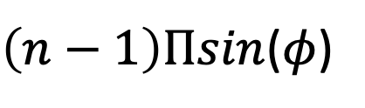
$3d cos$($φ$)
$2d sin$($φ$)
Beamforming in 2D space
$d sin$($φ$)
$$E1$$
$$E2$$
$$E3$$
$$E4$$
…
N elements
$$d$$
$$d$$
$$d$$
Path difference with n^{th} element:
$\left(n−1\right)d sin$($φ$)
Phase difference with n^{th} element:
$\left(n−1\right)d sin$($φ$) 2Π/λ
Setting d = (λ /2), we get:
$\left(n−1\right)\text{Π}sin$($φ$)

Slide 20
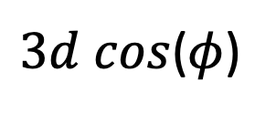
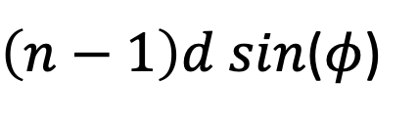

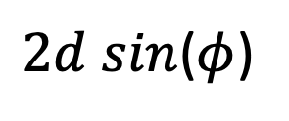

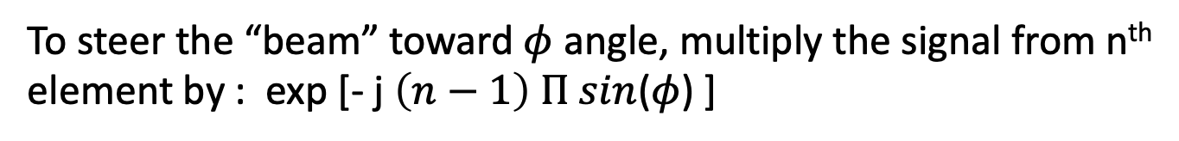




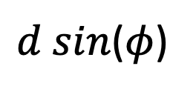

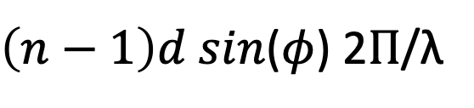
$3d cos$($φ$)
$2d sin$($φ$)
Beamforming in 2D space
$d sin$($φ$)
$$E1$$
$$E2$$
$$E3$$
$$E4$$
…
N elements
$$d$$
$$d$$
$$d$$
Path difference with n^{th} element:
$\left(n−1\right)d sin$($φ$)
Phase difference with n^{th} element:
$\left(n−1\right)d sin$($φ$) 2Π/λ
Setting d = (λ /2), we get:
$\left(n−1\right)\text{Π}sin$($φ$)
To steer the “beam” toward $φ$ angle, multiply the signal from n^{th} element by : exp [- j $\left(n−1\right) \text{Π} sin$($φ$) ]

Slide 21
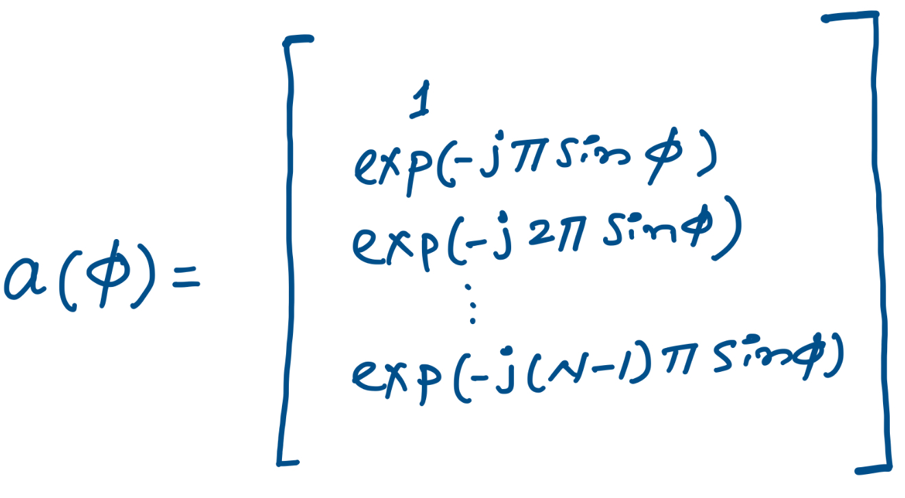
$3d cos$($φ$)
$2d sin$($φ$)
Beamforming in 2D space
$d sin$($φ$)
$$E1$$
$$E2$$
$$E3$$
$$E4$$
…
N elements
$$d$$
$$d$$
$$d$$
Steering vector:

Slide 22
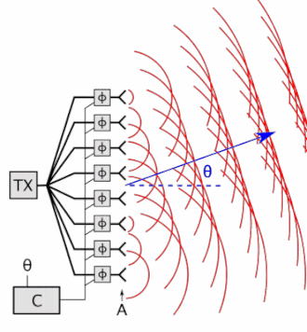
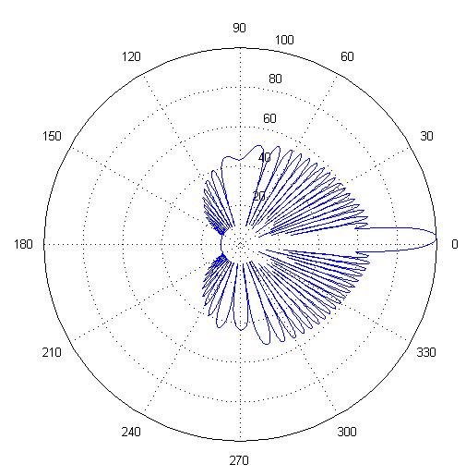
Beam-steering
Delay-sum beamformer or Phased array
Notes:
http://www.waves.utoronto.ca/prof/svhum/ece422/notes/15-arrays2.pdf

Slide 23
Beamforming in Complex Environments

Slide 24
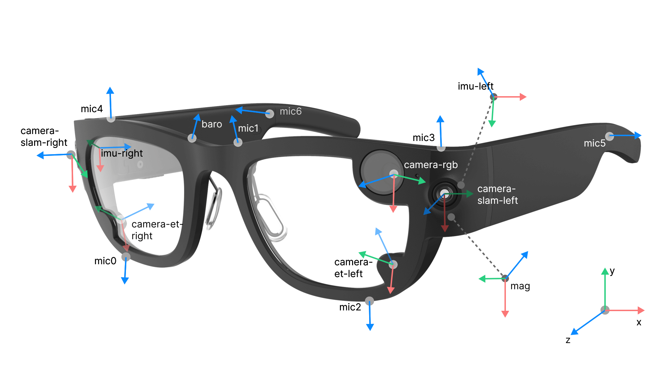
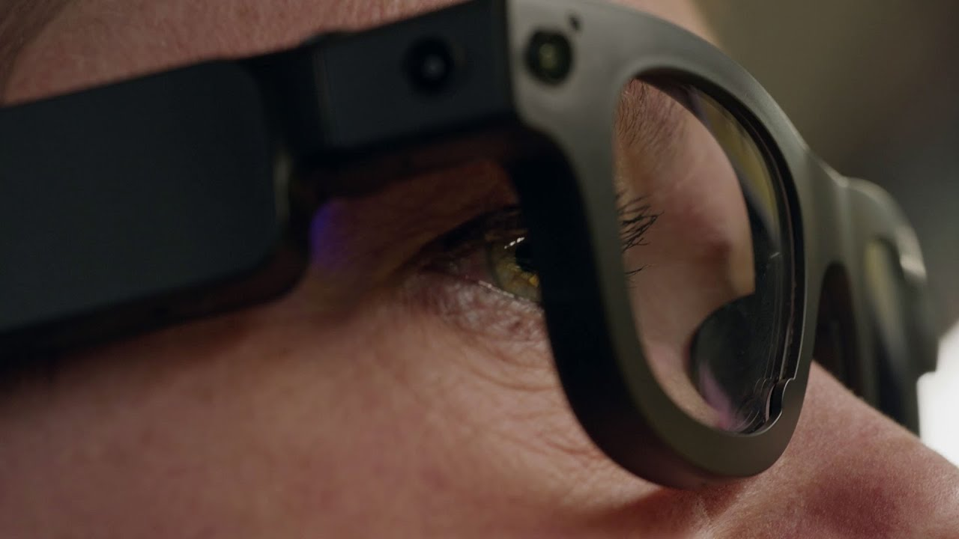
Real-world array as not “Ideal”

Slide 25
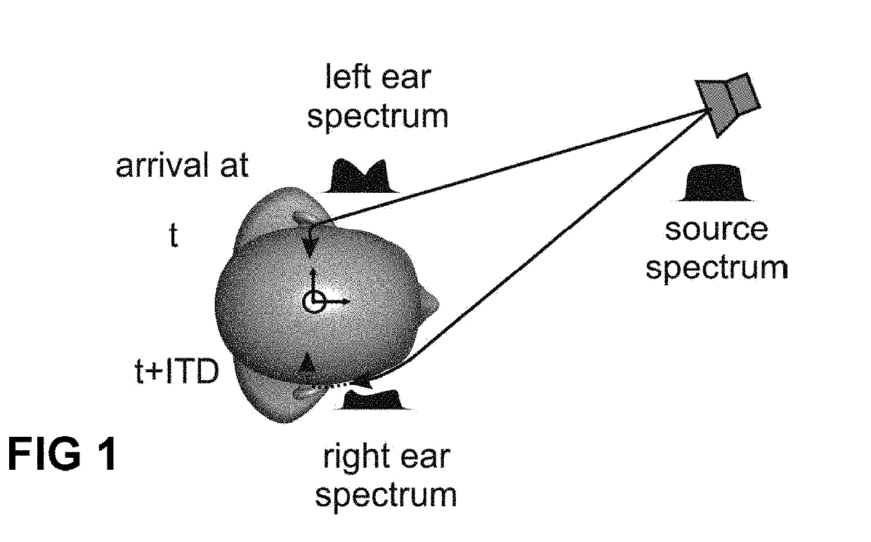
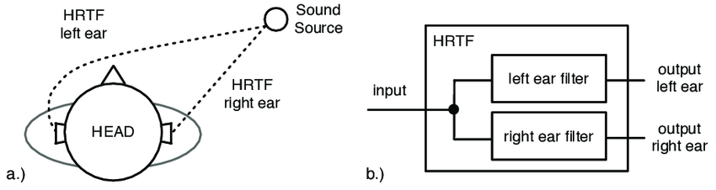
Head-related transfer function (HRTF)

Slide 26
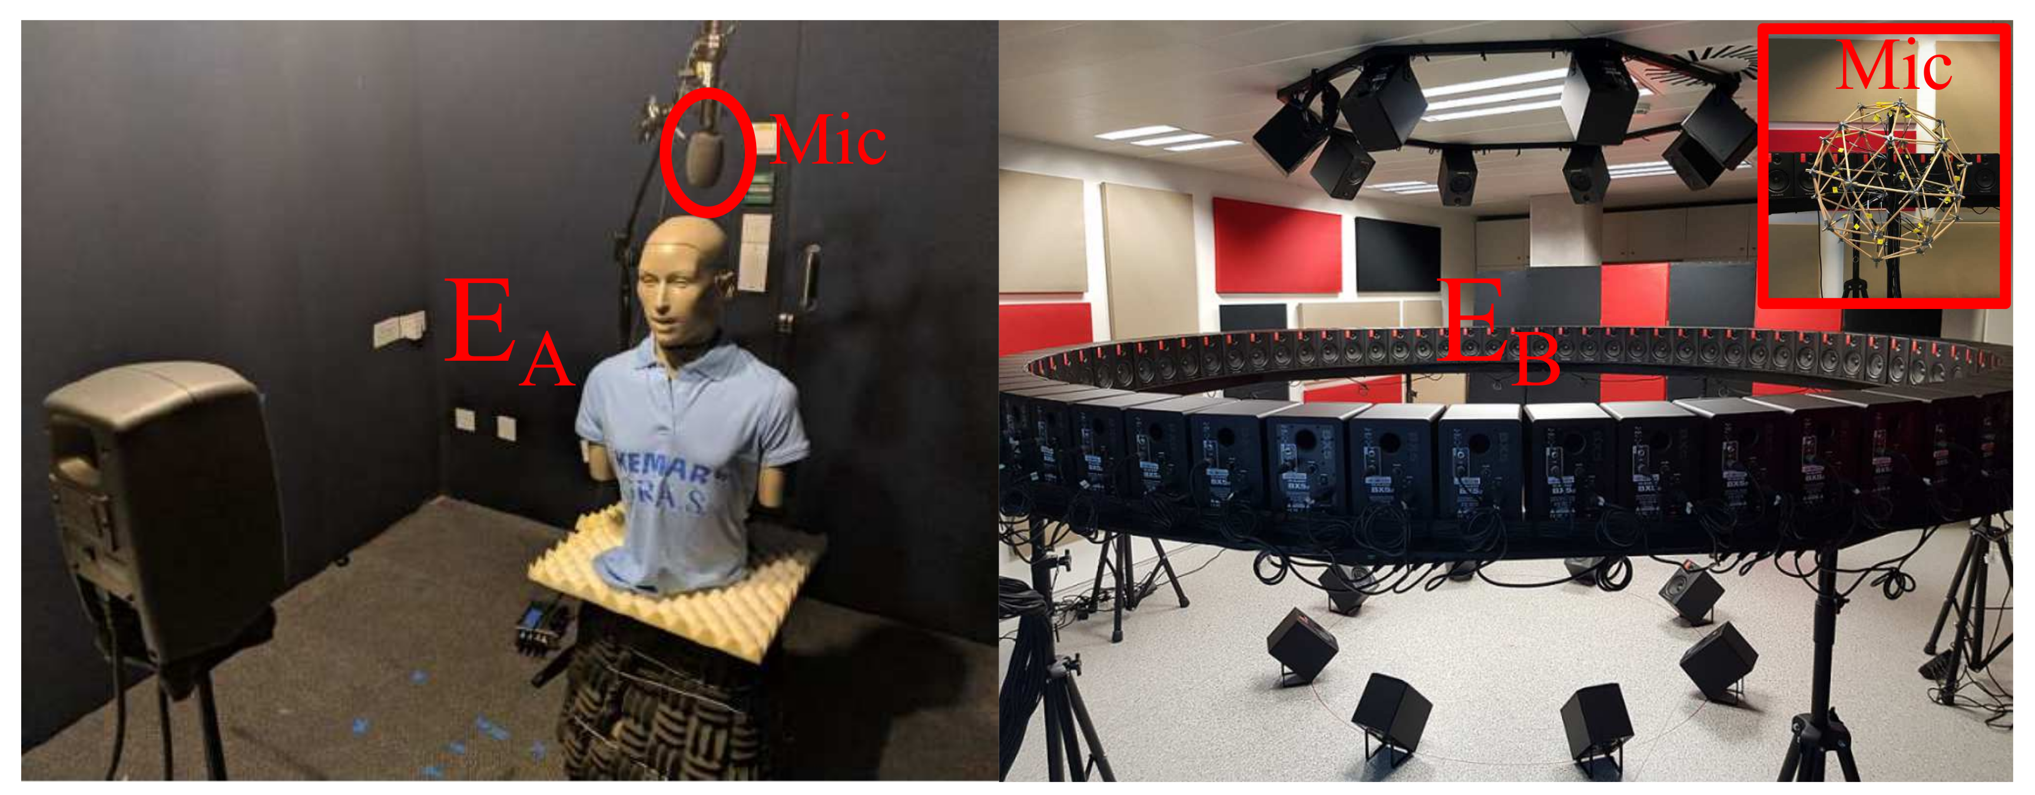
Head-related transfer function (HRTF)

Slide 27
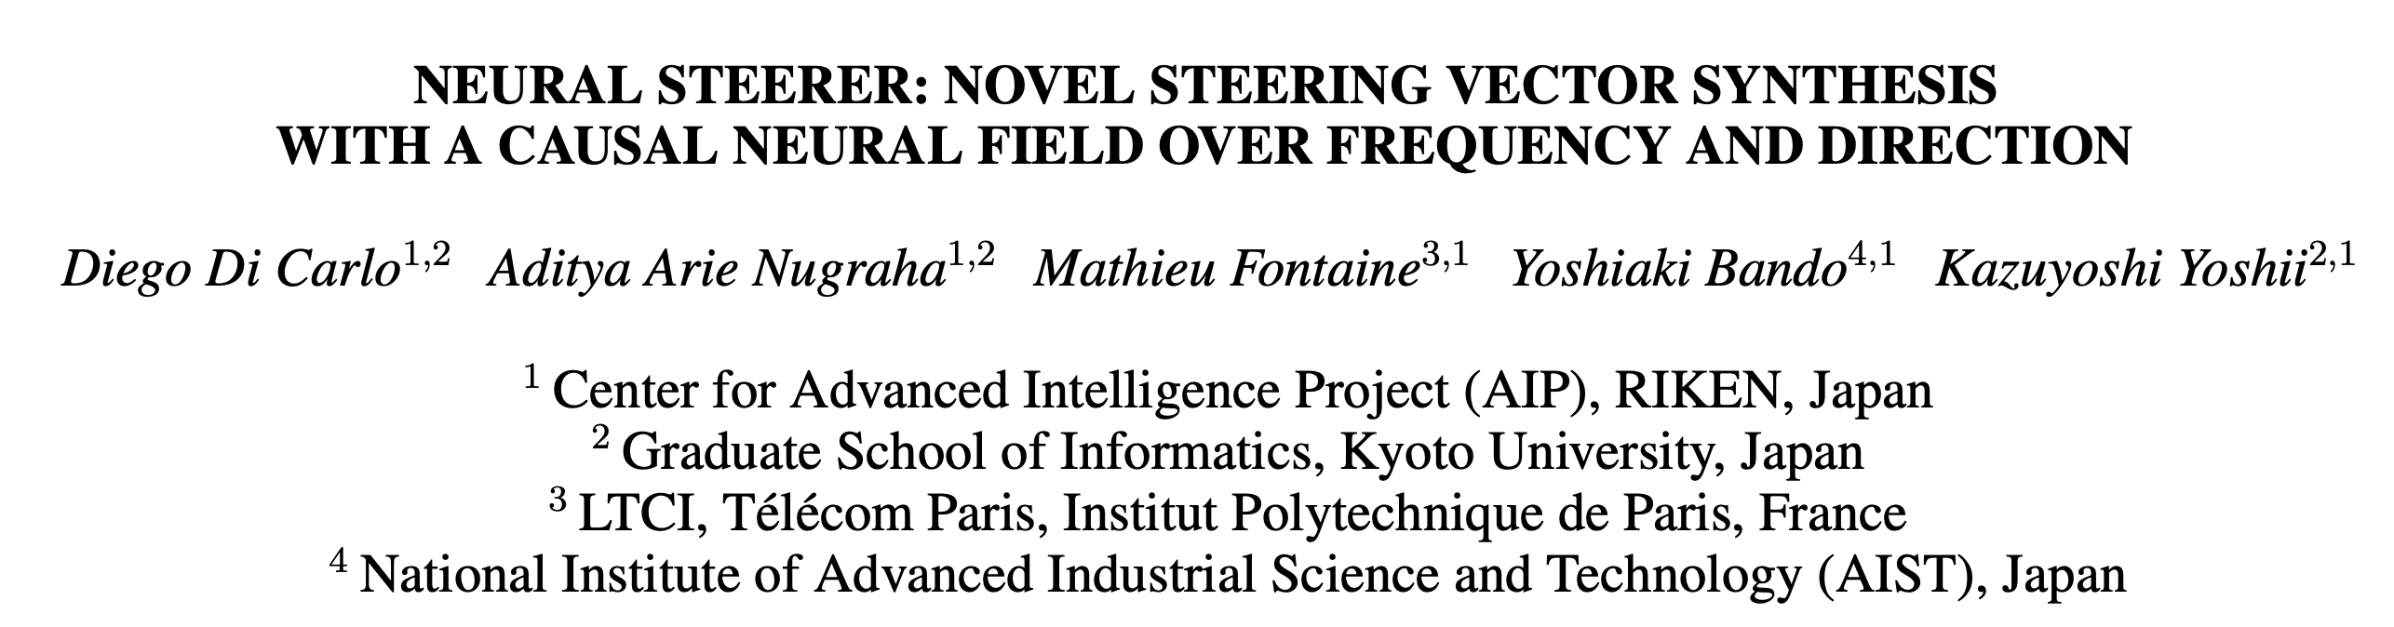
https://arxiv.org/pdf/2305.04447

Slide 28
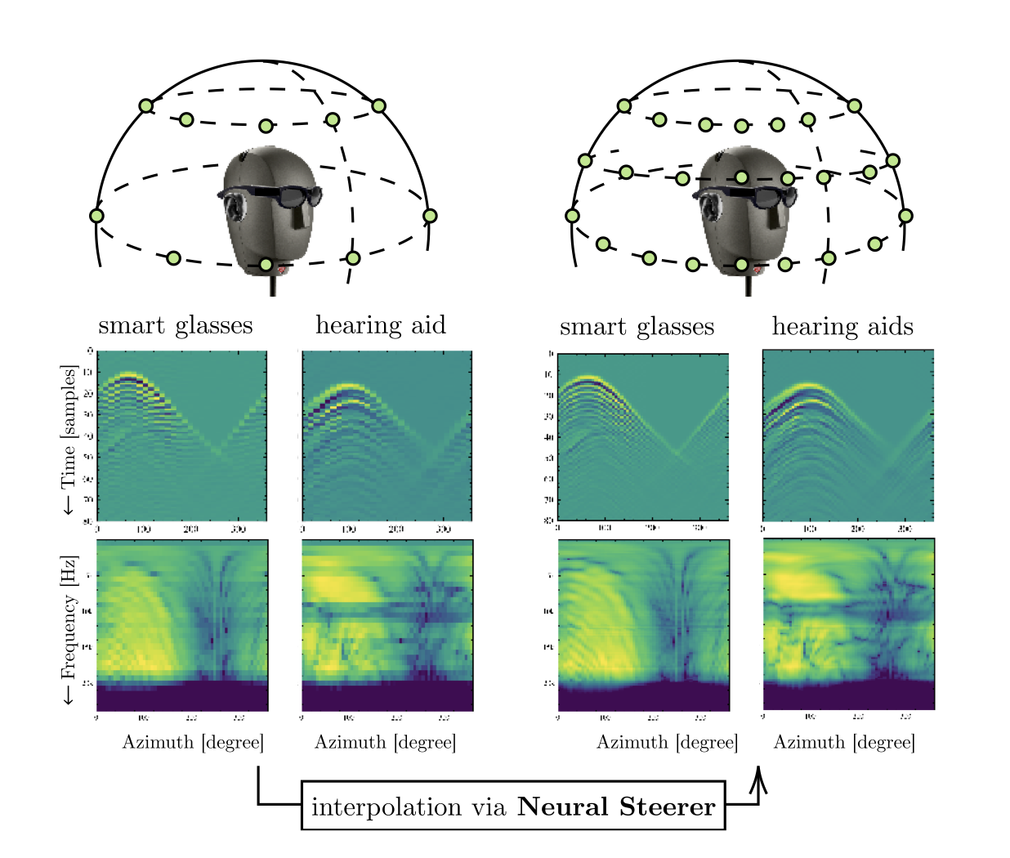

Slide 29
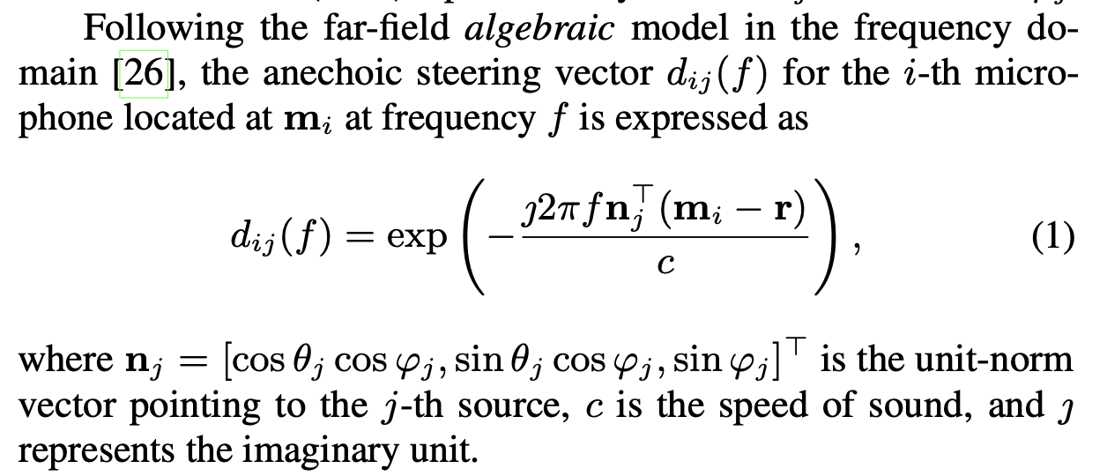
Steering vector

Slide 30
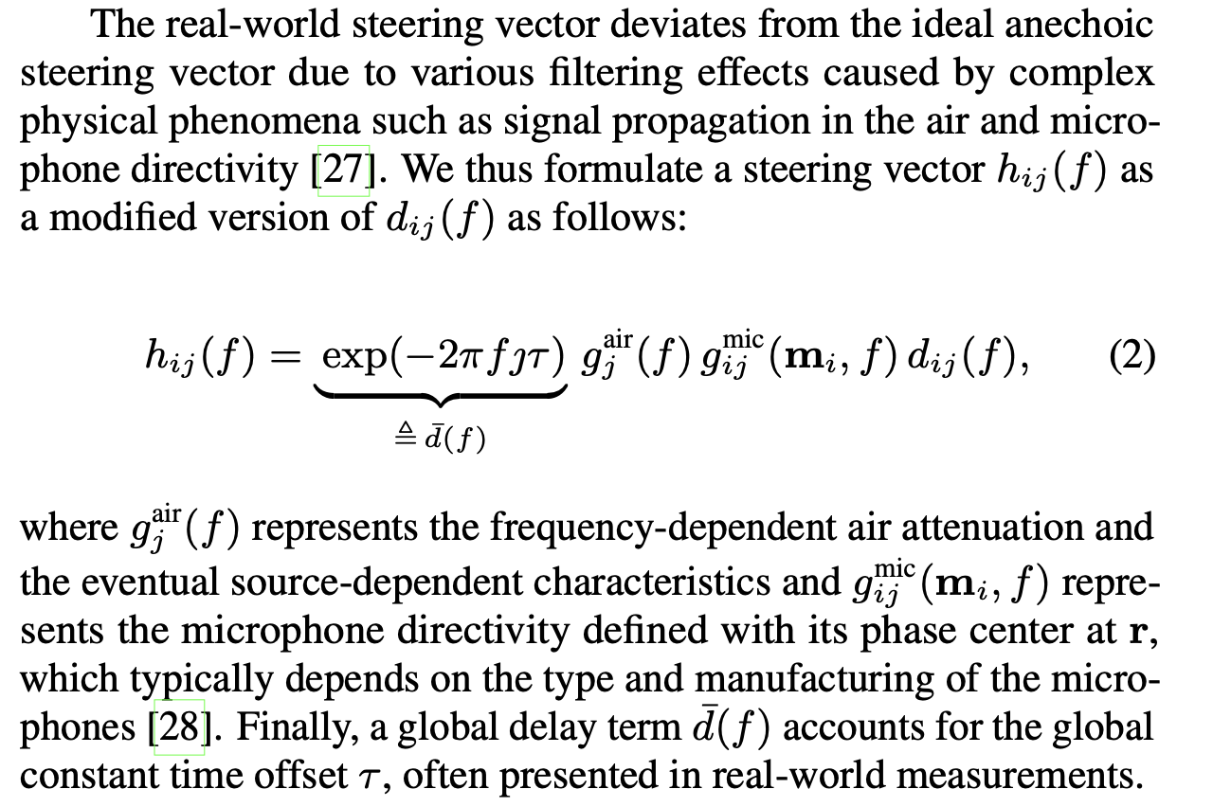
Steering vector

Slide 31
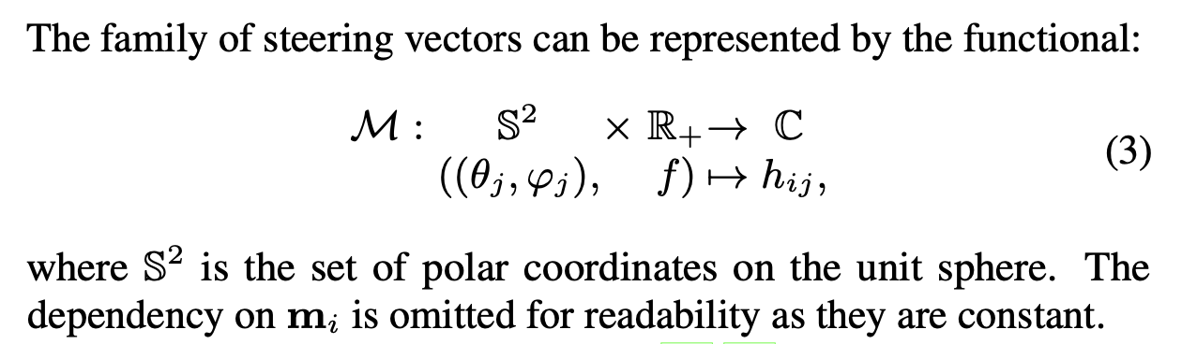
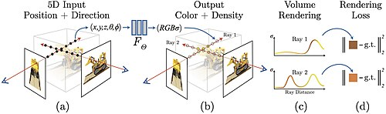
Steering vector
Neural fields do not work with discrete data (e.g. sequences, images, tokens), but map continuous inputs (e.g., spatial coordinates, time) to continuous outputs (i.e., scalars, vectors, etc.).

Slide 32
Neural Field Representation/INR

Slide 33
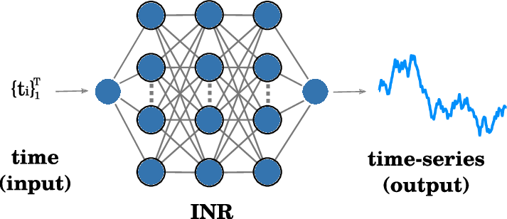
Neural Field Representation/INR
Neural fields do not work with discrete data (e.g. sequences, images, tokens), but map continuous inputs (e.g., spatial coordinates, time) to continuous outputs (i.e., scalars, vectors, etc.).

Slide 34
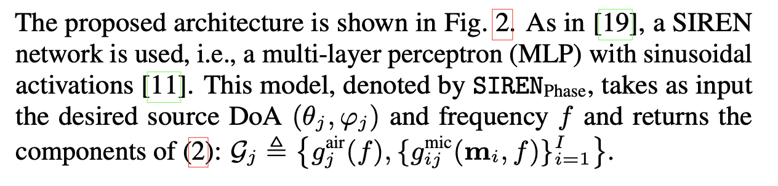
Steering Vector as Neural Fields

Slide 35
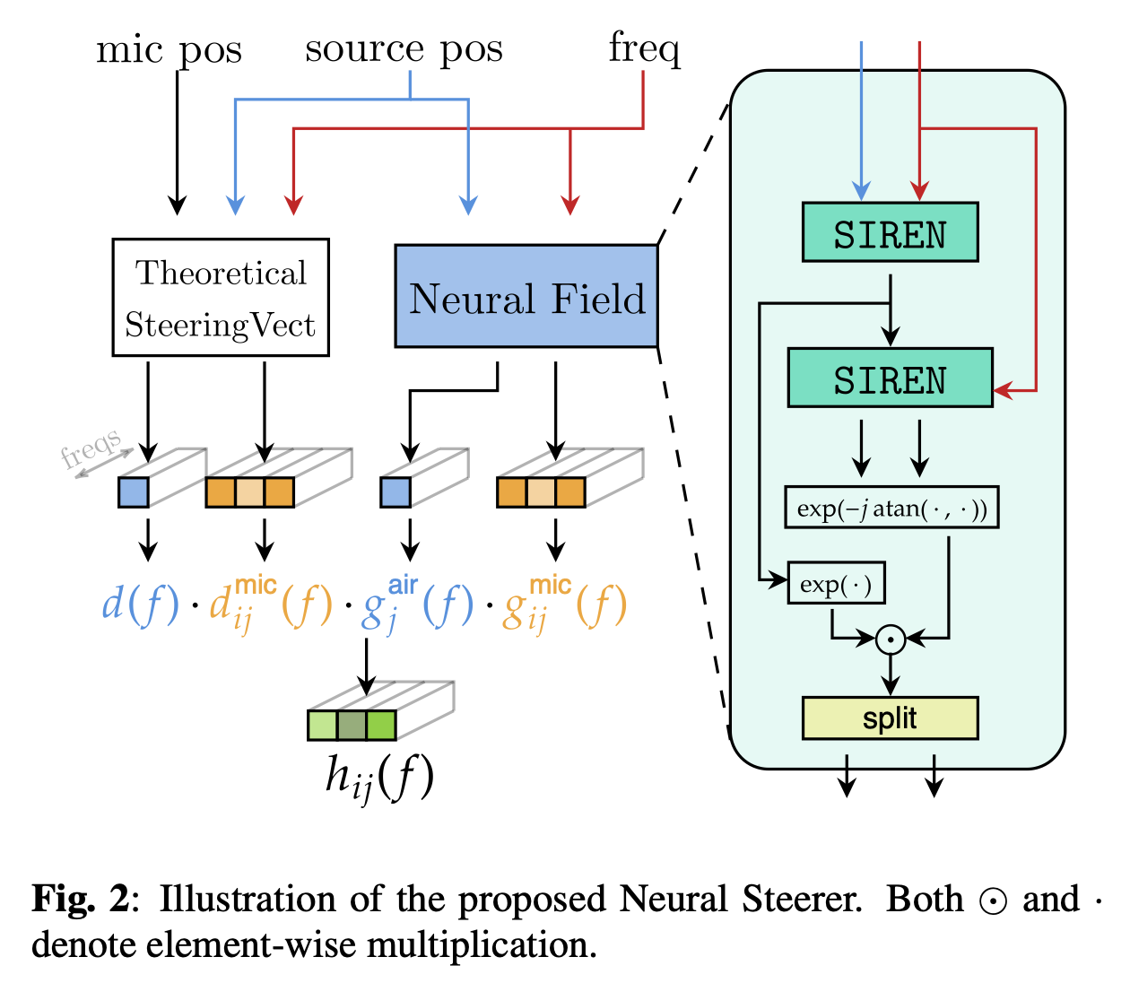

Slide 36
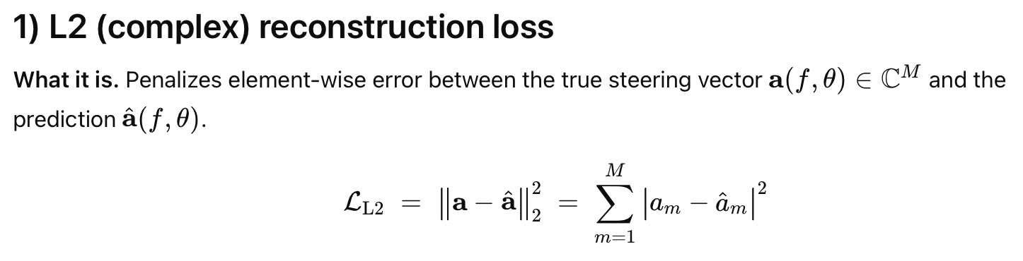
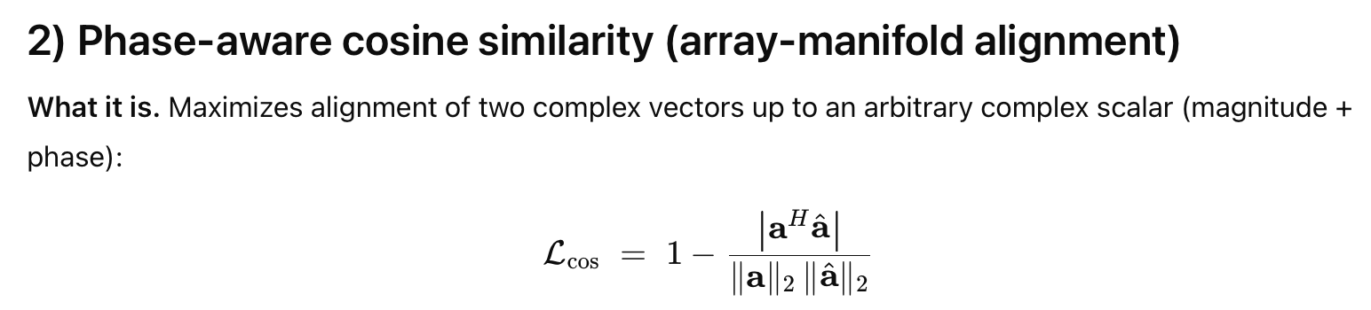
Loss function

Slide 37
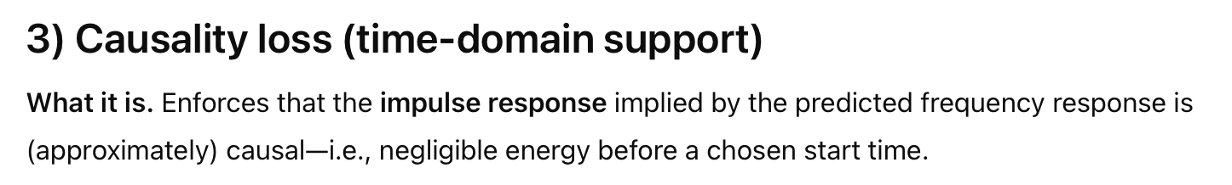
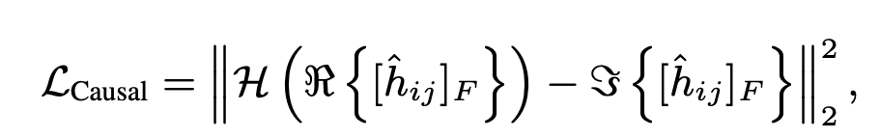
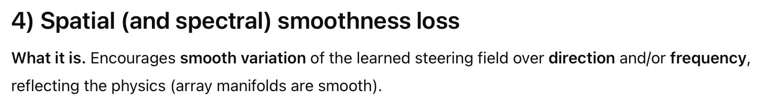
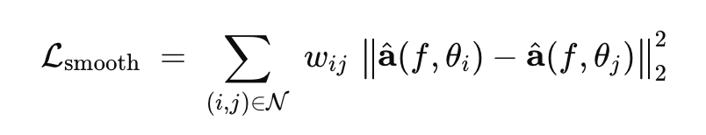
Loss function

Slide 38
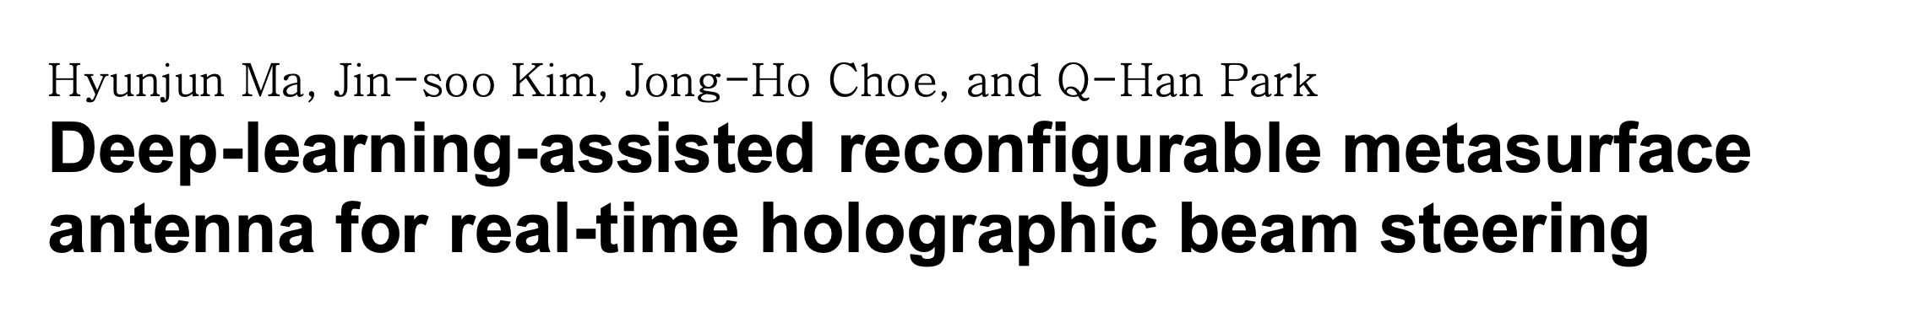
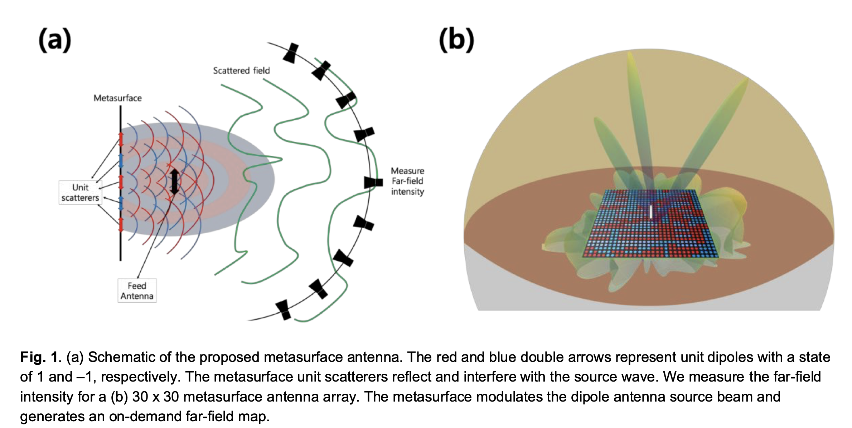

Slide 39
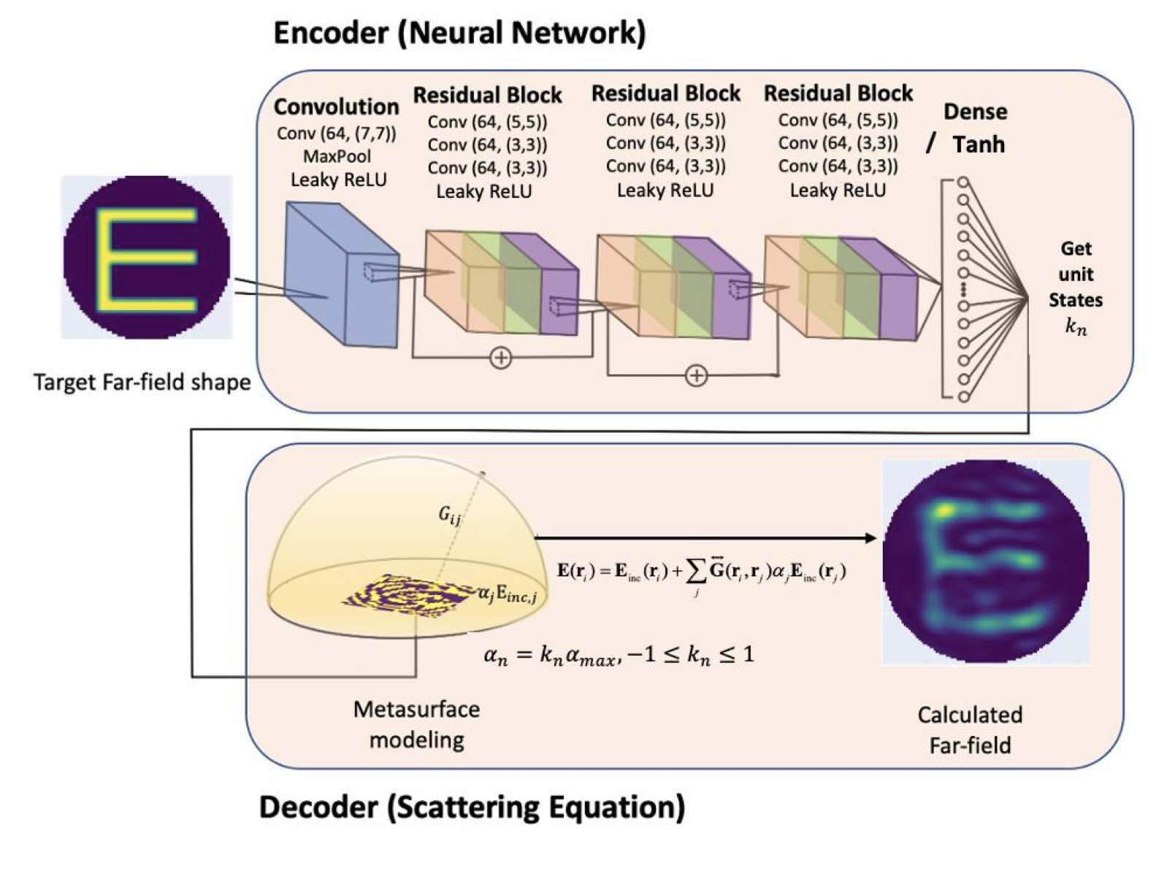

Slide 41
Beamforming in 2D space

Slide 42
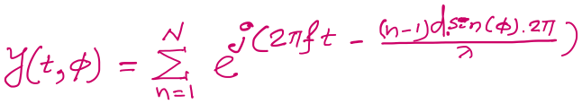

$3d cos$($φ$)
$2d sin$($φ$)
Beamforming in 2D space
$d sin$($φ$)
$$E1$$
$$E2$$
$$E3$$
$$E4$$
…
N elements
$$d$$
$$d$$
$$d$$
Path difference with n^{th} element:
$\left(n−1\right)d sin$($φ$)
Phase difference with n^{th} element:
$\left(n−1\right)d sin$($φ$) 2Π/λ
Signal at 1st sensor:
$e^{j\left(2πft\right)}{ }$
Combined signal:

Slide 43
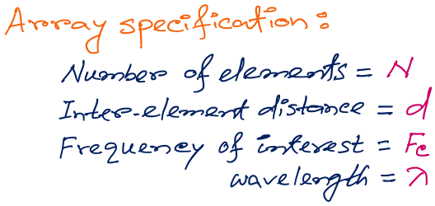
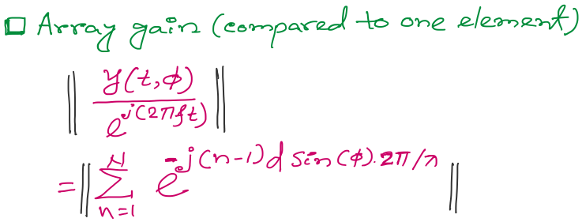
Beamforming in 2D space
f
Notes:
http://www.waves.utoronto.ca/prof/svhum/ece422/notes/15-arrays2.pdf

Slide 44

Beamforming in 2D space
Notes:
http://www.waves.utoronto.ca/prof/svhum/ece422/notes/15-arrays2.pdf

Slide 45
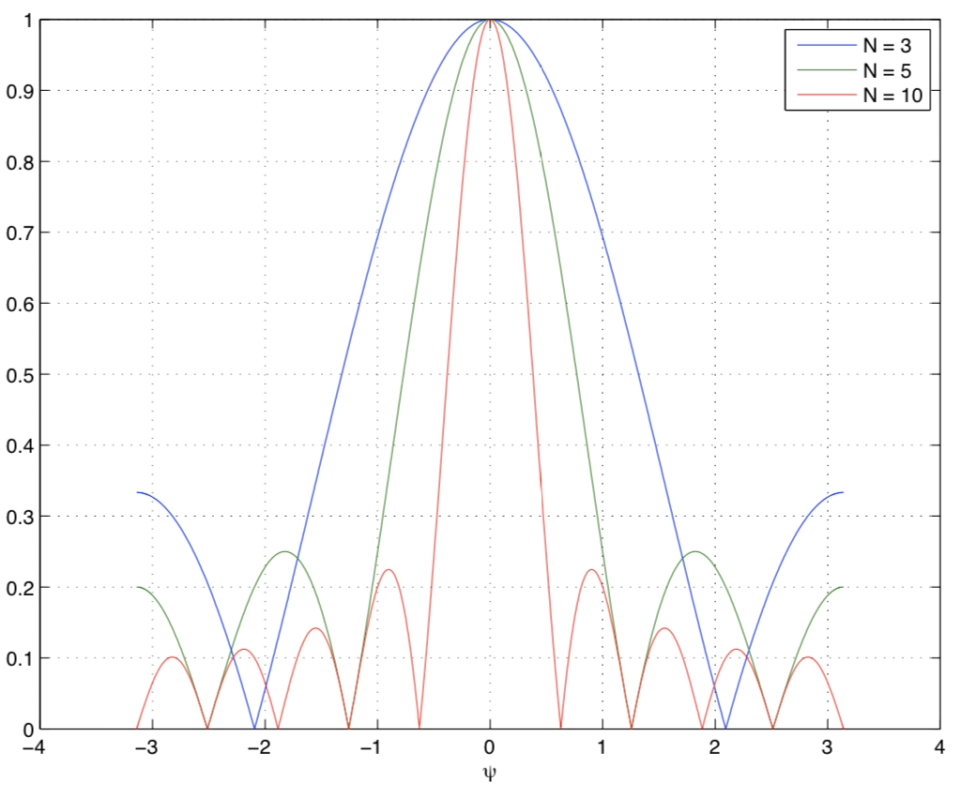
Beamforming in 2D space
Gain
-90 -60 -30 0 30 60 90
Angle
Notes:
http://www.waves.utoronto.ca/prof/svhum/ece422/notes/15-arrays2.pdf

Slide 46
Beamforming in 2D space
Notes:
http://www.waves.utoronto.ca/prof/svhum/ece422/notes/15-arrays2.pdf

Slide 47
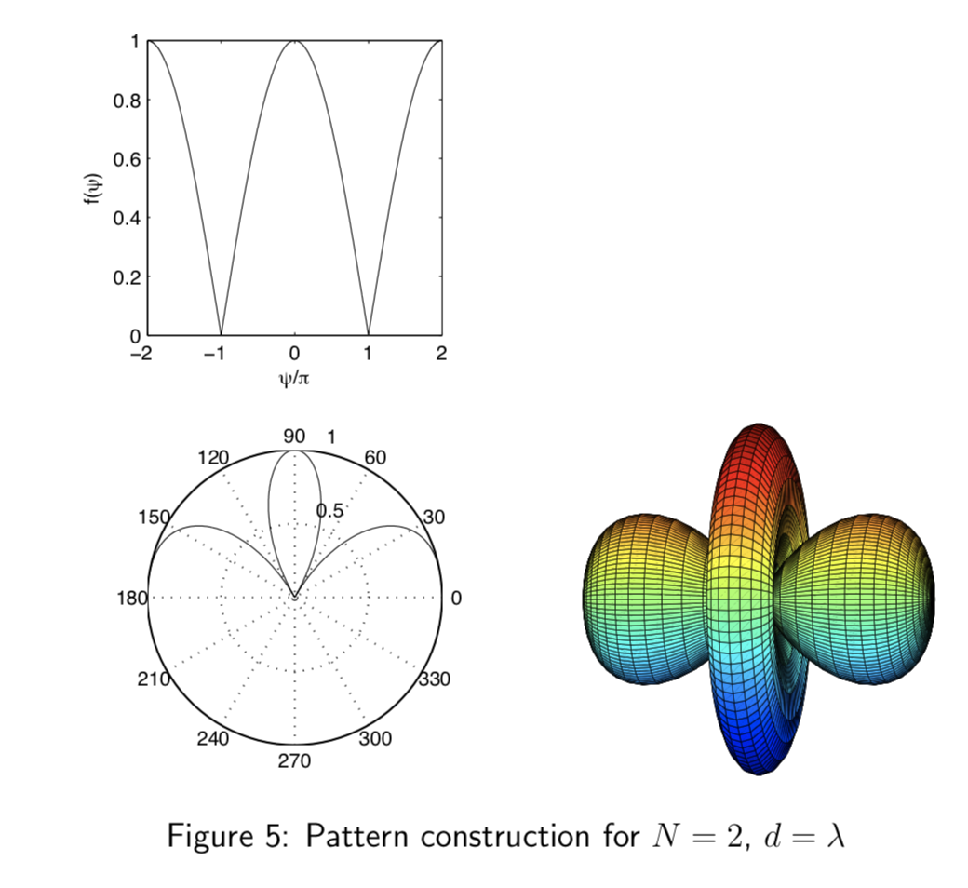
Beamforming in 2D space
Notes:
http://www.waves.utoronto.ca/prof/svhum/ece422/notes/15-arrays2.pdf

Slide 48
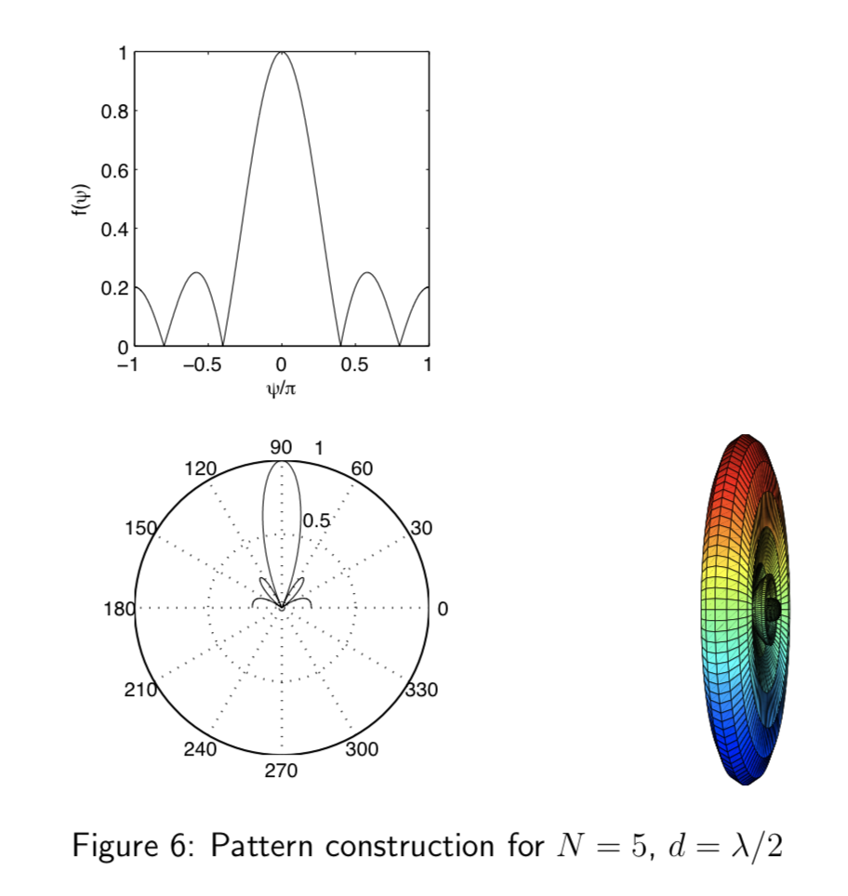
Beamforming in 2D space
Notes:
http://www.waves.utoronto.ca/prof/svhum/ece422/notes/15-arrays2.pdf

Slide 49
Beamforming in 2D space

Slide 50
Sensing with an Array
$$φ$$
$$d$$
Extra phase-1
Extra phase-2
+
Combined signal

Slide 51
Sensing with an Array
$$φ$$
$$d$$
Extra phase-1
Extra phase-2
= $e^{jΘ2}{ }$
= $e^{jΘ1}{ }$
+
= $e^{j\left(2πft\right)}{ }+e^{j\left(2πft + \frac{2π d sin(φ)}{λ}\right)}{ }$

Slide 52
Sensing with an Array
$$φ$$
$$d$$
Extra phase-1
Extra phase-2
= $e^{jΘ2}{ }$
= $e^{jΘ1}{ }$
+
= $e^{j\left(2πft+Θ1\right)}{ }+e^{j\left(2πft + \frac{2π d sin(φ)}{λ}+Θ2\right)}{ }$

Slide 53
Beam-steering
Delay-sum beamformer or Phased array
Notes:
http://www.waves.utoronto.ca/prof/svhum/ece422/notes/15-arrays2.pdf

Slide 54
Beam-steering
Phased array
Add additional phase:
$−\left(n−1\right)d sin$(𝚹_{s}) 2Π/λ
Notes:
http://www.waves.utoronto.ca/prof/svhum/ece422/notes/15-arrays2.pdf

Slide 58
Beamforming in 2D space
Approximation for ‘far field’
$$φ$$
$$?$$
$$d$$

Slide 59
Beamforming in 2D space
Approximation for ‘far field’
$$φ$$
$d sin$($φ$)
$$?$$
$$φ$$
$$d$$

Slide 60
Beamforming in 2D space
Approximation for ‘far field’
$$φ$$
Along this line
$d sin$($φ$)
$$φ$$
$$d$$
Combined signal = $\sin\left(2πft\right) + \sin\left(2πft+ \frac{2π d sin (φ)}{λ}\right)$
= $e^{j\left(2πft\right)}{ }+e^{j\left(2πft+ \frac{2π d sin(φ)}{λ}\right)}{ }$

Slide 61
Beamforming in 2D space
Approximation for ‘far field’
Parameters: d, $φ$, $λ$ (or f)
Does the gain depend on the distance from the array?
$$φ$$
Along this line
$d sin$($φ$)
$$φ$$
$$d$$
Combined signal = $\sin\left(2πft\right) + \sin\left(2πft+ \frac{2π d sin (φ)}{λ}\right)$
= $e^{j\left(2πft\right)}{ }+e^{j\left(2πft+ \frac{2π d sin(φ)}{λ}\right)}{ }$

Slide 62
Beamforming in 2D space
Directional gain of an array

Slide 63
Beamforming in 2D space

Slide 64
Beamforming in 2D space
$$φ$$
$$d$$

Slide 65
Beamforming in 2D space
$$φ$$
$$d$$
+
Combined signal
= $e^{j\left(2πft\right)}{ }+e^{j\left(2πft + \frac{2π d sin(φ)}{λ}\right)}{ }$

Slide 66
Sensing with an Array

Slide 67
Sensing with an Array

Slide 68
Sensing with an Array

Slide 69
Sensing with an Array
Extra path delay
== additional phase

Slide 70
Sensing with an Array
Extra path delay
== additional phase
+
Received combined signal

Slide 71
Sensing with an Array
Extra path delay
== additional phase
+
Received combined signal

Slide 72
Sensing with an Array
Extra path delay
== additional phase
+
Received combined signal

Slide 73
Sensing with an Array
$$φ$$
Extra path delay
== additional phase
+
Received combined signal

Slide 74
Sensing with an Array
Approximation for ‘far field’

Slide 75
Sensing with an Array
Approximation for ‘far field’
Extra path delay
== additional phase

Slide 76
Sensing with an Array
Approximation for ‘far field’
$$φ$$
$d sin$($φ$)
$$d$$
+
Received combined signal

Slide 77
Sensing with an Array
Approximation for ‘far field’
$$φ$$
Along this line
$d sin$($φ$)
$$d$$
= $e^{j\left(2πft\right)}{ }+e^{j\left(2πft+ \frac{2π d sin(φ)}{λ}\right)}{ }$
Combined signal

Slide 78
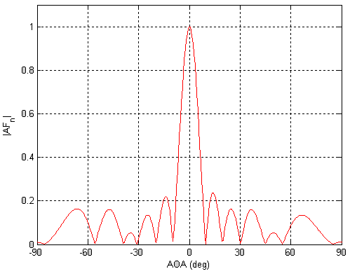
Sensing with an Array: Spatial gain
$$φ$$

Slide 79
Sensing with an Array
$$φ$$
$$d$$
+
Combined signal
= $e^{j\left(2πft\right)}{ }+e^{j\left(2πft + \frac{2π d sin(φ)}{λ}\right)}{ }$

Slide 80
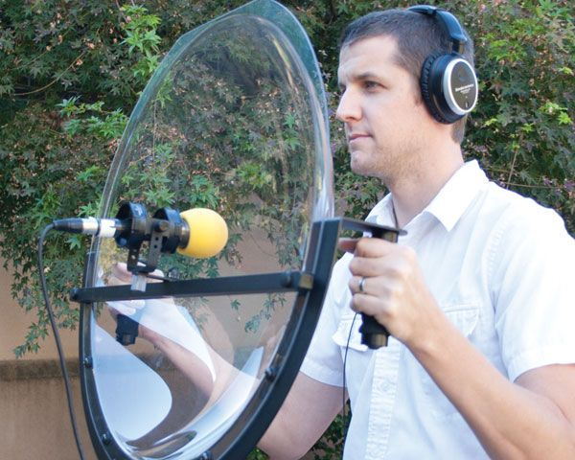
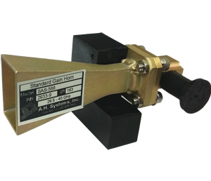
Directionality of signals: Physical guiding

Slide 81


Directionality of signals: Array of sensors

Slide 82
Uniform Linear Array (ULA)

Slide 83
Beamforming in 2D space
$d sin$($φ$)
$$E1$$
$$E2$$
$$E3$$
$$E4$$
…
N elements
$$d$$
$$d$$
$$d$$
Interelement distance = d

Slide 84
Beamforming in 2D space
$3d sin$($φ$)
$2d sin$($φ$)
$d sin$($φ$)
$$E1$$
$$E2$$
$$E3$$
$$E4$$
…
N elements
$$d$$
$$d$$
$$d$$
Interelement distance = d

Slide 85
Beamforming in 2D space
$3d sin$($φ$)
$2d sin$($φ$)
$d sin$($φ$)
$$E1$$
$$E2$$
$$E3$$
$$E4$$
…
N elements
$$d$$
$$d$$
$$d$$
Path difference with n^{th} element:
$\left(n−1\right)d sin$($φ$)
Phase difference with n^{th} element:
$\left(n−1\right)d sin$($φ$) 2Π/λ

Slide 86
Beamforming in 2D space
$3d sin$($φ$)
$2d sin$($φ$)
$d sin$($φ$)
$$E1$$
$$E2$$
$$E3$$
$$E4$$
…
N elements
$$d$$
$$d$$
$$d$$
Interelement distance = d
Path difference with n^{th} element:
$\left(n−1\right)d sin$($φ$)
Phase difference with n^{th} element:
$\left(n−1\right)d sin$($φ$) 2Π/λ

Slide 87
$3d cos$($φ$)
$2d sin$($φ$)
Beamforming in 2D space
$d sin$($φ$)
$$E1$$
$$E2$$
$$E3$$
$$E4$$
…
N elements
$$d$$
$$d$$
$$d$$
Path difference with n^{th} element:
$\left(n−1\right)d sin$($φ$)
Phase difference with n^{th} element:
$\left(n−1\right)d sin$($φ$) 2Π/λ
Signal at 1st sensor:
$e^{j\left(2πft\right)}{ }$
Combined signal:

Slide 88
Beamforming in 2D space
f
Notes:
http://www.waves.utoronto.ca/prof/svhum/ece422/notes/15-arrays2.pdf

Slide 89
Beamforming in 2D space
Notes:
http://www.waves.utoronto.ca/prof/svhum/ece422/notes/15-arrays2.pdf

Slide 90
Beamforming in 2D space
Gain
-90 -60 -30 0 30 60 90
Angle
Notes:
http://www.waves.utoronto.ca/prof/svhum/ece422/notes/15-arrays2.pdf

Slide 91
Beamforming in 2D space
Notes:
http://www.waves.utoronto.ca/prof/svhum/ece422/notes/15-arrays2.pdf

Slide 92
Beamforming in 2D space
Notes:
http://www.waves.utoronto.ca/prof/svhum/ece422/notes/15-arrays2.pdf

Slide 93
Beamforming in 2D space
Notes:
http://www.waves.utoronto.ca/prof/svhum/ece422/notes/15-arrays2.pdf

Slide 94
Beamforming in 2D space

Slide 95
Sensing with an Array
$$φ$$
$$d$$
Extra phase-1
Extra phase-2
+
Combined signal

Slide 96
Sensing with an Array
$$φ$$
$$d$$
Extra phase-1
Extra phase-2
= $e^{jΘ2}{ }$
= $e^{jΘ1}{ }$
+
= $e^{j\left(2πft\right)}{ }+e^{j\left(2πft + \frac{2π d sin(φ)}{λ}\right)}{ }$

Slide 97
Sensing with an Array
$$φ$$
$$d$$
Extra phase-1
Extra phase-2
= $e^{jΘ2}{ }$
= $e^{jΘ1}{ }$
+
= $e^{j\left(2πft+Θ1\right)}{ }+e^{j\left(2πft + \frac{2π d sin(φ)}{λ}+Θ2\right)}{ }$

Slide 98
Beam-steering
Delay-sum beamformer or Phased array
Notes:
http://www.waves.utoronto.ca/prof/svhum/ece422/notes/15-arrays2.pdf

Slide 99
Beam-steering
Phased array
Add additional phase:
$−\left(n−1\right)d sin$(𝚹_{s}) 2Π/λ
Notes:
http://www.waves.utoronto.ca/prof/svhum/ece422/notes/15-arrays2.pdf

Slide 100
Beam-steering
Delay-sum beamformer or Phased array
Notes:
http://www.waves.utoronto.ca/prof/svhum/ece422/notes/15-arrays2.pdf

Slide 101



Slide 102


Slide 103

Computationally controlling beam direction

