Slide 1
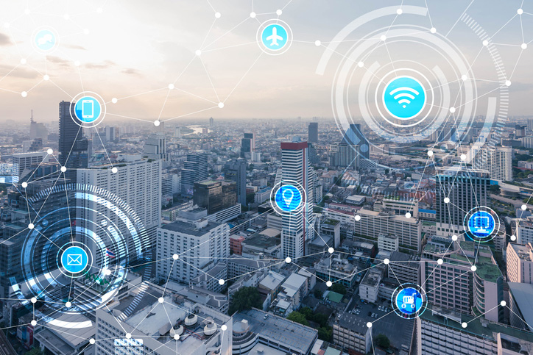
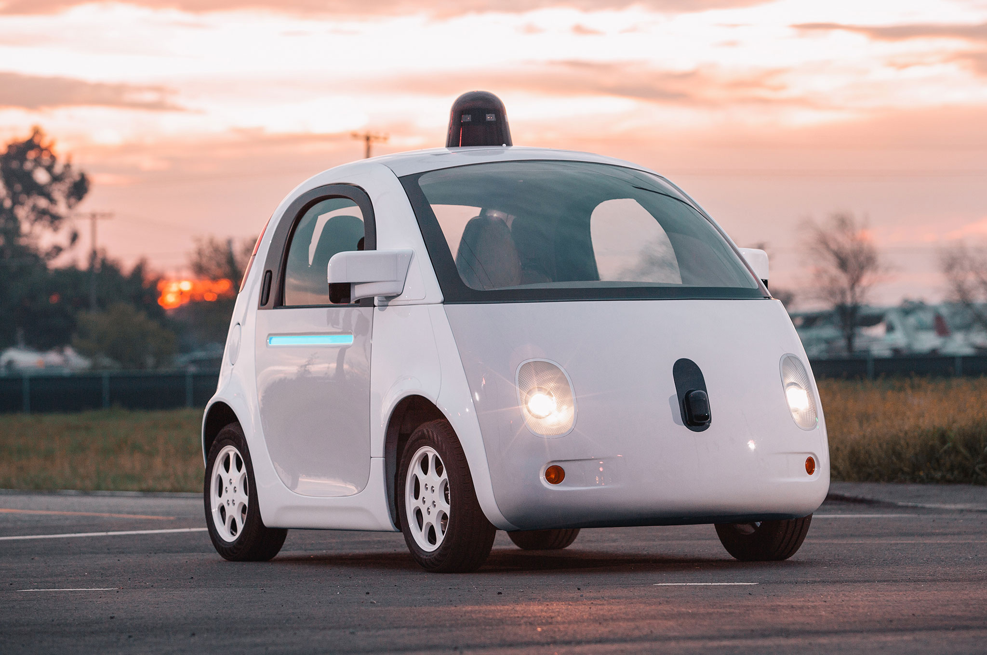
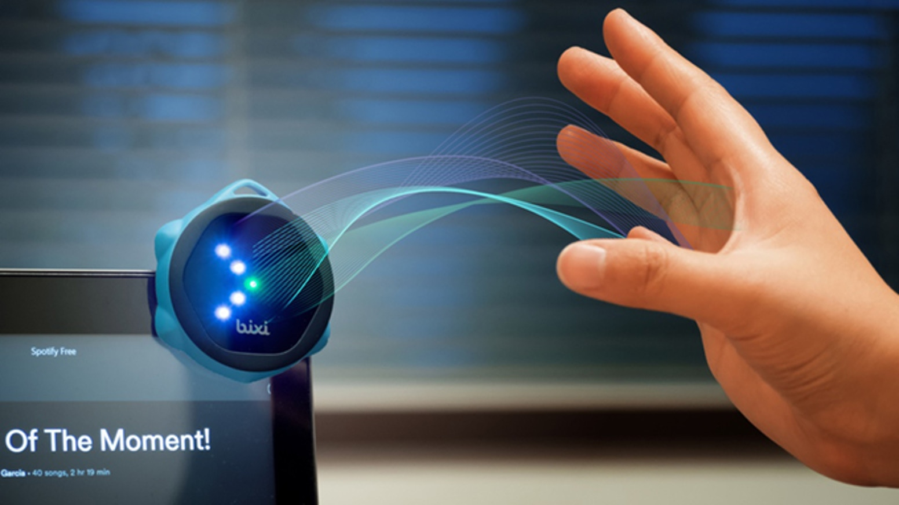
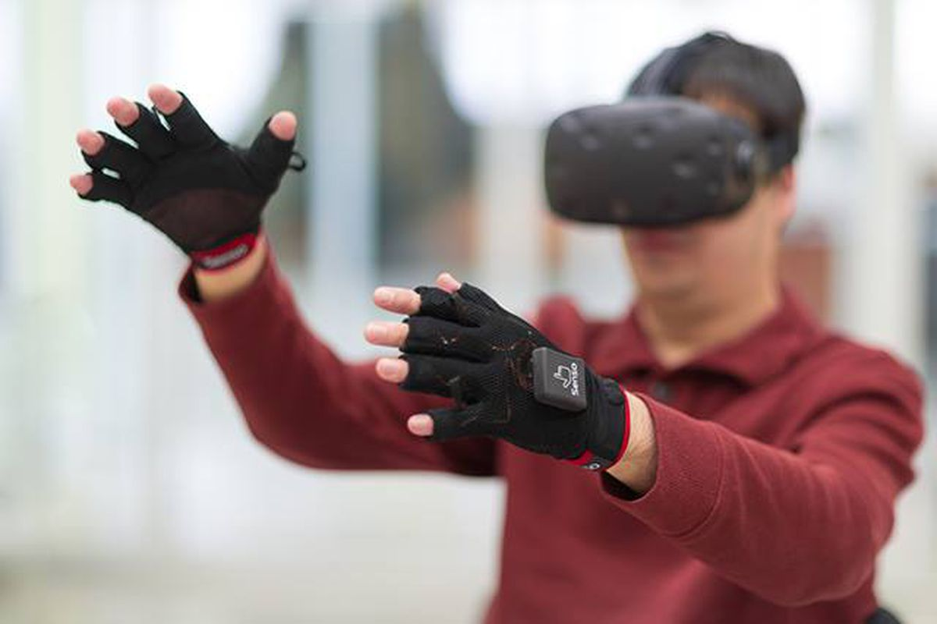

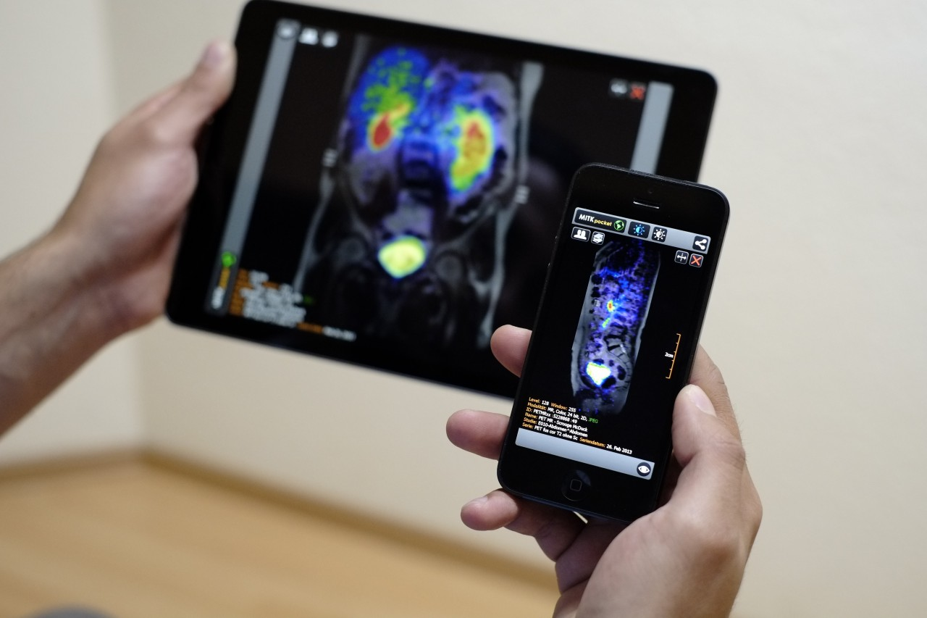
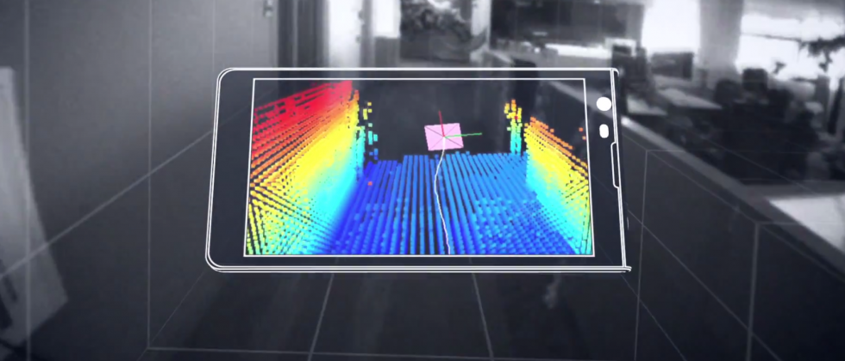
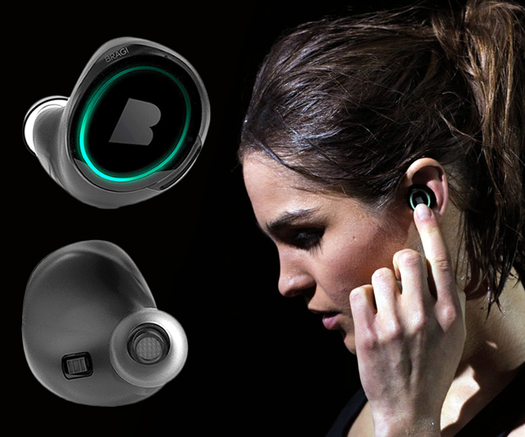
Machine Learning for Physical Sensing & Perception
CMSC 818V : Fall 2025
Lecture 2_4: Inverse problems: Spatial Perception
Nirupam Roy
Tu-Th 3:30 – 4:45pm
IRB 1207

Slide 2
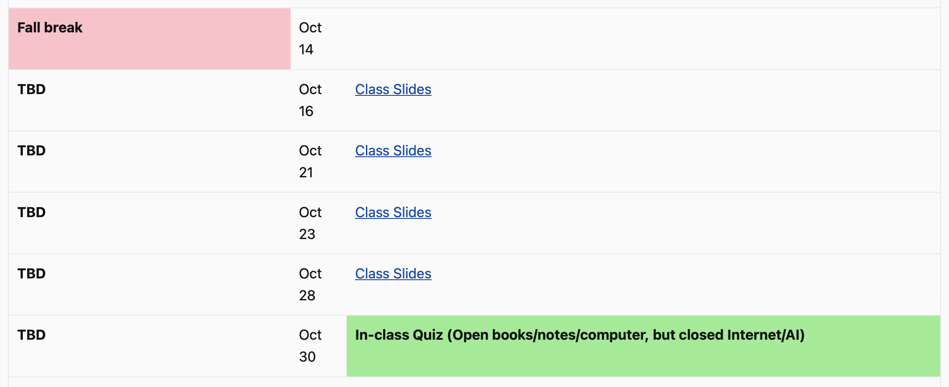
Announcements

Slide 3
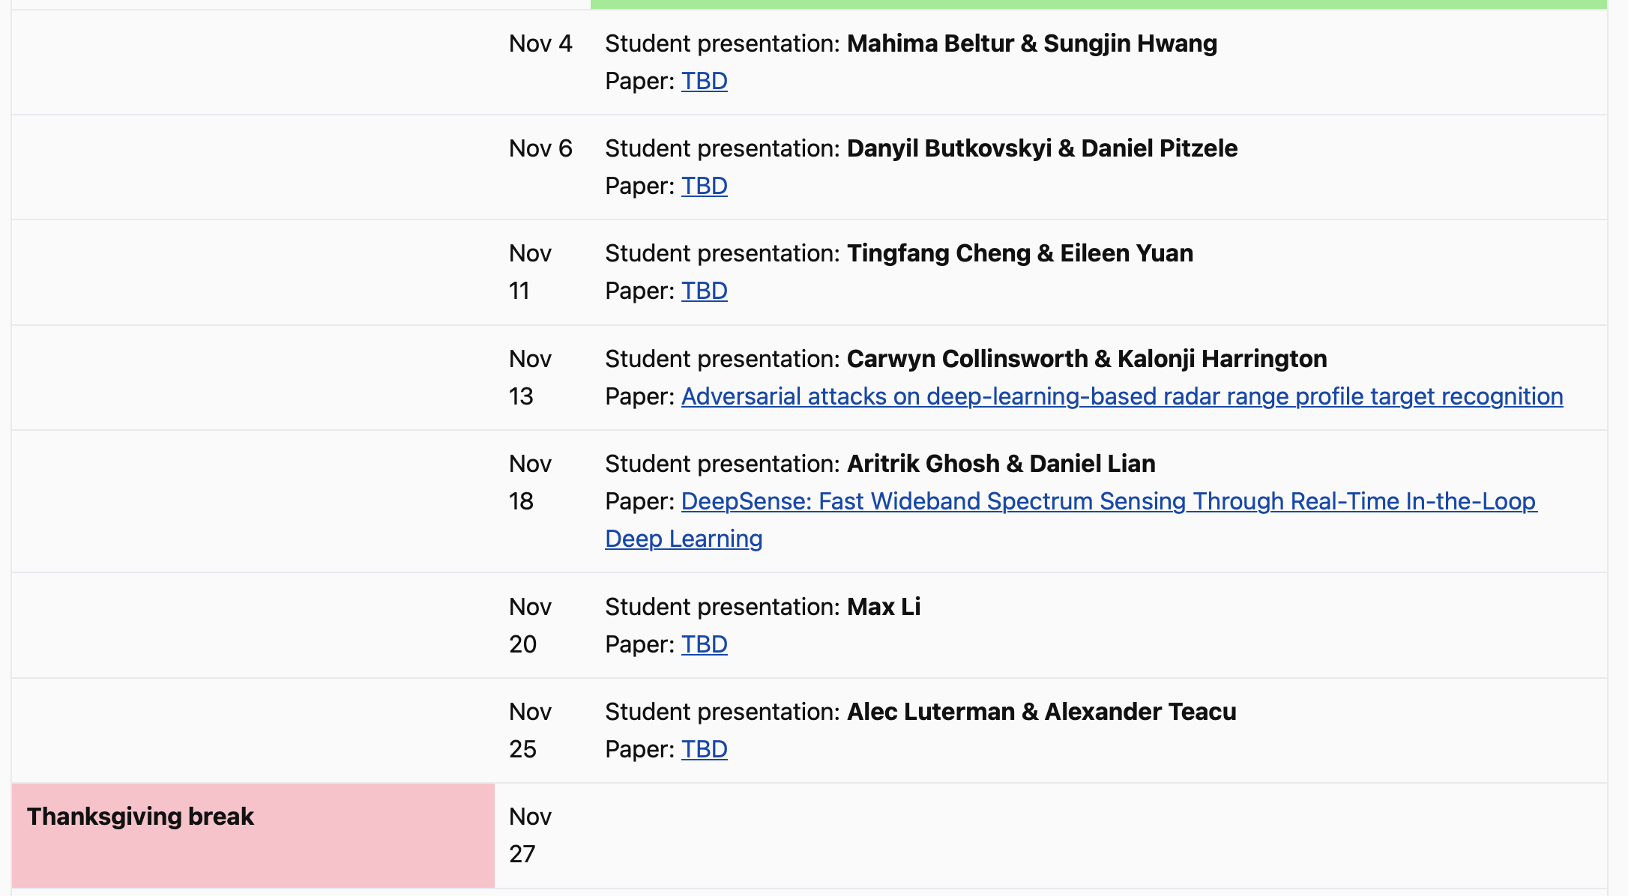
Announcements

Slide 4
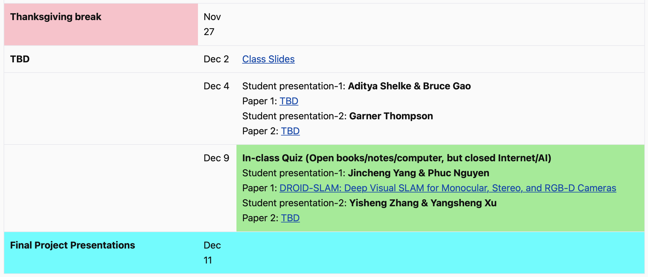
Announcements

Slide 5
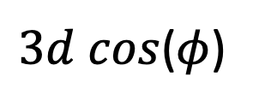
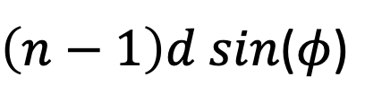

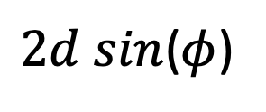

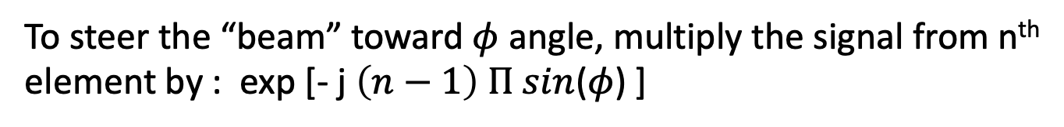
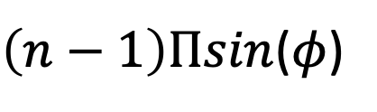




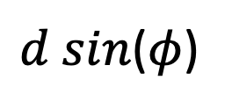

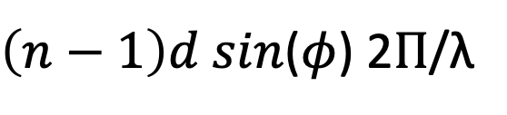
$3d cos$($φ$)
$2d sin$($φ$)
Beamforming in 2D space (Recap…)
$d sin$($φ$)
$$E1$$
$$E2$$
$$E3$$
$$E4$$
…
N elements
$$d$$
$$d$$
$$d$$
Path difference with n^{th} element:
$\left(n−1\right)d sin$($φ$)
Phase difference with n^{th} element:
$\left(n−1\right)d sin$($φ$) 2Π/λ
Setting d = (λ /2), we get:
$\left(n−1\right)\text{Π}sin$($φ$)
To steer the “beam” toward $φ$ angle, multiply the signal from n^{th} element by : exp [- j $\left(n−1\right) \text{Π} sin$($φ$) ]

Slide 6
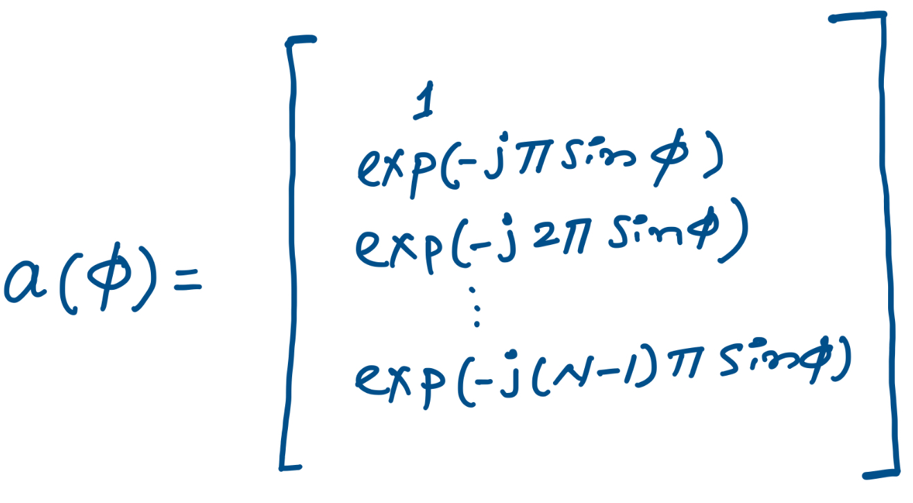
$3d cos$($φ$)
$2d sin$($φ$)
Beamforming in 2D space (Recap…)
$d sin$($φ$)
$$E1$$
$$E2$$
$$E3$$
$$E4$$
…
N elements
$$d$$
$$d$$
$$d$$
Steering vector:

Slide 7
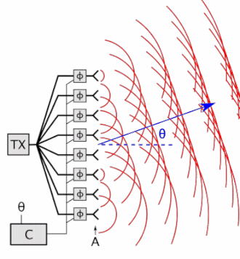
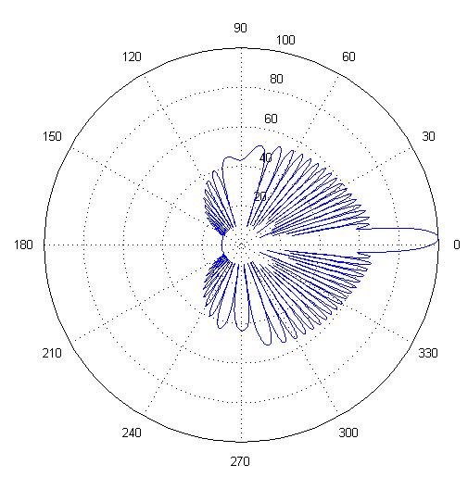
Beam-steering (Recap…)
Delay-sum beamformer or Phased array
Notes:
http://www.waves.utoronto.ca/prof/svhum/ece422/notes/15-arrays2.pdf

Slide 8
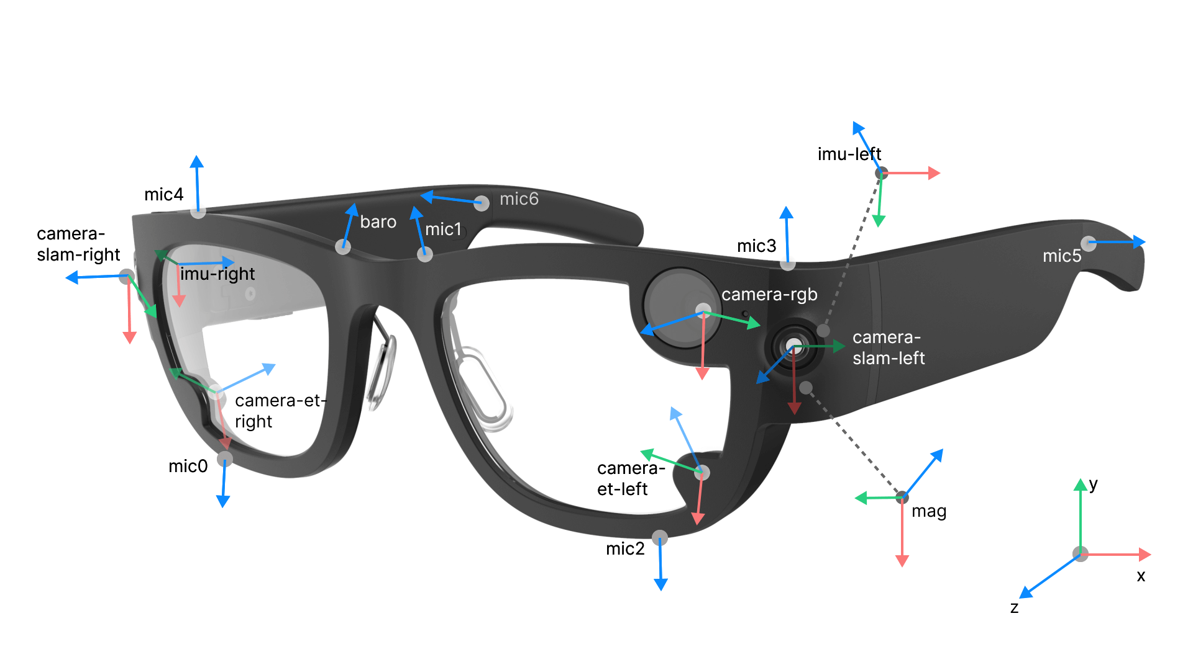
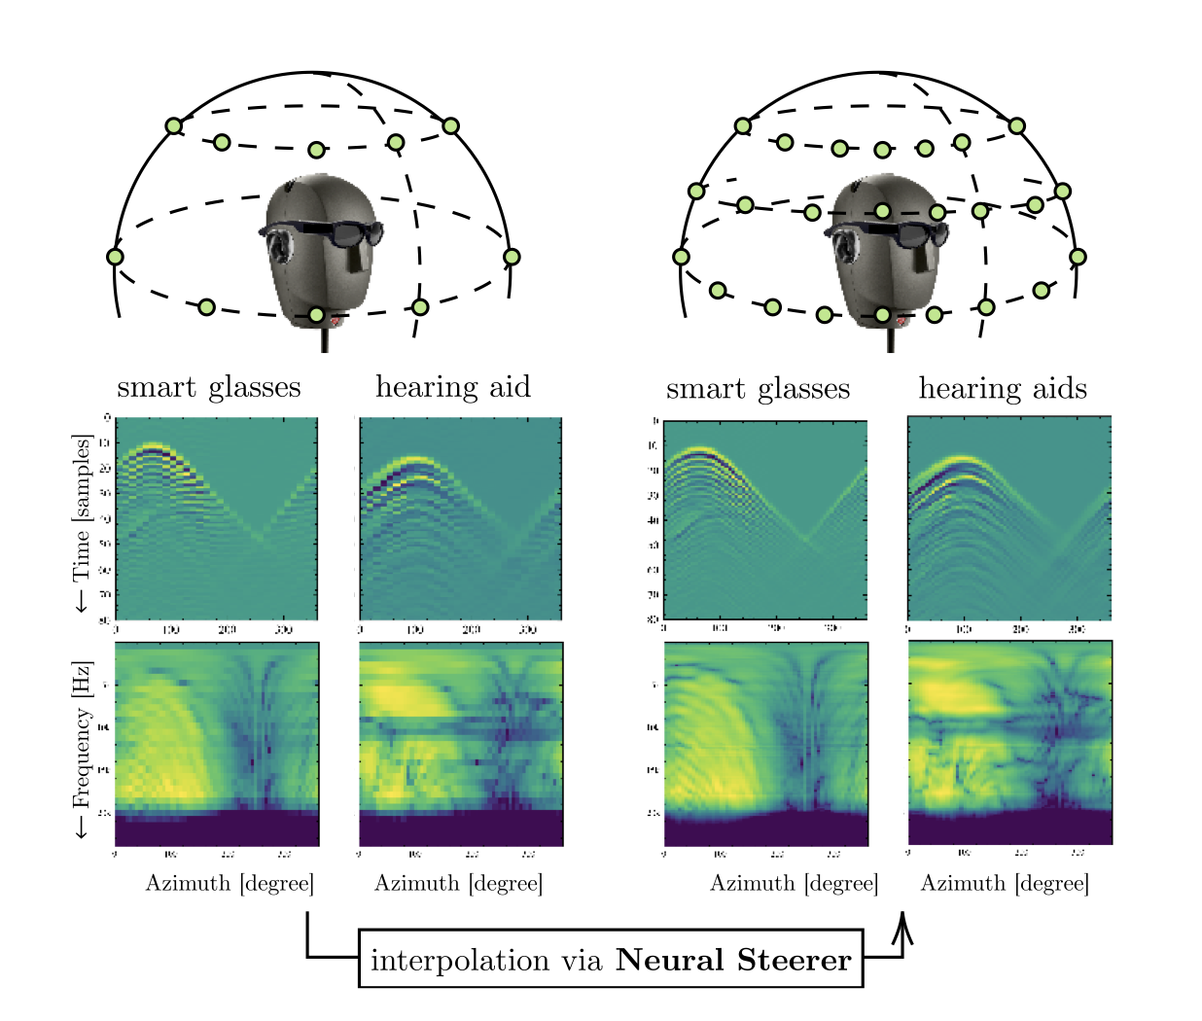
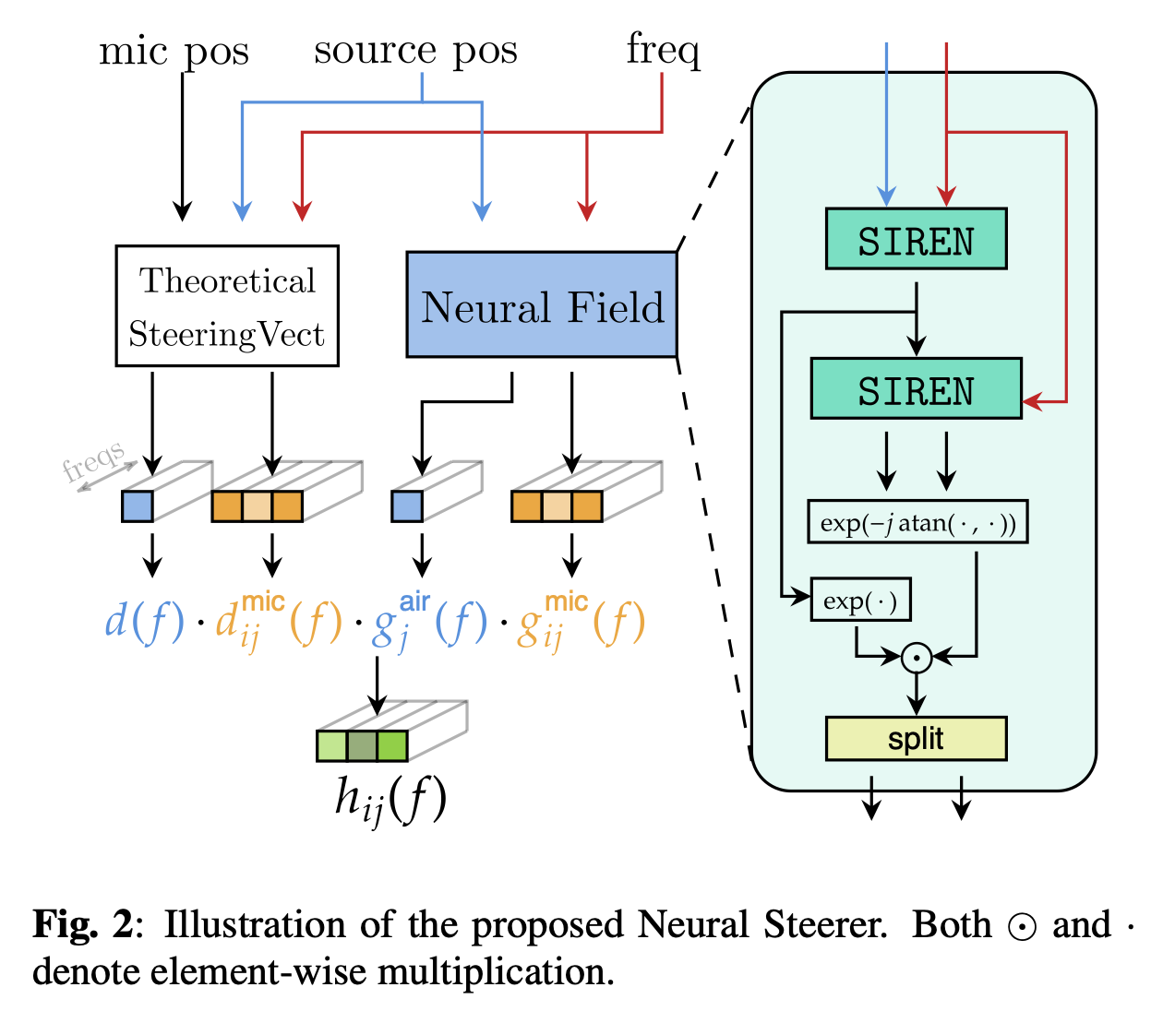
Beamforming in Complex Environments (Recap…)

Slide 9
Direction of Arrival (DoA) Estimation

Slide 10
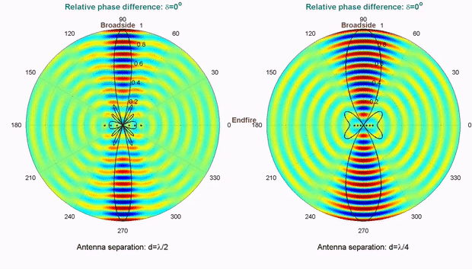
Computationally controlling beam direction

Slide 11
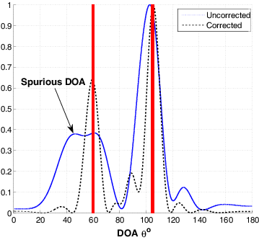
Computationally controlling beam direction

Slide 12
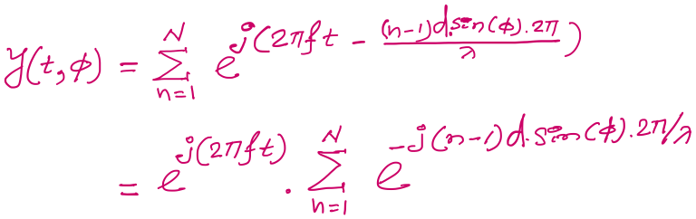

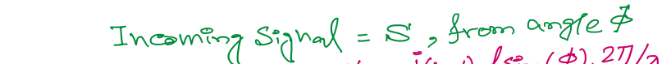
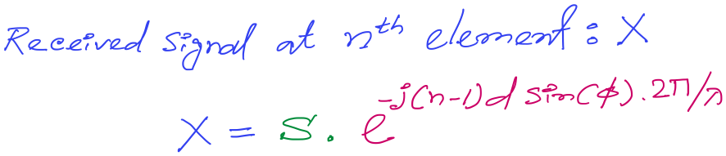
DoA Estimation: Delay-sum
Notes:
http://www.waves.utoronto.ca/prof/svhum/ece422/notes/15-arrays2.pdf

Slide 13
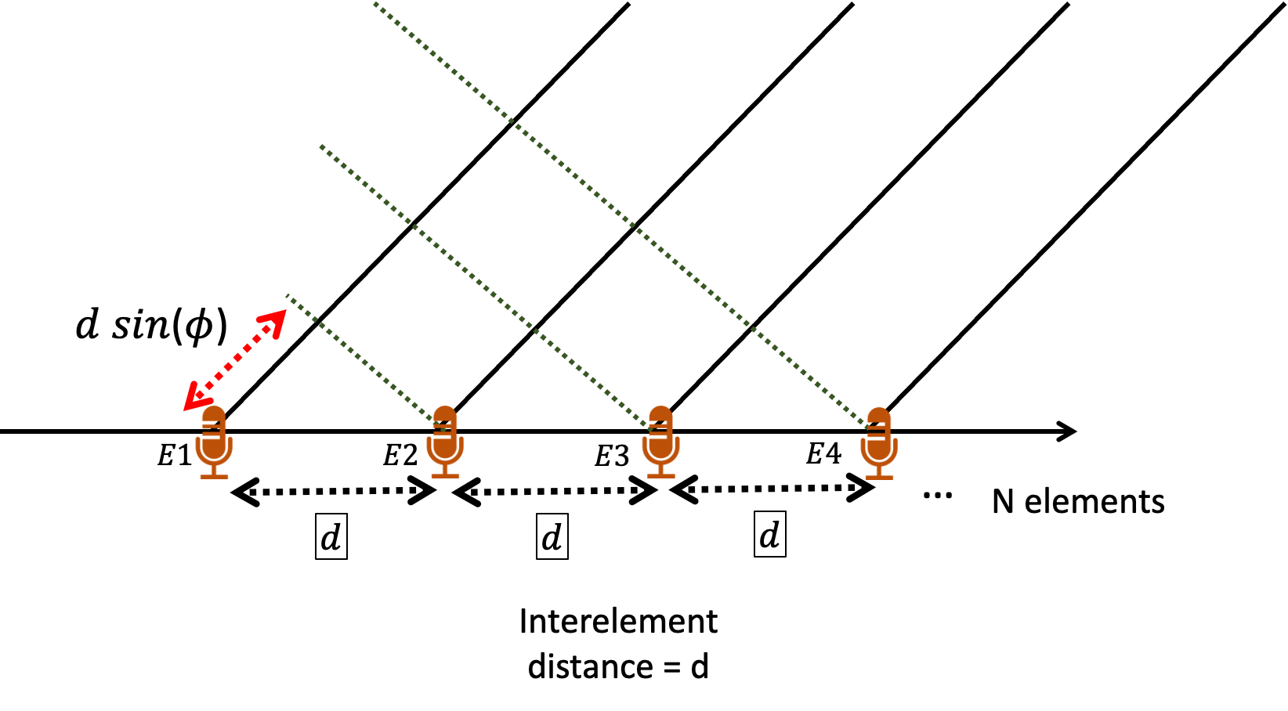
DoA Estimation: Delay-sum
For 3rd mic, n == 3
Notes:
http://www.waves.utoronto.ca/prof/svhum/ece422/notes/15-arrays2.pdf

Slide 14
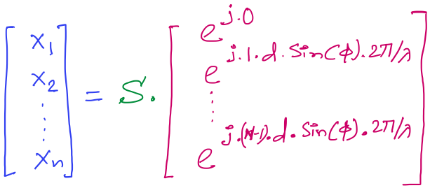

DoA Estimation: Delay-sum
Received signals in all elements:
…
Note: Here the samples from individual sensors are collected separately and simultaneously, not added together.
Steering vector
Notes:
http://www.waves.utoronto.ca/prof/svhum/ece422/notes/15-arrays2.pdf

Slide 15
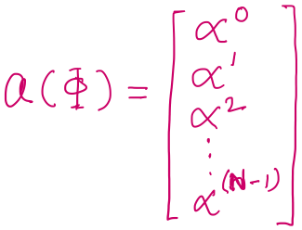

DoA Estimation: Delay-sum
Received signals in all elements:
Notes:
http://www.waves.utoronto.ca/prof/svhum/ece422/notes/15-arrays2.pdf

Slide 16
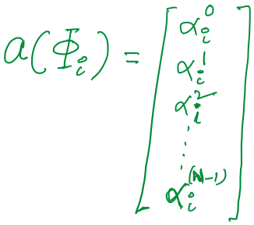

DoA Estimation: Delay-sum

Slide 17
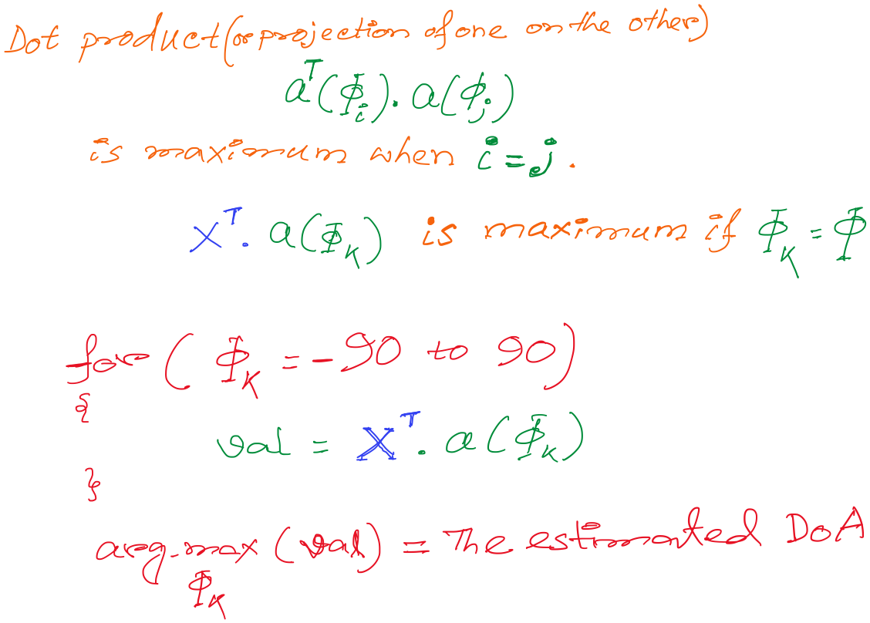
DoA Estimation: Delay-sum

Slide 18
DoA Estimation: Delay-sum

Slide 19
DoA Estimation: Delay-sum
How is this a “delay -sum” ?

Slide 20
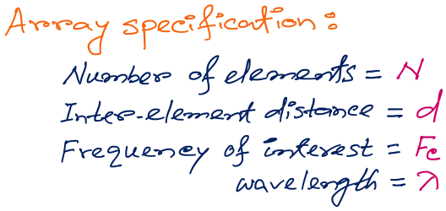
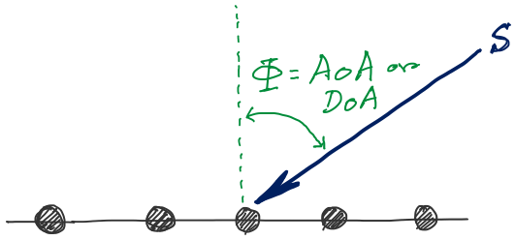
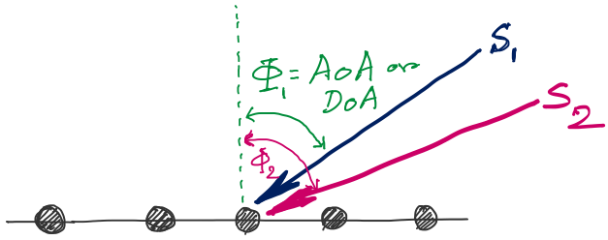
DoA Estimation
d
d
d
d
Notes:
http://www.waves.utoronto.ca/prof/svhum/ece422/notes/15-arrays2.pdf

Slide 21
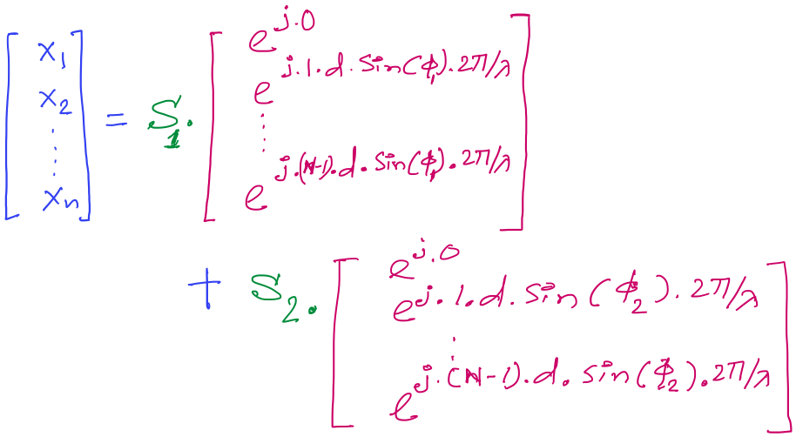
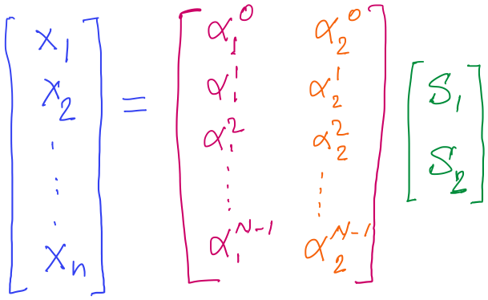
DoA Estimation

Slide 22
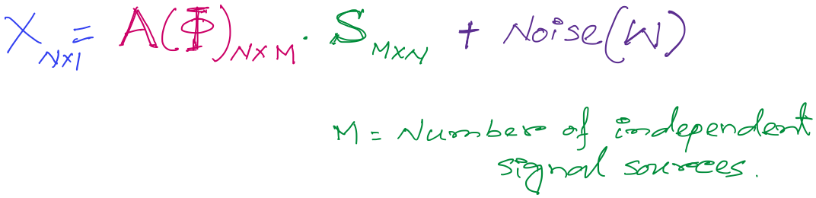
DoA Estimation
Mx1
Steering matrix

Slide 23
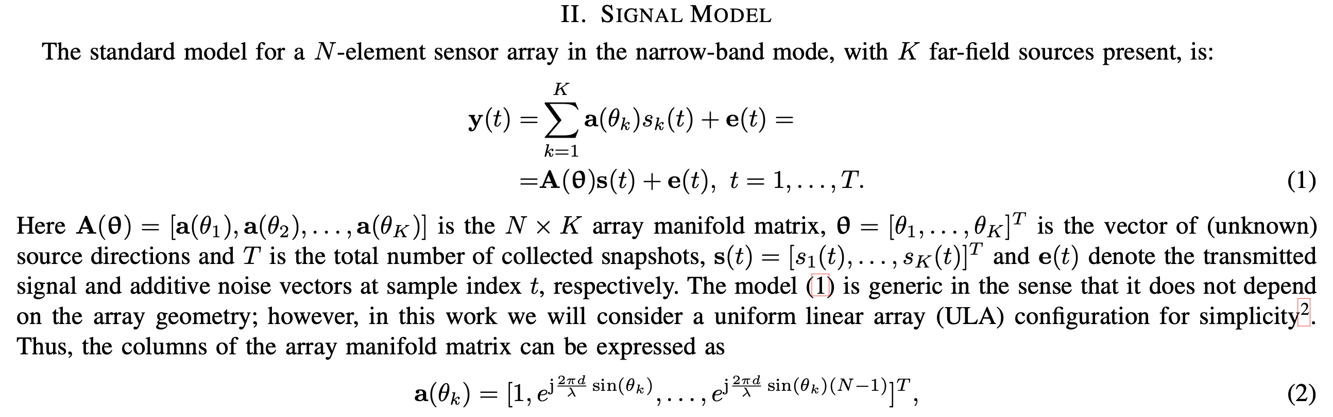
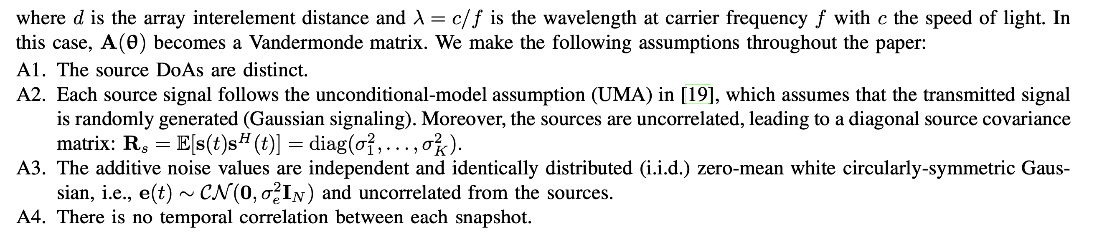
DoA Estimation

Slide 24
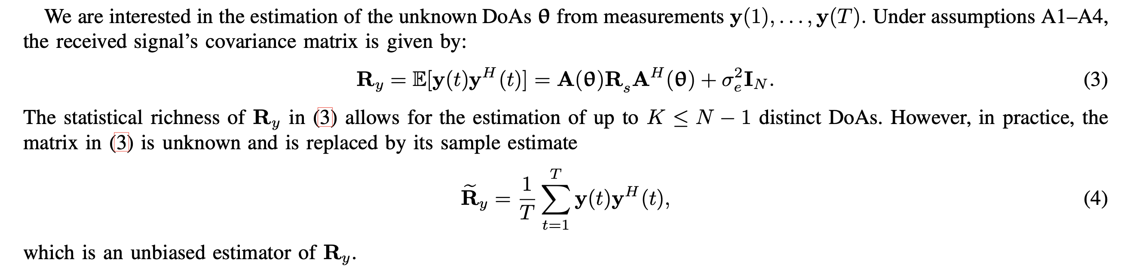
DoA Estimation

Slide 25
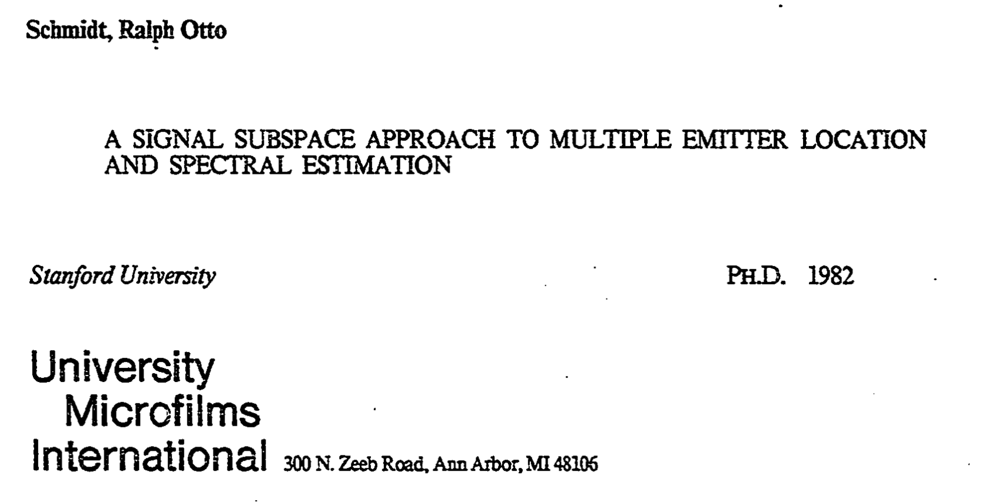
A subspace algorithm for DoA: MUSIC
Paper: https://www.proquest.com/docview/303236366?pq-origsite=gscholar&fromopenview=true&sourcetype=Dissertations%20&%20Theses

Slide 26
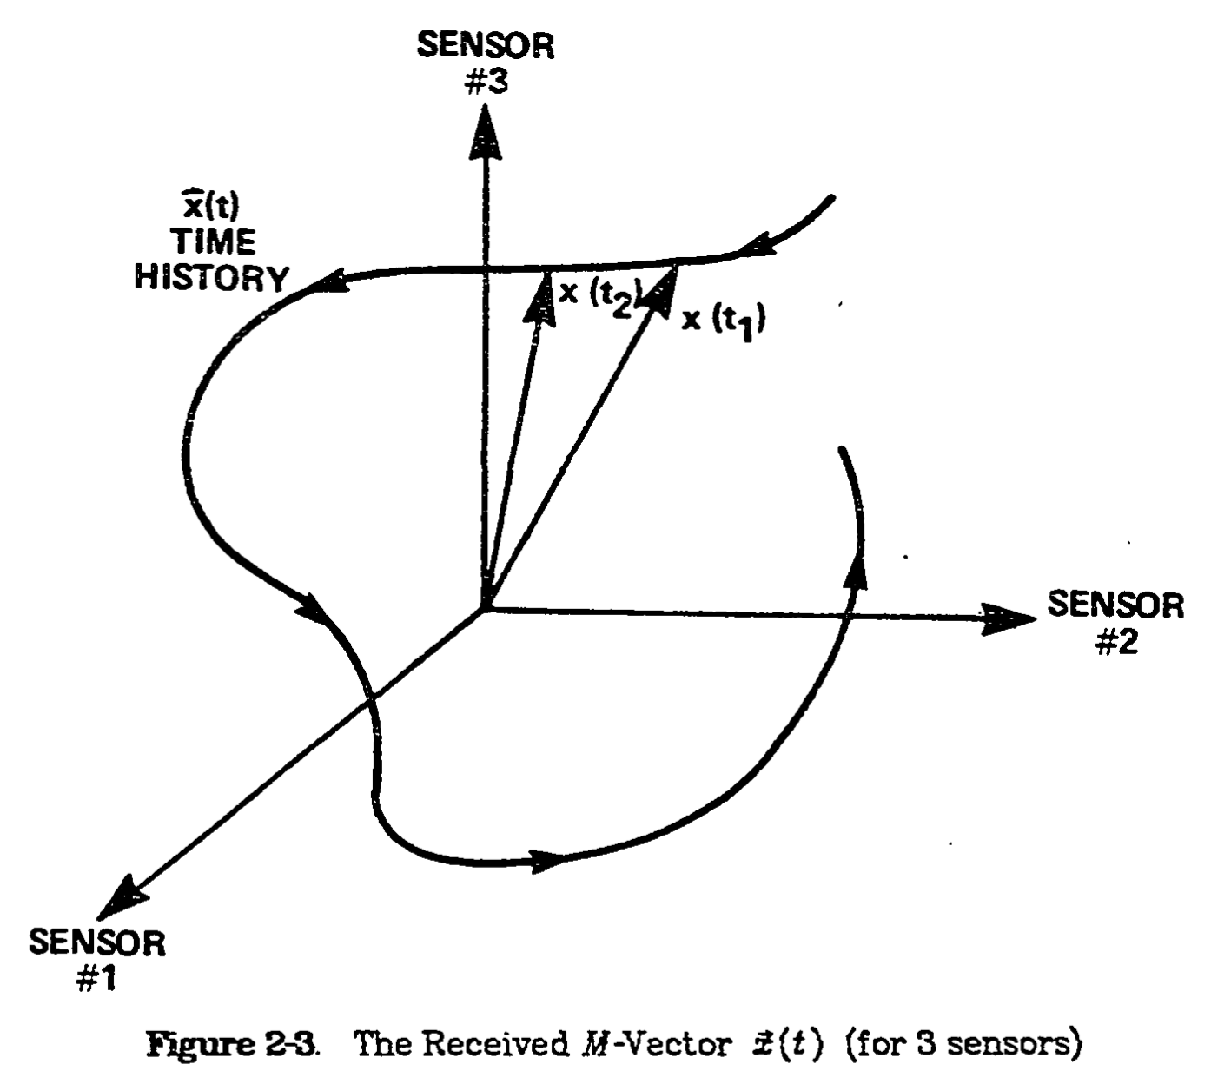
A subspace algorithm for DoA: MUSIC

Slide 27
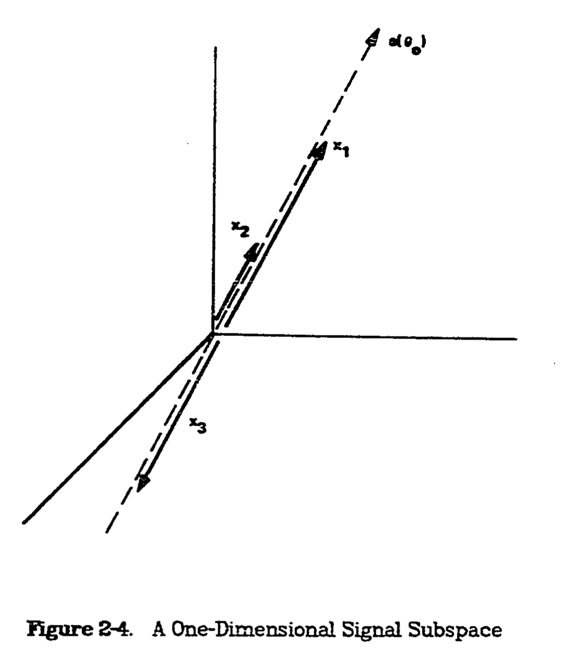
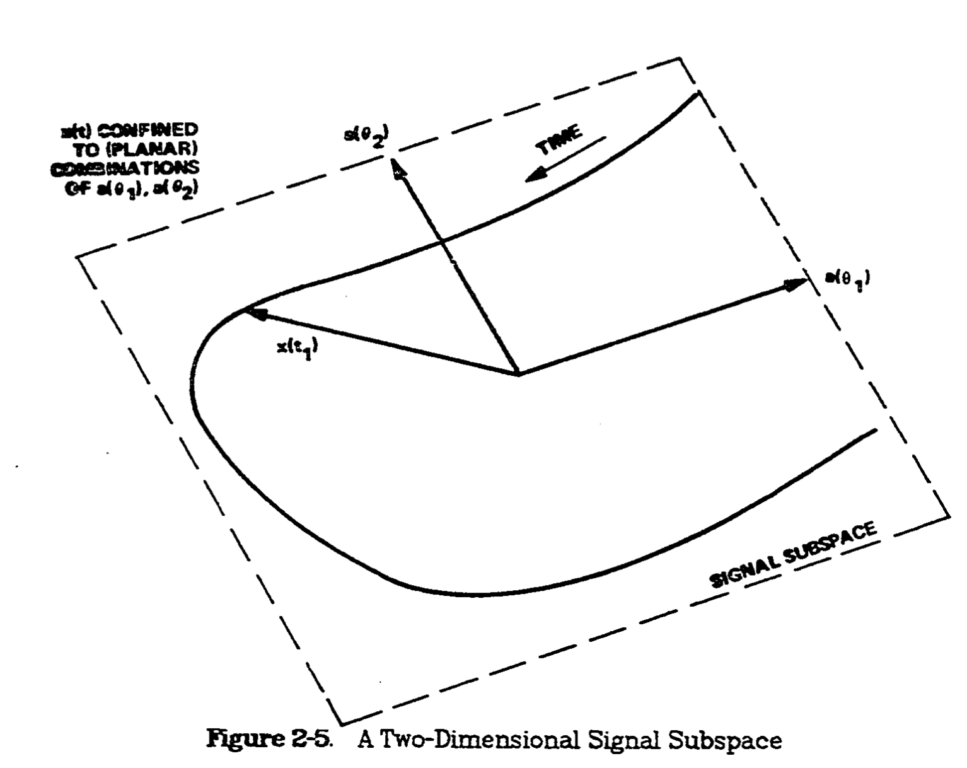
A subspace algorithm for DoA: MUSIC

Slide 28
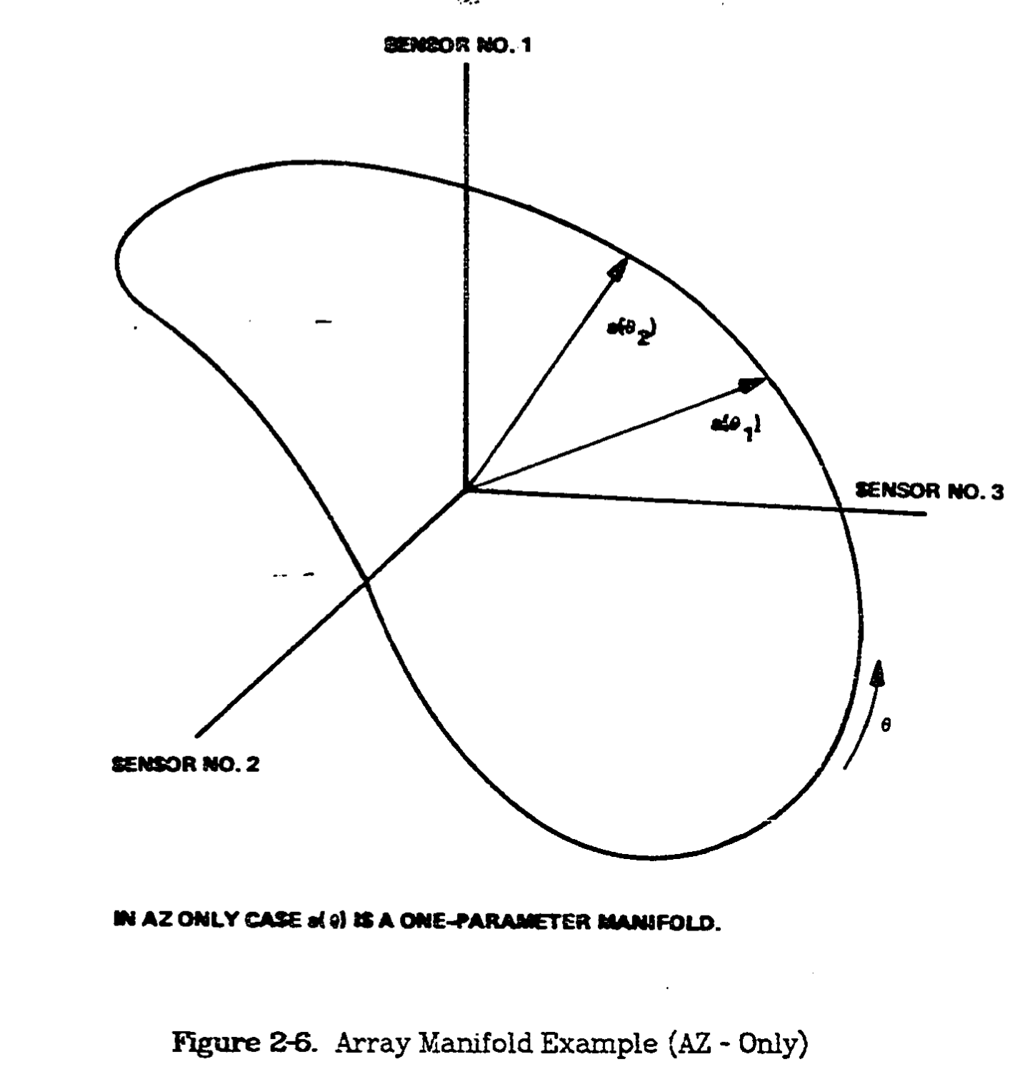
A subspace algorithm for DoA: MUSIC

Slide 29
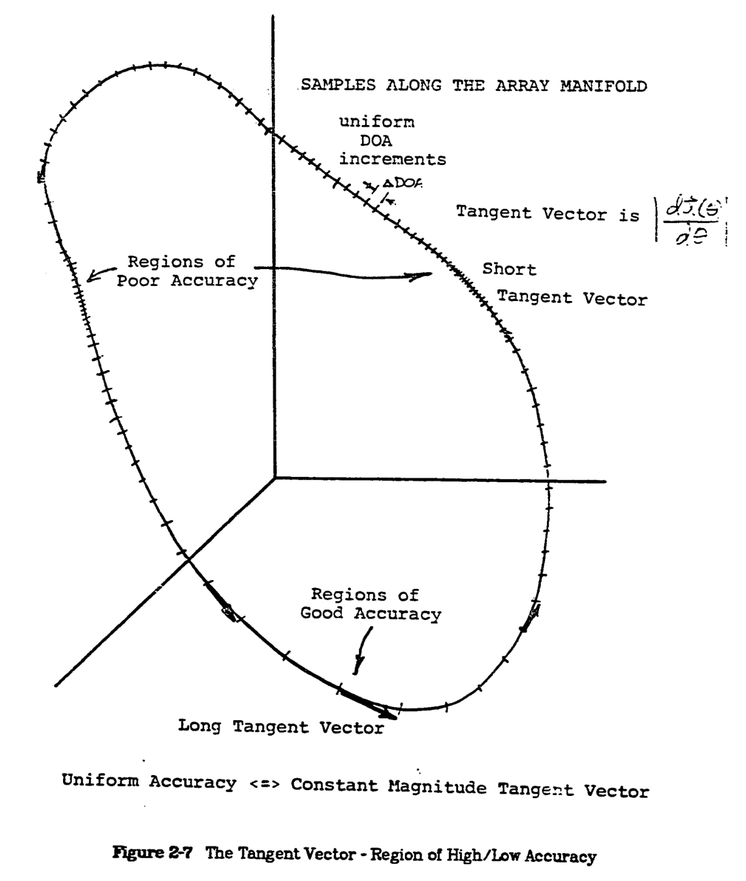
A subspace algorithm for DoA: MUSIC

Slide 30
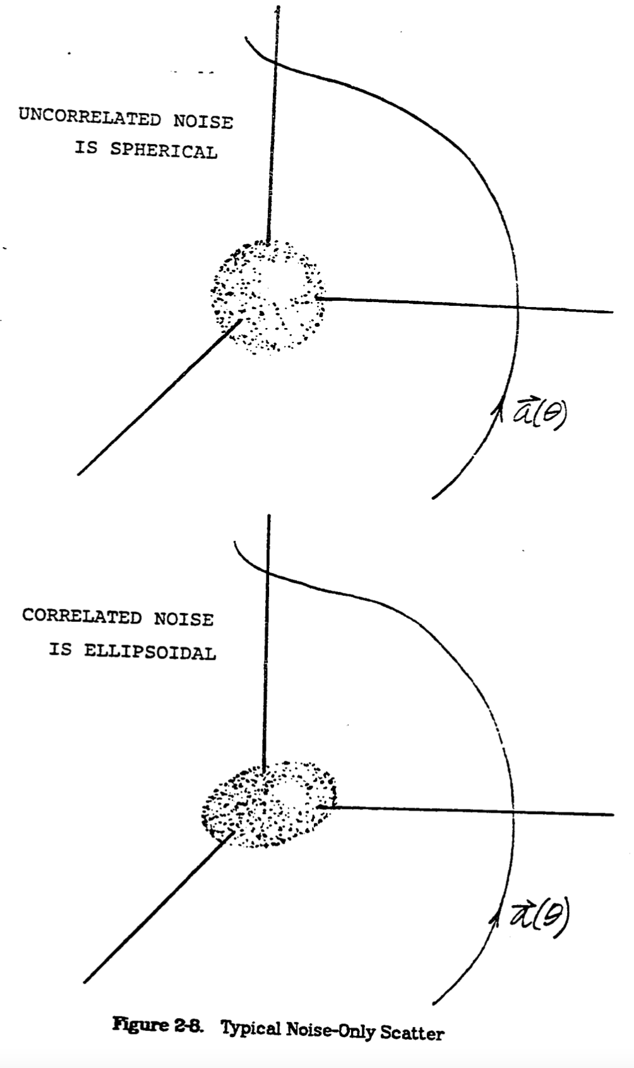
A subspace algorithm for DoA: MUSIC

Slide 31
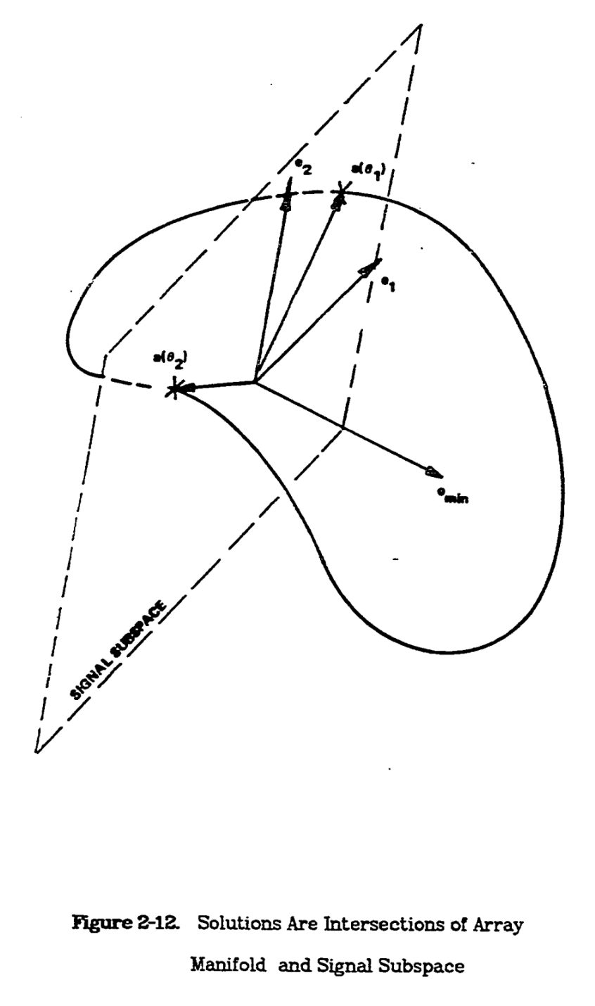
A subspace algorithm for DoA: MUSIC

Slide 32

A subspace algorithm for DoA: MUSIC

Slide 33

A subspace algorithm for DoA: MUSIC

