Slide 1

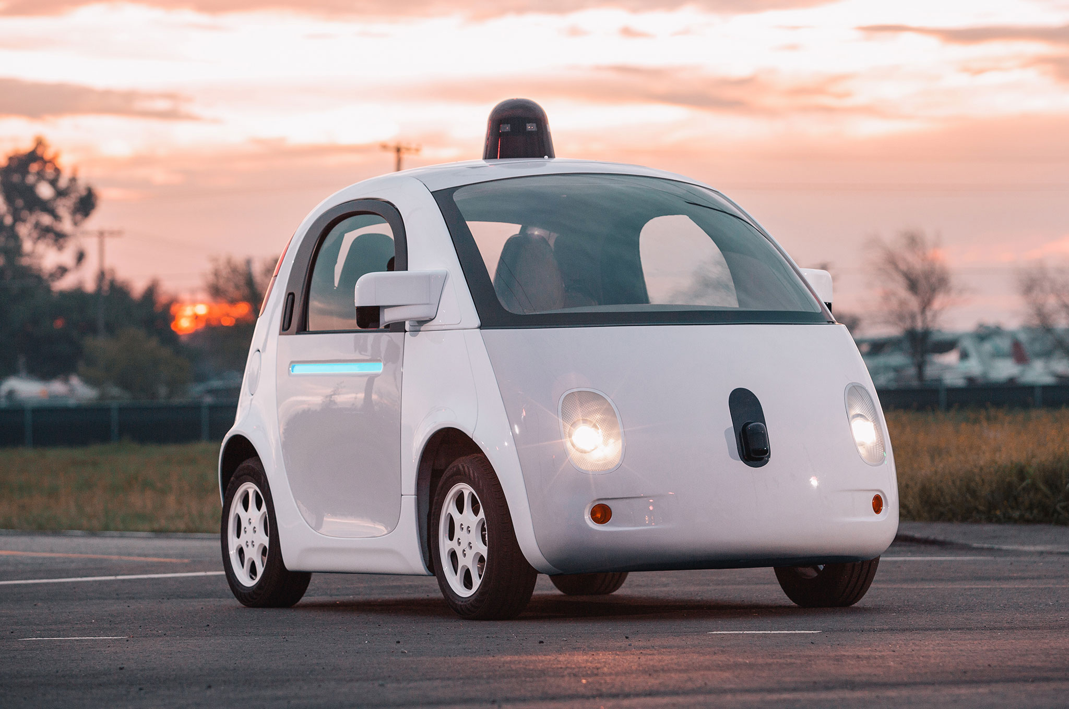
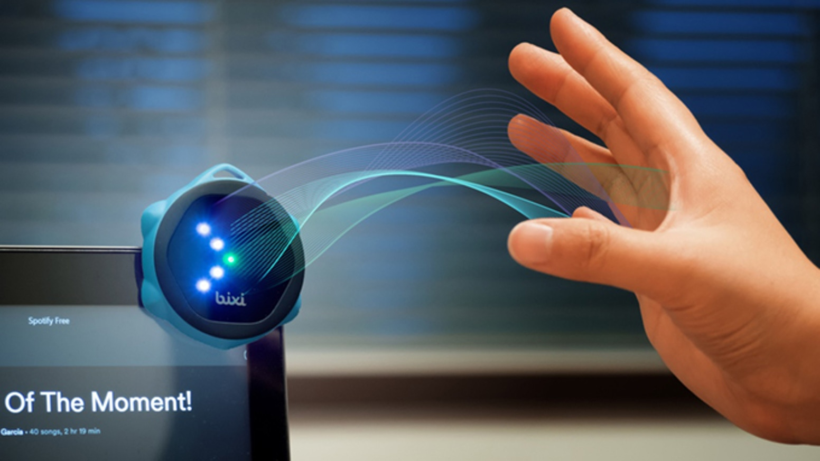


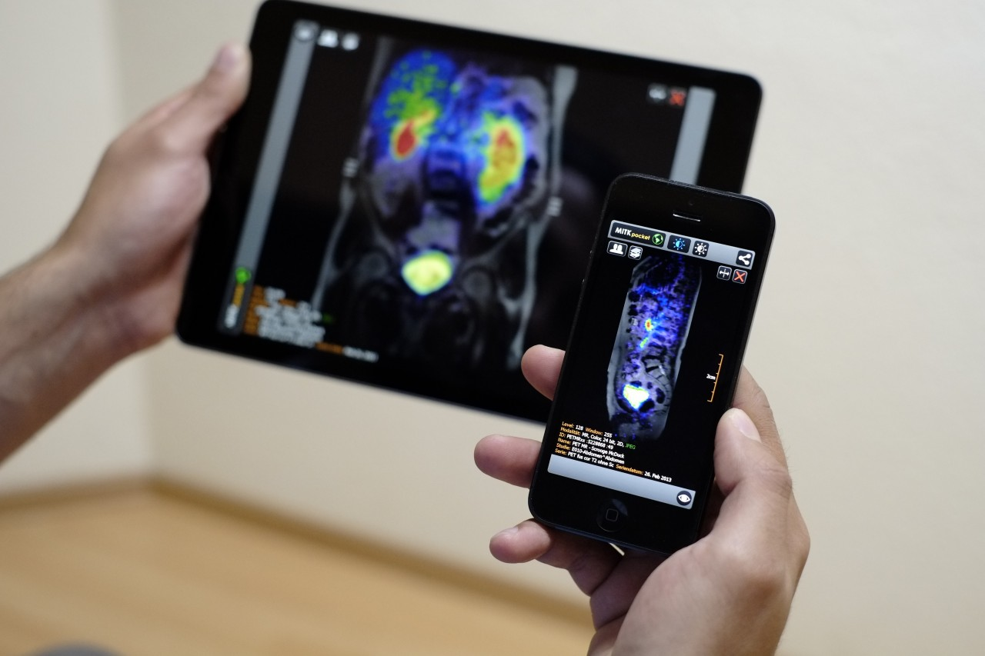
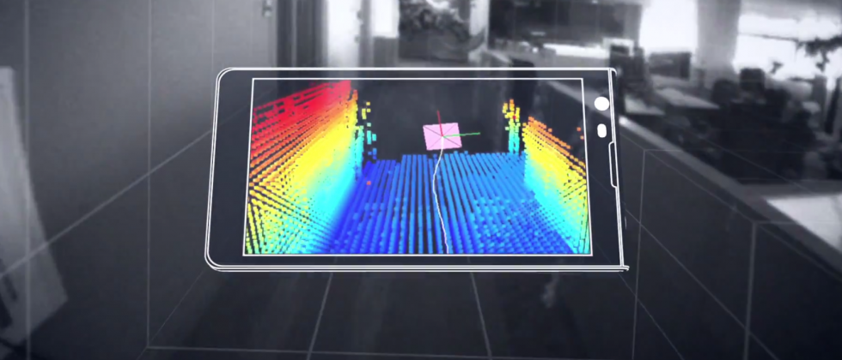

Machine Learning for Physical Sensing & Perception
CMSC 818V : Fall 2025
Lecture 3_1: Active Wave Imaging
Nirupam Roy
Tu-Th 3:30 – 4:45pm
IRB 1207

Slide 2
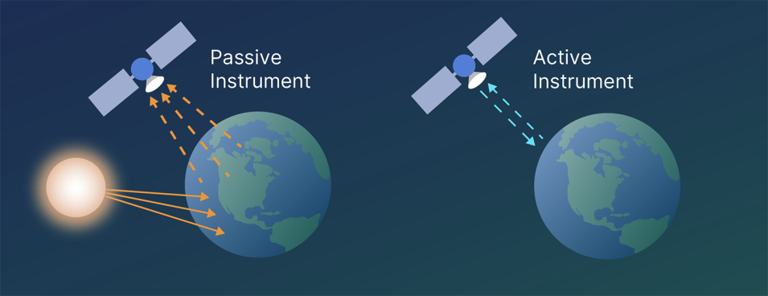

Slide 3
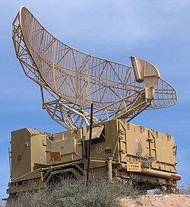

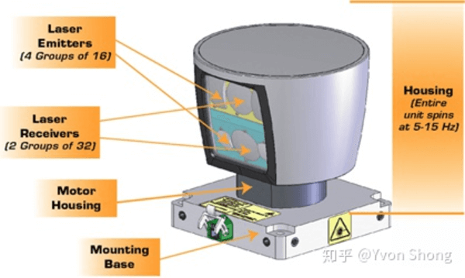
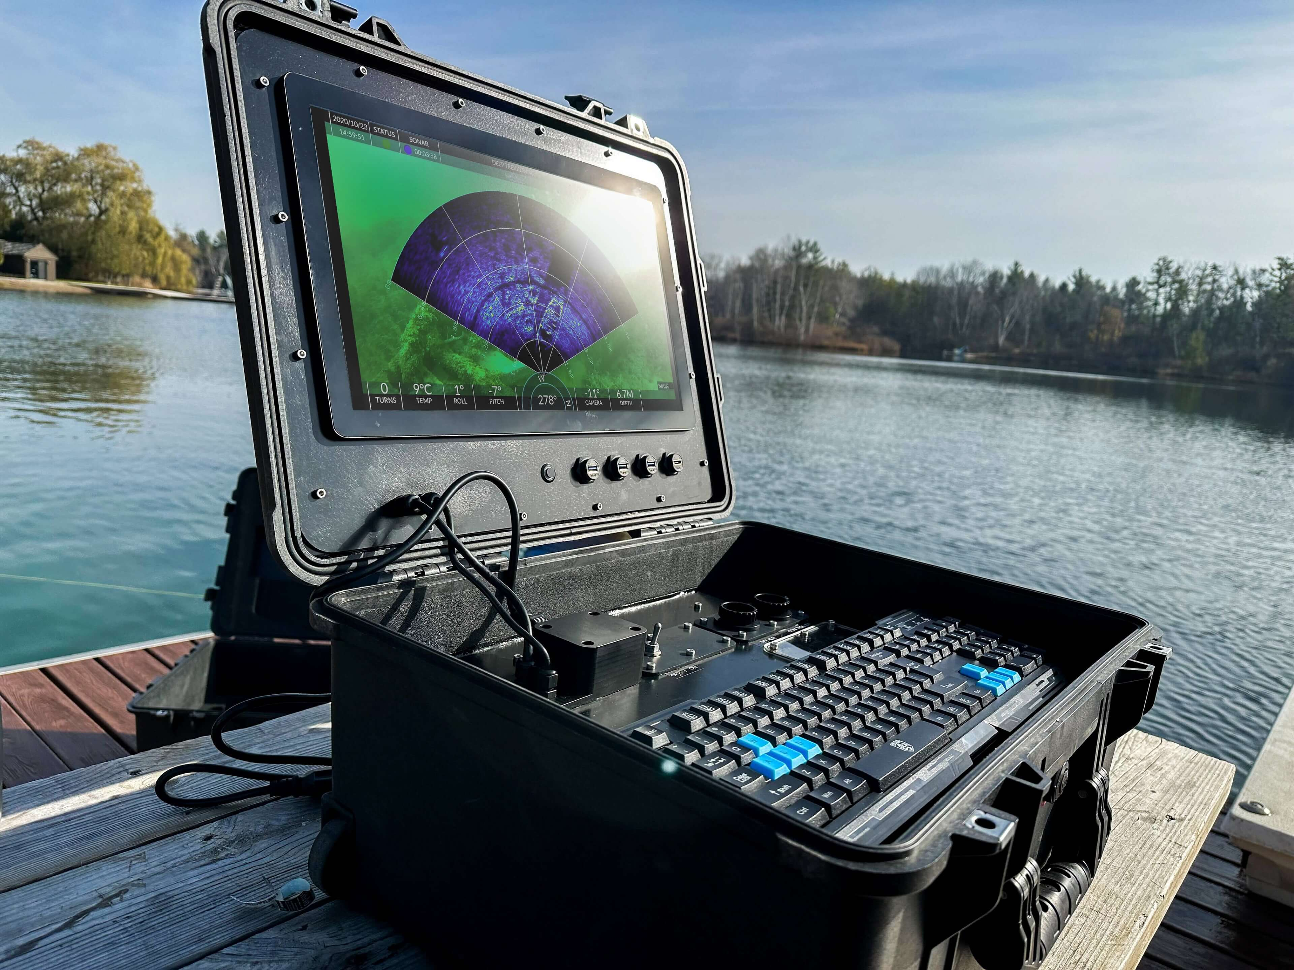
LiDAR
SONAR
Camera
RADAR

Slide 4
RADAR = Radio Detection And Ranging
SONAR = Sound Navigation and Ranging

Slide 5
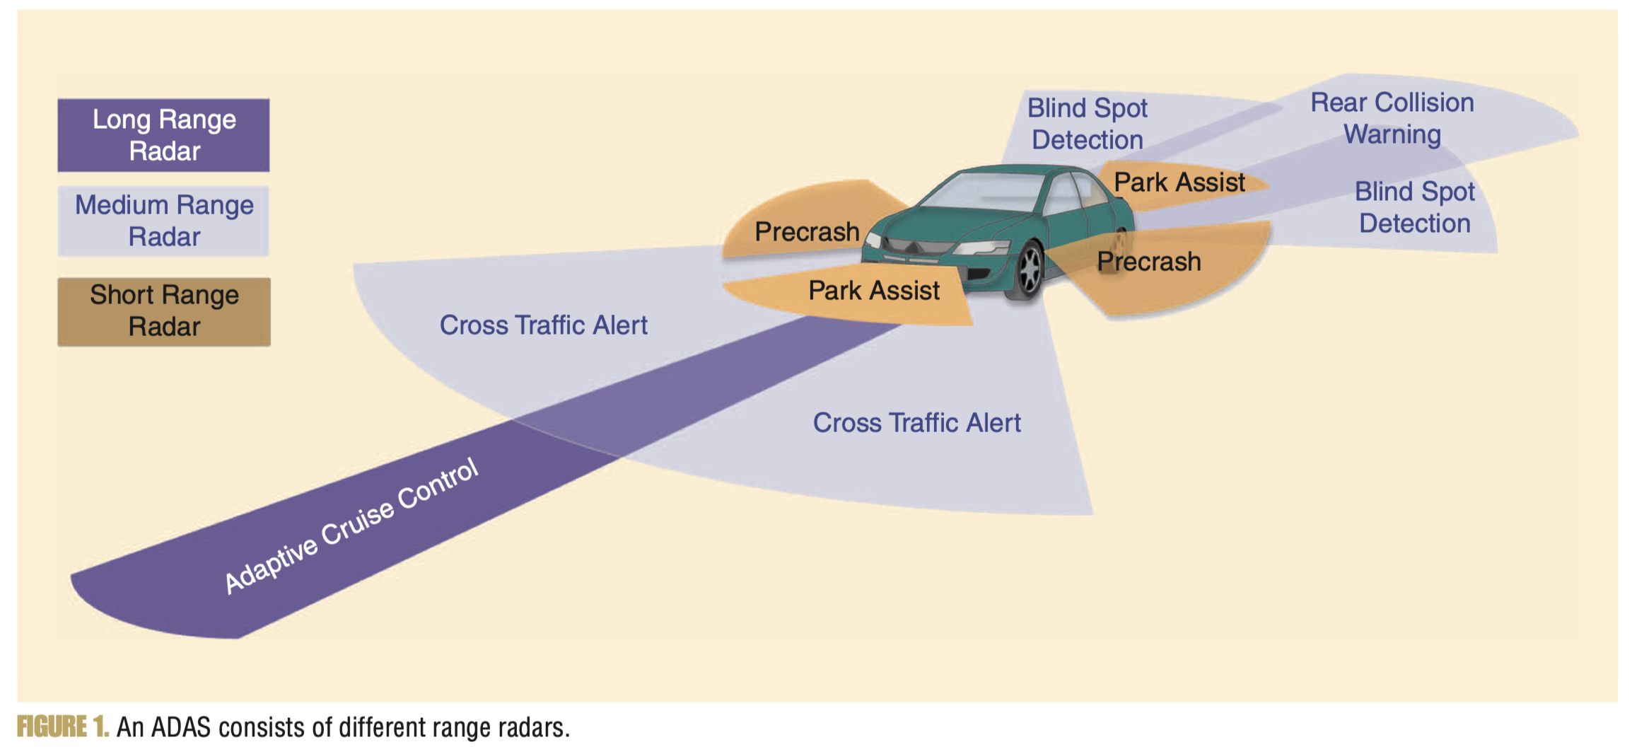
Automotive Radar

Slide 6
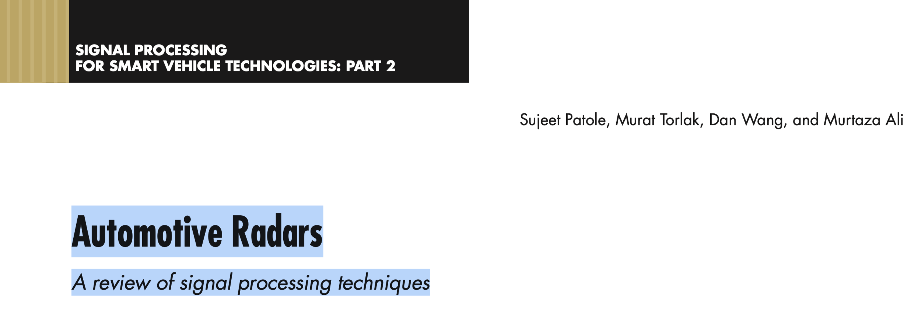

Acknowledgements
https://udrc.eng.ed.ac.uk/sites/udrc.eng.ed.ac.uk/files/attachments/Introduction%20Radar%20signal%20processing.pdf
https://ieeexplore.ieee.org/stamp/stamp.jsp?tp=&arnumber=7870764
https://www.ti.com/content/dam/videos/external-videos/ko-kr/2/3816841626001/5415203482001.mp4/subassets/mmwaveSensing-FMCW-offlineviewing_0.pdf

Slide 7
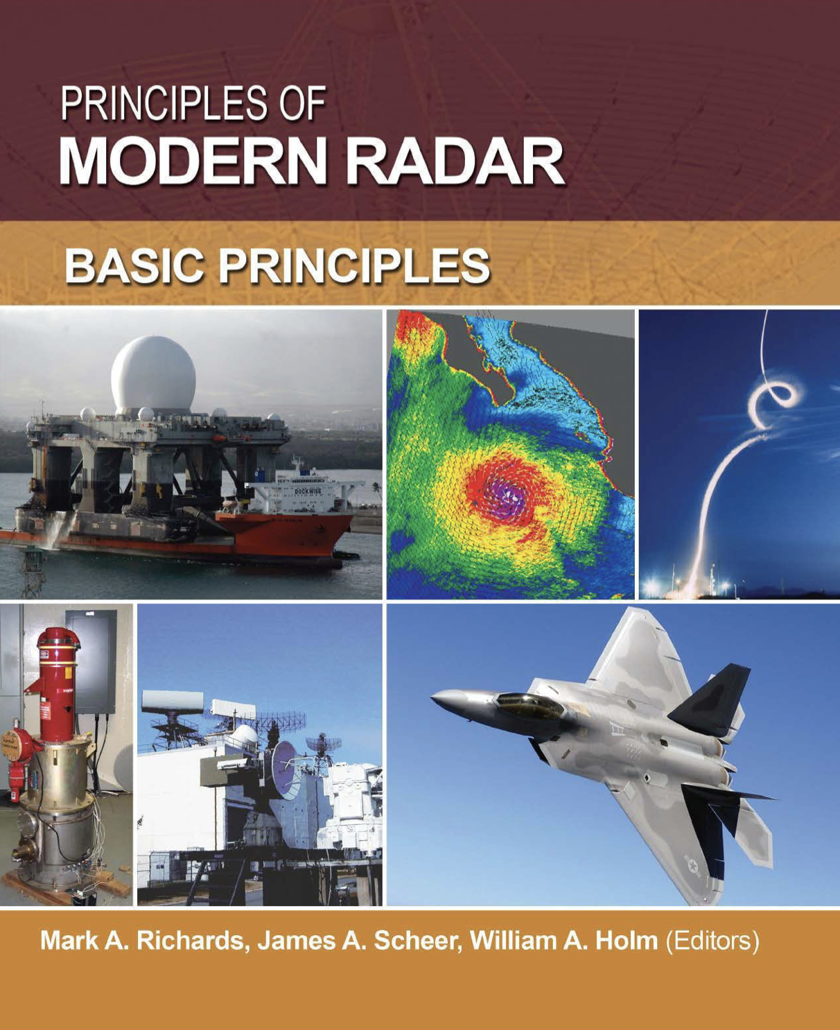
https://ftp.idu.ac.id/wp-content/uploads/ebook/tdg/MILITARY%20PLATFORM%20DESIGN/Richards_M._Scheer_J._Holm_W._Principles_of_mo.pdf

Slide 12
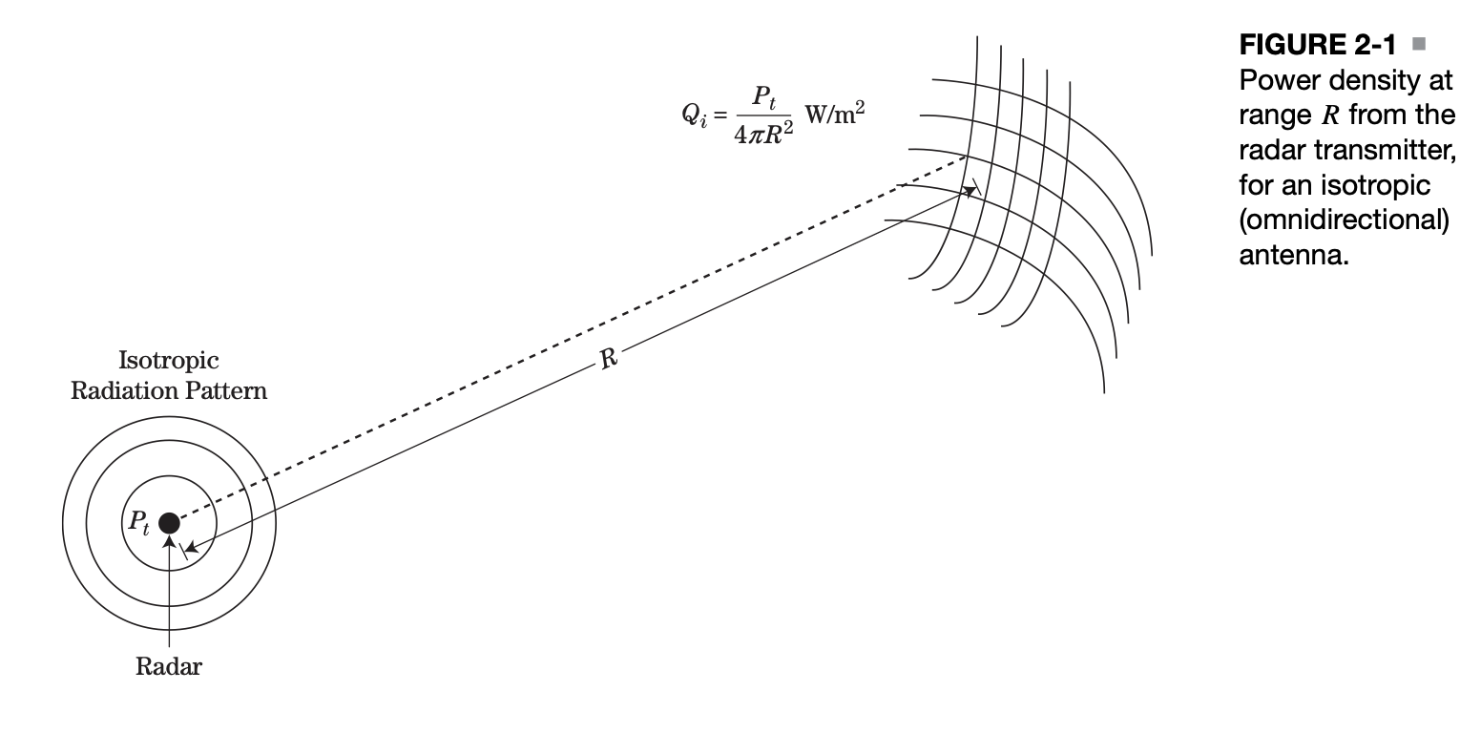
Radar equation

Slide 13
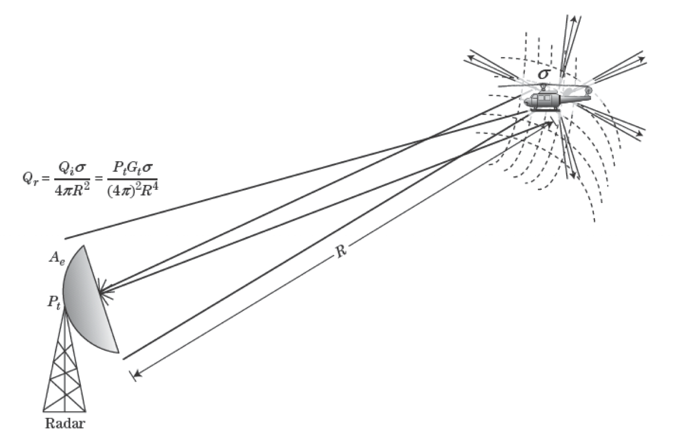
Radar equation
𝞼 = RADAR cross section (RCS)

Slide 14
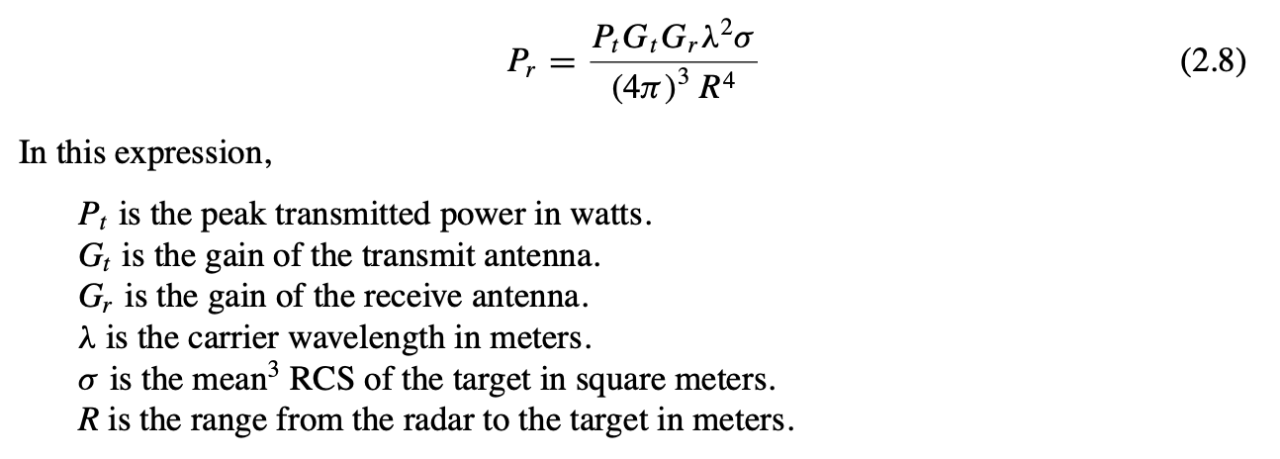
Radar equation

Slide 18
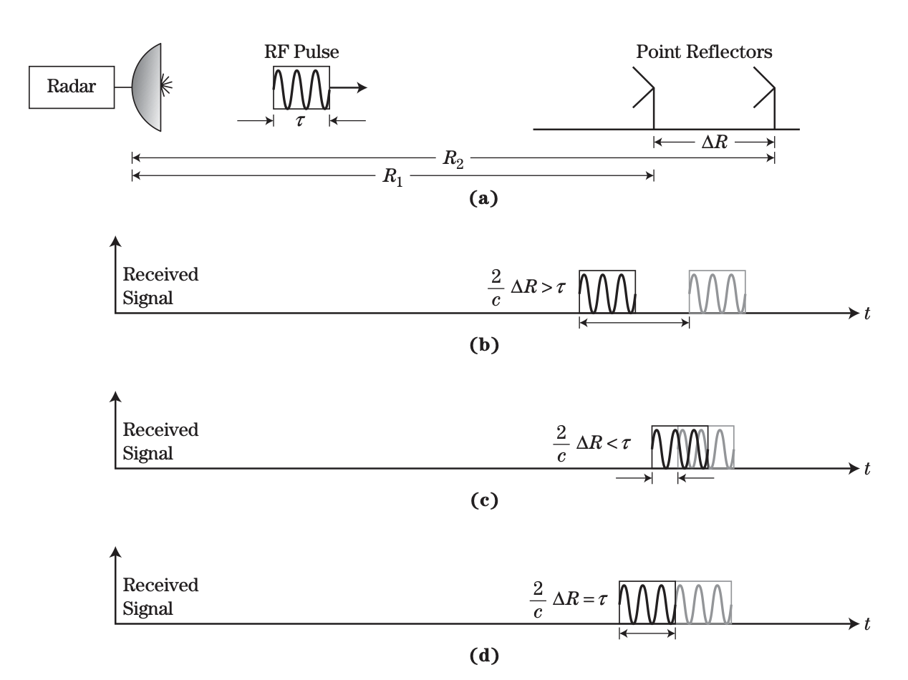
Radar: Range resolution

Slide 20
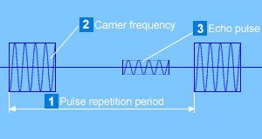

Slide 29
Distance estimation (Ranging)
in
time-domain vs frequency-domain

Slide 30


Amplitude
Time (or Sample #)

Slide 31
Time delay
Amplitude
Time (or Sample #)

Slide 32
Time delay
Amplitude
Time (or Sample #)
Freq.
What difference will you see in frequency domain?

Slide 33
Time delay
Amplitude
Amplitude
Time (or Sample #)
Time (or Sample #)
Freq.
Freq.
What difference will you see in frequency domain?

Slide 34
Time delay
Amplitude
Amplitude
Time (or Sample #)
Time (or Sample #)
Freq.
Freq.
What difference will you see in frequency domain?

Slide 35
Can we send the signal continuously?
Time delay
Amplitude
Amplitude
Time (or Sample #)
Time (or Sample #)
Freq.
Freq.
What difference will you see in frequency domain?

Slide 36
Phase and time-of-arrival both can estimate distance.
What are the pros and cons?

Slide 37
Time delay
Amplitude
Amplitude
Time (or Sample #)
Time (or Sample #)
Freq.
Freq.
How are the phases related?

Slide 38
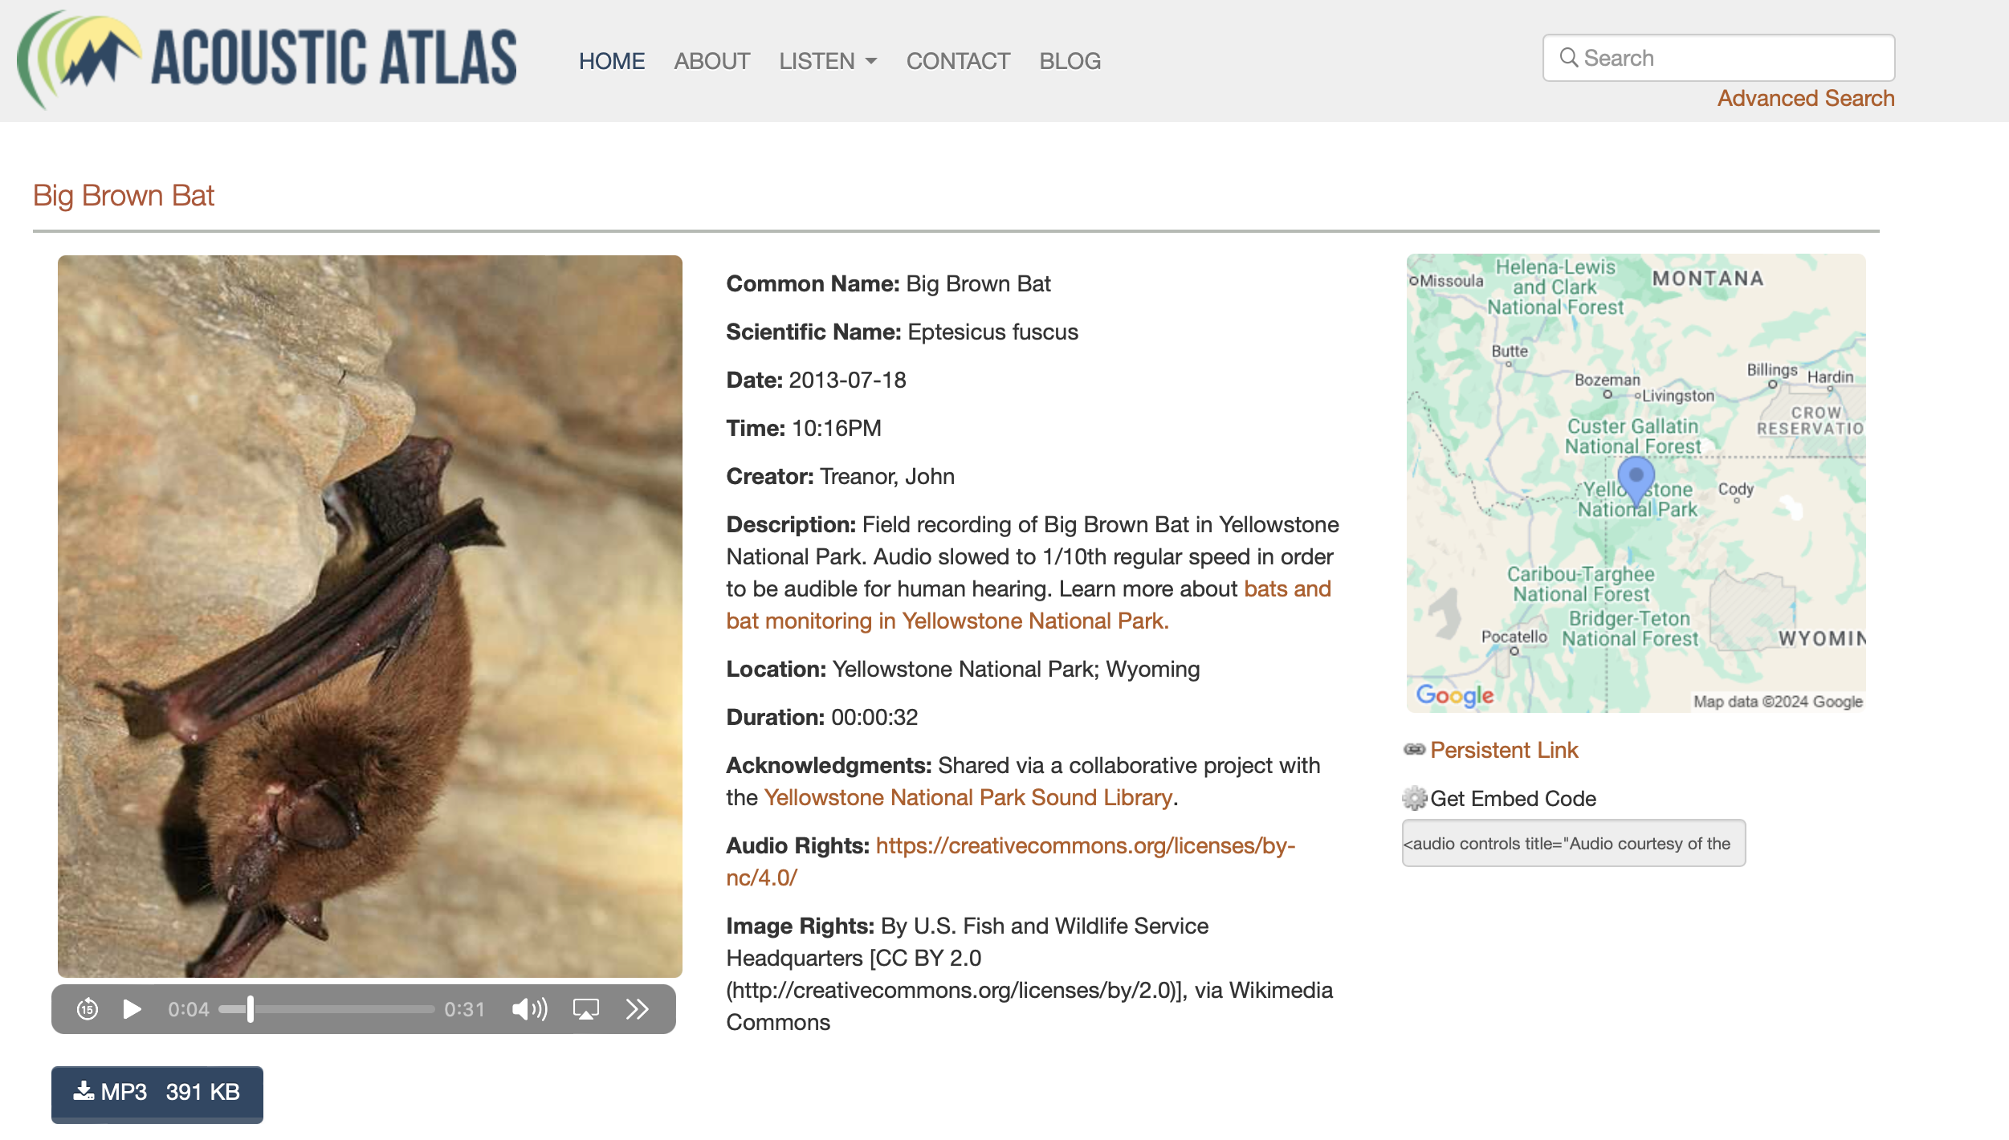
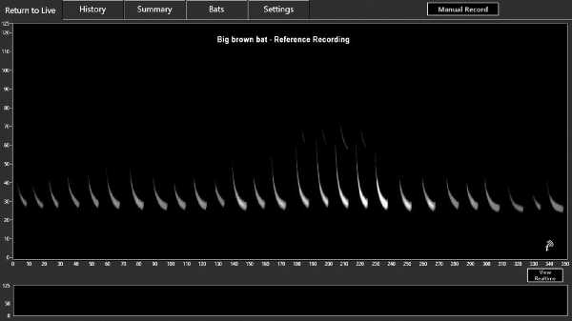


Slide 39
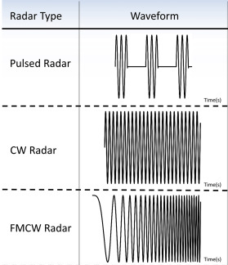
Pulsed RADAR vs Continuous-Wave (CW) RADAR

Slide 40
Chirp as the Tx signal (Frequency modulated signal)
Frequency
Time

Slide 41
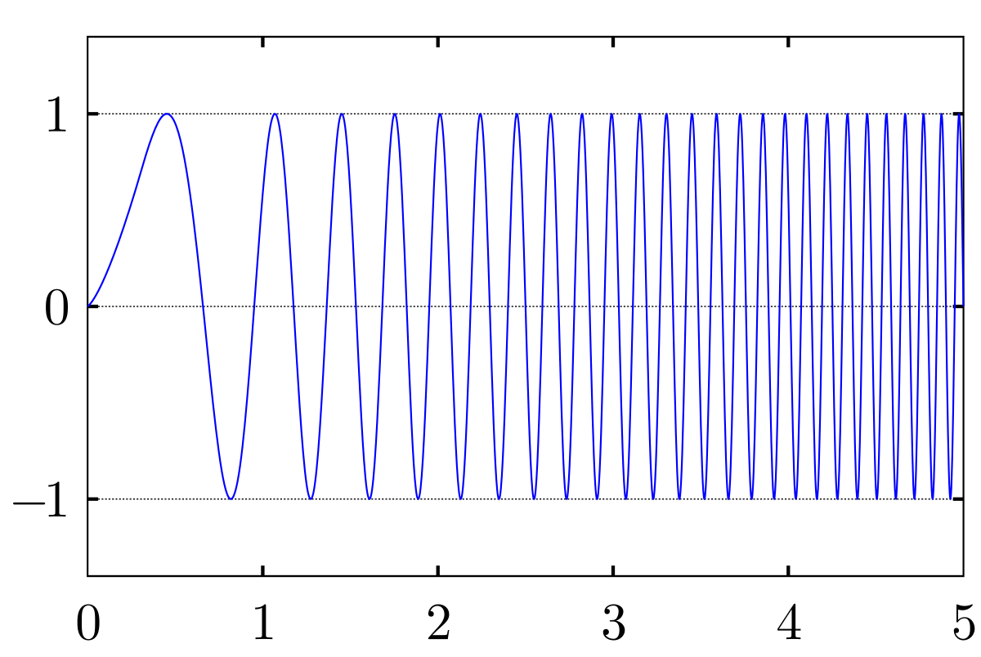
Chirp as the Tx signal (Frequency modulated signal)
Frequency
Time
Amplitude
Time

Slide 42
Chirp as the Tx signal (Frequency modulated signal)
Freq.
f_{H}
Time

Slide 43
Chirp as the Tx signal (Frequency modulated signal)
Freq.
f_{H}
β
Slope, = B/ T_{C}
Bandwidth = B = f_{H} - f_{C}
f_{C}
Time
Sweep time = T_{C}
[Chirp = Frequency sweep]

Slide 44
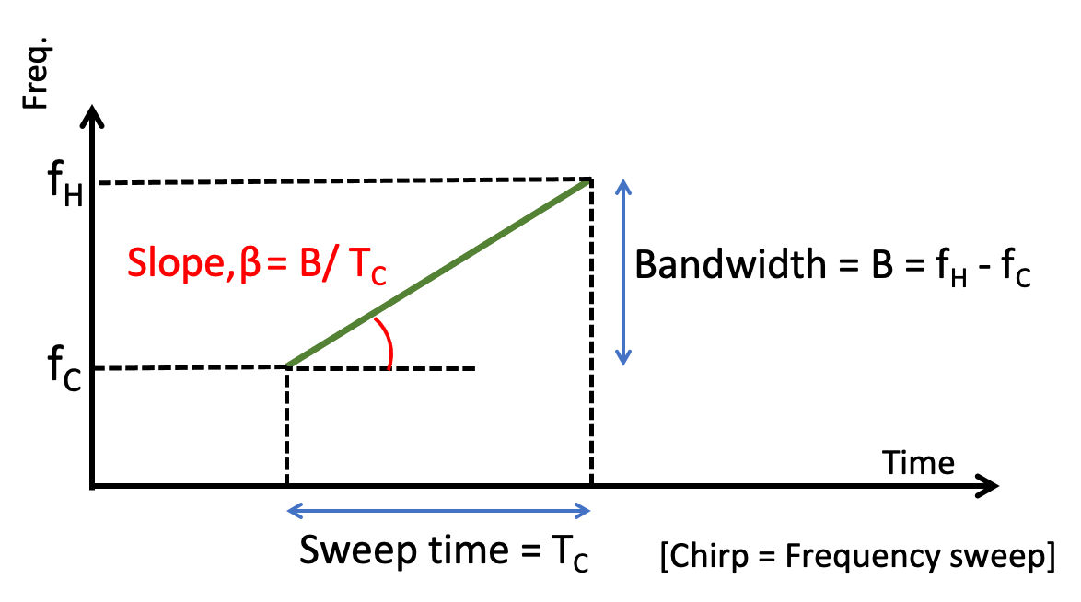
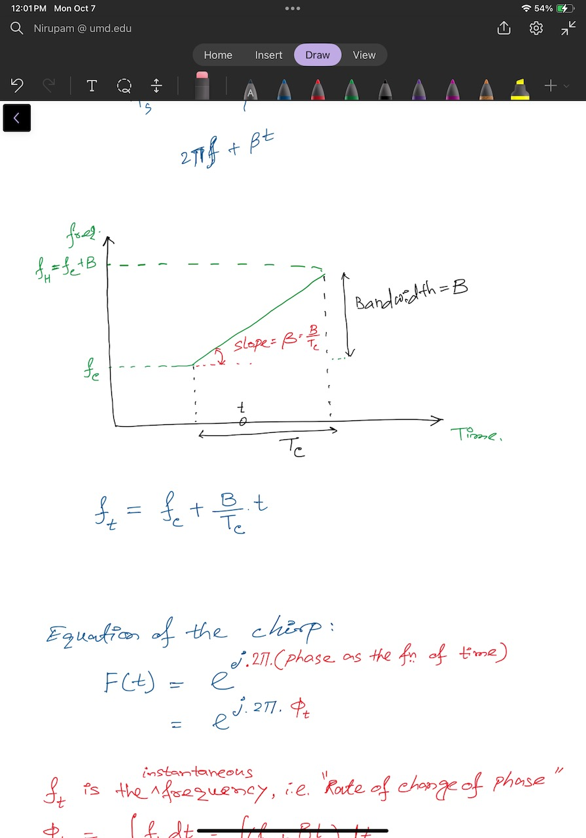
Chirp as the Tx signal (Frequency modulated signal)
Instantaneous frequency at time t:

Slide 45
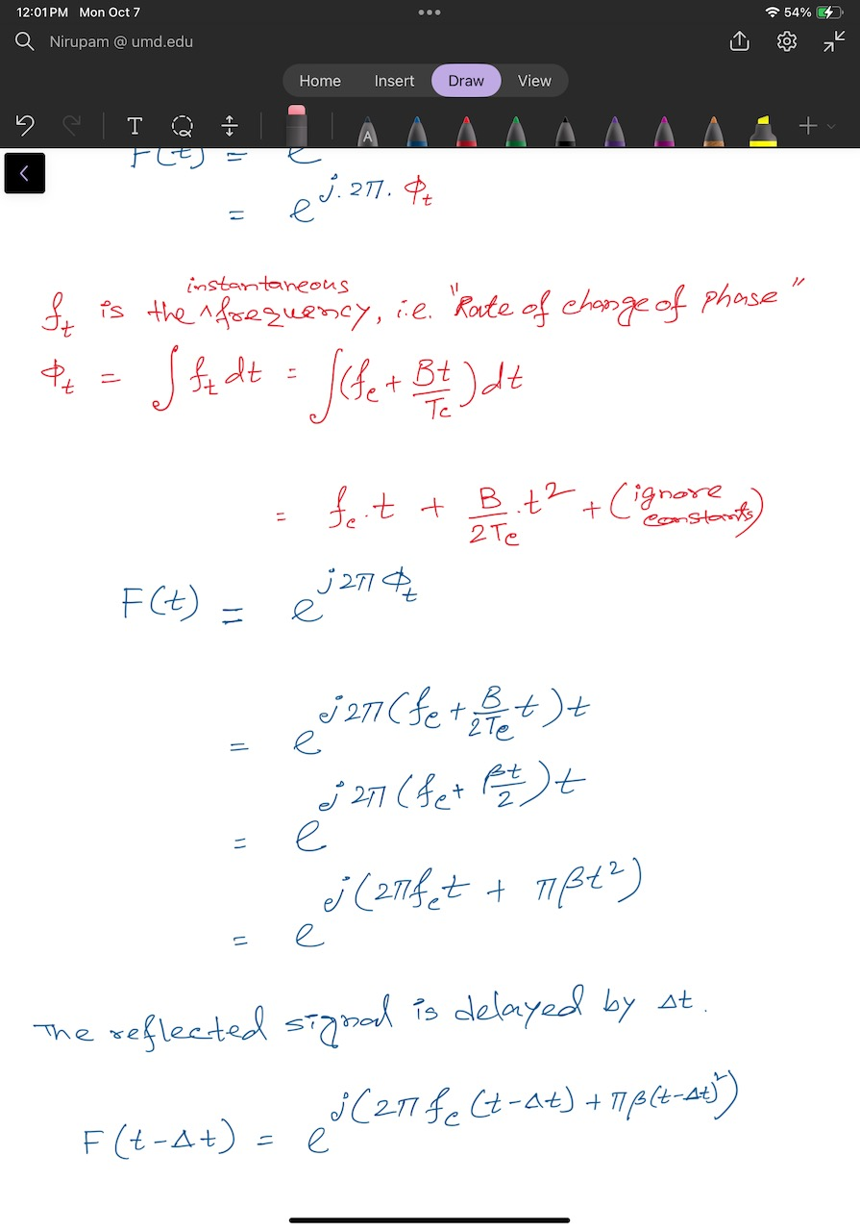
Chirp as the Tx signal (Frequency modulated signal)
Instantaneous frequency at time t:

Slide 46
Chirp as the Tx signal (Frequency modulated signal)
Chirp signal equation:

Slide 47
Chirp as the Tx signal (Frequency modulated signal)
Chirp signal equation:

Slide 48
Signal Detection and Ranging: RADAR & SONAR

Slide 49
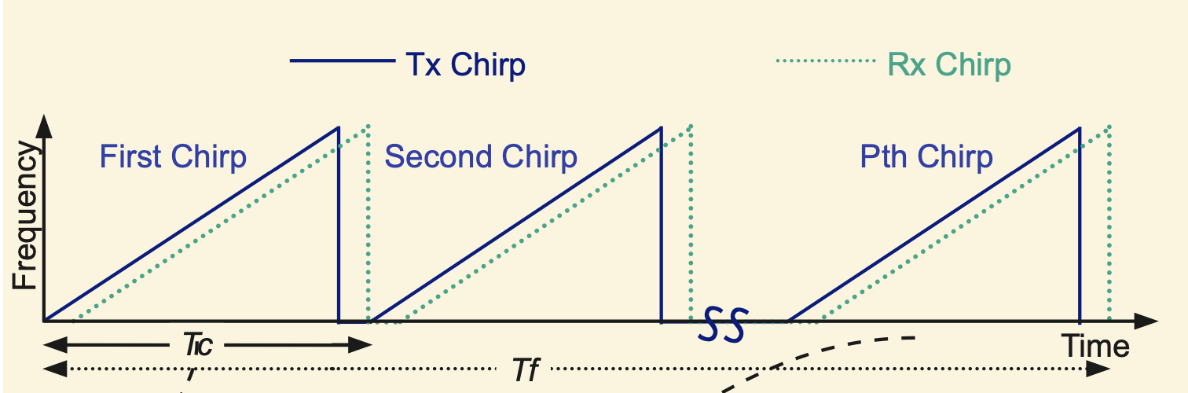
Frequency Modulated Continuous Wave (FMCW)

Slide 50
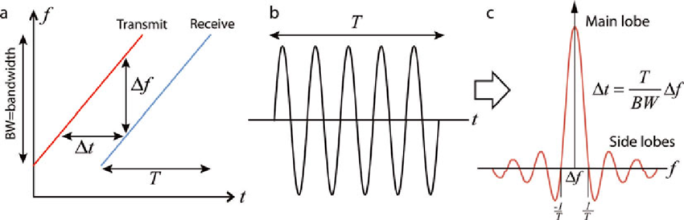
Frequency Modulated Continuous Wave (FMCW)

Slide 51
Delay results in frequency difference

Slide 52
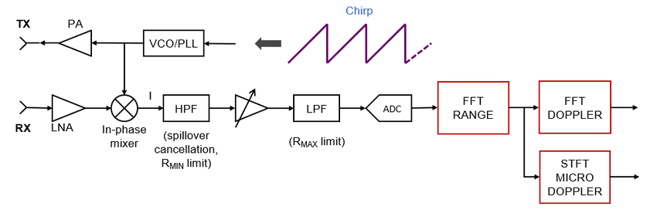
Detection of frequency difference

Slide 53
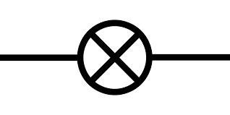
Beat frequency: Derivation
X

Slide 54
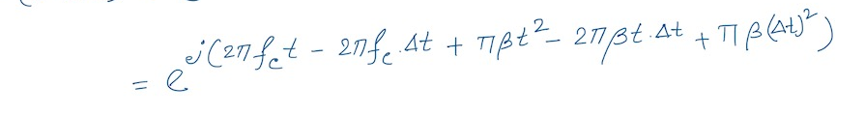
Beat frequency: Derivation
-
X
-

Slide 55
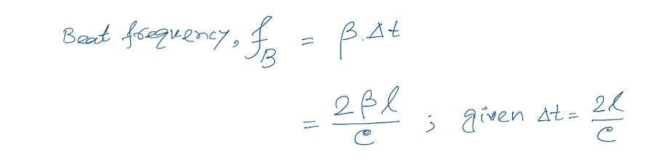
Beat frequency: Derivation
-
X
-
Also called, the
Intermediate Frequency (IF)

Slide 56
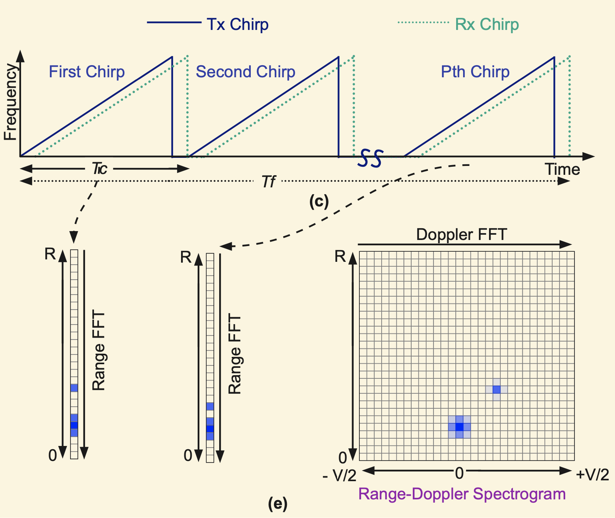

Slide 57
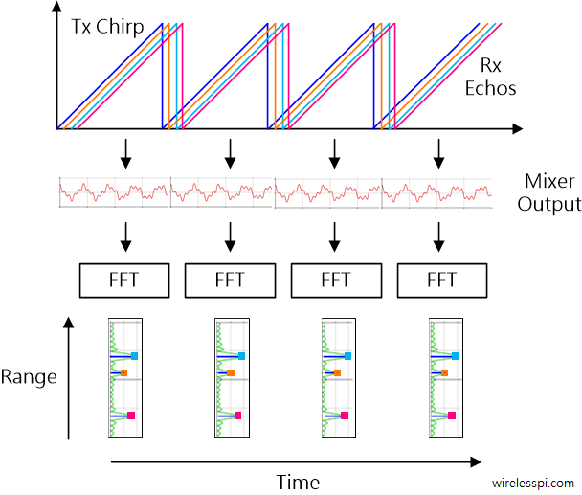

Slide 58
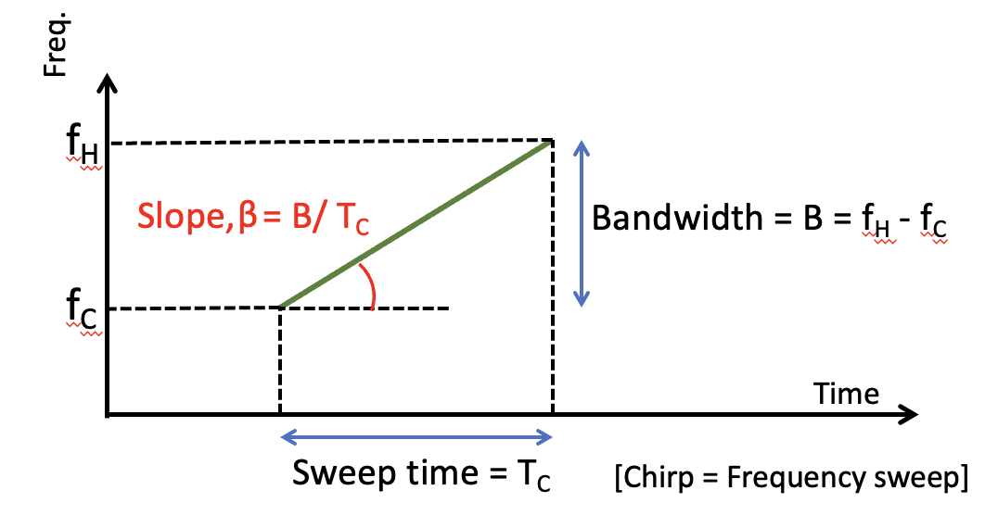
FMCW range resolution
For two objects separated by a distance Δd,
the difference in their IF frequencies is given by: β*2 Δd/C
Since the observation interval is Tc, the FFT resolution is (1/Tc).
To be separately observed, β*2 Δd/C >= 1/Tc
Or, Δd >= C/2* β*Tc
Or, Δd >= C/2* B

Slide 59
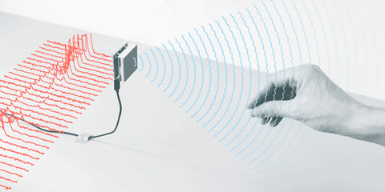

Slide 60
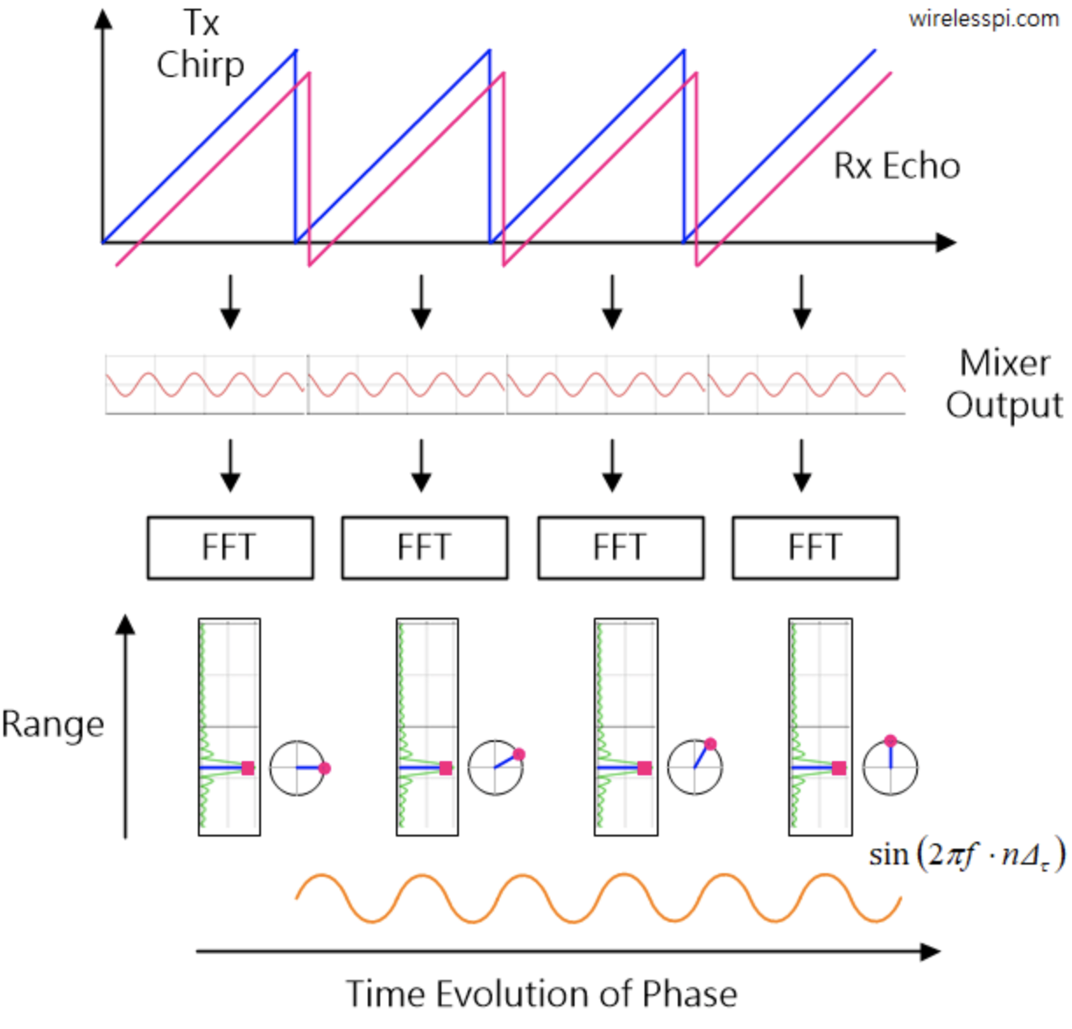

Slide 61
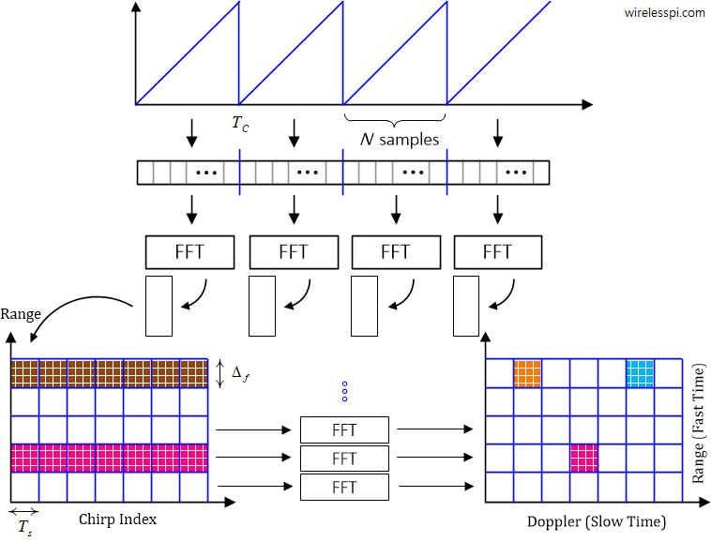

Slide 62
Range-Doppler plot: Detection of range and velocity

Slide 63
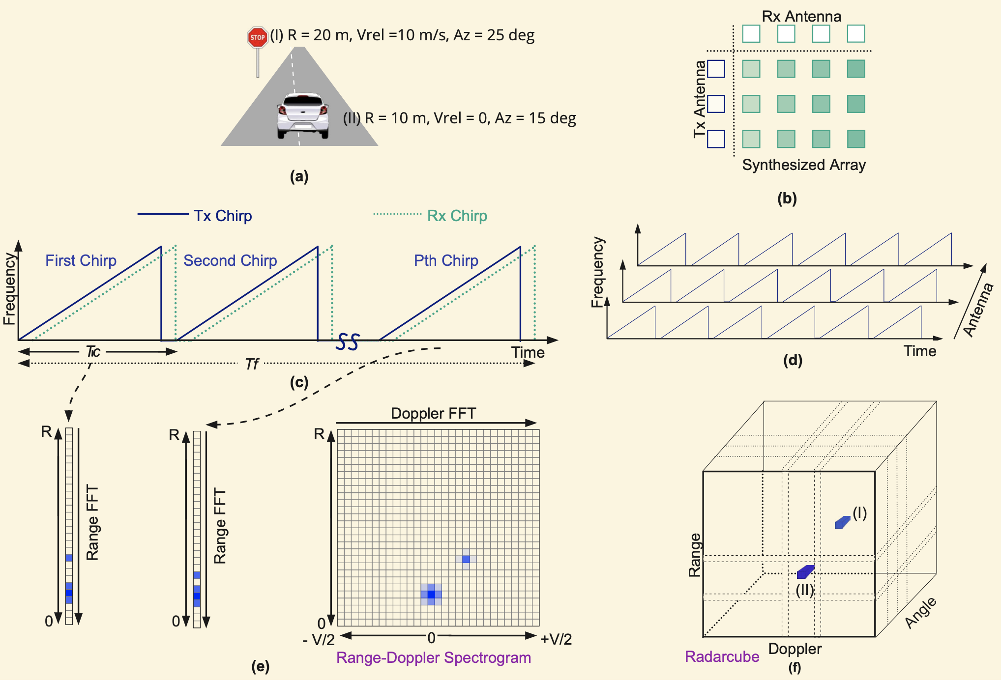
Angle FFT: Detection of range, velocity, and angle

