Slide 1

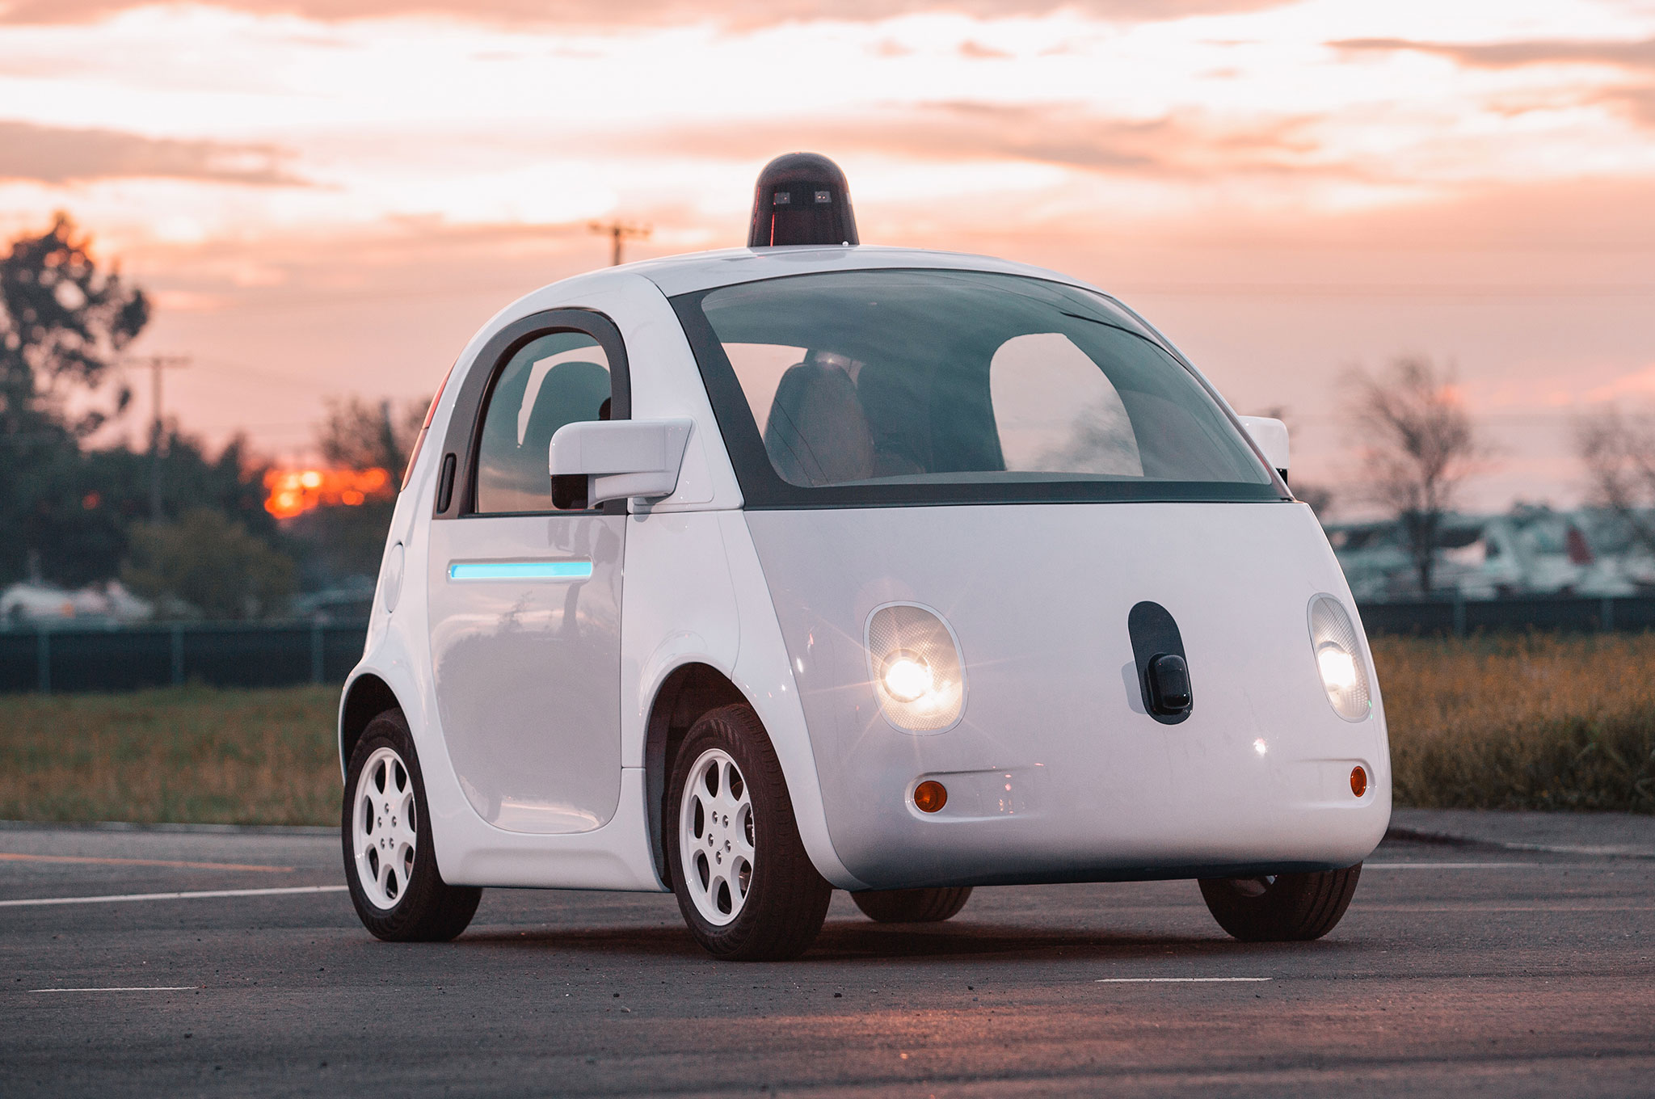

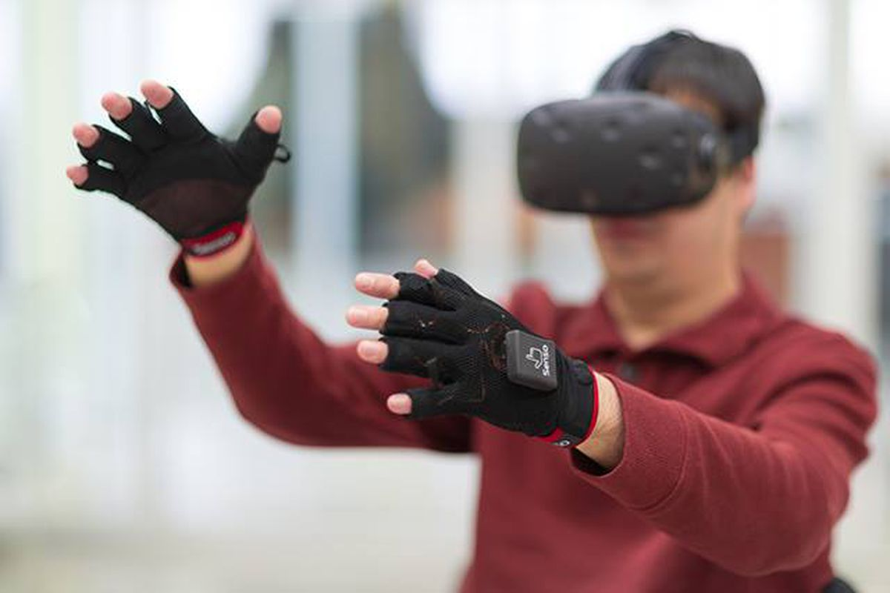

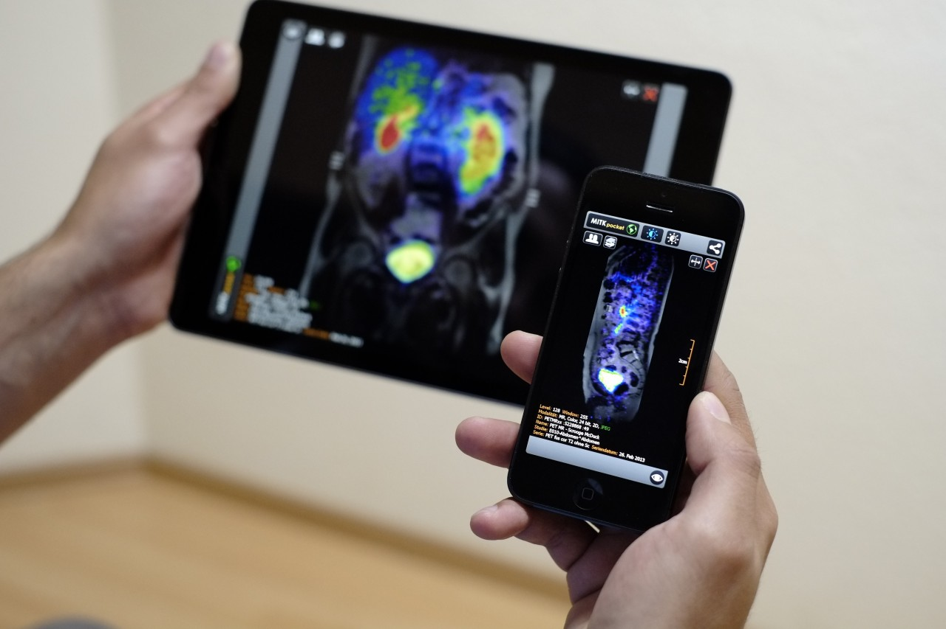
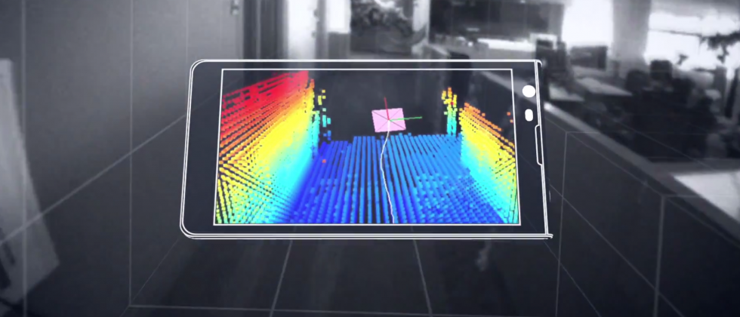

Machine Learning for Physical Sensing & Perception
CMSC 818V : Fall 2025
Lecture 3_2: Active Wave Imaging
Nirupam Roy
Tu-Th 3:30 – 4:45pm
IRB 1207

Slide 2
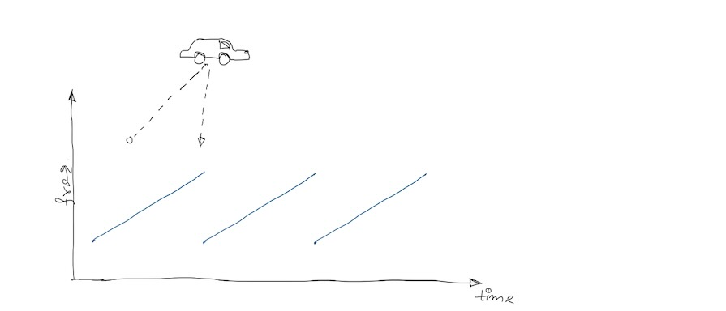

Slide 3
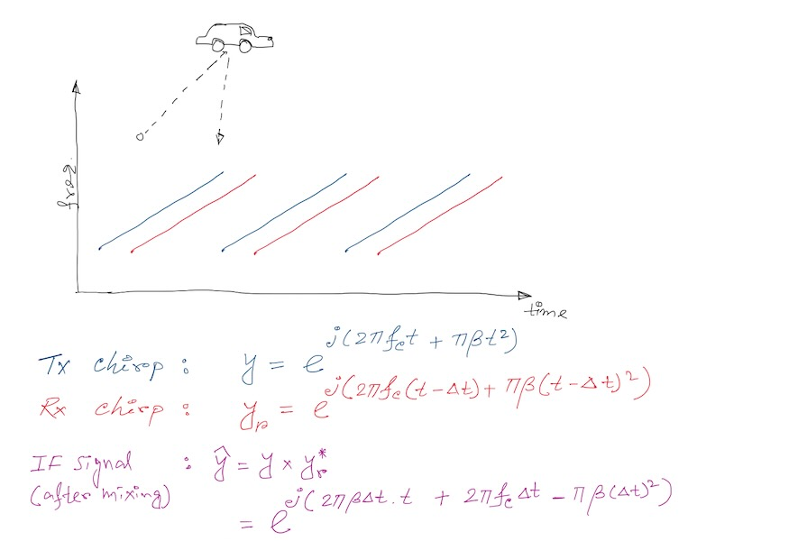

Slide 4
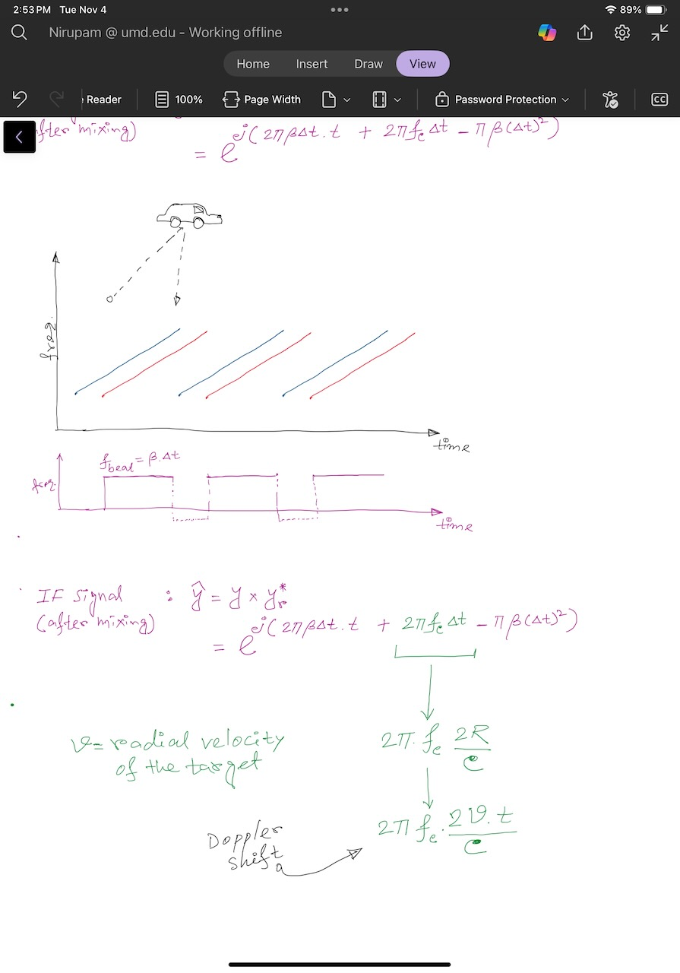

Slide 5
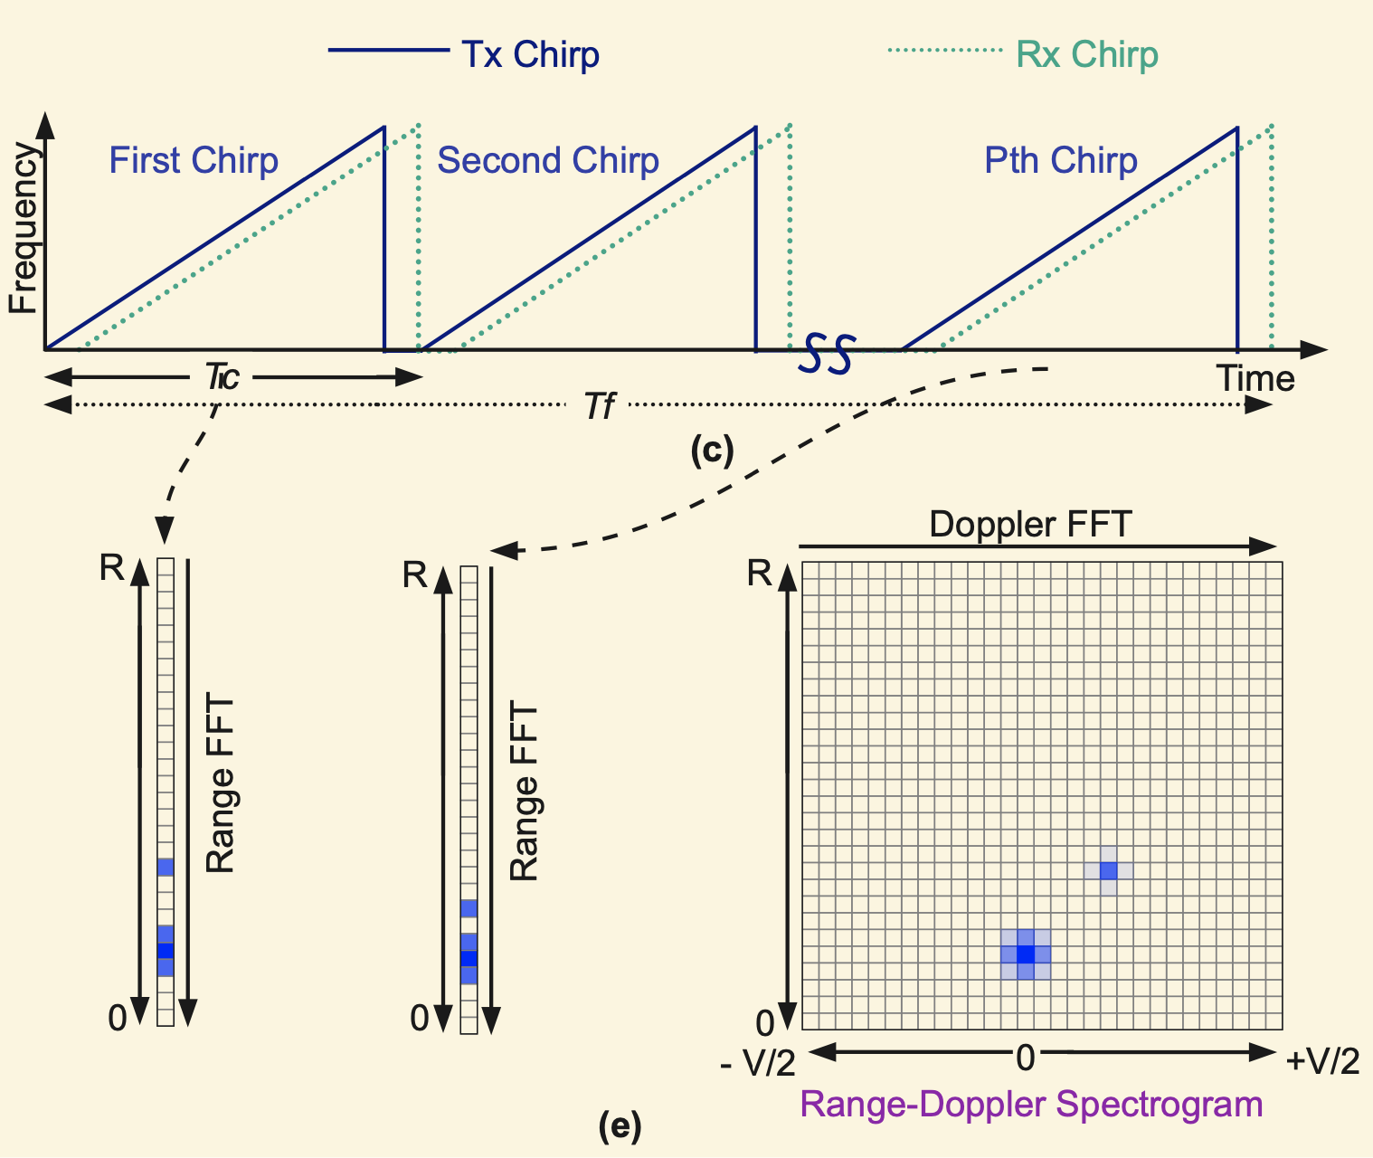

Slide 6
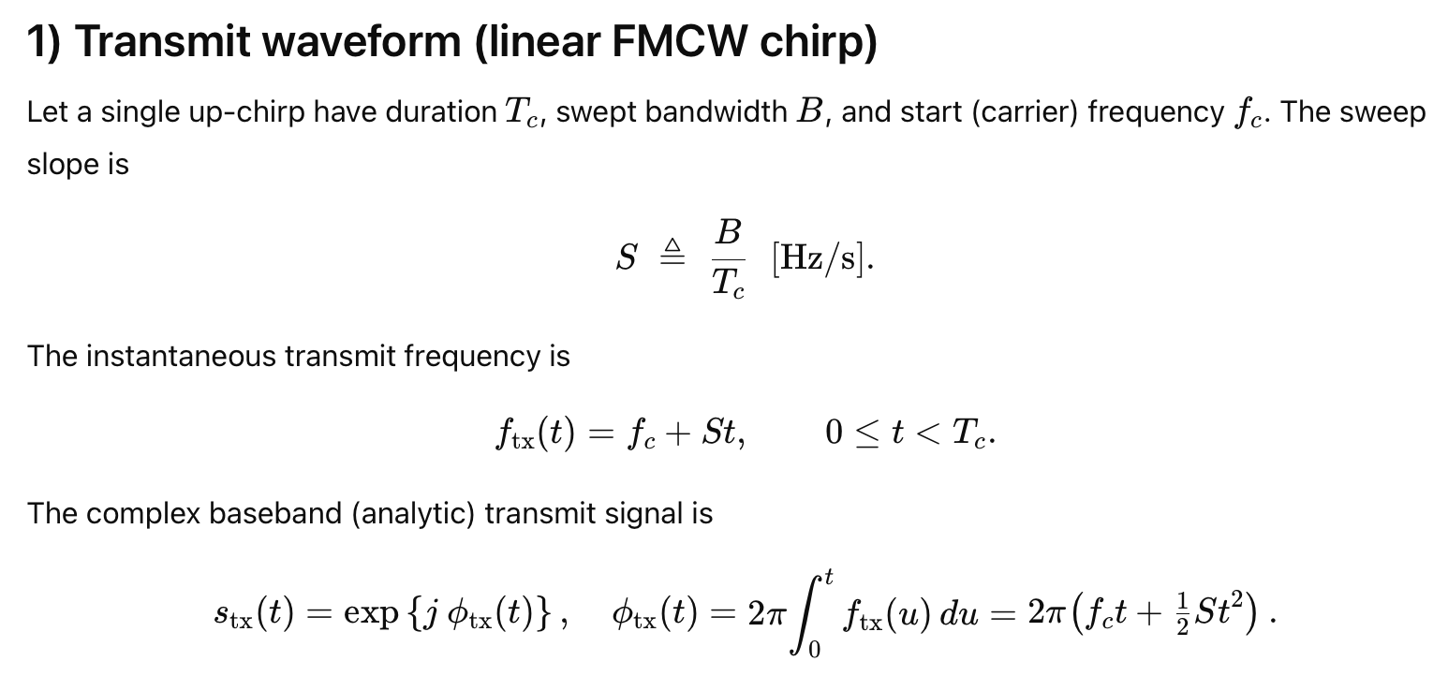

Slide 7
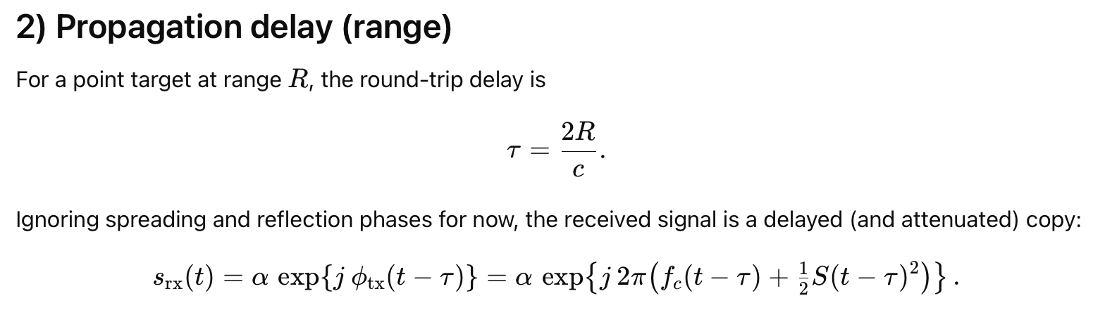

Slide 8
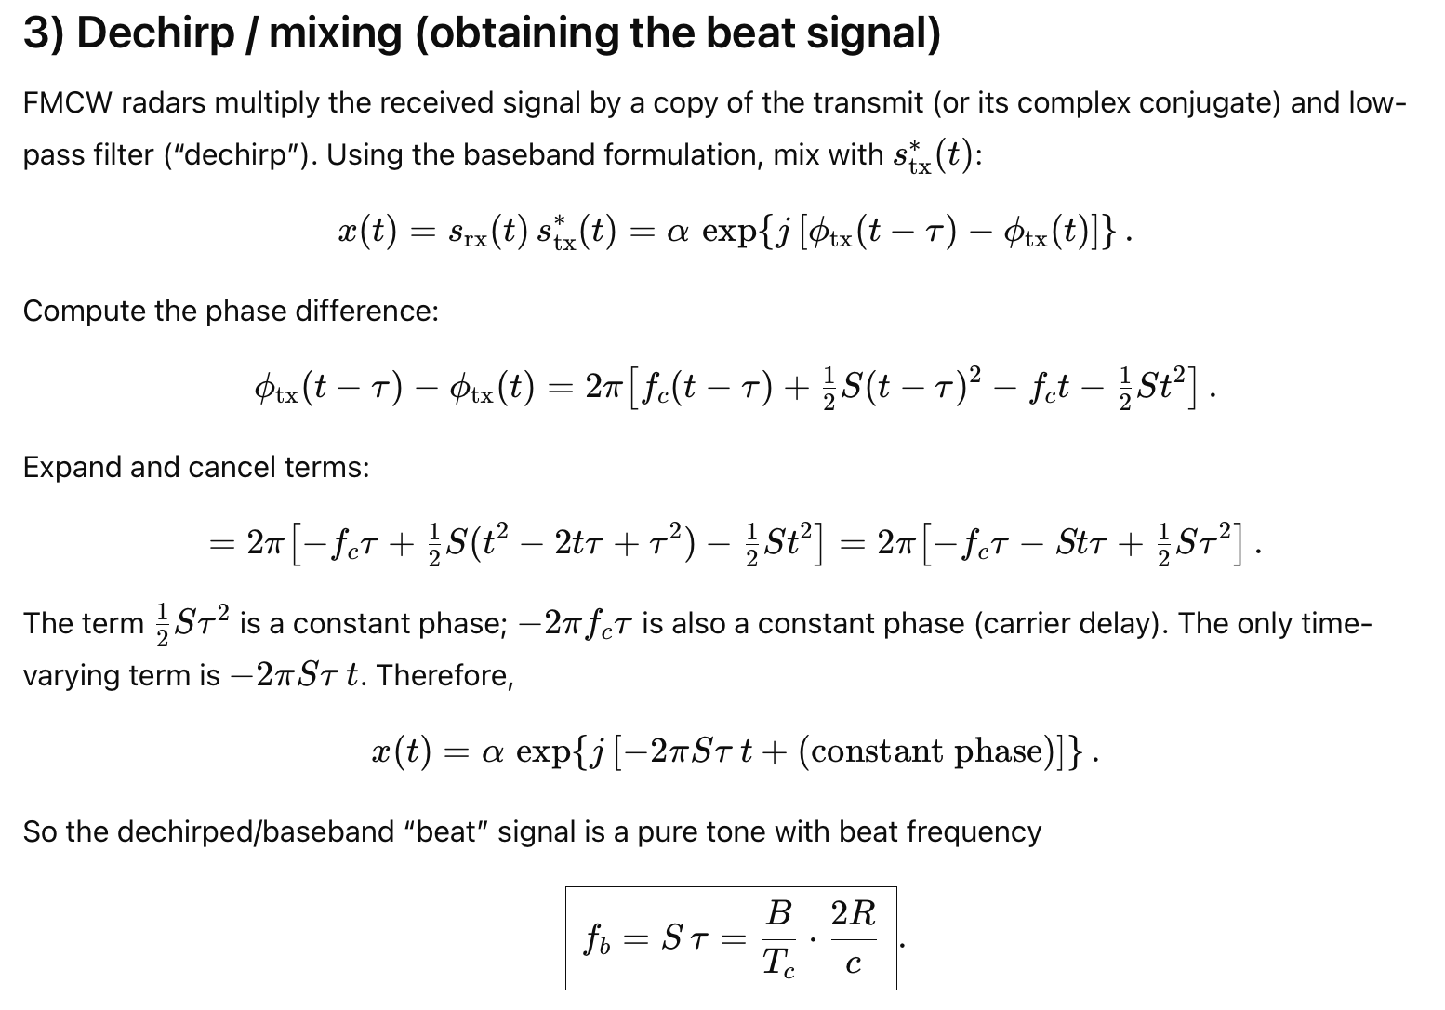

Slide 9
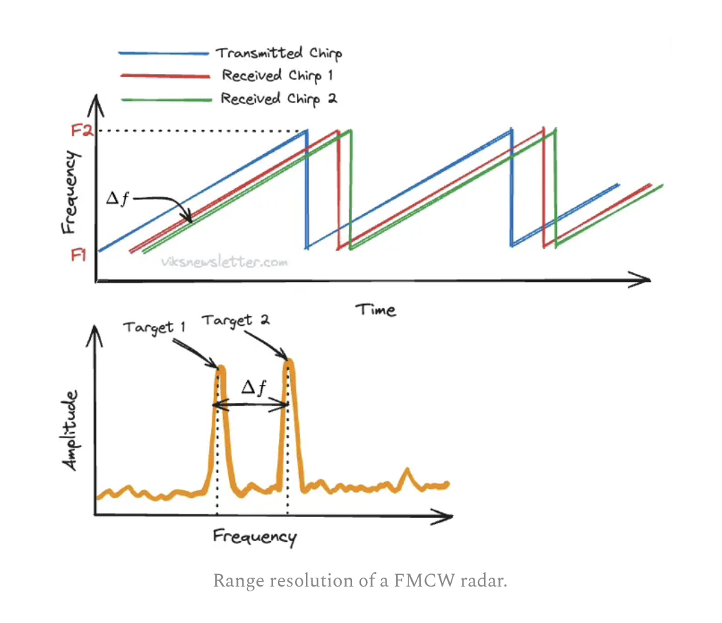
FMCW range resolution
Image: https://www.viksnewsletter.com/p/how-radar-measures-angle

Slide 10
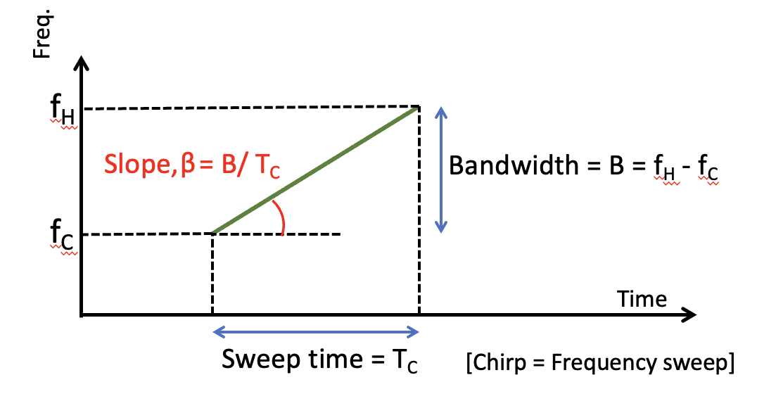
FMCW range resolution
For two objects separated by a distance Δd,
the difference in their IF frequencies is given by: β*2 Δd/C
Since the observation interval is Tc, the FFT resolution is (1/Tc).
To be separately observed, β*2 Δd/C >= 1/Tc
Or, Δd >= C/2* β*Tc
Or, Δd >= C/2* B

Slide 11
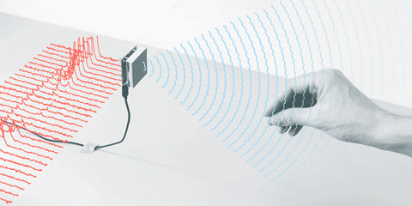
Moving objects

Slide 12
An ignored “static phase” is time dependent
Notes:
Rate of change of phase is frequency.

Slide 13
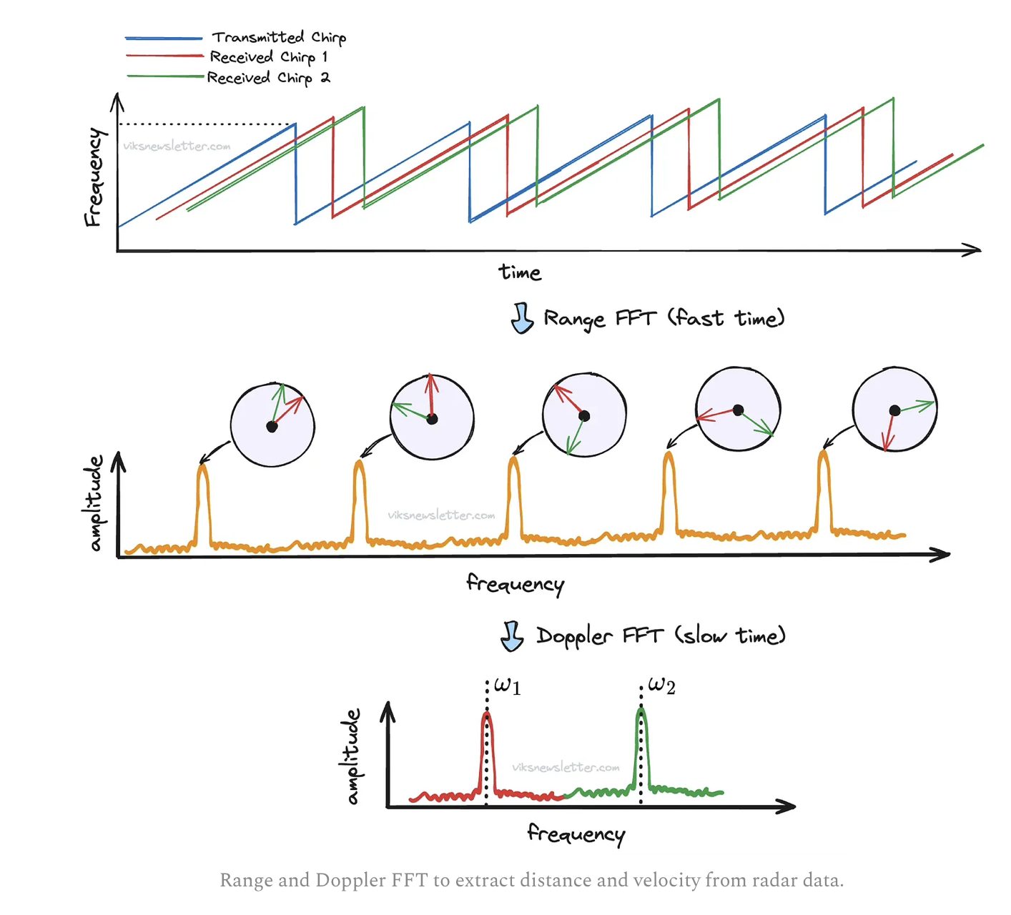
Image: https://www.viksnewsletter.com/p/how-radar-measures-angle

Slide 14
Image: https://www.viksnewsletter.com/p/how-radar-measures-angle

Slide 15
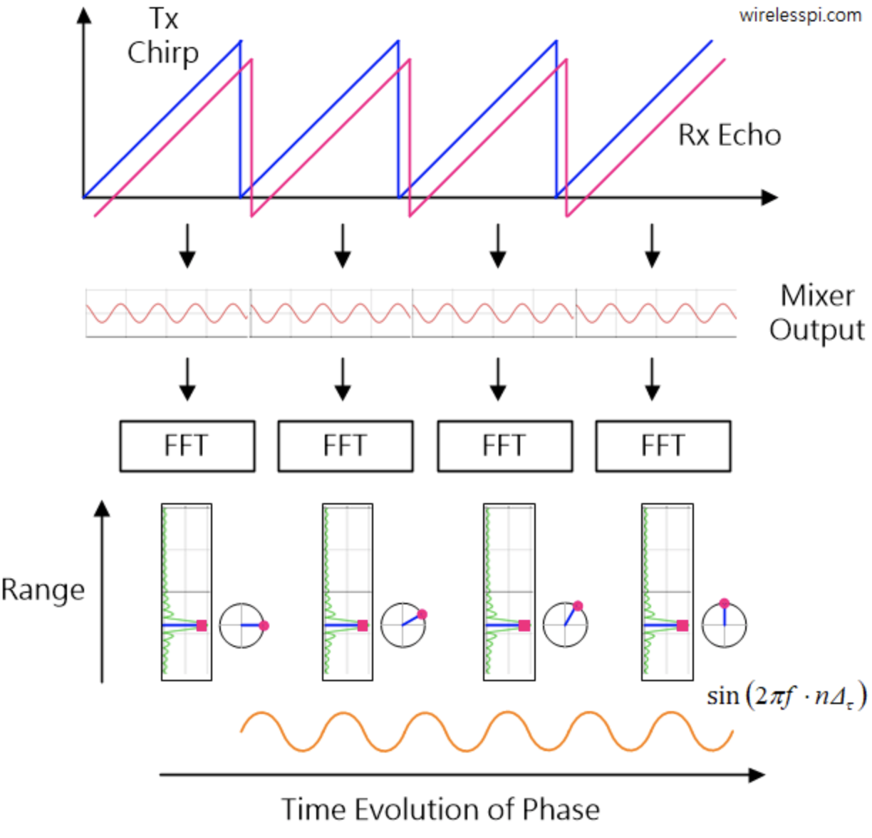

Slide 16
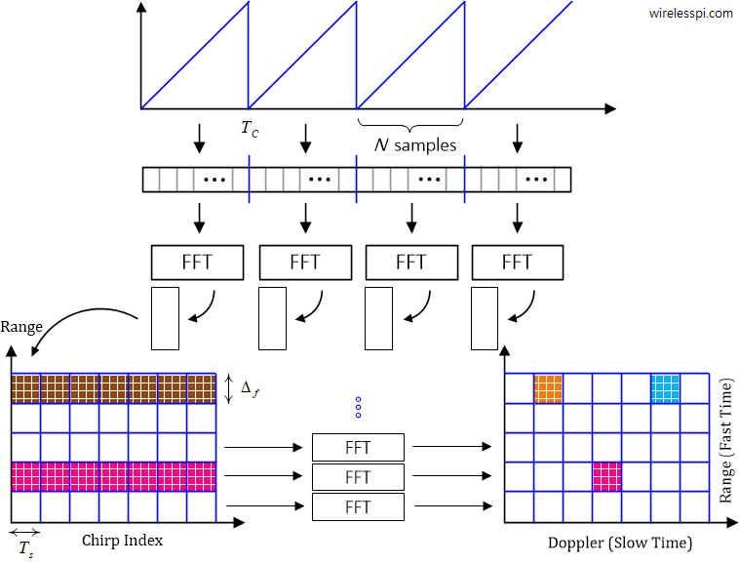

Slide 17
Range-Doppler plot: Detection of range and velocity

Slide 18
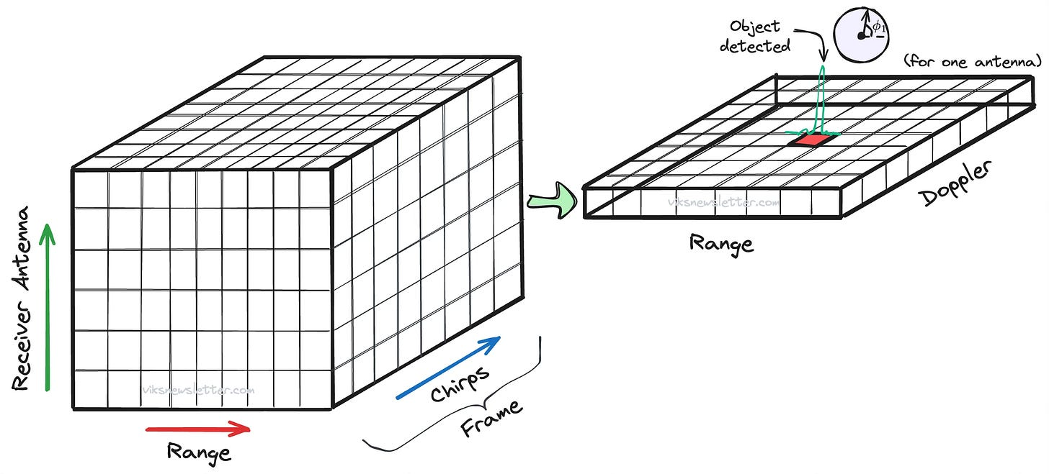
Radar Cube
Image: https://www.viksnewsletter.com/p/how-radar-measures-angle

