Slide 1

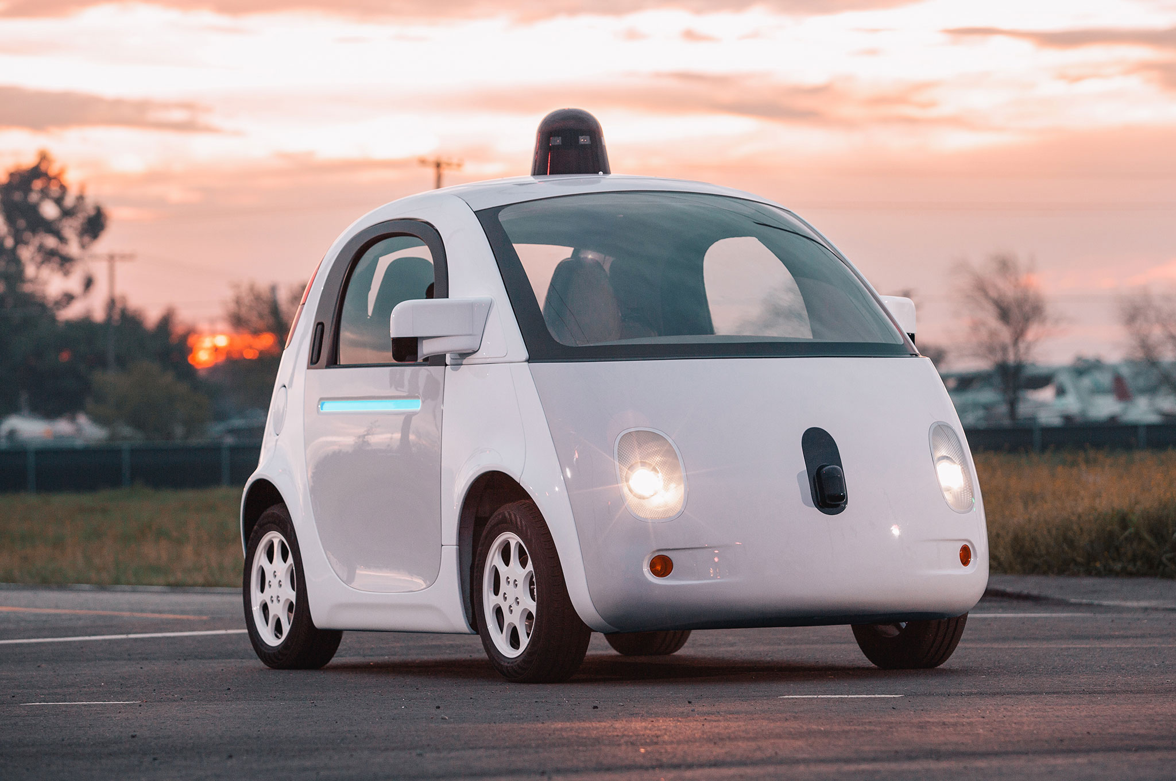

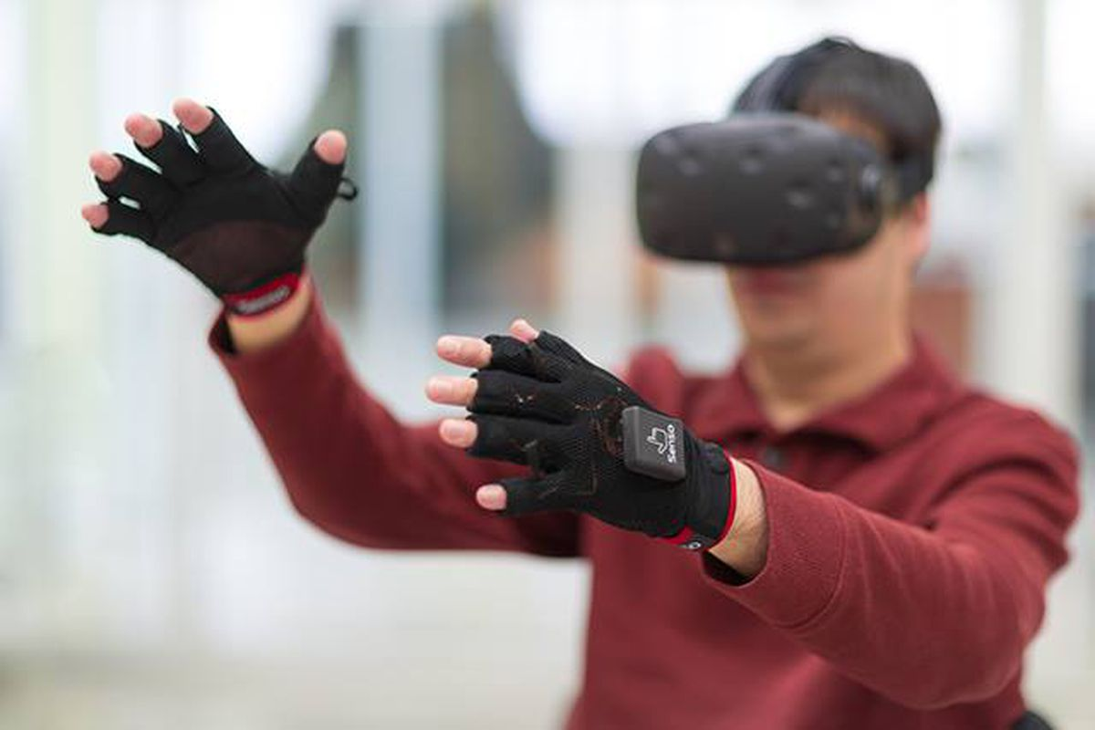

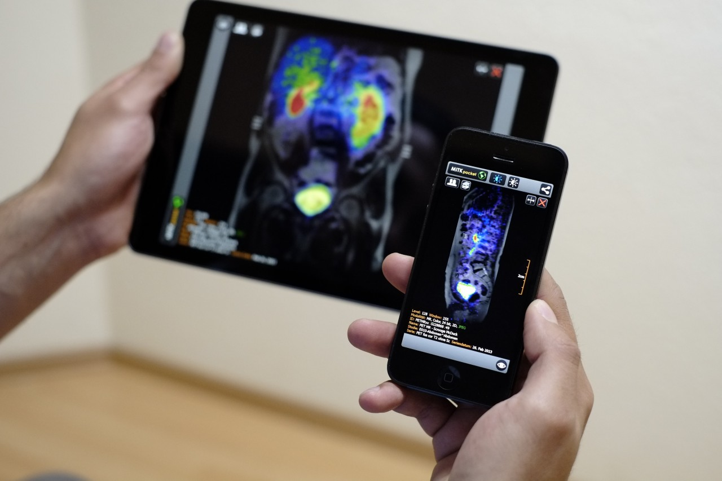
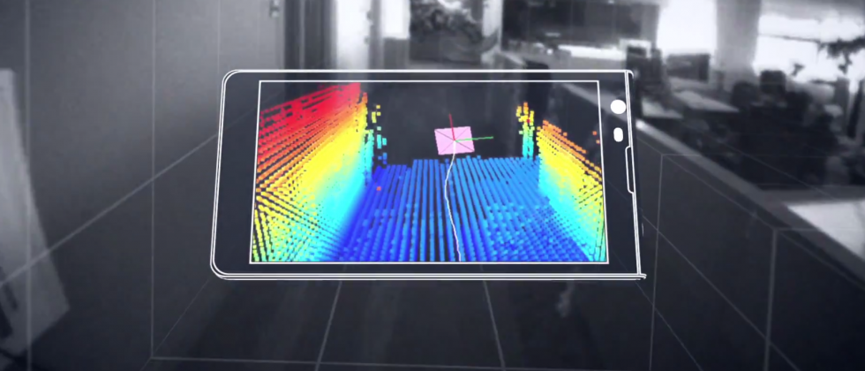
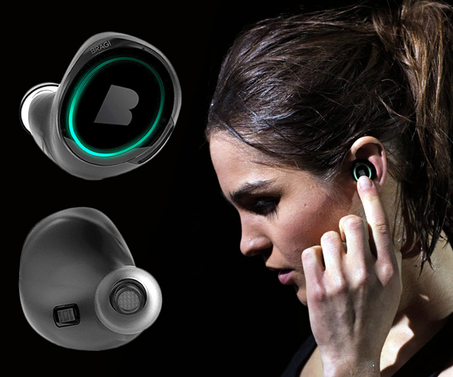
Machine Learning for Physical Sensing & Perception
CMSC 818V : Fall 2025
Lecture 3_3: Active Wave Imaging
Nirupam Roy
Tu-Th 3:30 – 4:45pm
IRB 1207

Slide 2
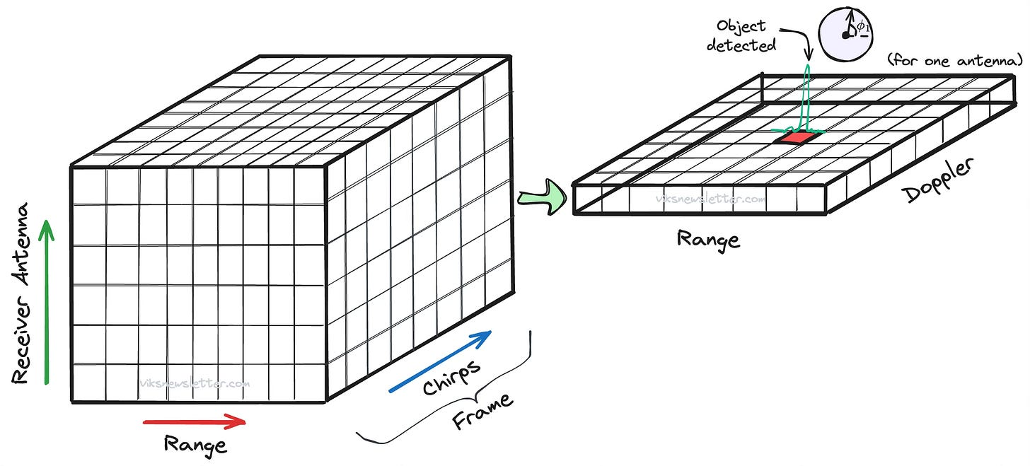
Radar Cube
Image: https://www.viksnewsletter.com/p/how-radar-measures-angle

Slide 3
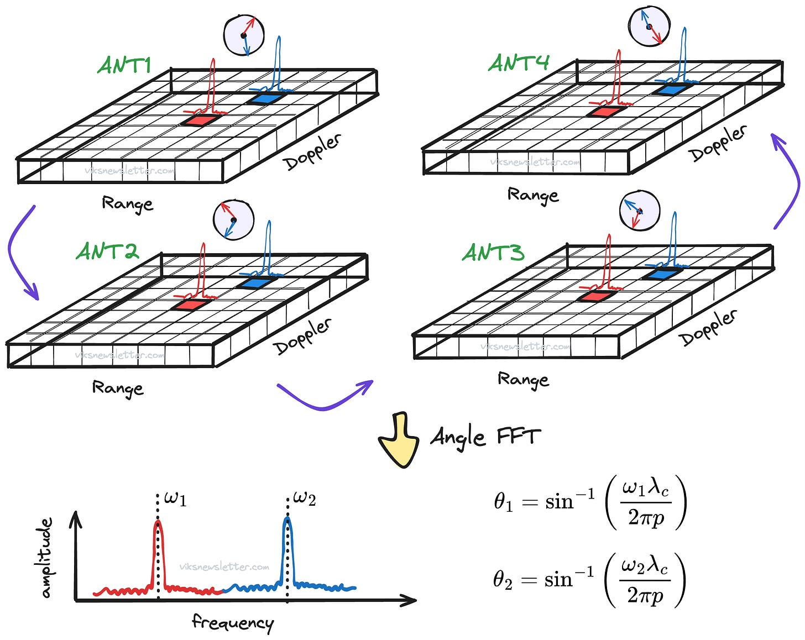
Radar Cube: Angle FFT
Image: https://www.viksnewsletter.com/p/how-radar-measures-angle

Slide 4
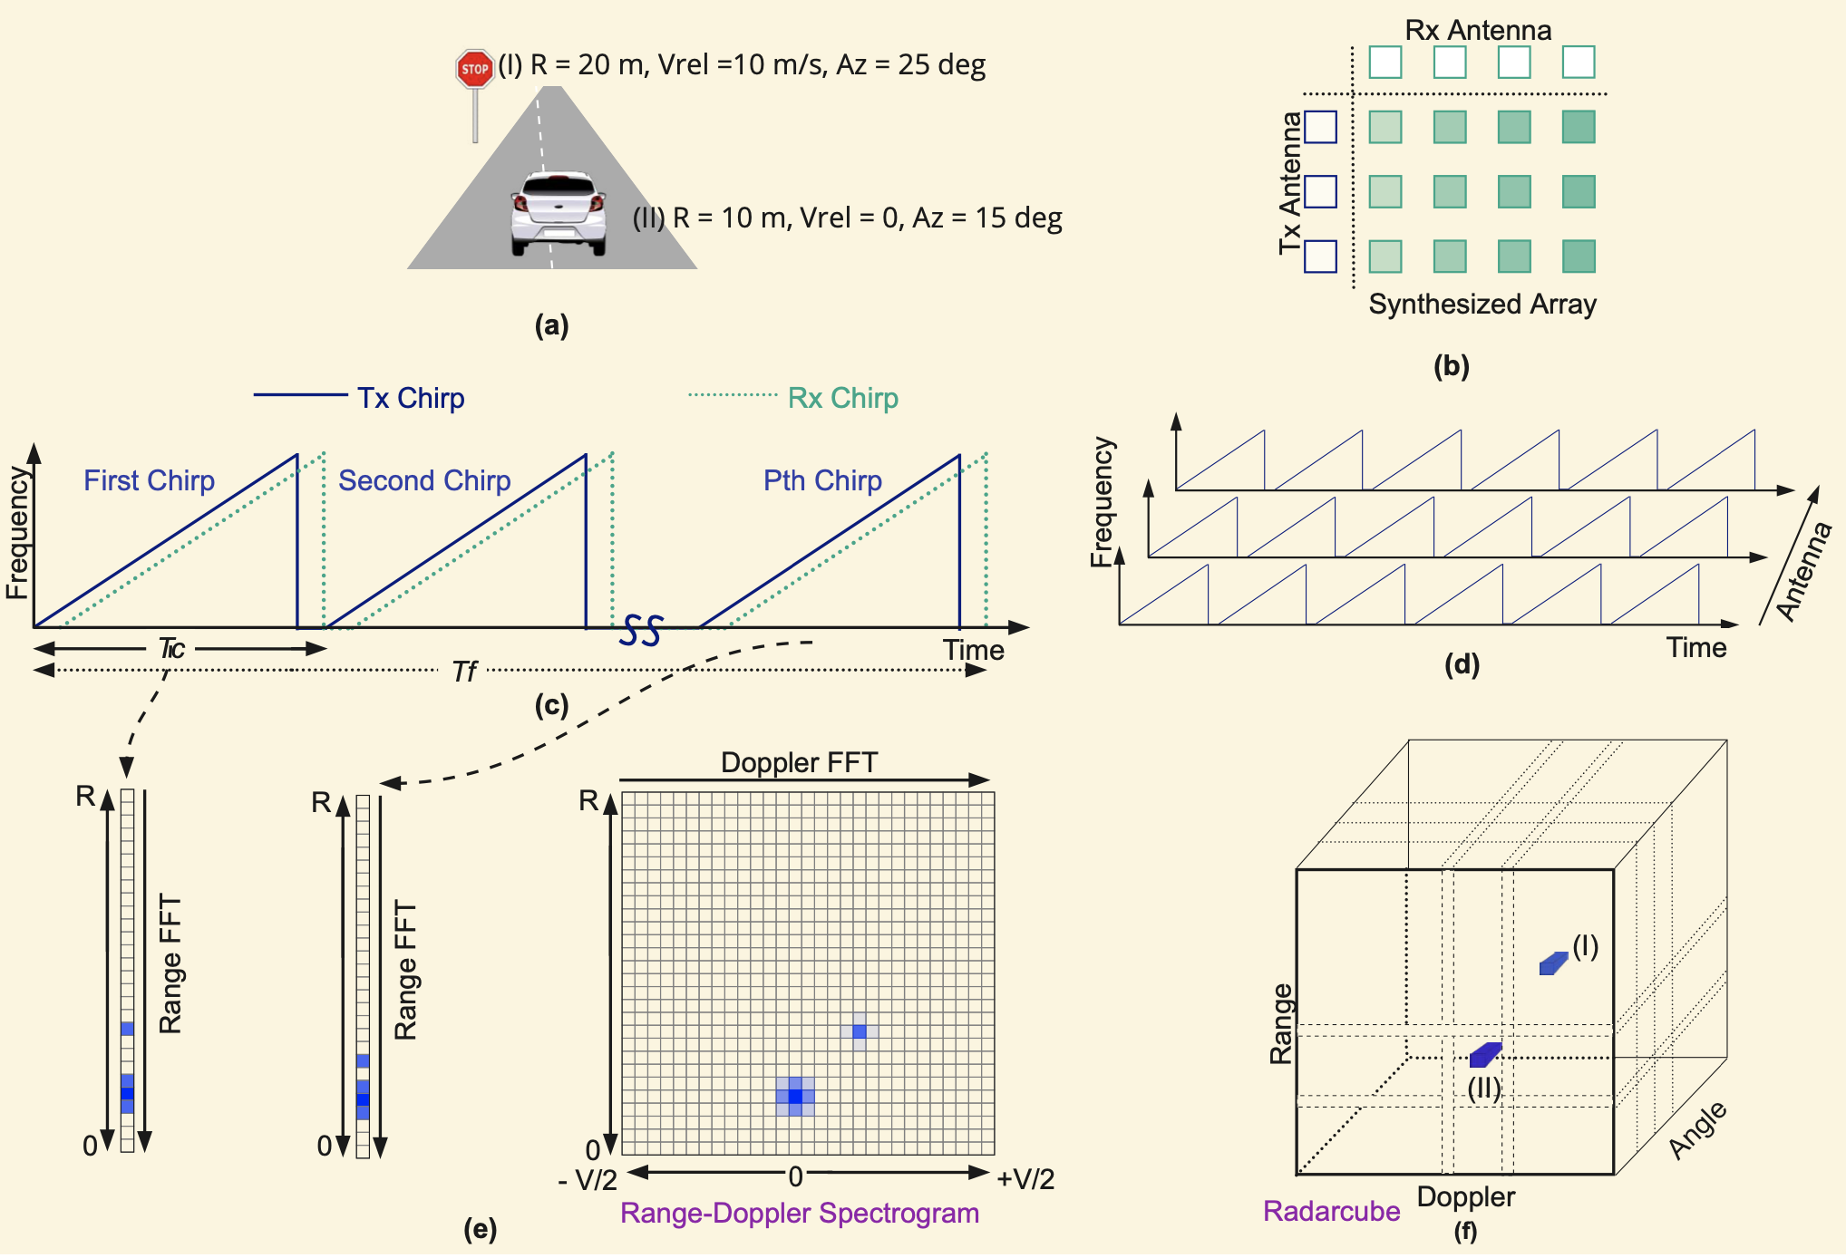
Angle FFT: Detection of range, velocity, and angle

Slide 5
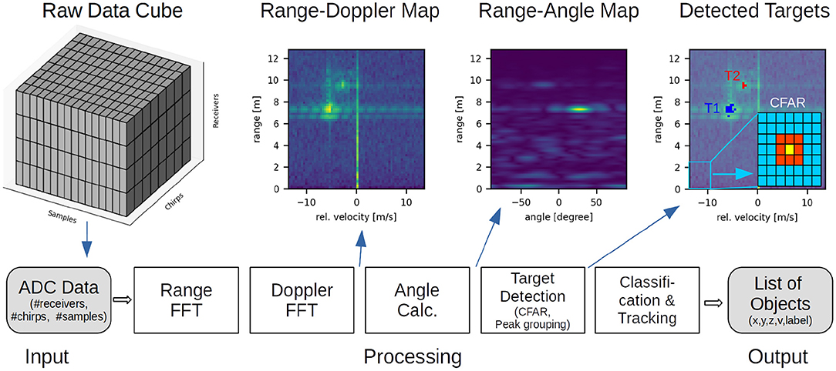
Processing of radar-cube for detection
Image: https://www.frontiersin.org/journals/neuroscience/articles/10.3389/fnins.2022.851774/full

Slide 6
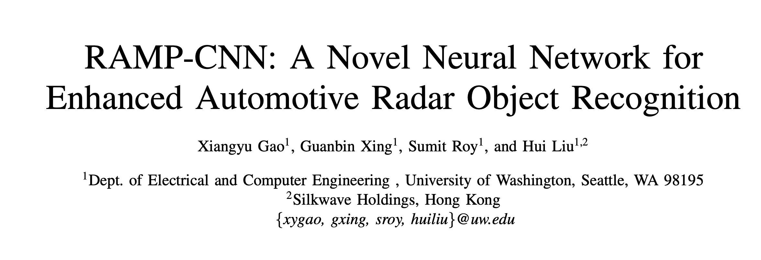
Ref: https://arxiv.org/pdf/2011.08981 (2022)

Slide 7
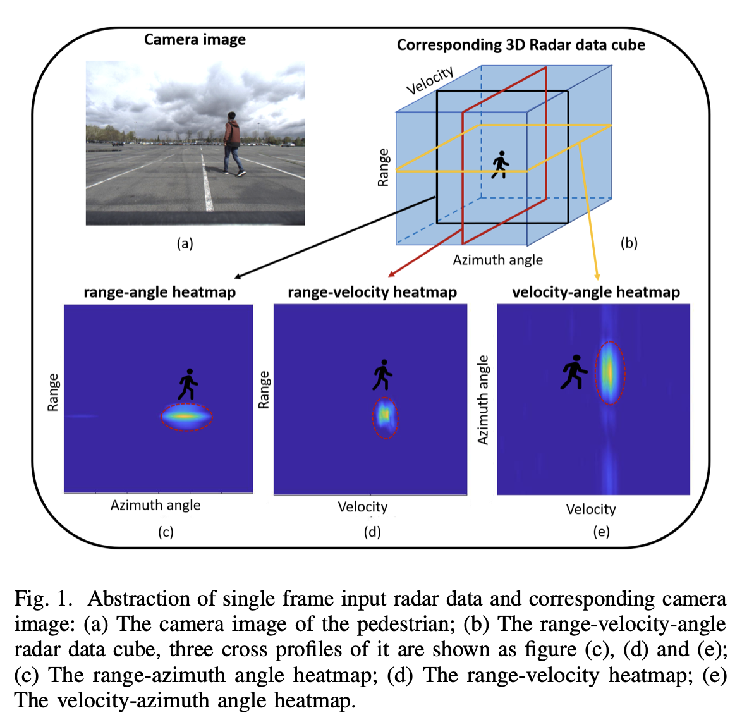

Slide 8
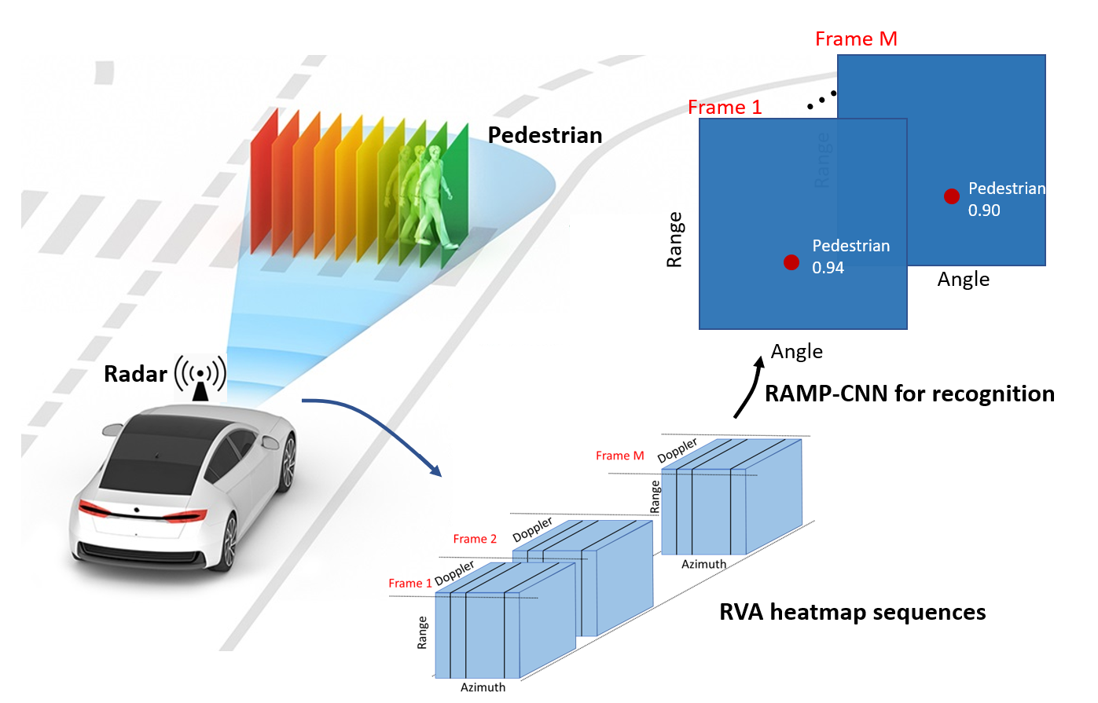

Slide 9
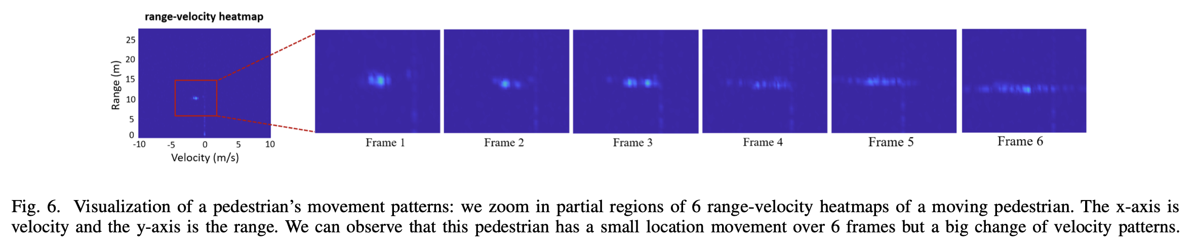

Slide 10
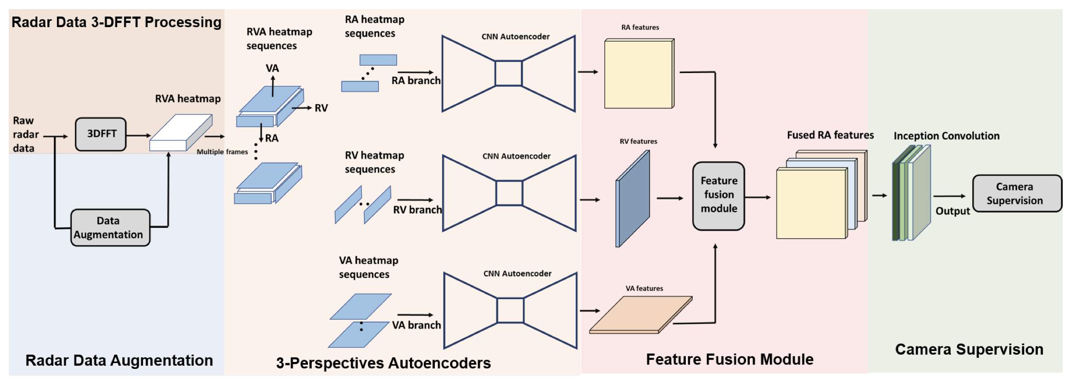
RAMP-CNN

Slide 11
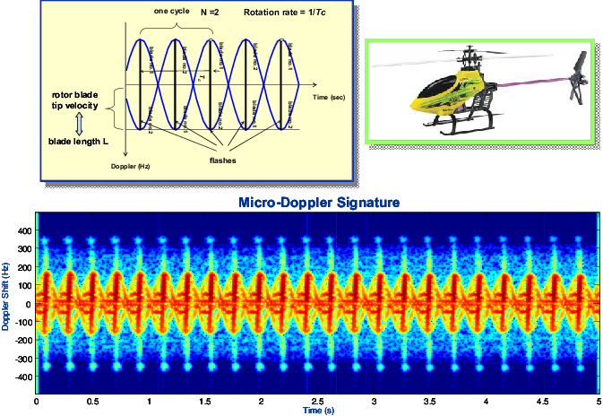
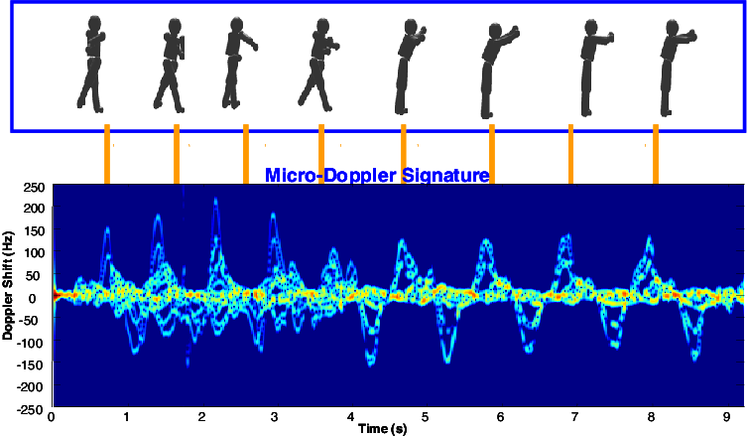
Micro-doppler signature

Slide 12
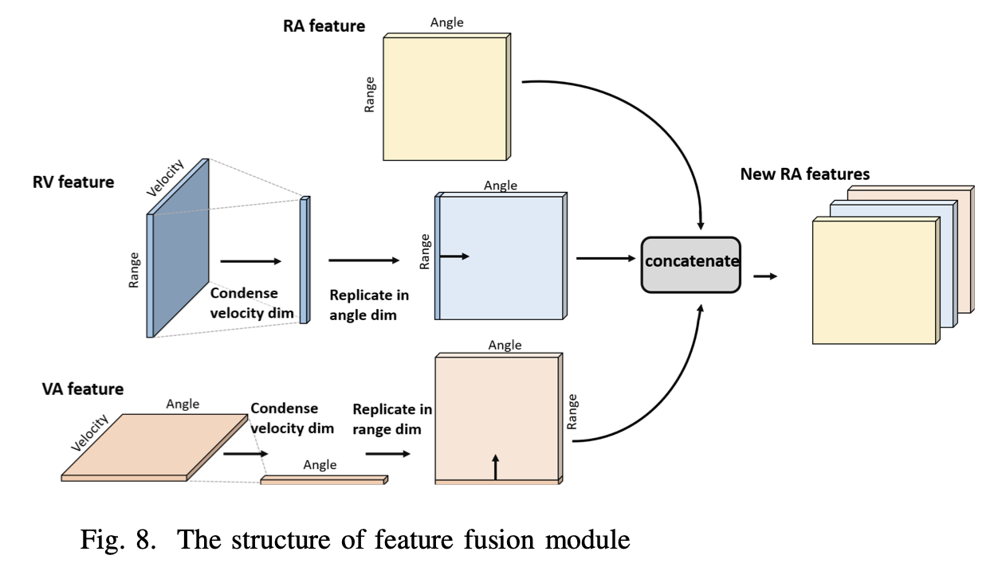
Feature fusion

Slide 13
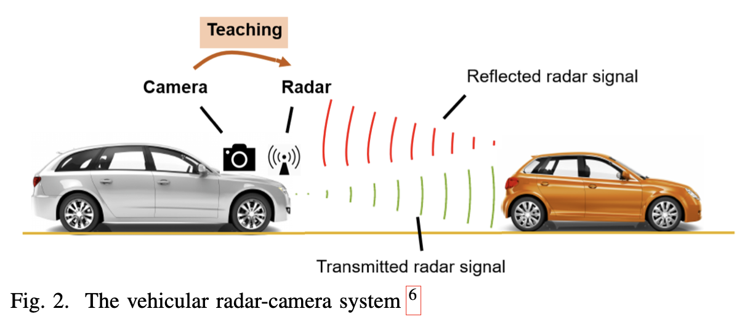
Camera-supervision

Slide 14
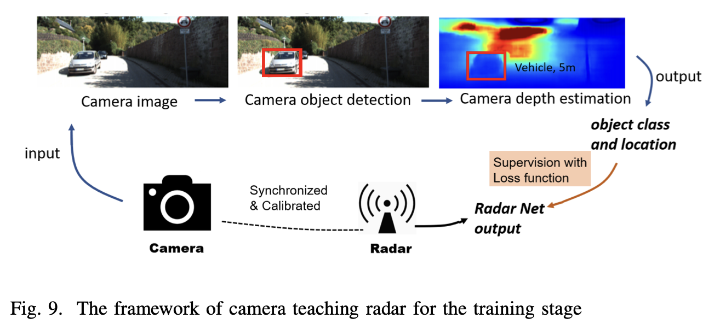
Camera-supervision

Slide 15
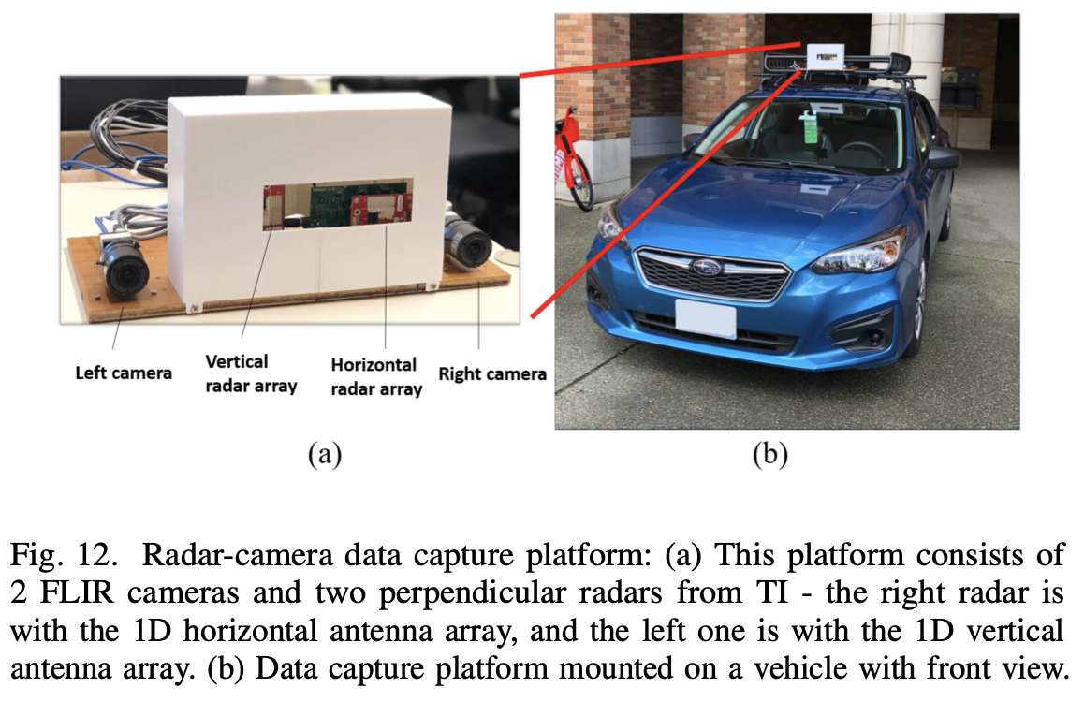
Physical setup

Slide 16
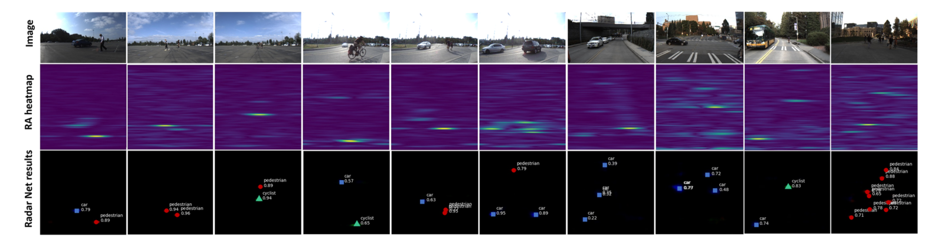
Results

Slide 17
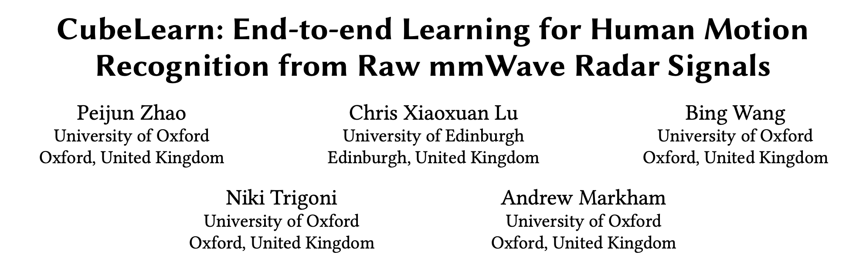
Ref: https://arxiv.org/pdf/2111.03976 (2021)

Slide 18
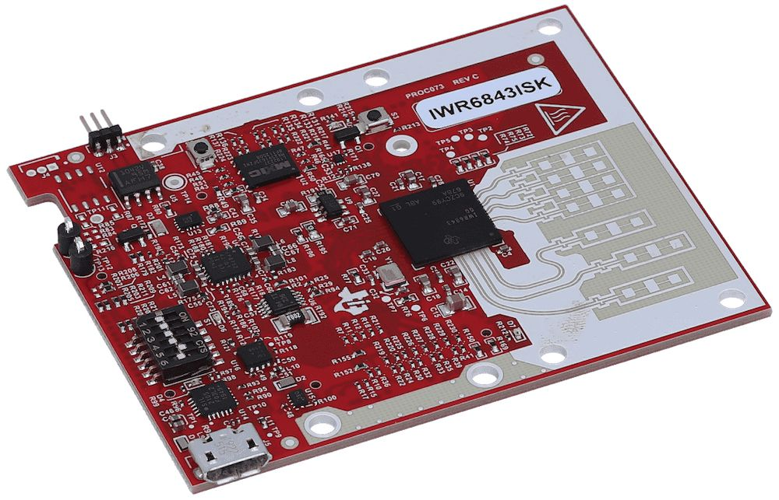
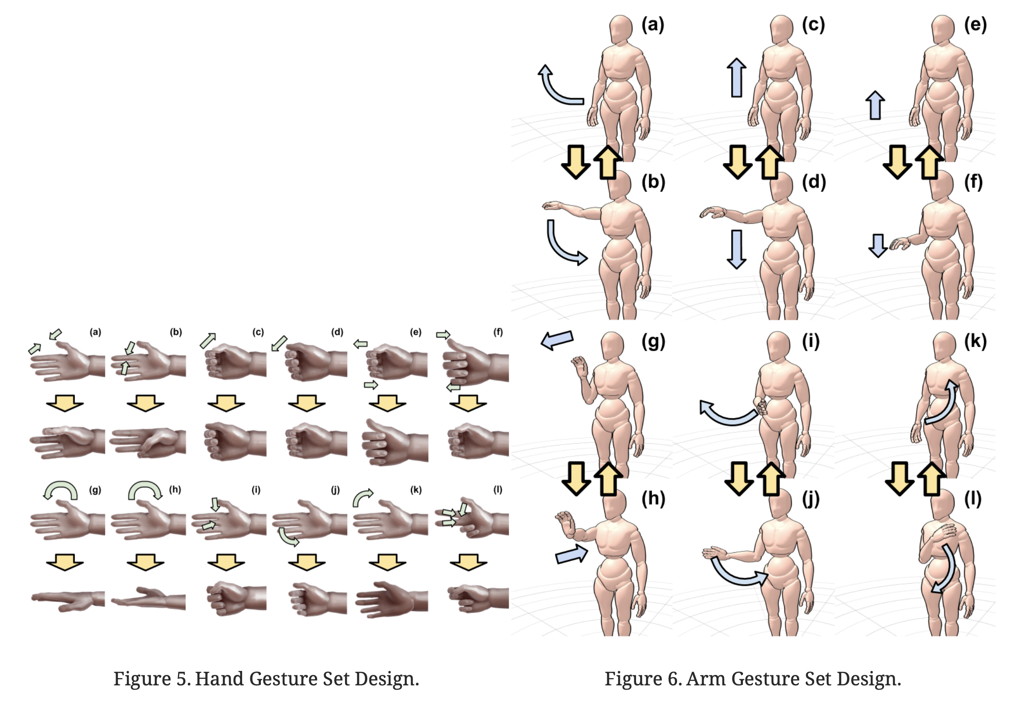
Gesture recognition with mmWave radar

Slide 19
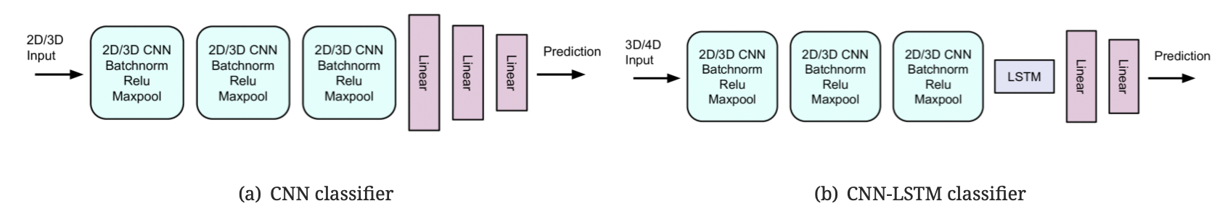
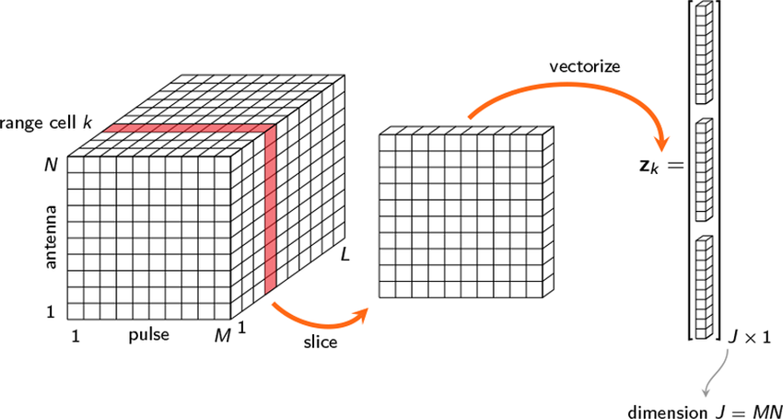
Traditional approaches

Slide 20
Problems with Conventional DFT pre-processing
Lack of adaptive transformation bases.
Fourier transformation bases are equally spaced and fixed
Limited resolution.
DFT has inherent resolution limitation
Decoupled with task-oriented information.
is not designed specifically for certain tasks

Slide 21
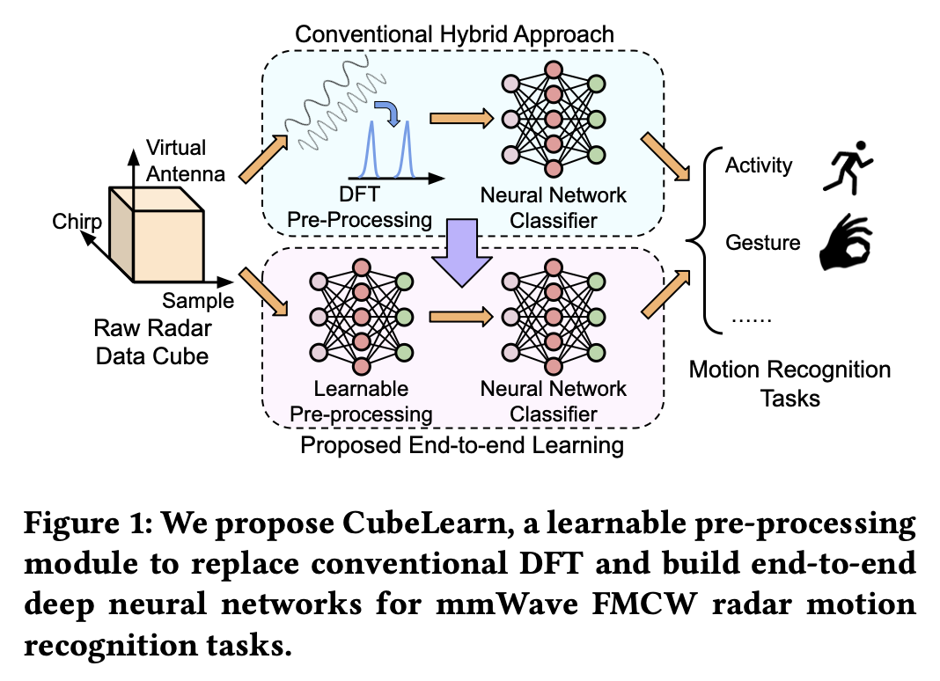
CubeLearn

Slide 22
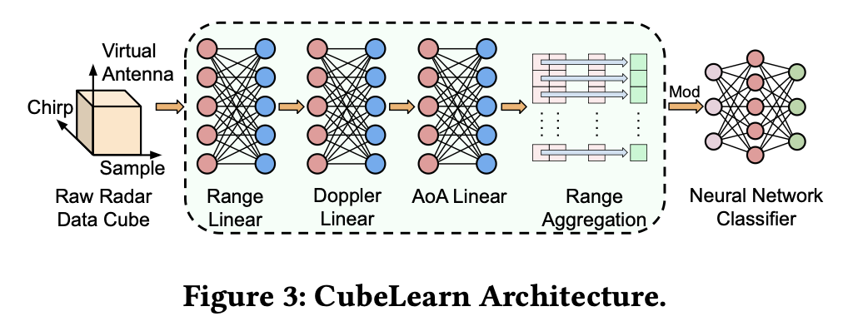
CubeLearn

Slide 23
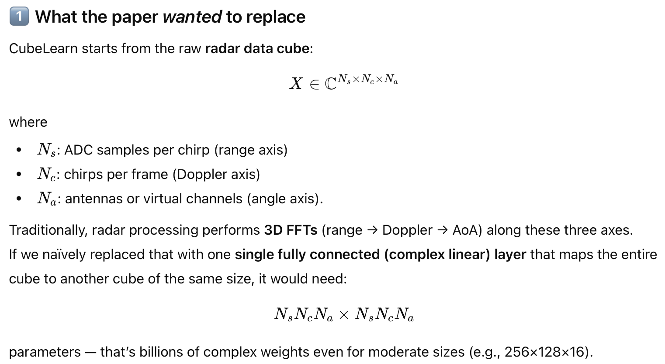
CubeLearn: Core intuition

Slide 24
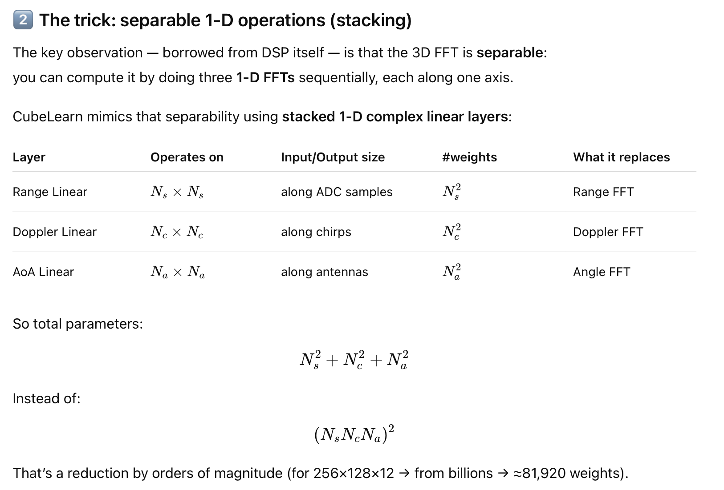
CubeLearn: Core intuition

Slide 25
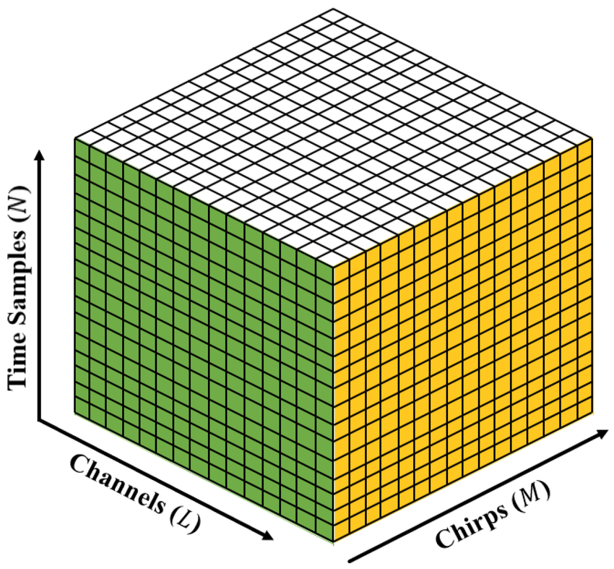
CubeLearn: Core intuition

Slide 26
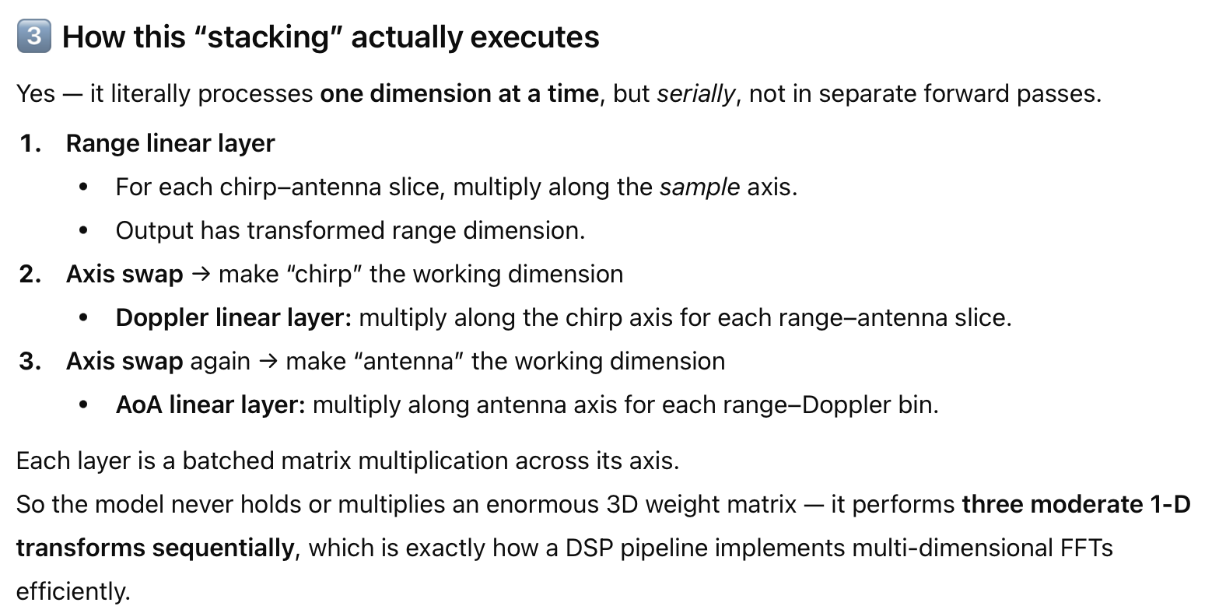
CubeLearn: Core intuition

Slide 27
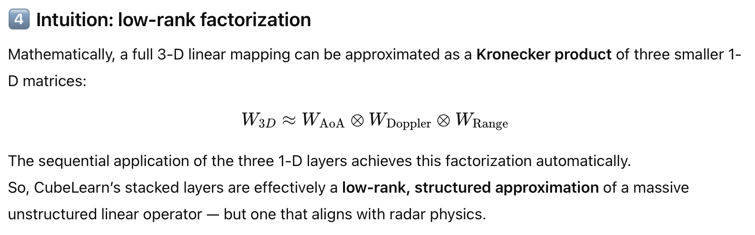
CubeLearn: Core intuition

Slide 28
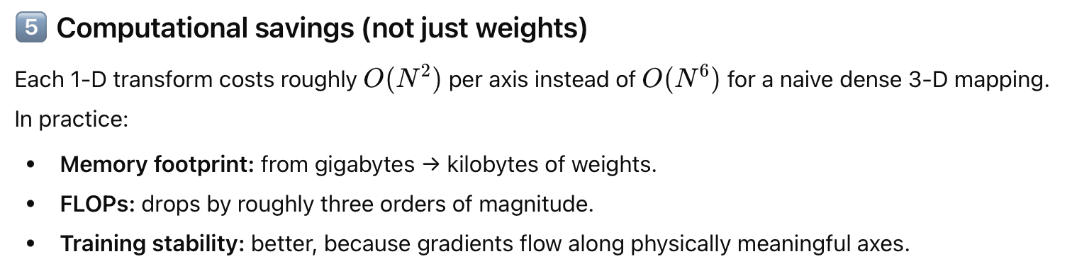
CubeLearn: Core intuition

Slide 29
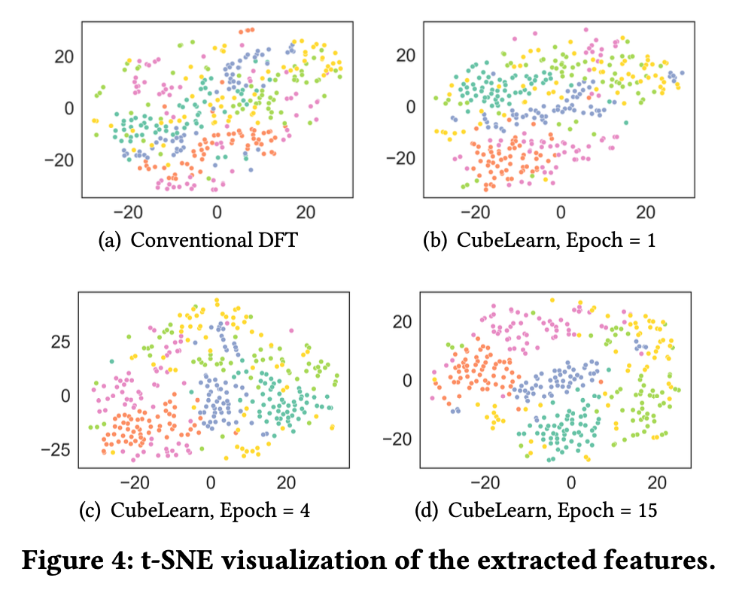
Results
Notes:
t-SNE (t-distributed Stochastic Neighbor Embedding) is an unsupervised non-linear dimensionality reduction technique for data exploration and visualizing high-dimensional data.

