Slide 1

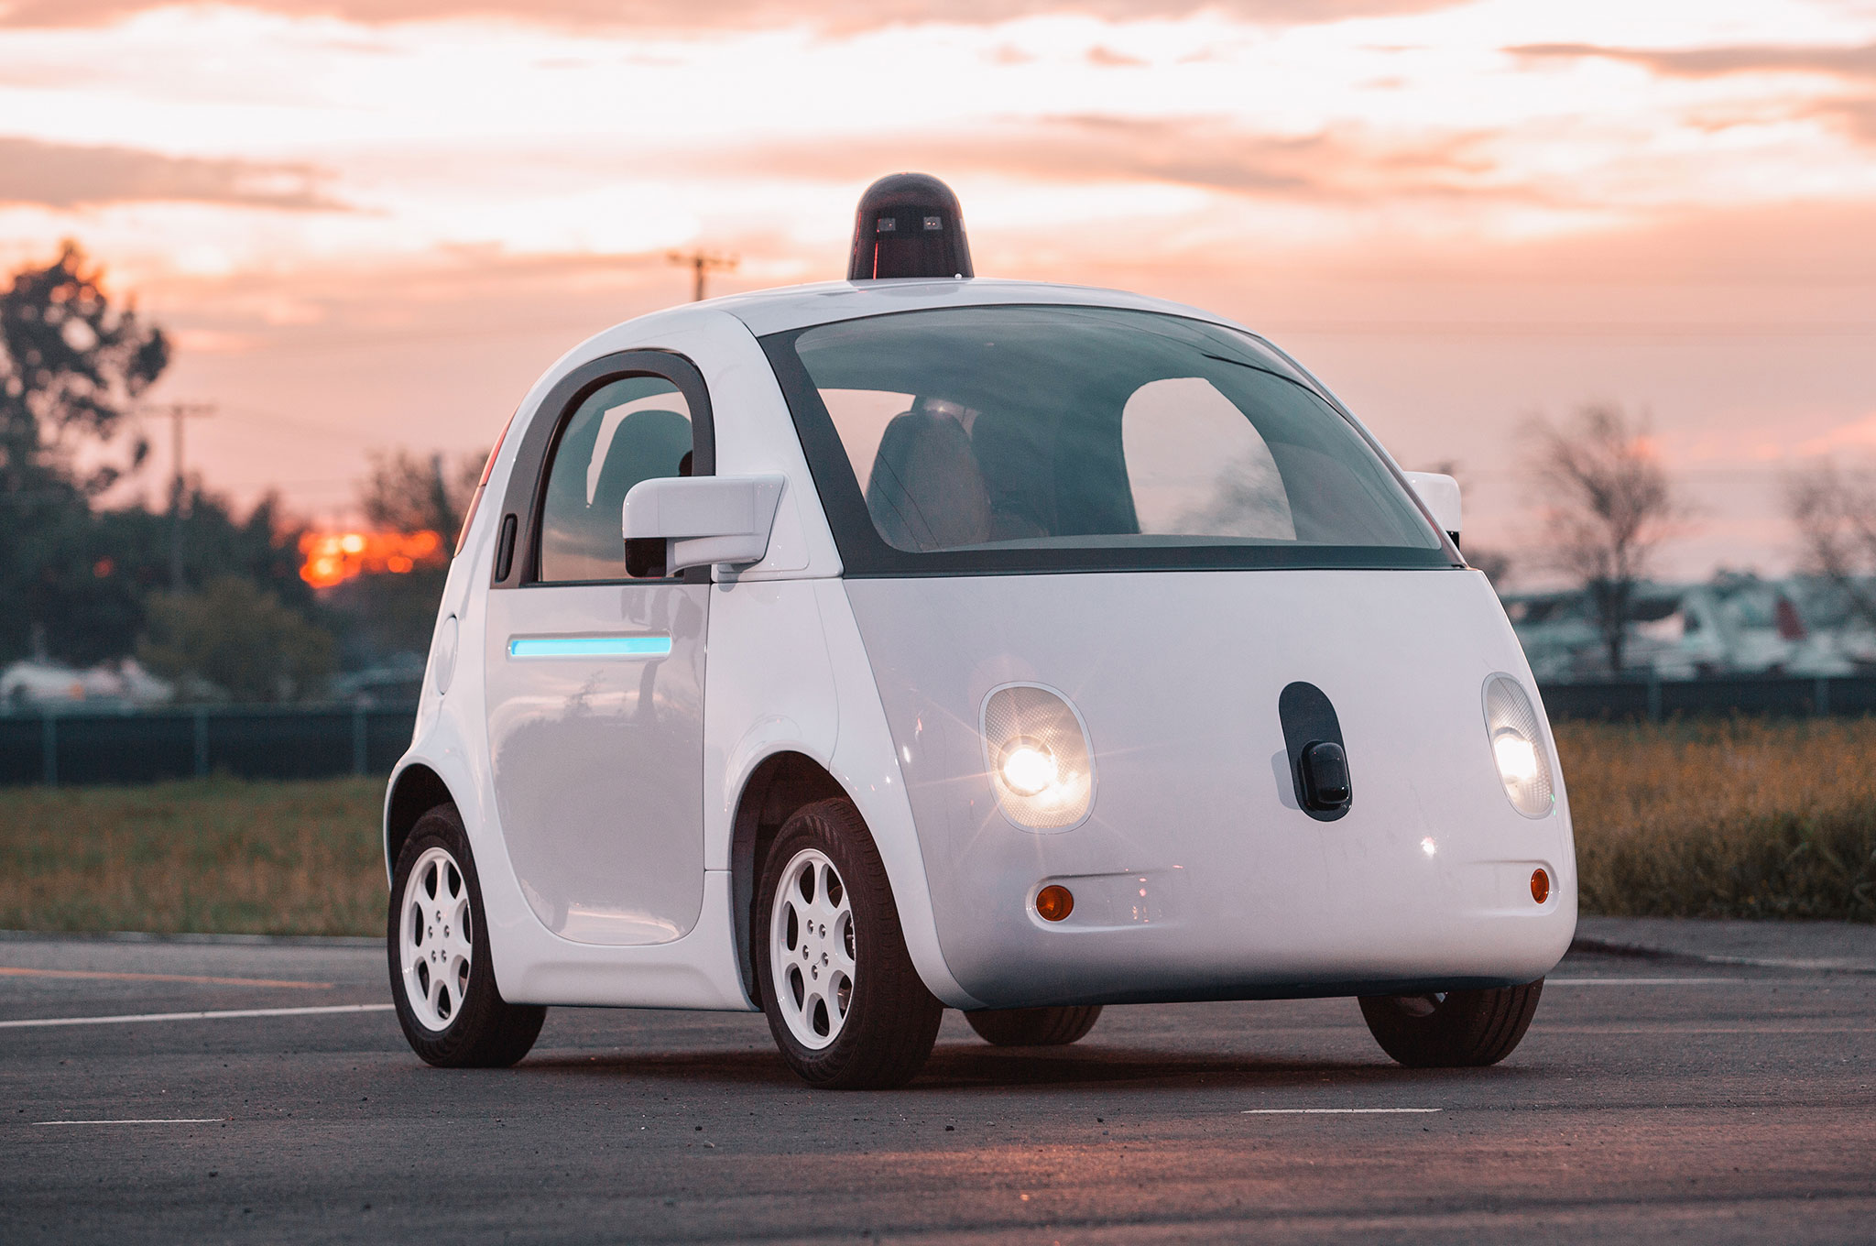
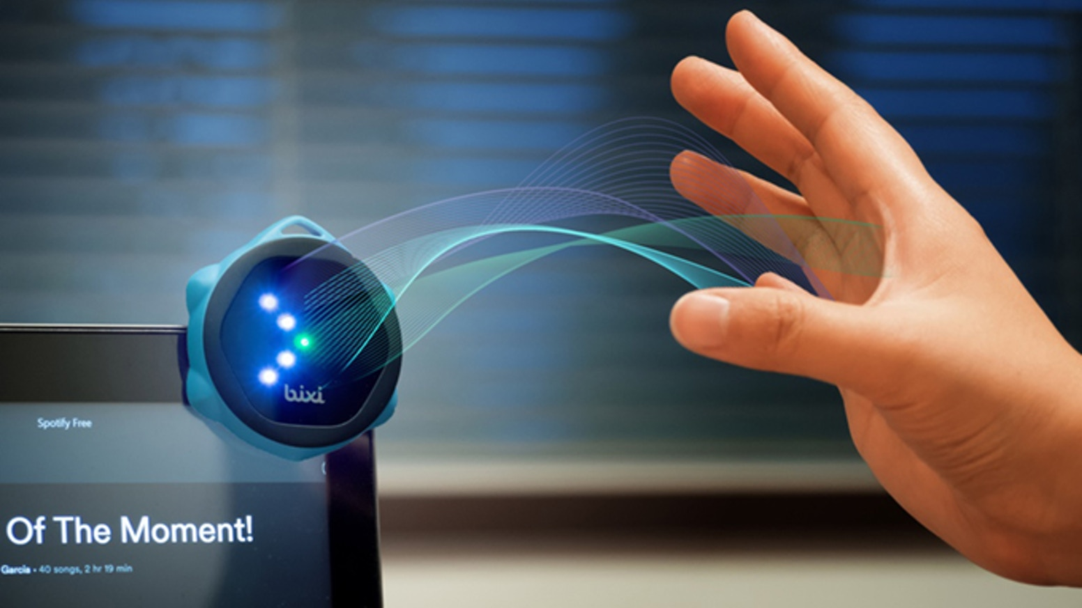
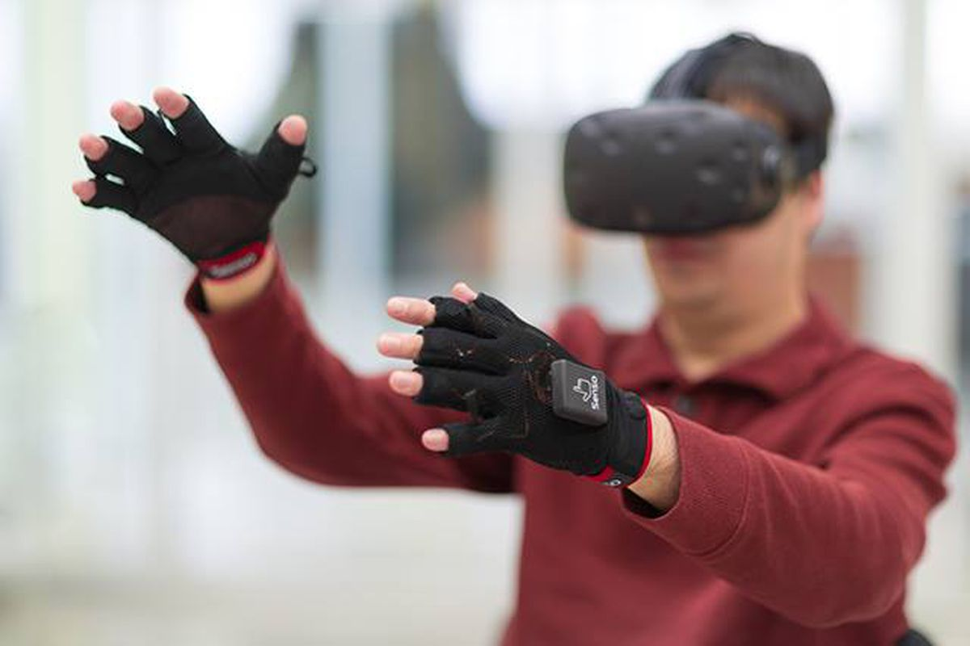

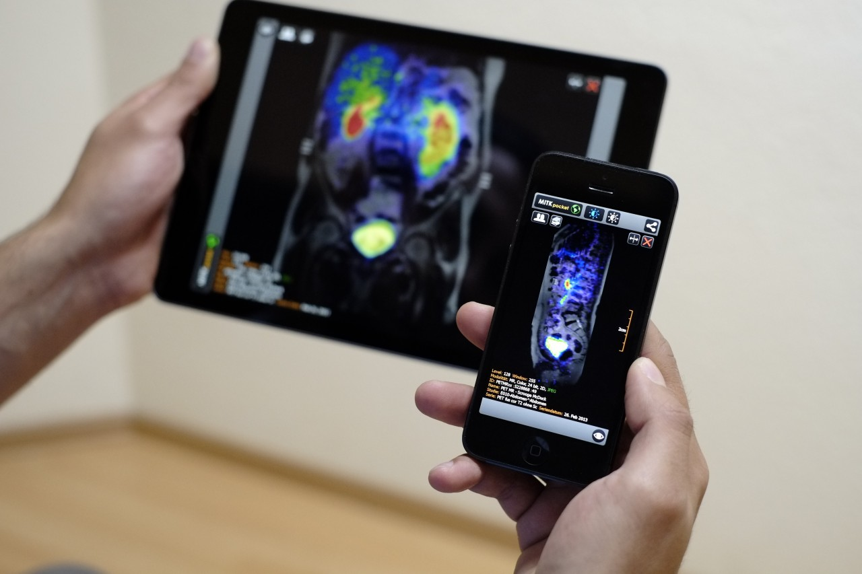
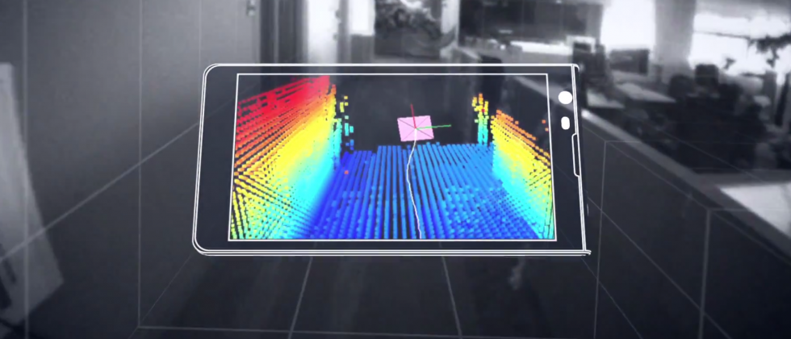
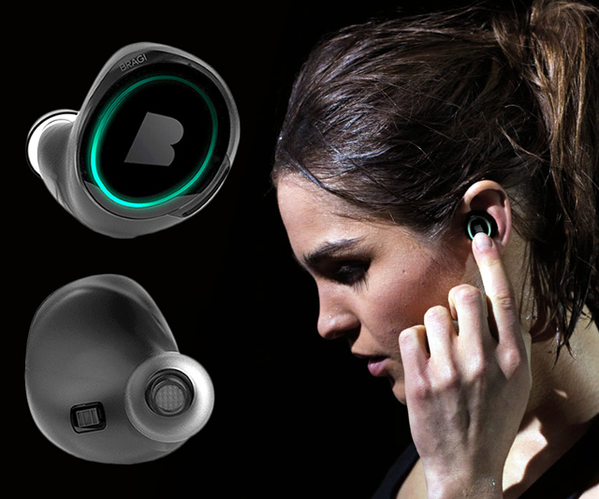
Machine Learning for Physical Sensing & Perception
CMSC 818V : Fall 2025
Lecture 4_1: Active Volumetric Sensing
Nirupam Roy
Tu-Th 3:30 – 4:45pm
IRB 1207

Slide 2
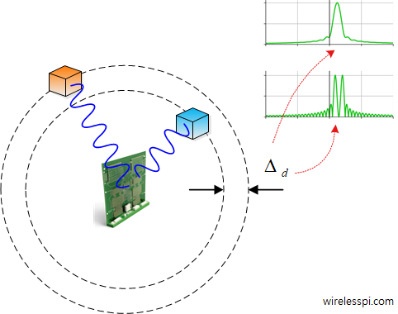
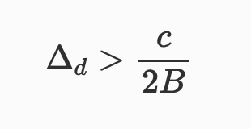
Radar: Range resolution

Slide 3
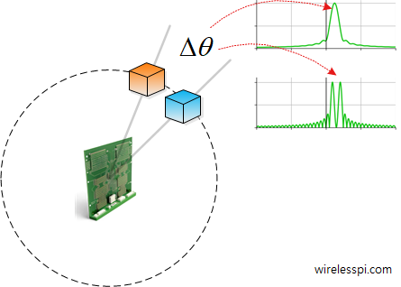

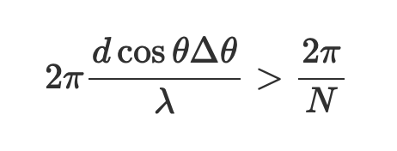
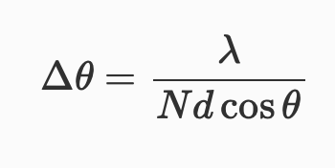
Radar: Angular resolution

Slide 4
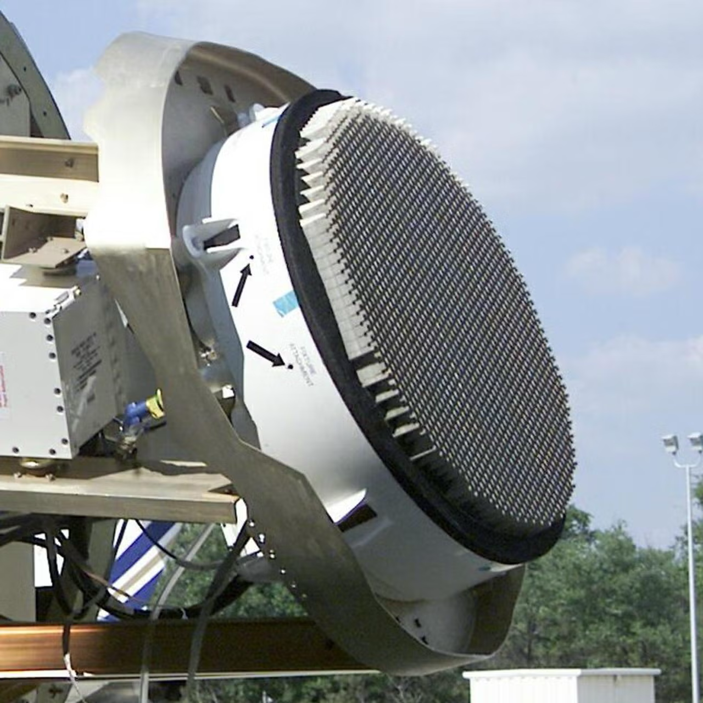
Radar Array

Slide 5
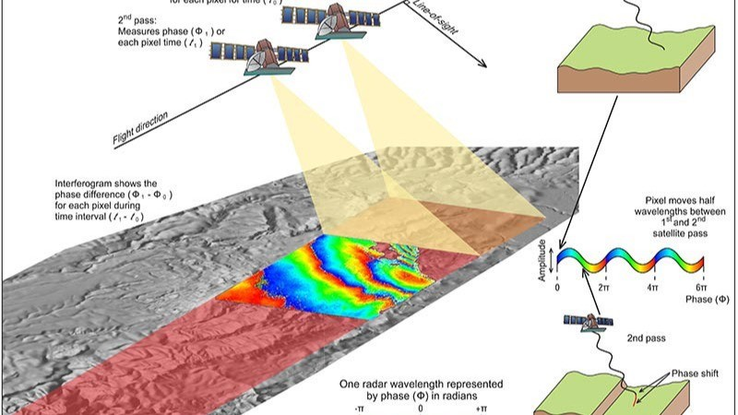
Synthetic Aperture Radar

Slide 6
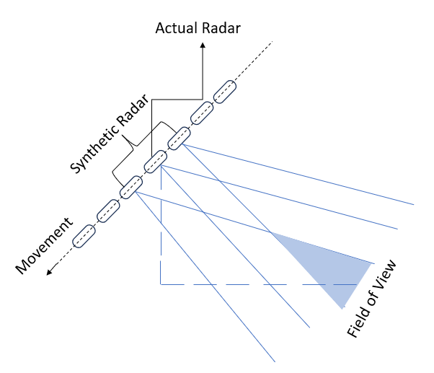
Synthetic Aperture Radar

Slide 7
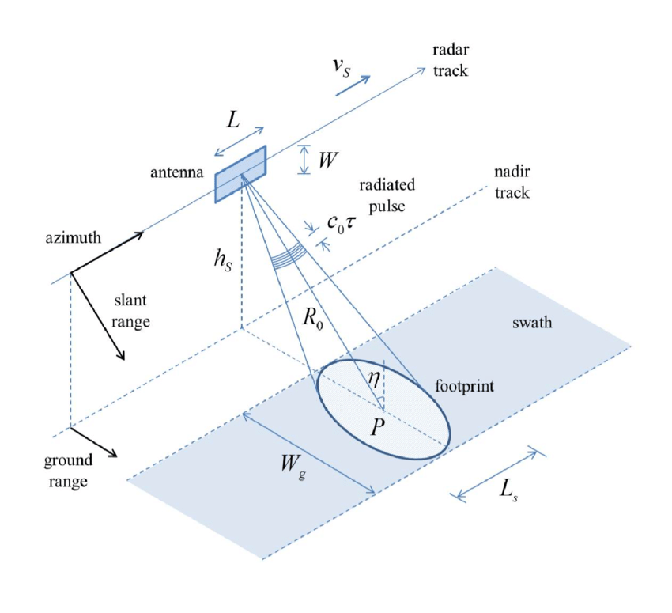
Synthetic Aperture Radar

Slide 8
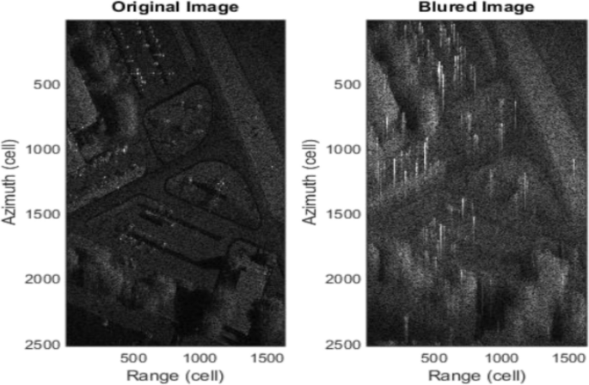
Blur in SAR

Slide 9



Where the blur comes from
Consider a single azimuth line after range compression. In azimuth-frequency (Doppler) domain let (2D radar data)

Slide 10

Where the blur comes from

Slide 11


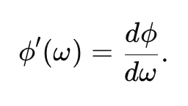
Where the blur comes from

Slide 12


Phase Gradient Algorithm (PGA)

Slide 13


Phase Gradient Algorithm (PGA)

Slide 14



Phase Gradient Algorithm (PGA)

Slide 15

MobiSys 2018 – Best paper award
https://www.cs.utexas.edu/~meiwang/uploads/8/9/9/1/89919297/aim.pdf

Slide 16
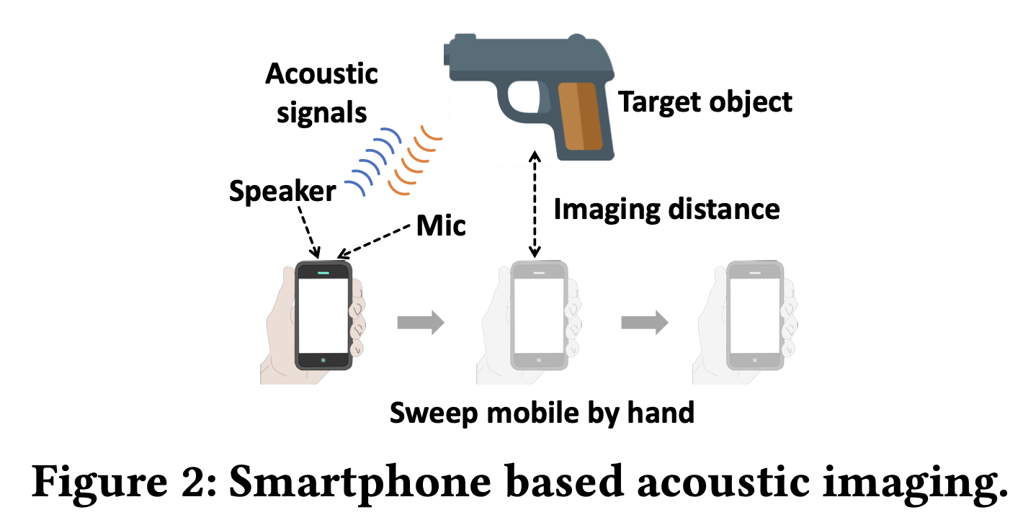

Slide 17
