Slide 1

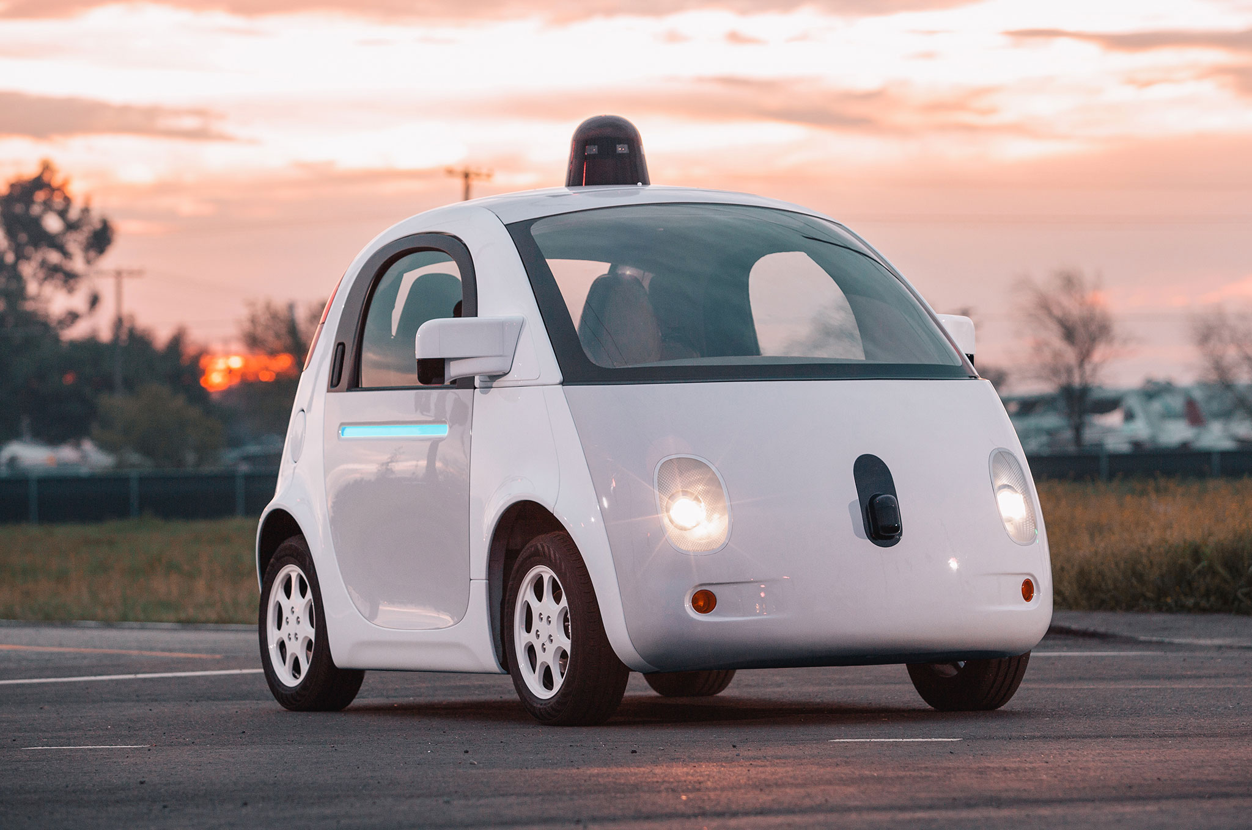

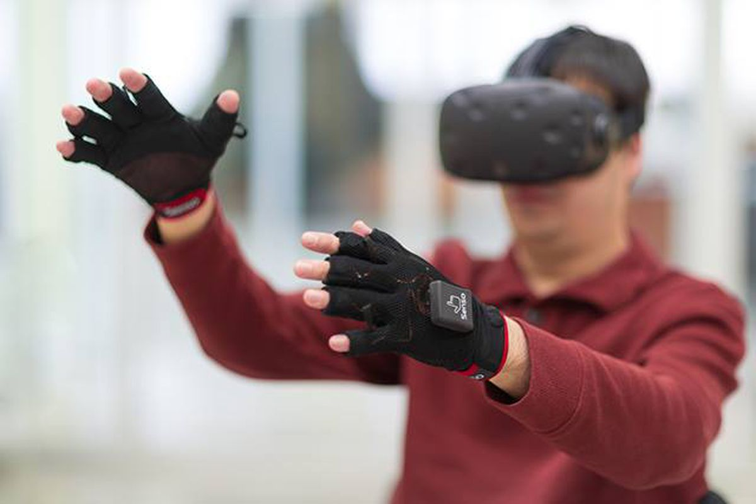

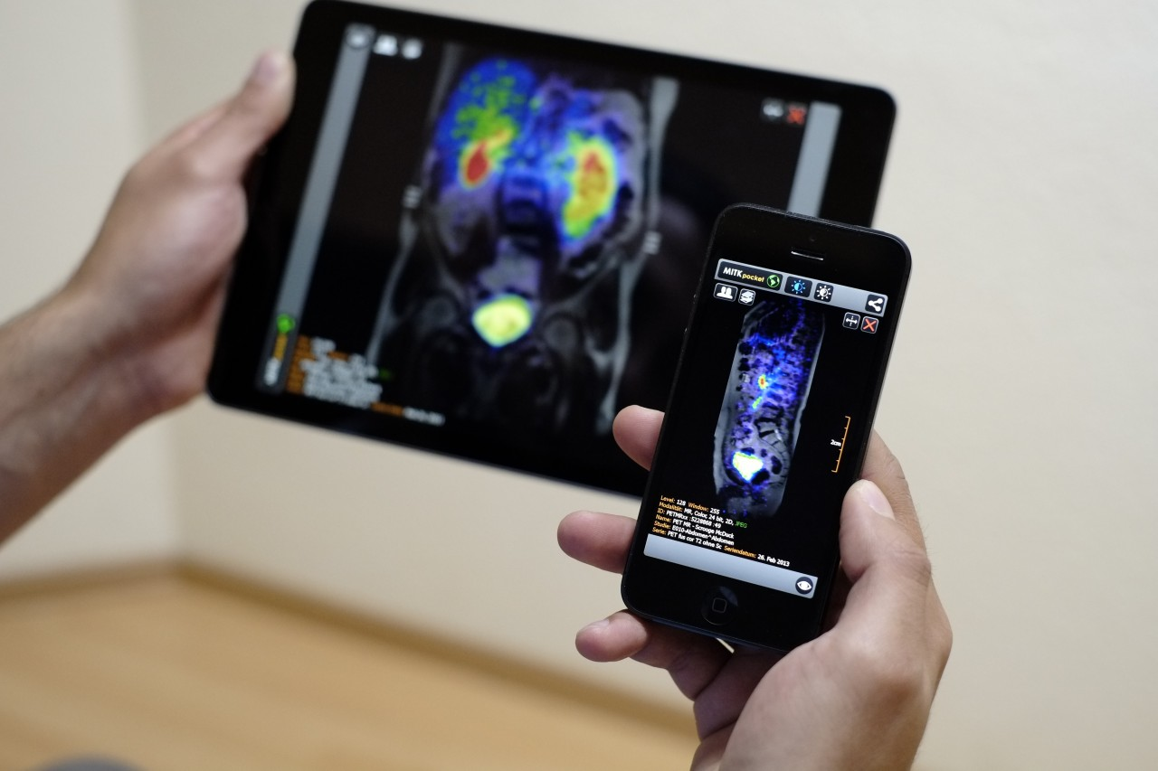
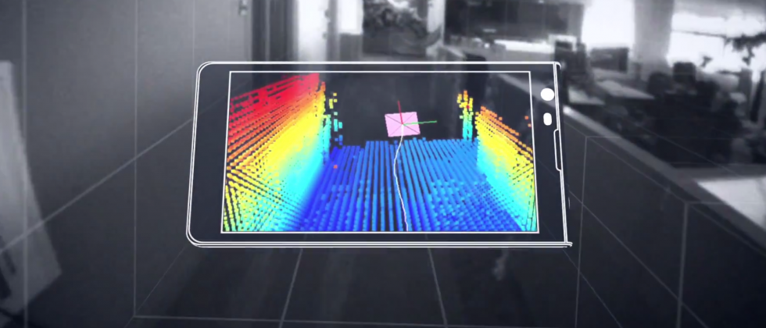
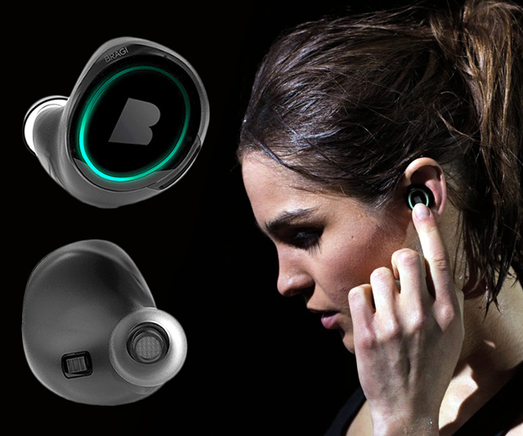
Machine Learning for Physical Sensing & Perception
CMSC 818V : Fall 2025
Lecture 4_2: Active Volumetric Sensing
Nirupam Roy
Tu-Th 3:30 – 4:45pm
IRB 1207

Slide 2
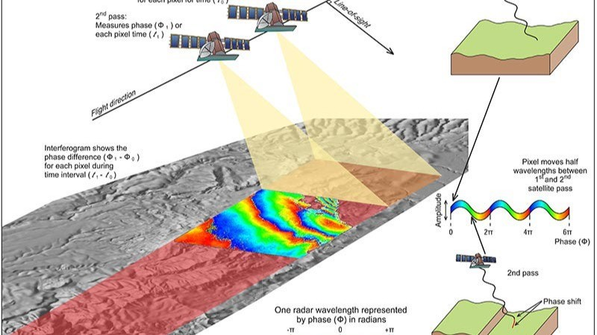
Synthetic Aperture Radar

Slide 3
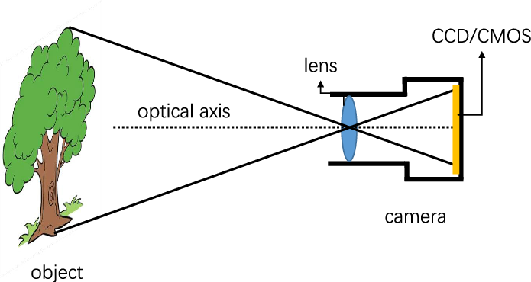
Standard RADAR vs SAR (Analogy)
Standard RADAR

Slide 4
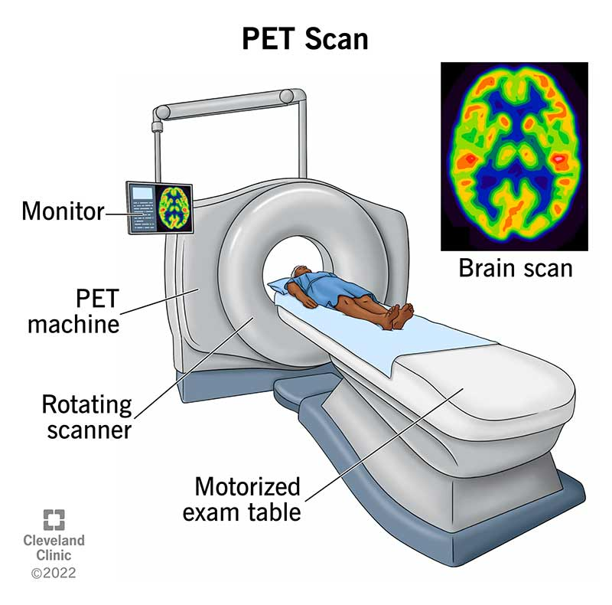
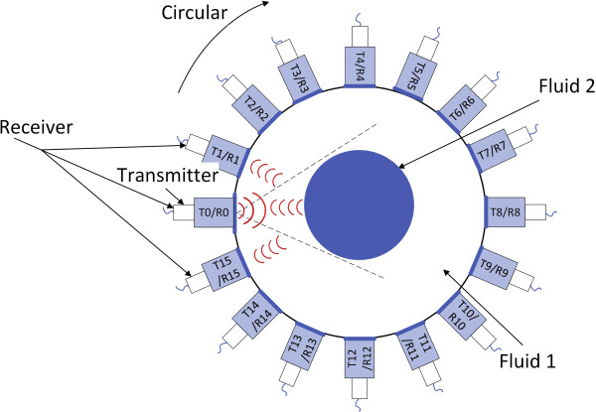
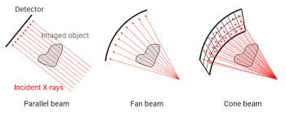
Standard RADAR vs SAR (Analogy)
Standard RADAR
Synthetic Aperture RADAR (SAR)

Slide 5
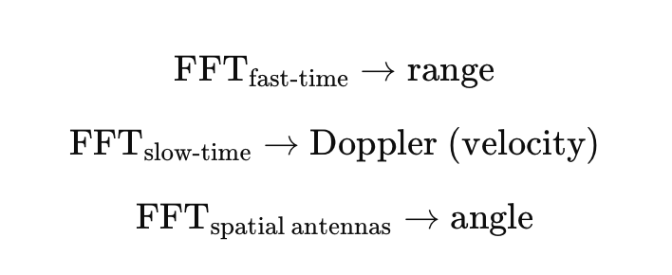
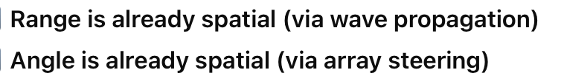
Standard RADAR vs SAR
Standard RADAR:

Slide 6

Standard RADAR vs SAR
Synthetic Aperture RADAR (SAR)
Notes:
Not a sinusoidal change in phase….rather a chirp like change.

Slide 7
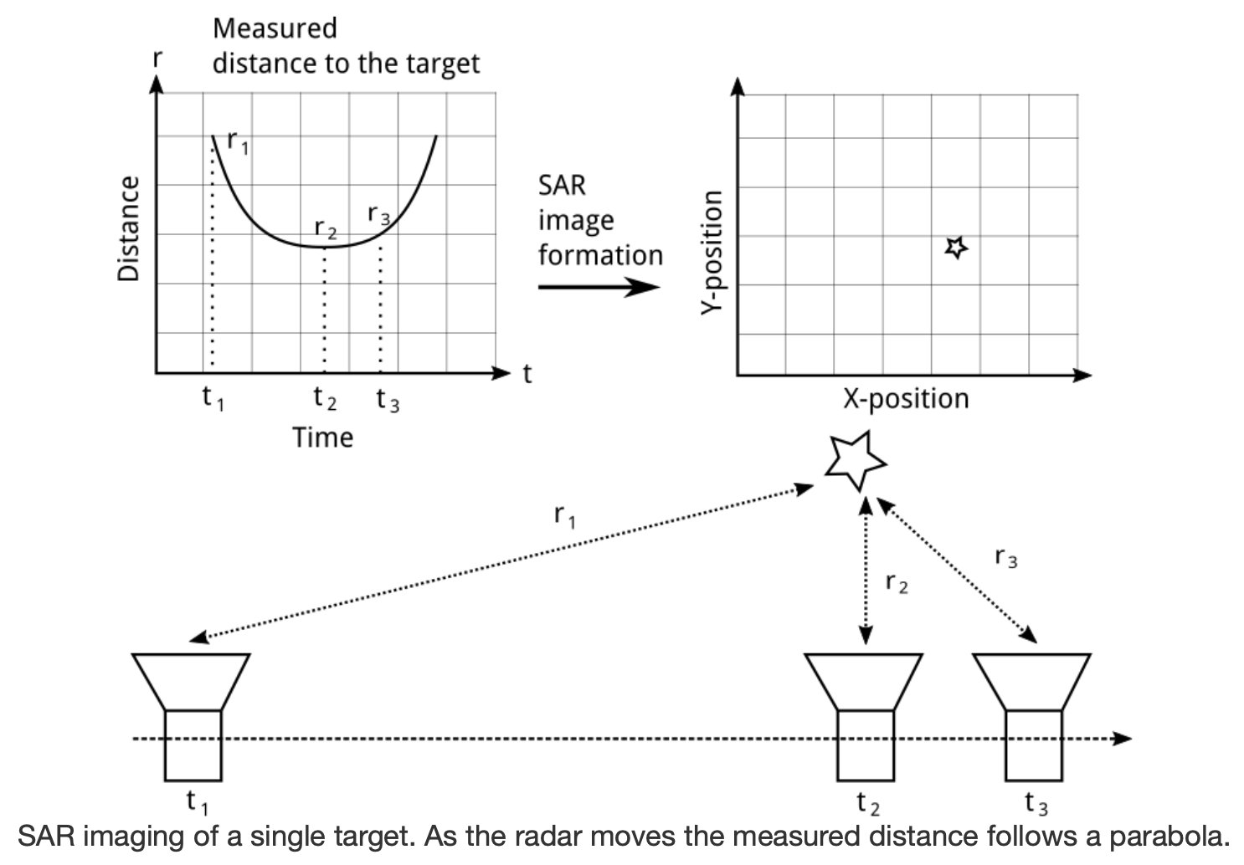
SAR Doppler direction

Slide 8
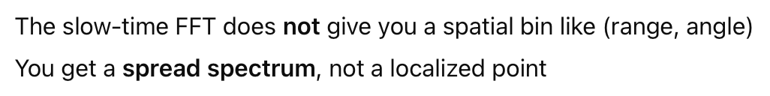
Standard RADAR vs SAR
Synthetic Aperture RADAR (SAR)

Slide 9
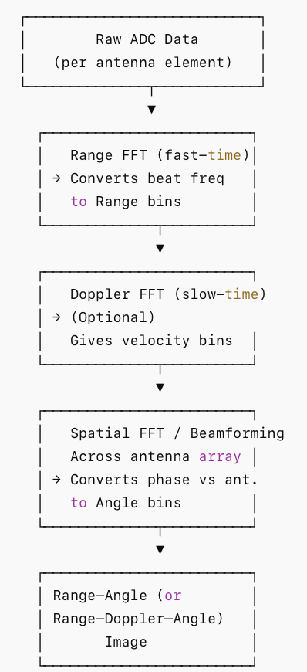
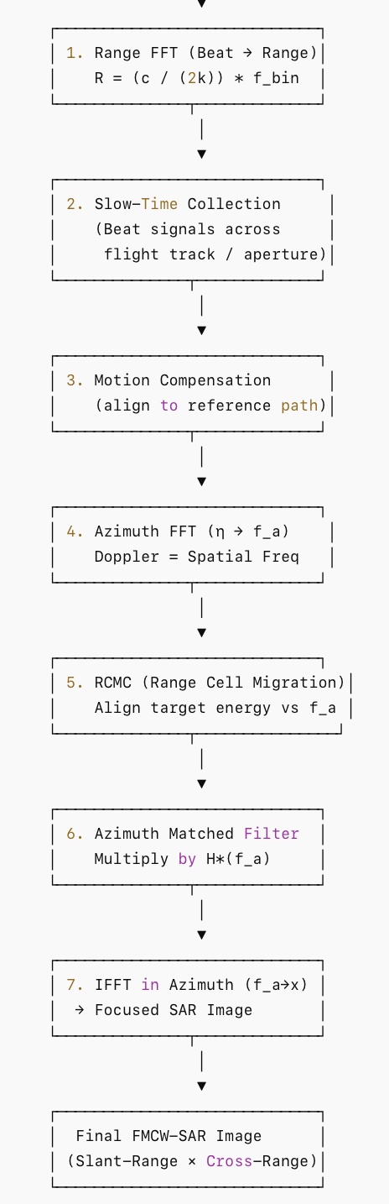
Standard RADAR
SAR

Slide 10
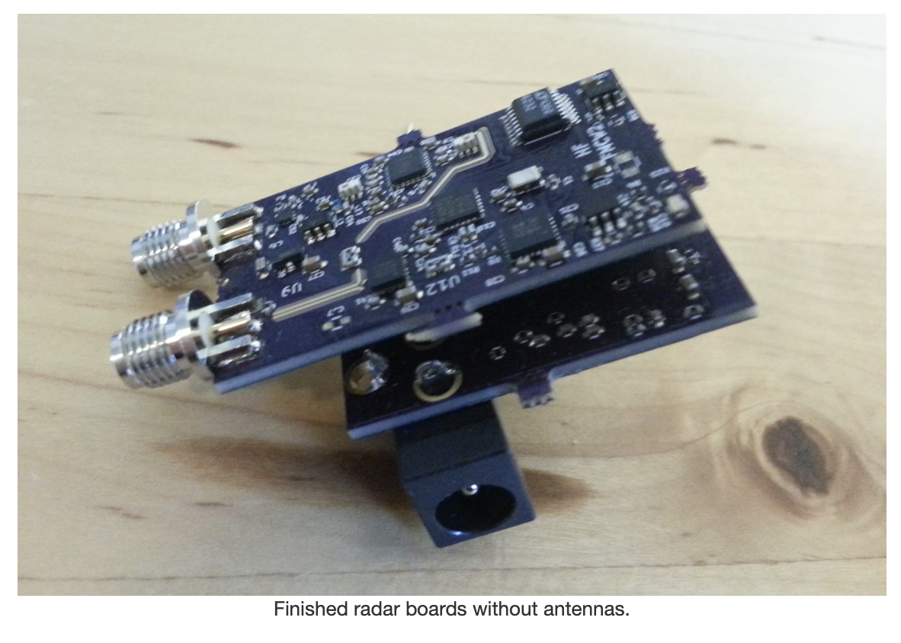
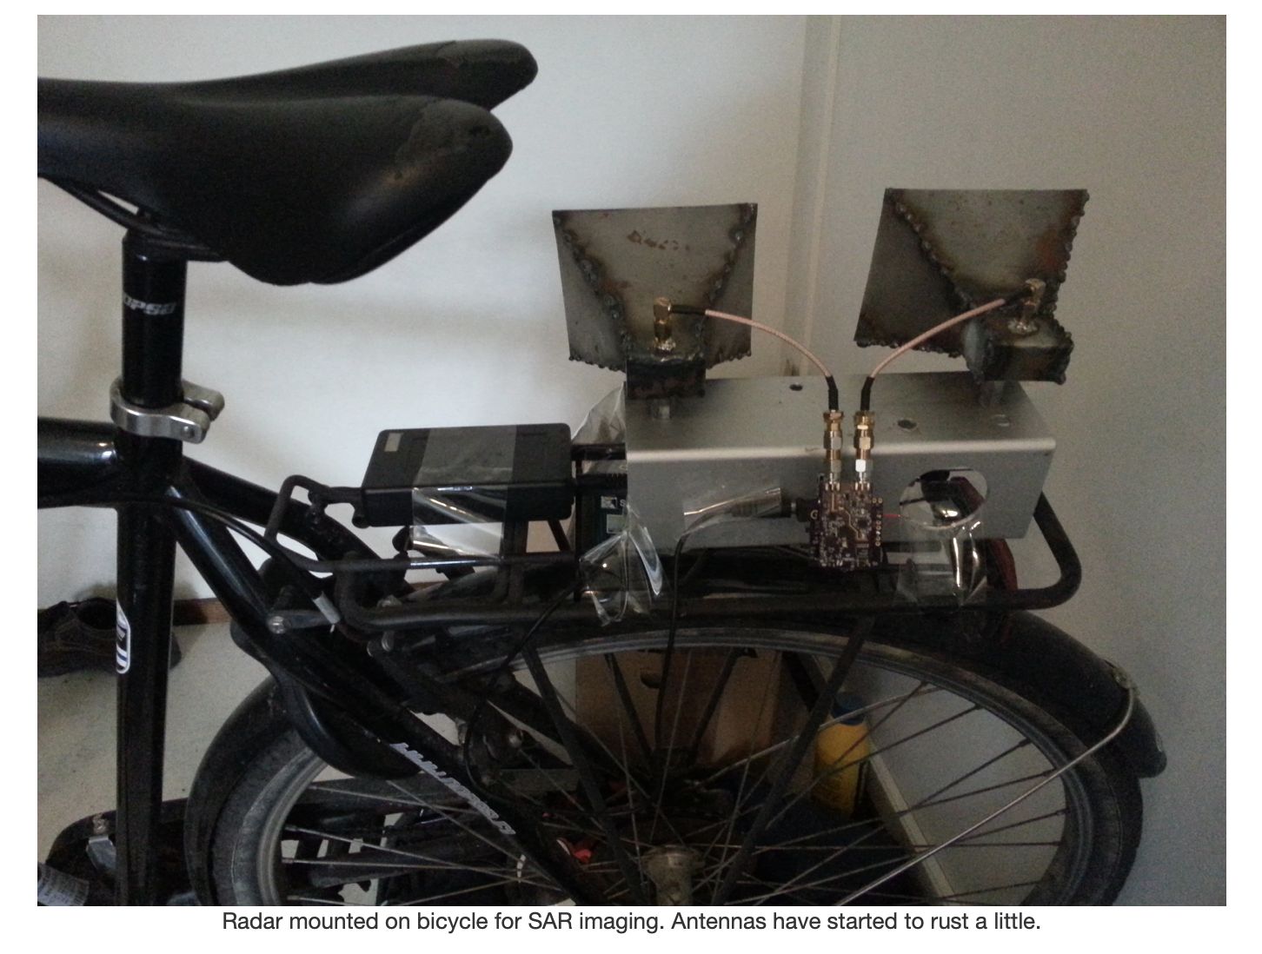
An example
Ref: https://hforsten.com/homemade-synthetic-aperture-radar.html
Ref: https://hforsten.com/synthetic-aperture-radar-imaging.html

Slide 12
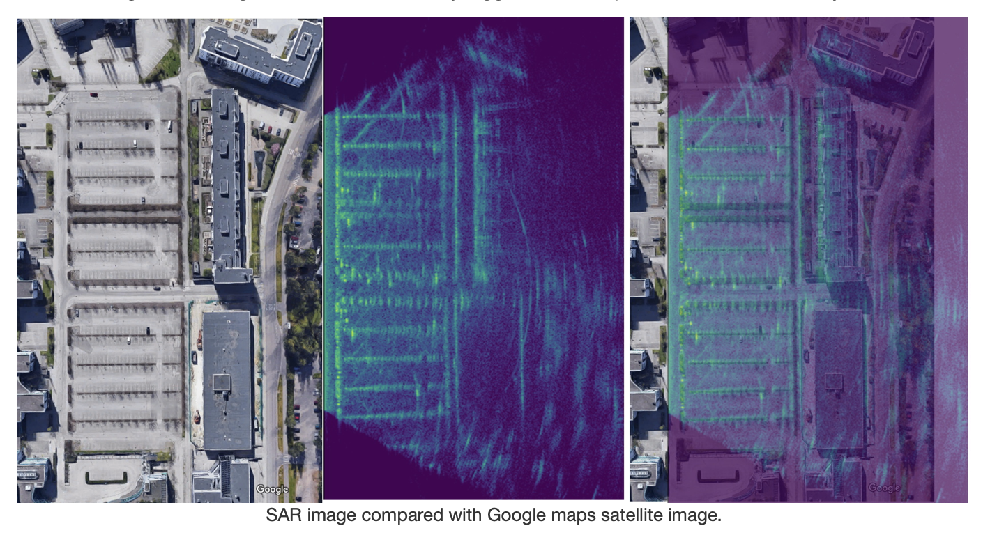
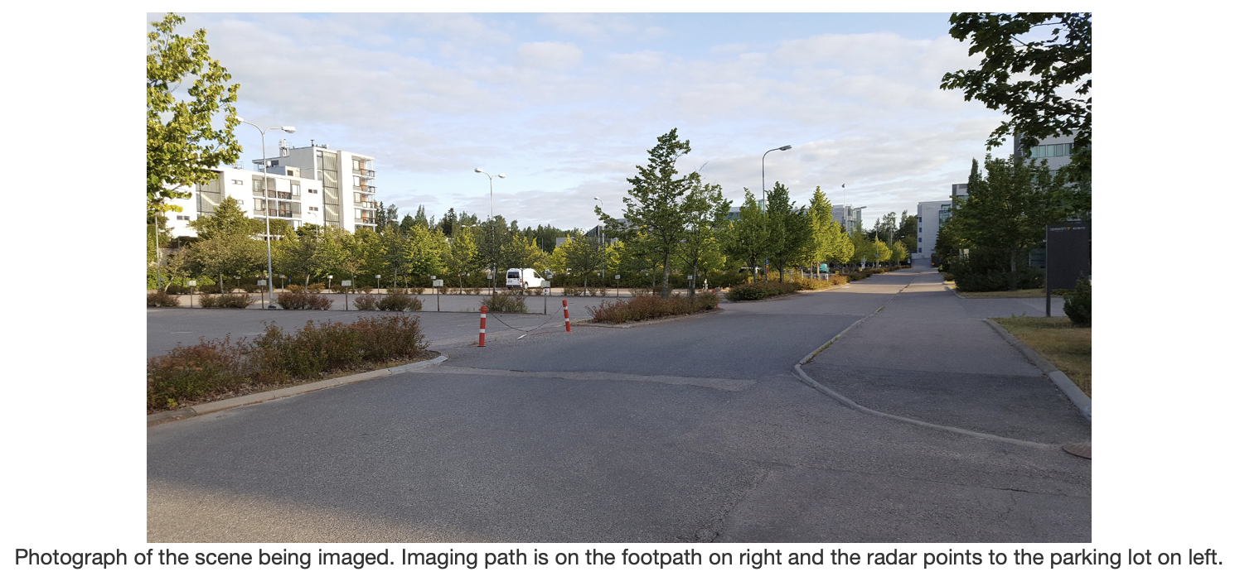
An example

Slide 13
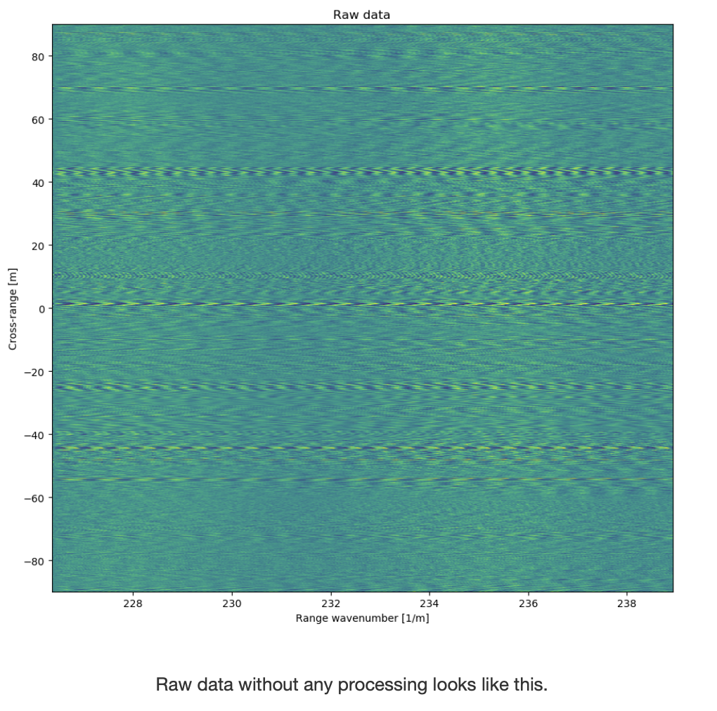
Raw data

Slide 14
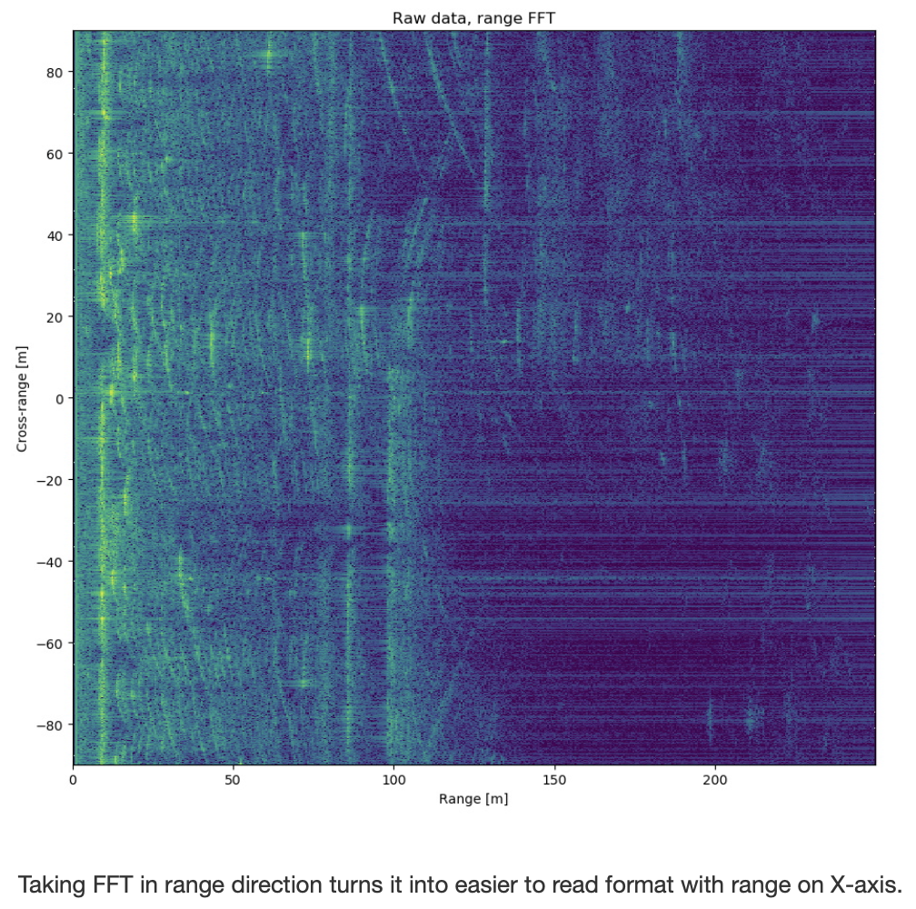
After Range FFT

Slide 15
SAR Doppler direction

Slide 16
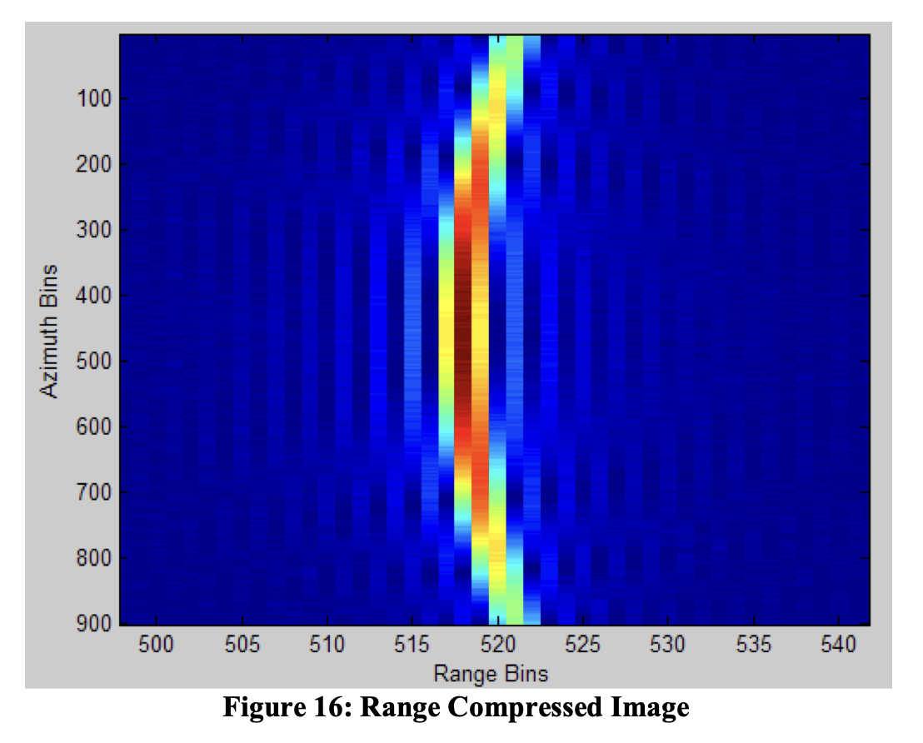
Range Migration

Slide 17
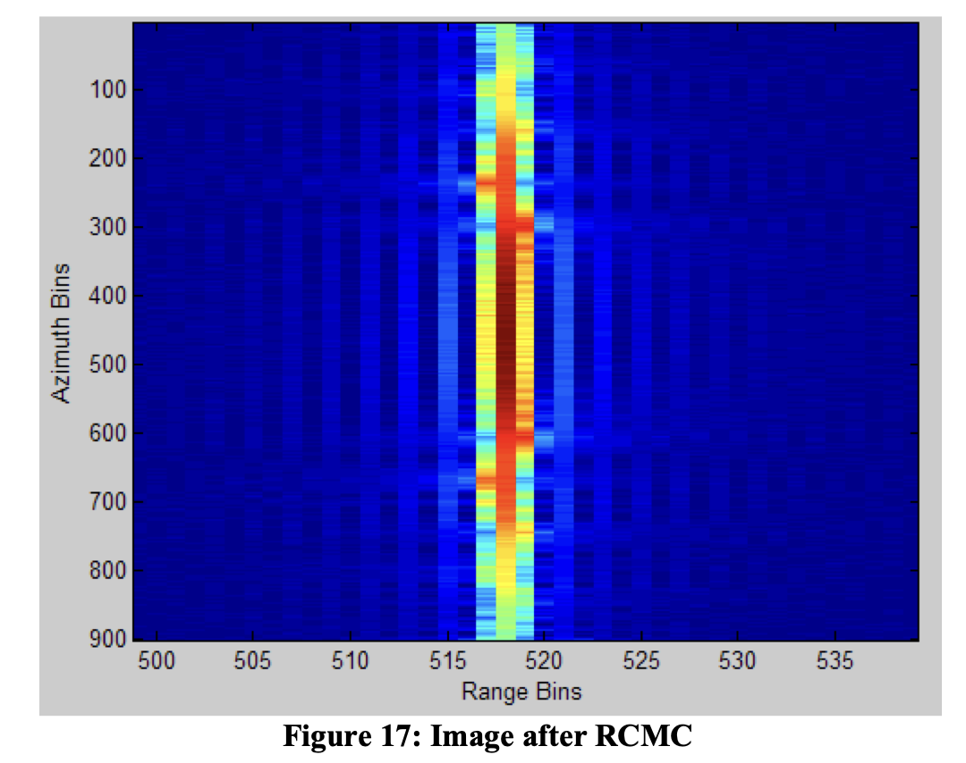

Slide 18
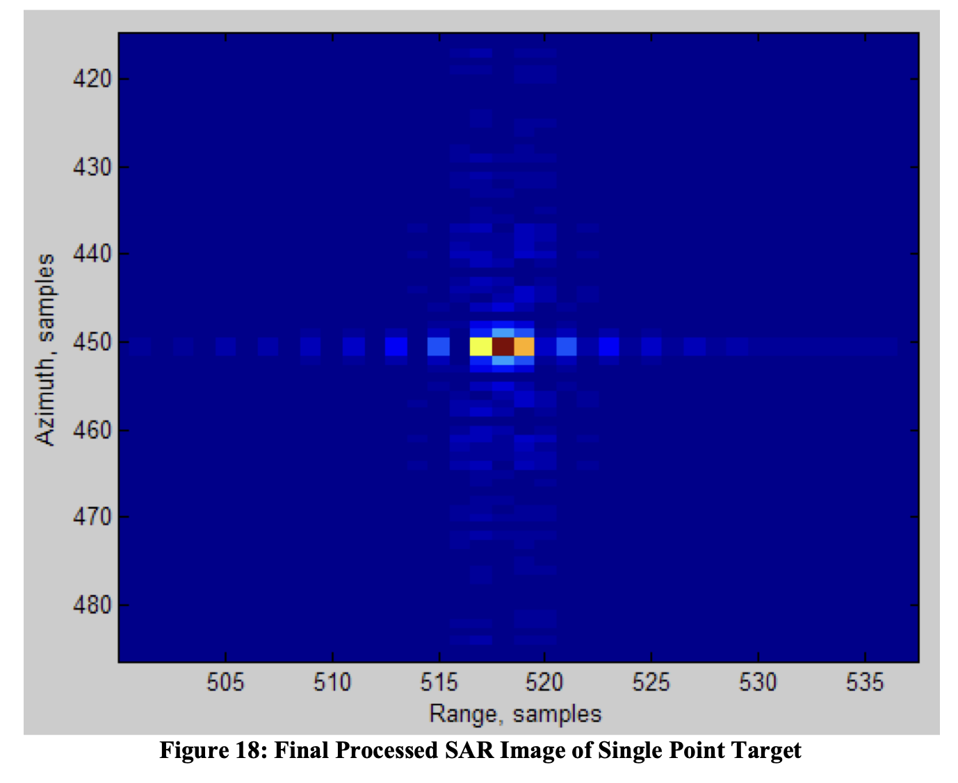

Slide 19
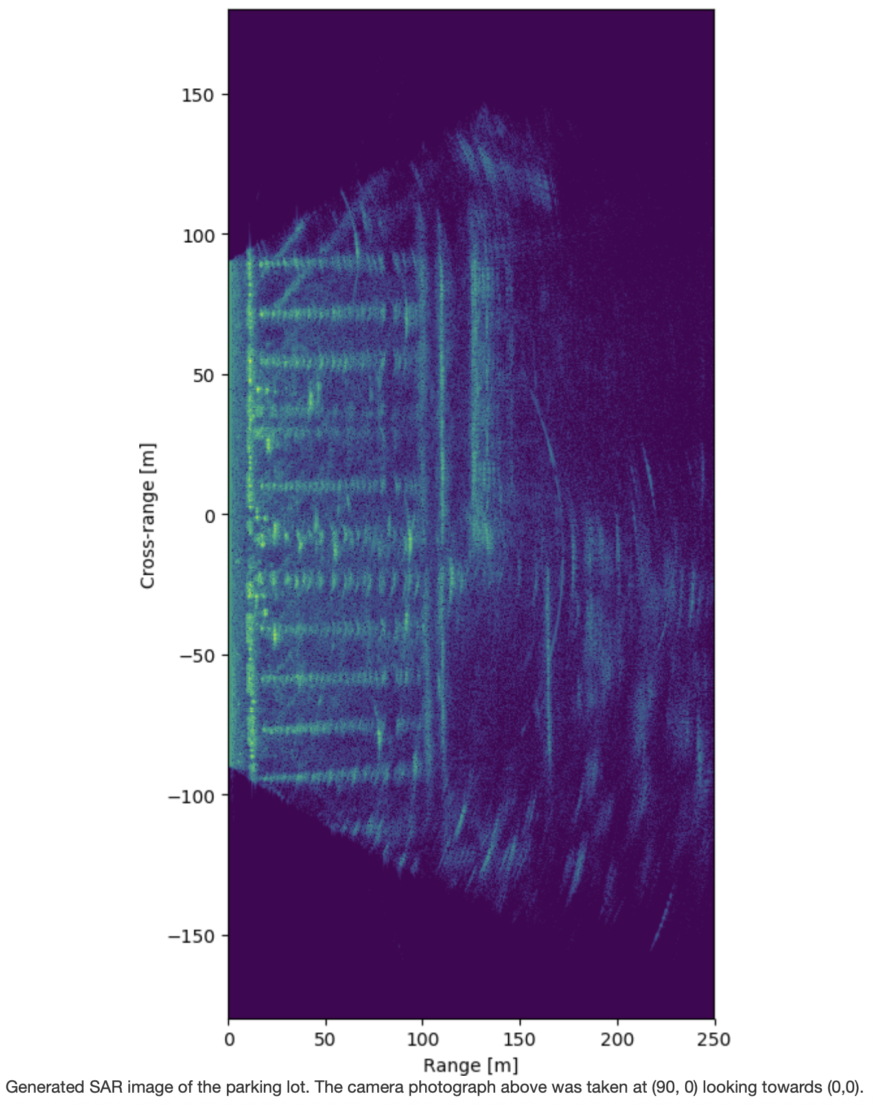
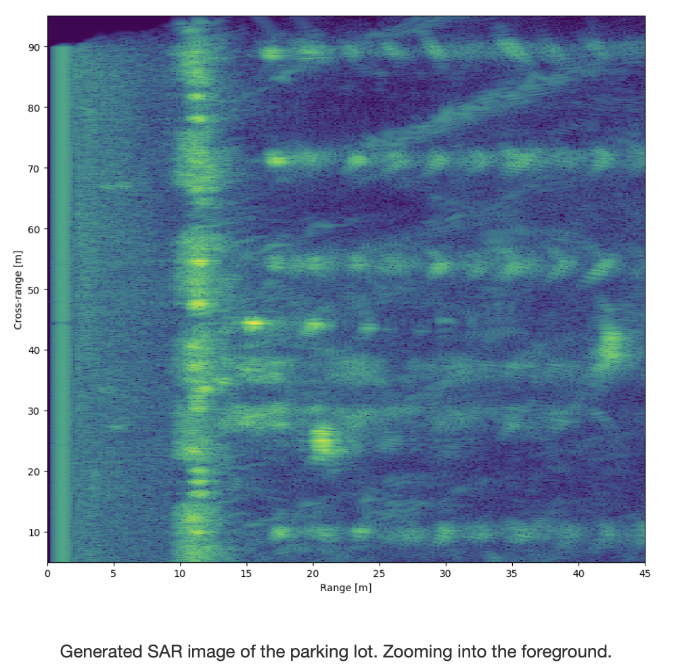
Range Migration

Slide 20
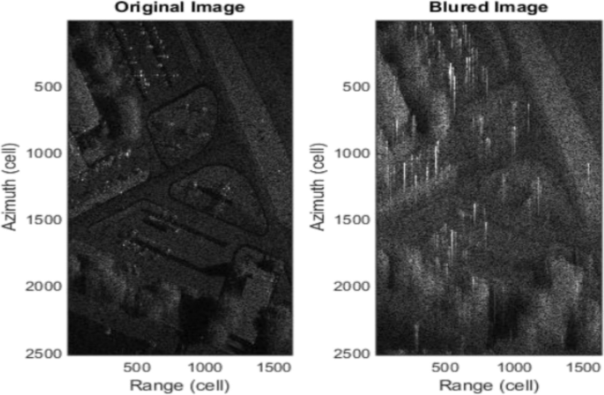
Blur in SAR

Slide 21

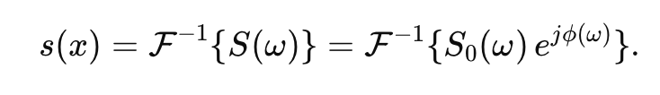
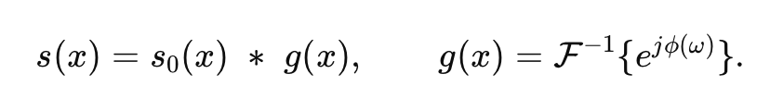
Where the blur comes from
Consider a single azimuth line after range compression. In azimuth-frequency (Doppler) domain let (2D radar data)

Slide 22
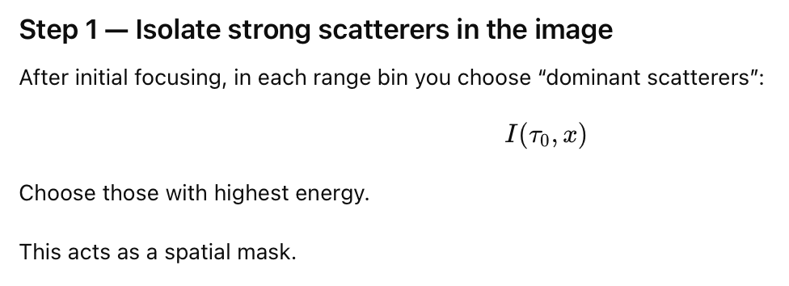
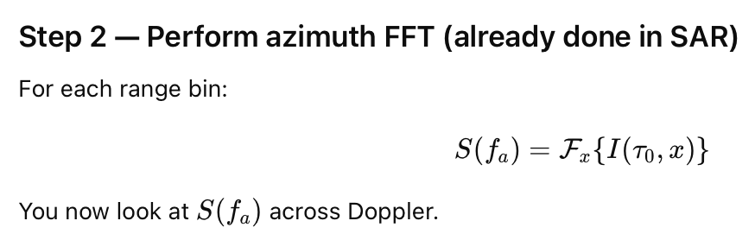
Phase Gradient Algorithm (PGA)

Slide 23
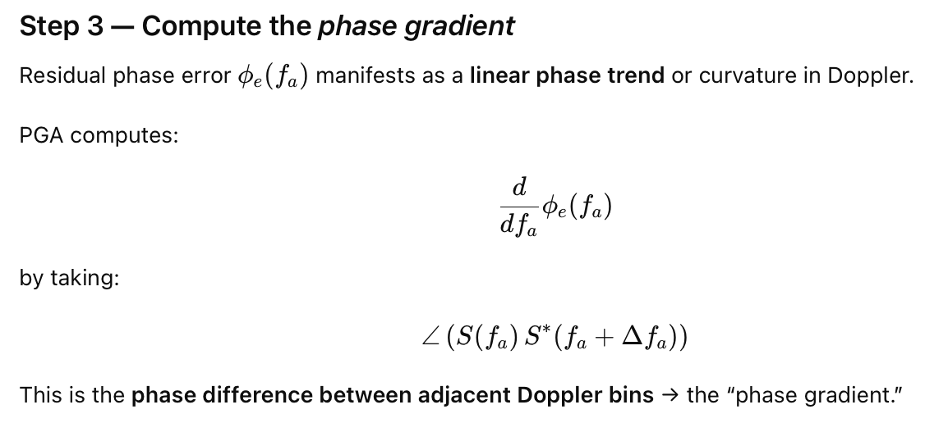
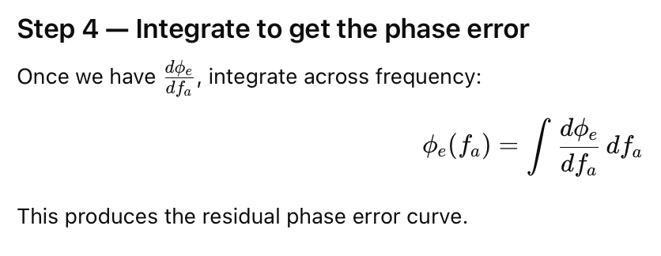
Phase Gradient Algorithm (PGA)

Slide 24
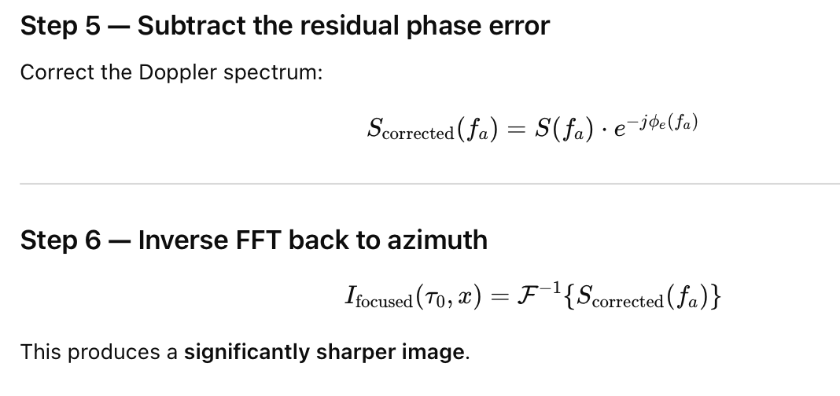
Phase Gradient Algorithm (PGA)

Slide 25
Final results

Slide 26

MobiSys 2018 – Best paper award
https://www.cs.utexas.edu/~meiwang/uploads/8/9/9/1/89919297/aim.pdf

Slide 27
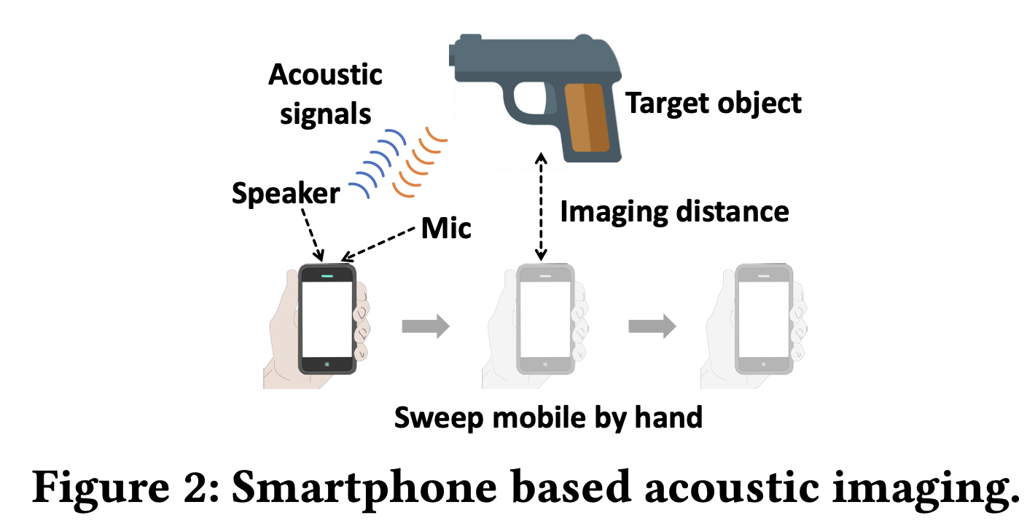

Slide 28
