Slide 1

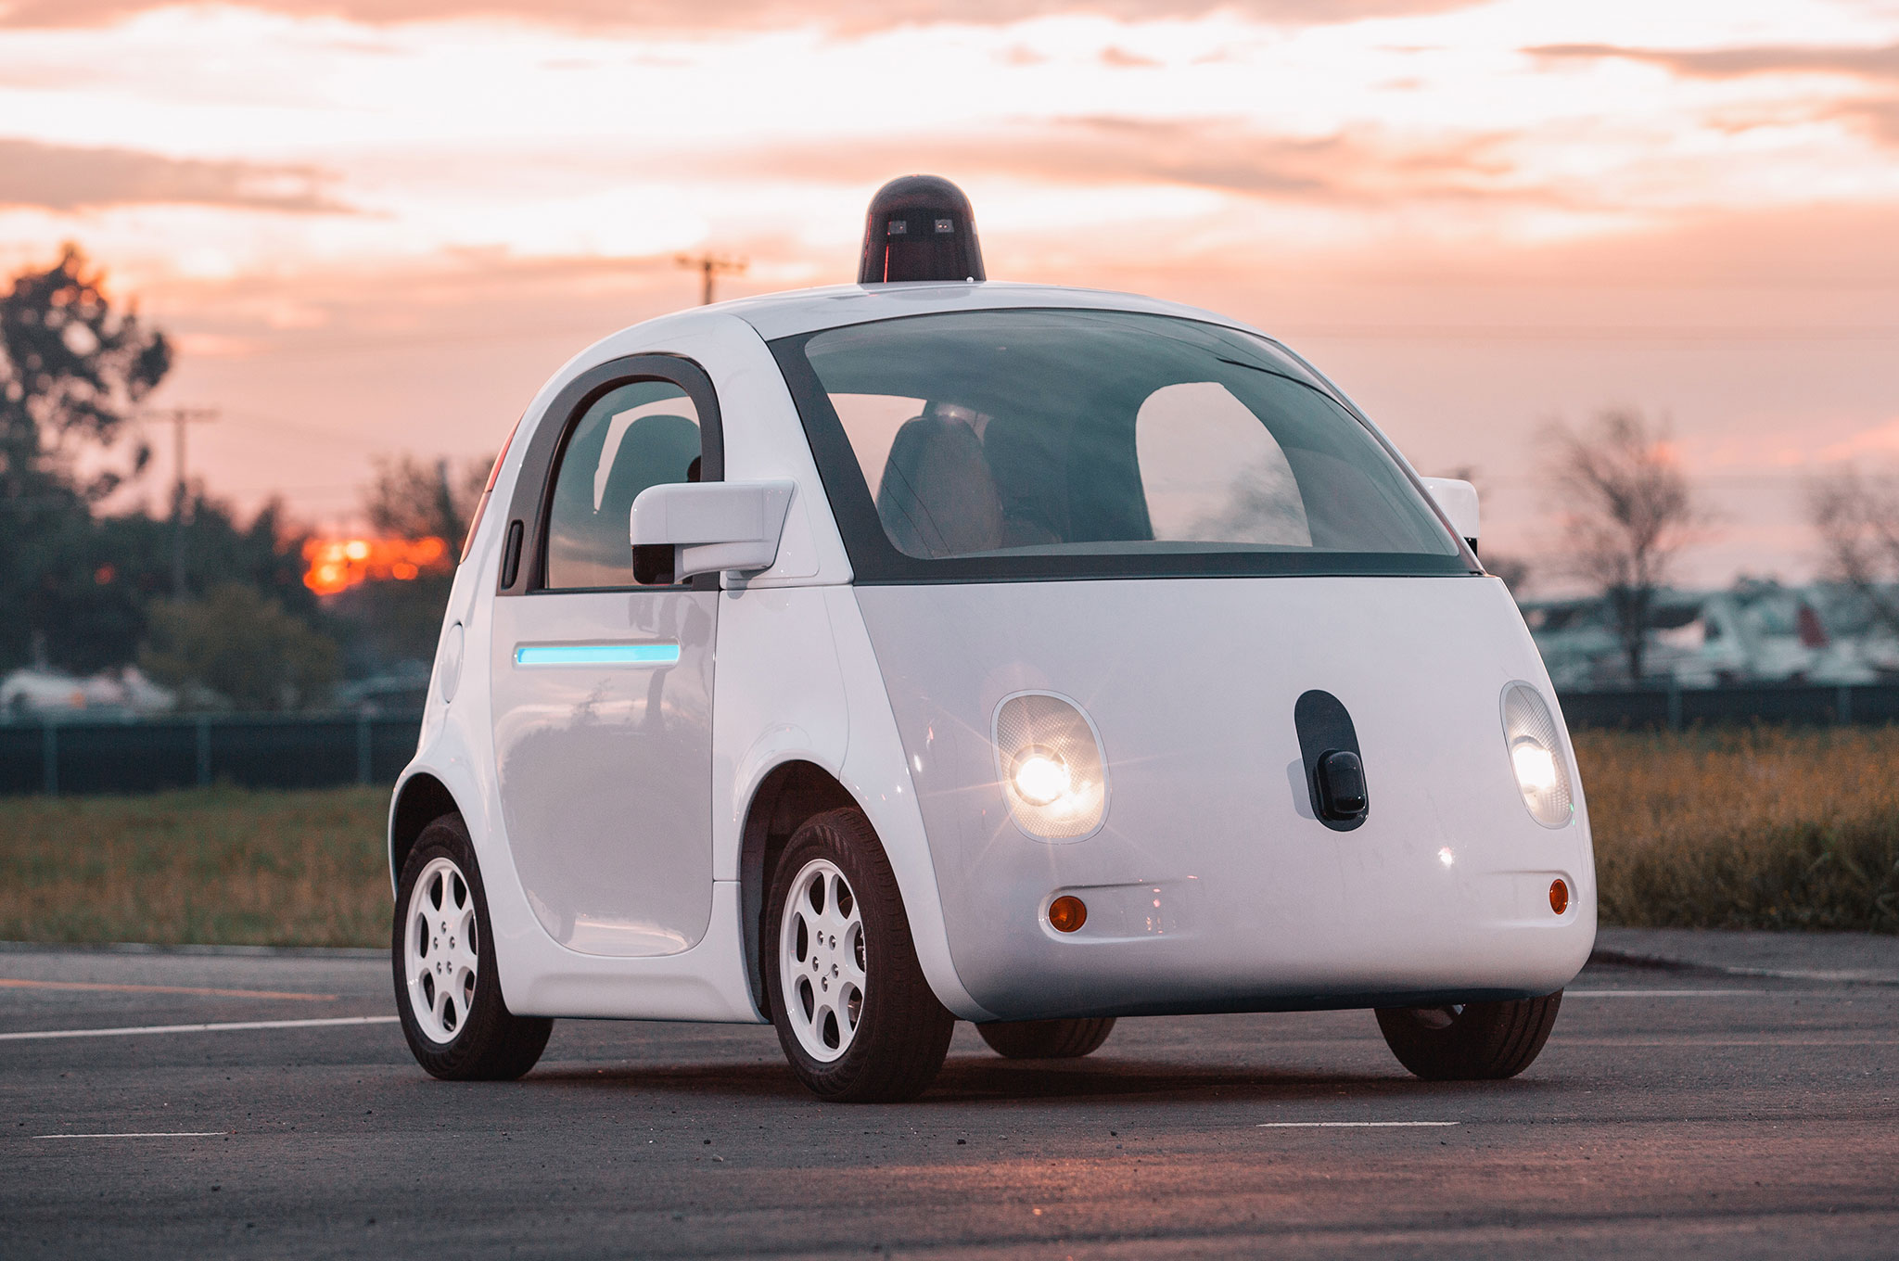

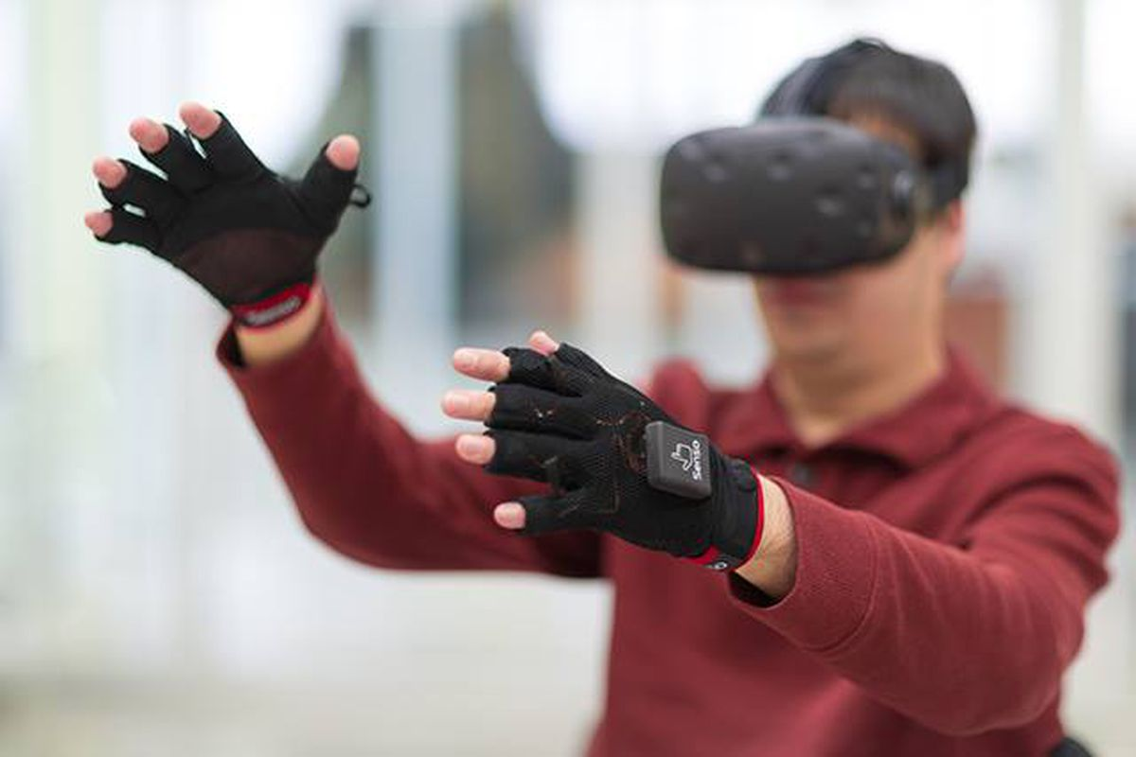

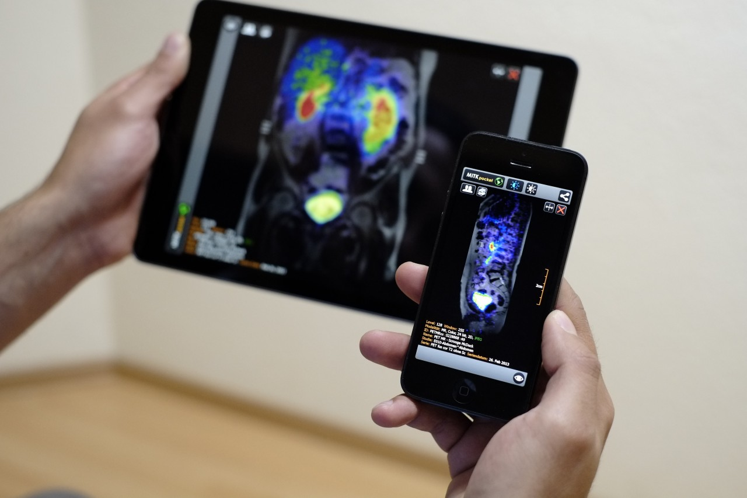
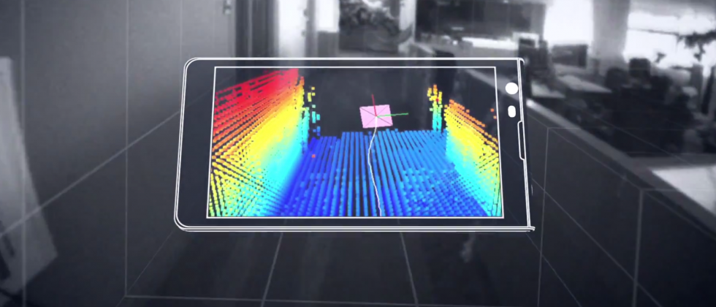
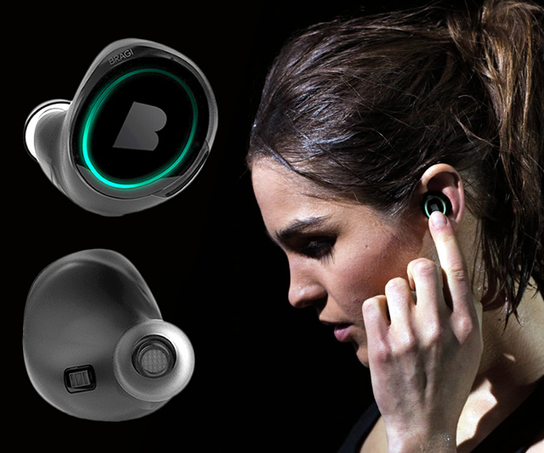
Machine Learning for Physical Sensing & Perception
CMSC 818V : Fall 2025
Lecture 4_3: Active Volumetric Sensing
Nirupam Roy
Tu-Th 3:30 – 4:45pm
IRB 1207

Slide 2
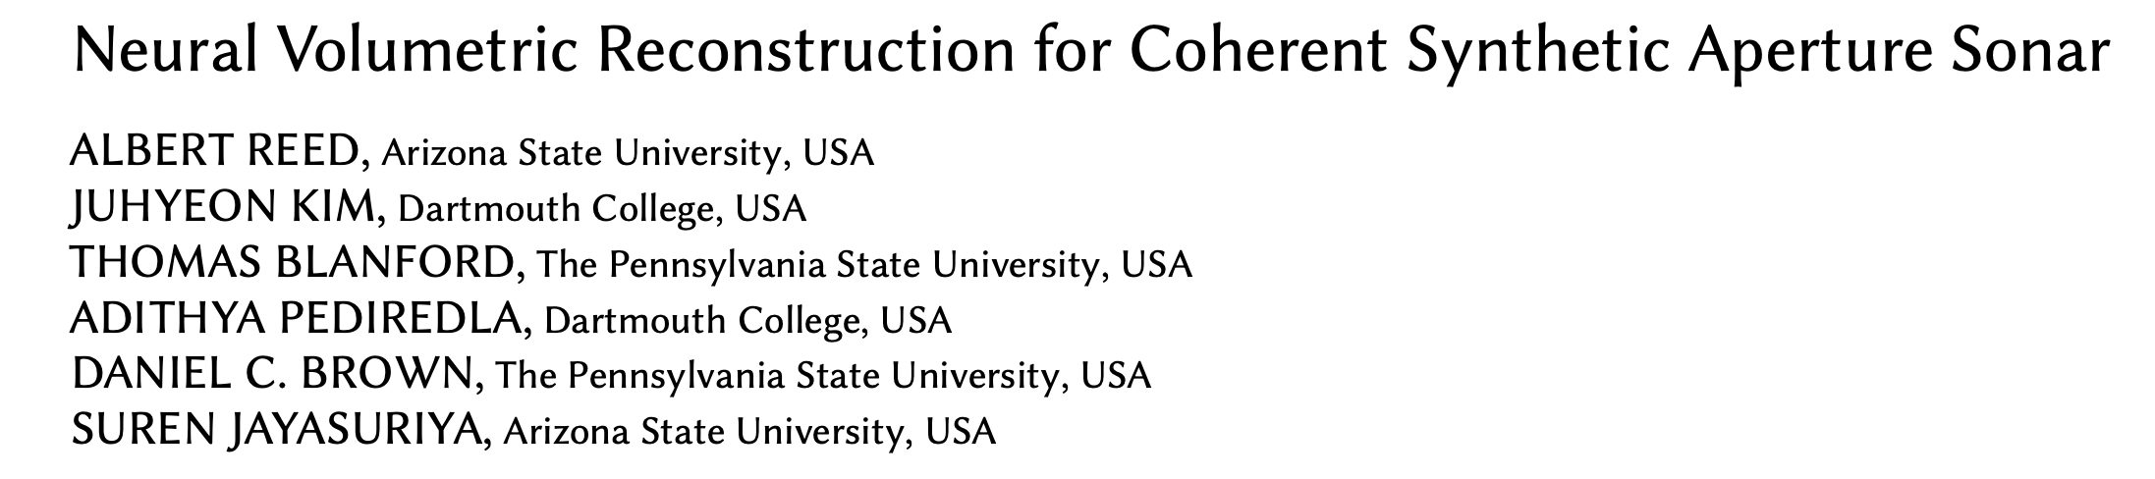
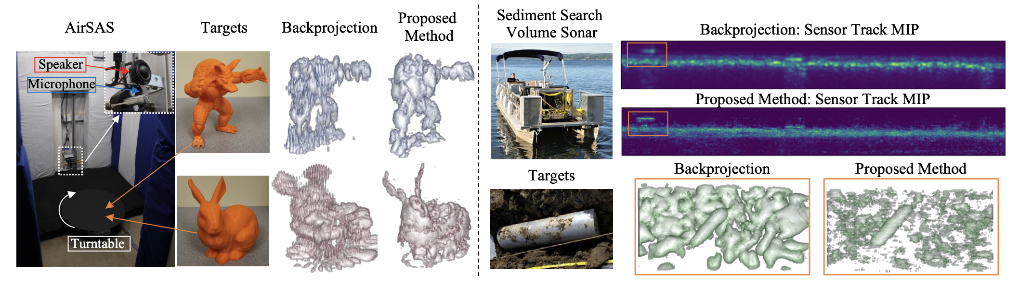
Neural Volumetric Reconstruction

Slide 3
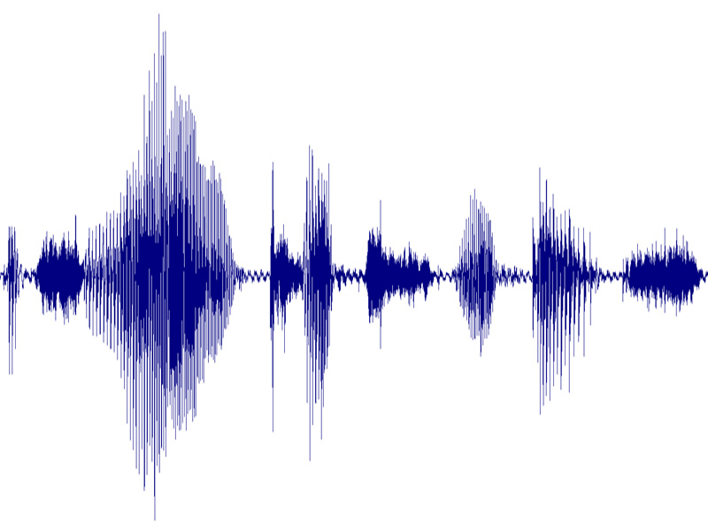
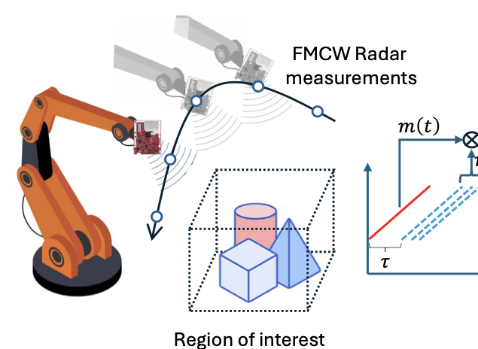

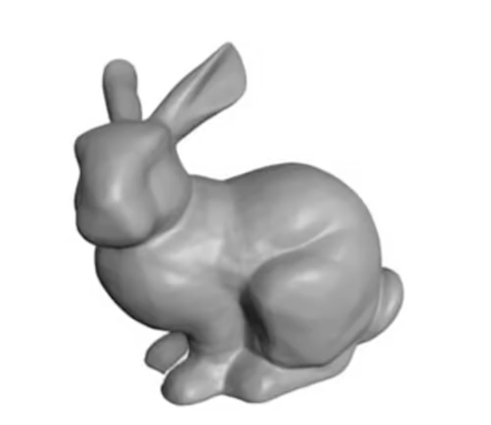
SAR/SAS volumetric reconstruction
<sensor-location-i>
Estimate:
σ (x, y, z)
Z
X
Y

Slide 4
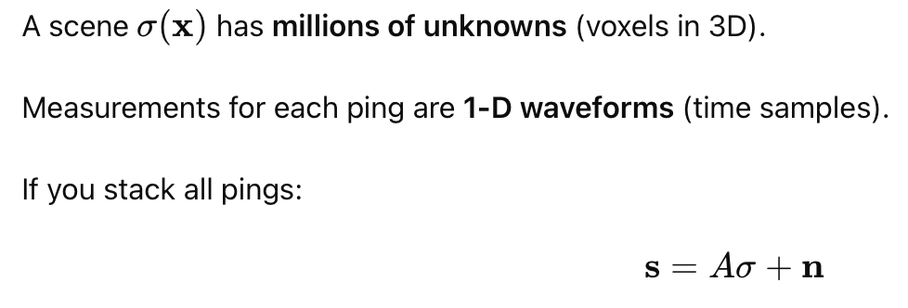
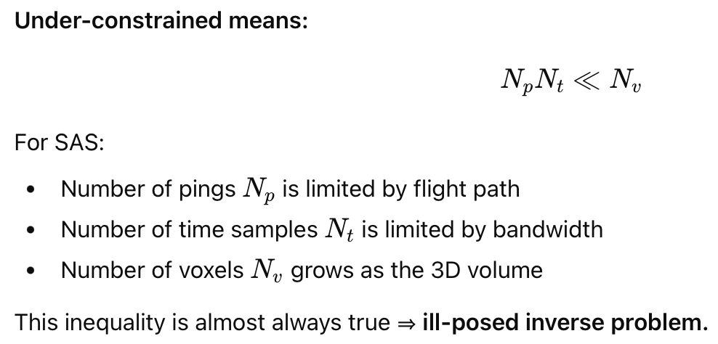
SAR/SAS volumetric reconstruction: An Ill-posed Inverse Problem

Slide 5
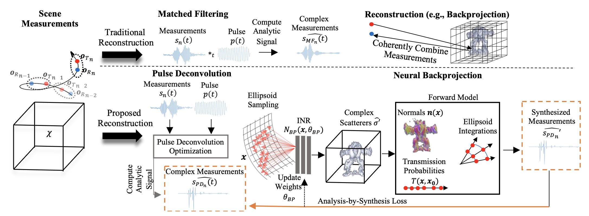
Traditional and Proposed Approaches

Slide 6
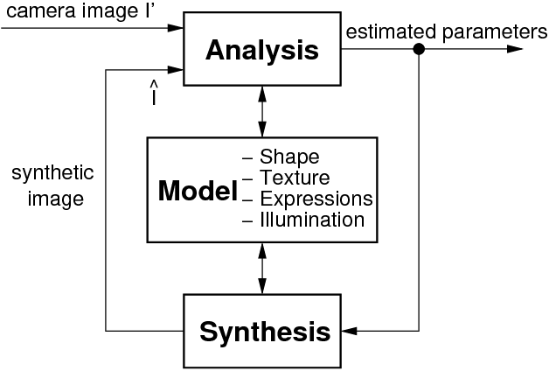
Analysis-by-synthesis

Slide 7

SAR volumetric reconstruction
<x, y, z>
σ
<sensor-location-i>
Forward model
Calculate
loss
Ground truth
Z
<sensor-location-i>
X
Y

Slide 8
Traditional and Proposed Approaches

Slide 9
Analysis-by-synthesis

Slide 10
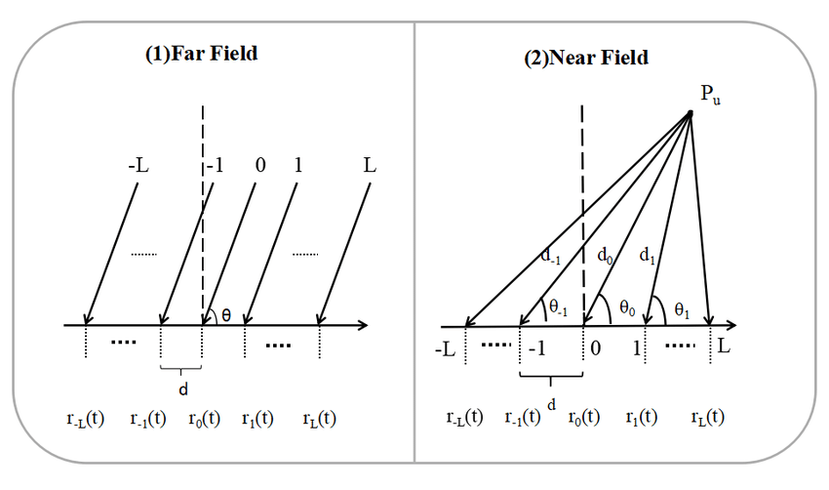
Forward model: Example

Slide 11
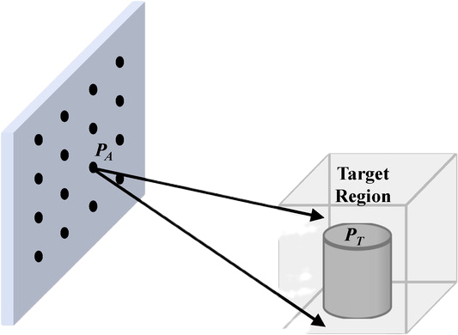
Forward model:

Slide 12
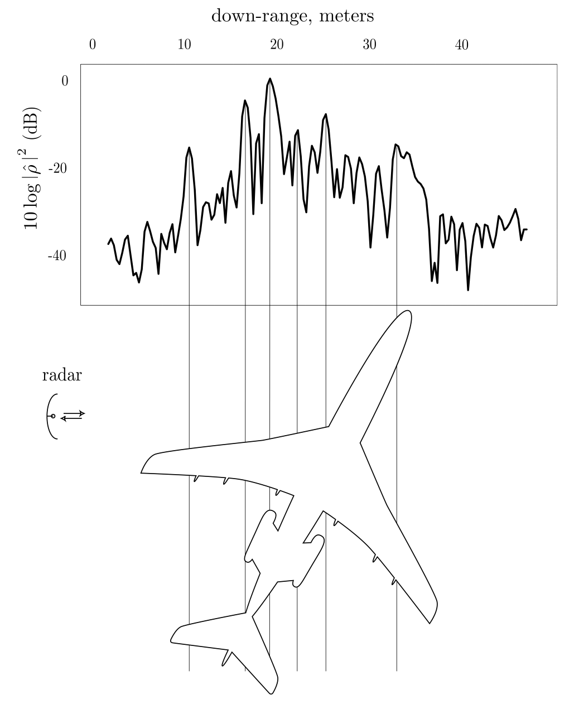
Forward model: Scattering-center models
https://www.math.colostate.edu/~cheney/Classes/borden02.pdf?utm_source=chatgpt.com
Notes:
Weak point-scatterer / scattering center models in radar/SAR: Used widely in inverse scattering and SAR imaging, where an object is approximated by a few dominant scattering centers.

Slide 13
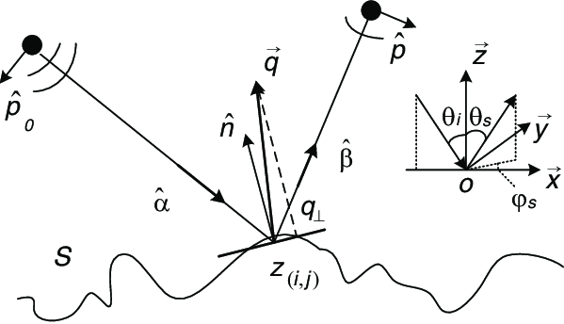
Forward model: Facet / Kirchhoff (geometric) surface models
https://www.researchgate.net/publication/228343259_Robust_semi-deterministic_facet_model_for_fast_estimation_on_EM_scattering_from_ocean-like_surface
Notes:
Weak point-scatterer / scattering center models in radar/SAR: Used widely in inverse scattering and SAR imaging, where an object is approximated by a few dominant scattering centers.

Slide 14
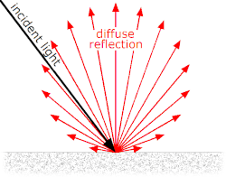
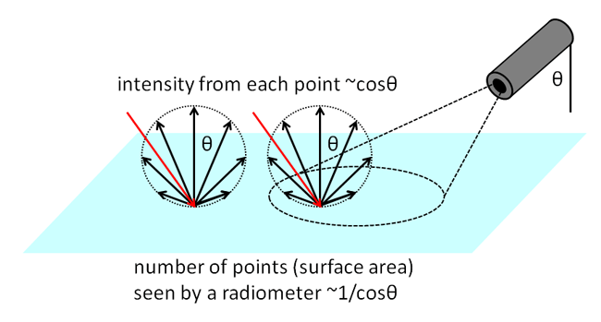
Forward model: Lambertian / Bi-directional Reflectance-type reflectivity models
Notes:
continuous surface with a reflectivity and a ‘Lambertian’ scattering law.
Lambertian reflectance is the property that defines an ideal "matte" or diffusely reflectingsurface. The apparent brightness of a Lambertian surface to an observer is the same regardless of the observer's angle of view.

Slide 15
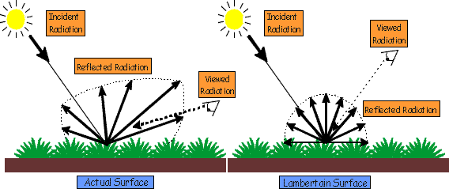
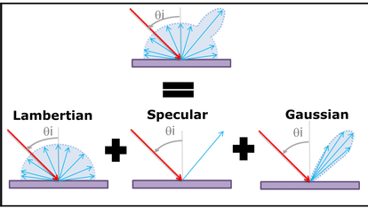
Forward model: Lambertian / Bi-directional Reflectance-type reflectivity models
Notes:
continuous surface with a reflectivity and a ‘Lambertian’ scattering law.
Lambertian reflectance is the property that defines an ideal "matte" or diffusely reflectingsurface. The apparent brightness of a Lambertian surface to an observer is the same regardless of the observer's angle of view.

Slide 16
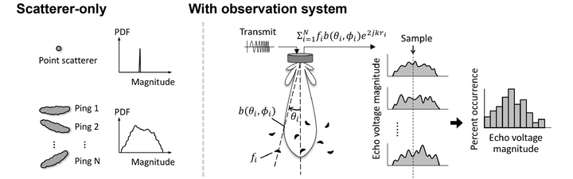
Forward model: Volume & statistical scattering models
https://www.researchgate.net/publication/228343259_Robust_semi-deterministic_facet_model_for_fast_estimation_on_EM_scattering_from_ocean-like_surface
Notes:
For volumetric clutter (fish schools, sediment, bubbles), people often model the environment as many random discrete scatterers and then derive statistics of the echo:

Slide 17
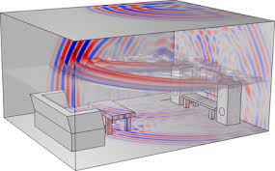
Forward model: High-fidelity numerical models
Notes:
Full-wave / numerical models (e.g., boundary element method, finite element, coupled-mode) which simulate scattering from full 3D geometry without collapsing to points or facets.

Slide 18
Forward model: Point scattering model
Key principles
Discrete Scatterers: Continuous surfaces are discretized into a finite number of scattering centers. These are conceptualized as being much smaller than the acoustic wavelength, similar to a Rayleigh approximation, though they incorporate more complex, model-based amplitudes.
Independent Returns: A fundamental assumption is that the scattered field from neighboring points is incoherent or statistically independent. This simplifies the mathematics and allows for efficient parallel computation (e.g., using GPUs).
Deterministic and Stochastic Components: The amplitude of each scatterer is determined by both a deterministic physical model (e.g., local scattering strength, incidence angle, and material properties) and a random scale factor.
Coherent Summation: The independent returns from all points are coherently combined in the frequency domain, considering the round-trip propagation time and the sonar's directivity pattern (beam pattern).

Slide 19
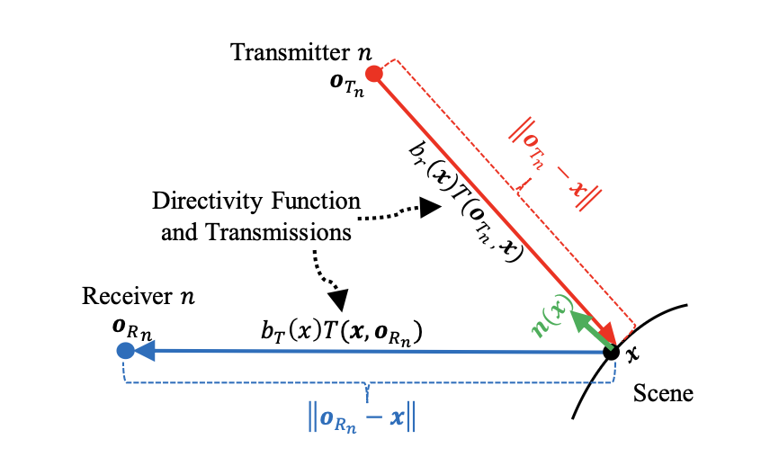
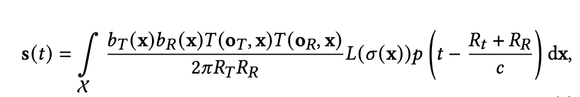
Forward model: Point scattering model

Slide 20

Matched Filtering/Deconvolution

Slide 21
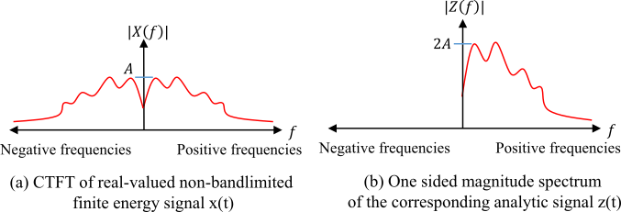

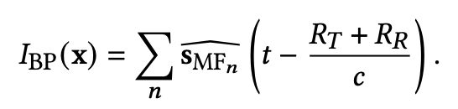
SAS reconstruction with time-domain Backprojection
Hilbert transform
Backprojection

Slide 22
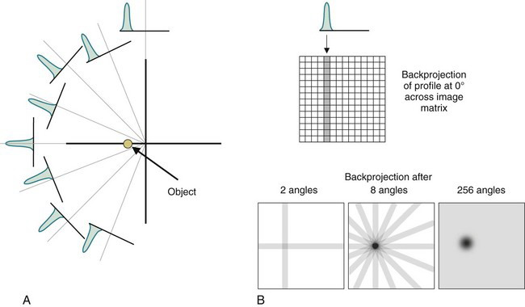
SAS reconstruction with time-domain Backprojection

Slide 23
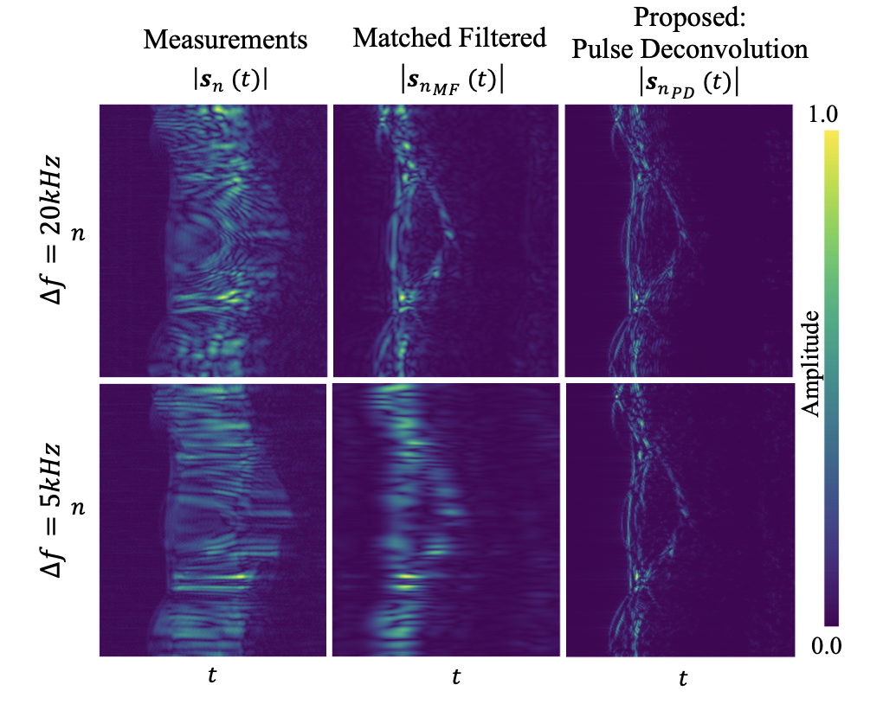
Matched Filtering

Slide 24
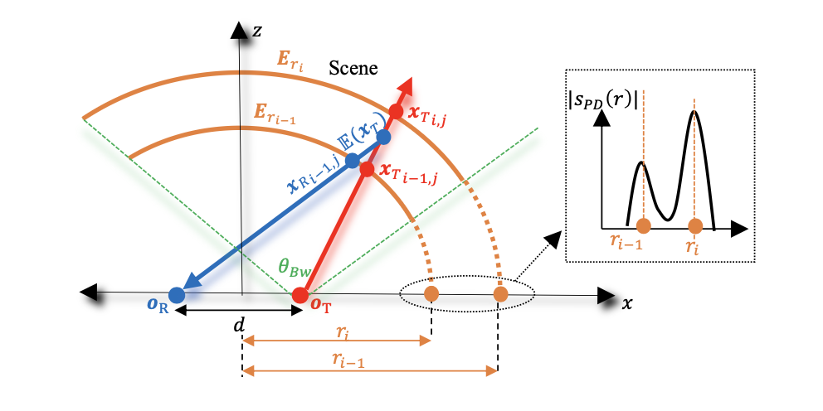
XX

Slide 25
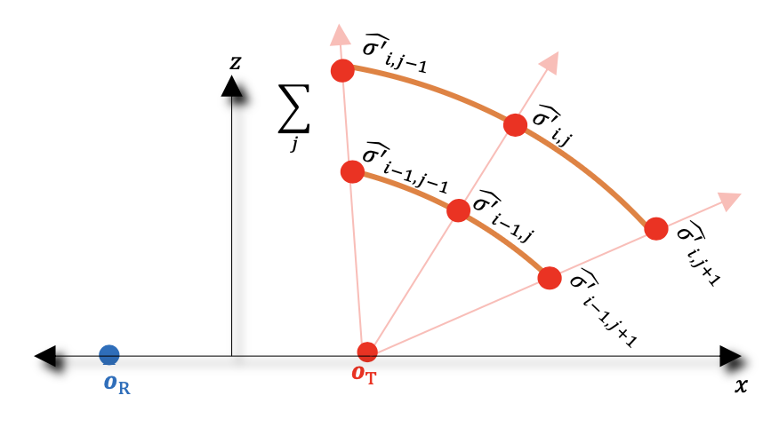
XX

Slide 26
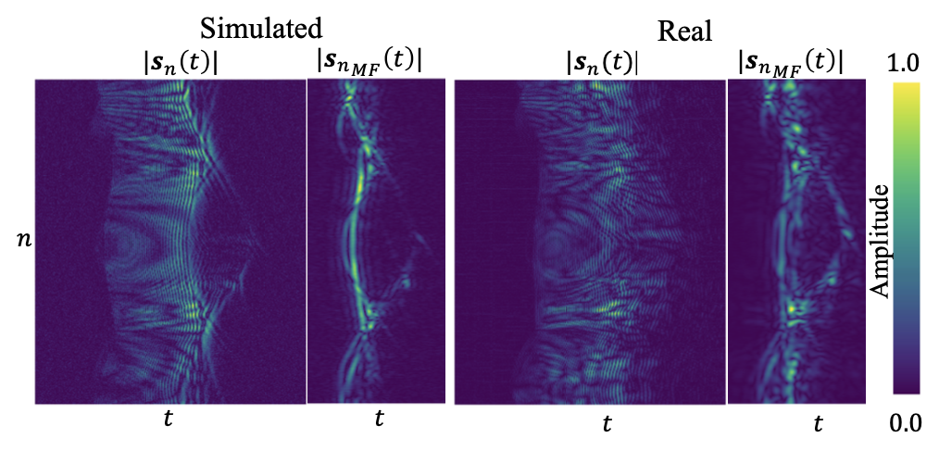
XX

Slide 27
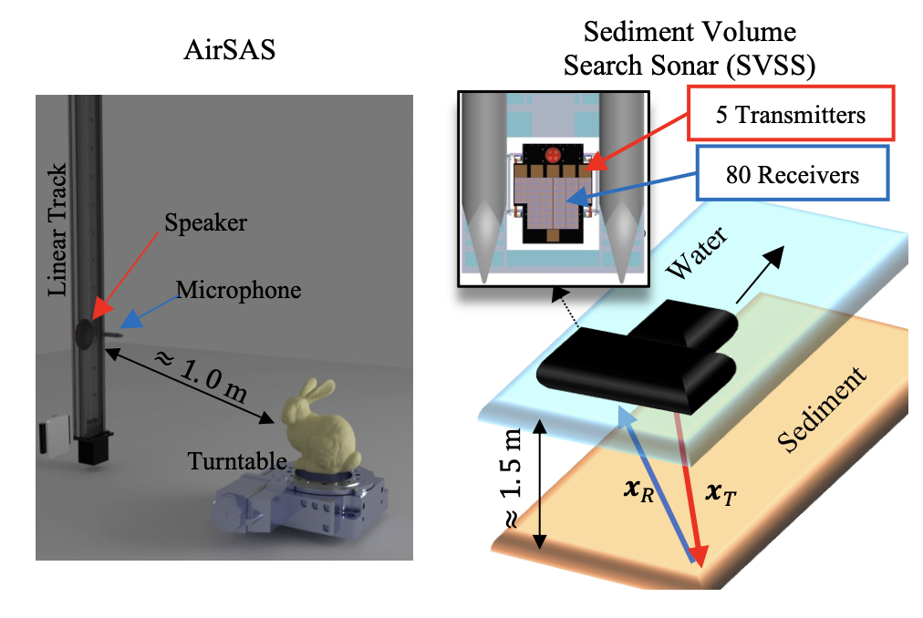
XX

Slide 28
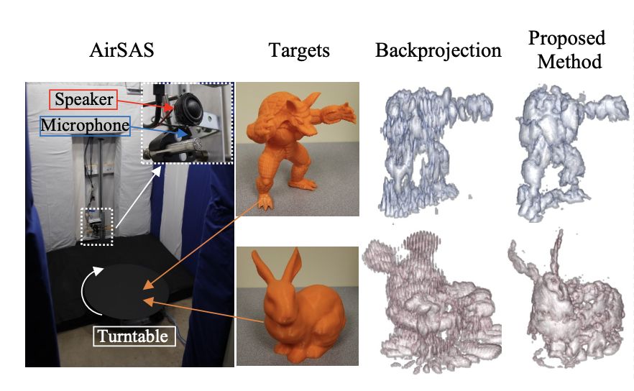

Slide 29
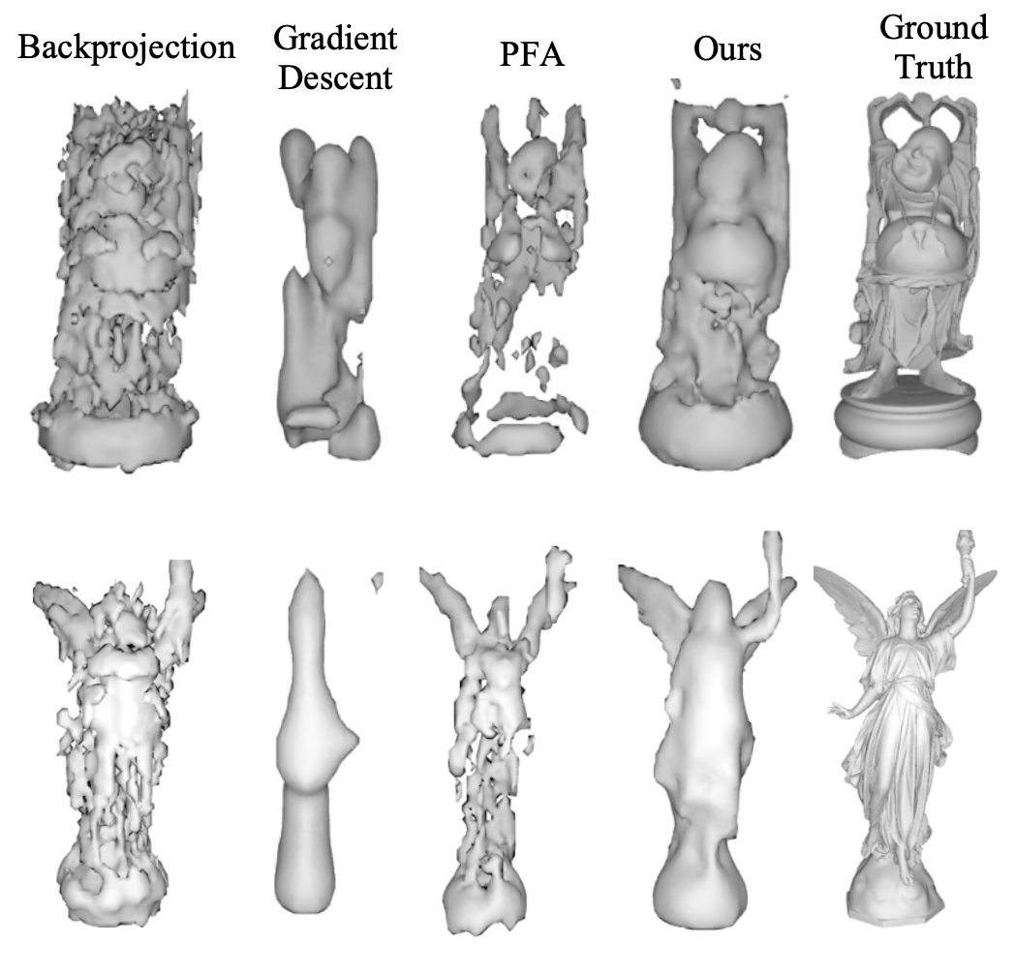
XX

Slide 30
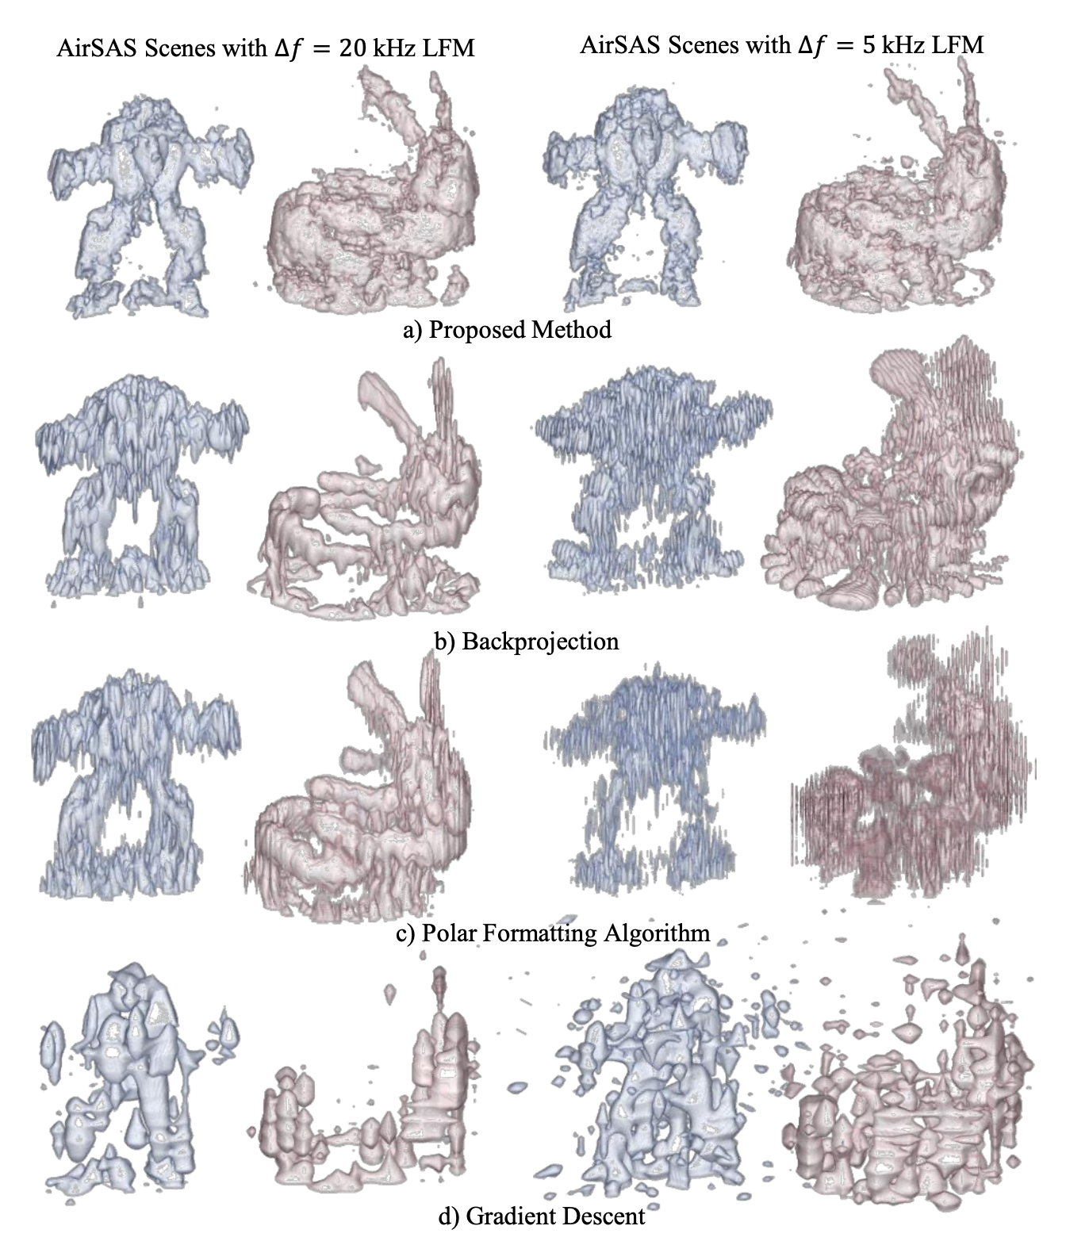
XX

Slide 31
XX

Slide 32
XX

Slide 33
XX

Slide 34
XX

Slide 35
XX

Slide 36
XX

Slide 37
XX

Slide 38
XX

Slide 39
XX

Slide 40
XX

Slide 41
XX

Slide 42
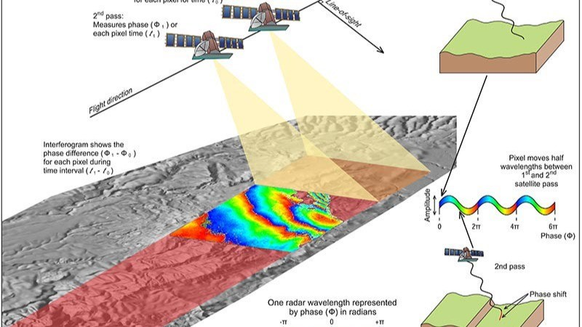
Synthetic Aperture Radar

Slide 43
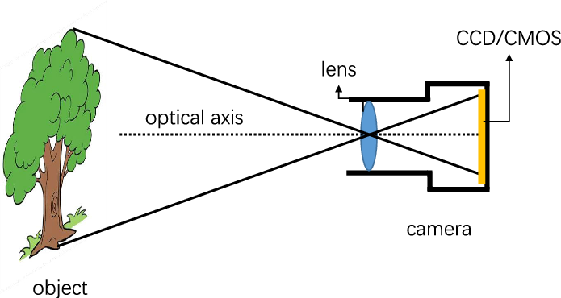
Standard RADAR vs SAR (Analogy)
Standard RADAR

Slide 44
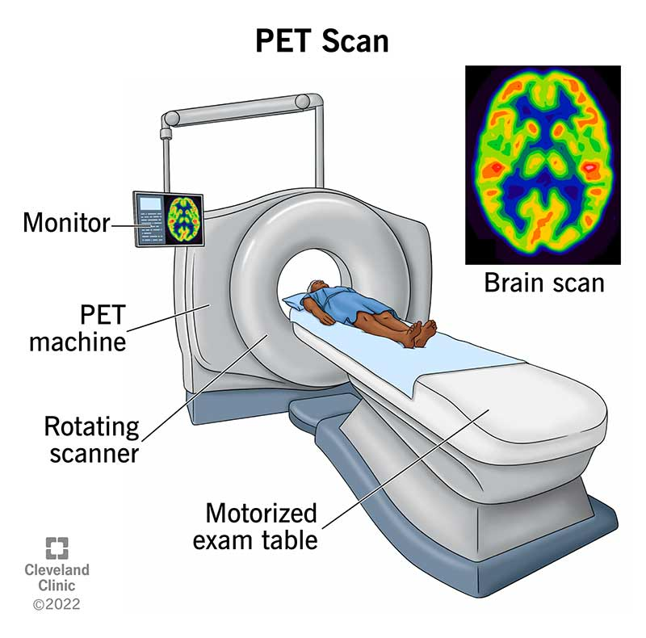
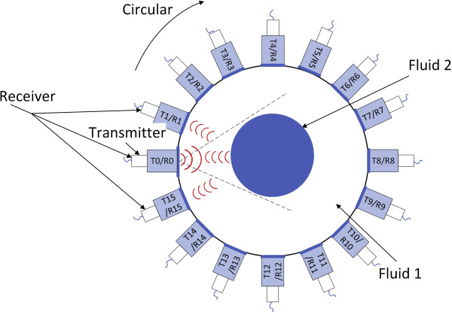
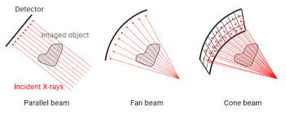
Standard RADAR vs SAR (Analogy)
Standard RADAR
Synthetic Aperture RADAR (SAR)

Slide 45
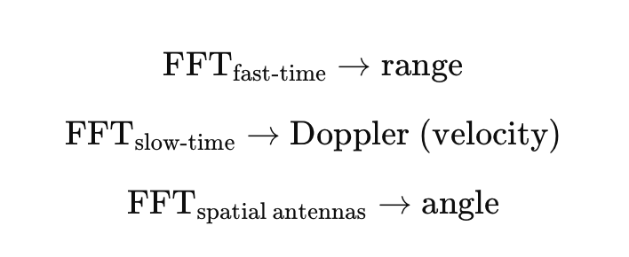
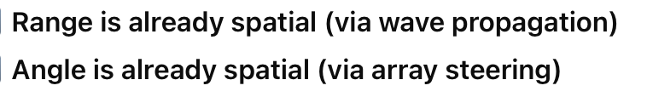
Standard RADAR vs SAR
Standard RADAR:

Slide 46

Standard RADAR vs SAR
Synthetic Aperture RADAR (SAR)
Notes:
Not a sinusoidal change in phase….rather a chirp like change.

Slide 47
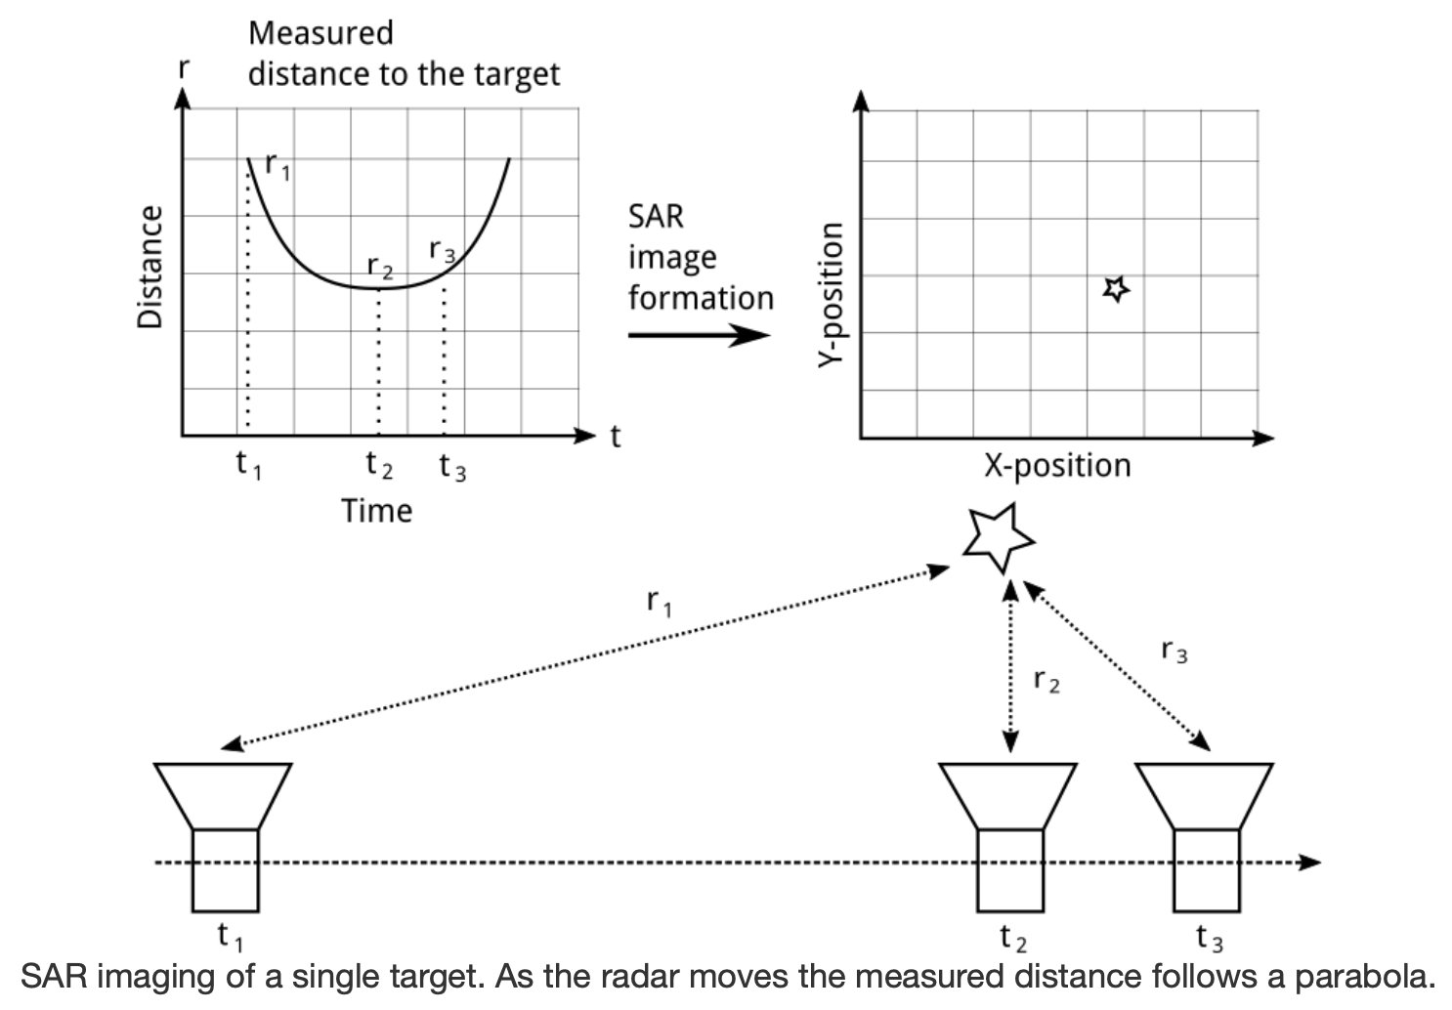
SAR Doppler direction

Slide 48
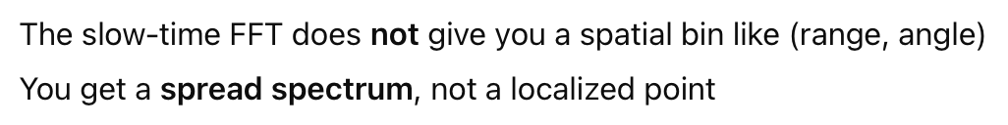
Standard RADAR vs SAR
Synthetic Aperture RADAR (SAR)

Slide 49
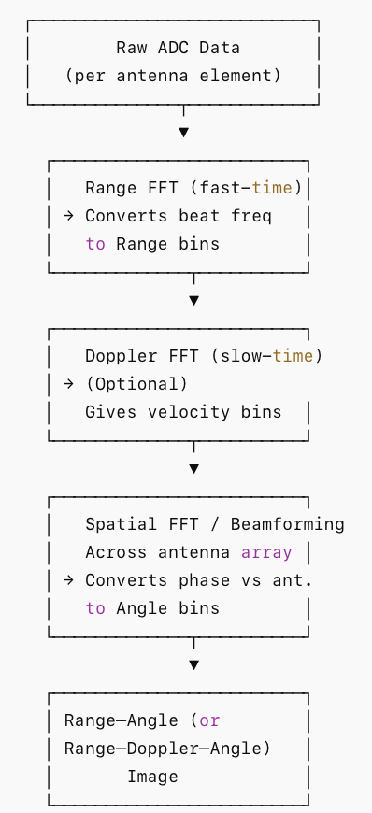
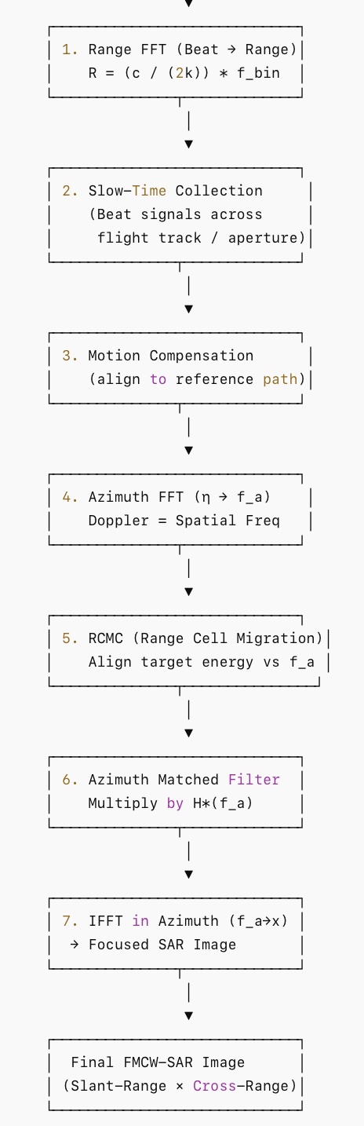
Standard RADAR
SAR

Slide 50
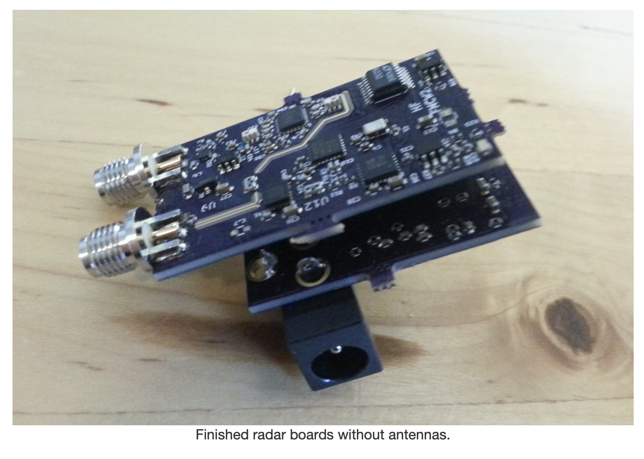
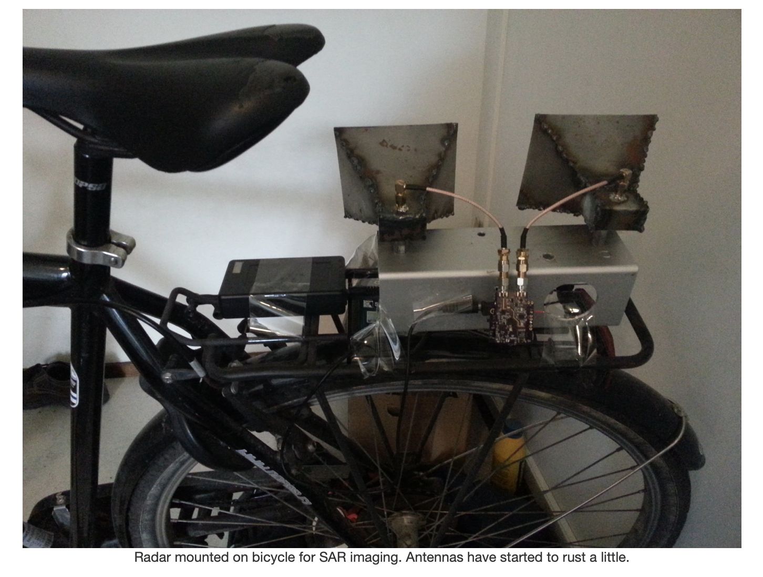
An example
Ref: https://hforsten.com/homemade-synthetic-aperture-radar.html
Ref: https://hforsten.com/synthetic-aperture-radar-imaging.html

Slide 52


An example

Slide 53

Raw data

Slide 54

After Range FFT

Slide 55
SAR Doppler direction

Slide 56

Range Migration

Slide 57


Slide 58


Slide 59


Range Migration

Slide 60

Blur in SAR

Slide 61



Where the blur comes from
Consider a single azimuth line after range compression. In azimuth-frequency (Doppler) domain let (2D radar data)

Slide 62


Phase Gradient Algorithm (PGA)

Slide 63


Phase Gradient Algorithm (PGA)

Slide 64

Phase Gradient Algorithm (PGA)

Slide 65
Final results

Slide 66

MobiSys 2018 – Best paper award
https://www.cs.utexas.edu/~meiwang/uploads/8/9/9/1/89919297/aim.pdf

Slide 67


Slide 68


