Slide 1

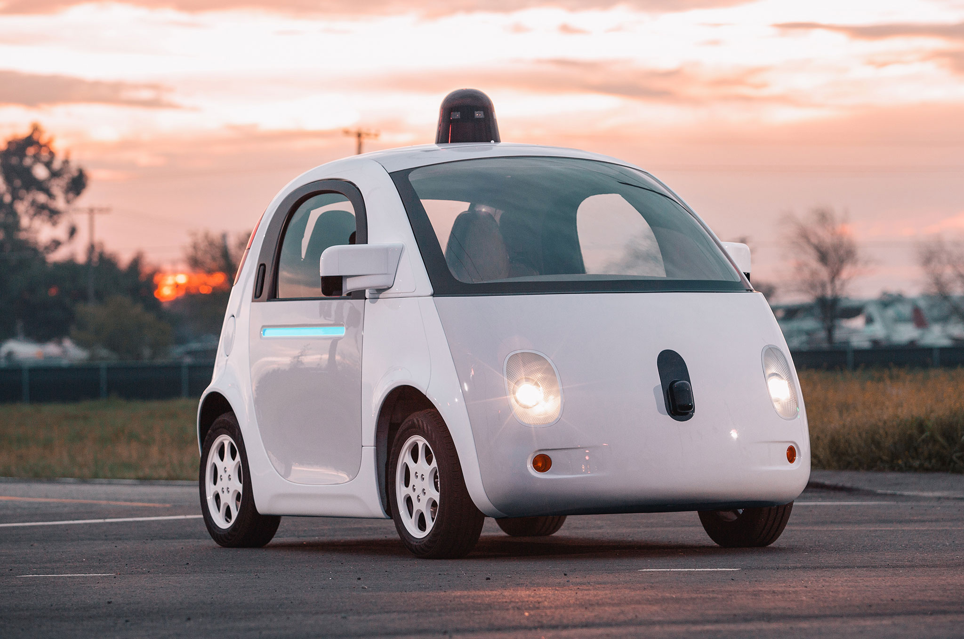

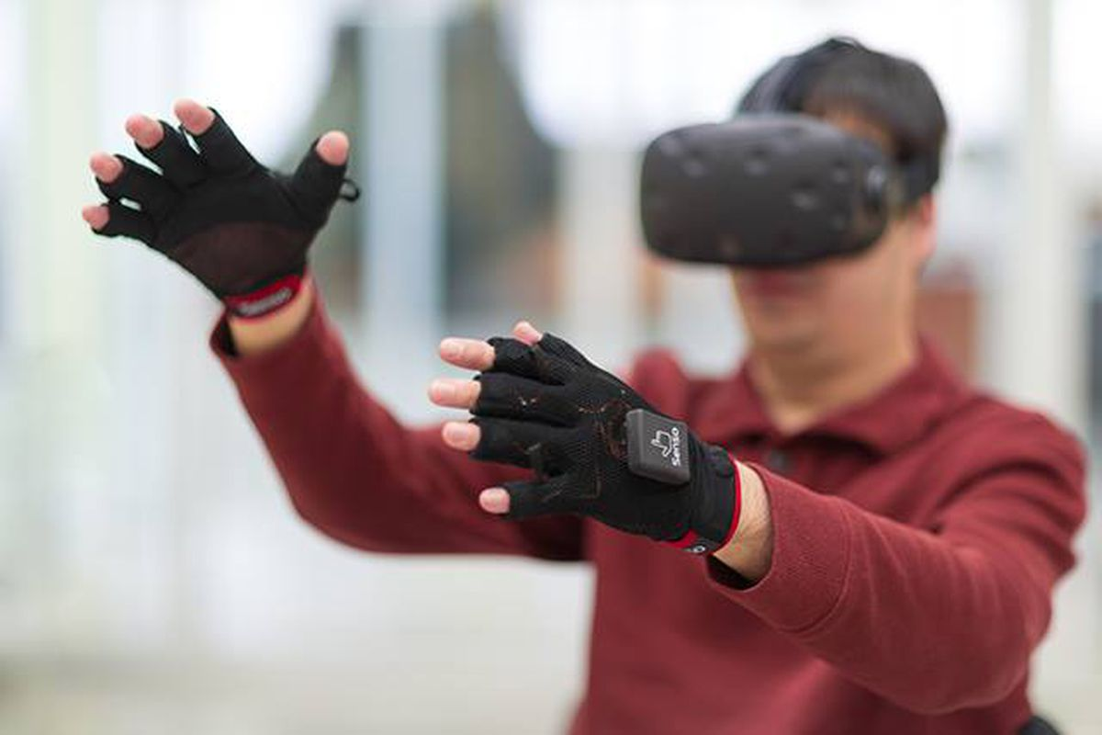

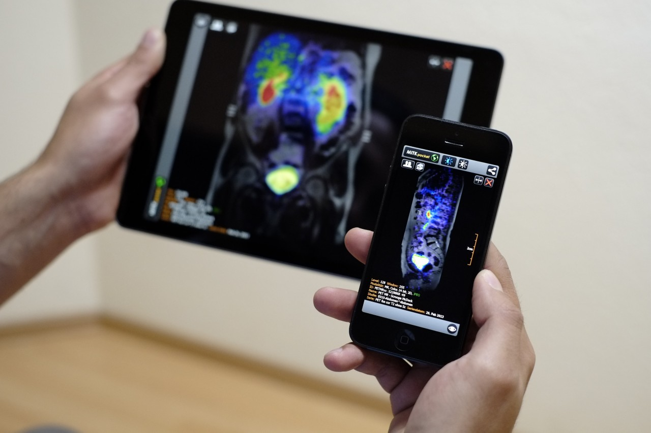
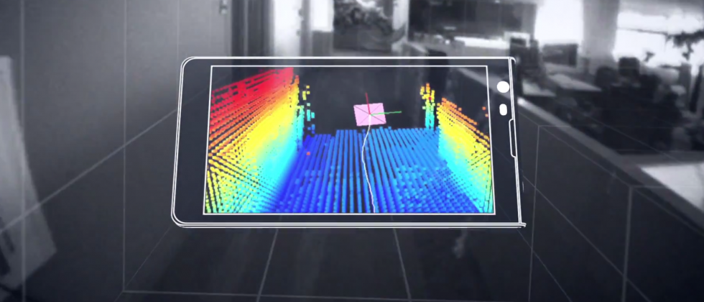
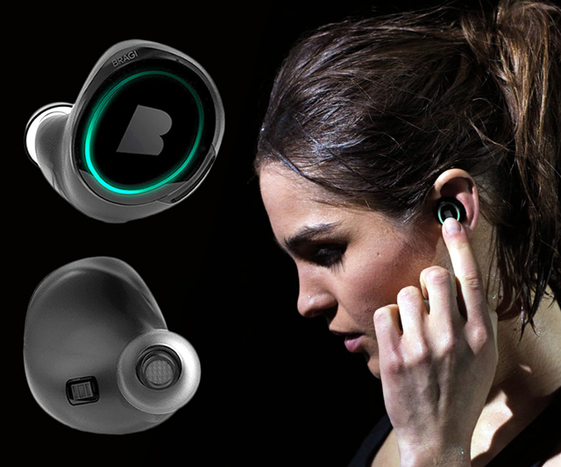
Machine Learning for Physical Sensing & Perception
CMSC 818V : Fall 2025
Lecture 4_4: Active Volumetric Sensing
Nirupam Roy
Tu-Th 3:30 – 4:45pm
IRB 1207

Slide 2
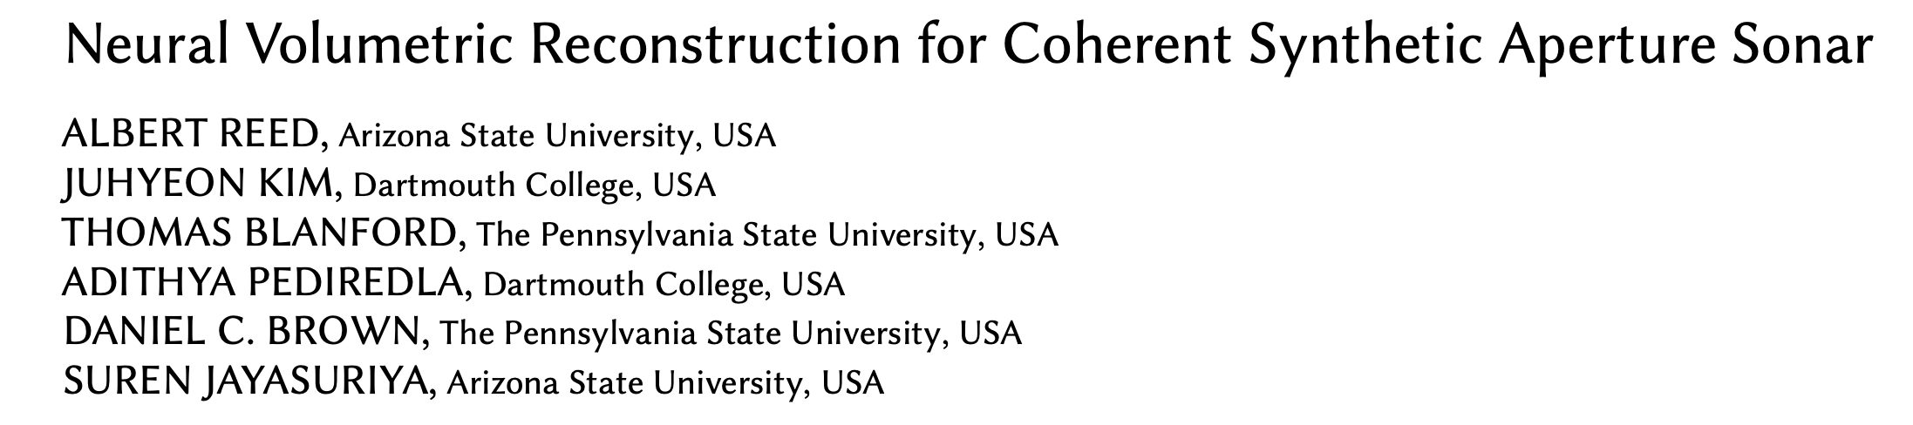
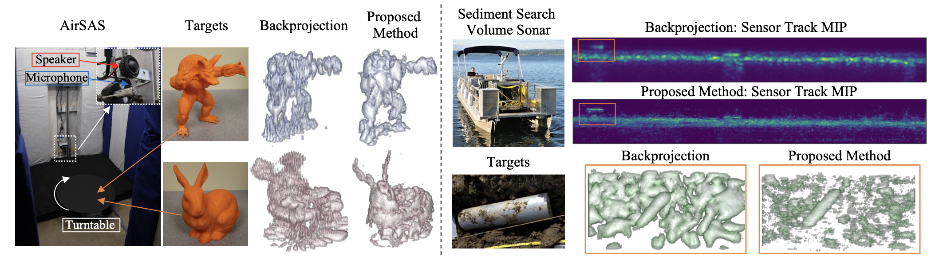
Neural Volumetric Reconstruction

Slide 3
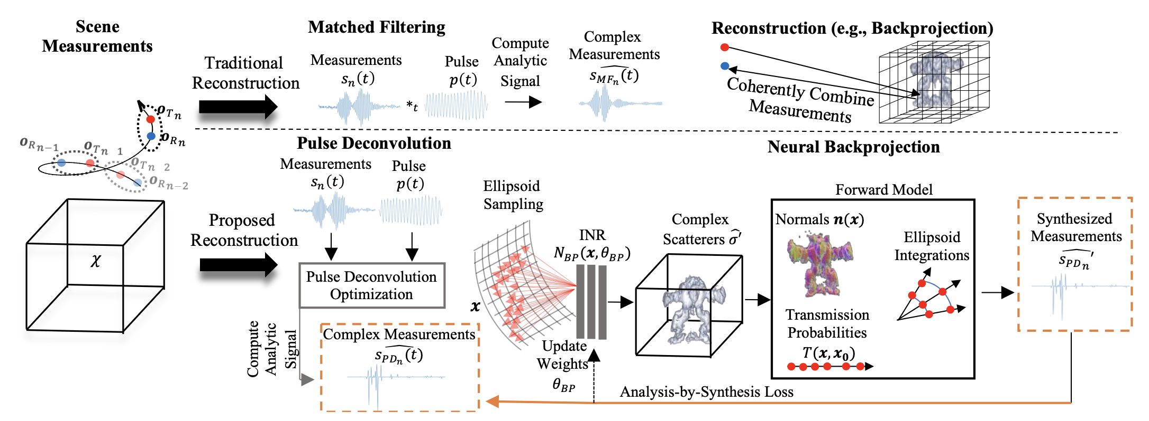
Traditional and Proposed Approaches

Slide 4

Matched Filtering/Deconvolution

Slide 5
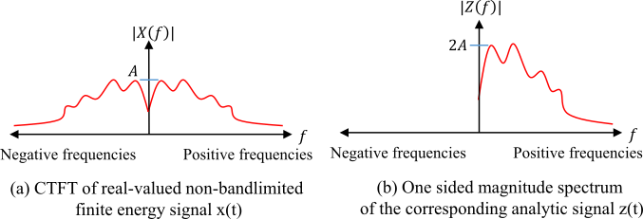

SAS reconstruction with time-domain Backprojection
Hilbert transform

Slide 6
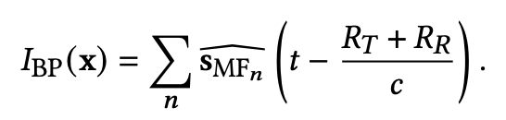
SAS reconstruction with time-domain Backprojection
Hilbert transform
Backprojection

Slide 7
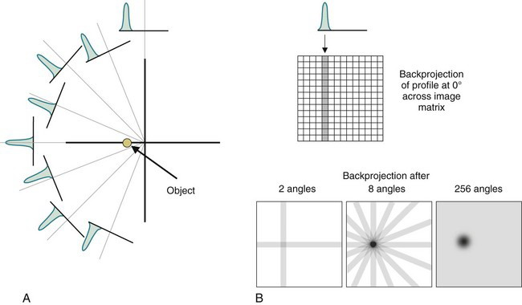
SAS reconstruction with time-domain Backprojection

Slide 8
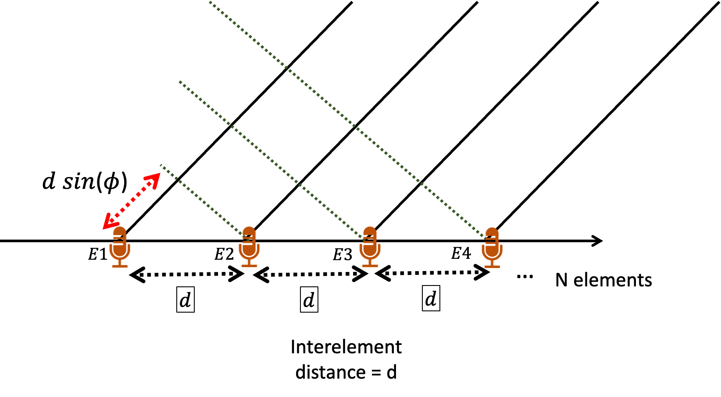
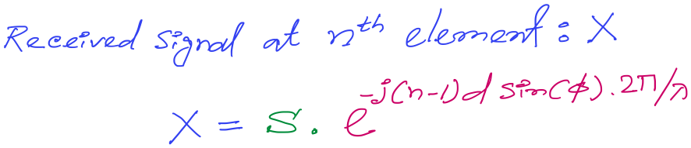

DoA Estimation: Delay-sum
For 3rd mic, n == 3
Notes:
http://www.waves.utoronto.ca/prof/svhum/ece422/notes/15-arrays2.pdf

Slide 9
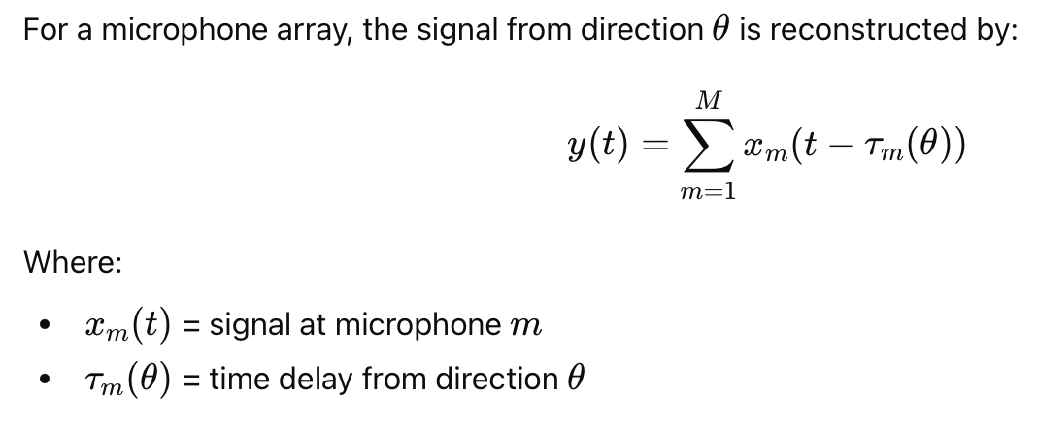
Backprojection in Angle

Slide 10
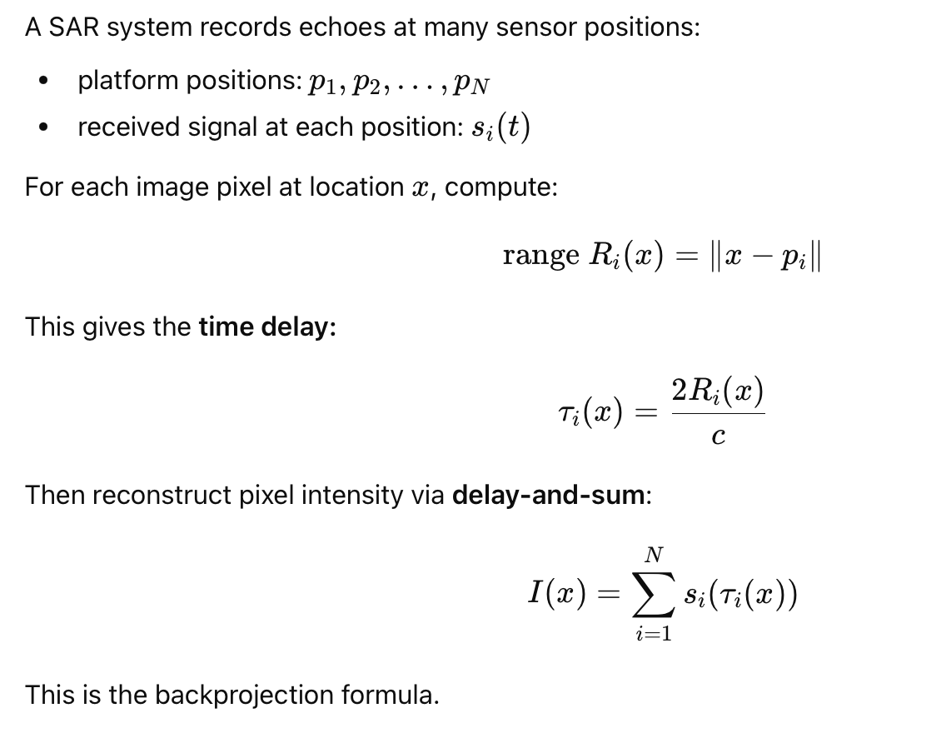
Backprojection in Position/Pixel

Slide 12
Positional Encoding: Context and Parallel Processing
Contextual Embedding-1
Contextual Embedding-2
Contextual Embedding-3
Self Attention
Embedding-1
Embedding-2
Embedding-3
Dog
Bites
Man

Slide 13
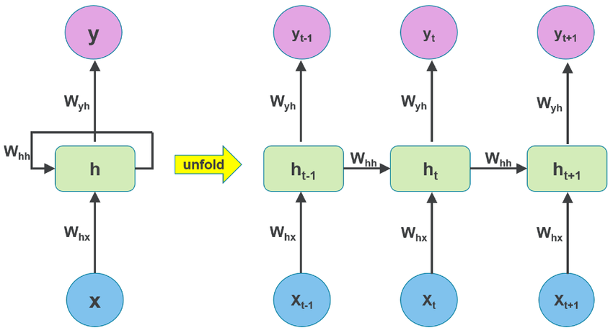
Positional Encoding
RNN: Inherently sequential

Slide 14
Positional Encoding: Context and Parallel Processing
Contextual Embedding-1
Contextual Embedding-2
Contextual Embedding-3
Self Attention
Embedding-1
Embedding-2
Embedding-3
Dog
Bites
Man
Man
Bites
Dog

Slide 15
Positional Encoding: Context and Parallel Processing
Contextual Embedding-1
Contextual Embedding-2
Contextual Embedding-3
Self Attention
Embedding-1
Embedding-2
Embedding-3
Dog+1
Bites+2
Man+3
Man+1
Bites+2
Dog+3

Slide 16
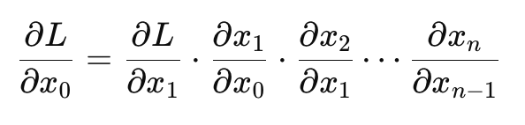


Positional Encoding: Context and Parallel Processing
Problems with indexing:
Contextual Embedding-1
Contextual Embedding-2
Contextual Embedding-3
1) No upper bound, not good for NN/backpropagation
- Exploding gradient, saturation, overflow
- Vanishing gradient
Self Attention
Embedding-1
Embedding-2
Embedding-3
1
2
3
Dog
Bites
Man
Man
Bites
Dog

Slide 17
Positional Encoding: Context and Parallel Processing
Problems with indexing:
Contextual Embedding-1
Contextual Embedding-2
Contextual Embedding-3
1) No upper bound, not good for NN/backpropagation
- Exploding gradient, saturation, overflow
- Vanishing gradient
Self Attention
Embedding-1
Embedding-2
Embedding-3
1
2
3
Dog
Bites
Man
How about normalizing the indices?
Man
Bites
Dog
Notes:
Not good. The embedding changes for positions depending on the cardinality of the tokens.

Slide 18
Positional Encoding: Context and Parallel Processing
Problems with indexing:
Contextual Embedding-1
Contextual Embedding-2
Contextual Embedding-3
2) Discrete indices
-- Not good for learning multiscale patterns.
-- Not a smooth differentiable map from coordinate to
functions
Self Attention
Embedding-1
Embedding-2
Embedding-3
1
2
3
Dog
Bites
Man
How about normalizing the indices?
Man
Bites
Dog
Notes:
Not good. The embedding changes for positions depending on the cardinality of the tokens.

Slide 19
Positional Encoding
Can we use sinusoids for positional encoding?
Amplitude
Time (sec)
0.00
0.25
0.50
0.75
1.00
1.25

Slide 20
Positional Encoding
Can we use sinusoids for positional encoding?
Amplitude
Position
1
2
3
4
5
6

Slide 21
Positional Encoding
Can we use sinusoids for positional encoding?
Amplitude
Position
1
2
3
4
5
6
Embedding-1
Embedding-2
Embedding-3
Dog
0.2
Bites
0.1
Man
0.9

Slide 22
Positional Encoding
Can we use sinusoids for positional encoding?
Amplitude
Position
1
2
3
4
5
6
Embedding-1
Embedding-2
Embedding-3
0.2
0.9
0.1
0.3
0.9
0.5

Slide 23


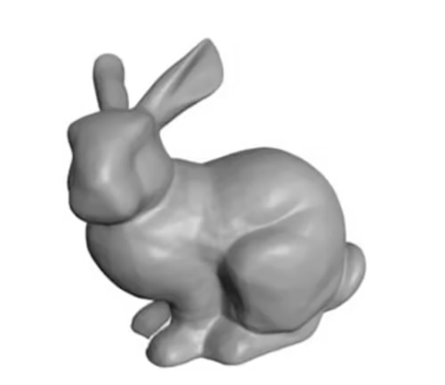
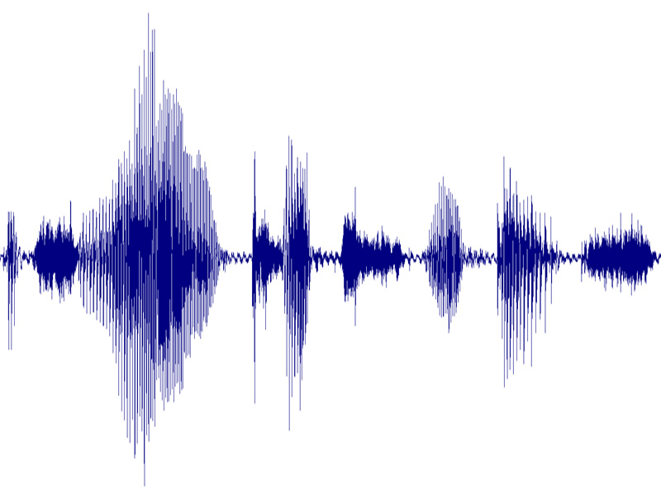
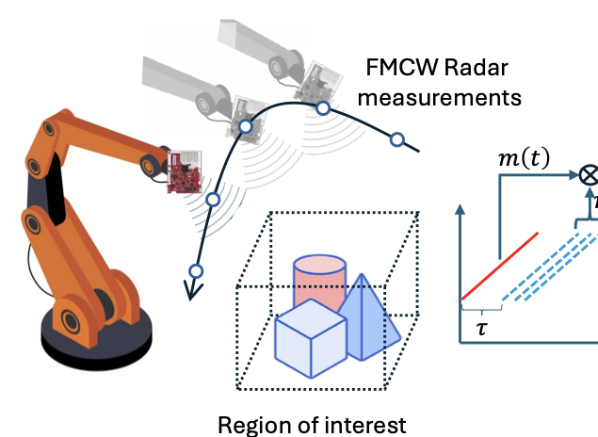
Positional Encoding in INR
Positionally
coded
<x’, y’, z’>
<x, y, z>
σ
<sensor-location-i>
Forward model
Calculate
loss
Ground truth
Z
<sensor-location-i>
X
Y

Slide 24

Positional Encoding in INR
Positionally
coded
<x’, y’, z’>
<x, y, z>
σ
<sensor-location-i>
Forward model
Calculate
loss
Ground truth
Z
<sensor-location-i>
X
Y
Encoding function:

Slide 25
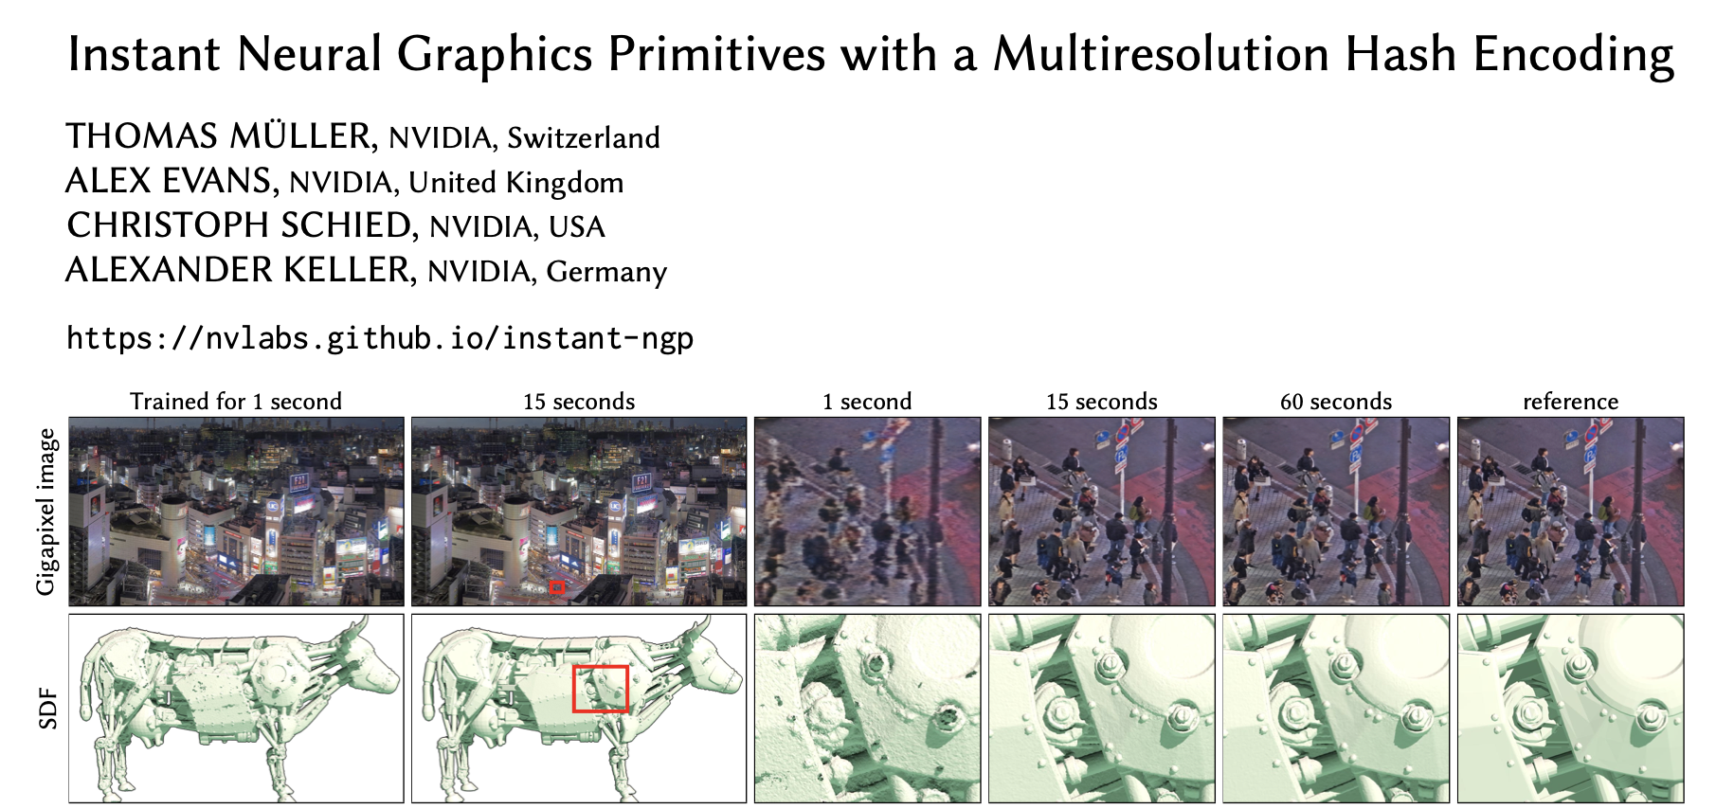
Positional Encoding

Slide 26
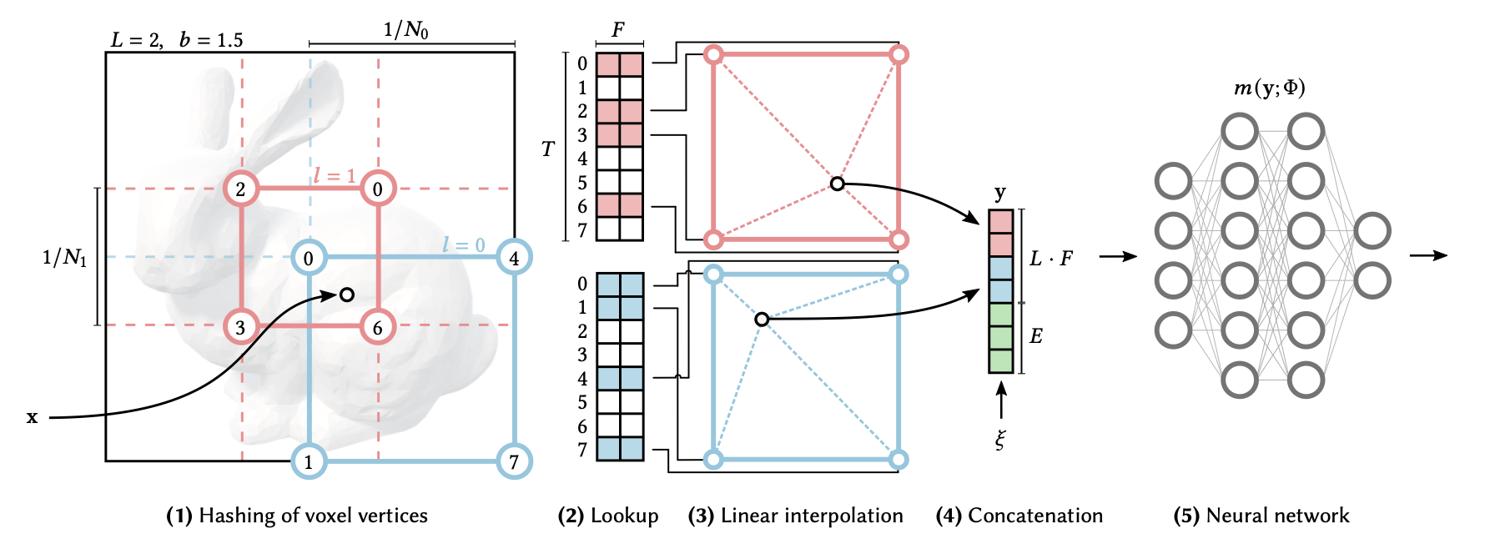
Multiresolution Hash Encoding

