Slide 1





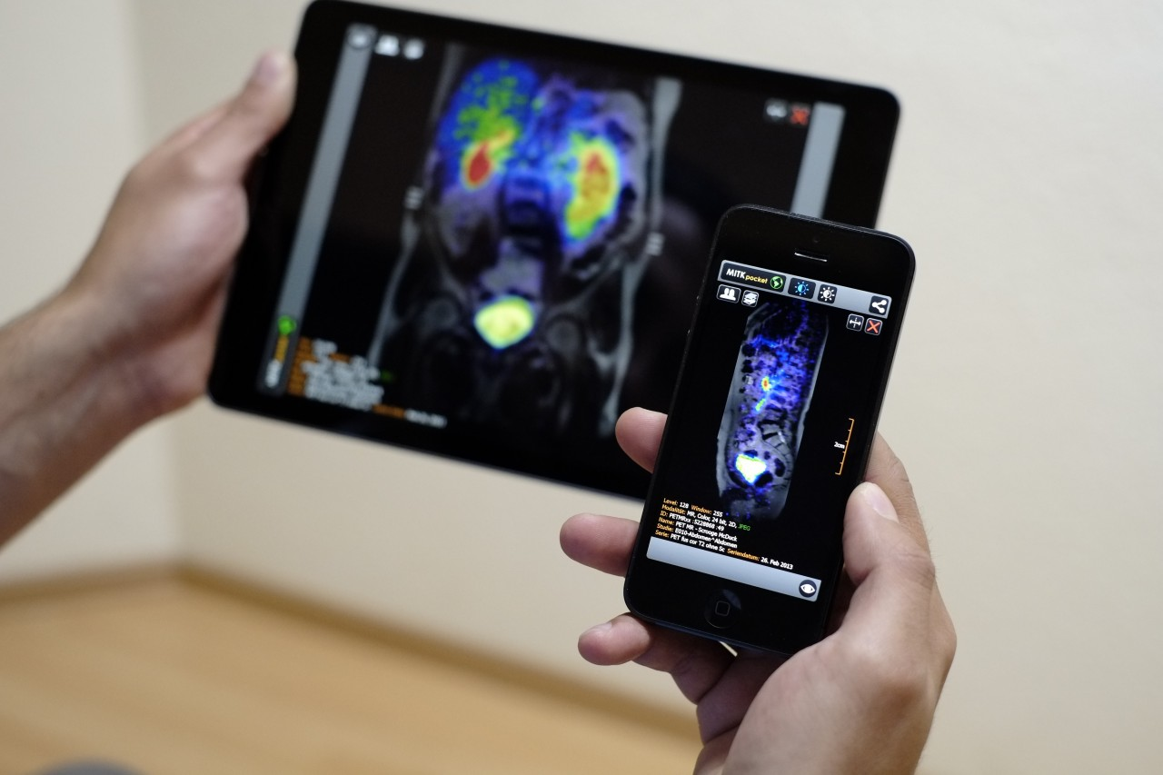
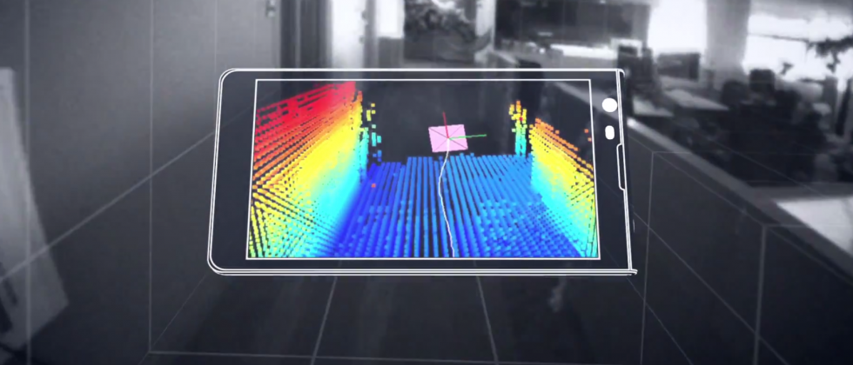

Machine Learning for Physical Sensing & Perception
CMSC 818V : Fall 2025
Lecture 4_5: Active Volumetric Sensing
Nirupam Roy
Tu-Th 3:30 – 4:45pm
IRB 1207

Slide 2
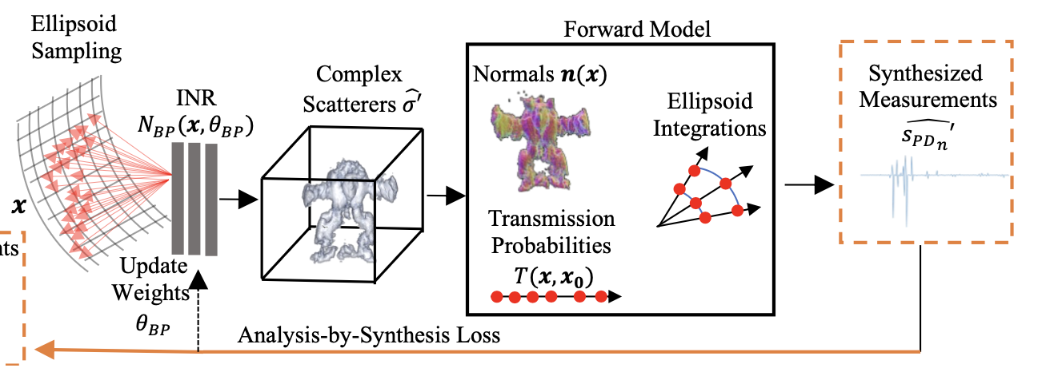
Neural Volumetric Reconstruction

Slide 3


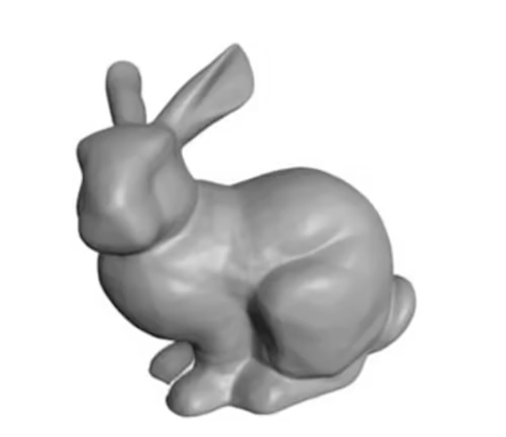
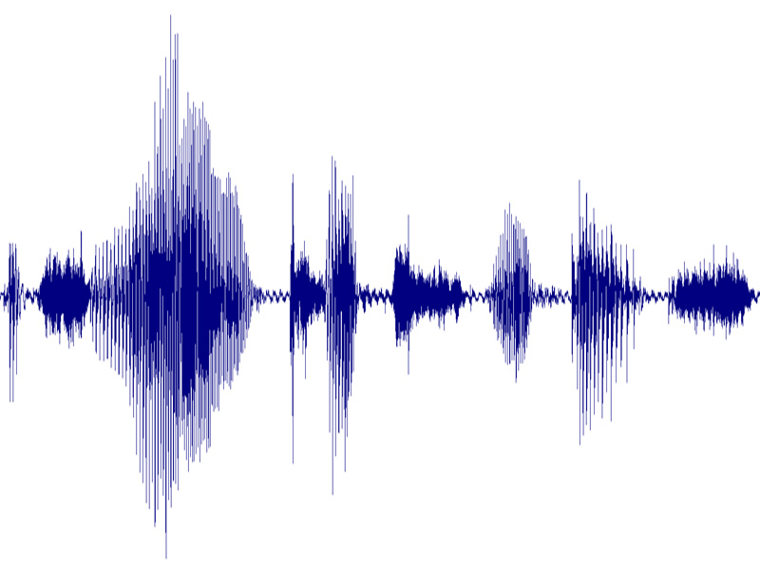
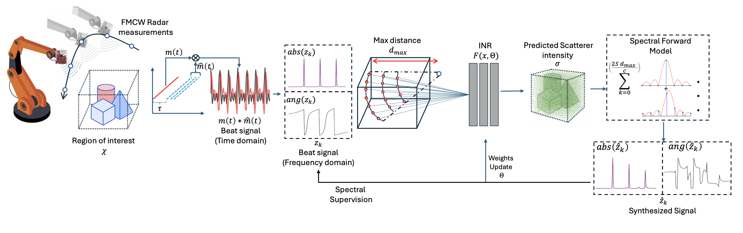

Positional Encoding in INR
Positionally
coded
<x’, y’, z’>
<x, y, z>
σ
<sensor-location-i>
Forward model
Calculate
loss
Ground truth
Z
<sensor-location-i>
X
Y
Encoding function:

Slide 4
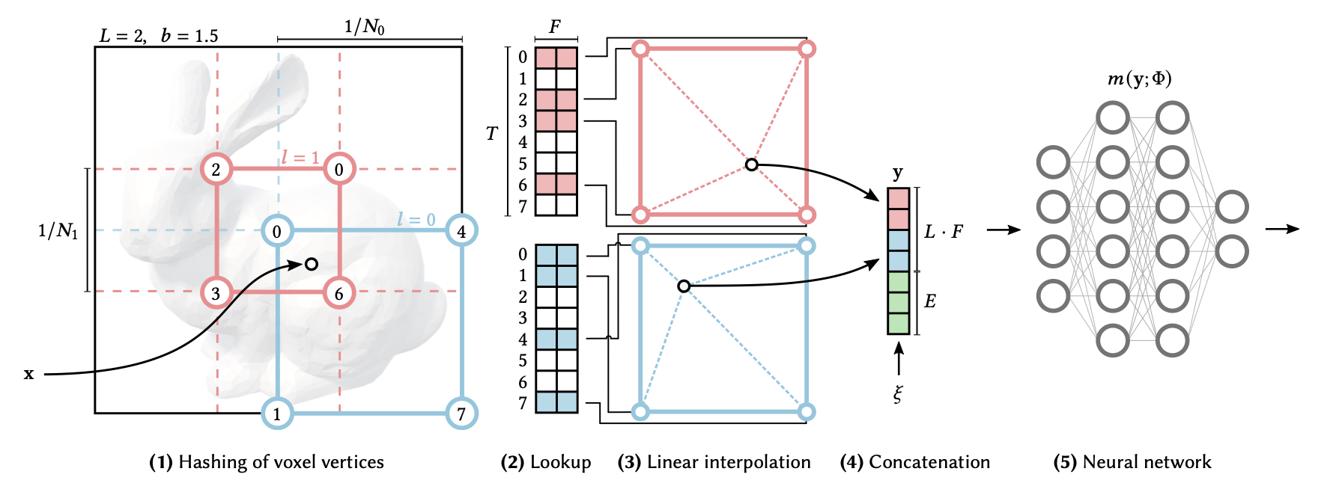
Multiresolution Hash Encoding

Slide 5
Time-Domain vs Frequency-Domain Supervision

Slide 6
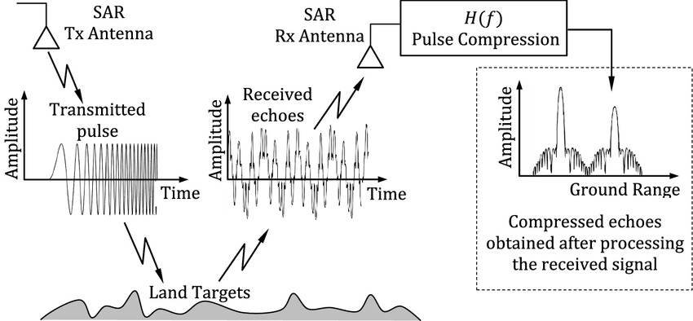
Pulse VS FMCW

Slide 7
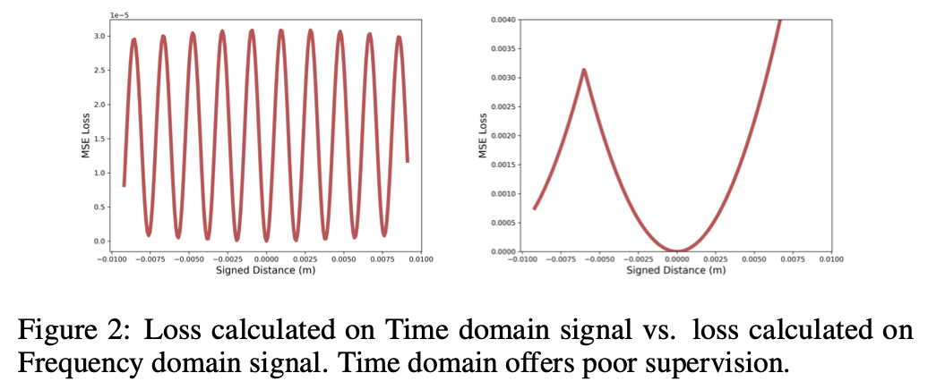
Time-Domain vs Frequency-Domain Supervision
In the context of FMCW SAR,
learning from Time-Domain Signals is Fundamentally Ill-Conditioned

Slide 8
SPiNR: Spectral Domain Neural Reconstruction for Passband FMCW Radars - 2025

Slide 9
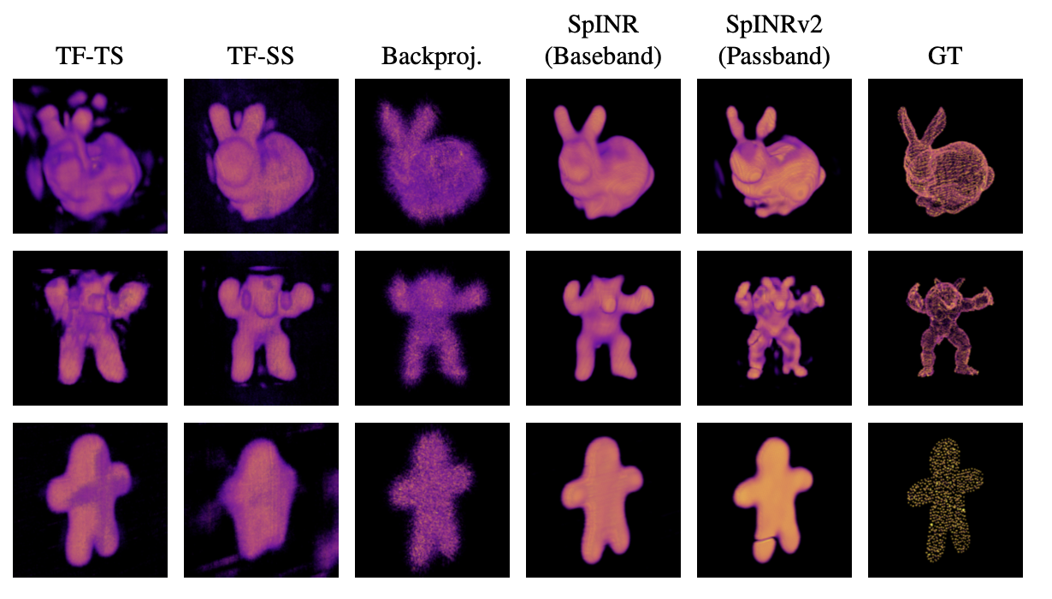
SPiNR: Spectral Domain Neural Reconstruction for Passband FMCW Radars - 2025

Slide 10
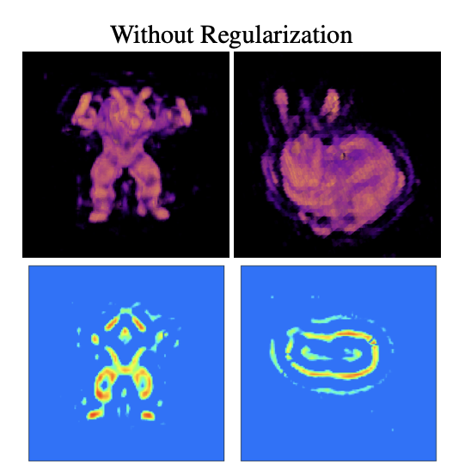
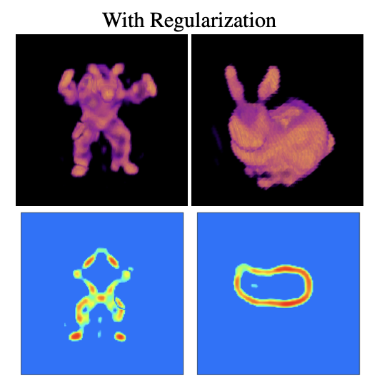


Smoothness and sparsity regularization on reconstruction quality.

Slide 11
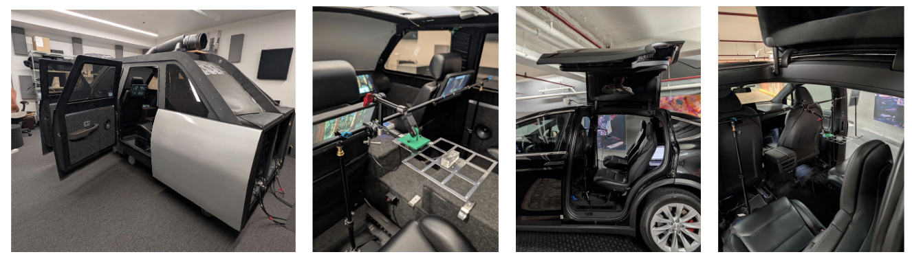
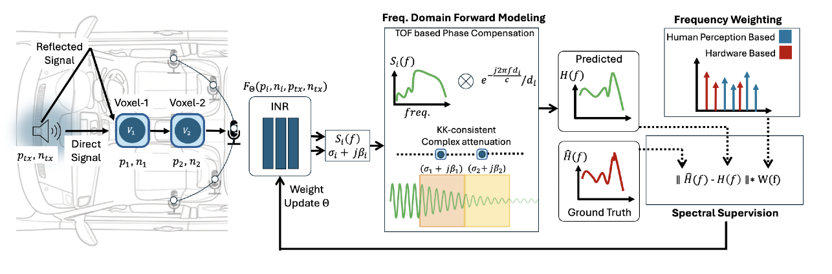
INFER: Learning Implicit Neural Frequency Response Fields for Confined Car Cabin - 2025

Slide 12
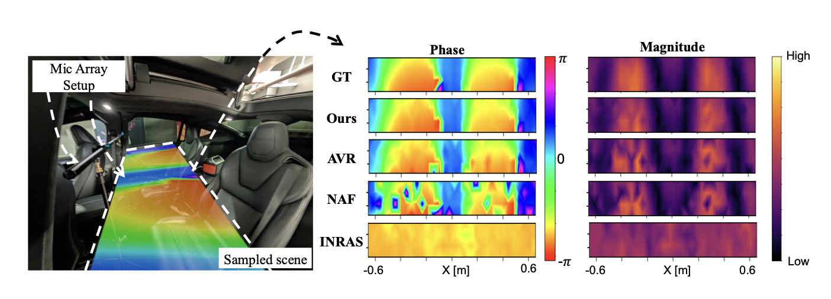
INFER: Learning Implicit Neural Frequency Response Fields for Confined Car Cabin - 2025

Slide 13
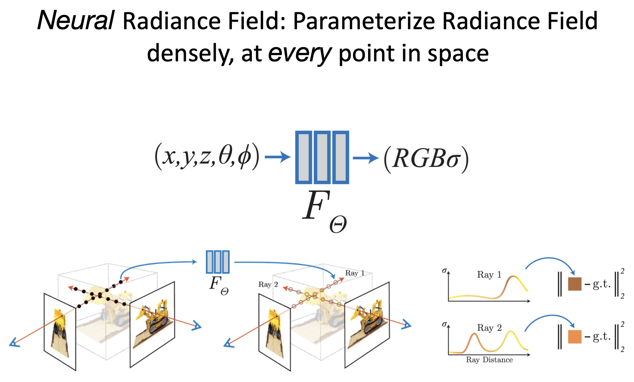

Slide 14
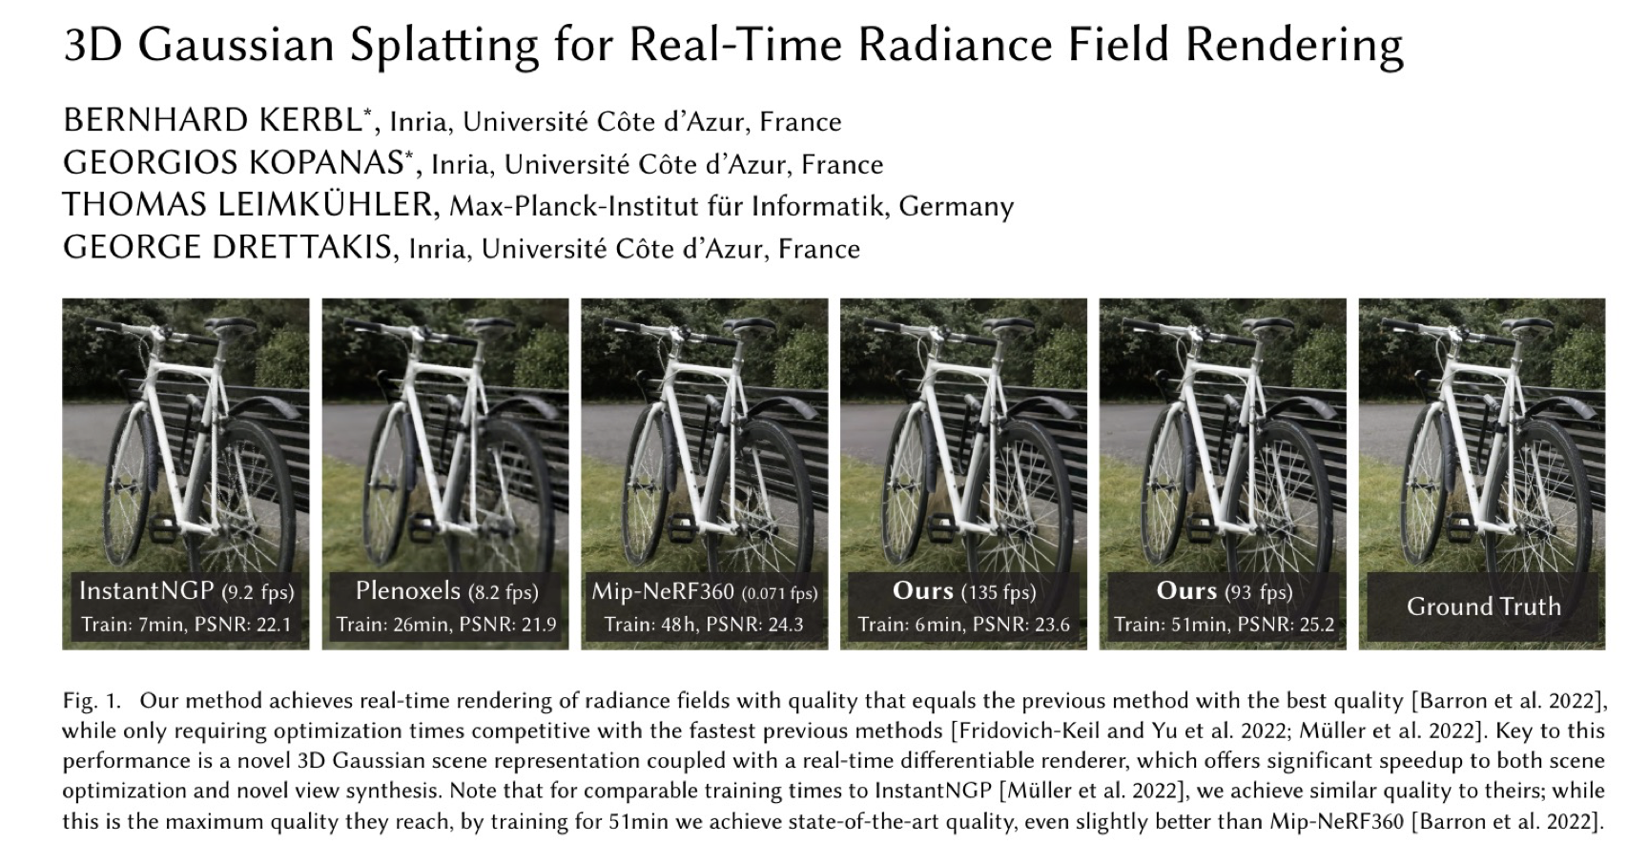

Slide 15
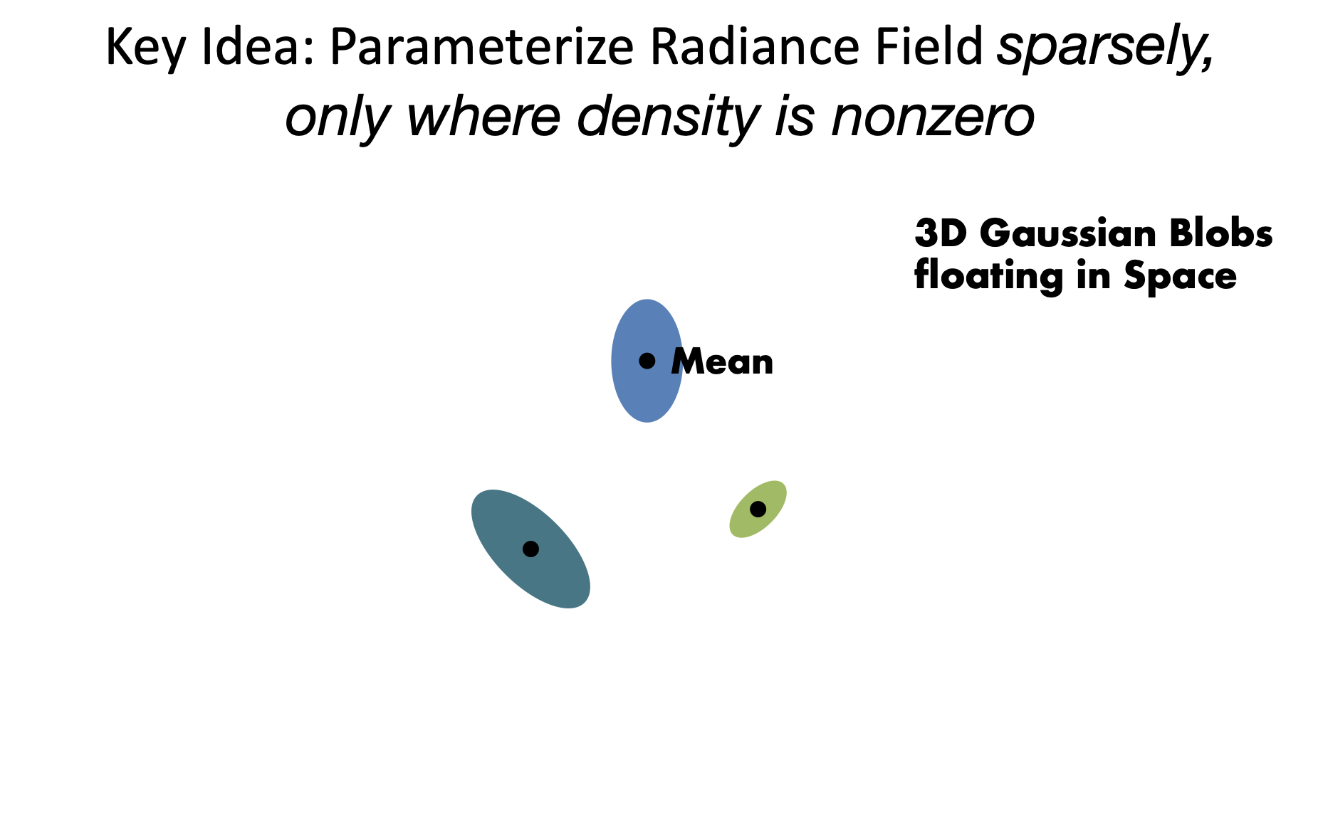

Slide 16
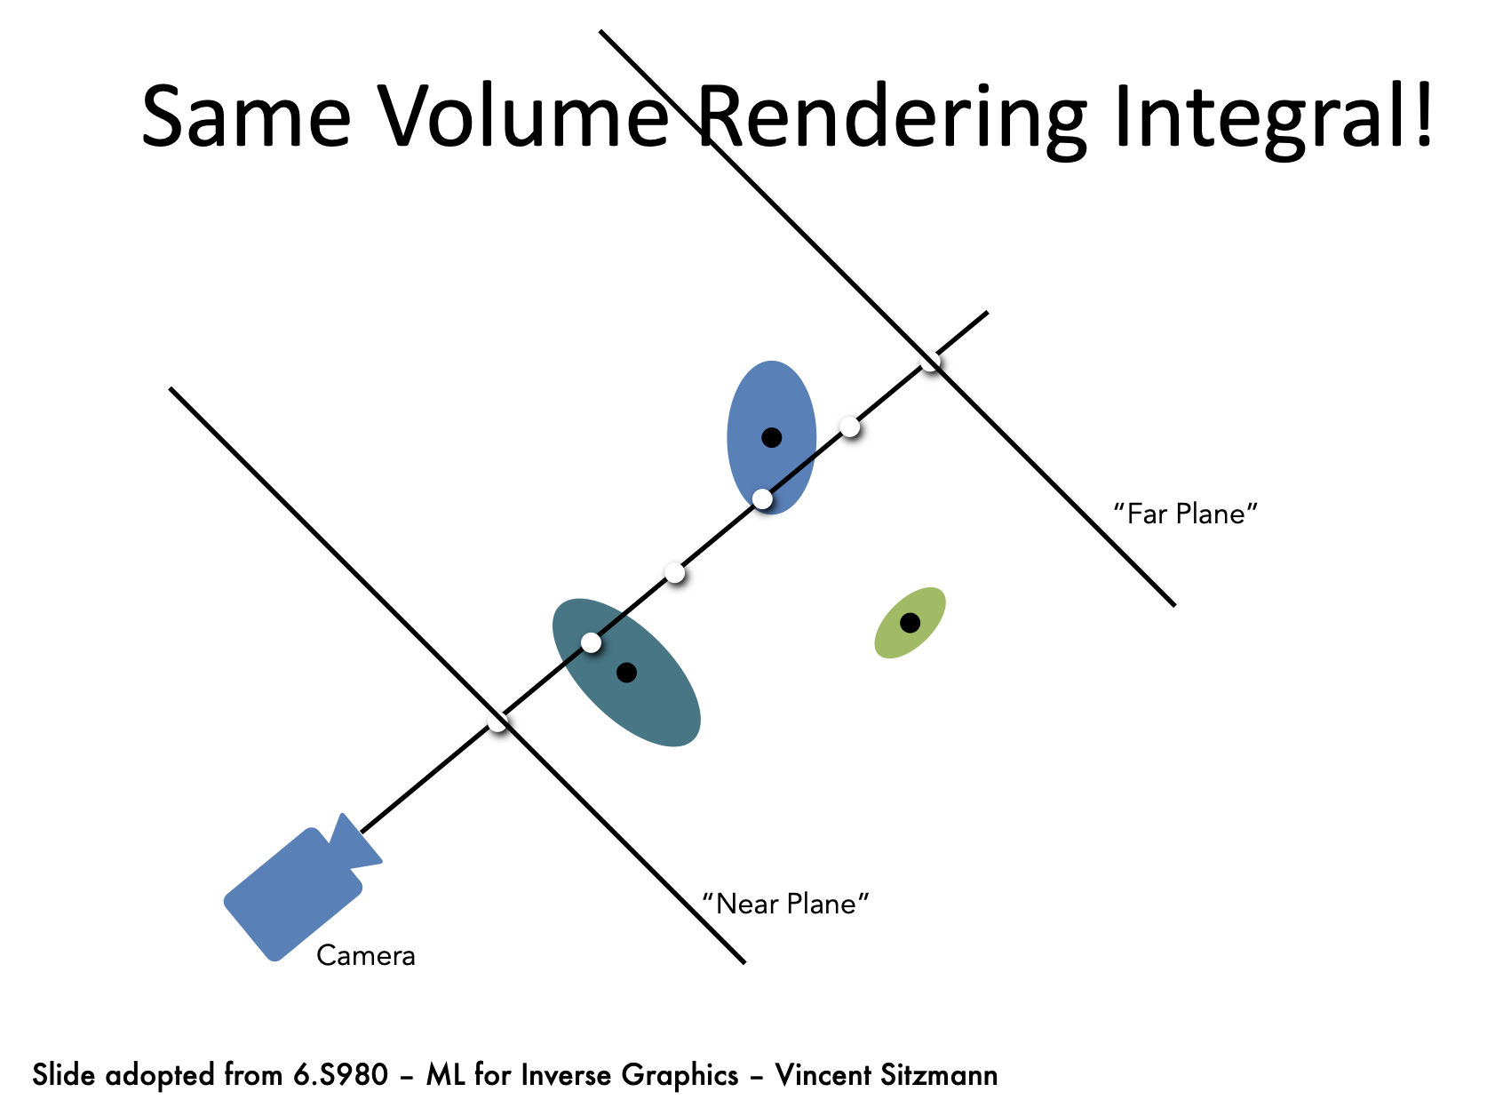

Slide 17
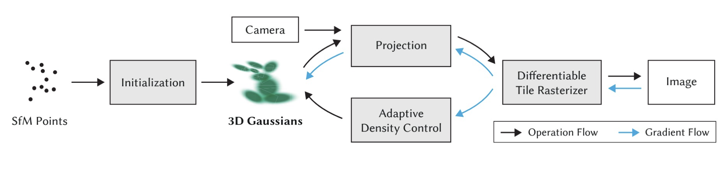
3D Gaussian Splatting

Slide 18
3D Gaussian Splatting

Slide 19
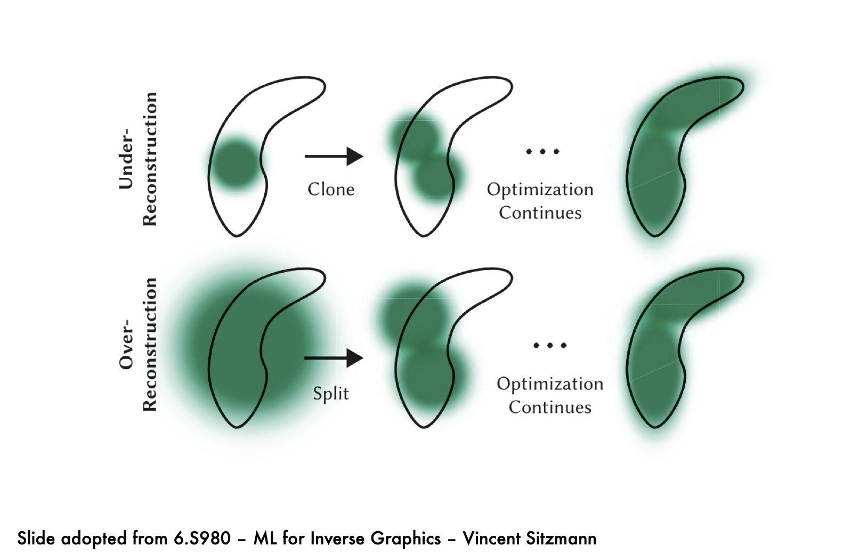
3D Gaussian Splatting

Slide 20
3D Gaussian Splatting

Slide 21
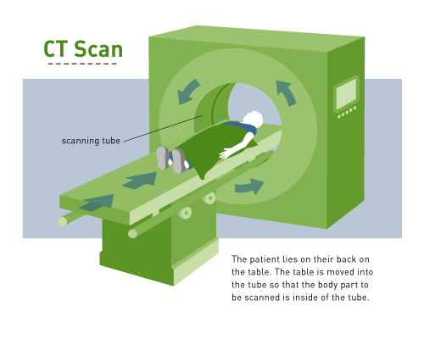
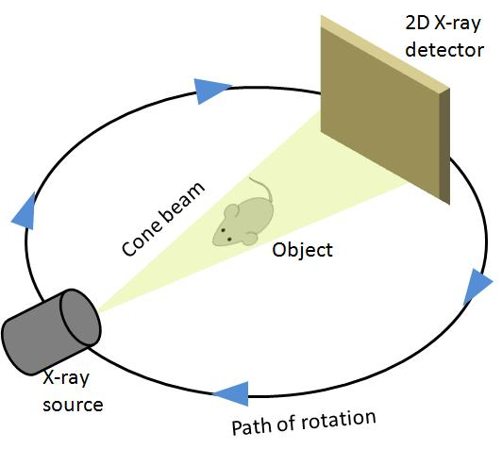
Tomography

Slide 22
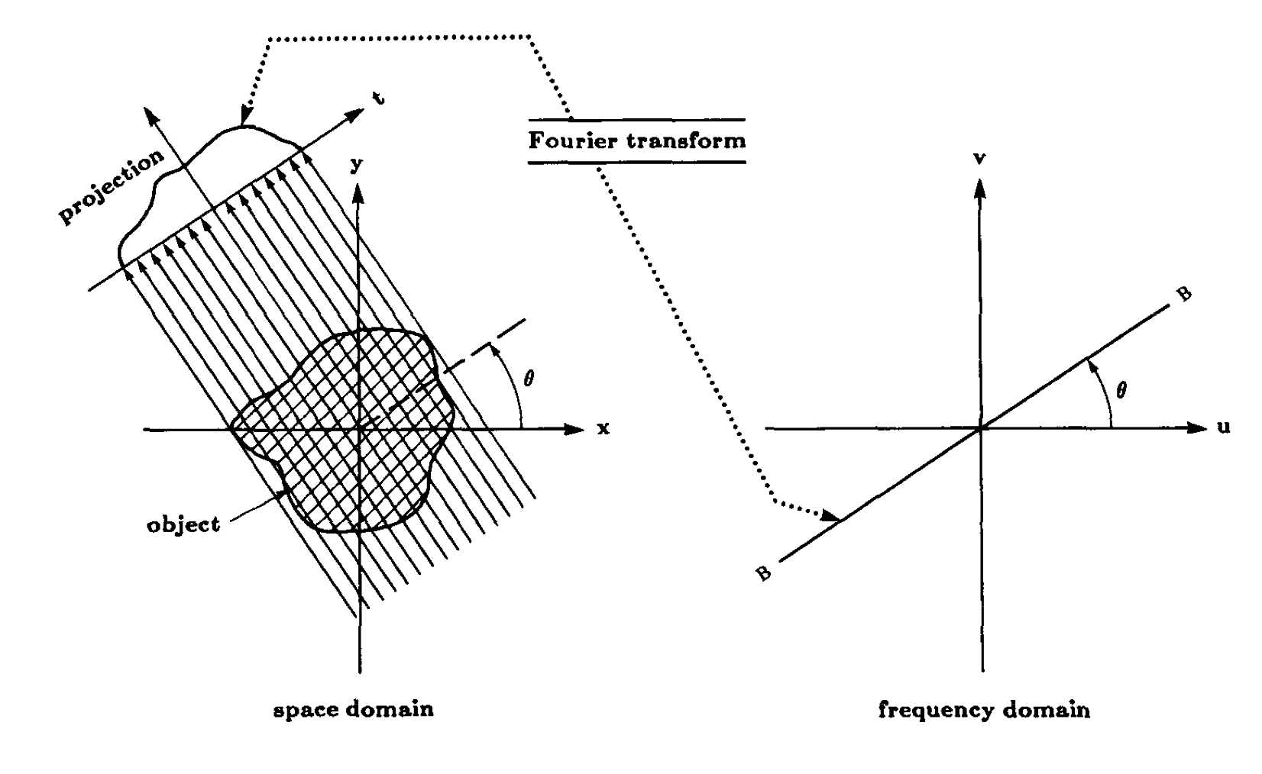
Tomography

Slide 23
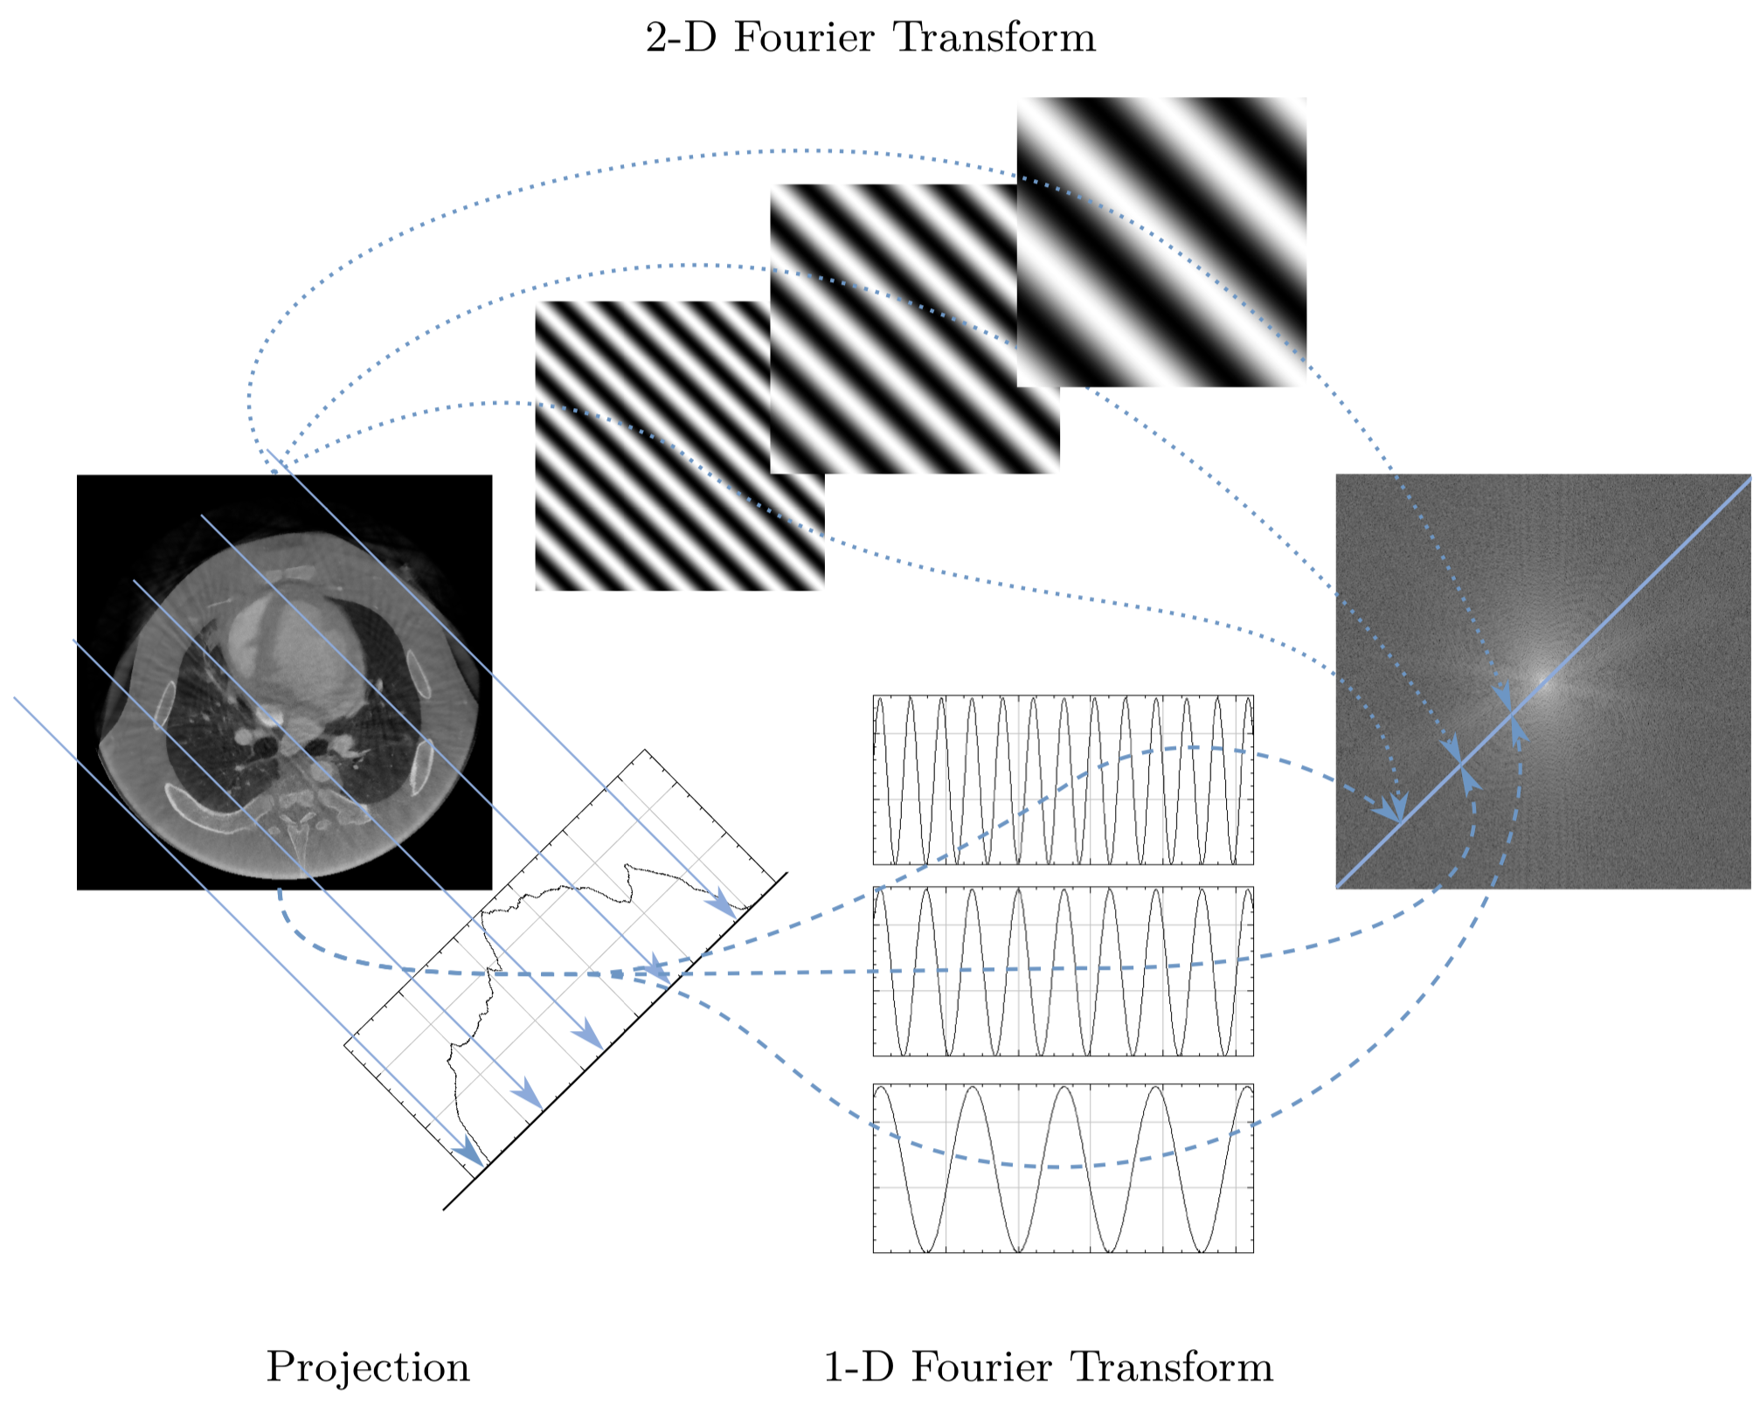
Tomography: Central slice theorem

Slide 24
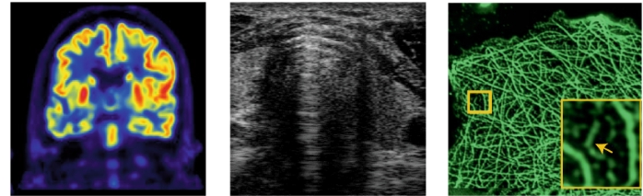
Unrolled / model-based deep networks
Physics-informed / operator-aware networks
Generative priors (especially diffusion / score-based)
Implicit neural fields / NeRF for tomography

