Slide 1

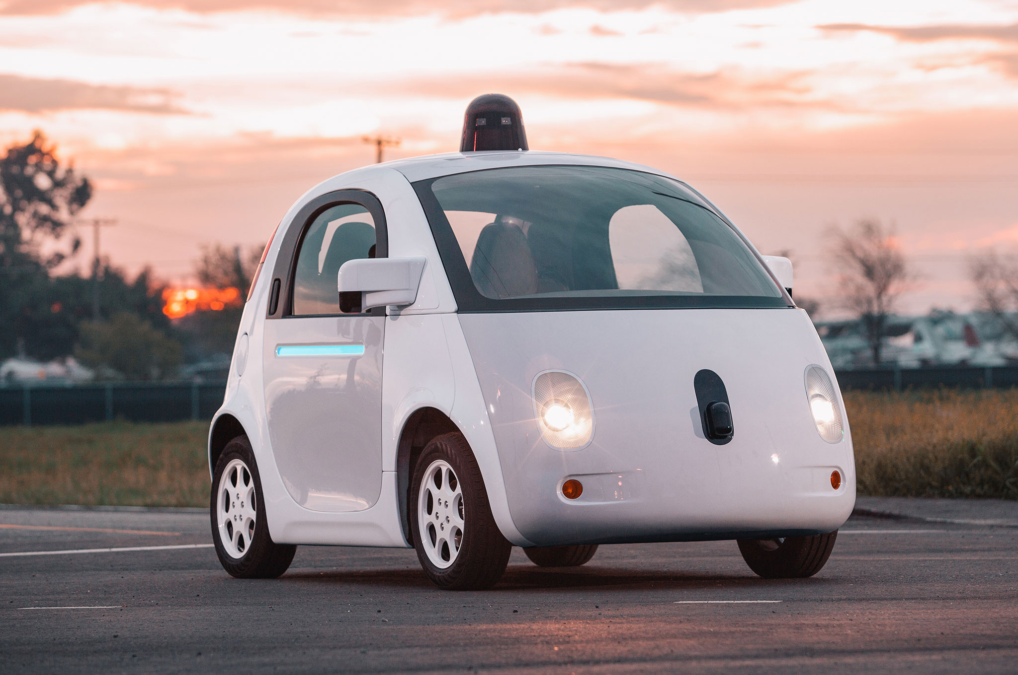



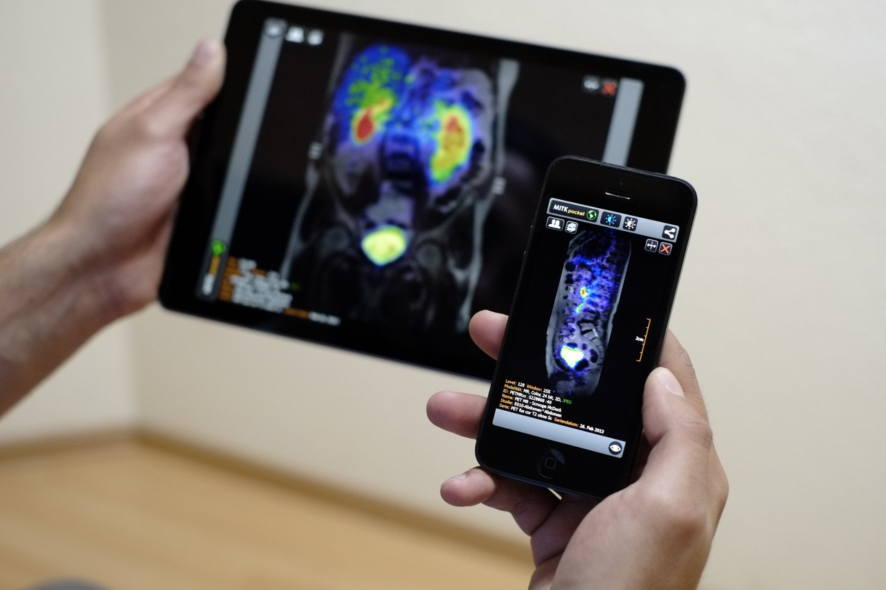
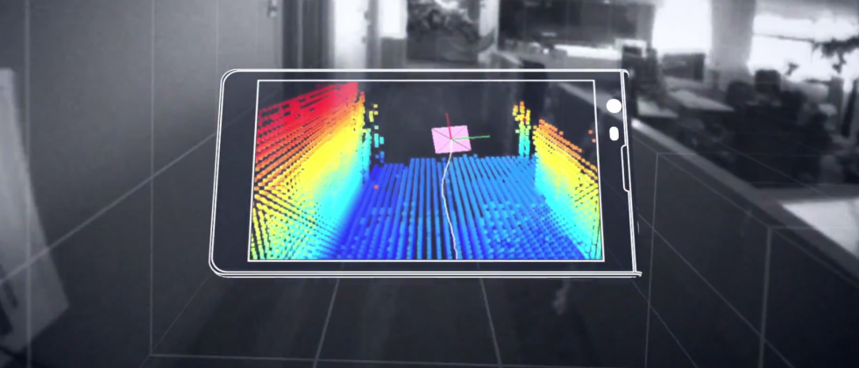


Machine Learning for Physical Sensing & Perception
CMSC 818V : Fall 2026
Lecture 1: From the Physical World to Sensor Data
Nirupam Roy
Tu-Th 12:30 – 1:45pm
IRB 2107

Slide 2
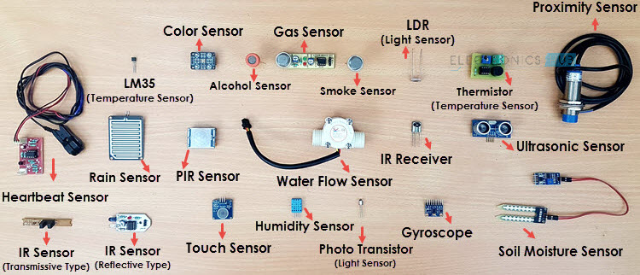
What is a sensor?
Is there a common principle?
Notes:
Image source: https://www.electronicshub.org/different-types-sensors/

Slide 3

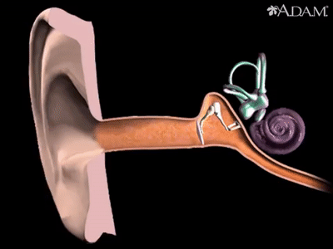
How does a sound sensor work?
Sound
Sensor

Slide 4
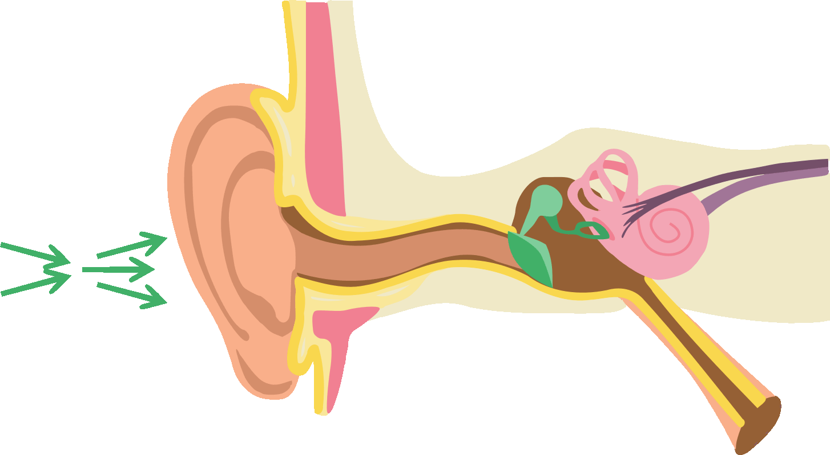
How does a sound sensor work?

Slide 5
How does a sound sensor (microphone) work?

Slide 6
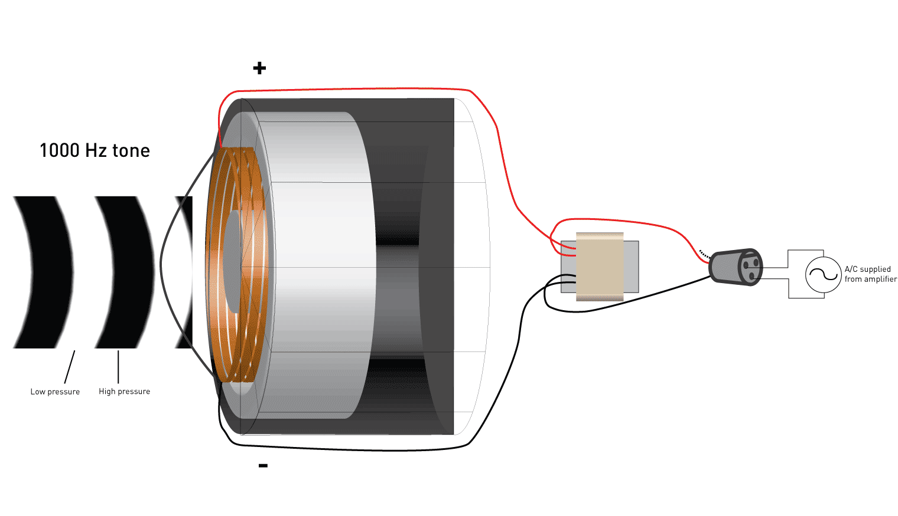
How does a sound sensor (microphone) work?

Slide 7
How does a sound sensor (microphone) work?
Amplitude
Time (sec)
0.00
0.25
0.50
0.75
1.00
1.25

Slide 8
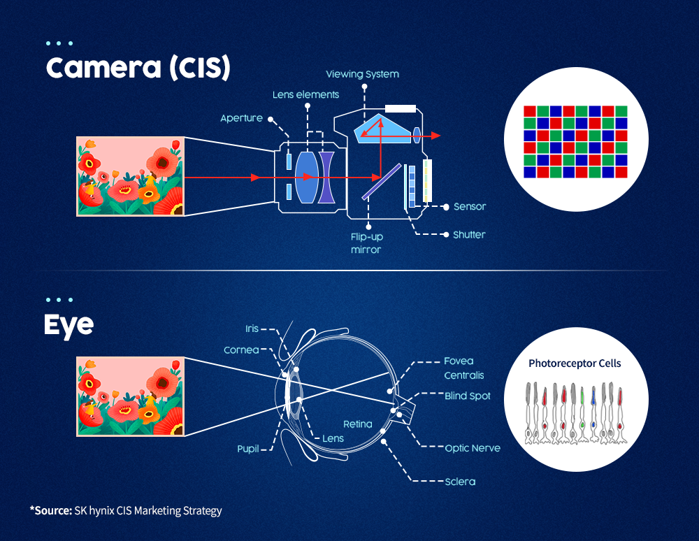
How does a camera sensor work?

Slide 9
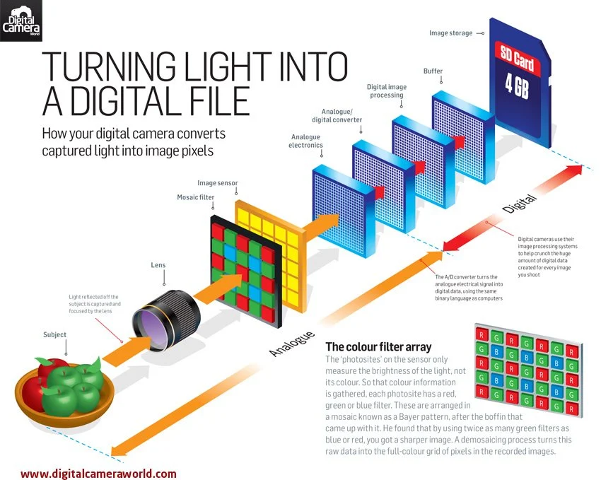

Slide 10
Sensor data is not the physical world.
It is the result of a physical process acting on the world.
A photograph is photons at pixels — not "flower."
A recording is air pressure at a diaphragm — not "voice."
An IQ sample is a reflected echo — not "car."
2
2

Slide 11
From physical state to sensor data
physical interaction / propagation
sensor / transduction
x
z
y
latent physical state
propagated / interacted field
observed sensor data
Every sensing system, however different its physics, follows this same three-stage abstraction. We will map camera, microphone, and radar onto it repeatedly today.
3
3

Slide 12
The forward measurement model
y = F (x ; θ ) + n
x
F
θ
y
n
latent physical state
forward / measurement process
environmental or sensor parameters
observed sensor data
measurement noise
This is the equation the whole semester keeps coming back to — for every sensing system we study, we will identify each of these five terms.
4
4

Slide 13
Today's plan · 75 minutes
1
Physical state vs. sensor observation
10 min
2
The universal sensing pipeline
10 min
3
Three phenomena, three sensing systems
20 min
4
Sensors are transducers
8 min
5
The complete forward measurement model
10 min
6
Deterministic model vs. stochastic measurement
5 min
7
What information was lost?
7 min
5
5

Slide 14
Physical State vs. Sensor Observation
What does a sensor actually measure?
6

Slide 15
A photograph of a flower
What did the camera actually measure?
It did NOT measure…
It DID measure…
"Flower" (a semantic category)
Shape
Material
Color as an abstract property
Distance
Photons converted into electrical charge at pixels.
7
7

Slide 16
The imaging pipeline, physically
Illumination
Surface
interaction
Propa-
gation
Optics
Photo-
detector
ADC
Pixels
Latent scene: x = { geometry, material, illumination, pose }
Observation: y = pixel intensities
The photograph is a highly indirect trace of x — filtered through illumination, surfaces, propagation, and the sensor itself.
cf. Berkeley CS 180 — pinhole camera → pixels → physics of light → image formation → computation.
8
8

Slide 17
Three concepts to fix today
1
2
3
Latent variable / physical state
Observable
Measurement operator
A quantity that exists physically but is not directly observed.
What the sensor actually measures.
y = F(x) — the mapping from latent state to measurement.
This distinction — latent state vs. observable, linked by an operator — is foundational for inverse problems covered later lectures.
9
9

Slide 18
The Universal Sensing Pipeline
10

Slide 19
Fundamental principle of sensors
Electrical fluctuations
proportional to the
speed/volume of air-flow
Air flow
Mapping
10 Miles per hour
Mapping
Notes:
Generalization beyond camera

Slide 20
SENSOR
A circuit that converts the reaction to measurable electrical signal (voltage, current, or energy)
A structure or material
that reacts to the physical phenomenon
A physical phenomenon
We want to measure
Interpretation of the signal, storing the data

Slide 21
Fundamental principle of sensors
“Sensors are transducers”
A transducer is a device that converts energy from one physical form into another

Slide 22
Fundamental principle of sensors
Temperature
Voltage
Thermo-couple
Time
At time t
Mapping
Temp.
40° F
(a scalar value)
Time
Temperature signal

Slide 23
Generalizing beyond the camera
Physical
State
Physical
Phenom-
enon
Propagation
Interaction
Transducer
Signal
Every sensing system — camera, microphone, radar, or otherwise — instantiates this same six-stage chain.
What differs across modalities is the physics of propagation and interaction, and what counts as the transducer.
This is the general form of x → z → y from before, expanded one level.
11
11

Slide 25
Passive vs. active sensing
Passive sensing
Active sensing
The sensor observes energy it did not emit.
The sensor emits energy and measures what returns.
Camera: illumination → scene → camera
Radar: transmitter → EM propagation → target → EM propagation → receiver
Microphone: source → acoustic field → mic
Also: sonar, ultrasound, LiDAR, structured light.
The sensor has no control over the illumination or the source — it only listens.
Because we control the transmitted signal, we control part of F itself.
12
12

Slide 26
Active sensing → sensing system design
y = F (x ; u )
u = a design variable we control: transmitted waveform, illumination pattern, frequency, sensor position, …
An idea worth planting early:
Machine learning may eventually optimize u — the sensing process itself — not merely infer x from fixed measurements.
13
13

Slide 27
Three Physical Phenomena,
Three Sensing Systems
Light → camera · Sound → microphone · RF → radar
14

Slide 28
A. Light → camera: from radiance to pixels
L source
(illumination)
Material
interaction
L reflected
Lens
Sensor
Reflection, at the level we need today:
Diffuse reflection
Specular reflection
Wavelength-dependent reflectance (ρ)
I_{measured} ∝ (I_{illumination} × ρ)
Pixel intensity depends jointly on object, illumination, geometry, and sensor — so two images of the same object need not have the same y.
15
15

Slide 29
B. Sound → microphone: from pressure to a waveform
Free field: a speaker creates a pressure variation
Now put the speaker in a room:
p (r ) ∝ 1 / r
y (t) = s (t) * h(t) + n(t)
s(t): source h(t): acoustic channel / room y(t): mic signal
The microphone observes the source convolved with the environment: measurement contains information about both source AND environment.
16
16
Notes:
(Don’t worry about the * operator yet — formal convolution is Lecture 2. The physical meaning is what matters today.)

Slide 30
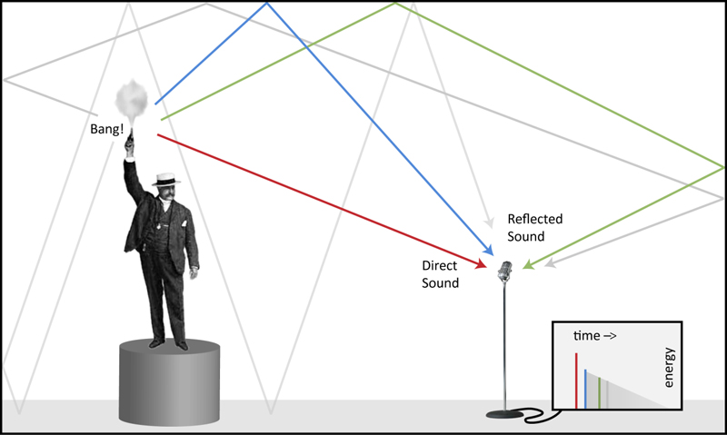
B. Sound → microphone: from pressure to a waveform

Slide 31
One equation, five research directions
Source separation
Localization
Room inference
Dereverberation
Spatial audio
y(t) = s (t) * h(t) + n(t)
All five directions follow from one physical fact: this equation mixes what you want (s) with where you are (h).
17
17

Slide 32
C. RF / radar → receiver: distance is encoded in time
Transmit
s(t)
EM
propagation
Reflector
EM
propagation
Receive
y(t)
For one ideal reflector at distance d:
Distance
y (t) = α s (t − τ) + n (t)
is encoded in delay τ
τ = 2d / c
18
18

Slide 33
Velocity and direction, too
If the object moves…
With multiple antennas…
f_{D} ∝ v
Location / direction becomes encoded in the phase differences between receivers.
The reflected frequency shifts — the Doppler effect. Velocity is encoded in frequency.
Physical properties are transformed by propagation into measurable signal properties.
19
19

Slide 34
A table worth remembering
Physical quantity
Signal manifestation
Distance
Delay
Velocity
Doppler shift
Direction
Inter-sensor phase / time difference
Material
Reflection / absorption
Geometry
Multipath / scattering
Motion
Temporal modulation
20
20

Slide 35
Sensors Are Transducers
A sensor performs a physical conversion, not magic · ~8 minutes
21

Slide 36
A sensor converts a physical quantity to an electrical one
Analog
SENSOR
Digital
A physical phenomenon we want to measure
A structure or material that reacts to the physical phenomenon
A circuit that converts the reaction to a measurable electrical signal (e.g. voltage)
Interpretation of the signal, storing the data
Microphone
Camera
pressure → voltage
photons → electrons
Accelerometer
Antenna
acceleration → proof-mass displacement → electrical signal
EM field → voltage / current
22
22

Slide 37
The generic sensor response
v = g (q)
v = g (q ; θ_{s}) + n_{s}
idealized
realistic
This one equation introduces the practical vocabulary of every real sensor:
Sensitivity
Dynamic range
Saturation
Bias
Calibration
Nonlinear-
ity
Sensor noise
Sensor characteristics are part of the forward model.
23
23

Slide 38
The Forward Measurement Model
Assembling x, θ, F, and n
24

Slide 39
Forward Measurement Model
y = F (x )
y = F (x ; θ )
y = F (x ; θ ) + n
A deterministic map from state to measurement
+ environment / sensor parameters
+ measurement noise — the full model
Each addition makes the model more physically honest — and each will matter for how we later estimate x.
25
25

Slide 40
x: the latent physical state
As a vector of physical quantities
As a spatial field
x = [ position, velocity, orientation ]
x (r ) = reflectivity at r
e.g., the state of a target tracked by radar, or a rigid body sensed by an IMU.
e.g., a scene’s reflectivity map, or a room’s acoustic impulse response.
x can be a finite-dimensional vector or a continuous field — the abstraction covers both.
26
26

Slide 41
Extended notes
The Forward Model and θ, In Depth
Two questions students ask most often · reference slides
43

Slide 42
What is a forward model?
y = F (x ; θ ) + n
A model of the physical process that maps the state of the world to the measurements produced by a sensor.
F maps the latent physical state x into the expected sensor measurement y, given system/environment parameters θ.
Notice what F does not have to be: it does not need to be the physical state itself, or the measurement itself — it is the mapping between them.
44

Slide 43
A forward model doesn't have to be exact
F can take many forms:
Derived from physics
Simulated numerically
Approximated
Partly learned from data
Completely learned
The test:
“If I gave you the true physical state, could your model predict what the sensor would measure?” If yes — you have a forward model.
45

Slide 44
The forward question vs. the inverse question
The forward question
The inverse question
“If I know where the target is, what signal should the radar receive?”
“Given the received signal, where is the target?”
A concrete instance — a target at distance d:
y (t) = α s (t − 2 x /c) + n(t)
x → y
forward model
y → x̂
inverse problem
46
46

Slide 45
The forward model, across sensing systems
In every system, the forward model predicts the measurement from the physical state.
System | Physical state x | Forward model predicts
Camera | 3D scene, materials, lighting | Pixel intensities
Microphone | Sound source + room | Recorded waveform
Radar | Target position / velocity | RF echo / IQ samples
LiDAR | Surface geometry | Return times / intensities
IMU | Body motion | Acceleration and gyro readings
CT | Internal attenuation map | X-ray projections
47

Slide 46
θ: what does it actually mean?
y = F (x ; θ ) + n
Parameters describing the sensing system, environment, and propagation conditions that determine the forward process.
θ is not what we are trying to infer — it is what the forward model needs to know to relate x to y.
θ is a parameter of the model, not a label — some θ are known and chosen, others are unknown and must be estimated alongside x.
48

Slide 47
θ across five sensing systems
System | x — quantity of interest | θ — forward-model parameters
Camera | Object geometry / pose | Illumination, camera pose, focal length, exposure
Microphone array | Source location | Room geometry/materials, mic locations, speed of sound
Radar | Target position / velocity | Antenna geometry, carrier frequency, transmitted waveform
WiFi localization | User location | AP position, room geometry, furniture, antenna response
IMU | Motion / trajectory | Sensor bias, scale factor, orientation, gravity
49

Slide 48
The x / θ boundary depends on the task, not the quantity
Task: speaker localization
Task: room reconstruction
x = speaker location
x = room geometry / materials
θ = room geometry / materials
θ = everything else (source signal, mic array geometry, …)
The same physical quantity — room geometry — is θ in one task and x in the other. The split is set by what you are trying to infer, not by the physics itself.
50

Slide 49
Clean terminology for the whole pipeline
x
physical state of interest
θ
system/environment parameters governing measurement formation
F
forward model
y
sensor measurement
n
measurement noise / unmodeled effects
F
x
y
θ
what we want
what we measure
51

Slide 50
F vs. θ: model structure vs. instantiation
F specifies the structure of the forward model; θ specifies the parameters that instantiate it for a particular system or environment.
y (t) = (1/r) s (t − r/c) + n(t)
x = r (distance) θ = c (propagation speed)
For a richer room-acoustic model:
θ = { room geometry, wall reflection coefficients, microphone positions, c, … }
F
θ
x
model structure / physical laws
parameters that instantiate that model
physical state we want to infer
52

Slide 51
Why not just call θ "nuisance parameters"?
Some θ are known, deliberately chosen design parameters:
Antenna spacing
Radar carrier frequency
Camera focal length
Others are genuinely unknown nuisance parameters:
Room materials — and other unmodeled environmental conditions
θ mixes both known design choices and unknown nuisances — so "nuisance parameters" is too narrow a name for what it actually captures.
53

Slide 52
θ: nuisance / environment parameters
Room geometry
Materials
Illumination
Temperature
Sensor gain
Microphone response
Antenna configuration
θ is not what we usually want to estimate — but it shapes F, so ignoring it silently biases our inference of x.
27
27

Slide 53
F and n: process and uncertainty
F: the forward model
n: measurement noise
The known — or partially known — physical process transforming x into measurements. Sometimes physics-based, sometimes learned, often both.
The measurement uncertainty not captured by the deterministic part of the model — sensor electronics, thermal noise, unmodeled effects.
28
28

Slide 54
From a deterministic map to a probabilistic model
Once we admit noise, y is no longer a deterministic function of x — it is a random variable given x.
p ( y | x)
the probabilistic measurement model
Bayesian inference (later lectures) are built on this model.
29
29

Slide 55
Deterministic Model vs.
Stochastic Measurement
Why y = F(x) is almost never literally true
30

Slide 56
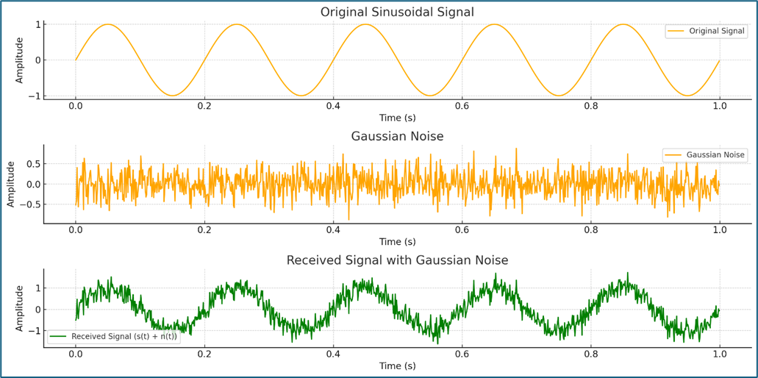
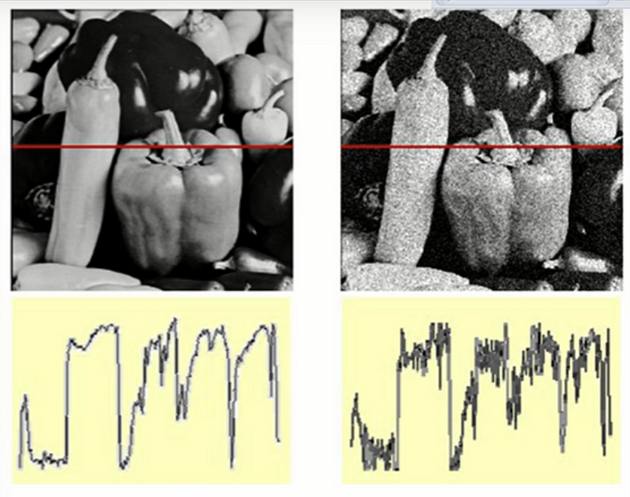
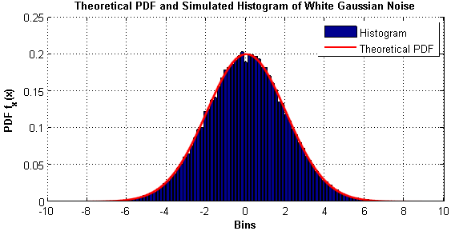
Gaussian noise

Slide 57
Why y = F(x) is almost never literally true
Instead, we write y = F(x) + n. For Gaussian noise:
p (y |x ) ∝ exp [ −‖y−F (x)‖² / 2σ ² ]
n ~ 𝒩 (0, σ ² )
This is the origin of a very common pattern in estimation: under Gaussian measurement noise, maximizing p(y|x) becomes minimizing squared measurement error.
We will not derive it in detail today — just recognize the shape when it returns in Lecture 3.
31
31

Slide 58
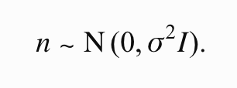
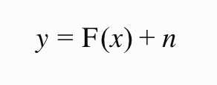
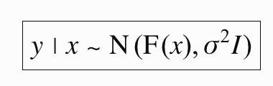
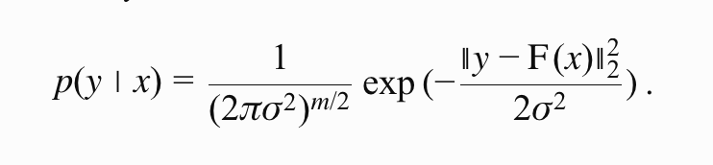
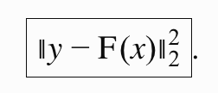
Why y = F(x) is almost never literally true

Slide 59
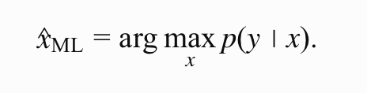
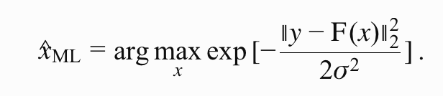
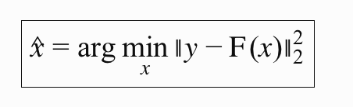
Why does least-squares appear everywhere?

Slide 60
Why does least-squares appear everywhere?
argmax_{x} p (y | x )
≡
argmin_{x} ‖y − F (x)‖²
Because under Gaussian measurement noise, maximizing the likelihood of y given x is the same optimization as minimizing measurement error. That is why least-squares estimation appears everywhere.
32
32

Slide 61
What Information Is Lost During Sensing?
From forward models to inverse problems
54

Slide 62
What information is lost during sensing?
A sensor does not capture the complete physical state of the world.
The forward process transforms, mixes, compresses, and often irreversibly discards information before producing the measurement.
y = F (x ; θ ) + n
even with no noise:
y = F (x ; θ )
We generally cannot uniquely recover x from y.
55

Slide 63
1. Dimensionality reduction
The physical world often has many more degrees of freedom than the measurement — the clearest example is a camera.
projection
3D world
2D image
A pixel tells us where something projects onto the image plane, but not its depth.
u = fX/Z v = fY/Z
Many 3D points can produce the same (u, v) — e.g. (X, Y, Z) and (2X, 2Y, 2Z) project to the same image location.
Depth information has been partially lost through projection.
56

Slide 64
2. Multiple causes, one measurement
Suppose a camera measures a dark pixel. Why is it dark?
Dark material
Weak illumination
Surface orientation
Shadow
y ∝ illumination × reflectance
Illumination is governed by θ; reflectance depends on x (and sometimes θ too).
x₁ ≠ x₂ but F(x₁; θ₁) = F(x₂; θ₂)
Different combinations of physical quantities can give the same y — the fundamental many-to-one nature of many forward models.
57

Slide 65
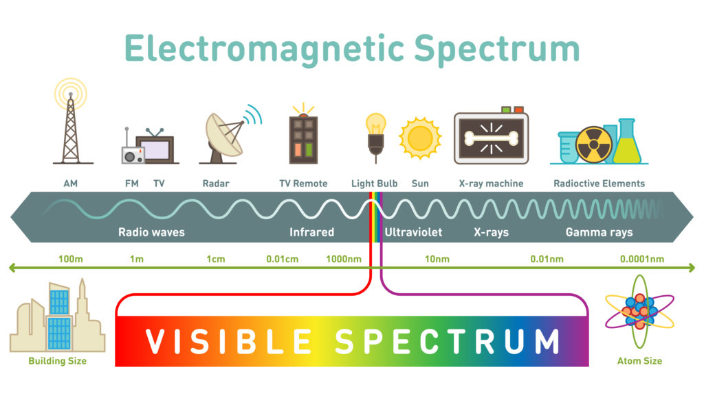
3. The sensor is an information bottleneck

Slide 66
3. The sensor is an information bottleneck
Every sensor has limited sensitivity.
L(λ) ⟶ (R, G, B)
A rich electromagnetic spectrum is reduced to approximately three channels.
Two different spectral distributions can therefore produce the same RGB values.
Similarly, a microphone measures pressure variation over a limited frequency range — it does not capture every property of the acoustic field.
The sensor itself acts as an information bottleneck.
58

Slide 67
4. Finite resolution destroys detail
If two objects are closer than the radar's range resolution, their reflections may merge into one return.
continuous scene → finite pixels
x(t) → x[n]
Fine-scale spatial or temporal information can disappear.
PREVIEW — LECTURE 2
PREVIEW — LECTURE 6
Sampling can destroy information.
Measurement geometry determines resolution.
59

Slide 68
5. Occlusion: some states are never measured
A camera observes the front surface of a box, but not the back.
complete 3D object → visible-surface projection
No amount of processing of a single image can directly recover measurements that were never acquired. Any reconstruction of the back must come from assumptions or prior knowledge.
The same issue occurs in radar shadowing, ultrasound, LiDAR, and many other sensing systems.
60

Slide 69
6. Mixing: contributions become entangled
y(t) = s(t) ∗ h(t) + n(t)
A microphone measurement contains both the source s(t) and the environment h(t) — they are not separately observed.
Likewise, wireless CSI may contain the superposition of many propagation paths:
H(f) = Σₖ αₖ exp(−j2πfτₖ)
The receiver measures the combined channel, not necessarily each individual reflector/path.
Information may not be completely absent — it may be entangled.
lost information ≠ mixed/latent information — a sophisticated inverse method can sometimes disentangle the latter.
61

Slide 70
7. Noise limits distinguishability
y = F(x; θ) + n
Suppose two physical states produce slightly different ideal measurements:
F(x₁) ≈ F(x₂)
If the difference is smaller than the measurement noise, the sensor may not be able to distinguish them.
Even a theoretically invertible mapping may be practically unrecoverable.
62

Slide 71
Three concepts this motivates
Ambiguity
Can different physical states explain the same measurement?
Identifiability
Can the physical state of interest be uniquely determined from the available measurements?
Observability
Do the measurements contain enough information about the state to recover it?
Especially important for dynamical systems, later in the course.
x₁ ≠ x₂, F(x₁) ≈ F(x₂)
For Lecture 1 we emphasize ambiguity and identifiability, and only briefly mention observability — formal observability fits better with state estimation.
63

Slide 72
Where does the lost information go?
x
F(⋅; θ)
y
3D → 2D
projection loss
continuous → sampled
resolution loss
many wavelengths → RGB
spectral loss
multiple paths → one signal
mixing
hidden surfaces → no measurement
occlusion
ideal signal → noisy signal
uncertainty
If the forward process loses information, how can we recover the physical state?
64

Slide 73
What information was lost?
The sensor gives us y. We actually want x.
How do we get from y back to x?
36
36
Notes:
That is the question Lectures 2–4 will progressively answer.

Slide 74
The bridge to inverse problems
Measurements + Physics + Priors + Learning
⟶ Physical inference
Much of physical sensing ML exists because the measurement alone is insufficient.
We use physical structure, multiple measurements, priors, and learned regularities to resolve what the forward process made ambiguous.
65

Slide 75
What Information Was Lost?
Can we recover x uniquely from y?
33

Slide 76
Many states, one measurement
A camera maps 3D → 2D
A microphone recording is ambiguous, too
Many different 3D scenes can produce the exact same photograph — the projection discards depth.
It may be compatible with many combinations of source, location, and room.
x₁
y
same measurement, different causes
x₂
x₃
34
34

Slide 77
Naming the phenomenon
F (x₁) = F (x₂) even when x₁ ≠ x₂
Information loss
Ambiguity
Observability
Identifiability
What gets discarded when x is compressed into y.
When several distinct x explain the same y equally well.
Whether x can in principle be determined from y.
Whether that determination is unique.
35
35

Slide 78
Eight concepts to leave with
Latent physical state x
Observable measurement y
Forward / measurement operator F
Physical propagation & interaction
Transduction
Measurement noise & uncertainty
Nuisance / environmental parameters θ
Identifiability / ambiguity, intuitively
The target: comfortably interpret y = F(x; θ) + n for any new sensing problem.
37
37

Slide 79
In-class exercise: decompose four sensing systems
For each system, fill in: x, physical phenomenon, F, y, θ, n.
Camera
Microphone array
Automotive radar
Smartphone IMU
Worked example — Automotive radar
x
= { target position, velocity, reflectivity }
F
= { EM propagation + reflection + antenna + receiver }
y
= { complex IQ samples }
θ
= { antenna geometry, carrier frequency, environment }
If you can perform this decomposition for an unfamiliar sensing system, Lecture 1 has succeeded.
38
38

Slide 80
A recurring analytical language
1
What is x?
2
What is y?
3
What is F?
4
Which parts of F are known? Which are learned?
5
What information about x actually survives into y?
40
40

Slide 81
The forward model, decomposed across eight sensing systems
For every system: y = F(x; θ) + n — the same five terms, instantiated differently.
Sensor / System | x Latent physical state | F Forward process | y Measurement | θ Nuisance parameters | Information encoded | Ambiguity
Camera | 3D position, geometry, pose, material/appearance | Illumination → surface interaction/reflection → propagation → optics → image sensor | Pixel intensities / RGB image | Illumination, camera pose, focal length, exposure, reflectance, background | Projection, texture, edges, apparent size, motion, perspective | 3D→2D projection loses depth; different geometry/material/illumination combinations can yield similar images
Microphone Array | Source position, source signal | Sound generation → acoustic propagation → reflections/reverberation → microphones | Multichannel audio waveforms | Room geometry, wall materials, microphone geometry, speed of sound, microphone response | Inter-microphone delay, phase difference, amplitude, reverberation structure | Multipath can mimic direct paths; symmetric locations or poor array geometry can produce similar measurements
Automotive Radar | Target range, velocity, angle, reflectivity | RF transmission → propagation → target reflection/scattering → return propagation → antenna/receiver | Complex IQ samples; range-Doppler data | Carrier frequency, waveform, antenna geometry, environment, target reflectivity | Delay → range; Doppler → velocity; inter-antenna phase → angle; amplitude → reflectivity | Multiple targets may overlap; multipath can create ghost targets; finite bandwidth/aperture limits resolution
Smartphone IMU | Position, velocity, orientation | Physical motion → inertial forces/rotation → MEMS transduction → electrical signal | 3-axis acceleration and angular velocity | Sensor orientation, gravity, scale factors, bias, temperature, calibration | Translational acceleration, angular motion, short-term dynamics | Absolute position is not directly observed; bias/noise integration causes severe drift
LiDAR | 3D surface geometry, reflectivity | Laser emission → propagation → surface reflection → return propagation → photodetector | Return time, intensity, point cloud | Sensor pose, beam direction, surface reflectivity, atmosphere | Delay → depth; scan angle + range → 3D location; intensity → reflectivity | Occlusion; weak returns from dark surfaces; glass, fog, and multiple reflections can confuse measurements
WiFi CSI Localization | Device/person location, orientation, environment state | RF transmission → multipath propagation/reflection/diffraction → receiving antenna | Complex CSI across antennas/subcarriers | AP/receiver geometry, room layout, walls, furniture, people, frequency, antenna response | Amplitude, phase, multipath delay structure, frequency-selective fading | Different locations can yield similar CSI; environmental changes can alter CSI without changing location
Medical Ultrasound | Tissue geometry/properties, acoustic impedance/scattering distribution | Ultrasound transmission → propagation through tissue → reflection/scattering → return propagation → transducer | Echo RF waveforms across transducer elements | Speed of sound, attenuation, transducer geometry, transmitted pulse | Delay → depth; amplitude → tissue/interface properties; array differences → direction | Multiple scattering, variable sound speed, and similar tissue responses can create ambiguous reconstructions
Thermal Camera | Surface temperature, emissivity, geometry | Thermal emission → atmospheric propagation → IR optics → detector | Infrared intensity image | Emissivity, ambient temperature, atmospheric absorption, camera calibration | Thermal radiation intensity related to temperature/material | Temperature and emissivity are entangled; different combinations can produce similar measured intensity
42

Slide 82
Further looking, not required reading
MIT 6.011 — Signals, Systems and Inference
Primary background. Philosophically closest to this course: signals, systems, and inference rather than DSP in isolation. Recommend the introductory lecture material, not extensive reading.
MIT Signals and Systems — Oppenheim
A classical signals/systems refresher. The full course (convolution, Fourier transforms, sampling, quantization) serves as a semester-long reference.
Berkeley CS 180 — Computer Vision and Computational Photography
Example of the light → optics → image pipeline: pinhole cameras, pixels, physics of light, and image formation.
39
39

Slide 83
Questions?
Next: Lecture 2 — Signal Representations
41

