Slide 1

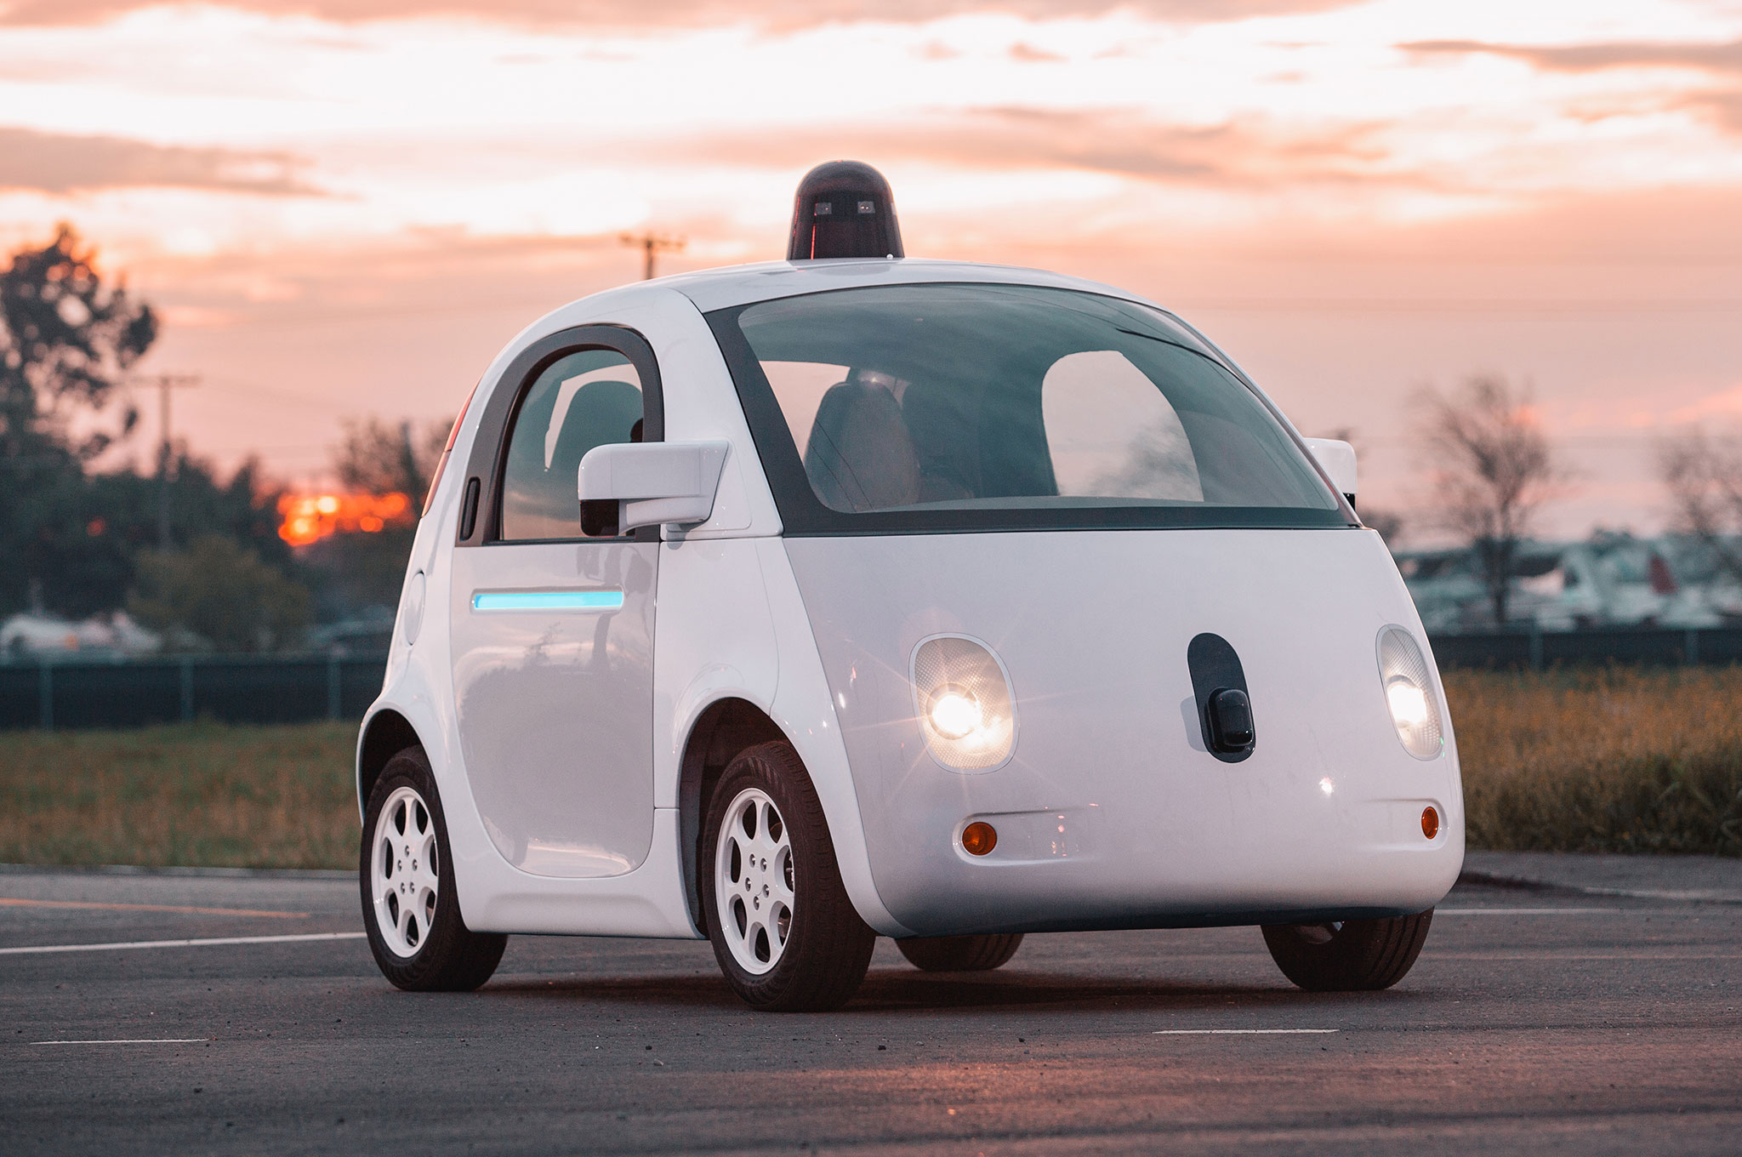



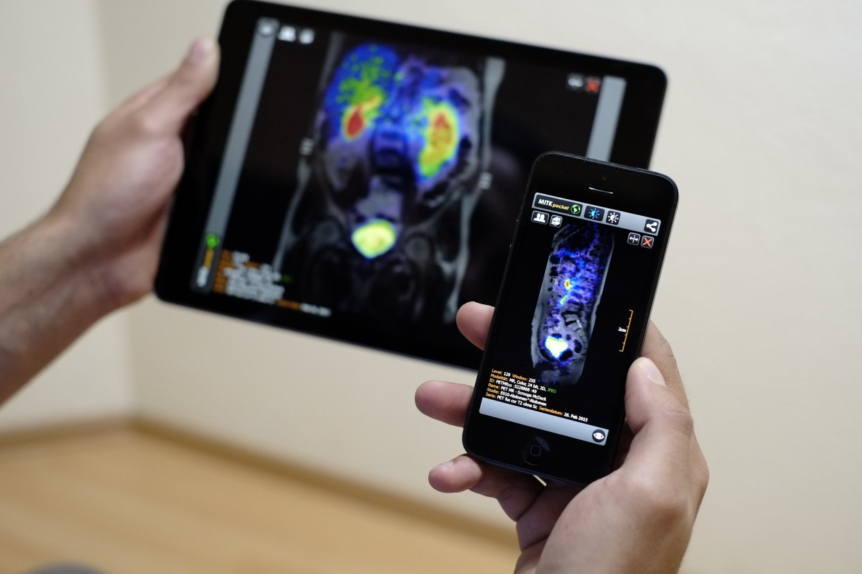
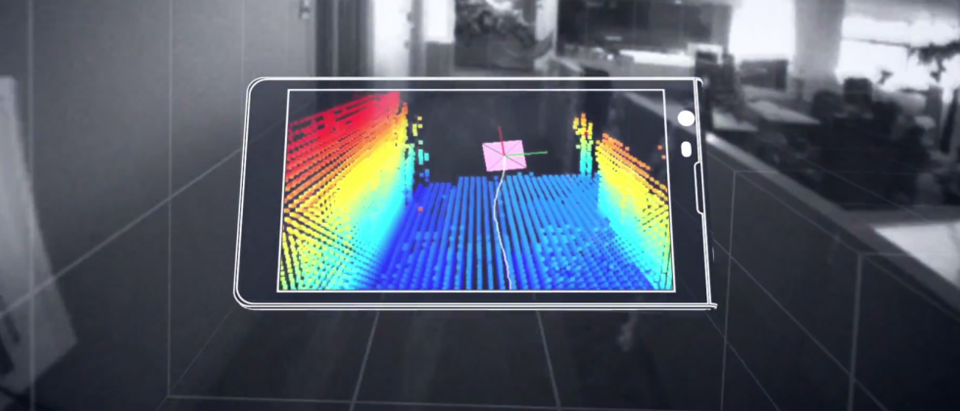


Machine Learning for Physical Sensing & Perception
CMSC 818V : Fall 2026
Lecture 2: Signals as Measurements of Physical Phenomena
Nirupam Roy
Tu-Th 12:30 – 1:45pm
IRB 2107

Slide 2
The Forward Measurement Model
Assembling x, θ, F, and n
24

Slide 3
What is a forward model?
y = F (x ; θ ) + n
A model of the physical process that maps the state of the world to the measurements produced by a sensor.
F maps the latent physical state x into the expected sensor measurement y, given system/environment parameters θ.
Notice what F does not have to be: it does not need to be the physical state itself, or the measurement itself — it is the mapping between them.
44

Slide 4
A forward model doesn't have to be exact
F can take many forms:
Derived from physics
Simulated numerically
Approximated
Partly learned from data
Completely learned
The test:
“If I gave you the true physical state, could your model predict what the sensor would measure?” If yes — you have a forward model.
45

Slide 5
The forward question vs. the inverse question
The forward question
The inverse question
“If I know where the target is, what signal should the radar receive?”
“Given the received signal, where is the target?”
An instance — a target at distance d:
y (t) = α s (t − 2 τ) + n(t)
y (t) = α s (t − 2 x /c) + n(t)
x → y
forward model
y → x̂
inverse problem
46
46

Slide 6
The forward model, across sensing systems
In every system, the forward model predicts the measurement from the physical state.
System | Physical state x | Forward model predicts
Camera | 3D scene, materials, lighting | Pixel intensities
Microphone | Sound source + room | Recorded waveform
Radar | Target position / velocity | RF echo / IQ samples
LiDAR | Surface geometry | Return times / intensities
IMU | Body motion | Acceleration and gyro readings
CT | Internal attenuation map | X-ray projections
47

Slide 7
θ: what does it actually mean?
y = F (x ; θ ) + n
Parameters describing the sensing system, environment, and propagation conditions that determine the forward process.
θ is not what we are trying to infer — it is what the forward model needs to know to relate x to y.
θ is a parameter of the model, not a label — some θ are known and chosen, others are unknown and must be estimated alongside x.
48

Slide 8
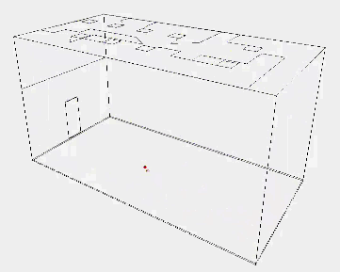
θ: what does it actually mean?

Slide 9
θ across five sensing systems
System | x — quantity of interest | θ — forward-model parameters
Camera | Object geometry / pose | Illumination, camera pose, focal length, exposure
Microphone array | Source location | Room geometry/materials, mic locations, speed of sound
Radar | Target position / velocity | Antenna geometry, carrier frequency, transmitted waveform
WiFi localization | User location | AP position, room geometry, furniture, antenna response
IMU | Motion / trajectory | Sensor bias, scale factor, orientation, gravity
49

Slide 10
The x / θ boundary depends on the task, not the quantity
Task: speaker localization
Task: room reconstruction
x = speaker location
x = room geometry / materials
θ = room geometry / materials
θ = everything else (source signal, mic array geometry, …)
The same physical quantity — room geometry — is θ in one task and x in the other. The split is set by what you are trying to infer, not by the physics itself.
50

Slide 11
Clean terminology for the whole pipeline
x
physical state of interest
θ
system/environment parameters governing measurement formation
F
forward model
y
sensor measurement
n
measurement noise / unmodeled effects
F
x
y
θ
what we want
what we measure
51

Slide 12
F vs. θ: model structure vs. instantiation
F specifies the structure of the forward model; θ specifies the parameters that instantiate it for a particular system or environment.
y (t) = (1/r) s (t − r/c) + n(t)
x = r (distance) θ = c (propagation speed)
For a richer room-acoustic model:
θ = { room geometry, wall reflection coefficients, microphone positions, c, … }
F
θ
x
model structure / physical laws
parameters that instantiate that model
physical state we want to infer
52

Slide 13
Why not just call θ "nuisance parameters"?
A nuisance parameter is a parameter that affects the sensor measurement but is not the quantity you actually want to estimate.
Some θ are known, deliberately chosen design parameters:
Antenna spacing
Radar carrier frequency
Camera focal length
Others are genuinely unknown nuisance parameters:
Room materials — and other unmodeled environmental conditions
θ mixes both known design choices and unknown nuisances — so "nuisance parameters" is too narrow a name for what it actually captures.
53

Slide 14
θ: nuisance / environment parameters
Room geometry
Materials
Illumination
Temperature
Sensor gain
Microphone response
Antenna configuration
θ is not what we usually want to estimate — but it shapes F, so ignoring it silently biases our inference of x.
27
27

Slide 15
F and n: process and uncertainty
F: the forward model
n: measurement noise
The known — or partially known — physical process transforming x into measurements. Sometimes physics-based, sometimes learned, often both.
The measurement uncertainty not captured by the deterministic part of the model — sensor electronics, thermal noise, unmodeled effects.
28
28

Slide 16
From a deterministic map to a probabilistic model
Once we admit noise, y is no longer a deterministic function of x — it is a random variable given x.
p ( y | x)
the probabilistic measurement model
Bayesian inference (later lectures) are built on this model.
29
29

Slide 17
Deterministic Model vs.
Stochastic Measurement
Why y = F(x) is almost never literally true
30

Slide 18
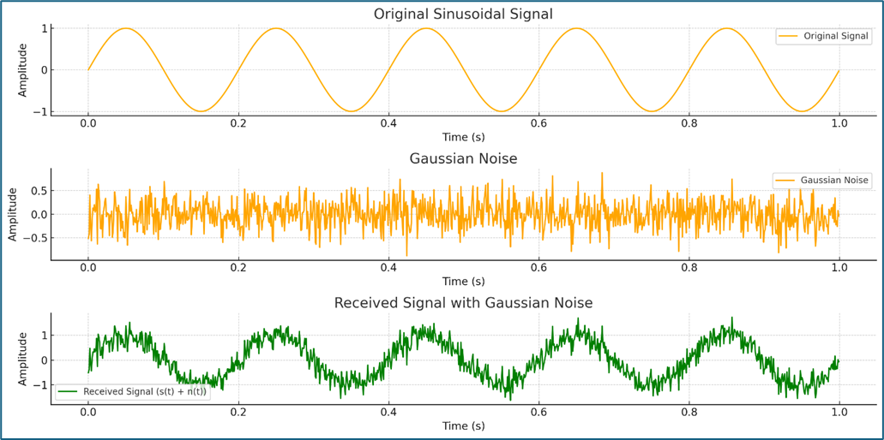
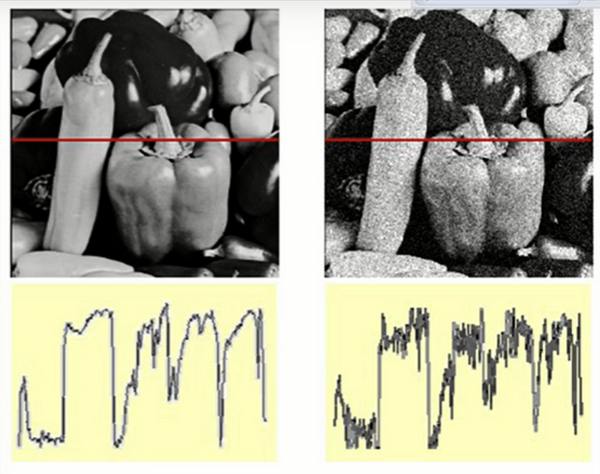
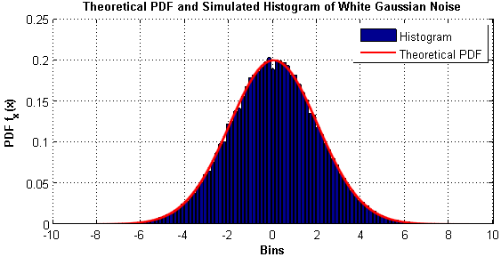
Gaussian noise

Slide 19
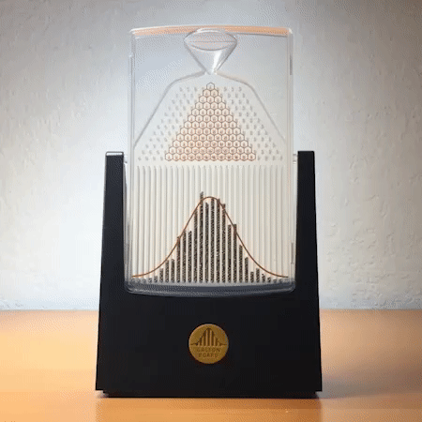
Why Gaussian?
The Central Limit Theorem (CLT) (roughly):
When many independent random contributions are added together, their sum tends to
have a Gaussian (normal) distribution, even if the individual contributions are not Gaussian.
Galton board

Slide 20
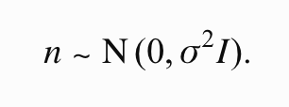
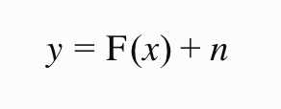
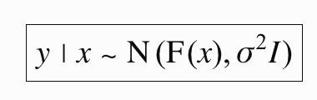
Why y = F(x) is almost never literally true
Instead, we write y = F(x) + n. For Gaussian noise:
p (y |x ) ∝ exp [ −‖y−F (x)‖² / 2σ ² ]
n ~ 𝒩 (0, σ ² )
This is the origin of a very common pattern in estimation: under Gaussian measurement noise, maximizing p(y|x) becomes minimizing squared measurement error.
We will not derive it in detail today — just recognize the shape when it returns in Lecture 3.
31
31

Slide 21
What Information Is Lost During Sensing?
From forward models to inverse problems
54

Slide 22
What information is lost during sensing?
A sensor does not capture the complete physical state of the world.
The forward process transforms, mixes, compresses, and often irreversibly discards information before producing the measurement.
y = F (x ; θ ) + n
even with no noise:
y = F (x ; θ )
We generally cannot uniquely recover x from y.
55

Slide 23
1. Dimensionality reduction
The physical world often has many more degrees of freedom than the measurement — the clearest example is a camera.
projection
3D world
2D image
A pixel tells us where something projects onto the image plane, but not its depth.
u = fX/Z v = fY/Z
Many 3D points can produce the same (u, v) — e.g. (X, Y, Z) and (2X, 2Y, 2Z) project to the same image location.
Depth information has been partially lost through projection.
56

Slide 24
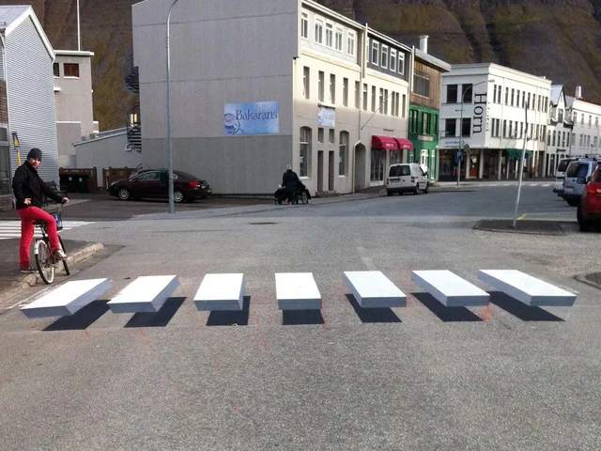
2. Multiple causes, one measurement
Suppose a camera measures a dark pixel. Why is it dark?
Dark material
Weak illumination
Surface orientation
Shadow
y ∝ illumination × reflectance
Illumination is governed by θ; reflectance depends on x (and sometimes θ too).
x₁ ≠ x₂ but F (x₁; θ₁) = F (x₂; θ₂)
Different combinations of physical quantities can give the same y — the fundamental many-to-one nature of many forward models.
57

Slide 25
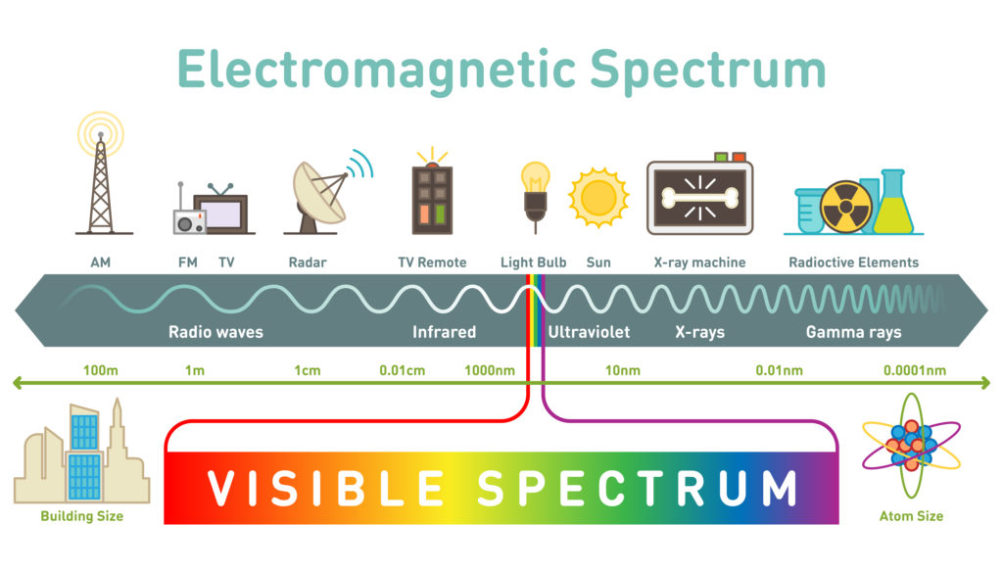
3. The sensor is an information bottleneck

Slide 26
3. The sensor is an information bottleneck
Every sensor has limited sensitivity.
L(λ) ⟶ (R, G, B )
A rich electromagnetic spectrum is reduced to approximately three channels.
Two different spectral distributions can therefore produce the same RGB values.
Similarly, a microphone measures pressure variation over a limited frequency range — it does not capture every property of the acoustic field.
The sensor itself acts as an information bottleneck.
58

Slide 27
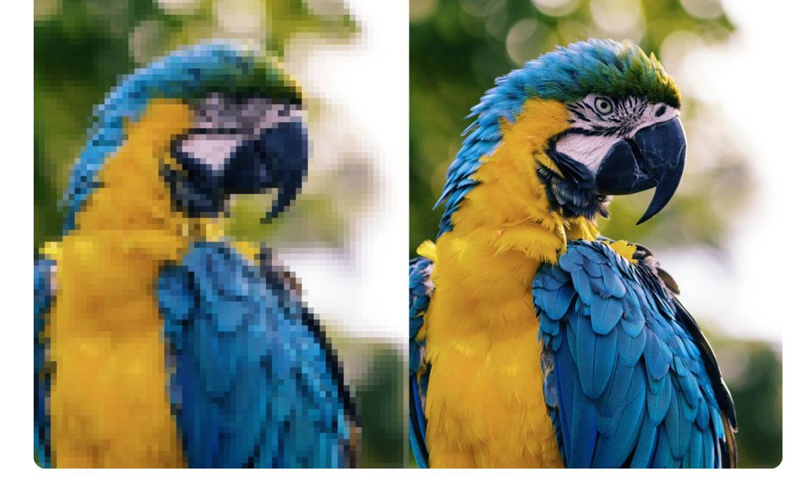
4. Finite resolution destroys detail
If two objects are closer than the radar's range resolution, their reflections may merge into one return.
continuous scene → finite samples
x (t) → x [n]
Fine-scale spatial or temporal information can disappear.
59

Slide 28
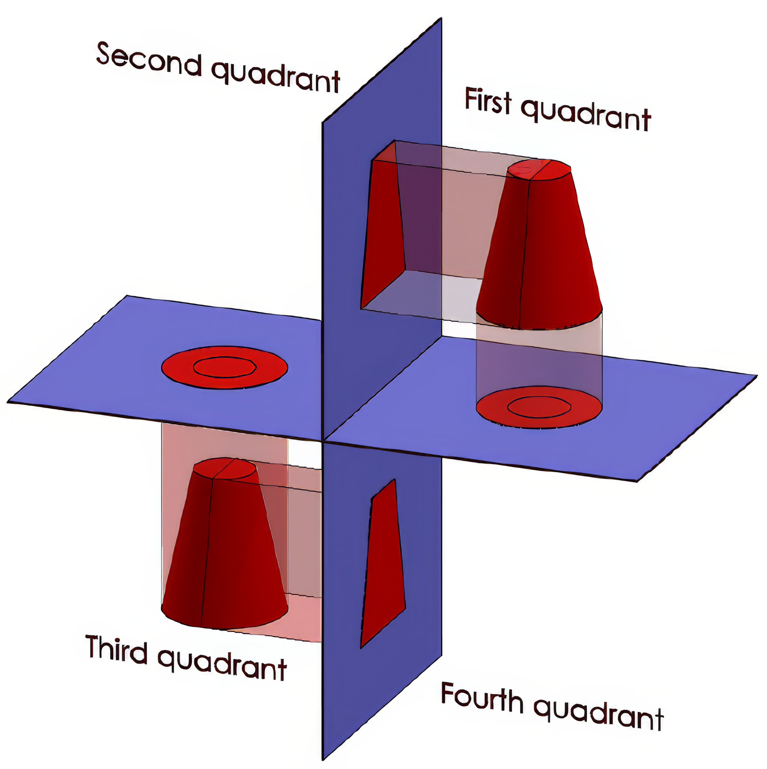
5. Occlusion: some states are never measured
A camera observes the front surface of a box, but not the back.
complete 3D object → visible-surface projection
No amount of processing of a single image can directly recover measurements that were never acquired. Any reconstruction of the back must come from assumptions or prior knowledge.
The same issue occurs in radar shadowing, ultrasound, LiDAR, and many other sensing systems.
60

Slide 29
6. Mixing: contributions become entangled
y(t) = s(t) ∗ h(t) + n(t)
A microphone measurement contains both the source s(t) and the environment h(t) — they are not separately observed.
Likewise, wireless CSI may contain the superposition of many propagation paths:
H(f) = Σₖ αₖ exp(−j2πfτₖ)
The receiver measures the combined channel, not necessarily each individual reflector/path.
Information may not be completely absent — it may be entangled.
lost information ≠ mixed/latent information — a sophisticated inverse method can sometimes disentangle the latter.
61

Slide 30
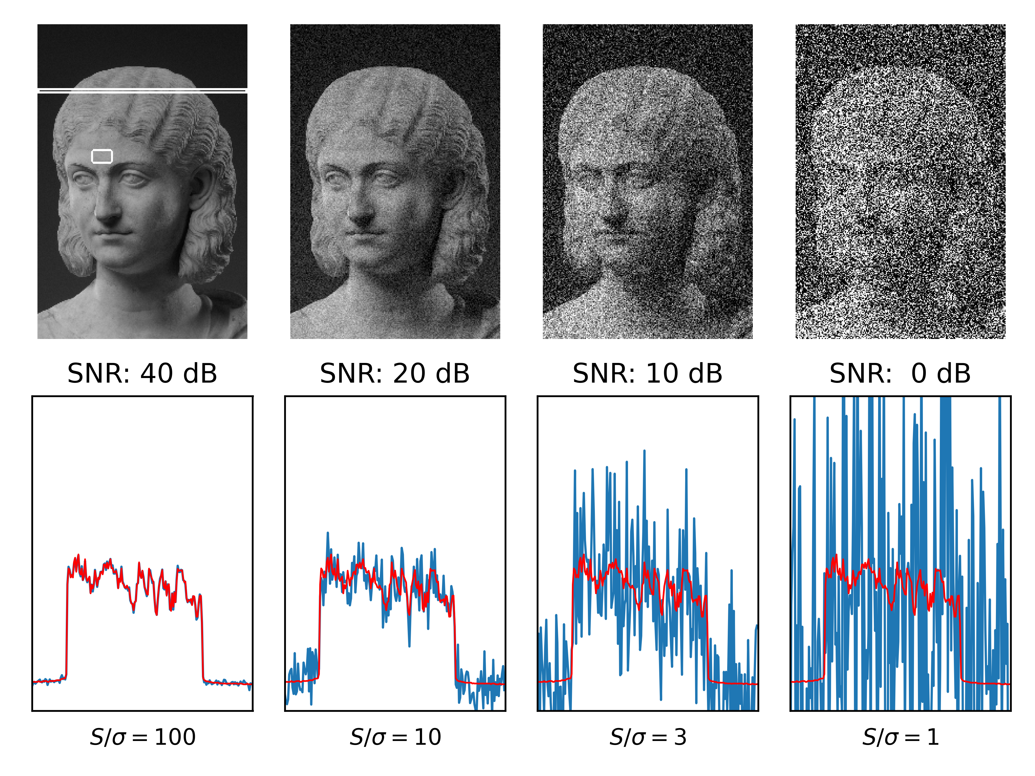
7. Noise limits distinguishability (Signal-to-noise ratio or SNR)
y = F (x ; θ ) + n
Suppose two physical states produce slightly different ideal measurements:
F(x₁) ≈ F(x₂)
If the difference is smaller than the measurement noise, the sensor may not be able to distinguish them.
Even a theoretically invertible mapping may be practically unrecoverable.
62

Slide 31
Three concepts this motivates
Ambiguity
Can different physical states explain the same measurement?
Identifiability
Can the physical state of interest be uniquely determined from the available measurements?
Observability
Do the measurements contain enough information about the state to recover it?
Especially important for dynamical systems, later in the course.
x₁ ≠ x₂, F(x₁) ≈ F(x₂)
For Lecture 1 we emphasize ambiguity and identifiability, and only briefly mention observability — formal observability fits better with state estimation.
63

Slide 32
Where does the lost information go?
x
F(⋅; θ)
y
3D → 2D
projection loss
continuous → sampled
resolution loss
many wavelengths → RGB
spectral loss
multiple paths → one signal
mixing
hidden surfaces → no measurement
occlusion
ideal signal → noisy signal
uncertainty
If the forward process loses information, how can we recover the physical state?
64

Slide 33
What information was lost?
The sensor gives us y. We actually want x.
How do we get from y back to x?
36
36
Notes:
That is the question Lectures 2–4 will progressively answer.

Slide 34
The bridge to inverse problems
Measurements + Physics + Priors + Learning
⟶ Physical inference
Much of physical sensing ML exists because the measurement alone is insufficient.
We use physical structure, multiple measurements, priors, and learned regularities to resolve what the forward process made ambiguous.
65

Slide 35
How does information about the physical world become
encoded in “Signals” ?
(amplitude, time, frequency, and phase)
2

Slide 36
1. What is a signal?
5

Slide 37
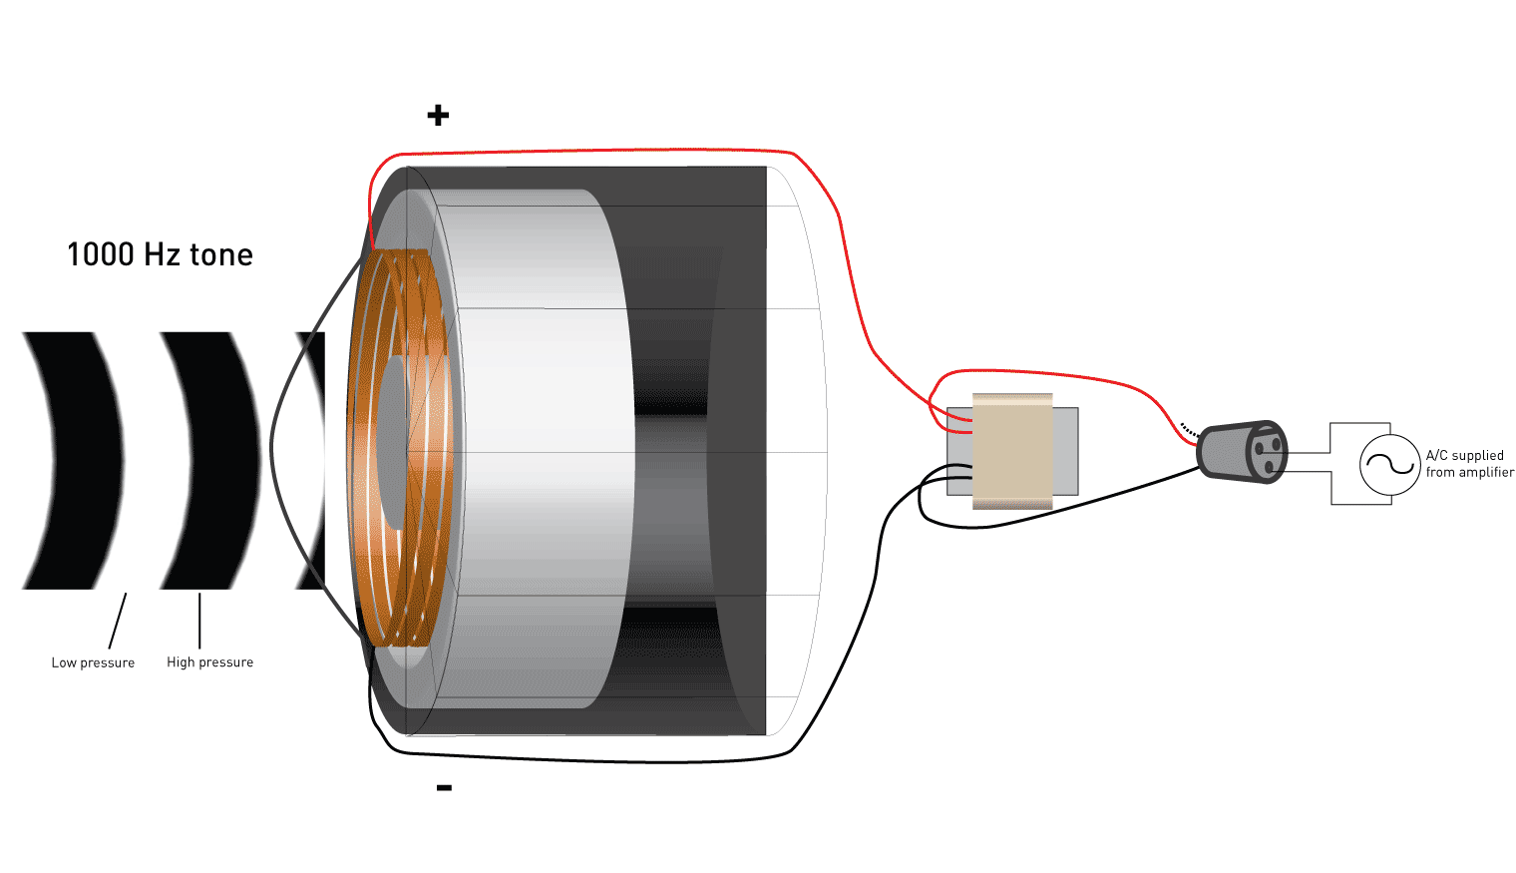
Modeling a Signal
Amplitude
Time (sec)
0.00
0.25
0.50
0.75
1.00
1.25

Slide 38
Define “Signal”
A signal is any physical quantity that varies with one or more independent variables (such as time, space, or both) and conveys information about a system or phenomenon.

Slide 39
Define “Signal”
A signal is any physical quantity that varies with one or more independent variables (such as time, space, or both) and conveys information about a system or phenomenon.
A signal is a mathematical function of one or more independent variables (like time or space).

Slide 40

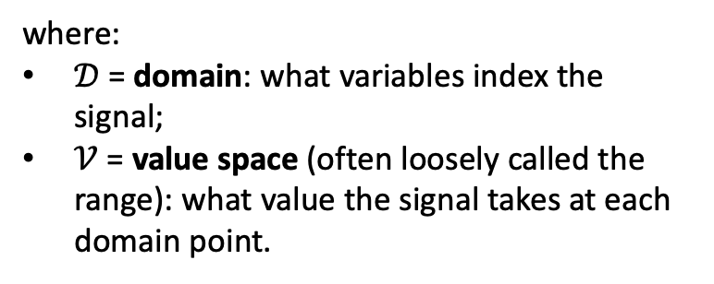
Define “Signal”
A signal is any physical quantity that varies with one or more independent variables (such as time, space, or both) and conveys information about a system or phenomenon.
A signal is a mathematical function of one or more independent variables (like time or space).
where:
$𝒟$ = domain: what variables index the signal;
$𝒱$ = value space (often loosely called the range): what value the signal takes at each domain point.

Slide 41
Define “Dimension” of a signal
The number of independent variable of the function.
1D signals:
Audio waveform x(t) -- (time).
Stock price x[n] -- (discrete index).
2D signals:
Grayscale image x(m,n) -- (row, column)
3D signals:
Video x(m,n,t) (space + time)

Slide 42
Define “Dimension” of a signal
The number of independent variable of the function.
1D signals:
Audio waveform x(t) -- (time).
Stock price x[n] -- (discrete index).
2D signals:
Grayscale image x(m,n) -- (row, column)
3D signals:
Video x(m,n,t) (space + time)
What about a color image?

Slide 43
Scalar-valued vs. Vector-valued
Output of a Sensor

Slide 44

Sensor data
Sensor data
Sensor
Scalar
Time
Vector
Sensor data
Time
Mapping

Slide 45

Sensor data
Sensor data
Sensor
Scalar
Time
Vector
Sensor data
Output at time t
<V_{x} (t), V_{y}(t), V_{z}(t)>
Time
Mapping

Slide 46
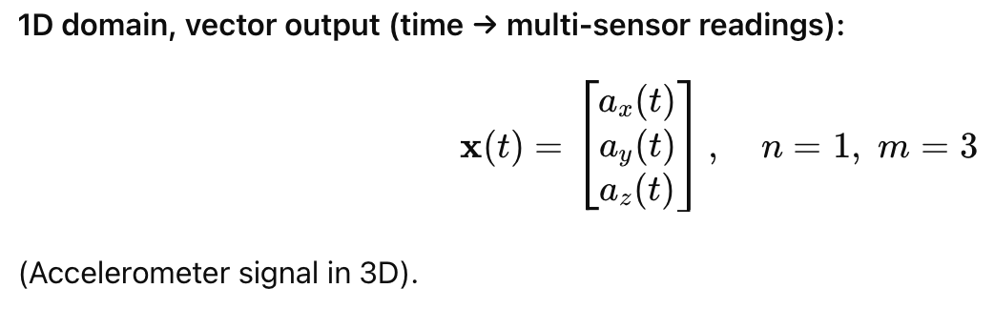
Y
V_{y}
V_{x}
X
Z
Output at time t
<a_{x} (t), a_{y}(t), a_{z}(t)>
3-axis accelerometer sensor

Slide 47
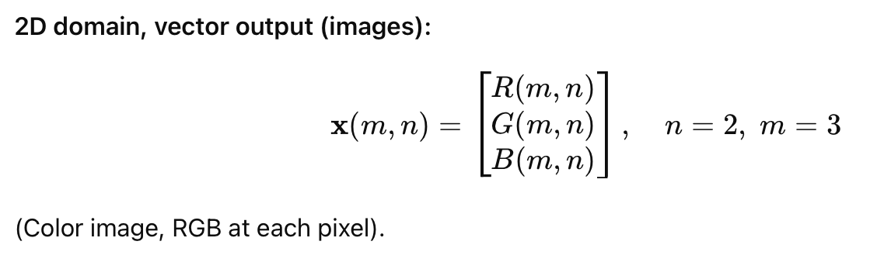
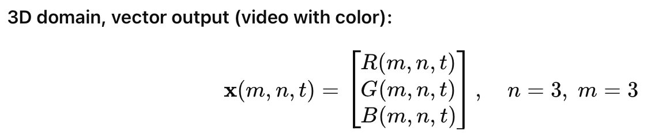
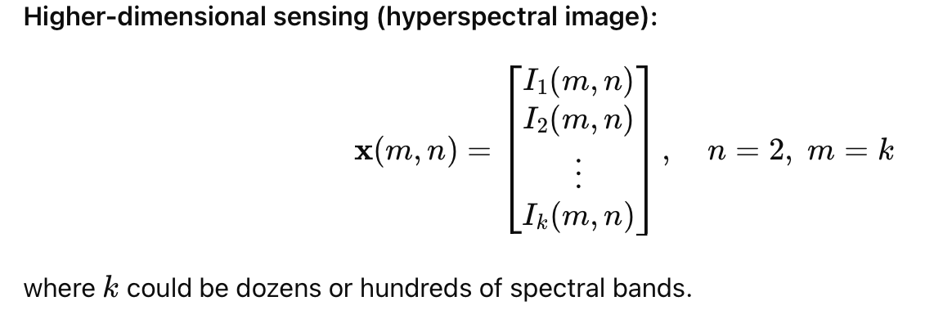
domain=1, value space=3
domain=2, value space=3
domain=3, value space=3
domain=2, value space=3

Slide 48
Sensor data
Is an image a multi-dimensional signal?

Slide 49
Sensor data
Is a gray-scale image a scalar-valued or a vector-valued signal?

Slide 50
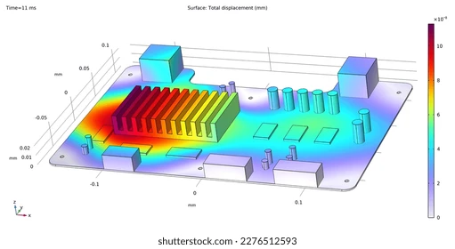
Scalar and Vector fields
Temperature distribution (scalar field)

Slide 51
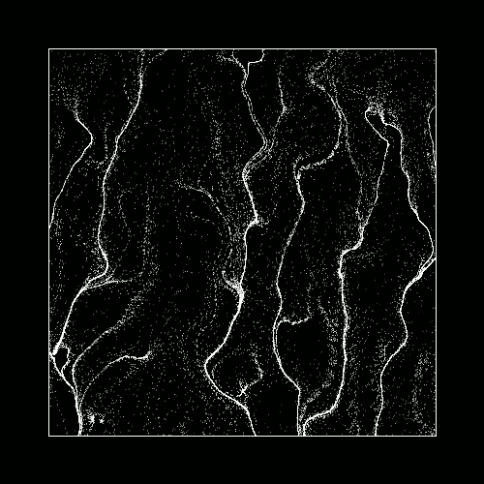
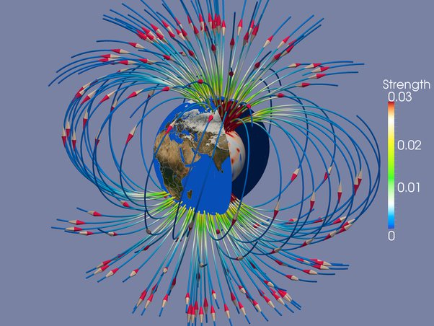
Scalar and Vector fields
Particle flow
(vector field)
Magnetic field (vector field)

Slide 52
2. How Signals ”encodes” physical
information
Amplitude, Frequency, and Phase

Slide 53
Amplitude: how strongly did the world interact with the signal?
7

Slide 54
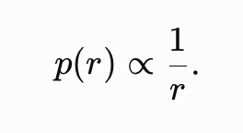
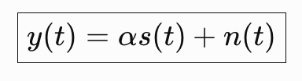
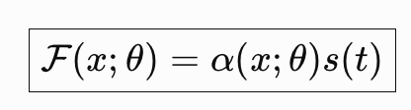
Path-loss model
y(t) = A s(t)
What determines A ?
propagation distance
absorption
reflectivity
scattering strength
source strength
sensor gain
Acoustic example — ideal spherical spreading
Amplitude contains physical information — but it is usually confounded.
A weak radar return could mean: a distant target · a poorly reflecting target · propagation loss · antenna orientation.
8

Slide 55
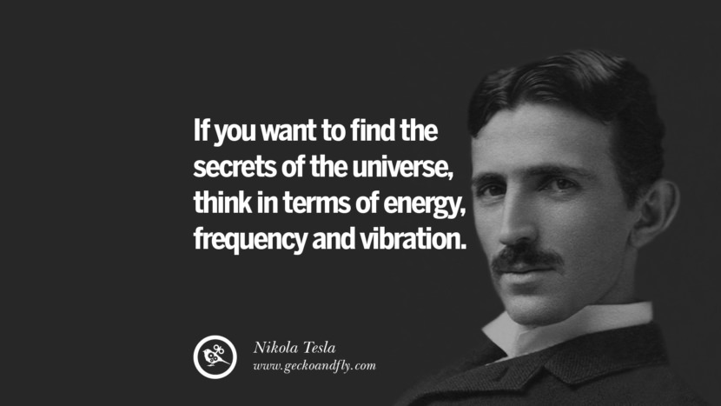
What is frequency?

Slide 56
Definition of Frequency
Frequency is the number of occurrences of a repeating event per unit time (independent variable).

Slide 57
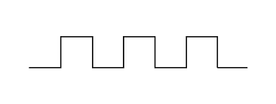
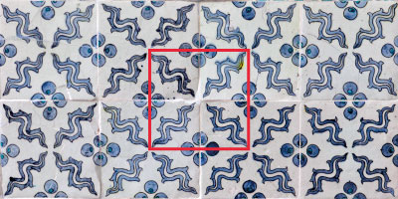
1D function
2D function

Slide 58
What can be a simple repeating
“function” == signal?

Slide 59
Frequency, Amplitude, and Phase

Slide 60
Model for a signal (frequency, amplitude, and phase)

Slide 61
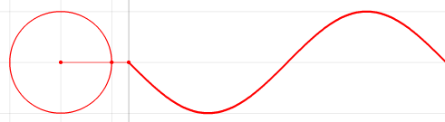
Frequencies of an arbitrary signal
Time

Slide 62
Frequency, Amplitude, and Phase

Slide 63


Model for a signal (frequency, amplitude, and phase)
$$A . sin⁡(θ)$$
$$A . cos⁡(θ)$$

Slide 64
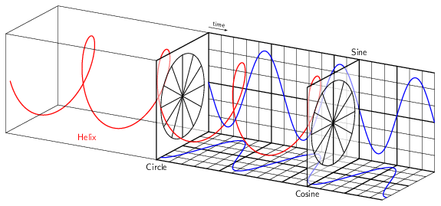
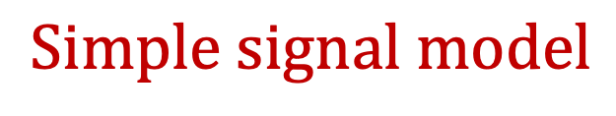
Model for a signal (frequency, amplitude, and phase)
$$Simple signal model$$

Slide 65
Frequency, Amplitude, and Phase
Frequency: 2Hz
Amplitude
Time (sec)
0.00
0.25
0.50
0.75
1.00
1.25
Notes:
1) Two common terms related to signals are amplitude and frequency. Frequency is the number of repetition of the signal per second.

Slide 66
Frequency, Amplitude, and Phase
Frequency: 2Hz
Amplitude
Time (sec)
0.00
0.25
0.50
0.75
1.00
1.25
Frequency: 4Hz
Amplitude
Time (sec)
0.00
0.25
0.50
0.75
1.00
1.25

Slide 67
Frequencies of an arbitrary signal
Frequency: 2Hz
Amplitude
Time (sec)
0.00
0.25
0.50
0.75
1.00
1.25
Amplitude
Time (sec)
0.00
0.25
0.50
0.75
1.00
1.25

Slide 68
Frequencies of an arbitrary signal
Time

Slide 69


Frequencies of an arbitrary signal
$$f cycles per second$$
$$2π angles per cycle$$
Time

Slide 70
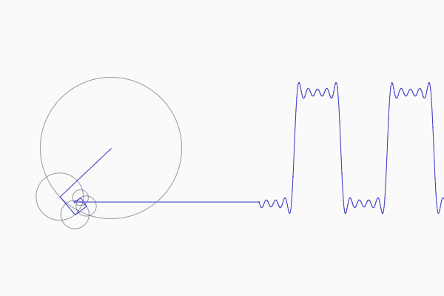
Frequencies of an arbitrary signal

Slide 71
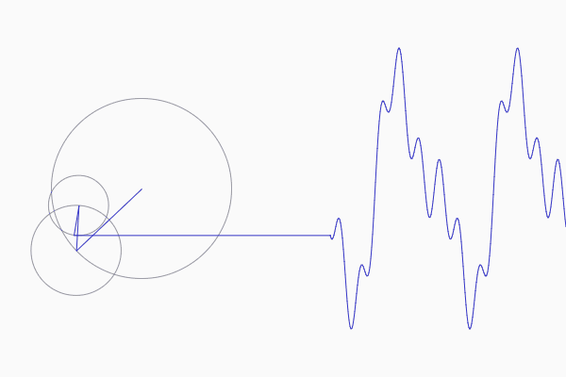
Frequencies of an arbitrary signal

Slide 72
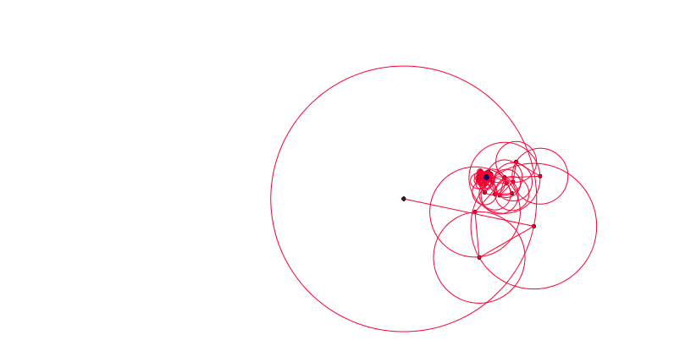
Frequencies of an arbitrary signal

Slide 73
The concept of the Fourier series
Amplitude
Time (sec)
0.00
0.25
0.50
0.75
1.00
1.25
The key idea: Any function can be written as the sum of sinusoidal functions.
Amplitude
Time (sec)
0.00
0.25
0.50
0.75
1.00
1.25

Slide 74

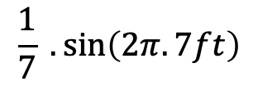
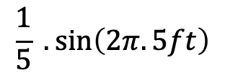
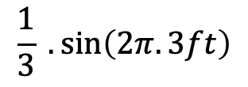
Time Domain and Frequency Domain
Approx. square wave
$$1 .\sin\left(2πft\right)$$
$$\frac{1}{3} .\sin\left(2π.3ft\right)$$
$$\frac{1}{5} .\sin\left(2π.5ft\right)$$
$$\frac{1}{7} .\sin\left(2π.7ft\right)$$

Slide 75
Analogy: Food coloring chart
Basis for food colors
Notes:
Emphasize basis and coefficient using Color analogy

Slide 76
Analogy: Food coloring chart
Basis for food colors
Notes:
Emphasize basis and coefficient using Color analogy

Slide 77
Analogy: Food coloring chart
Basis for food colors
Notes:
Emphasize basis and coefficient using Color analogy

Slide 78
Analogy: Food coloring chart
Basis for food colors
Notes:
Emphasize basis and coefficient using Color analogy

Slide 79
Time Domain and Frequency Domain
Time domain view
Frequency domain view

Slide 80
Why do we need
the frequency domain view?

Slide 81

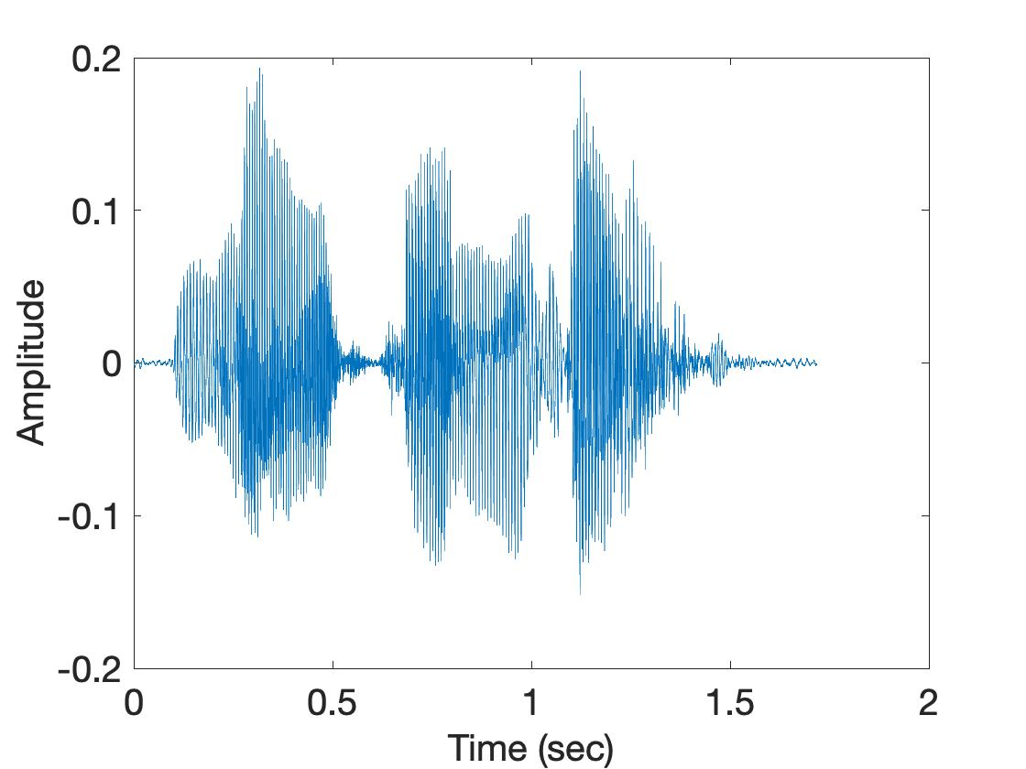
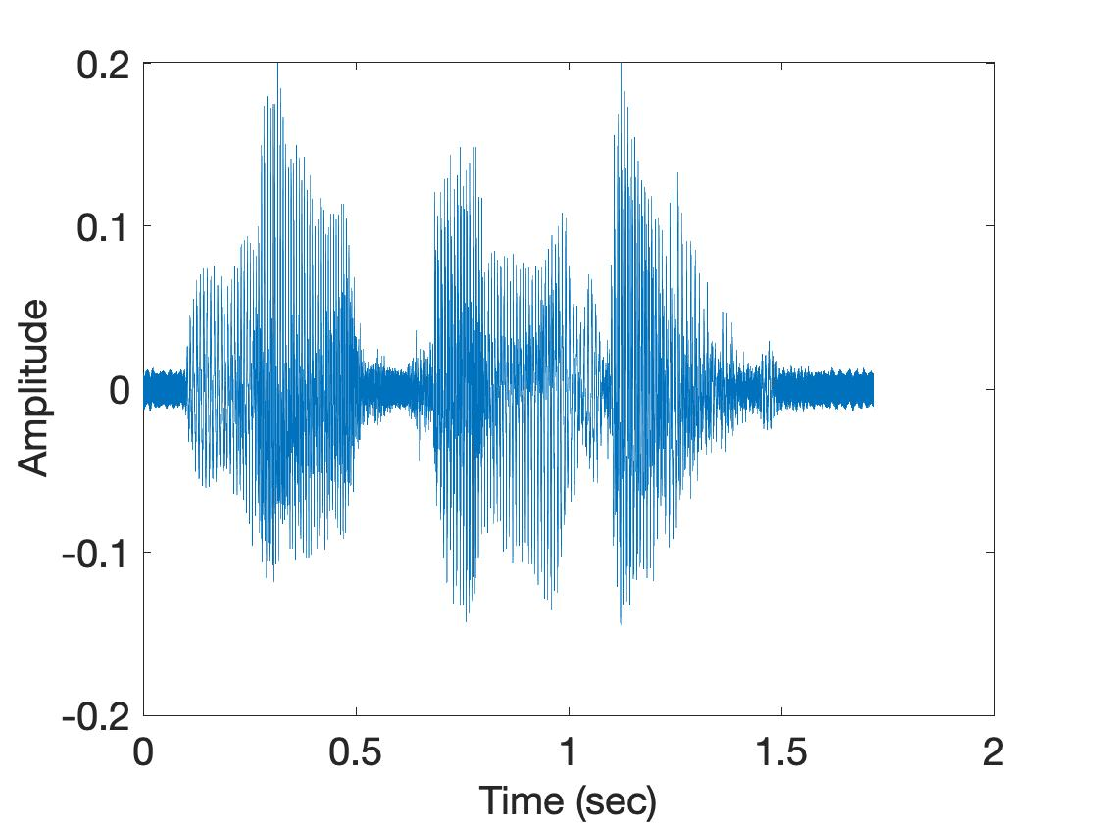
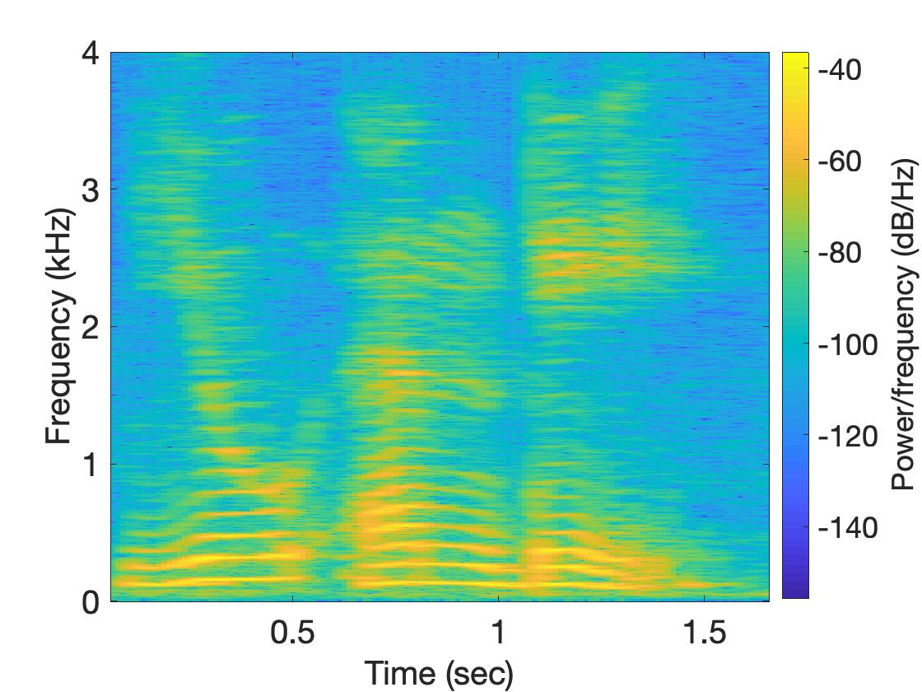
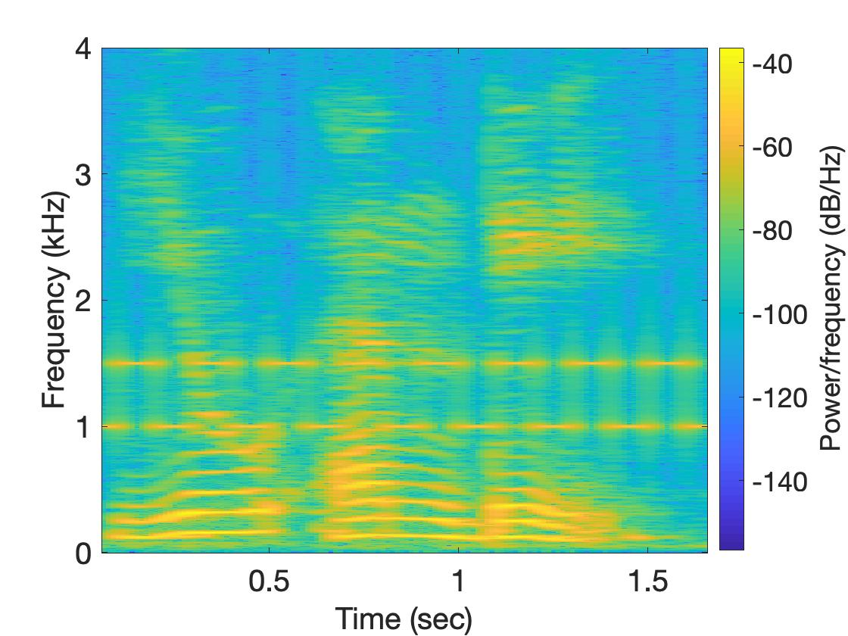
Why do we need the frequency domain view?
Sound
Sound + Noise
Time
domain
Freq.
domain

Slide 82
Model for a signal (frequency, amplitude, and phase)
Time

Slide 83


Model for a signal (frequency, amplitude, and phase)
$$f cycles per second$$
$$2π angles per cycle$$
Time

Slide 84
Model for a signal (frequency, amplitude, and phase)
One cycle
+A
A
0
Amplitude
-A
Time

Slide 85
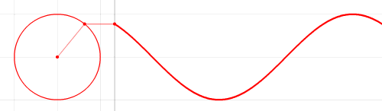




Model for a signal (frequency, amplitude, and phase)
$$2π angles per cycle$$
$$f cycles per second$$
A
𝚹
time = t second
$$=$$
$$A . sin⁡(θ)$$
$$=$$
$$A . sin⁡(2πft)$$

Slide 86
Model for a signal (frequency, amplitude, and phase)
$$2π angles per cycle$$
$$f cycles per second$$
A
𝚹
Phase
time = t second
$$=$$
$$A . sin⁡(θ)$$
$$=$$
$$A . sin⁡(2πft)$$

Slide 87

Model for a signal (frequency, amplitude, and phase)
$$2π angles per cycle$$
$$f cycles per second$$
A
𝚹
Phase
time = t second
$$=$$
$$A . sin⁡(θ)$$
$$=$$
$$A . sin⁡(2πft)$$
$$A . sin⁡(2πft+φ)$$
-- with initial/additional phase ϕ

Slide 88

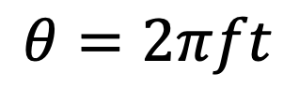



Model for a signal (frequency, amplitude, and phase)
1
$$sin⁡(θ)$$
𝚹
$$cos⁡(θ)$$
$$f cycles per second$$
$$θ=2πft$$
$$2π angles per cycle$$

Slide 89
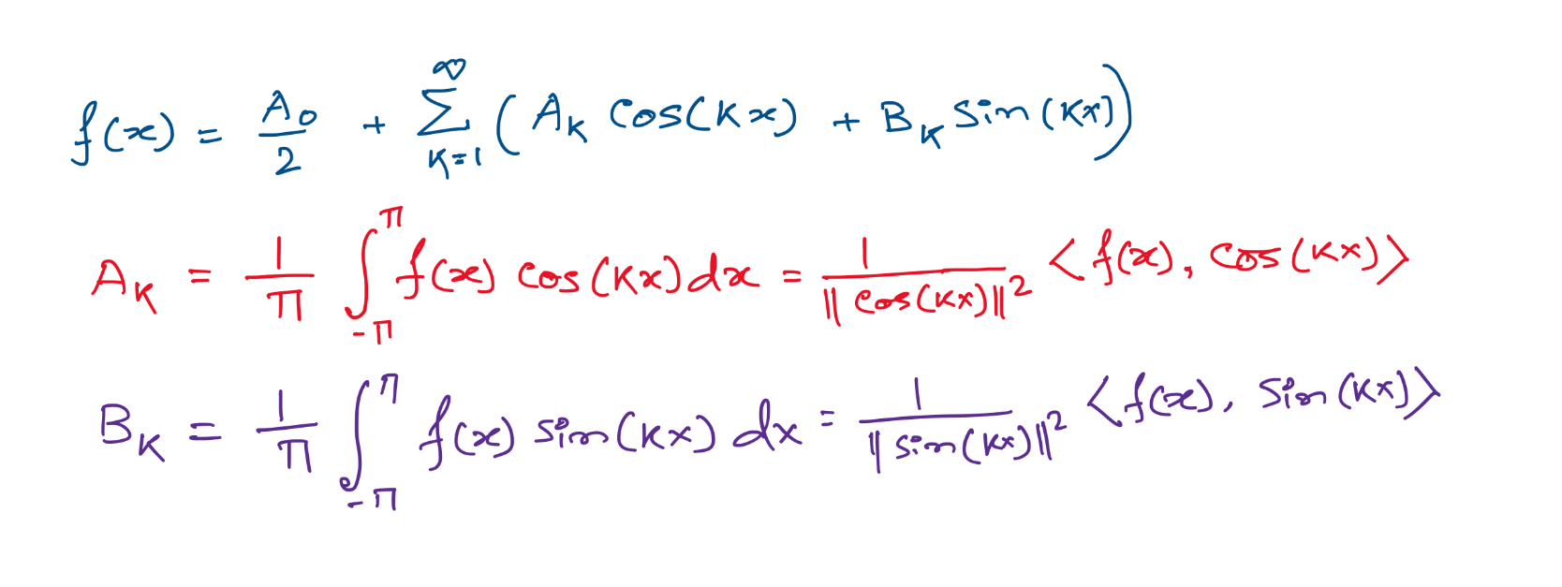
Projections on sinusoids

Slide 90
Projections on sinusoids
Notes:
Talk about cos() is an even function and sin() is odd. The even component of the function f() is captured by the cos() and odd is by sin().
Odd fn X Odd fn = Even fn.
Even X Odd = Odd
Eve X Eve = Even
Integration of an odd function between –a to a, is zero.

Slide 91
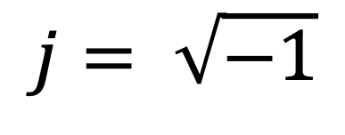
Complex numbers
Imaginary
$$j= \sqrt{−1}$$

Slide 92
Complex numbers and Natural exponential
j
j

Slide 93
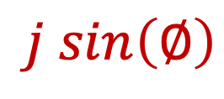

Complex numbers and Natural exponential
…
…
…
$$\cos\left(∅\right)$$
$$j sin\left(∅\right)$$
Euler’s formula

Slide 94

Complex numbers and Natural exponential
$$e^{j∅}=\cos{∅+j sin∅}$$

Slide 95
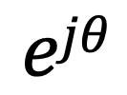


Model for a signal (frequency, amplitude, and phase)
$$\cos\left(θ\right)+j \sin\left(θ\right)$$
$$=$$
$$ejθ$$

Slide 96


Model for a signal (frequency, amplitude, and phase)
$$ej 2πft$$
$$\cos\left(θ\right)+j \sin\left(θ\right)$$
$$=$$
$$ejθ$$
$$=$$

Slide 97



$$ej 2πkx$$
$$Holds true for multidimension signals:$$

Slide 98
Visualizing Transient Frequencies

Slide 99
Visualizing transient frequencies
U
M
D

Slide 100
Spectrogram
U
M
D

Slide 101
Frequency components change over time
Amplitude
Time (sec)
0.00
0.25
0.50
0.75
1.00
1.25
FFT
A set of
frequencies

Slide 102
Frequency components change over time
Amplitude
Time (sec)
0.00
0.25
0.50
0.75
1.00
1.25
FFT

Slide 103
Frequency components change over time
Amplitude
Time (sec)
0.00
0.25
0.50
0.75
1.00
1.25
FFT
FFT

Slide 104
Frequency components change over time
U
M
D

Slide 105
Spectrogram
U
M
D
[
[
[
FFT of overlapping windows
of samples
(Spectrogram)
[
FFT
FFT
FFT
FFT

Slide 106
Spectrogram
U
M
D

Slide 107
Analog
Digital
Physical signal
(voice)
Spectrogram plot
on computer
FFT
Time varying voltage
signal
A collection of numbers

Slide 108
Sampling

Slide 109

SENSOR
Analog
Analog
A structure or material
That reacts to the physical phenomenon
A circuit that converts the reaction to measurable electrical signal (e.g. voltage)
A physical phenomenon
We want to measure
Interpretation of the signal, storing the data
Digital

Slide 110
Analog
Digital
Physical signal
(voice)
Spectrogram plot
on computer
FFT
Time varying voltage
signal
A collection of numbers
?

Slide 111
Analog
Digital
Physical signal
(voice)
Spectrogram plot
on computer
FFT
Time varying voltage
signal
A collection of numbers
ADC
Analog-to-Digital Converter

Slide 112
Sampling
Amplitude
Time (sec)
0.00
0.25
0.50
0.75
1.00
1.25

Slide 113
Sampling
Amplitude
Time (sec)
0.00
0.25
0.50
0.75
1.00
1.25
Amplitude
Time (sec)
0.00
0.25
0.50
0.75
1.00
1.25
[ 0.34 0.22 0.09 0.21 0.30 0.08 0.09 ]

Slide 114
Sampling
Amplitude
Time (sec)
0.00
0.25
0.50
0.75
1.00
1.25
T = Sampling interval
f_{s}= 1/T = Sample rate (or sampling frequency)
Clock

Slide 115
1-dimensional sampling

Slide 116
1-dimensional sampling
(we sample the domain
of the function, not the
value-sapce)
Y
V_{y}
V_{x}
X

Slide 117
1-dimensional sampling
2-dimensional sampling

Slide 118
1-dimensional sampling
2-dimensional sampling
3-dimensional sampling

Slide 119
Analog
Digital
Physical signal
(voice)
Spectrogram plot
on computer
FFT
Time varying voltage
signal
A collection of numbers
ADC
Analog-to-Digital Converter

Slide 120

Digitization process (What is inside an ADC)

Slide 121

Digitization process (What is inside an ADC)

Slide 122
Digitization process (What is inside an ADC)
Sample and hold

Slide 123

Digitization process (What is inside an ADC)
Notes:
[PC] https://panoradio-sdr.de/analog-digital-conversion/

Slide 124
Discrete in time and in amplitude
Amplitude
Time (sec)
0.00
0.25
0.50
0.75
1.00
1.25
Amplitude
Time (sec)
0.00
0.25
0.50
0.75
1.00
1.25
[ 0.34 0.22 0.09 0.21 0.30 0.08 0.09 ]

Slide 125
Digitization process (What is inside an ADC)
Notes:
[PC] https://panoradio-sdr.de/analog-digital-conversion/

Slide 126


Quantization level and Bit resolution of an ADC
Notes:
[PC] https://en.wikipedia.org/wiki/Quantization_%28signal_processing%29

Slide 127
Digitization process (What is inside an ADC)
Sample and hold
Quantized

Slide 128

Digitization process (What is inside an ADC)

Slide 129
Gliding over
the Sampling Theorem

Slide 130
Sampling theorem
Amplitude
Time (sec)
0.00
0.25
0.50
0.75
1.00
1.25
Amplitude
Time (sec)
0.00
0.25
0.50
0.75
1.00
1.25

Slide 131
Sampling theorem
Amplitude
Time (sec)
0.00
0.25
0.50
0.75
1.00
1.25
Aliasing: Two signals become indistinguishable
after sampling
Amplitude
Time (sec)
0.00
0.25
0.50
0.75
1.00
1.25

Slide 132
Aliasing
Amplitude
Time (sec)
0.00
0.25
0.50
0.75
1.00
1.25
Amplitude
Time (sec)
0.00
0.25
0.50
0.75
1.00
1.25

Slide 133

Aliasing

Slide 134


Moiré patterns
Location: Ground level, near Gannon Auditorium and across from the large screen.
Photos may be used for websites, professional purposes, your LinkedIn profile, etc. For best results, please avoid fine stripes, checks, bright colors or busy patterns.

Slide 135
How to find a good sample rate?
Suppose you sample a signal in some way. If you can exactly reconstruct the signal from the samples, then you have done a proper sampling and captured the key signal information
Notes:
[Reference slides] http://terrano.ucsd.edu/jorge/teaching/mae143a/lectures/8sampling.pdf

Slide 136
How to find a good sample rate?
Suppose you sample a signal in some way. If you can exactly reconstruct the signal from the samples, then you have done a proper sampling and captured the key signal information
The sampling frequency f_{s} , is the number of samples per second. This is to be compared with the signal cyclic frequencies
Notes:
[Reference slides] http://terrano.ucsd.edu/jorge/teaching/mae143a/lectures/8sampling.pdf

Slide 137



How to find a good sample rate?
11.1 samples/cycle
3.2 samples/cycle
1.05
samples/cycle

Slide 138
How to find a good sample rate?
Nyquist-Shannon sampling theorem:
In order to uniquely represent a signal F(t) by a set of samples, the sampling rate must be more than twice the highest frequency component present in F(t).
If sample rate is f_{s} and maximum frequency we want to
record is f_{max} , then
f_{s} > 2f_{max}

Slide 139
Amplitude
Time (sec)
0.00
0.25
0.50
0.75
1.00
1.25
Nyquist frequency = Maximum alias-free frequency
for a given sample rate.
Nyquist rate = Lower bound of sample rate for a
signal.
(f_{s} / 2)
(2f_{max})

Slide 140
Samples of the physical phenomena
Amplitude
Time (sec)
0.00
0.25
0.50
0.75
1.00
1.25
Amplitude
Time (sec)
0.00
0.25
0.50
0.75
1.00
1.25
[ 0.34 0.22 0.09 0.21 0.30 0.08 0.09 ]

Slide 141
Samples of the physical phenomena
Amplitude
Time (sec)
0.00
0.25
0.50
0.75
1.00
1.25
[ 0.34 0.22 0.09 0.21 0.30 0.08 0.09 ]
A point in the N-dimensional space

Slide 142

Signal as a point in a N-dimensional space

Slide 143

Projection and Dot product of vectors

Slide 144

Change of basis

Slide 145
“Change of basis” to Frequency domain

Slide 146
Recall from past…
Amplitude
Time (sec)
0.00
0.25
0.50
0.75
1.00
1.25
The key idea: Any function can be written as the sum of sinusoidal functions.
Amplitude
Time (sec)
0.00
0.25
0.50
0.75
1.00
1.25

Slide 147
Time Domain and Frequency Domain
Time domain view
Frequency domain view

Slide 148

“Change of basis” to Frequency domain

Slide 149
“Change of basis” to Frequency domain
Fourier Basis

Slide 150


Finding good basis: Orthogonality

Slide 151



Finding good basis: Orthogonality
What makes two signals orthogonal?
The formal definition for orthogonal signals is that their inner product
(also called the dot product) is zero:

