Slide 1

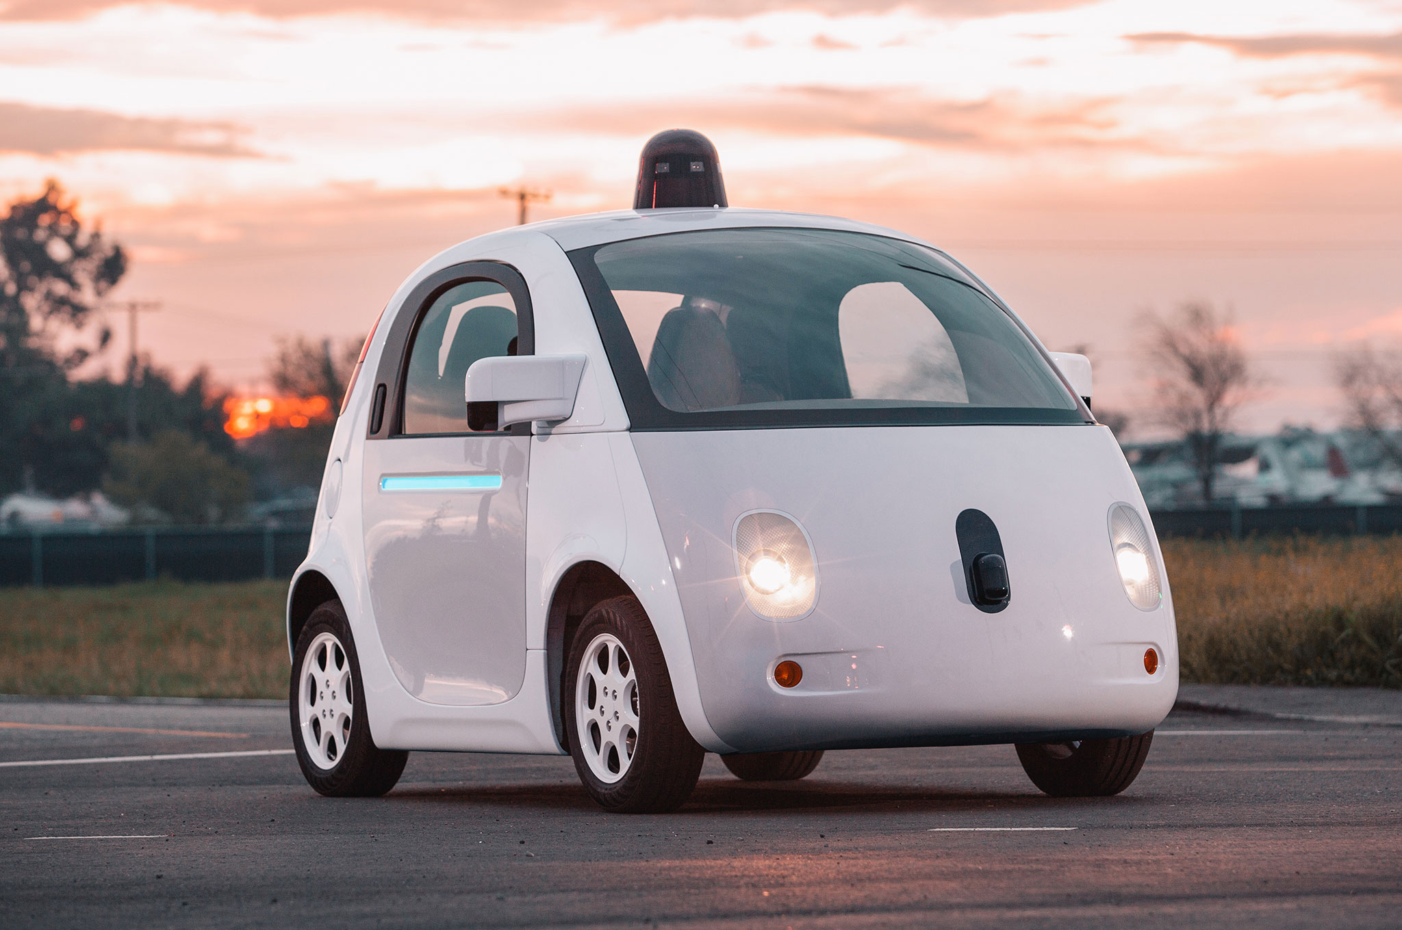



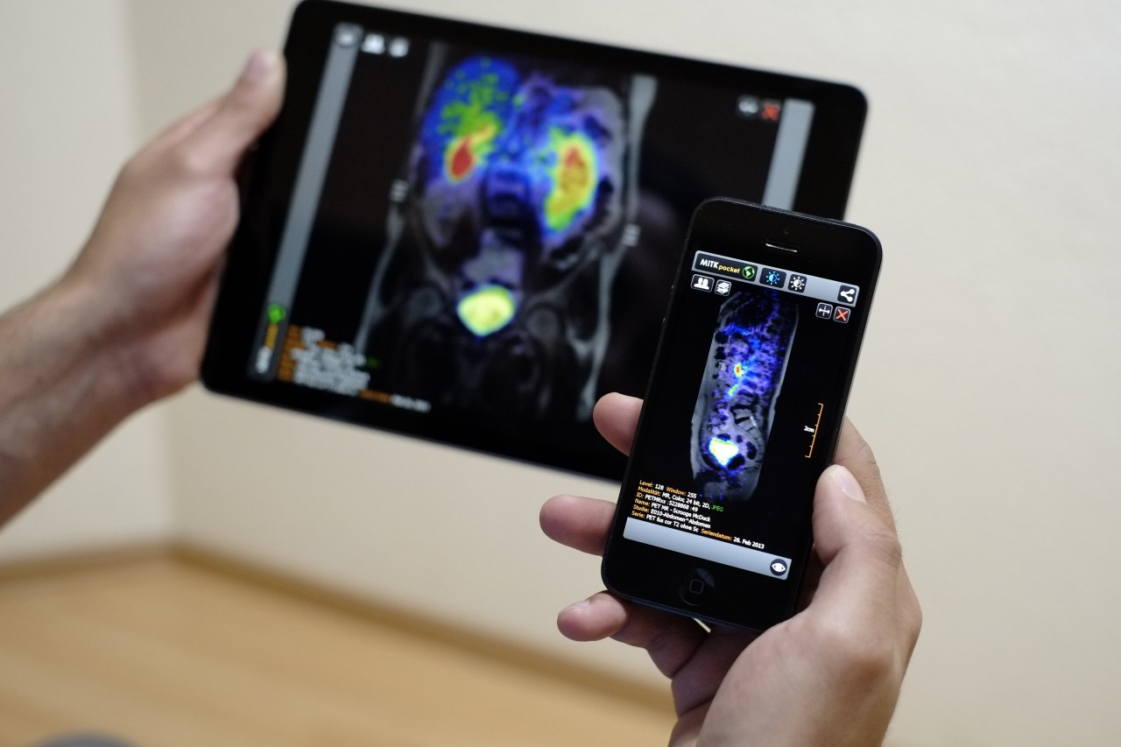
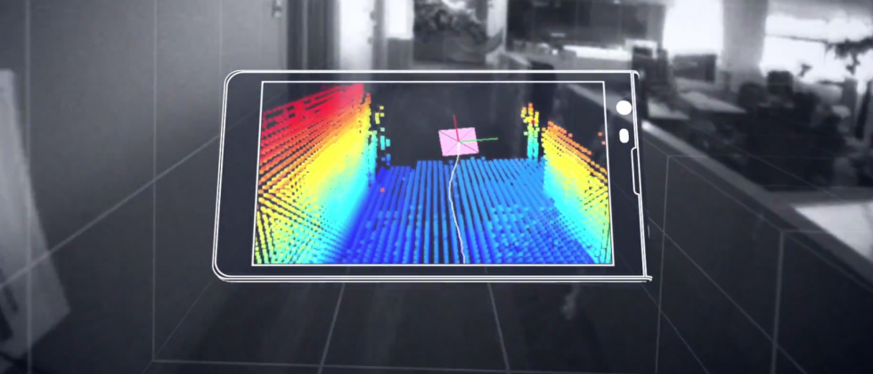

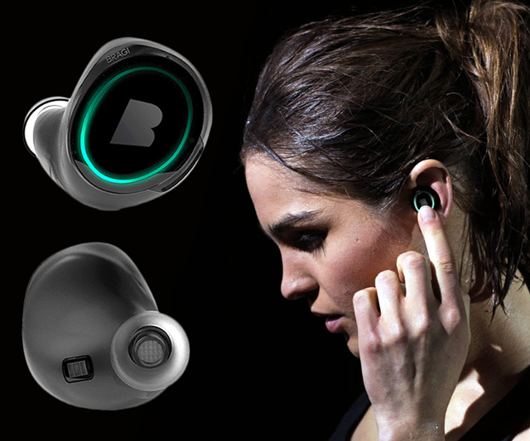
Machine Learning for Physical Sensing & Perception
CMSC 818V : Fall 2026
Lecture 4: From Inverse Problems to Physics-Guided Learning
Nirupam Roy
Tu-Th 12:30 – 1:45pm
IRB 2107

Slide 2
Where Lecture 3 left off
y = f(x, θ) + n
A physical forward model turns a state x into a measurement y.
The classical inverse recovers x by fitting the data and penalizing implausible solutions.
x̂ = arg min_{x} D(y, f(x,θ)) + λR(x)
data term — stay consistent with what the sensor actually measured
regularizer — prefer plausible states among those consistent with the data
Lecture 4 is not a switch from physics to generic deep learning — it is the next question forced by the inverse problem itself.
1

Slide 3
The central lecture question
Which component of the inference chain is still missing?
When the classical inverse is inaccurate, non-unique, computationally expensive, or based on incomplete physics — should learning...
replace the inverse outright,
supply the missing prior,
accelerate / unroll the solver,
repair the forward model,
discover the dynamics, or
only enforce a known physical law?
2

Slide 4
Six answers, one per section of this lecture
1
2
3
Learn the
Inverse
Learn the
Prior
Unroll the
Optimizer
the map itself
is too complex
data alone doesn't
pick one state
the objective is right;
iteration is slow
4
5
6
Learn Missing
Physics
Learn the
Dynamics
Constrain with
Physics
the model is
incomplete, biased
the transition law
itself is unknown
the law is known;
the field is sparse
Same rhythm every time: meet the physical systems, expose the shared failure mode, add exactly the learning that failure demands.
3

Slide 5
Every section follows the same rhythm
Two or three very different sensing systems will turn out to share exactly one mathematical failure — that repetition, not the sensor hardware, is the actual lesson.
meet the
physical systems
write the forward
model x, y, f, θ, n
expose the shared
mathematical failure
add the precise
learning remedy
Notation stays fixed throughout: physical state x, forward physics f(x,θ), measurement y, noise n, learned component φ. New vocabulary is the sensor's — not the mathematics'.
Watch for the moment each section closes: what the new method still cannot guarantee becomes the transition question into the next one.
4

Slide 6
1 Learn the Inverse Directly
When a useful inverse mapping exists statistically, even though an analytic inverse is unavailable
5

Slide 7
A formal definition: the direct learned inverse
Use this to establish the simplest possible relationship between Machine Learning and inverse problems: the network is an approximator of the map from sensor measurements to a desired latent physical state.
y = f(x, θ) + n → x̂ = g_{φ}(y)
Given paired data {(yᵢ, xᵢ)}, gφ is fit directly by empirical risk minimization — no explicit optimization runs at test time.
This can be useful even when the analytic inverse is hard to write down or too slow to invert online.
6

Slide 8
Supervised training and a physical consistency check
φ̂ = arg min_{φ} (1/N) Σᵢ L(g_{φ}(yᵢ), xᵢ)
For squared error, the predictor is driven toward the conditional mean E[x | y]. This can be useful even when the analytic inverse is hard — but it does not ensure that the predicted state actually reproduces the observed measurement.
physical consistency check: f(x̂, θ) ?≈ y
A direct learned inverse can be accurate statistically without being an explicit model of the sensing physics. It may exploit reproducible correlations that are useful in-distribution but brittle when the sensing environment changes.
7
Notes:
L() = per example Loss function.

Slide 9
Example A — sparse-view CT: what a detector measures
X-ray source
(rotating)
tissue
(attenuation)
detector value =
ray integral
An X-ray source and detector rotate around the body; each detector value is produced after X-rays pass through tissue.
With only a small number of projection angles, the scanner records incomplete angular information.
y ≈ Ax + n (after Beer–Lambert log transform; A encodes ray–pixel intersection lengths)
8

Slide 10
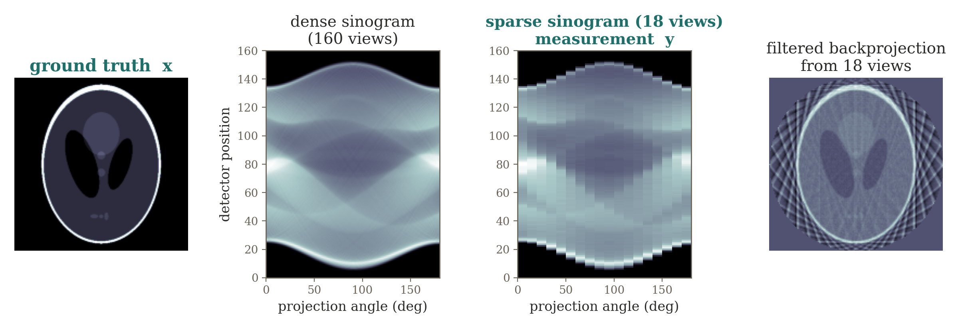
CT measurement formation: dense to sparse
Filtered backprojection assumes sufficiently dense angular sampling. With few views, the reconstruction shows streaks and large null / near-null directions — several images become almost equally consistent with the data.
9

Slide 11
Learned direct reconstruction
sparse
sinogram y
learned
inverse gφ
reconstructed
image x̂
A network gφ can be trained to map sparse projection data directly to the image, or to map an initial artifact-laden reconstruction to a corrected image.
What the network has learned that is not in the sparse sinogram?
[Ref] Zhu et al., AUTOMAP, Nature 2018 — a canonical learned-reconstruction example.
10
Notes:
Answer: “anatomy” as the answer for the next section.
Learned inverse is fast and flexible, but can sacrifice physical consistency and robustness.​
This is exactly why methods like LISTA, unrolled networks, MoDL, and physics-guided reconstruction are attractive: they try to retain the known forward model while learning only the difficult parts.

Slide 12
Example B — RF fingerprint localization: the physical environment
A device receives Wi-Fi / UWB / cellular signals from several fixed transmitters (access points).
Walls, furniture, and people create site-specific reflection, diffraction, and shadowing.
Two locations with similar geometric ranges can therefore have very different channel signatures.
y = f_{site}(x) + n f_{site} unknown / too costly to model
A complete electromagnetic / multipath forward model exists in principle but is too costly and too environment-specific for routine inversion. Classical triangulation's simplified distance-to-signal model is what multipath violates.
11

Slide 13
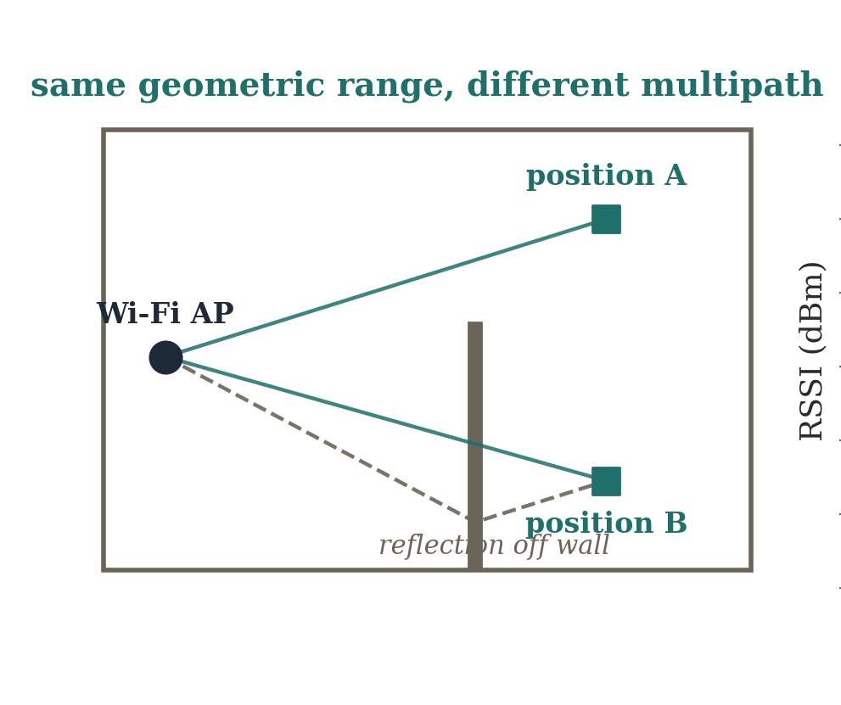
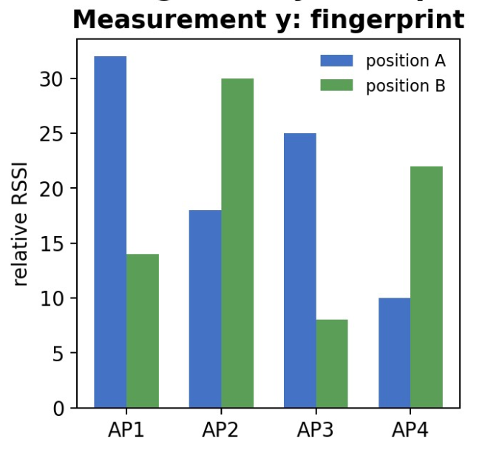
From fingerprint to position: a site-specific inverse
gφ learns the empirical inverse from fingerprint vector to position. Contrast “geometry-based localization” with “fingerprint-based inverse inference” — what happens when furniture or AP placement changes?
[Ref] Wang et al., DeepFi, MobiCom 2015.
12

Slide 14
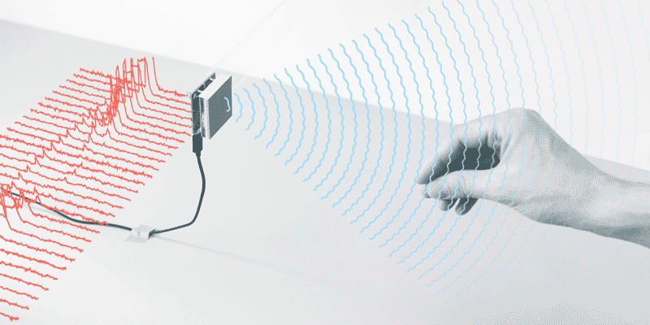
Example C — radar gesture sensing: the physical measurement
FMCW radar
(chirps)
moving scatterers
(hand / body)
range / Doppler /
angle features
Different body parts create time-varying reflections with different range and radial velocity.
Raw beat signals are transformed by known radar signal processing into range / Doppler / angle features — exact inversion from distributed scattering to semantics is not analytically defined.
Broadens “inverse problem”: the target x can be a low-dimensional state or label, not only a pixelwise image.
13

Slide 15
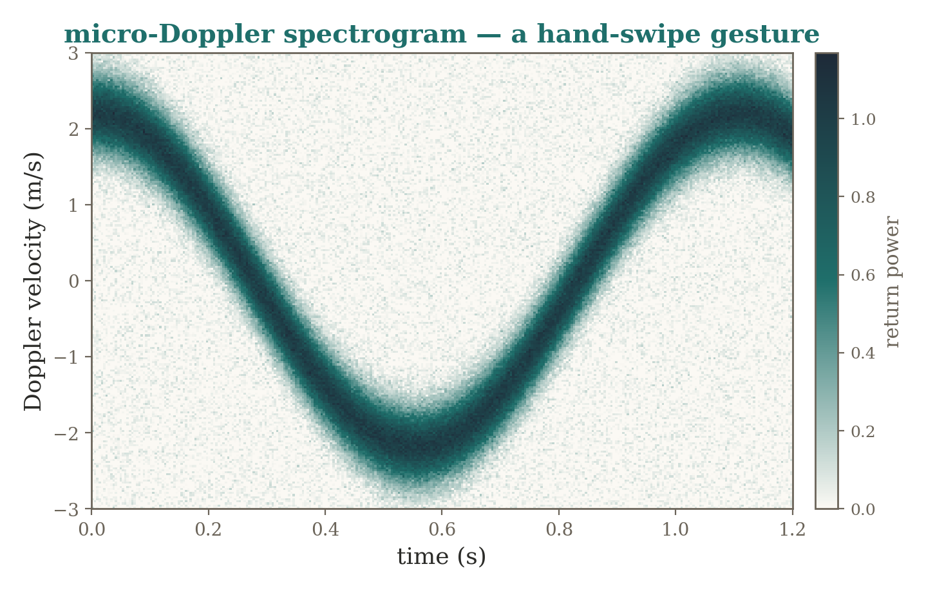
Radar gesture sensing: inverse inference need not mean image reconstruction
The full physical reflectivity field is more detailed than the task requires — gφ maps the structured radar measurement directly to a semantic, task-relevant state, not a full reflectivity image.
14

Slide 16
Three systems, one learned-inverse abstraction
System | measurement y | target x | why direct learning helps | what it may ignore
CT | sparse projections | attenuation image | learn difficult inverse | known projector A / consistency
RF localization | RSSI / CSI | position | site-specific inverse | causal propagation / domain shift
Radar gesture | radar tensor | activity / gesture | task-level inverse | full scene physics
15

Slide 17
Why direct learning is not enough
A direct inverse is trained on a particular distribution of states and environments — performance can degrade sharply out of distribution.
Nothing in the training objective enforces that f(x̂,θ) actually reproduces the observed measurement y.
Measurement consistency and generalization are both left entirely to the data.
If the forward operator A is already known and the real difficulty is that the measurements are insufficient, why learn the entire inverse? Can we keep measurement physics exact and learn only what makes a state plausible?
16

Slide 18
2 Learn the Prior, Not the Entire Inverse
When many physical states explain the same measurements equally well
17

Slide 19
Two sources of information in reconstruction
x̂ = arg min_{x} D(y, Ax) + λ R(x)
sensor physics A
D(y, Ax): does x explain what the sensor measured?
prior knowledge R(x)
is x plausible, independent of this measurement?
reconstruction x̂
The measurement term knows the experiment; the prior knows the world.
4
Notes:
Reconnect to Lecture 3 (MAP estimation, least squares). Two questions judge every candidate x: does it explain the data (D), and is it plausible regardless of this particular measurement (R)?

Slide 20
Ambiguity lives in the null space
y = Ax + n
With limited or weak measurements, A can be rank-deficient or ill-conditioned. If z lies in the null space, then:
Az = 0 ⟹ A(x + z) = Ax
Even when the null space is only approximate, small singular values create directions that are weakly observed and therefore unstable under noise.
The likelihood / data term can tell us whether a candidate explains y — never whether it is a plausible physical state.
18

Slide 21
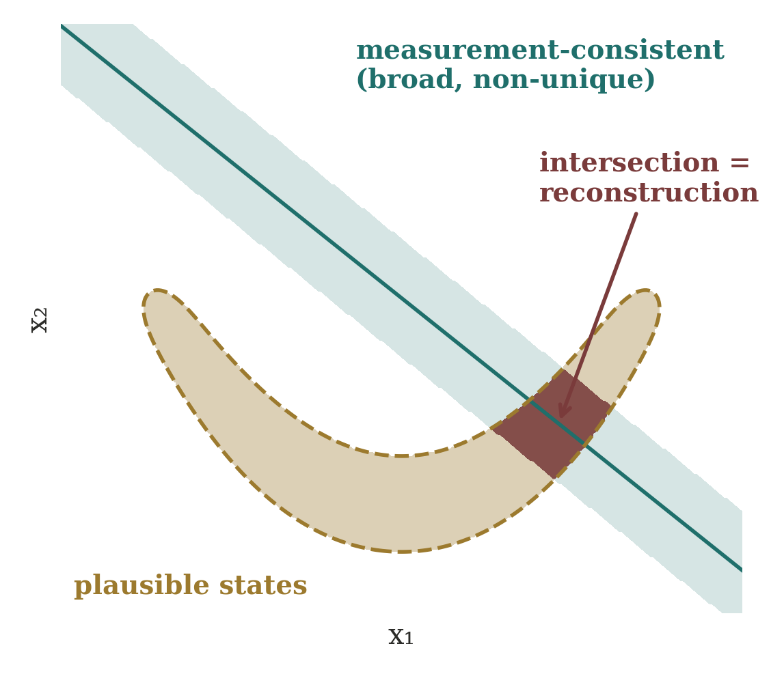
Why is a prior needed at all?
Undersampling, null spaces, ill-conditioning, noise, missing frequencies, limited views, occlusion…
…all let many states x explain the same y.
Data consistency narrows the set; it may not select one stable answer.
Reconstruction seeks the intersection with the plausible set.
Without a prior, “the” solution of an inverse problem is often not even defined.
5

Slide 22
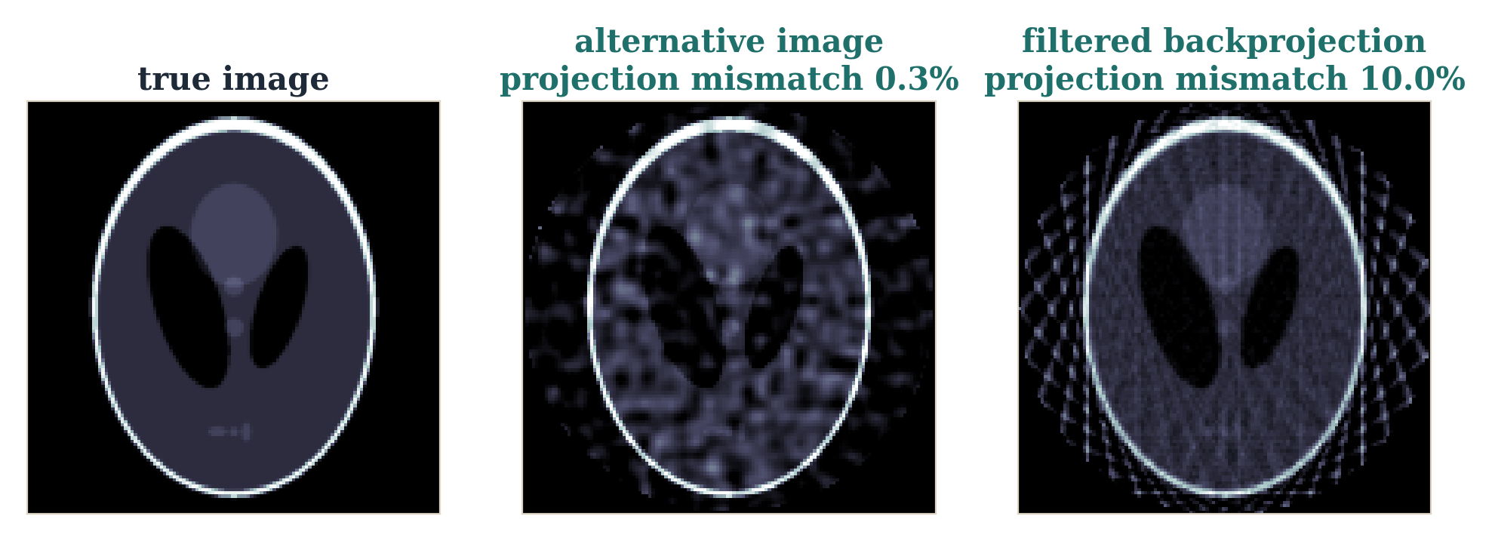
Sparse-view CT: fitting data is not enough
18 projection angles. The middle image was built by adding a (near) null-space pattern of A to the truth: its projections differ by only 0.3%, yet the anatomy is visibly different. FBP matches the data worse (10%) and shows streaks.
The sensor cannot tell these images apart — something else must.
6
Notes:
Computed with skimage radon: z was obtained by gradient descent on ||Az||^2 from a smooth random image, so Az is nearly zero. x + z is therefore almost perfectly measurement-consistent. This is the concrete version of the 2D picture on the previous slide.

Slide 23
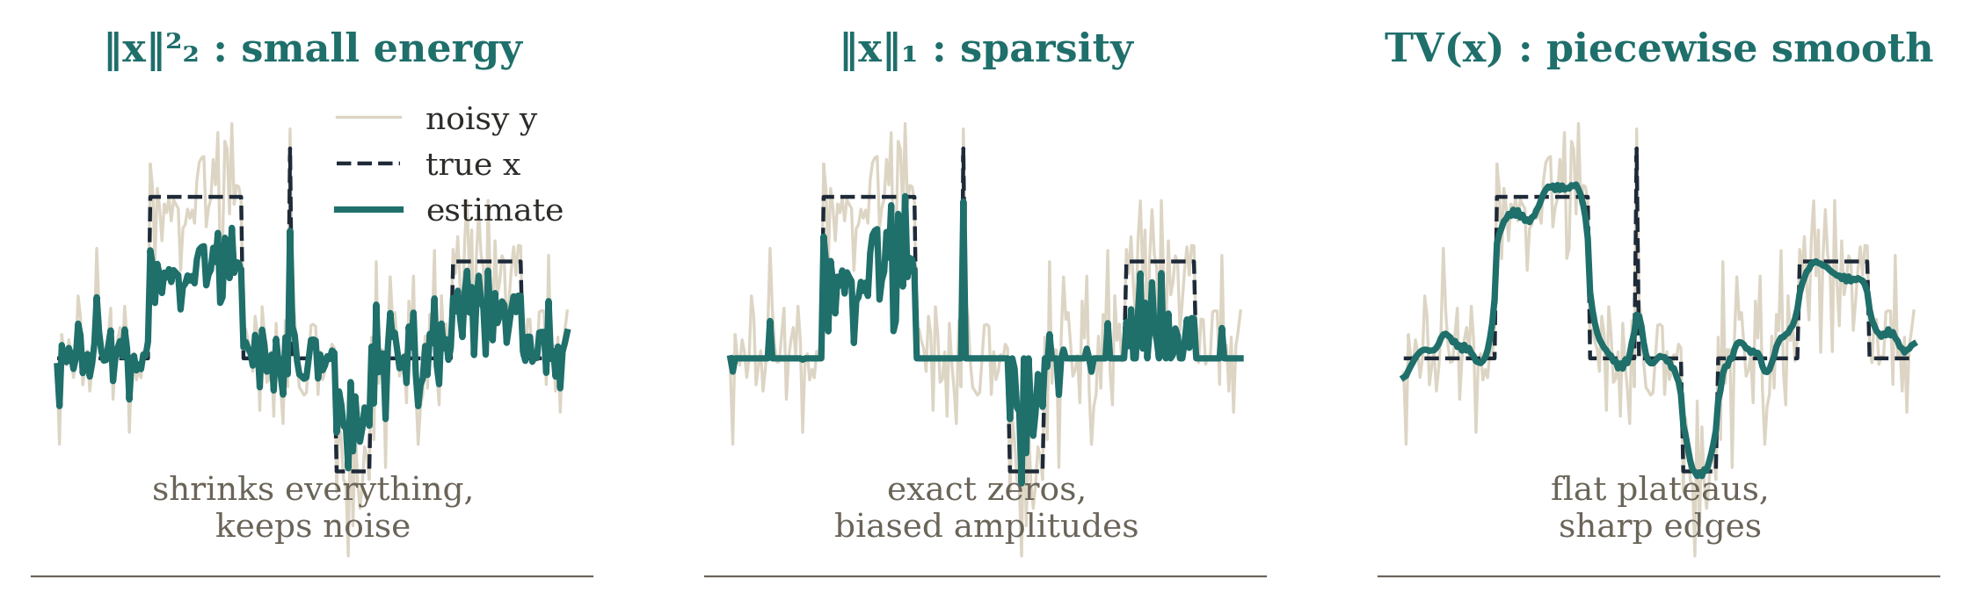
Classical priors are assumptions
R(x) = ‖x‖₂² R(x) = ‖x‖₁ R(x) = TV(x)
Hand-designed: small energy (Tikhonov), sparsity, piecewise smoothness.
Powerful because they encode structure — intentionally simple.
Who decided “sparse”, “smooth”, or “piecewise smooth”? We did.
Real anatomy, RF occupancy patterns and room impulse responses carry richer structure than these can express.
7
Notes:
Same noisy signal, three hand-designed priors. L2 shrinks everything uniformly and keeps the noise; L1 produces exact zeros but biases amplitudes; TV gives flat plateaus with sharp edges. Each prior is a statement about the world. Learned priors continue this idea rather than replacing inverse-problem thinking.

Slide 24
Learn the prior, not the whole inverse
direct inverse: x̂ = g_{φ}(y)
learned prior: x̂ = arg min_{x} D(y, Ax) + λ R_{φ}(x)
labels teach the entire y → x map
y
large network gφ
x̂
physics stays explicit; data only teach what x looks like
y
known A +
data consistency
learned
prior
x̂
Smaller sample burden: the network need not rediscover A.
More interpretable, and measurement consistency stays explicit.
8

Slide 25
Three technical forms of learned prior
1 Explicit regularizer
2 Learned proximal
3 Generative / score
Rφ(x)
Dφ(x)
Gφ(z), sφ(x, t)
outputs a scalar
outputs a corrected x
outputs x, or a direction
how implausible is x?
how should x be improved?
where do plausible x live?
All three keep A. They differ in what the network outputs, and so in how the prior enters the solver.
9

Slide 26
MAP estimation: the Bayesian connection
x̂_{MAP} = arg min_{x} ∥Ax−y∥₂² + λR(x)
p(x|y) ∝ p(y|x) p(x) R(x) ∝ −log p(x)
R(x) is simply extra information about x that the measurement term cannot supply. A learned prior replaces a hand-designed R with a model learned from plausible states.
The likelihood tells us which x agrees with the data — never which data-consistent x is physically plausible.
19

Slide 27
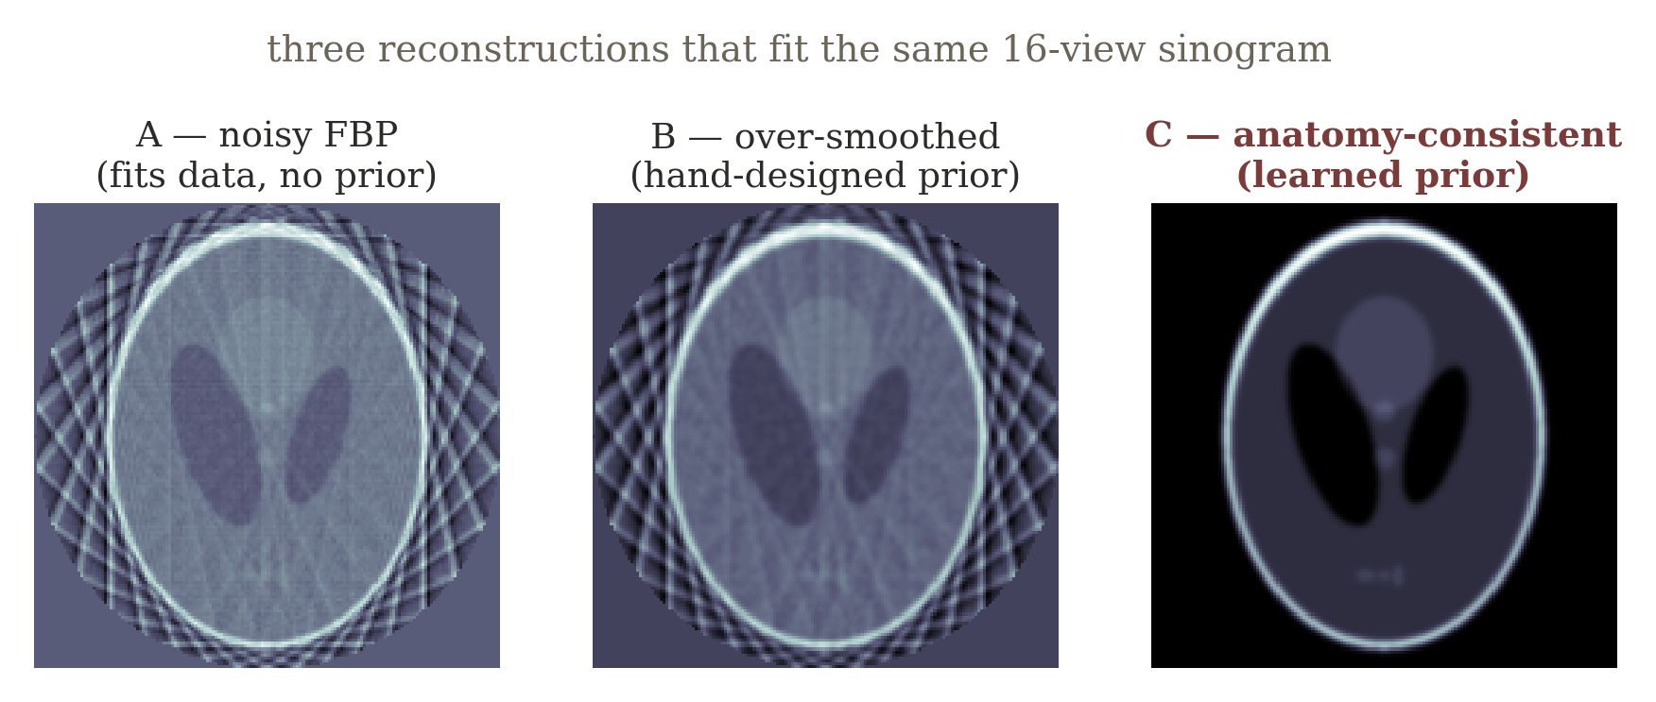
Example A — sparse-view CT, revisited: non-uniqueness
Reuse exactly the same scanner from Section 1, but now focus on what sparse angular sampling fails to observe. “Which term in the objective can distinguish A, B, and C if ‖Ax−y‖ is nearly the same for all three?”
20

Slide 28
What anatomical knowledge contributes
Tikhonov / smoothness — neighboring pixels should not fluctuate arbitrarily.
Total variation — the image may be piecewise-smooth with a small number of important edges.
Sparsity in a transform basis — coefficients in wavelets or learned dictionaries may be mostly small.
Learned prior — a network, denoiser, or generative / score model captures higher-order structure from examples.
Important wording: the learned prior should not be described as “hallucinating missing measurements.” It supplies a statistical preference among states that already compete under the measurement model. The risk of hallucination arises when the prior overwhelms data consistency.
21

Slide 29
Example B — device-free RF tomography: the physical setup
Fixed radios surround a room. A person or object perturbs wireless links whose propagation paths pass through or near the body.
The room is discretized into many candidate cells — the unknown is a 2-D attenuation or occupancy field over hundreds of cells.
y ≈ Ax + n each row of A describes how one radio link weights the cells it crosses
Optional anchor: Wilson & Patwari, “Radio Tomographic Imaging with Wireless Networks,” IEEE TMC 2010.
22

Slide 30
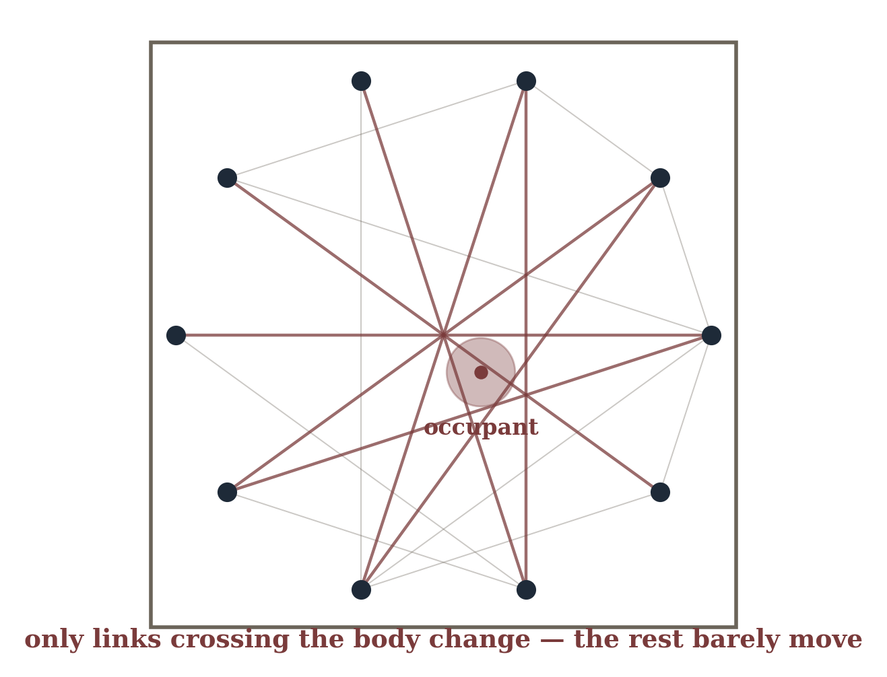
RF tomography made visible: perimeter links, pixel grid
There can be far fewer links than pixels — a dense arbitrary attenuation pattern is impossible to determine uniquely from the measurements alone.
23

Slide 31
Count equations against unknowns
~20–50
≪
~400+
independent link
measurements
unknown grid
cells
24

Slide 32
Occupancy priors: what model learns
Sparsity — an occupied region is a small fraction of the full grid.
Spatial contiguity — a person occupies a connected region, not scattered isolated cells.
Nonnegativity and human-scale shape — physically meaningful occupancy has size and form constraints.
Or a fully learned occupancy distribution fit from many observed room layouts.
Same shared failure mode as CT: measurement consistency alone does not choose a unique plausible state.
25

Slide 33
Example C — motion deblurring: the physical forward model
sharp scene
x
blur kernel H
(motion / exposure)
blurred pixels
y
During finite exposure, camera or object motion spreads light from a sharp scene across neighboring pixels; H approximates the integration process.
y = Hx + n or in frequency: Y(f) = H(f)X(f) + N(f)
26

Slide 34
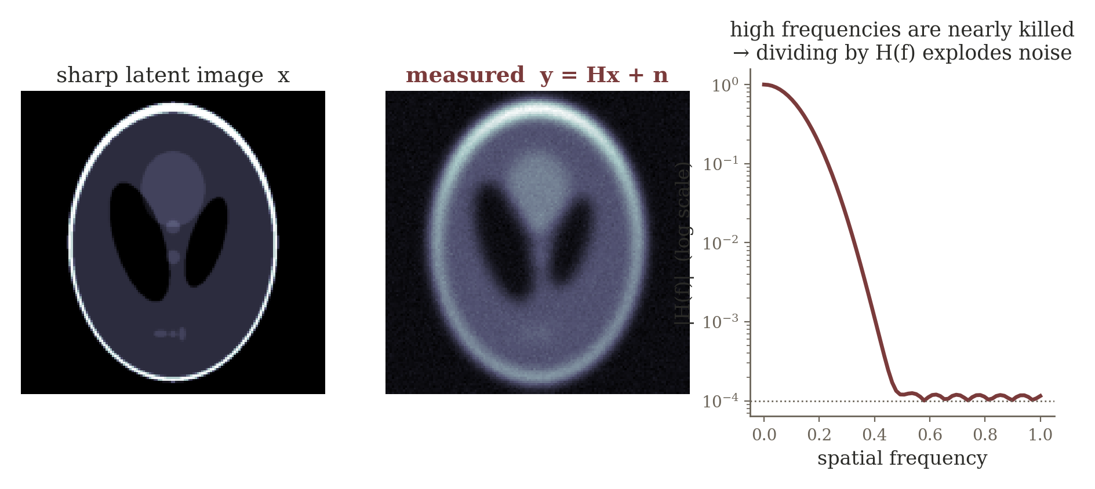
Frequency-domain instability: small H(f), small singular value
If H(f) is close to zero at some frequencies, naive inversion x̂ = y/H amplifies noise severely — explicitly the same singular-value story from Lecture 3, now expressed in the Fourier basis.
27

Slide 35
Natural-image priors recover what the sensor lost
Natural-image knowledge: edges persist, textures have structure, local statistics are non-arbitrary.
A learned image prior can restore stable high-frequency structure while the data-fidelity term preserves what was actually observed.
Many different sharp images can be almost equally data-consistent with a blurry observation — the prior is what selects the one that also looks like a photograph.
28

Slide 36
Three technical forms of a learned prior
Explicit learned regularizer — learn a scalar plausibility penalty and retain explicit optimization
min_{x} D(y,Ax) + λR_{φ}(x)
Learned proximal / denoising operator — replace the hand-designed proximal step with a trainable denoiser
x_{k+1} = D_{φ}( x_{k} + ηA^{T}(y−Ax_{k}) )
Generative / score prior — restrict or bias x toward a learned distribution of plausible states
x ~ p_{φ}(x), or use ∇_{x} log p_{φ}(x)
CT anatomy, human occupancy, and natural-image structure are physically different priors, but mathematically they answer the same question: among the states that agree with the sensor, which should we consider plausible?
29

Slide 37
Shared failure mode across three systems
Sparse-view CT
RF tomography
Motion deblurring
same projections;
many images can
approximately fit
limited measurements
few links cannot
uniquely identify a
dense attenuation
field
many sharp images
can produce nearly
the same blur
prior: anatomy is structured
prior: occupancy is sparse + contiguous
prior: natural images have
structured edges / textures
Shared failure mode: measurement consistency alone does not choose a unique plausible state.
Transition question: the objective and prior are now good, but solving the optimization requires tens or hundreds of expensive iterations. Can the algorithm itself become the architecture?
30

Slide 38
Form 1: Explicit Learned Regularizer
Learn a scalar plausibility penalty; keep the optimizer explicit
10

Slide 39
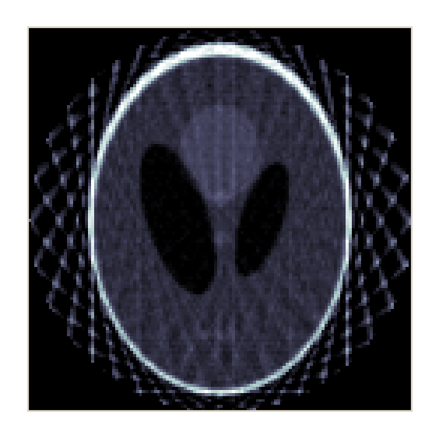
Form 1: an explicit learned regularizer
x̂ = arg min_{x} D(y, Ax) + λ Rφ(x)
R_{φ} : R^{n} → R
network Rφ
one scalar “energy”
candidate x
Input: a candidate state or image x. Output: one number.
Low Rφ(x): plausible. High Rφ(x): implausible.
The optimizer stays explicit; only the prior term is learned.
11

Slide 40
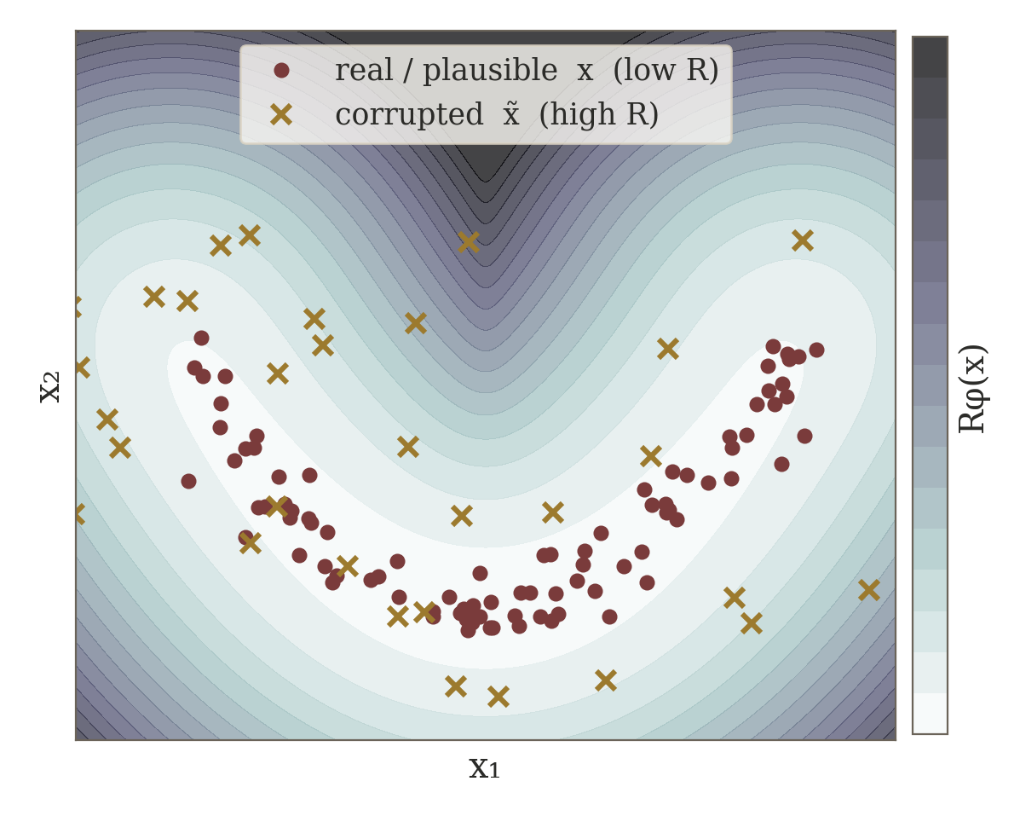
How can the explicit regularizer be trained?
R_{φ}(x_{real}) < R_{φ}(x̃_{bad})
view: R_{φ}(x) ≈ −log p_{φ}(x)
Separate: train Rφ on real vs. corrupted / unrealistic states (ranking or energy loss), freeze, plug in.
End-to-end: unroll the reconstruction and train Rφ for final reconstruction quality.
Once Rφ is frozen, the inverse solver only needs its gradient with respect to x.
12
Notes:
Toy picture: the energy shown is -log of a density fitted to plausible samples (a Gaussian mixture standing in for a trained network). Real samples sit in the low-energy valley; corrupted versions land on the high-energy slopes. A ranking loss enforces exactly this ordering.

Slide 41
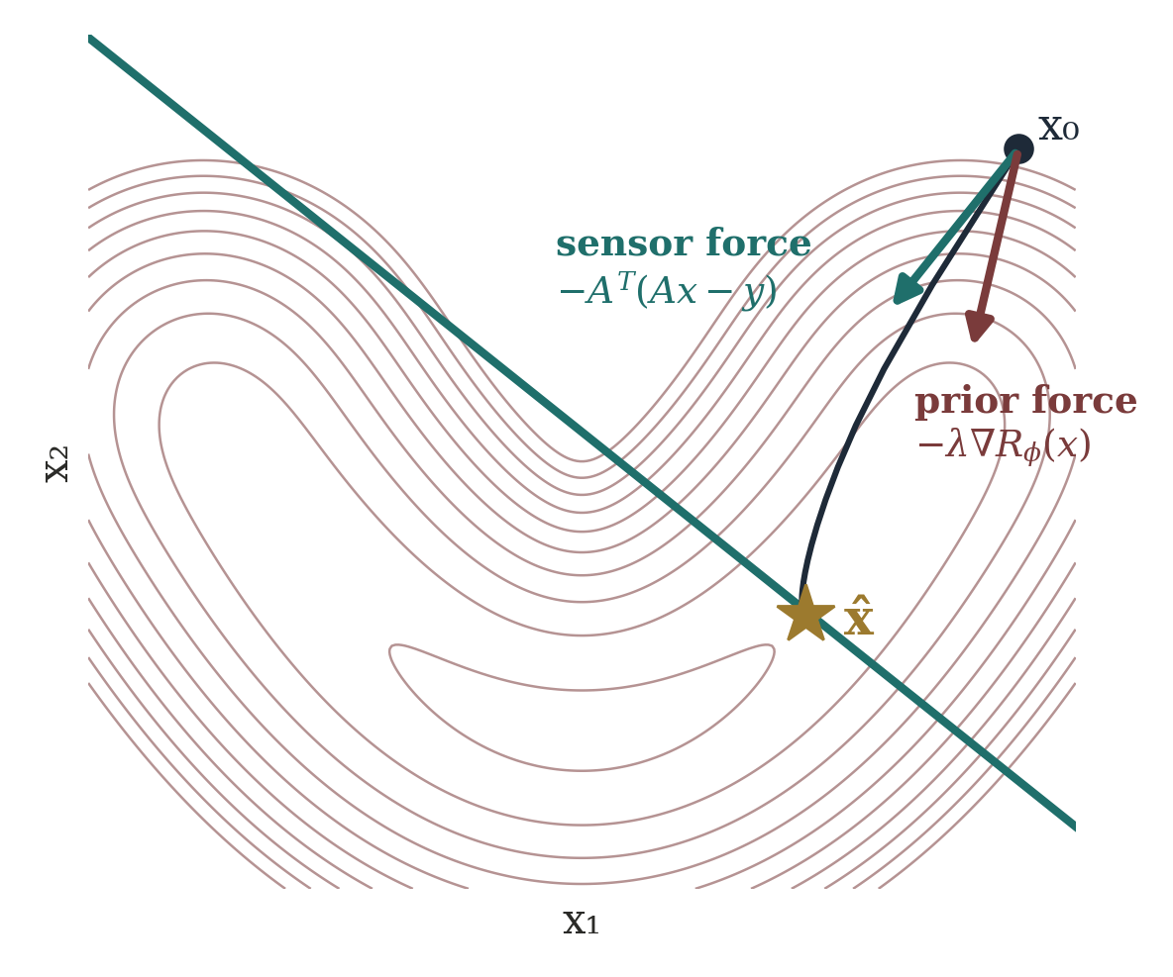
What does the optimizer do with a scalar?
x_{k+1} = x_{k} − η [ A^{T}(Ax_{k} − y) + λ∇_{x}R_{φ}(x_{k}) ]
Sensor force: pull toward the measured data.
Prior force: the direction that reduces learned implausibility.
The network never outputs the reconstruction — it shapes the landscape.
Sparse-view CT: one force pushes toward the projections, the other toward plausible anatomy.
13
Notes:
The 2D figure is a real gradient-descent run on D + lambda R with R = -log p from the toy density. At x0 the two unit arrows show the sensor and prior forces; the iterate converges to the point on the measurement line that is also plausible. Note the landscape has another intersection on the left arm — initialization and lambda matter.

Slide 42
Form 2: Learned Proximal / Denoiser
Learn the correction step instead of writing R(x)
14

Slide 43
Form 2: Learn the Proximal/Denoiser
(proximal is a mechanism, not “sparsity”)
z_{k} = x_{k} + η A^{T}(y − Ax_{k}), x_{k+1} = prox_{ηλR}(z_{k})
data-consistency
gradient step
prior / proximal
step
repeat
Prior R(x) | Its proximal step
‖x‖₁ (sparsity) | soft-thresholding (ISTA)
TV(x) | a TV-denoising problem
other priors | a different correction operator
“Proximal” names how a prior is enforced — broader than sparsity or any activation function.
15

Slide 44
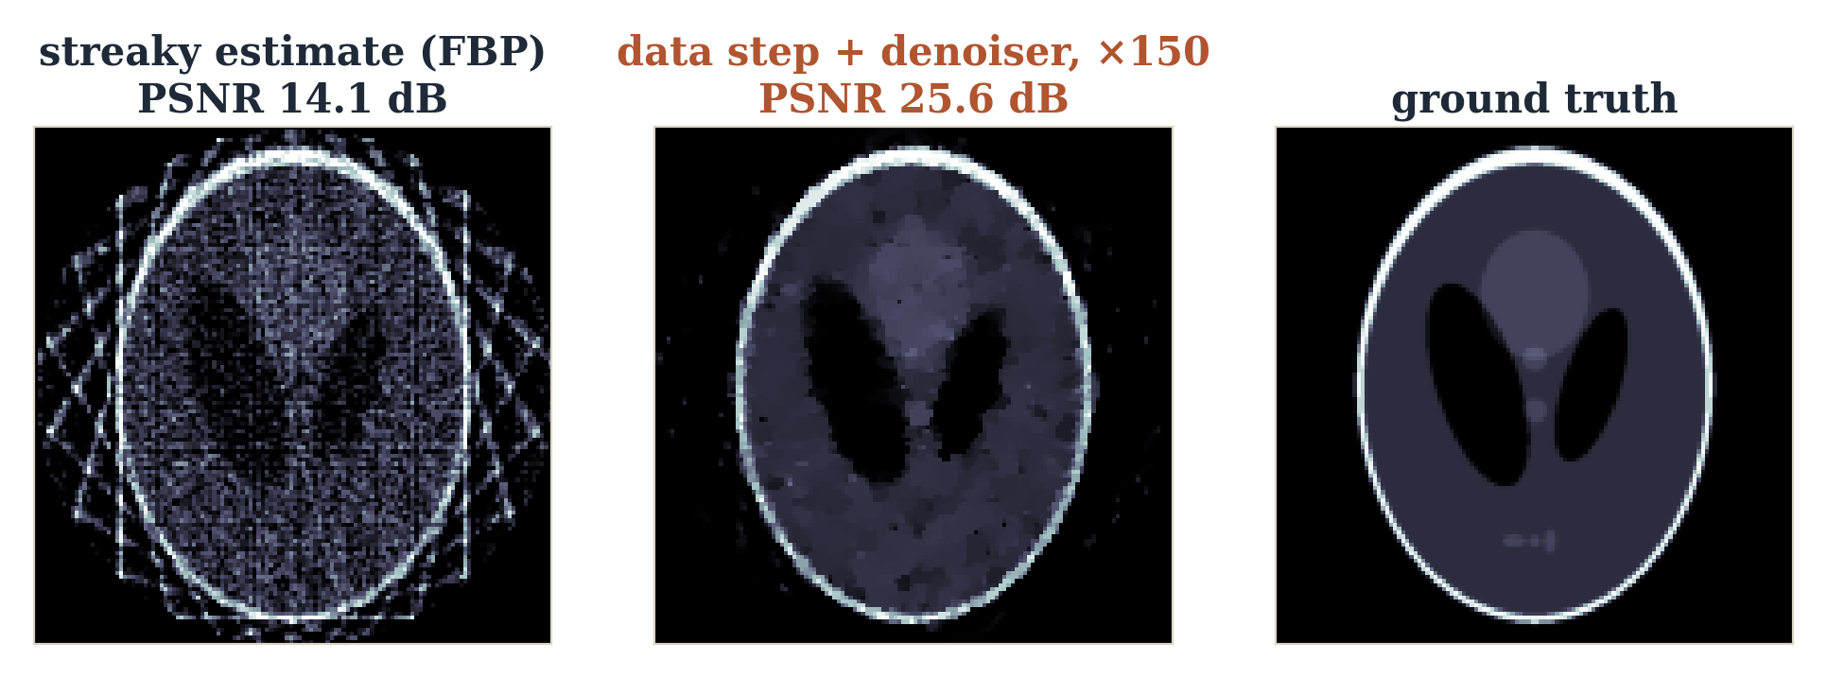
Learn the proximal action instead of R(x)
x_{k+1} = D_{φ}( x_{k} + η A^{T}(y − Ax_{k}) )
Input: a measurement-corrected but imperfect zₖ. Output: a corrected state of the same size.
Dφ may be a CNN, U-Net, ResNet or transformer.
“Denoising” includes noise, aliasing, streaks, ringing — any artifact.
16
Notes:
Real run: 12-view sparse CT with 2% noise, plug-and-play FISTA for 150 iterations. The denoiser here is TV (Chambolle) standing in for a learned D_phi — the slot a CNN or U-Net would occupy. PSNR goes from 14.1 dB (FBP) to 25.6 dB.

Slide 45
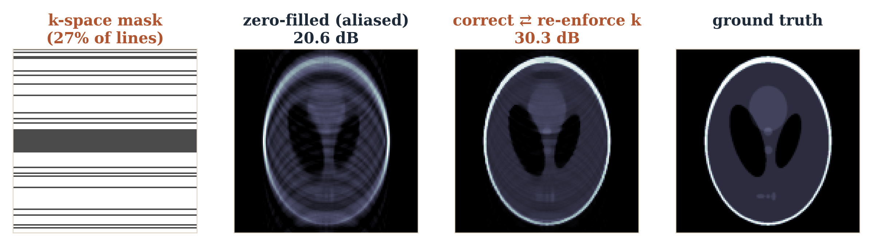
How is a learned denoiser trained?
separate: min_{φ} ‖D_{φ}(x̃) − x*‖²
end-to-end: min_{φ} ‖x_{K}(y; φ) − x*‖²
Separate: make corrupted / clean pairs, train Dφ, freeze it, insert it in the loop.
End-to-end: unroll K steps and train Dφ for this inverse task — task-specific correction, not generic denoising.
MRI loop: undersampled k-space → data consistency → learned correction → repeat.
17
Notes:
Real simulation: Cartesian undersampling keeps 27% of phase-encode lines (16 central + random). Zero-filled inverse FFT is aliased (20.6 dB). Alternating a correction step (TV, standing in for D_phi) with re-inserting the measured k-space lines reaches 30.3 dB after 80 iterations.

Slide 46
Explicit regularizer vs. learned proximal
Rφ(x)
Dφ(x)
“How bad is this x?”
“How should I improve this x?”
outputs a scalar
outputs a corrected signal / image
enters through ∇Rφ in the objective
replaces the proximal step directly
Both are learned priors. The denoiser route is often easier to deploy: it learns the correction action directly.
18

Slide 47
Form 3: Generative and Score Priors
Model the whole plausible set — or the direction toward it
19

Slide 48
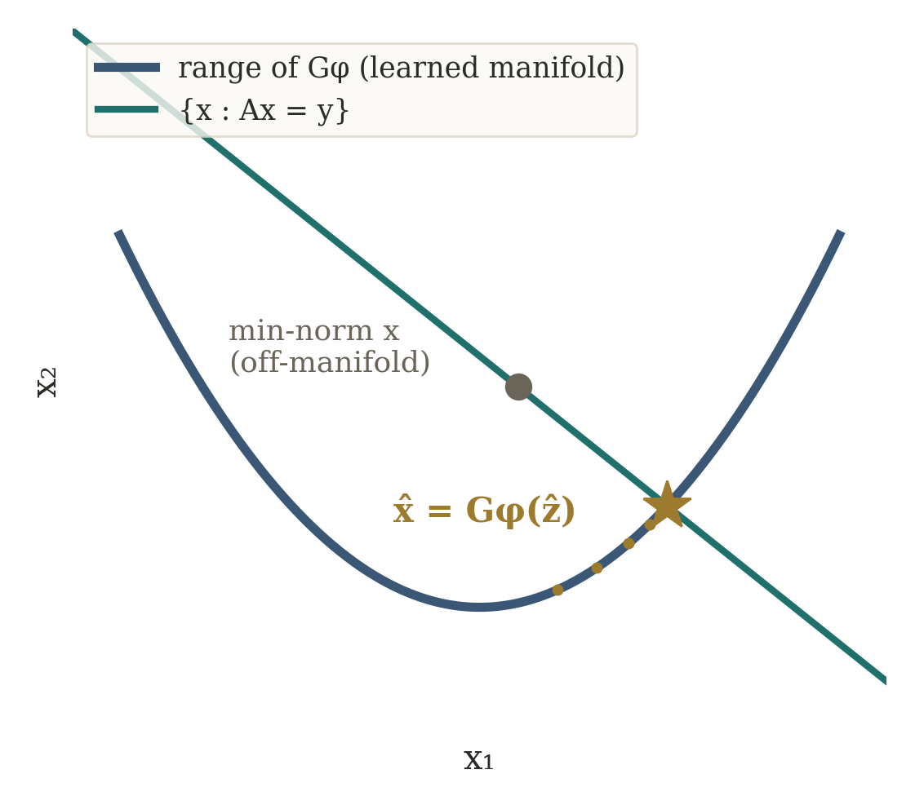
Form 3: a generative prior
z ~ p(z), x = G_{φ}(z)
ẑ = arg min_{z} D(y, AG_{φ}(z))
x̂ = G_{φ}(ẑ)
G is trained on examples of plausible states.
Reconstruction is restricted to what G can produce.
Far stronger than “smooth” or “sparse”.
CT: search only among anatomically plausible images, then pick the one that best explains the projections.
20

Slide 49
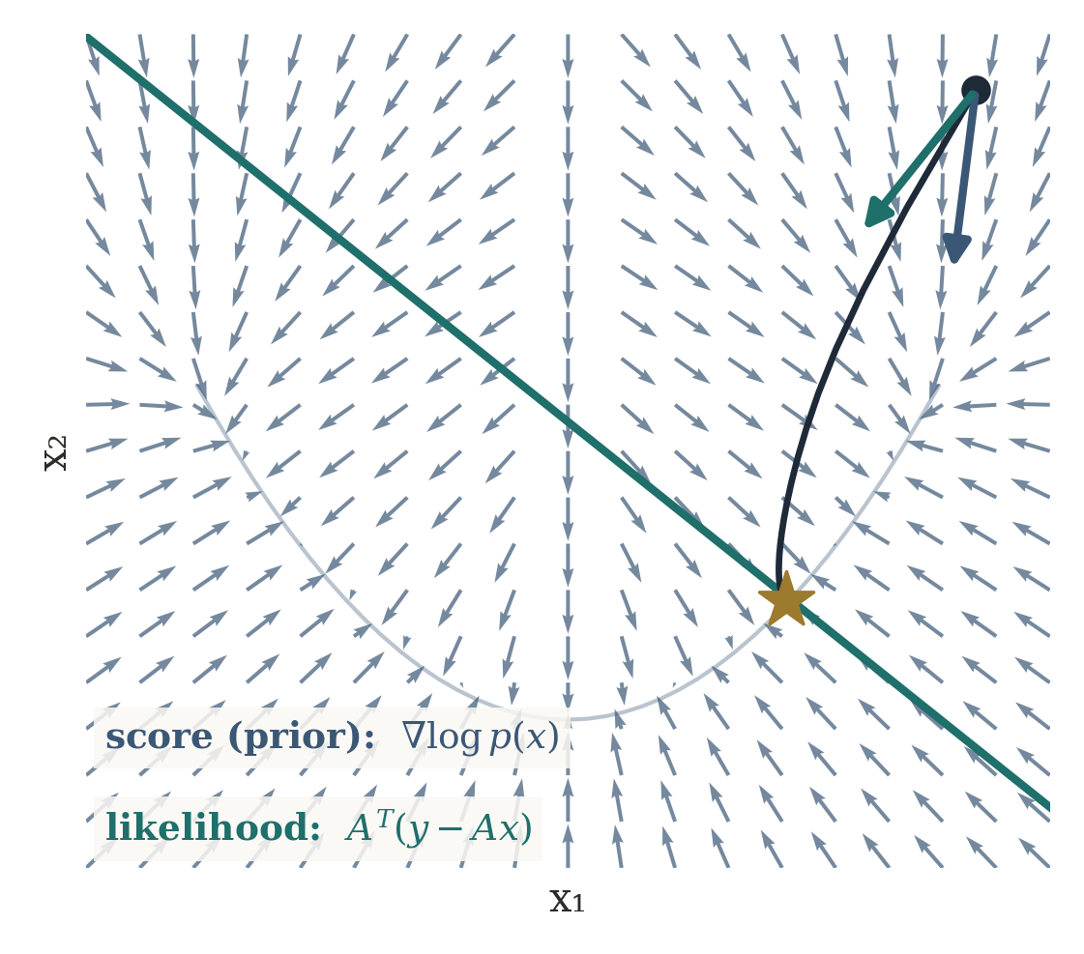
Score prior: a direction toward probability
s_{φ}(x, t) ≈ ∇_{x} log p_{t}(x)
∇log p(x|y) = ∇log p(y|x) + ∇log p(x)
Input: noisy state xₜ and noise level t.
Output: a vector the size of x, pointing to more probable states.
Gaussian noise: likelihood direction ∝ Aᵀ(y − Ax).
Posterior direction = measurement consistency + learned plausibility — the same two forces, now as vectors.
21
Notes:
Keep diffusion mechanics light. The quiver field is the exact score of the toy density; the dark path is gradient ascent on log p(x|y) = score + likelihood, ending on the measurement line inside the plausible set.

Slide 50
Training input / output summary
Model | Input | Output | Training signal
Explicit Rφ | state x | scalar Rφ(x) | plausible < implausible
Learned proximal Dφ | imperfect x̃ | corrected x | corrupted→clean, or end-to-end
Generator Gφ | latent z | plausible x | distribution of real x
Score sφ | noisy xₜ, t | direction | clean x + controlled noise
In every row the forward model A is not learned — it stays in the solver.
23

Slide 51
How each form enters the inverse
Form | How it is used | Intuition
Explicit regularizer | add to objective, differentiate | score plausibility
Learned proximal | replace the proximal step | correct toward plausible
Generative prior | search the generator's range | stay on learned manifold
Score prior | add to likelihood direction | climb toward high probability
Spend most class time on the first two rows — they build directly on MAP, regularization, ISTA and LISTA.
24

Slide 52
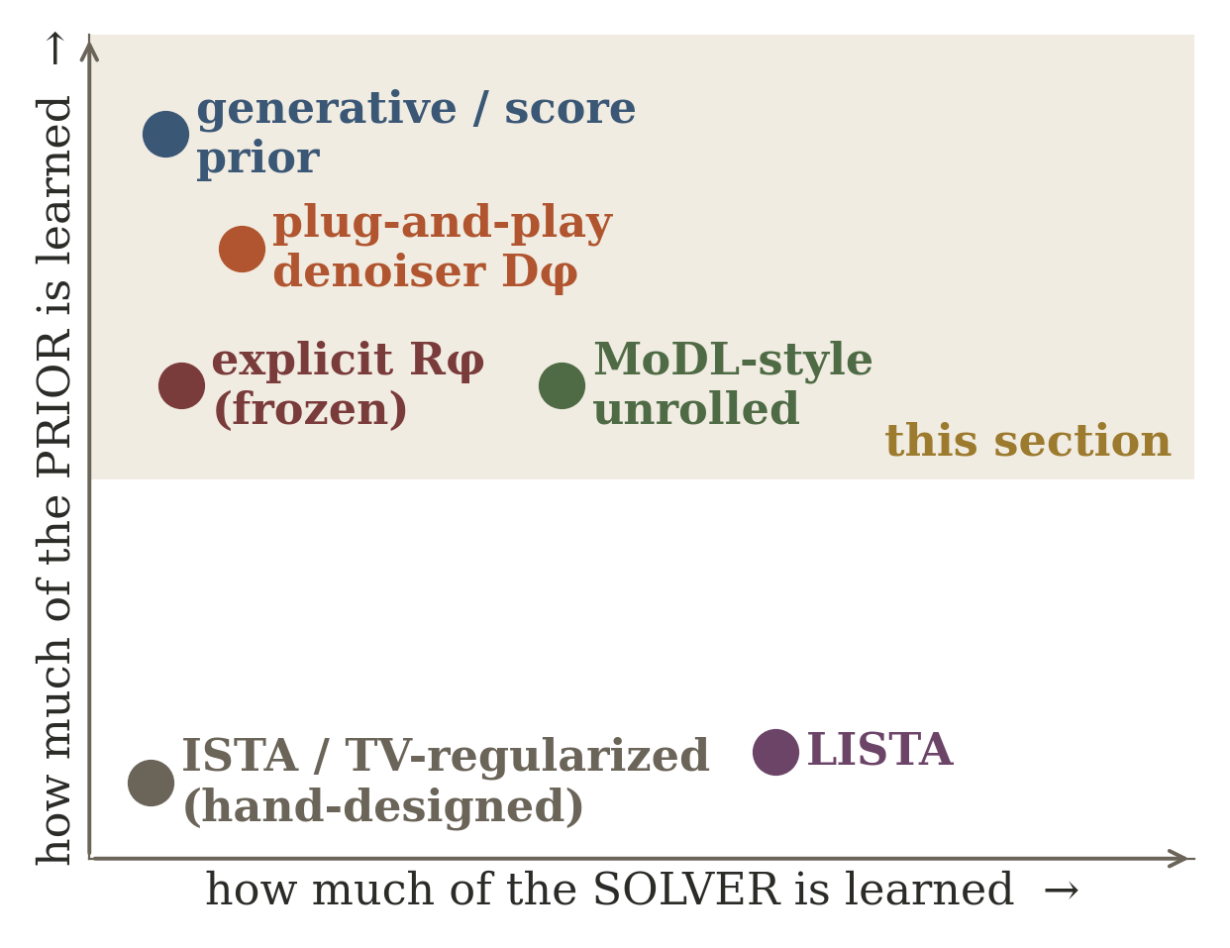
Where does this sit relative to LISTA?
LISTA: learn the solver
learned prior: learn x
LISTA learns how to optimize a sparse problem faster.
Learned priors learn what plausible x looks like.
Unrolled methods (MoDL) do both: A fixed, prior block learned, steps optionally learned.
Two independent axes: “what is learned?” — the solver, the prior, or both.
25

Slide 53
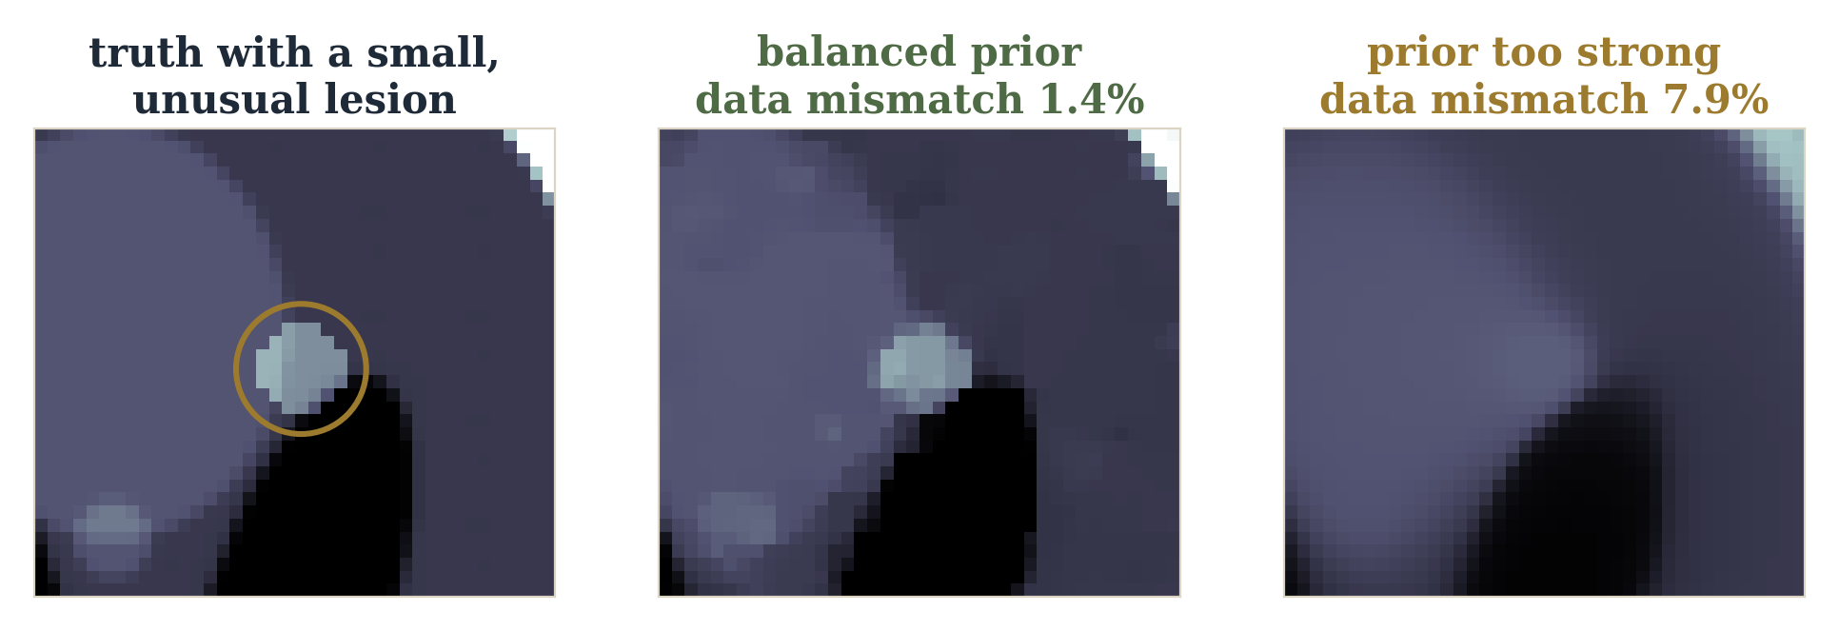
Plausibility must not overpower evidence
Too large a λ or too strong a prior hides unusual but real structure (here a small lesion).
A strong prior can give a plausible-looking answer that no longer matches the measurements (1.4% → 7.9% mismatch).
Keep measurement consistency explicit whenever the forward model is trustworthy.
Known physics → what can explain y. Learned prior → which explanations are plausible.
26
Notes:
Real 24-view CT run with a 3.5-pixel lesion added to the phantom. Same plug-and-play solver; only the prior strength changes (TV weight 3e-4 vs 1e-2). The strong prior removes the lesion and the data residual rises from 1.4% to 7.9% — the reconstruction is 'cleaner' but no longer explains the measurements. Next: learned iterative reconstruction, where the prior block and parts of the optimizer are trained together while the sensing physics remains explicit.

Slide 54
Summary: three ways to learn the prior
known A + learned prior
scalar energy
Rφ(x)
correction
Dφ(x)
distribution / score
pφ(x), ∇log pφ(x)
Next: learned iterative reconstruction — train the prior block and parts of the optimizer together, while the sensing physics stays explicit.
27

Slide 55
3 Learn / Unroll the Optimizer
When the objective is principled but repeated numerical optimization is too slow
31

Slide 56
Keep the objective. Learn the solver.
The purpose of this section: show that a neural-network architecture can be derived from a known numerical algorithm — the most concrete bridge from optimization to deep learning in this course.
principled objective,
slow generic solver
unroll K iterations
into K trainable stages
The architecture inherits the inverse algorithm rather than being chosen arbitrarily.
32

Slide 57
Sparse inverse objective
min_{x} ½∥Ax−y∥₂² + λ∥x∥₁
This is a LASSO-form objective: a quadratic data-fit term plus an ℓ₁ penalty that prefers sparse x.
ISTA performs a gradient step on the measurement term followed by the proximal operator of the ℓ₁ prior — soft-thresholding.
33

Slide 58
One ISTA update
x_{k+1} = S_{λη} [ x_{k} + ηAᵀ(y − Ax_{k}) ]
Write four ISTA iterations vertically. This single update, repeated, is the entire classical algorithm.
34

Slide 59
Physical meanings of the terms
Axₖ — what the current candidate state predicts the sensor should have measured.
y − Axₖ — the residual in measurement space.
Aᵀ(y − Axₖ) — maps that disagreement back into state / image coordinates.
η — how aggressively to correct the state.
Sλη — imposes that most coefficients / candidate paths should be small or zero.
35

Slide 60
Turn an iterative solver into a trainable architecture
classical iteration
residual
y − Axₖ
backproject
Aᵀ(·)
update
xₖ + η·
prox / shrink
Sλ
unrolled network
Iteration 1
(trainable)
Iteration 2
(trainable)
Iteration 3
(trainable)
Iteration 4
(trainable)
Keep the physics operators A and Aᵀ; learn the thresholds, step sizes, denoisers, or selected transforms.
36

Slide 61
From iterations to layers: what becomes trainable?
Step sizes η, thresholds λ, transforms, denoisers, or preconditioners can each be made learnable.
“Tied” parameters reuse the same values across all stages; “untied” parameters let each stage specialize.
Trainable choices: the architecture is fixed by the algorithm; only how much freedom each stage gets is a design decision.
Erase the repeated algebra and replace each written-out iteration with one reusable block — this is the moment an optimizer visually becomes a network.
37

Slide 62
Example A — accelerated MRI: what the scanner measures
MRI measures spatial-frequency coefficients in k-space rather than image pixels.
Acquisition time is reduced by sampling only a subset of k-space.
y = PFx + n F: Fourier transform; P: selects acquired coefficients
F and P are known almost exactly from the acquisition protocol — there is little reason to ask a network to relearn the Fourier transform.
38

Slide 63
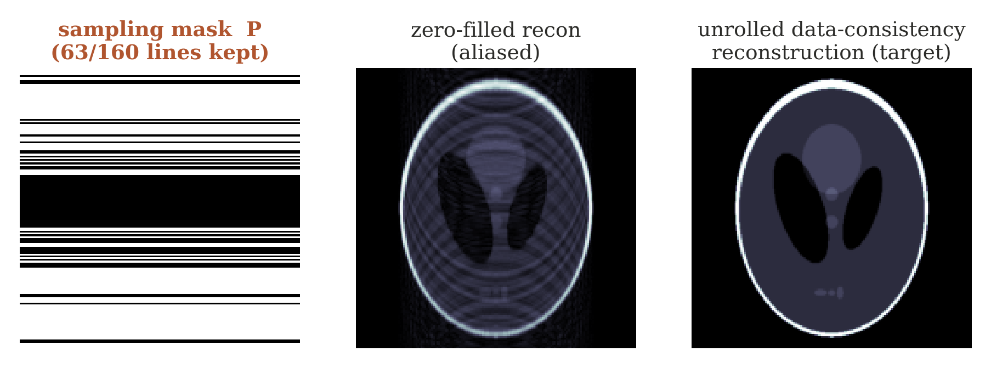
Undersampling mask and the inverse difficulty
Reconstruction from undersampled k-space is ill-posed; compressed-sensing / iterative methods can be computationally expensive.
39

Slide 64
MRI unrolled reconstruction: exact physics, learned correction
data
consistency
learned
prior
data
consistency
learned
prior
Every stage explicitly enforces consistency with measured k-space, alternating with a learned image-domain prior / denoiser.
Teaching move: which block should never be learned? The known sampling / Fourier operation — unless there is a calibration error.
Optional anchor: Aggarwal, Mani & Jacob, MoDL, IEEE TMI 2019.
40

Slide 65
Example B — iterative CT: one physical correction loop
predict projections Axₖ
compare to scanner data y − Axₖ
backproject the residual Aᵀ(·)
denoise / regularize the update
Keep the first CT iteration entirely physical — only after this loop is understood should the unrolled network be drawn.
41

Slide 66
The CT loop becomes unrolled stages
stage 1
(trainable)
stage 2
(trainable)
stage 3
(trainable)
stage 4
(trainable)
Repeated A / Aᵀ operations are computationally costly; hand-tuned regularization may be suboptimal for the true image distribution.
Learn update strength and image prior / correction while retaining A and Aᵀ, exactly, in every stage.
42

Slide 67
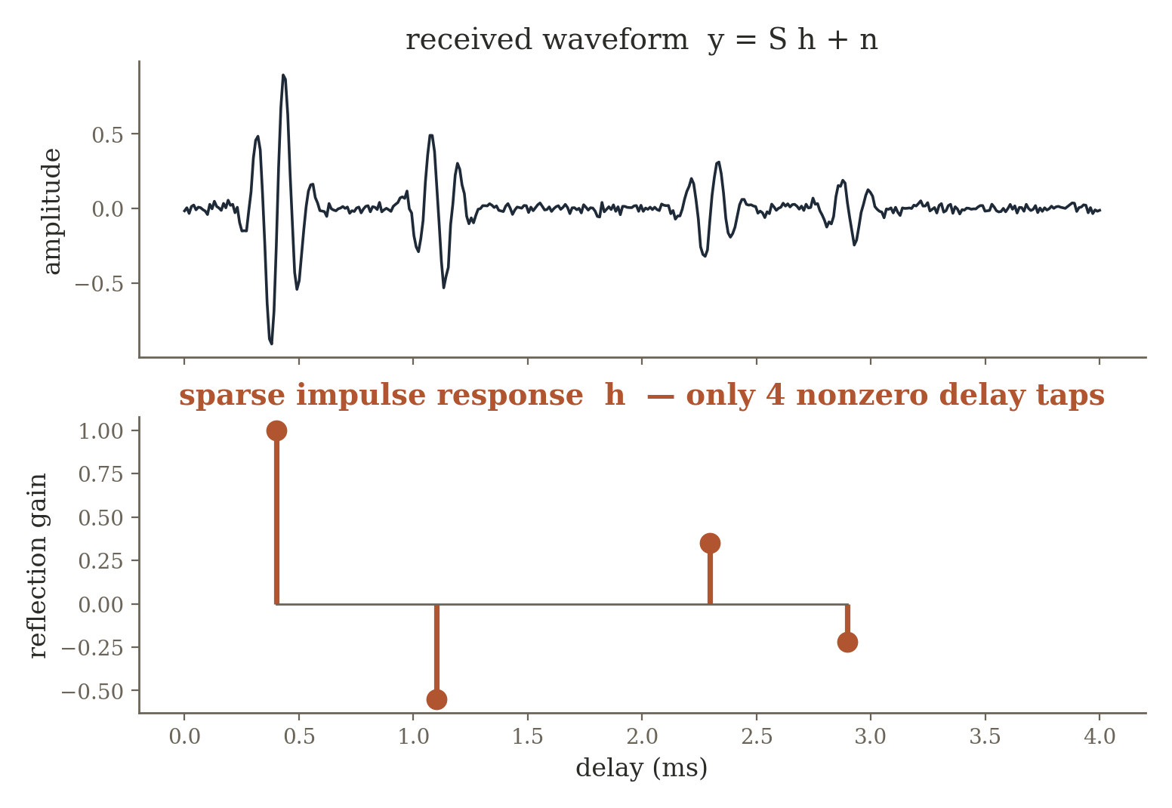
Example C — sparse acoustic channel estimation
y = Sh + n S built from the known transmitted probe / convolution operator
Each nonzero tap is one physical reflection path — soft-thresholding becomes a physical statement: most candidate delays correspond to no path.
LISTA-like stages learn thresholds / transforms that solve the whole family of sparse channel problems rapidly. Optional anchor: Gregor & LeCun, LISTA, ICML 2010.
43

Slide 68
MoDL: learned prior + exact data consistency
x^{k+1} = DataConsistency( D_{φ}(x_{k}), y, A )
The learned block proposes a more plausible state.
The physics block pulls that proposal back toward what the sensor actually measured.
Repeating the pair creates a strong inductive bias and reduces the burden on training data.
Synthesis of Sections 1–3: direct inverse, learned prior, and unrolling are not three unrelated deep-learning tricks. They are three increasingly conservative decisions about how much of a classical inverse pipeline to retain explicitly.
44

Slide 69
4 Learn the Missing Physics
When the analytic model is valuable but does not capture the real environment
45

Slide 70
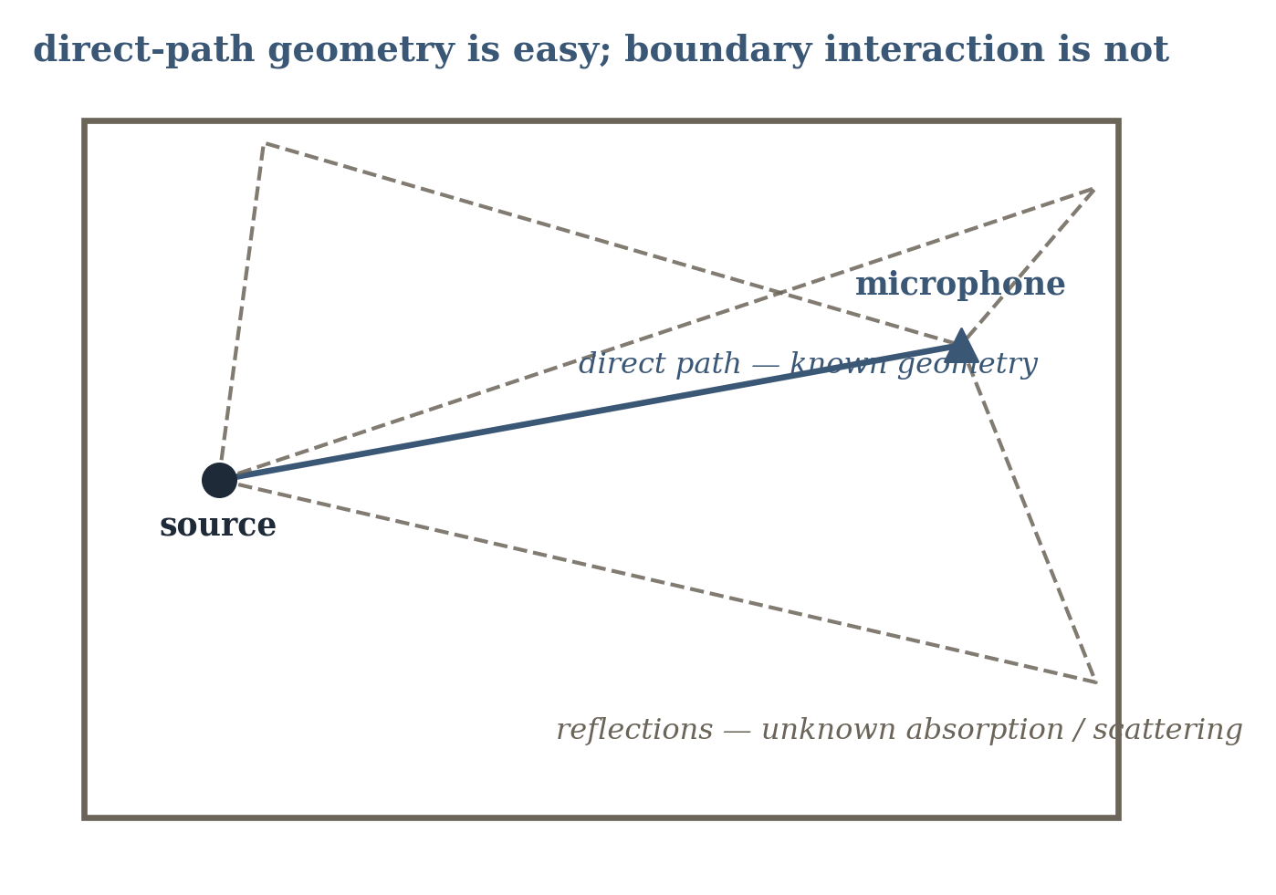
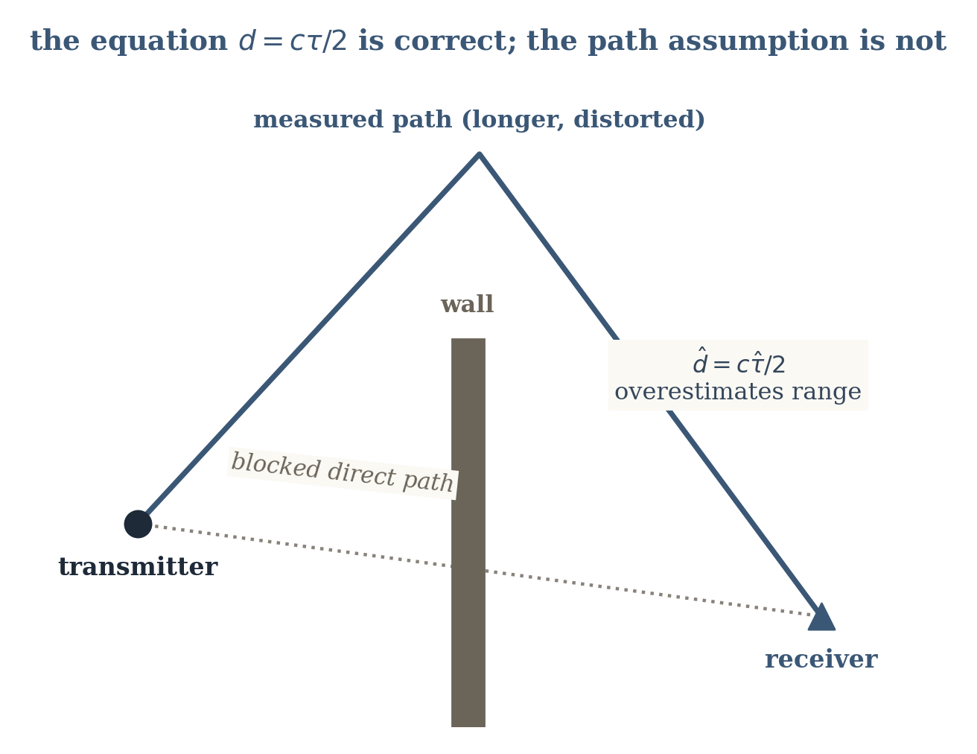
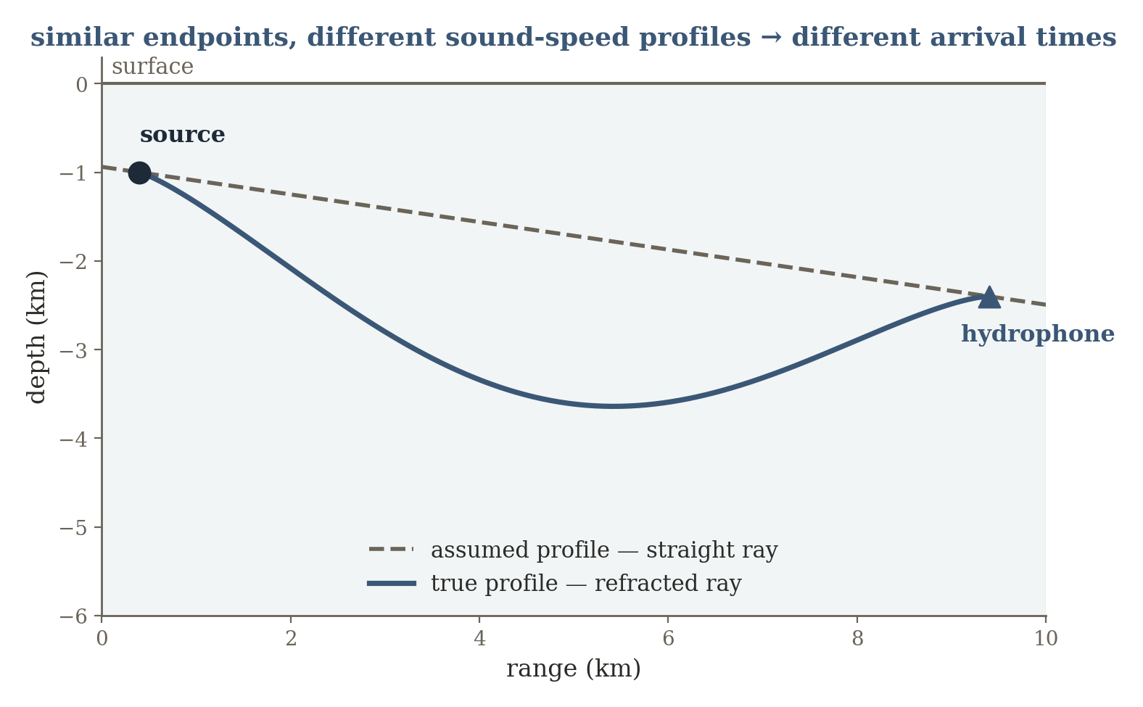
A new failure mode: the forward model itself is imperfect
So far, A or f(x,θ) was assumed correct. Real sensing systems often fail because the analytic model itself is systematically incomplete.
sound-speed profile bends rays;
boundaries vary
known geometry;
uncertain materials / scattering
d = cτ is valid;
measured τ may be a reflected path
Three different environments, one shared design principle: trusted physics remains useful, plus a learned correction for the omitted mechanism.
46

Slide 71
Noise versus model mismatch
y = f_{true}(x,θ) + n = f_{phys}(x,θ) + δ(x,θ,context) + n
Noise n describes stochastic variation around a model.
The mismatch δ is structured: it repeats, because the simplified forward model omits a real mechanism, a latent path, a boundary condition, a calibration error, or an environmental parameter.
This section should sharply distinguish model mismatch from random measurement noise — δ is where the physics is wrong, not where the sensor is noisy.
47

Slide 72
Three hybrid strategies
Parameter learning — keep the functional form f fixed but infer unknown θ.
Residual learning — retain fphys and learn only a residual correction rφ.
Neural component / constitutive relation — replace one difficult submodel inside a larger physical computation.
ŷ = f_{phys}(x,θ) + r_{φ}(x, context)
hybrid model
48

Slide 73
Example A — room acoustics: the physical problem
A source emits sound in a room. The direct path is set mainly by source–microphone geometry and sound speed.
Reflections and reverberation depend on walls, materials, furniture, scattering, directivity, and frequency.
Measurement y: impulse responses or transfer functions between measured source and microphone positions. Target x: the acoustic transfer function at new positions, or latent room parameters.
49

Slide 74
Room acoustics: what is known, what is not
Geometric acoustics or the wave equation provides a meaningful baseline for the direct path and early reflections.
Exact boundary conditions and reflection / scattering coefficients are usually unavailable — a purely geometric model gets delay structure right but misses realistic reverberant energy and frequency dependence.
Teaching move: ask students to classify each quantity as x, θ, a known constant, or a nuisance variable — this reinforces forward-model notation.
50

Slide 75
Learn the acoustic residual or its parameters
Estimate boundary / material parameters, learn a residual acoustic field, or learn one difficult boundary interaction — while keeping propagation geometry explicit.
51

Slide 76
Example B — UWB / radar ranging: line-of-sight vs NLOS
A transmitter and receiver estimate propagation delay. Under line of sight, the earliest path approximates geometric distance.
A wall or corner can block the direct path, so the first detected energy arrives only after reflection or diffraction.
d = cτ (one-way radio ranging; cτ/2 for monostatic radar) — correct for the path whose delay τ is measured
52

Slide 77
Correct law, wrong path assumption
The hidden assumption “measured path = geometric direct path” fails under NLOS, producing a systematic positive bias rather than zero-mean sensor noise.
d_{corrected} = cτ − b_{φ}(features)
53

Slide 78
Example C — underwater acoustics: known wave law, uncertain medium
Sound propagates through water whose sound speed varies with temperature, salinity, and depth. Refraction bends rays; surface and seafloor boundaries create additional paths.
Wave / ray physics is known, but the sound-speed profile c(z,t) and boundary state can be only partially measured and time-varying.
Target x: source range / location, environmental profile, or scene structure. Measurement y: arrival times, phases, amplitudes, or impulse responses at hydrophones.
54

Slide 79
Same endpoints, different ray path: structured mismatch
A nominal straight-line or fixed-profile model produces structured range and phase errors as the medium changes. Should environmental uncertainty be folded into noise? Doing so throws away exploitable structure.
55

Slide 80
Identifiability warning
Technical caution: if both x and an expressive residual rφ are free, the network can explain the measurements in many ways. Hybrid models still need identifiability, calibration data, parameter constraints, or regularization so the learned correction does not absorb the entire physics.
Transition question: what if the unknown physical component is not a static correction, but the rule that carries the state forward through time?
56

Slide 81
5 Learn the Dynamics
When sensing gives trajectories and the unknown is the transition law itself
57

Slide 82
Dynamics: the state-space framing
x_{t+1} = f(x_{t}, u_{t}; θ) + w_{t}
y_{t} = h(x_{t}) + v_{t}
The target isn't a single static inverse — now we want a model for how a physical state evolves under a control input.
A trajectory supplies repeated state-transition examples. Depending on what is known, learning can target only θ, a residual around known dynamics, or the functional form of f itself.
58

Slide 83
Three levels: parameters → residual → equation discovery
classical
parameter ID
residual /
hybrid dynamics
black-box
neural dynamics
sparse equation
discovery
A spectrum, not a binary choice — how much of the transition law do we already trust?
As trust in the known transition law decreases from left to right, the learning target grows from a handful of parameters to an entire governing equation.
59

Slide 84
Example A — mobile robot with wheel slip
Motor commands imply an ideal velocity and turning rate, but actual motion depends on friction, slip, vibration, surface texture, battery voltage, and mechanical asymmetry.
The nominal kinematic model fkin(xt, ut) is known — ideal kinematics systematically miss slip and platform-specific effects.
A fully black-box model would waste the correct geometric part that fkin already gets right.
60

Slide 85
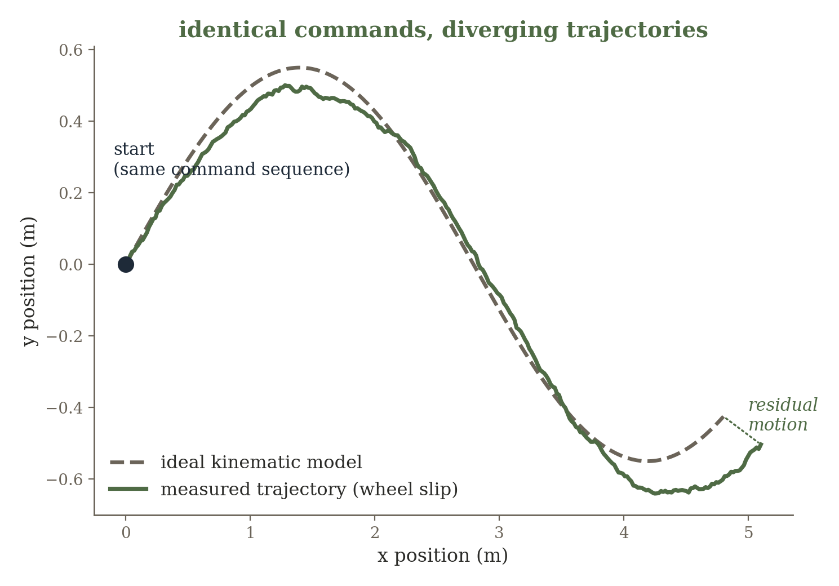
Keep kinematics, learn the residual motion
x_{t+1} = f_{kin}(x_{t},u_{t}) + r_{φ}(x_{t},u_{t},context)
Teaching move: which variables should the residual receive? Surface type, battery voltage, or recent motion history can make the missing physics observable.
61

Slide 86
Example B — HVAC / room thermal dynamics: the physical setup
Room temperature changes because of thermal capacitance, heat transfer through walls, outdoor temperature, HVAC input, solar gain, and occupancy.
Energy-balance / RC-network equations provide the structure.
C (dT/dt) = (T_{out} − T)/R + Q_{HVAC}
Coefficients R and C vary by building and are not known from first principles with enough precision for prediction / control.
62

Slide 87
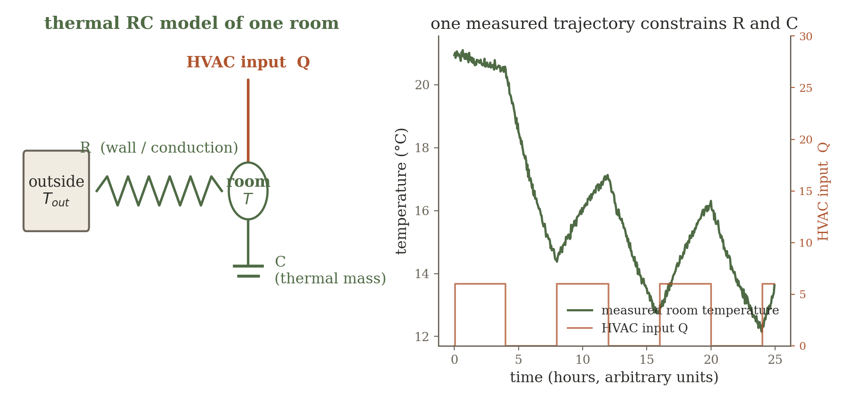
System identification of R and C
Estimate θ = {R, C, …} from measured trajectories rather than replacing the energy-balance model. This distinguishes “learning a physical parameter” from “learning a neural network” — both are system identification.
63

Slide 88
Example C — discover the pendulum's equation
Observe angular position over time, possibly under several initial conditions; construct or estimate velocity and acceleration.
We deliberately pretend the exact equation form is unknown, although the state variables and candidate nonlinearities are available.
A familiar system on purpose — students can check whether the discovered terms make physical sense.
Teaching move: what goes wrong if the derivative estimates are noisy? This exposes a real practical difficulty in equation discovery.
64

Slide 89
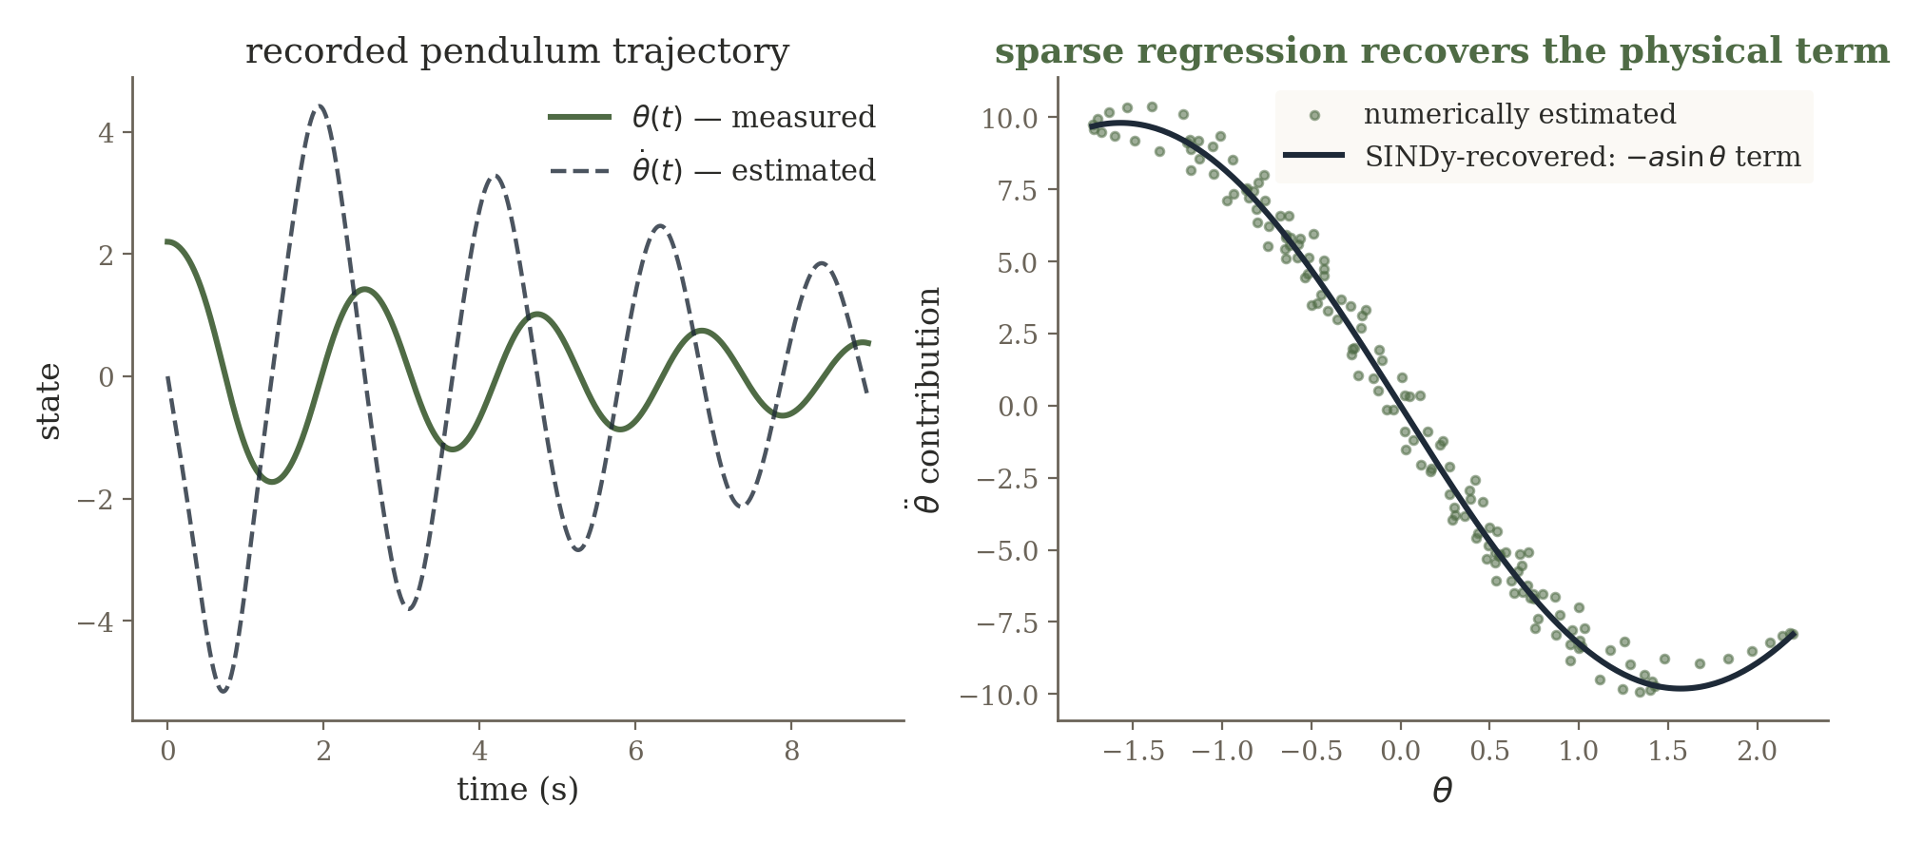
SINDy: sparse identification of nonlinear dynamics
Θ(X) = [ 1, x, x², xv, sin(x), … ]
Ẋ = Θ(X) Ξ
Sparse regression keeps only a few columns — the result is an explicit candidate physical law, not merely a predictor.
Brunton, Proctor & Kutz — SINDy, PNAS 2016
65

Slide 90
Robot vs HVAC vs SINDy: what part of dynamics is trusted?
Compared to... | Trade-off
neural dynamics model | higher expressive power, much lower interpretability
classical parameter ID | SINDy can also search over the equation's form, not just coefficients
Shared question across robot, HVAC, and pendulum: how much of the transition law do we trust? Robot — trust geometry, learn the residual. HVAC — trust the equation form, estimate parameters. Pendulum / SINDy — use data to select the equation terms themselves.
Important caveat: numerical differentiation amplifies noise, and the candidate-library choice strongly affects what gets discovered.
66

Slide 91
6 Constrain Learning with Known Physics
When the law is known but the field is only sparsely observed
67

Slide 92
The reverse problem: law known, state sparsely observed
This section deliberately reverses the previous one. In system identification the trajectory is observed and the law is uncertain. Here the governing law is known, but the spatial / temporal field is only sparsely measured.
System ID (SINDy)
Physics-Constrained Field
state fully observed;
equation unknown
equation known;
state sparsely observed
Same recurring question, mirrored: how much of the physical description can we trust, and where must data fill the gap?
68

Slide 93
A continuous neural field: uφ(r, t)
uφ(r, t): spatial–temporal coordinate → predicted physical field value
Rather than predicting a fixed image, a coordinate network can represent temperature, pressure, displacement, velocity, concentration, or another continuous field.
Automatic differentiation supplies spatial and temporal derivatives of uφ directly — exactly what a PDE residual needs.
69

Slide 94
The physics-constrained objective
L = L_{data} + λ_{PDE}L_{PDE} + λ_{BC}L_{boundary} + λ_{IC}L_{initial}
Ldata — match sensor observations at measured coordinates.
LPDE — penalize residual of the governing equation at collocation points, including places with no sensor.
LBC / LIC — enforce boundary and initial conditions.
The PDE residual is evaluated at collocation points that need no sensor at all — the physical law supervises the network between sensors.
70

Slide 95
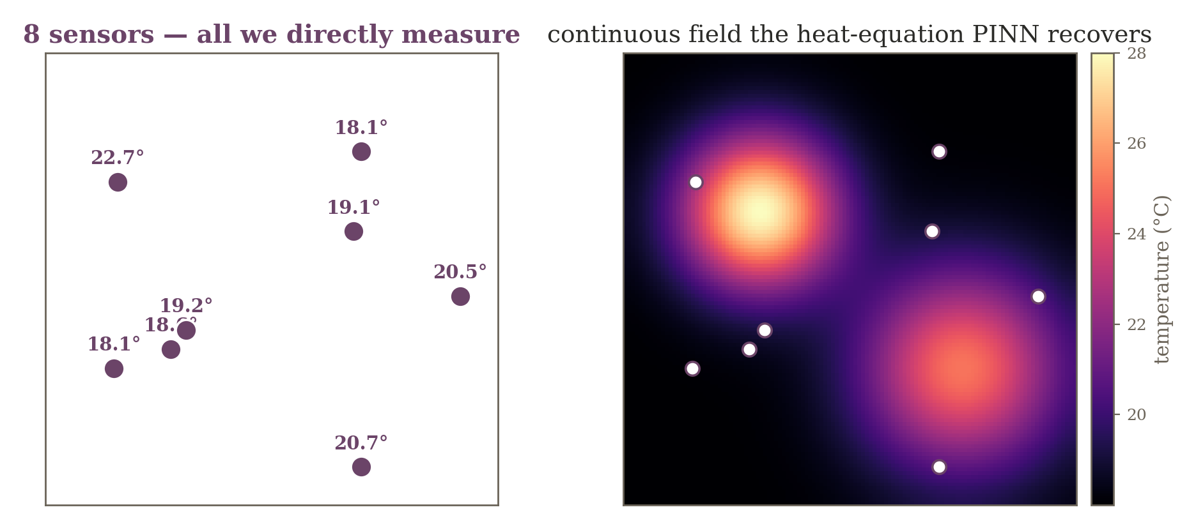
Example A — room temperature field from 8 sensors
∂T/∂t = α∇²T
Pure interpolation admits infinitely many fields through 8 points. The heat equation eliminates every field with impossible spatial curvature or temporal evolution.
71

Slide 96
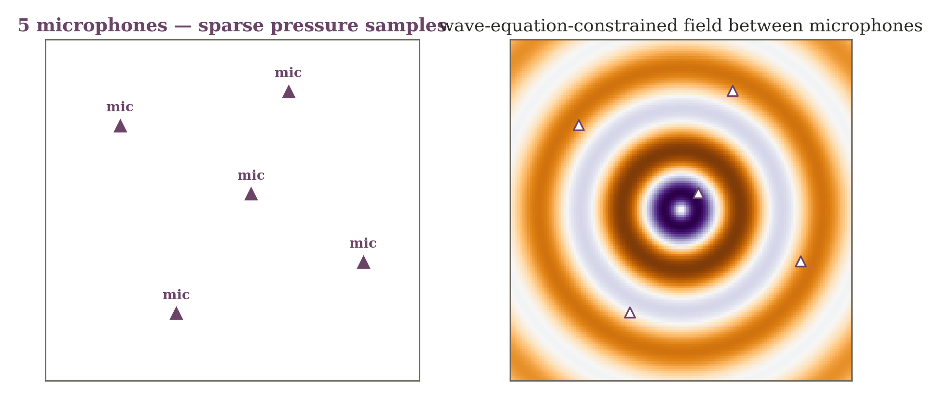
Example B — acoustic pressure field from 5 microphones
Ordinary spatial interpolation ignores phase and wave behavior. A wave / Helmholtz residual enforces physically consistent oscillation between microphones.
72

Slide 97
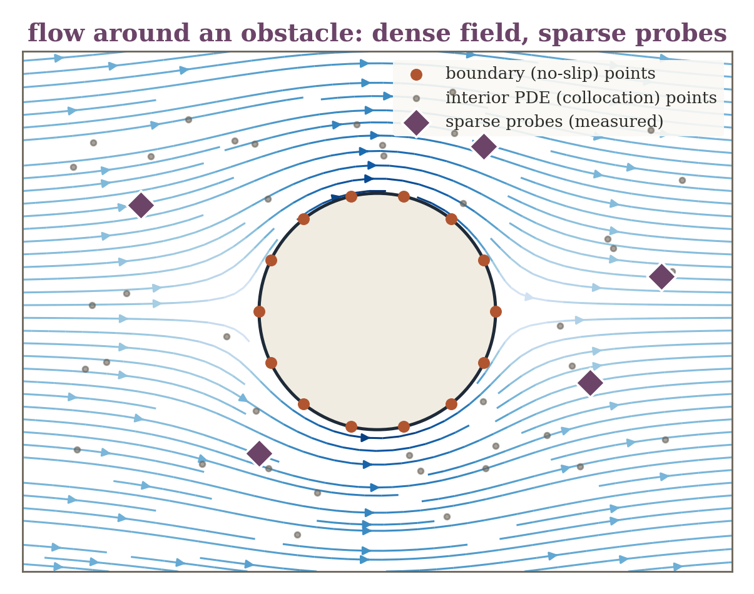
Example C — flow field from sparse probes
Same idea, different PDE family — a conceptual preview, not a full computational-fluid-dynamics treatment.
Pressure / velocity probes sample only a few locations around an obstacle; continuity and momentum equations couple distant points and constrain the boundary separately from the interior.
The idea is not specific to heat or acoustics — any field with a known governing PDE and sparse sensors fits this same recipe.
73

Slide 98
Technical caution: PINNs are not automatically superior
Loss terms can live on very different scales — balancing data, PDE, and boundary losses matters.
High-frequency solutions and stiff PDEs can be difficult to optimize.
If the governing equation or boundary conditions are wrong, physics constraints can force the network toward the wrong solution.
The broader idea matters more than the acronym: use known governing laws as supervision and inductive bias — not as an unquestionable oracle.
74

Slide 99
7 Synthesis: Choose the Learning Target from the Failure Mode
A design procedure, not a catalog of model names
75

Slide 100
The decision ladder, complete
1
2
3
Learn the
Inverse
Learn the
Prior
Unroll the
Optimizer
map too complex
to write down
data alone doesn't
pick one state
objective is right;
iteration is slow
4
5
6
Learn Missing
Physics
Learn the
Dynamics
Constrain with
Physics
model incomplete
or biased
transition law
itself unknown
law known; field
sparsely observed
The architecture follows from what is known, what is measured, and what is missing — not the other way around.
76

Slide 101
Cross-domain synthesis — sensing systems I
System | Known physics | Failure mode | Learning role
Sparse-view CT | ray-integral geometry A | non-uniqueness, slow inverse | learn prior / unroll solver
RF fingerprint localization | partial propagation knowledge | analytic inverse impractical | learn direct inverse
RF tomography (occupancy) | link-sensitivity matrix | underdetermined | learn prior
Accelerated MRI | Fourier transform + sampling mask | iterative reconstruction is slow | unroll / data consistency
Sparse echo / channel est. | convolution with known probe | slow sparse recovery | LISTA-like unrolling
Room acoustics | geometry / wave propagation law | unknown boundaries, materials | learn residual / parameters
77

Slide 102
Cross-domain synthesis — sensing systems II
System | Known physics | Failure mode | Learning role
UWB / radar NLOS ranging | c × delay relation | wrong latent-path assumption | learn bias / mismatch
Underwater acoustics | wave propagation | unknown sound-speed profile | hybrid forward model
Robot / bristle-bot motion | nominal kinematics | wheel slip / friction | system ID / residual dynamics
HVAC thermal dynamics | energy balance (RC model) | unknown coefficients | parameter identification
Pendulum / oscillator | basic state variables | equation form unknown | SINDy — equation discovery
Room temperature field | heat equation | state sparsely observed | PINN / constrained field
Acoustic pressure field | wave / Helmholtz equation | state sparsely observed | PINN / neural field
Fluid flow field | continuity / momentum | state sparsely observed | PINN / neural field
78

Slide 103
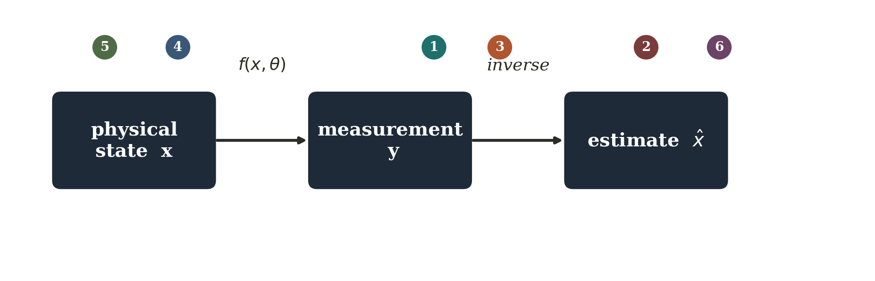
One board diagram to keep visible throughout
circle the inverse g — direct learning circle R(x) — learned priors
circle the iterative arrows — unrolling circle f or θ — model mismatch & system ID
circle the governing PDE — physics-constrained neural fields
Physical sensing ML is the design of inference systems that decide carefully what should come from measurements, what from known physics, and what should be learned from data.
79

Slide 104
Questions worth sitting with
CT: if two images produce nearly identical sparse projections, can any optimizer determine the correct one without additional information?
MRI: why is it wasteful to ask a neural network to re-learn the Fourier transform?
UWB NLOS: is the error best modeled as sensor noise, an unknown latent path, or a systematic bias term?
Temperature PINN: can a field match every sensor perfectly and still violate the heat equation?
80

Slide 105
Selected references
Role | Reference
Direct learned inverse | Zhu et al. — AUTOMAP, Nature 2018
Learned sparse inference / unrolling | Gregor & LeCun — LISTA, ICML 2010
Model-based deep reconstruction | Aggarwal, Mani & Jacob — MoDL, IEEE TMI 2019
Plug-and-play priors | Venkatakrishnan, Bouman & Wohlberg — GlobalSIP 2013
Equation discovery | Brunton, Proctor & Kutz — SINDy, PNAS 2016
Physics-informed neural networks | Raissi, Perdikaris & Karniadakis — J. Comp. Phys. 2019
Kak & Slaney, Principles of Computerized Tomographic Imaging — CT foundations.
81

