Slide 1
Information Dynamics
A Fresh Look at Information
Its Properties and Implications
Ashok K Agrawala
University of Maryland
College park, MD 20742
Agrawala@cs.umd.edu
(301) 405-2525

Slide 2
Collaborators
Christian Almazan
Ron Larsen
Udaya Shankar
Doug Szajda
Suman Banarjee
Marat Fayzullin
…

Slide 3


Slide 4
What Information does this picture carry ?
Has it changed recently?

Slide 5
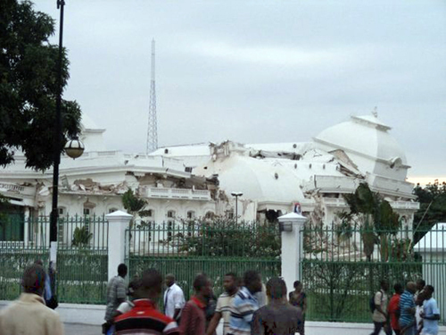

Slide 6
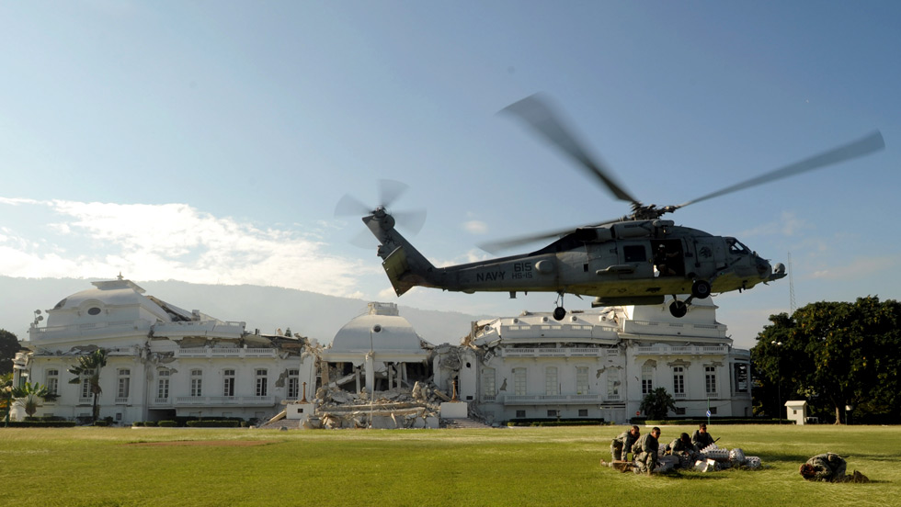

Slide 7


Slide 8
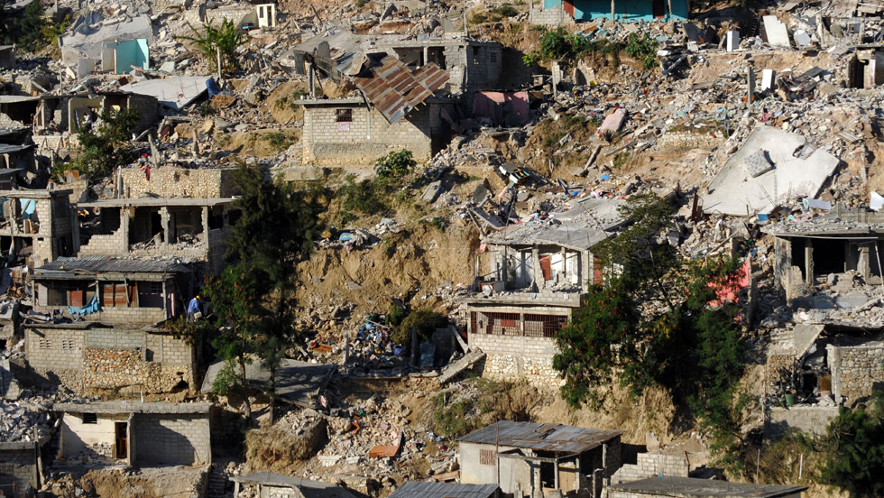

Slide 9
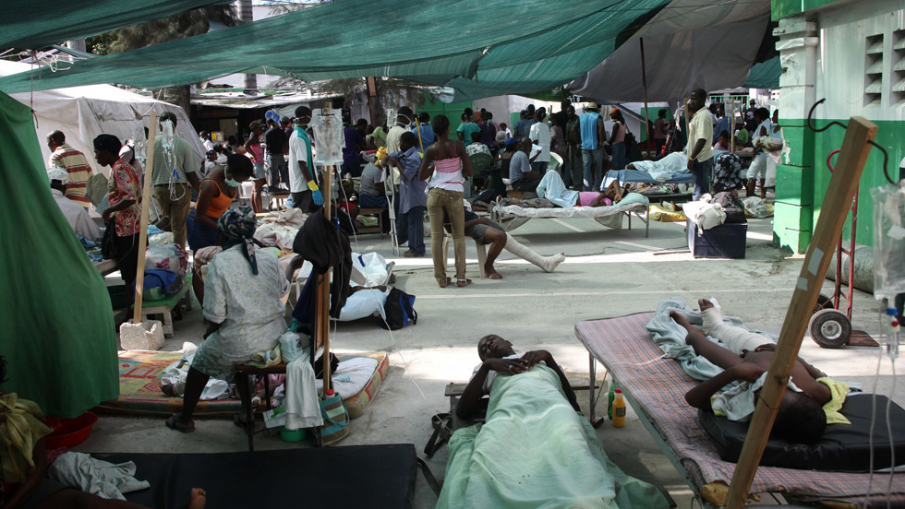

Slide 10


Slide 11
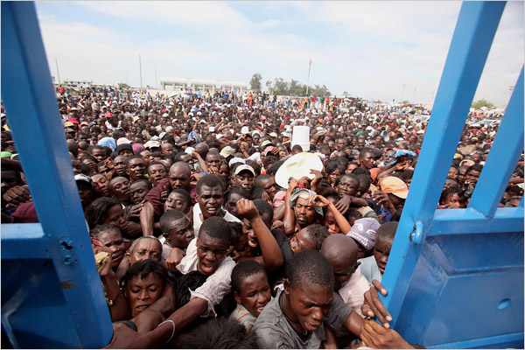

Slide 12


Slide 13
What Information does this sequence carry ?
What is the basic nature
of Information?
Only Sentient entities
handle it!

Slide 14
What is Information ?
Information is different from its representation !!
Can have many representations
  Are they equivalent??
2
2
II
010
TWO
do

Slide 15
Information
Many forms
  Technical – Shannon
  Everyday use
Distinction between information and its Representation

Slide 16
Information and Representation
Sentient Entity
Information
Information
Perceived
Reality
Perceived
Reality
Representation
Representation

Slide 17
Information versus its Representation
No one-to-one mapping
Representation is meaningless without a relation to the appropriate contextual information
Must understand the relationship of the representation to the appropriate information
Representations are transmitted across boundaries via physical means (messaging, voices, etc.)
All typical manipulations of information are through manipulations of its representation
How is the mapping carried out?

Slide 18
Perceived Reality
All a sentient entity knows…
  Facts
  Figures
  Relationships
  Models
  …
…about
  The environment
  another entity or system
  Itself

Slide 19
Perceived Reality
Any local node maintains its view of the universe and other entities in the form of Perceived Reality
Perceived reality is based on
  Prior Model of the Universe and Other Entities
  Explicit information received and processed
    Explicit information is processed to integrate it with the perceived reality
    This integration is based on the model of the universe
    Information may change the model
All actions are initiated using the knowledge of the perceived reality
All systems have been bootstrapped with information to start its “life”

Slide 20
Models
Abstraction of an entity or a system.
Contains properties and relationships believed to be true.
One part of an entity’s perceived reality is the model of another entity.
Constantly refined by information:
  New, Refuting, Removing, …

Slide 21
Perceived Reality
When a message is received
  Its contents are converted into information based on the current perceived reality
  That information is assimilated into the current perceived reality
  A message (representation) can not be converted into information unless the perceived reality contains the means for reverse mapping
    Language – Symbols - …

Slide 22
What is Information ?
Information Entity
Information has many
  interrelationships
    attributes
    properties
Interrelationships are information also
Such interrelationships exist whether they are enumerated/identified or not

Slide 23
Information and Representation
From Information to Representation:
  Some facts will not be retained!
  Loss of relationships!
Manipulation:
  Informational
  Representational

Slide 24
What is Information ?
Information is handled by Sentient Entities
Its representations can be handled by machines
Machines only manipulate representations of information.
2 + 3 = 5
010
Adder
101
011

Slide 25
Information and Representation
Sentient
Information
Information
Operation
Perceived
Reality
Perceived
Reality
Representation
Representation
Operation

Slide 26
What Is Information ?
It is a property /description/characteristics of something
That something may be another piece of information
  An object – Physical, logical, virtual,conceptual – group
  An action
  A trigger
  A relationship
Significance of Information is its interrelationships
  May be direct or indirect
  Exist whether enumerated or not
  May be static or dynamic
Typically retain only small amount of information considered relevant in any system

Slide 27
Nature of Information
Quantifiable
  Only in the context
    Temperature in this room
      Scale
      Accuracy
      Time it was recorded
      Who took it
      What instrument was used - precision
Non-quantifiable
  Most of the information we deal with is of this type

Slide 28
Information Representation
Representations are essential to store, move, or process information
Capture only some aspects/views/projections of information –
  A good system designer carries other aspects in her head.
Example: Data Structure
  Contains not only representation of some quantities but also of some relationships

Slide 29
Information Representation
Use – Requires associating meaning to it
  Meaning can only be assigned in context
Context
  Integer between 50 and 100
  Represents temperature in this room in degrees F.
If both sides understand the context
  Only need representation of integer number
If not
  Common understanding may be English
  Include description along with the temperature value

Slide 30
Information Representation
Algorithm
  Sequence of steps
    Have common understanding of elemental steps
      Depend on the way they are expressed
        Machine instructions
        Higher level language
        Pseudocode
        …

Slide 31
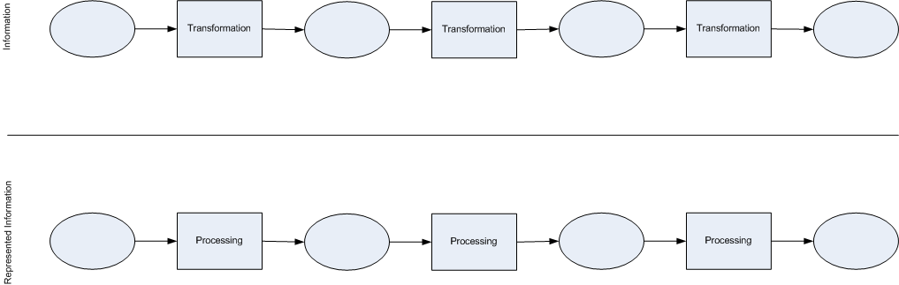
Multi-step Processing

Slide 32
Explicit and Implicit Information
Explicit
  Conveyed explicitly through messages etc.
Implicit
  Derived from explicit and the current knowledge of its relationships - perceived reality- models
  Requires processing
    Spending Resources: Time and Energy
  Can be different for different agents !!

Slide 33
Meta-Information
Ontology
Levels of Meta Information?

Slide 34
What can we do with information
Using Information requires ACTION
Create/capture
Store
Move/Retrieve
Use
  To derive implicit information – making it explicit
  To determine some other action to be taken (Choice)
  To activate a physical operation (output)

Slide 35
Storage of information
In order to store any information which is explicit we need a representation for it
In order to use it as information we need to retrieve it from storage
A representation of information suitable for storage may not retain many interrelationships.
  On retrieving
    some may be recalculated
    some may be lost forever
    In particular – information relating to time will be lost unless time stamping is done
Storing/Retrieving of Information are actions
Note that any and all actions generate lot more information than can be captured

Slide 36
Movement of information
Only explicit (represented) information can be moved from one location to the other
Information to be moved must be in a representation which is understood
  and can be interpreted by the sender and the receiver.
The understanding can come from explicitly represented agreements ( which in turn require conventions - Protocols)
It must be storable
Requires an action

Slide 37
Information movement infrastructure
Network
  Provides the ability to move info from location x to y
  Who initiates the move
    When
    Why
How does y know that x has some information it needs?
How does x know that y needs that information?
Knowledge about where what information is?
  Search Engines !!
    Have to know where the search engine is and how to access it.

Slide 38
Implications of Information Movement
Moving information from location x to location y takes time t_{xy}
At y we can only get information from x which is at least t_{xy} old

Slide 39
Information Uncertainty Principle-1
The perceived reality at any location CAN NOT be the same as the actual reality at any remote location of the global reality
  Due to the transmission and processing delays
It is not sufficient to receive the information
  It must be interpreted and processed to integrate it with the current perceived reality
Perceived reality at a location may be consistent with global/remote reality but can not be the same
We can never have a complete model of another entity:
  models abstract knowledge

Slide 40
Information Uncertainty Principle - 2
Due to finite precision of measurement and representations we can never have complete and precise knowledge of any quantifiable information
We deal with this uncertainty all the time !!!

Slide 41
Value of Information
Implicit understanding of the value
Is entity/agent specific
Use in selecting – deciding among options for processing and taking action
Value of information changes with time
  Different for each agent
  Depends on his perceived reality
  Can not assign a fixed ordinal scale to the value

Slide 42
Value of Information
Value may be captured by uncertainty models
Example – queue length at a router
  The knowledge of the queue length at time t may be precise
  The knowledge at a later time given the value at t will have a variance which will increase with time
  When we want to know the value of queue length from some other location, the information movement delay increases the variance

Slide 43
Information Fusion
Given Multiple observations –
  How to integrate them into one “view”
  One view may contain multiple options / likely scenarios

Slide 44
Capture of Information
Two mechanisms
  Observation –
    Through direct or indirect observation/ monitoring/measurement
  Processing of info – Make implicit information explicit
    To enumerate interrelationships
    To make deductions
    To make inductions
    Using models
Example: Mathematics
  A set of interrelationships with a description of when they apply
  A framework for deductions and inductions to add to the information base
  Analytical Results => defined interrelationships and descriptions of applicability

Slide 45
Action
Physical Action
  Results in physical manipulation
Non- Physical
  Thinking
    Exploring inter-relationships
  Processing within a computer
All Actions take time and consume energy
Begins with an information trigger!
Usually done with respect to an event.

Slide 46
Action
Requires Processing
Starts under the control of “Trigger”
Needs
  Processor
    Possibly other resources
    For some time
  At a location
  Information as input
Outcome
  Additional Information
    Explicit from Implicit
  Trigger(s)
  Storage
  Movement
  Physical results
    Commands to actuators

Slide 47
Three Levels
Information
Represented Information
Physical

Slide 48
Types of Actions
Make implicit information explicit
Carry out interpretation/storage/movement of information
Carry out a physical action by issuing a command to a physical processor
Transform some information into some trigger which is used to control some later action

Slide 49
Trigger
Required for carrying out an action at a particular time/under some conditions
Defines
  What action, where, using what resources, at what time or under what conditions (priority, precedence etc.)
Based on information/location/time/value
Requires processing to convert information into a Trigger
When relationships are fixed – hardwired design – Design time Trigger
When relationships are dynamic trigger has to reflect it

Slide 50
Large Complex System
A collection of N entities capable of carrying out certain operations
Has a mission
Physical resources which can carry out the actions
  At various locations
Mechanism for moving information (communication)
Design Carried out at Information Level

Slide 51
Coordination:
A Distributed System
Information-centric view
Many interacting autonomous agents
  Who needs what information at what time
    Why
    How will he use it
  Who has that information at what time
  How to get the right information at the right place at the right time
  Most algorithms – mechanisms for such movement of information with respect to elemental processing capabilities assumed

Slide 52
Role of Time
Do we need a global/universal clock?
What type of time is appropriate for Information Dynamics?
  Absolute Time with a Counter (though it has a value relative to a starting point)
  Relative Time through Causality

Slide 53
Consistency
How can coordination take place without consistency of models each entity has from one another?
Models between communicating entities must be consistent and accurate enough
Who has the responsibility to fix broken models?
Do models follow a set of rules?
  Logically, relationally, or operationally.

Slide 54
Awareness
In order for entity A to be aware of entity B, entity A must have a model of entity B.
Entity B need not have a model of entity A.
Being aware does not mean having complete knowledge of another.

Slide 55
Levels of Abstraction
Any massively complex system has to be viewed at an appropriate level of complexity
  Information with right degree of detail
  Only relationships of interest and their connections of interest are retained

Slide 56
Planning
Requires knowledge about future
  Using Models
  Estimates
    Accuracy
    Confidence
Knowledge of Dynamics
  Expected changes over time

Slide 57
Example – Mutual Exclusion Problem
N Agents - Cooperative
Any agent can enter its CS if nobody else is in its CS
Check if anybody is in its CS
  If not – enter
  If yes – wait and try again
Each action takes time
  State of agents can change in that time
Entry
CS
Exit
Non – CS
LOOP

Slide 58
Mutual Exclusion Problem
How to know the state of all other agents
  Shared memory model
  Distributed –
    through messages
Shared Memory Model
  Set up a mechanism for sharing of state information
    Semaphore
  Delay
    Atomic action
  Define checking mechanism
Distributed
  Messages
Algorithms vary in terms of the implications of messages and their meaning
Simplest – Ask everybody for permission and enter when received from everybody
How to process a permission request?

Slide 59
Example - Security
A
B
Key
Key
Key – part of “perceived reality”
How does B know which key to use?
Public Key encryption

Slide 60
Example – Link State Routing
Each node measures delays
Periodically send the measured delay to every other node
Determine route as the minimum delay path from source to destination
Need delay when packet gets there not what it was
Estimate of future delay rapidly moves towards the steady state values
IF Steady State values are known
  Reduce communication
  Improve routing
Demonstrated through implementation/simulation

Slide 61
Information-centric Design
Having right information at the right place at the right time
Explicitly take into account the time dependent aspect of information
Explicitly take into account the value of information
Explicitly take into account implicit information
Organize/design system based on the dynamics of information requirements

Slide 62
Rover Technology
Context-aware computing platform
  Location
  Time
Self-describing Information Representations
Services/actions depend on context

Slide 63
Rover Technology

Slide 64
Rover Technology
Designed to address issues in
  Enterprise Applications
  Command and Control Applications
  Pervasive Computing
  Sensor Networks
  …

Slide 65
Rover Network Diagram

Slide 66
Uses of Information Dynamics
Framework for
  Approaching system designs
  System Analysis
    Given a design determine
      All Information Dynamics – Explicit and Implicit
      Decision Structure
      Actions
  System Synthesis
    Outcome required
      Processing/Action needed
      Information needed

Slide 67
Questions???

