Slide 1
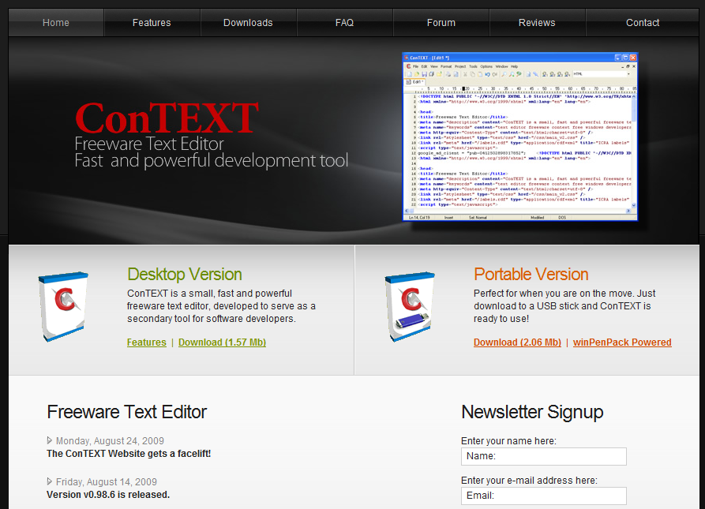
Thoughts on Context
CMSC818G
Spring 2010
Presenter
Christian Almazan
25 February 2010

Slide 2
Thinking About Context
Getting started…

Slide 3
What’s Your Definition?
We mention the word context frequently.
Take out a piece of paper…
  (or type it on your laptop)
  …and write your definition down.
We will not grade you on this…
  …and you only have thirty seconds.

Slide 4
Let’s Take a Survey
Groupings
Environment
Situation
Descriptions
Influence
Interrogative Words
Which, What
Whose
Who, Whom
What, Which
Where
Whence
Whither
When
How
Why, Wherefore
Whether
Surroundings
State
Relationships
Characteristics
Framework
Relevance
Location
Time
Identity
Event

Slide 5
Student Definitions of Context
Did anyone have a definition without a word from the previous slide?
Last year, 14 students asked to give their definition of context, twice.
  Students had overlapping definitions.
  No one matched each other definitions.
  All students changed their definitions the second time, some more drastic than others.

Slide 6
What issues can arise when using context?
Before we examine context…

Slide 7
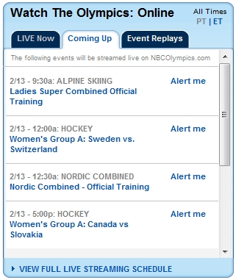

Time Zone Conversion Issues

Slide 8
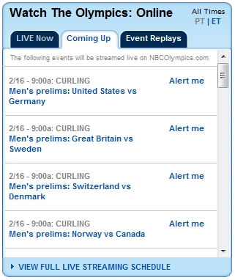
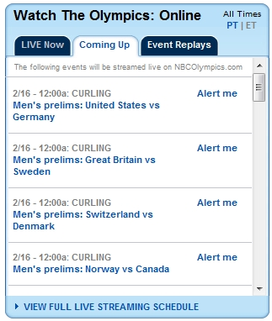
Three Days Later…

Slide 9
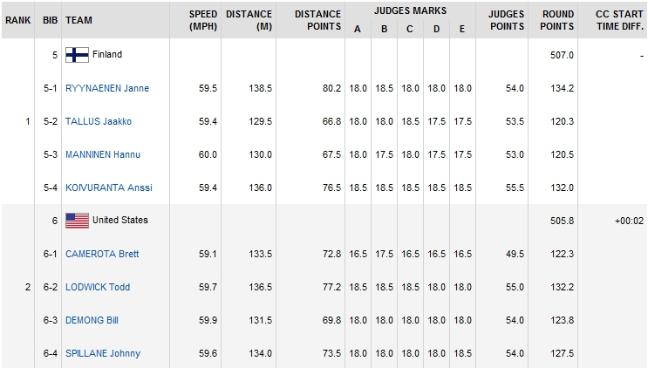
Nordic Combined – Ski Jumping

Slide 10
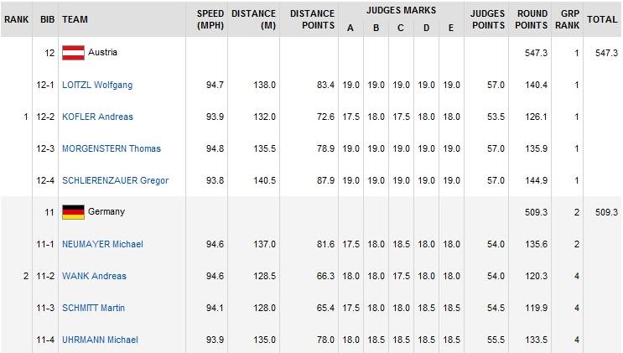
Ski Jumping – Speed?

Slide 11
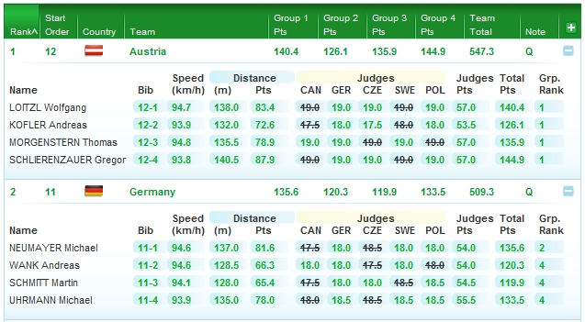
Numbers Not Converted

Slide 12
Understanding without Context?
What does the term Rabbit mean to you?
PHIL858P – What is Information?
  I took this course in Fall 2004.
  What was this class about?

Slide 13
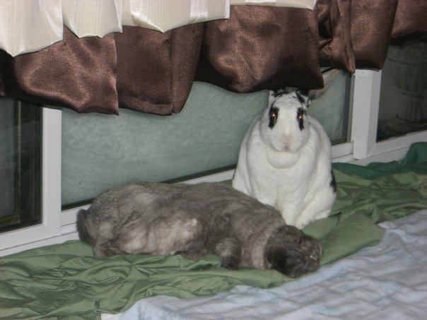
Rabbit – Animals

Slide 14
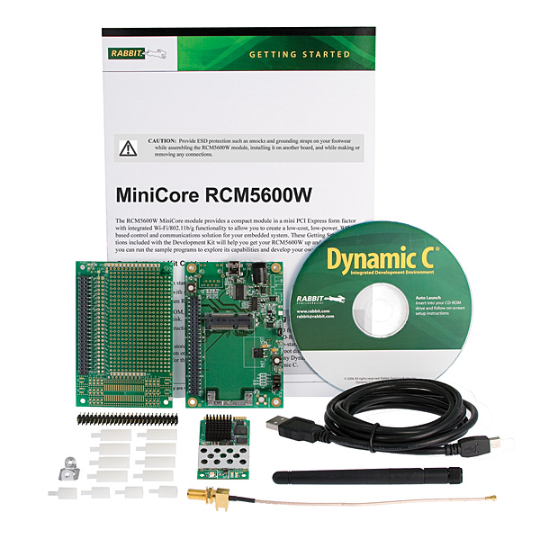
Rabbit – Microprocessor

Slide 15

Rabbit – Automobile

Slide 16
PHIL818P – Course Information
Taught by Professor Jeffrey Bub.
  Ph.D. in Mathematical Physics (1966)
  Distinguished University Professor
    Department of Philosophy
      Foundations of Physics Group
      Philosophy of the Sciences
    Institute for Physical Science and Technology

Slide 17
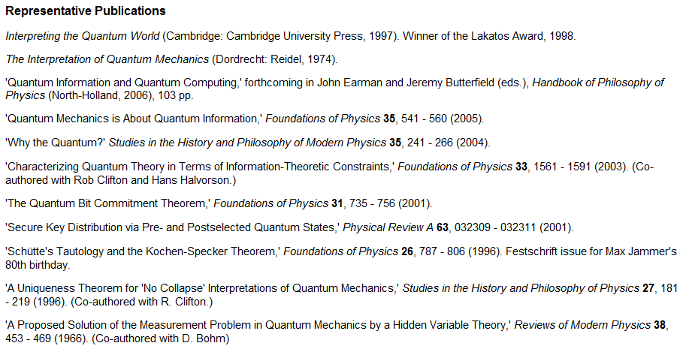
Class – Quantum Information

Slide 18
Basic Context Issues
Sporting Event
  Incorrect Data Transformations
  No Transformation Performed
  Specified Units Incorrect
Missing Context
  Devoid of any context, cannot really tell what someone thinks or wants to convey.
  If we cannot answer a question immediately, we attempt to build up context.

Slide 19
An Aside on Information
We need to understand something first…

Slide 20
Information Types
Technical Information
“Frequently the messages have meaning; that is they refer to or are correlated according to some system with certain physical or conceptual entities. These semantic aspects of communication are irrelevant to the engineering problem.” – Shannon
Everyday Information
The natural use of language and communication between people, typically involving understand and meaning.

Slide 21
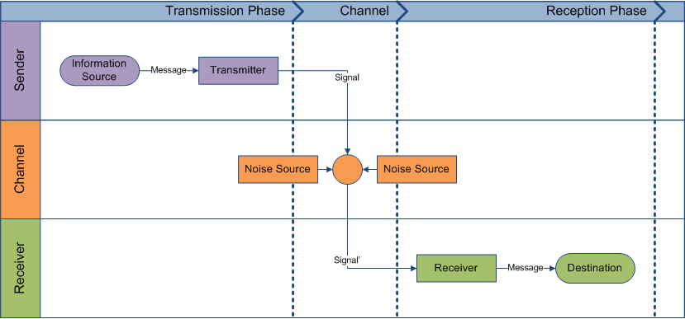
Technical Information

Slide 22
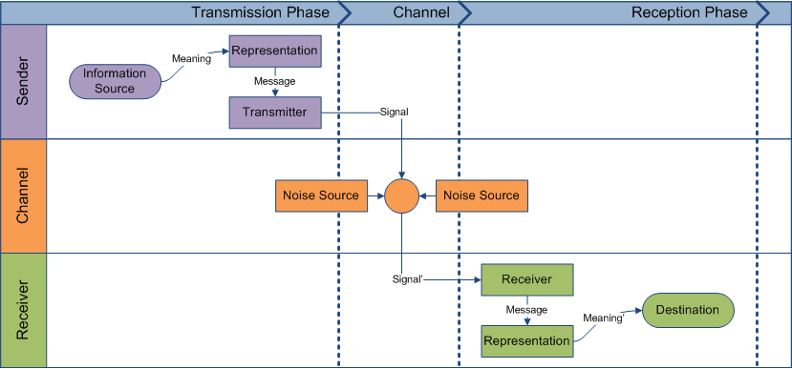
Everyday Information

Slide 23
Definitions of Context
Just a sampling of…

Slide 24
Thoughts Before Moving Forward
“Although frequently used in cognitive sciences or other disciplines, context stays a very ill-defined concept.”
  Bazire and Brézillon
We cannot possibly predefine the entire context possible since the environment it exists within changes frequently.
  Coutaz, Crowley, Dobson, and Garlan

Slide 25
Dictionary Definitions
Etymology
From the Latin contextus
Merriam-Webster
“the part of a discourse that surround a word or passage and can throw light on its meaning”
“the interrelated conditions in which something exists or occurs : environment, setting”
WordNet
“discourse that surrounds a language unit and helps to determine its interpretation”
“to weave together”
“the set of facts or circumstances that surround a situation or event”

Slide 26
Hints to Learn Word Meaning
Drum / Konopak
Sternberg
Perceptual
Similar sound words.
Syntactic
Internal structure or grammatical function of words.
Semantic
General meaning dimensions of a word.
Correct
A specific definition.
Temporal
Spatial
Value
Static
Functional Descriptive
Causal/Enablement
Class Membership
Equivalence

Slide 27
Computer Science Terminology
Traditional Definition
Theory of Computation
“that which surrounds, and gives meaning to, something else”
“in a grammar it refers to the symbols before and after the symbol under construction”
Definitions
Context-Sensitive Help
Contextual Search
Multitasking Context Switch
Context-Sensitive Menu
Terminology

Slide 28
Context-Aware Computing (1)
Schilit / Theimer
Location, spatially close people and objects, and the changes to people and objects.
Schilit / Adams / Want
Where you are.
Who you are with.
What resources are nearby.
Things of Interest move and change over time.
Lighting, noise level, network connectivity, communication costs, communication bandwidth, and social situations.

Slide 29
Context-Aware Computing (2)
Brown
Context, when attached to an electronic note, consists of anything part of that note’s environment.
Location, proximity of objects, critical states, computer states, imaginary states, and time.
Pascoe
Any physical or conceptual states relevant to an entity in nearby environments.
Engelhardt / Schmidt
Relationships of hypertext documents through linking.
Bazire / Brézillon
Constraints of a Given Tasks.

Slide 30
Dey’s Formal Definition
Dictionary Definitions
Should not be considered sufficient or used directly.
Synonyms of Context
Difficult to apply in practice.
Specific Definitions
Limited scope, not widely applicable.
Issues
Context is any information that can be used to characterize the situation of an entity.
An entity is a person, place, or object that is considered relevant to the interaction between a user and an application, including the user and application themselves.
Definition

Slide 31
Operational Definition
Dey provides only a formal definition without regard to the practice of using context in an operational environment.
  Zimmermann, Lorenz, and Oppermann
Categories
Individuality
Activity
Operations
Methods and Reasons of
Context Transitions
Location
Time
Relations
Methods of
Sharing Context Between Entities

Slide 32
Our Definition of Context
Context consists of one or more relationships an information item has to another information item.
An information item can be any entity, either physical (such as a person, a computer, an object), virtual (such as a computer service, a group of people, a message), or a concept (location, time, and so on).
A relationship describes a predicate connecting two or more information items.

Slide 33
Considerations on the Use of Context
Aspects of Context (1)

Slide 34
Interpretation Issues
Experiences
McComb’s Model
Every entity has unique experiences.
Entities utilize experiences to incorporate new information they receive.
Interpretations of information can differ due to individual experiences.
Perception
Synthesis
Hypothesis
Prediction
Testing

Slide 35
Cultural Issues
We utilize and specify context with respect to cultural influences.
We assimilate information from divergent and heterogeneous data sources.
  Each may have relevant data.
  May not match due to cultural formatting.
Example: 02/03/2009
  February 3, 2009 or March 2, 2009?

Slide 36
Abstraction Issues
Whether they explicitly recognize this or not – we use abstractions every day.
How does this affect context?
  We do not always need the lowest level of detail for a piece of context.
  We may need to group related pieces of context together.

Slide 37
Accuracy versus Resolution
Accuracy
  How exact does a value have to be?
    Ten meter accuracy from a coordinate given.
  Measure error between the measured value and the actual value.
Resolution
  How far apart a value can be measured?
    City-Level Resolution vs. Coordinates
What would suit an application?

Slide 38
Critical Aspects of Context
Aspects of Context (2)

Slide 39
Identity
Entities (information items) have names.
One of the most crucial aspects of developing computer systems.
Reality
Physical
Cardinality
Single Named Entity
Specificity
Permanent
Virtual
Group of Related Entities
Small-Scale
Medium-Scale
Large-Scale
Anonymous

Slide 40
Time
We live in a causal universe.
  Anyone supporting a non-causal universe?
Absolute versus Relative
  Absolute – with respect to a global clock
  Relative – starting from a specific point
Representations of Time
  Numerical Digit
  Specific Date and Time
  Execution Graph

Slide 41
Location – Importance / Types
Whether physical or virtual, everything happens at a location.
Physical versus Logical
  Physical – a place in the world
  Logical – a place in a computer system
Absolute versus Relative
  Absolute – shared reference grid
  Relative – with respect to a frame of reference

Slide 42
Location – Representations
Coordinate / Physical
Semantic
Symbolic
(x, y, z)
building → room → floor
country → state → city
on a train approaching Denver
next to a mailbox
in the kitchen

Slide 43
Categorizing Context
Aspects of Context (3)

Slide 44
High Level Groupings
Schmidt et. al.
Self (device state, physiological, cognitive)
Environment (physical, social)
Lieberman / Selker
User
Task
Rodden, Chervest, Davis, Dix
Infrastructure
System
Activity (behavior, task)
System
Application
Location
Physical Context
Schilit, Adams, Want
Computing
User
Physical
Time
[Chen / Kotz]
Sensor Information Level (Derived from Sensors)
Context Information Level (Relevant to a User)
User Level (Interactions)
Barkuus

Slide 45
Low Level Groupings
Space
Time
Real versus Virtual
Mobility by Movement
Mobility by Device Type
Cardinality
Entity Type
Presence
Identity
Attributes
[RCDD]
Location
Time
Nearby Objects
Network Bandwidth
Light
Tilt
Vibration
Proximity
Sound
Temperature
[CK]

Slide 46
Discussion
Searching the Internet to find a definition of context?
First Search Result
  Google
  Bing

