Slide 1

Horus: A WLAN-Based Indoor Location Determination System
Moustafa Youssef
2003
H
O
R
U
S
H
O
R
U
S

Slide 2
Motivation
Ubiquitous computing is increasingly popular
Requires
  Context information: location, time, …
  Connectivity: 802.11b, Bluetooth, …
Location-aware applications
  Location-sensitive billing
  Tourist services
  Asset tracking
  E911
  Security
  …

Slide 3
Location Determination Technologies
GPS
Cellular-based
Ultrasonic-based: Active Bat
Infrared-based: Active Badge
Computer vision: Easy Living
Physical proximity: Smart Floor
Not suitable for indoor
  Does not work
  Require specialized hardware
  Scalability

Slide 4
WLAN Location Determination
Triangulate user location
  Reference point
  Quantity proportional to distance
WLAN
  Access points
  Signal strength= f(distance)
Software based

Slide 5
Roadmap
Motivation
Location determination technologies
Introduction
Noisy wireless channel
Horus components
Performance evaluation
Conclusions and future work

Slide 6
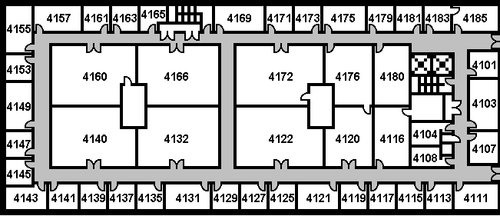
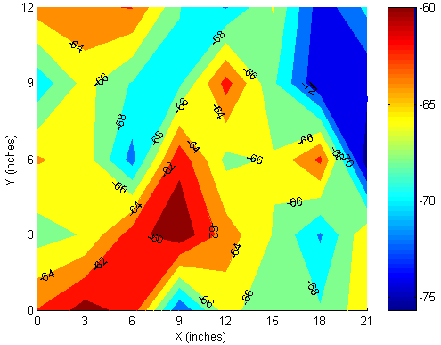
WLAN Location Determination (Cont’d)
Signal strength= f(distance)
Does not follow free space loss
Use lookup table ≡ Radio map
Radio Map: signal strength characteristics at selected locations

Slide 7
WLAN Location Determination (Cont’d)
(x_{i}, y_{i})
[-50, -60]
(x, y)
5
[-53, -56]
13
Offline phase
  Build radio map
  Radar system: average signal strength
Online phase
  Get user location
  Nearest location in signal strength space (Euclidian distance)
[-58, -68]

Slide 8
WLAN Location Determination Taxonomy

Slide 9
Horus Goals
High accuracy
  Wider range of applications
Energy efficiency
  Energy constrained devices
Scalability
  Number of supported users
  Coverage area

Slide 10
Contributions
Taxonomy of WLAN location determination systems
Modeling the signal strength distributions using parametric and non-parametric distributions
Handling correlation between successive samples from the same access point
Allowing continuous space estimation
Clustering of radio map locations
Handling small-scale variations
Compare the performance of the Horus system with other systems

Slide 11
Roadio-map
Motivation
Location determination technologies
Introduction
Noisy wireless channel
Horus components
Performance evaluation
Conclusions and future work

Slide 12
Sampling Process
Active scanning
  Send a probe request
  Receive a probe response

Slide 13
Signal Strength Characteristics
Temporal variations
  One access point
  Multiple access points
Spatial variations
  Large scale
  Small scale

Slide 14
Temporal Variations

Slide 15
Temporal Variations

Slide 16
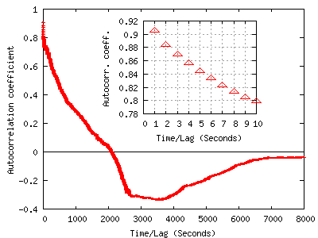
Temporal Variations:
Correlation

Slide 17
Spatial Variations: Large-Scale

Slide 18
Spatial Variations: Small-Scale

Slide 19
Roadio-map
Motivation
Goals
Introduction
Noisy wireless channel
Horus components
Performance evaluation
Conclusions and future work

Slide 20
Testbeds
A.V. William’s
  4th floor, AVW
  224 feet by 85.1 feet
  UMD net (Cisco APs)
  21 APs (6 on avg.)
  172 locations
  5 feet apart
  Windows XP Prof.
FLA
  3rd floor, 8400 Baltimore Ave
  39 feet by 118 feet
  LinkSys/Cisco APs
  6 APs (4 on avg.)
  110 locations
  7 feet apart
  Linux (kernel 2.5.7)
Orinoco/Compaq cards

Slide 21
Horus Components
Basic algorithm [Percom03]
Correlation handler [InfoCom04]
Continuous space estimator [Under]
Locations clustering [Percom03]
Small-scale compensator [WCNC03]

Slide 22
Basic Algorithm:
Mathematical Formulation
x: Position vector
s: Signal strength vector
  One entry for each access point
s(x) is a stochastic process
P[s(x), t]: probability of receiving s at x at time t
s(x) is a stationary process
  P[s(x)] is the histogram of signal strength at x

Slide 23
Basic Algorithm:
Mathematical Formulation

Slide 24
Basic Algorithm:
Mathematical Formulation
Argmax_{x}[P(x/s)]
Using Bayesian inversion
  Argmax_{x}[P(s/x).P(x)/P(s)]
  Argmax_{x}[P(s/x).P(x)]
P(x): User history

Slide 25
Basic Algorithm
Offline phase
  Radio map: signal strength histograms
Online phase
  Bayesian based inference

Slide 26
WLAN Location Determination (Cont’d)
-40 -60 -80
(x_{i}, y_{i})
(x, y)
P(-53/L1)=0.55
[-53]
P(-53/L2)=0.08
-40 -60 -80

Slide 27
Basic Algorithm:
Signal Strength Distributions

Slide 28
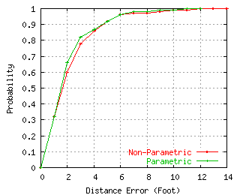
Basic Algorithm:
Results
Accuracy of 5 feet 90% of the time
Slight advantage of parametric over non-parametric method
  Smoothing of distribution shape

Slide 29
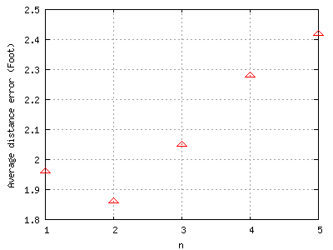
Correlation Handler
Need to average multiple samples to increase accuracy
Independence assumption is wrong

Slide 30
Correlation Handler:
Autoregressive Model
s(t+1)=α.s(t)+(1- α).v(t)
α: correlation degree
E[v(t)]=E[s(t)]
Var[v(t)]= (1+ α)/(1- α) Var[s(t)]

Slide 31
Correlation Handler: Averaging Process
s(t+1)= α.s(t)+(1- α).v(t)
s ~ N(0, m)
v ~ N(0, r)
A=1/n (s₁+s₂+...+s_{n})
E[A(t)]=E[s(t)]=0
Var[A(t)]= m²/n² { [(1- α ^{n})/(1- α)]² + n+ 1- α ² *(1- α ^{2(n-1)})/(1- α ²) }

Slide 32
Correlation Handler: Averaging

Slide 33
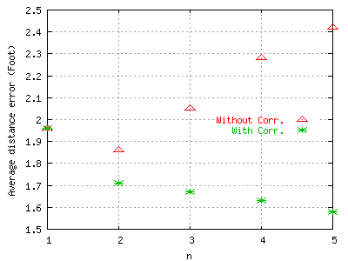
Correlation Handler:
Results
Independence assumption: performance degrades as n increases
Two factors affecting accuracy
  Increasing n
  Deviation from the actual distribution

Slide 34
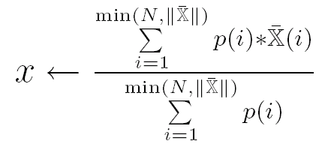
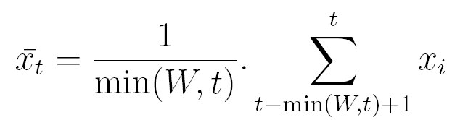
Continuous Space Estimator
Enhance the discrete radio map space estimator
Two techniques
  Center of mass of the top ranked locations
  Time averaging window

Slide 35
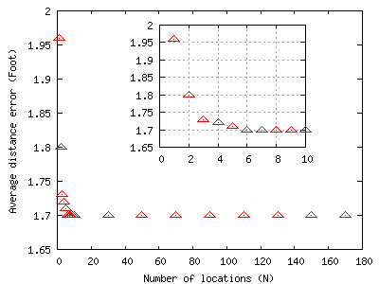
Center of Mass:
Results
N = 1 is the discrete-space estimator
Accuracy enhanced by more than 13%

Slide 36
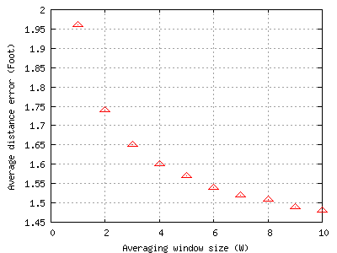
Time Averaging Window:
Results
N = 1 is the discrete-space estimator
Accuracy enhanced by more than 24%

Slide 37
Horus Components
Basic algorithm
Correlation handler
Continuous space estimator
Small-scale compensator
Locations clustering

Slide 38
Small-scale Compensator
Multi-path effect
Hard to capture by radio map (size/time)

Slide 39
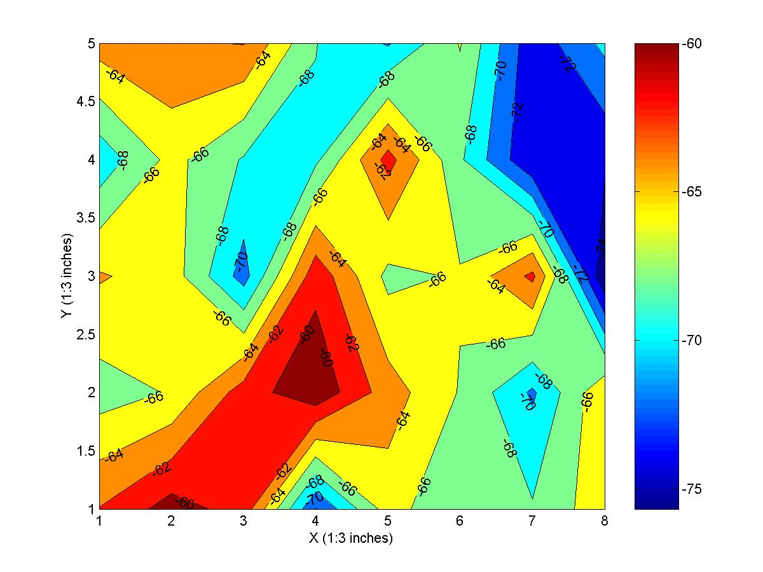
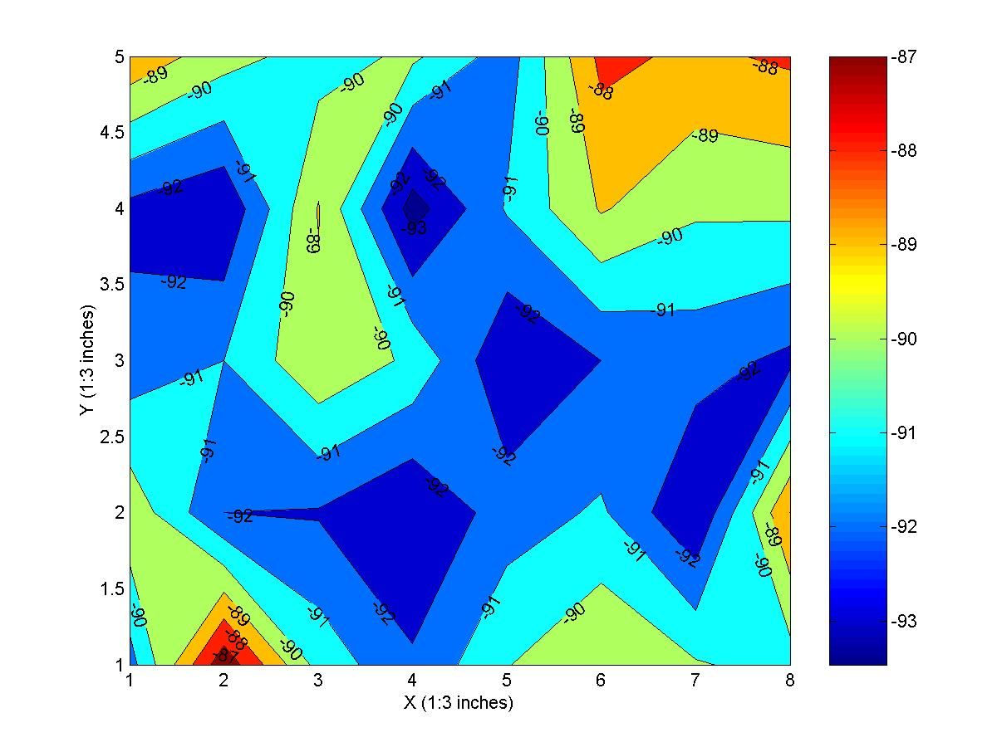
Small-scale Compensator:
Small-scale Variations
AP1
AP2
Variations up to 10 dBm in 3 inches
Variations proportional to average signal strength

Slide 40
Small-scale Compensator:
Perturbation Technique
Detect small-scale variations
  Using previous user location
Perturb signal strength vector
  (s₁, s₂, …, s_{n}) → (s₁±d₁, s₂±d₂, …, s_{n}±d_{n})
  Typically, n=3-4
d_{i} is chosen relative to the received signal strength

Slide 41
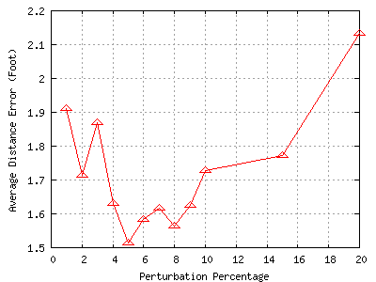
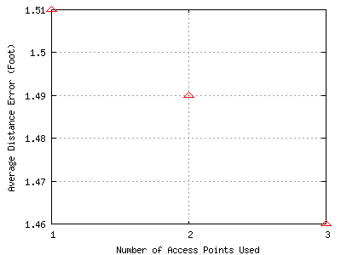
Small-scale Compensator:
Results
Perturbation technique is not sensitive to the number of APs perturbed
Better by more than 25%

Slide 42
Horus Components
Basic algorithm
Correlation handler
Continuous space estimator
Small-scale compensator
Locations clustering

Slide 43
Locations Clustering
Reduce computational requirements
Two techniques
  Explicit
  Implicit

Slide 44
Locations Clustering:
Explicit Clustering
Use access points that cover each location
Use the q strongest access points
S=[-60, -45, -80, -86, -70]
S=[-45, -60, -70, -80, -86]
q=3

Slide 45
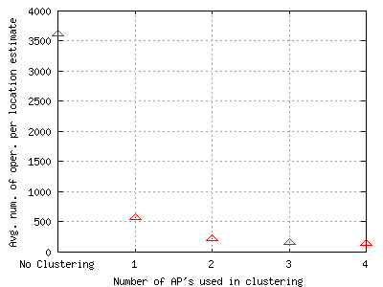
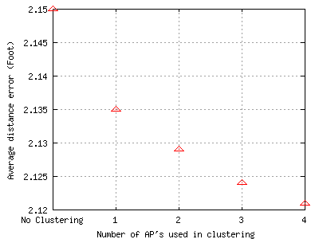
Locations Clustering:
Results- Explicit Clustering
An order of magnitude enhancement in avg. num. of oper. /location estimate
As q increases, accuracy slightly increases

Slide 46
Locations Clustering:
Implicit Clustering
Use the access points incrementally
Implicit multi-level clustering
S=[-60, -45, -80, -86, -70]
S=[-45, -60, -70, -80, -86]
S=(-45, -60, -70, -80, -86)

Slide 47
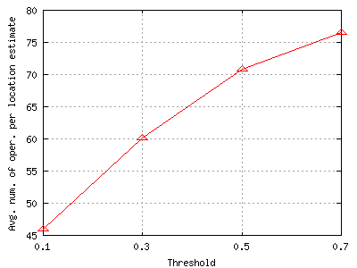
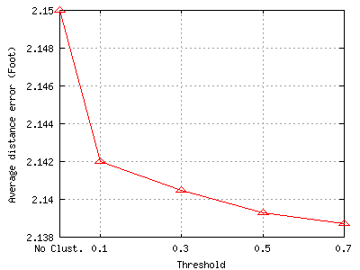
Locations Clustering:
Results- Implicit Clustering
Avg. num. of oper. /location estimate better than explicit clustering
Accuracy increases with Threshold

Slide 48
Horus Components

Slide 49
Roadio-map
Motivation
Location Determination technologies
Introduction
Noisy wireless channel
Horus components
Performance evaluation
Conclusions and future work

Slide 50
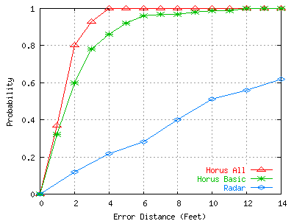
Horus-Radar Comparison

Slide 51
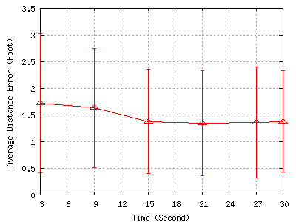
Training Time
15 seconds training time per location

Slide 52
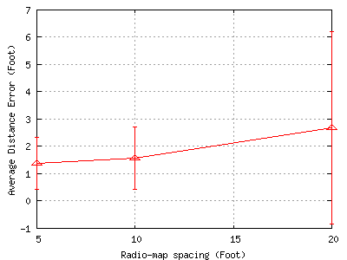
Radio map Spacing
Average distance error increase by as much as 100% (20 feet)
14 feet gives good accuracy

Slide 53
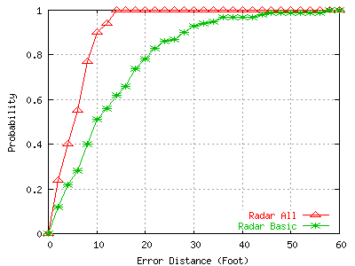
Radar with Horus Techniques
Average distance error enhanced by more than 58%
Worst case error decreased by more than 76%

Slide 54
Roadio-map
Motivation
Location Determination technologies
Introduction
Noisy wireless channel
Horus components
Performance evaluation
Conclusions and future work

Slide 55
Conclusions
The Horus system achieves its goals
High accuracy
  Through a probabilistic location determination technique
  Smoothing signal strength distributions by Gaussian approximation
  Using a continuous-space estimator
  Handling the high correlation between samples from the same access point
  The perturbation technique to handle small-scale variations
Low computational requirements
  Through the use of clustering techniques

Slide 56
Conclusions (Cont’d)
Scalability in terms of the coverage area
  Through the use of clustering techniques
Scalability in terms of the number of users
  Through the distributed implementation
Training time of 15 seconds per location is enough to construct the radio-map
Radio map spacing of 14 feet
Horus vs. Radar
  More accurate by more than 11 feet, on the average
  More than an order of magnitude savings in number of operations required per location estimate
Horus vs. Ekahau

Slide 57
Conclusions (Cont’d)
Modules can be applied to other WLAN location determination systems
  Correlation handling, continuous-space estimator, clustering, and small-scale compensator
Applied to Radar
  Average distance error enhanced by more than 58%
  Worst case error decreased by more than 76%
Techniques presented thesis are applicable to other RF-technologies
  802.11a, 802.11g, HiperLAN, and BlueTooth, …

Slide 58
Future Work
Using the user history in location estimation and clustering
Dynamically change the system parameters based on the environment
Experimenting with other continuous distributions
Optimal placement of access point to obtain the best accuracy
Techniques to ensure user privacy

Slide 59
Future Work (Cont’d)
Different clustering techniques
Automating the radio-map generation process
Changing the radio map based on the environment
Effect of adding/removing access points
Designing and developing applications and services
Handling difference between different manufactures

