Slide 1
Information Dynamics A Fresh Look at Information Its Properties and Implications
Ashok K Agrawala
University of Maryland
College park, MD 20742
Agrawala@cs.umd.edu
(301) 405-2525

Slide 2
Collaborators
Christian Almazan
Shivsubramani Krishnamoorthi
Ron Larsen
Udaya Shankar
Doug Szajda
Suman Banarjee
Marat Fayzullin
Preeti Bhargava
James Lampton
Nick Gramsky
…

Slide 3
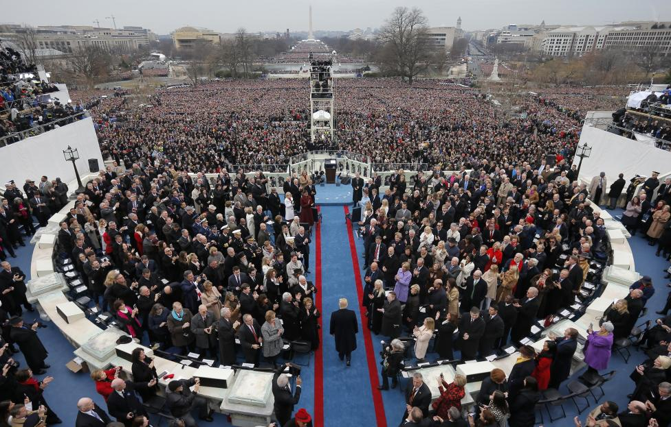

Slide 4
What Information does this picture carry ?

Slide 5
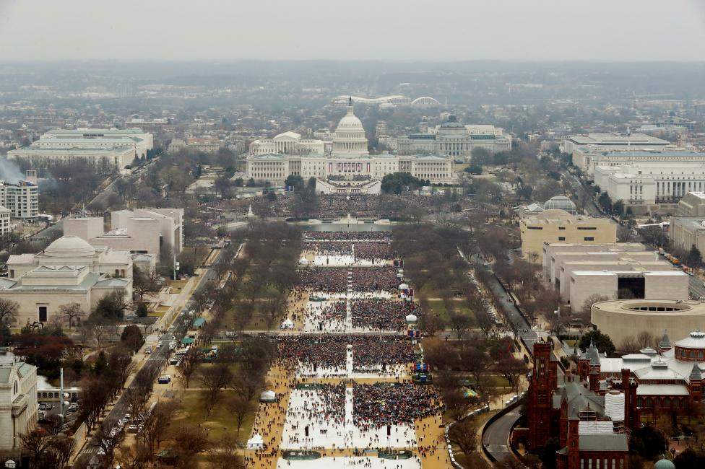

Slide 8
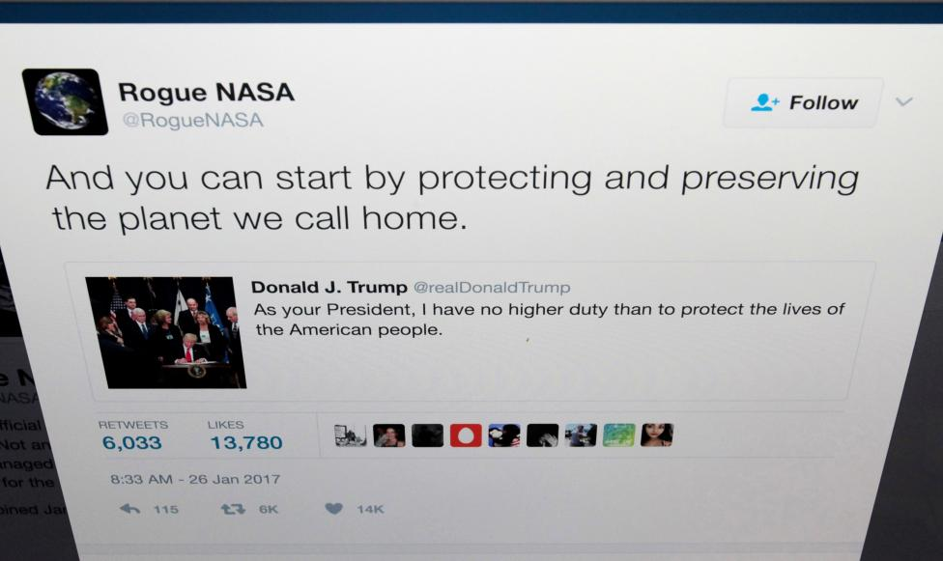

Slide 9
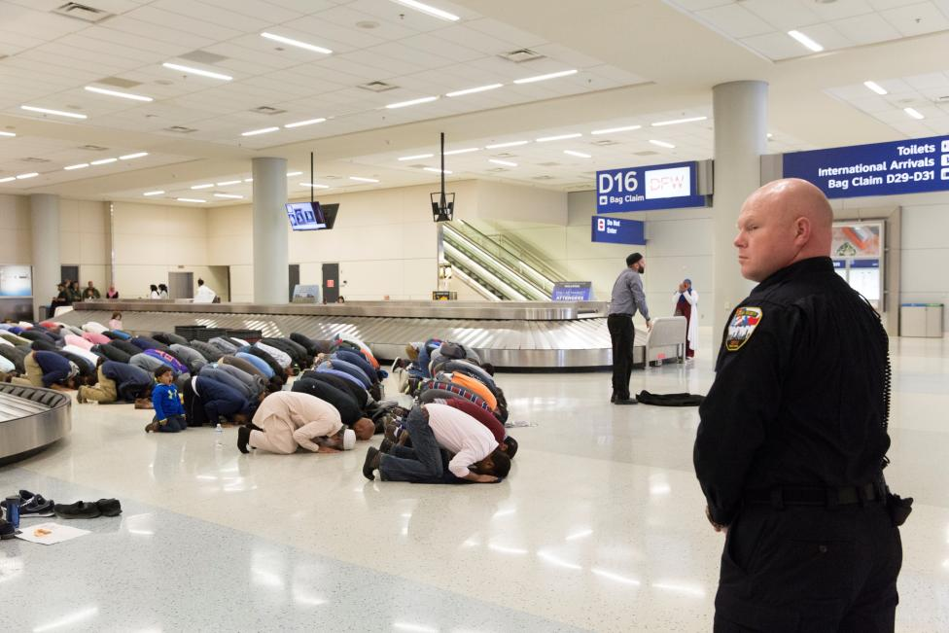

Slide 10
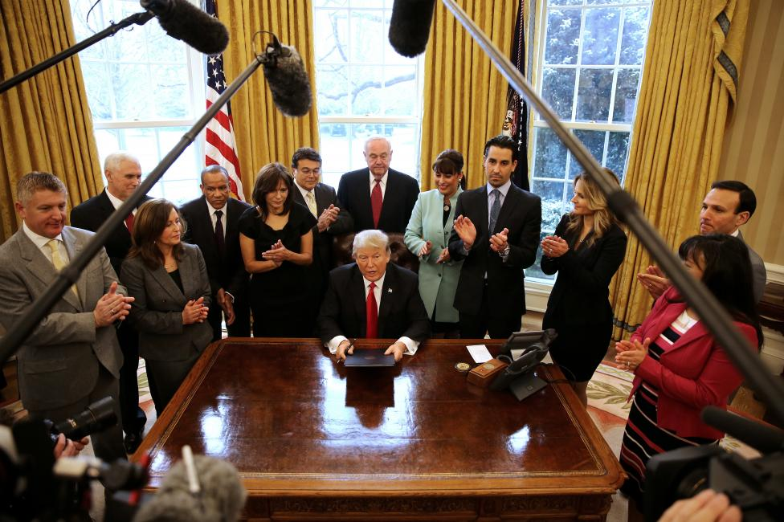

Slide 12
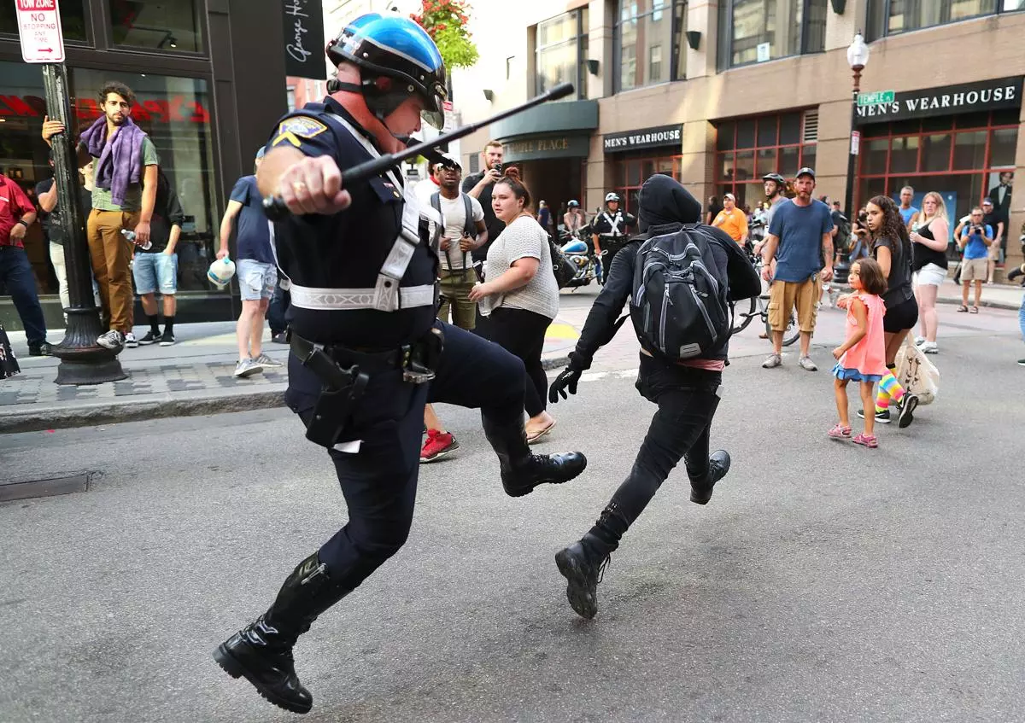

Slide 15
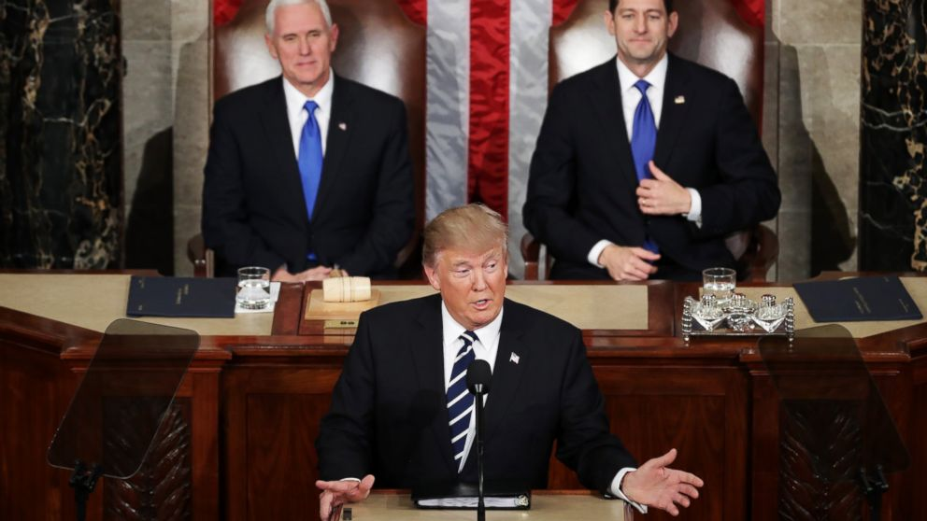

Slide 16
What Information does this sequence carry ?

Slide 17
What is the basic nature of Information?
Only Sentient entities
handle it!

Slide 18
What is Information ?
Information is different from its representation !!
Can have many representations
Are they equivalent??
2
2
II
010
TWO
do

Slide 19
Information
Many forms
Technical – Shannon
Everyday use
Distinction between information and its Representation

Slide 20
Information and Representation
Sentient Entity
Information
Information
Perceived
Reality
Perceived
Reality
Representation
Representation

Slide 21
Information versus its Representation
No one-to-one mapping
Representation is meaningless without a relation to the appropriate contextual information
Must understand the relationship of the representation to the appropriate information
Representations are transmitted across boundaries via physical means (messaging, voices, etc.)
All typical manipulations of information are through manipulations of its representation
How is the mapping carried out?

Slide 22
Perceived Reality
All a sentient entity knows…
Facts
Figures
Relationships
Models
…
…about
The environment
another entity or system
Itself

Slide 23
Perceived Reality
Any local node maintains its view of the universe and other entities in the form of Perceived Reality
Perceived reality is based on
Prior Model of the Universe and Other Entities
Explicit information received and processed
Explicit information is processed to integrate it with the perceived reality
This integration is based on the model of the universe
Information may change the model
All actions are initiated using the knowledge of the perceived reality
All systems have been bootstrapped with information to start its “life”

Slide 24
Models
Abstraction of an entity or a system.
Contains properties and relationships believed to be true (or false).
One part of an entity’s perceived reality is the model of another entity.
Constantly refined by information:
New, Refuting, Removing, …

Slide 25
Perceived Reality
When a message is received
Its contents are converted into information based on the current perceived reality
That information is assimilated into the current perceived reality
A message (representation) can not be converted into information unless the perceived reality contains the means for reverse mapping
Language – Symbols - …

Slide 26
What is Information ?
Information Entity
Information has many
interrelationships
attributes
properties
Interrelationships are information also
Such interrelationships exist whether they are enumerated/identified or not

Slide 27
Information and Representation
From Information to Representation:
Some facts will not be retained!
Loss of relationships!
Manipulation:
Informational
Representational

Slide 28
What is Information ?
Information is handled by Sentient Entities
Its representations can be handled by machines
Machines only manipulate representations of information.
2 + 3 = 5
010
Adder
101
011

Slide 29
Information and Representation
Sentient
Information
Information
Operation
Perceived
Reality
Perceived
Reality
Representation
Representation
Operation

Slide 30
What Is Information ?
It is a property /description/characteristics of something
That something may be another piece of information
An object – Physical, logical, virtual,conceptual – group
An action
A trigger
A relationship
Significance of Information is its interrelationships
May be direct or indirect
Exist whether enumerated or not
May be static or dynamic
Typically retain only small amount of information considered relevant in any system

Slide 31
Nature of Information
Quantifiable
Only in the context
Temperature in this room
Scale
Accuracy
Time it was recorded
Who took it
What instrument was used - precision
Non-quantifiable
Most of the information we deal with is of this type

Slide 32
Information Representation
Representations are essential to store, move, or process information
Capture only some aspects/views/projections of information –
A good system designer carries other aspects in her head.
Example: Data Structure
Contains not only representation of some quantities but also of some relationships

Slide 33
Information Representation
Use – Requires associating meaning to it
Meaning can only be assigned in context
Context
Integer between 50 and 100
Represents temperature in this room in degrees F.
If both sides understand the context
Only need representation of integer number
If not
Common understanding may be English
Include description along with the temperature value

Slide 34
Information Representation
Algorithm
Sequence of steps
Have common understanding of elemental steps
Depend on the way they are expressed
Machine instructions
Higher level language
Pseudocode
…

Slide 35
Multi-step Processing

Slide 36
Explicit and Implicit Information
Explicit
Conveyed explicitly through messages etc.
Implicit
Derived from explicit and the current knowledge of its relationships - perceived reality- models
Requires processing
Spending Resources: Time and Energy
Can be different for different agents !!

Slide 37
Meta-Information
Ontology
Levels of Meta Information?

Slide 38
What can we do with information
Using Information requires ACTION
Create/capture
Store
Move/Retrieve
Use
To derive implicit information – making it explicit
To determine some other action to be taken (Choice)
To activate a physical operation (output)

Slide 39
Storage of information
In order to store any information which is explicit we need a representation for it
In order to use it as information we need to retrieve it from storage
A representation of information suitable for storage may not retain many interrelationships.
On retrieving
some may be recalculated
some may be lost forever
In particular – information relating to time will be lost unless time stamping is done
Storing/Retrieving of Information are actions
Note that any and all actions generate lot more information than can be captured

Slide 40
Movement of information
Only explicit (represented) information can be moved from one location to the other
Information to be moved must be in a representation which is understood
and can be interpreted by the sender and the receiver.
The understanding can come from explicitly represented agreements ( which in turn require conventions - Protocols)
It must be storable
Requires an action

Slide 41
Information movement infrastructure
Network
Provides the ability to move info from location x to y
Who initiates the move
When
Why
How does y know that x has some information it needs?
How does x know that y needs that information?
Knowledge about where what information is?
Search Engines !!
Have to know where the search engine is and how to access it.

Slide 42
Implications of Information Movement
Moving information from location x to location y takes time t_{xy}
At y we can only get information from x which is at least t_{xy} old

Slide 43
Information Uncertainty Principle-1
The perceived reality at any location CAN NOT be the same as the actual reality at any remote location of the global reality
Due to the transmission and processing delays
It is not sufficient to receive the information
It must be interpreted and processed to integrate it with the current perceived reality
Perceived reality at a location may be consistent with global/remote reality but can not be the same
We can never have a complete model of another entity:
models abstract knowledge

Slide 44
Information Uncertainty Principle - 2
Due to finite precision of measurement and representations we can never have complete and precise knowledge of any continuously quantifiable information
We deal with this uncertainty all the time !!!

Slide 45
Value of Information
Implicit understanding of the value
Is entity/agent specific
Use in selecting – deciding among options for processing and taking action
Value of information changes with time
Different for each agent
Depends on his perceived reality
Can not assign a fixed ordinal scale to the value

Slide 46
Value of Information
Value may be captured by uncertainty models
Example – queue length at a router
The knowledge of the queue length at time t may be precise
The knowledge at a later time given the value at t will have a variance which will increase with time
When we want to know the value of queue length from some other location, the information movement delay increases the variance

Slide 47
Information Fusion
Given Multiple observations –
How to integrate them into one “view”
One view may contain multiple options / likely scenarios

Slide 48
Capture of Information
Two mechanisms
Observation –
Through direct or indirect observation/ monitoring/measurement
Processing of info – Make implicit information explicit
To enumerate interrelationships
To make deductions
To make inductions
Using models
Example: Mathematics
A set of interrelationships with a description of when they apply
A framework for deductions and inductions to add to the information base
Analytical Results => defined interrelationships and descriptions of applicability

Slide 49
Action
Physical Action
Results in physical manipulation
Non- Physical
Thinking
Exploring inter-relationships
Processing within a computer
All Actions take time and consume energy
Begins with an information trigger!
Usually done with respect to an event.

Slide 50
Action
Requires Processing
Starts under the control of “Trigger”
Needs
Processor
Possibly other resources
For some time
At a location
Information as input
Outcome
Additional Information
Explicit from Implicit
Trigger(s)
Storage
Movement
Physical results
Commands to actuators

Slide 51
Three Levels
Information
Represented Information
Physical

Slide 52
Types of Actions
Make implicit information explicit
Carry out interpretation/storage/movement of information
Carry out a physical action by issuing a command to a physical processor
Transform some information into some trigger which is used to control some later action

Slide 53
Trigger
Required for carrying out an action at a particular time/under some conditions
Defines
What action, where, using what resources, at what time or under what conditions (priority, precedence etc.)
Based on information/location/time/value
Requires processing to convert information into a Trigger
When relationships are fixed – hardwired design – Design time Trigger
When relationships are dynamic trigger has to reflect it

Slide 54
Large Complex System
A collection of N entities capable of carrying out certain operations
Has a mission
Physical resources which can carry out the actions
At various locations
Mechanism for moving information (communication)
Design Carried out at Information Level

Slide 55
Coordination: A Distributed System
Information-centric view
Many interacting autonomous agents
Who needs what information at what time
Why
How will he use it
Who has that information at what time
How to get the right information at the right place at the right time
Most algorithms – mechanisms for such movement of information with respect to elemental processing capabilities assumed

Slide 56
Role of Time
Do we need a global/universal clock?
What type of time is appropriate for Information Dynamics?
Absolute Time with a Counter (though it has a value relative to a starting point)
Relative Time through Causality

Slide 57
Consistency
How can coordination take place without consistency of models each entity has from one another?
Models between communicating entities must be consistent and accurate enough
Who has the responsibility to fix broken models?
Do models follow a set of rules?
Logically, relationally, or operationally.

Slide 58
Awareness
In order for entity A to be aware of entity B, entity A must have a model of entity B.
Entity B need not have a model of entity A.
Being aware does not mean having complete knowledge of another.

Slide 59
Levels of Abstraction
Any massively complex system has to be viewed at an appropriate level of complexity
Information with right degree of detail
Only relationships of interest and their connections of interest are retained

Slide 60
Planning
Requires knowledge about future
Using Models
Estimates
Accuracy
Confidence
Knowledge of Dynamics
Expected changes over time

Slide 61
Example – Mutual Exclusion Problem
N Agents - Cooperative
Any agent can enter its CS if nobody else is in its CS
Check if anybody is in its CS
If not – enter
If yes – wait and try again
Each action takes time
State of agents can change in that time
Entry
CS
Exit
Non – CS
LOOP

Slide 62
Mutual Exclusion Problem
How to know the state of all other agents
Shared memory model
Distributed –
through messages
Shared Memory Model
Set up a mechanism for sharing of state information
Semaphore
Delay
Atomic action
Define checking mechanism
Distributed
Messages
Algorithms vary in terms of the implications of messages and their meaning
Simplest – Ask everybody for permission and enter when received from everybody
How to process a permission request?

Slide 63
Example - Security
A
B
Key
Key
Key – part of “perceived reality”
How does B know which key to use?
Public Key encryption

Slide 64
Example – Link State Routing
Each node measures delays
Periodically send the measured delay to every other node
Determine route as the minimum delay path from source to destination
Need delay when packet gets there not what it was
Estimate of future delay rapidly moves towards the steady state values
IF Steady State values are known
Reduce communication
Improve routing
Demonstrated through implementation/simulation

Slide 65
Information-centric Design
Having right information at the right place at the right time
Explicitly take into account the time dependent aspect of information
Explicitly take into account the value of information
Explicitly take into account implicit information
Organize/design system based on the dynamics of information requirements

Slide 66
Rover Technology
Context-aware computing platform
Location
Time
Self-describing Information Representations
Services/actions depend on context

Slide 67
Uses of Information Dynamics
Framework for
Approaching system designs
System Analysis
Given a design determine
All Information Dynamics – Explicit and Implicit
Decision Structure
Actions
System Synthesis
Outcome required
Processing/Action needed
Information needed

Slide 68
Questions???

