Slide 1
Information Dynamics and Rover Technology
Ashok Agrawala
Nicholas Gramsky
Department of Computer Science
University of Maryland
Agrawala@cs.umd.edu 301 405 2525

Slide 2
Approach
Information Dynamics
Framework to formulate and address basic issues of information
Rover
System to practice aspects of information dynamics
Current version - third generation

Slide 3
Basic Nature of Information As the term is used in Everyday Use
Always related to many other pieces of information
Its context
Its meaning, usefulness, and use depends on the context
The value of a piece of information depends on the situation and the context
In isolation a piece of information may have very little value
There is a model (collection of relationships) or a template for every generic piece of information
A piece of information may have “Name” which may be used in place of the detailed description with full context.
Car
Make and Model
Color
VIN
Purchase Date
Owner
Insurance
….
Tag No

Slide 4
Template
4AB1575 - MD
Toyota Prius
Red
30904958509
01/15/2012
Agrawala
GEICO
….
A graph for the generic piece of information
Instantiated with specifics
Some specifics may also have templates which can be expanded as needed
Car Tag No
Make and Model
Color
VIN
Purchase Date
Owner
Insurance
….
Tag No

Slide 5
Template
Example - person
Health
Height/weight
Insurance
Primary Doctor
Allergies
Medications
History
….
Lab Tests
Person/Name
Age
Home -Address
Phone
Profession
Religion
….
Health
Ethenicity
email

Slide 6
Relationship
A piece of information also
Carries with it information that can be used in determining the relevance.
Example –
If a car is involved in an accident the date of purchase may have no relevance

Slide 7
Information and Representation
In physical world we only deal with representations of pieces of information
We use many representations for the same piece of information
Distinction of information and its representation has many far reaching implications
Usually only the sentient beings handle the information itself

Slide 8
Information and Representation
Sentient Entity
Information
Information
Perceived
Reality
Perceived
Reality
Representation
Representation

Slide 9
Manipulation?
Machines only manipulate representations of information.
2 + 3 = 5
010
Adder
101
011

Slide 10
Information Manipulation
Sentient
Information
Information
Operation
Perceived
Reality
Perceived
Reality
Representation
Representation
Operation

Slide 11
Primitives
Entities
Real or virtual – Basic building block – Information element
Permanent or temporary
Activities
Carries out a physical or virtual manipulation
Requires resources, energy and information
Generates information
Takes a finite amount of time
Results in change of state of a system
May have sub-activities
Initiated by a trigger – based on some information
Relationships
Describes how two primitives relate to each other
Can also have context
Can be derivative or transitive
Events
Triggers
E.G. Accident on the Road
Situation
What a system is handling
Triggered by some information identifying an event
The information about the situation is organized as a situation graph

Slide 12
Acquiring Information
Manual
A call from the scene
A report by an officer
…..
Sensors
A camera at the intersection
Other sensors
Through services invoked by the system
Weather
Location of Hazardous Material
Person on the wanted list?
…
Triggered automatically or manually.

Slide 13
Logging
All actions and transactions are time-stamped
All sources of information are tracked
Provenance
Can examine off line how the situation graph was built

Slide 14
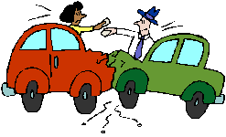
Relevant Information
A situation graph only retains relevant information
Not every detail required in all the situations
Eg. Qualification not relevant during an accident
It’s your mistake. I am never wrong. I have a Ph.D.!!!!

Slide 15
Rover – A Dynamic Information Management System
Integration and fusion platform that provides a mechanism to aid communication of heterogeneous information to all interested and authorized parties.
Provides means to store and retrieve contextual information
Facilitates provision of relevant services and information to the applications/users so that the contextual information could be used more effectively
Processes information as a human might
Collection of dynamic ontologies
Implement ontologies as information is presented

Slide 16
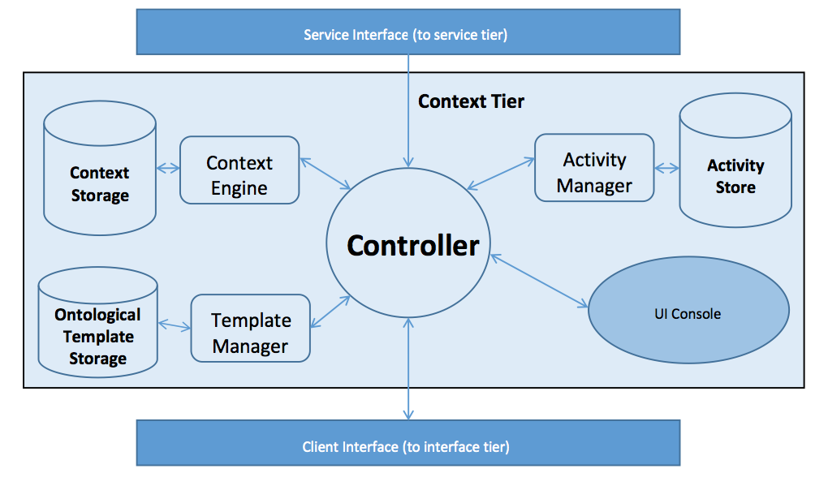
Rover Architecture

Slide 17
Rover Architecture
Controller
Handles inter-module communication
Answers External calls/API
Context Engine
Fetches Context and provides relevant context
Executes Dynamic Ontological Models
Applies filters as needed to build models
Context Store
Graph DB storing context models as they expand and are enriched
Neo4j DB
Template Manager
Fetches Ontological Models from Template Store

Slide 18
Rover Architecture
Template Store
Ontological Store
Holds models for entities, events, relationships and activities
Activity Manager
Monitors activities as they are executed
Evaluates goal states
Monitors context in order to instantiate activities
Service Tier
Access to external services
Client Interface
Web Service / REST API
UI Console (forthcoming)
Displays Situation Graph

Slide 19
Context Storage and Representation
Graph Database (Neo4j)
Native Graph storage and processing
Nodes and Relationships to store data
A Graph –[:records_data]->Node-[:has]->Properties
Nodes are vertices
Can be labeled/indexed
Relationships
Can query relationships just as you would nodes
Both nodes and relationships are enriched through attributes
key : value stores assign attributes in a NoSQL fashion

Slide 20
Example of situation graph expansion and contraction
Accident specifically Road Accident
Start with basic entities an relationships as model dictates
Dynamic Ontological Model expands and contracts situation graph as information becomes present or changes
Information can be cached
Models can be expanded
Activities (as triggered) are instantiated
Add additional entities as needed
Constant enrichment of relevant context

Slide 21
Relevant Context
Context that is relevant to the situation
Relevancy is determined by the situation itself
Based on expert knowledge (static)
Semantic Relatedness (real time)
If a person sustains an injury, certainly his medical information is relevant
If he obtained the injury because of an accident, automobile information is relevant too

Slide 22
Relevant Context - Demo
In the event of a `Road Accident’, relevant context for Car is - driver, passenger, model, owner
In the event of a `Accident induced personal injury’, relevant context for Person involved is - personal information, automobile information, medical records

Slide 23
Accident can be categorized as :
Road Accident
Cars
Persons
Chemical Accident
Building
Persons
Accident
Sub class
Sub class
Road Accident
Chemical Accident

Slide 24
Road Accident - Event
Road
Accident
Cars
Time
Persons
Location
Roads
Entities:
Roads affected
Cars
Persons
Attributes:
Location
Time
Involving
Impacting
Driven By
Involving

Slide 25
Person - Entity
Personal
Professional Credentials
Home
Owns
Person
Medical Records
Has
Automobile
Owns
Friends
Friend of
Name
SSN
Address
Blood Results
Contains
Blood Type
Weight
Height
Diploma?
Master’s Degree?
Job Title
Contains
Allergies

Slide 26
Car - Entity
Car
Person
Owned By
Driver
Driven By
Wanted by Police
Passenger
Passenger In
State
Purchase Details
Purchase Date
Purchase Price
Make
Model
Year
Color
VIN
Damaged?
Drivable?
Has Fuel?

Slide 27
Transport injured - Activity
Locate ambulance(s)
Select and Call
Get stretcher
Get injured
Transport to Location
Determine Location to Transport

Slide 28
Towing - Activity
Locate Towing Service
Place order
Hookup Car
Remove from Scene

Slide 29
Situation Graph – Accident Creation
Road Accident
Car 1
Car2
Persons
Location
Roads affected

Slide 30
Situation Graph
Road Accident
Driver 1
Car 1
Car 2
Location
Roads affected
Driver2
Basic Template Is now instantiated
Basic entity list is added as model expand
Select relevant information about these entities for the situation

Slide 31
Car (Template)
Car
Owner
Owned By
Driver
Driven By
Criminal status
Passenger
Passenger In
State
Purchase Details
Purchase Date
Purchase Price
Make – Model
Tag#
Year
Color
VIN
Damaged?
Drivable?
Has Fuel?

Slide 32
Car – Relevant Information
Car
Owner
Owned By
Driver
Driven By
Criminal status
Passenger
Passenger In
State
Purchase Details
Purchase Date
Purchase Price
Make
Model
Year
Color
VIN
Damaged?
Drivable?
Has Fuel?

Slide 33
Person (Template)
Friends
Friend of
Personal
Professional Credentials
Home
Owns
Person
Medical Records
Has
Automobile
Owns
Name
SSN
Address
Blood Results
Contains
Blood Type
Weight
Height
Diploma?
Master’s Degree?
Job Title
Contains
Allergies

Slide 34
Person – Relevant Context
Friends
Friend of
Personal
Professional Credentials
Home
Owns
Person
Medical Records
Has
Automobile
Owns
Name
SSN
Address
Blood Results
Contains
Blood Type
Weight
Height
Diploma?
Master’s Degree?
Job Title
Contains
Allergies

Slide 35
Situation Graph – After Initial Template
Name
Address
Personal
Road Accident
Driver 1
Car 1
Location
Roads affected
Driver2
Car 2
Person 3
Driver Of
Owns
Stolen?
State
Person 4
Responds Tp
Stolen?
State
Driver Of,
Owns
Name
Address
Personal

Slide 36
Situation Graph – As info comes in
Name
Address
Personal
Road Accident
Driver 1
Car 1
Location
Roads affected
Driver2
Car 2
Person 3
Driver Of
Owns
Stolen?
State
Person 4
Responds Tp
Stolen?
State
Driveable? - Yes
Driver Of,
Owns
John Doe
123 Fake St
Personal
Honda Acord
MD Tags 123ABC

Slide 37
Situation Graph – Dynamic Ontology Performs Automatic Query
Name
Address
Personal
Road Accident
Driver 1
Car 1
Location
Roads affected
Driver2
Car 2
Person 3
Driver Of
Owns
Stolen?
State
Person 4
Responds Tp
Stolen?
Yes
State
Driveable? - Yes
Driver Of,
Owns
John Doe
123 Fake St
Personal
Honda Acord
MD Tags 123ABC

Slide 38
Situation Graph – Context Triggers Activity
Name
Address
Personal
Road Accident
Driver 1
Car 1
Location
Roads affected
Driver2
Car 2
Person 3
Make Arrest
Locate Towing Service
Place order
Hookup Car
Remove from Scene
Driver Of
Owns
Person 4
Responds Tp
Stolen?
Yes
State
Driveable? - Yes
Driver Of,
Owns
John Doe
123 Fake St
Personal
Honda Acord
MD Tags 123ABC

Slide 39
Situation Graph – More Information
Jane Doe
234 Elm St.
Injured!
Name
Address
Personal
Personal
Road Accident
Driver 1
Car 1
Location
Roads affected
Driver2
Car 2
Person 3
Driver Of
Owns
Stolen
No
State
Person 4
Responds Tp
Stolen?
State
Driveable? - Yes
Driver Of,
Owns
John Doe
123 Fake St
Personal
Honda Acord
MD Tags 123ABC

Slide 40
Situation Graph – Context Caches Information by Expanding Situation Graph
Jane Doe
234 Elm St.
Injured!
Name
Address
Personal
Personal
Medical Records
Road Accident
Driver 1
Car 1
Location
Roads affected
Driver2
Car 2
Person 3
Driver Of
Owns
Person 4
Responds Tp
Driver Of,
Owns
John Doe
123 Fake St
Personal

Slide 41
Situation Graph – Context Triggers Activity
Jane Doe
234 Elm St.
Injured!
Name
Address
Personal
Personal
Medical Records
Road Accident
Driver 1
Car 1
Location
Roads affected
Driver2
Car 2
Person 3
Driver Of
Locate ambulance(s)
Select and Call
Get stretcher
Get injured
Transport to Location
Determine Location to Transport
Owns
Person 4
Responds Tp
Assists With
Person 5
Driver Of,
Owns
John Doe
123 Fake St
Personal

Slide 42
Template Generation
Capturing Domain knowledge
The way of handling a situation
Built by experts to start with
Dynamic in Nature
Activity Manager monitors context as it arrives
Values trigger activities or additional context queries
Can we learn the templates??

Slide 43
Value of information
Depends on the situation
Current situation graph
Models for Value of Information
A notion of value of each piece of information in a situation graph is kept and is dynamically updated as additional information arrives
It is used in establishing the priorities
For activities
For acquiring additional information
…

Slide 44
Delegation
Parts of handling of a situation may be delegated to a subordinate system which shares information with the first system.
For example – Handling of Fire if there is any at the time of an accident
The subordinate system feeds information to the main system as needed

Slide 45
Handling…
Incomplete information
Graph nodes with generic labels/information
Duplicate information
Keep each version with source identification
Merge identical information
Uncertain Information
Keep the degree of trust measure.

Slide 46
Merging Situation Graphs
When two situation graphs have a common node the graphs may be merged
Merged situation graph may be given a new identity with the identity of the two situations merged kept in the log.

Slide 47
Concluding Remarks
Information Dynamics
Framework for managing information in most realistic way to support human decision making
Rover Technology
Applicable in a variety of domains
Domain knowledge captured as templates and rules
Chosen technologies that scale well
M-Urgency
Public Safety system deployed at the University of Maryland

