Slide 1
CSMC 818G/CMSC 498Z
Information-Centric Design of
Context-Aware Systems
Using Information Technology to Improve the Quality of Life
Prof. Ashok K Agrawala
© 2018 Ashok Agrawala

Slide 2
What is this Course About
Improving the quality of life using information technology

Slide 3
Participants
CMSC 818G
  22 registered
CMSC 498Z
  3 Registered
– Coordinator

Slide 4
Topics to be Covered
Information Dynamics
Context and Context Aware Computing
Location –Determination and Use
Activity Recognition
Context Modeling and Reasoning
Learning from Context
Context-Aware Systems and Middleware
Proactive Computing
Other issues – Security, Privacy,…

Slide 5
Workload
Class Presentation and Write-up
  Will assign a topic for each class and each student has to pick a topic, present and prepare a 4-5 page summary write up to be distributed to the class before presentation
Class participation and discussions
Project
Midterm
Final

Slide 6
Project
Teams of 2 /3
Projects
Conference Quality paper
Regular updates to be provided in class
Significant part of the grade.

Slide 7
Methodology
Lectures
  Focused presentation on a topic
    Slides posted on the web
    Write up to be distributed before presentation.
      Annotate by adding your notes to catch the major points that may come up in discussions after the presentation.
Proof of Concept Demonstrations/Projects
    MojoNetwork
    CAADS
    ROVER II

Slide 8
Grading
Based on
  Class participation
  Weekly activities
  Papers/Presentations/ Projects
  Exams

Slide 9
Interactions
In Class
Through “Piazza”
Papers
Web postings
Individualized
…

Slide 10
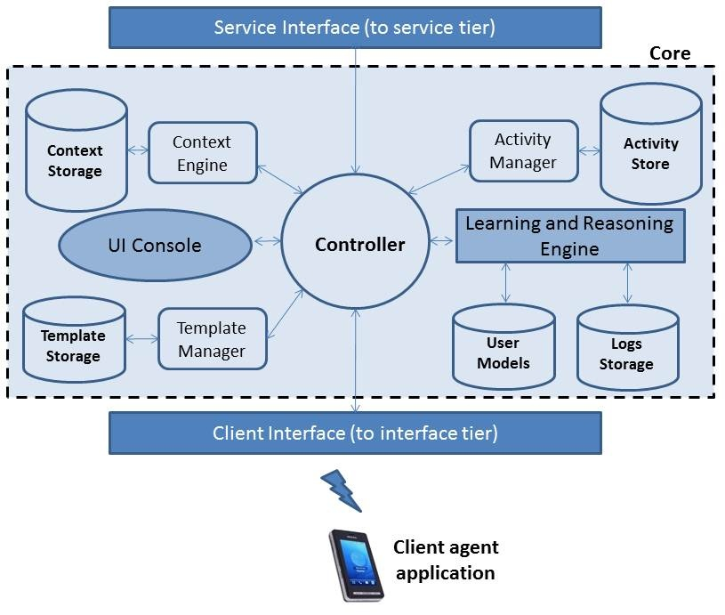
Rover

Slide 11
Quality of Life
What does it mean to you?

Slide 12
Perspective
Individual
  Family
  Social Groups
  Friends Circle
  …
Organization
  International - UN
  Corporation
  Government
  Non-profit

Slide 13
Class Presentations
CMSC818G Students
Signup – Available shortly
Augment the reading list by adding 2-5 recent papers
Make slides available for posting on the web
A write up on the topic
  Presenter
  Others

Slide 14
Project Steps
Organize the group
  Lead/Coordinator
Select a topic
  Prepare Brief Description
    Purpose
    Who are the users
    What impact it will have
    Working title of the paper
Project Plan
  Roles
  Timeline
Resources Required
  Computing
  Datasets
  Sensors
  …
Interim Reports
Final Report
Paper Draft

Slide 15
Project topics

Slide 16
Some Basic Notions
Information
  Fundamental Nature
  Implications
Interrelationships
Context
Models
Limitations of Physical representations of information

Slide 17
Technological aspects
Processing
Storage
Human Interaction
Communications
Inputs
  Sensors
Outputs
  Actuations
  Commands
  Messages

Slide 18
When reading a paper
  Standard paper questions:
    What is the claim of the paper?
    What is the key idea of the paper?
    What are the strengths and weaknesses of the paper?
  Information-Centric questions:
    What is the purpose of the ‘information’ they are capturing?
    What ‘information’ are they capturing?
    How are they capturing the ‘information’?
    How are they storing the ‘information’?
    What ‘contextual information’ are they capturing?
    Is the ‘information’ being captured sufficient or useful for the purpose?
    What additional ‘information’ could or should be captured?

