Slide 1
Applied Mechanism Design For Social Good
John P Dickerson
Lecture #12 – 03/06/2018
CMSC828M
Tuesdays & Thursdays
9:30am – 10:45am

Slide 2
This class:
Organ Exchange

Slide 3
Kidney transplantation
US waitlist: over 100,000
  36,157 added in 2014
4,537 people died while waiting
11,559 people received a kidney
from the deceased donor waitlist
  (See last class’ lecture on deceased donor allocation.)
5,283 people received a kidney from a living donor
  Some through kidney exchanges!
Demand
Supply
Last time, I promise!
[Roth et al. 2004]

Slide 4




Kidney exchange
Wife
Husband
D₁ P₁
Donors
Patients
D₂ P₂
Brother
Brother
(2- and 3-cycles, all surgeries performed simultaneously)

Slide 5
Non-directed donors & chains
[Rees et al. 2009]
NDD
D1
D2
D3
…
Pay it forward
P1
P2
P3
Not executed simultaneously, so no length cap required based on logistic concerns …
… but in practice edges fail, so often some finite cap is used!

Slide 6
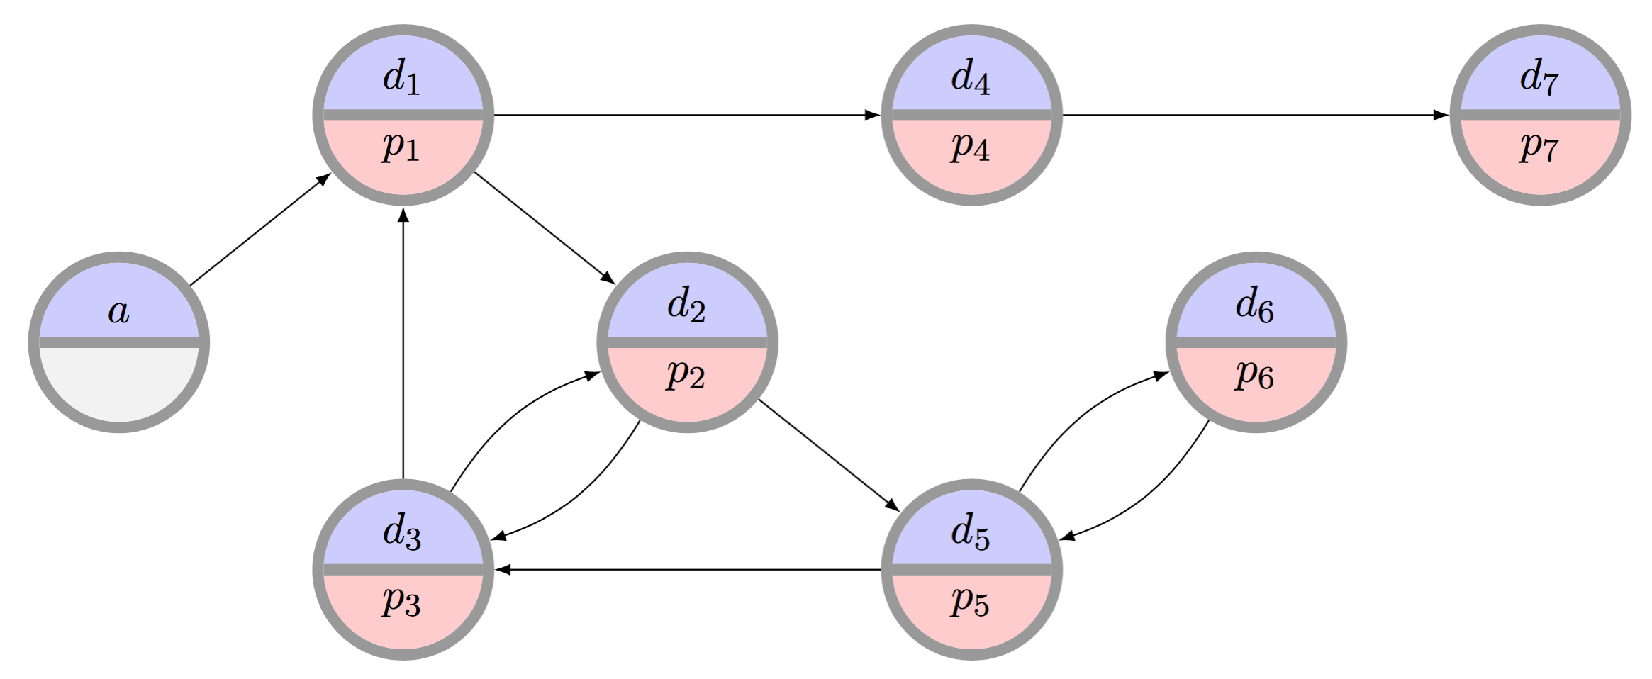
The clearing problem
The clearing problem is to find the “best” disjoint set of cycles of length at most L, and chains (maybe with a cap K)
  Very hard combinatorial optimization problem that we will focus on in the succeeding two lectures.

Slide 7
Individual rationality (IR)
Will I be better off participating in the mechanism than I would be otherwise?
Long-term IR:
  In the long run, a center will receive at least the same number of matches by participating
Short-term IR:
  At each time period, a center receives at least the same number of matches by participating

Slide 8
Strategy proofness
Do I have any reason to lie to the mechanism?
In any state of the world …
  { time period, past performance, competitors’ strategies, current private type, etc }
… a center is not worse off reporting its full private set of pairs and altruists than reporting any other subset
→ No reason to strategize

Slide 9
Efficiency
Does the mechanism result in the absolute best possible solution?
Efficiency:
  Produces a maximum (i.e., max global social welfare) matching given all pairs, regardless of revelation
IR-Efficiency:
  Produces a maximum matching constrained by short-term individual rationality

Slide 10
First: Only Cycles (no Chains)

Slide 11
The basic kidney exchange game
[Ashlagi & Roth 2014, and earlier]
Set of n transplant centers T_{n} = {t₁ ... t_{n}}, each with a set of incompatible pairs V_{h}
Union of these individual sets is V, which induces the underlying compatibility graph
Want: all centers to participate, submit full set of pairs
An allocation M is k-maximal if there is no allocation M' that matches all the vertices in M and also more
  Note: k-efficient → k-maximal, but not vice versa

Slide 12
Individually rational?
[Ashlagi & Roth 2014, and earlier]
Vertices a₁, a₂ belong to center a,
b₁, b₂ belong to center b
Center a could match 2 internally
By participating, matches only 1 of its own
Entire exchange matches 3 (otherwise only 2)
????????????????
Center a
a₁
a₂
Center b
b₁
b₂

Slide 13
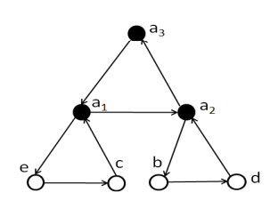
It can get much worse
[Ashlagi & Roth 2014, and earlier]
Theorem: For k>2, there exists G s.t. no IR k-maximal mechanism matches more than 1/(k-1)-fraction of those matched by k-efficient allocation
Bound is tight
All but one of a's vertices is part of another length k exchange (from different agents)
k-maximal and IR if a matches his k vertices (but then nobody else matches, so k total)
k-efficient to match (k-1)*k
Example: k=3

Slide 14
Restriction #1
[Ashlagi & Roth 2014, and earlier]
Theorem: For all k and all compatibility graphs, there exists an IR k-maximal allocation
Proof sketch: construct k-efficient allocation for each specific hospital's pool V_{h}
Repeatedly search for larger cardinality matching in an entire pool that keeps all already-matched vertices matched (using augmenting matching algorithm from Edmonds)
Once exhausted, done

Slide 15
Restriction #2
[Ashlagi & Roth 2014, and earlier]
Theorem: For k=2, there exists an IR 2-efficient allocation in every compatibility graph
Idea: Every 2-maximal allocation is also 2-efficient
This is a PTIME problem with, e.g., a standard O(|V|³) bipartite augmenting paths matching algorithm
By Restriction #1, 2-maximal IR always exists → this 2-efficient IR always exists

Slide 16
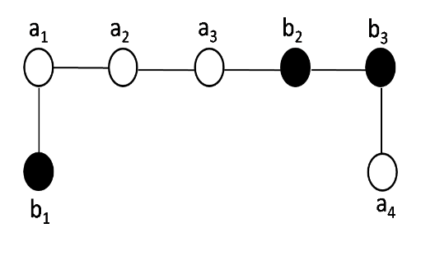
Restriction #3
[Ashlagi et al. 2015]
Theorem: No IR mechanism is both maximal and strategyproof (even for k=2)
Suppose mechanism is IR and maximal . . .

Slide 17
More negative mechanism design results
[Ashlagi et al. 2015]
Just showed IR + strategyproof → not maximal
No IR + strategyproof mechanism can guarantee more than ½-fraction of efficient allocation
Idea: same counterexample, note either the # matched for hospital a < 3, or # matched for hospital b < 2. Proof by cases follows
No IR + strategyproof randomized mechanism can guarantee 7/8-fraction of efficiency
Idea: same counterexample, bounds on the expected size of matchings for hospitals a, b

Slide 18
Hopeless …?

Slide 19
Dynamic, Credit-Based Mechanism
[Hajaj et al. AAAI-2015]
Repeated game
Centers are risk neutral, self interested
Transplant centers have (private) sets of pairs:
  Maximum capacity of 2k_{i}
  General arrival distribution, mean rate is k_{i}
  Exist for one time period
Centers reveal subset of their pairs at each time period, can match others internally

Slide 20
Credits
Clearinghouse maintains a credit balance c_{i} for each transplant center over time
High level idea:
  REDUCE c_{i}: center i reveals fewer than expected
  INCREASE c_{i}: center i reveals more than expected
  REDUCE c_{i}: mechanism tiebreaks in center i’s favor
  INCREASE c_{i}: mechanism tiebreaks against center I
  Also remove centers who misbehave “too much.”
Credits now → matches in the future

Slide 21
The dynamic mechanism
Initial credit update
  Centers reveal pairs
  Mechanism updates credits according to k_{i}
Compute maximum global matching
  Gives the utility U_{g} of a max matching
Selection of a final matching
  Constrained to those matchings of utility U_{g}
  Take c_{i} into account to (dis)favor utility given by matching to a specific center i
  Update c_{i} based on this round’s (dis)favoring
Removal phase if center is negative for “too long”

Slide 22
Theoretical guarantees
Theorem: No mechanism that supports cycles and chains can be both long-term IR and efficient
Theorem: Under reasonable assumptions, the prior mechanism is both long-term IR and efficient

Slide 23
Lots of open problems here
Dynamic mechanisms are more realistic, but …
Vertices disappear after one time period
All hospitals the same size
No weights on edges
No uncertainty on edges or vertices
Upper bound on number of vertices per hospital
Distribution might change over time
...
Project?

Slide 24
What do efficient matchings Even look like …?
Next class: given a specific graph, what is the “optimal matching”
This class: given a family of graphs, what do ”optimal matchings” tend to look like?
Use a stylized random graph model, like [Saidman et al. 2006]:
  Patient and donor are drawn with blood types randomly selected from PDF of blood types (roughly mimics US makeup), randomized “high” or “low” CPRA
  Edge exists between pairs if candidate and donor are ABO-compatible and tissue type compatible (random roll weighted by CPRA)

Slide 25
Random graph Primer
Canonical Erdős-Rényi random graph G(m,p) has m vertices and an (undirected) edge between two vertices with probability p
Let Q be the property of “there exists a perfect matching” in this graph
The convergence rate to 1 (i.e., “there is almost certainly a near perfect matching in this graph) is exponential in p
Pr(G(m,m,p) satisfies Q) = 1 – o(2^{-mp})
At least as strong with non-bipartite random graphs
Early random graph results in kidney exchange are for “in the large” random graphs that (allegedly) mimic the real compatibility graphs
All models are wrong, but some are useful?

Slide 26
A stylized Erdős-Rényi-style Model of Kidney Exchange
In these random (ABO- & PRA-) graphs:
  # of O-{A, B, AB} pairs > {A, B, AB}-O pairs
  # of {A, B}-AB pairs > AB-{A, B} pairs
  Constant difference between # A-B and # B-A
Idea #1: O-candidates are hard to self-match
Idea #2: {A, B}-candidates are hard to self-match
Idea #3: “symmetry” between A-B and B-A (equally hard to self-match, give or take)

Slide 27
Efficient matching in dense graphs with only cycles
Under some other assumptions about PRA …
Almost every large random (ABO- & PRA-) graph has an efficient allocation that requires exchanges of size at most 3 with the following:
  X-X pairs are matched in 2- or 3-way exchanges with other X-X pairs (so-called “self-demand”)
  B-A pairs are 2-matched with A-B pairs
  The leftovers of {A-B or B-A} are 3-matched with “good” {O-A, O-B} pairs and {O-B, O-A pairs}
  3-matches with {AB-O, O-A, A-AB}
  All the remaining 2-matched as {O-X, X-O}

Slide 28
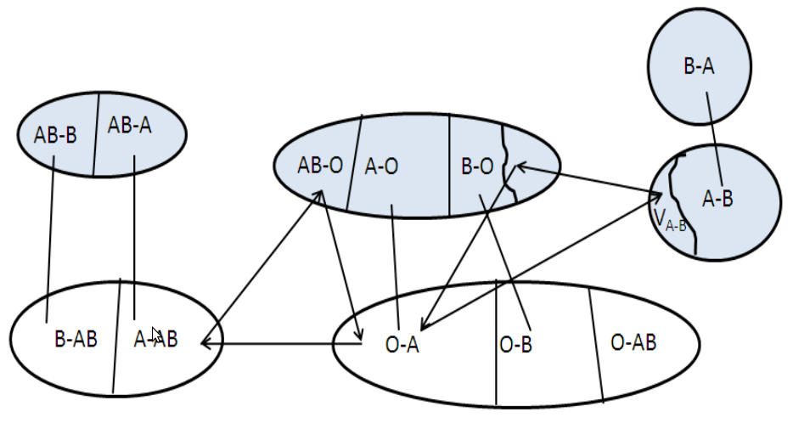
Visually …

Slide 29
Price of fairness
Efficiency vs. fairness:
  Utilitarian objectives may favor certain classes at the expense of marginalizing others
  Fair objectives may sacrifice efficiency in the name of egalitarianism
Price of fairness: relative system efficiency loss under a fair allocation [Bertismas, Farias, Trichakis 2011]
[Caragiannis et al. 2009]

Slide 30
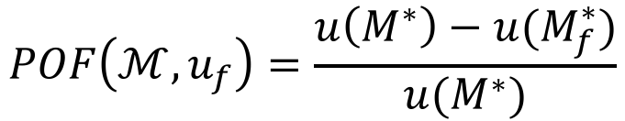
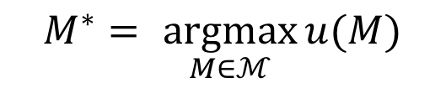
Price of fairness in kidney exchange
[Dickerson et al. AAMAS-14]
Clearing problem: find a matching M* that maximizes utility function
$$M^{∗}= \underset{M∈ℳ}{argmax}{u(M)}$$
Price of fairness: relative loss of match efficiency due to fair utility function
$$POF\left(ℳ,u_{f}\right)=\frac{u\left(M^{∗}\right)−u(M_{f}^{∗})}{u(M^{∗})}$$

Slide 31
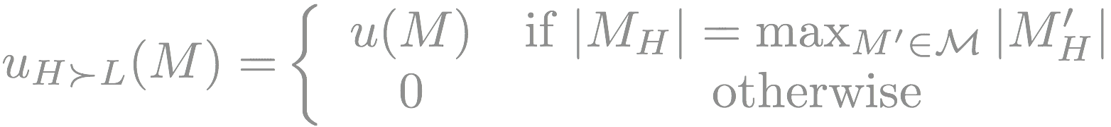

V_{{L,H}} : lowly-, highly-sensitized vertices
λ : fraction of pool that is lowly-sensitized
p_{{L,H}} : prob. ABO-compatible is tissue-type incompatible
p = λp_{L} + (1-λ)p_{H} : average level of sensitization
“Most stringent” fairness rule:
Theorem
Assume p < 2/5, λ ≥ 1-p, and “reasonable” distribution of blood types.
Then, almost surely as n → ∞,
(And this is achieved using cycles of length at most 3.)

Slide 32
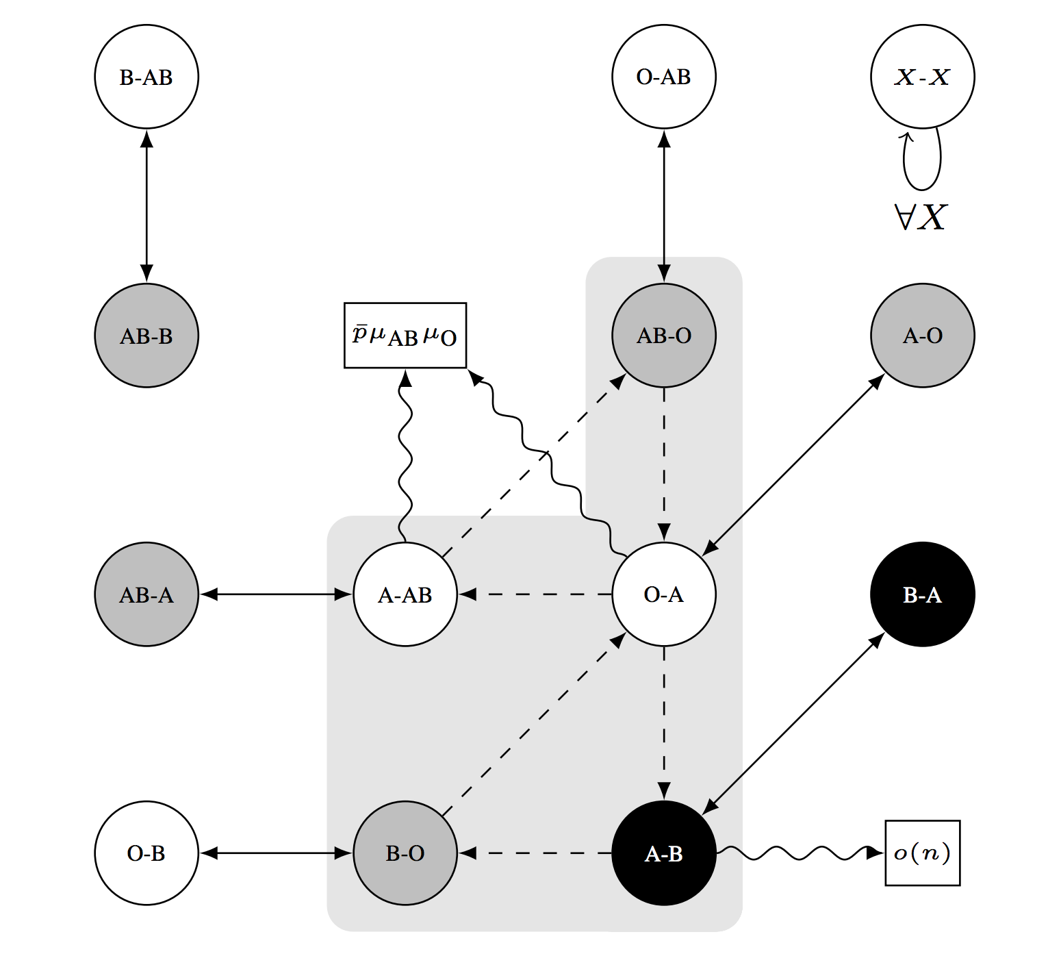
In theory, the price of fairness is low
More on 10/6!

Slide 33
Problems with this type of model
Dense model [Saidman et al. 2006, etc.]
Constant probability of edge existing
Less useful in practice [Ashlagi et al. 2012+, Dickerson et al. 2014+]
Better? Sparse model [Ashlagi et al. 2012]
1-λ fraction is highly-sensitized (p_{H} = c/n)
λ fraction is lowly-sensitized (p_{L} > 0, constant)
But still:
Random graph models tend to be “in the large”, no weights, no uncertainty, fairly homogeneous … so not perfect!

Slide 34
A taste of the sparse model …

Slide 35
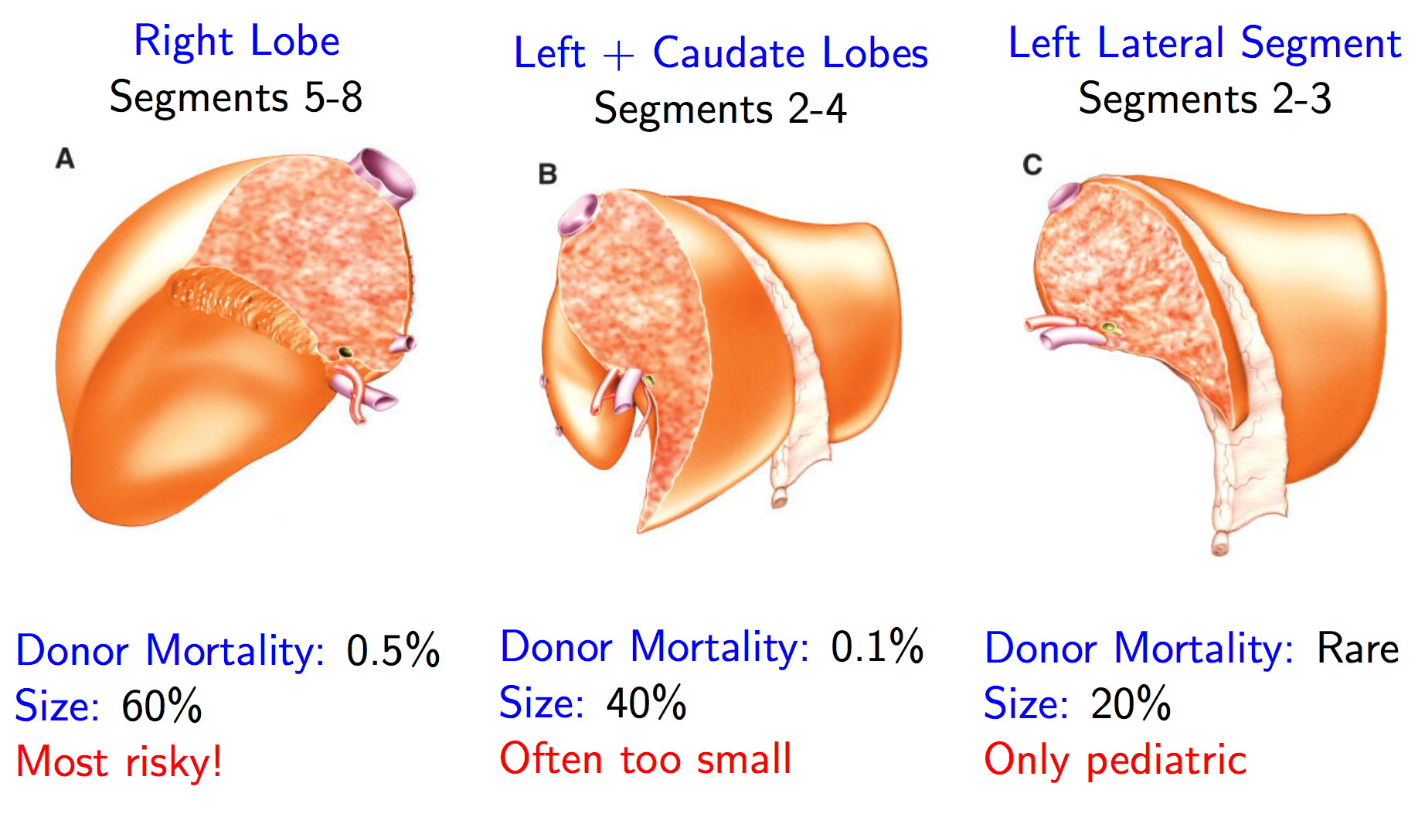
Moving beyond kidneys: Livers
[Ergin, Sönmez, Ünver w.p. 2015]
Similar matching problem (mathematically)
Right lobe is biggest but riskiest; exchange may reduce right lobe usage and increase transplants
[Sönmez 2014]

Slide 36

Moving beyond kidneys: Multi-Organ Exchange
[Dickerson Sandholm AAAI-14, JAIR-16]
Chains are great! [Anderson et al. 2015, Ashlagi et al. 2014, Rees et al. 2009]
Kidney transplants are “easy” and popular:
  Many altruistic donors
Liver transplants: higher mortality, morbidity:
  (Essentially) no altruistic donors
P1
P2
P3
P4
…
Kidney
A
Kidney
Liver
Kidney
D1
D2
D3
D4

Slide 37
Sparse graph, many altruists
n_{K} kidney pairs in graph D_{K}; n_{L} = γn_{K} liver pairs in graph D_{L}
Number of altruists t(n_{K})
Constant p_{K→L} > 0 of kidney donor willing to give liver
Constant cycle cap z
Theorem
Assume t(n_{K}) = βn_{K} for some constant β>0. Then, with probability 1 as n_{K} → ∞,
Any efficient matching on D = join(D_{K},D_{L}) matches Ω(n_{K}) more pairs than the aggregate of efficient matchings on D_{K} and D_{L}.
Building on [Ashlagi et al. 2012]

Slide 38
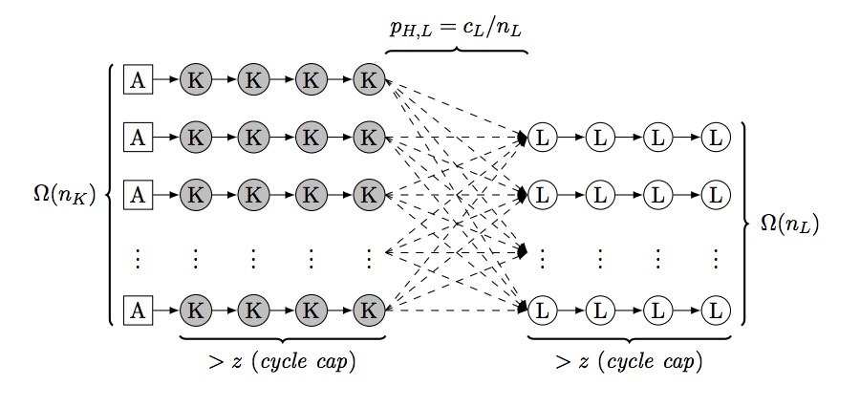
Intuition
Find a linear number of “good cycles” in D_{L} that are length > z
  Good cycles = isolated path in highly-sensitized portion of pool and exactly one node in low portion
Extend chains from D_{K} into the isolated paths (aka can’t be matched otherwise) in D_{L}, of which there are linearly many
  Have to worry about p_{K→L}, and compatibility between vertices
Show that a subset of the dotted edges below results in a linear-in-number-of-altruists max matching
  → linear number of D_{K} chains extended into D_{L}
  → linear number of previously unmatched D_{L} vertices matched

Slide 39
Sparse graph, few altruists
n_{K} kidney pairs in graph D_{K}; n_{L} = γn_{K} liver pairs in graph D_{L}
Number of altruists t – no longer depends on n_{K}!
λ is frac. lowly-sensitized
Constant cycle cap z
Theorem
Assume constant t. Then there exists λ’ > 0 s.t. for all λ < λ’
Any efficient matching on D = join(D_{K},D_{L}) matches Ω(n_{K}) more pairs than the aggregate of efficient matchings on D_{K} and D_{L}.
With constant positive probability.
Building on [Ashlagi et al. 2012]

Slide 40
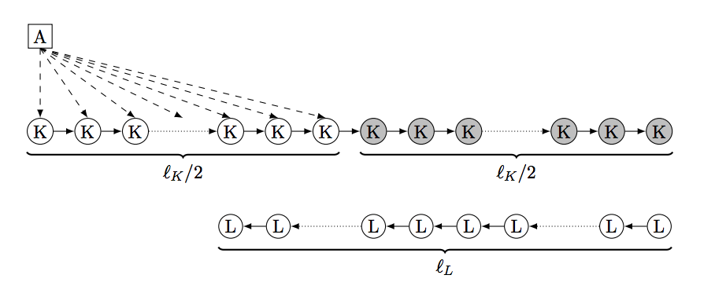
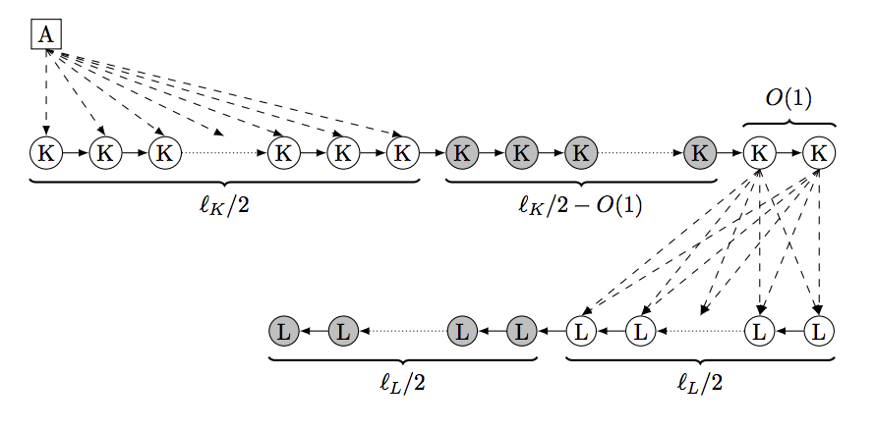
Intuition
For large enough λ (i.e., lots of sensitized patients), there exist pairs in D_{K} that can’t be matched in short cycles, thus only in chains
  Same deal with D_{L}, except there are no chains
Connect a long chain (+altruist) in D_{K} into an unmatchable long chain in D_{L}, such that a linear number of D_{L} pairs are now matched

Slide 41
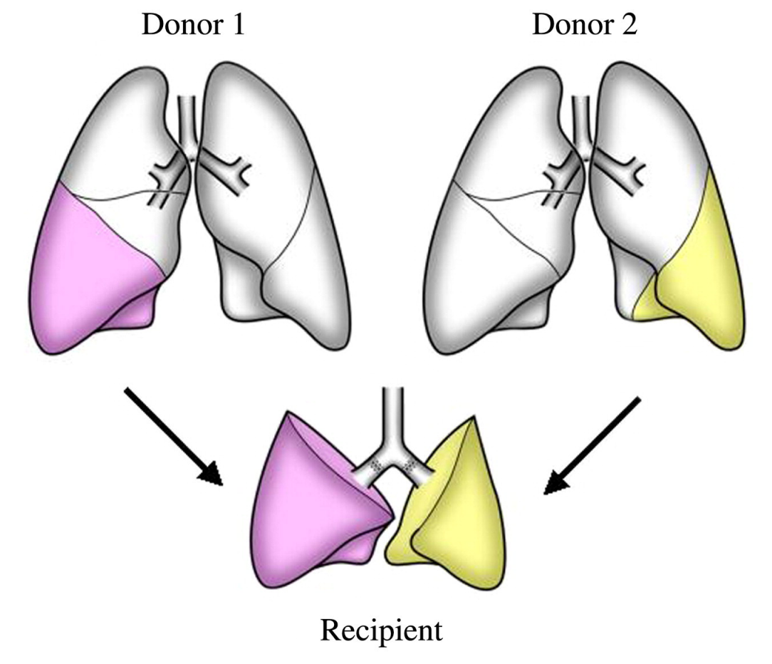
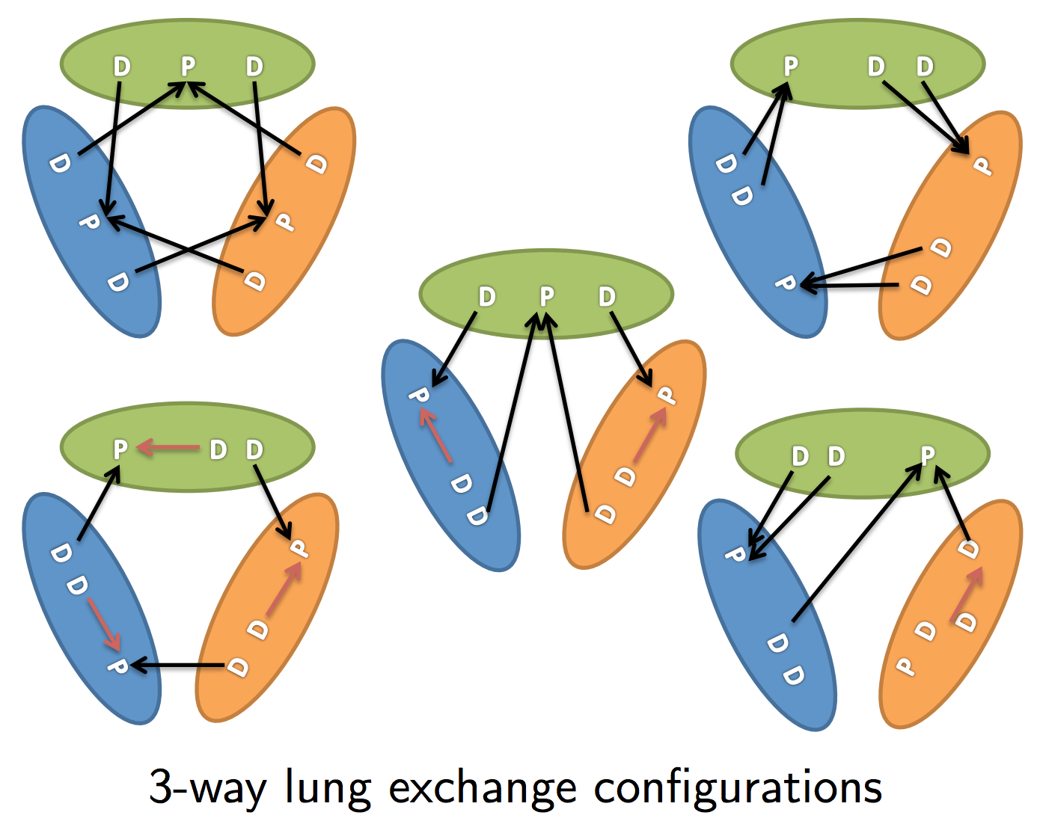
Moving beyond kidneys: Lungs
[Ergin, Sönmez, Ünver w.p. 2014]
Fundamentally different matching problem
  Two donors needed
[Date et al. 2005; Sönmez 2014]
(Compare to the single configuration for a “3-cycle” in kidney exchange.)

Slide 42
Other Recent & Ongoing research in this space
Dynamic matching theory with a kidney exchange flavor:
Akbarpour et al., “Thickness and Information in Dynamic Matching Markets”
Anderson et al., “A dynamic model of barter exchange”
Ashlagi et al., “On matching and thickness in heterogeneous dynamic markets”
Das et al., “Competing dynamic matching markets”
Mechanism design:
Blum et al. “Opting in to optimal matchings”
Not “in the large” random graph models:
Ding et al., “A non-asymptotic approach to analyzing kidney exchange graphs

Slide 43
Next Class:
Optimal batch clearing of Organ exchanges

