Slide 1
Finding long chains in kidney exchange using the traveling salesman problem
Ross Anderson, Itai Ashlagi, David Gamarnik
and Alvin E. Roth
(Presented by Alireza Farhadi)

Slide 2
Kidney Exchange Problem
Given donors and patients, maximize the total number of transplants performed
Two types of donors
Altruistic donors: willing to donate their kidney without asking for anything
Patient-donor pairs

Slide 3
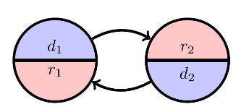
Kidney Exchange Problem
Cycles
Chains

Slide 4
Kidney Exchange Problem
To exchange cycles, all the surgeries must be performed simultaneously
Very complicated for the large cycles
Each cycle can have at most $k$ nodes

Slide 5
Formal Definition
$G=\left(V,E;w\right)$ : a directed weighted graph
$k$ : maximum length of cycles
$N$ : altruistic donors
$P$ : patient-donor pairs
$V=N∪P$

Slide 6
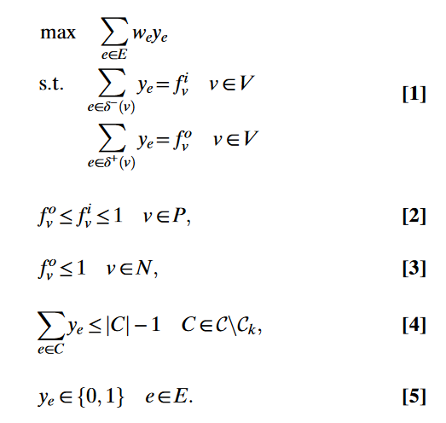
Recursive IP Formulation
$y_{e}$ : decision variable for each edge
$f_{v}^{i}$ : in-flow of vertex $v$
$f_{v}^{o}$ : out-flow of vertex $v$
$C$ : set of all cycles
$C_{k}$ : all the cycles with the length at most $k$

Slide 7
Recursive IP Formulation
Number of constraints is exponential in $|E|$
Eliminate all the constraints for the cycles
Add violated constraints and resolve the IP

Slide 8
TSP-Based IP
Using different decision variables for cycles and chains
Finding chains is similar to prize-collecting TSP.
PC-TSP: visit each city (patient-donor pair) exactly once, but with the additional option to pay some penalty to skip a city (penalized for leaving pairs unmatched)
We add a decision variable for every cycle of length at most $k$

Slide 9
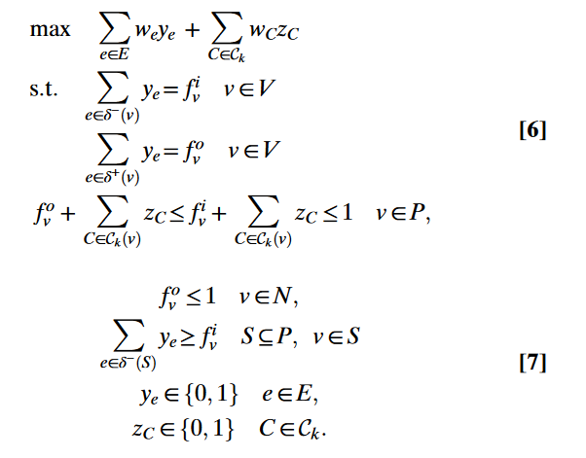
TSP-Based IP
$z_{C}$ : decision variable for the cycles of length at most $k$

Slide 10
TSP-Based IP
Every chain begins in $N$ (altruistic donors)
For every vertex $v$, and a partitioning of vertices into sets $S, V\backslash S$such that $v∈S$ and $N ⊆V/S$
In-flow of $S$ must be at least $f_{v}^{i}$
Number of constraints is exponential in $|E|$

Slide 11
Finding violated Constraints
Violated constraints can be found using the max flow-min cut problem.
We add a source vertex $s$ to our graph and connect it to the vertices in $N$ to get a new graph $\overline{G}=\left(\overline{V},\overline{E};\overline{w}\right)$
$\overline{V}=V ∪\left\{s\right\}$
$\overline{E}=E ∪\left\{\left(s,n\right) \right| n∈N\}$
$\overline{w}= \left\{\begin{aligned}y_{e} e∈E \\ 1 otherwise\end{aligned}\right.$
For every vertex $v$, we solve the max flow-min cut problem with the source $s$ and the sink $v$

Slide 12
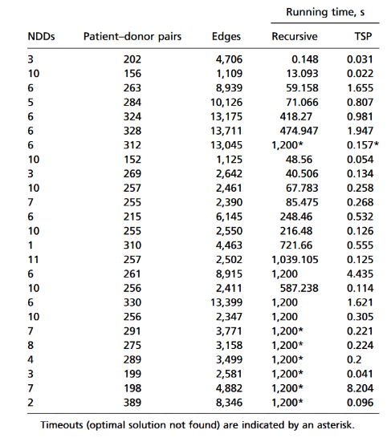
Performance of TSP-IP

Slide 13
Thank You

