Slide 1
Applied Mechanism Design For Social Good
John P Dickerson
Lecture #13 – 3/8/2018
CMSC828M
Tuesdays & Thursdays
9:30am – 10:45am

Slide 2
This class:
Batch Clearing of
Organ Exchanges

Slide 3
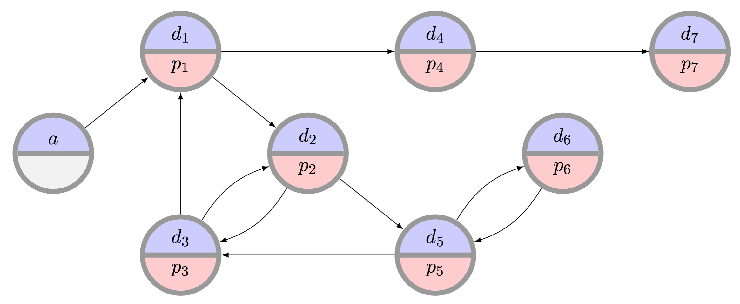
The clearing problem
The clearing problem is to find the “best” disjoint set of cycles of length at most L, and chains (maybe with a cap K)
  This class: only consider static matching in the present
  Next class: more general dynamic matching over time

Slide 4
Special case: L = 2
PTIME: translate to maximum matching on undirected graph
v₁
v₂
v₃
v₄
v₁
v₂
v₃
v₄
v₆
v₅
v₆
v₅
???????????????
(Six pairs, no altruists.)
v₁
v₂
v₃
v₄
v₁
v₂
v₃
v₄
v₆
v₅
v₆
v₅

Slide 5
Special case: L = ∞
PTIME via formulation as maximum weight perfect matching
v₁
v₂
v₃
v₄
v₁
v₂
v₃
v₄
v₆
v₅
v₆
v₅
???????????????
(Six pairs, no altruists.)
Donors:
d₁
d₂
d₃
d₄
d₅
d₆
Edge weights:
= 0
= w_{e}
Patients:
p₁
p₂
p₃
p₄
p₅
p₆

Slide 6
General Case: L = ?
NP-hard via reduction from 3D-matching:
Given disjoint sets X, Y, Z of size q …
... and a set of triples T ⊆ X x Y x Z ...
... is there a disjoint subset M ⊆ T of size q?
1
1
1
T = {
(1,1,1),
(2,3,2),
(1,2,1),
(3,2,3),
}
2
2
2
3
3
3
??????????????

Slide 7
General Case: L = ?
Construct a gadget for each t_{i} = {x_{a}, y_{b}, z_{c}} in T
Gadgets intersect only on vertices in X ⋃ Y ⋃ Z
x_{a}^{i}
y_{b}^{i}
z_{c}^{i}
1
2
L-1
1
2
L-1
1
2
L-1
x_{a}
y_{b}
z_{c}

Slide 8
General case: L = ?
M is perfect matching → construction has perfect cycle cover.
For t_{i} in T:
x_{a}^{i}
y_{b}^{i}
z_{c}^{i}
1
2
L-1
1
2
L-1
1
2
L-1
x_{a}
y_{b}
z_{c}

Slide 9
General case: L = ?
M is perfect matching → construction has perfect cycle cover.
For t_{i} not in T:
x_{a}^{i}
y_{b}^{i}
z_{c}^{i}
1
2
L-1
1
2
L-1
1
2
L-1
x_{a}
y_{b}
z_{c}

Slide 10
General Case: L = ?
We have a perfect cycle cover → M is a perfect 3D matching
Construction only has 3-cycles and L-cycles
Short cycles (i.e., 3-cycles) are disjoint from the rest of the graph by construction
Thus, given a perfect cover (by assumption):
Widgets either contribute according to t_{i} in M …
… or t_{i} not in M.
Thus there is a perfect matching in the original 3D matching instance.

Slide 11
Hopeless …?

Slide 12
Basic Approach #1:
The Edge formulation
[Abraham et al. 2007]
Binary variable x_{ij} for each edge from i to j
Maximize
u(M) = Σ w_{ij} x_{ij}
Subject to
Σ_{j} x_{ij} = Σ_{j} x_{ji} for each vertex i
Σ_{j} x_{ij} ≤ 1 for each vertex i
Σ_{1≤k≤L} x_{i(k)i(k+1)} ≤ L-1 for paths i(1)…i(L+1)
(no path of length L that doesn’t end where it started – cycle cap)
Flow constraint

Slide 13
State of the art for edge formulation
[Anderson et al. PNAS-2015]
Builds on the prize-collecting traveling salesperson problem [Balas Networks-89]
  PC-TSP: visit each city (patient-donor pair) exactly once, but with the additional option to pay some penalty to skip a city (penalized for leaving pairs unmatched)
They maintain decision variables for all cycles of length at most L, but build chains in the final solution from decision variables associated with individual edges
Then, an exponential number of constraints could be required to prevent the solver from including chains of length greater than K; these are generated incrementally until optimality is proved.
  Leverage cut generation from PC-TSP literature to provide stronger (i.e. tighter) IP formulation

Slide 14
Best Edge Formulation
[Anderson et al. 2015]
A
Ck
C3
If: flow into v from a chain
Then: at least as much flow across cuts from {A}
A
C1
V
A
C2
…
Notes:
If there is flow into V, then for every way V can be cut off from NDDs, there must be at least as much flow over that cut.

Slide 15
Basic Approach #2:
The Cycle Formulation
[Roth et al. 2004, 2005,
Abraham et al. 2007]
Binary variable x_{c} for each feasible cycle or chain c
Maximize
u(M) = Σ w_{c} x_{c}
Subject to
Σ_{c : i in c} x_{c} ≤ 1 for each vertex i

Slide 16
Solving the Cycle Formulation IP
Too large to write down
O(max{ |P|^{L}, |A||P|^{K-1} }) variables
|A| = 5, |V|=300, L=3, K=20 … |A||P|^{K-1} ≈ 5 x 10⁴⁷
Approach: branch-and-price [Barnhart et al. 1998]:
Branch: select fractional column and fix its value to 1 and 0 respectively
Fathom the search node if no better than incumbent
  Solve LP relaxation using column generation
x₇
1
0
x₄
…
1
0
…
…
Notes:
Even with only 1000 patients, there are 3M cycles.

Slide 17
Column generation
Master LP P has too many variables
Won’t fit in memory, and/or would take too long to solve
Begin with restricted LP P’, which contains only a small subset of the variables (i.e., cycles)
OPT(P’) ≤ OPT(P)
Solve P’ and, if necessary, add more variables to it
We do this intelligently by solving the pricing problem
Repeat until OPT(P’) = OPT(P)

Slide 18
DFS to solve pricing problem
[Abraham et al. EC-07]
Pricing problem:
  Optimal dual solution π* to reduced model
  Find non-basic variables with positive price (for a maximization problem)
    0 < weight of cycle – sum of duals in π* of constituent vertices
    Positive price for cycle → dual constraint is violated
    No positive price cycles → no dual constraints violated
First approach [Abraham et al. EC-2007] explicitly prices all feasible cycles and chains through a DFS
  Can speed this up in various ways, but proving no positive price cycles exist still takes a long time

Slide 19
General pricing of cycles & Chains is NP-hard
[Plaut et al. arXiv:1606.00117]
Reduce from Hamiltonian path
Arbitrary graph G

Slide 20
Comparison
Tradeoffs in number of variables, constraints
  IP #1: O(|E|^{L}) constraints vs. O(|V|) for IP #2
  IP #1: O(|V|²) variables vs. O(|V|^{L}) for IP #2
IP #2’s relaxation is weakly tighter than #1’s. Quick intuition in one direction:
  Take a length L+1 cycle. #2’s LP relaxation is 0.
  #1’s LP relaxation is (L+1)/2 – with ½ on each edge
Recent work focuses on balancing tight LP relaxations and model size [Constantino et al. 2013, Glorie et al. 2014, Klimentova et al. 2014, Alvelos et al. 2015, Anderson et al. 2015, Mak-Hau 2015, Manlove&O’Malley 2015, Plaut et al. 2016, …]:
  Newest work: compact formulations, some with tightest relaxations known, all amenable to failure-aware matching

Slide 21
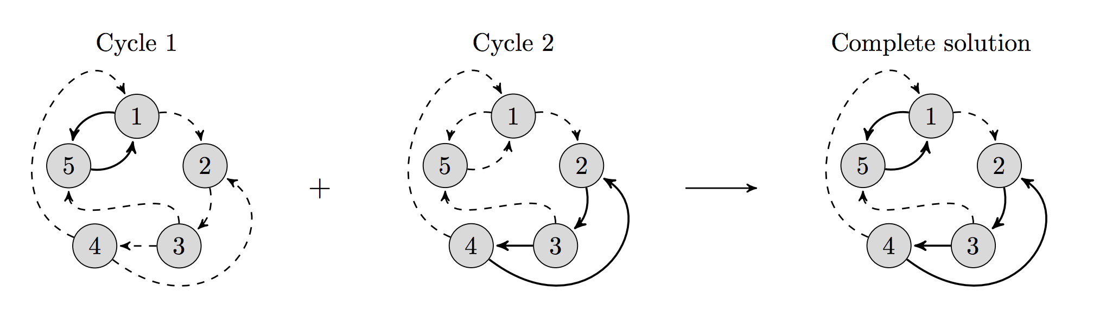
Compact formulations
[Constantino et al. EJOR-14]
Previous models: exponential #constraints (CG methods)
or #variables (B&P methods)
Let F be upper bound on #cycles in a final matching
Create F copies of compatibility graph
Search for a single cycle or chain in each copy
  (Keep cycles/chains disjoint across graphs)

Slide 22
Compact formulations
1A
1B
1C
1D
1E
1A: max edge weights over all graph copies
1B: give a kidney <-> get a kidney within that copy
1C: only use a vertex once
1D: cycle cap
Polynomial #constraints and #variables!

Slide 23
PIEF: A compact model for cycles only
[Dickerson Manlove Plaut Sandholm Trimble EC-16]
Builds on Extended Edge Formulation of Constantino et al.
O(|V|) copies of graph, 1 binary variable per edge per copy
Enforce at most one cycle per graph copy used
Track positions of edges in cycles for LP tightness
THEOREM
The tightest known non-compact LP relaxation
Z_{CF} = Z_{PIEF}
(disallowing chains)
(EC-16 paper also presents HPIEF, which is a compact formulation for cycles and chains, but with weaker Z_{HPIEF})

Slide 24
PICEF: Position-Indexed Chain-Edge Formulation
[Dickerson et al. EC-16]
In practice, cycle cap L is small and chain cap K is large
Idea: enumerate all cycles but not all chains [Anderson et al. 2015]
That work required O(|V|^{K}) constraints in the worst case
This work requires O(K|V|) = O(|V|²) constraints
MAIN
IDEA
Track not just if an edge is used in a chain, but where in a chain an edge is used.
For edge (i,j) in graph: K’(i,j) = {1} if i is an altruist
K’(i,j) = {2, …, K} if i is a pair

Slide 25
PICEF: Position-Indexed Chain-Edge Formulation
[Dickerson et al. EC-16]
Maximize
u(M) = Σ_{ij in E} Σ_{k in K’(i,j)} w_{ij} y_{ijk} + Σ_{c in C} w_{c} z_{c}
Subject to
Σ_{ij in E} Σ_{k in K’(i,j)} y_{ijk} + Σ_{c : i in c} z_{c} ≤ 1 |  | for every i in Pairs
Each pair can be in at most one chain or cycle
Σ_{ij in E} y_{ij1} ≤ 1 |  | for every i in Altruists
Each altruist can trigger at most one chain via outgoing edge at position 1
Σ_{j:ij in E} y_{ijk+1} - Σ_{j:ji in E ⌃ k in K’(j,i)} y_{jik} ≤ 0 |  | for every i in Pairs and k in {1, …, K-1}
Each pair can be have an outgoing edge at position k+1 in a chain iff it has an incoming edge at position k in a chain

Slide 26
What if there are Still too many Variables?
[Dickerson et al. EC-16]
In particularly dense graphs or if, in the future, longer cycle caps are allowed, PICEF may need too many cycle variables
Solve via branch and price by storing only a subset of columns in memory, then solving pricing problem
Search for variables with positive price, bring into model
Previously: that search is exponential in chain cap [Abraham et al. 2007, Glorie et al. 2014, Plaut et al. 2016]
General: pricing chains & cycle is NP-hard [arXiv:1606.00117]
But we only need to price cycles, not chains!
PRICING
PICEF is the first branch-and-price-based model with provably correct polynomial-time pricing

Slide 27
Polynomial-TIME Cycle Pricing
[Glorie et al. MSOM-2014, Plaut et al. AAAI-2016]
Solve a structured problem that implicitly prices variables
Variable = x_{c} for cycle (not chain) c
Price of x_{c} = w_{c} – Σ_{v in c} δ_{v}
Example
Price: (2+3+2) – (δ_{P1}+δ_{P2}+δ_{P3})
= Σ_{e in c} w_{e} – Σ_{v in c} δ_{v}
= Σ_{(u,v) in c} [w_{(u,v)} – δ_{v}]
Idea: Take G, create G’ s.t. all edges e = (u,v) are reweighted r_{(u,v)} = δ_{v} – w_{(u,v)}
Positive price cycles in G = negative weight cycles in G’
P1
2
2
P2
3
P3
w_{c}

Slide 28
Adapted Bellman-Ford Pricing for cycles only
[Glorie et al. MSOM-2014, Plaut et al. AAAI-2016]
Bellman-Ford finds shortest paths
Undefined in graphs with negative weight
Adapt B-F to prevent internal looping during the traversal
  Shortest path is NP-hard (reduce from Hamiltonian path):
    Set edge weights to -1, given edge (u,v) in E, ask if shortest path from u to v is weight 1-|V| → visits each vertex exactly once
  We only need some short path (or proof that no negative cycle exists)
Now pricing runs in time O(|V||E|L²)

Slide 29
Failure-aware Kidney Exchange
More on uncertainty next lecture!
[Dickerson et al. EC-13, EC-16]
In practice, not all edges exist; lots of recent work [Li et al. 2011, Dickerson et al. 2013, Blum et al. 2013, Anderson et al. 2015, Blum et al. 2015, Glorie et al. 2016, Pedroso&Ikeda 2016, Assadi et al. 2016]
One approach: associate a success probability p with each edge, maximize expected size of remaining matching after independent edge failures [Dickerson et al. 2013]:
  Cycles succeed only if all edges succeed
  Chains succeed up to first edge failure
Earlier compact formulations cannot be adapted to this model due to expected utility of edge changing based on position
Minor adjustment to PICEF’s objective function:
u_{p}(M) = Σ_{ij in E} Σ_{k in K’(i,j)} p^{k} w^{ij} y_{ijk} + Σ_{c in C} p^{|c|} w_{c} z_{c}
Can also adapt Bellman-Ford to give a failure-aware polynomial time pricing algorithm for cycles
B&P

Slide 30
How do All These models perform in PRactice?
Test on real and simulated match runs from:
  US UNOS exchange: 143+ transplant centers
  UK NLDKSS: 20 transplant centers
Following are tests against actual code for:
  BnP-DFS [Abraham et al. EC-07]
  BnP-Poly [Glorie et al. MSOM-14, Plaut et al. AAAI-16]
  CG-TSP [Anderson et al. PNAS-15]

Slide 31
Real Match Runs
UNOS & NLDKSS

Slide 32
UNOS: 286 match runs
NLDKSS: 17 match runs

Slide 33
Generated Data
|P|=700, Increasing %Altruists

Slide 34

Solvers that are not shown timed out (within one-hour period).
Notes:
CG-TSP, BP-DFS, and others timed out, while our models
* Can still clear these exchange
* Scale more gracefully

Slide 35
Is Life Always so (NP-)Hard?

Slide 36
One Simple Assumption Complexity Theory Hates!
[Dickerson Kazachkov Procaccia Sandholm arxiv:1605.07728]
Observation: real graphs are constructed from a few thousand if statements
  If the patient and donor have compatible blood types …
  ... and if they are compatible on 61 tissue type features ...
  ... and if their insurances match, and ages match, and ...
  ... then draw a directed edge; otherwise, don’t
Hypothesis: real graphs can be represented by a small constant number of bits per vertex – we’ll test later
THEOREM
Given a constant number of if statements and a constant cycle cap, the clearing problem is in polynomial time

Slide 37
A New model For kidney Exchange
[Dickerson et al. arxiv:1605.07728]
Graph G = (V, E) with patient-donor pair v_{i} in V with
  Attribute vectors d_{i} and p_{i} such that the qth element of d_{i} (resp. p_{i}) takes on one of a fixed number of types
  E.g., d_{i}^{q} or p_{i}^{q} takes a blood type in {O, A, B, AB}
  Call Θ the set of all possible “types” of d and p
Then, given compatibility function f : Θ x Θ → {0,1} that uniquely determines if an edge between d_{i} and p_{j} exists
  We can create any compatibility graph (for large enough vectors in D and P)
(Altruists are patient-donor pairs where the “patient” is compatible with all donors → chains are now cycles)

Slide 38
Clearing is now in polynomial time
THEOREM
Given constant L and |Θ|,
the clearing problem is in polynomial time
Let f(θ,θ’) = 1 if there is a directed edge from a donor with type θ to a patient with type θ’
For all θ = ( <θ_{1,p},θ_{1,d}> …, <θ_{r,p},θ_{r,d}>) in Θ^{2r} let
f_{C}(θ) = 1 if f(θ_{t,d},θ_{t+1,p}) = 1 and f(θ_{r,d},θ_{1,p}) = 1
Given cycle cap L, define
T(L) = { θ in Θ^{2r} : r ≤ L and f_{C}(θ) = 1 }

Slide 39
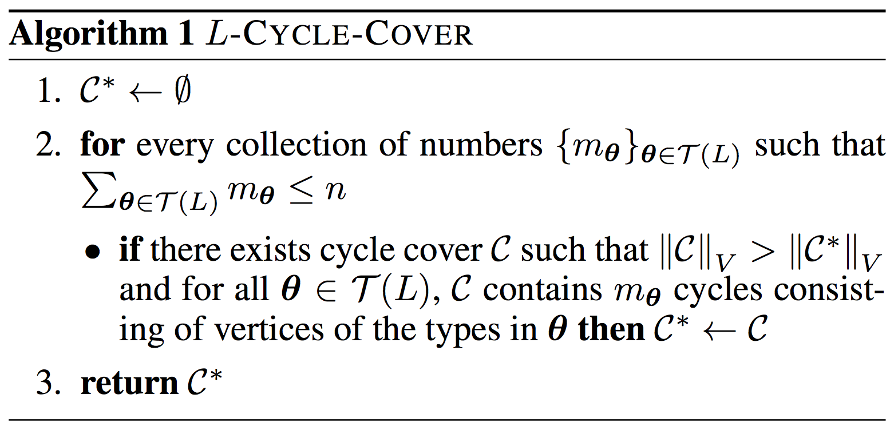
Clearing is now in polynomial time
T(L) is all vectors of types that create feasible cycles of length up to L

Slide 40
Clearing is now in polynomial time
Each set {m_{θ}} says we have m_{θ1} cycles of type θ₁, m_{θ2} cycles of θ₂, …, m_{θ|T(L)|} cycles of θ_{|T(L)|}, constrained to at most n cycles total

Slide 41
Clearing is now in polynomial time
Check to see if this collection is a legal cycle cover – just check that each type θ isn’t used too many times in m_{θ}

Slide 42
Clearing is now in polynomial time
Return the legal cycle cover such that the sum over θ of m_{θ} is maximized – aka the largest legal cycle cover

Slide 43
Flipping attributes is also easy
The human body tries to reject transplanted organs
  Before transplantation, can immunnosupress some “bad” traits of the patient to increase transplant opportunity
  Takes a toll on the patient’s health
Suppose we can pay some cost to change attributes
For all θ, θ’ in Θ, let
c : Θ x Θ → R be cost of flipping θ → θ’
Flip-and-Cover: maximize match size minus cost of flips
THEOREM
Given constant L and |Θ|,
the Flip-and-Cover problem is in polynomial time

Slide 44
A Concrete Instantiation: Thresholding
Associate with each patient and donor a k-bit vector
  Count “conflict bits” that overlap at same position
  If more than threshold t conflict bits, don’t draw an edge
Example: k = 2, blood containing antigens A and B
  Θ = 2^{{ has-A, has-B }} x 2^{{ no-A, no-B }}
Draw edge if <d_{i}, p_{j}> ≤ t; do not draw edge otherwise
Donor type A = [ 1, 0 ]
Patient type AB = [ 0, 0 ]
Donor blood type
Patient blood type
Donor type A = [ 1, 0 ]
Patient type O = [ 1, 1 ]
AS IDE
Related to intersection graphs:
Each vertex has a set; draw edge between vertices iff sets intersect (by at least p elements)

Slide 45
Upper Bound: Sometimes You need Lots of bits
THEOREM
For any n > 2, there exists a graph on n vertices that is not (k,0)-representable for all k < n
For each vertex i, draw edge to each vertex except vertices i-1 and i
BWOC assume (k,0)-representable, k < n:
Consider vertex 1
(1, n) not in E; (1, i) in E otherwise
Then there is a conflict bit between vertex 1 and n that is not “turned on” anywhere else
Do for n vertices → require k ≥ n
1
2
6
3
5
4

Slide 46
Hardness: How many Bits do I Need For This Graph?
Given: an input graph G = (V, E)
subset F of C(V, 2)
fixed positive k, nonnegative t
Does there exist:
k-length bit vectors d_{i}, p_{i} for all v_{i} in V
such that for (i,j) in F, also (i,j) in E iff <d_{i},p_{j}> ≤ t
THEOREM
The (k,t)-representation problem is NP-complete
(proof via reduction from 3SAT)

Slide 47
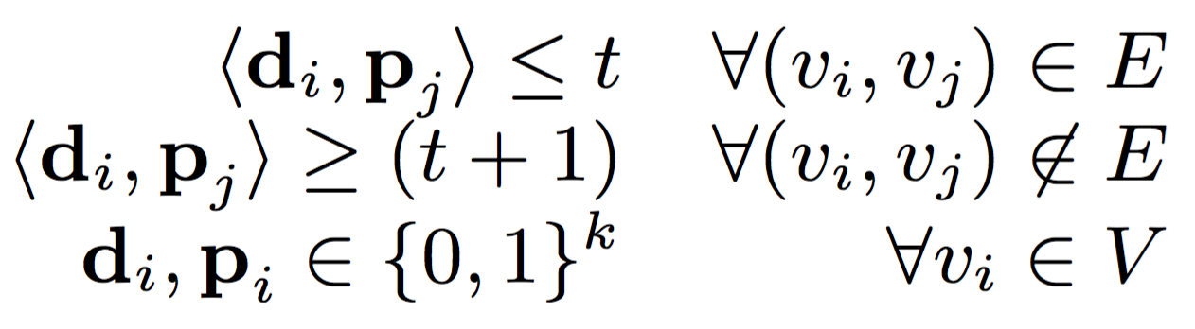
Computing
(k,t)-Representations: QCP
For each vertex, give k bits to the patient and k bits to the donor
If an edge does not exist, make sure the overlap is greater than t
If an edge exists in the graph, assert the source donor vector and sink patient vector overlap by at most t
Quadratically-constrained discrete feasibility program:
  Constraint matrix not positive semi-definite → non-convex
State-of-the-art nonlinear solvers (e.g., Bonmin) fail
[Bonami et al. 2008]

Slide 48
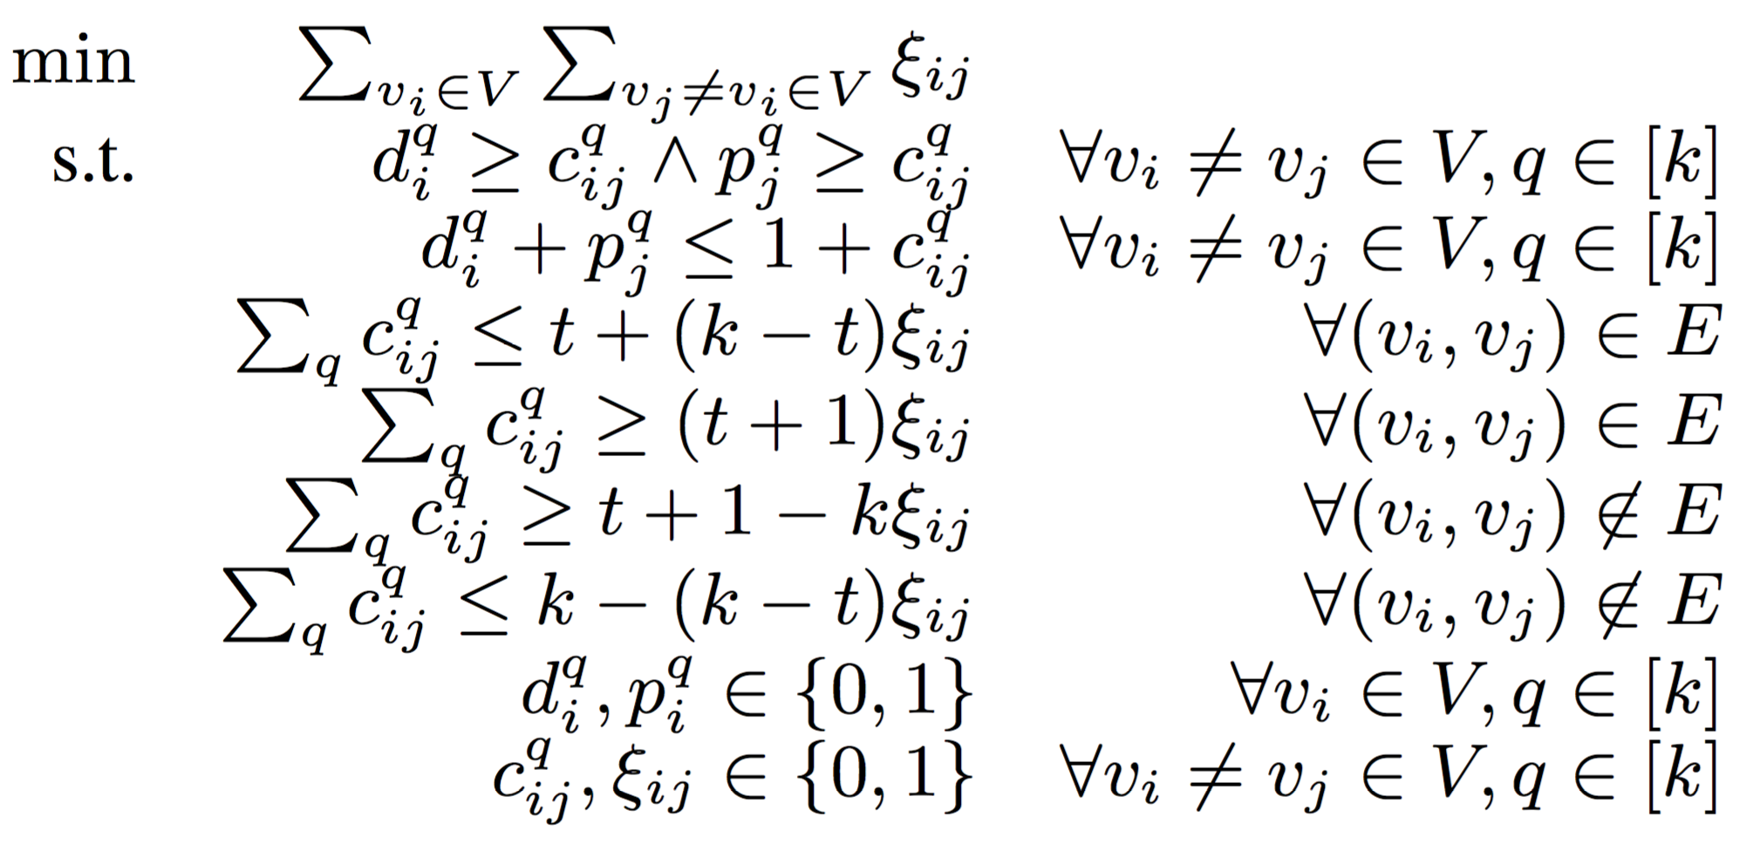
Computing
(k,t)-Representations: IP
Integer program minimizes number of “conflict edges”
  CPLEX struggles to find non-trivial solutions
  CPLEX cannot find feasible solution (when forcing all ξ_{ij} = 0)

Slide 49
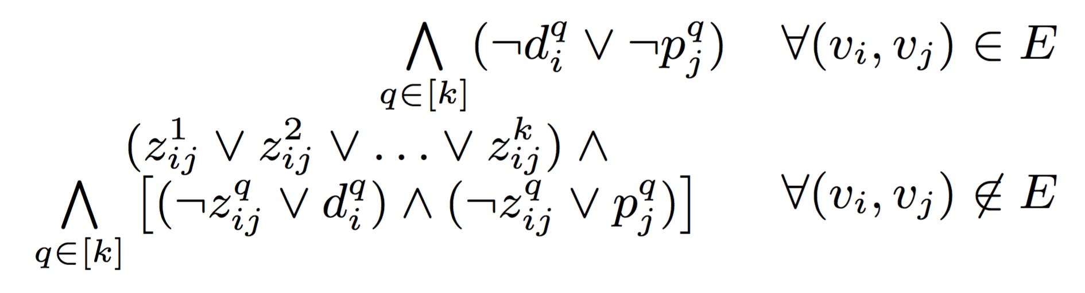
Computing
(k,0)-Representations: SAT
Specific case of t = 0: if an edge does not exist, force any overlap
Specific case of t = 0: if an edge exists, allow no overlap
When t = 0, can use a compact SAT formulation
  Interesting because it closely mimics real life
We can solve small- and medium-sized graphs
  Use Lingeling, a good parallel SAT solver [Biere 2014]

Slide 50
Can we represent real graphs with a small number of bits?
Theory: k = |V|
Proved SAT
Unknown (?)
Proved UNSAT
Bigger real-world graphs (UNOS 2010 – 2012)

Slide 51
Relaxing the threshold
Everyone matched!*
(4-bit overlap allowed)
3x pairs matched!
(1-bit overlap allowed)
*all bits created equal, and not actually flipping bits – just relaxing global threshold
Loosen bit threshold t on real UNOS graphs

Slide 52
Next Class:
Dynamic Optimization

