Slide 1
FutureMatch: Combining Human Value Judgments and Machine Learning to Match in Dynamic Environments
By John Dickerson and Tuomas Sandholm
Presentation by Ashton Webster

Slide 2
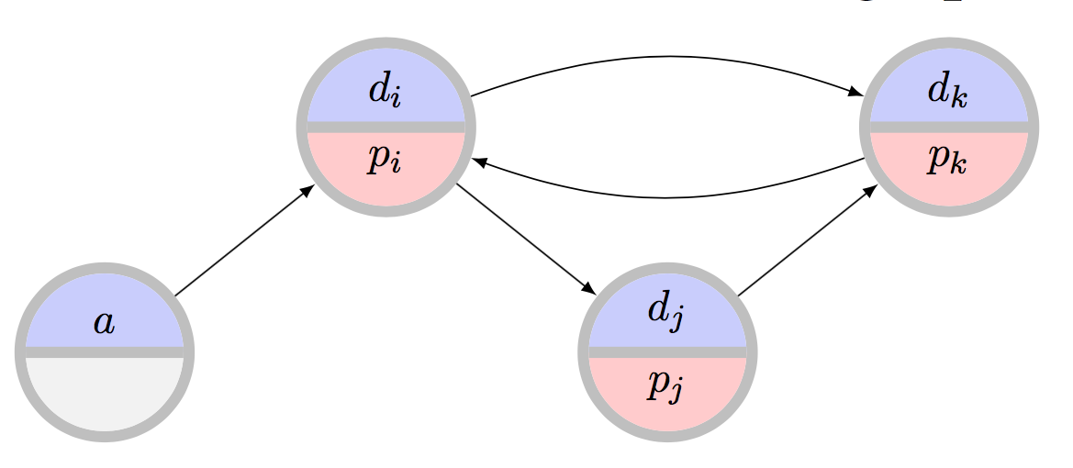
Background: Kidney Exchanges and Our Favorite Diagram
Patient-Donor Pairs enter exchange
Edges represent compatibility
Only going to consider live transplants (not deceased) in this talk

Slide 3
Background: State of the Art In Practice*
Myopic matching
Current UNOS matching attempts to maximize matches weighted by priority points
Sensitization Priority
Current UNOS matching prioritizes matching for highly sensitized patients and patients under 18
* as of 2014
Notes:
“The UNOS priority points take into account the following factors: do the donor and patient have zero antigen mismatch in tissue type, sensitization of the patient, prior organ donor status, pediatric status, wait time, geographic proximity, and other antibody specificities.”

Slide 4
Background: State of the Art In Theory*
Potentials:
Dickerson et al. [1]: Considering future value of edges in kidney exchanges can provide many benefits
Edge Failure and Failure Aware Models
Alshagi et al. [2]: Use reported failure rate for ADP data
Dickerson et al. [3]: Show that failure aware models outperform others
* as of 2014
Notes:
— Receiving a transplant from the deceased donor waiting list
— Receiving a transplant from another exchange
— Patient or donor becoming too ill for surgery or expiring
— An altruistic patient “running out of patience” and donating elsewhere, or not at all
— A donor in a chain reneging (i.e., backing out after his patient received a kidney)
— Pregnancy or sickness changing a patient or donor’s antigen incompatibilities

Slide 5
Methodology overview
Combine 3 main factors:
Edge weights - representing objective function values
Potentials - representing future value of pair
Edge Failure - Utility discounting based on probability of edge exiting the pool

Slide 6
Separating the Ends and the Means
Current discussion by experts often confounds the desired objectives (ends) and (means)
Example: “We should seek to increase total matches by preferring matching highly sensitized matches, because highly sensitized patients will be difficult to match in the future”
Experts should only be discussing the Ends, model should handle the Means
Ends roughly correspond to edge weights
Means roughly correspond to potentials

Slide 7
Objective Functions
 | Deterministic | Failure Aware
MaxCard | Maximize the total number of patients who are algorithmically matched | Maximize the total number of patients who receive transplants in expectation
MaxCard-Fair | Maximize the total number of patients who are algorithmically matched, where “marginalized” patients are weighted in the objective by some constant factor β | Maximize the total number of patients who receive transplants in expectation, where “marginalized” patients are weighted in the objective by some constant factor β
MaxLife | Maximize the total time algorithmically matched donor organs last in patients | Maximize the total time transplanted donor organs will last in patients in expectation

Slide 8
Objective Functions: MaxCard and MaxCard-Fair
MaxCard-Fair is a generalization of MaxCard
Think of MaxCard as MaxCard-Fair with no vertices receiving the β increase
V_{p} ⊆V represents preferred edges
β is positive (in this case in the set {1,2,3,4,5})
𝑤_{e} is original edge weight

Slide 9
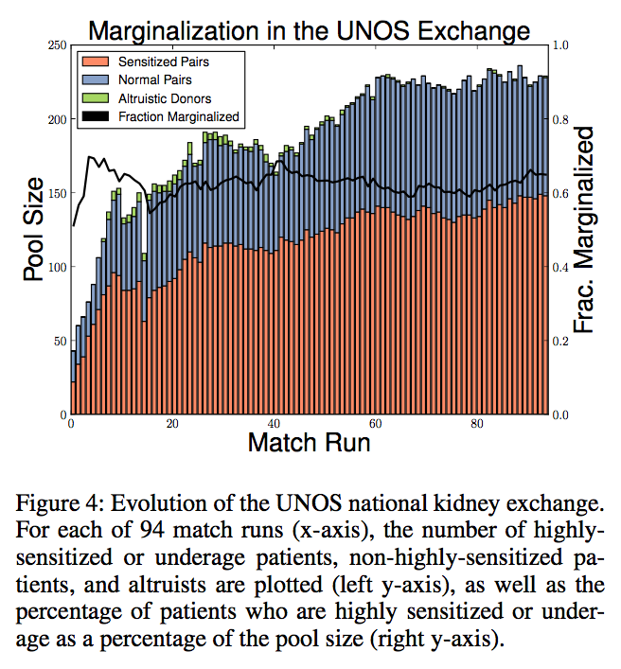
MaxCard-Fair: Preferred (Marginalized) Vertices

Slide 10
Objective Functions: MaxLife
How long does the Kidney survive in its new host?
Available data:
75,264 living donor transplant events between 11/1/1987 and 6/30/2013
25% are failed, 75% are not marked as failed
Human Leukocyte Antigen (HLA) test results (tissue types) for patient and donors
Notes:
Note that maxlife is attempting to maximize the aggregate life of the kidney after transplant, not the life of the recipient
75% not marked as failed could be (i) the recipient is alive with the kidney still or (ii) the recipient died but not because of the kidney

Slide 11
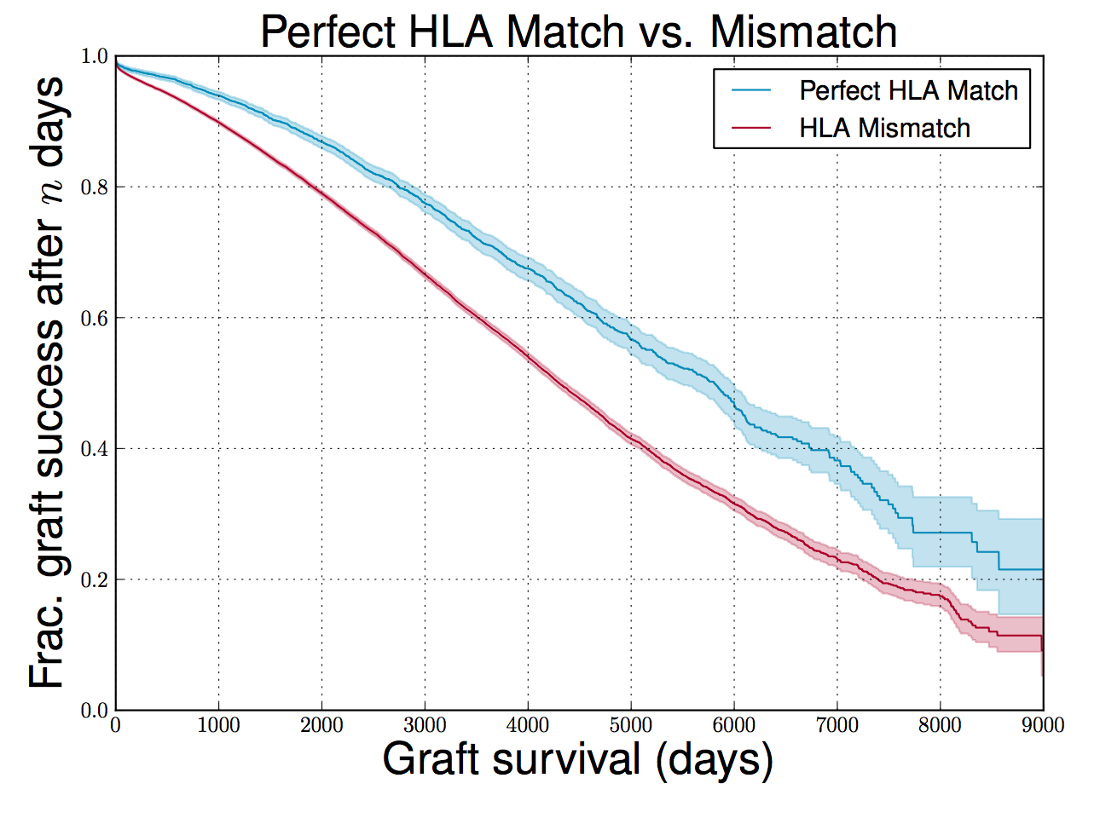
Notes:
Median survival for perfect match: 5808
Median survival for imprefect match: 4300

Slide 12
MaxLife: How long does a Kidney last?
Use a Cox Proportional Hazards Regression:
Features (X):
recipient age
donor age - recipient age
recipient and donor HLA profile (3 components each: HLA-A, HLA-B, HLA-DR)
donor and recipient blood type compatibility
Notes:
Proportional Hazard models: type of survival model which relates time that passes until event occurs to some covariates
In proportional models, hazard rates (number of hazards per unit time) are affected by covariates in a multiplicative fashion
H(t) = instantaneous risk of graft failure at time t
H_o(t) = baseline hazard rae at time t with all covariates set to 0
b = learned parameters
X = available features

Slide 13
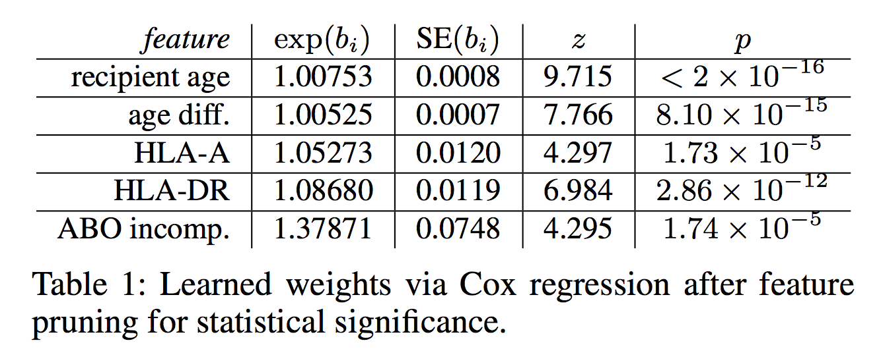
MaxLife: Modeling how long a Kidney Lasts
omitting HLA-B because it does not have a significant impact on hazard rate
Example: unit increase in HLA-DR mismatch feature will result in a 1.087 * baseline hazard rate

Slide 14
MaxLife: Using the learned model to get edge weights
x^{e} is features for donor pair associated with edge e
b_{i} are learned Cox regression weights
Intuitively: lower risk edges have higher weights

Slide 15
What are Potentials?
How much do we expect this pair to contribute in the future?
Let ϴ be each blood type combination:
4 x 4 = 16 blood type pairings for pairs ({O-A, O-B, O-AB … AB-AB})
4 blood types for altruists ({O, A, B, AB})
For each type θϵϴ, determine potential P_{θ}

Slide 16
Learning Potentials
Sequential Model-Based Algorithm Configuration (SMAC) used to derive potentials for each type [4]
Process:
Select Potentials (“parameters”)
Run simulation and calculate performance metric
Feed back performance metric
SMAC updates potentials accordingly
Repeat

Slide 17
Combining Edge Weights and Potentials
𝑓_{𝑤} (e) is updated edge weight
𝑤(e) is original edge weight
P_{θd} and P_{θp} are donor and patient potentials, respectively

Slide 18
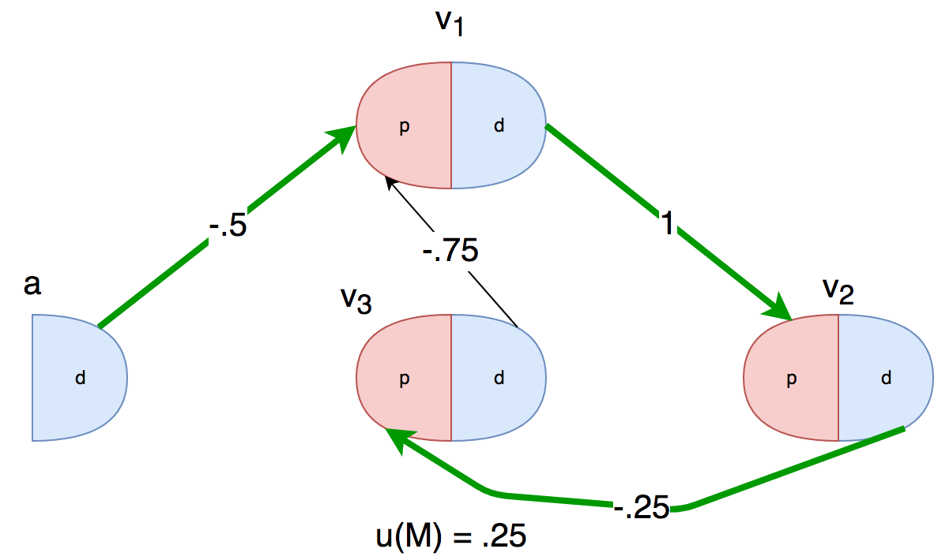
Example: High Potential Pair

Slide 19
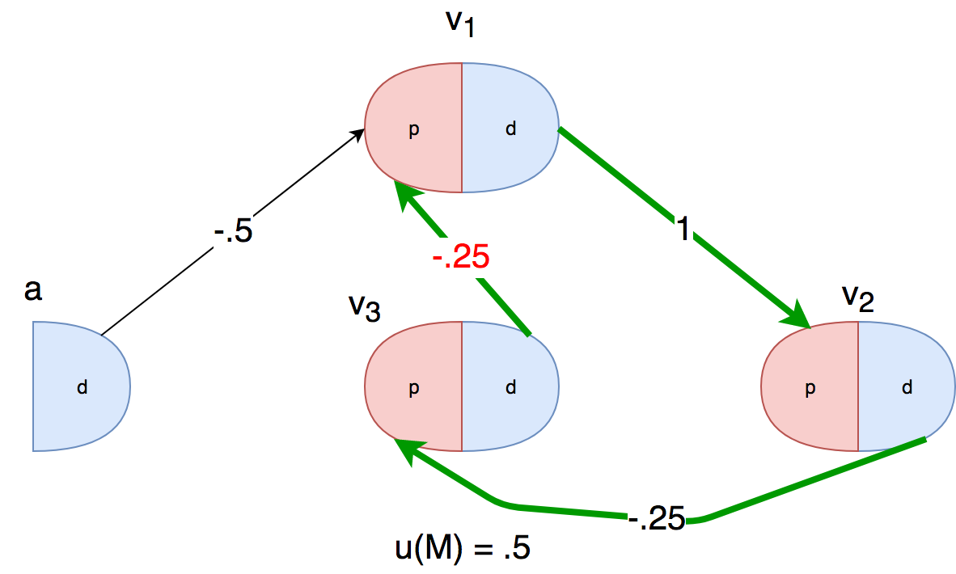
Example: High Potential Altruists

Slide 20
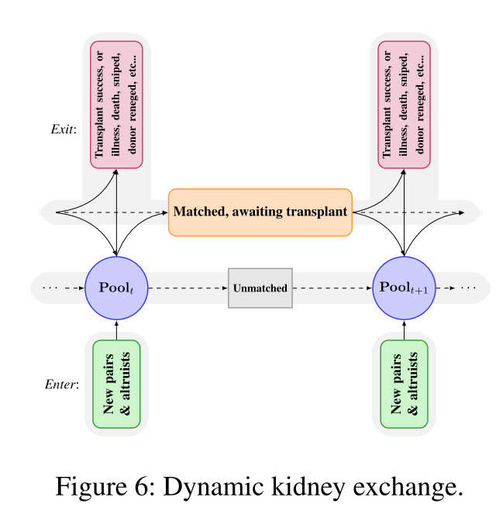
Realistic Dynamic Failure-Aware Model
Patient/Donor Pairs enter the pool due to self/family member diagnoses or altruism
Patients may be matched
If matched, they may exit if they die, switch to another exchange, or successfully receive a kidney
If matched, the may return if their matched partner exits
Unmatched patients return to the pool

Slide 21
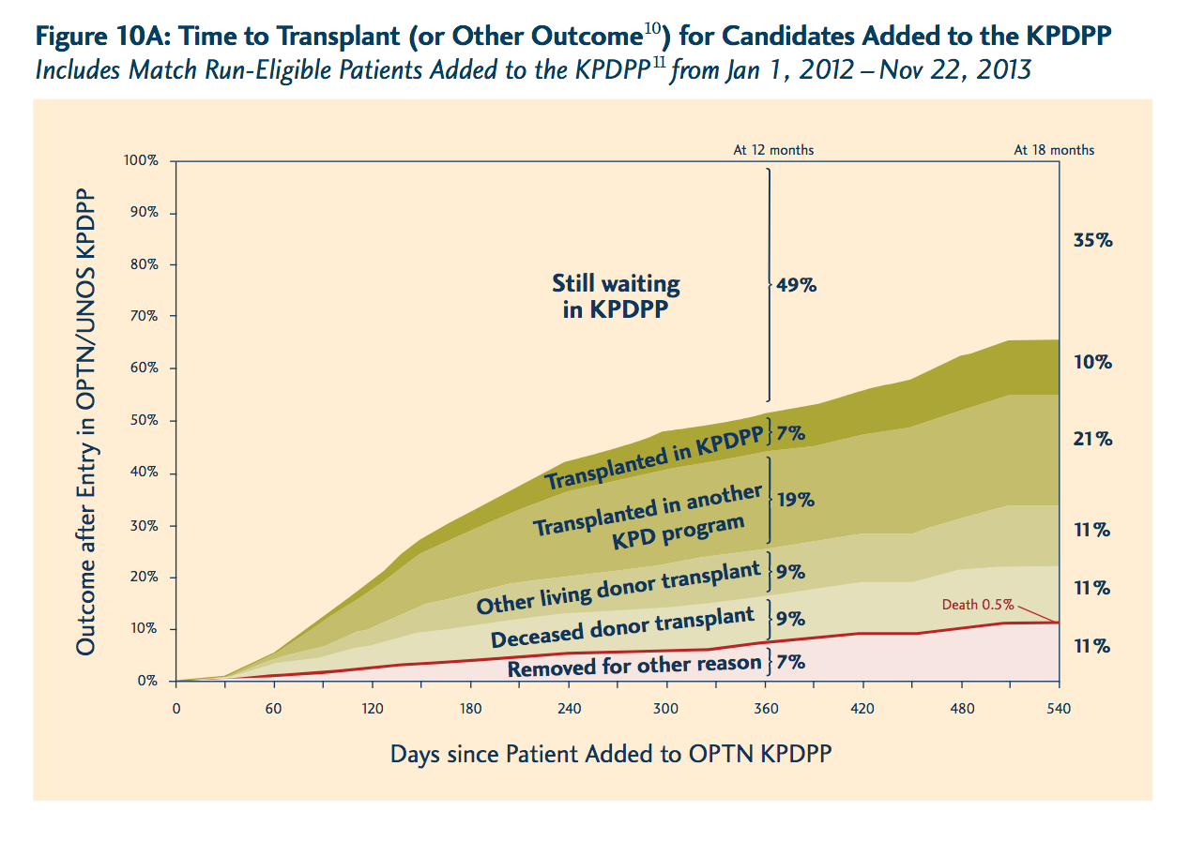
Realistic Dynamic Model: Informing Transition Probabilities
https://optn.transplant.hrsa.gov/media/1827/kpd_report.pdf
Notes:
“We set the relevant entrance and exit probabilities based on the real UNOS kidney exchange data”, I believe this is the figure they used.

Slide 22
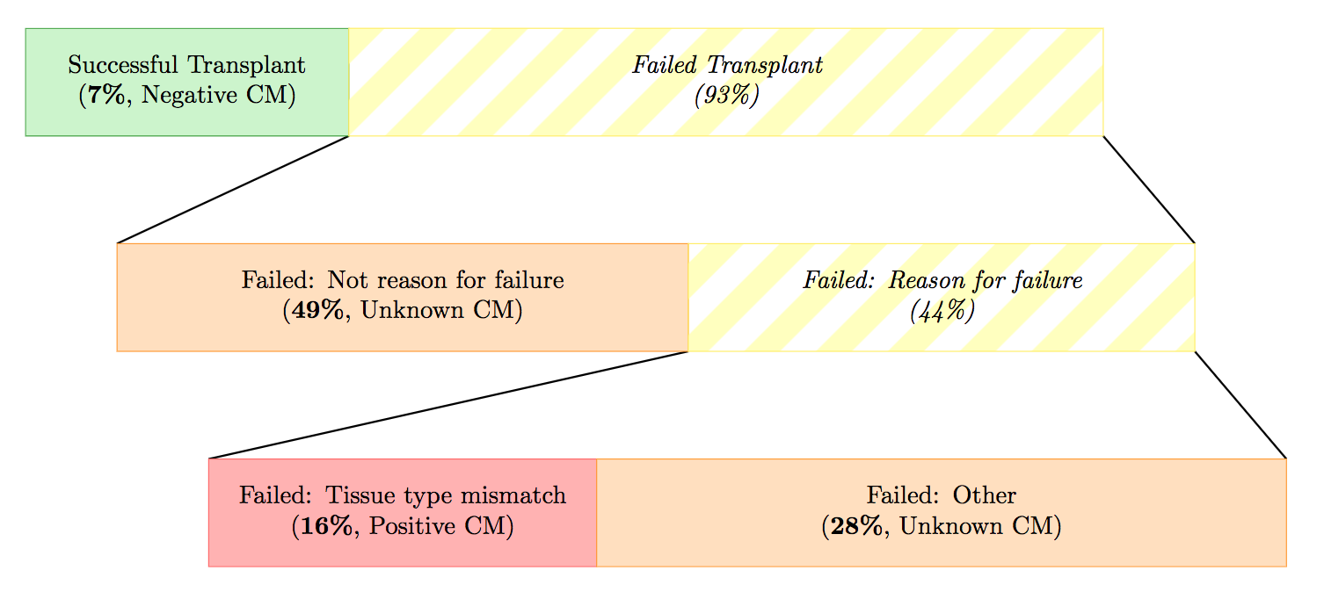
Edge Failure: Most Matches Fail
https://www.cs.cmu.edu/~sandholm/failure-aware%20kidney%20exchange.ec13.pdf

Slide 23
Failure Aware Model: Modeling Edge Failure
How can we make utility take into account edge failure?
Can’t just encode in edge weights: not independent
Updated cycle utility
Updated chain utility
Notes:
Cycle utility:
First term: original utility, sum of edge utilities
Second term: Probability of all edges succeeding
Chain utility
First Term: For each possible failure point in the chain, add the probability we fail there times the utility up to that point times all previous edges succeeding
Second term: discounted Utility if all edges succeed

Slide 24
Experiments
All models use edge weights learned for objective functions MaxCard, MaxCard-Fair, and MaxLife
24 time steps representing 1 week intervals of matching
Graphs randomly sampled from real UNOS data, 140 random graphs per configuration
Baseline: Deterministic (not failure aware) and myopic (no potentials)
FutureMatch: failure aware and potentials

Slide 25
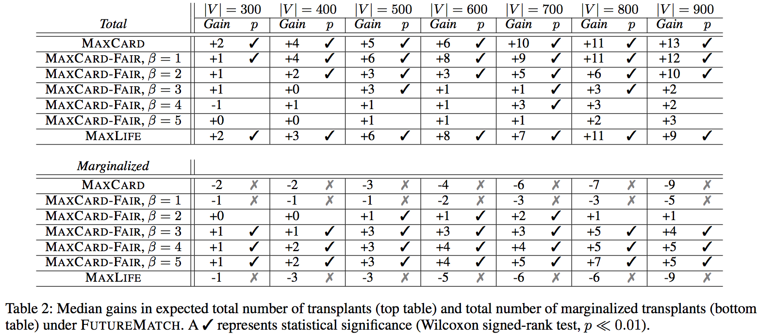
Results: Median expected Gain/Loss
Example (highlighted): In graphs of size 500, the median difference in number of matches for FutureMatch relative to the myopic, deterministic baseline is +3, and this is statistically significant.
Notes:
compare max card total vs marginalized: in all cases marginalized matches take a hit if we don’t consider fairness!
Similarly for maxlife
MaxCard-Fair gives more and more matches to marginalized groups while total matches does not increase by as much

Slide 26
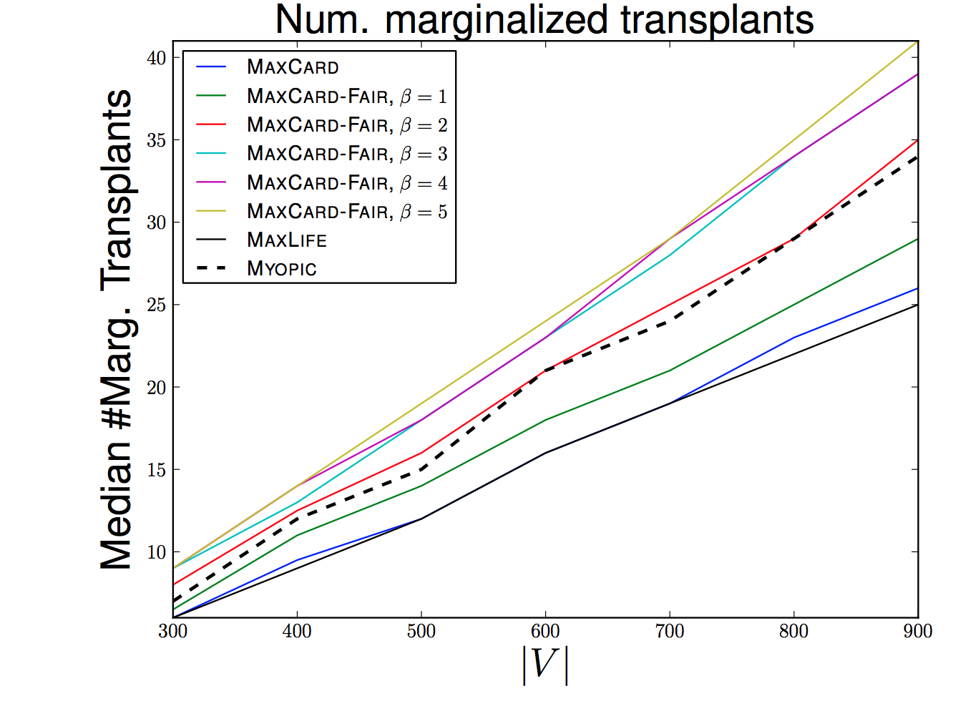
Results: Marginalized Impact
Notes:
MaxCard and MaxLife: Very similar, maxlife appears to just favor longer lasting kidneys
MaxCard and MaxLife underperform for marginalized transplants relative to baseline (myopic)
MaxCard-Fair - as beta increases, more marginalized transplants

Slide 27
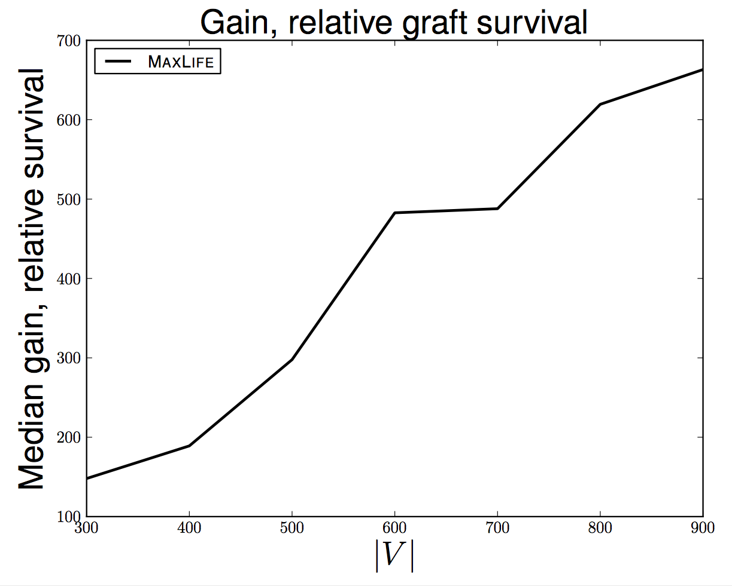
Results: MaxLife Works

Slide 28
Conclusions
Potentials and failure-aware modeling can be used to improve overall matches
Special weighting is required to avoid bias towards non-marginalized patients
Results are based on real data and attempt to mimic dynamic nature of matching

Slide 29
References
Unless otherwise indicated, all figures were taken from the paper or original work.
Dickerson, J. P., Procaccia, A. D., & Sandholm, T. (2012). Dynamic Matching via Weighted Myopia with Application to Kidney Exchange. Proceedings of the Twenty-Sixth AAAI Conference on Artificial Intelligence, 1340–1346. Retrieved from https://www.cs.cmu.edu/~sandholm/dynamicMatchingViaWeightedMyopia.aaai12.pdf%5Cnhttp://dl.acm.org/citation.cfm?id=2900728.2900918
Ashlagi, Itai, Duncan S. Gilchrist, Alvin E. Roth, and Michael A. Rees. "Nonsimultaneous Chains and Dominos in Kidney Paired Donation—Revisited (pdf)." American Journal of Transplantation 11, no. 5 (May 2011): 984–994.
Dickerson, J. P., Procaccia, A. D., & Sandholm, T. (2013). Failure-aware kidney exchange. Proceedings of the 14th ACM Conference on Electronic Commerce, 1(212), 323–340. https://doi.org/10.1145/2482540.2482596
Hutter, F., Hoos, H. H., & Leyton-Brown, K. (2011). Sequential Model - Based Optimization for General Algorithm Configuration. Lecture Notes in Computer Science, 5, 507–223. https://doi.org/10.1007/978-3-642-25566-3_40

Slide 30
Questions?

