Slide 1
Applied Mechanism Design For Social Good
John P Dickerson
Lecture #14 – 03/13/2018
CMSC828M
Tuesdays & Thursdays
9:30am – 10:45am

Slide 2
This class:
Managing Short-term uncertainty in Exchanges
(With some fairness)

Slide 3
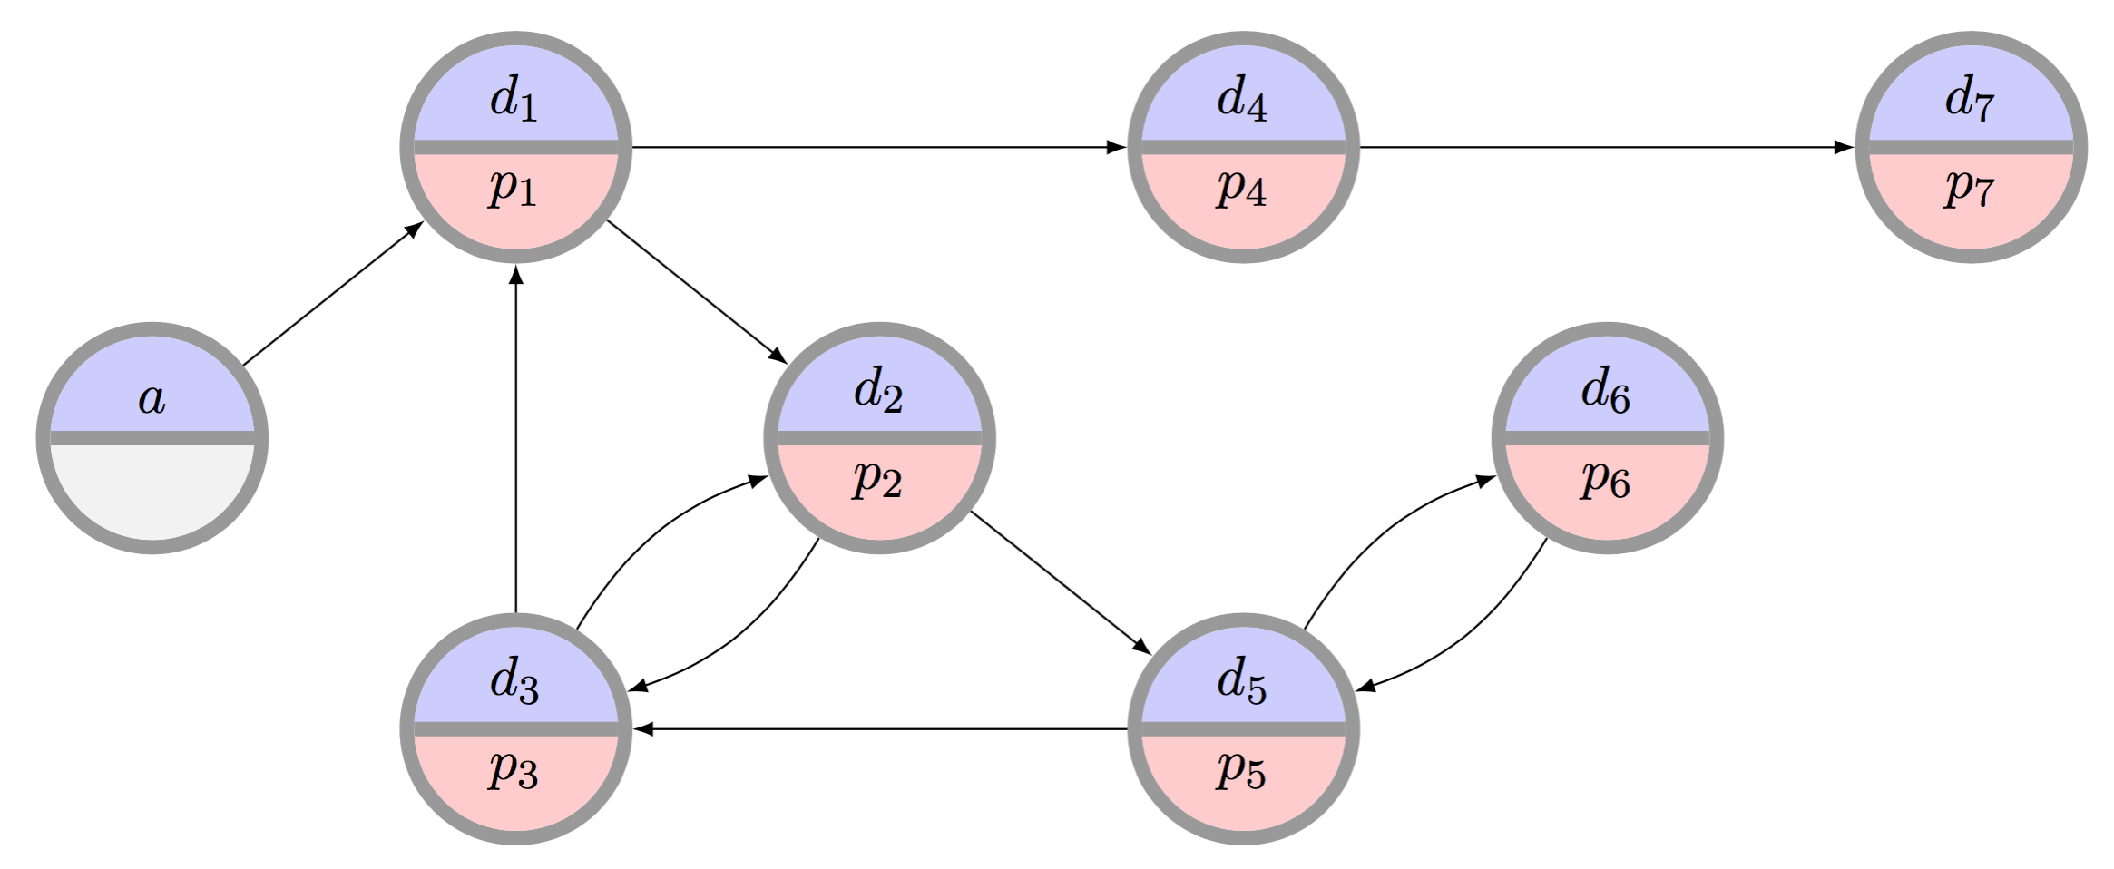
The clearing problem
The clearing problem is to find the “best” disjoint set of cycles of length at most L, and chains (maybe with a cap K)
  Last class: only considered static deterministic matching
  This class: matching under short-term uncertainty
  Next class: general long-term dynamic matching over time

Slide 4
Matched ≠ Transplanted
Only around 10% of UNOS matches resulted in an actual transplant
  Similarly low % in other exchanges [ATC 2013]
Many reasons for this. How to handle?
One way: encode probability of transplantation rather than just feasibility
  for individuals, cycles, chains, and full matchings

Slide 5
Failure-aware model
Compatibility graph G
  Edge (v_{i}, v_{j}) if v_{i}’s donor can donate to v_{j}’s patient
  Weight w_{e} on each edge e
Success probability q_{e} for each edge e
Discounted utility of cycle c
u(c) = ∑w_{e} • ∏q_{e}
Value of successful cycle
Probability of success

Slide 6


Failure-aware model
Discounted utility of a k-chain c
Cannot simply “reweight by failure probability”
A
q₁
1
q₂
2
q₃
3
q₄
4
… + 2q₁q₂(1-q₃)
1q₁(1-q₂)
… + 4q₁q₂q₃q₄
… + 3q₁q₂q₃(1-q₄)
Exactly first i transplants
Chain executes in entirety

Slide 7
Our problem
Discounted clearing problem is to find matching M* with highest discounted utility
Utility of a match M: u(M) = ∑ u(c)
Maximum cardinality
3
Maximum expected transplants
1
2

Slide 8
“In the Large”
G(n, t(n), p): random graph with
  n patient-donor pairs
  t(n) altruistic donors
  Probability Θ(1/n) of incoming edges
Constant transplant success probability q
For all q∈ (0,1) and α, β > 0, given a large G(n, αn, β/n), w.h.p. there exists some matching M’ s.t. for every maximum cardinality matching M,
u_{q}(M’) ≥ u_{q}(M) + Ω(n)
THEOREM

Slide 9
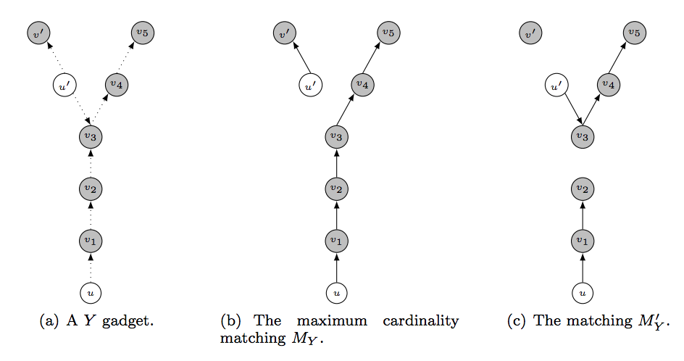
Brief intuition: Counting Y-gadgets
For every structure X of constant size, w.h.p. can find Ω(n) structures isomorphic to X and isolated from the rest of the graph
Label them (alt vs. pair): flip weighted coins, constant fraction are labeled correctly → constant × Ω(n) = Ω(n)
Direct the edges: flip 50/50 coins, constant fraction are entirely directed correctly → constant × Ω(n) = Ω(n)

Slide 10
In theory, we’re losing out on expected actual transplants by maximizing match cardinality.
… What about in practice?

Slide 11
UNOS
2010-2014

Slide 12
Solving this new problem
Real-world kidney exchanges are still small
  Mostly around 300 donors and 300 patients
Undiscounted clearing problem is NP-hard when cycle/chain cap L ≥ 3 (reduction from 3D-matching last class)
  Special case of our problem
  (Set success rate q = 1 for all edges)
THEOREM
The restricted discounted maximum cycle cover problem is NP-hard.

Slide 13
We can’t use the current solver
Branch-and-bound IP solvers use upper and lower bounds to prune subtrees during search
Upper bound: cycle cover with no length cap
(Last class: PTIME through max weighted perfect matching)
But now it is better to use shorter cycles instead of longer cycles to cover the same set of vertices …
d₁
d₂
d₃
d₄
d₅
d₆
v₁
v₂
v₃
v₄
v₆
v₅
p₁
p₂
p₃
p₄
p₅
p₆

Slide 14
WE can’t use the current solver
B&B upper bound
THEOREM
The unrestricted discounted maximum cycle cover problem is NP-hard.
Reduce from 3D-matching, like last class. Intuition:
3-cycles are better than L-cycles, for L>3
Want the top (blue) vertices matched in 3-cycles, not L-cycles
We showed this happens iff there is a 3D-matching

Slide 15
We can use parts of the current solver
B&B lower bound
THEOREM
The restricted discounted maximum cycle cover problem is solvable in PTIME for L=2.
For all 2-cyles between u and v in the original graph, set corresponding undirected edge weight in translated graph to:
  w_{e’} = q_{(u,v)} • q_{(v,u)} • ( w_{(u,v)} + w_{(v,u)} )
q₁
2q₁q₂
v₁
v₂
v₃
v₄
v₁
v₂
v₃
v₄
q₂
v₆
v₅
v₆
v₅

Slide 16
Pricing: Considering only “good” chains
THEOREM
Given a chain c, any extension c’ will not be needed in an optimal solution if the infinite extension has non-positive value
Optimistic future value of infinite extension
Donation to waitlist
Discounted utility of current chain
Pessimistic sum of LP dual values in model

Slide 17
Scalability experiments
|V| | CPLEX | Ours | Ours without chain curtailing
10 | 127 / 128 | 128 / 128 | 128 / 128
25 | 125 / 128 | 128 / 128 | 128 / 128
50 | 105 / 128 | 128 / 128 | 125 / 128
75 | 91 / 128 | 126 / 128 | 123 / 128
100 | 1 / 128 | 121 / 128 | 121 / 128
150 |  | 114 / 128 | 95 / 128
200 |  | 113 / 128 | 76 / 128
250 |  | 94 / 128 | 48 / 128
500 |  | 107 / 128 | 1 / 128
700 |  | 115 / 128
900 |  | 38 / 128
1000
Runtime limited to 60 minutes; each instance given 8GB of RAM.
|V| represents #patient-donor pairs; additionally, 0.1|V| altruistic donors are present.

Slide 18
In theory and practice, we’re helping the global bottom line by considering post-match failure …
… But can this hurt some individuals?

Slide 19
Sensitization at UNOS
Highly-sensitized patients: unlikely to be compatible with a random donor
Deceased donor waitlist: 15%-20%
Kidney exchanges: much higher (60%+)
“Easy to match” patients
“Hard to match” patients

Slide 20
Recall:
Price of fairness
Efficiency vs. fairness:
Utilitarian objectives may favor certain classes at the expense of marginalizing others
Fair objectives may sacrifice efficiency in the name of egalitarianism
Price of fairness: relative system efficiency loss under a fair allocation
[Bertismas, Farias, Trichakis 2011]
[Caragiannis et al. 2009]

Slide 21
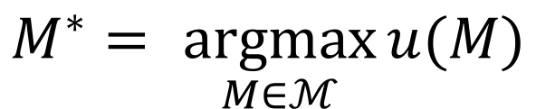



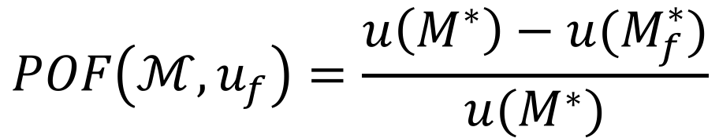
Price of fairness in kidney exchange
Want a matching that maximizes
utility function
$$M^{∗}$$
$$u:ℳ→ℝ$$
$$M^{∗}= \underset{M∈ℳ}{argmax}{u(M)}$$
Price of fairness: relative loss of match efficiency due to fair utility function :
$$u_{f}$$
$$POF\left(ℳ,u_{f}\right)=\frac{u\left(M^{∗}\right)−u(M_{f}^{∗})}{u(M^{∗})}$$

Slide 22

From theory to practice
Last class, we saw that the price of fairness is low in theory
Fairness criterion: extremely strict.
Theoretical assumptions (standard):
Big, dense graphs (“n → ∞”)
Cycles (no chains)
No post-match failures
Simplified patient-donor features
$$POF\left(ℳ,u_{H≻L}\right)≤2/{33}$$
What about the price of fairness in practice?

Slide 23
Toward usable fairness rules
In healthcare, important to work within (or near to) the constraints of the fielded system
[Bertsimas, Farias, Trichakis 2013]
Experience working with UNOS
We now present two (simple, intuitive) rules:
Lexicographic: strict ordering over vertex types
Weighted: implementation of “priority points”

Slide 24
Lexicographic fairness
Find the best match that includes at least α fraction of highly-sensitized patients
Matching-wide constraint:
Present-day branch-and-price IP solvers rely on an “easy” way to solve the pricing problem
Lexicographic constraints →
pricing problem requires an IP solve, too!
Strong guarantee on match composition …
… but harder to predict effect on economic efficiency

Slide 25
Weighted fairness
Value matching a highly-sensitized patient at (1+β) that of a lowly-sensitized patient, β>0
Re-weighting is a preprocess →
works with all present-day exchange solvers
Difficult to find a “good” β?
Empirical exploration helps strike a balance

Slide 26
Theory vs. “Practice”
Lexicographic fairness

Slide 27
Price of fairness: Generated data
Size | Saidman (US) | Saidman (UNOS) | Heterogeneous
10 | 0.24% (1.98%) | 0.00% (0.00%) | 0.98% (5.27%)
25 | 0.58% (1.90%) | 0.19% (1.75%) | 0.00% (0.00%)
50 | 1.18% (2.34%) | 1.96% (6.69%) | 0.00% (0.00%)
100 | 1.46% (1.80%) | 1.66% (3.64%) | 0.00% (0.00%)
150 | 1.20% (1.86%) | 2.04% (2.51%) | 0.00% (0.00%)
200 | 1.43% (2.08%) | 1.55% (1.79%) | 0.00% (0.00%)
250 | 0.80% (1.24%) | 1.86% (1.63%) | 0.00% (0.00%)
500 | 0.72% (0.74%) | 1.67% (0.82%) | 0.00% (0.00%)
Average (st.dev.) % loss in efficiency for three families of random graphs, under the strict lexicographic rule.
Good: aligns with the theory
Bad: standard generated models aren’t realistic

Slide 28
UNOS runs
Lexicographic fairness, varying failure rates

Slide 30
UNOS runs
Weighted fairness, varying failure rates

Slide 32
Contradictory goals
Earlier, we saw failure-aware matching results in tremendous gains in #expected transplants
Gain comes at a price – may further marginalize hard-to-match patients because:
  Highly-sensitized patients tend to be matched in chains
  Highly-sensitized patients may have higher failure rates (in APD data, not in UNOS data)

Slide 33
Beats efficient deterministic
UNOS runs, weighted fairness, constant probability of failure (x-axis), increase in expected transplants over deterministic matching (y-axis)

Slide 34
Can we be more proactive in this balancing act?

Slide 35
Pre-match edge testing
Idea: perform a small amount of costly testing before a match run to test for (non)existence of edges
E.g., more extensive medical testing, donor interviews, surgeon interviews, …
Cast as a stochastic matching (or set packing) problem:
Given a graph G(V,E), choose subset of edges S such that:
|M(S)| ≥ (1-ε) |M(E)|
Need: “sparse” S, where every vertex has O(1) incident tested edges

Slide 36
General theoretical results
Adaptive: select one edge per vertex per round, test, repeat
Stochastic matching:
(1-ε) approximation with O_{ε}(1) queries per vertex, in O_{ε}(1) rounds
Stochastic k-set packing:
(2/k – ε) approximation with O_{ε}(1) queries per vertex, in O_{ε}(1) rounds
THEOREM
Non-adaptive: select O(1) edges per vertex, test all at once
Stochastic matching:
(0.5-ε) approximation with O_{ε}(1) queries per vertex, in 1 round
Stochastic k-set packing:
(2/k – ε)² approximation with O_{ε}(1) queries per vertex, in 1 round
THEOREM

Slide 37
Adaptive algorithm
For R rounds, do:
Pick a max-cardinality matching M in graph G, minus already-queried edges that do not exist
Query all edges in M
Input Graph
r | Base graph | Matching picked | Result of queries
1:
2:

Slide 38
Intuition for adaptive algorithm
If at any round r, the best solution on edges queried so far is small relative to omniscient …
  ... then current structrure admits large number of unqueried, disjoint augmenting structures
  For k=2, aka normal matching, simply augmenting paths
Augmenting structures might not exist, but can query in parallel in a single round
  Structures are constant size → exist with constant probability
  Structures are disjoint → queries are independent
  → Close a constant gap per round

Slide 39
UNOS Data
At p=0.5, one edge test per vertex → +21% OPT
Even 1 or 2 extra tests would result in a huge lift

Slide 40
Next Class:
Dynamic Optimization

