Slide 1
Buying Cures Versus Renting Health:
Financing Health Care with Consumer Loans
Vahid Montazerhodjat, David M. Weinstock, Andrew W. Lo (2016)

Slide 2
Overview
This is the first paper to propose specific methods for implementing a Health Care Loan (HCL) market and to assess one’s financial viability
Goals:
Create a market which is attractive to both high-risk and low-risk investors
Create a market which can finance expensive drug costs
Correctly model loan default rates - crucial to estimating the financial viability of HCLs

Slide 3
Solutions
Use Diversification and Securitization to attract both low-risk and high risk investors
Estimate loan defaults probabilities using student loan and U.S. Census data
Run Monte Carlo simulations which can be used to estimate financial viability of HCL markets

Slide 4
Estimating Probability of Loan Default
Create 3 separate models for default probability
DPI: debt-payment-to-income ratio (a random variable)
𝞪 and 𝞫: model parameters 𝝓: CDF of the normal distribution

Slide 5
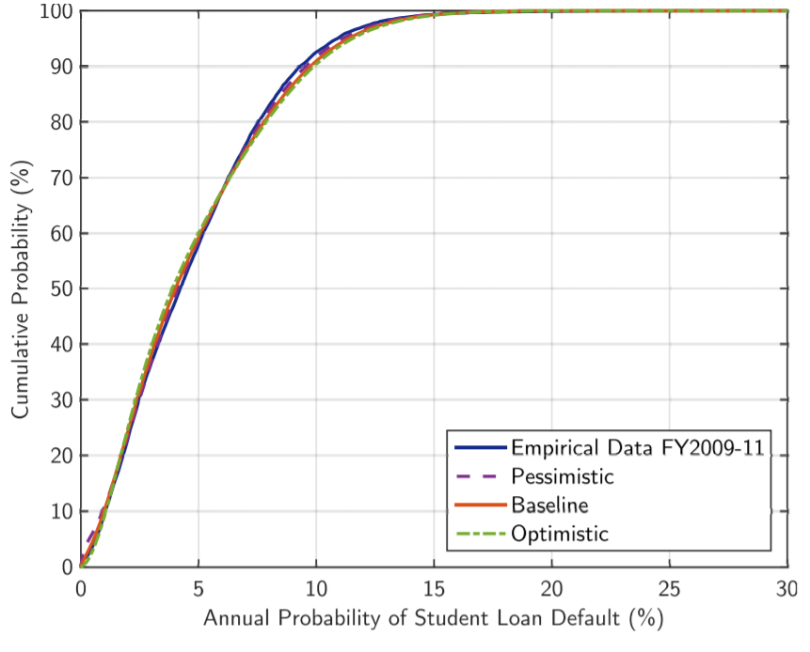
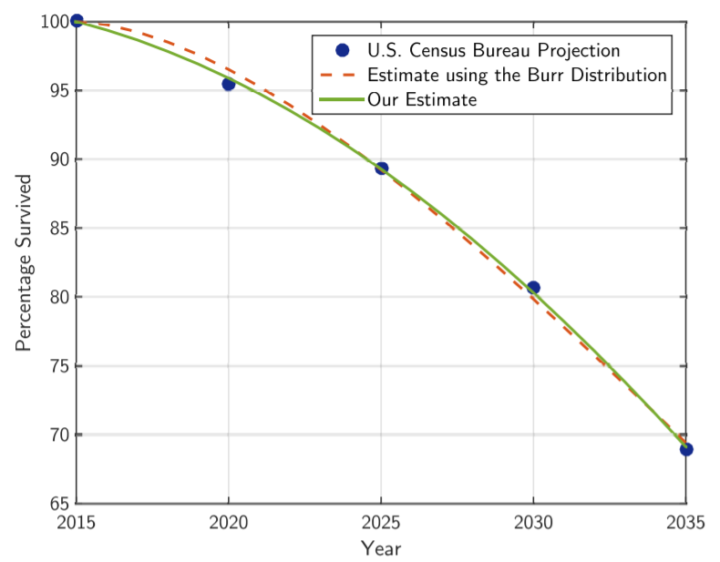

Slide 6
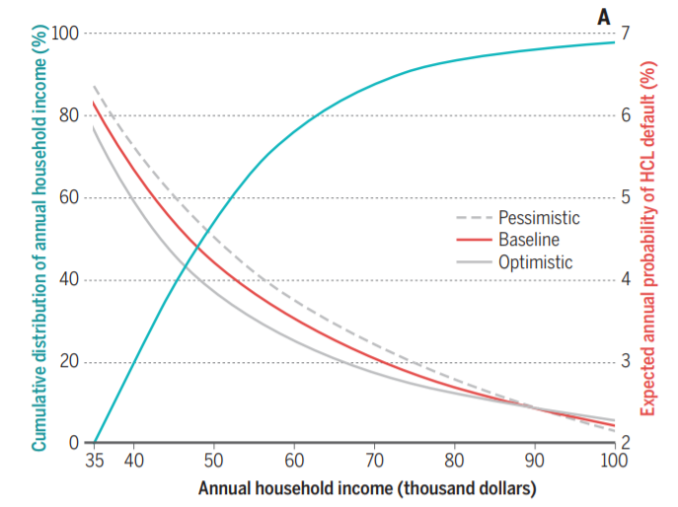

Slide 7
Simulation: Structure and Assumptions
Run 10 million Monte Carlo simulations under each default probability function
Assumptions
12,500 patients (arbitrary)
$84,000 cost per drug and $40,000 loan (based on HCV cure cost)
9.1% interest rate (aims for at least 15% return rate guarantee)
9 year repayment terms (maximum term for which $40,000 loan is viable)

Slide 8
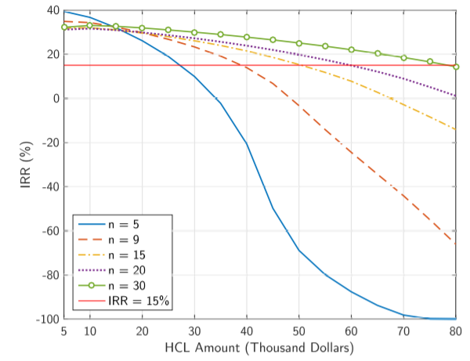
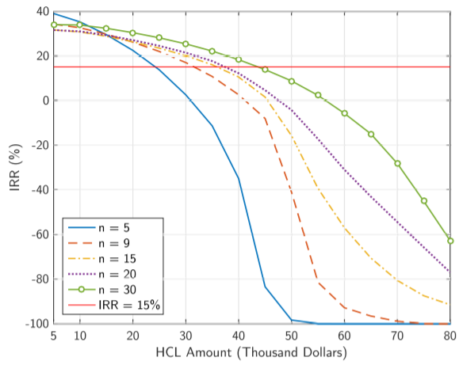

Slide 9
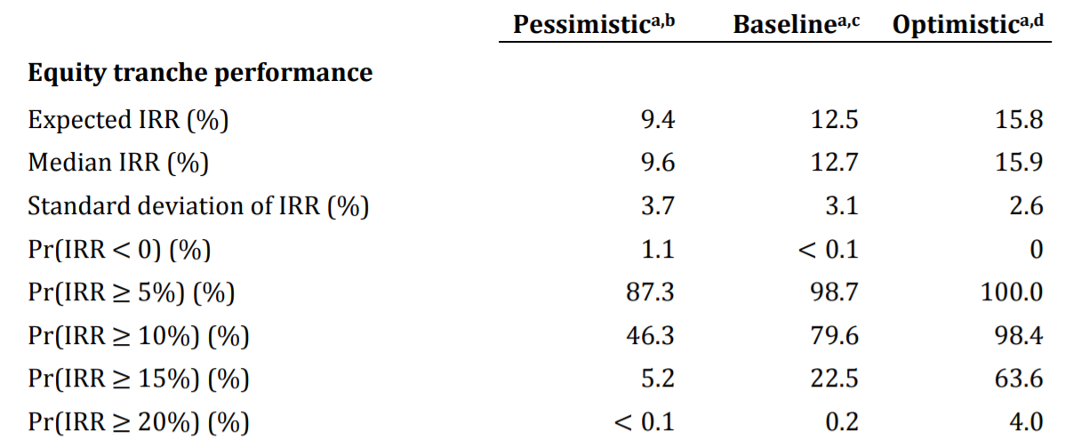

Slide 10
Challenges and Limitations
Is it realistic to assume health insurers will pay high up front costs?
High U.S. drug prices
Can’t help with truly expensive drugs like gene therapies ($1 million cost)
Still not well suited for lower income households
Was it right to make default estimates based on student loan data?
Securitization is risky left unregulated

