Slide 1
Intro to the Fair Allocation
CMSC 828M
Rangfu Hu

Slide 2
The model of cutting a divisible cake
Heterogeneous: different ingredients and different toppings
Divisible: cut without destroying their values
Agents: several partners with different preference over different ingredients
Subjectively Fair: each agent receive a piece, that he or she believes to be a fair share
A problem of dividing a divisible, heterogeneous and desirable resource is called fair cake-cutting, can be used to other resources: land estates, advertisement space, broadcast time

Slide 3
The model of cutting a divisible cake: Math
The cake is the interval [0,1]
Set of agents N={1,...,n}
Each of agent has a valuation function Vi over pieces of cake
Additive: if X∩Y=∅then Vi (X)+Vi (Y) = Vi (X⋃Y)
∀i∈N, Vi ([0,1]) = 1
Find an allocation A = A1,...,An

Slide 4
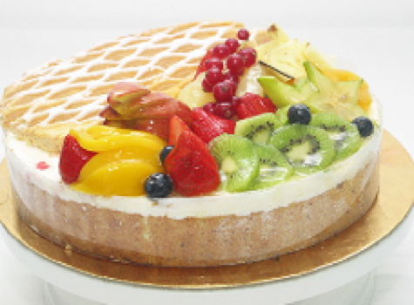
Fairness Definitions
Envy Free(EF):
Each agent receives a piece that values at least as much as every other piece
∀i,j∈N, Vi(Ai) ≥ Vi(Aj)
Proportionality(PR):
Each agent receives a piece that values at least 1/n of the value of the entire cake
∀i∈N, Vi(Ai) ≥ 1/n
Example cake:
The cake has two parts: fruit and cookie
Two agents: Alice and George
Alice values the cookie as 0.9 and fruit as 0.1
George values the cookie as 0.3 and fruit as 0.7
Give all cookies to Alice and all fruit to George
EF and PR

Slide 5
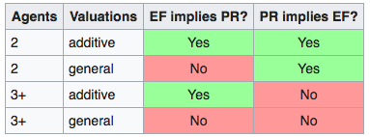
Fairness Definitions: with additive
For n=2 with additive, EF and PR are always equivalent
For n> 2 with additive, EF can implies to PR but not the other way

Slide 6
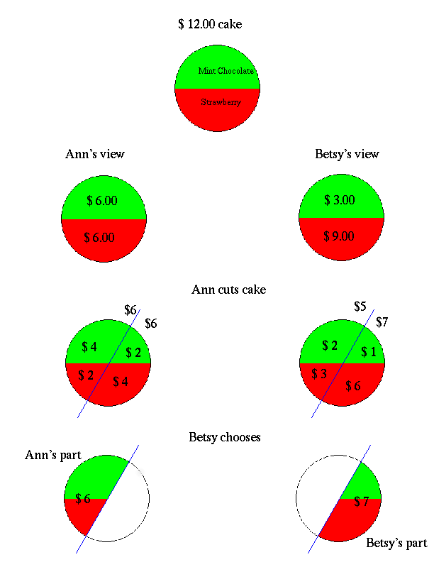
Cut and Choose Algorithm: 2 players
A cake with strawberry(½)and chocolate(½)
Ann’s valuation: strawberry(½) and chocolate(½)
Betsy’s valuation: strawberry(¼) and chocolate(¾)
Step 1: Let Ann cut the cake into two pieces, where those two pieces has the same value from Ann’s valuation
For Ann: Each of the two pieces worth ½
For Betsy: one piece worth 5/12 and the other 7/12
Step 2: Let Betsy choose one piece and Ann will get the rest one
For Ann: get ½
For Besty: get 7/12 EF and PR

Slide 7
Cut and Choose Algorithm: 3 players
Stage 1: Cut
Player 1 divides cake into 3 equal pieces
Player 2 trims the largest pieces such that the remaining part of this piece equals to the second largest pieces
Now we call the trimmed part cake 2 and the rest forms cake 1

Slide 8
Cut and Choose Algorithm: 3 players
Stage 2: Choose Cake 1
Players are going to choose in order of player 3, player 2, and player 1
Player 3 choose the largest piece
Choose the trimmed remaining piece
not choose the trimmed remaining piece
Player 2 will choose the trimmed remaining pieces if player 3 didn’t
Either player 2 or player 3 is going to choose the trimmed remaining piece; call that player T (trimmed)and the other T’
3. Player 1 chooses the remaining(untrimmed)piece

Slide 9
Cut and Choose Algorithm: 3 players
Stage 3: Allocate Cake 2
Cut:
Player T’ cut cake 2 into 3 equal pieces
Choose:
Players are going to choose in order of player T, player 1, and playerT’

Slide 10
Cut and Choose Algorithm: 3 players
EF for cake 1:
Cut: player 1 cut and player 2 trimmed; Choose order: Player 3, player 2, Player 1
Player 3 chooses first shouldn’t envy player 1 or player 2
Player 2 likes the trimmed remaining piece and the original second largest piece the same and also better than the third piece, so player 2 will not envy player 1 or player 3
Player 1 like those two untrimmed piece the same of ⅓ and also better than the trimmed remaining piece, so player 1 will not envy player 2 and player 3
The allocation of cake 1 is EF

Slide 11
Cut and Choose Algorithm: 3 players
EF for cake 2:
Cut: player T’; Choose order: Player T, player 1, Player T’
Player T choose first so shouldn’t envy player T’ or player 1
Player T’ is indifferent weighing the three pieces of cake 2, so player 2 will not envy player T or Player 1
Player 1 choose before player T’ so will not envy player T’; even if player T gets the whole cake 2, it will be totally ⅓ of the whole cake combine the allocation of cake1 and cake2 to player T, so player 1 will not envy player T
The cut and choose algorithm is EF for 3 players

Slide 12
Successive Pair Algorithm: n players
Recursively divide the cake for n-1 players to get their pieces
Assume everyone is happy to divide among n-1 player with∀i∈n-1, Vi ≥ 1/(n-1)
Let n-1 players cut their own pieces into n equal pieces and let the last player n join, each piece for every player: ∀i∈n-1, Vi ≥ (1/(n-1))/n
The last playerN will choose 1 largest piece separately from n-1 player’s part
The n-1 player will get the remaining n-1 equal pieces from their own part
For n-1 player: V’≥ (n-1)*(1/(n-1)/n), so V’≥ 1/n for them.
For Player n: V-n≥1*(V1/n) + 1*(V2/n)… + 1*(V(n-1)/n)
=(V1+...+Vn-1)/n
=1/n, where we can guarantee PR for it but not necessarily EF

Slide 13
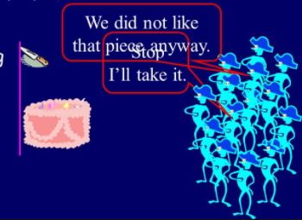
Continuously Moving Knife Algorithm
Moves the knife continuously across the cake until some player say stop
This player will get this piece
Tell lies means risk of gaining less in this game
V=1/n or this player will not yell out
The rest player continues
(n-1) will get 1/n or they will not yell
But for the last player:
He never yells: those V(1, N-1)<(n-1)*1/n
The remaining value Vn>1-(n-1)/n
The last player will get Vn>1/n, PR
However, EF can not Guaranteed here

Slide 14
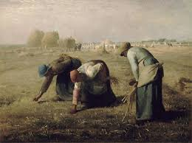
Maximin Share
$14
$60 $40
Step 1: Let player1 to put items into 3 bundles $5 $10
Step 2: Player 1 get the least valued bundle (bundle with minimum value)

Slide 15
Maximin Share Total: $29
Total: $60 Total: $40
$14
$60 $40
Maximin: player1 needs to find a strategy which $5 $10
will maximizes the value of minimum valued bundle: here is $29

Slide 16
Maximin Share Guarantee
MMS guarantees that of player i:
∀n ≥ 3 there exist additive valuation functions that do not admit an MMS allocation
It is always possible to give each player at least ⅔ of his MMS
--Procaccia & Wang[EC-2014]
p.s possible of giving each player at least 3/4 of MMS has been proved
--Ghodsi et al. [EC-2018]
--

Slide 17
Maximin Share Guarantee: Algorithm for ½ MMS
Allocate those items with value greater than ½ MMS to players and ignore this part: Left items each values less than ½ MMS
Start to put those items into bundles, when one bundle first reaches the value of ½ MMS for one player, this player is going to yell stop and get this bundle.
Repeat this process until all items in bundles has been allocated to the rest n players
Look at one of those bundles:
Call this bundle A of several items: V(A)≥ ½ MMS
Call the last piece into this bundle item b: V(A-b)≤ ½ MMS, V(b)≤ ½ MMS
The allocation for n players: V≥ n*MMS
V(A)=V(A-b)+V(b)≤ MMS, ½ MMS≤ V(A)≤ MMS
½ MMS is guaranteed for n players in the allocation of smaller items in bundle

