Slide 1
Applied Mechanism Design For Social Good
John P Dickerson
Lecture #1 – 01/25/2018
CMSC828M
Tuesdays & Thursdays
9:30am – 10:45am

Slide 2
Markets come in many forms …
… some of which don’t conform to conventional notions of markets …
… and some in which money may play little or no role.
– excerpt from Who Gets What – and Why
Notes:
Markets and marketplaces come in many forms …
… some of which don’t conform to conventional notions of markets …
… and some in which money may play little or no role.

Slide 3
Aesthetically-displeasing One-Slide Course Summary
Mechanism design is a field in economics and game theory that takes an engineering approach to designing economic mechanisms or incentives, toward desired objectives, in strategic settings, where players act rationally.
AKA “reverse game theory” – we’re designing the rules of the game, not figuring out how to play it.
This course: can we design mechanisms for societal problems that perform well in practice, are computationally tractable, and whose workings and results are understandable by humans?
More info: https://cs.umd.edu/class/spring2018/cmsc828M/

Slide 4
Prerequisite Knowledge
Aimed at Ph.D. students – but likely accessible to others with mathematical maturity and interest.
Assuming:
Basic CS undergrad knowledge of theory (correctness proofs, NP-hardness, impossibility results)
Basic CS/Math undergrad knowledge of optimization
Convex optimization, LPs, IPs – one lecture of primer, too
Basic CS/Math undergrad knowledge of statistics and probability
Ability to consume scientific papers (CS, Econ, OR)
All of this can be learned on the fly! Recommended books …

Slide 5
Book #1: “The AGT BOOK”
It’s free online! Check the course webpage.

Slide 6
Book #2: “CSC Handbook”
It’s free online! Check the course webpage.

Slide 7
Book #3: “Matching Market Design”
It’s not free online! UMD has one copy.

Slide 8
Book #4: “Combinatorial Auctions”
It’s free online! Check the course webpage.

Slide 9
Who am I?
http://jpdickerson.com

Slide 10
Who are you?
PhD/MSc/BSc?
Area?
Background in: CS, game theory, mechanism design, HCI?
Interest in this course?
Goals in life? And goals for this course?
Advisor?
Please let me know if you did not receive my listserv email last night! I will send out updates via the listserv, and probably via Piazza.

Slide 11
Course structure
First 4 lectures: primers in GT/MD and optimization
Next 23 lectures: theory + application areas
Security games
Healthcare markets (organ allocation, financing R&D)
Food allocation
Combinatorial assignment (bidding on courses)
Incentive auctions (FCC spectrum allocation)
Fair Division (allocating rooms to schools)
Voting (#oprah2020)
School choice (assigning kids to schools)
Prediction markets (#oprah2020?)
2-3 lectures of “floating topics” – ideas?
Final 2-3 lectures: project presentations ?????
Ambitious …

Slide 12
Grade #1: Project
Students will complete a semester-long course project on something related to market and mechanism design.
Individual or small group
100% theory, 100% applied, or convex combination
Goal: create something publishable!
Important dates:
Project proposals will be due in early March
Project presentations will be during the last 2-3 lectures
Project writeups—formatted as, say, a NIPS conference paper or similar—will be due by the exam date for this course (Monday, May 14 at 8:00AM).

Slide 13
A few projects from last Year …
Some projects from last year that are/will be published:
Faez Ahmed: diverse b-matching (IJCAI-17, arXiv)
Neal Gupta: competition in dynamic matching markets (under double-blind review)
Duncan McElfresh: a new fairness metric for kidney exchange (AAAI-18, arXiv)
Elissa Redmiles: behavioral economics and two-factor authentication (under double-blind review)
Candice Schumann: diversity and multi-armed bandits (under review, arXiv)
23 students last year, 14 projects, at least 5 will be published in top venues!
… 35%+ “acceptance rate” – it’s easier to get published via CMSC828M than in top CS conferences ;).

Slide 14
Grade #2: Present a paper
Students will present for at least ½ of a lecture on one of the assigned papers:
(Welcome to do an entire class, but talk to me beforehand!)
John covers the basics of a topic in the first half of lecture
Check out the course webpage for topics
Also: feel free to suggest a topic you like!
Logistics:
We’ll figure this out in second week
I’ll post some example presentations

Slide 15
Grade #3: Take-Home exams
The majority of students want this to be an MSc/PhD qualifier
So this course is an AI qualifier for CMSC grad students
What this means:
“… the courses' written exam(s) which must account for at least 30% of the grade.” – UMD graduate handbook
Implementation:
One take-home midterm; 24 hours to do it
One take-home final; 48 hours to do it
I’ll let you pick when you take exams (within reason; see site)

Slide 16
Grade #4: Class Participation
Please please please please please read the paper(s) before coming to class!
I want to speak with you, not at you …
Present ½ of the class on the paper – JPD gives intro
Participate on Piazza, help brainstorm project ideas, ask questions in class, answer questions in class, etc.
(These should be easy points for everyone.)

Slide 17
Grade Breakdown | Qualifier Approval
60% course project:
5% project proposal (early March)
5% project checkup (April)
15% in-class presentation (early May)
35% course project writeup (mid-May)
10% presenting a paper
30% examinations:
Better of 10%/20% or 15%/15% midterm/final
= A+

Slide 18
Important Walls of Text

Slide 19
Anti-Harassment
Common Sense!
(Adapted from ACM SIGCOMM’s policies)
The open exchange of ideas and the freedom of thought and expression are central to our aims and goals. These require an environment that recognizes the inherent worth of every person and group, that fosters dignity, understanding, and mutual respect, and that embraces diversity. For these reasons, we are dedicated to providing a harassment-free experience for participants in (and out) of this class.
Harassment is unwelcome or hostile behavior, including speech that intimidates, creates discomfort, or interferes with a person's participation or opportunity for participation, in a conference, event or program.

Slide 20
Academic Integrity
Common Sense!
(Text unironically stolen from Hal Daumé III)
Any assignment or exam that is handed in must be your own work (unless otherwise stated). However, talking with one another to understand the material better is strongly encouraged. Recognizing the distinction between cheating and cooperation is very important. If you copy someone else's solution, you are cheating. If you let someone else copy your solution, you are cheating (this includes posting solutions online in a public place). If someone dictates a solution to you, you are cheating.
Everything you hand in must be in your own words, and based on your own understanding of the solution. If someone helps you understand the problem during a high-level discussion, you are not cheating. We strongly encourage students to help one another understand the material presented in class, in the book, and general issues relevant to the assignments. When taking an exam, you must work independently. Any collaboration during an exam will be considered cheating. Any student who is caught cheating will be given an F in the course and referred to the University Office of Student Conduct. Please don't take that chance – if you're having trouble understanding the material, please let me know and I will be more than happy to help.

Slide 21
Example Application Areas Many of which we’ll cover in future classes

Slide 22
Example: Matching markets
In matching problems, prices do not do all – or any – of the work
Agents are paired with other (groups of) agents, transactions, or contracts
Workers to firms
Children to schools
Residents to hospitals
Patients to deceased donors
Advertisements to viewers
Riders to rideshare drivers

Slide 23
Uncertainty in Matching Markets
Does a matched edge truly exist?
How valuable is a match?
Will a better match arrive in the future?
F
?
W

Slide 24
Competition in Matching Markets
Rival matching markets compete over the same agents
How does this affect global social welfare?
How to differentiate?

Slide 25
Cadence of Matching Markets
FREQUENCY
How quickly do new edges form?
How frequently does a market clear?
Is clearing centralized or decentralized?
Can agents reenter the market?

Slide 26
Example: Resident-Hospital Assignment
1940s: decentralized resident-hospital matching
Market “unraveled”, offers came earlier and earlier, quality of matches decreased
1950s: NRMP introduces hospital-proposing deferred acceptance algorithm
1970s: couples increasingly don’t use NRMP
1998: matching with couple constraints
(Stable matching may not exist anymore …)
Take-home message Looks like: M.D.s aren’t the only type of doctor who help people!

Slide 27
Example: Combinatorial course allocation [Images from Budish et al. working paper 2016]
Bidding
Dynamic exclusions
“Funny money” used for bidding

Slide 28
Example: Voting
Set of voters N and a set of alternatives: {Hillary Clinton, The Donald, Gary Johnson}
Each voter ranks the candidates:
v₁: The Donald > HRC > Gary Johnson
v₂: HRC > Gary Johnson > The Donald
… A preference profile is the set of all voters’ rankings
Can we choose a voting rule – that is, a function that takes preference profiles and returns a winning alternative – that:
“Behaves well”
Isn’t manipulable by strategic agents

Slide 29
Example: fair allocation
Divisible goods:
Splitting land, cutting cake
Indivisible goods:
Splitting up assets after divorce (house, cars, pets)
A chief concern: defining and guaranteeing the fairness of the final allocation
An allocation is envy free if each player values her own allocated set of goods at least as highly as any other player’s allocated set
When do envy-free allocations exist? How can we compute them? What can we do when they don’t exist?
http://spliddit.org

Slide 30
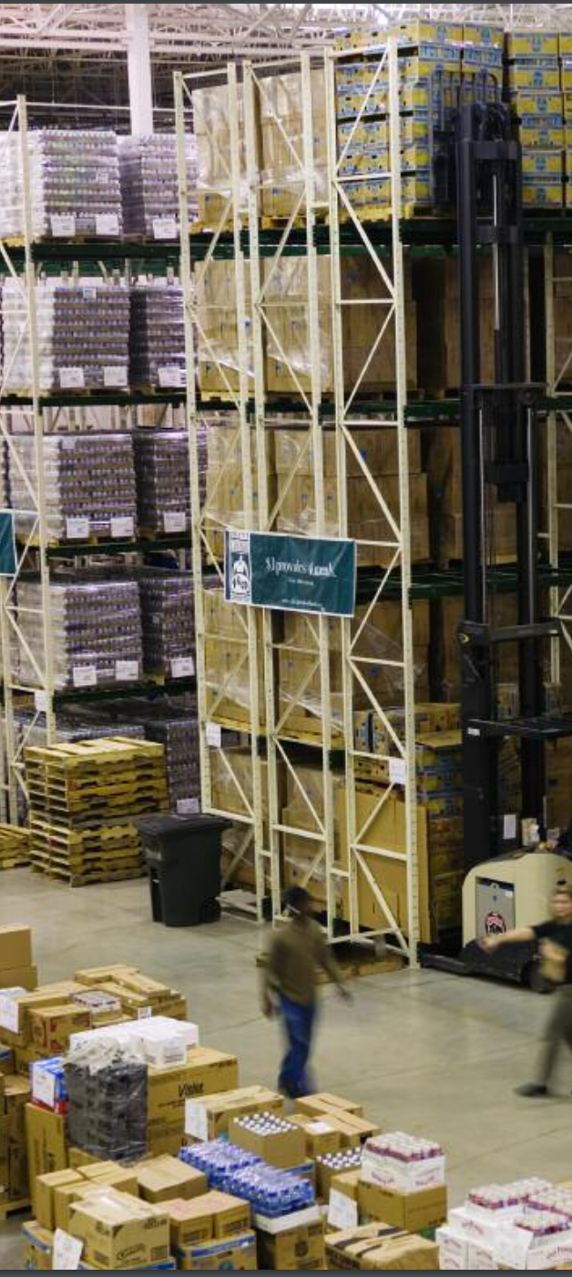
Example: Food Bank Allocation
Food banks supply nutrition to the needy for free or at a reduced cost
Much of that food comes from donors (e.g. supermarkets, manufacturers)
Distribution is overseen by a large non-profit organization, Feeding America
Previously: centralized allocation based on perceived need of food banks
Currently: food banks bid in an online auction using a fake currency for loads of donated food.

Slide 31
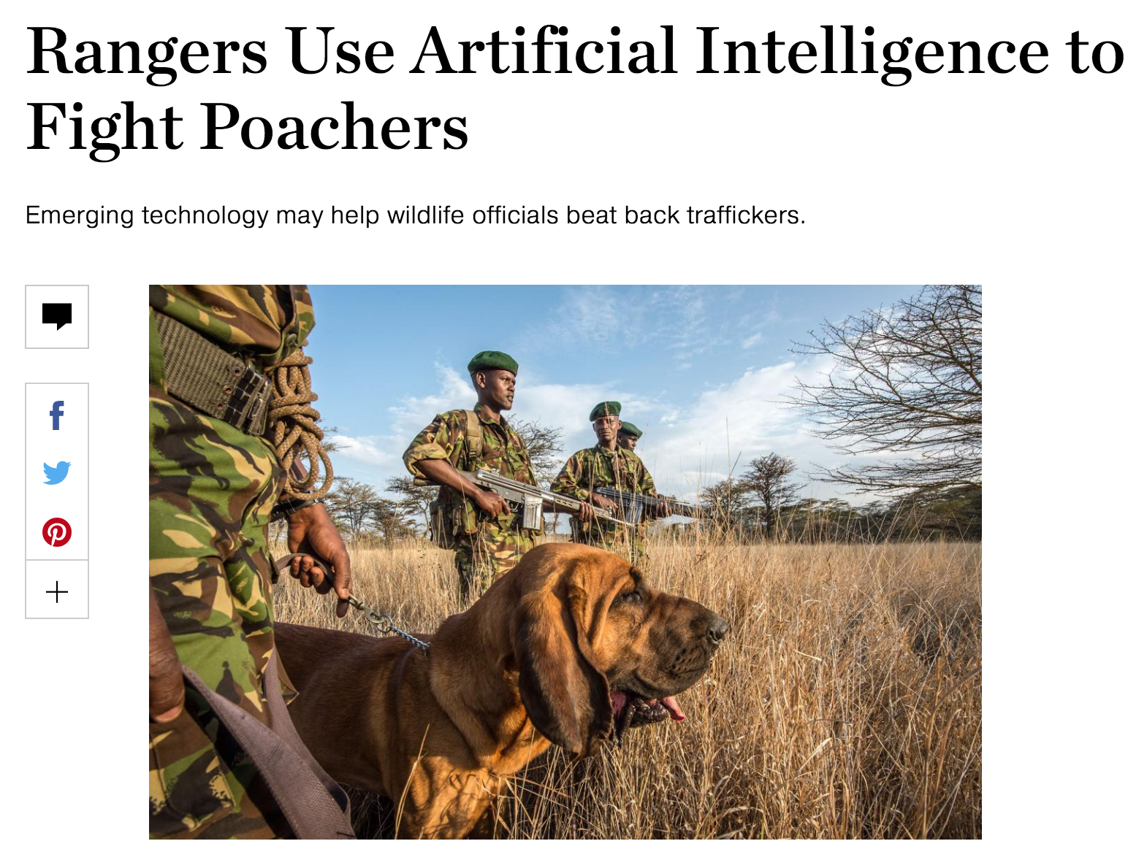
Example: Security GAmes
Where should we deploy security forces (checkpoints, cop cars, dogs, troops), assuming a rational adversary who can observe our deployment strategy?
Checkpoints at airports
Patrol routes on the water on the borders
Anti-poacher teams near big game
How do we compute these strategies?
What if the adversary isn’t rational?

Slide 32
Example: Kidney Transplantation
US waitlist: over 100,000
36,157 added in 2014
4,537 people died while waiting
11,559 people received a kidney from the deceased donor waitlist
5,283 people received a kidney from a living donor
Some through kidney exchanges
(We work extensively with the UNOS exchange.)
Demand
Supply
[Roth et al. 2004]

Slide 33
Example: Deceased-Donor Allocation
Online bipartite matching problem:
Set of patients is known (roughly) in advance
Organs arrive and must be dispatched quickly
Constraints:
Locality: organs only stay good for 24 hours
Blood type, tissue type, etc.
Who gets the organ? Prioritization based on:
Age?
QALY maximization?
Quality of match?
Time on the waiting list?

Slide 34
Example: Kidney Exchange
Wife
Husband
D₁ P₁
Donors
Patients
D₂ P₂
Brother
Brother
(2- and 3-cycles, all surgeries performed simultaneously)

Slide 35
Non-directed donors & chains
[Rees et al. 2009]
NDD
D1
D2
D3
…
Pay it forward
P1
P2
P3
Not executed simultaneously, so no length cap required based on logistic concerns …
… but in practice edges fail, so some finite cap is used!

Slide 36
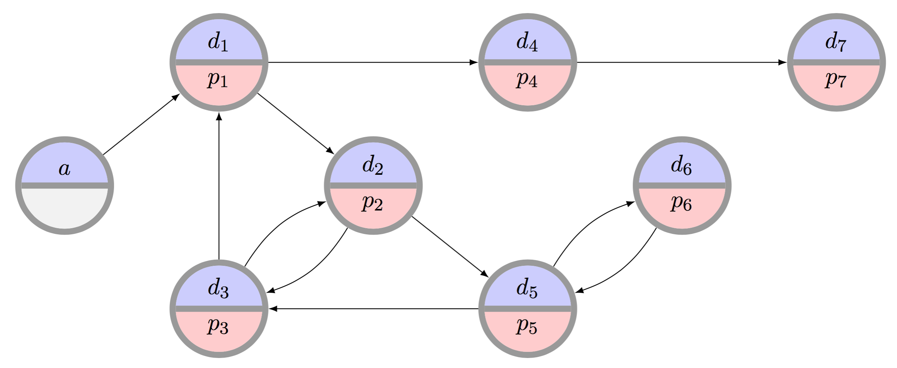
Example: Kidney Exchange
What is the “best” matching objective?
Maximize matches right now or over time?
Maximize transplants or matches?
Prioritization schemes (i.e. fairness)?
Modeling choices?
Incentives? Ethics? Legality?
Can we design a mechanism that performs well in practice, is computationally tractable, and is understandable by humans?

Slide 37
Techniques we’ll use (Next three lectures will cover these, In the context of Mechanism Design)

Slide 38
Combinatorial Optimization
Combinatorial optimization lets us select the “best element” from a set of elements.
Some PTIME problems:
Some forms of matching
2-player zero-sum Nash
Compact LPs
Some PPAD- or NP-hard problems:
More complex forms of matching
Many equilibrium computations
Some > NP-hard problems:
Randomizing over a set of all feasible X, where all feasible X must be enumerated (#P-complete)

Slide 39
C.O. for Kidney Exchange: The Edge formulation
[Abraham et al. 2007]
Binary variable x_{ij} for each edge from i to j
Maximize
u(M) = Σ w_{ij} x_{ij}
Subject to
Σ_{j} x_{ij} = Σ_{j} x_{ji} for each vertex i
Σ_{j} x_{ij} ≤ 1 for each vertex i
Σ_{1≤k≤L} x_{i(k)i(k+1)} ≤ L-1 for paths i(1)…i(L+1)
(no path of length L that doesn’t end where it started – cycle cap)
Flow constraint

Slide 40
C.O. For Kidney Exchange: The Cycle Formulation
[Roth et al. 2004, 2005,
Abraham et al. 2007]
Binary variable x_{c} for each feasible cycle or chain c
Maximize
u(M) = Σ w_{c} x_{c}
Subject to
Σ_{c : i in c} x_{c} ≤ 1 for each vertex i

Slide 41
C.O. For Kidney Exchange: Comparison
Tradeoffs in number of variables, constraints
IP #1: O(|E|^{L}) constraints vs. O(|V|) for IP #2
IP #1: O(|V|²) variables vs. O(|V|^{L}) for IP #2
IP #2’s relaxation is weakly tighter than #1’s. Quick intuition in one direction:
Take a length L+1 cycle. #2’s LP relaxation is 0.
#1’s LP relaxation is (L+1)/2 – with ½ on each edge
Recent work focuses on balancing tight LP relaxations and model size [Constantino et al. 2013, Glorie et al. 2014, Klimentova et al. 2014, Alvelos et al. 2015, Anderson et al. 2015, Mak-Hau 2015, Manlove&O’Malley 2015, Plaut et al. 2016, …]:
We will discuss (9/29) new compact formulations, some with tightest relaxations known, all amenable to failure-aware matching

Slide 42
Game Theory & Mechanism Design
We assume participants in our mechanisms are:
Selfish utility maximizers
Rational (typically – sometimes relaxed)
Game theory & M.D. give us the language to describe desirable properties of mechanisms:
Incentive compatibility
Individual rationality
Efficiency

Slide 43
Machine learning
Predicting supply and demand
Computing optimal matching/allocation policies:
MDPs
RL
POMDPs, if you’re feeling brave/masochistic
Aside: recent work looks at fairness and discrimination in machine learning – could be an interesting project.
“… when a search was performed on a name that was “racially associated” with the black community, the results were much more likely to be accompanied by an ad suggesting that the person had a criminal record—regardless of whether or not they did.”

Slide 44
Random Graph Theory

Slide 45
Next class: Game Theory Primer

