Slide 1
Gerrymandering
Brian Ondov

Slide 2
PBS

Slide 3
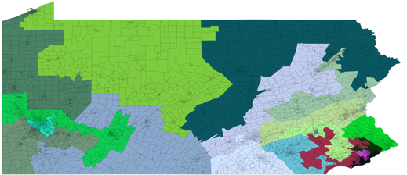
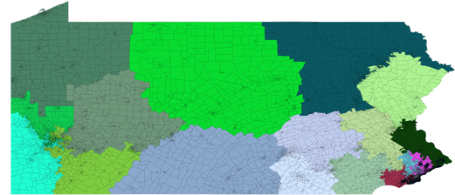
Chikina, Frieze & Pegden 2017
Markov chain sampling
New test for outliers: $\sqrt{ε}$

Slide 4
Wisconsin
wisc.edu
wisconsin.gov

Slide 5
Herschlag, Ravier & Mattingly 2017

Slide 6
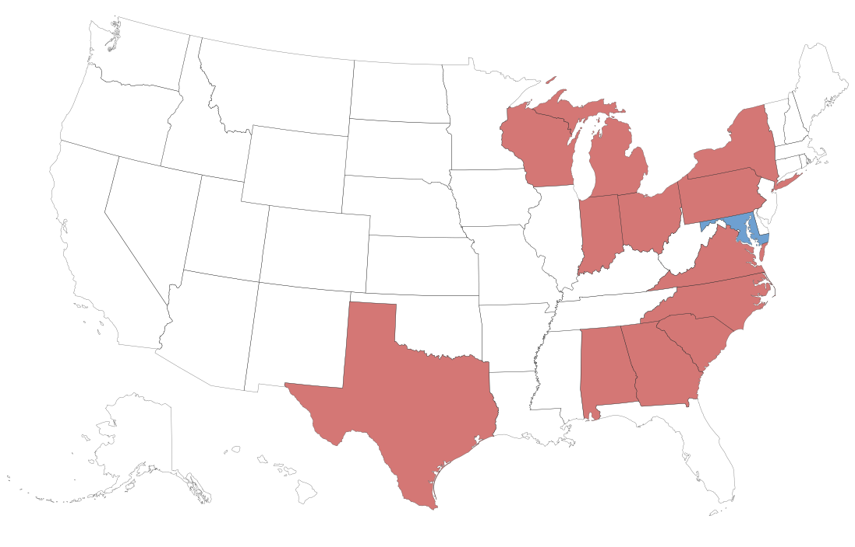
Efficiency Gap
Stephanopoulos & McGhee, 2014
l := losing districts
w := winning districts
T_{w} := winning threshold
x := wasted votes
V := total votes
$$x_{i}=\sum_{l}{v_{i,l}+\sum_{w}{v_{i,w}−T_{w}}}$$
$$E.G.=\frac{x_{1}−x_{2}}{V}$$
E.G. > 7%
New York Times

Slide 7
Gill v. Whitford, Oct. 2017 (Wisconson map)
Supreme Court

Slide 8
fair division
“Zeus, most glorious and greatest of the eternal gods, take which ever of these portions your heart within you bids.”
- Prometheus, Hesiod’s Theogony
MFA Boston

Slide 9
Fair Division
Wesley
Pegden
“A Partisan Districting Protocol with Provably Nonpartisan Outcomes”
I cut, you freeze
Serial dictatorship
Ariel
Procaccia
Dingli
Yu

Slide 10
example
Slate

Slide 11
Competing objectives
Slate

Slide 12
Varied utility
Slate

Slide 13
Slate

Slide 14
Slate

Slide 15
Slate

Slide 16
Slate

Slide 17
Slate

Slide 18
Formal Procedure

Slide 19
Proving Fairness
Step 1
Prove non-geometric allocation
Step 2
Generalize to geometric case
Step 3
???
Step 4
Profit

Slide 20
Proof?

Slide 21
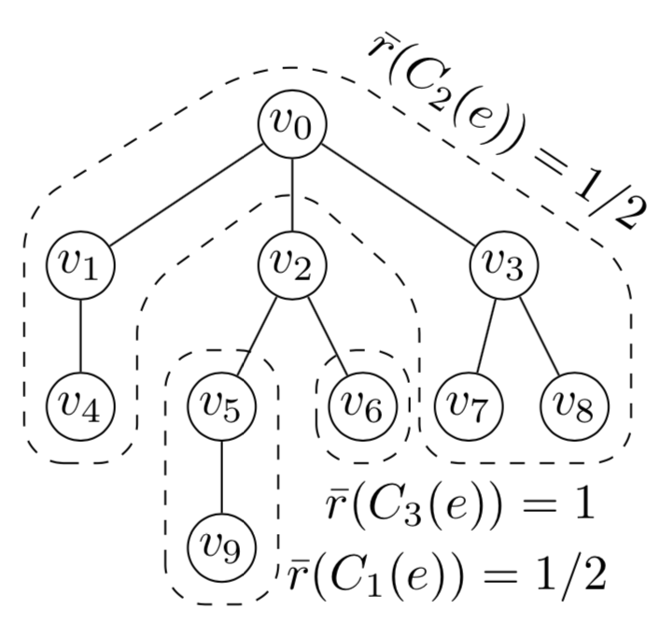
Proof?

Slide 22
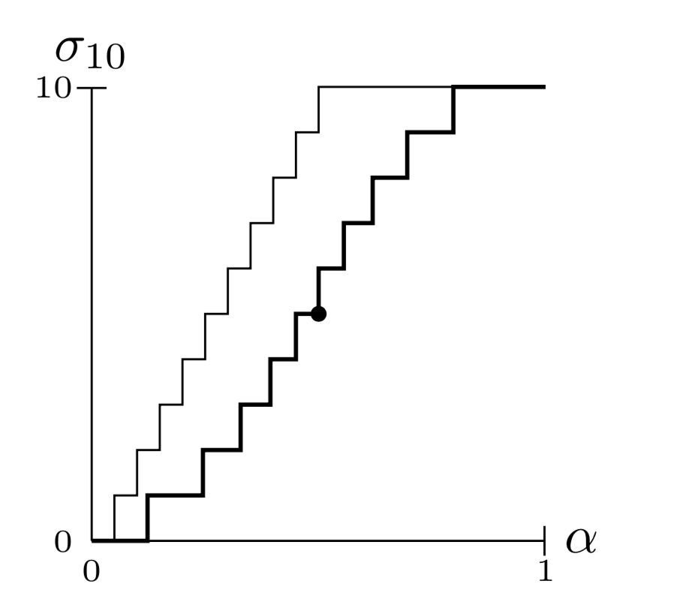
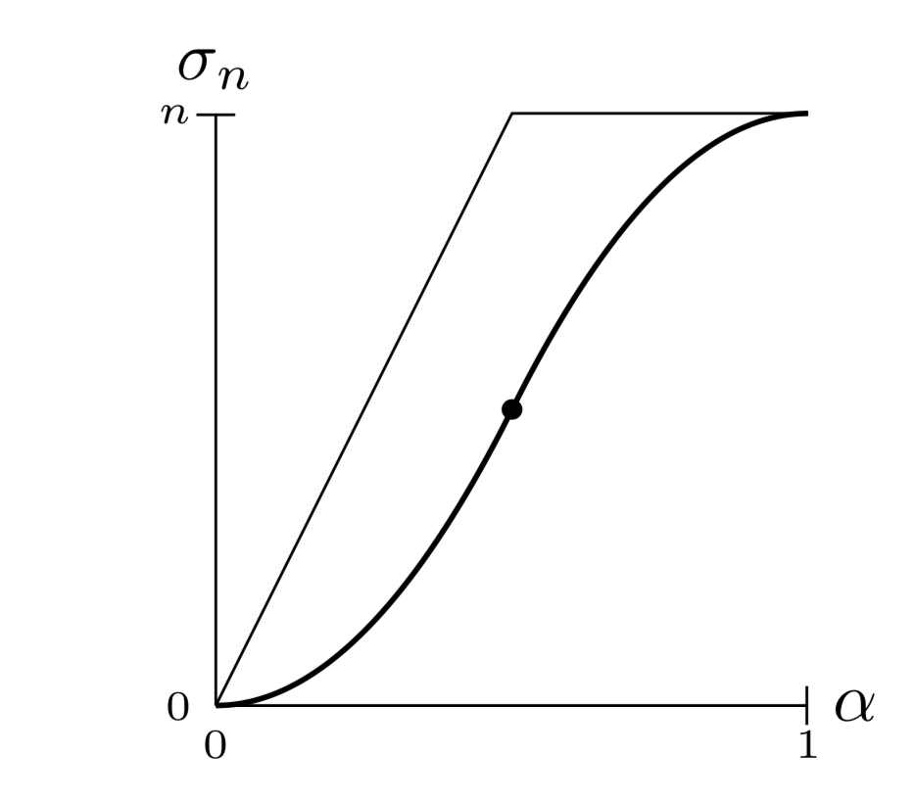
$$σ(n, s)$$
: slate from optimal play (player 1)
districts
districts
support
support

Slide 23
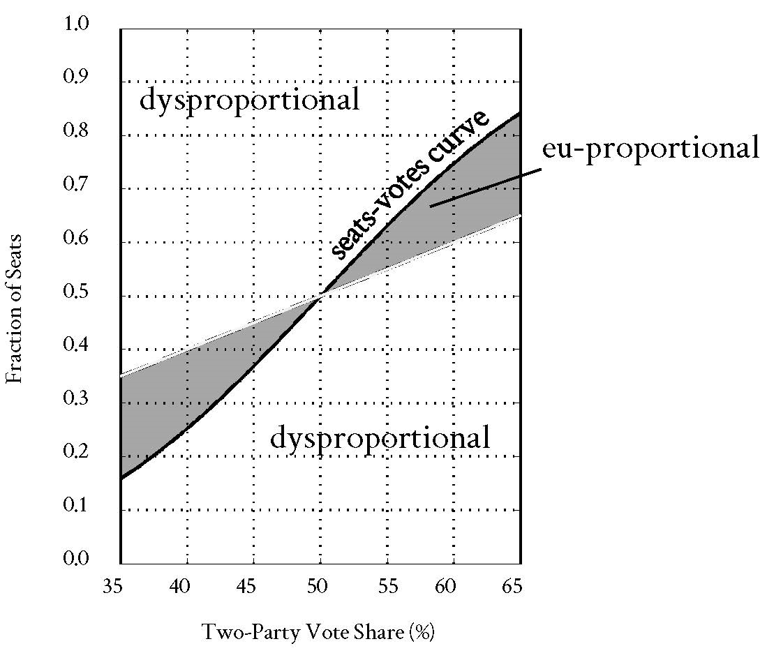
Wang 2016

Slide 24
Provable Fairness: Piece of Cake!
Amazon

