Slide 1
Maximizing the Spread of Influence through a Social Network
Kempe, Kleinberg, and Tardos (2003)
Notes:
Good to keep in mind that this was published before the time of online social networks as we know them today. Before Facebook, Twitter, Instagram, and Snapchat were even started. Chatrooms and discussion boards are older.

Slide 2
Paper Overview
Introduction
History
Diffusion Models
Paper Contributions
Approach
Diffusion Models ( + Assumptions)
Example Network
Efficient Approximation
Experimental Results
Generalization
Non progressive processes
Marketing Strategies

Slide 3
Introduction
Problem: Need to try to convince a people to adopt a product/behavior
Constraints: Let’s say you have a limited budget
Approach?
Notes:
Specifically concerned with: viral/word-of-mouth marketing . So our budget would be for advertising.
Maximize the expected number of adopters with this limited budget

Slide 4
History
Traditional Methods:
Mass Marketing
Direct Marketing
Customers don’t necessarily make decisions in a vacuum
Notes:
What about network effects?

Slide 5
Diffusion of ideas
Social networks play a fundamental role as a medium for the spread of information
Dynamics of adoption is important
Prior research work in diffusion processes:
“viral marketing” effects in the success of new products
adoption of various strategies in game theoretic settings
cascading failures in power systems.
Notes:
A social network — the graph of relationships and interactions within a group of individuals — plays a fundamental role as a medium for the spread of information
important to understand how the dynamics of adoption are likely to unfold within the underlying social network: the extent to which people are likely to be affected by decisions of their friends and colleagues, or the extent to which “word-of-mouth” effects will take hold.
diffusion processes for “word-of-mouth” and “viral marketing” effects in the success of new products [4, 7, 10, 13, 14, 20, 26], the sudden and widespread adoption of various strategies in game theoretic settings [6, 12, 21, 32, 33], and the problem of cascading failures in power systems [2, 3].

Slide 6
Diffusion Models
Activation of Nodes (Users) in a directed Social Network Graph (G)
Models considered:
Independent Cascades
Linear Threshold
Initial Assumption: Progressive
Notes:
Other models:
Voter model
Heat diffusion model
We show that approximation algorithms for maximizing the spread of influence in these models can be developed in a general framework based on submodular functions

Slide 7
Diffusion Models: Linear Threshold
Model Parameters
Edge weight b_{v,w} : Neighbor influence
Threshold θ_{v} : tendency to adopt innovation
Diffusion proceeds in discrete time steps:
Select initial set of active nodes A₀
Nodes active at time step t are also active at time step t+1
Check activation condition and update state A_{t} at every time step
(Granovetter and Schelling)
Activation condition
2
b_{1,2}
b_{4,1}
4
1
3
b_{1,3}
Notes:
Theta is weighted fraction of v’s neighbors that must become active in order for v to become active

Slide 8
Diffusion Models: Linear Threshold
Inactive Node
0.6
Active Node
0.3
0.2
0.2
Threshold
X
Active neighbors
0.1
0.4
U
0.5
0.3
Stop!
0.2
w
0.5
v

Slide 9
Diffusion Models: Independent Cascades
Model Parameters
Edge weight p_{v,w} : Activation success probability
Diffusion proceeds in discrete time steps:
Select initial set of active nodes A₀
Nodes active at time step t are also active at time step t+1
Active node v given a single chance to activate neighbor w
Multiple neighbors’ attempted sequenced in random order
2
p_{1,2}
p_{4,1}
4
1
3
p_{1,3}

Slide 10
Diffusion Models: Independent Cascades
0.6
Inactive Node
0.3
0.2
0.2
Active Node
X
U
Newly active
node
0.1
0.4
Successful
attempt
0.5
0.3
0.2
Unsuccessful
attempt
w
0.5
v
Stop!

Slide 11
Influence Maximization Problem
Domingos-Richardson framework: Find a k-node subset A₀ of maximum influence σ(A₀)
Questions:
How is influence defined?
What is a submodular function?
Why is this important?
THIS IS NP-HARD!
Notes:
We begin by departing somewhat from the Domingos-Richardson framework in the following sense: where their models are essentially descriptive, specifying a joint distribution over all nodes’ behavior in a global sense, we focus on more operational models from mathematical sociology [15, 28] and interacting particle systems [11, 17] that explicitly represent the step-by-step dynamics of adoption
Need to select a k-subset of individuals S to activate in a social network such that they maximize the expected number of final activated nodes. NP-hard to determine the optimum for influence maximization for the models we consider

Slide 12
Paper Contributions
First provable approximation guarantee to within a factor of (1 - 1/e - 𝜺)
Experimental validation: Comparison with popular heuristics
Extensions
General Framework
Complex Marketing Actions
Non-Progressive
A general approach for reasoning about the performance guarantees of algorithms for these types of influence problems in social network
Notes:
First provable approximation guarantee to within a factor of (1 - 1/e - 𝜺) of optimal for both linear threshold and independent cascade model. Main content of result is the analysis framework needed for obtaining a provable performance guarantee. The algorithm that achieves this performance guarantee is a natural greedy hill-climbing strategy.
Node selection heuristics based on the well-studied notions of degree centrality and distance centrality from the field of social networks.

Slide 13
Approximation Guarantees
We want to find k-element set A₀ for which σ(A₀) is maximized
THEOREM: For a non-negative, monotone submodular function σ, let S be a set of size k obtained by selecting elements one at a time, each time choosing an element that provides the largest marginal increase in the function value. Let S∗ be a set that maximizes the value of f over all k-element sets.
Then σ(S) ≥ (1−1/e) ·σ(S∗); in other words, S provides a (1−1/e) approximation. (Nemhauser, Wolsey, Fisher, 78)
Influence function σ submodularity proof?
Notes:
Assumption: the greedy algorithm can evaluate the underlying function exactly, which may not be the case for the influence function σ(A). Simulation gives us arbitrarily close answer in poly-time.
Extensions: Complex marketing actions and weighted influence functions
G. L. Nemhauser, L. A. Wolsey and M. L. Fisher: An analysis of approximations for maximizing submodular set functions. Mathematical Programming 1978

Slide 14
Approximation Guarantees
Assumptions:
σ is non-negative
Submodular function: σ(S ∪ {v}) − σ(S) ≥ σ(T ∪ {v}) − σ(T)
Monotone: σ(S ∪ {v}) ≥ σ(S)

Slide 15
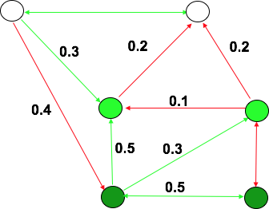
Submodularity: Independent Cascades
Pre-flip coins for each pair of nodes (v,w) using p_{v,w}
X: State of edges (live/blocked)
R(v,X): Set of nodes with live-edge paths from x
σ_{x}(S ∪ {v}) − σ_{X}(S) = R(v,X) -
σ_{X}(S ∪ {v}) − σ_{X}(S) ≥ σ_{X}(T ∪ {v}) − σ_{X}(T)
Notes:
Formulating an equivalent view of the process, which makes it easier to see that there is an order-independent outcome, and which provides an alternate way to reason about the submodularity property

Slide 16
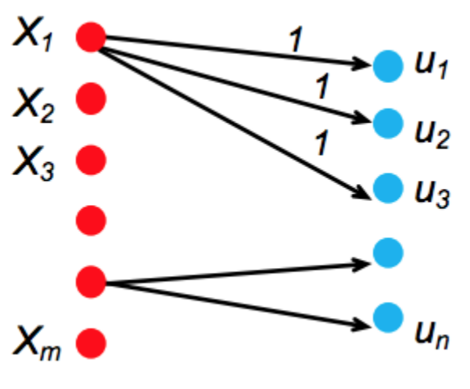
NP-Hardness: Independent Cascades
Reduce to set-cover problem
Sets X₁,...,X_{m}
Nodes u₁,...,u_{n}
Edge between X_{i} and u_{j} if u_{j} in X_{i}
Set of k nodes A σ(A) >= n+k
Optimization is NP-Hard

Slide 17
Submodularity Proof: Linear Threshold
Slightly more complicated: Activation dependent on aggregate
Trigger Graph Model: Pick a live incoming edge for each node v using b_{v,w} .
X: State of edges (live/blocked)
R(v,X): Set of nodes with live-edge paths from x
Claim: Trigger graph model = Linear threshold model
Notes:
Cumulative action of neighbors makes a node active
Negatively correlate the decisions so that at most one live edge enters each node
We need to prove that reachability under our random choice of live and blocked edges defines a process equivalent to that of the Linear Threshold Model.

Slide 18
Submodularity Proof: Linear Threshold
State of model is the pair (A_{t-1},A_{t})
Show that transition probabilities between states are same in both models
Both models start in same state
Distribution over states is always identical
Pr(v becomes active at time = t+1)
In model 1: Chance that influence weights in A_{t} \ A_{t-1} push it over threshold given not already exceeded.
In model 2: Chance that its live edge comes from A_{t} \ A_{t-1} and not A_{t-1,} A_{t-2} ,..., A₀
In both cases it is the same:
Notes:
Based on equivalent live-edge graphs • Find a random edge selection process, such that each edge is either live or blocked, and all live edges form a random live-edge graph. • Show that a diffusion model is equivalent to the reachability in random live-edge graphs: Given any seed set S, the distribution of active node sets after the diffusion process with seed set S ends is the same as the distribution of node set reachable from S in a random live edge graph. • Applicable to both IC and LT mode

Slide 19
NP-Hardness: Linear Threshold
Show to be equivalent to vertex-cover problem
Optimization is NP-Hard

Slide 20
Experimental Results
Run on co-authorship network from the complete list of papers in the high energy physics theory section of the e-print arXiv (2003)
10748 nodes (researchers), and 53000 edges (co-authorship)
Greedy Algorithm VS
Structural measures
Degree Centrality
Distance Centrality
Random selection
Notes:
it is desirable to use a network dataset that exhibits many of the structural features of large-scale social networks
The degree and distance centrality-based heuristics are commonly used in the sociology literature as estimates of a node’s influence
While processing the data, we corrected many common types of mistakes automatically or manually. In order to deal with aliasing problems at least partially, we abbreviated first names, and unified spellings for foreign characters. We believe that the resulting graph is a good approximation to the actual collaboration graph (the sheer volume of data prohibits a complete manual cleaning pass).
significant performance gains over several widely-used structural measures of influence
We also ran experiments on the co-authorship graphs induced by theoretical computer science papers. We do not report on the results here, as they are very similar to the ones for high-energy physics.
Notice that because the optimization problem is NP-hard, and the collaboration graph is prohibitively large, we cannot compute the optimum value to verify the actual quality of approximations.

Slide 21
Experimental Results
Linear Threshold Model: multiplicity of edges as weights. Weight of edge (u→v) = C_{uv} / d_{u}
Independent Cascade Model:
Case 1: uniform probabilities p on each edge (parallel edges?)
Case 2: edge from u to v has probability 1/ d_{v} of activating v.
For σ(A): Simulate the process 10000 times for each targeted set, re-choosing thresholds or edge outcomes pseudo-randomly from [0, 1] every time
Notes:
We study a special case of the Independent Cascade Model that we term “weighted cascade”, in which each edge from node u to v is assigned probability 1/dv of activating v.
f nodes u and v have cu,v parallel edges, then we assume that for each of those cu,v edges, u has a chance of p to activate v, i.e. u has a total probability of 1 − (1 − p) cu,v of activating v once it becomes active.

Slide 22
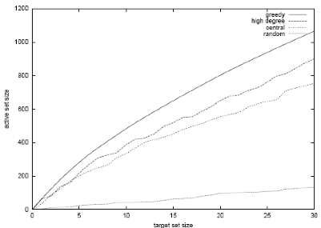
Linear Threshold Model
Greedy algorithm outperforms
Degree centrality node heuristic by about 18%
Distance centrality heuristic by over 40%
Notes:
This shows that significantly better marketing results can be obtained by explicitly considering the dynamics of information in a network, rather than relying solely on structural properties of the graph.
Neither of the heuristics incorporates the fact that many of the most central (or highest-degree) nodes may be clustered, so that targeting all of them is unnecessary. In fact, the uneven nature of these curves suggests that the network influence of many nodes is not accurately reflected by their degree or centrality
Don’t target just the highly central youtubers. Maybe target people with just 10’s of thousands of followers to reach more of the network

Slide 23
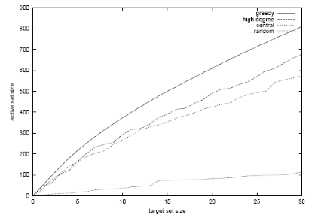
Independent Cascade Model: Case 2
Notes:
Notice the striking similarity to the linear threshold model. The scale is slightly different (all values are about 25% smaller), but the behavior is qualitatively the same, even with respect to the exact nodes whose network influence is not reflected accurately by their degree or centrality

Slide 24
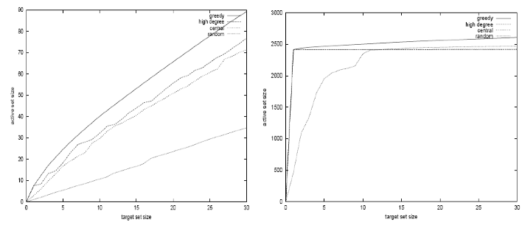
Independent Cascade Model : Case 1
Notes:
The reason is that in expectation, each node is influenced by the same number of other nodes in both models (see Section 2), and the degrees are relatively concentrated around their expectation of 1
The graph for the independent cascade model with probability 1%, given in Figure 3, seems very similar to the previous two at first glance. Notice, however, the very different scale: on average, each targeted node only activates three additional nodes. Hence, the network effects in the independent cascade model with very small probabilities are much weaker than in the other models. Several nodes have degrees well exceeding 100, so the probabilities on their incoming edges are even smaller than 1% in the weighted cascade model. This suggests that the network effects observed for the linear threshold and weighted cascade models rely heavily on low-degree nodes as multipliers, even though targeting high-degree nodes is a reasonable heuristic. Also notice that in the independent cascade model, the heuristic of choosing random nodes performs significantly better than in the previous two models.
The improvement in performance of the “random nodes” heuristic is even more pronounced for the independent cascade model with probabilities equal to 10%, depicted in Figure 4. In that model, it starts to outperform both the high-degree and the central nodes heuristics when more than 12 nodes are targeted. It is initially surprising that random targeting for this model should lead to more activations than centrality-based targeting, but in fact there is a natural underlying reason that we explore now. The first targeted node, if chosen somewhat judiciously, will activate a large fraction of the network, in our case almost 25%. However, any additional nodes will only reach a small additional fraction of the network. In particular, other central or high-degree nodes are very likely to be activated by the initially chosen one, and thus have hardly any marginal gain. This explains the shapes of the curves for the high-degree and centrality heuristics, which leap up to about 2415 activated nodes, but make virtually no progress afterwards. The greedy algorithm, on the other hand, takes the effect of the first chosen node into account, and targets nodes with smaller 0 500 1000 1500 2000 2500 3000 0 5 10 15 20 25 30 active set size target set size greedy high degree central random Figure 4: Independent cascade model with probability 10% marginal gain afterwards. Hence, its active set keeps growing, although at a much smaller slope than in other models. The random heuristic does not do as well initially as the other heuristics, but with sufficiently many attempts, it eventually hits some highly influential nodes and becomes competitive with the centrality-based node choices. Because it does not focus exclusively on central nodes, it eventually targets nodes with additional marginal gain, and surpasses the two centrality-based heuristics.

Slide 25
Generalizations of Diffusion Models
Generalized threshold
Define monotone threshold function f_{v}(S) such that node v is activated for f_{v}(S) ≥ θ_{v}
Linear Threshold:
General cascade
Define success probability probability p_{v}(u, S)
Independent cascade p_{v,u} independent of S
These can be shown to be equivalent
NP-hard to approximate in general
Notes:
The general model proposed above includes large families of instances for which the influence function σ(·) is not submodular.
In general, it is NP-hard to approximate the influence maximization problem to within a factor of n 1−ε , for any ε > 0.

Slide 26
Non-progressive processes
Nodes can switch back to inactivity
Can be reduced to progressive case
k interventions rather than k nodes
Theorem: The non-progressive influence maximization problem on G over a time horizon τ is equivalent to the progressive influence maximization problem on the layered graph Gτ . Node v is active at time t in the non-progressive process if and only if v_{t} is activated in the progressive process.
Notes:
Instead of activating k nodes at the same time, decide when to activate a node

Slide 27
General Marketing Strategies
m: #marketing actions M_{i}
Different nodes may respond to marketing actions in different ways
Marketing strategy vector x
h_{v}(x) : probability that node v is activated by strategy x
Non-decreasing
s
Notes:
Intuitively, Inequality (1) states that any marketing action is more effective when

Slide 28
General Marketing Strategies
Expected revenue from final activated set σ(A)
Maximize this using a hill-climbing algorithm
THEOREM 6.1. When the hill-climbing algorithm finishes with strategy x, it guarantees that g(x) ≥ (1 − e − k·γ k+δ·n ) · g(xˆ), where xˆ denotes the optimal solution subject to P i xˆi ≤ k
Notes:
The proof that this algorithm gives a good approximation consists of two steps. First, we show that the function g we are trying to optimize is non-negative, non-decreasing, and satisfies the “diminishing returns” condition (1). Second, we show that the hillclimbing algorithm gives a constant-factor approximation for any function g with these properties. The latter part is captured by the following theorem.

Slide 29
Questions?

