Slide 1
Applied Mechanism Design For Social Good
John P Dickerson
Lecture #25 – 04/26/2018
CMSC828M
Tuesdays & Thursdays
9:30am – 10:45am

Slide 2
Prediction markets
Thanks to: Yiling Chen (YC), Christian Kroer (CK), Dave Pennock’s blog (DP)

Slide 3
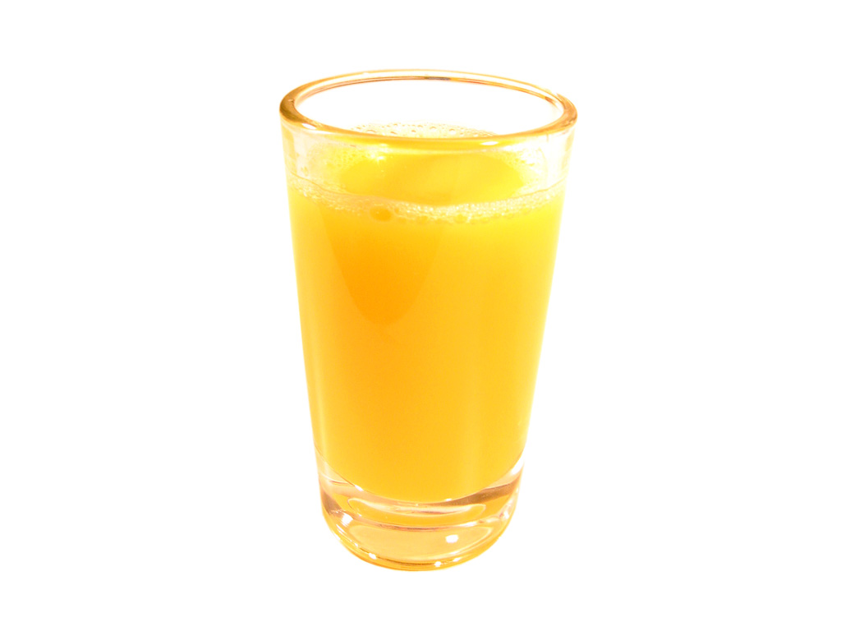
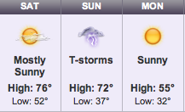
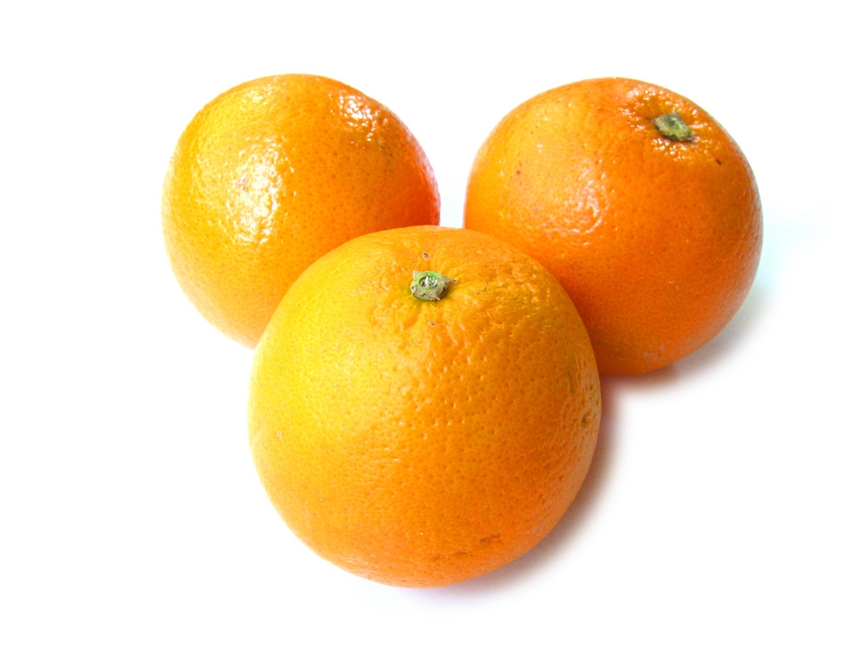
Orange Juice Futures and Weather
Orange juice futures price can improve weather forecast! [Roll 1984]
Trades of 15,000 pounds of orange juice solid in March
Notes:
98% of concentrated orange juice in US is from central Florida region.
75 pounds of oranges per person per year in 2000

Slide 4
Events of Interest
Will category 3 (or higher) hurricane make landfall in Florida in 2017?
Will Google reinstate its Chinese search engine?
Will Democratic party win the Presidential election?
Will Microsoft stock price exceed $65?
Will there be a cure for cancer by 2020?
Will sales revenue exceed $200k in April?

Slide 5
The Prediction Problem
An uncertain event to be predicted
Q: Will category 3 (or higher) hurricane make landfall in Florida in 2011?
Dispersed information/evidence
Residents of Florida, meteorologists, ocean scientists…
Goal: Generate a prediction that is based on information from all sources

Slide 6
Bet = Credible Opinion
Q: Will Vinay Deolalikar’s proof of P≠NP be validated?
Scott Aaronson: “I have a way of stating my prediction that no reasonable person could hold against me: I’ve literally bet my house on it.”
Betting intermediaries
Las Vegas, Wall Street, IEM, Intrade (in the past), PredictIt, …
Info
Info
I bet $200K that the proof is incorrect.
The proof is correct.
Notes:
Both a prediction and a bet are based on one’s information. What we really care about is the information. We want mechanisms that help us get the information.
Vinay Deolalikar’s proof
Scott Arronson’s bet on it.

Slide 7
Prediction Markets
A prediction market is a financial market that is designed for information aggregation and prediction.
Payoffs of the traded contract is associated with outcomes of future events.
$1×Percentage of Vote Share That Trump Wins
$1 Trump wins
$0 Otherwise

Slide 8
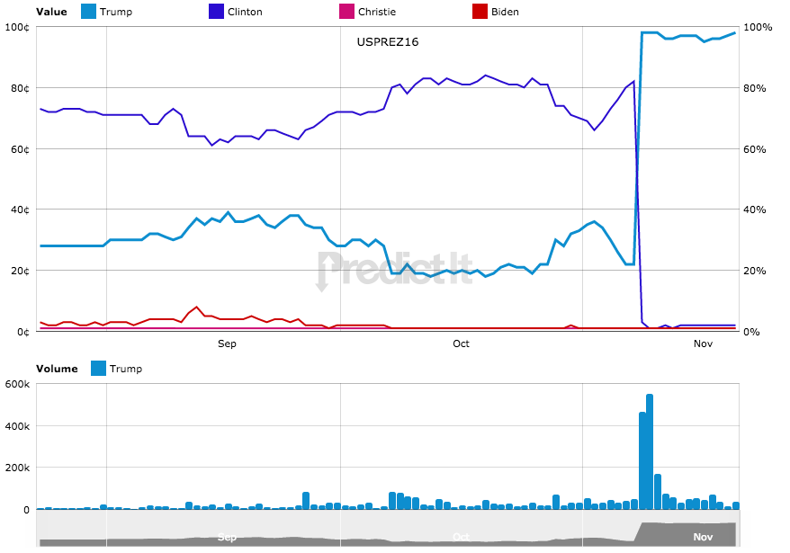
Source: PredictIt US General Election Market

Slide 9
Does it work?
Yes, evidence from real markets, laboratory experiments, and theory
Racetrack odds beat track experts [Figlewski 1979]
I.E.M. beat political polls 451/596 [Forsythe 1992, 1999][Oliven 1995][Rietz 1998][Berg 2001][Pennock 2002]
HP market beat sales forecast 6/8 [Plott 2000]
Sports betting markets provide accurate forecasts of game outcomes [Gandar 1998][Thaler 1988][Debnath EC’03][Schmidt 2002]
Market games work [Servan-Schreiber 2004][Pennock 2001]
Laboratory experiments confirm information aggregation
[Plott 1982;1988;1997][Forsythe 1990][Chen, EC’01]
Theory: “rational expectations” [Grossman 1981][Lucas 1972]
Prediction markets still beat polls in the 2016 US Election

Slide 10
Why Markets? – Get Information
Speculation ➔ price discovery
price ≈ expectation of r.v. | all information
$1 if UMD wins, $0 otherwise
Event Outcome
Value of Contract
Payoff
P( UMD wins )
$1
UMD wins
?
$P( UMD wins )
1- P( UMD wins )
$0
UMD loses
Equilibrium Price ≈ Value of Contract ≈ P( UMD Wins )
Market Efficiency
Notes:
New England Patriots v.s. Philadelphia Eagles

Slide 11
Non-Market Alternatives vs. Markets
Opinion poll
  Sampling
  No incentive to be truthful
  Equally weighted information
  Hard to be real-time
Ask Experts
  Identifying experts can be hard
  Combining opinions can be difficult
Prediction Markets
  Self-selection
  Monetary incentive and more
  Money-weighted information
  Real-time
  Self-organizing

Slide 12
Non-Market Alternatives vs. Markets
Machine learning/Statistics
  Historical data
  Past and future are related
  Hard to incorporate recent new information
Prediction Markets
  No need for data
  No assumption on past and future
  Immediately incorporate new information
Caveat: Markets have their own problems too – manipulation, irrational traders, etc.

Slide 13
Prediction Market Desiderata
Liquidity
People can find counterparties to trade whenever they want
Bounded budget (loss)
Total loss of the market institution is bounded
Expressiveness
There are as few constraints as possible on the form of bets that people can use to express their opinions
Computational tractability
The process of operating a market should be computationally manageable

Slide 14
Continuous Double Auction (CDA)
$1 if UMD wins, $0 otherwise
Buy orders
Sell orders
$0.12
$0.30
$0.09
Price = $0.14
$0.17
$0.15
$0.13

Slide 15
What’s Wrong with The CDA?
Thin market problem
When there are not enough traders, trade may not happen
No trade theorem [Milgrom & Stokey 1982]
Why trade at all? These markets are zero-sum games (negative sum w/ transaction fees)
For all money earned, there is an equal (greater) amount lost; am I smarter than average?
Rational risk-neutral traders will never trade
But trade happens …

Slide 16
Automated Market Makers (MM)
An automated market maker is the market institution who sets the prices and is willing to accept orders at the price specified
Why use them ????????????
Liquidity!
Market makers bear risk. Thus, we desire mechanisms that can bound the loss of market makers.
That bound has to be a function of the actions of the bidders and prices charged by the MM … what do we do?

Slide 17
Logarithmic Market Scoring Rule (LMSR)
[Hanson 03, 06]
Example: one market, two outcomes o₁, o₂
Two types of shares:
  ”Trump wins”: pays $1 if Trump wins, else $0
  “Trump doesn’t win”: pays $1 if Trump doesn’t win, else $0
MM tracks shares outstanding for each outcome
q₁, q₂ are total quantity purchased for each outcome
MM keeps cost function tracking total money spent by traders so far, C(q₁, q₂)
C(q₁, q₂) = b * ln( e^{q1/b} + e^{q2/b} ) (for LMSR, at least)
Must set scalar b – black art [Pennock 2010]
Higher b: higher (i.e., worse) bound on MM loss ☹
Higher b: can buy more shares without huge price swing ☺

Slide 18
Logarithmic Market Scoring Rule (LMSR)
[Hanson 03, 06]
Trader arrives, wants to buy 13 shares of o₁:
Price = C(q₁ + 13, q₂) - C(q₁, q₂)
Trader arrives, wants to sell 250 shares of o₂:
Price = C(q₁, q₂ - 250) - C(q₁, q₂)
Trader arrives, wants to change shares outstanding to (q₁*, q₂*):
Price = C(q₁*, q₂*) - C(q₁, q₂)
MM can quote price for changing an outcome o_{i}:
“Price” p_{i}(q₁,q₂) = e^{qi/b} / (e^{q1/b} + e^{q2/b})
Price to move from q_{i} to q_{i}+k = ∫q_{i} to q_{i}+k p(q₁,q₂)dq_{i}

Slide 19
LMSR: A Concrete 2-outcome Example
Set b = 100, start of the market (q₁,q₂) = (0,0)
Prices ????????????
p₁ = p₂ = e^{0/100} / (e^{0/100} + e^{0/100}) = ½
Trader arrives, wants to buy 10 shares of o₁:
C(10,0) – C(0,0) = 100*[ ln( e^{10/100} + e⁰ ) - ln( e⁰ + e⁰ ) ] = $5.12
… Time passes, (q₁,q₂) = (50,10) …
Trader arrives, wants to sell 10 shares of o₁:
C(40,10) – C(50,10) =
100*[ ln( e^{40/100} + e^{10/100} ) - ln( e^{50/100} + e^{10/100} ) ] = -$5.87
Trader profited $5.12 - -$5.87 = $0.75!

Slide 20



Logarithmic Market Scoring Rule (LMSR)
[Hanson 03, 06]
Standard LMSR-based MM:
Contracts: $1 iff o₁, $1 iff o₂, …, $1 iff o_{N}
Price functions
Cost function
Payment

Slide 21
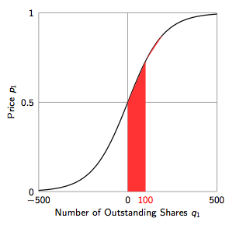
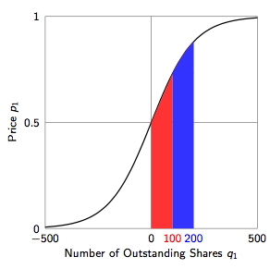
Logarithmic Market Scoring Rule (LMSR)
[Hanson 03, 06]
Worst-case MM loss = b log N
(Setting b is a bit of an art form.)

Slide 22
Combinatorial
Prediction Markets
Events of interest often have a large outcome space
Information may be on a combination of outcomes
Expressiveness:
Expressiveness in getting information
Expressiveness in processing information (on the MM side)

Slide 23
Combinatorial Prediction Markets
Champion
Final
Duke
Princeton
Final
UMD
Harvard
Example bets:
Duke wins at least 1 match
UMD beats Harvard but doesn’t become champion
Harvard beats Duke
UMD+Princeton wins more matches than Harvard
Price of security should be equal to probability of event
How should purchase of no. 4 affect probability of no. 1?
Notes:
Harvard -> Berkeley
Duke -> MIT
Princeton -> Brown

Slide 24
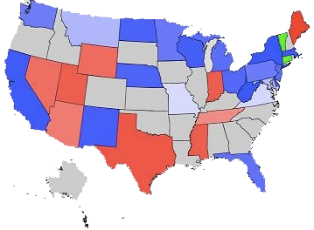
Combinatorics: Boolean Logic
n Boolean events
Outcomes: all possible 2^{n} combinations of the events
Contracts (created on the ﬂy):
2-clause Boolean betting
A Democrat wins Florida & not Massachusetts
$1 iff Boolean Formula

Slide 25
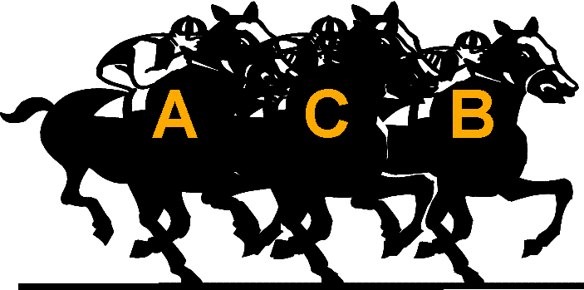
Combinatorics:
Permutations
n competing candidates
Outcomes: all possible n! rank orderings
Contracts (created on the ﬂy):
Subset betting
Candidate A ﬁnishes at position 1, 3, or 5
Candidate A, B, or C ﬁnishes at position 2
Pair betting
Candidate A beats candidate B
$1 iff Property

Slide 26
Pricing Combinatorial Betting with LMSR
LMSR price function:
p_{i}(q) = e^{qi/b} / Σ_{j} e^{qj/b}
It is #P-hard to price 2-clause Boolean betting, subset betting, and pair betting in LMSR. [Chen et. al. EC-08]
Restricted tournament betting with LMSR can be priced in polynomial time. [Chen, Goel, and Pennock EC-08]

Slide 27
Expressiveness matters!
[Kroer et al. EC-16]
State of the art:
General bidding languge in combinatorial prediction market
Dramatic improvement over running multiple independent markets for each outcome
Huge (theoretical and experimental) tractability issues

Slide 28
An Ethicist’s View on the use of prediction markets
Specifically, Policy Analysis Markets (PAM)
Views expressed are not necessarily mine and definitely not my employer’s …
Thanks to: Dan Weijers, Philosophy Prof @ Cal State

Slide 29
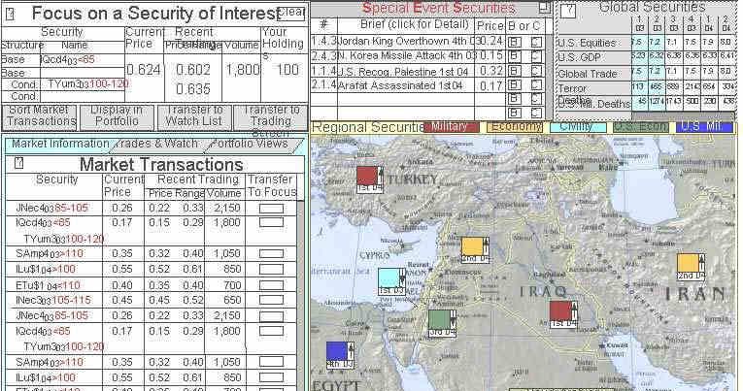
Predicting Terrorism
DARPA → funds → FutureMAP → includes sub-project → PAM
Dan Weijers 3/12/2012 PAM 1
Notes:
DARPA “Its mission was to become an engine of technological change that would bridge the gap between fundamental discoveries and their military use.” (Looney 2004, 405; c.f. Hiawatha Bray, ‘‘In Defense of DARPA Programs,’’ The Boston Globe, 3 August 2003.). You might know some of DARPA’s other work, like the Internet and stealth technology (Looney 2004, 405).
“Also from the start, we planned to forecast military and political instability around the world, how US policies would effect such instability, and how such instability would impact US and global aggregates of interest.3 (in note 3: It was my job to survey possible application areas and to choose one.) The reasoning behind this choice was that since the cost to create markets does not depend much on the topic, while the value of estimates varies enormously with the topic, the greatest benefit relative to cost would come from the highest value estimates. And what could be more valuable than to inform the largest defense policy decisions?” Hanson 2006, p259

Slide 30
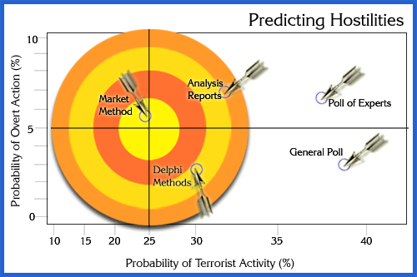
The main method of Predicting Terrorism?
Supposedly better than:
Reports
Delphi
Experts
Polls
Dan Weijers 3/12/2012 PAM 2
Notes:
Not sure about this slide

Slide 31
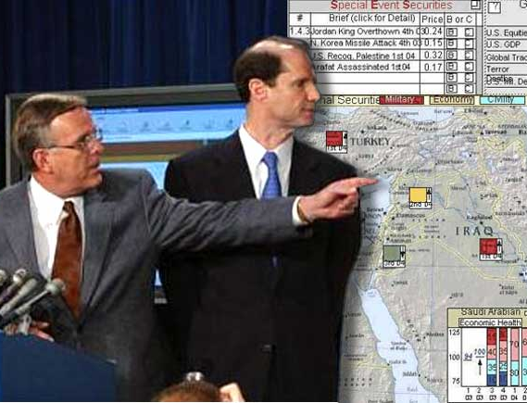
The fallout
Less than positive comments:
“just wrong”
“ridiculous… grotesque,”
“defies common sense”
“absurd… disgusting”
“loopiest manifestation of … belief… markets [can] solve all problems”
“a new level of absurdity”
“unbelievably stupid”
FutureMAP terminated asap
Dan Weijers 3/12/2012 PAM 3
Notes:
“just wrong”—Sen. Daschle
“ridiculous… grotesque,”—Sen. Wyden
“defies common sense”—Sen. Roberts
“absurd… disgusting”—Sen. Dorgan
“loopiest manifestation of… belief… in the power of markets to solve all problems”—Pearlstein
“a new level of absurdity... almost seems a mockery of itself.” —Stiglitz
“despicable… one of the most callous and plainly retarded ideas I’ve ever heard…”—Blogger Greg Saunders

Slide 32
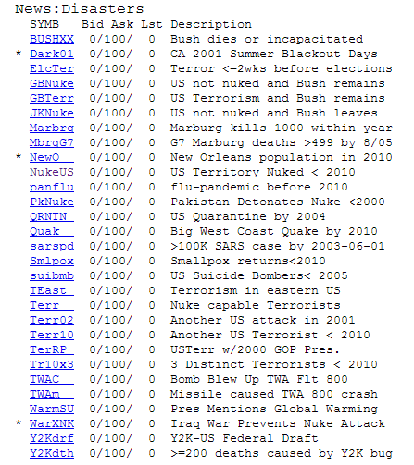
Private groups take over
Future Exchange & Others
Play money
Small
Open to all
Intrade
Unlimited money, large
Open to most, but not US
Closed: “financial irregularities”
iPredict
$10,000 net limit on money in
Small/med
Only available in New Zealand
Notes:
Future exchange = play money,
Intrade = big

Slide 33
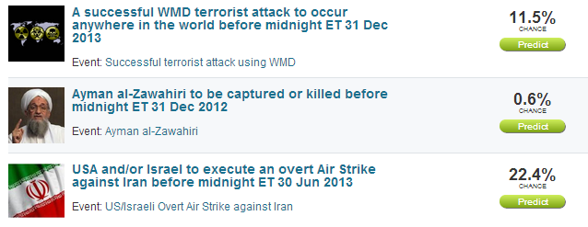
Intrade
WMD TERROR ATTACK Open interest: 709 shares
Open price: $1.15 ≈ 11.5% Life low: $0.50 ≈ 5.0%
Life high: $5.99 ≈ 59.9% Total volume: 1,314 shares
Dan Weijers 3/12/2012 Other PMs 2

Slide 34

Funding the wrong thing
“If our intelligence agencies are that incompetent, shouldn’t we be more concerned with improving the intelligence than setting up some goofy-ass online casino?” – Blogger Greg Saunders
Budget for trial of FutureMAP was USD 1-5MM
In terms of total DoD budget: non-issue
Dan Weijers 3/12/2012 Several Moral Concerns 2

Slide 35
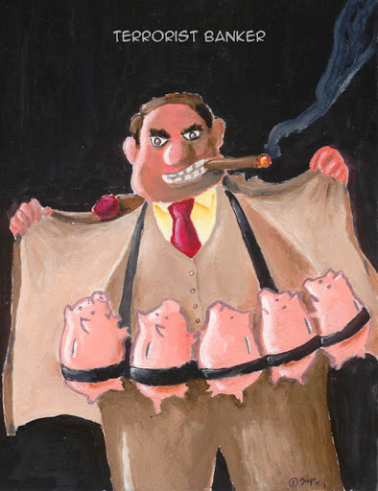
Encouraging terrorism
“Most traders try to influence their investments” – US Senator Daschle
Could cause people to commit acts of terror to make a quick buck
Less risky ways to make money
Could make money from stock market anyway
Non-issue
Dan Weijers 3/12/2012 Several Moral Concerns 3

Slide 36
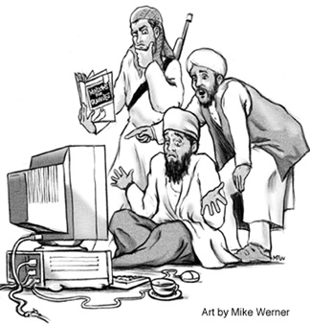
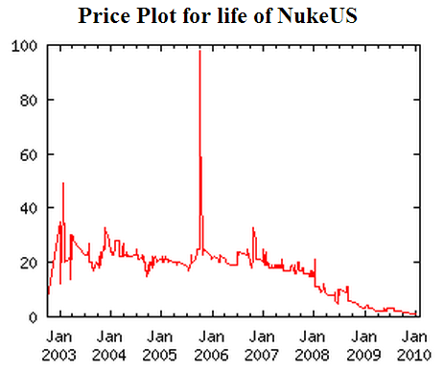
Terrorists will use it to trick us
“[T]errorists themselves could… make false bets to mislead intelligence authorities.” – US Senators Wyden and Dorgan
Prediction markets very resistant to manipulation
But maybe not for terrorist events
Different notion of utility …
Potential major issue
Should be investigated further
Dan Weijers 3/12/2012 Several Moral Concerns 4

Slide 37
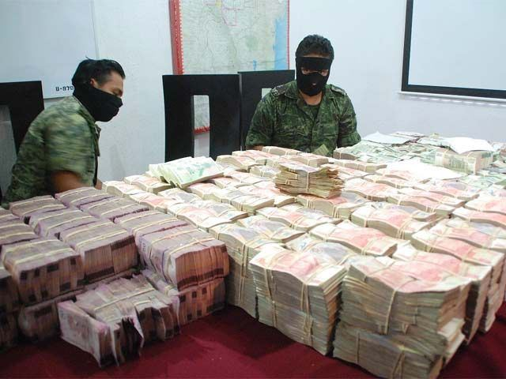
Funding terrorists
“Would be assassins and terrorists could easily use … clever trading strategies to profit from their planned misdeeds.” – Pearlstein (columnist)
Paying bad guys for the greater good
Paying informants
Paying ransoms
It’s a big risk for terrorists
They make their chances of getting caught higher …
A minor issue
Notes:
It’s like bringing a suitcase of real money to the kidnappers (while planning on capturing them at the moment of exchange)

Slide 38
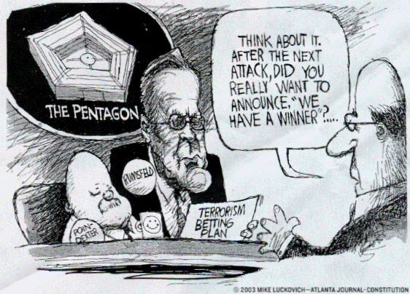
The repugnance of Betting on death
“[T]he fact that our government is essentially setting up a terrorist bookmaking operation is despicable.” – Blogger Greg Saunders
Betting on death isn’t new
Life insurance
Military spending decisions
Non-issue unless…
Dan Weijers 3/12/2012 Betting on Death 1
Notes:
Unless… there is something more about betting on terrorism markets that make them especially bad

Slide 39
How would you like it?
Death pool aka dead pool
Imagine a contract:
On your death or assassination
On a WMD attack on your city
On your PM’s assassination?
Depends on if you were already a target
Dan Weijers 3/12/2012 Betting on Death 2

Slide 40
Innocently Profiting from terrorism
Anyone profiting from successful acts of terrorism seems wrong…
But many non-terrorists already accidentally profit from terrorism
People who specialize in monitoring/preventing terrorism
Some stocks
Some businesses
Accidental profiting is a non-issue
Dan Weijers 3/12/2012 Betting on Death 3

Slide 41
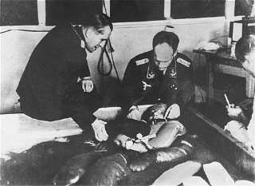
Purposefully Profiting from terrorism
Believing there will be a terrorist attack and deciding to profit from it
Trying to benefit from an immoral act
Analogy: Using Nazi medical research?
  Different motives: help others vs. self?
Seems repugnant when done to benefit self
But what is immoral about it?
Who or what is harmed?

Slide 42
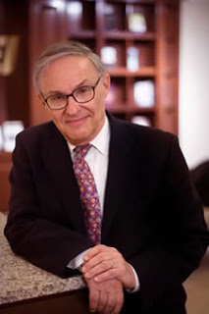
Wisdom of repugnance?
…Or knee-jerk moralizing?
Person-affecting
Desensitized to terrorism → become terrorist?
Some people would find it offensive
Virtue ethics (character-tarnishing)
Analogy: violent computer games?
Disrespect of an important ideal
Life, peace, freedom?
Analogy: blasphemy?
“Shallow are the souls that have forgotten how to shudder.” – Leon Kass
Dan Weijers 3/12/2012 Wisdom of Repugnance? 1

Slide 43
Motivations & moral effects
Moral | Motivations
effect | $$ | Status | Fun | Manipulative | Informative
Effect on character | Induce greed, callousness, schaden-freude/mild sadism | Induce pride, callousness, schaden-freude/mild sadism | Induce callousness, schaden-freude/mild sadism | Dishonesty, callousness, (morbid curiosity?) | Beneficence
Disrespect of ideals | Life, peace, freedom | Life, peace, freedom | Life, peace, freedom | Life, peace, freedom | Respect for life, peace, freedom
“PAM… should prove as engaging as it is informative.”—Official PAM website
Beneficence: researchers should explicitly prioritize a research participant’s welfare as a goal in any trial
Dan Weijers 3/12/2012 Wisdom of Repugnance? 2
Notes:
So, not much difference overall between the negative effects of play or real money markets.

Slide 44

The harms of pms on terrorism
So PMs on terrorism could:
Desensitize people to the point they become terrorists
Offend some people
Encourage greed, pride, callousness, schadenfreude/mild sadism, dishonesty, morbid curiosity, and beneficence
Disrespect the ideals of life, peace, and freedom
… just like computer games?
Dan Weijers 3/12/2012 Wisdom of Repugnance? 3

Slide 45
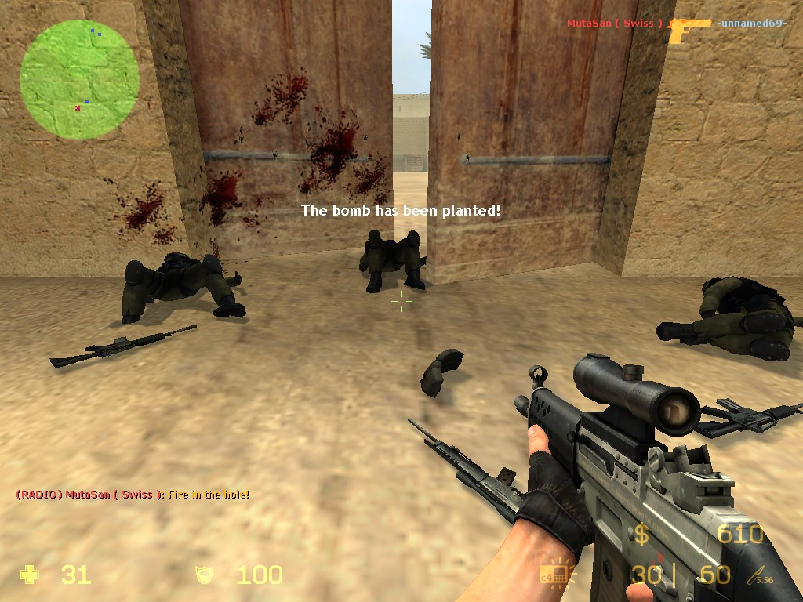
Wisdom of repugnance?
So PMs on terrorism could:
    Desensitise people to the point they become terrorists
    Disrespect the ideals of life, peace, and freedom
    Encourage greed, pride, callousness, schadenfreude/mild sadism, Dishonesty, callousness, morbid curiosity, and benificence
… just like computer games?
Dan Weijers 4/12/2012 Betting on Death 1
Notes:
Desensitise people to the point they become terrorists (Columbine?)
Disrespect the ideals of life, peace, and freedom (you’re supposed to kill innocents and blow things up)
Encourage
pride (kills displayed to all at end),
Callousness (scenarios in the game are similar to real life terrorist events),
schadenfreude/mild sadism (killing (virtual) people brings joy),
Dishonesty (using hacks to kill people more easily),
morbid curiosity (what happens when I stab you in the head?),
Greed (top players are professional)
and beneficence (not so much)

Slide 46
But More recently …

Slide 47
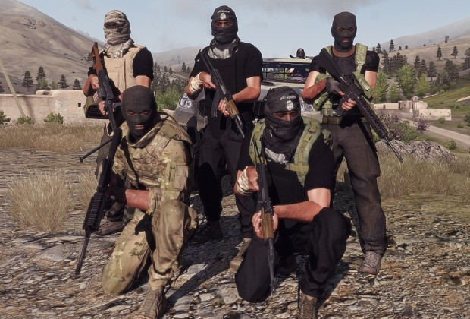

Slide 48
How serious are The harms?
Desensitize people to the point they become terrorists
Very serious but very very unlikely
Disrespect the ideals of life, peace, and freedom
Not very serious (?) but very likely
Encourage greed, pride, callousness, schadenfreude/mild sadism, dishonesty, morbid curiosity, and beneficence
Not very serious (effects on character will be tiny)
… but very likely
Offending some people
Not very serious but very likely
= Non-issue
= Minor issue
= Minor issue
= Minor issue

Slide 49
Ethical issues scorecard
Compared to no PMs | Offensive | Character tarnishing | Ideal disres-pecting | Might fund terrorism | Terrorists manipu-lating us | Likely to produce useful information
Govt. only PM | No | No | No | No | No | Yes ?
PAM | Yes | Yes | Yes | Yes | Maybe | Yes ??
Intrade | Yes | Yes | Yes | Yes | Unlikely | Maybe ??
Net Exchange | Yes | Yes | Yes | No | Unlikely | No ?
 | Minor issue | Minor issue | Minor issue | Minor issue | Potential major issue | Major benefit
Dan Weijers 3/12/2012 Ethical Assessment 1
Notes:
Also a minor benefit of developing beneficence in people who have informational motives

Slide 50
Ethical assessment
Compared to no PMs | Issues that should cause repugnance | Terrorists manipulating us | Likely to produce useful information | Net benefit?
Govt. only PM | None | No | Yes ? | Definitely
PAM | 4 | Maybe | Yes ?? | Probably
Intrade | 4 | Unlikely | Maybe ?? | Unlikely
Net Exchange | 3 | Unlikely | No ? | No
 | Minor issues | Potential major issue | Major benefit
Dan Weijers 3/12/2012 Ethical Assessment 2
Notes:
Also a minor benefit of developing beneficence in people who have informational motives

Slide 51
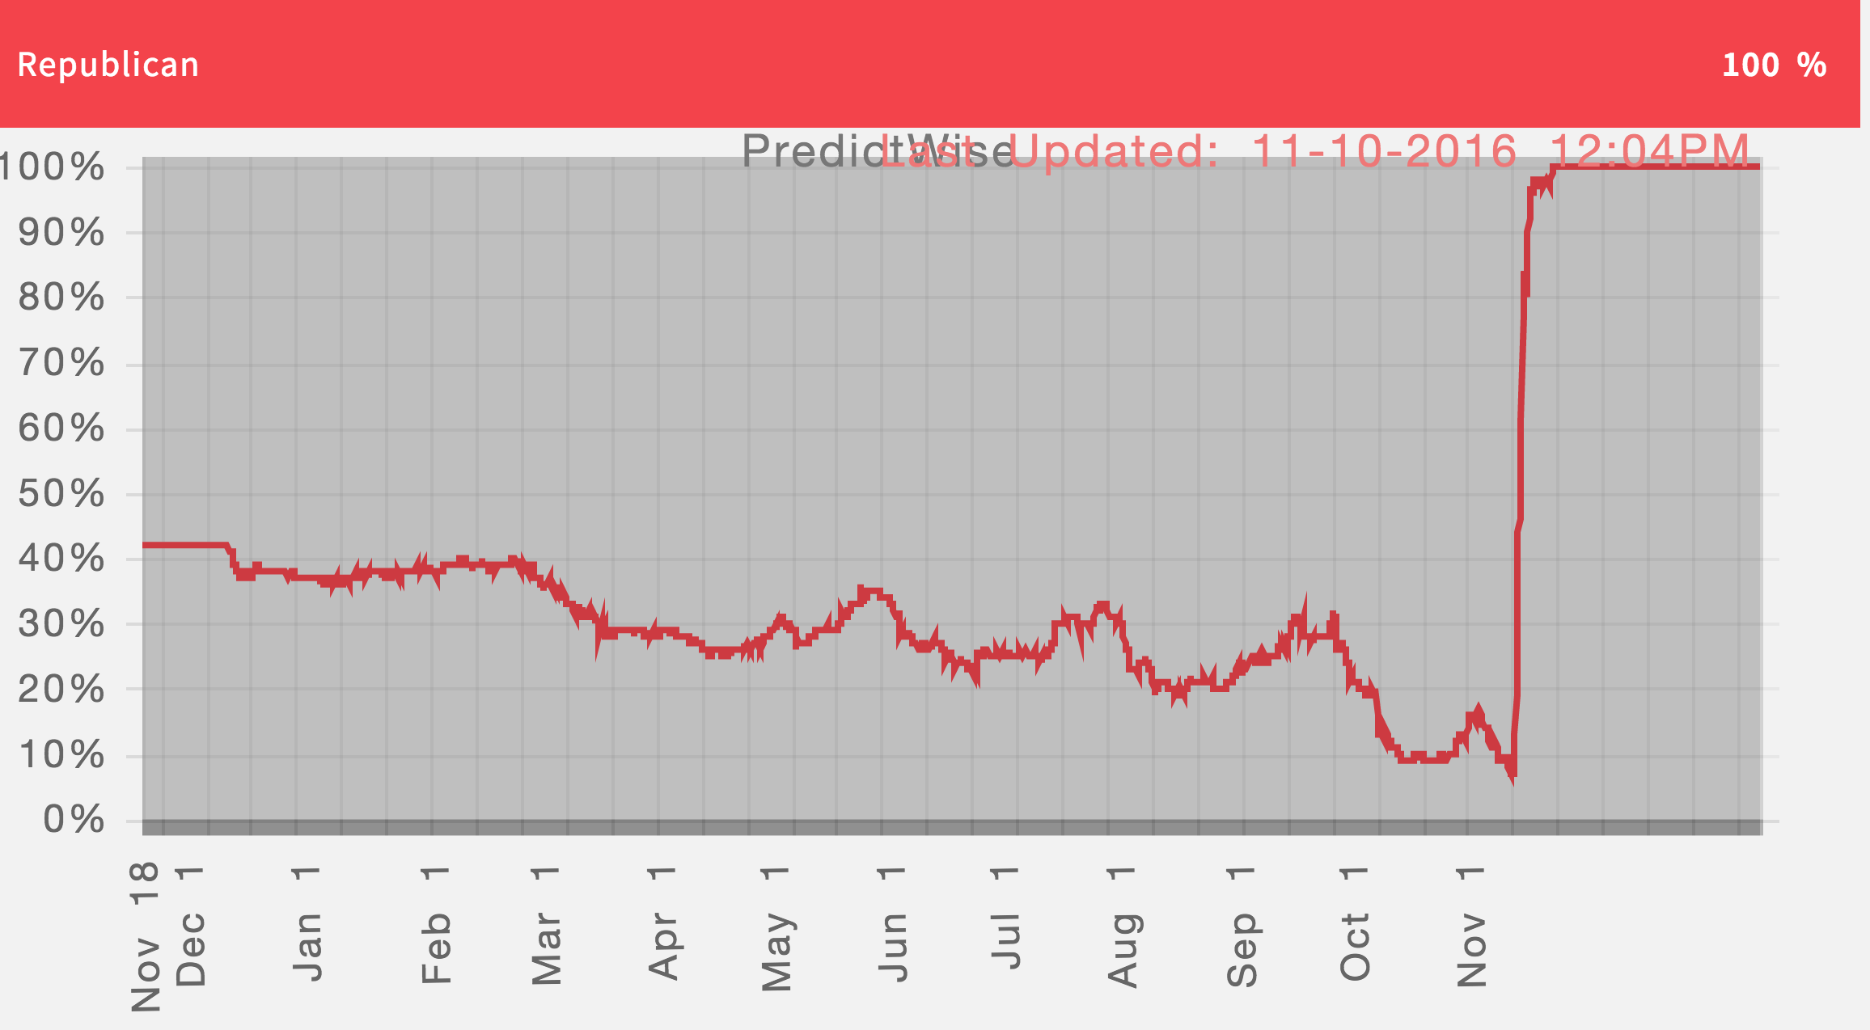
Thoughts from the CS Side of Things
Economists and philosophers – and CS folks – can be very tone deaf, to the point of ruining what could be good ideas
Price manipulation seems like a huge concern to me
These markets are currently heavily regulated in the US (i.e., generally must use funny money) ...
... and maybe that’s okay until we figure things out

Slide 52
Next Class:
Thanksgiving = ∅ (Thursday)

